Slide 1
Working without Solvents
Lecture #17
Date:
Course #

Slide 2
Outline
Global Solvent Market
Chemistry without organic solvents
  Supercritical Fluids
  Ionic Liquids
  Aqueous Chemistry
  Solvent-Free processes
    Mechanochemistry

Slide 3
Outline
Global Solvent Market
Chemistry without organic solvents
  Supercritical Fluids
  Ionic Liquids
  Aqueous Chemistry
  Solvent-Free processes
    Mechanochemistry

Slide 4
Global Solvent Market
Global solvents market is significant, with almost 30 million kilo tons consumed in 2016.It projects the mark to be a 31.50 billion dollar sector.
Increased volume and revenue states that consumption will increase.
What factors do you think are the main drivers?
http://www.marketresearchstore.com/news/global-solvents-market-167
Notes:
Answer: The major driving factor for the global solvents market is strong demand from various end-user industries including paints and coatings, pharmaceutical. Revival of global economy with increasing demand from the construction and automobile industry is driving demand for solvents.

Slide 5
Lets’ Recap
Advantages of Solvents:
Places reagents into a common phase where they can react
Dissolve solids so that they can be pumped from one location to another
Lower viscosity and easier mixing
Regulate temperatures of reactions
Allow recovery of solids by filtration
Extract compounds from mixtures
Recrystallization
Cleaning

Slide 6
Let’s Recap
Disadvantages of Solvents:
When released into the air, nitrogen oxides react with escaped VOC’s to form ground-level ozone and smog
Destruction of the upper atmosphere
Toxicity and health risks to workers
  Chlorinated and other solvents
  Miscarriages
  Birth defects
Risk of fires and explosions if VOC not controlled properly
Monetary Cost

Slide 7
Chemistry without organic solvents
Main alternatives to organic solvents:
Supercritical Fluids
Ionic Liquids
Aqueous Chemistry
Solvent-Free processes
Mechanochemical Conditions
https://www.freeimages.com/search/green-tube

Slide 8
Outline
Global Solvent Market
Chemistry without organic solvents
  Supercritical Fluids
  Ionic Liquids
  Aqueous Chemistry
  Solvent-Free processes
    Mechanochemistry

Slide 9
Supercritical Fluids
Supercritical Fluids are any substance at a temperature and pressure above its critical point, where distinct liquid and gas phases do not exist.
So once above the P_{cr} & T_{cr} , a vapor can be transformed into a supercritical fluid!
https://commons.wikimedia.org/wiki/File:Phase-diag2.svg

Slide 10
Critical points of some common supercritical fluids
Material | T_{c} | P_{c} (bar)
Ammonia | 132.4 | 113.2
Carbon dioxide | 31.1 | 73.8
Ethane | 32.2 | 48.7
Ethene | 9.2 | 50.4
Fluoroform | 25.9 | 48.2
Propane | 96.7 | 42.5
Water | 374.2 | 220.5

Slide 11
Supercritical CO₂
Watch Videos!
Supercritical CO₂ Martin Poliakoff demonstrates Supercritical CO₂
Unique and Attractive Properties
Effuse through solids like a gas
Small changes in pressure or temperature result in large changes in density, allowing many properties of a supercritical fluid to be "fine-tuned".
A major advantage of supercritical solvents is their ease of removal. Simply decrease the pressure and vent off the gas.
https://commons.wikimedia.org/wiki/File:Critical_carbon_dioxide-2.jpg
Notes:
https://vimeo.com/142691501

Slide 12
1. Supercritical CO₂
Sub-critical
Approaching critical
Above critical point
CO₂ Gas
Liquid CO₂
Fully homogeneous supercritical CO₂
 | H₂O | CO₂ | NH₃ | C₂H₄ | C₂H₆ | C₃H₈ | CHF₃
Tc / °C | 374.2 | 31.1 | 132.4 | 9.2 | 32.2 | 96.7 | 25.9
Pc/ bar | 220.5 | 73.8 | 113.2 | 50.4 | 48.7 | 42.5 | 48.2
Notes:
Image Source: http://publications.rwth-aachen.de/record/60657/files/Fahmy_Sherif.pdf – not sure we can use these images??

Slide 13
Supercritical CO₂
Advantages
Disadvantages
Non-flammable
Low viscosity
Good solvent for gases
Readily removed
Non-toxic
Cheap
Relatively poor solvent
Requires high pressure equipment to create supercritical CO₂
  Often times more expensive
  Potentially dangerous
  More maintenance involved
More expertise required

Slide 14
Supercritical CO₂
Supercritical CO₂ in action today
Decaffeination of Coffee (and other seed oil extractions in food sector)
Biomass gasification➔ biofuels
Dry-cleaning
Refrigeration (benign refrigerants)
Analytical separations and chromatography
Polymer foaming
Chemical Reactions
Notes:
Self-made diagram

Slide 15
Example: Solvair-scCO₂ Dry-cleaning
Image: http://solvaircleaning.com/howitworks.html
Notes:
1. Start: Clothes Placed In The Machine
Home washing and other drycleaning methods require clothing to be separated into several different categories such as weight and color. Solvair, however, has been designed so that many items usually separated, like heavy coats and light-weight silks or colored and white garments, can be cleaned together.
2. Cleaning: Environmentally Friendly Cleaning Liquid
Solvair uses an environmentally friendly, biodegradable cleaning liquid to remove stains and dirt, conceptually similar to water and detergent in home laundry. This cleaning liquid is drained then later purified and reused by the system.
3. Drying: Pressurization
Once the garments have been cleaned they are damp and need to be dried. A major benefit of the process is that drying is performed without heat. Solvair uses liquid carbon dioxide (CO₂) for drying. Under pressure, CO₂becomes a liquid and is used to rinse the cleaning liquid from the garments.
4. Drying: CO₂ Rinses
The Solvair machine is pressurized and liquid CO₂ is brought into the cleaning wheel. This is the same kind of CO₂ that gives carbonated beverages their bubbles. The Solvair Cleaning System does not create new CO₂. The CO₂ used in Solvair has been reclaimed from other emission sources. The cleaning liquid is attracted to the liquid CO₂ . This allows multiple cool liquid CO₂ rinse and drain cycles to be used to thoroughly remove cleaning liquid from the clothes. Because the machine is filled with this cool liquid and vapor during drying instead of heated air, the process is very gentle.
5. Drying: Depressurizing
At the end of the drying cycle, the pressure in the machine is reduced until the CO₂ converts from a liquid to a gas, completely and instantly drying garments.
6. Clothes Are Clean And Dry
Clothes are clean, bright and odor free. This is a far more effective and energy efficient method of drying than using heat. Garments dry completely and simultaneously, regardless of weight. This means that a heavy coat and a silk blouse will dry at the exact same time.

Slide 16
Chemical Reactions using scCO₂
Since H₂ is very miscible in supercritical CO₂, it’s been found to be highly effective in hydrogenation reactions.
Imine hydrogenation is 20x faster in supercritical CO₂ compared to standard solvents

Slide 17
Outline
Global Solvent Market
Chemistry without organic solvents
  Supercritical Fluids
  Ionic Liquids
  Aqueous Chemistry
  Solvent-Free processes
    Mechanochemistry

Slide 18
Ionic Liquids (IL’s)
Ionic Liquids (IL’s) are salts which are fluids at ambient & room temperatures.
Ionic liquids consist of a mixture a positively charged molecule, i.e ammonium or phosphonium cation, and a negatively charged molecule, i.e anion.

Slide 19
Ionic Liquids (IL’s)
First generation of low melting point IL’s:
  Used for electrochemical purposes
    [EtNH₃][NO₃]: 1st low-temperature IL, 1914
    N-alkylpyridinium and 1,3-dialkylimidazolium chloroaluminates(III) (AlCl₄⁻)
    Large sensitivity to water
Second generation of low melting point IL’s:
  Stable to water and most organic chemicals
  Possess some unique properties:
    High ionic conductivity
    Non-volatility
    Non-flammable
    High thermal stability
    Liquid over a wide temp range
    Highly solvating, yet non-coordinating
  Concerns about toxicity and persistence

Slide 20
Ionic Liquids (IL’s)
Common examples of IL’s

Slide 21
Properties of IL’s
Tunable properties:
Miscibility with water is effected by:
anion
length of alkyl chain on the cation
Thermal stability depends on composition of anion:
Example: [PF₆]⁻ decomposes to form HF (etches glass) and decomposes in the presence of Al
Density and viscosity dependent on the anion:
Density increases in the order of:
  BF₄⁻ < PF₆⁻ < (CF₃SO₂)₂N
  Viscosity increases in the order of
  (CF₃SO₂)₂N < BF₄⁻ < PF₆⁻ < NO₃⁻
Unique properties
  High ionic conductivity
  Non-volatility
  Non-flammable
  High thermal stability
  Liquid over a wide temp range
  Highly solvating, yet non-coordinating
Melting point
Density
Viscosity
Miscibility with water
Change according to the
composition of the ions

Slide 22
Ionic Liquids (IL’s)
Advantages
Disadvantages
Very low vapor pressure
Can facilitate as a catalyst
Viscosity is tunable
High stability at high temperatures
Readily prepared
Recyclable!
Concerns with toxicity
Non-biodegradable
Synthesis requires haloalkanes
Extraction and purification of IL’s requires organic solvents.

Slide 23
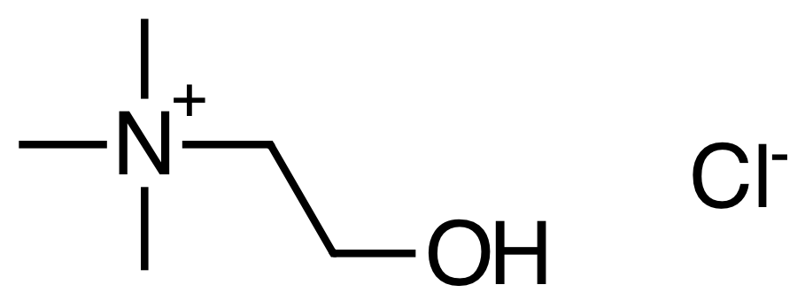
Ionic Liquids (IL’s): Next generation
New IL’s are being designed that address biodegradability and toxicity concerns – some examples
Choline chloride: readily biodegradable
Incorporation of the ester linkage in the chain of the imidazolium IL increases biodegradability
Pyridinium based IL’s generally are more biodegradable than imidazolium based IL’s: 1-octyl-3-methyl pyridinium bromide passes a ready biodegradation test.
Notes:
From: Chem. Reviews, 2007, Vol. 107, No. 6, 2207-2227

Slide 24
Ionic Liquids (IL’s)
Ionic liquids have been found useful for a wide range of chemical reactions and processes, including hydrogenation reactions, biocatalysis reactions such as transesterification and perhydrolysis, and electrochemical applications such as battery electrolytes
Another use for ionic liquids is as a medium for separation of biologically produced feedstocks from a fermentation broth, such as acetone, ethanol, or butanol
Ionic liquids have been found to dissolve cellulose: allowing for the processing of biomass

Slide 25
Outline
Global Solvent Market
Chemistry without organic solvents
  Supercritical Fluids
  Ionic Liquids
  Aqueous Chemistry
  Solvent-Free processes
    Mechanochemistry

Slide 26
Aqueous Chemistry
Water is the ultimate benign solvent!

Slide 27
Water-based Chemistry
Advantages
Disadvantages
Abundant
Cheap
Non-toxic
Non-flammable
High specific heat
A lot of reagents and materials are water/moisture sensitive
Generally poor solvent for organics
Energy intensive
Generated waste may be difficult to treat due to complexity.

Slide 28
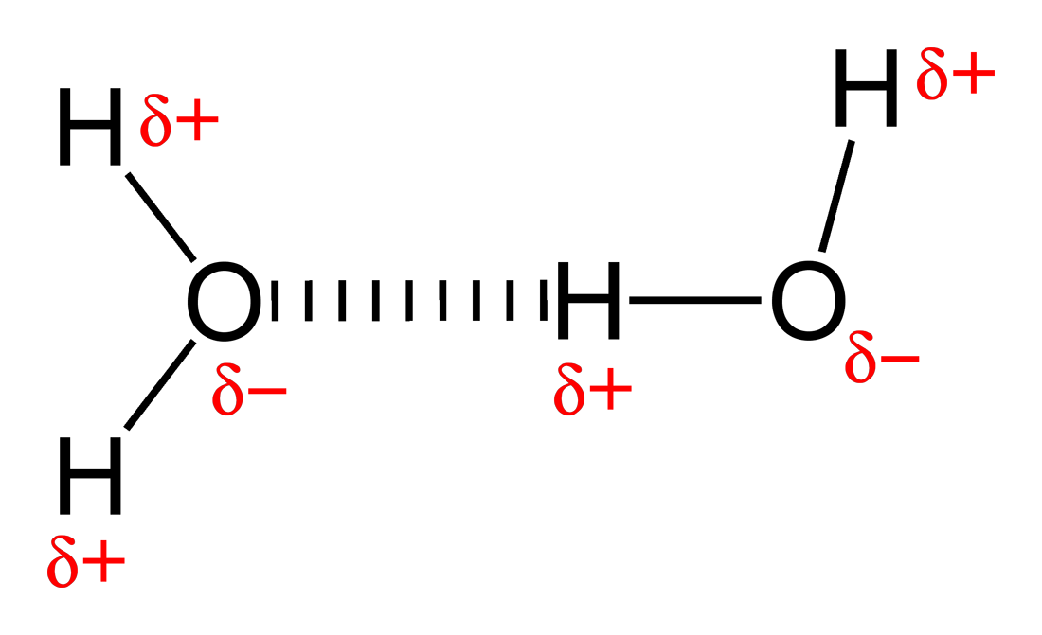
Advantages of Water
Solvent | Dielectric constant
Water | 80
Formic acid | 58
Dimethyl sulfoxide (DMSO) | 47
Dimethylformamide (DMF) | 38
Acetonitrile (MeCN) | 37
Methanol | 33
Ethanol | 30
Acetone | 21
n-Propanol | 20
n-Butanol | 18
Isopropanol (IPA) | 18
Dichloromethane (DCM) | 9.1
Tetrahydrofuran (THF) | 7.5
Acetic acid | 6.2
Ethyl acetate | 6
Chloroform | 4.8
Diethyl ether | 4.3
Toluene | 2.4
Benzene | 2.3
1,4-Dioxane | 2.3
Hexane | 2
Air stable
Natural, abundant
Non-flammable
Non-explosive
High heat capacity
High polarity
Image: Wikimedia Commons: https://commons.wikimedia.org/wiki/File:Hydrogen-bonding-in-water-2D.png
Notes:
Image: Wikimedia Commons: https://commons.wikimedia.org/wiki/File:Hydrogen-bonding-in-water-2D.png

Slide 29
Water-based Chemistry
At high temperatures water becomes less dense and less polar
  becomes more like an organic solvent (due to reduction in H-bonding).
At high temperatures water also becomes more ionic
  becomes more acidic and more basic(increased [H₃O+] and [OH-]).
At 300 °C water behaves similarly to acetone

Slide 30
Water-based Chemistry
Example:
Geraniol isomerization -a source of fragrances without organic solvents.
220ºC
terpinol
linalol

Slide 31
Water-based Chemistry
Bruce Lipshutz Surfactants
“Micellar Chemistry”
Reaction use water as the solvent
Majority of reactions are performed at room temperature
Wide range of chemistry has been demonstrated
https://www.sigmaaldrich.com/technical-documents/articles/technology-spotlights/tpgs-750-m.html
Notes:
Lipshutz and co-workers have recently developed a second-generation technology to their original PTS-enabling surfactant based on the polyoxyethanyl-α-tocopheryl succinate derivative, TPGS-750-M. This designer surfactant is composed of a lipophilic α-tocopherol moiety and a hydrophilic PEG-750-M chain, joined by an inexpensive succinic acid linker. Upon dissolution in water, the amphiphile spontaneously forms micelles. The balance and composition of TPGS-750-M’s lipophilic and hydrophilic components has been tailored to promote a broader array of chemistry in water more efficiently than that seen in PTS. Furthermore, this new, more practical surfactant can be readily substituted for older amphiphiles, usually with equal or greater efficiency in terms of both yield and reaction times.

Slide 32
Water-based Chemistry
Bruce Lipshutz Surfactant
Cross-coupling in water
Pd-Catalyzed Cross-coupling in water
Olefin Metathesis
C-H Activation Reactions
https://www.sigmaaldrich.com/technical-documents/articles/technology-spotlights/tpgs-750-m.html
Notes:
Lipshutz and co-workers have recently developed a second-generation technology to their original PTS-enabling surfactant based on the polyoxyethanyl-α-tocopheryl succinate derivative, TPGS-750-M. This designer surfactant is composed of a lipophilic α-tocopherol moiety and a hydrophilic PEG-750-M chain, joined by an inexpensive succinic acid linker. Upon dissolution in water, the amphiphile spontaneously forms micelles. The balance and composition of TPGS-750-M’s lipophilic and hydrophilic components has been tailored to promote a broader array of chemistry in water more efficiently than that seen in PTS. Furthermore, this new, more practical surfactant can be readily substituted for older amphiphiles, usually with equal or greater efficiency in terms of both yield and reaction times.

Slide 33
What is a micelle?
Hydrophobic
Hydrophilic
Micelle

Slide 34
Water as a Solvent for Organic Reactions
Li, C. J.; Chan, T. H. Organic Reactions in Aqueous Media, John Wiley & Sons, 1997. 2nd Edition, 2007.
Li, C. J. Chem. Rev. 1993, 93, 2023.
Li, C. J. Chem. Rev. 2005, 105, 3095.
Li, C. J. Tetrahedron (report), 1996, 52, 5643.
Li, C. J.; Chan, T. H. Tetrahedron (report), 1999, 55, 11149
Li, C. J. Acc. Chem. Res. 2002, 35, 533.
Li, C. J.; Wang, D. Chemtract, 2003, 16, 59.
Li, C. J. Angew. Chem. Int. Ed. Engl. 2003, 42, 4856.
Li, C. J.; Chen, L. Chem. Soc. Rev. 2006, 5, 68.

Slide 35
Outline
Global Solvent Market
Chemistry without organic solvents
  Supercritical Fluids
  Ionic Liquids
  Aqueous Chemistry
  Solvent-Free processes
    Mechanochemistry

Slide 36
Solvent-free
Has been around for many years
Provides one of the simplest solutions to the problem of solvents
Not many reactions amenable to solventless approach, particularly on large scale
Exothermic reactions can be dangerous on large scale – need close collaboration with chemical engineers to overcome such problems
Efficient mixing can be a problem, particularly when have solid reagents or products
Solvents still often required for extraction, separation and purification of products

Slide 37
Solvent-free Conditions
Advantages
Disadvantages
Solvent concerns eliminated
Solvent costs eliminated
High temperature and/or pressure required
Lower purity product obtained
“Work-up”: may still require solvents and processing
Notes:
22

Slide 38
Solvent-free reaction
Example: Solventless Aldol
Aldol condensation is a commonly performed reaction for the creation of carbon-carbon bonds. This reaction can be performed without solvent through mechanical grinding (mortar and pestle).
“Experiment 1: Solventless Reactions: The Aldol Reaction” in Green Organic Chemistry: Strategies, Tools, and Laboratory Experiments by Doxsee, K. M., and Hutchison, J. E., Brooks/Cole, 2004, 115-119
Notes:
For more examples of solventless reactions, see: Andrew P. Dicks (2009) Solvent-free reactivity in the undergraduate organic laboratory, Green Chemistry Letters and Reviews, 2:2, 87-100, and Andrew P. Dicks (2009), A review of aqueous organic reactions for the undergraduate teaching laboratory, 2:1, 9-21, undergraduate teaching laboratory, Green Chemistry Letters and Reviews, 2:1, 9-21
This experiment represents a commonly performed “greener” lab that can be performed without solvent. This neat (solventless) aldol condensation of 3,4-dimethoxybenzaldehyde and 1-indanone allows students to perform a based-catalyzed reaction by grinding two raw materials together and witnessing the melting of the reactants for the reaction to occur. The product is produced through aqueous work-up and recrystallized in ethanol/water.

Slide 39
Outline
Global Solvent Market
Chemistry without organic solvents
  Supercritical Fluids
  Ionic Liquids
  Aqueous Chemistry
  Solvent-Free processes
    Mechanochemistry

Slide 40
Solvent-free Process: Mechanochemistry
Chemistry physically activated
Motion → Friction → Heat → Reaction
Uses High Energy Ball Milling
Vibrating ball mill crushes particles which results in large surface areas.
Mixing of solids allows reaction at surfaces.
Thermal equilibrium is broken – “hot spots”, estimated at 10000 K, – Lasting 10^{‐7} seconds.
Collisions break crystalline material.
High pressures are generated.
Wilkening, M., Düvel, A., Preishuber-Pflügl, F., et al. (2016). Structure and ion dynamics of mechanosynthesized oxides and fluorides. Zeitschrift für Kristallographie - Crystalline Materials, 232(1-3), pp. 107-127.

Slide 41
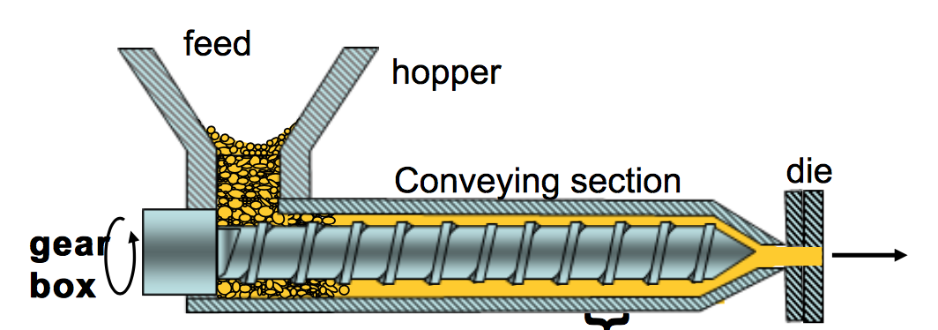
Solvent-free Process: Extruders
Extruders are used for:
  Mixing
  Pumping
  Reactions & Polymer modifications
  Polymer Blending
Similar to the use of ball mills to enhance chemical reactions with high collisions, extruders use mechanical force to promote chemical transformations.
Flow of materials
https://commons.wikimedia.org/wiki/File:Extruder_section.jpg

Slide 42
Solvent-free Process: Extruders
Example
Use of polymer?
No solvent required
High efficiency with minimal waste
Allows for novel properties not available in traditional processing and homopolymers
Image redrawn from: Maltlack, A. “Introduction to Green Chemistry” CRC Press, 2nd Edition, pp. 225
Notes:
Image redrawn from: Maltlack, A. “Introduction to Green Chemistry” CRC Press, 2nd Edition, pp. 225

Slide 43
Solvent-free Process: Extruders
Flow of materials
https://commons.wikimedia.org/wiki/File:Extruder_section.jpg

Slide 44
Tiered approach to harmful solvent use
Worst Case
Technology at plant’s or VOC source to destroy or recover solvents
A closed loop system to ensure all solvents are not lost during operations.
Substitute to a less harmful solvent
Use supercritical CO₂
Use water and water-based chemistry
Use no solvent: can the product be made just as well without the solvent?
Best Case

Slide 45
Summary
There are several ways in which organic solvents may be replaced or eliminated, and a good argument can often be made by implementing Green Chemistry practices.
It’s important to remember that changing solvents may require additional energy (e.g. stronger heating) and traditional organic solvents may still be needed for work-up & purification steps. Not to forget analytical determinations.
The choice of replacing or eliminating a solvent depends upon the reaction, upon the catalyst(s) and upon the method of product separation.

