Slide 1
Society, Economy, and the Environment

Slide 2
Why are Businesses Paying Attention?
Pollution, contamination, and waste are increasing along with population.
We blame society and corporations for encouraging increased customer demand, pushing consumption of life supporting resources further and further.
Even as these resources decline, consumption of these resources is still rising.
Anthropocene Review 2, no. 1 (April 2015): 81–98.

Slide 3
Why are Businesses Paying Attention?
The problem of declining resources is not felt as acutely in developed areas as it is in less developed parts of the world.
The UN Human Development Report from 2012 suggests that the richest 1% of the world, approximately 70 million people, receive as much income as the poorest 56%, or 4 billion people.
Companies are at risk of losing access to raw materials and to employees.
Unfortunately, we are not acting upon knowledge that we have as quickly as we need to in order to prevent the continuous degradation of the Earth and our ability to survive. This creates a sense of urgency in today’s corporate boardroom.
Green Chemistry & Chemical Stewardship Online Certificate Program: https://osha.washington.edu/pages/green-chemistry-chemical-stewardship-online-certificate-program

Slide 4
Society, economy, and the environment are the key dimensions of sustainability.
Society, Economy, and the Environment
Why?
Our society and economy heavily relies on the environment we live in. To sell product, one need access to resources (in a sustainable fashion), to have employees, one needs a healthy work environment…

Slide 5
The traditional view of economy, society, and the environment:
Society, Economy, and the Environment
When society, economy, and the environment are viewed as separate unrelated parts of a community, the community’s problems are also viewed as isolated issues. Economic development councils try to create more jobs. Social needs are addressed by health care services and housing authorities. Environmental agencies try to prevent and correct pollution problems.
Economy
Society
Environment

Slide 6
The current view of economy, society, and the environment:
The Triple Bottom Line
Society, Economy, and the Environment
Economy
Society
Understanding the three parts and their links is key to understanding sustainability, because sustainability is about more than quality of life. It is about balancing society, economy, and the environment.
Environment

Slide 7
A representation of the ideal economy, society, and the environment:
Society, Economy, and the Environment
The economy exists entirely within society because all parts of the human economy require interaction among people. However, society is much more than just the economy. Friends and families, music and art, religion and ethics are all important elements of society, but are not primarily based on the exchanging of goods and services.
Society, in turn, exists within the environment. Our basic requirements – air, food, and water – come from the environment as do the energy and raw materials for housing, transportation, and the products we depend on.
Environment
Society
Economy

Slide 8
Triple Bottom Line (TBL)
Society, Economy, and the Environment
TBL measures the impact of an organization's activities on the world by looking at profitability and shareholder values through its social, financial, and environmental capital.
Economy
Society
Environment
Most of major companies that include sustainability in their business plan use this model.

Slide 9
Pressures that companies are facing:
Sustainability and Business
Fiduciary responsibility to make profit: CEOs in public companies have a fiduciary responsibility to shareholders. It is the law for them to deliver profits. Even private companies and small companies have a fiscal responsibility to investors or venture capitalists to return profit on their investment. While there may be a desire to be more sustainable, it has not yet been included within the scope of fiduciary responsibility.
Fear of increased costs, process complexity, and reduced quality of the end product: There is an underlying assumption that being sustainable will drive up costs, erode profits, and threaten the ability of the company to maintain standards and ultimately survive in a competitive marketplace.
Measurement and Monitoring: Challenges surround what to measure along the three dimensions of the Triple Bottom Line. This includes internal agreement as to what to measure, how to measure, and finally how to put auditing procedures in place. Even if a company wanted to be sustainable, the methodology for setting objectives and measuring the results are often in nascent states.
Green Chemistry & Chemical Stewardship Online Certificate Program:
https://osha.washington.edu/pages/green-chemistry-chemical-stewardship-online-certificate-program

Slide 10
Sustainability and Business
Sustainability and Green Chemistry are imperative to business practices, can provide solutions at lower costs, use fewer resources, and the processes and results can be measured.

Slide 11
How?
Sustainability and Business
With the ability to establish multiple value creation levers over the short and long term such as:
Stronger brand and greater pricing power.
  Increased margins, producing greater profits and maximizing total shareholder return.
Improve customer loyalty and reduce the rate of churn.
  Boosting market share and revenue growth.
Create the culture aligned with sustainability goals: “maximize resource efficiency”, “eliminate and minimize hazards and pollution”, and “design systems holistically and use life cycle thinking” by focusing on design.
B. Torok and T. Dransfield (eds), 1st edn, JAN 2018, Elsevier, Amsterdam, The Netherlands, ISBN-13: 978-0128092705, 1058 pp.

Slide 12
Who?
Sustainability and Business
An awareness of the Principles of GC&GE should not be limited to the members of the design teams of sustainable and innovative products and processes.
Green chemistry requires top-down implementation of sustainable innovation from managers and leaders in addition to the bottom-up (emergence) implementation from designers (followers).
  Managers must be aware of the principles in order to implement sustainable approaches across multiple scales.
  Leaders must be aware of the principles in order to develop business models and strategies that are sustainable in the long term.
B. Torok and T. Dransfield (eds), 1st edn, JAN 2018, Elsevier, Amsterdam, The Netherlands, ISBN-13: 978-0128092705, 1058 pp.

Slide 13
Framework of Innovation Management Process: Seven Opportunities to Apply Green Chemistry
Sustainability and Business
Inputs
Human - The multidisciplinary approach requires innovative teams with diverse skill sets and knowledge. Actors require the ability to network and collaborate within the departments of an organization and beyond.
Physical/Natural - Renewable materials and energy; designing new materials, products, processes, and systems that are benign to human health and the environment.
Financial - A positive impact on value creation levers (stronger brand and greater pricing power) that can lead to increased total shareholder return.
B. Torok and T. Dransfield (eds), 1st edn, JAN 2018, Elsevier, Amsterdam, The Netherlands, ISBN-13: 978-0128092705, 1058 pp.

Slide 14
Sustainability and Business
Framework of Innovation Management Process: Seven Opportunities to Apply Green Chemistry
Innovation Strategy
Companies that follow a sustainable business should be able to derive competitive advantages that are based on a sustainable value proposition.
By reducing the costs associated with waste, companies can improve operational efficiencies and gain a competitive advantage via a cost advantage.
A greener product that’s certified as sustainable can be sold at a higher price.
B. Torok and T. Dransfield (eds), 1st edn, JAN 2018, Elsevier, Amsterdam, The Netherlands, ISBN-13: 978-0128092705, 1058 pp.

Slide 15
Sustainability and Business
Framework of Innovation Management Process: Seven Opportunities to Apply Green Chemistry
Knowledge Management
The leaders and managers of sustainability will require new core competencies that include sustainability literacy, external collaboration, and systems thinking.
Project teams that pursue sustainability initiatives, or that are involved in the creation of a new product or process, will require diverse skill sets.
B. Torok and T. Dransfield (eds), 1st edn, JAN 2018, Elsevier, Amsterdam, The Netherlands, ISBN-13: 978-0128092705, 1058 pp.

Slide 16
Sustainability and Business
Framework of Innovation Management Process: Seven Opportunities to Apply Green Chemistry
Organization and Culture
At the executive level, prioritization decisions based on values take the form of decisions to invest, or not, in new products, services, and processes.
Employees should prioritize decisions that lead to sustainable innovation and ultimately sustainable development.
  Organization and culture can also attract top talent (that pays close attention to a firm’s behavior) and could reduce employee turnover.
B. Torok and T. Dransfield (eds), 1st edn, JAN 2018, Elsevier, Amsterdam, The Netherlands, ISBN-13: 978-0128092705, 1058 pp.

Slide 17
Sustainability and Business
Framework of Innovation Management Process: Seven Opportunities to Apply Green Chemistry
Project Management
Awareness of Green Chemistry can guide project managers as they operate within the multiple levels of reporting (middle, upper manager, and executive levels).
As for project management, designers and managers should consider the entire life cycle of a product, including those of the materials and energy inputs.
B. Torok and T. Dransfield (eds), 1st edn, JAN 2018, Elsevier, Amsterdam, The Netherlands, ISBN-13: 978-0128092705, 1058 pp.

Slide 18
Sustainability and Business
Framework of Innovation Management Process: Seven Opportunities to Apply Green Chemistry
Portfolio Management
Leaders and managers can evaluate the sustainability of the projects that make up a portfolio in the context of Green Chemistry
A challenge for leadership is the development of performance metrics for sustainability efforts that are different from the usual metrics of portfolio management, such as patent portfolio size and R&D expenditure.
B. Torok and T. Dransfield (eds), 1st edn, JAN 2018, Elsevier, Amsterdam, The Netherlands, ISBN-13: 978-0128092705, 1058 pp.

Slide 19
Sustainability and Business
Framework of Innovation Management Process: Seven Opportunities to Apply Green Chemistry
Commercialization
The most effective methods of ideation for product innovation are customer visit teams, ethnographic research, leader user analysis, and focus groups.
Feedback from marketing and sales teams involved in the diffusion stage will help the designers of new products in the ideation phase since these teams will best understand market orientation or pull.
B. Torok and T. Dransfield (eds), 1st edn, JAN 2018, Elsevier, Amsterdam, The Netherlands, ISBN-13: 978-0128092705, 1058 pp.
Notes:
Ethnographic research is a qualitative method where researchers observe and/or interact with a study's participants in their real-life environment

Slide 20
Different Models of Sustainability
Nike – low carbon, closed loop model
The company is reducing the use of petroleum-derived solvents (PDSs) across the manufacturing process of their footwear product lines. Since 1995, there has been an actual 96% reduction in the use of PDSs per pair of shoes through the adoption of water-based adhesives.
In 2011, Nike committed to Zero discharge of hazardous chemicals by 2020.
https://news.nike.com/news/sustainable-innovation
https://news.nike.com/news/nike-inc-commitment-on-zero-discharge-of-hazardous-chemicals

Slide 21
Different Models of Sustainability
Unilever
As a result of their sustainability initiatives, Unilever factories are releasing 37% less emissions than in 2008, and waste is down 85%.
The example highlights how innovators are attempting to utilize matter and energy in a way that enhances performance and value while protecting the environment.
https://www.nytimes.com/2015/11/22/business/unilever-finds-that-shrinking-its-footprint-is-a-giant-task.html?_r=0

Slide 22

The Interface Company
Case Study
Does running a business by conviction mean sacrificing profit?
Prepared by
Abigail Enghirst ~ Karen Schenck ~ Justin Vickerman ~ Karen Wisont

Slide 23
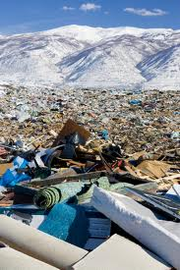
A Sizeable Global Industry
Case Study: The Interface Company
Market Value
Global:
$150 billion (2012)
US:
>$10 billion (2010)
Production and Waste
Produced annually:
3 million tons
(6 billion pounds)
Discarded annually:
~2 million tons
(4 billion pounds)
Interface Waste
1996: 15 million lbs
2009: 3.4 million lbs
Interface:
$927 million (2010)
Municipal solid waste: 1% (by weight)
2% by volume
75% reduction
$372 million cumulative avoided waste cost
Interface Inc. is a company selling carpet tiles
Notes:
It wasn’t the potential cost savings that led Interface to examine their waste stream, though, it was their founder/CEO, Ray Anderson who had an vision to transform the company to sustainability, which he defined as eventually operating the petrol–intensive company in such a way as to eventually take nothing from the earth that is not naturally and rapidly renewable. This vision was inspired by a story Anderson read about the reindeer population on St. Matthew Island.
http://www.allbusiness.com/economy-economic-indicators/economic-indicators/11749247-1.html
http://www.reportlinker.com/p099484/World-Flooring-and-Carpets-Market.html
http://wasteage.com/Recycling_And_Processing/carpet-diversion-201012/
http://www.informinc.org/fact_CWPcarpet.php
one gallon of oil is lost for every three square yards that are disposed in landfills
60% of carpet made in the US is made of nylon

Slide 24
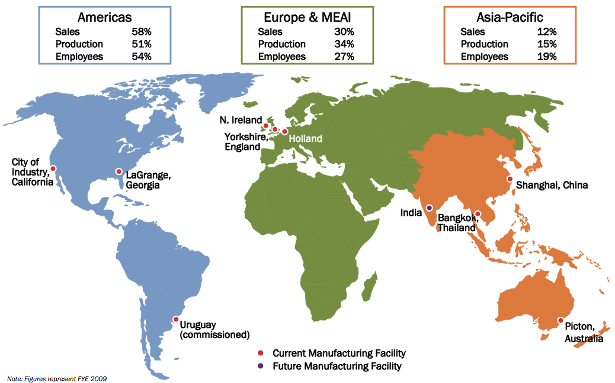
Where is Interface?
Case Study: The Interface Company
Notes:
Sales focused in US and Europe, looking to Asia for new growth

Slide 25

Ray Anderson
Case Study: The Interface Company
A “Spear in the Chest”
“I stood indicted as a plunderer, a destroyer of the earth, a thief of my grandchildren’s future. And I thought, my God, someday what I do here will be illegal. Someday they’ll send people like me to jail.”
“I was so wrong, for so long…There is a better way to make a bigger profit…and at the same time do it honestly and legitimately, not at the expense of the earth.”

Slide 26
Ray Anderson’s Vision
Case Study: The Interface Company
“To be the first company that, by its deeds, shows the entire industrial world what sustainability is in all its dimensions:
people, process, product, place and profits — by 2020
and in doing so we will become restorative through the power of influence.”
Notes:
Accomplishing any mission begins with a clear vision, which Ray Anderson had basically articulated back in 1994.

Slide 27
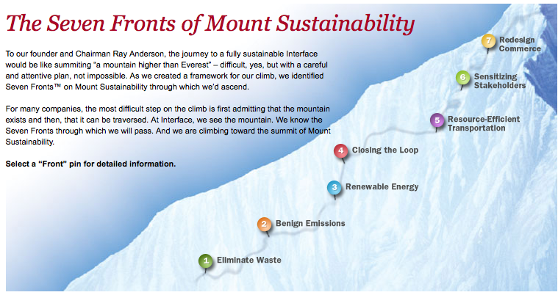
Notes:
Anderson describing the seven faces of mount sustainability
“We realized there are seven faces of the mountain…today we would say there are eight faces and we’re still looking for the ninth. At the time we identified the seven faces of the mountain, we said, “we’ve got to climb each one of those to its own peak and we’ll meet at the top.” And that point at the top will represent will represent sustainability—take nothing, do no harm. And the first face of the mountain is eliminate waste. Any cost that we incur that does not add value to our customer is by definition waste. Today we would say any fossil fuel energy is by definition waste. The second face of the mountain is one of emissions to be sure that whatever we emit from our factories is harmless to the environment. That means working with our suppliers upstream because what comes into our factories will go out either as product or as solid waste, liquid effluent, or gaseous emissions. The third face of the mountain is energy. We want to operate our factories on renewable energy. Today we’re a fourth of the way there. The fourth face of the mountain is material flows. We want to get our products back at the end of their first life and give them life after life. The fifth face of the mountain is the transportation face—moving people and product in climate-neutral, resource-efficient, harmless-to-the-environment way. We’re quite well along the on that with people; we have a way to go yet with product, though. The sixth face of the mountain is maybe the most important because nothing of lasting value happens without it—that is the culture shift. It’s one mind at a time adopting this new paradigm, this new way of thinking about the world and the industrial system and our place within that industrial system. And then the seventh face of the mountain, we really think that someday we’ll be able to reinvent the way we go to market—instead of selling products, stuff, we’ll sell the service that the product delivers to the customer. For carpets it’s the color and the texture, the design, the ambience, the comfort under foot, the acoustical value…all the reasons anybody would want our carpet. In the first place, just sell them the service and retain ownership in the stuff, the means of delivering the service. The eighth face of the mountain has just emerged more clearly for us—and that is the social equity face of the mountain. We have a long way to go to figure that face of the mountain out. And I couldn’t begin to tell you how far we are up that particular face because it’s a whole different set of metrics. We in fact invented a whole new set of metrics called EcoMetrics; this is just as important on the environmental initiative as the financial metrics are on financial side of the business and now we have the SocioMetrics to figure out, the social equity side of this”

Slide 28
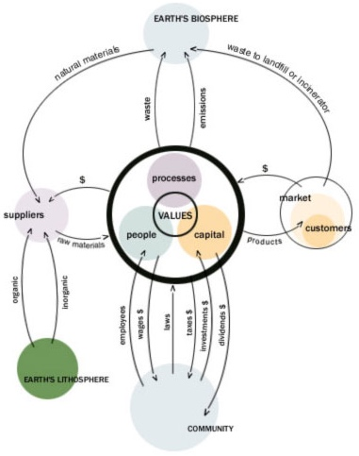
A 20th Century Company
Case Study: The Interface Company
Center
- Common to all companies
- Values are core
Suppliers
- Materials for capital
Customers
- Capital for products
- Used products to landfill
Biosphere
- Collects waste and emissions
Lithosphere
- Suppliers take materials (oil)
Community
- Employees for wages
- Capital exchange
- Regulation
Notes:
28

Slide 29
…to A Prototypical 21st Century Company
Climbing the Mountain
Case Study: The Interface Company
x
x
Step 1
Eliminate Waste
1
Notes:
29
Here’s where you’re aiming (peak of Mount Sustainability is the 21st century prototypical company)…
Eliminate waste in manufacturing process
Eliminate product waste sent to landfills or incinerators at end of useful-life
CONVICTION

Slide 30
Case Study: The Interface Company
…to A Prototypical 21st Century Company
Climbing the Mountain
x
x
x
Step 2
Benign Emissions
2
1
Notes:
30
Eliminate emissions generated during manufacturing processes

Slide 31

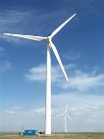
Case Study: The Interface Company
…to A Prototypical 21st Century Company
Climbing the Mountain
x
x
x
Step 3
Renewable Energy
3
2
1
Notes:
31
Supply energy from renewable sources (solar, wind, biomass, etc.)

Slide 32
Case Study: The Interface Company
…to A Prototypical 21st Century Company
Climbing the Mountain
x
x
x
x
Step 4
Closing The Loop
4
x
x
3
2
1
Notes:
32
Prevent toxic emissions upstream – what comes in will go out. End-of-pipe solutions are unsustainable – we must leave toxic substances in the lithosphere

Slide 33
Case Study: The Interface Company
…to A Prototypical 21st Century Company
Climbing the Mountain
x
x
x
x
x
Step 5
Resource Efficient
Transportation
x
x
5
x
x
4
3
2
1
Notes:
33
Eliminate harmful emissions from transportation (employee commutes, business travel, supplier shipments, product shipments – all transportation in the business cycle)

Slide 34
Case Study: The Interface Company
…to A Prototypical 21st Century Company
Climbing the Mountain
x
x
x
x
x
S
S
Step 6
Sensitizing Stakeholders
x
x
6
S
5
x
x
4
3
2
1
S
Notes:
34
Introduce valuable sensitivity connections — ties to the community, suppliers and customers, and within the organization

Slide 35
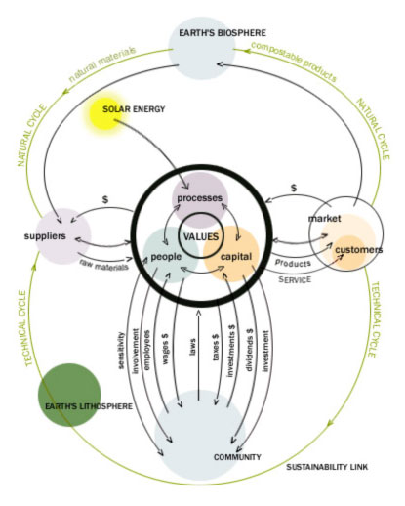
Case Study: The Interface Company
…to A Prototypical 21st Century Company
Climbing the Mountain
Step 7
Redesign
Commerce
7
6
5
4
3
2
1
Notes:
35
Redesign commerce — shift emphasis from selling products to providing service, ensure that price reflects full costs, increase market share at the expense of inefficient competitors, shift tax laws from taxing good things (income and capital) to bad things (pollution, waste, emissions)
Introduce closed loop recycling via the Natural Cycle — emphasizing natural raw materials and compostable products
Technical Cycle — giving man-made materials and precious organic molecules life after life

Slide 36
Mission Zero Goals:
Approximately 60% Progress as Assessed in 2010
100
90
% progress to goal
80
70
60
50
40
Sensitizing Stakeholders
30
R.E. Transportation
Redesign Commerce
Benign Emissions
Renewable Energy
Closing the Loop
20
Waste
10
0
Notes:
Based on Anderson’s 1994 “spear in the chest,” the new direction of Interface was based on the vision “to be the first company that, by its deeds, shows the entire industrial world what sustainability is in all it’s dimensions: people, process, product, place and profits – and in doing so, become restorative through the power of influence.”
Anderson understood that sustainability had to be approached from a systems perspective or a “whole company” approach. Over the years as the commitment to sustainability reached all parts of Interface, it evolved into a shared mission: Mission Zero.
Sixteen years into the journey, and a decade away from the date Interface predicted for achieving the vision (2020), the company is approximately 60% along. They are doing better along some faces than others but are making strides on all faces.
Not all initiatives have been successes…but by fostering an engaged culture of people connected to Mission Zero who feel empowered to effect change, there is continued innovation.
Some lowlights and highlights
36

Slide 37
Good Intentions = Lost Revenue
Case Study: The Interface Company
Profitable company
Ray Anderson decided to become first truly sustainable company
$780 million in sales (1994)
$50 million cost savings (1994-1997)
$1.2 billion in sales (1998)
Drop in sales, cumulative losses
Anderson replaced (as President 1997, as CEO 2001)
Must a company sacrifice profit to pursue conviction?
Notes:
While Interface made great strides in the environmental and social realms, after the initial savings from waste reduction was realized, net income dropped dramatically
They lost sight of the business end of things (like creating a product that people wanted—today’s carpet tiles are much more attractive)

Slide 38
Finding Balance Between Conviction and Profit
Focus on profit
Balance of profit
and conviction
Focus on conviction
Economic
Environmental
Environmental
Social
Economic
Social
Social
Environmental
Economic
“Innovative business models and products must work financially, or it won’t matter how good they are ecologically and socially.” -SengeH
Notes:
In its early years, Interface the typical industrial firm
Plunders of the earth focused on profits through destruction
Spear in the chest moment resulted in pendulum swing far to the left
Economic loss, the firm becomes unsustainable
Today – sustainable equilibrium achieved
Earning economic profit
Continuing progresses towards mission zero
Simulating creative innovation fostered by intrinsic motivation

Slide 39
The results in terms of Economic & Sustainability (2017)
Case Study: The Interface Company
Economic
Sales $ 996m (up 3.9% since 2016)
Operating Income (up 29% since 2016)
Net Profit of $ 53m
Returned $ 91m to shareholders via share repurchase program
Reduced total debt by $ 40m
Sustainability
88% energy from Renewable sources
GHG emissions from energy use is down 96% (since 1996)
58% of materials in products (recycled or bio-based sources)
Waste to landfill is down 91% (since 1996)
Water use is down 88% (since 1996)
Average carbon footprint is down 66% (since 1996)
https://interfaceglobal.gcs-web.com/static-files/de9b7f61-b910-4b7c-8dab-b569ad401701

Slide 40





The Ingredients of Prototypical 21st Century Success
Case Study: The Interface Company
Environment
Financial
Social
Lead by example
Leave the world a better place
Maintain sustainable profits and growth within the industry
Notes:
"To be the first company that, by its deeds, shows the entire industrial world what sustainability is in all its dimensions: people, process, product, place and profits – and in doing so, become restorative through the power of influence". -Ray Anderson

Slide 41
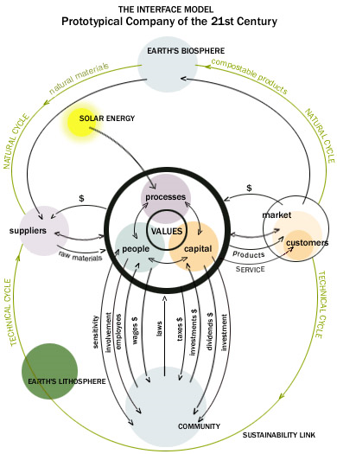

Slide 42
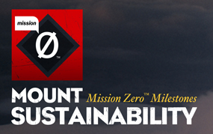
Case Study: The Interface Company
“The choice between conviction and profits is a false choice; more creativity is required.”
-Ray Anderson
Notes:
A leader with a passion for sustainability can change the course of his company.
A company with a unified vision can change business as usual.
No mountain is too high for hard work and ingenuity to conquer.

Slide 43
Sustainability Discussion
What sustainable practices are incorporated in your company?
Is there a room for improvement?
How can YOU contribute to sustainability within your organization and what can these contributions be?
How successful would the Interface model be at your organization?
Do you have to sacrifice some profit to become a sustainable company?

Slide 44
Green Washing
The act of misleading consumers regarding practices of a company or the environmental benefits of a product or a service.
Deceptive use of Green Marketing, or claiming to do good and doing the opposite.

Slide 45
Examples of Green Washing
Source: Wikipedia

Slide 46
Other Green Washing Phrases to Consider
Cruelty free, bio, eco, carbon neutral, earth-friendly, true green

Slide 47
Reasons Companies Use Green Washing
Using Green Wave for Profit
  Consumers are likely to buy green products or services and because many consumers can’t tell of the product claim is true.
Keeping with the Green Trend
  To show competitive advantage over the competitor.
Public Relations

Slide 48
Common Features of Green Washing
Suggestive pictures
Irrelevant claims
Hidden trade-offs
Green product
Distraction from the greater impact made by the product

Slide 49
Preventing Green Washing
Better regulation
Development and use of reliable metrics
Certifications
Consumer awareness
Reporting green washing

