Slide 1
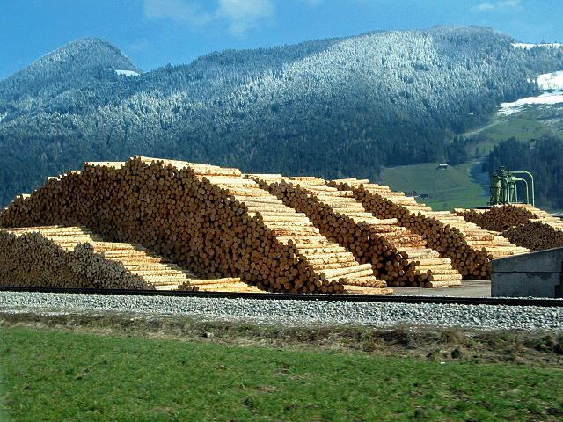
Yale-UNIDO Train-the-Facilitator Workshop in Green Chemistry
Renewable Feedstocks
CENTER for GREEN CHEMISTRY
and GREEN ENGINEERING at YALE
Image: Wikimedia Commons, Author: R. Möhler

Slide 2
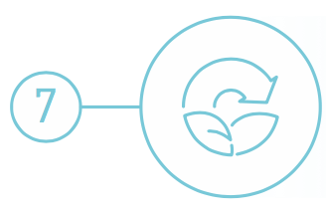
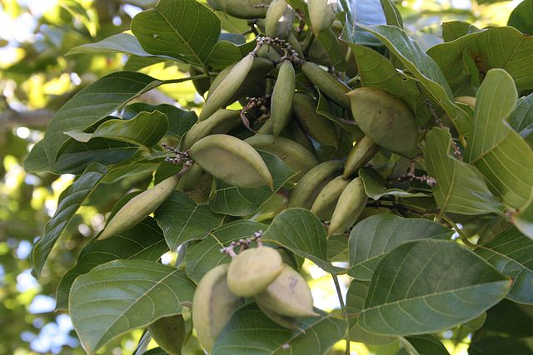
Use of Renewable Feedstocks
A raw material or feedstock should be renewable rather than depleting whenever technically and economically practical.
Image: Wikipedia, Pongamia Pinnata Seeds

Slide 3
Topics To Be Covered
Energy and Feedstock Consumption
Petroleum
Renewable Feedstocks
  Biomass Feedstocks
  Carbohydrate Feedstocks
  Lipid Oils and Terpenes as Feedstocks
  Protein Feedstocks
Renewable Feedstocks as a Source of Energy
First, Second, and Third Generation Feedstocks
The Advantages and Drawbacks of Biofuel

Slide 4

Renewable vs. Depleting Feedstocks
Feedstock:
A raw material to supply or fuel or industrial process.
Renewable or Depleting is a question of time:
A renewable resource is determined to be renewable if it can be replenished in a relevant amount of time.
Fossil fuels are depleting because they cannot be replenished in a practical timeframe from vegetation.
Image: Wikimedia Commons, Author: Johnlacrosse

Slide 5
Energy Consumption: Data and Projections
Increasing world energy consumption since 1990.
The graph includes a prediction for year 2035, where the projected energy consumption will reach 770 quadrillion British Thermal Unit [BTU].
Source: U.S. Energy Information Administration [U.S. EIA].

Slide 6
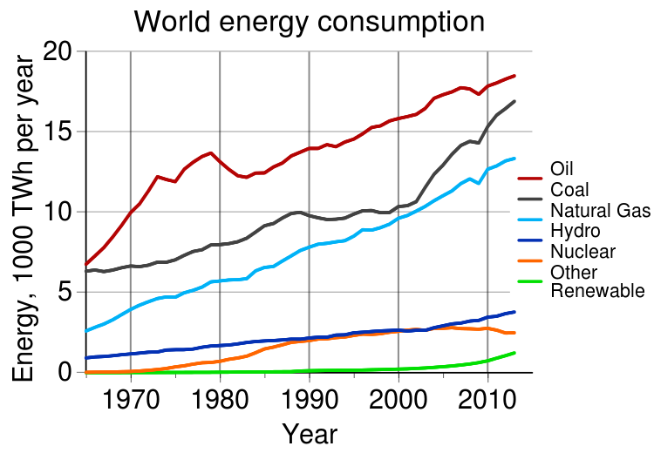
Energy Feedstock Consumption
Oil, coal and natural gas remain the predominant sources of energy, but the use of renewables is still increasing.
Source: Statistical Review of World Energy
Increasing world energy consumption: 1970-2010.

Slide 7
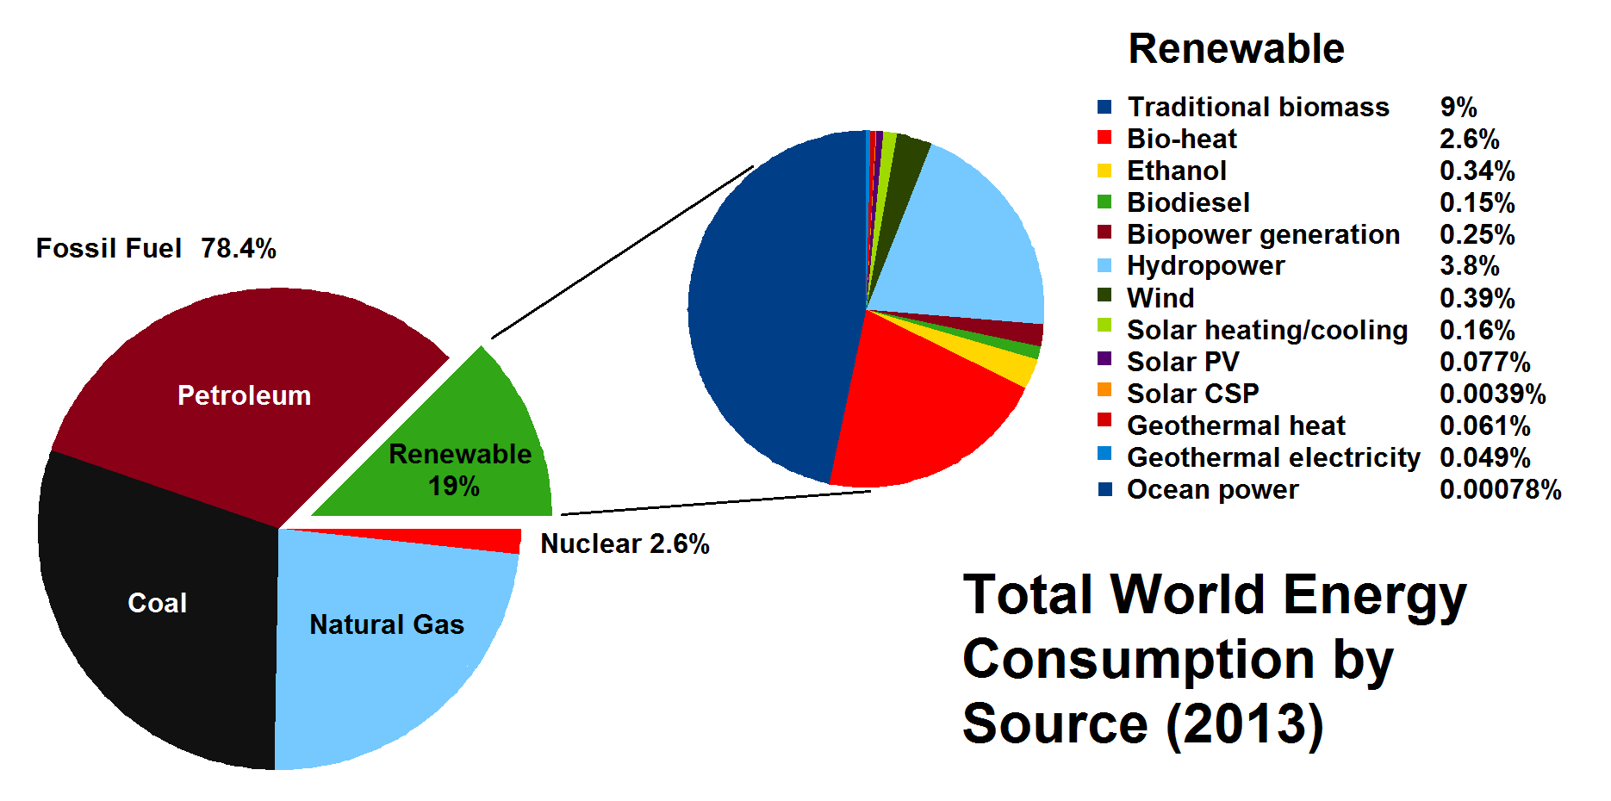
Energy Feedstocks Sources
World energy consumption by source as reported in 2013.
While the use of fossil fuels is still predominant, by 2013 there was an increase in the use of renewable sources of energy. Most renewable energy comes from biomass.
Source: REN21 Renewables 2014 Global Status Report.

Slide 8
What are the most common feedstocks today?
Image: Creative Commons

Slide 9
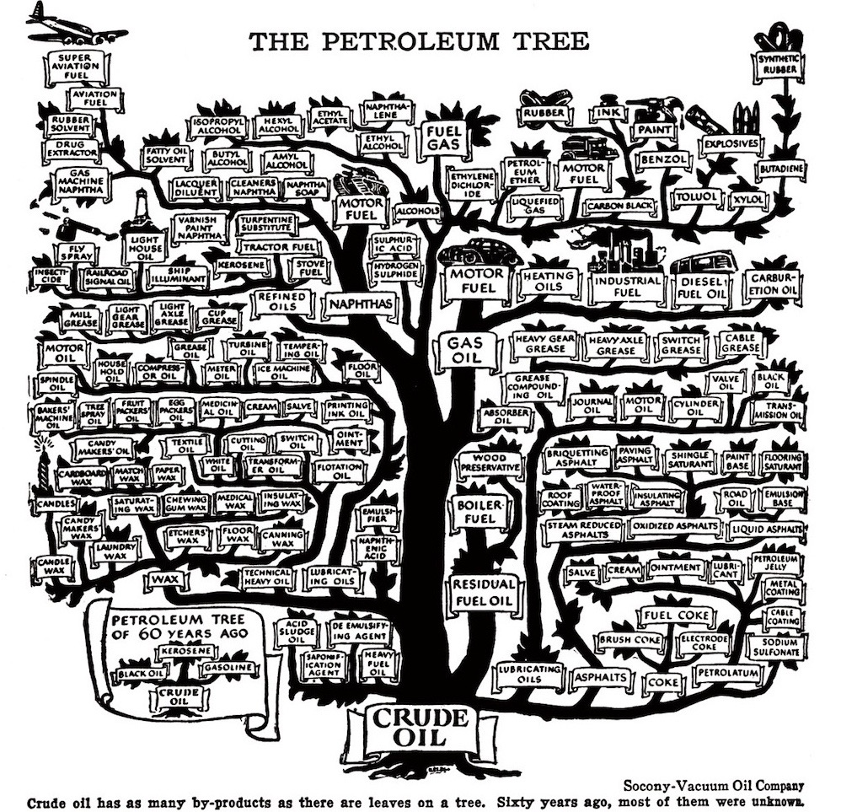
What is petroleum used for?

Slide 10
How is petroleum generated and used?
Biomaterials [Carbohydrates, Proteins, Lipids]
Highly Functionalized Molecules
Over millennia
1. High temperature, and pressure; natural process of oil creation
2. Oil extraction and processing
Petroleum Products [Hydrocarbons – highly reduced state]
3. Separation and oxidation, high energy input
Functionalized Compounds [Olefins, Alkylchlorides]
4. Further functionalization, replacing reactive groups with functional groups of interest
Highly Functionalized Molecules

Slide 11
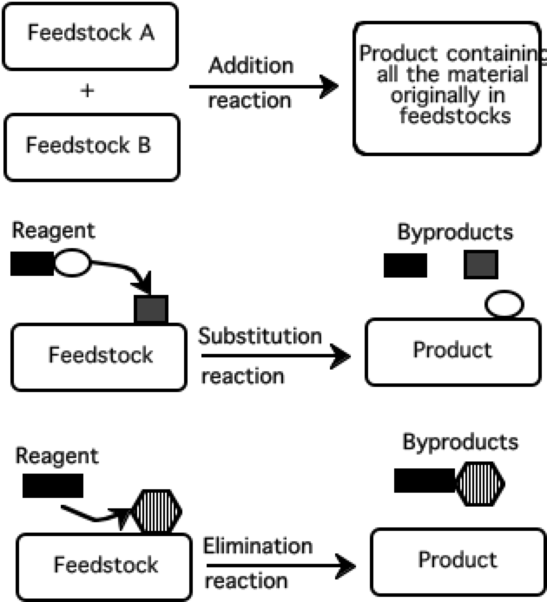
Three major categories of reaction processes by which feedstocks are acted upon by reagents to yield products
Petroleum hydrocarbon molecules are in a highly reduced chemical state and often must be oxidized to be used as a feedstock.
The oxidation process consumes energy and often uses severe and hazardous reagents which are capable of oxidations of non reactive molecules.
The majority of reactions for petroleum feedstocks are substitutions since reactive groups need to be replaced with the desired group.
This process generates several byproducts, which oftentimes are considered a waste.

Slide 12
How are petroleum products made?
By using a fractionation column.
By oxidation (typically by a powerful oxidizing agent like chloride) and adding numerous additives.

Slide 13
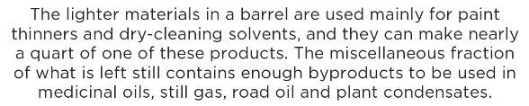
What can be made from one barrel of oil?
http://www.visualcapitalist.com/can-made-one-barrel-oil/

Slide 14
Notes:
Today, the list of petroleum based products is even longer.

Slide 15
What characterizes an ideal feedstock?
An ideal feedstock is renewable and poses no hazards to humans or the environment.
An ideal feedstock can be converted to the desired product using only a few steps.
The reaction gives a 100% yield and has 100% atom economy.

Slide 16
Renewable feedstocks
Renewable feedstocks include the following materials:
Biomass (algae, corn, switchgrass, poplar, willow, sorghum, and bamboo)
Agricultural waste (ex. manure)
CO₂

Slide 17
What can be made from renewable feedstocks?
Defense and aerospace
Adhesives
Coatings
Corrosion, inhibitors
Automotive
Solvents
Polymers
Fuels
Household cleaners
Surfactants
Fragrances
Dyes
Electronics
Solder
Housings
Displays
Agriculture
Pesticides
Fungicides
Fertilizers
Cosmetics
Builders
Chelating agents
Dyes
Specialty Chemicals
Pharmaceuticals
Used in Academic Research Labs

Slide 18
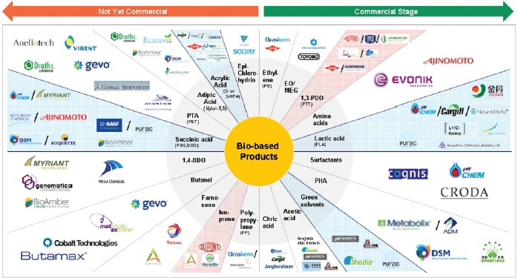
Companies that make bio-based products
Image: National Research Council. 2015. Industrialization of Biology: A Roadmap to Accelerate the Advanced Manufacturing of Chemicals. Washington, DC: The National Academies Press. https://doi.org/10.17226/19001.

Slide 19
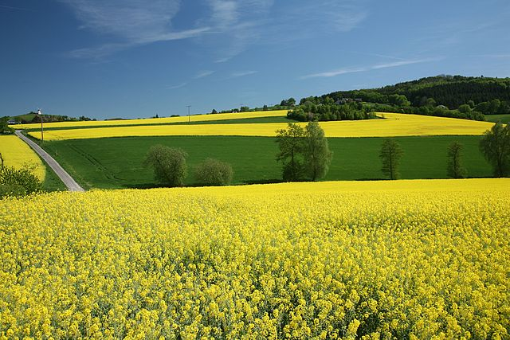
Biological feedstocks
Organisms have provided a huge share of the materials used by humans throughout their existence.
Biomass: Plant material generated by photosynthesis
• Biomass is the leading candidate to replace petroleum as a feedstock for the organic chemicals industry.
• Partially oxidized biomass material avoids expensive, and sometimes difficult oxidation steps in oxidizing petroleum
Image: Wikimedia Commons, Author: Daniel Schwen

Slide 20
Biomass Platforms
Only about 4% utilized by humans
(food, ethanol, sweeteners)
Building blocks for a diverse chemical platform.
Nature’s richest source of aromatic carbon. Used in polymers, adhesives, production of phenolic chemicals.
Converted into polymers, lubricants, and detergents.

Slide 21
Carbohydrate Feedstocks
Carbohydrates can be used as feedstocks for chemical processes
Carbohydrates are created in several forms:
• Sucrose sugar, C₁₂H₂₂O₁₁, is squeezed from sugar cane as sap and is extracted from sugar beets and sugar cane with water.
• Starch, a polymer of glucose readily isolated from grains (such as corn) and from potatoes, and is readily broken down by adding water to produce glucose.
• Huge amounts of cellulose, which occur in the woody parts of plants, can be broken down to glucose with cellulase enzymes.

Slide 22
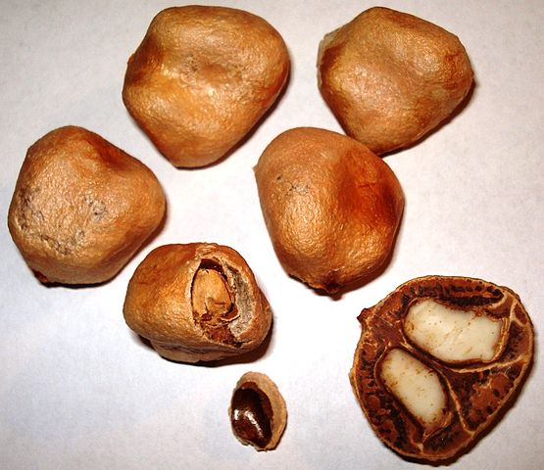
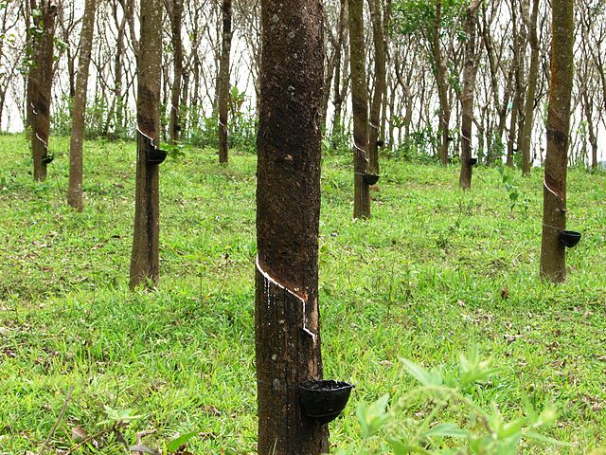
Lipid Oils and Terpenes
Lipid oils can be extracted from the seeds of some plants.
• Volatile solvent n-hexane, C₆H₁₄, is used to extract the oils.
• Solvents are distilled off from the extract and recirculated through the process.
Hydrocarbon terpenes can be tapped from rubber trees as a latex suspension in tree sap.
Steam treatment and distillation are used to extract terpenes from sources such as pine or citrus tree biomass.
Image: Wikimedia Commons, Marula - Sclerocarya birrea – Seeds, Author: Genet
Image: Wikimedia Commons, Rubber trees in Kerala, India, Author: M.arunprasad

Slide 23
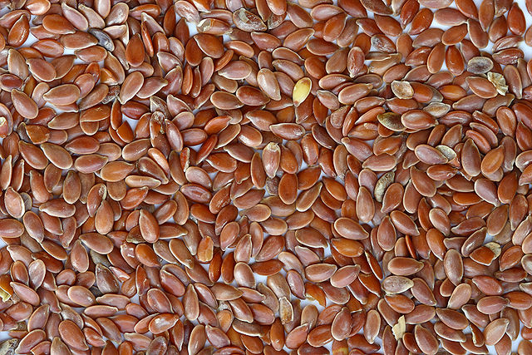
Protein Feedstocks
Grain seeds can be used as sources of protein.
• Grain seeds are generally used for food.
• They are potentially useful as chemical feedstocks for specialty applications.
• Transgenic plants can be used to make specialty proteins, such as medicinal agents.
Image: Wikimedia Commons, Brown Flax Seeds, Author: Sanjay Acharya

Slide 24
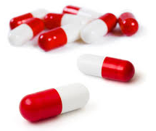
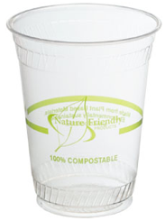

How are biological feedstocks processed?
?
Fermentation
Microorganisms
(aerobic, anaerobic)
Enzymes
Images: Creative commons

Slide 25
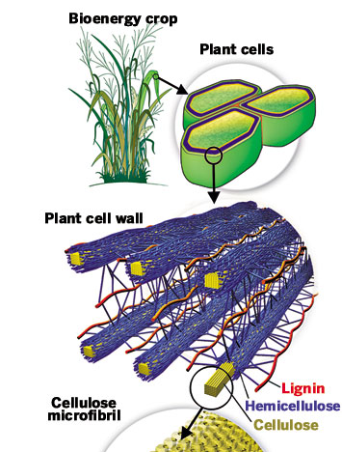
Example: Enzymatic lignocellulose breakdown
Lignocellulose is a complex polymer obtained from plant cell walls. It has many aromatic subunits.

Slide 26
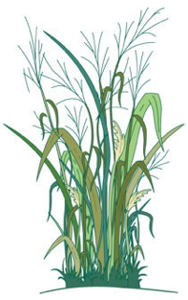

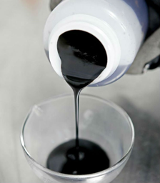
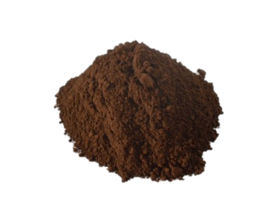
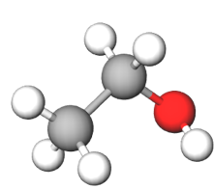
Main Industries for Lignocellulose
Retains applied nitrogen longer in the plants’ root zone, optimizing crop utilization and yield, and reducing nutrient run-off.
Retains applied nitrogen longer in the plants’ root zone, optimizing crop utilization and yield, and reducing nutrient run-off.
PAPER INDUSTRY
BIOETHANOL INDUSTRY
Lignin powder
Bioethanol
Burnt or Discarded

Slide 27
Lignin: A Source of Renewable ‘Drop-in’ Platform Chemicals
A Need of New Technology:
Economical
Sustainable
Selective
Efficient
phenol
The lignin structure includes aromatic (ring) structures.
If it is broken down selectively, it can be a source of drop-in platform chemicals such as phenol.

Slide 28
A Depolymerization Strategy for the Valorization of Lignin
With the addition of hydrogen and a selective catalyst, lignin can be broken down into phenols.
Lignin
Phenols

Slide 29
Example: Penicillin production using fermentation
Penicillin antibiotics were among the first medications to be effective against many bacterial infections caused by staphylococci and streptococci. They are still widely used today, though many types of bacteria have developed resistance due to the extensive use.
The secondary metabolite of a fungus - Penicillium chrysogenum - grows using a carbon source of glucose and lactose.
Once the fungus reaches a stationary phase, it starts producing the antibiotic.

Slide 30
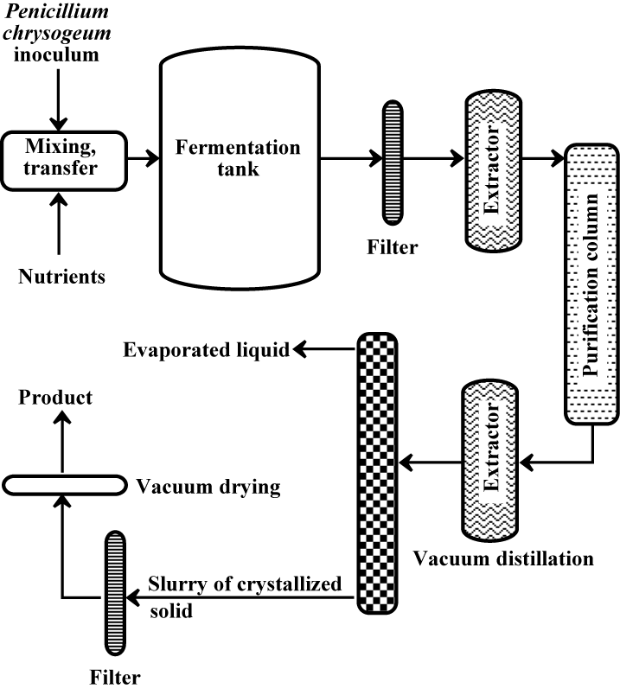
Requirements for a successful fermentation process:
Proper nutrients
Sterile conditions
Temperature regulation
Oxygen level
pH control
The fermentation process is similar for other commodity products, such as antibiotics, insulin, ethanol, organic acids, vitamins and enzymes.

Slide 31
The Top 10 Chemical Targets
(platform chemicals from bio-feedstocks)

Slide 32
Why use renewable feedstocks?
Economic reasons:
  The inherent long-term tendency for petroleum price increases.
  A fluctuation of a few cents in the price of crude oil can result in massive price swings for downstream products.
  The constant decrease in cost of renewable resources.
Scientific reasons:
  The constant improvement in quality of renewable feedstocks.
  Modern plant breeding.
  Genetic manipulation.
  Breakthroughs in catalysis (enzymes, etc.).
Environmental reasons:
  Biological compatibility (to an extent).
  The use of waste streams (wood pulping, agriculture, etc.).

Slide 33
Some Potential Challenges of Using Renewable Feedstocks
Feedstock cultivation
  Competition with food supply
  Land demand
  Nutritional needs
  Diseases
  Initial investment
Harvesting method to maximise yields and minimise degradation of product
Post harvest processing
Product extraction and purification
Product standardization
Complexity
Product storage, packing, and distribution
New methodologies for alternative feedstocks

Slide 34
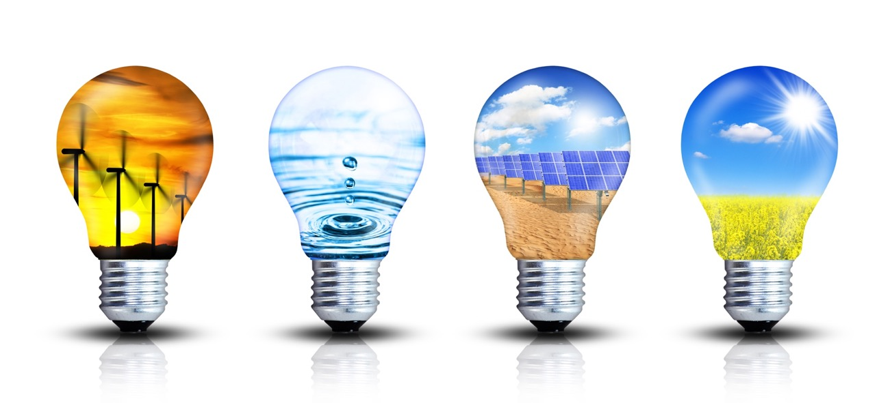
What about energy from renewable resources?

Slide 35
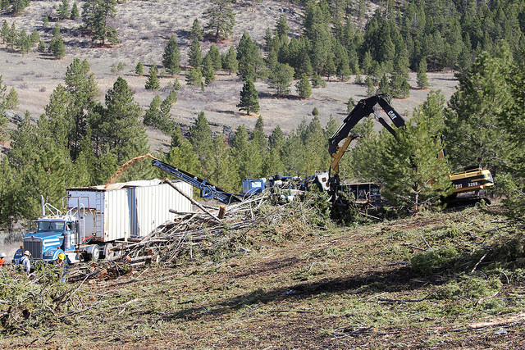
Environmental Consequences
At first glance, we might think that biofuels are inherently environmentally friendly, but is this true?
That depends on how the biofuels are produced.
Image: Flickr, Tribal Biofuel, Author: U.S. Department of Agriculture

Slide 36
Environmental Issues
Bioenergy can have positive impacts:
• Green house gas reduction (through fossil-fuel substitution).
• More agrobiodiversity, soil carbon increase, less erosion.
But these impacts can also be negative:
• Green house gas from cultivation, soil carbon, life-cycle, direct and indirect land-use changes.
• Loss of biodiversity from land-use changes, water use, agrochemicals, erosion.

Slide 37
Types of Biofuel
First Generation Biofuels
Grains are used to produce ethynol
Food versus fuel
Second Generation Biofuels
Using agricultural wastes ←→ lignocellulosics
Lignocellulosics for ethanol
Oils for biodiesel
Grasses
These crops were not domesticated for use as biofuels
Third Generation Biofuels (looking to the future)
Algae

Slide 38
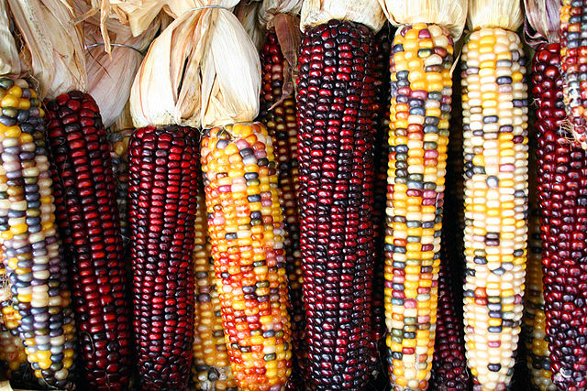
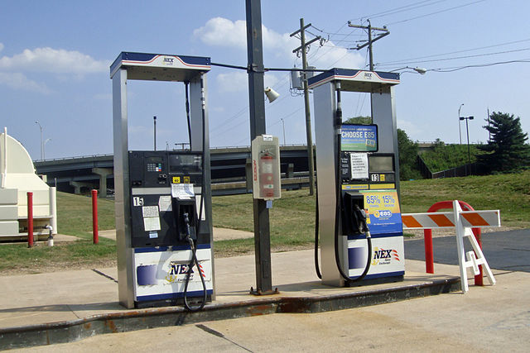
First Generation: The Corn-based Ethanol Production Process
Grind up the feedstock so it can be easily and quickly processed.
Sugar is dissolved out of the material.
The sugar is fed to microbes that use it for food, producing ethanol and carbon dioxide in the process.
Purify the ethanol to desired concentration.
Images: Wikipedia Commons, Corncobs, Author: Sam Fentress; Wikimedia Commons, Biofuel Pumps, Author: Mario Roberto Duran Ortiz
Notes:
Source: Department of Energy, Alternative Fuels Data Center, “How is Ethanol Made?”, available at http://www.eere.energy.gov/afdc/altfuel/eth_made.html

Slide 39
Food verses Biofuel: The Math
To fill up an average 25 gallon SUV gas tank with ethanol requires the same amount of grain as it takes to feed 1 person for 1 year.
Every person in the U.S. uses 500 gallons of gasoline per year.
That means that each year, every person in the U.S. would use enough gasoline to feed 20 people for one year.
There are 300 million people in the U.S. – if each person was using enough food to feed 20 people to run their cars, that alone would require enough grain to feed 6 billion people.
Notes:
Source: Sharon Astyk, “Ethics of Biofuels” Energy Bulletin (Dec. 28 2006), available at http://www.energybulletin.net/24169.html

Slide 40
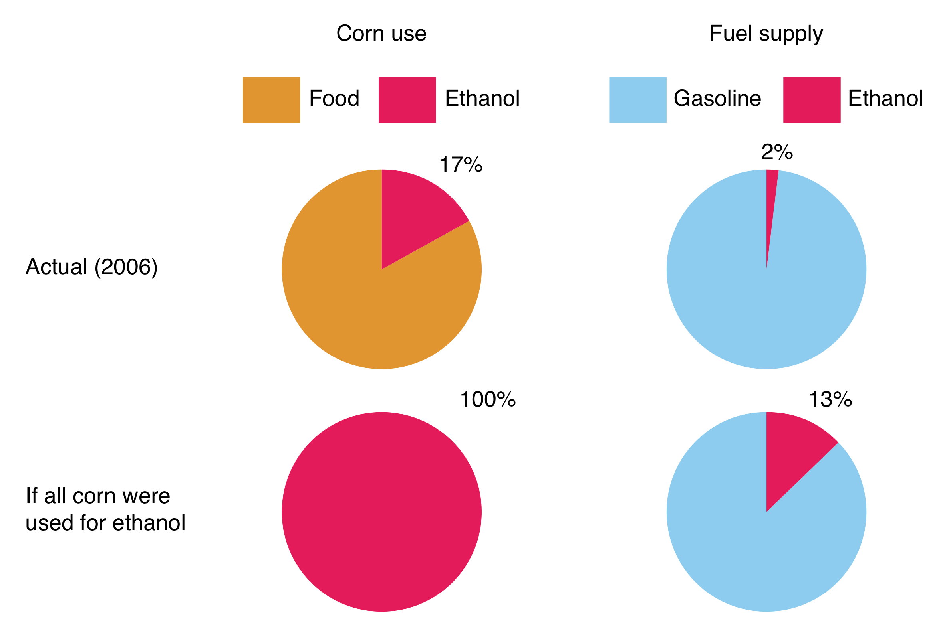
Ethanol Supply: The Effect on Corn Supply and on Gasoline Supply

Slide 41
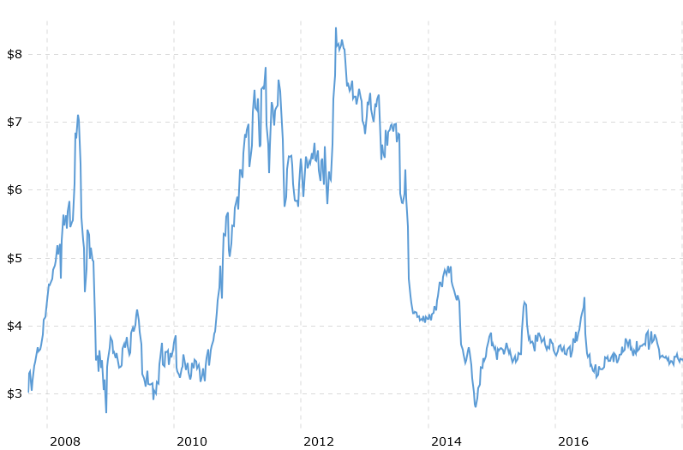
Ethanol Demand and Corn Prices
There is a large increase in demand for corn for ethanol production.
  Current production capacity is at over 5 billion gallons.
  This is projected to increase to over 9 billion gallons with plants currently under construction.
Corn prices continue to fluctuate. Bushels of corn sold for over $8 (USD) each in July 2012.
Graph: http://www.macrotrends.net/2532/corn-prices-historical-chart-data

Slide 42
Types of Biofuel
First Generation Biofuels
Grains are used to produce ethynol
Food versus fuel
Second Generation Biofuels
Using agricultural wastes ←→ lignocellulosics
Lignocellulosics for ethanol
Oils for biodiesel
Grasses
These crops were not domesticated for use as biofuels
Third Generation Biofuels (looking to the future)
Algae

Slide 43
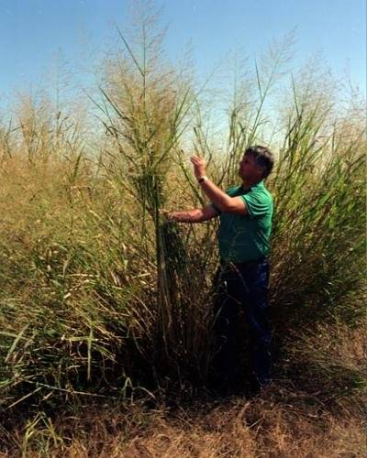
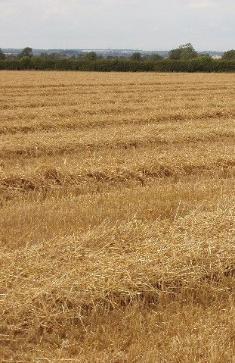
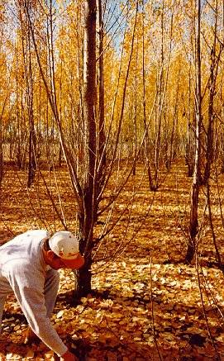
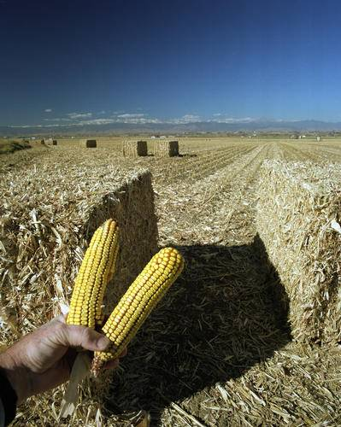
Second Generation Biofuels: Cellulosic Feedstock
Switchgrass
Wheat Straw
Hybrid Poplar
Corn Stalks
Image, Wikimedia Commons, Author: David Hawgood

Slide 44
Second Generation Biofuels
  To qualify as second generation, a feedstock must not be suitable for human consumption and meet the following criteria:
    Should grow on marginal (non-agricultural) land.
    Should not require large amounts of water or fertilizer.
    Certain food products can become second generation fuels when they are no longer useful for consumption:
        Waste vegetable oil (2nd generation feedstock).
        Virgin vegetable oil (1st generation feedstock).

Slide 45
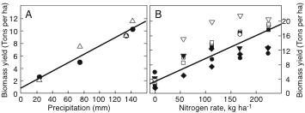
Switchgrass as a Feedstock
Switchgrass still needs water and fertilizer to grow.
Nutrients needed:
corn versus switchgrass.
Water
Nitrogen fertilizer
kg ha⁻¹ yr⁻¹ | Corn | Switchgrass
N | 148 | 0
P | 23 | 4
K | 50 | 6
Data of Lee et al. and Muir et al, collated in Gressel,
“Genetic Glass Ceilings, Hopkins, 2007

Slide 46
Second Generation Biofuels: Oils and biodiesel
Biodiesel refers to vegetable oil or animal fat-based diesel fuel consisting of long-chain esters. The main component of vegetable oil is triglycerides, which require transesterification prior to usage as a fuel.
BIODIESEL

Slide 47
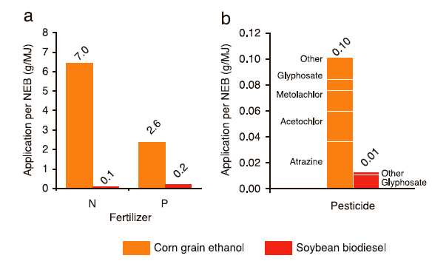
Environmental Consequences per Unit Energy
Comparing the Environmental Impact
Greenhouse Gas Emissions per Unit Energy
Soybean biodiesel needs less fertilizer and pesticide than corn ethanol.
Soybean biodiesel produces significantly less green house gas.
Data of Lee et al. and Muir et al, collated in Gressel“Genetic Glass Ceilings, Hopkins, 2007

Slide 48
Advantages of Biodiesel
Reduces other pollutants.
35% reduction in unburned hydrocarbons through life cycle. Hydrocarbons are smog and ozone precursors.
8% reduction in sulfur oxides. The release of sulfur oxides can lead to acid rain.
3% reduction in methane.
32% reduction in particulate matter (PM10 68%).
83.6% reduction in particulate matter soot.
79% reduction in wastewater.
96% reduction in hazardous waste, but double the non-hazardous waste.
Compared to conventional diesel processing, biodiesel requires additional processing and has a lower overall energy return. Energy return is one of the important parameters that enables engineers to evaluate the efficiency and viability of a process. Energy return describes the amount one can gain from the production verses the amount of energy input. Biodiesel lags far behind conventional diesel processing in this regard.
Notes:
Source: National Biodiesel Board,” Lifecycle Summary,” available at http://www.nbb.org/pdf_files/fuelfactsheets/LifeCycle_Summary.PDF

Slide 49
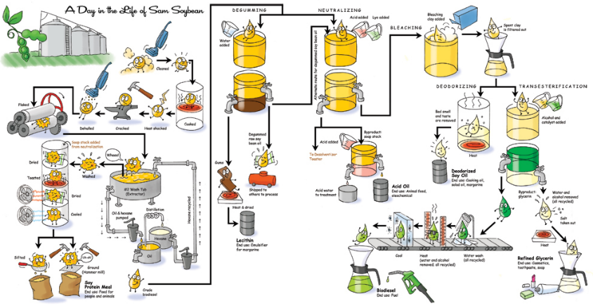
Steps Required to Produce Biofuel from Soybeans
Retrieved: nancymeyersdesign.com

Slide 50
Types of Biofuel
First Generation Biofuels
Grains are used to produce ethynol
Food versus fuel
Second Generation Biofuels
Using agricultural wastes ←→ lignocellulosics
Lignocellulosics for ethanol
Oils for biodiesel
Grasses
These crops were not domesticated for use as biofuels
Third Generation Biofuels (looking to the future)
Algae

Slide 51
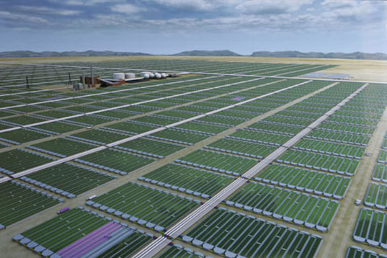
Third Generation Biofuels: Algae Feedstock

Slide 52
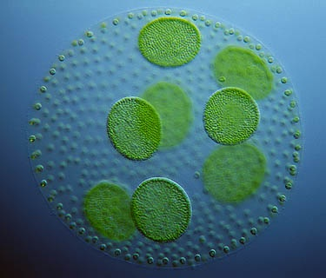
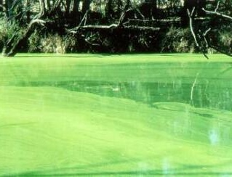
What is algae?
Algae is a large and diverse group of simple, usually autotrophic, organisms that can have either unicellular or multicellular forms.

Slide 53
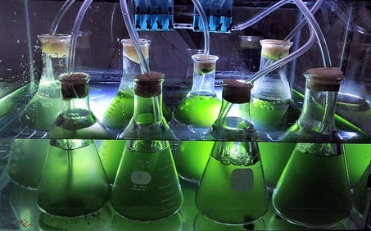
What does algae needs to grow?
Carbon dioxide
Sunlight
Water

Slide 54
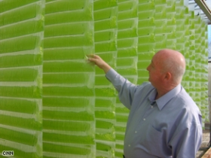
Is Algae “Green Gold”?
Currently being developed.
30 times more oil per acre than current crops that are being used.
No sulfur.
Non-toxic
Highly biodegradable,
Not subject to a commodity risk like crude oil, corn, and soybeans are.
Notes:
Source: EcoFriend Article, “Algae BioFuels: PetroSun’s Subsidiary to Develop Bio-diesel Form Algae” India (2006), available at http://www.ecofriend.org/entry/algae-biofuels-petrosuns-subsidiary-to-develop-bio-diesel-form-algae/

Slide 55
Pros
Algae: The Pros and Cons
Cons
Versatility in growth methods
Versatility in uses
Speed of production
Potential for huge production levels
CO2 reduction
Energy intensive
Not competitive against foreign oil (yet)
Needs funding
Technology not ready (yet)

Slide 56
How to Overcome the Technical Roadblocks to Low-Cost Advanced Biofuel Production
Make all of the components of biomass available for biofuel and co-product production:
Use the appropriate parts of specific plants.
Improve the efficiency of biomass to biofuel conversion:
Do it faster, cheaper, and sustainably.
Minimize the cost of biomass transportation.
Move more for less.

Slide 57
Biofuels as an Alternative
Biofuels are not THE answer to sustainable energy, but biofuels may be part of the answer.
Biofuels may offer environmental and economic advantages over fossil fuels, but the magnitude of these advantages depends on how a biofuel crop is grown and converted into a usable fuel.

Slide 58
Topics Covered
Energy and Feedstock Consumption
Petroleum
Renewable Feedstocks
  Biomass Feedstocks
  Carbohydrate Feedstocks
  Lipid Oils and Terpenes as Feedstocks
  Protein Feedstocks
Renewable Feedstocks as a Source of Energy
First, Second, and Third Generation Feedstocks
The Advantages and Drawbacks of Biofuel

Slide 59
Sponsored by Yale-UNIDO Initiative
QUESTIONS?
CENTER for GREEN CHEMISTRY
and GREEN ENGINEERING at YALE

