Slide 1
Introduction: Chemicals in the Society
Awareness Raising Workshop
GLOBAL GREEN CHEMISTRY INITIATIVE
EXPERT
YALE REPRESENTATVE
CENTER for GREEN CHEMISTRY
and GREEN ENGINEERING at YALE

Slide 2
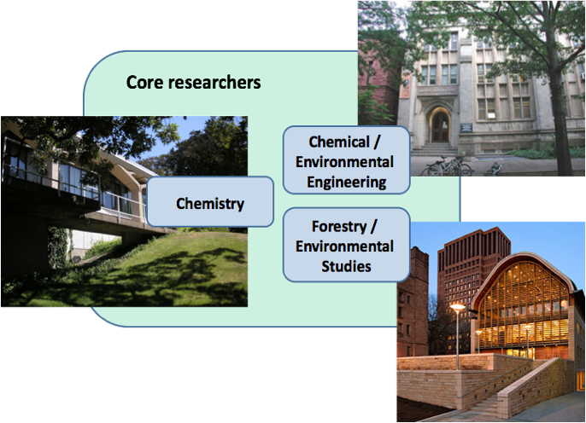

CENTER for GREEN CHEMISTRY and GREEN ENGINEERING at YALE
School of Law, School of Medicine School of Management
School of Architecture
School of Divinity

Slide 3
Prepare a Diverse Next Generation
Catalyze Implementation
Education Materials
Courses
Training Trainers
Graduate Workshops
Faculty Training
Industrial Partnerships
Policy advancement
Bench Marking
Assessment Protocols
Center’s Objectives
Advance Science
Raise Awareness
Basic Research
Technical Workshops
Research Tools
Promote Research Investment
Advance the next research agenda
Conferences
Books
Multimedia
Web presence
Public Engagement

Slide 4






Areas of Research Interest
INTERGRATED
BIOREFINERY
NOVEL SORBENT
MATERIALS
DESIGNING SAFER
CHEMICALS
OPTIMIZING THE
ENERGY-WATER NEXUS
WASTE
VALORIZATION
EARTH-ABUNDANT
GREEN CATALYSTS

Slide 5

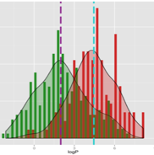
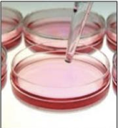
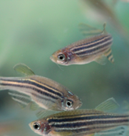

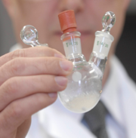



Toxicology
Chemistry
Molecular Biology
Computational Chemistry

Slide 6
Raising awareness/preparing the next generation
Practitioners
Graduate students
Teachers
NGO’s
Policy makers
General public
Scientists
Undergraduate students
Industry partners
Other Centers
Government
Notes:
Advance the science.
Prepare the next generation.
Catalyze Implementation.
Raise awareness.

Slide 7

Education Initiatives
PROFESSIONAL DEVELOPMENT
GREEN CHEMISTRY & CHEMICAL STEWARDSHIP ONLINE CERTIFICATE PROGRAM
WORKSHOPS AND TRAININGS
(Global Green Chemistry Initiative)
UNDERGRADUATE CURRICULUM
LESSON PLANS AND HANDS-ON ACTIVITIES
SAFER CHEMICAL DESIGN GAME
VIDEOS
HIGH SCHOOL CURRICULUM
SUMMER SCHOOL – PATHWAYS TO SCIENCE
LESSON PLANS AND DEMONSTRATIONS

Slide 8
GLOBAL GREEN CHEMISTRY INITIATIVE
BRAZIL, COLOMBIA, EGYPT, SERBIA, SOUTH AFRICA, SRI LANKA
MISSION:
To increase the general global awareness and capacities on deployable Green Chemistry approaches for the design of products and processes that advance global environmental benefits throughout their life cycles.
PROJECT ACTIVITIES:
WORKSHOPS
UNDERGRADUATE CURRICULUM
TECHNICAL COMPENDIUM
GUIDANCE DOCUMENT

Slide 9
GLOBAL GREEN CHEMISTRY INITIATIVE
BRAZIL, COLOMBIA, EGYPT, SERBIA, SOUTH AFRICA, SRI LANKA
1-Day Awareness Raising Workshops
5-Day Train-the-Facilitators Workshops
  To strengthen national and regional Green Chemistry initiatives in partnering countries and to enable partners to become hubs for education and training in Green Chemistry
University Curriculum
  To educate the new generation of chemists in Green Chemistry
Technology Compendium
  To develop a systematic review of Green Chemistry technologies known by 2017
Guidance Document
  To develop a roadmap to Green Chemistry implementation for different stakeholders

Slide 10
Agenda
8:30 Welcome Remarks
9:00 – 10:00 Introduction
10:00 – 10:20 Break
10:20 – 12:00 Fundamentals of Green Chemistry
12:30 – 12:45 Lunch and Networking
12:45 – 14:15 Areas or Research in Green Chemistry
14:15 – 14:30 Break
14:30 – 16:00 Case Study examples
16:00 Closing Remarks

Slide 11
Everything is a chemical
But what does that mean?
  Name everything in the room that is a chemical
  Name everything in the room that is not a chemical
Chemicals are related to:
  Food
  Transportation
  Communication
  Information Technology
  Economy
Notes:
Note: Engage the public from the beginning – ask them to name everything that is/is not a chemical.
Answers may vary. Bottom line of this exercise is that everything is a chemical or has been touched by a chemical.
Make a transition to different areas.

Slide 12
Chemicals and Food
Fertilizers
  More food can be grown for the population
  Revolution came with the Haber Bosch process
Pesticides
  Mosquitos carrying deadly diseases can be controlled
  Algal blooms which lead to eutrophication are controlled
Food preservatives
  Longer shelf life leads to population spreading to less favorable places
  In the early 1900s, the Haber-Bosch process allowed incorporation of Nitrogen from the air and lead to population growth.
Image source: Wikipedia
Notes:
Fertilizers – Allowed to grow more food to feed the population. Give example of Haber Bosh process. https://en.wikipedia.org/wiki/Haber_process
Pesticides – Agents which deter, incapacitate, kill, or otherwise discourage pests. Kill mosquitos which transmit deadly diseases like yellow fever and malaria; Controls algal bloom which can lead to eutrophication
Food preservatives – Keep food away from spoiling; Longer shelf life;

Slide 13
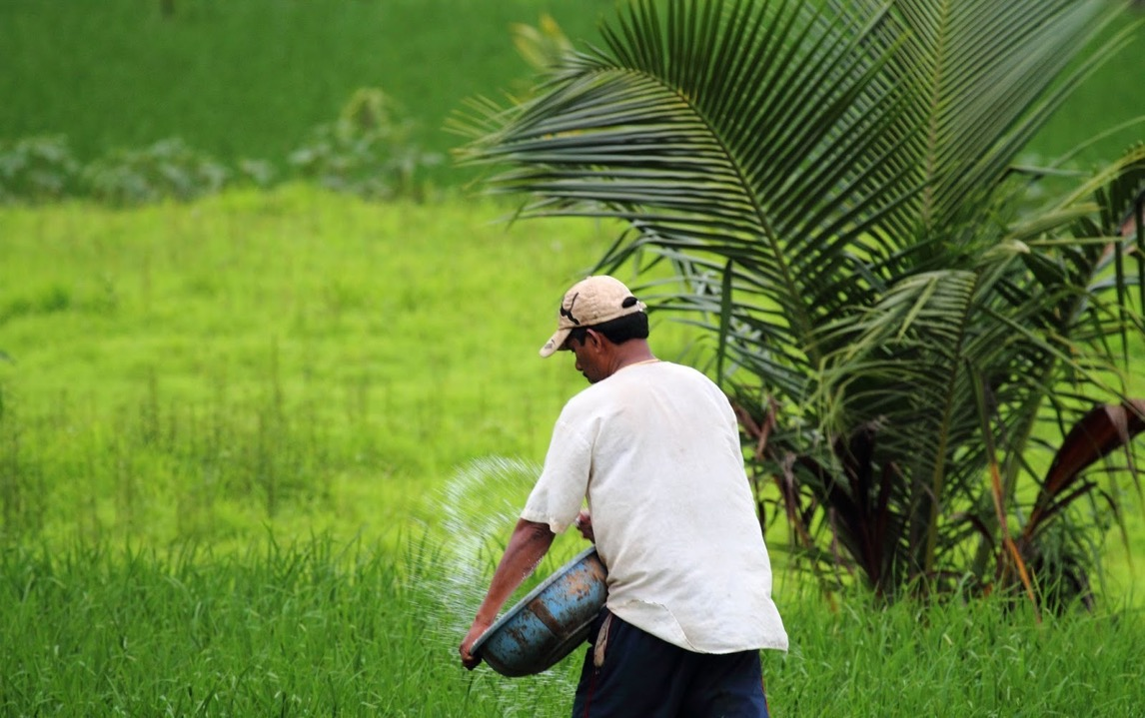
Over 80% of produced urea is used to fertilize crops

Slide 14
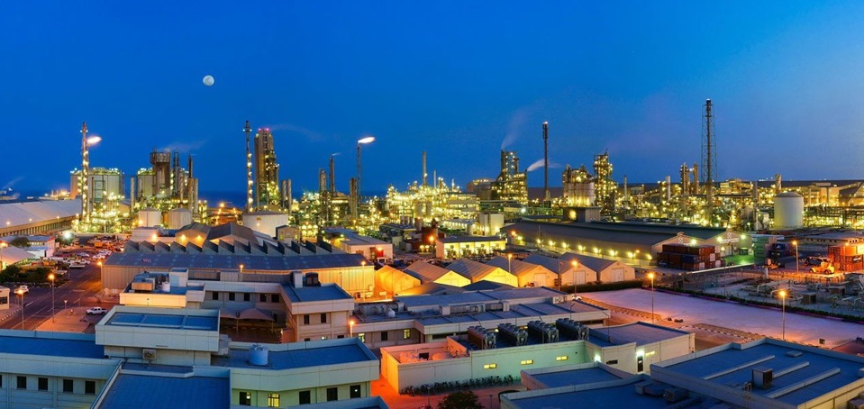
2 NH₃ + CO₂ ⇌ H₂N-COONH₄
H₂N-COONH₄ ⇌ (NH₂)₂CO + H₂O
AE_{Trost} = 76.9%
Over 190 million tons of urea is produced each year
Production located near cheap energy sources
Cost and impact of transportation?
Notes:
Reliance of High T and High P to drive equillibria across to the product,
Urea is the world's most produced chemical
• Over 190 million tons of urea is produced each year
• Over 80% of urea is used to fertilize crops
• Demand for urea fertilizer is growing at over 3%
- even faster than the global rise in population.
QAFCO – 4th largest producer of Urea on a global scale!

Slide 15
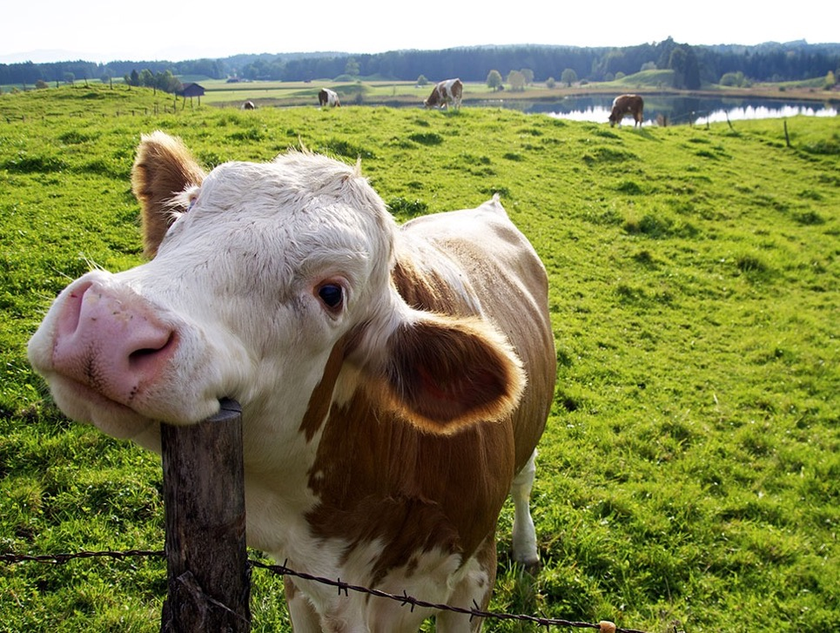
Livestock Farming– For Food/Leather/Milk
18% of global greenhouse gas emissions
Notes:
Livestock farming for meat is responsible for ~18% of all greenhouse emissions, more than all global transport combined.
Cells from a single cow could produce 175 million quarter-pounders.,…. traditional farming methods would need 440,000 cows.
Global meat demand estimated to increase by 73% by 2050.
But we already use 70% of farm land for livestock.

Slide 16
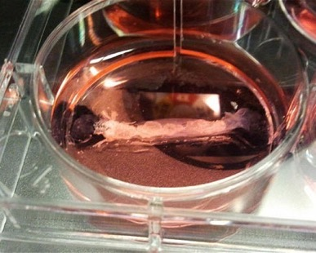
60% less energy,
10% of water,
1% of land,
90% fewer greenhouse gas emissions,
Notes:
using biotechnology to induce stem cells to differentiate into muscle tissue and to manufacture the meat products in bioreactors.
Cells taken from organism – cultured – fed sugar (metabolism) divide/grow/multiply to produce ”synthetic biomass” which can be harvested and processed like ground meat….. Texture/taste/fat content?
Minimal GHG, reduced reliance on land for agriculture…

Slide 17
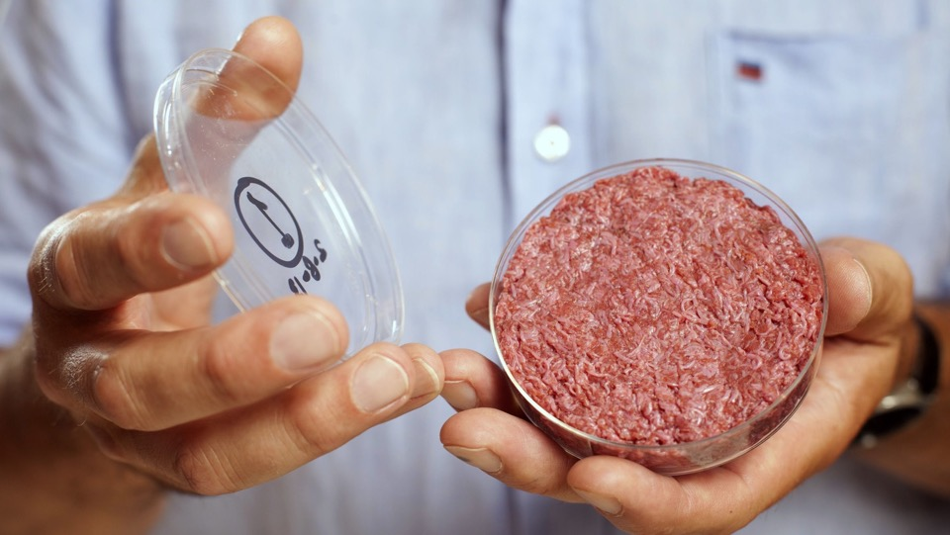
60% less energy*
£250,000
University of Maastricht
Notes:
Factories of the future will artificially grow meat – this could use 60% less energy
A proof of concept burger is being made and will cost €250,000 and not taste too great but is only a start!
The meat is produced from natural, unmodified cells and is grown using natural ingredients such as sugars, proteins, minerals and vitamins. If food technology methods are used to add taste and/or texture (as it happens in traditional meat technology) they are food industry standard and internationally recognized.
Arguably, cultured beef is safer than farmed beef, as the closed production process eradicates the risk of human diseases contracted from livestock (e.g. diseases as BSE, salmonellosis, or E. coli poisoning). For the record: cultured meat is fundamentally different from genetically modified food. No genetic modification is involved in this process. Tissue cultured meat is normal meat; it is made from normal muscle cells.

Slide 19
Reduced Risk of Bovine Spongiform Encephalopathy (BSE),
Reduced Exposure to Antibiotics – (AMR), e-coli
Bacterial Load/Cleanliness - Growth, Processing….
Animal Welfare.

Slide 20
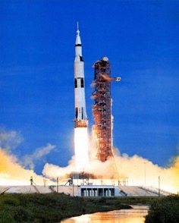
Chemicals in Transportation
Gasoline/Diesel
  Fast ground transportation was enabled
Jet Fuel
  Air transportation was enabled
  Globalization and international trade is possible
Rocket Fuel
  Satellites placed on the Earth’s orbit allow communication and navigation
Vulcanized Rubber
  Tires, shoe soles, hoses and conveyor belts can be made
Deicing of plane wings
  Aviation in all conditions is made possible
Apollo 15 launching
Image source: Wikicommons
Notes:
Gasoline/Diesel – fuel enabled fast ground transportation
Jet fuel/rocket fuel – enabled global transportation
Vulcanized rubber – vulcanized rubber has a superior mechanical properties. It’s used in tires, shoe soles, hoses, and conveyor belts.
Deicing of plane wings – enabled aviation in all conditions

Slide 21

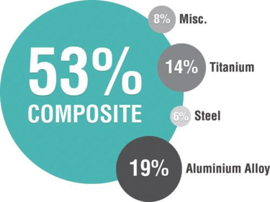
Boeing 787 - Dreamliner

Slide 22
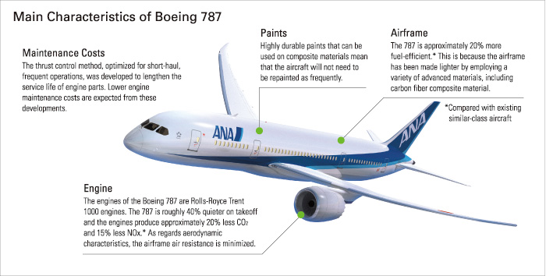
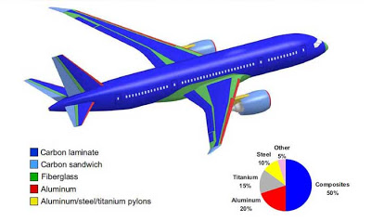
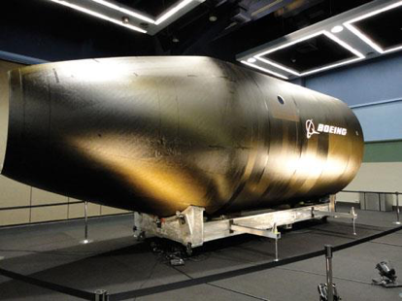

Slide 23
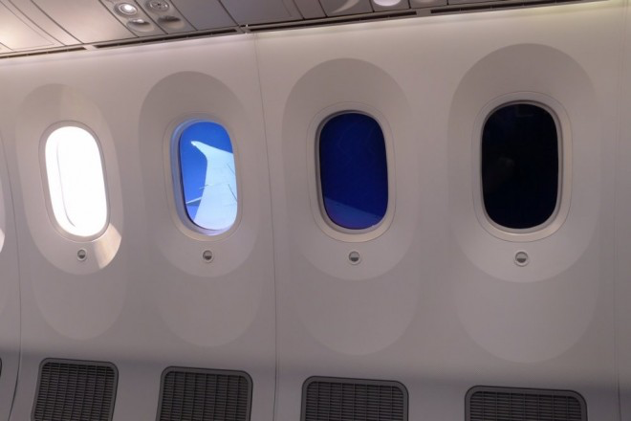
Notes:
Electrochromic technology uses electricity to change the color and light transmission of a transparent medium containing materials that are capable of generating color. This medium is typically sandwiched between two thin transparent layers that have transparent conductive coatings on the side that comes into contact with the medium. In this case, it is an electronic gel medium sandwiched between two thin panels. An electric current is passed into the conductive coatings and across the panel to cause an electrochemical reaction to occur in the gel. Applying a small electrical DC voltage across the gel causes it to darken, while removing the voltage allows the gel to return to its natural, transparent state.

Slide 24
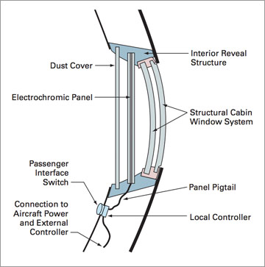

Slide 25
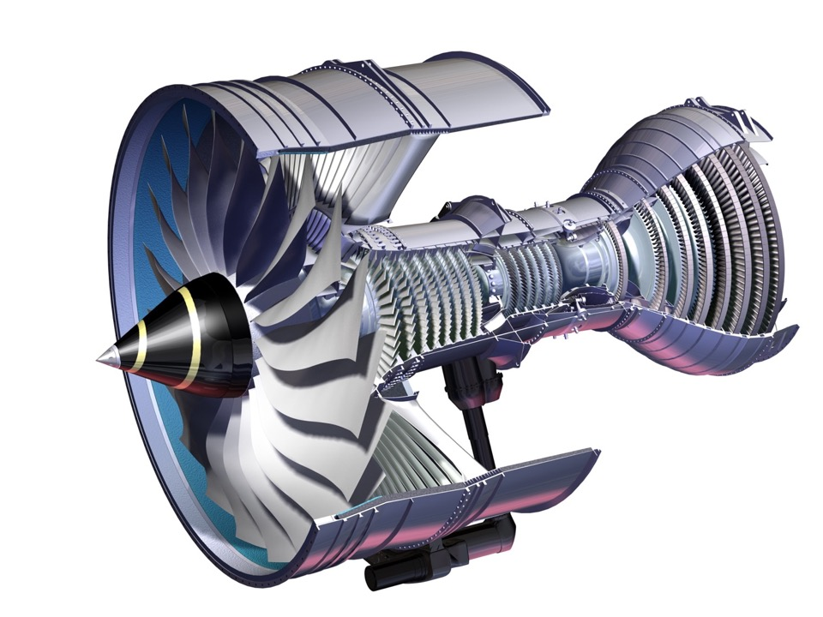
Power by the Hour
Source: Rolls Royce
Notes:
Rolls Royce don’t sell jet engines – they sell power by the hour
They are only paid while the engine is being used

Slide 26
Chemicals in the Economy
Chemical industry sector
  Total pharmaceutical revenue had reached $1 trillion in 2014
Petrochemicals
  Global market is estimated to reach $791 billion by 2018
Consumer products
    Most products that we see, touch, and feel are petroleum based
Job creation
  Robust selection of consumer/personal care products leads to job creation and increase in GDP
    Approximately 1 million direct jobs from chemicals industry
    Approximately 6 million indirect jobs

Slide 27
Chemicals and Unintended Consequences
Chemicals can also negatively impact the society.
How?
Notes:
While chemicals drive health, food, transportation, communication industries, they can also impact society in a negative way and lead to unintended and unpredicted consequences.

Slide 28
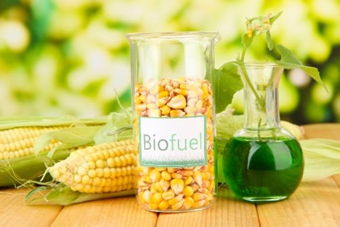
Unintended Consequences
Biofuels made from corn that compete with food, feed, and land use.
Biofuels made from corn.
Image source: Adobe Stock
Notes:
Biofuels, specifically made from corn, an abundant vegetable, seems like a great idea. But when the corn needs land, fertilizers, water, and infrastructure for harvesting, then production of biofuel becomes unintended consequence.

Slide 29
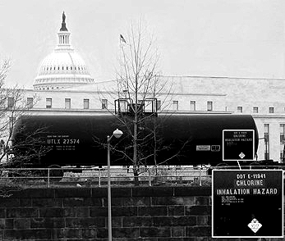
Unintended Consequences
Purifying water with acutely lethal substances.
Chlorine transported in Washington D.C.
Notes:
Everyone should have an access to clean water. What if to get purified water, acutely lethal substances like chlorine are used?

Slide 30
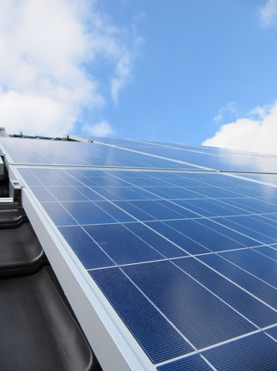
Unintended Consequences
Renewable energy through the use of precious, rare, toxic metals in photovoltaics.
Solar panel installed on the roof of the building
Image source: Wikipedia
Notes:
Energy which does not rely on petroleum but rather on solar can be a good thing. But what if the solar panel technology relies on rare earth and precious metals?

Slide 31
Other Environmental Challenges
Population
Energy
Global Change
Resource Depletion
Food Supply
Toxics in the Environment
Notes:
There are other environmental challenges we as society have to think about when considering chemicals.

Slide 32
Population Trends
Source: U.N. World Population Prospects, 2000 Revision
Population growth in developing countries is predicted to reach 7.8 billion by 2050.
G-10 countries remain the same.
Notes:
The population growth happens mostly in developing countries (G77). By 2050, we will most likely reach 9.5 billion.
These countries need biggest support and attention.

Slide 33
Quality of Life dilemma
Empirical data shows that increased quality of life correlates with sustainable population control
Increased quality of life, however, has historically resulted in increased damage to the biosphere and the earth’s ability to sustain life
Notes:
To maintain the quality of life with the increased population, big changes need to happen.

Slide 34
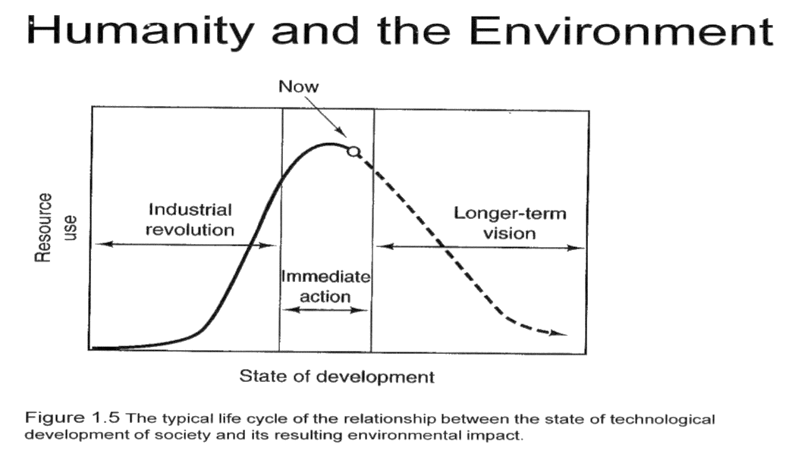
Impact of Development on the Environment
Notes:
9
As of now, we as population live very unsustainably. To maintain our current life, we will need more and more resources, which with increasing population is not possible. The graph shows the relationship between the state of technological development of the society and environmental impact. Currently we are using maximum resources and not considering the future.

Slide 35
Populational challenge
The challenge: How to increase quality of life while minimizing detrimental effects to human health, the environment, and the biosphere
The solution: Green Chemistry and Green Engineering provide a mechanism to address this challenge in very real terms

Slide 36
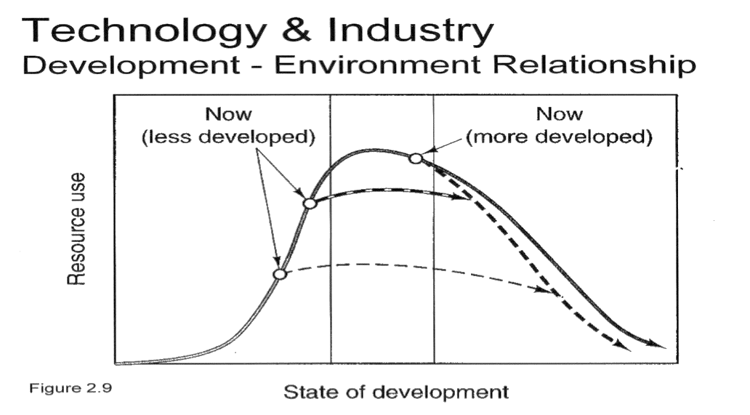
Efficiency through Science and Technology
Notes:
Advances in technology (and green chemistry) allow to reduce the resource use and maintain the quality of life even with increasing population.

Slide 37
“The great enemy of the truth is very often not the lie -- deliberate, contrived and dishonest
but the myth -- persistent, persuasive and realistic.”
John F. Kennedy
Notes:
A famous quote by JFK.

Slide 38
Other Environmental Challenges
Population
Energy
Global Change
Resource Depletion
Food Supply
Toxics in the Environment

Slide 39
Energy
The vast majority of the energy generated in the world today is from non-renewable sources that damage the environment:
  Carbon dioxide and greenhouse gases
  Depletion of resources
    Rare earth metals, fossil fuels
  Effects of mining, drilling
    Contamination of streams, lakes and ground water by fracking fluid or Sulphur ores
  Toxics
    Separation agents like benzene, toluene and xylene (BTX) which are shown to be carcinogenic.

Slide 40
Growing Energy Consumption
Energy use has approximately doubled in the past 30 years
Notes:
Energy consumption of growing due to our lifestyle and the new technological demands.

Slide 41
What type of energy future?
Sources: DOE/EIA-Word energy projection system
Notes:
Oil and coal are still dominant sources of energy. Renewable materials are present but in minority.

Slide 42
Energy
Green Chemistry will be essential in both:
  Developing the alternatives for energy generation (photovoltaics, hydrogen, fuel cells, biobased fuels, etc.)
  Continuing the path toward energy efficiency with catalysis and product design at the forefront

Slide 43
Other Environmental Challenges
Population
Energy
Global Change
Resource Depletion
Food Supply
Toxics in the Environment

Slide 44
Global Change
Concerns for climate chaos, oceanic temperature, stratospheric chemistry, and global distillation can be addressed through the development and implementation of green chemistry technologies

Slide 45
Temperature change
Source: http://www.sustainablescale.org/
Notes:
2
Temperature change in 1000 years. Temperate fluctuates +/- 0.2 C. The most dramatic temperature change happened since the industrial revolution in 1960 until recent times. The current numbers (not shown here) indicate that we will cross 1.5 degree Celsius in 10 years.
For the description what that means see here: http://globalwarming.berrens.nl/globalwarming.htm

Slide 46
Carbon dioxide, methane and nitrous oxide concentrations over the past 1,000 years
Notes:
Carbon dioxide is on the rise too.

Slide 47
CO₂ is not the only anthropogenic GHG

Slide 48
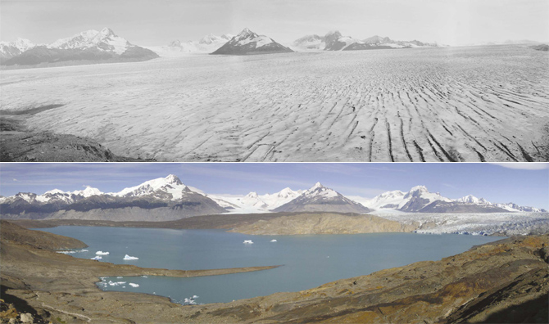
Upsala Glacier - Los Glaciares National Park
Patagonia, Argentina.
1928
2004
Notes:
Larsen A 1995, B 2002, C. July this year, largest ever recorded calving event, 12% of the Larsen C calved to form the larges iceburg ever.
If the glacial ice of western antartica calved global sea level would rise approx 15 feet!

Slide 49
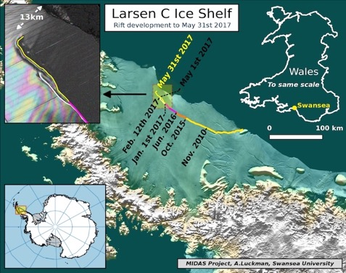
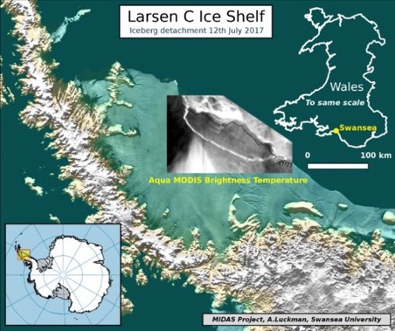
The calving occurred sometime between Monday 10th July and Wednesday 12th July 2017, when a 5,800 square km section of Larsen C broke away.
Anticipated to be due to thermal changes in both sea and air temperature.
Predicted to give rise to an increase in global sea level of the order of 2-3 mm.
(this is minimal because the ice was already afloat)
Notes:
Larsen A 1995, B 2002, C. July this year, largest ever recorded calving event, 12% of the Larsen C calved to form the larges iceburg ever.
If the glacial ice of western antartica calved global sea level would rise approx 15 feet!

Slide 50
Other Environmental Challenges
Population
Energy
Global Change
Resource Depletion
Food Supply
Toxics in the Environment

Slide 51
Resource Depletion
Due to the over utilization of non-renewable resources, natural resources are being depleted at an unsustainable rate.
Examples of depleting resources: precious metals, fossil fuels
These are used to support of our current life style, economy, etc

Slide 52
Resource Depletion
Renewable resources can be made increasingly viable technologically and economically through green chemistry:
  Biomass
    Algae for fuel, lignin for platform chemicals
  Nanoscience & technology
  Transformations with visible light
    Light rather than solvents
  Carbon dioxide as feedstock
    In plastics
  Chitin as feedstock
    In packaging
  Waste utilization
    By biodegradation

Slide 53
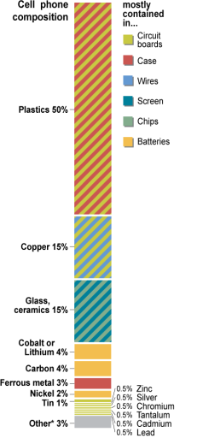

Elements in a Mobile Phone?
Roughly 40 different elements
H, Li, Be, C, N, O, F, Al, Si, S, Cl, K, Ca, Ti, Cr, Mn, Fe, Co, Ni, Cu, Zn, Ga, As, Br, Sr, Y, Zr, Ru, Pd, Ag, Cd, In, Sn, Sb, Ba, Ta, W, Pt, Au, Hg, Pb, Bi, Nd.
mobile phone weighing 100 grams, contains
  13.7 g of copper
  0.189 g of silver
  0.028 g of gold
  0.014 g of palladium
Source: Basel Convention, 2006; Lindholm (Nokia report), 2003

Slide 54
Chemicals in Communication
Notes:
Note: It is said that the smartphone includes over 75% of the periodic table. In many cases a variety or rare earth metals are used to produce colors in the smartphone's screen.
Question to consider: The current prediction is that by 2010, there will be over 2.8 billion smartphone users. Knowing that the current design requires all the above elements, what does this mean from the sustainability stand point? Chemistry aside, can we afford making phones the way we do? Why/why not?
Possible answer: No – there won’t be sufficient amount of elements to sustain the current (unsustainable) trajectory.

Slide 55
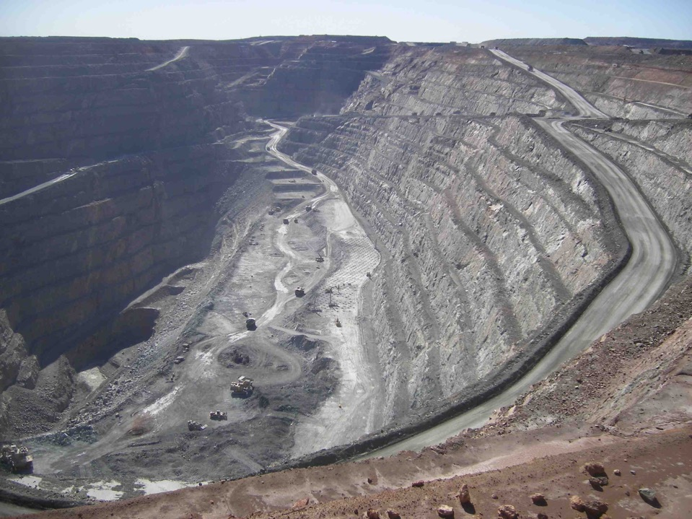
Au
2 m tonnes waste
691,000 litres water
141 kg cyanide
Kalgoorlie gold mine, Australia
Notes:
Copper produces around 250 tonnes of solid waste per tonne of copper
Gold however generates a minimum of two million tonnes of solid waste to produce a single kilogram
one kilogram also takes 691,000 litres of water, and 141 kilograms of cyanide
this gold mine in Australia shows what that means on scale to meet our needs

Slide 56
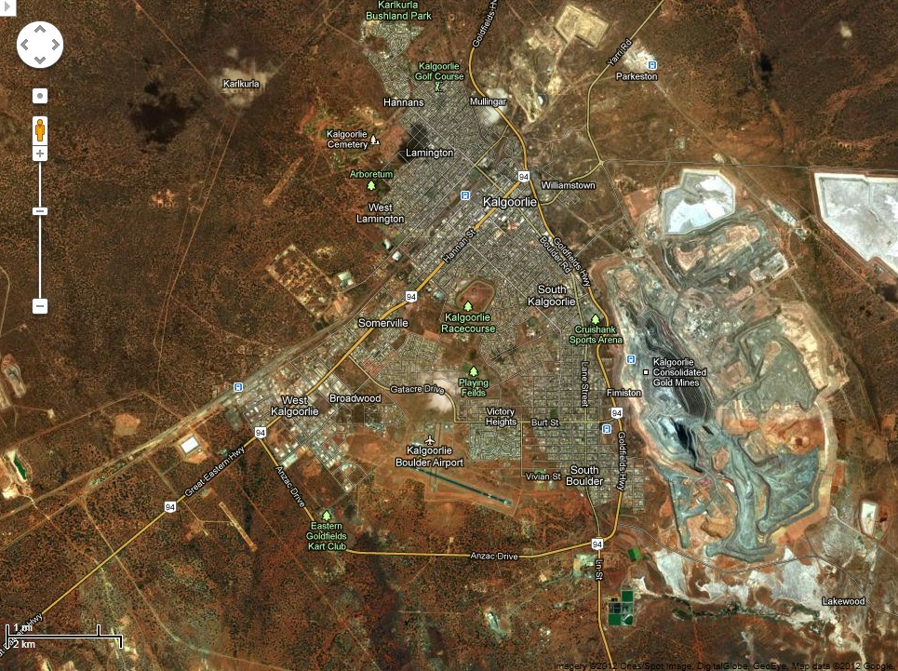
Kalgoorlie gold mine, Australia – Google Earth
Notes:
playing around on Google Earth – these mines aren’t hard to find
between now and 2050 we need to produce as much minerals as since humanity started....

Slide 57
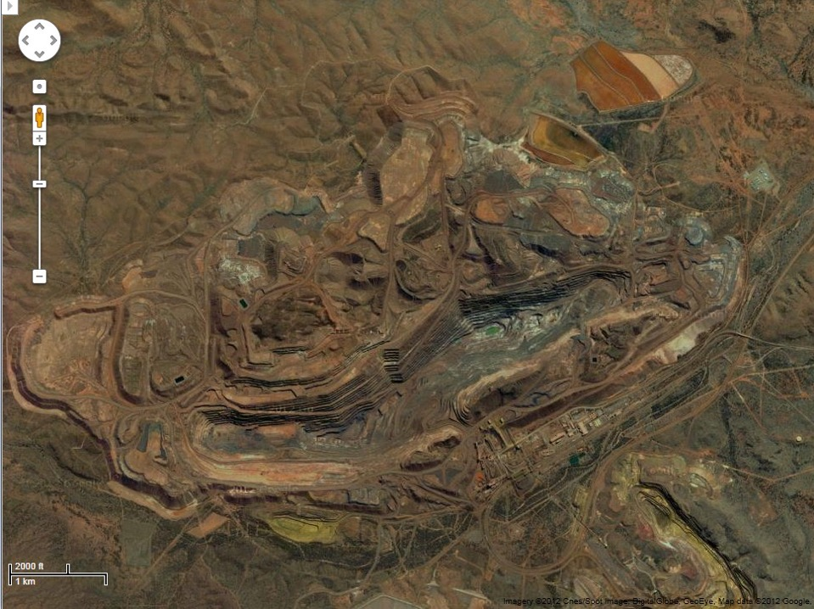
Newman iron ore mine, Pilbara, Australia – Google Earth
Notes:
.....that means a lot more deposits like those in the Pilbara region of Western Australia need to be found
this one is for iron ore near Newman and we can put its scale into context by overlaying venice where we are right now

Slide 58
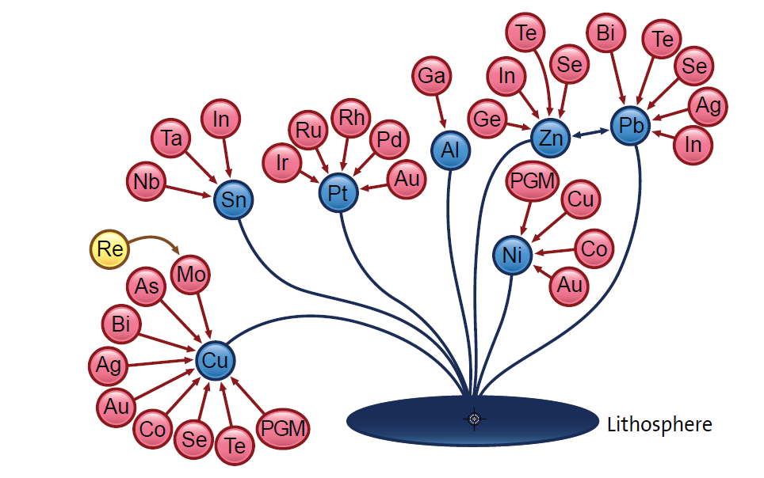
Secondary Metals Synergy of Supply
Notes:
However the bulk of metals are obtained as by-products of major, primary metals (those in blue)
This means the economics of supply/demand is dominated by the commodity metals

Slide 59
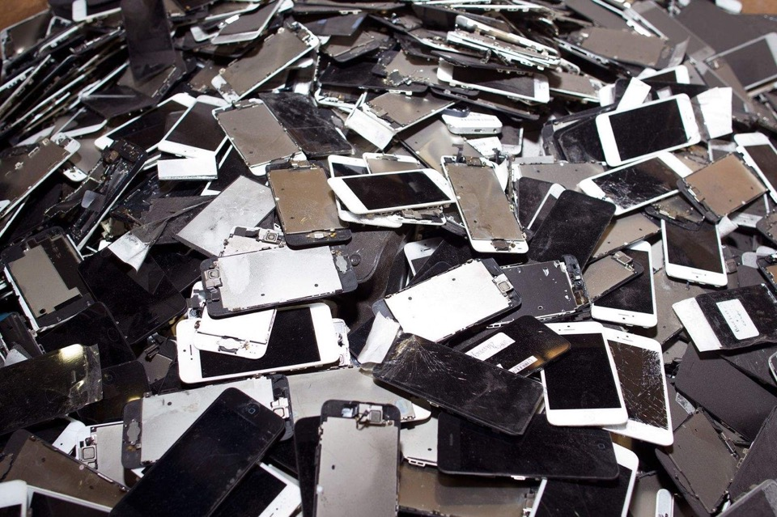
One ton of iPhones would deliver 300 times more gold than a ton of gold ore and 6.5 times more silver than a ton of silver ore.

Slide 60

Communication and
Information Technology
Nanotechnology
  Creation of many materials and devices with applications in nanomedicine (drug delivery), nanoelectronics (computer processors), biomaterials, and personal products (sunscreens)
Displays
  LCD (TV, watches, calculators)
Display device magnified showing a nano structure
Image source: Wikicommons

Slide 61
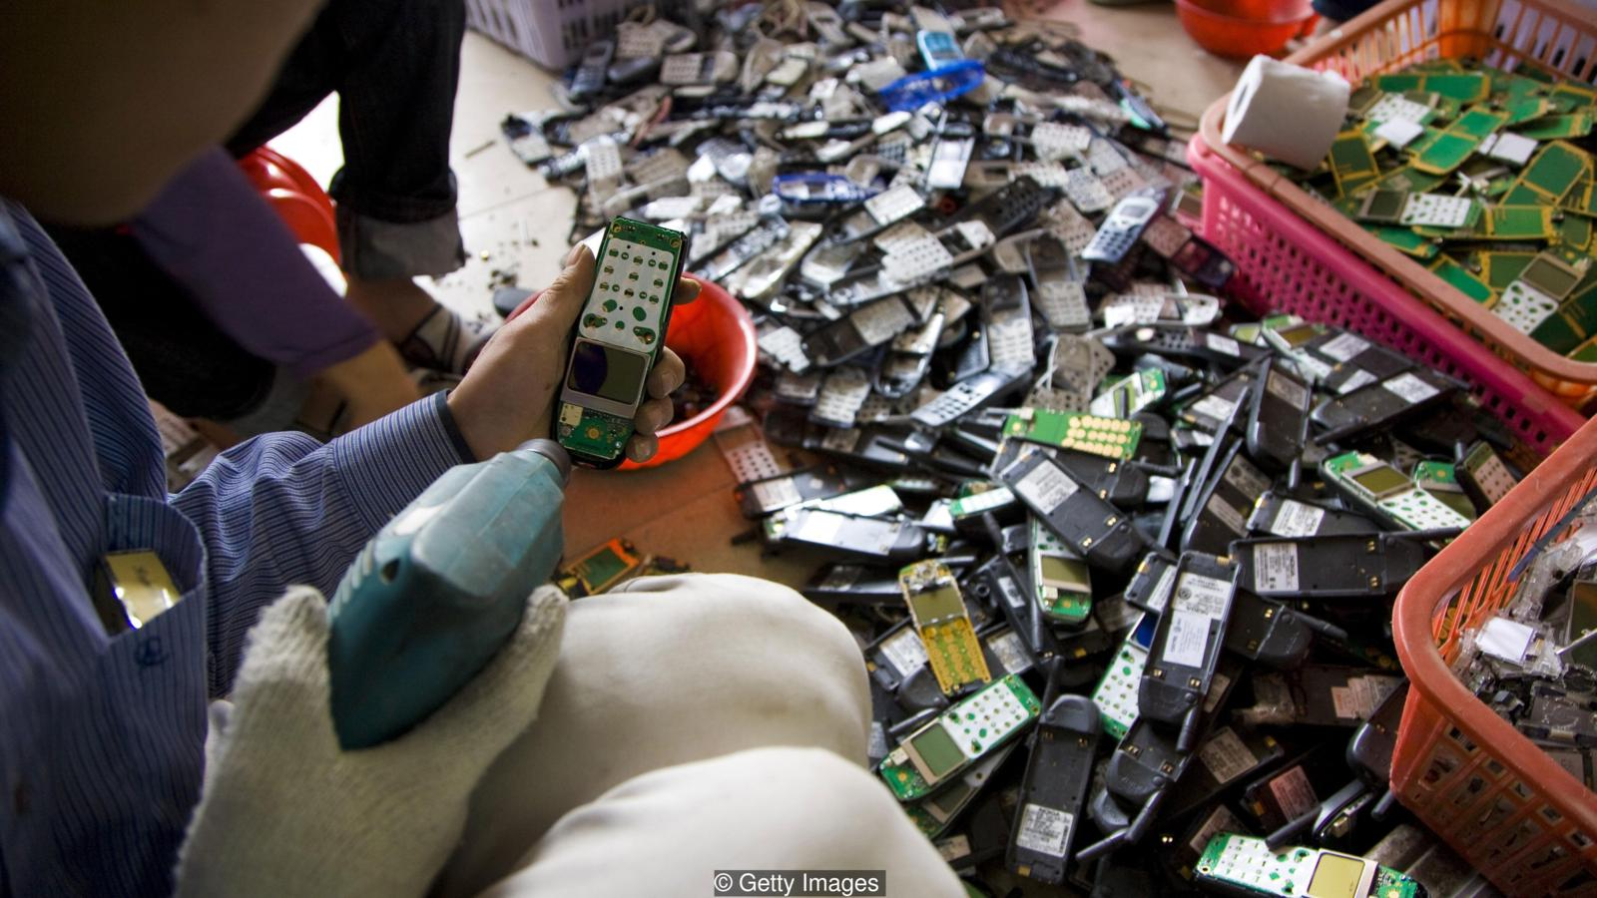

Slide 62
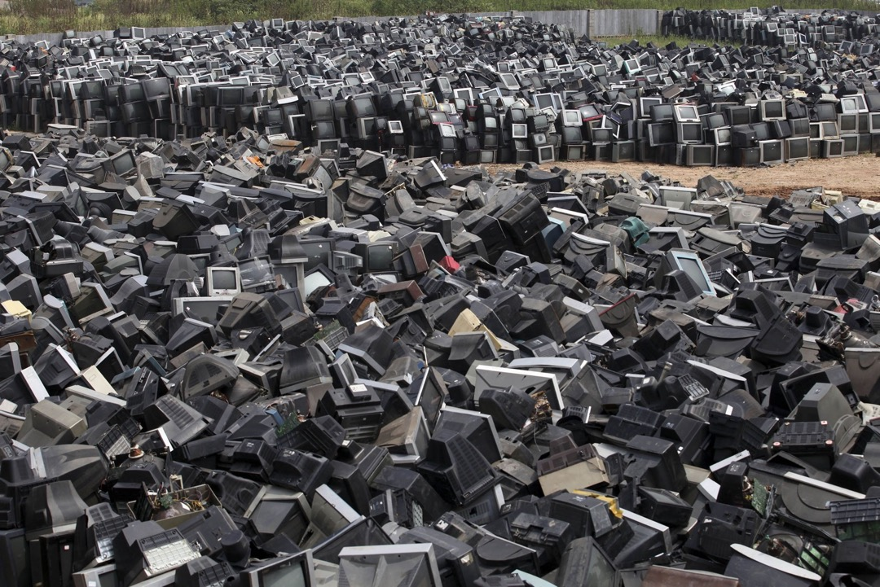

Slide 63
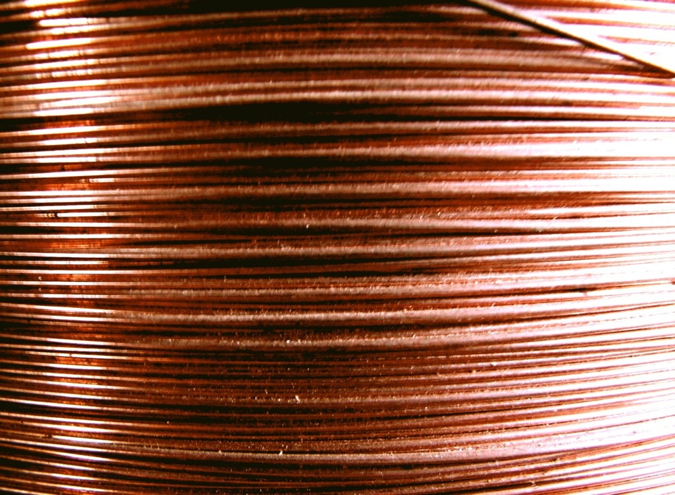
Cu
170 kg
Notes:
even for the commodity metals, much is tied up in infrastructure – in the west we have about 170 kg of copper associated with our lifestyles – if all 7 billion of us had as much it would be more than double all the copper ever mined in human history

Slide 64
Other Environmental Challenges
Population
Energy
Global Change
Resource Depletion
Food Supply
Toxics in the Environment

Slide 65
Food Supply
While current food levels are sufficient, distribution is inadequate
Agricultural methods are unsustainable
Advances in future food production intensity is needed

Slide 66
Increase in Grain Production
There is a growing demand in grain production in developing, industrialized and transition countries.
Source: FAO 1989-2000
Notes:
8

Slide 67
Use of Pesticides
Notes:
3

Slide 68
Food Supply
Green chemistry is developing:
  Pesticides which only effect target organisms and degrade to innocuous by-products
  Fertilizers and fertilizer adjutants that are designed to minimize usage while maximizing effectiveness
  Methods of using agricultural wastes for beneficial and profitable uses

Slide 69
Other Environmental Challenges
Population
Energy
Global Change
Resource Depletion
Food Supply
Toxics in the Environment

Slide 70
Toxics in the environment
Substances that are toxic to humans, the biosphere and all that sustains it, are currently still being released at a cost of life, health and sustainability.

Slide 71
Body Burden
In 2000-2001 the study showed that human body includes 148 xenobiotic.
Of the chemicals found:
  76 suspect carcinogens in humans or animals,
  94 are identified neurotoxins, and
  79 are linked to reproductive/developmental toxicity.
The synergistic effects of these chemicals in combination has not been studied.
One of Green Chemistry’s greatest strengths is the ability to design for reduced hazard.

Slide 72

Paracelsus (1493-1541) - the “father of toxicology”
“the dose makes the poison”

Slide 73
Sponsored by Yale-UNIDO Initiative
QUESTIONS?
CENTER for GREEN CHEMISTRY
and GREEN ENGINEERING at YALE

