Slide 1
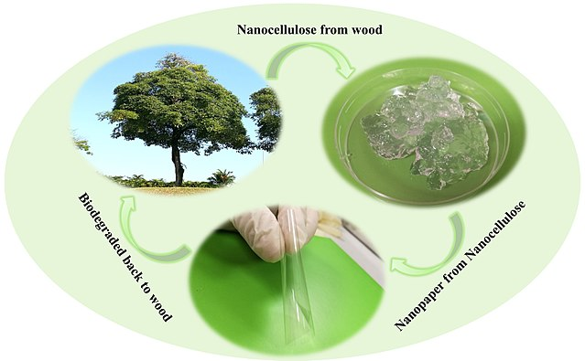
Yale-UNIDO Train-the-Facilitator Workshop in Green Chemistry
Definition & Benefits of Green Chemistry
CENTER for GREEN CHEMISTRY
and GREEN ENGINEERING at YALE
Image: Wikipedia, Biodegradation of nanocellulose, Author: Shaohui Li, Pooi See Lee

Slide 2
Topics To Be Covered
Green Chemistry and Design Criteria
Chemical Design
  Current Innovations in Chemical Design
Green Chemistry Design in Other Fields
The Market for Green Chemistry
Green Chemistry Benefits are In Demand
Applications of Green Chemistry - Examples

Slide 3
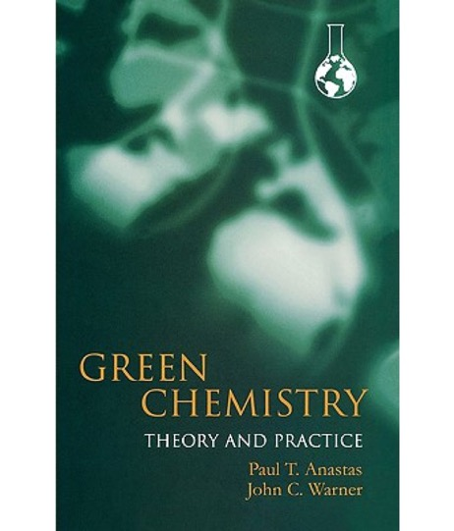
What is Green Chemistry?
Green chemistry is the design of chemical products and processes to reduce or eliminate the generation and use of hazardous substances.
Anastas, P. T., Warner, J. C. (2000). Green chemistry: Theory and Practice.
New York; Oxford University Press.
Notes:
Definition of the green chemistry: Green chemistry is the design of chemical products and processes that reduce or eliminate the use and generation of hazardous substances.
. The field was developed 25 years ago by Anastas and Warner, and presented in their seminal work “Green Chemistry: Theory and Practice”.

Slide 4
The Chemical Design Process
DECISION MAKING
Type of resources
What materials (feedstocks, additives) are needed?
Are the materials readily available?
How much material is needed?
Manufacturing process
What technology is needed?
What is the scale of the experiment?
Ultimately determining the characteristics of the waste stream, energy requirements, and the toxicity of the entire process.
Notes:
Types of resources:
While the starting materials are important (feedstocks), at the design phase the decision on the solvents, additional reactants is also necessary.
Decision on the scale of the manufacturing process is needed. Each industry is different, for example a big pharma will have other scale than a startup.
All these decisions determine the characteristics of the waste streem, energy usage, and toxicity of the entire process.

Slide 5

Traditional Design Criteria
Solubility
Melting Point
Glass transition temperature
Mechanical Properties (Tensile Strength, Modulus, Elongation)
Refractive Index
Surface Tension
Image: HP

Slide 6

Green Chemistry Inspired Design Criteria
Solubility
Melting Point
Glass transition temperature
Mechanical Properties (Tensile Strength, Modulus, Elongation)
Refractive Index
Surface Tension
Toxicity
Environmental Impact
As you can see, Green Chemistry’s view on the development of new products isn’t far from what’s currently being practiced. It’s simply thinking of the toxicological effects at the inception of product development that makes it a powerful tool.
Image: Philips

Slide 7
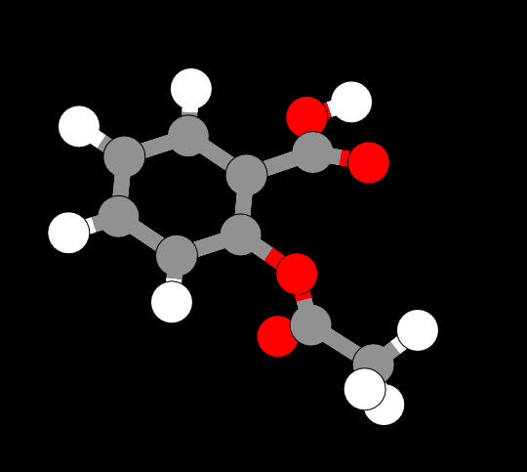
Focus on Chemical Design
The moment chemists begin to design, they are making choices about the health and environmental impacts of their product:
Design is intentional.
All characteristics, including performance and toxicity, can be designed.
Image source: ChemDoodle Web Components

Slide 8
It’s not just how you design, but what you design.
Potential Benefits Verses Investments
As the investments increase, so do the benefits. The largest benefit is when the company re-defines the problem and finds a novel solution.
Notes:
Example:
Tesla has developed an electric car, which is independent of the petroleum (redefining a problem)
Nissan has optimized the battery so the car can run longer without charging (optimizing the existing solution)

Slide 9
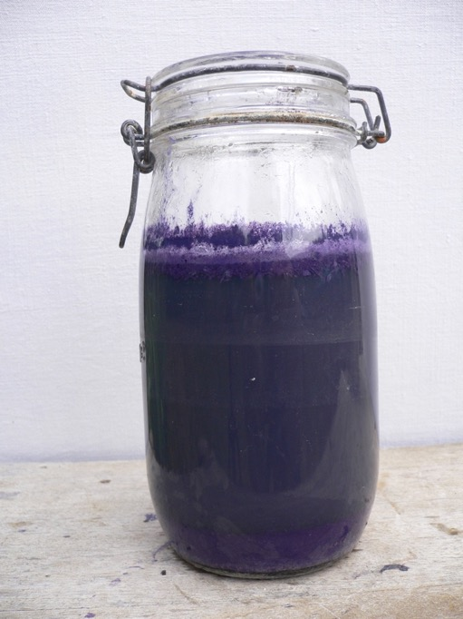
Example: Mauve
Once upon a time, color was for the rich. Dyes had to be painstakingly derived from plants or animals; quality was uneven and rich hues like purple were reserved for royalty.
That all changed in 1856, when 18-year-old chemistry student William Perkin discovered a vivid purple that could be used to dye silk and other fabrics.
In tribute to the Parisian fashion world, he named the first synthetic dye after the French name of a purple plant: mauve.
Image: Wikimedia Commons, Purple dye-bath with fresh Hexaplex trunculus, Author: Kanold

Slide 10
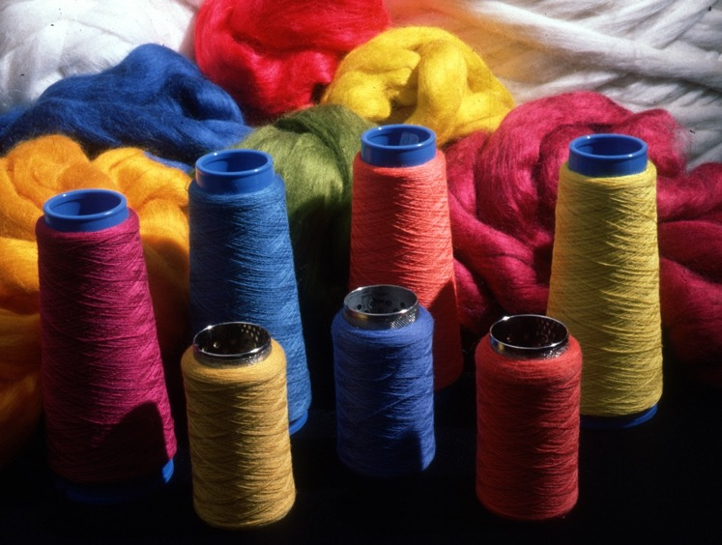
Example: Mauve
Perkin's mauve was soon followed by Verguin's fuchine, Manchester brown, Martius yellow, Nicholson's blue, Hofmann's violets, and a synthetic rainbow of other hues.
The market for natural dyes collapsed.
By the time Perkin tried to file the patent for his third dye, BASF beat him by one day.
Image: Wikimedia Commons, Dyed Wool Reels, Author: CSIRO

Slide 11
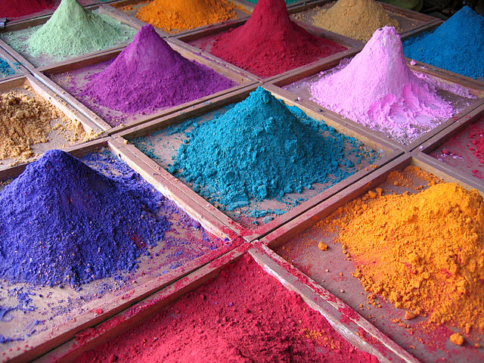
Commoditization
Soon everyone knew how to make synthetic dyes.
It didn’t make any difference whether you bought them from Perkin, or Nicholson or Hoffman.
It didn’t make any difference if you bought them in the U.K., or Germany, or the U.S.
Dyes became commodities.
It wasn’t enough to simply make mauve more efficiently.
Image: Wikimedia Commons, Pigments for sale on market stall, Goa, India. Author: Dan Brady

Slide 12
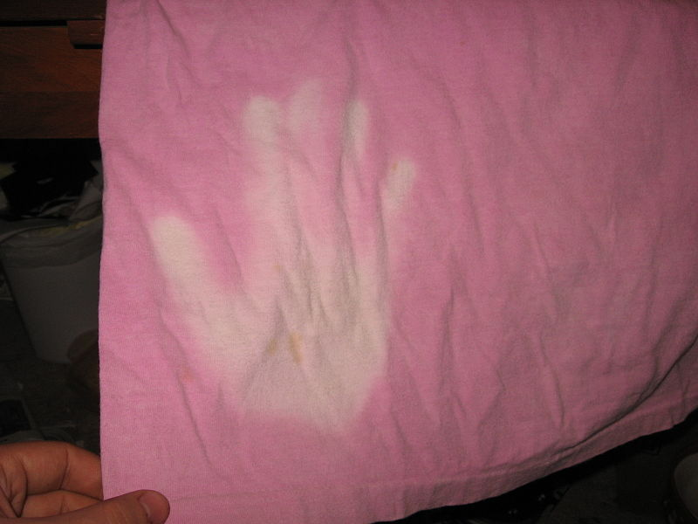
Dye Innovation Over Time
1856 - New colors
Mid 20th Century - Fade resistance dyes
1956 - Reactive dyes (for textiles)
1970s - Thermochromic dyes
Image: Wikimedia Commons, Thermochromism in clothing, Author: Piercetheorganist

Slide 13

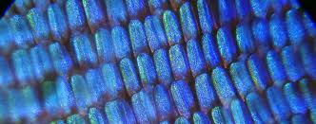
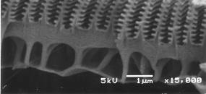
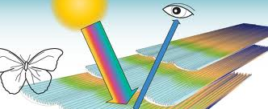
Current Innovations in Color: Color Without Chemicals
Innovation inspired by a butterfly which, as blue as it seems, doesn’t have an ounce of dye.
Image: Harvard Radcliff Institute, NISE Network, and The Mirasol Effect

Slide 14
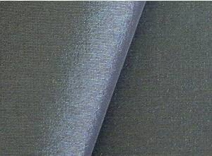

Current Innovations in Color: Color Without Chemicals
Morphotex Fibers
No dyes or pigments
Color based on varying thickness and structure of fibers
Reduced energy consumption and chemical release by eliminating dye processes
Teijin Limited of Japan
Image: Professor Greg Parker
Notes:
14
Left - Morphotex structural colored fibers
Right - Morpho Butterfly wings.
Teijin Fibers Limited of Japan produces Morphotex fibers. No dyes or pigments are used. Rather, color is created based on the varying thickness and structure of the fibers. Energy consumption and industrial waste are reduced because no dye process must be used.

Slide 15
Green Chemistry Across Industrial Sectors
Defense and aerospace
Adhesives
Coatings
Corrosion, inhibitors
Automotive
Solvents
Polymers
Fuels
Household cleaners
Surfactants
Fragrances
Dyes
Electronics
Solder
Housings
Displays
Agriculture
Pesticides
Fungicides
Fertilizers
Cosmetics
Builders
Chelating agents
Dyes
Pharmaceuticals

Slide 16
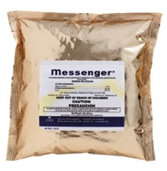
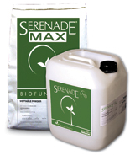
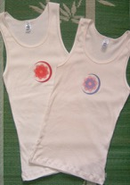
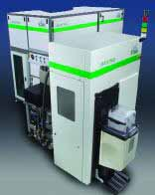
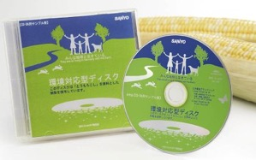
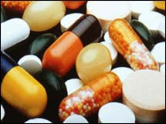
Green Chemistry Innovation in Other Fields
Home and Garden
Clothing
Electronics
Building materials
Cleaning products
Food products
Jewelry
And more!
Entertainment
Medicine

Slide 17
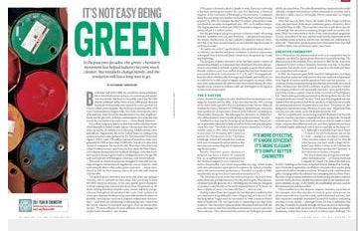




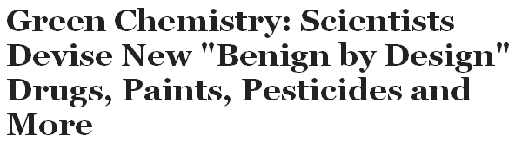



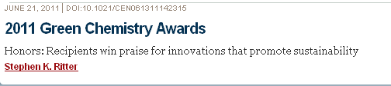
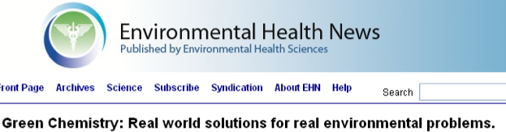



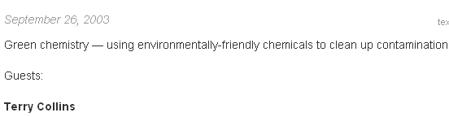



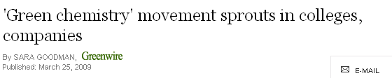
Headlines

Slide 18






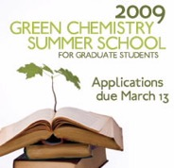



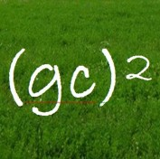

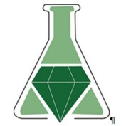






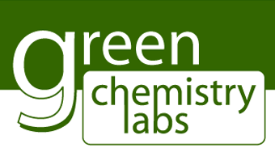
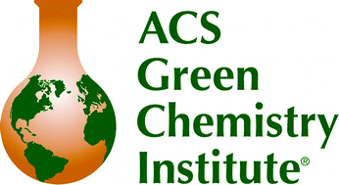
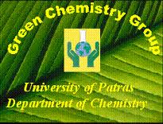




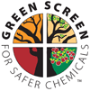
Networks

Slide 19
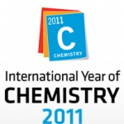

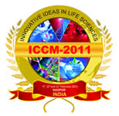


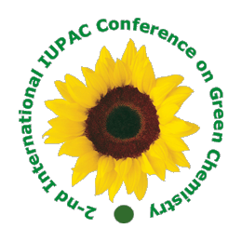
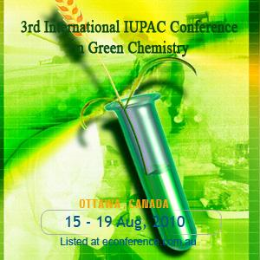




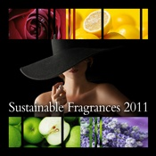

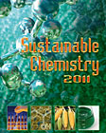
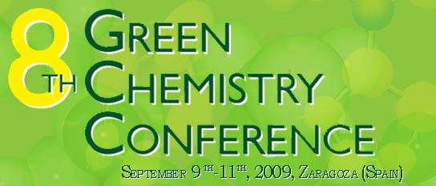
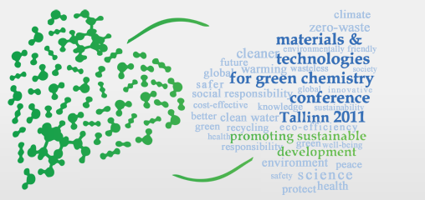
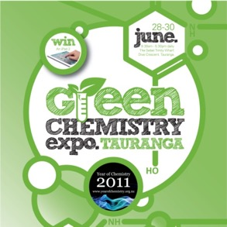
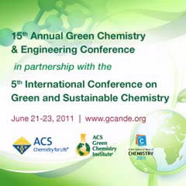

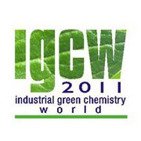



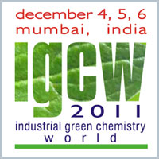
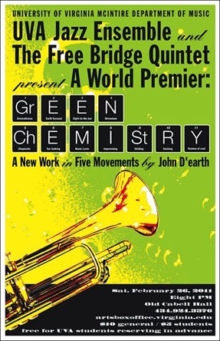
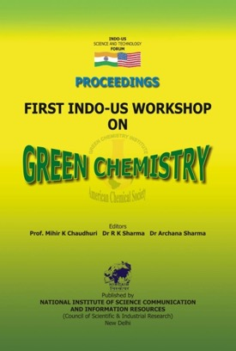

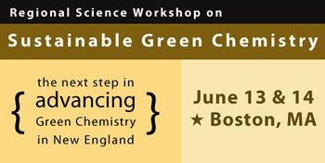


Sustainable Chemistry 2011
First International Conference
on Sustainable Chemistry
6 - 8 July 2011
Antwerp, Belgium
Conferences

Slide 20
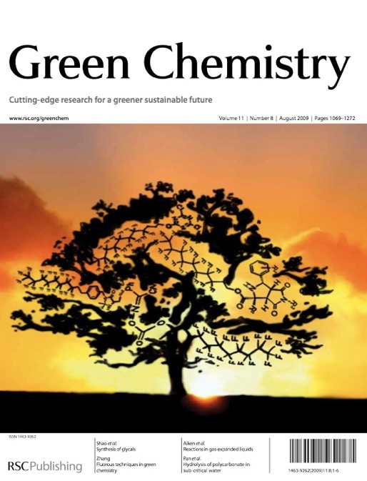
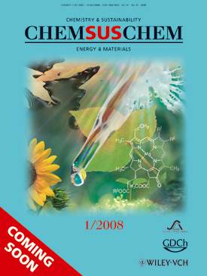
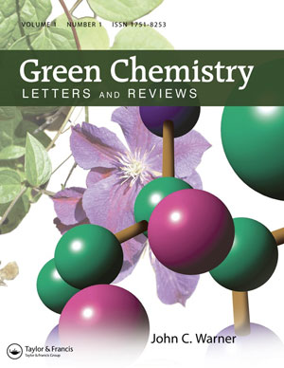


Journals

Slide 21
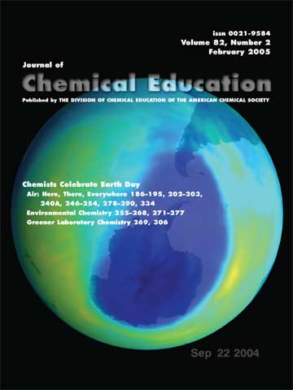

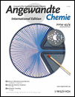





















Articles

Slide 22









































Business

Slide 23

Green Chemistry Market Predictions
Forecasted market size of the green chemistry industry worldwide from 2015 to 2020 (in billion U.S. dollars).
* Calculated based on the compound annual growth rate (CAGR) of 10.6 between 2015 and 2020, as stated by the source. Figures from 2016 to 2020 are forecasted.
Source: statista.com

Slide 24

The Growing Demand for “Greener” Chemicals
How the Chemical Industry Joined the Fight Against Climate Change
New York Times, October 16, 2016
Honeywell and Chemours (DuPont spin-off) actively backed regulations and moved towards more environmentally friendly refrigerants.
“The companies were driven less by idealism than by intense competition, and a bet that they could create more environmentally friendly alternatives.”
Global Warming Potential Comparison Chart
In 2006, the EU adopted the Mobile Air Conditioning (MAC) Directive that would reduce the climate impact of air conditioning in cars sold in the EU. The MAC Directive requires an automotive refrigerant with a GWP of less than 150 for use in new model vehicle platforms.
http://www.nytimes.com/2016/10/17/business/how-the-chemical-industry-joined-the-fight-against-climate-change.html?_r=0
Notes:
In September 2016, the so-called New York Declaration urged a global reduction in the use of HFCs.^{[7]} On 15 October 2016, due to these chemicals contribution to climate change, negotiators from 197 nations meeting at the summit of the United Nations Environment Programme in Kigali, Rwanda reached a legally-binding accord to phase out hydrofluorocarbons (HFCs) in an amendment to the Montreal Protocol.^{[8][9][10]}

Slide 25
Benefits of Green Chemistry
For the environment:
For human health:
For the economy:
For sustainability:
For science:
  Products will biodegrade and won’t persist in the environment.
  Products that won’t cause toxic harm to humans.
  Novel products can boost competitiveness.
Products made from renewable resources.
  Fundamental new insights.

Slide 26
Isn’t That How it is Done Now?
Entire industries are geared toward cleaning up after wasteful chemical syntheses.
Today’s scientific literature is filled with synthetic pathways that are inefficient in terms of design.
Reagents are seldom selected with regard to hazard.
Industrial chemicals do not have minimal hazard as a performance criterion.
Persistence of chemicals in the biosphere and in our bodies is a major global health issue (CDC 250 chemicals since 1945).
The vast majority of organic chemicals are made from depleting (non-renewable) feedstocks.
Our chemical industry deals with safety through engineering and security through barricades.

Slide 27
A Fundamental Change in Thinking
Green Chemistry moves our consideration of how to deal with environmental problems from the circumstantial to the intrinsic.
Hazard must be recognized as a flaw in the designing process.
Circumstantial
  - Use
  - Exposure
  - Handling
  - Treatment
  - Protection
  - Recycling
  - Costly
Intrinsic
  - Molecular design for reduced toxicity
  - Reduced ability to manifest hazard
  - Inherent safety from accidents or terrorism
  - Increased potential profitability

Slide 28
Approaching Risk: Exposure Versus Design
The conventional approach to hazards focuses on reducing risk by minimizing exposure.
- For example, wearing personal protective equipment or space ventilation if the chemical is volatile.
Green chemistry focuses on reducing risk by reducing hazard.
- If there is no hazard, exposure becomes irrelevant.

Slide 29
Traditional approach
More environmentally
benign than alternatives
Performs better
than alternatives
More economical
than alternatives

Slide 30
Holistic approach
Safety
Green
Chemistry
Performance
Cost

Slide 31

The 12 Principles of Green Chemistry
Waste Prevention
Atom Economy
Less Hazardous Chemical Synthesis
Designing Safer Chemicals
Safer Solvents and Auxiliaries
Design for Energy Efficiency
Use of Renewable Feedstocks
Reduce Derivatives
Catalysis
Design for Degradation
Real-time Analysis for Pollution Prevention
Inherently Safer Chemistry for Accident Prevention
Anastas, P. T.; Warner, J.C. Green Chemistry: Theory and Practice, Oxford University Press,1998
Notes:
Green chemistry is defined by 12 Principles, which address various topics. Most principles have tools or metrics associated to help the researcher and guide them through green chemistry improvements.

Slide 32

How Frequently Are The 12 Principles of Green Chemistry Implemented in Chemical Manufacturing?
This graph illustrates the frequency that the 12 principles of green chemistry are implemented in chemical manufacturing. Average chemical manufacturer responses (n = 17) to the 2012 Roundtable survey question “In your opinion, how frequently does your company implement the following principles of green chemistry?” on a scale of 1 to 4, where 1 is never implemented (same value used for not applicable), 2 is rarely implemented, 3 is regularly implemented, and 4 is fully implemented. The magnitude of each bar is the average response calculated using the corresponding scale value (e.g., 3 for regularly implemented).
Implementing Green Chemistry in Chemical Manufacturing: A Survey Report Robert J. Giraud, Paul A. Williams, Amit Sehgal, Ettigounder Ponnusamy, Alan K. Phillips, and Julie B. Manley
ACS Sustainable Chemistry & Engineering 2014 2 (10), 2237-2242

Slide 33
Examples of Green Chemistry Applications and Emerging Technologies

Slide 34
Algenol: sustainable production of ethanol from blue-green algae.
Algenol
Algenol developed a hybrid algae which diverts more than 80% of photosynthetically fixed carbon into ethanol.
Algae is not limited by photosaturation (the energy excess is not wasted).
Overall 15-20 times better productivity than corn based ethanol.
Equivalent to planting 40 million trees or removing cars 36,000 from the road.
Image: Green Chemistry Institute

Slide 35
BioAmber is used for the production of bio based succinic acid.
BioAmber
Developed technology which converts renewable sugars to bio based succinic acid using yeast.
Succinic acid is a building block for products such as polyurethanes, paints, and coatings.
Technology is compatible with existing supply chains.

Slide 36
Andalyze is a real time heavy metal detection device.
Andalyze
Developed technology which accurately detects and measures heavy metal concentrations in water in less than two minutes.
This greatly reduces cost and complexity of testing water sources for trace metal contamination which previously had to be done in laboratory setting.

Slide 37


Eco-Leather Corp.
Eco-Leather:
  Made out of natural fibers such as flax or cotton mixed with palm, corn, soybean and other plant oils that are laminated together in layers to create something that looks and feels as if it came from an animal.
Leather Tanning:
  Uses Chromium (III) Sulfate.
  Chromium gets oxidized to Chromium (VI) during the processes.
    Extremely toxic. Causes water pollution.
http://gizmodo.com/how-leather-is-slowly-killing-the-people-and-places-tha-1572678618
http://www.ecouterre.com/renewable-eco-leather-made-from-plant-oils-is-a-fashion-game-changer/richard-wool-plant-eco-leather-1/

Slide 38

HairPrint – John Warner @ WBI
Usually, the process of dying hair involves bleaching (oxidizing and decomposing the natural pigments eumelanin and pheomelanin).
  Hydrogen peroxide and ammonia or milder ethanolamine.
PPD and para-aminophenol react with the oxidant at high pH to produce the dyes.
  Alkaline pH also swells the hair cuticle to make dye penetration easier.
  Contains toxins, endocrine disruptors, and carcinogens.
  Not renewable.
Image: Compound Interest

Slide 39


HairPrint – John Warner @ WBI
Color restoration (not coloring or bleaching).
Mimics how hair gets its color naturally.
  Eumelanin synthesis (for brown and black hair) is the pigment our body synthesizes (it is also responsible for skin tanning and eye iris color).
5,

Slide 40
Renewable nylon through commercialization of BIOLONTM DDDA
Verdezyne
The current global demand for dodecanedioic acid (DDDA) is estimated to be 100 million pounds per year. All DDDA currently on the market is produced from fossil-based sources.
BIOLONTM DDDA technology focuses on the production of dicarboxylic acid chemical intermediates such as adipic acid, sebacic acid and dodecanedioic acid (DDDA), which is used to make nylon.
It is done by an aerobic fermentation process with genetically engineered Candida sp. yeast and is integrated with downstream product isolation and crystallization.
Image: Knot & Rope

Slide 41
CB&I for AlkyClean®, a solid acid catalyst alkylation technology.
CB&I
Scientists have been trying to replace liquid acid technologies with a greener solid acid catalyst technology.
Prior approaches failed because of poor product selectivity and/or excessively rapid catalyst deactivation, coupled with the lack of an acceptable catalyst regeneration procedure.
CB&I developed and commercialized an inherently safer technology to produce alkylate, a clean gasoline component.
This replaced the traditional toxic and corrosive liquid acid catalysts with an inherently safer technology that also has a lower environmental impact.

Slide 42
Instinct® Technology, which makes nitrogen fertilizers work more effectively.
DOW Agrosciences LLC
Crop genetics and precision application methods have improved the efficiency of applied nitrogen fertilizers, but losses to the environment are still significant after soil bacteria quickly convert nitrogen from the applied urea or ammoniacal form to nitrate.
In the nitrate form, nitrogen fertilizer is susceptible to losses through leaching or as emissions in the form of nitrous oxide.
This technology reduces fertilizer nitrate leaching to ground and surface waters, and atmospheric nitrous oxide emissions.
  Nutrient pollution is one of America’s most widespread, costly and challenging environmental problems.
Instinct® Technology retains applied nitrogen longer in the plants’ root zone, optimizing crop utilization and yield, and reducing nutrient run-off.

Slide 43
AirCarbon: Greenhouse Gas Transformed into High-Performance Thermoplastic.
Newlight Technologies
Methane is emitted by natural sources such as wetlands. It is also the second most prevalent greenhouse gas emitted in the U.S. from human activities, such as leakage from natural gas systems and the raising of livestock.
AirCarbon is a carbon capture technology that combines methane with air to produce to produce polymers at environmentally friendly, ambient conditions.
This technology allows polymerization beyond previous maximum limits and generates a yield of nine kilograms of polymer for every one kilogram of biocatalyst (9:1) – nine times more material compared to previous technologies.
This process matches the performance of a wide range of petroleum-based plastics while out-competing on price and is used to make bags, cell phone cases, containers, furniture, and other products.

Slide 44

Halogen-Free Firefighting Foams
RE-HEALING halogen-free firefighting foams
  (Presidential Green Chemistry Challenge: 2014 Designing Greener Chemicals Award)
93% of the RE-HEALING ingredients can be degraded in 28 days, and complete degradation within 42 days. In contrast, halogenated flame retardants are known to be highly persistent.

Slide 45
I'm greenTM Polyethylene production
Braskem
PE is the most common plastic. The annual global production is around 80 million tons. Its primary use is in packaging (plastic bags, containers including bottles, etc.).
Conventional polyethylene uses fossil sourced raw materials, such as oil or natural gas
I'm greenTM Polyethylene is a plastic produced from ethanol sugarcane - a renewable raw material - and captures and fixes CO2 from the atmosphere during its production, helping to reduce emission of greenhouse gases.
It retains the same properties, performance, and application versatility of polyethylene from fossil fuels.
Image: Braskem

Slide 46

Switchable Solutions Inc.
Solubility characteristics of solvents can be tailored with the addition or removal of CO₂:
  Without CO₂, it behaves like a low-polarity regular organic solvent.
  With CO₂, it has very high polarity, and is miscible with water.
  It can be used for:
    - Waste water treatment
    - Asphalt recovery and reuse
    - Polystyrene recycling
    - Purification of solids

Slide 47
Halogenated Compounds Elimination
Perchloroethylene (PERC)
  Dry cleaning solvent (accounts for greater than 80% of use).
  Toxicity / Environmental Impact
    - Volatile, but highly stable, and non-flammable.
    - Probably carcinogenic to humans.
    - Common soil contaminant.
Dry cleaning can be done with supercritical CO₂
  Closed loop to minimize amount of CO₂ lost.
  Complete eliminated the need for PERC.

Slide 48
Alternative Bleaching – Moving Away From Chlorine
Conventional Paper Bleaching: Chlorine dioxide (ClO₂)
  Produces unacceptable quantities of chlorinated pollutants, and many are exceptionally toxic.
TAML/H₂O₂
  Alternative catalytic breakdown of H₂O₂ to provide the oxidative equivalent.

Slide 49

Enzyme Replaces Precious Metals
Januvia
Merck's top-selling diabetes drug
$1.9 Billion in sales (2009)
Traditional Synthesis
  - 250 psi H₂ hydrogenation
  - Rhodium
Improved Synthesis using enzyme
  - 99.95% selectivity to desired product
53% improvement in productivity
Eliminates all heavy metal wastes
Sitagliptin, the active ingredient in Merck's Januvia
http://www.rsc.org/chemistryworld/News/2010/June/17061002.asp (Accessed on 4/1/2016)
Savile, C. K.; Janey, J. M.; Mundorff, E. C.; Moore, J. C.; Tam, S.; Jarvis, W. R.; Colbeck, J. C.; Krebber, A.; Fleitz, F. J.; Brands, J.; Devine, P. N.; Huisman, G. W.; Hughes, G. J., Biocatalytic Asymmetric Synthesis of Chiral Amines from Ketones Applied to Sitagliptin Manufacture. Science 2010, 329 (5989), 305-309.

Slide 50

Plastics – From PET to PLA
PET Plastic
Image: WikiCommons

Slide 51


Plastics – From PET to PLA
CORN
PLA Plastic

Slide 52
Catalysis with earth abundant transition metals.
Professor Paul J. Chirik of Princeton University
Catalyst technology has relied on some of the least abundant elements in the Earth’s crust – palladium, platinum, rhodium, and iridium. In addition to their high cost, price volatility, and toxicity, extraction of these elements has significant environmental consequences.
Alkene hydrosilylation is an example of a metal-catalyzed chemical reaction that is used on an industrial scale in the manufacture of silicones from alkenes and silanes.
Silicones are found in a range of consumer products including adhesives, household utensils, medical devices, health care products, and low rolling resistance tires.
Chirik’s group discovered a new class of hydrosilylation catalysts based on earth-abundant transition metals, such as iron and cobalt, that have superior performance to existing platinum catalysts.
This base metal catalyst technology offers the opportunity to enable new chemical processes that provide the desired product exclusively, eliminate distillation steps, and avoid the generation of byproducts and unnecessary waste.

Slide 53

Moving Toward Ending Our Dependence on Organic Solvents
Professor Bruce Lipschultz
Developing designer surfactants that allow for chemical reactions in
‘nanomicelles’ in water.
Organic molecules are typically insoluble or unreactive in water, which is why
toxic, flammable, petroleum-derived organic solvents are used.
Micelles have hydrophilic exteriors and hydrophobic interiors, allowing for the
encapsulation (and reaction) of organic molecules in aqueous environments.
Using safe, nontoxic, and inexpensive chemicals, 50-100nm micelles can be
formed in water that, by increasing effective concentration, also dramatically increase reaction rates without additional energy input.
This can be applied to several important C-C bond forming reactions.
Recycling of the surfactant is very efficient and the purity of the water being used is not very important.
Image: Bruce H. Lipshutz (Wkipedia)

Slide 54
Aerobic Alcohol Oxidation
Oxidation: a major step to add value to petroleum derived chemicals.
In scale it is one of the most polluting transformations.
  Conventional Reagents:
    - Chromium-based reagents (CrO3.py, pyridinium dichromate, etc.)
    - Oxalyl Chloride (ClCOCOCl)
    - Hypervalent Iodine Compounds
Shannon Stahl: Aerobic Alcohol Oxidation at room temperature, mediated by copper

Slide 55

Alternative Plasticizers
PVC requires plasticizers for its many applications (softer products).
Most widely used plasticizer: phthalates, particularly DiNP (previously DEHP was utilized).
  - EU/US – banned DEHP/DINP & 5 others in products intended for children’s use (under 3 years old).
  - Phthalate exposure linked to liver toxicity, endocrine disruption, and carcinogenicity.

Slide 56
Alternative Plasticizers
Isosorbide Diester
  One to one substitution of phthalate additive in PVC.
  Thermally stable, biodegradable, biosafe.

Slide 57
Microwave Assisted Syntheses
MAS can save energy by shortening reaction time while providing comparable thermo energy to reaction.
Image: A Review of Microwave-Assisted Reactions for Biodiesel Production (Bioengineering)

Slide 58
Topics Covered
Green Chemistry and Design Criteria
Chemical Design
  Current Innovations in Chemical Design
Green Chemistry Design in Other Fields
The Market for Green Chemistry
Green Chemistry Benefits are In Demand
Applications of Green Chemistry - Examples

Slide 59
Sponsored by Yale-UNIDO Initiative
QUESTIONS?
CENTER for GREEN CHEMISTRY
and GREEN ENGINEERING at YALE

