Slide 1
Green Chemistry:
It All Starts at the Beginning
Lecture # 4
Date:
Course #

Slide 2
Outline
Periodic Table
  Why is it useful
  Reading the periodic table
  Isotopic Symbols
Atoms ➔ Elements
Periodic Trend
  Connection to bonding
Elements: Relevancy to Green Chemistry

Slide 3
Outline
Periodic Table
  Why is it useful
  Reading the periodic table
  Isotopic Symbols
Atoms ➔ Elements
Periodic Trend
  Connection to bonding
Elements: Relevancy to Green Chemistry

Slide 4
First thing first…
Chemistry is the field of study concerned with the characteristics, composition, and transformations of matter.
Matter is anything that occupies space.
Mass refers to the amount of matter present.

Slide 5
https://upload.wikimedia.org/wikipedia/commons/6/68/Periodic_table_vectorial.png

Slide 6
http://elements.wlonk.com/ElementsTable.htm
Notes:
More than just elements!
Elements make up a lot of todays materials, drugs, and things we interact with on a daily basis.

Slide 7
How is the Periodic Table Organized?
“Rows” and “Columns”
Groups
  Group 1A
  Group 2A
  Group 3A
  Group 4A
Classifications and Categories
  Metals and Non-metals
Group 5A
Group 6A
Group 7A
Group 8A

Slide 8
  An element’s location on the periodic table predicts its behavior and properties.
  The periodic table is one of many tools that chemist use in their “chemistry tool box”.
Did you know?
Image Source: Pixabay
Notes:
Image Source: https://pixabay.com/en/toolbox-tool-box-box-metallic-red-152140/

Slide 9
    Main Group Elements (A-Groups)
      Group IA are the alkali metals. They will react with water to make very caustic solutions.
      Group IIA are the alkaline earth metals.
      Group VIIA are called halogens.
      Group VIIIA are called noble gases.

Slide 10
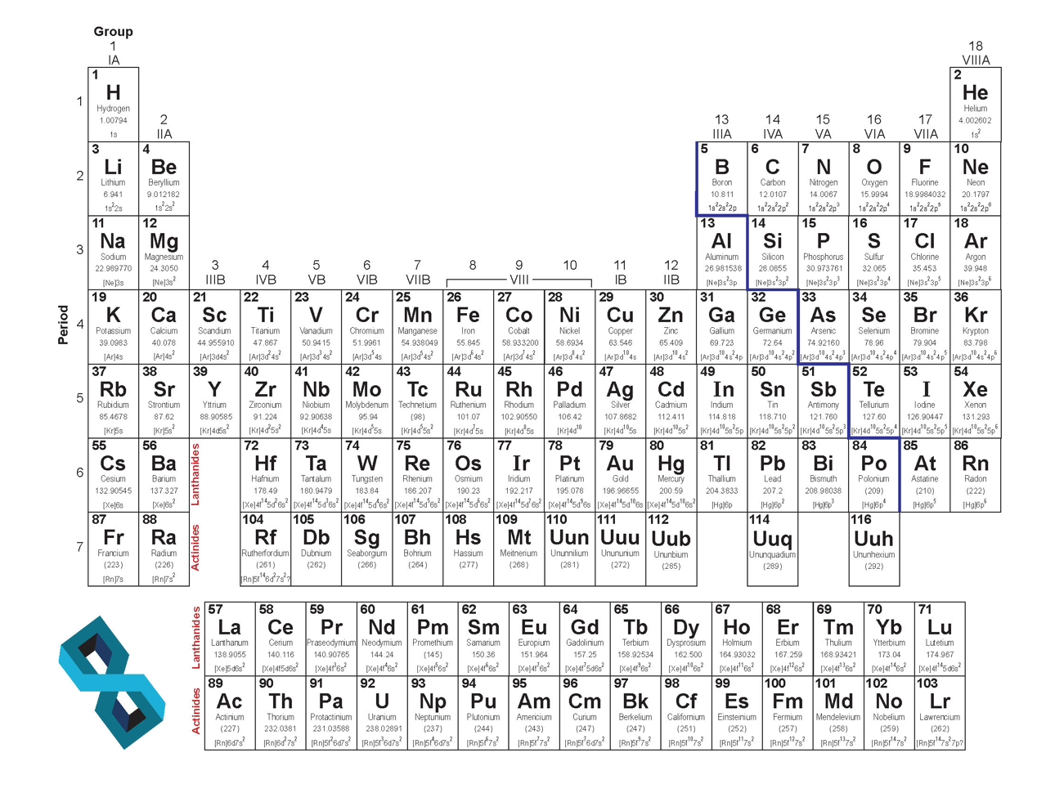
Group IA

Slide 11
Group IIA

Slide 12
Group VIIA: Halogens

Slide 13
Noble Gases

Slide 14
Main Elements

Slide 15
Transition
Metals

Slide 16
Metals and Non-Metals
Metals:
Lustrous
Deform without breaking
Conducts heat
Conducts electricity
Nonmetals:
Doesn’t conduct heat well
Doesn’t conduct electricity well
Gas, Liquid, or brittle solid

Slide 17
Non-Metals
Metals

Slide 18
Outline
Periodic Table
  Why is it useful
  Reading the periodic table
  Isotopic Symbols
Atoms ➔ Elements
Periodic Trend
  Connection to bonding
Elements: Relevancy to Green Chemistry

Slide 19
Atoms → Elements
What are elements made of?
What are elements composed of?
What gives them their specific properties?

Slide 20
The Atomic Theory
Elements = matter
The fundamental unit of matter – the atom.
1800s: John Dalton
  Elements are composed of extremely small particles = ATOMS
  All atoms of a given element are alike but atoms of one element differ from the atoms of any other atom.
John Dalton
Image Source: Wikipedia Commons
Notes:
https://commons.wikimedia.org/wiki/File:Dalton_John_desk.jpg

Slide 21
The Atomic Theory

Slide 22
Atoms? What are they exactly?
  Elementary Particles:
    Proton
    Neutron
    Electron
Image Source: Wikipedia Commons
Notes:
Image Source: https://commons.wikimedia.org/wiki/File:Atom_diagram.png

Slide 23
Atoms? What are they exactly?
The Protons and Neutrons of an Atom are packed in the Nucleus.
Electrons can be thought of as ’clouds’ around the nucleus.
Image Source: Wikipedia Commons
Notes:
Image Source: https://commons.wikimedia.org/wiki/File:Atom_diagram.png

Slide 24
Atoms: The Proton
      This is the particle that differentiates the various elements.
          How?
      “Reside” in the nucleus
      Has a POSITIVE CHARGE

Slide 25
Atoms: The Neutron
      This is the particle that differentiates the various isotopes of an element.
          How?
      Just like the proton, neutrons “reside” in the nucleus on an element
      Has similar size as a proton
      Unlike the proton, the neutron has NO CHARGE

Slide 26
Atoms: The Electron
      This is the particle that differentiates the various oxidation states of an element.
          How?
      In contrast, the electron “resides” outside the nucleus on an element
          Known as the electron cloud
      Has a NEGATIVE CHARGE
      Much smaller than protons and neutrons

Slide 27
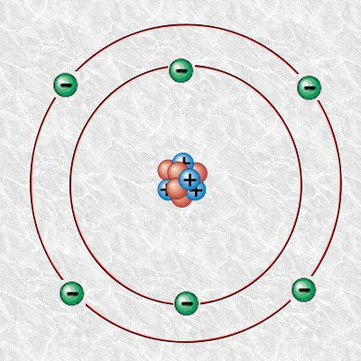
Example: Carbon Atom
An Atom is electrically neutral.
Electrons have negative charge.
Protons have positive charge.
To maintain electrical neutrality, atoms have equal numbers of protons and electrons.
Image Source: Wikipedia
Notes:
Image Source: https://en.wikipedia.org/wiki/File:Carbon-atom.jpg

Slide 28
http://www.compoundchem.com/2016/10/13/atomicmodels/
Notes:
Discuss with the class on the progression of the atomic models and how they evolved.

Slide 29
Isotopic Symbols
Mass Number
The number of protons plus the number of neutrons in an atom is the mass number. [MN]
The identity of the element is given by its one or two letter atomic symbol. [E]
The number of protons in an atom is the atomic number. [AN]
E
MN
AN
Atomic Number

Slide 30
Isotopic Symbols
Let’s Practice!
Write the isotopic symbol for an atom with 5 protons and 6 neutrons.
Answer:
B
11
5

Slide 31
Isotopic Symbols
Write the isotopic symbol for an atom with 15 protons and 16 neutrons.
Answer:
P
31
15

Slide 32
Isotopic Symbols
Write the isotopic symbol for the atom Sodium with 10 neutrons.
Answer:
21
Na
11

Slide 33
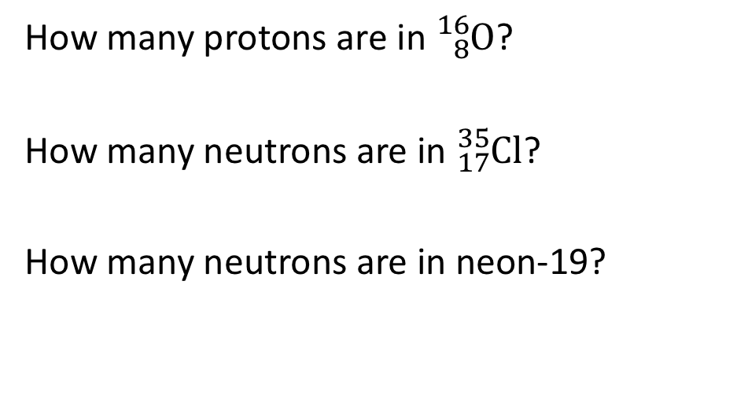
Isotopic Symbols
Answer:
8
How many protons are in ${}_{8}^{16}O$?
How many neutrons are in ${}_{17}^{35}{Cl}$?
How many neutrons are in neon-19?
18
9

Slide 34
Outline
Periodic Table
  Why is it useful
  Reading the periodic table
  Isotopic Symbols
Atoms ➔ Elements
Periodic Trend
  Connection to bonding
Elements: Relevancy to Green Chemistry

Slide 35
Remember the tool box?
There’s another way that chemists/scientist use the periodic table as a tool:
Periodic Trends and Physical Properties

Slide 36
Trend 1: Effective Nuclear Charge
The Effective Nuclear charge represents the actual nuclear charge minus the shielding constant.
https://upload.wikimedia.org/wikipedia/commons/thumb/b/b3/Effective_Nuclear_Charge.svg/2000px-Effective_Nuclear_Charge.svg.png

Slide 37
Trend 1: Effective Nuclear Charge
Electrons closer to the nucleus shield other electrons from the protons’ attraction –‘shielding electrons’.
https://upload.wikimedia.org/wikipedia/commons/thumb/b/b3/Effective_Nuclear_Charge.svg/2000px-Effective_Nuclear_Charge.svg.png

Slide 38
Increasing Effective Nuclear Charge
Increasing Effective Nuclear Charge

Slide 39
Trend 2: Atomic Radius
The larger the effective nuclear charge, the more retained the electrons will be to the nucleus (positive charge attracts negative charge) → Everything is tighter – thus smaller.
Larger Effective Nuclear Charge = Smaller Atomic Radius
Why do we care?

Slide 40
Increasing Atomic Radius
Increasing Atomic Radius
Notes:
Atomic radius determined mostly by how retained electrons are by the nucleus. – larger the effective nuclear charge, the more retained, smaller radius.

Slide 41
Trend 3: Ionization Energy
Ionization Energy is the minimum energy required to remove an electron from a gaseous atom in its ground state.

Slide 43
Trend 4: Electronegativity
Electron Affinity is the energy change that occurs when an electron is gained by an atom.
Electronegativity is the tendency of an atom to attract electrons (that electron isn’t necessarily transferred).

Slide 45
Trend 5: Melting and Boiling Points
Melting Point: Temperature at which a substance goes from solid to liquid state.
Boiling Point: Temperature at which a substance goes from liquid to gaseous state.
These temperatures are determined by interatomic forces:
Stronger Van der Waals forces = higher melting and boiling points

Slide 46
Trend 6: Volatility
Volatility: tendency of a substance to vaporize.
Vapor Pressure: the pressure of a gas resulting from evaporation of a liquid.
Higher Vapor Pressure = higher volatility
How is it related to boiling point?
Boiling point is the temperature at which vapor pressure equals atm. Pressure.
The lower the boiling point = the higher the vapor pressure = the higher the volatility
Volatility has the opposite trend as boiling point.

Slide 47
Trend 7: Acidity
Acidity: tendency of an anion to release a proton.
Higher electron affinity = higher withholding of electrons = better capacity to stabilize an anion = increasing acidity
Bigger atomic radius = higher polarizability = higher ability to delocalize negative charge = increasing acidity
Notes:
Higher electronegativity – higher withold of electrons – stabilitzation of anion – acidity increases
Atomic radius – delocolize negative charge – acidity increases.
Polarizability = ease with which electron cloud can be distorted.

Slide 48
Trend 7: Acidity
Acidity: tendency of an anion to release a proton.
Basicity: tendency of an anion to host a proton -exactly the opposite trend.
Notes:
Higher electronegativity – higher withold of electrons – stabilitzation of anion – acidity increases
Atomic radius – delocolize negative charge – acidity increases.

Slide 49
Outline
Periodic Table
  Why is it useful
  Reading the periodic table
  Isotopic Symbols
Atoms ➔ Elements
Periodic Trend
  Connection to bonding
Elements: Relevancy to Green Chemistry

Slide 50
Green Chemistry: Elements
Endangered Elements:
  With exponential growth of technological advancements ➔ more elements/materials are needed.
  Most elements used today utilize precious metals.
  Iron, Fe, is the most abundant metal on earth.
  More research on investigating further uses of non-precious metals in everyday applications is needed.
Understanding the concept of bonds and the effect of atomic combinations can lead to new alternative products.

Slide 52
Summary
Periodic Table
  A tool for chemists for:
    Understanding atoms, elements
    Understanding periodic trends and properties of elements
Elements: Relevancy to Green Chemistry
  Some elements have limited supply (“endangered elements”)
  Understanding the concept of bonds and the effect of atomic combinations can lead to new alternative products.

