Slide 1
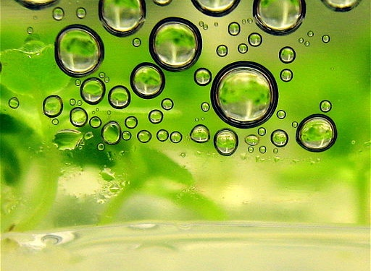
Yale-UNIDO Train-the-Facilitator Workshop in Green Chemistry
The 12 Principles of Green Chemistry
CENTER for GREEN CHEMISTRY
and GREEN ENGINEERING at YALE
Image: Wikimedia Commons, Author: Steve Jurvetson

Slide 2
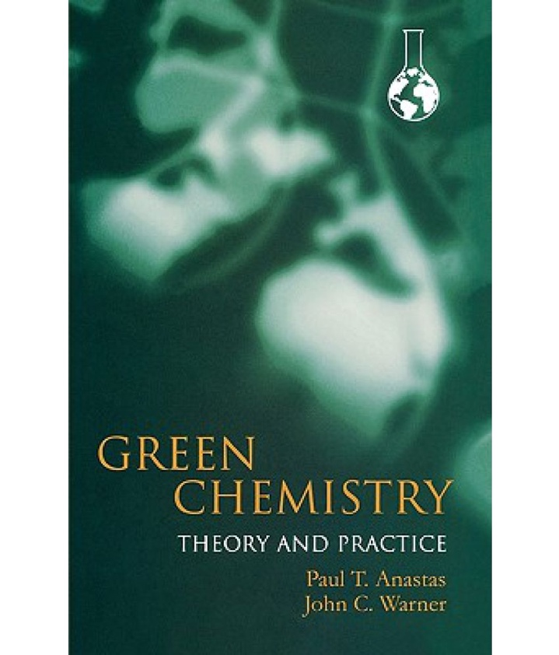
The 12 Principles of Green Chemistry
Anastas, P. T.; Warner, J.C. Green Chemistry: Theory and Practice, Oxford University Press,1998

Slide 3
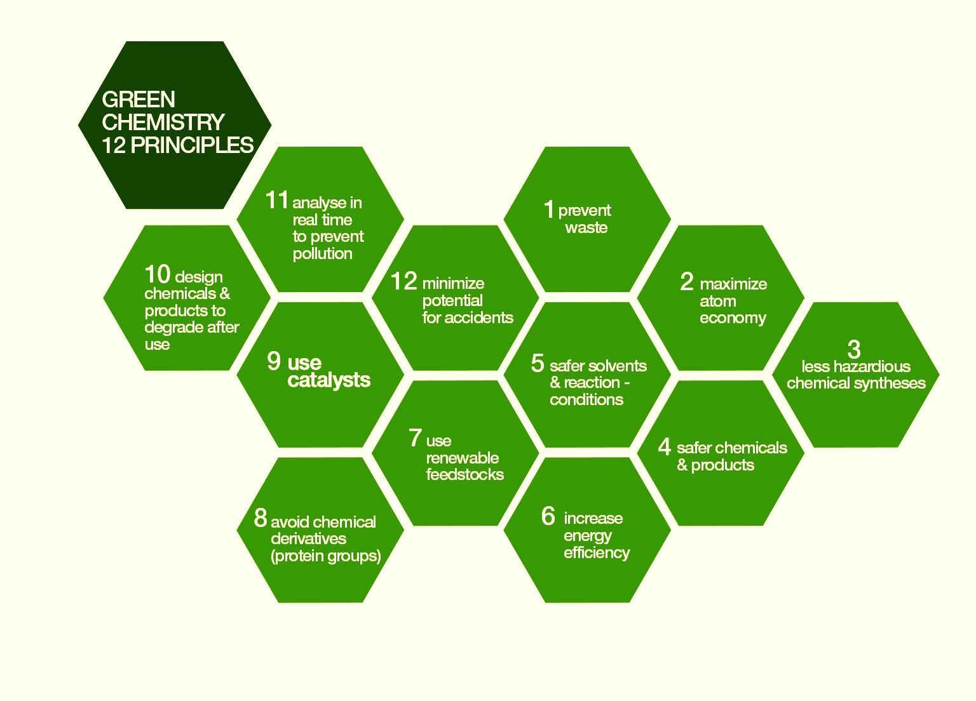
The 12 Principles of Green Chemistry
The principles address:
  Toxicity
    - Reducing the hazard
  Feedstocks
    - Use of renewable resources
  Designing safer products
    - Non toxic products by design
  Biodegradability
    - Enhancing break down at the end of life
  Energy
    - Reducing the energy needs
  Accidents
    - Eliminating accidents
  Efficiency
    - Shorter processes and synthesis
Anastas, P. T.; Warner, J.C. Green Chemistry: Theory and Practice, Oxford University Press,1998

Slide 4

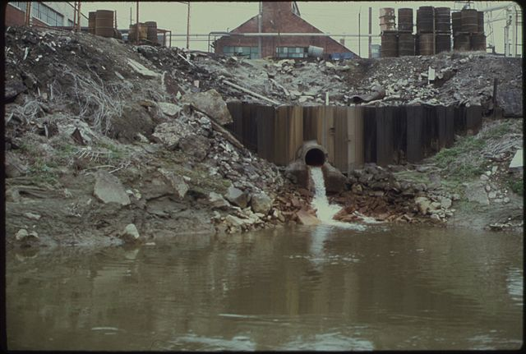
Waste Prevention
It is better to prevent waste than to treat or clean up waste after it is formed.
Image: Harshaw Chemical Company discharges waste water into the Cuyahoga river
Source: National Archives and Records Administration

Slide 5
What is waste?
Waste Prevention
Waste is anything that is a leftover from the product/process and cannot be re-used.
Waste can be produced in any stage of a process life-cycle:
Origins of feedstock
Manufacturing
Distribution
Use
End of life
When is waste not waste?
When it can be reused, becoming a feedstock.
When it can be reduced or completely eliminated.

Slide 6
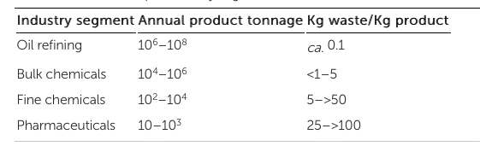
Waste Prevention
Waste generated by different industry segments:
Production of pharmaceuticals produces a lot of waste due making complex molecules with demanding quality standards, often requiring batch processing; there are greater regulatory constraints and often high value and low volume products are manufactured.
Many industry sectors try to decrease waste generation by decreasing the number of synthetic steps to generate the product and by implementing a solvent recovery system.
R. A. Sheldon, Chem. Ind., 1992, 903–906
R. A. Sheldon, Chem. Ind., 1997, 12–15

Slide 7
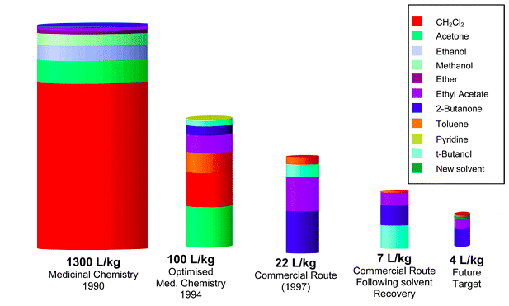
Waste Prevention
Case study: Sildenafil citrate production
Sildenafil citrate, commonly known as Viagra, is a selective inhibitor of phosphodiesterase 5 (PDE5). This new drug immediately became a major seller, achieving sales of more than $1 billion during its first year on the market. With such a rapid sales take off it was critical that the environmental performance of the synthesis was good from the outset.
Conventional sildenafil citrate synthesis included:
11 step synthesis, which gave a 4.2% overall yield.
Tin chloride, a heavy metal and a major environmental polluter.
The use of stoichiometric quantities of thionyl chloride in a solvent. This has a high environmental impact.
Hydrogen peroxide, which causes burns upon skin contact and is a fire and transportation hazard, especially when in contact with organic materials.
Produced over 1300 L of waste per 1 kg of product.
The amount of organic waste produced by the sildenafil citrate processes at various time points
Dunn, P.J et al Green Chem., 2004, 6, 43-48

Slide 8
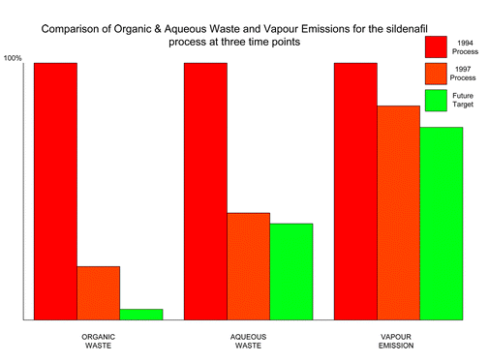
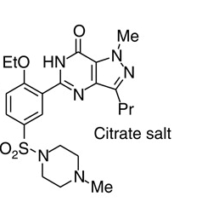
Waste Prevention
Case study: Sildenafil citrate production
Alternative production of sildenafil citrate:
Average yield of last three steps = 97% yield.
Reduction of the ratio of solvent waste/kg product over 17 years from 1300 L/kg to only 7 L/kg by minimizing solvent use, increasing solvent recovery, improving solvent selection, and telescoping steps.
Only the solvents t-butanol, ethyl acetate, 2-butanone, and a trace of toluene still require disposal.
Dunn, P.J et al Green Chem., 2004, 6, 43-48

Slide 9
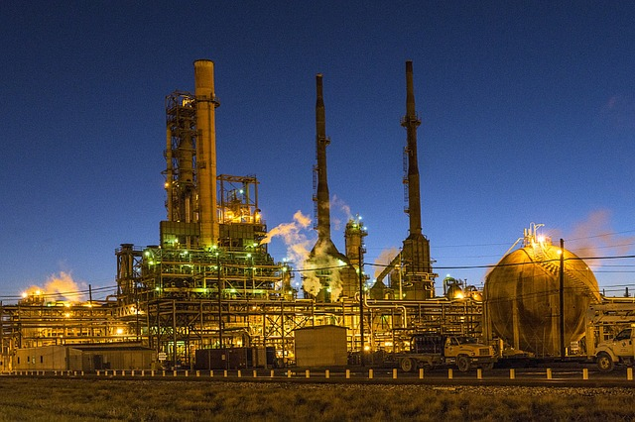
Waste Prevention
Case study: Phenols
Phenols are widely used in household products and as intermediates for industrial synthesis. They are often referred to as drop-in platform chemicals.
Conventional method of obtaining phenols from petroleum:
Petroleum
Phenols (benzene, toluene, xylenes)
The method is not sustainable – it is dependent on depleting resources.
Image: Pixabay

Slide 10
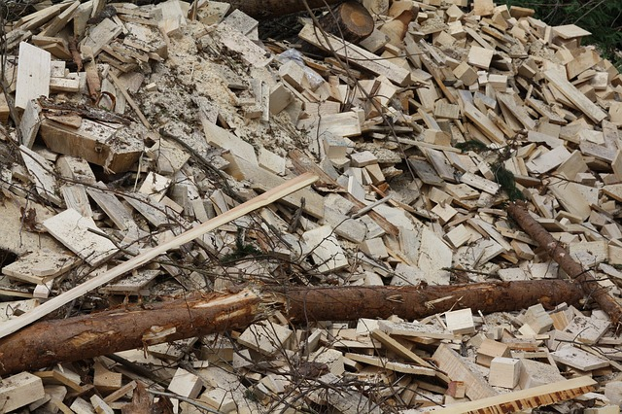
Waste Prevention
Case study: Phenols
Alternative production of phenols from biomass waste using depolymerization:
This method uses abundant product (waste) as a starting material.
Biomass
Phenols
Image: Pixabay

Slide 11
Waste Prevention
Case study: Production of ethylene oxide
Ethylene oxide is used as an intermediate in the production of several industrial chemicals, the most notable of which is ethylene glycol. It is also used as a fumigant in certain agricultural products and as a sterilant for medical equipment and supplies.
Conventional ethylene oxide synthesis included:
A 2-step synthesis with a chlorohydrin intermediate.
For each kilogram of product, 5 Kg of waste were disposed.

Slide 12
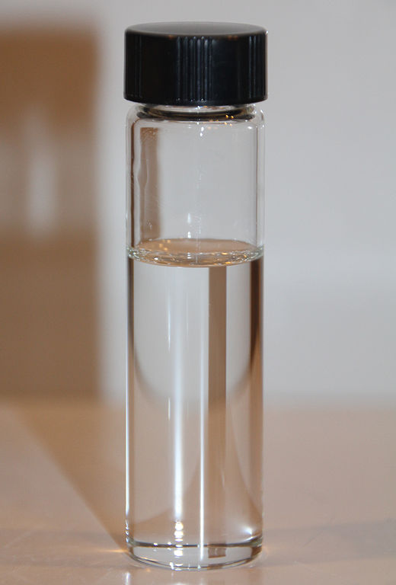
Waste Prevention
Case study: Production of ethylene oxide
Alternative production of ethylene oxide:
Use of molecular oxygen removes the need for chlorine.
New process generates more than 16 times less waste than the original one, and eliminates the formation of waste water.
Image: Wikimedia Commons, Author: LHcheM

Slide 13
Waste Prevention
Case study: Revalorization of biofuel byproducts
When byproducts cannot be avoided, other innovative solutions should be considered. One productive solution is to seek an industrial ecology approach where the waste can become a new raw material with significant value for another process as it re-enters the life-cycle. This approach is currently being applied to the production of biofuel.
1.
Biofuel
+
Waste
Energy
2.
Waste
+
Material
Energy

Slide 14
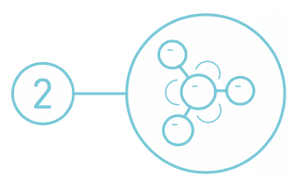
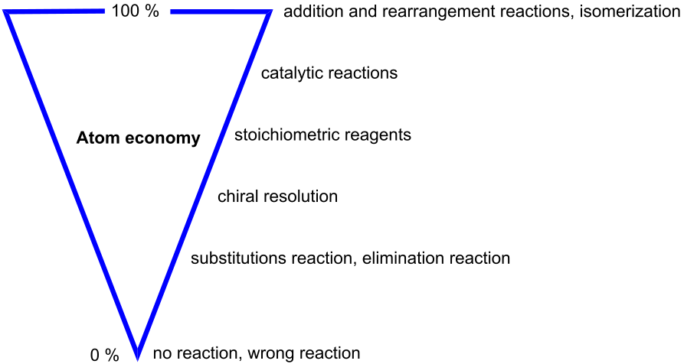
Atom Economy
Synthetic methods should be designed to maximize the incorporation of all materials used in the process into the final product.
Image: Wikimedia Commons, Author: Astrid 91

Slide 15
Atom Economy
In 1990 Barry Trost introduced the concept of synthetic efficiency: Atom Economy (AE). It refers to the concept of maximizing the use of raw materials so that the final product contains the maximum number of atoms from the reactants.
The ideal reaction would incorporate all of the atoms of the reactants.
The AE is measured as the ratio of the molecular weight of the desired product over the molecular weights of all reactants used in the reaction.
Additional considerations when designing a green reaction:
Generation of co-products and waste, toxicity of co-products and waste, energy needs, purification steps, solvent and catalyst usage

Slide 16
Atom Economy
Example: Epoxidation of styrene
Assume 100% yield.
100% of the desired epoxide product is recovered.
100% formation of the co-product: m-chlorobenzoic acid.
A.E. of this reaction is 23%.
77% of the products are waste.
styrene
desired epoxide
waste

Slide 17
Atom Economy
Case study: Styrenes
Styrenes are precursors to polystyrene. Polystyrene is one of the most widely used plastics, the scale of its production being several million tons per year.
Conventional method of styrene production:
Use of benzene, a known carcinogen, as a starting material.
High temperature (800-950 ⁰C).

Slide 18
Atom Economy
Case study: Styrenes
Alternative method of styrene production from butadiene using Diels-Alder reaction:
Diels-Alder reaction = 100% atom economy.
Use of non-toxic starting material.

Slide 19
Atom Economy
Case study: Ibuprofen
Conventional synthesis of ibuprofen:
  6 stoichiometric steps.
  <40% atom utilization.

Slide 20
Atom Economy
Case study: Ibuprofen
Alternative catalytic synthesis of ibuprofen:
  3 catalytic steps.
  80% atom utilization.
  BHC

Slide 21
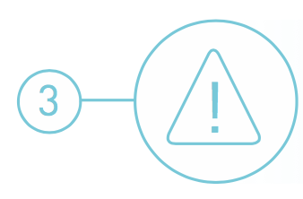
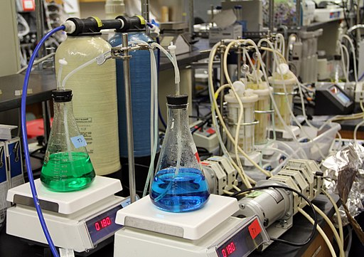
Less Hazardous Chemical Synthesis
Whenever practicable, synthetic methodologies should be designed to use and generate substances that possess little or no toxicity to human health and the environment.
Image: Wikimedia Commons, Center for Biofilm Research Laboratory Montana State University

Slide 22
Less Hazardous Chemical Synthesis
Ideally, non-toxic substances are used to synthesize a chemical product.

Slide 23
Less Hazardous Chemical Synthesis
Organic chemistry’s synthetic toolbox has been significantly improved over the past decade by the innovative work of green chemists and the many new reactions that have been developed.
Cascade, or tandem reactions, such as C–H activation, metathesis, and enzymatic reactions are some excellent examples of the cleaner and more efficient synthetic tools that are now available to organic chemists.

Slide 24
Less Hazardous Chemical Synthesis
Case study: Synthesis of adipic acid
Adipic acid (AA), also referred to as hexanedioic acid, is one of the most produced commodity chemicals worldwide. With a projected global market size of more than 7 billion US dollars by 2019, AA is a versatile building block for an array of processes in the chemical, pharmaceutical and food industries. Its primary use is as a precursor for the synthesis of the polyamide Nylon-6,6.
Conventional synthesis of adipic acid:
Uses benzene, a known carcinogen, as a starting material.
Involves oxidation with an excess of HNO3, and production of greenhouse gas nitrous oxide (N₂O), the latter accounting for approximately 5–8% of the worldwide anthropogenic N₂O emissions.

Slide 25
Less Hazardous Chemical Synthesis
Case study: Synthesis of adipic acid
Alternative synthesis of adipic acid:
Development of biocatalytic processes for producing adipic acid and catechol from sugars.
Biocatalytic process using yeast converts sugars to cis,cis-muconic acid, and this intermediate stage allows ready access to catechol and adipic acid.
Uses water as solvent at ambient temperature and pressure.
Raj, K et al. Biocatalytic production of adipic acid from glucose using engineered Saccharomyces cerevisiae. Metabolic Engineering Communications. 6, 2018, 28-32

Slide 26
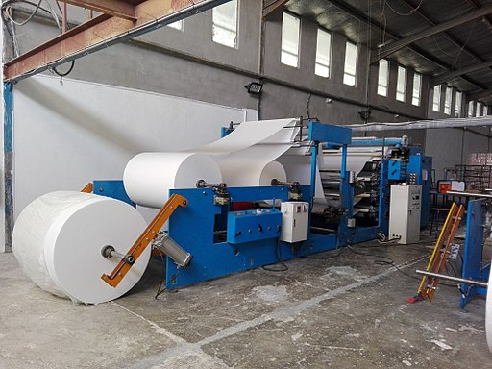
Less Hazardous Chemical Synthesis
Case study: Paper Bleaching
Conventional paper bleaching with Chlorine dioxide (ClO₂):
Produces unacceptable quantities of chlorinated pollutants.
Many of these pollutants are exceptionally toxic.
Alternative technology for paper bleaching with TAML/H₂O₂:
Alternative catalytic breakdown of H₂O₂ provides the oxidative equivalent.
Lower temperature and time requirements.
Image: Wikimedia Commons, Author: Sammutawe

Slide 27
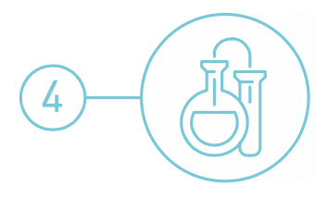
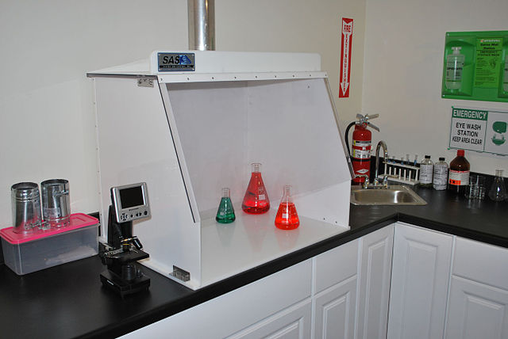
Designing Safer Chemicals
Chemical products should be designed to preserve efficacy of the function while reducing toxicity.
Image: Wikimedia Commons, Author: Sentryair

Slide 28
The modern motto of toxicology:
Designing Safer Chemicals
“Everything is toxic. It is simply depends on the dose”
Often otherwise phrased as
“The dose makes the poison.”
Risk = Hazard x Exposure
Green chemistry and engineering focus on reducing risk by reducing hazard.

Slide 29
Designing Safer Chemicals
Hazard types to avoid:
  Toxicological/Eco-toxicological
    Carcinogenicity
    Reproductive
    Developmental
    Neurological
    Global warming potential
    Ozone depleting potential
    Bioaccumulation
    Persistence
  Physical
    Explosivity
    Flammability
    Corrosivity
Physical/Chemical Properties to consider:
  Water solubility
  Log Kow
  Volatility
  Molar volume
  Aspect ratio
  Radical formation
  Nucleophilicity
  Electrophilicity
  pH/pKa
  Surface area
  Reducing potential
  Oxidizing potential
  Polarizability

Slide 30
Designing Safer Chemicals
Chemists can design chemicals which have reduced toxicity by:
- Manipulation of chemical bonds, chemical functional groups.
  Reactive functional groups have a greater potential to be toxic. Removing these groups is likely to reduce toxicity.
- Elimination of the molecular initiating event that activates pathway
  While difficult to achieve, if the chemical is modified not to interact with the biological pathway, no biological effect is triggered and the toxicity can be avoided.
- Reducing or eliminating bioavailability.
  If a chemical does not absorb into a body, it cannot cause harm.

Slide 31
Designing Safer Chemicals
Case study: Antifoulants
Antifoulants are generally dispersed in the paint as it is applied to the hull. Organotin compounds such as tributyltin oxide (TBTO) have traditionally been used. TBTO works by gradually leaching from the hull and killing the fouling organisms in the surrounding area.
Conventional use of organotin compounds as antifoulants:
TBTO and other organotin antifoulants have long half-lives in the environment (the half-life of TBTO in seawater is over 6 months).
They bioconcentrate in marine organisms (the concentration of TBTO in marine organisms has been found to be up to 104 times greater than in the surrounding water).
Organotin compounds are chronically toxic to marine life and can enter food chain.
They are bioaccumulative.
Tributyltin oxide (TBTO)

Slide 32
Designing Safer Chemicals
Case study: Antifoulants
Alternative antifoulants:
Sea-Nine® 211 works by maintaining a hostile growing environment for marine organisms. When organisms attach to the hull (treated with DCOI), proteins at the point of attachment with the hull react with the DCOI. This reaction with the DCOI prevents the use of these proteins for other metabolic processes. The organism detaches itself and searches for a more hospitable surface to grow upon.
Only organisms attached to hull of ship are exposed to toxic levels of DCOI.
Readily biodegrades once leached from ship (half-life is less than one hour in sea water).

Slide 33
Designing Safer Chemicals
In 2014, the Solberg Company earned an award for its halogen-free RE-HEALING Foams for use in fighting fires. Traditionally, firefighting foams used fluorinated surfactants, persistent chemicals that have the potential for negative environmental impacts.
The RE-HEALING firefighting foam concentrates use a blend of non-fluorinated surfactants and sugars. This works well and with far less environmental impact.
Control, extinguishing time, and burnback resistance are paramount to the safety of firefighters everywhere, and the new foams have excellent performance in each category. The RE-HEALING Foams also achieve full regulatory compliance with existing fire protection standards.
https://www.epa.gov/greenchemistry/presidential-green-chemistry-challenge-2014-designing-greener-chemicals-award

Slide 34
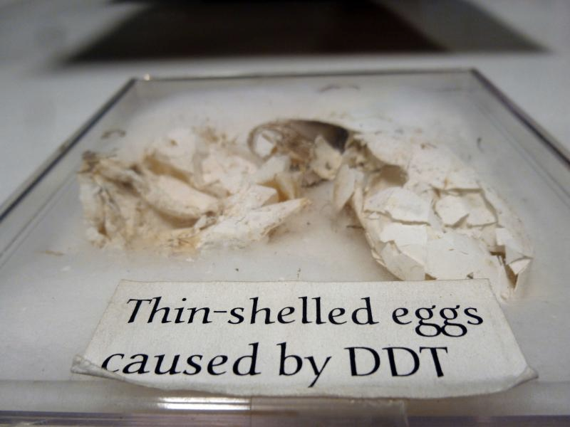
Designing Safer Chemicals
Case study: Pesticides
Conventional use of agricultural pesticide and a malarial control agent Dichlorodiphenyltrichloroethane (DDT):
Carcinogenic.
The threat to wildlife - especially birds – has almost led to the extinction of a bald eagle population.
DDT
Image Source: http://www.avoidingregret.com/2014/06/photo-essay-eggs-and-nests-of-bird.html
Notes:
DDT was used in the second half of World War II to control malaria and typhus among civilians and troops. After the war, DDT was made available for use as an agricultural insecticide and its production and use duly increased. Müller was awarded the Nobel Prize in Physiology or Medicine "for his discovery of the high efficiency of DDT as a contact poison against several arthropods" in 1948
Unfortunately it’s effect on birds was not tested. Research have shown that for certain species, DDT causes the thinning of eggshells which led almost to species extinction.

Slide 35
Designing Safer Chemicals
Case study: Pesticides
Toxicity scorecard
Rat: LD₅₀>5000 mg/kg
Duck: LD₅₀>5000 mg/kg
Fish: LC_{50-96h}=30.0 mg/L
Bee: LD₅₀=0.0025 mg/bee
Alternative (and natural) use of Spinosad for insect control:
  Produced by bacteria Saccharopolyspora spinosa.
  Isolated from Caribbean soil samples (sugar mill).
  It selectively targets nervous system of insects.
  Demonstrates high selectivity, low mammalian toxicity, and a good environmental profile.
  Saccharopolyspora spinosa
  Dow AgroSciences

Slide 36
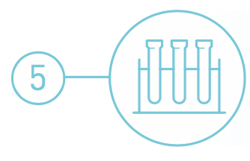
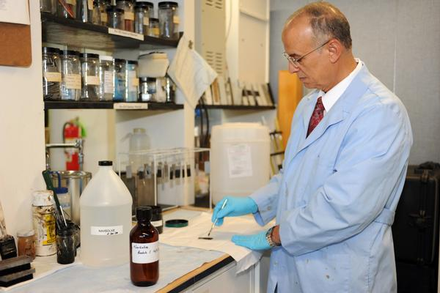
Safer Solvents and Auxiliaries
The use of auxiliary substances (solvents, separation agents, etc.) should be made unnecessary whenever possible and, when used, innocuous.
Image: Dr. El Sayed Arafat from NAWCAD’s Materials Lab, U.S. Navy

Slide 37
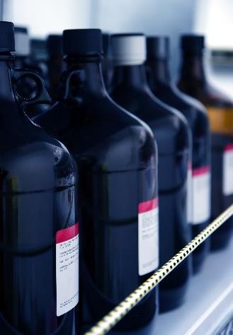
Safer Solvents and Auxiliaries
Solvents account for the vast majority of mass wasted in syntheses and processes. Moreover, many conventional solvents are toxic, flammable, and/or corrosive.
Solvents volatility and solubility have contributed to air, water and land pollution, have increased the risk of workers’ exposure, and have led to serious accidents.
Recovery and reuse, when possible, is often associated with energy-intensive distillation and sometimes cross contamination. In an effort to address all those shortcomings, chemists have started to search for safer solutions.

Slide 38
Safer Solvents and Auxiliaries
Problematic organic solvents
Greener alternatives
Easily separable, safe
Avoidance
Zero
Volatility
Environmentally
benign and safe
No Solvent Supercritical fluids
Water solvent Ionic liquids

Slide 39
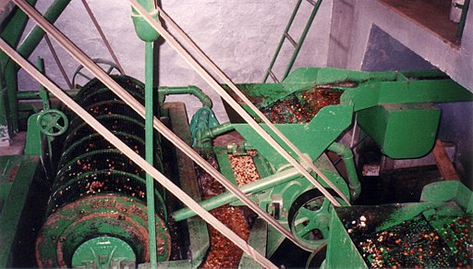
Safer Solvents and Auxiliaries
Case study: Coffee decaffeination
Conventional method of coffee decaffeination:
Coffee decaffeination was performed in a chlorinated organic solvent, dichloromethane (DCM), exposure to which can lead to headaches, mental confusion, nausea, vomiting, dizziness and fatigue.
Coffee beans were heated with steam and then exposed to DCM for decaffeination.
Image: Wikimedia Commons, Coffee Mechanical Separator, Aquapulp

Slide 40
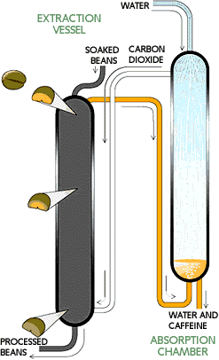
Safer Solvents and Auxiliaries
Case study: Coffee decaffeination
Alternative method for coffee decaffeination:
Soaking green coffee beans in water doubles their size, allowing the caffeine to dissolve into water inside the bean.
Caffeine removal occurs in an extraction vessel (70 feet high,10 feet in diameter), suffused with carbon dioxide at roughly 90 °C and 250 atm. Caffeine diffuses into this scCO₂. The beans enter at the top of the chamber and move toward the bottom over 5 hours.
Decaffeinated beans at the bottom of the vessel are removed, dried and roasted.
Recovery of dissolved caffeine occurs in an absorption chamber. A shower of water droplets leaches the caffeine out of the supercritical carbon dioxide. The caffeine in this aqueous extract is then often sold to soft-drink manufacturers and drug companies. The purified carbon dioxide is recirculated for further use.
Zosel, K. Practical Applications of Material Separation with Supercritical Gases. Angew. Chem., Int. Ed. 1978, 17, 702-709

Slide 41
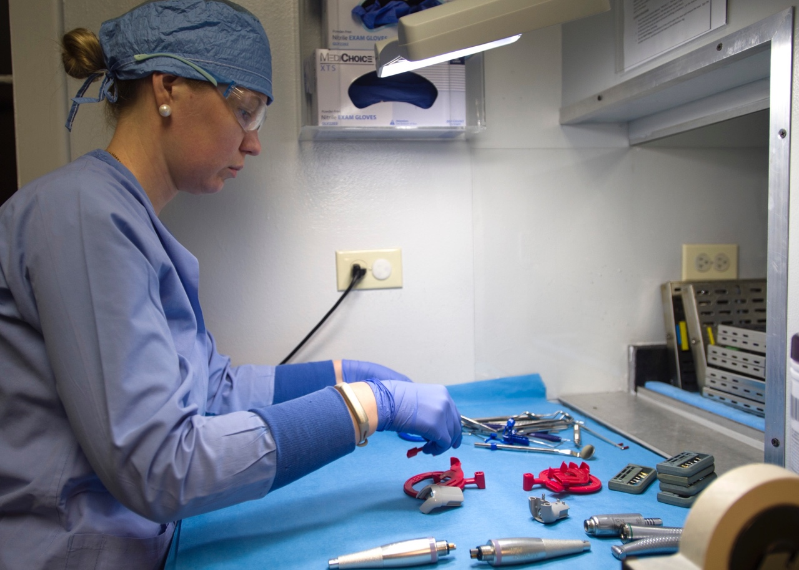
Safer Solvents and Auxiliaries
Case study: Medical sterilization
Conventional medical sterilization:
Delicate biomedical materials such as
vaccines and tissues are conventionally sterilized with ethylene oxide - a carcinogenic, mutagenic, toxic, and flammable gas - or with gamma radiation, which is lethal to all cells.
Both methods damage the materials they are sterilizing.
Ethylene oxide persists in tissue.
Image: Svetlana Pohovey, 359th Medical Group, U.S. Air Force photo/Staff Sgt. Kevin Iinuma

Slide 42
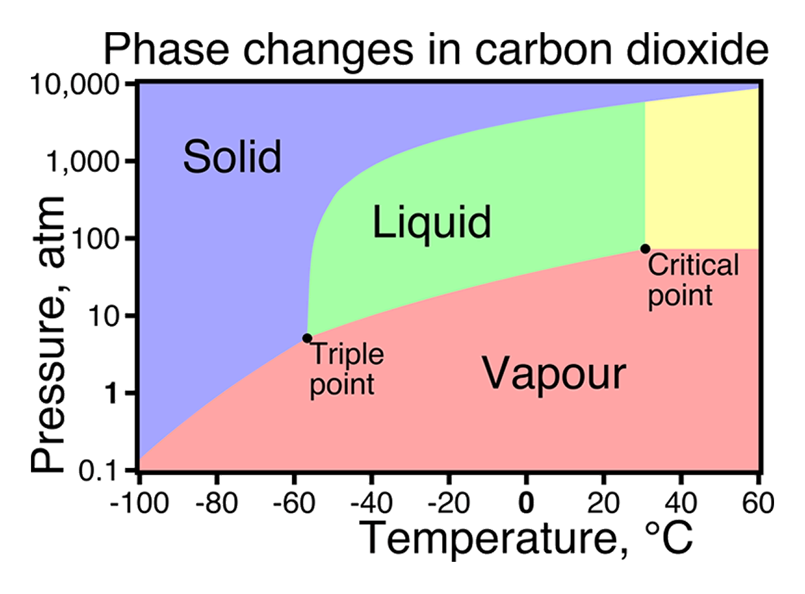
Safer Solvents and Auxiliaries
Case study: Medical sterilization
Alternative medical sterilization:
Development of a supercritical carbon dioxide (scCO₂) based method for sterilization of biological material.
NovaSterilis sterilization uses scCO₂, peracetic acid, and small amounts of water at low temperatures and modest pressures to achieve rapid sterilization of sensitive biomaterials.
NovaSterilis Inc.

Slide 43
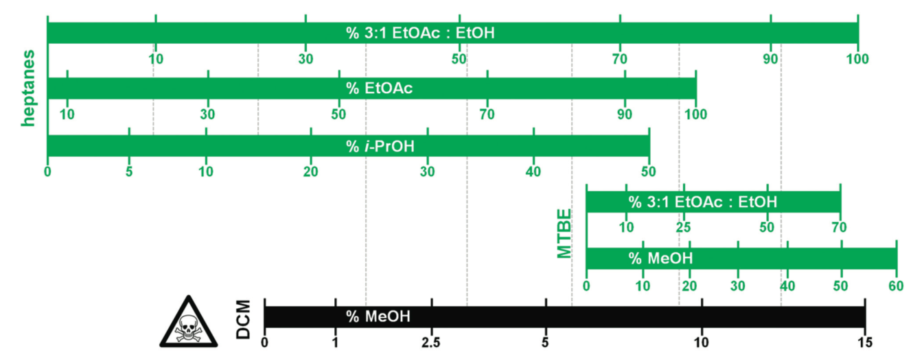
Safer Solvents and Auxiliaries
Case study: Replacing dichloromethane (DCM) in chromatography
Amgen developed a guide to replace DCM with greener alternatives. DCM is known to be associated with respiratory and cardiovascular toxicity in humans, carcinogenicity, and genotoxicity.
The guide on the right compares the eluting power of different greener solvent mixtures with reference to DCM-Methanol.
Amgen’s Green Solvents for Chromatography in practice. If a compound suitably elutes in 5% DCM–MeOH, the bar chart predicts that 60% 3 : 1 EtOAc : EtOH in heptanes or 40% i-PrOH in heptanes would be a suitable starting point to evaluate greener solvent alternatives.

Slide 44
Safer Solvents and Auxiliaries
Case study: Manufacturing process for sertraline, the active ingredient in the popular drug Zoloft®
Zoloft® is an anti-depressant and was once one of the best selling pharmaceuticals on the market.
Conventional sertraline synthesis:
Synthesis was a three step process.
Used 4 hazardous solvents (methylene chloride, tetrahydrofuran, toluene, and hexane).
Zoloft®

Slide 45
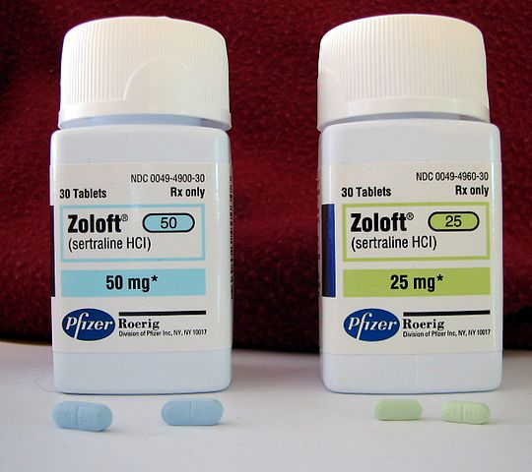
Safer Solvents and Auxiliaries
Case study: Manufacturing process for sertraline, the active ingredient in the popular drug Zoloft®
Alternative sertraline synthesis:
The process was streamlined to a single step that is carried out in ethanol, a much less toxic solvent.
The new process is also catalytic, cutting down on starting materials by 60%, 45%, and 20% for the three components of the reaction.
The combined steps eliminated 310,000 pounds of titanium tetrachloride, 220,000 pounds of 50% sodium hydroxide, 330,000 pounds of 35% hydrochloric acid waste, and 970,000 pounds of solid titanium dioxide waste per year.
Image: Wikimedia Commons, Author: Ragesoss
Pfizer, Inc

Slide 46

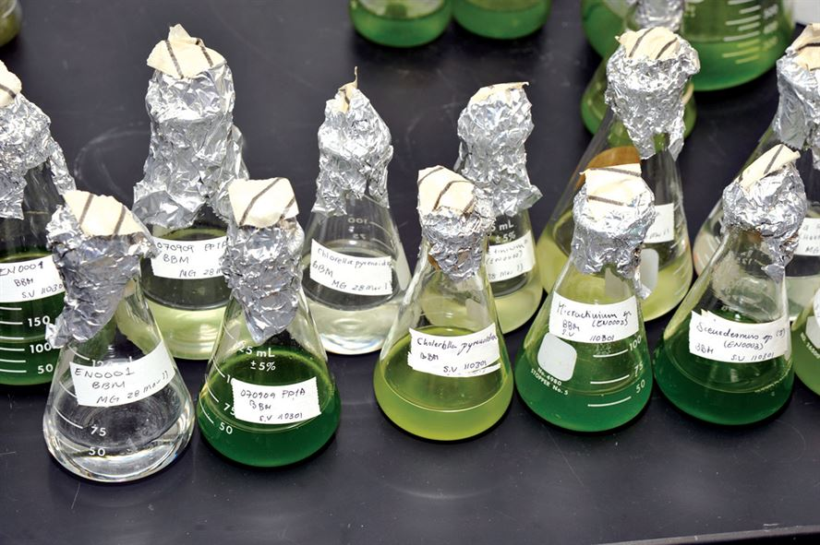
Design for Energy Efficiency
Energy requirements should be recognized for their environmental and economic impacts and should be minimized. Synthetic methods should be conducted at ambient temperature and pressure.
Image: U.S. Air Force photo/Bill Evans

Slide 47
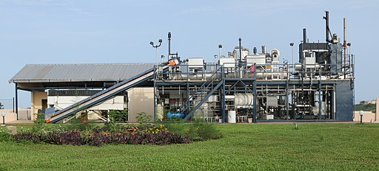
Design for Energy Efficiency
Most energy is used for heating, cooling, separations and pumping.
Ideally, all reactions are performed at ‘ambient’ conditions – room temperature and atmospheric pressure – in order to minimize energy usage.
Image: Wikimedia Commons, Janicki Omni Processor Pilot Plant in Dakar, Senegal , Author: Janicki Bioenergy

Slide 48
Design for Energy Efficiency
Case Study: Atorvastatin
Atorvastatin, a cholesterol-lowering drug, suffers from an energy-demanding synthesis as a result of two cryogenic reactions at - 70 ºC
New biocatalytic synthesis uses enzyme DERA and shortens the process by removing two energy intensive chemical steps.
Notes:
Deoxyribose-5-phosphate Aldolase as a Synthetic Catalyst'

Slide 49
Design for Energy Efficiency
Sono-, microwave-, and photo-assisted chemistry are known to save energy, improve reaction time, and catalytic activity.
Sonochemistry:
Uses of high frequency (20-100 kHz) sound waves to promote chemical reaction.
The collapse of bubbles formed in a solution generates a very high temperature and a higher pressure than conventional heating.
Used in the production of triglycerides from methyl transesterification.
Microwave:
Uses a high-frequency electric field to heat or cool the local environment with electrical charges.
Avoids unnecessarily prolonged residence time at a given temperature.
Photo-assisted:
Naturally occurring, such as using the sun as a catalyst.
Used in photo-driven acylation for the production of valuable synthetic intermediates and commercial fragrances in bulk.
Used by BASF to develop automotive primer coating, a precursor readily able to be crosslinked under photo irradiation, as opposed to its conventional energy-intensive thermally driven variation.

Slide 50
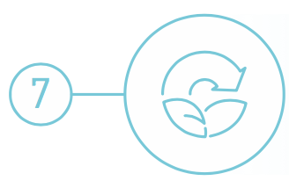
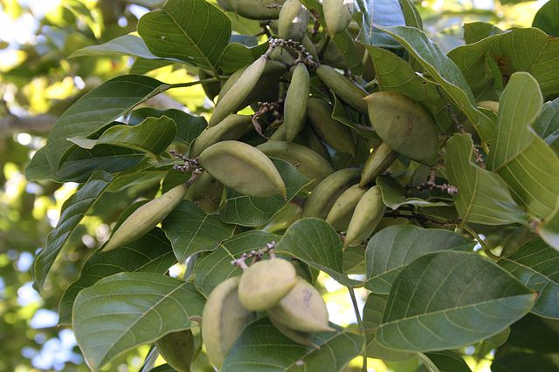
Use of Renewable Feedstocks
A raw material or feedstock should be renewable rather than depleting whenever technically and economically practical.
Image: Wikipedia, Pongamia Pinnata Seeds

Slide 51
Use of Renewable Feedstocks
Biomaterials [Carbohydrates, Proteins, Lipids]
Highly Functionalized Molecules
Petroleum Products [Hydrocarbons]
Functionalized Compounds [Olefins, Alkylchlorides]
Highly Functionalized Molecules

Slide 52
Use of Renewable Feedstocks
Only about 4% utilized by humans
(food, ethanol, sweeteners)
Building blocks for a diverse chemical platform.
Nature’s richest source of aromatic carbon. Used in polymers, adhesives, production of phenolic chemicals.
Converted into polymers, lubricants, and detergents.

Slide 53

Case study: Producing polymers from renewable resources (PHAs)
Use of Renewable Feedstocks
Polyhydroxyalkanoates (PHAs) are a broadly useful family of natural, environmentally friendly, and high-performing, bio-based plastics.
The development of microorganisms that produce polyhydroxyalkanoates (PHAs) are from renewable feedstocks such as cornstarch and cellulose hydrolysate.
The microorganisms have proven to be applicable to conventional commercial equipment and can even be recycled using this same equipment.
They can be used in biodegradable products, such as credit cards.
They are comparable with polyolefins - which are made from petroleum feedstocks - in terms of strength, melting point, and can be manufactured with the existing equipment.
Metabolix
Image: Alpha Stock Images, Author: Nick Youngson

Slide 54
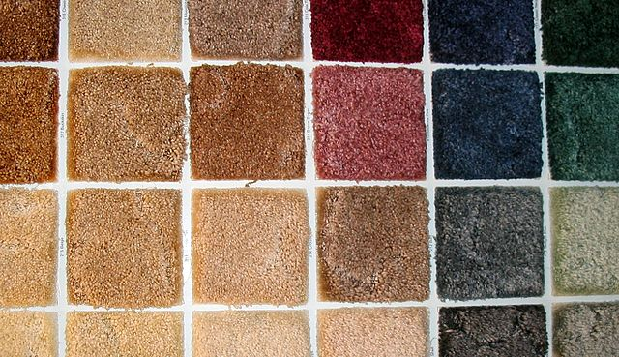
Use of Renewable Feedstocks
Case study: Carpet tile backings
Conventional synthesis:
Carpet tile backings were usually comprised of bitumen, polyvinyl chloride (PVC), or polyurethane - which are all derived from petroleum.
PVC - the most common base for carpet tile backings - is made from vinyl chloride, a toxic substance which releases toxic dioxins and hydrochloric acid as byproducts upon combustion.
Image: Wikimedia Commons, Swatches of Carpet, Author: Quadell

Slide 55
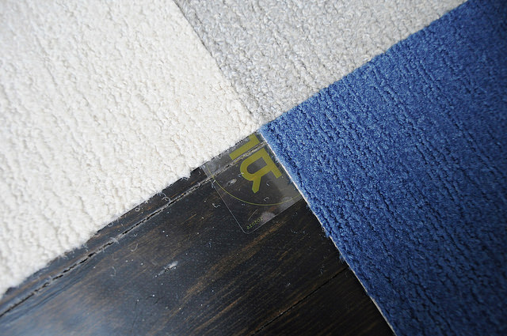
Use of Renewable Feedstocks
Case study: Carpet tile backings
Alternative synthesis:
The development of a new, recoverable carpet backing.
Utilizing a combination of low-toxicity polyolefin resins, the backing can be separated from any fiber and recovered by elutriation, grinding, and air separation.
Collection, transportation, elutriation, and reprocessing is less expensive than using fresh starting material.
Shaw Industries, Inc
Image: Flickr, Author: Emily May

Slide 56
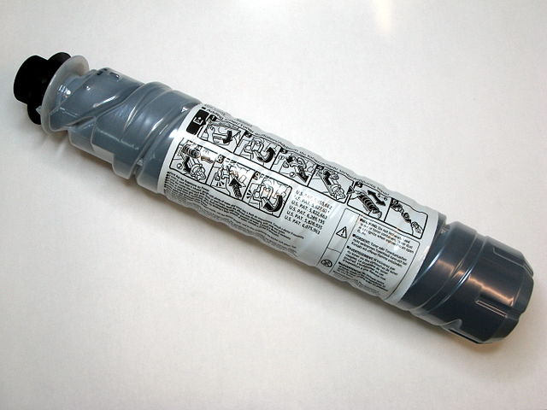
Use of Renewable Feedstocks
Case study: Development and commercialization of toners
Conventional synthesis:
Over 400 million pounds of toner are consumed in the U.S. each year.
Conventional petroleum-based resin toners are difficult to remove from paper, making paper recycling more intensive.
Image: Wikimedia Commons, Black toner container, Author: Adamantios

Slide 57
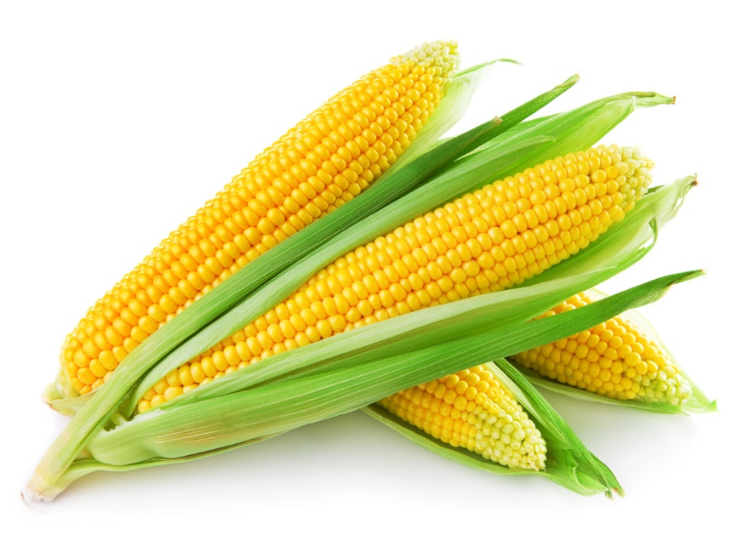
Use of Renewable Feedstocks
Case study: Development and commercialization of toners
Alternative process:
The development of a novel, bioderived printer toner that is easier to deink from paper.
This technology incorporates functional groups in their toners that are susceptible to chemical degradation for recycling.
These toners are biobased, derived from soybean oil and corn.
At 25% market penetration, this technology could reduce CO₂ emissions by 360,000 tons/year.
Battelle

Slide 58
Use of Renewable Feedstocks
Case study: Production of levulinic acid
Levulinic acid is used as a precursor for pharmaceuticals, plasticizers, and various other additives. It is also widely used as a building block or starting material for a wide number of compounds.
Conventional synthesis:
Obtained by heating hexoses (glucose, fructose) or starch in dilute hydrochloric acid or sulfuric acid.
The yield depends on the nature of the acid, acid concentration, temperature, and pressure.
The reaction also produces hard to remove by-products.

Slide 59
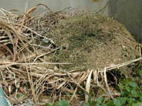
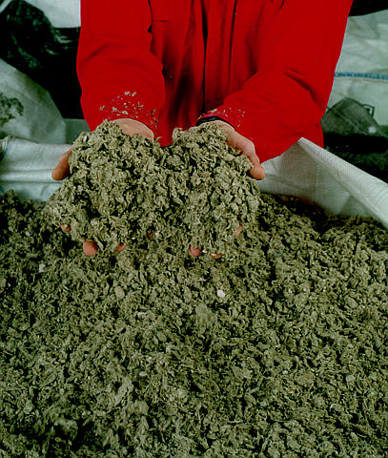
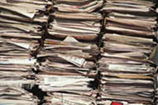
Use of Renewable Feedstocks
Case study: Production of levulinic acid
Agricultural
residues,
waste wood
Alternative synthesis:
Levulinic acid can be obtained from paper mill sludge, agricultural and municipal waste and paper.
Utilizes a high-temperature, dilute-acid hydrolysis process that converts cellulosic biomass.
Municipal solid waste
and waste paper
Levulinic acid
Paper mill
sludge
Biofine, Inc

Slide 60
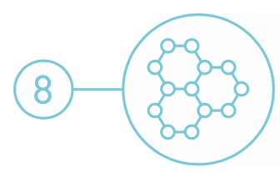
Reduce Derivatives
Unnecessary derivatization (blocking group, protection/deprotection, temporary modification of physical/chemical processes) should be avoided whenever possible.
Image: Wikimedia Commons, Center for Biofilm Research Laboratory Montana State University

Slide 61
Reduce Derivatives
Conventional approach
Substrate
Intermediate A
Intermediate B
Intermediate C
Intermediate D
Intermediate E
Product
Green Chemistry approach
Substrate
Product
Notes:
Whenever possible, limit number of steps and unnecessary transformations. Avoid the use of protecting groups as it requires extra reagents and generates more waste.

Slide 62
Reduce Derivatives
Case study: 6-aminopenicillanic acid
Synthesis of 6-aminopenicillanic acid – core moiety of penicillin
Conventional synthesis of 6-aminopenicillanic acid using 3 steps and intermediate products:
Alternative synthesis using enzyme and fewer derivatives:

Slide 63
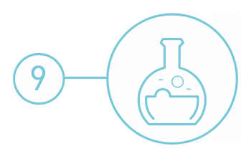
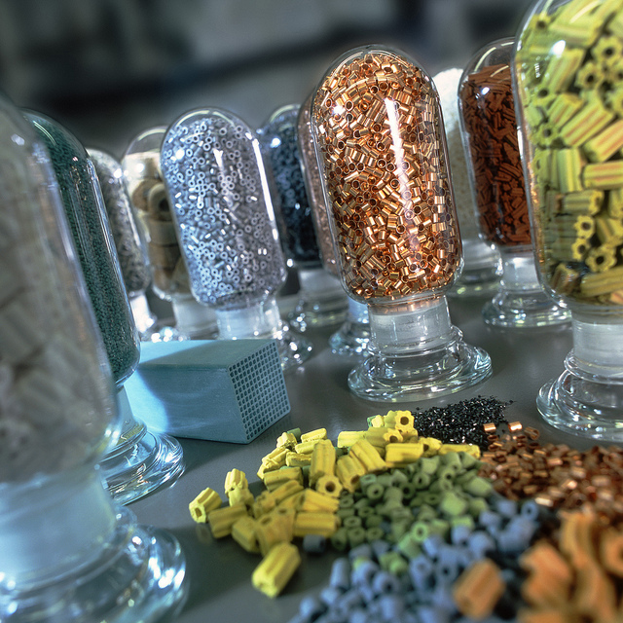
Catalysis
Catalytic reagents (as selective as possible) are superior to stoichiometric reagents.
Image: Flickr, Catalysts, Author: BASF Catalysts

Slide 64
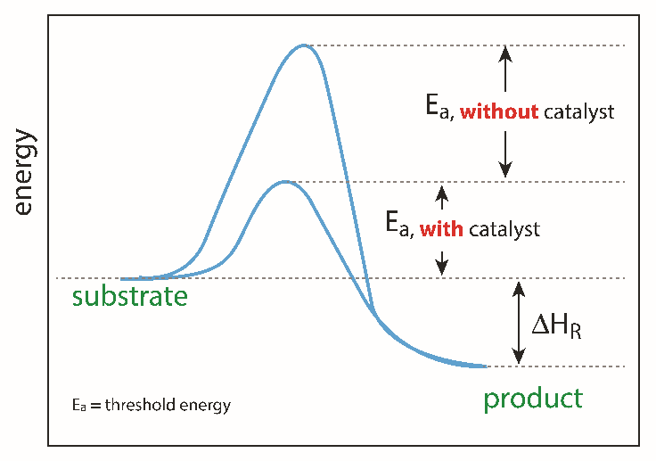
Catalysis
Catalysts can facilitate complex reactions by:
  Lowering the activation energy of the reaction.
  Reducing temperature necessary to achieve a reaction.
  Controlling the site of the reaction (selectivity enhancement).
Image source: Adobe stock
Notes:
Catalysts lower the activation (threshold energy) in the reaction.

Slide 65
Heterogeneous vs Homogeneous
Catalysis
Distinct solid phase
Readily regenerated & recycled
Readily separated
Rates not as fast
Diffusion limited
Sensitive to poisons
Lower selectivity
Long service life
High energy process
Poor mechanistic understanding
Same phase as rxn medium
Expensive and/or difficult to separate
Difficult to separate
Very high rates
Not diffusion controlled
Robust to poisons
High selectivity
Short service life
Mild conditions
Mechanisms well understood

Slide 66
Catalysis
Heterogeneous vs Homogeneous
Distinct solid phase
Readily regenerated & recycled
Readily separated
Rates not as fast
Diffusion limited
Sensitive to poisons
Lower selectivity
Long service life
High energy process
Poor mechanistic understanding
Same phase as rxn medium
Expensive and/or difficult to separate
Difficult to separate
Very high rates
Not diffusion controlled
Robust to poisons
High selectivity
Short service life
Mild conditions
Mechanisms well understood
Green
catalyst

Slide 67
Catalysis
Case study: Green naproxen synthesis
Nonsteroidal anti-inflammatory drug (NSAID) of the propionic acid class (the same class as ibuprofen) that relieves pain, fever, swelling, and stiffness; COX inhibitor
  97% yield in three steps
  Dartt and Davis
Notes:
cyclooxygenase

Slide 68
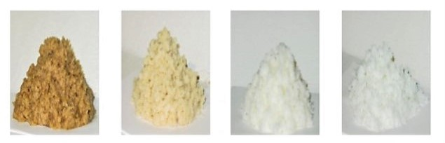
Catalysis
Case study: Paper production
Polyoxometalate (POM) catalysts
  - non-toxic, inorganic cluster compounds
  - selectively delignify wood
  - utilize only air and water
Allows use of oxygen instead of chlorine as the whitener of paper pulp and water as the solvent
Generates only CO₂ and H₂O, instead of chlorinated organics
  Hill, Emory University;
  Hill et al, Nature 2001, 414, 191–195
1st step
2nd step
3rd step
4th step

Slide 69
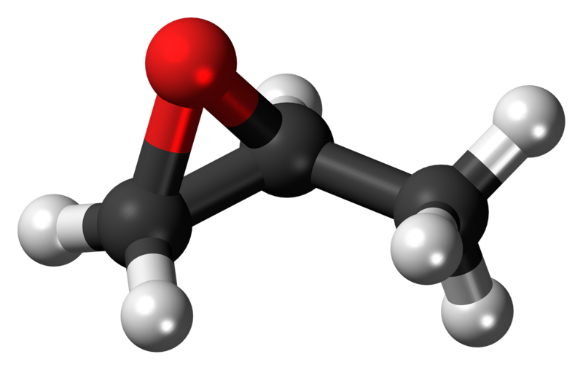
Catalysis
One of Dow Chemical’s awards is for a green catalyst that reduces the environmental footprint associated with producing propylene oxide, one of the biggest volume industrial chemicals in the world. The Hydrogen Peroxide to Propylene Oxide (HPPO) process, which was developed jointly with BASF, serves as a chemical building block for a vast array of products including detergents, polyurethanes, de-icers, food additives, and personal care items. The new process reduces the production of wastewater by as much as 70–80 percent and reduces the use of energy by 35 percent over conventional technologies.
propylene oxide molecule
https://www.epa.gov/greenchemistry/presidential-green-chemistry-challenge-2010-greener-synthetic-pathways-award
Image: Wikipedia, propylene oxide molecule, Author: Jynto

Slide 70
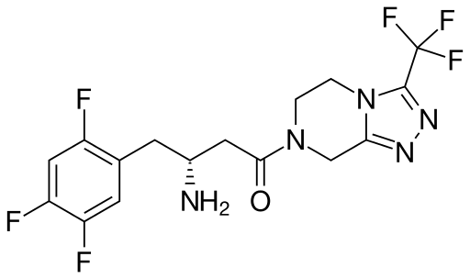
Catalysis
A new catalyst developed by pharmaceutical companies Merck and Codexis for the green synthesis of sitagliptin - the active ingredient in the type 2 diabetes treatment Januvia™ - may also be useful in the manufacturing of other drugs. For example, recent clinical trial showed that it may help patients with acute coronary syndrome.
sitagliptin
https://www.epa.gov/greenchemistry/presidential-green-chemistry-challenge-2010-greener-reaction-conditions-award
Image: Wikipedia, sitagliptin, Author: NEUROtiker

Slide 71
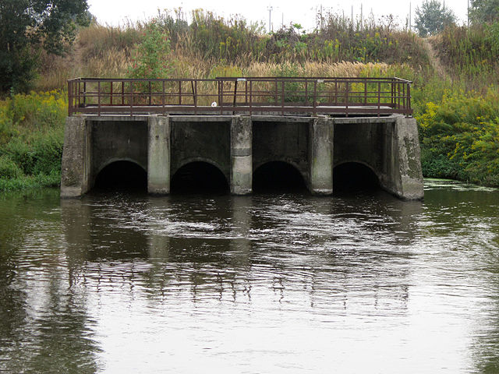
Catalysis
An example of green catalysts with the potential to reduce the pharmaceutical industry’s environmental impact is the powerful series of tetra-amido macrocyclic ligand (TAML) catalysts modelled on natural peroxidase enzymes developed by Terry Collins of Carnegie Mellon University. Collins thinks that using the catalysts at a late stage in the sewage treatment process would allow them to break down a wide variety of chemical residues - including those from Lipitor, Prozac, Zoloft, the contraceptive pill, and more - before they enter the environment.
https://www.epa.gov/greenchemistry/presidential-green-chemistry-challenge-1999-academic-award
Image: Wikicommons, Pipes of the Minsk sewage treatment plant, Author: Homoatrox

Slide 72

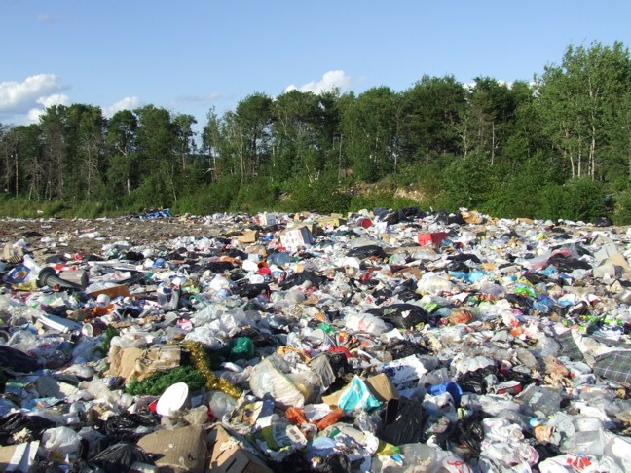
Design for Degradation
Chemical products should be designed so that at the end of their function they do not persist in the environment and instead break down into innocuous degradation products.
Image: Wikicommons, a landfill in Dryden, Ontario, Author: Michelle Arseneault

Slide 73
Design for Degradation
Early examples:
  Sulfonated detergents
    Alkylbenzene sulfonates – 1950’s & 60’s
    Foam in sewage plants, rivers, and streams
    Persistence was due to long alkyl chain
    Introduction of an alkene group into the chain increased degradation
  Chlorofluorocarbons (CFCs)
    Do not break down, persist in atmosphere and contribute to destruction of the ozone layer.
  DDT
    Bioaccumulate and cause thinning of egg shells

Slide 74
Design for Degradation
Case study: Plasticizers
Plasticizers for plastics are additives, most commonly phthalate esters in PVC applications. Almost 90% of plasticizers are used in PVC, giving this material improved flexibility and durability. The majority of PVC is used to produce films and cables.
Conventional plasticizers, such as DiNP, are an additive used to soften plastics:
DiNP exposure has been linked to liver toxicity, endocrine disruption, and carcinogenicity.
The additives persist in the environment.

Slide 75
Design for Degradation
Case study: Plasticizers
Alternative plasticizers, such as isosorbide diester, can be derived from starch:
Offers 1 to 1 substitution of DiNP in plastics.
Isosorbide diester is thermally stable and biodegradable.

Slide 76
Design for Degradation
Case study: Plastics
Conventional plastics (PET) are made from petroleum:
PET Plastic persists in the environment
It is made from depleting resources
Petroleum
high temperature
vacuum
catalyst

Slide 77
Design for Degradation
Case study: Plastics
Alternative process:
Synthesis of PolyLactic Acid (PLA) from starch:
The development of a biobased, compostable, and recyclable polylactic acid (PLA) polymer that uses 20–50 percent less fossil fuel resources than comparable petroleum-based polymers.
It is the first family of polymers derived entirely from renewable resources that can compete cost-effectively with traditional fibers and plastic packaging materials.
The manufacturing process consists of three solvent-free steps that lead to the production of lactic acid, lactide, and PLA high polymer with very high yields and internal recycling schemes that reduce waste.
PLA is fully biodegradable or can be readily hydrolyzed into lactic acid for recycling back into the process.
Cargill Dow LLC

Slide 78
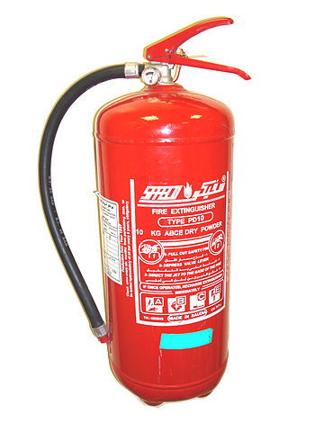
Design for Degradation
Case study: Fire extinguishers
Conventional approaches:
Chemical additives or alternatives to water for firefighting applications can have negative long-term environmental and health effects.
Halon gases are destructive to the ozone layer.
Aqueous film-forming foams release both toxic hydrofluoric acid and fluorocarbons when used.
Fluorosurfactant compounds are resistant to microbial degradation, often leading to contamination of groundwater supplies and failure of wastewater treatment systems.
Image: Wikimedia Commons, Author: Caduser2003

Slide 79
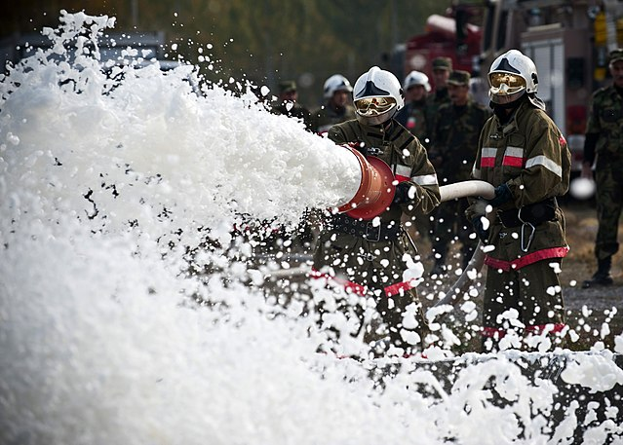
Design for Degradation
Case study: Fire extinguishers
Alternative production:
The development of a fire extinguishing foam that is nontoxic and highly biodegradable.
PYROCOOL F.E.F. (Fire Extinguishing Foam) is an alternative formulation based on a biodegradable surfactant.
PYROCOOL F.E.F. has a low application volume.
Extinguishing an oil tanker fire estimated to take 10 days can be put out in 12.5 minutes.
Image: Wikimedia Commons, Kyrgyz Republic firefighters, Author: Senior Airman Brett Clashman, U.S. Air Force

Slide 80


Real-time Analysis for Pollution Prevention
Analytical methodologies need to be further developed to allow for real-time in-process monitoring and control prior to the formation of hazardous substances.
Image: Wikimedia Commons, Author: Hindustanilanguage

Slide 81


Real-time Analysis for Pollution Prevention
Real time analysis for a chemist is the process of “checking the progress of chemical reactions as it happens”.
Knowing when your product is “done” can save a lot of waste, time, and energy!

Slide 82
The Role of Analytical Chemistry
Real-time Analysis for Pollution Prevention
Analytical chemistry has been at the heart of the environmental movement since its inception. It’s been used in:
    Identification
    Monitoring
    Measurement
    Characterization

Slide 83

What Does Green Analytical Chemistry Mean?
Real-time Analysis for Pollution Prevention
Green Chemistry is applicable to all chemical processes, including the methods, protocols and processes of environmental analytical chemistry.
Image: Wikipedia

Slide 84

Examples of Green Analytical Chemistry Methodologies
Real-time Analysis for Pollution Prevention
X-ray fluorescence detection for multi-metal matrix
Solid-phase extraction and micro-extraction
Supercritical Fluid Extraction
Image Sources: https://www.thermofisher.com, https://www.intechopen.com/books/herbicides-advances-in-research/recent-advances-in-the-extraction-of-triazines-from-water-samples, http://soviethammer.info/thlon/s/supercritical-fluid-extraction-co2/

Slide 85

Process Analytical Chemistry to Minimize Waste Generation
Real-time Analysis for Pollution Prevention
Through the use of real-time, in-process monitors, sensors, etc., pollution and hazardous waste generation can be prevented rather than simply measured after it is produced.
Solid-acid catalyzed 1-butene/isobutane alkylation process:
  replaces HF and H₂SO₄ catalysts
  process utilizes supercritical CO₂ to prevent coke accumulation in pores of solid catalyst
  on-line GC analysis
Subramaniam, University of Kansas
Ind. Eng. Chem. Res., 2001, 40 (18), pp 3879–3882
Image: Wikimedia Commons, Author: Smokefoot
Notes:
Alkylation of isobutane with n-butenes to form highly branched isoparaffins is an important process in gasoline manufacture. This reaction is currently catalyzed using either liquid hydrofluoric acid or sulfuric acid. Although these liquid acids rapidly catalyze the alkylation reaction, there are a number of drawbacks associated with their use. Solid acids have been studied extensively as possible catalysts for alkylation. However, with solid acid catalysts, the catalyst deactivates rapidly with time on stream. It is been hypothesized and shown that when the reaction is carried in supercritical media, the solid acid catalyst deactivation slows down considerably; however, high temperatures are needed to bring the reaction mixture to supercritical conditions, which results in the formation of undesired products. In this study, the effects of using different operation conditions for alkylation on a USY zeolite were investigated. It was observed that the deactivation rate was slower in supercritical-phase alkylation. Carbon dioxide was used as a diluent to lower the critical temperature of the reaction mixture in the ratio 27/9/1 for carbon dioxide/isobutene/1-butene. The use of diluent favored both alkylate selectivity and coke precursor removal.

Slide 86
Continuous Flow Reactors
Real-time Analysis for Pollution Prevention
Replacing batch reactors on large, medium, and even small scale has distinct advantages:
  Precise control of reaction conditions.
  Reproducible reaction outcome (product purity).
  Minimizes waste, and provides increased safety.
Image Sources: http://encyclopedia.che.engin.umich.edu/Pages/Reactors/menu.html, https://www.technologynetworks.com/drug-discovery/product-news/automated-compound-library-production-294622

Slide 87

Real-time Analysis for Pollution Prevention
Case study: Real-time analysis in cooling systems
Conventional Cooling Systems:
They consume large amounts of water.
Microbial growth and mineral scale decrease the efficiency and increase energy consumption of heat-exchange.
However, high levels of biocide to prevent microbial growth increases the risk of leaks in the system.
Biocide and metal-byproducts from corrosion are then released into the environment with the waste water.
https://www.epa.gov/greenchemistry/presidential-green-chemistry-challenge-2008-greener-reaction-conditions-award
Image: Wikimedia Commons, Cooling tower and cooling water discharge at a Philippsburg nuclear power plant, Author: Michael Kauffmann

Slide 88

Real-time Analysis for Pollution Prevention
Case study: Real-time analysis in cooling systems
In 2008 Naclo Company won the EPA Greener Reaction Conditions Award for their innovative 3D TRASAR® Technology.
Alternative Cooling System with 3D TRASAR® Technology:
The 3D TRASAR® System allows for the real-time monitoring of mineral scale buildup.
This system can also utilize poor-quality water.
3D Scale Control prevents mineral scale formation to increase efficiency.
3D Bio-control performs a real-time check for planktonic and sessile bacteria. This reduces the amount of biocide used since biocides are then added only when necessary, rather than on a set schedule.
The 3D TRASAR® System greatly reduces the amount of wastewater discharged from cooling systems.
https://www.epa.gov/greenchemistry/presidential-green-chemistry-challenge-2008-greener-reaction-conditions-award
Image: Wikipedia, A lavender-colored nonpotable water pipeline in Mountain View, California, Author: Grendelkhan

Slide 89


Inherently Safer Chemistry
for Accident Prevention
Substance and the form of a substance used in a chemical process should be chosen so as to minimize the potential for chemical accidents, including releases, explosions, and fires.
Image: Flickr, Author: sea turtle

Slide 90
Inherently Safer Chemistry
for Accident Prevention
Accidents can be avoided by minimizing hazards
Approaches to design safer chemistry can include the use of solids or low vapor pressure substances in place of volatile liquids.
Other approaches include avoiding the use of molecular halogens in large quantities.
Continuous flow processes can help to minimize chemical hazards.

Slide 91
Inherently Safer Chemistry
for Accident Prevention
Case study: Designing safer polymers for use in airplanes
Polyhydroxyamide (PHA):
Can be molded into seats, bins, and wall panels.
It is synthesized under mild conditions.
It decomposes into fire-resistant polybenzoxazole (PBO) and water upon heating.
  Westmoreland, UMass Amherst
Image Source: https://videohive.net/item/plane-interior-flying-in-the-clouds/9895121

Slide 92


Inherently Safer Chemistry
for Accident Prevention
Tragedy in Bhopal, India - 1984
In arguably the worst industrial accident in history, 40 tons of methyl isocyanate were accidentally released when a holding tank overheated at a Union Carbide pesticide plant, located in the heart of the city of Bhopal. 15,000 people died and hundreds of thousands more were injured.
Chemists try to avoid things that explode, light on fire, are air-sensitive, etc.
When these things happen in the “real world”, lives are lost.
methyl isocyanate
Image: Wikimedia Commons, Bhopal Plant in 2010, Author: Julian Nitzsche

Slide 93
Inherently Safer Chemistry
for Accident Prevention
Tragedy in Bhopal, India - 1984
December 3, 1984 – toxic gas leaked from a Union Carbide factory, killing thousands instantly and injuring many more (many of who died later of exposure). Up to 20,000 people have died as a result of exposure (3-8,000 instantly). More than 120,000 still suffer from ailments caused by exposure
What happened?
Methyl isocyanate - used to make pesticides - was being stored in large quantities on-site at the plant.
Methyl isocyanate is highly reactive, exothermic molecule.
Most safety systems either failed or were inoperative.
Water was released into the tank holding the methyl isocyanate.
The reaction occurred and the methyl isocyanate rapidly boiled, producing large quantities of toxic gas.

Slide 94
Inherently Safer Chemistry
for Accident Prevention
Case study: Production of gasoline alkylate with AlkyClean® Technology
In 2016 Albemarle and CB&I won the EPA green chemistry award for their inherently safer AlkyClean® process technology.
AlkyClean® Technology:
The AlkyClean® solid acid alkylation process produces high quality alkylate without using liquid acid catalysts.
The solid acid alkylation process is safer for both people working directly in production and for people in the area surrounding the production facility.
There are also environmental and economic benefits since neither acid-soluble oils nor spent acids are produced.
Conventional alkylate production:
Alkylate is typically produced from the reaction of isobutane and light olefins.
This requires the use of liquid acid catalyzed processes, such as hydrofluoric acid.
Hydrofluoric acid is extremely toxic. When released it forms clouds that can be lethal for up to five miles.

Slide 95
More examples available
Inherently Safer Chemistry
for Accident Prevention
Presidential Green Chemistry Challenge Winners
https://www.epa.gov/greenchemistry/presidential-green-chemistry-challenge-winners
How Industrial Applications in Green Chemistry Are Changing Our World (white paper) by American Chemical Society

Slide 96
Synthesis Comparison Exercise
Inherently Safer Chemistry
for Accident Prevention
Dihydropyrimidone is a pharmaceutical compound that displays medicinal properties as vasodilatory calcium-channel blockers and anti-viral, anti-bacterial, and anti-inflammatory agents. More than one synthetic schemes have been proposed for its synthesis since the late 1800s. Compare the two synthetic routes and analyze which pathway is greener. In your argument, be sure to consider and compare all aspects of the reaction.

Slide 97
Sponsored by Yale-UNIDO Initiative
QUESTIONS?
CENTER for GREEN CHEMISTRY
and GREEN ENGINEERING at YALE

