Slide 1
Train-the-Facilitator 5-day Workshop
GLOBAL GREEN CHEMISTRY INITIATIVE
CENTER for GREEN CHEMISTRY
and GREEN ENGINEERING at YALE

Slide 2
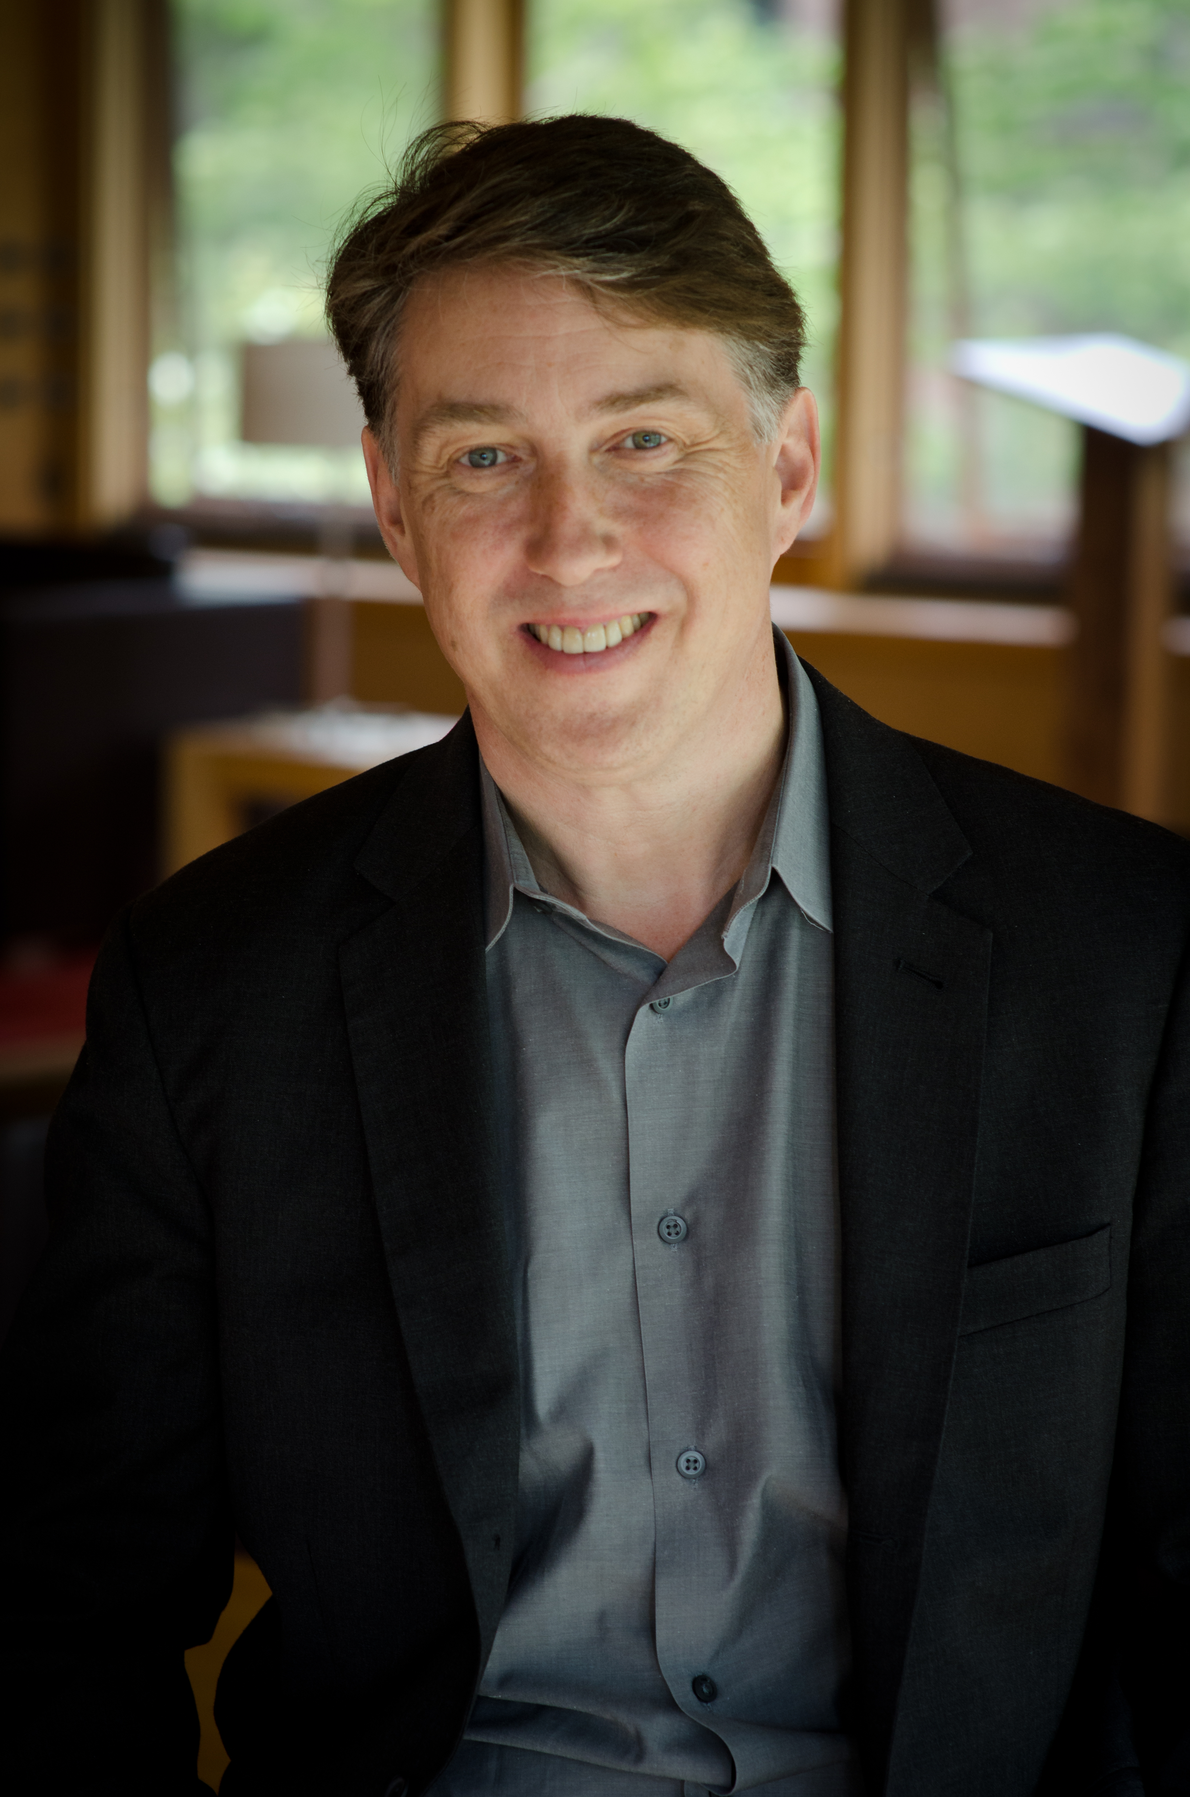
Professor Paul T. Anastas
Teresa and H. John Heinz III Chair in Chemistry for the Environment at Yale University
Known as the ‘Father of Green Chemistry’
Green Chemistry: Theory and Practice.
Anastas, P. T., & Warner, J. C. (2000)
Published over 150 research papers and 14 books
Program Lead & Team Leader,
Global Green Chemistry Initiative [GGCI]
Founding Director, Center for Green Chemistry & Green Engineering at Yale

Slide 3
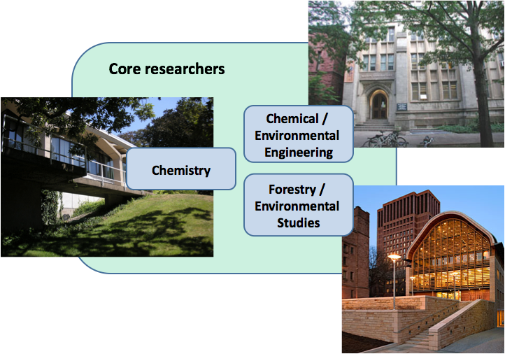
CENTER for GREEN CHEMISTRY and GREEN ENGINEERING at YALE
Affiliated with Schools of
Law, Medicine, Divinity,
Management, & Architecture

Slide 4
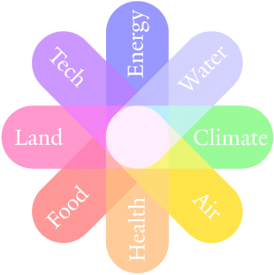
Multidisciplinary Approach
Addressing some of the world’s most pressing challenges at the nexus of resource issues

Slide 5
The Objectives of the Center for Green Chemistry & Green Engineering at Yale
Advancing the Science
Basic research
Technical workshops
Research tools
Promote research investment
Advance the research agenda
Catalyzing Implementation
Industrial partnerships
Policy advancement
Benchmarking
Roundtables
Assessment protocols
Preparing the Next Generation
Education materials
Yale courses
Training trainers
Graduate workshops
Faculty training
Raising Awareness
Conferences/symposia
Books
Multi-media
Web presence
Public engagement

Slide 6
Areas of Research Interest
INTEGRATED
BIOREFINERY
NOVEL SORBENT
MATERIALS
DESIGNING SAFER
CHEMICALS
OPTIMIZING THE
ENERGY-WATER NEXUS
WASTE
VALORIZATION
EARTH-ABUNDANT
GREEN CATALYSTS

Slide 7
Raising Awareness & Preparing the Next Generation
Practitioners
Graduate students
Teachers
NGO’s
Policy makers
General public
Scientists
Undergraduate students
Industry partners
Other Centers
Government
For more information, please go to https://greenchemistry.yale.edu/
Notes:
Advance the science.
Prepare the next generation.
Catalyze Implementation.
Raise awareness.

Slide 8
GLOBAL GREEN CHEMISTRY INITIATIVE
MISSION:
To increase the general global awareness and capacities on deployable Green Chemistry approaches for the design of products and processes that advance global environmental benefits throughout their life cycles.
BRAZIL, COLOMBIA, EGYPT, SERBIA, SOUTH AFRICA, SRI LANKA

Slide 9
Project Activities
1-Day Awareness Raising Workshops
5-Day Train-the-Facilitators Workshops
To strengthen national and regional Green Chemistry initiatives in partnering countries and to enable partners to become hubs for education and training in Green Chemistry
University Curriculum
To educate the new generation of chemists in Green Chemistry
Technology Compendium
A systematic review of current Green Chemistry technologies
Guidance Document
A roadmap to Green Chemistry implementation for different stakeholders

Slide 10
What can you expect?
Examples, case studies, exercises, discussions, work in teams/groups.
To maximize workshop’s impact, active engagement is a key.
Overview
Examples of Green Chemistry
Fundamentals
of
Green Chemistry
Partner’s Content
Putting
Green Chemistry
into Practice

Slide 11
5-Day Train-the-Facilitators Workshops
DAY 1
Sustainability
Disasters & Unintended Consequences
Day 2
Green Chemistry – Definition and Principles
Feedstocks
Day 3
Catalysis, Solvents
Waste, Metrics
Day 4
Theory to Practice, Innovation
Design for Reduced Hazard
Day 5
Partner's Case Studies
Lessons Learned

Slide 12
At the end of the workshop, you will:
Have an in-depth understanding of Green Chemistry, including origins, technologies and how it drives environmental and economic goals for societal benefit.
Be a green chemistry facilitator and be able to disseminate green chemistry to your networks by using practical and tangible examples that encourage the change.
Be connected to other like-minded people who embrace green chemistry as a solution.

Slide 13
Your Instructors
Fill as appropriate

