Slide 1
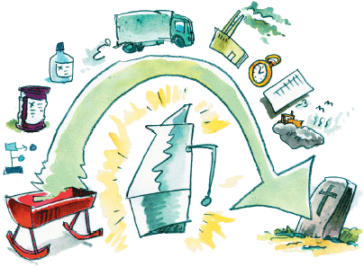
Reporting and Metrics
Cradle to Grave
Cradle to Shelf
Comprehensive Evaluation of Impact
Source: Wikipedia

Slide 2
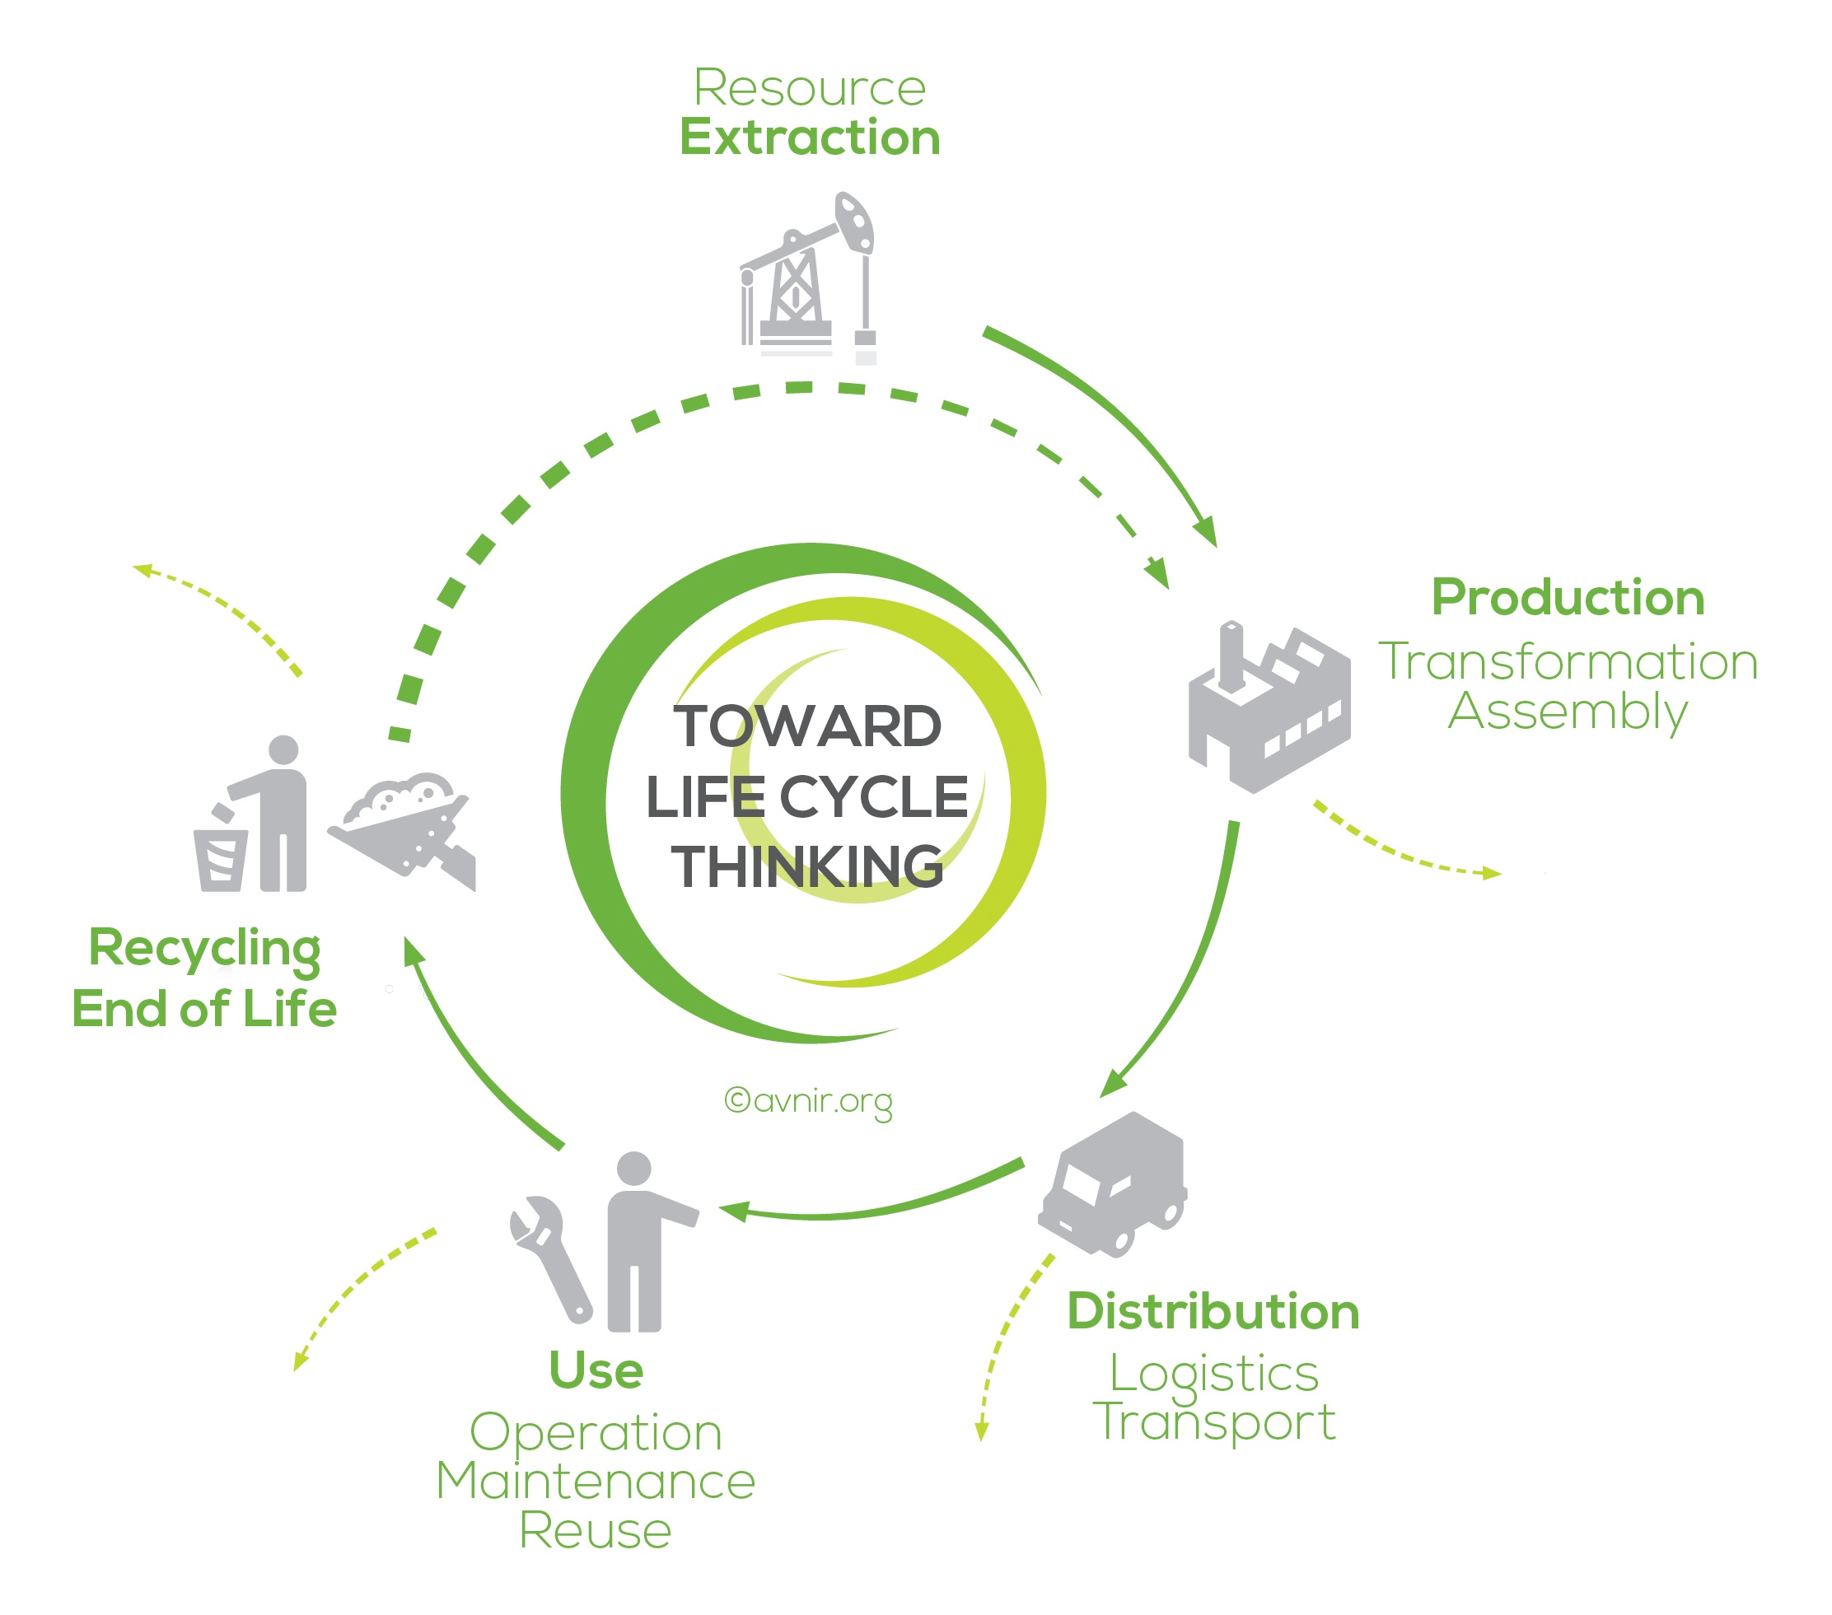
Life-Cycle Assessment
A life-cycle assessment (LCA, also known as life-cycle analysis, ecobalance, and cradle-to-grave analysis) is a technique to assess environmental impacts associated with all the stages of a product's life from-cradle-to-grave (i.e., from raw material extraction through materials processing, manufacture, distribution, use, repair and maintenance, and disposal or recycling).
http://www.avnir.org/EN/

Slide 3
Life-Cycle Assessment
Two attributes make LCA distinct and useful as an analytical tool:
  Whole system consideration of the total product life-cycle.
  Presentation of tradeoffs among multiple environmental issues.
LCA is quantitative (within limits)

Slide 4
ISO
ISO is an independent, non-governmental international organization with a membership of 162 national standards bodies.
It is an organization setting international standards.
ISO also publishes technical reports, technical specifications, publicly available specifications and guides.

Slide 5
Scope of ISO 14040
ISO 14040 contains general information on:
  Goal and scope of LCA
  LCI phase
  LCIA phase
  Interpretation phase
  Reporting and critical review
  Limitations
  Relationship between phases
  Conditions for use of value choices and optional elements
Normative references: Need to use 14044 to apply 14040
Phases of an LCA

Slide 6
The Four Steps of an LCA
Goal and Scope Definition (ISO 14040)
The Life-Cycle Analysis also called Life Cycle Inventory (ISO 14041) - What are the energy, raw materials, emissions, and wastes? What data is needed?
Life-Cycle Impact Assessment (ISO 14042) - Assess environmental impacts identified in the life-cycle inventory.
Life-Cycle Improvement - (ISO 14043) Identify opportunities to reduce the environmental impacts by modification of the life-cycle inventory.
ISO1400 link provided for reference only.
Phases
  Portions of LCA procedure
Goal and Scope
Interpretation
Inventory Analysis
Impact Assessment

Slide 7
Phase 1: Goal and Scope
Goal
Goal statement is the first component of an LCA and guides much of the subsequent analysis
Goal must state:
Intended use
Reasons for study
Audience
Whether comparative and disclosed to public
Scope
Scope provides background information, details methodological choices, and lays out report format
Scope includes:
Product system
Functions of systems
Functional unit
System boundary
Allocation procedures
Impact categories, assessment
method and interpretation type
Scope follows the goal and provides background information, details methodological choices, and tells how the report will be formatted.
  Data requirements
  Assumptions
  Limitations
  Initial data quality requirements
  Type of critical review, if any
  Type and format of report

Slide 8
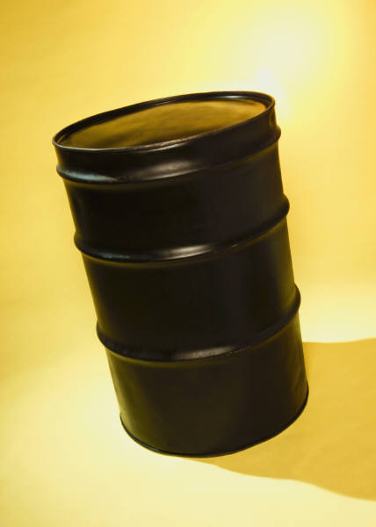
Functional Unit
functional unit = 1 barrel of toluene
Synthesis | I_{AP} | I_{GW} | I_{INHT} | I_{INGT} | I_{OD} | I_{SF} | PER t_{1/2}, h | ACCU logK_{ow} | I_{AD}
route A
route B
route C

Slide 9
Functional Unit
functional unit = 100 hectares of pest-free land
Cmpd | Mass req’d | I_{AP} | I_{GW} | I_{INHT} | I_{INGT} | I_{OD} | I_{SF} | PER t_{1/2}, h | ACCU logK_{ow} | I_{AD}
A | 1 kg
B | 5 kg
C | 0.4 kg

Slide 10
Phase 2: Life Cycle Inventory (LCI)
  Data collection
  As much input and output data as possible is collected
  Can be presented in report or kept private, if confidentiality agreements warrant
  Useful for other researchers that could use that data

Slide 11
An input/output analysis is required for each process.
Phase 2: Life-Cycle Inventory
Data Needs Input/Output Analysis
Inputs
Outputs
Raw Material Acquisition
Water
Effluent
Airborne
Emissions
Solid Wastes
Other
Environmental
Releases
Useable
Products
Manufacturing, Processing, & Formulation
Energy
Distribution & Transportation
Use/Re-Use/Maintenance
Raw Materials
Recycle
Waste Management
System Boundary

Slide 12
Phase 2: Life-Cycle Inventory
Each process is subdivided into the unit processes/steps, where a detailed input/output analysis is conducted.
Process materials,
reagents, solvents, &
catalysts (including
reuse & recycle
from another stage).
Energy
Raw Material Inputs
Reuse/Recycle
Includes reuse
and recycle of
materials from
another stage.
Unit Process
Primary Product
Useful Co-Product
Waste
Fugitive &
Untreated Waste
Treatment &
Disposal

Slide 13
Phase 3: Life Cycle Impact Assessment (LCIA)
  Conversion of inventory data into environmental impact potentials
  Impact categories, indication, and characterization models are chosen
  Data are grouped based on potential to cause certain environmental impacts (classification)
  Input and output quantities converted to potential impacts based on characterization factors (characterization)
  Optional steps: Normalization, grouping, weighting
Potential = P = potential for harm per gram of compound, relative to a reference compound
Index = I = harm for the whole process
I = P • m

Slide 14
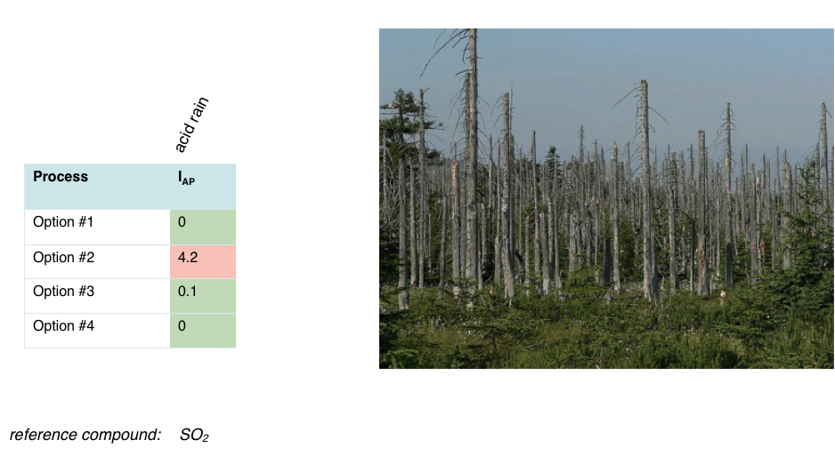
Phase 3: Life Cycle Impact Assessment (LCIA)
AP_{i} =
α_{i}/MW_{i}
I_{A} = Σ AP_{i} • m_{i}
α_{SO2}/MW_{SO2}
i

Slide 15
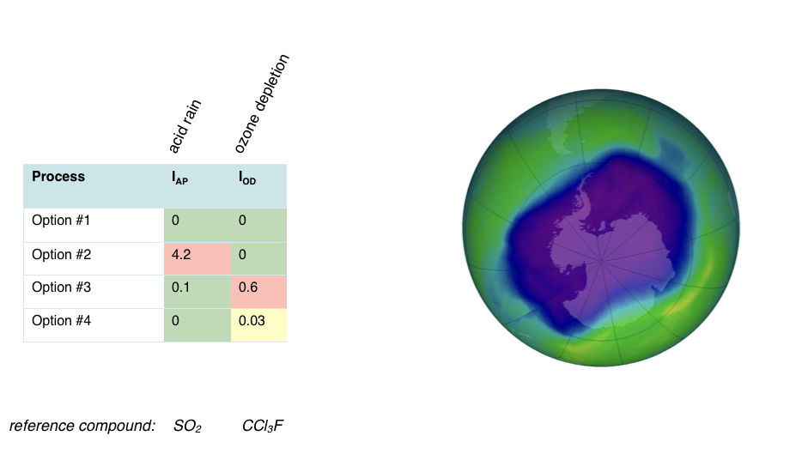
Phase 3: Life Cycle Impact Assessment (LCIA)
ODP_{i} =
δ[O₃]_{i}
I_{OD} = Σ ODP_{i} • m_{i}
δ[O₃]_{CCl3F}
i

Slide 16
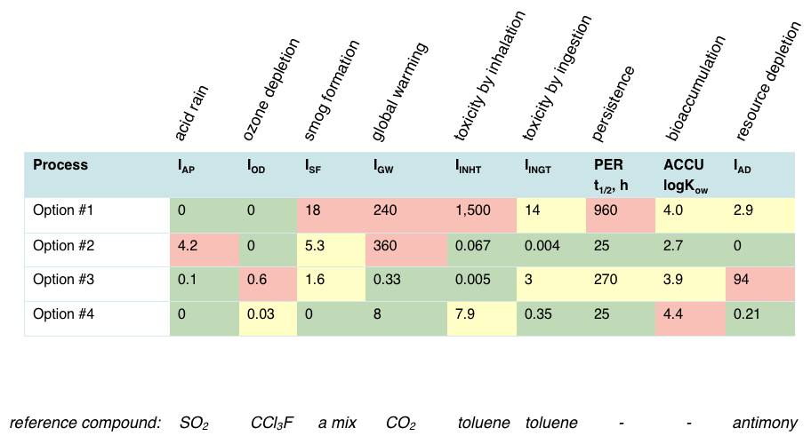
Phase 3: Life Cycle Impact Assessment (LCIA)

Slide 17
Phase 4: Interpretation
Continually ongoing during assessment to help guide other phases.
Discussion of inventory analysis and impact assessment results in LCA study.
Can be modeled as conclusions and recommendations to the decision maker.
Should be consistent with and based on goal and scope of the study.
Should reflect the various uncertainties inherent in LCA including:
  LCA is based on a relative approach using a functional unit.
  Impacts are “potential”.

Slide 18

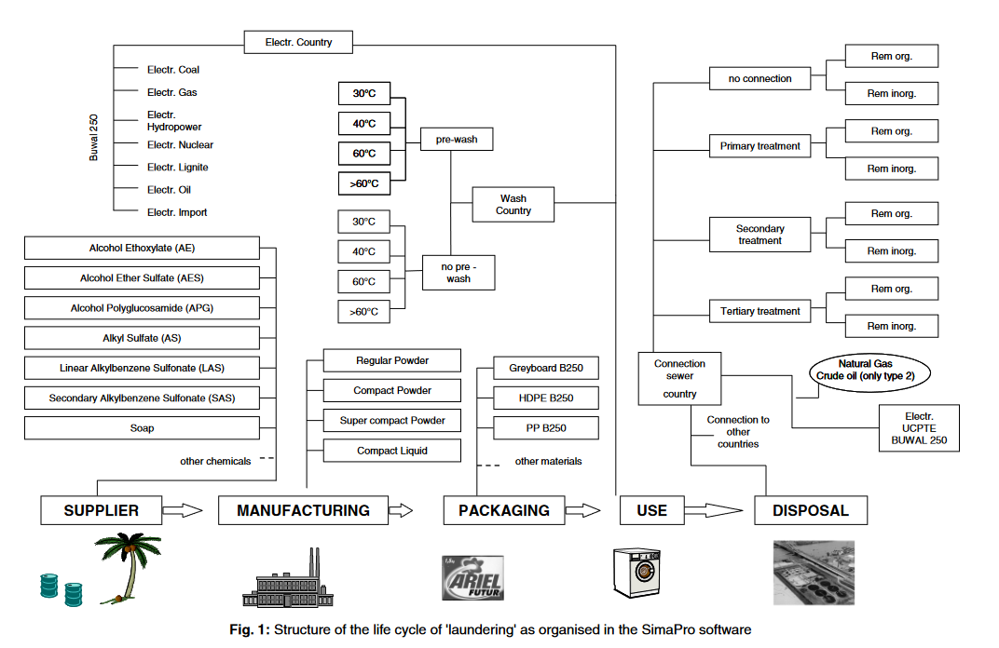
An Example: Laundry
In the 1990s Procter & Gamble launched a project to perform the LCA of laundry
So what do you think is costing the most in terms of GHG emissions?
Note: study done using Belgium in model
E. Saouter, G. Van Hoof. The International Journal of Life Cycle Assessment 7.2 (2002): 103-114.

Slide 19

An example: Laundry
In the 1990s Procter & Gamble launched a project to perform the LCA of laundry
The analysis showed that
  more than 80% of the energy consumption occurs during the consumer use stage (mainly for heating of the water).
  Air and solid waste follow the same pattern, most of these being associated with the energy generation for the use stage.
  More than 98% of the biological oxygen demand, however, is associated with the disposal stage even after accounting for removal during treatment.
Note: study done using Belgium in model
E. Saouter, G. Van Hoof. The International Journal of Life Cycle Assessment 7.2 (2002): 103-114.

Slide 20
Example of an LCA
Possible Goal:
  Is an electric car greener than a combustion engine vehicle?
Possible Scope:
  Do analysis on environmental damage and human toxicity.
Output:
  Global warming (GWP), terrestrial acidification (TAP), particulate matter formation (PMFP), photochemical oxidation formation (POFP), human toxicity (HTP), freshwater eco‐toxicity (FETP), terrestrial eco‐toxicity (TETP), freshwater eutrophication (FEP), mineral resource depletion (MDP), fossil resource depletion (FDP).

Slide 21
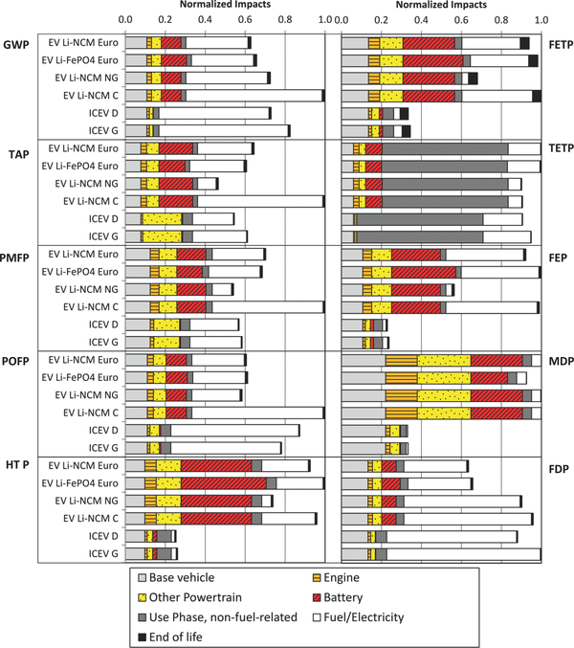
Comparative Environmental Life Cycle Assessment of Conventional and Electric Vehicles
global warming
freshwater
ecotoxicity
acidifica-tion
terrestrial
ecotoxicity
ICEV = internal combustion engine vehicle
EV = electric vehicle
LiNCM = lithium nickel cobalt manganese
LiFePO₄ = lithium iron phosphate
PbA = lead acid
particulate matter
freshwater
eutrophication
mineral resource depletion
smog
The study compares 4 electric cars (with different batteries) and 2 conventional cars in terms of environmental impact
human toxicity
fossil resource depletion
J. Industrial Ecology (2013) 17, 53.
Notes:
Normalized impacts of vehicle production. Results for each impact category have been normalized to the largest total impact. Global warming (GWP), terrestrial acidification (TAP), particulate matter formation (PMFP), photochemical oxidation formation (POFP), human toxicity (HTP), freshwater eco‐toxicity (FETP), terrestrial eco‐toxicity (TETP), freshwater eutrophication (FEP), mineral resource depletion (MDP), fossil resource depletion (FDP), internal combustion engine vehicle (ICEV), electric vehicle (EV), lithium iron phosphate (LiFePO₄), lithium nickel cobalt manganese (LiNCM), coal (C), natural gas (NG), European electricity mix (Euro).
eutrophication. : the process by which a body of water becomes enriched in dissolved nutrients (such as phosphates) that stimulate the growth of aquatic plant life usually resulting in the depletion of dissolved oxygen.
IF THIS IMAGE HAS BEEN PROVIDED BY OR IS OWNED BY A THIRD PARTY, AS INDICATED IN THE CAPTION LINE, THEN FURTHER PERMISSION MAY BE NEEDED BEFORE ANY FURTHER USE. PLEASE CONTACT WILEY'S PERMISSIONS DEPARTMENT ON PERMISSIONS@WILEY.COM OR USE THE RIGHTSLINK SERVICE BY CLICKING ON THE 'REQUEST PERMISSIONS' LINK ACCOMPANYING THIS ARTICLE. WILEY OR AUTHOR OWNED IMAGES MAY BE USED FOR NON-COMMERCIAL PURPOSES, SUBJECT TO PROPER CITATION OF THE ARTICLE, AUTHOR, AND PUBLISHER.

Slide 22
Comparative Environmental Life Cycle Assessment of Conventional and Electric Vehicles
✘
global warming
freshwater
ecotoxicity
acidifica-tion
terrestrial
ecotoxicity
✘
particulate matter
freshwater
eutrophication
✘
mineral resource depletion
smog
✘
human toxicity
fossil resource depletion
J. Industrial Ecology (2013) 17, 53.
Notes:
Normalized impacts of vehicle production. Results for each impact category have been normalized to the largest total impact. Global warming (GWP), terrestrial acidification (TAP), particulate matter formation (PMFP), photochemical oxidation formation (POFP), human toxicity (HTP), freshwater eco‐toxicity (FETP), terrestrial eco‐toxicity (TETP), freshwater eutrophication (FEP), mineral resource depletion (MDP), fossil resource depletion (FDP), internal combustion engine vehicle (ICEV), electric vehicle (EV), lithium iron phosphate (LiFePO₄), lithium nickel cobalt manganese (LiNCM), coal (C), natural gas (NG), European electricity mix (Euro).
eutrophication. : the process by which a body of water becomes enriched in dissolved nutrients (such as phosphates) that stimulate the growth of aquatic plant life usually resulting in the depletion of dissolved oxygen.
IF THIS IMAGE HAS BEEN PROVIDED BY OR IS OWNED BY A THIRD PARTY, AS INDICATED IN THE CAPTION LINE, THEN FURTHER PERMISSION MAY BE NEEDED BEFORE ANY FURTHER USE. PLEASE CONTACT WILEY'S PERMISSIONS DEPARTMENT ON PERMISSIONS@WILEY.COM OR USE THE RIGHTSLINK SERVICE BY CLICKING ON THE 'REQUEST PERMISSIONS' LINK ACCOMPANYING THIS ARTICLE. WILEY OR AUTHOR OWNED IMAGES MAY BE USED FOR NON-COMMERCIAL PURPOSES, SUBJECT TO PROPER CITATION OF THE ARTICLE, AUTHOR, AND PUBLISHER.

Slide 23
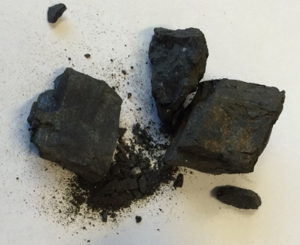
Comparative Environmental Life Cycle Assessment of Conventional and Electric Vehicles
✘
global warming
freshwater
ecotoxicity
Check their assumptions!
These authors assumed European power mix.
acidifica-tion
terrestrial
ecotoxicity
✘
particulate matter
freshwater
eutrophication
✘
mineral resource depletion
smog
✘
human toxicity
fossil resource depletion
coal
hydroelectricity
J. Industrial Ecology (2013) 17, 53.
Notes:
Normalized impacts of vehicle production. Results for each impact category have been normalized to the largest total impact. Global warming (GWP), terrestrial acidification (TAP), particulate matter formation (PMFP), photochemical oxidation formation (POFP), human toxicity (HTP), freshwater eco‐toxicity (FETP), terrestrial eco‐toxicity (TETP), freshwater eutrophication (FEP), mineral resource depletion (MDP), fossil resource depletion (FDP), internal combustion engine vehicle (ICEV), electric vehicle (EV), lithium iron phosphate (LiFePO₄), lithium nickel cobalt manganese (LiNCM), coal (C), natural gas (NG), European electricity mix (Euro).
eutrophication. : the process by which a body of water becomes enriched in dissolved nutrients (such as phosphates) that stimulate the growth of aquatic plant life usually resulting in the depletion of dissolved oxygen.
IF THIS IMAGE HAS BEEN PROVIDED BY OR IS OWNED BY A THIRD PARTY, AS INDICATED IN THE CAPTION LINE, THEN FURTHER PERMISSION MAY BE NEEDED BEFORE ANY FURTHER USE. PLEASE CONTACT WILEY'S PERMISSIONS DEPARTMENT ON PERMISSIONS@WILEY.COM OR USE THE RIGHTSLINK SERVICE BY CLICKING ON THE 'REQUEST PERMISSIONS' LINK ACCOMPANYING THIS ARTICLE. WILEY OR AUTHOR OWNED IMAGES MAY BE USED FOR NON-COMMERCIAL PURPOSES, SUBJECT TO PROPER CITATION OF THE ARTICLE, AUTHOR, AND PUBLISHER.

Slide 24
Results of LCA Study
Electric cars powered by the present European electricity mix offer a 10% to 24% decrease in global warming potential relative to conventional diesel or gasoline vehicles
Electric cars exhibit the potential for significant increases in human toxicity, freshwater eco‐toxicity, freshwater eutrophication, and metal depletion impacts, largely emanating from the vehicle supply chain (energy consumption, battery replacement)
Recommendation:
Improving the environmental profile of electric cars requires engagement around reducing vehicle production supply chain impacts and promoting clean electricity sources in decision making regarding electricity infrastructure.

Slide 25
Powers and limitations of LCA
Powers
Limitations
LCA functions by building and sharing databases: if you know the LCA for the production of for instance styrene, you can use this analysis for the reaction of styrene oxidation, styrene polymerization…..
Allows for true comparison by using concepts such as function unit
Allows to point at important shortcomings and opportunities in green technologies
Open to updates based on new science and developing techniques
Iterative process with continual interpretation.
Some environmental/health issues may be missing: yet more are developed
LCA is an approximation because of difficulty to capture all aspects of the process, account for variability, etc.
LCA data collected contains uncertainty.
LCA depends on geographical location, which prevents generalization

Slide 26


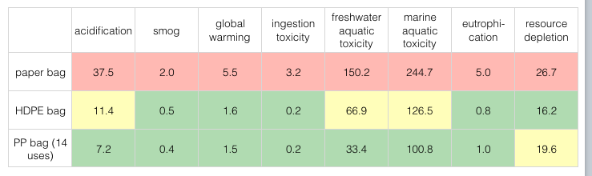
Examples of LCA

Slide 27

Examples of LCA

Slide 28
Examples of LCA
used 1 y then landfilled
used 1 y then landfilled

Slide 29

Examples of LCA
used 6 y then landfilled
6 trees used 1 y each, then landfilled

Slide 30


Examples of LCA
impacts caused by:
• editorial office
• paper manufacture
• printing
• paper transportation/distribution
• paper recycling, deinking (assume: 60% recycled)
impacts caused by:
• editorial office
• downloading
• computer manufacture/use/disposal
• transport of computer China to Europe
• modem manufacture/use/disposal
• 10 minutes / day of reading time

Slide 31
Examples of LCA
impacts caused by:
• editorial office
• paper manufacture
• printing
• paper transportation/distribution
• paper recycling, deinking (assume: 60% recycled)
impacts caused by:
• editorial office
• downloading
• computer manufacture/use/disposal
• transport of computer China to Europe
• modem manufacture/use/disposal
• 10 minutes / day of reading time

Slide 32
In-Class Exercise: LCA and Input-Output
Use the Input-Output (Embodied Energy & Operating Energy) Quick tool to estimate energy resulting from production of product.
  Use economic activity to derive estimates of materials and energy resources required for that activity, as well as the resulting environmental emissions.
  Online Tool : http://www.eiolca.net
  Task: Estimate Embodied energy and emissions associated with manufacturing of an automobile verses a bicycle.
    Use the database – look into energy use for us 2002.
      Total energy TJ/1million $ (scale for 1 car worth $35000).
      Look at greenhouse gas emissions.
      Compare automobile and a bicycle.
Notes:
One of the goals of the sustainability lecture is to give participants an understanding of how we can measure sustainability using scientific tools to make sure that triple bottom line is achieved. This activity creates a comparison of two products, assesses the materials and energy resources required, as well as the environmental emissions resulting from making these products. The tool easily evaluates a commodity or service and provides guidance on the relative impacts of different types of products, materials, services, or industries with respect to resource use and emissions throughout the supply chain.
For example, the effect of producing an automobile would include not only the impacts at the final assembly facility, but also the impact from mining metal ores, making electronic parts, forming windows, etc. that are needed for parts to build the car.
In this exercise, participants will explore embodied energy and emissions associated with the manufacturing of an automobile versus a bicycle.
For an automobile,
1. Go to online tool: http://www.eiolca.net
2. Click “Use the Tool” in the upper left corner leading to a window.
3. There are several different models to choose from. For the purpose of this exercise, please select “US 2002 (428 sectors) Purchaser” model.
This model will include all inputs up until the product is purchased, as opposed to production stage only.
The “(Show more details)” link provides additional information on every database.
4. Now, please select the “Vehicles and Other Transportation Equipment” sector and “Automobile Manufacturing” in detailed sector.
Your car will be worth $30,000, which corresponds to 0.03 million dollars.
5. And finally, please select “Energy” in the category of results to display and “Run” the model.
The results are shown in the form of a table. To produce the car worth $30,000 and to sell it to the purchaser, 0.218 of total energy (TJ) (tera joule 10^12) is used. This energy comes from coal (0.065TJ), Natural gas (0.063TJ), Petroleum (0.044TJ), Bio waste (0.010TJ) and Electric (0.036TJ).
In column Sector, the total energy is broken down into sectors.
Now, please “Change the Input” (upper left corner) to “Greenhouse gas”. Unit in metric tons
Record the results. Repeat this analysis for the bicycle.
For Bicycle,
1. Repeat the same analysis for the bicycle
2. Select the “Vehicles and Other Transportation Equipment” sector and “Motorcycle, bicycle and parts manufacturing” in detailed sector.
3. Your bicycle is worth $200, which corresponds to $0.002 million dollars.
4. And finally, please select “Energy” in the category of results to display and “Run” the model.
Compare and contrast the embodied energy and GHG emission for the car and bicycle.
Questions:
1. How are the inputs similar, how are they different? (consider total energy and categories).
2. Discuss the assumptions for the car and bicycle.
3. Does the result change based on the product lifetime?
Yes - it depends how long do you use the car or a bicycle. If you buy a car every 5 years, the embodied energy will be higher per year than if you buy a car every 10 or 15 years.
Assuming that embodied energy for a car is 0.218 TJ over lifetime,
0.218/5 =0.436 TJ per year, providing that car is kept for 5 years = 121,111.11 kWH
0.218/10 = 0.0218 TJ per year providing that car is kept for 10 years = 6055.555555556 kWH
0.218/15 = 0.0145 TJ per year providing that car is kept for 15 years = 4,027.77 kWH
The average person in U.S. uses 10,766 kWh per year.
In SA, The typical home consumes between 230kWh and 340kWh per person per month.
4. What if the economic activity is the same for car and the bike? [you purchase $30,000 worth of bikes?]
You need more total energy to make bikes worth $30k (compare to 0.218 TJ)
Also more CO2 emissions are generated for $30k worth of bikes (compare to 14.6)
5. Are there differences in energy source between different countries?
Most certainly yes. Germany will be different than China and different than USA.
6.How about toxic releases for auto production?
Data taken from Toxics Release Inventory (TRI) wherein,
Fugitive Air Releases
Releases to air that do not occur through a confined air stream, including equipment leaks, evaporative losses from surface impoundments and spills, and releases from building ventilation systems. Sometimes called releases from nonpoint sources.
Stack Air Releases
Releases to air that occur through confined air streams, such as stacks, vents, ducts or pipes. Sometimes called releases from a point source.
Air Releases
Total releases to air include all TRI chemicals emitted by a plant from both its smoke stack(s) as well "fugitive" sources (such as leaking valves).
Land Releases
Land releases include all the chemicals disposed on land within the boundaries of the reporting facility.
Publicly Owned Treatment Works
A POTW is a facility that is owned by a state or municipality.

Slide 33
Questions:
In-Class Exercise: LCA and Input-Output
How are the inputs similar, how are they different? (consider total energy and categories).
Discuss the assumptions for the car and bicycle.
Does the result change based on the product lifetime?
Notes:
Questions:
1. How are the inputs similar, how are they different? (consider total energy and categories).
2. Discuss the assumptions for the car and bicycle.
3. Does the result change based on the product lifetime?
Yes - it depends how long do you use the car or a bicycle. If you buy a car every 5 years, the embodied energy will be higher per year than if you buy a car every 10 or 15 years.
Assuming that embodied energy for a car is 0.218 TJ over lifetime,
0.218/5 =0.436 TJ per year, providing that car is kept for 5 years = 121,111.11 kWH
0.218/10 = 0.0218 TJ per year providing that car is kept for 10 years = 6055.555555556 kWH
0.218/15 = 0.0145 TJ per year providing that car is kept for 15 years = 4,027.77 kWH
The average person in U.S. uses 10,766 kWh per year.
In SA, The typical home consumes between 230kWh and 340kWh per person per month.

Slide 34
Topics Covered
Sustainability – Myths and Facts
Society, Economy, and the Environment
Business and Sustainability
  Applying Green Chemistry to Management
Different Models of Sustainability
Case Study: The Interface Company
Green Washing
Life-Cycle Assessment

Slide 35
Sponsored by Yale-UNIDO Initiative
QUESTIONS?
CENTER for GREEN CHEMISTRY
and GREEN ENGINEERING at YALE

