Slide 1
Designing Future Products with Reduced Toxicity
Lecture #24
Date:
Course #

Slide 2
Outline
Approaches to hazard minimization through molecular design
Case study: Codexis
Alternatives to animal testing
QSAR-Quantitative Structure Activity Relationship
The nexus of chemistry and toxicology
Sources of high throughput data

Slide 3
Outline
Approaches to hazard minimization through molecular design
Case study: Codexis
Alternatives to animal testing
QSAR-Quantitative Structure Activity Relationship
The nexus of chemistry and toxicology
Sources of high throughput data

Slide 4
By Changing the Molecular Charge: Cephalosporins
Clinical nephrotoxicity was recognized early – damage to proximal tubular epithelia.
Mechanism: the drug is rapidly transported across basolateral membranes via the organic anion transporter, OAT1. Transport out of other side of cell into lumen is less well characterized (involves other OAT, OAT4).
Cephalosporin has a very low affinity for OAT4 due to its zwitterionic character, resulting in considerable intracellular accumulation.
Cephaloridine
Notes:
Cephalosporins are a type of beta-lacatam antibiotic.
First generation:Cephaloridine

Slide 5
Cephalothin
In contrast, cephalothin, an anionic analog of the original zwitterionic drug, rapidly moves across the epithelia from blood into urine.
Is thus not a neurotoxin.
Cephalothin
Notes:
Kidney International (1999) 56, 2128–2136; doi:10.1046/j.1523-1755.1999.00789.x
http://www.nature.com/ki/journal/v56/n6/full/4491152a.html
Page 34

Slide 6
By Manipulating Sterics: Paraquat and Diquat
Mechanism: After oral ingestion, a very small fraction is absorbed, but the blood levels remain constant for many hours as paraquat is not metabolized by the liver. Instead, it accumulates in the lungs and is retained there even after blood concentrations decrease.
Paraquat was found to enter the lung via carrier-mediated transmembrane transport, specifically the polyamine transport system.
Diquat
Paraquat
Notes:
Paraquat is s non-selective contact herbicide of the diphenyl class. It was introduced in the 1960s and became used worldwide.
However it was soon recognized that paraquat also cause selective pulmonary toxicity to humans (damage to alveolar cells type I and II, causing edema, inflammation and hermorrhage, lung fibrosis).

Slide 7
Through SAR Data: Nonylphenols and Glycidyl Ethers
Polyethoxylatednonylphenols
Emulsifiers, surfactants
When n = 14-19, intense myocardial necrosis at 40 mg/kg.day in dogs and guinea pigs
When n<14>19, no myocardial effects
Glycidyl ethers
When n = 7-9, mutagenic, cause testicular lesions
When n = 11-13+, non-mutagenic

Slide 8
By Manipulating Electrophilicity: Acrylates
Acrylate is understood to be carcinogenic because it can readily undergo Michael addition reactions.
The addition of a methyl group to form methacrylate decreases the electrophilicity of the b-carbon, and decreases tendency for Michael reactions.
While this does not reduce the commercial efficacy, but whereas acrylate causes cancer in experimental assays, methacrylate does not.
Acrylate
(carcinogenic)
Methacrylate
(non-carcinogenic)
Notes:
Electr

Slide 9
By Facilitating Detoxification: Benzene
Benzene is known to cause hematoxicity and leukemia in humans.
This is understood to be due to one of its metabolites, (E,E)-mucoanaldehyde.
Toluene is comparatively much less toxic, as the methyl group is oxidized more easily than the benzene ring to give benzoic acid.

Slide 10
By Isosteric Substitution: Carbon with Silicon
DDT is well known to be environmentally persistent.
DDT analog with Silicon was synthesized.
While less persistent, the analog turned out to be non-toxic to insects.
This is due to the more readily oxidized (metabolized) Si-H bond compared to C-H and also the larger size of the molecule.
DDT
(Toxic to insects)
Si-DDT Analog
(Non-toxic to insects)

Slide 11
Outline
Approaches to hazard minimization through molecular design
Case study: Codexis
Alternatives to animal testing
QSAR-Quantitative Structure Activity Relationship
The nexus of chemistry and toxicology
Sources of high throughput data

Slide 12


Codexis, Inc. & Dr. Yi Tang, UCLA
Winner in the Area of Greener Synthetic Pathways
Courtesy of ACS Green Chemistry Institute and
Presidential Green Chemistry Challenge Awards

Slide 13
Overview
Title: An Efficient Biocatalytic Process to Manufacture Simvastatin
Summary:
Simvastatin, a leading drug for treating high cholesterol, is manufactured from a natural product. The traditional multistep synthesis was wasteful and used large amounts of hazardous reagents. Professor Tang conceived a synthesis using an engineered enzyme and a practical low-cost feedstock. Codexis optimized both the enzyme and the chemical process. The resulting process greatly reduces hazard and waste, is cost-effective and meets the needs of customers. Some manufacturers in Europe and India use this process to make simvastatin.
File source: ACS Green Chemistry Institute:
https://www.acs.org/content/dam/acsorg/greenchemistry/industriainnovation/pgcca-2012-winner-codexis.ppt

Slide 14
Motivation – Business Drivers
Simvastatin was originally developed by Merck under the brand name Zocor® as a cholesterol lowering drug.
  In 2005, Zocor® was Merck’s best selling drug and the second-largest selling statin in the world with about $5 billion in sales.
  In 2006, Zocor® went off patent and simvastatin became the most-prescribed statin in the world.
Why was it important to spend resources developing this technology?
  Simvastatin is one of the most important drugs on the market for treating cardiovascular diseases.
  In 2010, there were over 94 million prescriptions for Simvastatin.
  Codexis saw a great opportunity to reduce cost and waste to environment by reducing complexity of manufacturing process.
File source: ACS Green Chemistry Institute:
https://www.acs.org/content/dam/acsorg/greenchemistry/industriainnovation/pgcca-2012-winner-codexis.ppt

Slide 15
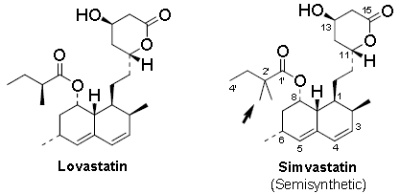
Motivation - Innovations in Science and Engineering
Simvastatin is a derivative of lovastatin, a fungal natural product, and contains an additional methyl group at the C2’ position of the side chain.
This subtle structural modification makes simvastatin more potent in the reduction of total and low-density lipoprotein cholesterol (LDL-C) with decreased hepatoxicity and reduced side effects.
Existing Technology
  Two routes to manufacturing simvastatin:
    Hydrolysis/Esterification
    Direct Methylation
  Disadvantages for both processes:
    Low overall yields (<70%)
    Utilize excess hazardous and toxic reagents
    Require copious amounts of solvents
Can we do better?
?
Chemical structure of lovastatin (left) and its semi-synthetic derivative simvastatin (right) with additional methyl substituent (arrow).

Slide 16
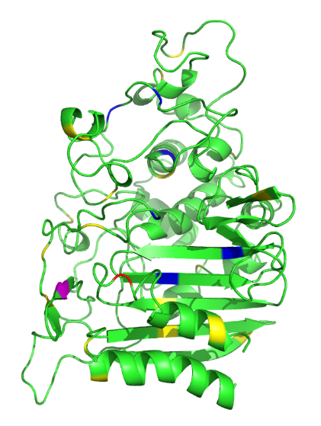
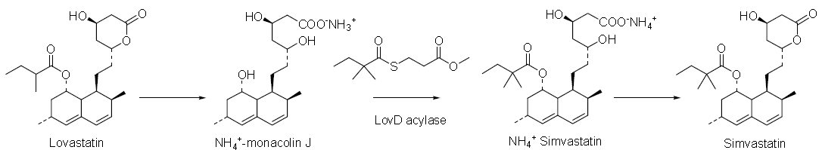
Technology Development
Approach: Design a green manufacturing process for simvastatin using biocatalysis while optimizing chemical process engineering.
The UCLA team…
  cloned and identified the LovD enzyme for biological synthesis of lovastatin,
  demonstrated that LovD can be used to synthesize simvastatin, and
  identified a simple acyl donor (DMB-SMMP) that could potentially support an economic, large-scale process.
LovD acylase
File source: ACS Green Chemistry Institute:
https://www.acs.org/content/dam/acsorg/greenchemistry/industriainnovation/pgcca-2012-winner-codexis.ppt

Slide 17
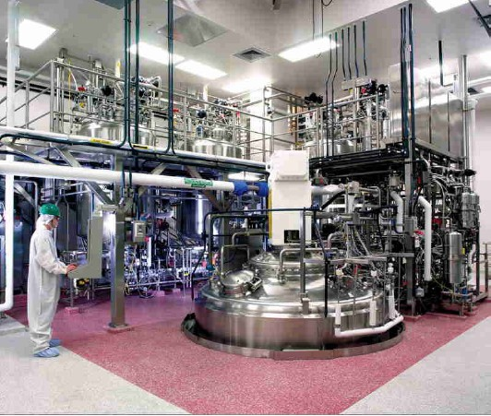
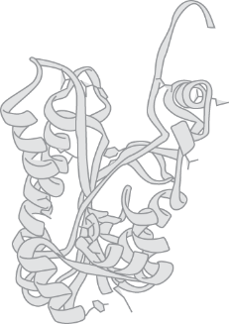
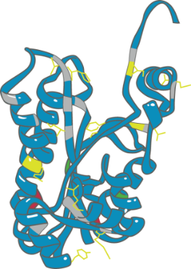
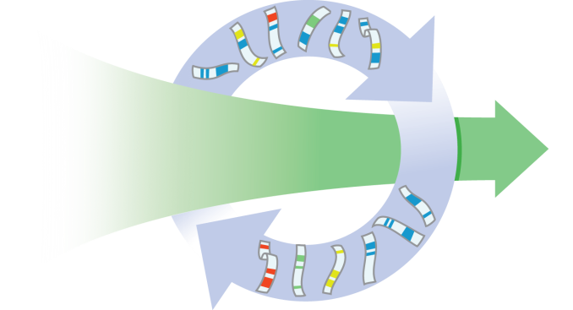


Technology Development
Codexis…
  recognized that this basic process could be improved via its CodeEvolver™ technologies and licensed the UCLA technology,
  improved the enzyme as well as the process chemistry to enable a large scale simvastatin manufacturing process,
  established commercialization path via Arch Pharmalabs and a second undisclosed partner, and
  established biocatalyst manufacture at contract manufacturer.
Natural Biocatalyst
Directed evolution
Optimized Biocatalyst
+
=
File source: ACS Green Chemistry Institute:
https://www.acs.org/content/dam/acsorg/greenchemistry/industriainnovation/pgcca-2012-winner-codexis.ppt

Slide 18

Business Activities
Established commercialization path via Arch Pharmalabs and a second undisclosed partner.
Established biocatalyst manufacture at contract manufacturer.
Maintain long term relationships with several partner companies.
Partner companies come inbound seeking new technology and processes, which results in limited outbound marketing.
File source: ACS Green Chemistry Institute:
https://www.acs.org/content/dam/acsorg/greenchemistry/industriainnovation/pgcca-2012-winner-codexis.ppt

Slide 19
Impact - Environmental, Health, and Safety Benefits
Catalyst is produced efficiently from renewable feedstocks.
Reduced use of toxic and hazardous substances like tert-butyl dimethyl silane chloride, methyliodide, n-butyl lithium.
Improved energy efficiency as the reaction is run at ambient temperature and at near atmospheric pressure.
Reduction in solvent use due to the aqueous nature of the reaction conditions.
The only biproduct (methyl 3-mercaptopropionic acid) is recycled.
The major waste streams generated are biodegraded in biotreatment facilities.
Codexis’ process can produce simvastatin with yields of 97%.
  Significant when compared to <70% with other manufacturing routes.
File source: ACS Green Chemistry Institute:
https://www.acs.org/content/dam/acsorg/greenchemistry/industriainnovation/pgcca-2012-winner-codexis.ppt

Slide 20
Impact - Economic Benefits
Customers have evaluated the simvastatin produced biocatalytically and confirmed that it meets their needs.
Total manufacturing costs are reduced by this new process.
  Less feedstock materials and solvents required.
  Less energy and water required during the aqueous and biodegradable waste streams.
File source: ACS Green Chemistry Institute:
https://www.acs.org/content/dam/acsorg/greenchemistry/industriainnovation/pgcca-2012-winner-codexis.ppt

Slide 21
Designing New Molecules is Not a Trivial Task
Even if chemists design one chemical, it still has to undergo tests for toxicity and efficacy!
Traditionally, these test have been animal test at various stages with a large number of animals.

Slide 22
Outline
Approaches to hazard minimization through molecular design
Case study: Codexis
Alternatives to animal testing
QSAR-Quantitative Structure Activity Relationship
The nexus of chemistry and toxicology
Sources of high throughput data

Slide 23
Alternatives to Animal Testing
1959 Russel & Burch proposed that “if animals were to be used in experiments, every effort should be made to replace them with non-sentient alternatives’.
They created a strategy that is currently referred to as 3R
  Refinement – refine experimental methods to decrease unnecessary pain and trauma to animals.
  Reduction – reduce the number of animals used in experiments.
  Replacement – replace the animal experiments by in vitro and in silico techniques.

Slide 24
Refinement
Modifications to reduce pain and distress to animals:
Use sedatives, anesthetics for pain relief.
Use less sensitive species.
Use smaller doses.
Shorter testing time if possible.

Slide 25
Reduction
Design of Experiment (DOE) well defined.
Share research animals if possible.
Avoid duplicate testing due to human error.
  Better execution of testing.
  Sharing data to avoid repetitions.
Image source: wikipedia

Slide 26
Replacement
Relative replacement – humane killing to provide cells or tissues for in vitro studies.
Absolute replacement – use of cell lines or cells for in vitro testing.
Hela cells
Image source: biodataofdrvhp.blogspot.com

Slide 27
In vitro testing
Based on animal or human components (cell, tissue, organ culture).
Based on organisms not considered animals (microorganisms, invertebrates).
ADVANTAGES
DISADVANTAGES
Less stress to the animals
Fewer animals required
No need to extrapolate from animal data since human tissue culture is available
Unable to produce a complete physiological response
Components lose the ability to cross talk to other tissues
Cannot determine the effect or route of administration

Slide 28
What do you measure with in vitro testing?
Synthesis (appearance) of certain substances (production of proteins, enzymes, antibodies, metabolites)
Changes in membrane permeability
Cell damage
For example, liver cells in response to toxic substances:
  Use sugar to increase their metabolism (sugar use can be detected)
  Produce certain proteins which could be detected
  Use amino acids to synthesize proteins
  Have reduced viability
  Undergo morphological changes

Slide 29

Where is in vitro used in drug discovery?
Target identification and validation
Lead identification and optimization
ADME
Toxicology
>>>>>>
Cell based screening

Slide 30
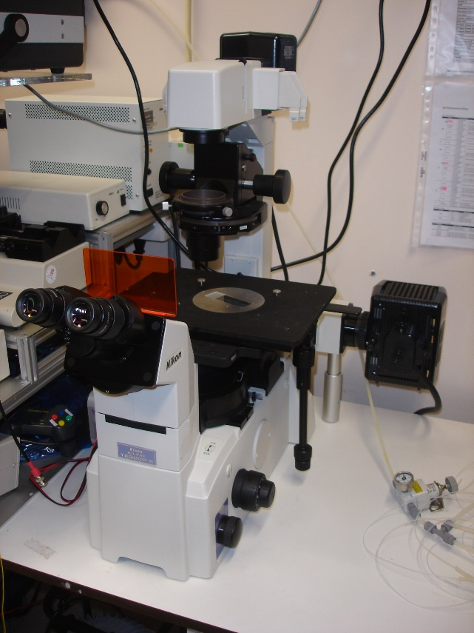
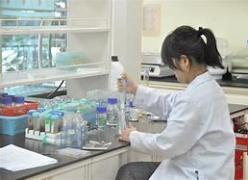
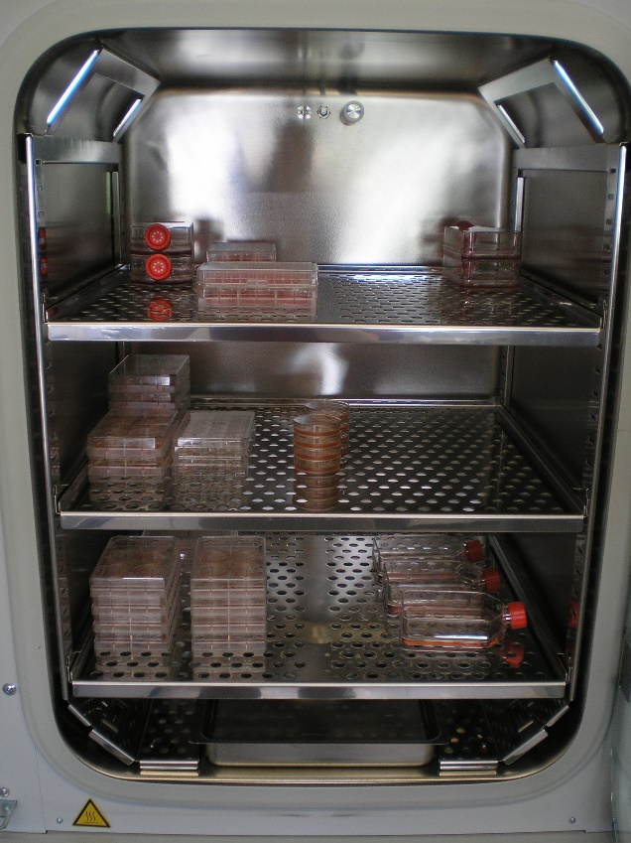
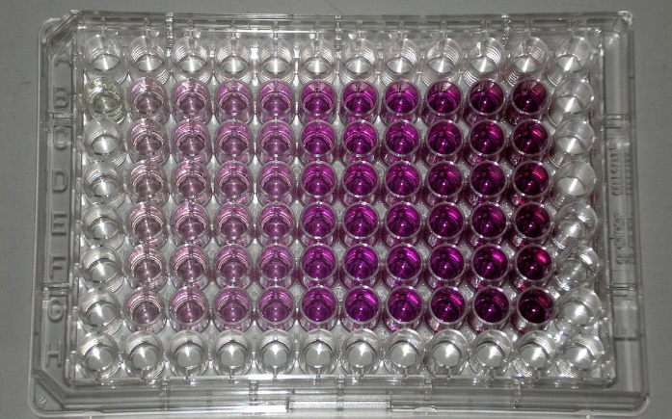
Tissue culture laboratory
Tissue culture hood
Plates with assay
Tissue culture microscope
CO₂ incubator

Slide 31
In silico testing (computer modeling)
Researchers have developed a wide range of sophisticated computer models that simulate human biology and the progression of developing diseases.
Studies show that these models can relatively accurately predict how drugs will react in the human body.
Some say that in silico testing may replace animal testing because using animals may not be longer needed due to a high predictive power by computers.

Slide 32
Outline
Approaches to hazard minimization through molecular design
Case study: Codexis
Alternatives to animal testing
QSAR-Quantitative Structure Activity Relationship
The nexus of chemistry and toxicology
Sources of high throughput data

Slide 33
QSAR-Quantitative Structure Activity Relationship
Assumes that similar chemicals behave similarly.
Behavior of the chemical is derived from the structure.
QSAR seeks for a relationship between chemical structure and activity.

Slide 34
Why people use QSAR?
Not sufficient data on the majority of chemicals.
Not all chemicals will be tested.
QSAR has been used for over 60 years.
Better to predict than have nothing.

Slide 35
QSAR Basics
They are associated with a specific endpoint [like LC50 or oxidative stress].
They ‘group’ chemicals based on toxicity.
Predict endpoints directly from chemical structure.

Slide 36
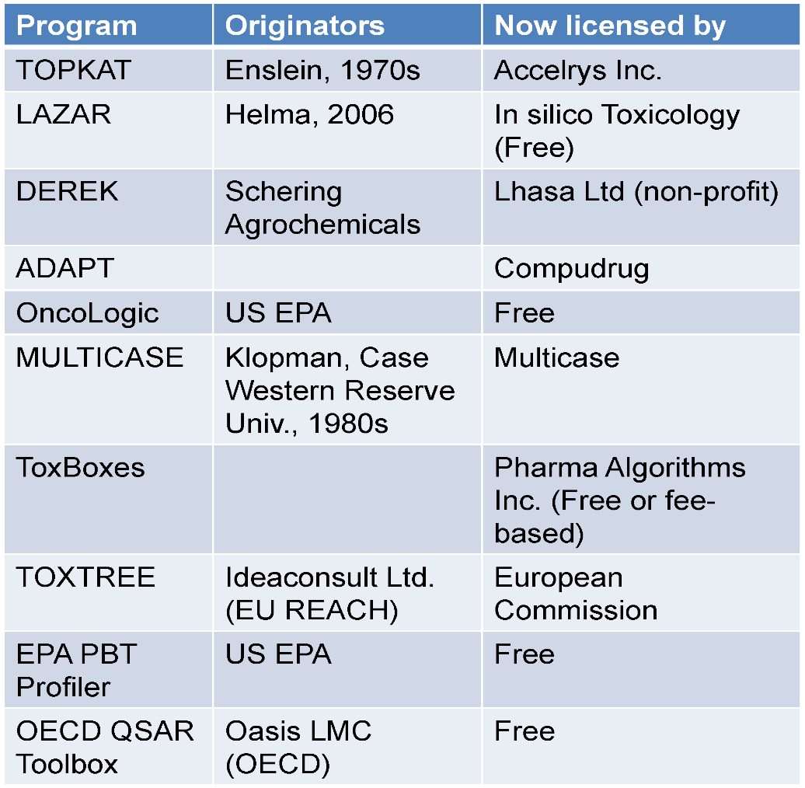
Examples of Popular Toxicity Prediction Tools
Current limitations of QSARS
Lack of validation with up-to-date data.
Application to a narrow range of chemical structures.
Qualitative output.

Slide 37
Outline
Approaches to hazard minimization through molecular design
Case study: Codexis
Alternatives to animal testing
QSAR-Quantitative Structure Activity Relationship
The nexus of chemistry and toxicology
Sources of high throughput data

Slide 38
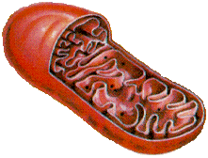
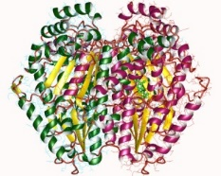

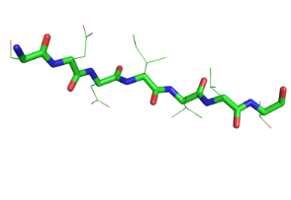

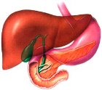


New Approach:
Crossroads of Computational Chemistry and Toxicology
Computational chemistry
Toxicology
Organelles
Technological and
Scientific Advances
Enzymes
Receptors
Genes
Cells
Tissues
Polypeptide
DNA strands
Organs
Small molecules
Whole organisms
System size
As toxicology has increased the understanding of underlying biological processes leading to toxicity, computational chemistry has grown capable of describing the chemical transformations involved in these processes.
Courtesy of Molecular Design Research Network and Dr. Adelina Voutchova
Notes:
Jakub’s slide

Slide 39
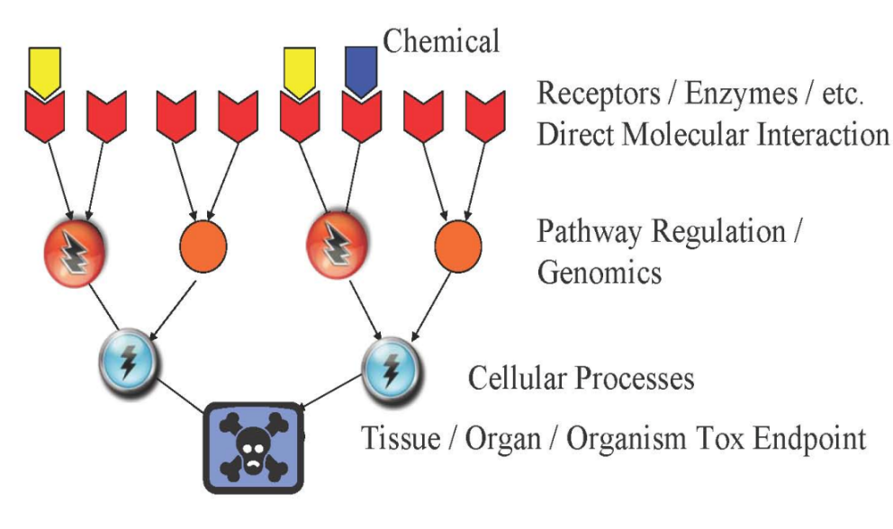
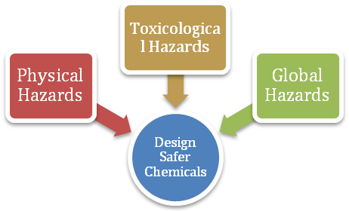
Understanding the Physicochemical Properties Associated with Reduced Hazard
DESIGN
Chemical and Physical Properties
pKa
mol. wt.
chain branching
log P
molecular refractivity
E_{HOMO} E_{LUMO}
electronegativity
hardness
hydrolyzable groups
dipole
log D_{7.4}
# H-bond acceptor/donor
Carcinogens
Toxins
Flammability
Radioactivity
Risk of Explosion
Chemical Reactivity
Pollution
Persistence
Depletion of resources
Courtesy of Molecular Design Research Network and Dr. Adelina Voutchova

Slide 40
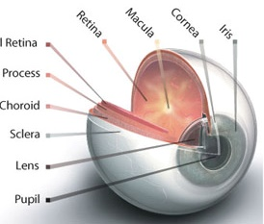
Property-Based Guidelines for Bioavailability
Acidic substance
Chemical
Basic substance
pKa<7
pKa>7
Absorption organs
GI tract
Skin
Lungs
Eyes
Unionized at pH>pKa
Lipid soluble
Un-ionized at pH>pKa
Absorbed across intestine membrane intoblood
Courtesy of Molecular Design Research Network and Dr. Adelina Voutchova
Notes:
Different absorption mechanisms - GI tract has largest SA, resp has largets blood flow & thinnest membrane, skin has variable thicknes; different requirements for water sol

Slide 41
Property-Based Guidelines for Bioavailability
water solubility molecular size
vapor pressure < 0.001 mmHg
molecular size < 500 Da
log P_{ow} 0 - 5
Non-ionization at GI pH
Absorption organs
GI tract
Skin
Lungs
Eyes
Particle size < 5um
molecular size < 400 Da
vapor pressure < 0.001 mmHg
molecular size < 400 Da
log P_{ow} 0 - 6
presence of solvents
Ionization (polar, ionized)
Voutchkova, A.; Osimitz, T.; Anastas, T. Chem. Rev. 2010, 110, 5845

Slide 42
Adverse Outcome Pathways
Molecular
Cellular
Tissue
Organ
Organ System
Individual
Population
Ecosystem
Macro-Molecular
Interactions
Cellular
Responses
Organ
Responses
Organism
Responses
Population
Responses
Toxicant
Gene activation
Protein production
Altered signaling
Altered physiology
Disrupted homeostasis
Altered tissue development/ function
Lethality
Impaired
Development
Impaired
Reproduction
Chemical
Properties
Receptor/Ligand
Interaction
DNA Binding
Protein Oxidation
Structure
Recruitment
Extinction
Mechanistic understanding is critical for evaluating toxicity pathways
Design guidelines will be rationalized according to molecular initiation events
Ankley et al. 2010 ET&C; Source: Gary Ankley & Dan Villeneuve, EPA

Slide 43
Creating a reliable tool for chemists will not only predict the toxicity of existing chemicals, but will allow the future design of molecules with reduced hazard.

Slide 44

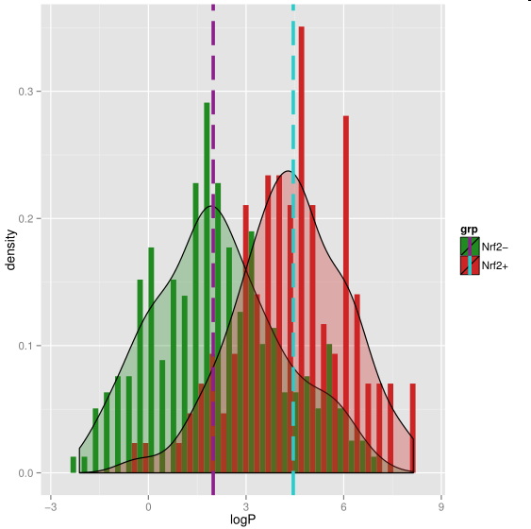
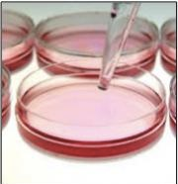
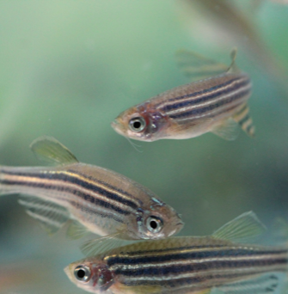

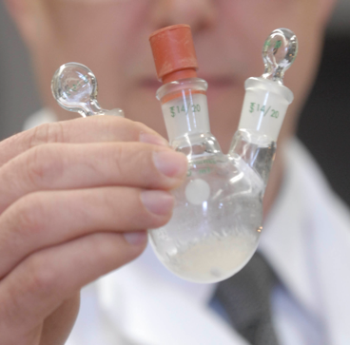





Molecular Design Research Network
Toxicology
Chemistry
Molecular Biology
Computational Chemistry
Courtesy of Molecular Design Research Network and Dr. Karolina Mellor
Notes:
MoDRN is the collaboration between 4 universities Baylor, GW, UWASH and Yale that uses advances in biology, toxicology, computational chemistry and engineering to develop a robust and well validated computer software that will not only predict toxicity of existing compounds but it will serve as a tool to redefine guidelines for the next generation molecules with reduced hazard. Our network will employ the newest strategies of computer modeling to build a computer software which will allow to understand what causes toxic endpoints and what can we do to avoid it. Our efforts will not only limit to research. To have the biggest possible impact we will engage educators and students on undergraduate and high school level to by including safer chemical design in students’ lesson plans and by developing interactive and hands-on teaching tools for undergraduate and high school students. Finally we plan to work with our colleagues across academia, colleagues across many industry sectors and policymakers on the government level to further inform and disseminate safe chemical concepts.

Slide 45
Outline
Approaches to hazard minimization through molecular design
Case study: Codexis
Alternatives to animal testing
QSAR-Quantitative Structure Activity Relationship
The nexus of chemistry and toxicology
Sources of high throughput data

Slide 46
Where is data coming from?
EPA ToxCast
Tox21
High throughput assays

Slide 47
What is an assay?
Assays can test almost any biological effect
In vitro assay in cell → in vivo outcome in organism
For example: cytotoxicity, gene expression or interaction with protein
An ideal assay is:
Reproducible: same result when repeated
Reliable: same result with different people repeat it
Sensitive: won’t miss an effect
Specific: won’t say there is an effect if there is not
Predictive of outcome of interest

Slide 48
Data from ToxCast
Set | Chemicals | Assays | Endpoints | Completion | Available
ToxCast Phase I | 293 | ~600 | ~700 | 2011 | Now
ToxCast Phase II | 767 | ~600 | ~700 | 03/2013 | 10/2013
ToxCast Phase IIIa | 1001 | ~100 | ~100 | Just starting | 2014
E1K (endocrine) | 880 | ~50 | ~120 | 03/2013 | 10/2013
Tox21 | 8,193 | ~25 | ~50 | Ongoing | Ongoing
~600
Assays
0
Chemicals
~8,200
Notes:
It’s important to note that this is not just a data collection exercise. ORD has assembled the infrastructure to house, QA, and analyze the tens of thousands of data points.
AND make all of this data publically available.

Slide 49
Data from ToxCast
ToxCast phase I: primarily pesticides
ToxCast phase II: industrial chemicals
ToxCast phase III: diverse chemical space; high production

Slide 50
Data Endpoints

Slide 51
If we can predict toxicity using computer models…
Then the need for expensive toxicology studies is reduced.
Then less time is needed to get a chemical into the market.
We cab have more confidence in chemicals rather than facing unintended consequences afterwards.
We can design the chemical with specific functions before animal trials.

Slide 52
Are we there yet?
Sadly, no.
Best prediction models offer only 65-70% accuracy for non-carcinogenic compounds.
  Still cannot replace in vivo and in vitro studies.
Once prediction power reaches 90-95%, the major shift in experimental strategy can occur.

Slide 53
Summary
There are many approaches to hazard minimization through molecular design: chemists have the opportunity to minimize hazard at the very beginning design stage!
Many alternatives to animal testing are being used and explored – although, animal testing is sometimes required
QSAR-Quantitative Structure Activity Relationship – can help chemists in design strategies; QSAR seeks for a relationship between chemical structure and activity.
The nexus of chemistry and toxicology:
  Mechanistic understanding is critical for evaluating toxicity pathways
  Design guidelines will be rationalized according to molecular initiation events
Sources of high throughput data - can help us in predictive approaches!

