Slide 1
Life Cycle Assessment
Lecture #10
Date:
Course #

Slide 2
Outline
Life Cycle Thinking and Life Cycle Assessment (LCA)
LCA Example: Laundry Detergent
LCA and Green Chemistry
LCA examples and discussions:
An example: i-STAT blood analyzing device
An example: Styrofoam take-out container

Slide 3
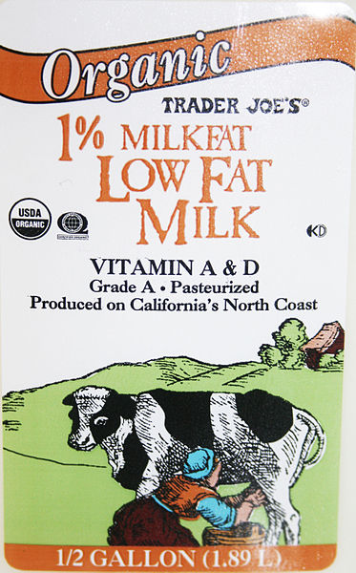
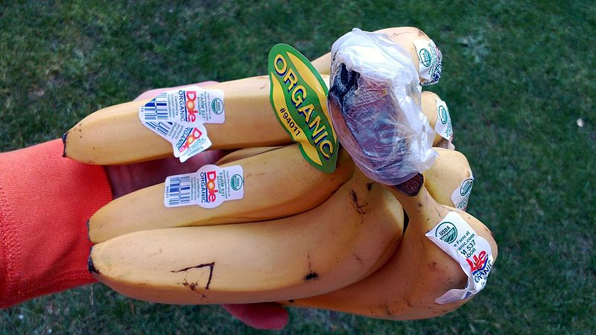
Product choice
Often guided by one or two concerns (end-of-life, material composition, etc.)
Disposable versus reusable
Recyclable
Bio-based
Can be guided by generic labelling – i.e., “Recyclable”, “Organic”, “Natural”, etc.
Our choices have impact!
How can we understand the impact of our choices?
Notes:
Image – bananas: https://commons.wikimedia.org/wiki/File:Organic_bananas_with_plastic_stickers.jpg – Creative Commons, Public Domain
Disposable cup image: https://commons.wikimedia.org/wiki/File:Disposable_cup_of_Sandstone_Point_Hotel,_Queensland.jpg
Coffee cup: https://commons.wikimedia.org/wiki/File:Cup_of_Costa_Coffee.jpg - CoolGuy at the English language Wikipedia
Milk: https://commons.wikimedia.org/wiki/File:TJ_MilkLabel.jpg – Creative Commons, Public Domain

Slide 4
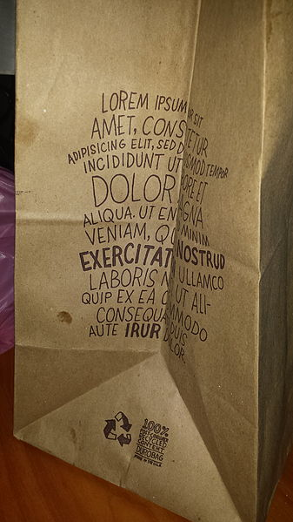
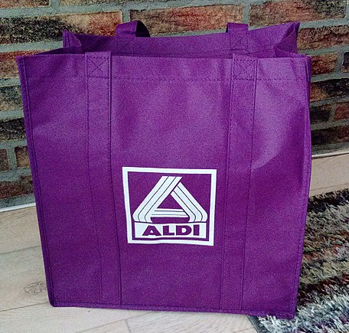
Life-Cycle Thinking
Allows for a more complete assessment of the environmental and human health impacts of a product
Can help us to understand that the “obvious” answer may not necessarily be the “right” answer (i.e. - Paper vs. Plastic vs. Reusable bag?)
Considers the impacts of a material throughout its full “life cycle”, looking at a range of inputs and environmental impacts
Images: Creative Commons
Notes:
For more info: Guidance on Life-Cycle Thinking and Its Role in Environmental Decision Making, Sustainable Materials Management Coalition, March 2014, https://www.michaeldbaker.com/wp-content/uploads/2014/03/Guidance-on-Life-Cycle-Thinking-031014.pdf
Reusable purple bag: https://commons.wikimedia.org/wiki/File:Purple_ALDI_bag_issued_during_their_re-opening_in_Winschoten_(2019)_02.jpg
Plastic shopping bag: https://commons.wikimedia.org/wiki/File:Groninger_flag_plastic_shopping_bag,_Groningen_(2018).jpg
Brown bag: https://commons.wikimedia.org/wiki/File:Lorem_ipsum.jpg

Slide 5
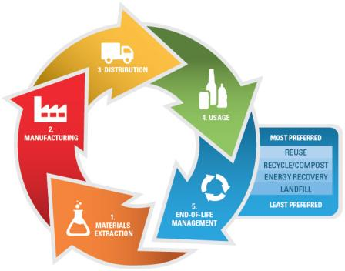
Impacts throughout a product lifecycle
Materials have environmental impacts through their product lifecycles!
The major stages in a material’s lifecycle include:
Materials Extraction
Manufacturing
Distribution
Usage
End-of-life Management
Each stage has many factors that determine the material’s impact
Image: U.S. EPA, Public domain
Notes:
Image: https://commons.wikimedia.org/wiki/File:Lifecycle_EPA.jpg and on here:

Slide 6
Product Life Cycle
Raw Materials Acquisition
Materials Manufacture
Product Use or Consumption
Product Manufacture
Final Disposition (Landfill, Combustion, Recycle, or Reuse)
Materials and Energy
Materials and Energy
Materials and Energy
Materials and Energy
Materials and Energy
Wastes
Wastes
Wastes
Wastes
Reuse
Product Recycling
Recreated from: Guidance on Life-Cycle Thinking and Its Role in Environmental Decision Making, Sustainable Materials Management Coalition, March 2014
Notes:
This is an illustration of a product’s full life cycle. Each of the stages has its own set of inputs (energy, water, chemicals) and environmental impacts such as toxic releases, ecological effects, greenhouse gas emissions.
Focusing on one aspect or one stage of a product life-cycle, then we may miss the big picture. Understanding more about the entire product life-cycle can help us to make more informed decisions

Slide 7
Life-Cycle Assessment (LCA)
1950’s – 1960’s: U.S. companies began to look at product life-cycles as part of their cost-accounting systems
1969: Coca-Cola Company commissioned 1st LCA to review soft-drink container options
1970’s: EPA conducted materials-flow studies to support the goal of diverting materials from landfills
Today: International protocols have been set up on how to conduct LCA’s
Many look beyond products and processes to understand how systems and economies are impacted
Notes:
Coca-cola article: Reduce by Journey Staff, 2012, https://www.coca-colacompany.com/stories/reduce

Slide 8
Outline
Life Cycle Thinking and Life Cycle Assessment (LCA)
LCA Example: Laundry Detergent
LCA and Green Chemistry
LCA examples and discussions:
An example: i-STAT blood analyzing device
An example: Styrofoam take-out container

Slide 9
LCA Example: Procter & Gamble Laundry Detergent Inventory (2001)
Raw Materials Acquisition
Materials Manufacture
Product Use or Consumption
Product Manufacture
Final Disposition (Landfill, Combustion, Recycle, or Reuse)
Q: Where do you believe are the greatest impacts in laundry detergent life-cycle? In which phase?
Notes:
Ask students to consider the product life-cycle of laundry detergent. Where would they assume the greatest impacts would be? In the formulation or manufacturing of the product? Use and consumption of the laundry detergent? Discharge into the waste water system?

Slide 10
LCA Example: Procter & Gamble Laundry Detergent Inventory (2001)
Raw Materials Acquisition
Materials Manufacture
Product Use or Consumption
Product Manufacture
Final Disposition (Landfill, Combustion, Recycle, or Reuse)
A: The greatest impacts were found in the product use phase due to the use of warm water!!
64% of solid waste
Over 70% of CO2 emissions
60% of human toxicity
(due to solid waste and air emissions from the generation of energy to heat the wash water)
Notes:
Ask students to consider the product life-cycle of laundry detergent. Where would they assume the greatest impacts would be? In the formulation or manufacturing of the product? Use and consumption of the laundry detergent? Discharge into the waste water system?

Slide 11
LCA Example: Procter & Gamble Laundry Detergent Inventory (2001)
Raw Materials Acquisition
Materials Manufacture
Product Use or Consumption
Product Manufacture
Final Disposition (Landfill, Combustion, Recycle, or Reuse)
Additional areas for improvement found in the disposal phase and also the materials manufacture phase
66% of the photochemical smog
(from VOCs from process emissions)
90% of the total biological oxygen demand (BOD*) of the process
(from wastewater from home laundering)
*BOD is a measure of organic pollution of water
Notes:
Ask students to consider the product life-cycle of laundry detergent. Where would they assume the greatest impacts would be? In the formulation or manufacturing of the product? Use and consumption of the laundry detergent? Discharge into the waste water system?

Slide 12
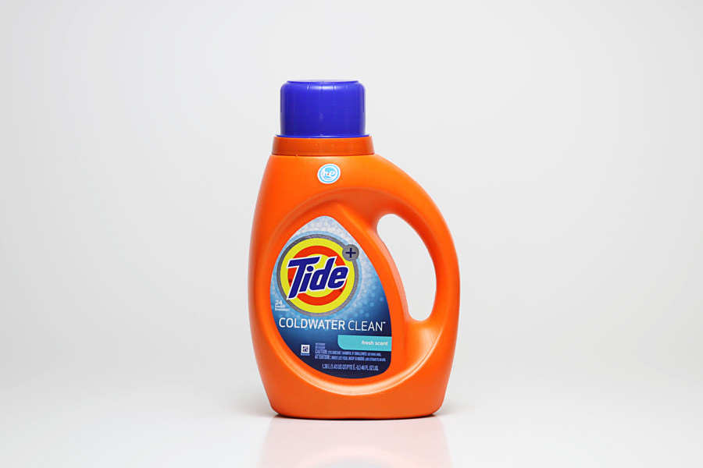
LCA Example: Procter & Gamble Laundry Detergent Inventory (2001)
Outcomes/findings:
P&G did not start with the answer
The outcomes guided their new product development
P&G launched Cold Water Tide in 2005
Most consumers continued to wash with warm water
Consumer education was needed
Tide focused on cleaning benefits, rather than environmental benefits
Image, Flickr: www.yourbestdigs.com/reviews/best-laundry-detergent/
Notes:
Coldwater Tide picture: https://www.flickr.com/photos/yourbestdigs/33036440816

Slide 13
Life-Cycle Analysis Helps Avoid Shifting the Issues
Looking at the entire life-cycle helps ensure reducing waste (for example) at one point does not simply create more waste at another point in the life-cycle.
Issues may be shifted – intentionally or inadvertently – among:
Processes or manufacturing sites
Geographic local
Different budgets and planning cycles (first cost)
Environmental media – air, water, soil (i.e., MTBE)
Sustainability dimension: economic, social, environmental burdens
Depends on “boundaries”
Be conscious of what is shifted and where!

Slide 14
What is Life Cycle Assessment (LCA)?
“Life Cycle Assessment (LCA) is a technique to make more informed decisions through a better understanding of the human health and environmental impacts of products, processes, and activities. This can include an evaluation of the air, water, land, and energy consequences of a product or process, and possible alternatives.”
-U.S. Environmental Protection Agency
U.S. EPA, Sustainable Materials Management basics, https://www.epa.gov/smm/sustainable-materials-management-basics

Slide 15
LCA’s can give unanticipated results!
For example:
Single attributes such as “compostable” and “recyclable” often do not correlate to lower impact
The impacts may shift from one stage to another
“Recycled content” and “recyclability” aren’t necessarily the most important consideration
Lighter and smaller volume packaging material that isn’t recycled can be preferable to heavier packaging material that is recycled (due to energy intensity in manufacturing and shipping of the original material)

Slide 16
Life-Cycle Assessment
Inputs
Outputs
Raw Materials Acquisition
Manufacturing
Use/Reuse/Maintenance
Recycle/Waste Management
Atmospheric Emissions
Raw Materials
Waterborne Wastes
Solid Wastes
Energy
Coproducts
Other releases
System Boundary
Recreated from: Guidance on Life-Cycle Thinking and Its Role in Environmental Decision Making, Sustainable Materials Management Coalition, March 2014
Notes:
The LCA process is pictured in this slide:
The center column identifies the basic life-cycle stages and activities evaluated in an LCA; the specifics of the stages will differ depending on the product or process being evaluated. Each of these life-cycle stages requires resources, which are listed in the first column – energy is consumed (electricity to run equipment, fuel for transportation, etc.) and materials are used (raw materials, packaging, water, etc.). These resources are referred to as inputs. Similarly, each of the life-cycle stages produces one or more types of waste (chemical or particulate emissions to air or water, solid waste, etc.). These emissions are referred to as Outputs. Co-products (useful materials that are not the primary intended product but are produced along with the intended product) are also identified in outputs. Material can also be reused or recycled back into the life cycle at various points.

Slide 17
Outline
Life Cycle Thinking and Life Cycle Assessment (LCA)
LCA Example: Laundry Detergent
LCA and Green Chemistry
LCA examples and discussions:
An example: i-STAT blood analyzing device
An example: Styrofoam take-out container

Slide 18
How does Green Chemistry relate to Life Cycle thinking?
The 12 principles of Green Chemistry are applicable across the product life cycle
Green chemistry can have the greatest impact in the manufacturing stage of a product life-cycle
Chem. Soc. Rev., 2015, 44, 5758-5777
Notes:
Chem. Soc. Rev., 2015, 44, 5758-5777, https://pubs.rsc.org/en/content/articlelanding/2015/cs/c4cs00445k#!divAbstract

Slide 19
Outline
Life Cycle Thinking and Life Cycle Assessment (LCA)
LCA Example: Laundry Detergent
LCA and Green Chemistry
LCA examples and discussions:
An example: i-STAT blood analyzing device
An example: Styrofoam take-out container

Slide 20
Understanding Life-cycle, an example: i-STAT blood analyzing device
A handheld system for rapid blood analysis: 2-3 drops of blood are placed into a cartridge, which is inserted into the handheld device for results within 2 minutes.
Let’s look at the cartridge!
i-STAT blood analyzing device by Abbott Labs: https://www.pointofcare.abbott/us/en/offerings/istat/istat-handheld
Notes:
i-STAT blood analyzing device by Abbott Labs: https://www.pointofcare.abbott/us/en/offerings/istat/istat-handheld

Slide 21
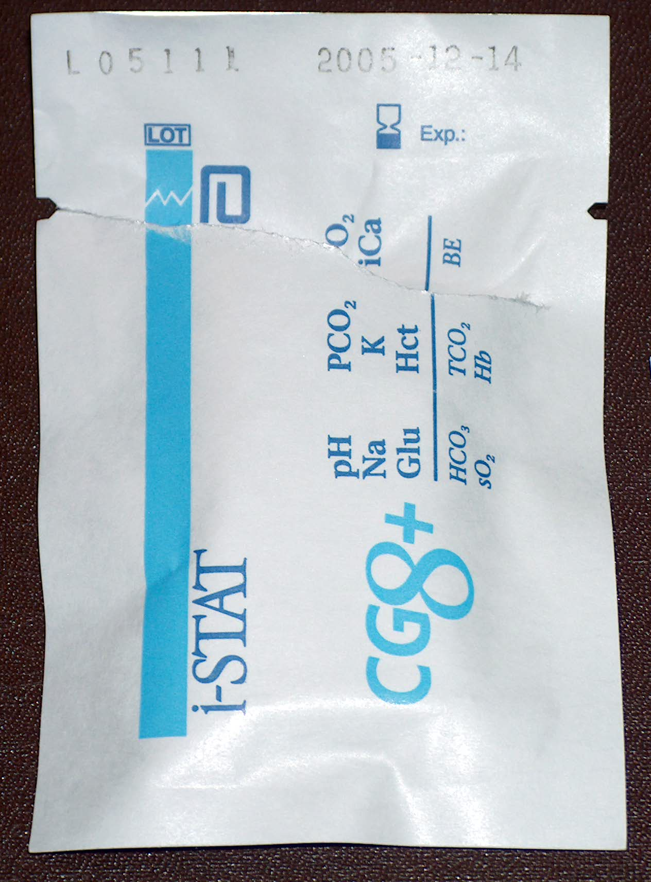
Understanding Life-cycle, an example: i-STAT blood analyzing device
Let’s look at this stage of the life-cycle: What are the materials used? Where do they come from?
Extraction
Purification
Production
manufacture
disposal
Raw materials
Synthesis
Production
Assembly of materials
Incineration
Land-fill
Composted
Degraded
Product use
Notes:
Please note that this is not a complete life-cycle assessment of this device! The purpose of looking at the materials in this device is to understand the complexity in only one stage – and, as one analyzes all of the stages within the product life cycle, the complexity increases greatly!

Slide 22
Understanding Life-cycle, an example: i-STAT blood analyzing device
Metal pod (Aluminum)
Liquid (Buffered solution with
known concentration of analytes for
which are measured)
Plastic opaque backing
(ABS)
Integrated circuit
(Si/SiO₂/Ag/Au/Ti/W/Pt)
Clear plastic front
(Polyethylene)
Label
(Paper/polymer
Inks, Adhesive)
Adhesive holding two
molded plastic pieces together
(Acrylic)
Polymer pad
(Rubber)

Slide 23
Understanding Life-cycle, an example: i-STAT blood analyzing device
List of identified materials and chemicals:
1. Opaque plastic backing: ABS
2. Clear plastic front: polyethylene
3. Polymer pad on front: rubber
4. Integrated circuits: Si / SiO2 / Ag / Au / Ti / W / Pt
5. Label: inks/polymer/adhesives
6. Metal pod on inside: Aluminum
7. Adhesive holding two molded plastic pieces together: Acrylic
8. Packaging (not shown): Material/inks/adhesives?
9. Liquid in metal pod: Buffered salt solution with known concentrations of the analytes for which we measure
Let’s look at one polymer on this list: where does this come from? How is it made?

Slide 24
Understanding Life-cycle, an example: i-STAT blood analyzing device
ABS: Acrylonitrile butadiene styrene
Source: Petrochemical, derived from petroleum sources
Manufacture: Graft polymerization of acrylonitrile and styrene on a preformed polybutadiene elastomer
Properties: Specific gravity = 1.06; opaque; higher tensile strength, lower elongation than HDPE and PP
Uses: transportation, appliances, pipe, conduit and pipe fittings; electrical, electronic components (radio housings, telephones, pocket calculators, lawn mower housing, luggage)
Survey of Industrial Chemistry, 3rd Edition, Philip J. Chenier
Notes:
Antioxidants and UV stabilizers can be added to help toward degradation.

Slide 25
olefins
aromatics
ethylene
propylene
C₄ stream
Pygas
benzene
toluene
xylenes
ethane
LPG
methane
methane
Associated
gases
naptha
naptha
NGL
Crude oil
Natural gas
Information from: https://www.petrochemistry.eu/interactive-flowchart/

Slide 26
ABS
acrylonitrile
styrene
butadiene
ethylbenzene
olefins
aromatics
ethylene
propylene
C₄ stream
Pygas
benzene
toluene
xylenes
ethane
LPG
methane
methane
Associated
gases
naptha
naptha
NGL
Crude oil
Natural gas
Information from: https://www.petrochemistry.eu/interactive-flowchart/

Slide 27
In-class exercise
Identify another polymer in the list of materials and investigate where it comes from using the following web page by PetroChemicals Europe, https://www.petrochemistry.eu/interactive-flowchart/
Create a simple graphic with the flow from petroleum source to the final polymer material.
What other aspects of this process should be considered beyond just the materials?

Slide 28
Understanding Life-cycle, an example: i-STAT blood analyzing device
List of identified materials and chemicals:
1. Opaque plastic backing: ABS
2. Clear plastic front: polyethylene
3. Polymer pad on front: rubber
4. Integrated circuits: Si / SiO2 / Ag / Au / Ti / W / Pt
5. Label: inks/polymer/adhesives
6. Metal pod on inside: Aluminum
7. Adhesive holding two molded plastic pieces together: Acrylic
8. Packaging (not shown): Material/inks/adhesives?
9. Liquid in metal pod: Buffered salt solution with known concentrations of the analytes for which we measure
Let’s look at Aluminum!

Slide 29
Understanding Life-cycle, an example: i-STAT blood analyzing device
J. Chem. Ed., Vol. 60, No. 5, 1983, pp. 411-413.
Al₂(SO₄)₃
Aluminum sulfate, alum
The process of extracting and processing aluminum (and essentially all chemicals) is linked to other chemical processes.
Bauxite is the world’s main source of aluminum. The mining and production process is harmful to the environment and very energy intensive (using temperatures over 1,000ºC)
Al₂O₃.2H₂O
bauxite
S
Sulfur
brimstone
O₂, H₂O
contact process
H₂SO₄
Sulfuric acid
Oil of vitriol
CaF(PO₄)₃ H₂O
Fluorapatite
Wet process acid
H₃PO₄
Phosphoric acid
(NH₄)₂SO₄
Ammonium sulfate
CH₄
Methane
Natural gas
H₂O
Steam reformer
process
H₂O
CO₂
Carbon
dioxide
N₂
Haber
process
O₂
H₂ + CO
Synthesis gas
+ H₂
hydrogen
NH₃
ammonia
HNO₃
Nitric acid
NH₄NO₃
Ammonium nitrate
NH₂CONH₂
urea

Slide 30
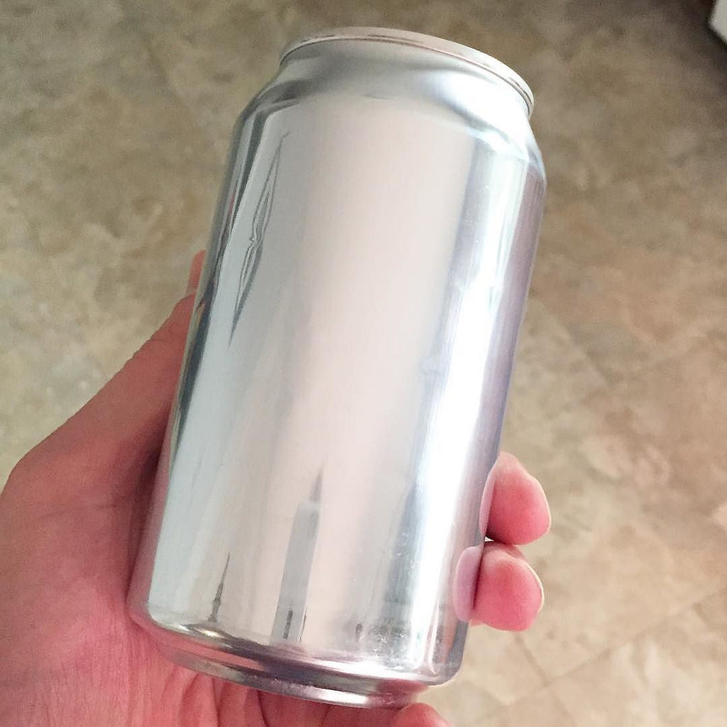
Aluminum: virgin material vs. recycled
LCA’s have shown:
Landfill diversion is not the most important benefit of using recycled content
Using recycled aluminum avoids the environmental footprint of mining and processing virgin material
The energy expended in recycling a kilogram of aluminum cans saves ~95% of the energy consumed in producing a kilogram of virgin material (this only accounts for the processing and not the mining, which would be an additional savings).
Image: Creative Commons, Flickr
Guidance on Life-Cycle Thinking and Its Role in Environmental Decision Making, Sustainable Materials Management Coalition, March 2014
Notes:
Aluminum can image: Creative Commons, Flickr: https://www.flickr.com/photos/bjornmeansbear/32027799924
Info from: Guidance on Life-Cycle Thinking and Its Role in Environmental Decision Making, Sustainable Materials Management Coalition, March 2014

Slide 31
Understanding Life-cycle: i-STAT blood analyzing device
We only looked at some of the materials within the cartridge!
Q: What are other factors to consider in a life-cycle assessment for this device?
Q: What are some ways Green Chemists might approach making this device more sustainable?
Extraction
Purification
Production
manufacture
disposal
Raw materials
Synthesis
Production
Assembly of materials
Incineration
Land-fill
Composted
Degraded
Product use
Notes:
Discuss the other aspects of producing, using and disposing this type of device. The cartridge itself is designed to be disposable and single-use. The used product will have blood in it and therefore most likely will need to be incinerated due to the content. What are these impacts? Also, the product must be distributed to the end user, therefore there will be transportation impacts. Life-cycle assessments can be complex since there are so many parts to a product life cycle!

Slide 32
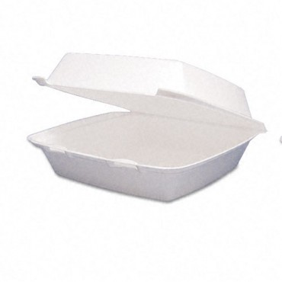
Considerations beyond materials: Energy & product lifecycle
In the city of New York, NY: an estimated 30,000 tons of polystyrene is placed in the landfill annually!
A life cycle assessment can help to understand the impacts of polystyrene production, use and disposal beyond landfill waste.
Newsweek, January 8, 2015, https://www.newsweek.com/styrofoam-food-containers-be-banned-new-york-city-298014
10 g Styrofoam container (polystyrene)

Slide 33
Understanding Life-cycle: Styrofoam example
This example will look at energy use along the product life cycle!
Extraction
Purification
Production
manufacture
disposal
Raw materials
Synthesis
Production
Assembly of materials
Incineration
Land-fill
Composted
Degraded
Product use

Slide 34
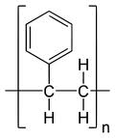
Raw materials & manufacturing
Crude oil
Ethane
Propane
Naptha
Steam
Nat. gas
Crude oil: Drilling (100s-1000s of m), pumping, distillation, desalting, etc.
Natural gas: Hydraulic fracturing, pumping, compression, pipeline transport, etc.
Steam: Water purification, fuel heating, pumping
Intrinsic factors: # of carbon atoms required for stoichiometry, heat capacity of water, oil/water partition coefficients, boiling points and vapor pressures
Q: How is polystyrene made?
Q: What raw materials is it derived from?
Q: What are the energy considerations?

Slide 35
Raw materials & manufacturing
Crude oil
Ethane
Propane
Naptha
Steam
Nat. gas
Manufacturing stages: thermal cracking, distillation, catalytic dehydrogenation, vacuum, separations
Intrinsic factors: boiling points and vapor pressures, densities

Slide 36
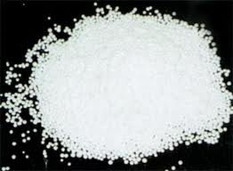
Raw materials & manufacturing
Manufacturing stages: synthesis and use of blowing agent (CO₂ or HFCs), extrusion / thermoforming
Intrinsic factors: crystalline and glass transition properties of polystyrene, physical/chemical properties of blowing agent
~85% prep. of “nurdles”
~15% conversion to foam

Slide 37
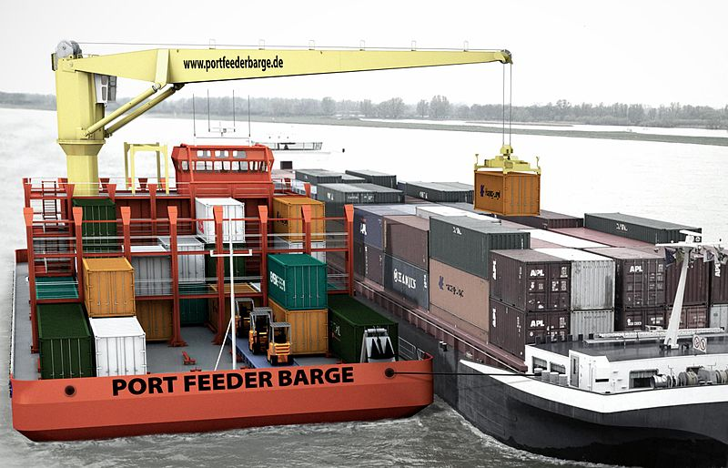
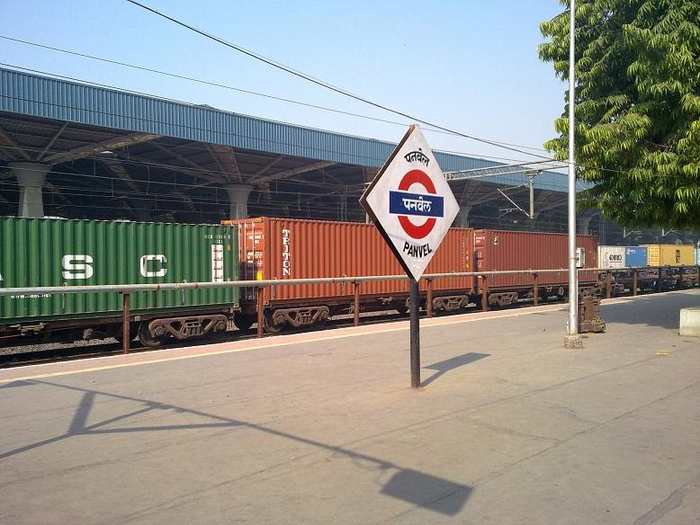
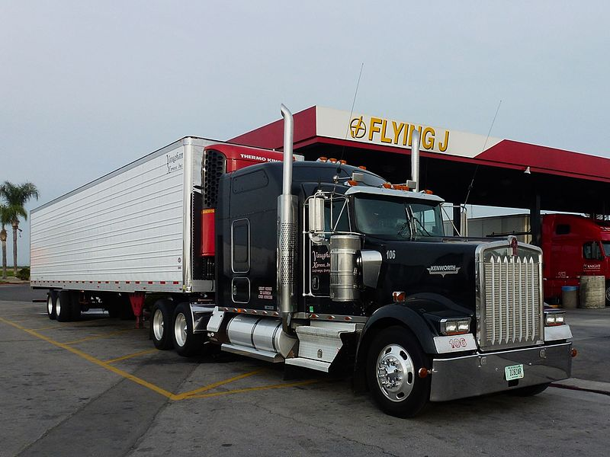
Transportation
Energy requirements: fuel, infrastructure construction/upkeep
Intrinsic factors: fuel energy densities, mass-distance
Images: Creative Commons
10 g container; cumulative energy (J)
Notes:
Left image: Creative Commons: https://commons.wikimedia.org/wiki/File:2011_11_25_Port_Feeder_Barge_Binnenschiff_Malchow_1.JPG
Middle image: Creative Commons: https://commons.wikimedia.org/wiki/File:Panel-Karjat_cargo_train.jpg
Right image: Creative Commons: https://commons.wikimedia.org/wiki/File:Bakersfield,_(CA)_Truck_Kenworth_at_Flying_J_Travel_(5).jpg

Slide 38
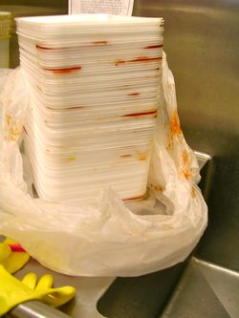
Use
Wash for 5 sec (~500 mL) with hot kitchen tap water (potable)
Intrinsic: heat capacity of water (4.183 J / g·°C)
10 g container; cumulative energy (J)
Notes:
Check image source!

Slide 39
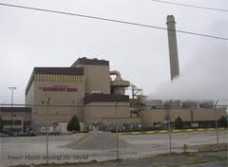
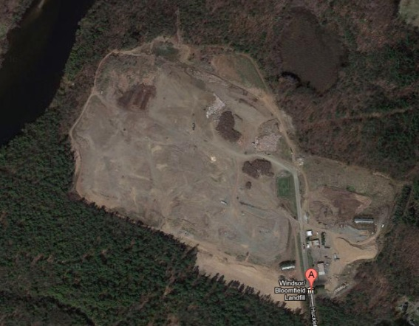
End of life
Municipal solid waste incineration:
Net energy recovery (some losses due to water, inorganics, etc.)
Intrinsic: PS enthalpy of combustion
Landfill: energy costs associated with leachate treatment (WWTP sludge), other pollutant capture
Intrinsic: m.w. of PS molecules, hydro/photo-stability
10 g container; cumulative energy (J)

Slide 40
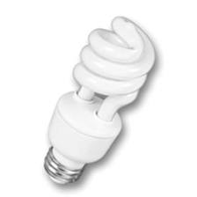
Net energy
≈ 1 MJ ≈ 11 W CFL for 24 hrs
10 g container; cumulative energy (J)

Slide 41
Design implications
Crude oil
Ethane
Propane
Naptha
Steam
Nat. gas
Building up a complex 3D structure from extremely simple inputs (CH₄, C₆H₆, H₂O) that must be purified and separated at various intermediate stages
Selection of styrene, benzene, ethylene etc. means their intrinsic properties determine energy consumption of purification and separation processes
Does function require styrene, benzene, ethylene etc?

Slide 42
Summary
Life Cycle Thinking and Life Cycle Assessment (LCA):
Considers the impacts of a material throughout its full “life cycle”, looking at a range of inputs and environmental impacts
Can help to not shift issues from one aspect to another and understand impacts as processes and products are changed
Green Chemistry principles apply across the product life cycle, but can have the greatest impact at the design and manufacturing stage

