Slide 1
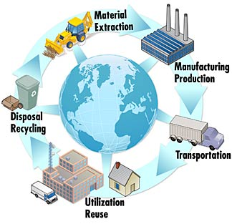

Yale-UNIDO Train-the-Facilitator Workshop in Green Chemistry
Metrics other than LCA
CENTER for GREEN CHEMISTRY
and GREEN ENGINEERING at YALE
Image: Wikimedia Commons, Life Cycle Thinking, Author:The National Institute of Standards and Technology (NIST)

Slide 2
Topics To Be Covered
Why do we need metrics in green chemistry?
Conventional chemistry metrics
  Yield
  Selectivity
  Conversion
3. Metrics in Green Chemistry
  Atom Economy
  Environmental (E) Factor
  Process Mass Intensity (PMI)
4. Life Cycle Thinking

Slide 3
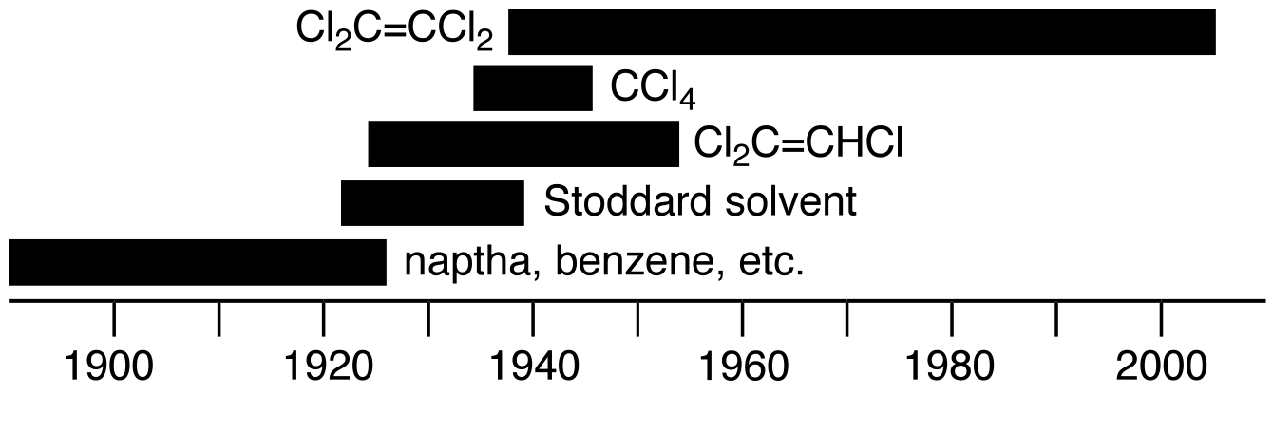
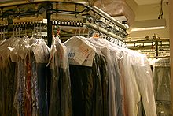
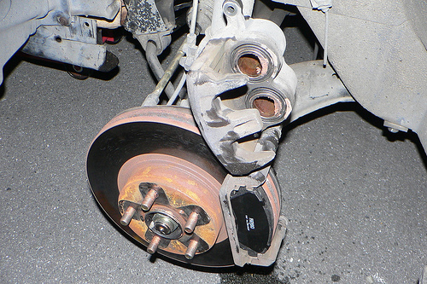

Risk migration
dry cleaning
Cl₂C=CCl₂
acetone & hexane
Image source: Wikipedia
disk brake and pads
Notes:
• naphtha, benzene (flammable)
• white spirits or Stoddard solvent, (C7-C12 alkanes, slightly less flammable), a chronic nephrotoxin (kidney)
• carbon tetrachloride (carcinogenic)
• trichloroethylene (toxic to liver and kidneys)
• perchloroethylene, “perc” (carcinogen, damages colour vision, Parikinson’s disease

Slide 4
Why do we need metrics?
choosing the greenest option
evaluating replacements (avoiding risk migration)
finding weaknesses in an option
guiding research & development
measuring improvement
Notes:
avoiding risk migration
making the best choice
finding weaknesses
measuring improvement

Slide 5
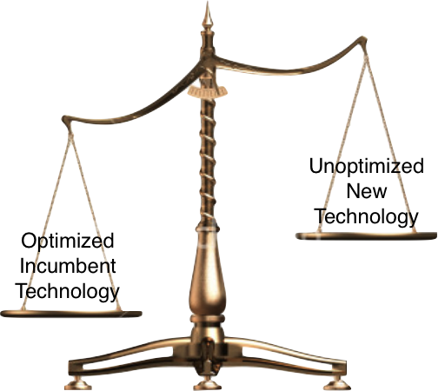
Why not use LCA for everything?
complex
time-consuming
requires emissions data
some chemicals never tested
inaccurate for new technologies
lack of LCA skills among staff
scarcity of skilled practitioners

Slide 6
Conventional Metrics: Yield
The Algebra of Organic Synthesis: Green Metrics, Design Strategy, Route Selection, and Optimization, J. Andraos, 2011, CRC Press

Slide 7
Yield Example (Nevirapine)
CONVENTIONAL SYNTHETIC CHEMISTRY PROCESS
Yield 79% 37% 94% 88% Overall Yield = 25%
GREEN CHEMISTRY BASED PROCESS BY NEWREKA
Yield 94% 98% 98% 96% Overall Yield = 86%
250% Improvement in Yield
Stage I
Diazo. & Hydrolysis
Stage II
Nitration
Stage III
Chlorination
Stage IV
Reduction
Stage V
Stage VI
Stage I
Diazo &
Hydrolysis
Stage II
Nitration
Stage III
Chlorination
Stage IV
Reduction
Stage V
Stage VI
Source: Newreka

Slide 8
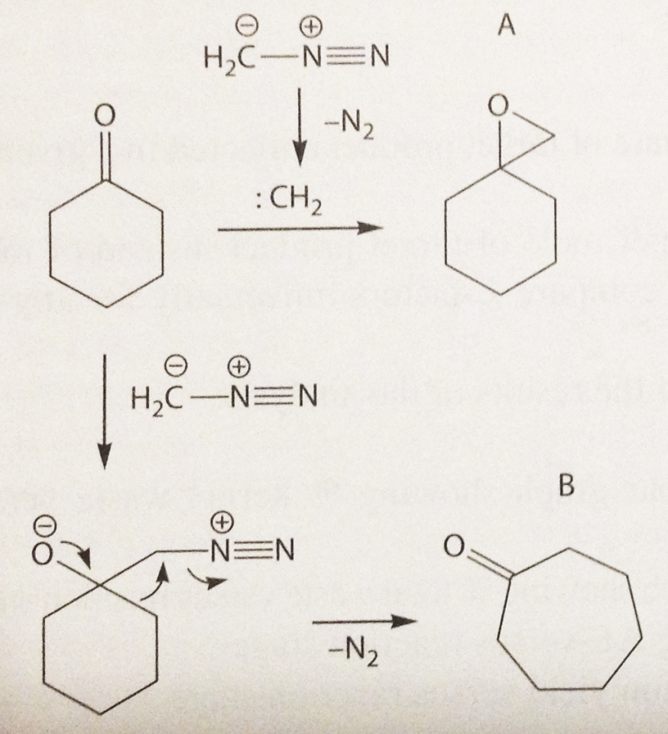
By-product vs side product
Point the side product, and the byproduct
Byproduct
Starting material
Target molecule
Side product

Slide 9
By-product vs side product
By-product of a reaction: a product formed in the reaction between reagents as a direct mechanistic consequence of producing the target product assuming a balanced chemical equation that accounts for the production of the target product
Side-product of a reaction: a product formed in the reaction, usually undesired, arising from a competing reaction pathway other than the one that produces the intended target product (+ by-products)
The Algebra of Organic Synthesis: Green Metrics, Design Strategy, Route Selection, and Optimization, J. Andraos, 2011, CRC Press

Slide 10
Conventional Metrics
Product
Side product
Product
Side product
n = stoichiometric coefficient
N = number of moles
N⁰ = initial number of moles

Slide 11


How good are these classic metrics?
How does classic metrics assess the following issues:
  The reaction is not quantitative
  There are unreacted starting materials
  I have some side product
  I produce by products
  I’m using solvent (in reaction, in work up)
  I’m using a catalyst (is it recovered?)
  I’m using auxiliaries
Conversion
Conversion
Selectivity
Need for Green Metrics
Calvo‐Flores, F.G. "Sustainable chemistry metrics." ChemSusChem 2.10 (2009): 905-919.

Slide 12


The green metrics
Material efficiency
  E factor
  Atom economy
  Carbon efficiency
  E factor based on molecular weight
  Effective mass yield
  Actual atom economy
  Environmental quotient
  Mass intensity
  Material recovery parameter
  Reaction mass efficiency
Energy efficiency
  Energy intensity
  Waste treatment energy
  Solvent recovery energy
From: Calvo‐Flores, F.G. "Sustainable chemistry metrics." ChemSusChem 2.10 (2009): 905-919.
If you want even more: The Algebra of Organic Synthesis: Green Metrics, Design Strategy, Route Selection, and Optimization, J. Andraos, 2011, CRC Press

Slide 13
Environmental Factor (E-Factor)
CHEM 462: 9. Atom Economy 1
Proposed by R. Sheldon in 1992
Notes:
13

Slide 14
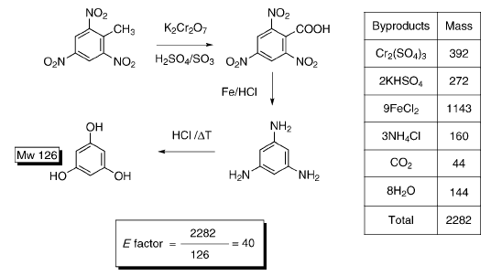
Environmental Factor (E-Factor)
Classical synthesis of phloroglucinol.
Compound masses are expressed in gram per mol.

Slide 15
Environmental Factor (E-Factor)
Depends on the definition of waste
  Non-recoverable starting materials, solvent, catalysts.
  Undesired side products.
Smaller E-factor means closer to zero waste
E-factor can be used to estimate/calculate the total waste generated:
  Amount of Waste = Amount of Product x E-factor
  E-factor = total waste (g) / product (g)
Industry sector | Annual production (t) | E-factor | Waste produced (t)
Oil refining | 10⁶-10⁸ | Ca. 0.1 | 10⁵ – 10⁷
Bulk chemicals | 10⁴-10⁶ | <1–5 | 10⁴ – 5 × 10⁶
Fine chemicals | 10²−10⁴ | 5–50 | 5 × 10² − 5 × 10⁵
Pharmaceuticals | 10–10³ | 25–100 | 2.5 × 10² − 10⁵
Notes:
Different types of processes have different range of E-factor

Slide 16
E-Factor Example
Friedel-Craft Alkylation (Substitution)
All numbers represent the mass of the chemical after the reaction.
Phenol | Chloroethane | Catalyst | Solvent | 4-Ethylphenol | 2-Ethylphenol | E-Factor
10 g | 20 g | 5 g | 1200 g | 80 g | 200 g | 6.575
  E-factor = total waste (g) / product (g)
 | At 10 g scale | 3-ton scale
Desired product | 200 g | 3 ton
Waste | 1315g | 19.725 ton
Industrial reactions are run on the big scale
Notes:
(10+20+5+1200+80) / 200 = 6.575
0.020 / 0.007 / 0

Slide 17
E-Factor Example (Nevirapine)
CONVENTIONAL SYNTHETIC CHEMISTRY PROCESS
E-Factor 32 38 28 4 Effluent
1920 TPA 2280 TPA 1680 TPA 240 TPA Total = 6120 TPA
(for 60TPA plant) (20,000 kg per day)
GREEN CHEMISTRY SOLUTION BY NEWREKA
E-Factor 6 6 1 4
Effluent 360 TPA 360 TPA 60 TPA 240 TPA Total = 1020 TPA
Stage I
Diazo. & Hydrolysis
Stage II
Nitration
Stage III
Chlorination
Stage IV
Reduction
Stage V
Stage VI
Stage I
Diazo &
Hydrolysis
Stage II
Nitration
Stage III
Chlorination
Stage IV
Reduction
Stage V
Stage VI
Source: Newreka

Slide 18
Process Mass intensity (PMI)
CHEM 462: 9. Atom Economy 1
Mass Intensity = e-factor + 1
Notes:
18

Slide 19
Atom Efficiency/Economy (AE)
CHEM 462: 9. Atom Economy 1
Proposed by Barry Trost in 1991
Calvo‐Flores, F.G. "Sustainable chemistry metrics." ChemSusChem 2.10 (2009): 905-919.
Notes:
19

Slide 20
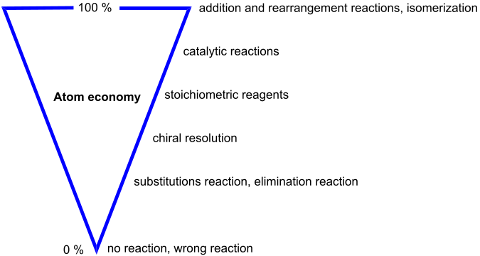
Atom economy
CHEM 462: 9. Atom Economy 1
Atom economy demands to minimize the quantity of matter that will not be in the desired product at the end.
Atom economy is among the green principles
Atom economy is often used as a generic term now in chemistry to talk about this idea of maximizing atoms from SM into products
Moores A. “Atom economy, principles and a few examples." in Green Catalysis (2009) Wiley
Notes:
20

Slide 21

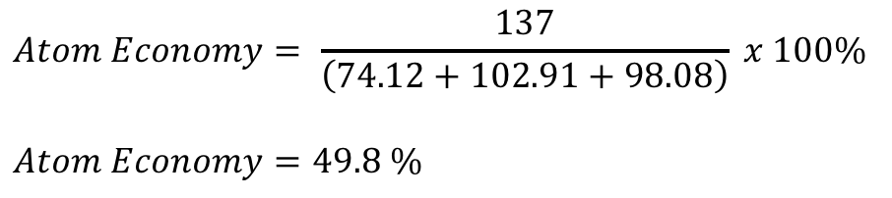
Atom economy Example
$Atom Economy=\frac{Mass of desired product∗}{Mass of all reactants∗}$
*including the stoichiometric coefficient
CH₃CH₂CH₂CH₂OH + NaBr + H₂SO₄ → CH₃CH₂CH₂CH₂Br + NaHSO₄ + H₂O
1 2 3 4 5 6 (Desired Product)
Reagent | M_{W} (g mol⁻¹)
1 (Reactant) | 74.12
2 (Reactant) | 102.91
3 (Reactant) | 98.08
4 (Desired Product) | 137
$$Atom Economy= \frac{137}{\left(74.12+102.91+98.08\right)} x 100\%$$
$$Atom Economy=49.8 \%$$
275.11 g mol⁻¹
Notes:
Reaction type??
137 / 275.11
49.8%

Slide 22
Atom Economy Example Two: Ibuprofen Synthesis
The Problem:
The traditional industrial synthesis of ibuprofen was developed and patented by the Boots Company of England in the 1960s (U.S. Patent 3,385,886). This synthesis is a six-step process and results in large quantities of unwanted waste chemical byproducts that must be disposed of or otherwise managed. Much of the waste that is generated is a result of many of the atoms of the reactants not being incorporated into the desired product (ibuprofen) but into unwanted byproducts (poor atom economy/atom utilization). The process also uses a variety of solvents, and catalysts (if any) are not used in stoichiometric amounts.
The Solution:
The BHC Company has developed and implemented a new greener industrial synthesis of ibuprofen that is only three steps (U.S. Patents 4,981,995 and 5,068,448, both issued in 1991). In this process, most of the atoms of the reactants are incorporated into the desired product (ibuprofen). This results in only small amounts of unwanted byproducts (very good atom economy/atom utilization) thus lessening the need for disposal and mediation of waste products. There are other environmental advantages to the green synthesis versus the brown synthesis, including solvents and catalyst.
- from Cann, M.C.; and Connelly, M.E. Real World Cases in Green Chemistry, American Chemical Society: Washington, DC, 2000

Slide 23
Brown synthesis
BHC synthesis
Ibuprofen
Synthesis

Slide 24
Exercise: Calculate AE of the Greener Synthesis of Ibuprofen
BHC synthesis

Slide 25
Exercise: Calculate AE of the Greener Synthesis of Ibuprofen
BHC synthesis

Slide 26
Exercise: Calculate AE of the Greener Synthesis of Ibuprofen
BHC synthesis

Slide 27
Exercise: Calculate AE of the Greener Synthesis of Ibuprofen
BHC synthesis

Slide 28
The Brown Synthesis of Ibuprofen
Brown synthesis

Slide 29
Brown synthesis
BHC synthesis
AE = 40%
AE = 77%
Ibuprofen
Synthesis

Slide 30
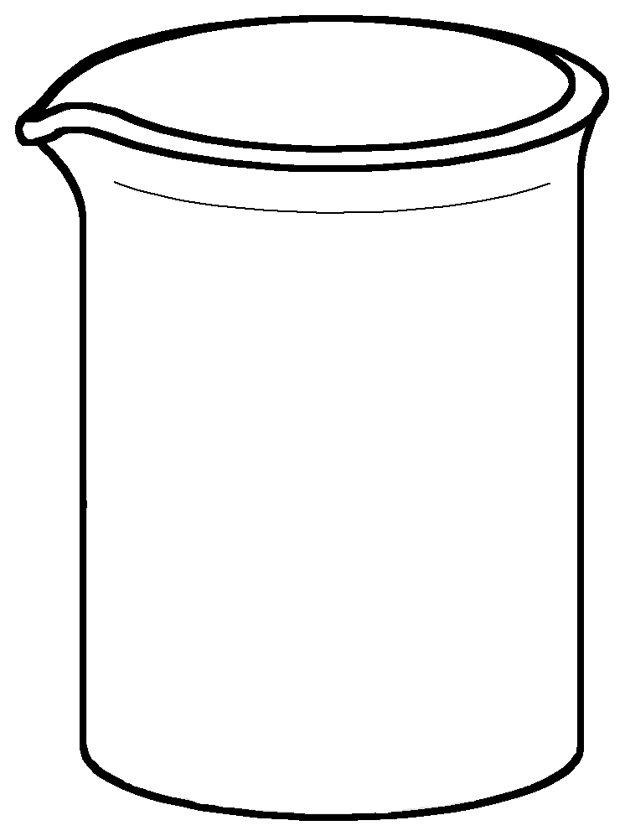
Life Cycle Thinking
Mass based metrics tell you nothing about environmental impact.
What if you want to consider environmental impact but can’t do an LCA?
ethyl acetate
dioxane

Slide 31
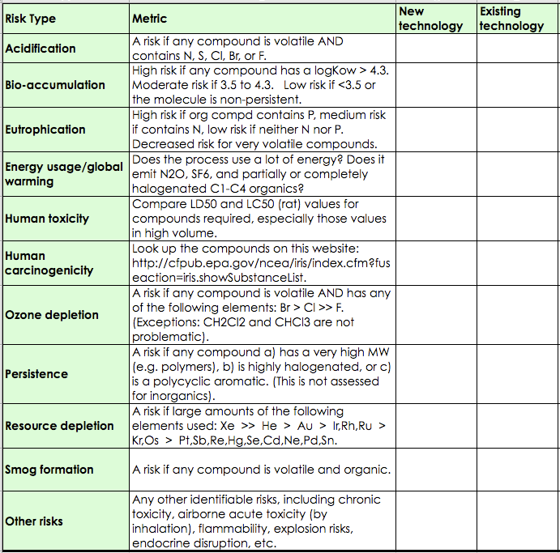
Life Cycle Thinking
ethyl acetate
dioxane
For every life stage, qualitatively consider risks.

Slide 32
Life Cycle Thinking (for comparing two chemicals)
ethyl acetate
dioxane
Use Stage: Look for risks in the compounds themselves
not a contributor to acid rain
not bioaccumulative
not eutrophying
low energy to distill
very little acute toxicity
not a carcinogen
not an ozone depleter
not persistent
minor resource depletion
smog-former
flammable
doesn’t form peroxides
may be a mutagen
not a contributor to acid rain
not bioaccumulative
not eutrophying
low energy to distill
very little acute toxicity
carcinogen
not an ozone depleter
not persistent
minor resource depletion
smog-former
flammable
forms explosive peroxides
may be a mutagen

Slide 33
Life Cycle Thinking (for comparing two chemicals)
ethyl acetate
dioxane
Manufacturing Stage: Look for risks in the synthesis tree

Slide 34
Life Cycle Thinking (for comparing two chemicals)
ethyl acetate
dioxane
Manufacturing Stage: Look for risks in the synthesis tree
acidification
bioaccumulation
eutrophication
energy usage/GHG
acute toxicity
carcinogenicity
ozone depletion
persistence
resource depletion
smog formation
Ni
Ni
Ir
Notes:
Ethyl acetate takes slightly more energy to make.

Slide 35
Life Cycle Thinking (for comparing two chemicals)
Reporting:
• clearly state what the new technology is being compared to.
• include both ADVANTAGES and DISADVANTAGES.
ethyl acetate
dioxane
Notes:
Ethyl acetate takes slightly more energy to make.

Slide 36
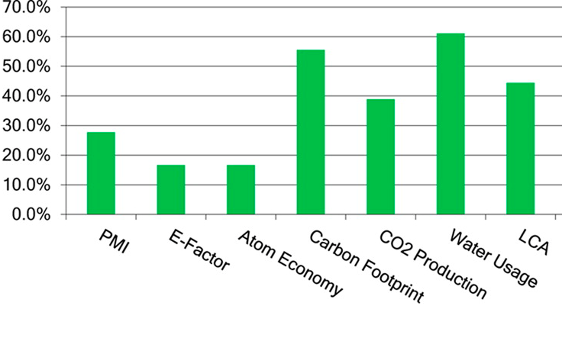
Green Chemistry-Related Metrics Used in Chemical Manufacturing
Chemical manufacturer responses (n = 18) to the 2012 Roundtable survey question “What green chemistry and engineering related metrics does your company use? Select all that apply.”
Percentage of respondents indicating one or more metrics surveyed in use computed as the ratio of [total responses – (not sure + none)]/(total responses). PMI = process mass intensity = (mass of raw materials)/(mass of final product).E-factor = (mass of waste)/mass of final product).LCA = life cycle assessment.
Implementing Green Chemistry in Chemical Manufacturing: A Survey Report Robert J. Giraud, Paul A. Williams, Amit Sehgal, Ettigounder Ponnusamy, Alan K. Phillips, and Julie B. Manley, ACS Sustainable Chemistry & Engineering 2014 2 (10), 2237-2242

Slide 37
Green Chemistry Metrics in Chemical Manufacturing - Discussion

Slide 38
Topics Covered
Why do we need metrics in green chemistry?
Conventional chemistry metrics
  Yield
  Selectivity
  Conversion
3. Metrics in Green Chemistry
  Atom Economy
  Environmental (E) Factor
  Process Mass Intensity (PMI)
4. Life Cycle Thinking

Slide 39
Sponsored by Yale-UNIDO Initiative
QUESTIONS?
CENTER for GREEN CHEMISTRY
and GREEN ENGINEERING at YALE

