Slide 1
Chemical Exposure and Dosage
Lecture #22
Date:
Course #

Slide 2
Outline
Risk Assessment
Hazard
Exposure
Dose
Dose Response Curve
LOAEL, NOAEL, and Reference Dose
Tools for Hazard Characterization

Slide 3
Outline
Risk Assessment
Hazard
Exposure
Dose
Dose Response Curve
LOAEL, NOAEL, and Reference Dose
Tools for Hazard Characterization

Slide 4
The Challenge of Environmental Risk
There are over 100,000 chemicals in global circulation.
700+ chemicals are introduced to the US Market each year.
85% of these chemicals lack experimental data.
This causes unintended biological activity which leads to increased hazard as well as toxic endpoints for humans and the environment.
Source: Wikimedia Commons

Slide 5
Key terms
Hazard — capability of a substance to cause an adverse effect.
Risk — probability that the hazard will occur under specific exposure conditions.
Risk assessment — the process by which hazard, exposure, and risk are determined.
Risk management — the process of weighing policy alternatives and selecting the most appropriate regulatory action based on the results of risk assessment and social, economic, and political concerns.

Slide 6
Risk Assessment Steps
Hazard identification — characterization of innate adverse toxic effects of agents.
Dose-response assessment — characterization of the relation between doses and incidences of adverse effects in exposed populations.
Exposure assessment — measurement or estimation of the intensity, frequency, and duration of human exposures to agents.
Risk characterization — estimation of the incidence of health effects under the various conditions of human exposure.
Interaction between processes of risk assessment and risk management (Image Source: ORAU, ©)
Toxicologyschools.com
Toxtutor.nml.nih.gov

Slide 7
Outline
Risk Assessment
Hazard
Exposure
Dose
Dose Response Curve
LOAEL, NOAEL, and Reference Dose
Tools for Hazard Characterization

Slide 8
Hazard
What types of chemical hazards are there?
Global Hazards (global warming, acid rain, security threat, ozone depletion)
Physical Hazards (explosivity, corrosivity, oxidizers/reducers, pH)
Toxicological
Environmental (aquatic toxicity, avian toxicity, mammalian toxicity)
Human (carcinogenicity, neurotoxicity, hepatotoxicity, dermal toxicity)
Hazard identification is the first component of the risk assessment (Image Source: ORAU, ©)
Toxicologyschools.com
Toxtutor.nml.nih.gov

Slide 9
Outline
Risk Assessment
Hazard
Exposure
Dose
Dose Response Curve
LOAEL, NOAEL, and Reference Dose
Tools for Hazard Characterization

Slide 10
Exposure - sources
Consumer products (perhaps 20 or more during a day)
Clothing
Residential and other water
Indoor and outdoor air
Food and food packaging
Beverages
Toys
Furniture
Carpeting, paint, and other building materials
Tobacco smoke
Household dust containing chemicals from consumer products
Outdoor soil and soil tracked indoors
Exposure assessment as a component of risk assessment (Image Source: ORAU, ©)
Toxicologyschools.com
Toxtutor.nml.nih.gov

Slide 11
Risk Equation
Risk = f(Hazard, Exposure)
Environmental risk is resulting from exposure to a potential environmental hazard
Risk can be reduced by in two ways:
As hazard , exposure needs to be reduced to 0
If hazard = 0, exposure can be
Ultimate goal is to use BENIGN materials

Slide 12
Why Use Benign Materials?
Exposure becomes irrelevant
Less dependence on systems which can fail or be sabotaged
Competitive advantage – reduces costs associated with toxic waste

Slide 13
Approaching Risks: Exposure versus Smart Design
The traditional approach to hazards focuses on reducing risk by minimizing exposure.
For example, wearing personal protective equipment or space ventilation if the chemical is volatile.
Green chemistry focuses on reducing risk by reducing hazard.
If there is no hazard, exposure becomes irrelevant.

Slide 14
LEED-Leadership in Energy and Environmental Design Green Buildings
Certification for design, construction and operation of green buildings.
Guidelines for site management, storm water & water use, building materials, energy conservation, and air quality.
Certification is granted on 4 levels – certified, silver, gold, and platinum based on accumulated points.
Country Name | Gross Square Meters* | Number of Projects
China | 34.62 | 931
Canada | 34.39 | 2,586
India | 15.90 | 644
Brazil | 7.43 | 380
Republic of Korea | 5.95 | 97
Taiwan | 5.66 | 99
Germany | 5.03 | 215
Turkey | 4.78 | 191
Sweden | 3.88 | 210
United Arab Emirates | 3.64 | 180
United States** | 336.84 | 27,699
Countries in terms of cumulative LEED-certified GSM space as of December 2016. LEED-certified spaces use fewer energy and water resources; save money for families, businesses, and taxpayers; reduce carbon emissions; and prioritize environmental and human health.

Slide 15
Mihelcic, J. R.; Zimmerman, J. B., Environmental engineering: Fundamentals, sustainability, design. Wiley Global Education: 2014.

Slide 16
How have we dealt with chemicals and the environment in the past?

Slide 17
Historical Approach to Environmental Problems
Waste treatment, control, and disposal; pollutant monitoring; hazardous waste site cleanup.
Development of standards for emissions to air, releases to water, and disposal by land, as well as regulation of these standards.
“Command and Control”

Slide 18
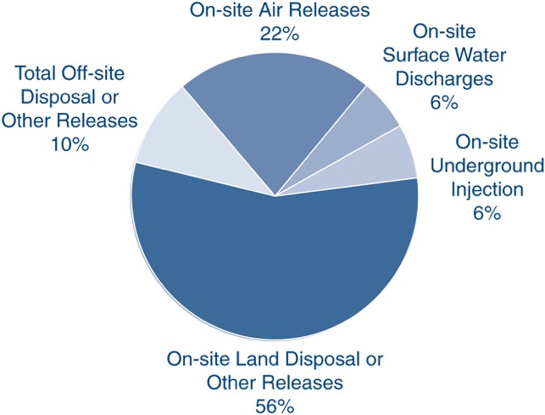
Chemicals in the Environment
In U.S., 3.93 billion lbs. of toxic chemicals were released directly to air, water, and land in 2011.
Only 650 of toxic chemicals and toxic chemical categories out of 78,000 in commerce are tracked by Toxic Release Inventory.
Mihelcic, J. R.; Zimmerman, J. B., Environmental engineering: Fundamentals, sustainability, design. Wiley Global Education: 2014.

Slide 19
Why should we care?

Slide 20
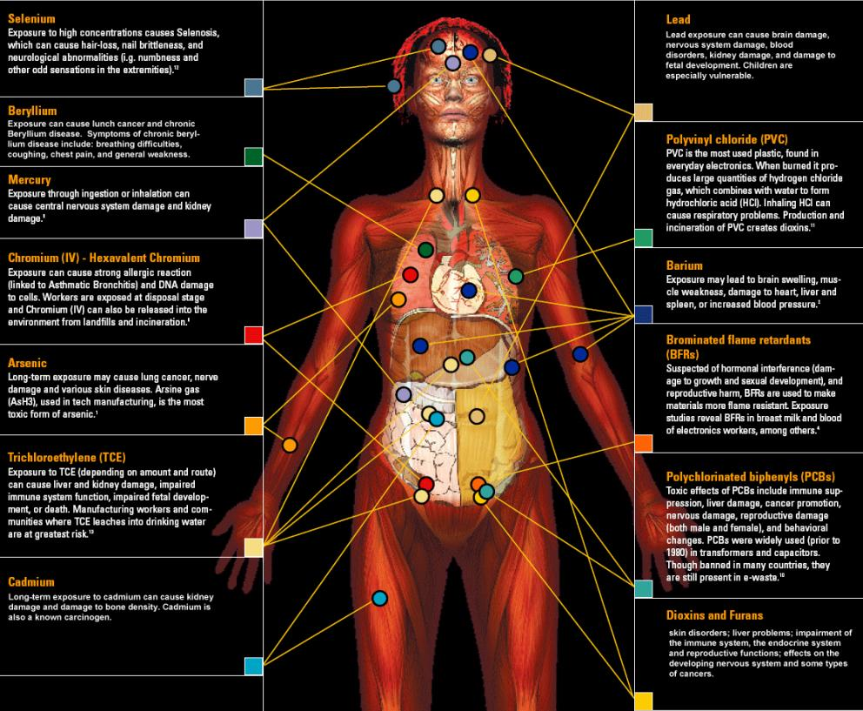
Body burden
148 chemicals in the body
Of the chemicals found:
76 cause cancer in humans or animals,
94 are toxic to the brain and nervous system, and
79 cause birth defects or abnormal development.
The dangers of exposure to these chemicals in combination has never been studied.
One of Green Chemistry’s greatest strengths is the ability to design for reduced hazard.
Image Source: http://svtc.org/our-work/e-waste/

Slide 21
What is the most important factor in bringing about the adverse biological impact?

Slide 22
Outline
Risk Assessment
Hazard
Exposure
Dose
Dose Response Curve
LOAEL, NOAEL, and Reference Dose
Tools for Hazard Characterization

Slide 23
Dose
Dose is the amount of a substance administered at given times.
For example:
650 mg Tylenol as a single dose
500 mg Penicillin every 8 hours for 10 days
10 mg DDT per day for 90 days

Slide 24
Dose Makes the Poison
An apparently nontoxic chemical can be toxic at high doses.
Highly toxic chemicals can be life saving when given in appropriate doses.
Sugarcane
Source: Wikimedia Commons

Slide 25
Lethal Doses
Approximate Lethal Doses of Common Chemicals (Calculated for a 160 lb. human from data on rats)
Chemical Lethal Dose
Sugar (sucrose) 3 quarts
Alcohol (ethyl alcohol) 3 quarts
Salt (sodium chloride) 1 quart
Herbicide (2, 4-D) one half cup
Arsenic (arsenic acid) 1-2 teaspoons
Nicotine one half teaspoon
Food poison (botulism) microscopic
Source: Marczewski, A.E., and Kamrin, M. Toxicology for the citizen, Retrieved August 17, 2000: www.iet.msu.edu/toxconcepts/toxconcepts.htm.

Slide 26
How is toxicity testing done?

Slide 27
Outline
Risk Assessment
Hazard
Exposure
Dose
Dose Response Curve
LOAEL, NOAEL, and Reference Dose
Tools for Hazard Characterization

Slide 28
Dose-Response
The dose-response relationship is a fundamental and essential concept in toxicology. It correlates exposures and the spectrum of induced effects.
The dose-response relationship is based on observed data from experimental animal, human clinical, or cell studies.
Dose-response assessment is a step in the risk assessment process (Image Source: ORAU, ©)
Toxicologyschools.com
Toxtutor.nml.nih.gov

Slide 29
Dose-Response
Knowledge of the dose-response relationship:
establishes causality that the chemical has in fact induced the observed effects.
establishes the lowest dose where an induced effect occurs - the threshold effect.
determines the rate at which injury builds up - the slope for the dose response.
The Linearized Multistage Model is used to extrapolate cancer risk from a dose-response curve using the cancer slope factor. (Image Source: NLM)

Slide 30
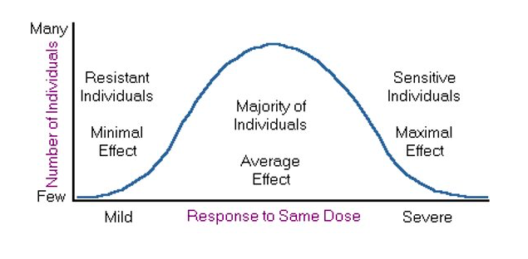
Variance in Population Susceptibility
As demonstrated above, a graph of the individual responses can be depicted as a bell-shaped standard distribution curve.
Toxtutor.nml.nih.gov

Slide 31
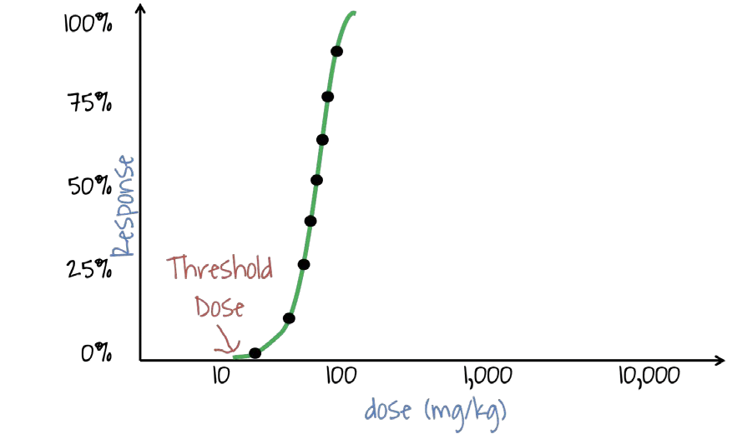
Dose-response
When we graph the dose of a substance and the percentage of a population that responds to that dose, the result is called the dose-response curve.
When plotting the response at various doses, the dose-response curve normally takes the form of a sigmoid curve that is shaped like the letter “S”.
For most effects, small doses are not toxic. The point at which toxicity first appears is known as the threshold dose level.
Shape and slope of the dose-response curve for predicting the toxicity of a substance at specific dose levels.
Toxicologyschools.com
Toxtutor.nml.nih.gov

Slide 32
Outline
Risk Assessment
Hazard
Exposure
Dose
Dose Response Curve
LOAEL, NOAEL, and Reference Dose
Tools for Hazard Characterization

Slide 33
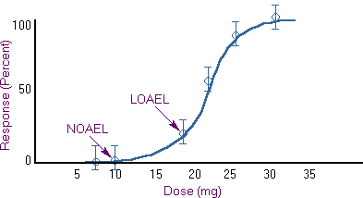
LD50, NOAEL, LOAEL, and RfD
LD 50- A common dose estimate for acute toxicity is the LD50 (Lethal Dose 50%).
This is a statistically derived dose at which 50% of the individuals will be expected to die.
NOAEL - No Observed Adverse Effect Level
Highest data point at which there was no adverse effect.
LOAEL - Low Observed Adverse Effect Level
Lowest data point at which there was an adverse effect.
LD 50
UF = Uncertainty factor (10-1000)
RfD – estimate of a daily oral exposure to the human population, that’s likely to be without risk of an effect.
Toxtutor.nml.nih.gov

Slide 34
Determining the Relative Safety of Pharmaceuticals
Toxicologists, pharmacologists, and others use effective and toxic dose levels to determine the relative safety of pharmaceuticals. As shown in this figure, two dose-response curves are presented for the same drug, one for effectiveness and the other for toxicity. In this case, a dose that is 50% to 75% effective does not cause toxicity. However, a 90% effective dose may result in a small amount of toxicity.
Toxicologyschools.com
Toxtutor.nml.nih.gov

Slide 35
Margin of Safety
The shaded area represents the doses at which the substance produces an effective dose response while the toxic dose response remains below the TD50.
Although more patients may benefit from higher doses, that is offset by the probability that toxicity will occur.
Ideally, effective dose DOES NOT overlap with the toxic dose. Otherwise this becomes an ethical issue.
Toxicologyschools.com
Toxtutor.nml.nih.gov

Slide 36
In-Class Discussion - Which Solvent Would You Use?
Solvent 99-2
100
90
Solvent 99-7
80
70
60
% Mortality
50
40
30
20
10
0
0 50 100 150 200 250 300 350
Inhaled Dose (ppm)
Plotted here are two theoretical curves for the toxicity of solvents used in the cleaning of silicon compounds. Both solvent 99-2 and 99-7 performed equally well against a variety of manufactured silicon compounds. The task at hand for you is to determine which solvent would you pick to be “safer” for use. As you can see from the accompanying data, both compounds have an equivalent Lethal dose 50 value (LD50). These are based on average values during a 6 hour exposure period.

Slide 37
In-Class Discussion - Which Solvent Would You Use?
Solvent 99-2
100
90
Solvent 99-7
80
70
60
% Mortality
50
40
30
20
10
0
0 50 100 150 200 250 300 350
Inhaled Dose (ppm)
Solvent 99-7 causes lethality at much lower levels than 99-2 (20ppm versus 100ppm respectively), and the response is much more predictable (i.e. less population heterogeneity). Solvent 99-2 because higher levels can be inhaled before any harmful effects should begin.
Courtesy of Dr. Karolina Mellor

Slide 38
Hazard Assessment
Review and analysis of toxicology data and assessing if the substance causes toxic effects.
Sources include animal and human studies and computational data.
These studies have difficulty with showing causation (if a risk factor lead to disease).
Mihelcic, J. R.; Zimmerman, J. B., Environmental engineering: Fundamentals, sustainability, design. Wiley Global Education: 2014.

Slide 39
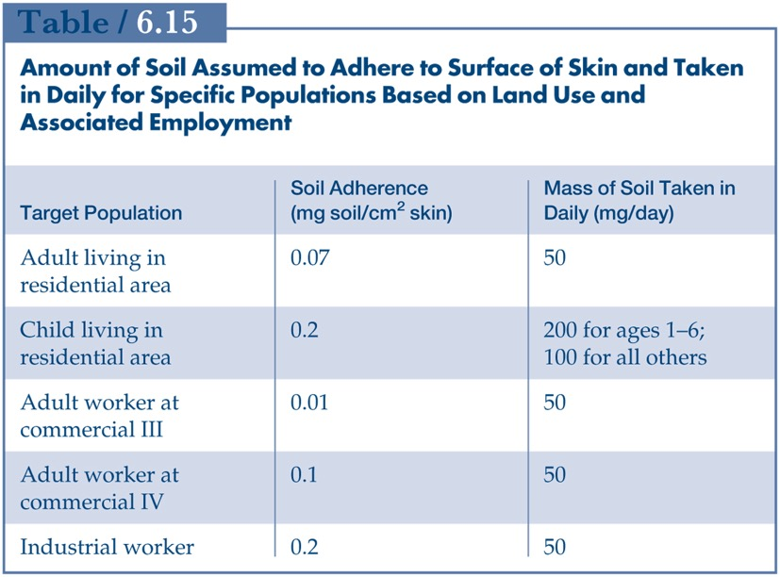
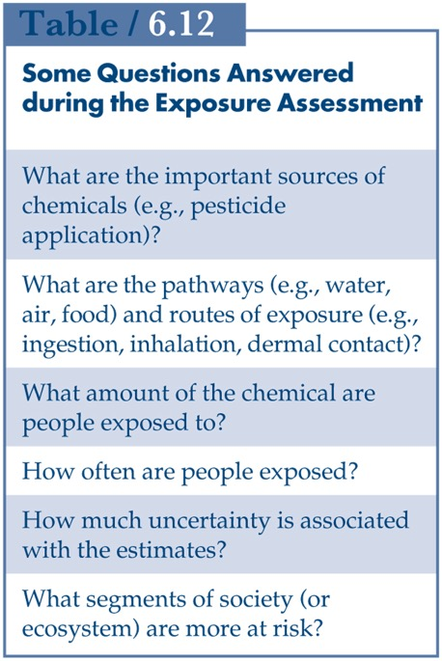
Exposure Assessment
Determines the extent and frequency of human exposure to target chemicals.
Guidelines for residential, industrial and commercial sites.
For engineers, the knowledge of risk and exposure provides information whether the site needs to be remediated.
Mihelcic, J. R.; Zimmerman, J. B., Environmental engineering: Fundamentals, sustainability, design. Wiley Global Education: 2014.

Slide 40
Outline
Risk Assessment
Hazard
Exposure
Dose
Dose Response Curve
LOAEL, NOAEL, and Reference Dose
Tools for Hazard Characterization

Slide 41
Tools For Hazard Characterization
ChemHAT - easy way to access summarized information on chemical hazards in the workplace.
ChemSpider
Protox
Safer Choice - for consumers, businesses, and purchasers to find products that perform and are safer for human health and the environment.
toxicity assessments based on experimental or predicted LD 50.
Notes:
Show tools

Slide 42
Brief Knowledge Check

Slide 43
The No Observed Adverse Effect Level (NOAEL) is the:
Lowest dose at which there was no observed toxic or adverse affect
Highest dose at which there was no observed toxic or adverse effect
Highest dose at which there was an observed adverse effect

Slide 44
The No Observed Adverse Effect Level (NOAEL) is the:
Lowest dose at which there was no observed toxic or adverse affect
Highest dose at which there was no observed toxic or adverse effect
Highest dose at which there was an observed adverse effect

Slide 45
The Lowest Observed Adverse Effect Level (LOAEL) is the:
Lowest dose at which there was an observed toxic or adverse effect
Lowest dose at which there was no observed toxic or adverse effect
Highest dose at which there was an observed adverse effect

Slide 46
The Lowest Observed Adverse Effect Level (LOAEL) is the:
Lowest dose at which there was an observed toxic or adverse effect
Lowest dose at which there was no observed toxic or adverse effect
Highest dose at which there was an observed adverse effect

Slide 47
The quantity of a substance administered to an individual over a period of time or in several individual doses is known as the:
administered dose
absorbed dose
total dose

Slide 48
The quantity of a substance administered to an individual over a period of time or in several individual doses is known as the:
administered dose
absorbed dose
total dose

Slide 49
Fractionation of a total dose so that the total amount administered is given over a period of time usually results in:
decreased toxicity
increased toxicity

Slide 50
Fractionation of a total dose so that the total amount administered is given over a period of time usually results in:
decreased toxicity
increased toxicity

Slide 51
The usual dosage unit that incorporates the amount of material administered or absorbed in accordance with the size of the individual over a period of time is:
PPM/hour
mg/kg/day
kg/100 lb/week

Slide 52
The usual dosage unit that incorporates the amount of material administered or absorbed in accordance with the size of the individual over a period of time is:
PPM/hour
mg/kg/day
kg/100 lb/week

Slide 53
The dose-response relationship helps a toxicologist determine:
whether exposure has caused an effect
the threshold dose
the rate of increasing effect with increasing dose levels
all of the above

Slide 54
The dose-response relationship helps a toxicologist determine:
whether exposure has caused an effect
the threshold dose
the rate of increasing effect with increasing dose levels
all of the above

Slide 55
Risk is the:
Capability of a substance to cause an adverse effect
Weighing of possible alternatives and selecting the most appropriate regulatory actions
Probability that a hazard will occur under specific exposure conditions

Slide 56
Risk is the:
Capability of a substance to cause an adverse effect
Weighing of possible alternatives and selecting the most appropriate regulatory actions
Probability that a hazard will occur under specific exposure conditions

Slide 57
A major component of exposure assessment involves:
Identifying the exposure pathways
Measuring the amount of a substance that is metabolized in the body
Determining the amount of exposure that must be reduced to comply with the acceptable risk level

Slide 58
A major component of exposure assessment involves:
Identifying the exposure pathways
Measuring the amount of a substance that is metabolized in the body
Determining the amount of exposure that must be reduced to comply with the acceptable risk level

Slide 59
Summary
Understanding the link between Hazard and Risk:
Hazard — capability of a substance to cause an adverse effect.
Risk — probability that the hazard will occur under specific exposure conditions.
Risk assessment — the process by which hazard, exposure, and risk are determined.
Exposure and Dose: understanding the link between chemical exposure and dose
Dose is the amount of a substance administered at given times.
Dose Response Curve - It correlates exposures and the spectrum of induced effects. Based on measured data.
LOAEL, NOAEL, and Reference Dose
There are open access tools available for hazard identification and characterization

