Slide 1

Yale-UNIDO Train-the-Facilitator Workshop in Green Chemistry
Mechanistic Toxicology
CENTER for GREEN CHEMISTRY
and GREEN ENGINEERING at YALE

Slide 2


John C. Warner
Mechanistic Toxicology
President and CTO
warnerbabcock institute for green chemistry
john.warner@warnerbabcock.com
Distinguished Professor of Green Chemistry
Monash University – School of Chemistry
John.Warner@Monash.edu
Cofounder
beyondbenign green chemistry education
john@beyondbenign.org
ENVR E-158A Green Chemistry
Harvard Extension School
JohnWarner@FAS.Harvard.Edu
@johnwarnerorg

Slide 3
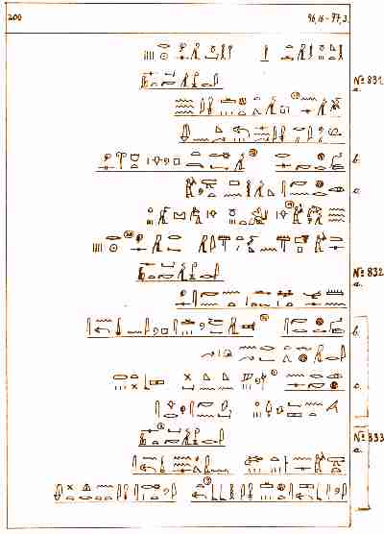
History of Toxicology
Antiquity
  The Ebers Papyrus (around 1500 BC)
This Egyptian papyrus from about 1552 B.C. is the oldest preserved medical document. It measures about 20.23 m in length and 30 cm. in height. More complete than the Edwin Smith papyrus, it is the most important medical papyrus yet recovered. It is written in hieratic script and contains the most complete record of Egyptian medicine known. The 110 pages scroll contains 700 magical formulas and folk remedies meant to cure afflictions ranging from crocodile bite to toenail pain and to rid the house of such pests as flies, rats, and scorpions.
The papyrus contains chapters on intestinal disease, helminthiasis, ophthalmology, dermatology, gynaecology, obstetrics, pregnancy diagnosis, contraception, dentistry, and the surgical treatment of abscesses, tumours, fractures and burns. The ancient Egyptians say that a depressed skull fracture looked like a puncture in a pottery jar.
It also includes a surprisingly accurate description of the circulatory system, noting the existence of blood vessels throughout the body and the hearts function as a centre of the blood supply. It also refers to birth control, diabetes mellitus, trachoma, hookworm and filariasis, as well as forms of arthritis.
The papyrus also contains a short section on psychiatry. It describes a condition of severe despondency that is equivalent to our modern definition of depression.
http://www.aldokkan.com/science/ebers.htm

Slide 4
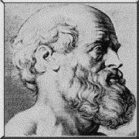
  Hippocrates (400 BC)
Introduced clinical toxicology principles by describing elemental concepts of bioavailability and overdose
http://www2.sjsu.edu/depts/Museum/hippoc.html
I swear by Apollo the Physician and Asclepius and Hygeia and Panaceia and all the gods and goddesses, making them my witnesses, that I will fulfill according to my ability and judgment this oath and this covenant: To hold him who has taught me this art as equal to my parent and to live my life in partnership with him, and if he is in need of money to give him a share of mine, and to regard his offspring as equal to my brothers in male lineage and to teach them this art--if they desire to learn it--without fee and covenant; to give share of precepts and oral instruction and all other learning to my sons and to the sons of him who has instructed me and to pupils who have signed the covenant and have taken an oath according to the medical law, but to no one else. I will apply dietetic measure for the benefit of the sick according to my ability and judgment; I will keep them from harm and injustice. I will neither give a deadly drug to anybody if asked for it, nor will I make a suggestion to this effect. Similarly I will not give a woman an abortive remedy. In purity and in holiness I will guard my life and my art. I will not use the knife, not even on sufferers from stone, but will withdraw in favor of such men as are engaged in this work. Whatever houses I may visit, I will come for the benefit of the sick, remaining free of all intentional injustice, of all mischief and in particular of sexual relations with both female and male persons, be they free or slaves. What I may see or hear in the course of the treatment or even outside of the treatment in regard to the life of men, which on no account one must spread abroad, I will keep to myself holding such things shameful to be spoken about. If I fulfill this oath and do not violate it, may it be granted to me to enjoy life and art, being honored with fame among all men for all time to come; if I transgress it and swear falsely, may the opposite be my lot. The Hippocratic Oath --Translated by Ludwig Edelstein
http://www.med.virginia.edu/hs-library/historical/antiqua/texto.htm

Slide 5
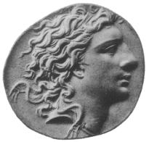
  Mithridates VI (132 - 63 BC)
Mithridates VI of Pontus, (132 BC- 63 BC), called Eupator Dionysius, was the king of Pontus in Asia Minor and one of Rome's most formidable and successful enemies.
Legend is that Mithridates sought to harden himself against poisoning by taking increasing sub-lethal doses of the poisons he knew of until he was able to tolerate lethal doses. A. E. Housman alludes to this practice, also known as mithridatism, in the poem "Terence, this is stupid stuff” in A Shropshire Lad. On account of this regimen, a universal antidote is sometimes called a mithridate.
This fear of poisoning -- rational for an ancient king -- is said to have taken a darkly poetic turn; when Mithridates was at last defeated by Pompey and in danger of capture by Rome, he is alleged to have attempted suicide by poison, but he couldn't take enough of the stuff to kill him and had instead to fall on his sword.
http://en.wikipedia.org/wiki/Mithridates_VI_of_Pontus

Slide 6

  Moses ben Maimon [Maimonides]
  (1135-1204)
Teach your tongue to say "I do not know" and you will progress.
The risk of a wrong decision is preferable to the terror of indecision.
You must accept the truth from whatever source it comes.
Poisons and their Antidotes
Treatise on the treatment of poisonings from insects, snakes
And mad dogs. Described the subject of bioavailability, noting
That milk, butter and cream can delay intestinal absorption.
http://www.maimonidesinstitute.com/history.html

Slide 7
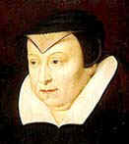
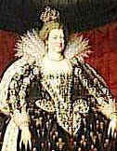
  Catherine de Medici (1519-1589)
Under the guise of delivering food to the sick and the poor, she tested concoctions, carefully noting the rapidity of the toxic response (onset of action), the effectiveness of the compound (potency), the degree of response of different parts of the body (specificity, site of action), and the complaints of the victim (clinical signs and symptoms).
http://www.saburchill.com/history/biblio/020.html

Slide 8
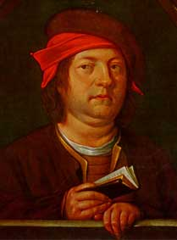
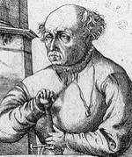
  Paracelsus [Phillippus Aureolus Theophrastus Bombastus von Hohenheim-Paracelsus]
  (1493-1541)
“All substances are poisons; there is none which is not a poison.
The right dose differentiates a poison from a remedy.”
Focused on the primary toxic agent as a chemical entity and held that:
1. Experimentation is essential in the examination of responses to chemicals.
2. One should make a distinction between the therapeutic and toxic properties of chemicals.
3. These properties are sometimes, but not always, indistinguishable except by dose.
4. One can ascertain a degree of specificity of chemicals and their therapeutic or toxic effects
“On the Miner’s Sickness and Other Diseases of Miners”
Addressed the etiology of miner’s disease, along with treatment
And prevention strategies.
http://en.wikipedia.org/wiki/Paracelsus
http://www.forteantimes.com/articles/157_paracelsus.shtml

Slide 9
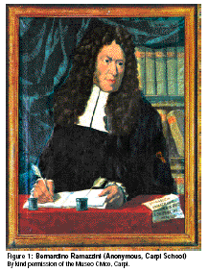
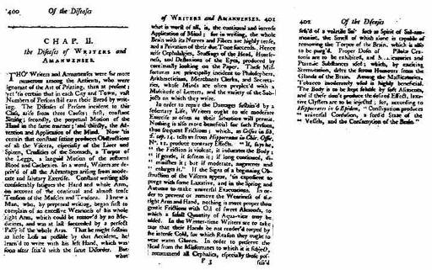
  Bernardino Ramazzini (1633-1717)
Discourse on the Disease of Workers
Discussed occupations ranging from miners
to midwives and including printers, weavers
and potters.
Occupational Toxicology
http://www.humanics-es.com/ramazzini.htm#ramazzini
http://www.alp.mcgill.ca/health_safety/Ergonomics/Ergo_res/lancet354_99_858.pdf#search='Bernardino%20Ramazzini'

Slide 10
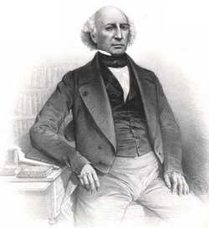
  Mathieu Joseph Bonaventure Orfila (1787-1853)
Forensic Toxicology
Used autopsy material and chemical analysis
systematically to provide legal proof of poisoning.
Trait des poisons or Toxicologie generate
A major work devoted expressly to
the toxicity of natural agents.
http://en.wikipedia.org/wiki/Mathieu_Joseph_Bonaventure_Orfila

Slide 11
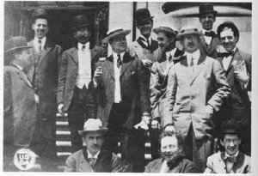
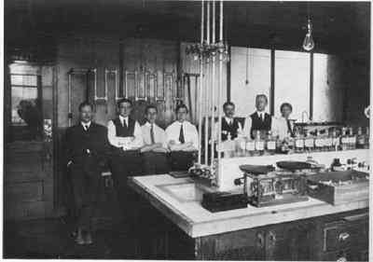
The Pure Food Bill of 1906: “The Wiley Bill”
In 1906, Upton Sinclair published his socialist novel, THE JUNGLE, aimed, as he later said, at people's hearts but hitting their stomachs instead. His few pages describing filthy conditions in Chicago's packing plants, widely reported and confirmed by governmental inquiry, cut meat sales in half, angered President Roosevelt, and pushed a meat inspection bill aimed at protecting the domestic market through the Congress. The President, in December 1905, had at long last sent a terse message to the Congress urging it to enact a pure food bill. The Senate had responded. Amidst the meat crisis, when the House leadership seemed again determined to give the food measure the silent treatment, Roosevelt called the speaker in and insisted that the bill be brought to the floor. Wiley energized his coalition to a last burst of pressure. Committees engaged in a final flurry of compromise. And the bill became law.
The 1906 law forbade interstate and foreign commerce in adulterated and misbranded food and drugs. Offending products could be seized and condemned; offending persons could be fined and jailed. Drugs had either to abide by standards of purity and quality set forth in the UNITED STATES PHARMACOPEIA and the NATIONAL FORMULARY, works prepared by committees of physicians and pharmacists, or meet individual standards chosen by their manufacturers and stated on their labels. An effort failed to place in the law food standards as defined by the agricultural chemists, but the law prohibited the adulteration of food by the removal of valuable constituents, the substitution of ingredients so as to reduce quality, the addition of deleterious ingredients, and the use of spoiled animal and vegetable products. Making false or misleading label statements regarding a food or a drug constituted misbranding. The presence and quantity of alcohol or certain narcotic drugs had to be stated on proprietary labels.
Inspectors from the Bureau of Chemistry's
office in Indianapolis, 1909.
A Bureau of Chemistry laboratory, 1911.
http://vm.cfsan.fda.gov/~lrd/history2.html

Slide 12




1930 The first Journal and the Creation of the NIH

Slide 13
1938 “The Copeland Bill”
Strengthening of the FDA.
Headlines the country over broke the news of a mounting death toll from "Elixir Sulfanilamide." The report was especially disturbing since sulfanilamide had been widely heralded in the press as a miracle medicine, a chemotherapeutical breakthrough. In this case, nothing was wrong with the sulfa, but in another respect a terrible mistake had been made. The chief chemist at a small pharmaceutical plant in Bristol, Tennessee, seeking for a liquid dosage form, had hit upon the solvent diethylene glycol. Unaware of reports describing the compound's toxicity, the chemist had tested his new concoction for appearance, fragrance, and flavor—but not for safety. Production began both in Bristol and in the firm's Kansas City plant. Nearly 2,000 pints of the viscous pink liquid were made, and on not one label was the solvent named.
Nearly two months later, the FDA heard a rumor that deaths were occurring in Oklahoma from some sulfa compound. Investigation quickly revealed the terrible truth. Only a technicality made the drug misbranded and let the FDA take action: all elixirs, according to the Pharmacopeia, must contain alcohol, and this "Elixir" did not. The agency threw its entire staff into the task of tracking down and seizing the poisonous medicine. Most of the 93 pints which had reached patients had been prescribed by doctors. Some, however, had been sold over the counter by druggists to customers whom they did not know, largely because of publicity praising sulfanilamide's effectiveness in treating gonorrhea. Displaying great patience and ingenuity, Food and Drug inspectors, aided by state and local authorities, managed to account for 99.2 per cent of all "Elixir Sulfanilamide" produced. In South Carolina, one bottle, not yet empty, was found on the very grave of an "Elixir" victim, tossed there by the bereaved in accordance with an ancient local rite.
Death from diethylene glycol is protracted and it is painful. The "Elixir," according to FDA calculations, brought death to at least 107 persons, many of them children. One of the most poignant documents in the whole record of food and drug legislation is a letter written to Franklin Roosevelt by the mother of one of the victims. She told how her child, a little girl of six, had died in agony, and begged the President to get a law so that other families would not have to suffer as hers had done. With the letter she sent a picture of her daughter's smiling face.
The chemist who concocted the "Elixir" took his own life, The doctor who owned the company—during the unfolding tragedy he had told the press, "I do not feel that there was any responsibility on our part"—paid a fine of $26,100, the highest ever levied under the 1906 law. The public, shocked into a new awareness that the law had loopholes, urged Congress to remedy the fault.
http://www.quackwatch.org/13Hx/MM/08.html

Slide 14


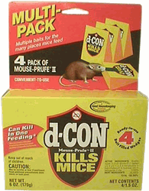

1947 “The Federal Insecticide, Fungicide and Rodenticide Act”
For the first time in US history, a substance that was neither
a drug nor a food had to be shown to be safe and efficacious.

Slide 15
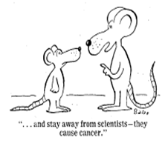
1958 The Additives Amendments to the Food, Drug and Cosmetics Act
“The Delaney Clause”
“Any chemical found to be carcinogenic in laboratory animals
or humans can not be added to the food supply.”
“… and stay away from scientists – they
cause cancer.”

Slide 16
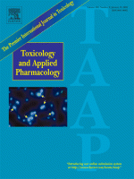

1960 A new “Society” and a New Journal...
“Toxicology and Applied Pharmacology”
“The Society of Toxicology”

Slide 17
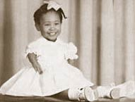
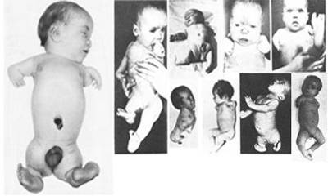
1961 Thalidomide
Thalidomide, was hailed as a "wonder drug" that provided a "safe, sound sleep".
Thalidomide was a sedative that was found to be effective when given to pregnant women to combat many of the symptoms associated with morning sickness. It was not realized that
Thalidomide molecules could cross the placental wall affecting the fetus until it was too late.
Thalidomide was a catastrophic drug with tragic side effects. Not only did a percentage of the population experience the effects of peripheral neuritis, a devastating and sometimes irreversible side effect, but Thalidomide became notorious as the killer and disabler of thousands of babies.
When Thalidomide was taken during pregnancy (particularly during a specific window of time in the first trimester), it caused startling birth malformations, and death to babies. Any part of the fetus that was in development at the time of ingestion could be affected.
For those babies who survived, birth defects included: deafness, blindness, disfigurement, cleft palate, many other internal disabilities, and of course the disabilities most associated with Thalidomide: phocomelia.
http://www.thalidomide.ca/en/index.html

Slide 18
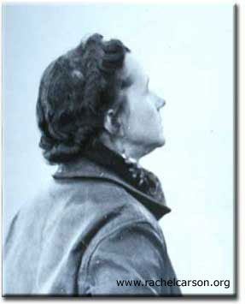

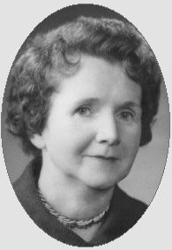
1962 Rachel Carson and Silent Spring
Attempts to understand the effects of chemicals on the embryo and fetus
and on the environment as a whole gained momentum.
New Legislation
New Journals
Cellular and Molecular Toxicology Developed
Risk Assessments Developed

Slide 19
Toxicology Primer

Slide 20
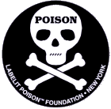
Toxicology Words
Toxicology: The study of the adverse
effects of chemicals on living organisms.
Involves cellular, biochemical and molecular
mechanisms of action.

Slide 21
  Different Areas of Toxicology
Mechanistic Toxicology: The cellular, biochemical and molecular mechanism by which chemicals
exert toxic effects on living organisms.
Toxicogenomics: Studies the genetic consequences and potential therapeutics
with respect to toxic cause and effect.
Descriptive Toxicology: Directly concerned with toxicity testing.
Regulatory Toxicologist: Responsible for deciding whether a drug or another chemical poses
a sufficiently low risk to be marketed for stated purposes. (Also sets
standards for amounts of substances permitted in various environments).
Forensic Toxicology: Analytical chemistry in medicolegal aspects of harmful effects of chemicals.
Clinical Toxicology: Studies the diseases caused by or uniquely associated with toxic substances.
Environmental Toxicology: Focuses on impacts on nonhuman organisms.
Ecotoxicology: Focuses on the impacts of toxic substances on population
dynamics in an ecosystem.
Developmental Toxicology: Studies the adverse effects of chemical exposure during preconception,
prenatal, and postnatal up to puberty on the development of an organism.
Teratology: The study of defects induced specifically between conception and birth.
Reproductive Toxicology: The study of the occurrence of adverse effects on the male or female
reproductive system that may result from exposure to a chemical substance.

Slide 22
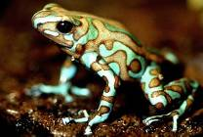
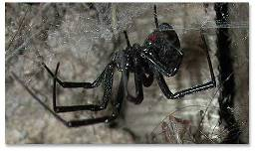


  Spectrum of Toxic Dose
LD₅₀ mg/kg
Ethyl Alcohol
Sodium Chloride
Ferrous Sulfate
Morphine
Phenobarbital
Picrotoxin
Strychnine
Nicotine
Tubocurarine
Hemicholinium-3
Tetrodotoxin
Dioxin (TCDD)
Botulinum toxin
10,000
4,000
1,500
900
150
5
2
1
0.5
0.2
0.1
0.001
0.00001

Slide 23
Classification of Toxic Agents
Toxin: A toxic substance that is produced by biological system such
as a plant, animal, fungus or bacteria.
Toxicant: A toxic substance that is produced or are a byproduct of anthropogenic activities.
Toxic agents can be classified in terms of:
Target Organs
Use
Source
Effect
or
Physical State
Chemical Stability
Chemical Reactivity
Chemical Structure
Poisoning Potential

Slide 24

Characteristics of Exposure
Chemical and
physical properties
Exposure Situation
Biotransformations
Metabolism
Overall susceptibility
of “victim”
time and concentration

Slide 25
  Route and Site of Exposure
Ingestion
Inhalation
Percutaneous
Gastrointestinal
Tract
Pulmonary System
(lung and alveoli)
Feces
Liver
Skin
Exhalation
Perspiration
Blood and Lymph System
Parenteral
Kidneys
Receptor Cells
Bladder
Bone and Fat
Urine
Adapted from Toxicological Chemistry, 2nd Edition, by S. E. Manahan, Lewis Publishers, 1992.

Slide 26
  Duration and Frequency of Exposure
Exposure in experimental animals:
Acute: single or repeated exposure for less than 24 hours
Subacute: repeated exposure for 1 month or less
Subchronic: repeated exposure for 1 to 3 months
Chronic: repeated exposure for more than 1 to 3 months

Slide 27
Effect of Different Elimination Rates
Slow Elimination
Toxic
Response
Concentration
Moderate Elimination
No Toxic
Response
Fast Elimination
Time

Slide 28
Effect of Different Elimination Rates with Repeated Doses
Elimination
Slow
Concentration
Elimination
Moderate
Elimination
Fast
1
2
3
4
5
Time (Days)

Slide 29
Undesired Effects
In medicine, each compound almost always produces more than one effect.
One effect is the desired effect of the therapy.
All other effects are undesirable effects or side effects.

Slide 30
  Allergic Reactions
Small molecules (haptens) are mostly unnoticed by the immune system.
They eventually combine with a protein to form an antigen.
The antigen can trigger the formation of antibodies.
Next time there is an exposure to this hapten an antigen-antibody interaction happens.
This induces an allergic response (anything from a skin rash to anaphylactic shock).

Slide 31
  Immediate versus Delayed Toxicity
Immediate toxic effects occur or develop rapidly after a single exposure.
Delayed toxic effects occur after some period of time.
Carcinogenic effects of chemicals can have long latency periods.
(Tumors observed 20 to 30 years after the initial exposure)

Slide 32
  Reversible versus Irreversible Toxic Effects
Most injuries to the Liver are reversible because liver tissue regenerates efficiently.
The central nervous system (CNS) does not regenerate well so most injuries are irreversible.

Slide 33
  Local versus Systemic Toxicity
Local effects occur at the site of immediate contact.
Systemic effects require absorption and distribution of a molecule from its entry spot to another site at which the effect is produced.

Slide 34
Interaction of Chemicals
An additive effect when the combined effect of the two chemicals is equal to the sum of the effects of each agent given alone.
A synergistic effect occurs when the combined effects of two chemicals are much greater than the sum of the effects of each agent given alone.
Potentiation occurs when one substance does not have a toxic effect on a certain organ or system but when added to another chemical makes that chemical much more toxic.
Antagonism occurs when two chemicals administered together interfere with each other’s actions or one interferes with the action of the other.

Slide 35
Tolerance
Tolerance is the reduced toxic response to a chemical because of prior exposure to that chemical or to a structurally similar chemical.
“The Arsenic Eaters”

Slide 36
Dose Response
Two types of dose-response relationships:
Individual Dose-Response (Refers to an individual organism)
Quantal Dose-Response (Refers to a population of organisms).
No effect
Range
Maximum
Range
Threshold
Increasing Effect
Increasing Dose

Slide 37
  Individual or Graded Dose Response Relationships
Compound B
Is more EFFECTIVE
Compound B
Compound A
Is less EFFECTIVE
Compound A
% Inhibition
Dose (mg/kg)
Compound A
Is more POTENT
Compound B
Is less POTENT

Slide 38
  Quantal Dose Response Relationships
“All or Nothing”
In a quantal study, the members of a population are assessed as either a “responder” or an “non-responder”
at a given dose.
Normal Frequency Distribution
% Mortality Frequency
Dose (mg/kg)
hypersusceptible
resistant

Slide 39
LD50
100
75
50
25
0
Cumulative Mortality %
LD₅₀
220 mg/kg
0 10 50 100 500 800
Dose (mg/kg)

Slide 40
Slopes are important
Compound B
100
75
50
25
0
Compound A
0 10 20 30 40 50 60 70 80 90 100 110 120
Dose (mg/kg)
Compound A and Compound B have roughly the same LD50.
Compound A has a “Flat” dose-response in that a large change in dosage is required to cause
a significant change in response.
Compound B has a “Steep” dose-response in that a small change in dosage will cause a
significant change in response.
At one half the LD50 dosage of compound B, less than 5% of the population would die.
At one half the LD50 dosage of compound A, around 45% of the population would die.

Slide 41
  Shape of the Dose Response Curve
    Essential Nutrients
100
75
50
25
0
Threshold for
adverse response
Response
Region of
Homeostasis
Deficiency
Dose (mg/kg)
Excess

Slide 42
  Assumptions in Deriving the Dose Response Relationships
1. The response is due to the chemical administered.
2. The magnitude of the response is related to the dose.
(There is a molecular target site with which the chemical
interacts to initiate the response that is related to the
concentration at the target site, which is in turn related to
the concentration of the dose administered).
3. There exists both a quantifiable method of measuring and
a precise means of expressing the toxicity.

Slide 43
  Therapeutic Index
The therapeutic index is defined as the ratio of the dose required to produce
a toxic effect and the dose needed to elicit the desired therapeutic response.
TI = LD₅₀ / ED₅₀
Dose required to produce a toxic effect
Dose needed to elicit the desired therapeutic response

Slide 44
Toxicokinetics

Slide 45
ADME
Absorption
Distribution
Metabolism
Elimination

Slide 46
General Scheme
Foreign Compound →
Enters the body (i.e., “in the blood”)
Distributed through the tissues
Metabolized
Eliminated

Slide 47
More Accurate:
Outside
Tissues
Inside the body “blood”
Outside
Metabolism
Outside

Slide 48
II. Absorption
A. Transfer across a membrane
Phospholipid
Cholesterol
Protein
Carbohydrate Marker

Slide 49
1. Passive Diffusion
Concentration Differential
  Entropy mediated/driven
“Transportability”
  Partition coefficient
  Size
  Degree of ionization
Toxic material
(high concentration)
None
[Organic Phase]
= P
[Water Phase]
Notes:
Ionization= if it’s too charged then it wont approach the membrane or it will go right through it. The problem is with the medium inonozed compounds, than it will stuck in the membrane

Slide 50
2. Facilitated Diffusion
Protein mediated
“specificity”
Always faster than passive… to a point
Inhibition is a possible toxic response
Competitive
  The toxic material “looks” like the normal substrate
Noncompetitive
  The toxic material does not “look” like the normal substrate
Notes:
Analogy to the room entrance: if you are outside and you want to go in by yourself, your intent is go in but may take you longer to find the room. When someone find you find the room that it is facilitad.
If S will

Slide 51
2. Facilitated Diffusion
Must be transmembrane
Outside
Inside

Slide 52
3. Active Transport
Regulation of essential nutrients
Excretion
  A.T. Proteins
  Kidney
  Acids
  Bases
  Metals

Slide 53
3. Active Transport
Reabsorption
Placenta
Intestine
Kidneys

Slide 54
4. “Others”
Phagocytosis
Pinocytosis

Slide 55
B. Different tissues involved in Absorption
GI Tract
Eat
Drink
Breath
Very site specific
pH
In the stomach pH ~1 – 3
Small intestines pH ~5 – 8

Slide 56
B. Different tissues involved in Absorption
Skin
Stratum Corneum
“Keratinaceous”
“Amides”
Sweat Glands
Hair Folicle

Slide 57
Lipophilic is “easier’ than hydrophilic to a point
What exacerbates diffusion through skin?
Increased blood flow
Abrasion
Hydration
Solvents

Slide 58
B. Different tissues involved in Absorption
Mucous membranes
Physical removal (sneeze, wipe, …)
Sneeze mostly
Nasopharyngeal
> 5 μm
Some swallow
Mostly swallow
Thracheobronchial
2 – 5 μm
Some smell
Alveolar
< 1 μm
“Mucociliary Escalator”

Slide 59
B. Different tissues involved in Absorption
Mucous membranes
It depends on blood solubility
Very soluble in blood: one inhalation will be sufficient for full absorption “ventilation limited”
Very lipophilic also gets absorbed in one breath “ventilation limited”
Poorly soluble “flow limited”

Slide 60
III. Disposition (Distribution and Elimination)
K_{e}
3 Kinetic Models
  “One compartment model”
C_{(t)}
Eliminate
Concentration as a function of time in the blood
If steep – “no worries”
lnC_{(t)}
If flat “probably a worry”
Slope = K_{e}
(t)

Slide 61
III. Disposition (Distribution and Elimination)
3 Kinetic Models
  “Two compartment model”
Blood
K_{e}
C₁
Conc.
C₂
C₂
“Something else”
C₁
time

Slide 62
III. Disposition (Distribution and Elimination)
3 Kinetic Models
  “Physiologically based kinetic model”
Lungs
K_{a}
Fatty tissues
K_{b}
Non-fatty tissues
K_{c}
Metabolism
Liver
K_{d}
Intestine
Kidney
Excrete

Slide 63
III. Disposition (Distribution and Elimination)
Exit Strategy
  Kidney
  Water soluble
  Smaller than a typical protein
Passive “Glomerular” filtration process
Active Secretory reabsorption

Slide 64
III. Disposition (Distribution and Elimination)
Exit Strategy
  Liver
  Excrete or metabolize
  Active, not much passive
  Excreted through bile into intestines
  Excreted in feces or reabsorbed

Slide 65
III. Disposition (Distribution and Elimination)
Exit Strategy
  Lungs/volatiles
  Other
    Skin
    Hair
    Sweat
    Nails
    Milk
< 1%

Slide 66
IV. Biotransformations
3 Phases
Phase I
Phase II
Phase III
Single “chemical” operation (“putting on a handle”)
1) Control solubility
Conjugation (“sticking something to it”)
2) Provide recognition
“Adjustment” of conjugate (“change the thing that was stuck”)

Slide 67
IV. Biotransformations
Phase I Transformations
  Oxidation
  Enzyme catalyzed
  Cytochrome P450
  Mono-oxygenase
  Xenobiotic
Pic of NADPH?

Slide 68
Examples: (carbon)
Epoxidation
Hydroxylation
Desaturation

Slide 69
Examples (nitrogen)
Demethylation
Hydroxylation

Slide 70
Examples (sulfur)
Demethylation
Sulf-oxidation

Slide 71
IV. Biotransformations
Phase I Transformations
  Hydrolysis
  Esters:
  Amides:
  Epoxides:

Slide 72
IV. Biotransformations
Phase I Transformations
  Reductions
  Azo compounds:
  Nitro compounds:
  Disulfides:

Slide 73
IV. Biotransformations
Phase II Transformations
  Conjugation
  Glucoronidation
U.D.P.
Urine Diphosphate Gucuronic acid

Slide 74
Phase I
Phase II
Xeno
Xeno-OH
Soluble
“Recognizable”

Slide 75
IV. Biotransformations
Phase II Transformations
  Sulfation
  3’-Phosphoadenosine-3’-phosphosulfate
Phase I
Phase II
Xeno
Xeno-NH₂

Slide 76
IV. Biotransformations
Phase II Transformations
  Glutathione Conjugation
(Glutamate)
(Cysteine)
(Glycine)
Soluble
Recognizable
“Redox tamed”
2
Glutathione precursor
Phase I
Phase II
Xeno-COOR
Xeno-COOH
Xeno-CO-S-Glutathione

Slide 77
IV. Biotransformations
Phase II Transformations
  Acetylation
  N-acetyltransferase
Phase I
Phase II
Xeno
Xeno-OH
More soluble
Recognizable

Slide 78
IV. Biotransformations
Phase II Transformations
  Glycine Conjugation
Phase I
Phase II
Xeno
Xeno-SH

Slide 79
IV. Biotransformations
Phase II Transformations
  Methylation
  Mine?
  Yours?
  S-adenosine methionine (SAM)

Slide 80
IV. Biotransformations
Phase III Transformations
Further modifications

Slide 81
IV. Biotransformations
Cautions
3 possible outcomes
Non-toxic metabolite
Excrete
Metabolize
Toxic metabolite
Xeno
Toxic metabolite
Damage

Slide 82
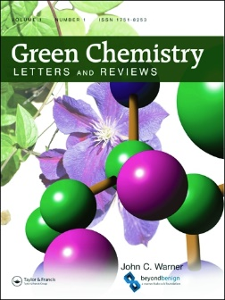
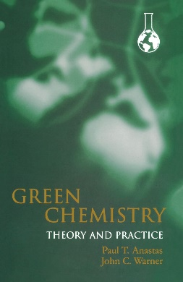
warnerbabcock.com
beyondbenign.org
johnwarner.org
in
John.Warner@WarnerBabcock.com
t
@JohnWarnerOrg

