Slide 1
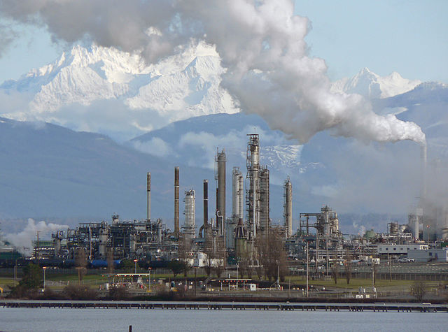
Yale-UNIDO Train-the-Facilitator Workshop in Green Chemistry
Waste Prevention
CENTER for GREEN CHEMISTRY
and GREEN ENGINEERING at YALE
Image: Wikimedia Commons, Anacortes Refinery, Author: Walter Siegmund

Slide 2

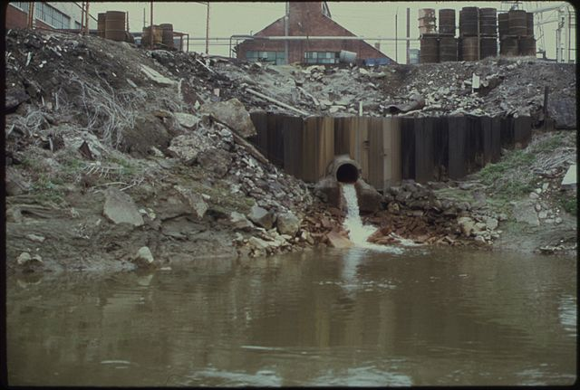
Waste Prevention
It is better to prevent waste than to treat or clean up waste after it is formed.
Image: Harshaw Chemical Company discharges waste water into the Cuyahoga river
Source: National Archives and Records Administration

Slide 3
Topics To Be Covered
The Waste Treatment Pyramid
Reduced Solvent Use
Waste as a Feedstock
Biodegradation of Waste
Designing Processes to Include Biodegradation of Waste

Slide 4
Waste treatment pyramid: The 4 Rs
Reduce, Reuse, Recycle, Recover
Prevention
We need various types of technology to reduce and reuse waste.
Ultimately, the production of waste should be prevented.
Most favored option
Reduction
Reuse
Recycling
Energy recovery
Disposal
Recycling
Composting
Incineration
Least favored option
Landfill
Notes:
Need for technologies to Reduce and Reuse waste.
Ultimately, the waste production should be Prevented

Slide 5
Landfills
Reduction
Reuse
Recycling
Energy recovery
Disposal
  Consolidated material is buried with mud and other sealing agents to enable chemical, bacteriological, and physical degradation.
  Semi-anaerobic conditions lead to production of methane and CO₂.
  If captured, landfill gas (methane) from decomposing garbage can be used to produce electricity, heat, and fuels.

Slide 6
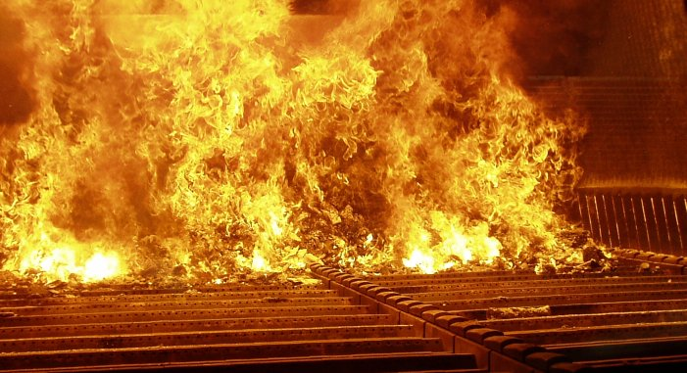
Incineration and Pyrolysis
Reduction
Reuse
Recycling
Energy recovery
Disposal
Incineration
  Solid organic waste is combusted.
  Some thermal treatments allow energy capture.
  Solid mass is reduced by 95-96%.
Pyrolysis
  Thermal decomposition at 200-300°C occurring in the absence of oxygen.
  Precursor of both the combustion and gasification processes.
  The products of biomass pyrolysis include biochar, bio-oil, and gases - such as methane, hydrogen, carbon monoxide, and carbon dioxide.

Slide 7
Recycling and Composting
Reduction
Reuse
Recycling
Energy recovery
Disposal
Recycling
  Converting waste materials into new materials and objects.
  Available for metals, plastic, paper, glass.
Composting
  Organics undergo a biological decomposition to form a material (compost) that is non-toxic to plant growth.
  By-product of the reaction are CO₂, water and heat.
Anaerobic conditions and biogas production
  Adopted for farm waste.
  Can reduce greenhouse gas emissions and can provide a cost-effective source of renewable energy.
  Recovered biogas can be an energy source for electricity, heating or transportation fuel.
Material | Energy savings
Aluminum | 95%
Cardboard | 24%
Glass | 5-30%
Paper | 40%
Plastics | 70%
Steel | 60%
Cost-benefit of recycling: energy savings

Slide 8
Reuse and Repurpose
Reduction
Reuse
Recycling
Energy recovery
Disposal
Gasification:
  Converts organic based materials into CO, H₂ and CO₂.
  Achieved by reacting the material at high temperatures (>700 °C), without combustion, with a controlled amount of oxygen and/or stem.
  The resulting gas mixture is called syngas.
  Syngas is combustible and often used as a fuel.
Alcohol production (biomass conversion into mixed alcohol fuels):
  Biological/chemical method for converting any biodegradable material into useful chemicals, such as biofuels (e.g., ethanol, propanol, n-butanol, isopropanol, 3-pentanol).
  Made by enzymatic breakdown of biomass into simple sugars, followed by yeast fermentation into alcohols.

Slide 9
The Reduction and Elimination of Waste
Reduction
Reuse
Recycling
Energy recovery
Disposal
Reduced solvent or solventless processes
Self separation
Process intensification
Material deposition
Use waste as a feedstock

Slide 10
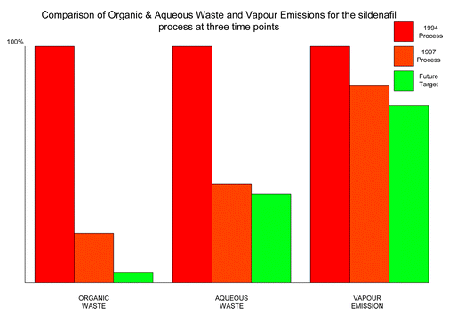
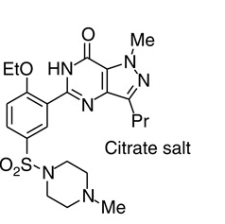
Reduced Solvent: Sildenafil Citrate Production
Sildenafil citrate, commonly known as Viagra, is a selective inhibitor of phosphodiesterase 5 (PDE5). This new drug has immediately became a major seller, achieving sales of more than $1 billion during its first year on the market. With such a rapid sales take off it was critical that the environmental performance of the synthesis was good from the outset.
Average yield of last three steps = 97% yield.
Reduction of the ratio of solvent waste/kg product over 17 years from 1300 L/kg to only 7 L/kg by minimizing solvent use, increasing solvent recovery, improving solvent selection, and telescoping steps.
Only the solvents t-butanol, ethyl acetate, 2-butanone, and a trace of toluene still require disposal.
Comparison of organic and aqueous waste and vapor emissions for the sildenafil citrate process at three time points
Dunn, P.J et al Green Chem., 2004, 6, 43-48

Slide 11
Reduced Solvent: dNTPs
They are the building blocks of both DNA and RNA, which are chains of nucleotides made through the processes of DNA replication and transcription. Nucleoside triphosphates also serve as a source of energy for cellular reactions and are involved in signaling pathways. Nowadays they are synthesized and used in molecular biology.
A one-pot, three step sequence.
Eliminates the need for several hazardous reagents such as ZnCl₂, triphenylphosphine, and solvents such as dimethylformamide and dichloromethane.
E-factor improved by an order of magnitude.
Solvent consumption reduced by 95%, hazardous waste by 65%,
preventing 1.5 million tons of hazardous waste per year.
Notes:
dNTPs are essencial feedstock to perform Polymarase Chain Reaction (PCR)

Slide 12
Reduced Solvent: Production of Ethylene Oxide
Ethylene oxide is used as an intermediate in the production of several industrial chemicals, the most notable of which is ethylene glycol. It is also used as a fumigant in certain agricultural products and as a sterilant for medical equipment and supplies.
Use of molecular oxygen removed the need for chlorine.
New process generated more than 16 times less waste than the original one, eliminating the formation of waste water.

Slide 13
Solventless Process: Mechanochemistry
Chemistry physically activated
Motion → Friction → Heat → Reaction
Uses High Energy Ball Milling
Vibrating ball mill crushes particles which results in large surface areas.
Mixing of solids allows reaction at surfaces.
Thermal equilibrium is broken – “hot spots”, estimated at 10000 K, – Lasting 10^{‐7} seconds.
Collisions break crystalline material.
High pressures are generated.
Wilkening, M., Düvel, A., Preishuber-Pflügl, F., et al. (2016). Structure and ion dynamics of mechanosynthesized oxides and fluorides. Zeitschrift für Kristallographie - Crystalline Materials, 232(1-3), pp. 107-127.

Slide 14
Utilizing Waste as a Feedstock
Some examples:
Waste cooking oil for biodiesel
Crustacean shell waste for chitosan based products
Red mud for bricks
Glycerol for lactic acid using catalyst

Slide 15
Example: Electrocatalytic Oxidation of Glycerol to Chemical Feedstocks
2011 US bio-diesel production reached 967 million gallons.
  1 Olympic-size swimming = approximately 660,000 gallons.
  Almost 1460 Olympic-sized swimming pools of glycerol.
Current treatment:
  Dispose (sold for $240/ton!).
  Combust as fuel.
“Waste”
Bio-diesel
Chen, L.; Ren, S.; Ye, X. P., Fuel Processing Technology 2014, 120, 40-47.
T. Werpy, G. Petersen, Top value added chemicals from biomass, Pacific Northwest National Laboratory (PNNL), National Renewable Energy Laboratory (NREL), Office of Biomass Program (EERE), 2004.

Slide 16
Glycerol to Other Chemicals
Skin exfoliating reagent
Polylactic acid
Industrial chemical precursors
Valuable medicinal product
Sunless tanning product
Anti-freeze
Notes:
There are just a handful of examples of what we could do with glycerol so BURNING it is definitely not the most efficient way to use the limited resources nature offers.

Slide 17
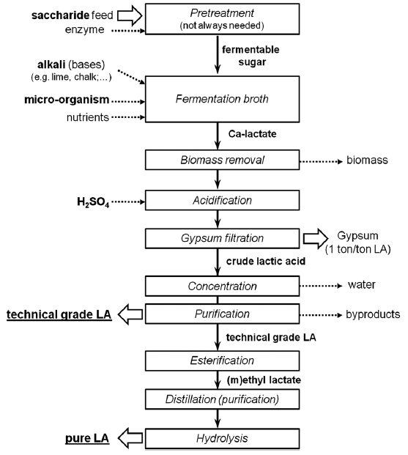
Production and Applications of Lactic Acid
  Other applications of Lactic Acid:
  Food preservatives
  Edible pH modifier
  Textile industry
  Cosmetic and pharmaceutical industries
90% of lactic acid comes from anaerobic fermentation of hexose sugar (e.g. corn starch).
Compete with food sources.
Slow and requires a lot of purifications.
Dusselier, M.; Van Wouwe, P.; Dewaele, A.; Makshina, E.; Sels, B. F., Energy & Environmental Science 2013, 6 (5), 1415-1442.

Slide 18
Water Electrolysis with Earth Abundant Metal Catalyst
e⁻
Power
Supply
e⁻
e⁻
e⁻
e⁻
e⁻
e⁻
2H₂O ---> O₂ + 4H⁺ + 4e⁻
2H⁺ + 2e⁻ ---> H₂
Cathode:
Any conductive materials
Anode:
Expansive platinum group metals
Anode
Cathode
Cobalt 1,2‐bis(diphenylphosphino)ethane
(Co-DPPE)
Bloomfield, A. J.; Sheehan, S. W.; Collom, S. L.; Crabtree, R. H.; Anastas, P. T., A heterogeneous water oxidation catalyst from dicobalt octacarbonyl and 1,2-bis(diphenylphosphino)ethane. New J. Chem. 2014, 38 (4), 1540-1545.
Notes:
Also, this catalyst works well in alkaline environment

Slide 19
Electrocatalytic Oxidation of Glycerol
e⁻
Power
Supply
e⁻
e⁻
e⁻
Water-compatible
Atmospheric pressure
Rm temp. or above
Very low current / voltage
e⁻
e⁻
e⁻
2H⁺ + 2e⁻ ---> H₂
2H₂O ---> O₂ + 4H⁺ + 4e⁻
Anode
Cathode

Slide 20
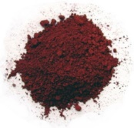
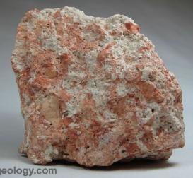
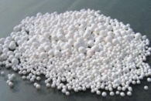
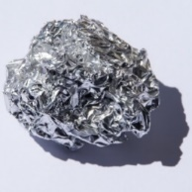
Example: Neutralization of Red Mud through Energy Efficient Extraction of Sodium Ions
The Bayer Process (Karl Bayer, 1887)
Red mud is a toxic byproduct of the industrial process that refines bauxite, raw aluminum ore, into aluminum oxide, or alumina.
NaOH, 170 – 180 °C
1 – 6 atm
Sodium aluminate
Na⁺ Al(OH)₄⁻
Red Mud
Precipitation
Element | Composition
Fe₂O₃ | 30-60wt%
Al₂O₃ | 10-20wt%
SiO₂ | 3-50wt%
Na₂O | 2-10wt%
CaO | 2-8wt%
TiO₂ | trace-25wt%
K, Cr, V, Ni, Ba, Cu, Mn, Pb, Zn, Sc | Traces
Bauxites
(4 – 5 tonne)
Alumina
Al₂O₃
(~2 tonne)
Depending on the origin, quality and composition of the bauxite, the amount of red mud left over from the alumina refining can vary widely. For every ton of alumina produced, the process can leave behind a third of a ton to more than two tons of red mud.
Electrolytic Reduction
Aluminum
(~1 tonne)
Source: http://www.aluminiumleader.com/production/aluminum_production
Notes:
http://www.aluminiumleader.com/production/aluminum_production/

Slide 21
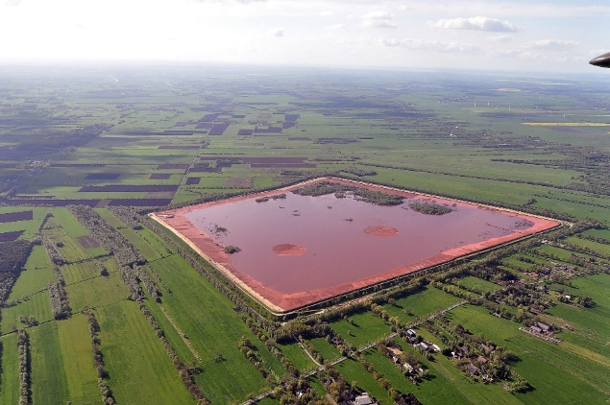
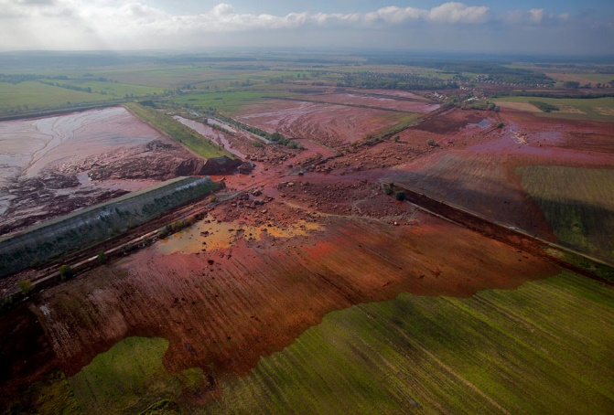
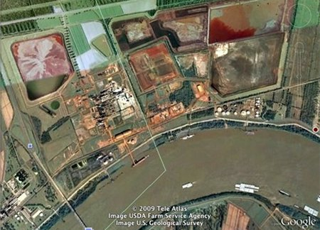
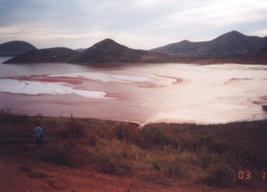
Red Mud: Pollution and Accidents
The mud also has a high pH because of the sodium hydroxide solution used in the refining process. The base is strong enough to kill plant and animal life, and to cause burns and damage to airways if the fumes are breathed.
Stade, Germany
Ajka, Hungary
Most refineries collect the mud in open ponds to allow some of the water to evaporate. Once it's dry, after several years, the red mud is buried or mixed with soil.
The red mud is kept in reservoirs, so there is the possibility of leaks and floods, as seen in western Hungary.
Noranda Alumina plant at Gramercy - located alongside the Mississippi River
Damandjodi, India
Notes:
http://www.theguardian.com/environment/2014/jan/08/devecser-hungary-eco-town
http://www.theatlantic.com/photo/2011/09/a-flood-of-red-sludge-one-year-later/100158/
http://lacoastpost.com/blog/?p=13160
http://redmud.org/red-mud/disposal/

Slide 22
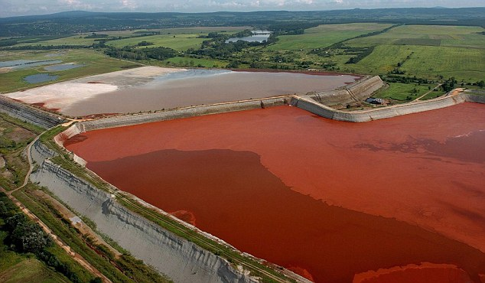
Red Mud: Neutralization and Potentials
If it is neutralized to pH 8 – 9:
  Building Materials
    Cement, bricks, tiles, etc.
  Pollution Control
    Removal of toxic heavy metal: Cd, Pb, Cr, etc..
    Removal of aromatic pollutant: dyes, phenols, chlorophenols, boron agents, etc.
Economically Unfeasible Schemes:
  Acid neutralization (from waste plant).
  CO₂ pumping.
  Seawater neutralization.
We can fight pollution with pollution!
Arch. Environ. Sci. 2012 ,6, 13-33

Slide 23
Neutralization of Red Mud through Selective Extraction of Sodium Ions
Co(Dppe)
Metal
Red Mud Heterogeneous Basic Aq. Solution
Sodium Hydroxide Solution
Na⁺
Na⁺
Na⁺
Na⁺
Na⁺ Ion Selective Membrane
*Patent Pending
2H₂O ---> 2O₂ + 4e⁻ + 4H⁺
Water oxidized to lower pH and pushes Na⁺ ions through
4 H₂O + 4e⁻ → 2H₂ + 4OH⁻
Generates OH⁻ to facilitate the Na⁺ passing

Slide 24
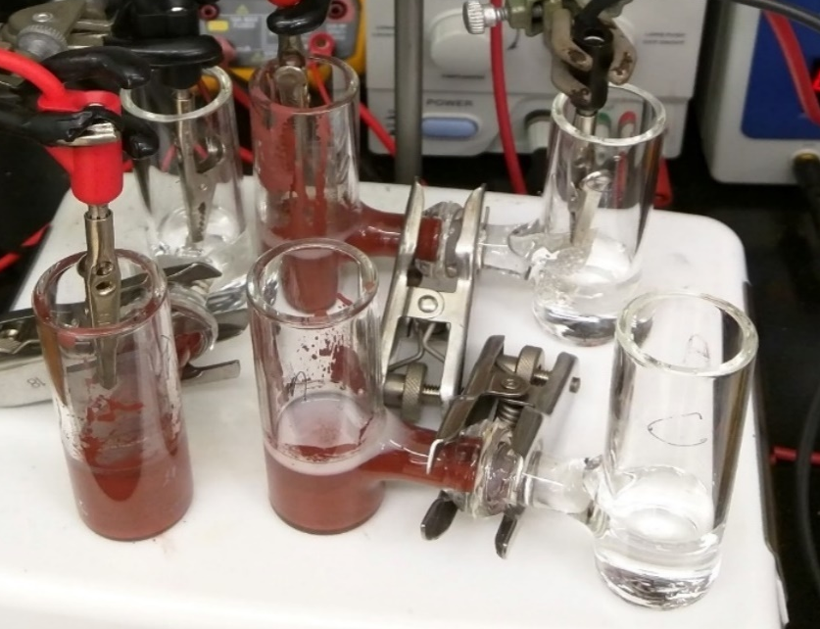
Successful Neutralization
 | K | Na | Fe | Al | Ca
[Ion]_{int.} (Anode) | 0.3 | 461 | 0.1 | 0.3 | 4.5
6 volt, Room Temperature, 12 hours
[Ion]_{hr=12} (Cathode – Trial 1) | 0.1 | 71.6 | - | - | 0.1
[Ion]_{hr=12} (Cathode – Trial 2) | 0.1 | 71.6 | - | - | 0.2
[Ion]_{hr=12} (Cathode – Control, no e⁻) | 0.0 | 0.0 | - | - | 0.0
Using this process, red mud can be neutralized at room temperature in 12 hours.

Slide 25
Biodegrade the Waste
Biodegradation - "A process by which microbial organisms transform or alter (through metabolic or enzymatic action) the structure of chemicals introduced into the environment." – US EPA, 2009
“Ready” biodegradability – remove 70% of dissolved organic carbon AND achieve 60% theoretical oxygen demand or CO₂ production within a 10-day window in a 28-day test. – OECD
“Ultimate” biodegradability – 60-70% of organic carbon converted to CO₂ within 28 days.

Slide 26
Aerobic Versus Anaerobic Digestion
Difference in oxygen supply, organism types, and products formed.

Slide 27
Aerobic Digestion
Bacteria consume organic matter.
Needs a constant supply of oxygen, pH adjustments, and mixing.
Byproducts: heat, CO₂, and H₂O.
Frequently used by water treatment plants or in composting.

Slide 28
Anaerobic Digestion
Bacteria consume organic matter in the absence of oxygen.
Common in fermentation and landfill; produces biogas consisting of methane, ammonia, hydrogen sulfide.
Biogas is considered a renewable energy.

Slide 29
Digestion versus Chemical Structure
Not all chemicals will biodegrade at the same rate (think plastic vs paper).
The rate of biodegradation depends on the microorganism, but also a chemical structure of the molecule.
Some parts of the molecule are known to be more biodegradable than the others.
There is a publically available software that analyses the chemical structure and predicts whether the molecule will degrade slower (days) or slower (months, years).

Slide 30
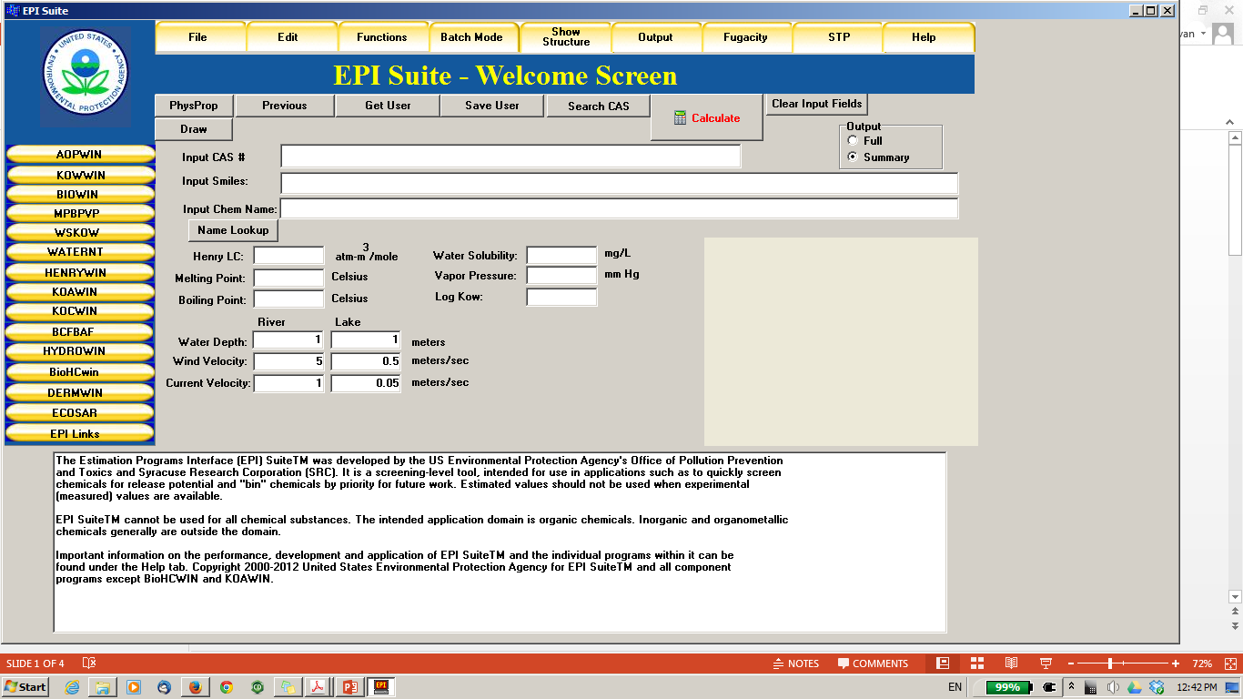
Predicting Biodegradation: EPA, EPISuite
EPI = Estimation Programs Interface http://www.epa.gov/oppt/exposure/pubs/episuitedl.htm

Slide 31
BIOWIN Models Based on Molecular Fragment Contributions
Six aerobic degradation models
  BIOWIN1&2: qualitative, based on database of 264 chemicals
  BIOWIN3&4: estimation of rate, based on 200 chemicals
  BIOWIN5&6: qualitative, based on database of 884 chemicals
New anaerobic degradation model
  BIOWIN 7: “screening level”, methanogenic bacteria, 169 chemicals

Slide 32
BIOWIN Demonstration/Exercise
Interface with ChemDraw
Exercise:
  Compare molecules with similar structure
  How do the aerobic (BIOWIN 6) and anaerobic (BIOWIN 7) estimates change?
  Note any parts of the molecule that are not used in the model
  When there is ambiguity, do the BIOWIN1-5 models help reveal any trends?

Slide 33
TEAM 1

Slide 34
TEAM 1
1.
Increasing number of rings & molecular weight
2.
Favors biodegradation
- OH
- Low molecular weight
Disfavors biodegradation
- High molecular weight
- Cl
3.
Most biodegradable (aerobic)
Least biodegradable
4.
1>2>4>3>5
Most biodegradable (anaerobic)
Least biodegradable
5.
4>1>2>3>5
Notes:
Increasing number of rings

Slide 35
TEAM 2

Slide 36
TEAM 2
1.
Bisphenol A derivatives: Halogenated and BPS
2.
Favors biodegradation
- Low molecular weight
Disfavors biodegradation
- High molecular weight
Tertiary carbon BPA
Halogens, but F better than Cl
3.
Poor biodegradation due to high MW
4.
Most biodegradable (aerobic)
Least biodegradable
1>6>3>4>2>5
5.
Most biodegradable (anaerobic)
Least biodegradable
6.
6>2>4=5>3>1

Slide 37
TEAM 3

Slide 38
TEAM 3
Different plasticizers
Linear and branched;
Two green plasticizers: Reduced ring to cyclo and isosorbide ring
1.
2.
Favors biodegradation
Linear chains
Cyclo
Esters
Disfavors biodegradation
Side chains and branching
Ethers
3.
Most biodegradable (aerobic)
Least biodegradable
4.
1>4>2>3>5
Most biodegradable (anaerobic)
Least biodegradable
5.
1>5>2>4>3

Slide 39
TEAM 4

Slide 40
TEAM 4
1.
Explosives (TNT, nitroglycerine)
2.
Favors biodegradation
Small molecular weight
OH
Disfavors biodegradation
CH₃
Large MW
NNO₂CH₃
3.
Most biodegradable (aerobic)
Least biodegradable
4>5>1=2=3
4.
Degrades faster due to small MW
Most biodegradable (anaerobic)
Least biodegradable
4>5>2>1>3
5.

Slide 41
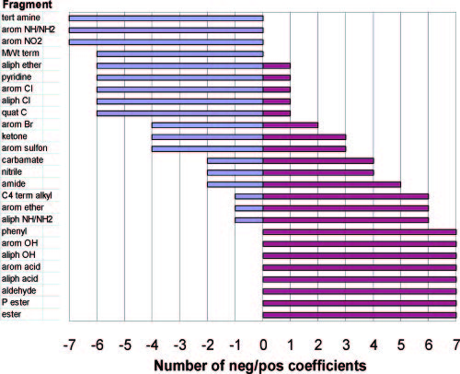
Summary of BIOWIN Models
Poorly degraded
Readily degraded

Slide 42
Design for Biodegradation?
Since we know the chemical moieties, functional groups, and types of bonds which make the molecule biodegradable, can we build-in biodegradability into chemical products?
YES!

Slide 43
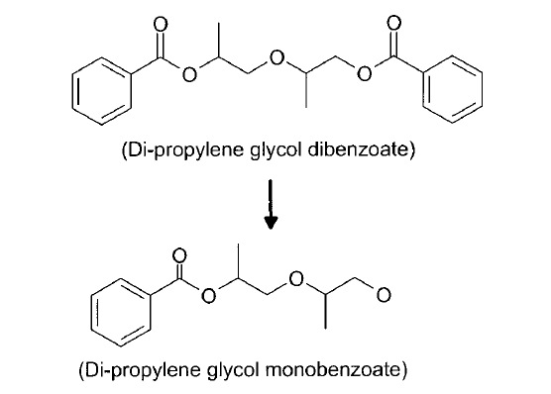
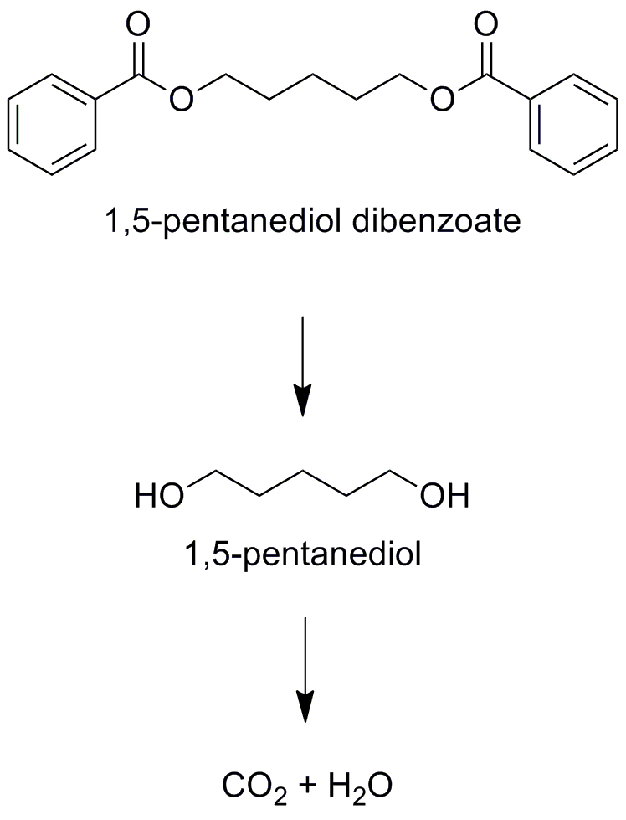
Example: Plasticizers
kills bacteria,
biodegradation halts
Plasticizers are additives in plastic applications. Almost 90% of plasticizers are used in PVC, giving this material improved flexibility and durability.
Di-propylene glycol dibenzoate decomposes into a product which is toxic to bacteria, and therefore stops the biodegradation process.
With slightly changed structure, 1,5-pentanediol dibenzoate biodegrades into CO₂ and H₂O
complete degradation to CO₂ + H₂O

Slide 44
Example: Pesticides
DDT – Dichlorodiphenyltrichloroethane, which was used as agricultural pesticide, is persistent in the environment.
Not only does it bioaccumulates, but it undergoes a reaction to DDE which is even more toxic than DDT.
DDT
Toxic
DDE
Methoxychlor shares many insecticidal properties as DDT and it’s potency, but it is not persistent.
It degrades into methoxychlor phenol, which has also low toxicity and it is easily excreted.
Low toxicity
methoxychlor
Methoxychlor phenol

Slide 45
Example: Detergents
Low biodegradation
Tetrapropylene alkylbenzene sulfonate (TPPS) was used as a surfactant for laundry detergents and accumulated into the water supply due to incomplete degradation.
Water tended to foam when coming out of the tap.
High biodegradation
TPPS was replaced by linear alkylbenzene sulfonate (LAS).
Replacing the methyl branched chain of TPPS by a linear carbon chain reduces the biopersistence.

Slide 46
Example: Antibacterial Products
Triclosan is an antibacterial and antifungal agent found in some consumer products, including toothpaste, soaps, detergents, toys, and surgical cleaning treatments.
It persists in the environment.
Low biodegradation
Chlorophene is a bacteriocide and fungicide in cosmetics.
It is very biodegradable in the media and entirely removeable from the wastewater.
High biodegradation

Slide 47
Topics Covered
The Waste Treatment Pyramid
Reduced Solvent Use
Waste as a Feedstock
Biodegradation of Waste
Designing Processes to Include Biodegradation of Waste

Slide 48
Sponsored by Yale-UNIDO Initiative
QUESTIONS?
CENTER for GREEN CHEMISTRY
and GREEN ENGINEERING at YALE

