Slide 1
Train-the-Facilitator 5-day Workshop
GLOBAL GREEN CHEMISTRY INITIATIVE
Prof. Philip Jessop, Queens University
Dr. Karolina Mellor, UNIDO Program Manager at Yale University
CENTER for GREEN CHEMISTRY
and GREEN ENGINEERING at YALE

Slide 2
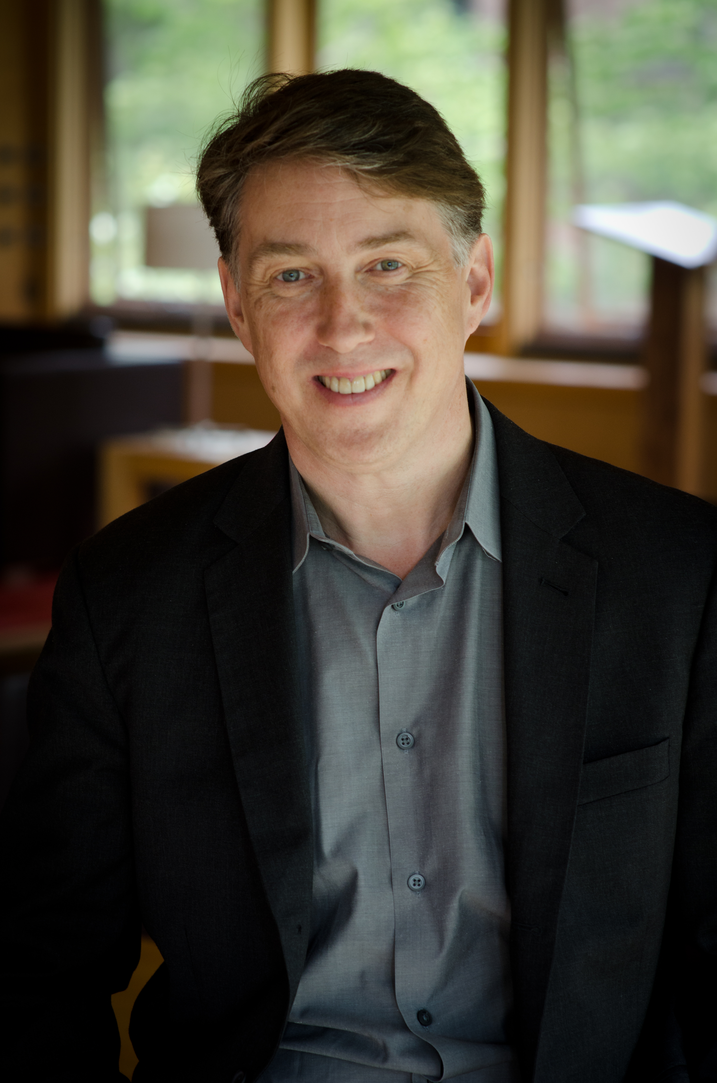
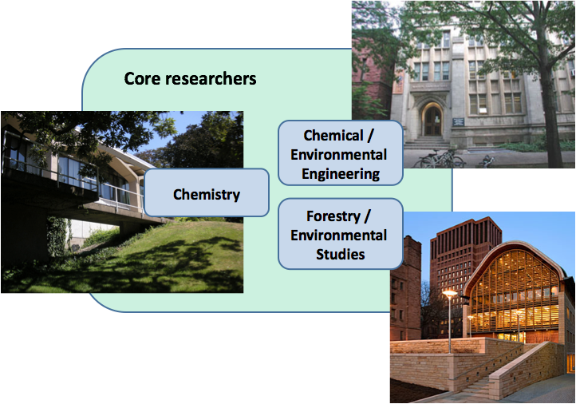
CENTER for GREEN CHEMISTRY and GREEN ENGINEERING at YALE
Founding Director
Professor Paul Anastas
Affiliated with Schools of
Law, Medicine, Divinity,
Management, & Architecture

Slide 3
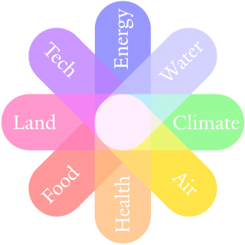
Multidisciplinary Approach
Addressing some of the world’s most pressing challenges at the nexus of resource issues

Slide 4
The Objectives of the Center for Green Chemistry & Green Engineering at Yale
Advancing the Science
Basic research
Technical workshops
Research tools
Promote research investment
Advance the research agenda
Catalyzing Implementation
Industrial partnerships
Policy advancement
Benchmarking
Roundtables
Assessment protocols
Preparing the Next Generation
Education materials
Yale courses
Training trainers
Graduate workshops
Faculty training
Raising Awareness
Conferences/symposia
Books
Multi-media
Web presence
Public engagement

Slide 5
Areas of Research Interest
INTEGRATED
BIOREFINERY
NOVEL SORBENT
MATERIALS
DESIGNING SAFER
CHEMICALS
OPTIMIZING THE
ENERGY-WATER NEXUS
WASTE
VALORIZATION
EARTH-ABUNDANT
GREEN CATALYSTS

Slide 6
Raising Awareness & Preparing the Next Generation
Practitioners
Graduate students
Teachers
NGO’s
Policy makers
General public
Scientists
Undergraduate students
Industry partners
Other Centers
Government
For more information, please go to https://greenchemistry.yale.edu/
Notes:
Advance the science.
Prepare the next generation.
Catalyze Implementation.
Raise awareness.

Slide 7
THE GLOBAL GREEN CHEMISTRY INITIATIVE
MISSION:
To increase the general global awareness and capacities on deployable Green Chemistry approaches for the design of products and processes that advance global environmental benefits throughout their life cycles.
Brazil Colombia Egypt Serbia South Africa Sri Lanka
Peru* Uganda* Ghana* Rwanda* Ethiopia* FYR Macedonia* Jordan* Kenia*
* Workshop participants

Slide 8
PROJECT ACTIVITIES
1-Day Awareness Raising Workshops
5-Day Train-the-Facilitators Workshops
To strengthen national and regional Green Chemistry initiatives in partnering countries and to enable partners to become hubs for education and training in Green Chemistry
University Curriculum
To educate the new generation of chemists in Green Chemistry
Technology Compendium
A systematic review of current Green Chemistry technologies
Guidance Document
A roadmap to Green Chemistry implementation for different stakeholders
https://www.global-green-chemistry-initiative.com

Slide 9
What can you expect from the 5 day Train-the-Facilitator Workshop?
Examples, case studies, exercises, discussions, work in teams/groups.
To maximize workshop’s impact, active engagement is a key.
Overview
Examples of Green Chemistry
Fundamentals
of
Green Chemistry
Partner’s Content
Putting
Green Chemistry
into Practice

Slide 10
5-Day Train-the-Facilitators Workshops
DAY 1
Sustainability
Disasters & Unintended Consequences
Day 2
Green Chemistry – Definition and Principles
Metrics, Renewable Feedstocks
Day 3
Catalysis, Solvents
Waste, Energy
Day 4
Theory to Practice, Innovation
Design for Reduced Hazard
Day 5
Partner's Case Studies
Lessons Learned

Slide 11
At the end of the workshop, you will:
Have an in-depth understanding of Green Chemistry, including origins, technologies and how it drives environmental and economic goals for societal benefit.
Be a green chemistry facilitator and be able to disseminate green chemistry to your networks by using practical and tangible examples that encourage the change.
Be connected to other like-minded people who embrace green chemistry as a solution.

Slide 12
Want to learn more?
Visit our websites:
greenchemistry.yale.edu
global-green-chemistry-initiative.com – slides available
Join our mailing list by emailing greenchemistry@yale.edu
Follow us on Twitter @YaleGCGE
Follow us on Facebook
@UNIDO @RECPnet @YaleGCGE #TrainTheFacilitators

Slide 13
Your Instructors: Karolina Mellor
Program Manager and Green Chemistry Educator at the Center for Green Chemistry and Green Engineering at Yale
Expertise in green chemistry research translation into educational materials including classes, workshops, publications, case studies, educational games and online certificates.
Received three National Science Foundation (NSF) educational grants.
9 years of biotech academic and professional experience –MSc in biotechnology, PhD in molecular biology.
Technology transfer experience.
Currently co-leads operations, outreach and development of the Center for Green Chemistry and Green Engineering.

Slide 14
Yale-UNIDO University Curriculum
To develop University Curriculum which will enable a next generation of chemists in Green Chemistry
Intended for undergraduates with no prior knowledge of green chemistry and
Aim is to teach how the principles of green chemistry can help resolve global human health and environmental issues.
Multimedia, diverse content that encourages team work and hands-on learning
Overview
Reimagining
Chemistry
Putting
Green Chemistry
into Practice
Fundamentals
of
Chemistry
Green
Chemistry

Slide 15
Yale-UNIDO Guidance Document
Outline the approaches and strategies used to engage a wide range of sectors including business, industry government academia, and civil society in green chemistry.
Specifically it will focus on:
1. Economic and societal benefits through the use of innovative Green Chemistry and Green Engineering technologies
2. How to implement Green Chemistry with respect to various business/educational/policy
3. Case studies that overlook the broad array of Green Chemistry innovations that are commercialized are near-term emerging opportunities

Slide 16
Yale-UNIDO
Technology Compendium
We are requesting the scientific community to provide template summaries of commercial Green Chemistry solutions
Incentives for Participation
Contributors to the Technology Compendium will be acknowledged
Faculty are encouraged to incorporate this exercise into curricula as a learning opportunity for students
ACS Green Chemistry student chapters can use this as a Green Chemistry activity for the 2018-2019 academic year
Requesting input no later than December, 2018
Google Form will be available on our GGCI website

