Slide 1
Solvents:
Understanding Their Role
Lecture #16
Date
Course #

Slide 2
UNIDO Solvents Video
https://www.youtube.com/watch?v=YMZfxbnA7sI

Slide 3
Outline
Learning objectives and outcomes
Understanding solvents
Solvent selection guides
Strategies for solvent replacement

Slide 4
Outline
Learning objectives and outcomes
Understanding solvents
Solvent selection guides
Strategies for solvent replacement

Slide 5
Learning Objectives
What are solvents
What they are used for
Why they are important
Solvent Characterization
Green Alternative Solvents & Resources

Slide 6
Learning Outcomes
At the end of the lecture, you should be able to….
Understand the various roles and functions of a solvent
Identify the advantages and disadvantages of solvents
Suggest substitutions for replacement of traditional solvents with greener alternative solvents

Slide 7
Outline
Learning objectives and outcomes
Understanding solvents
Solvent selection guides
Strategies for solvent replacement

Slide 8
What is a Solvent?
A solvent is a substance (typically a liquid) that dissolves a solute resulting in a solution.
Solution - the mixture formed when a substance dissolves in it
Solute - the substance that dissolves
Solvent - the liquid in the solution

Slide 9
Chemistry of Solvents
Solvents are used to dissolve something else
“Like dissolves like”

Slide 10
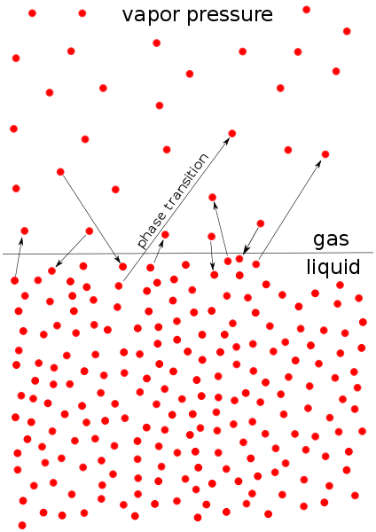
What Are the Properties of Solvents?
Solubility
Volatility – vapor pressure
Polarity
Viscosity
Image: Wikimedia commons
Notes:
Vapor pressure: https://commons.wikimedia.org/wiki/File:Vapor_pressure.svg

Slide 11
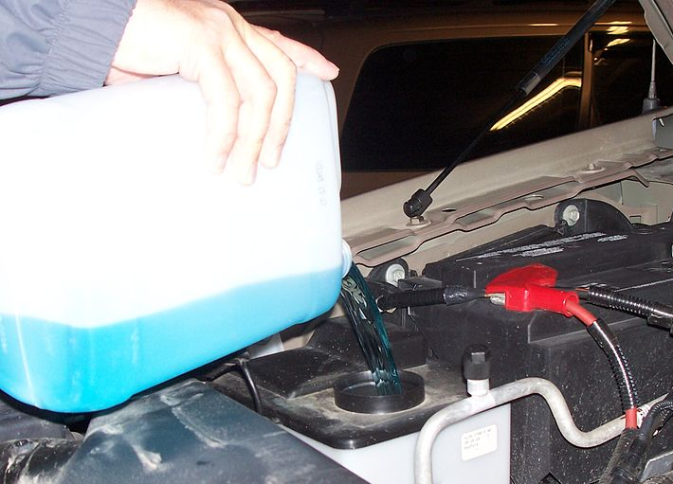

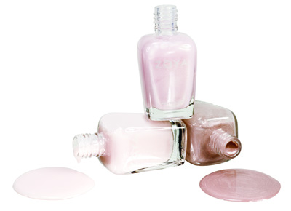

Common Examples of Solvents
Charcoal lighter fluid,
Windshield washer fluid,
Paint,
Household cleaners,
and even
And water!
Images: WikiMedia Commons
Notes:
Paint can image: https://commons.wikimedia.org/wiki/File:Paint_Can_-_The_Noun_Project.svg
Windshield washer fluid image: https://commons.wikimedia.org/wiki/File:Man_pouring_windshield_washer_fluid.jpg
Water drop: https://commons.wikimedia.org/wiki/File:Water_drop_001.jpg
Nail polish: https://commons.wikimedia.org/wiki/File:Zoya_Nail_Polish_Erin_Sally_and_Lauren.jpg

Slide 12
Uses of Solvents
As a Solvent….
Dissolution
Extraction
Degreasing
Inks, dyes, paints, coatings
Dilution, dispersal
Dry cleaning
As Something Else….
Fuels
Paint
Drugs & Therapeutics
Beverages
Antifreeze
Explosives
Pollutants

Slide 13
What makes a good solvent?
Species to be removed is highly soluble in the solvent
The solvent should have selectively from the species to be removed relative to other materials
Easily separate the species from the solvent after the extraction

Slide 14
Chemistry of Solvents
Facilitate reagents into a common phase where they can react
Dissolve solids so that they can be pumped from location to another
Lower viscosity and easier mixing
Regulate temperatures of reactions
Allow recovery of solids by filtration
Extract compounds from mixtures
Recrystallization
Cleaning

Slide 15
Chemical Class of Solvents
Aliphatic hydrocarbons
Cyclic hydrocarbons
Aromatic hydrocarbons
Ketones
Aldehydes
Alcohols
Ethers
Esters
Gasoline (octanes)
Cyclohexane
Benzene, toluene
Cyclohexanone, acetone
Acetaldehyde
Ethanol, methanol
Glycol ethers
Ethyl acetate

Slide 16
Chemical Class of Solvents
Nitrohydrocarbons
Halogenated alkanes
Halogenated alkenes
Mixtures
Ethylnitrate, TNT
1,1,1-trichlorethane, carbon tetrachloride, chloroform
Trichlorethylene, vinyl chloride
Kerosene, “white spirit”

Slide 17
Traditional Solvents
Volatile Organic Compounds
  Chloroform, carbon tetrachloride, methylene chloride, perchloroethylene (PERC)
  Benzene, Toluene, Xylene (BTX)
  Acetone, Ethylene Glycol, methylethyl ketone (MEK)
CFCs

Slide 18
The Problem with Solvents
Majority of all solvents are classified as organic solvents.
VOC’s – Volatile Organic Solvent
Large amounts of waste
Air Pollution
Potential health concerns

Slide 19
Treatment of VOC’s
All solvent waste & by-products must be properly contained and treated. Incineration of solvents is the standard method due to their vapor pressures/VOC’s.
Recovery of solvents isn’t the most effective process and has room to improve. According to GlaxoSmithKline, recovery efficiency is anywhere from 50-70%.

Slide 20






What Are the Concerns for Solvents?
Inherent Toxicity
Flammability
Environmental toxicity:
Aquatic toxicity
Atmospheric Ozone Production
Stratospheric Ozone Depletion
Global Warming Potential
Explosivity
Notes:
GHS hazard symbol icons
Inherent toxicity: Toxic (GHS06: Toxic), Harmful (GHS07: Harmful), Health Hazard (GHS08: Health hazard – includes chronic hazards)
For a full list of GHS hazard symbols and explanations: https://en.wikipedia.org/wiki/GHS_hazard_pictograms#Classes_3_and_4:_Flammable_liquids_and_solids

Slide 21
Environmental Regulation of Solvents
United States:
  Clean Air Act and Clean Air Act Amendments (Hazardous Air Pollutants List)
  Clean Water Act
  Toxics Release Inventory
  Toxic Substances Control Act
Montreal Protocol
European Commission, REACH Regulation
Notes:
Info on TSCA (US): https://www.epa.gov/laws-regulations/summary-toxic-substances-control-act
Info on REACH: http://ec.europa.eu/environment/chemicals/reach/reach_en.htm

Slide 22
Solvent Usage by Application
12000
Coatings, Inks,
Adhesives
10000
Industrial Cleaning
8000
Manufacturing
and Process
Solvent Usage (Millions of lbs)
6000
Consumer Products
Miscellaneous
4000
2000
0
1987
1992
1997

Slide 23
Uses of Solvents in Manufacturing Processes
Solvent
Separation &
purification
Chemical
reaction media
Cleaning
technologies
+
-
Facilitation & mediation
of intermolecular
reactions via solvent &
solute molecules or ions
Volatile & toxic
Product contamination
Environmental pollution
potential
Notes:
Benzene and toluene to clean the silicone contaminants (sealants, adhesives) from space craft hardware.

Slide 24
Solvent Substitutions are not always green
Organic Solvents:
  Good media for heat and mass transfer
  Low viscosity (improves reaction kinetics)
Switching out solvents can lead to increased energy cost during the manufacturing process
Not all current solvents are harmful!
  Ethyl acetate
  Ethanol
  Butanol
  Limonene (terpene based solvent extracted from citrus fruit like oranges)

Slide 25
The need for alternative solvents
Play a major role in many areas of technology
Provide many opportunities for improvement of environmental aspects.
Represent a very large proportion of the volatile organic compounds (VOCs) released into the atmosphere.
$1B spent on environmental technology, much of which is end of pipe equipment and associated operating costs to clean up emissions and air.

Slide 26
Alternative Solvents for Synthesis
Widely used throughout the chemical industry
  Synthetic Chemistry
    Reaction medium on laboratory and industrial scale
    Extensively used in work-up and purification (usually more than for reaction medium)
  Analytical Chemistry
    Sample extraction and preparation (Spectroscopy)
    Chromatography mobile phase (HPLC, TLC etc.)
  Crystallisation
    Recrystallisation to purify compounds and prepare crystals suitable for analysis

Slide 27
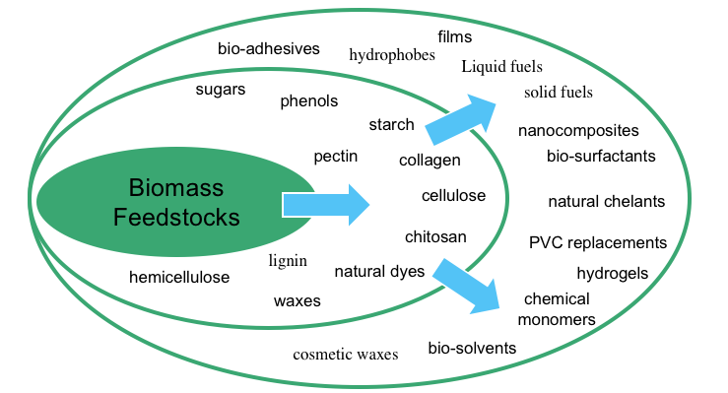
Bio-derived Solvents

Slide 28
Outline
Learning objectives and outcomes
Understanding solvents
Solvent selection guides
Strategies for solvent replacement

Slide 29
Solvent Selection Guides
The use of safer solvents is oftentimes the ‘low hanging fruit’ for implementing green chemistry principles. There are many solvent selection guides that have been published within the pharmaceutical sector and are being used as a basis for guiding the selection of safer solvent choices for chemical reactions, extractions, and separations. The following summary provides an overview of these guides, along with guidance towards safer solvent substitution.
Reactants 7%
Other 5%
Solvents (56%)
Water 32%
Composition by mass of the types of material used to manufacture an API (Active Pharmaceutical Ingredient): Solvents make up over 50% of the materials used!
Henderson, R. K., et. al. Green Chem., 2011, 13, 854-862
Notes:
Solvents make up over 50% of the materials used in the manufacture of an API (active pharmaceutical ingredient).

Slide 30
Pharmaceutical Sector Solvent Selection Guides
  Pfizer
  Glaxo-Smith Kline (GSK)
  Sanofi
  Amgen – substitutes for methylene chloride in separations (refer to Lecture #20, Green Analytical Chemistry)
  ACS Green Chemistry Institute Pharmaceutical Roundtable Solvent Selection Tool (launched Feb. 2018)
  CHEM21 Solvent Guide (2016)
  Criteria for solvent selection guides are based on all (or a sub-set of):
  Chemical functionality
  Physical properties
  Regulatory and legal classifications/limitations
  Environmental impact
  Health and safety
Notes:
Pfizer: “Green chemistry tools to influence a medicinal chemistry and research chemistry based organization”
Dunn and Perry, et. al., Green Chem., 2008, 10, 31-36
GSK: Henderson, R.K., et. al., Green Chem., 2011, 13, 854
ACS Green Chemistry Institute Pharma Roundtable Solvent Selection tool is based on the open access article: Org. Process Res. Dev., 2016, 20, 760-773: https://pubs.acs.org/doi/abs/10.1021/acs.oprd.6b00015

Slide 31
Pfizer Solvent Replacement Table
Undesirable Solvent | Alternative
Pentane | Heptane
Hexane(s) | Heptane
Di-isopropyl ether or diethyl ether | 2-MeTHF or tert-butyl methyl ether
Dioxane or dimethoxyethane | 2-MeTHF or tert-butyl methyl ether
Chloroform, dichloroethane or carbon tetrachloride | Dichloromethane
Dimethyl formamide, dimethyl acetamide or N-methylpyrrolidinone | Acetonitrile
Pyridine | Et₃N (if pyridine is used as a base)
Dichloromethane (extractions) | EtOAc, MTBE, toluene, 2-MeTHF
Dichloromethane (chromatography) | EtOAc/heptane
Benzene | Toluene
“Green chemistry tools to influence a medicinal chemistry and research chemistry based organization”
Dunn and Perry, et. al., Green Chem., 2008, 10, 31-36
Notes:
Pfizer created an internal solvent selection tool that has been widely publicized. The tool categorizes solvents based on worker safety (acute and chronic toxicity), process safety (flammability, and reactivity), and environmental and regulatory considerations. Solvents are categorized into “preferred”, “usable” and “undesirable” solvents and are also presented in a solvent replacement table that can be used to guide “greener” choices for solvents (Table in this slide). Through internal use of the solvent selection tool, Pfizer realized a 50% reduction in chlorinated solvent use, the reduction of undesirable ether usage by 97%, and the shifting of the use of less harmful heptane over hexane and pentane across their research division during 2004-2006.
Reference: Dunn, P. J., et. al., Green Chemistry, 2008, 10, 31-36.

Slide 32
Red Solvent | Flash point (°C) | Reason
Pentane | -49 | Very low flash point, good alternative available.
Hexane(s) | -23 | More toxic than the alternative heptane, classified as a HAP in the US.
Di-isopropyl ether | -12 | Very powerful peroxide former, good alternative ethers available.
Diethyl ether | -40 | Very low flash point, good alternative ethers available.
Dichloromethane | n/a | High volume use, regulated by EU solvent directive, classified as HAP in US.
Dichloroethane | 15 | Carcinogen, classified as a HAP in the US.
Chloroform | n/a | Carcinogen, classified as a HAP in the US.
Dimethyl formamide | 57 | Toxicity, strongly regulated by EU Solvent Directive, classified as HAP in the US.
N-Methylpyrrolidinone | 86 | Toxicity, strongly regulated by EU Solvent Directive.
Pyridine | 20 | Carcinogenic/mutagenic/reprotoxic (CMR) category 3 carcinogen, toxicity, very low threshold limit value (TLV) for worker exposures.
Dimethyl acetate | 70 | Toxicity, strongly regulated by EU Solvent Directive.
Dioxane | 12 | CMR category 3 carcinogen, classified as HAP in US.
Dimethoxyethane | 0 | CMR category 2 carcinogen, toxicity.
Benzene | -11 | Avoid use: CMR category 1 carcinogen, toxic to humans and environment, very low TLV (0.5 ppm), strongly regulated in EU and the US (HAP).
Carbon tetrachloride | n/a | Avoid use: CMR category 3 carcinogen, toxic, ozone depletor, banned under the Montreal protocol, not available for large-scale use, strongly regulated in the EU and the US (HAP).
“Green chemistry tools to influence a medicinal chemistry and research chemistry based organization”
Dunn and Perry, et. al., Green Chem., 2008, 10, 31-36
Notes:
This table summarizes the reason why the undesired solvents have been flagged as “undesirable” – you will see that some are because they have chronic hazards (i.e., chloroform is a known carcinogen) and others have physical hazards, such as diethyl ether having a very low flash point and being a peroxide former (both of which pose a physical hazard). It is useful to note that not all of the hazards are human heath hazards, but also can be due to flammability or explosion hazards (physical hazards)
“Green chemistry tools to influence a medicinal chemistry and research chemistry based organization”
Dunn and Perry, et. al., Green Chem., 2008, 10, 31-36

Slide 33
Pfizer’s results
Use of Solvent Replacement Guide resulted in:
50% reduction in chlorinated solvent use across the whole of their research division (more than 1600 lab based synthetic organic chemists, and four scale-up facilities) during 2004-2006.
Reduction in the use of an undesirable ether by 97% over the same two year period
Heptane used over hexane (more toxic) and pentane (much more flammable)
“Green chemistry tools to influence a medicinal chemistry and research chemistry based organization”
Dunn and Perry, et. al., Green Chem., 2008, 10, 31-36

Slide 34
GlaxoSmithKline (GSK) Solvent Selection Guide
Henderson, R.K., et. al., Green Chem., 2011, 13, 854
Notes:
Henderson, R.K., et. al., Green Chem., 2011, 13, 854
GSK has developed a solvent selection guide for use by their medicinal chemists. This solvent guide, shown in this slide, is a quick reference tool for practicing chemists to quickly identify solvents of concern. The guide is supported by a table which identifies the areas of concern in the following categories: waste, environmental impact, health hazards, flammability and explosion hazard, reactivity and stability, life cycle score and a legislation flag that alerts the user of any regulatory restrictions. The complete guide provides different levels of detail depending on the requirements by the user and the application.

Slide 35
ACS GCI Pharmaceutical Roundtable Solvent Selection Tool
Allows the user to focus on molecular properties of the solvent
  User identifies the properties → tool creates a shortlist of appropriate solvents that are also mapped with SHE (Safety, Health and Environmental Impact) data
Uses multivariate technique to allow a large number of parameters to be reduced to a small number of descriptors (lots of info and data!)
Contains 272 solvents within the tool
Open access tool!
https://www.acs.org/content/acs/en/greenchemistry/research-innovation/tools-for-green-chemistry/solvent-tool.html
Notes:
This tool was launched in 2018 – the link on the slide includes a document for download that contains background information on the tool and guidance for using the tool, including a workflow document. It is somewhat complex – but, could be a useful tool for a synthetic chemist.

Slide 36
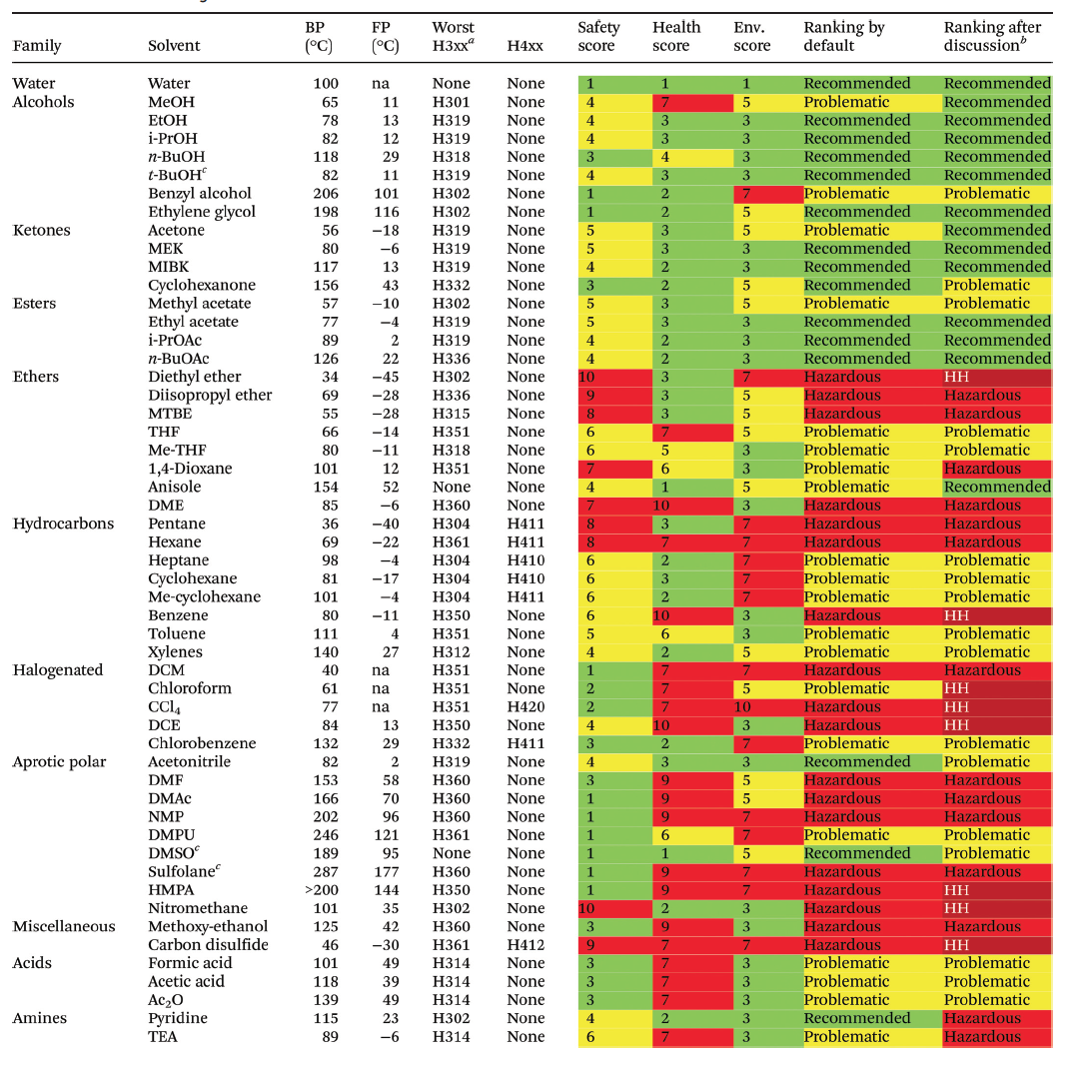
CHEM21 Solvent Guide
The CHEM21 online learning platform is a range of free, shareable and interactive educational and training materials created to promote the uptake of green and sustainable methodologies, with a particular focus on the synthesis of pharmaceuticals.
http://learning.chem21.eu/
Solvent selection CHEM21 video resource: http://learning.chem21.eu/methods-of-facilitating-change/tools-and-guides/solvent-selection-guides/
“CHEM21 selection guide of classical and less classical solvents” Denis Prat and et. Al, Green Chem., 2016, 18, 288

Slide 37
CHEM21 Solvent Selection Guide
Pros:
Useful for quick selection of the greenest solvent by “traffic light” visual aid
Survey comprised 53 classical solvents (see below)
Encompasses newer solvents and bio-derived solvents (attached)
A methodology that can give preliminary ranking of any solvent
Cons:
Solvent ranking adapted to the pharmaceutical industry
Boundaries between hazardous and highly hazardous cannot be clearly established due to not all companies listing the same banned solvents
Does not include supercritical fluids, gas expanding liquids, ionic liquids, high molecular weight glymes, fluorinated solvents, switchable solvents, deep eutectic solvents and Poly-Ethylene Glycols (PEGs)

Slide 38
CHEM21 Solvent Selection Guide
Overall ranking of solvents:
Ranking | Solvent
Recommended | Water, EtOH, i-PrOH, n-BuOH, EtOAc, n-BuOAc, anisole, sulfolane
Recommended or problematic | MeOH, t-BuOH, benzyl alcohol, ethylene glycol, acetone, MEK, MIBK, cyclohexanone, MeOAc, AcOH, Ac₂O
Problematic | Me-THF, heptane, Me-cyclohexane, toluene, xylenes, chlorobenzene, acetonitrile, DMPU, DMSO
Problematic or hazardous | MTBE, THF, cyclohexane, DCM, formic acid, pyridine
Hazardous | Diisopropyl ether, 1,4-dioxane, DME, pentane, hexane, DMF, DMAc, NMP, methoxy-ethanol, TEA
Highly hazardous | Diethyl ether, benzene, chloroform, CCl₄, DCE, nitromethane, CS₂, HMPA

Slide 39
HW #4: Solvent Substitution: CHEM21 Solvent Selection Guide
Using the CHEM21 Solvent Selection Guide, evaluate the solvents found in 2 different InkJet Ink formulations.
Use the solvent selection guide tables to look up solvents
If the solvent can not be found, use the CHEM21 interactive tool to generate a score using the following data:
  Boiling point, flash point, auto-ignition temperature, resistivity;
  Whether or not it is an ether that forms explosive peroxides;
  GHS statements and symbols;
  Whether or not it is hazardous to the ozone layer;
  Whether or not it is fully registered for REACH.
Which formulation would you recommend based on your rankings?
Notes:
Using the open access article (required reading): https://pubs.rsc.org/en/content/articlelanding/gc/2016/c5gc01008j#!divAbstract
CHEM21 selection guide of classical- and less classical solvents, Green Chem., 2016, 18, 288-296.
Also use the CHEM21 open-access resources available here: http://learning.chem21.eu/methods-of-facilitating-change/tools-and-guides/solvent-selection-guides/
Bp, Fp, auto-ignition temp and resistivity can generally be found on reliable Safety Data Sheets, or other reliable data websites (SigmaAldrich.com will have reliable SDS’s)
GHS statements and symbols can generally be found on reliable Safety Data Sheets, or other reliable data websites (SigmaAldrich.com will have reliable SDS’s)
To inquire whether the chemical is fully registered for REACH: https://echa.europa.eu/information-on-chemicals/registered-substances
Also, there is an option to use a synthetic chemistry example that can be found on the CHEM21 website: https://chem21repo.s3.amazonaws.com/media/sources/1154ec6efc90d816fcdb53a938ff7105.pdf

Slide 40
Outline
Learning objectives and outcomes
Understanding solvents
Solvent selection guides
Strategies for solvent replacement

Slide 41
Strategies of solvent replacement
Avoid or minimise solvents in first place
Use less toxic solvents
Use renewable solvents (not derived from petrochemicals)
Avoid VOC’s – solvents with low vapour pressure / high boiling points may be preferable as long as this does not lead to other complications.

Slide 42
Current approaches to solvent replacement in chemistry
No solvent
Water
Carbon dioxide
Ionic liquids
Lactate esters
Fluorous phase reactions
All have advantages and disadvantages which need to be considered when assessing suitability for replacement

Slide 43
Summary
Solvents are used to dissolve a solute – they have a range of properties and applications and can have a range of effects on human health and the environment
Green Alternative Solvents & Resources: Solvent selection guides from pharmaceutical sector and open-access resources are available
Strategies for solvent replacement:
  Avoid or minimise solvents in first place
  Use less toxic solvents
  Use renewable solvents (not derived from petrochemicals)
  Avoid VOC’s – solvents with low vapour pressure / high boiling points may be preferable as long as this does not lead to other complications.

