Slide 1
Designing for Recycling & Degradation
Lecture #14
Date
Course #

Slide 2
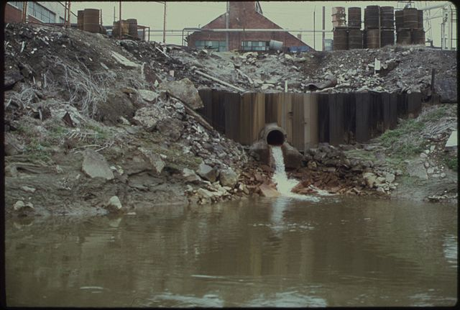
Principle #1: Waste Prevention
It is better to prevent waste than to treat or clean up waste after it is formed.
Image: Harshaw Chemical Company discharges waste water into the Cuyahoga river
Source: National Archives and Records Administration

Slide 3
Outline
The Waste Treatment Pyramid
Reduced Solvent Use
Waste as a Feedstock
Biodegradation
  Design rules/rules of thumb for biodegradation
Designing Products and/or Waste to Biodegrade

Slide 4
Outline
The Waste Treatment Pyramid
Reduced Solvent Use
Waste as a Feedstock
Biodegradation
  Design rules/rules of thumb for biodegradation
Designing Products and/or Waste to Biodegrade

Slide 5
Waste treatment pyramid: The 4 R’s
Reduce, Reuse, Recycle, Recover
Prevention
We need various types of technology to reduce and reuse waste.
Ultimately, the production of waste should be prevented.
Most favored option
Reduction
Reuse
Recycling
Energy recovery
Disposal
Recycling
Composting
Incineration
Least favored option
Landfill
Notes:
Need for technologies to Reduce and Reuse waste.
Ultimately, the waste production should be Prevented

Slide 6
Landfills
Reduction
Reuse
Recycling
Energy recovery
Disposal
  Consolidated material is buried with mud and other sealing agents to enable chemical, bacteriological, and physical degradation.
  Semi-anaerobic conditions lead to production of methane and CO₂.
  If captured, landfill gas (methane) from decomposing garbage can be used to produce electricity, heat, and fuels.
Image: Wikipedia

Slide 7
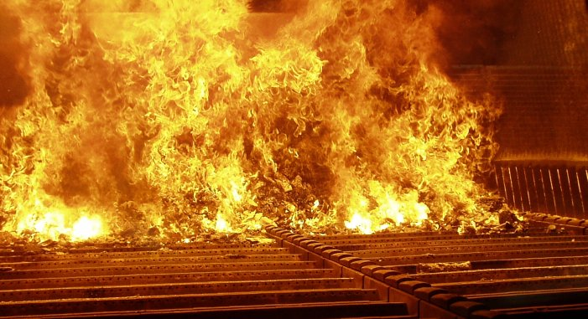
Incineration and Pyrolysis
Incineration
  Solid organic waste is combusted.
  Some thermal treatments allow energy capture.
  Solid mass is reduced by 95-96%.
Pyrolysis
  Thermal decomposition at 200-300°C occurring in the absence of oxygen.
  Precursor of both the combustion and gasification processes.
  The products of biomass pyrolysis include biochar, bio-oil, and gases - such as methane, hydrogen, carbon monoxide, and carbon dioxide.
Reduction
Reuse
Recycling
Energy recovery
Disposal
Image: Wikipedia

Slide 8
Recycling and Composting
Recycling
  Converting waste materials into new materials and objects.
  Available for metals, plastic, paper, glass.
Composting
  Organics undergo a biological decomposition to form a material (compost) that is non-toxic to plant growth.
  By-product of the reaction are CO₂, water and heat.
Anaerobic conditions and biogas production.
  Adopted for farm waste.
  Can reduce greenhouse gas emissions and can provide a cost-effective source of renewable energy.
  Recovered biogas can be an energy source for electricity, heating or transportation fuel.
Reduction
Reuse
Recycling
Energy recovery
Disposal
Material | Energy savings
Aluminum | 95%
Cardboard | 24%
Glass | 5-30%
Paper | 40%
Plastics | 70%
Steel | 60%
Cost-benefit of recycling: energy savings

Slide 9
Reuse and Repurpose
Reduction
Reuse
Recycling
Energy recovery
Disposal
Gasification:
  Converts organic based materials into CO, H₂ and CO₂.
  Achieved by reacting the material at high temperatures (>700 °C), without combustion, with a controlled amount of oxygen and/or stem.
  The resulting gas mixture is called syngas.
  Syngas is combustible and often used as a fuel.
Alcohol production (biomass conversion into mixed alcohol fuels):
  Biological/chemical method for converting any biodegradable material into useful chemicals, such as biofuels (e.g., ethanol, propanol, n-butanol, isopropanol, 3-pentanol).
  Made by enzymatic breakdown of biomass into simple sugars, followed by yeast fermentation into alcohols.

Slide 10
The Reduction and Elimination of Waste
Reduced solvent or solventless processes
Self separation
Process intensification
Material deposition
Use waste as a feedstock
Reduction
Reuse
Recycling
Energy recovery
Disposal

Slide 11
Outline
The Waste Treatment Pyramid
Reduced Solvent Use
Waste as a Feedstock
Biodegradation
  Design rules/rules of thumb for biodegradation
Designing Products and/or Waste to Biodegrade

Slide 12
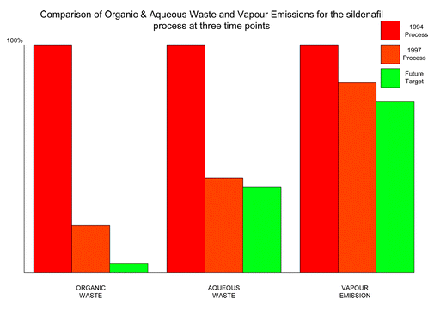
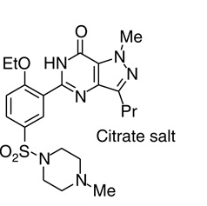
Reduced Solvent: Sildenafil Citrate Production
Sildenafil citrate, commonly known as Viagra, is a selective inhibitor of phosphodiesterase 5 (PDE5). This new drug has immediately became a major seller, achieving sales of more than $1 billion during its first year on the market. With such a rapid sales take off it was critical that the environmental performance of the synthesis was good from the outset.
Average yield of last three steps = 97% yield.
Reduction of the ratio of solvent waste/kg product over 17 years from 1300 L/kg to only 7 L/kg by minimizing solvent use, increasing solvent recovery, improving solvent selection, and telescoping steps.
Only the solvents t-butanol, ethyl acetate, 2-butanone, and a trace of toluene still require disposal.
Comparison of organic and aqueous waste and vapor emissions for the sildenafil citrate process at three time points
Dunn, P.J et al Green Chem., 2004, 6, 43-48

Slide 13
Reduced Solvent: dNTPs
They are the building blocks of both DNA and RNA, which are chains of nucleotides made through the processes of DNA replication and transcription. Nucleoside triphosphates also serve as a source of energy for cellular reactions and are involved in signaling pathways. Nowadays they are synthesized and used in molecular biology.
A one-pot, three step sequence.
Eliminates the need for several hazardous reagents such as ZnCl₂, triphenylphosphine, and solvents such as dimethylformamide and dichloromethane.
E-factor improved by an order of magnitude.
Solvent consumption reduced by 95%, hazardous waste by 65%,
preventing 1.5 million tons of hazardous waste per year.
Notes:
dNTPs are essencial feedstock to perform Polymarase Chain Reaction (PCR)

Slide 14
Reduced Solvent: Production of Ethylene Oxide
Ethylene oxide is used as an intermediate in the production of several industrial chemicals, the most notable of which is ethylene glycol. It is also used as a fumigant in certain agricultural products and as a sterilant for medical equipment and supplies.
E-Factor = 0.3
Use of molecular oxygen removed the need for chlorine.
New process generated more than 16 times less waste than the original one, eliminating the formation of waste water.

Slide 15
Solventless Process: Mechanochemistry
Chemistry physically activated
  Motion → Friction → Heat → Reaction
Uses High Energy Ball Milling
  Vibrating ball mill crushes particles which results in large surface areas.
  Mixing of solids allows reaction at surfaces.
  Thermal equilibrium is broken – “hot spots”, estimated at 10000 K, – Lasting 10^{‐7} seconds.
  Collisions break crystalline material.
  High pressures are generated.
Wilkening, M., Düvel, A., Preishuber-Pflügl, F., et al. (2016). Structure and ion dynamics of mechanosynthesized oxides and fluorides. Zeitschrift für Kristallographie - Crystalline Materials, 232(1-3), pp. 107-127.

Slide 16
Outline
The Waste Treatment Pyramid
Reduced Solvent Use
Waste as a Feedstock
Biodegradation
  Design rules/rules of thumb for biodegradation
Designing Products and/or Waste to Biodegrade

Slide 17
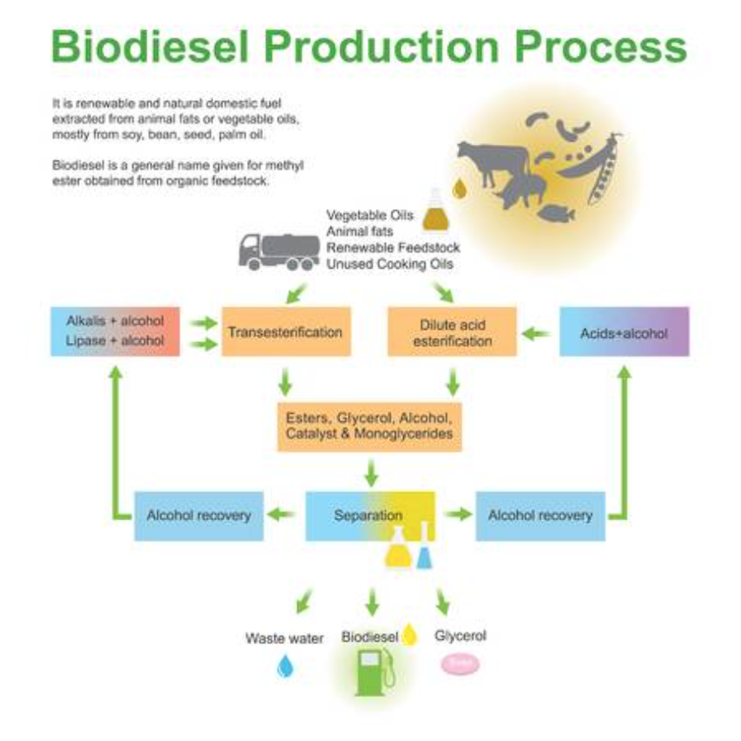
Utilizing Waste as a Feedstock
Some examples:
Waste cooking oil for biodiesel
Crustacean shell waste for chitosan based products
Red mud for bricks
Glycerol for lactic acid using catalyst
https://www.123rf.com/stock-photo/biodiesel_production.html?&sti=nb1guj45pd99v8lsd8|&mediapopup=70457693

Slide 18
Example: Electrocatalytic Oxidation of Glycerol to Chemical Feedstocks
2011 US bio-diesel production reached 967 million gallons.
  1 Olympic-size swimming = approx. 660,000 gallons.
  Almost 1460 Olympic-sized swimming pools of glycerol.
Current treatment:
  Dispose (sold for $240/ton!).
  Combust as fuel.
“Waste”
Bio-diesel
Chen, L.; Ren, S.; Ye, X. P., Fuel Processing Technology 2014, 120, 40-47.
T. Werpy, G. Petersen, Top value added chemicals from biomass, Pacific Northwest National Laboratory (PNNL), National Renewable Energy Laboratory (NREL), Office of Biomass Program (EERE), 2004.

Slide 19
Glycerol to Valuable Platform Chemicals
Skin exfoliating reagent
Polylactic acid
Industrial chemical precursors
Valuable medicinal product
Sunless tanning product
Anti-freeze
Notes:
There are just a handful of examples of what we could do with glycerol so BURNING it is definitely not the most efficient way to use the limited resources nature offers.

Slide 20
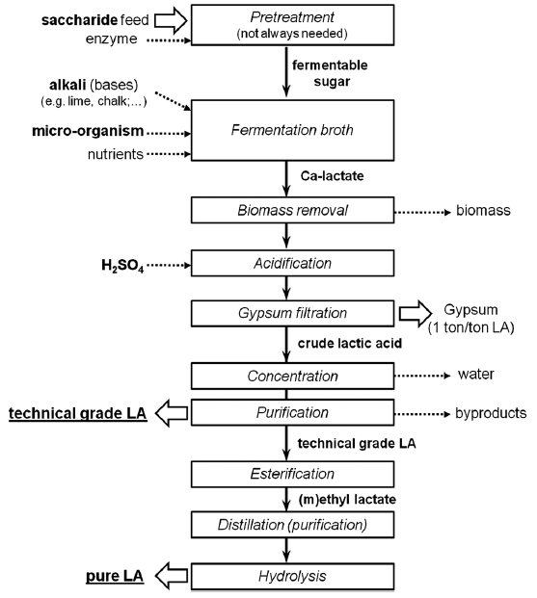
Production and Applications of Lactic Acid
  Other applications of Lactic Acid:
  Food preservatives
  Edible pH modifier
  Textile industry
  Cosmetic and pharmaceutical industries
90% of lactic acid comes from anaerobic fermentation of hexose sugar (e.g. corn starch).
Compete with food sources.
Slow and requires a lot of purifications.
Dusselier, M.; Van Wouwe, P.; Dewaele, A.; Makshina, E.; Sels, B. F., Energy & Environmental Science 2013, 6 (5), 1415-1442.

Slide 21
Water Electrolysis with Earth Abundant Metal Catalyst
e⁻
Power
Supply
e⁻
e⁻
e⁻
e⁻
e⁻
e⁻
2H₂O ---> O₂ + 4H⁺ + 4e⁻
2H⁺ + 2e⁻ ---> H₂
Cathode:
Any conductive materials
Anode:
Expansive platinum group metals
Anode
Cathode
Cobalt 1,2‐bis(diphenylphosphino)ethane
(Co-DPPE)
Bloomfield, A. J.; Sheehan, S. W.; Collom, S. L.; Crabtree, R. H.; Anastas, P. T., A heterogeneous water oxidation catalyst from dicobalt octacarbonyl and 1,2-bis(diphenylphosphino)ethane. New J. Chem. 2014, 38 (4), 1540-1545.

Slide 22
Electrocatalytic Oxidation of Glycerol
e⁻
Power
Supply
e⁻
Water-compatible
Atmospheric pressure
Rm temp. or above
Very low current / voltage
e⁻
e⁻
e⁻
e⁻
e⁻
2H⁺ + 2e⁻ ---> H₂
2H₂O ---> O₂ + 4H⁺ + 4e⁻
Anode
Cathode
Bloomfield, A. J.; Sheehan, S. W.; Collom, S. L.; Crabtree, R. H.; Anastas, P. T., A heterogeneous water oxidation catalyst from dicobalt octacarbonyl and 1,2-bis(diphenylphosphino)ethane. New J. Chem. 2014, 38 (4), 1540-1545.

Slide 23
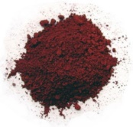
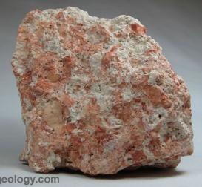
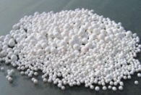
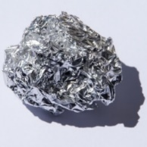
Example: Neutralization of Red Mud through Energy Efficient Extraction of Sodium Ions
The Bayer Process (Karl Bayer, 1887)
Red mud is a toxic byproduct of the industrial process that refines bauxite, raw aluminum ore, into aluminum oxide, or alumina.
NaOH, 170 – 180 °C
1 – 6 atm
Sodium aluminate
Na⁺ Al(OH)₄⁻
Red Mud
Precipitation
Element | Composition
Fe₂O₃ | 30-60wt%
Al₂O₃ | 10-20wt%
SiO₂ | 3-50wt%
Na₂O | 2-10wt%
CaO | 2-8wt%
TiO₂ | trace-25wt%
K, Cr, V, Ni, Ba, Cu, Mn, Pb, Zn, Sc | Traces
Bauxites
(4 – 5 tonne)
Alumina
Al₂O₃
(~2 tonne)
Depending on the origin, quality and composition of the bauxite, the amount of red mud left over from the alumina refining can vary widely. For every ton of alumina produced, the process can leave behind a third of a ton to more than two tons of red mud.
Electrolytic Reduction
Aluminum
(~1 tonne)
Source: http://www.aluminiumleader.com/production/aluminum_production
Notes:
http://www.aluminiumleader.com/production/aluminum_production/

Slide 24
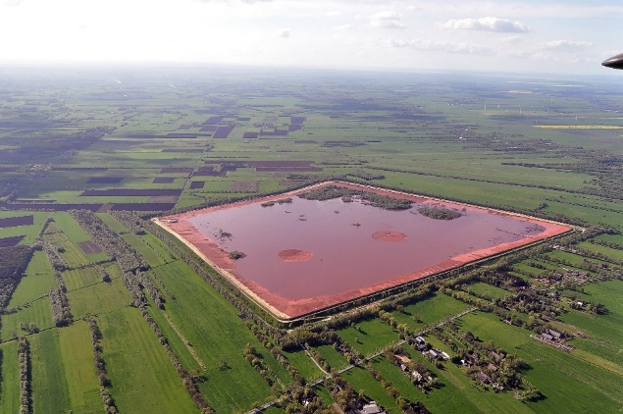
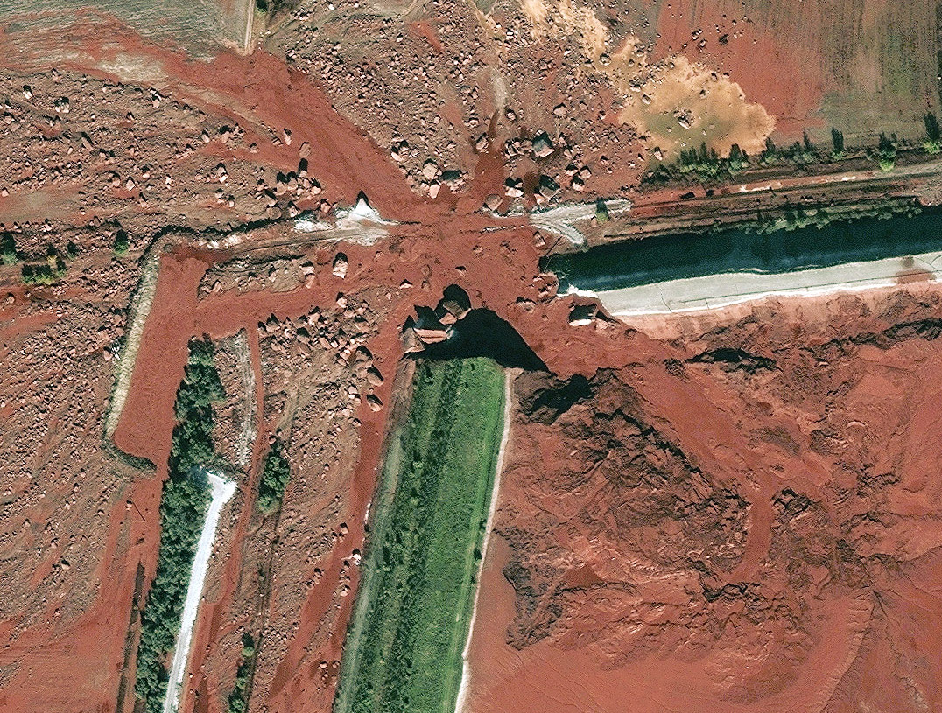
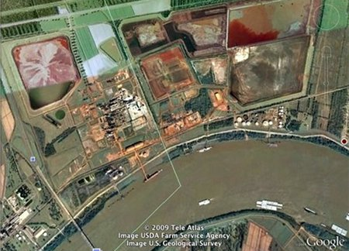
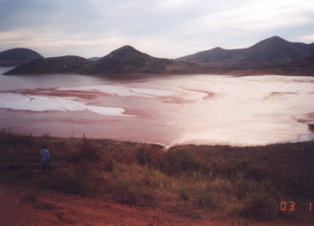
Red Mud: Pollution and Accidents
The mud also has a high pH because of the sodium hydroxide solution used in the refining process. The base is strong enough to kill plant and animal life, and to cause burns and damage to airways if the fumes are breathed.
Stade, Germany
Ajka, Hungary
Most refineries collect the mud in open ponds to allow some of the water to evaporate. Once it's dry, after several years, the red mud is buried or mixed with soil.
The red mud is kept in reservoirs, so there is the possibility of leaks and floods, as seen in western Hungary.
Noranda Alumina plant at Gramercy - located alongside the Mississippi River
Damandjodi, India
Image Source: Wikipedia Commons
Notes:
http://www.theguardian.com/environment/2014/jan/08/devecser-hungary-eco-town
http://www.theatlantic.com/photo/2011/09/a-flood-of-red-sludge-one-year-later/100158/
http://lacoastpost.com/blog/?p=13160
http://redmud.org/red-mud/disposal/

Slide 25
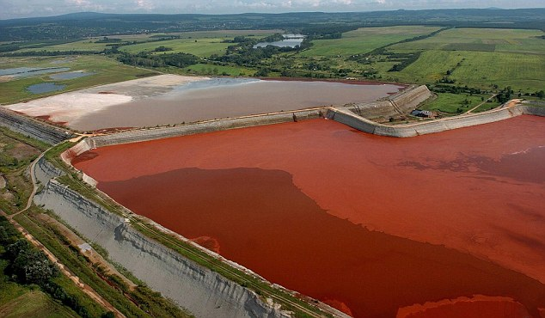
Red Mud: Neutralization and Potentials
If it is neutralized to pH 8 – 9:
  Building Materials
    Cement, bricks, tiles, etc.
  Pollution Control
    Removal of toxic heavy metal: Cd, Pb, Cr, etc..
    Removal of aromatic pollutant: dyes, phenols, chlorophenols, boron agents, etc.
Economically Unfeasible Schemes:
  Acid neutralization (from waste plant).
  CO₂ pumping.
  Seawater neutralization.
We can fight pollution with pollution!
Arch. Environ. Sci. 2012 ,6, 13-33

Slide 26
Neutralization of Red Mud through Selective Extraction of Sodium Ions
Co(Dppe)
Metal
Red Mud Heterogeneous Basic Aq. Solution
Sodium Hydroxide Solution
Na⁺
Na⁺
Na⁺
Na⁺
Na⁺ Ion Selective Membrane
*Patent Pending
2H₂O ---> 2O₂ + 4e⁻ + 4H⁺
Water oxidized to lower pH and pushes Na⁺ ions through
4 H₂O + 4e⁻ → 2H₂ + 4OH⁻
Generates OH⁻ to facilitate the Na⁺ passing
Courtesy of Dr. Jason Lam

Slide 27
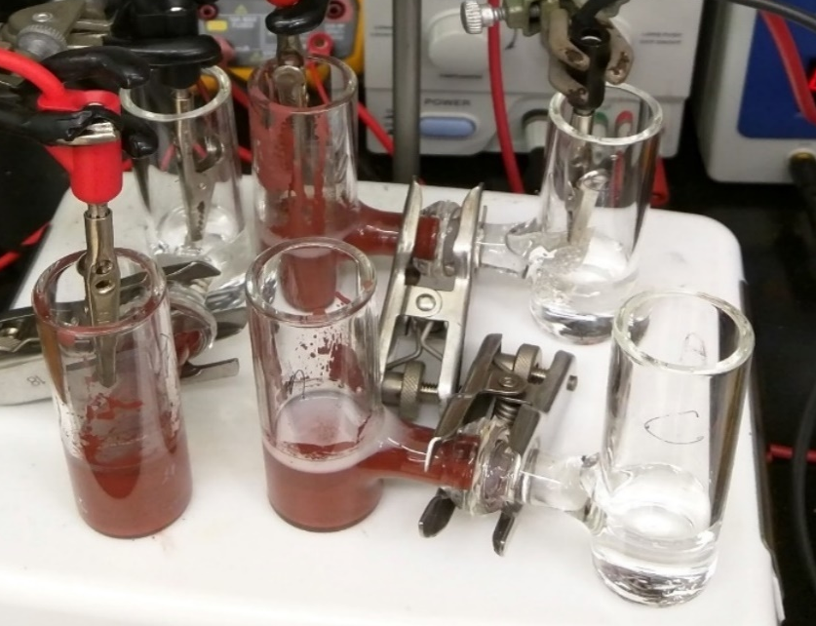
Successful Neutralization
 | K | Na | Fe | Al | Ca
[Ion]_{int.} (Anode) | 0.3 | 461 | 0.1 | 0.3 | 4.5
6 volt, Room Temperature, 12 hours
[Ion]_{hr=12} (Cathode – Trial 1) | 0.1 | 71.6 | - | - | 0.1
[Ion]_{hr=12} (Cathode – Trial 2) | 0.1 | 71.6 | - | - | 0.2
[Ion]_{hr=12} (Cathode – Control, no e⁻) | 0.0 | 0.0 | - | - | 0.0
Using this process, red mud can be neutralized at room temperature in 12 hours.
Courtesy of Dr. Jason Lam

Slide 28
Outline
The Waste Treatment Pyramid
Reduced Solvent Use
Waste as a Feedstock
Biodegradation
  Design rules/rules of thumb for biodegradation
Designing Products and/or Waste to Biodegrade

Slide 29
Biodegrade the Waste
Biodegradation - "A process by which microbial organisms transform or alter (through metabolic or enzymatic action) the structure of chemicals introduced into the environment." – US EPA, 2009
“Ready” biodegradability – remove 70% of dissolved organic carbon AND achieve 60% theoretical oxygen demand or CO₂ production within a 10-day window in a 28-day test. – OECD
“Ultimate” biodegradability – 60-70% of organic carbon converted to CO₂ within 28 days.

Slide 30
PBT Chemicals: History
Persistent
Bioaccumulative
Toxic
PBT chemicals are of high concern due to their resistance to degradation, high mobility in the environment, and high toxicity.
What makes a chemical structure more Persistent?

Slide 31
PBT Chemicals: Examples
Synthetic detergents (1950’s – 1960’s)
DDT (1960’s – today)
Plastics (today)

Slide 32
Example: Pesticides
DDT – Dichlorodiphenyltrichloroethane
Ideal insecticide:
  Inexpensive to prepare
  Very wide spectrum in activity
  Non-toxic to humans (or so they thought)
  Persistent, negating the requirement for re-treatment
  Inventors awarded Nobel Prize in 1948
1962: Rachel Carson, Silent Spring (https://youtu.be/Ipbc-6IvMQI)
  Linked widespread DDT use to cancer and thinning of bird eggs shells
  Carcinogen, endocrine disruptor, developmental and reproductive effects
Replaced in the developed world with more expensive pesticides, such as organophosphates
DDT

Slide 33
Aerobic Versus Anaerobic Digestion
Difference in oxygen supply, organism types and products formed.

Slide 34
Aerobic Digestion
Bacteria consume organic matter.
Needs a constant supply of oxygen, pH adjustments, and mixing.
Byproducts: heat, CO₂, and H₂O.
Frequently used by water treatment plants or in composting.

Slide 35
Anaerobic Digestion
Bacteria consume organic matter in the absence of oxygen.
Common in fermentation and landfill; produces biogas consisting of methane, ammonia, hydrogen sulfide.
Biogas is considered a renewable energy.

Slide 36
Digestion versus Chemical Structure
Not all chemicals will biodegrade at the same rate (think plastic vs paper).
The rate of biodegradation depends on the microorganism, but also a chemical structure of the molecule.
Some parts of the molecule are known to be more biodegradable than the others.
There is a publically available software that analyses the chemical structure and predicts whether the molecule will degrade slower (days) or slower (months, years).

Slide 37
Outline
The Waste Treatment Pyramid
Reduced Solvent Use
Waste as a Feedstock
Biodegradation
  Design rules/rules of thumb for biodegradation
Designing Products and/or Waste to Biodegrade

Slide 38
Reasons for resistance of a substance to microbial degradation
Environment
Appropriate microorganisms do not exist or are not present in the environment
There are inadequate nutrients for the microbial population
The temperature, pH or pO₂ is too low or too high; ionic conditions are unsuitable
Concentration of substrate is too high (toxic) or too low
The substrate is adsorbed or covalently attached to clays, humus, etc., or is physically inaccessible
The substrate is not accessible to attack because it is too large and/or insoluble
The substrate:
  Is not transported into the cell
  Is not a substrate for the available enzymes
  Is not an inducer for appropriate enzymes or transport systems
  Does not give rise to products that can integrate into normal metabolism
  Is converted into products that are toxic or interfere with normal metabolism
Molecule
From: Chem. Reviews, 2007, Vol. 107, No. 6, 2207-2227

Slide 39

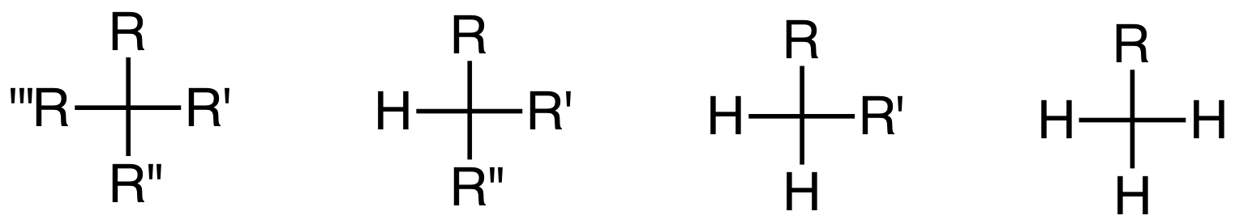
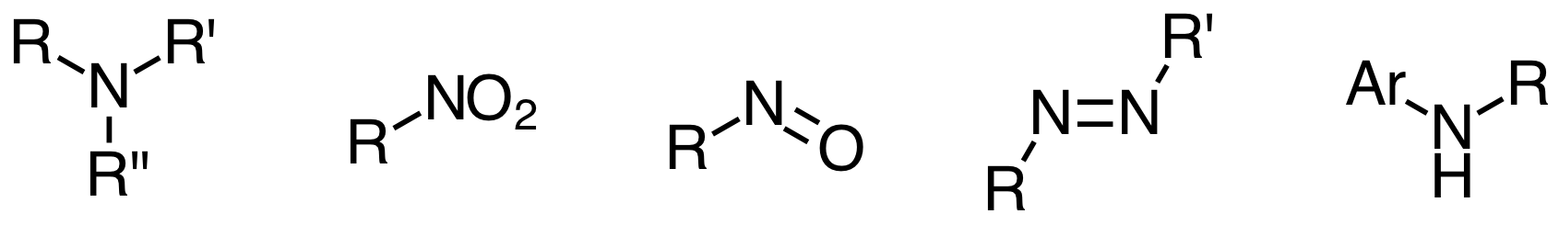
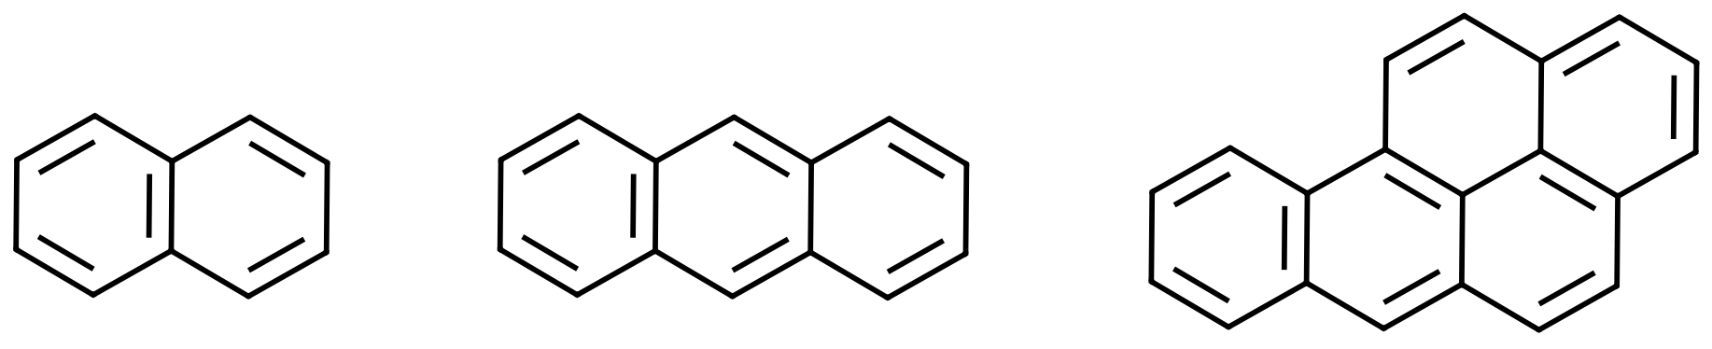
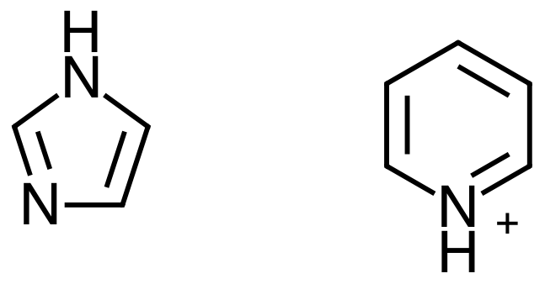
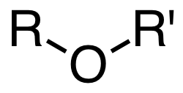
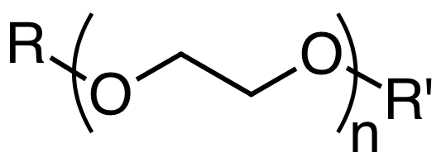
Rules of thumb for biodegradability
Feature | Structure
Halogens: Especially chlorine and fluorine and if more than 3 in a molecule
Chain branching if extensive: Quaternary C’s are problematic
Tertiary amine, nitro, nitroso, azo, and arylamino groups
Polycyclic aromatic residues
Heterocyclic residues
Aliphatic ether bonds (except in ethoxylates)
Features that increase resistance to aerobic biodegradation
Chem. Reviews, 2007, Vol. 107, No. 6, 2207-2227
Notes:
The addition of chlorine atom to a phenyl ring makes the ring less susceptible to attack by oxygenase enzymes, which use an electrophilic form of oxygen as the oxidant; strongly electron-withdrawing groups such as chlorine are therefore to be avoided if possible.
Features that increase resistance to aerobic biodegradation:
Halogens (especially chlorine and fluorine and if more than 3 in a molecule) (Electron withdrawing groups on a phenyl ring makes the ring less susceptible to attack)
Chain branching if extensive (quaternary C’s problematic)
Tertiary amine, nitro, nitroso, azo, and arylamino groups
Polycyclic residues (ex., PAHs) (especially with more than 3 rings)
Heterocyclic residues (ex., imidazole)
Aliphatic ether bonds (except in ethoxylates)

Slide 40
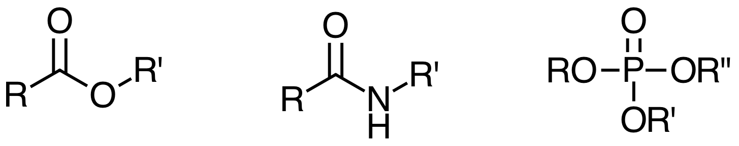
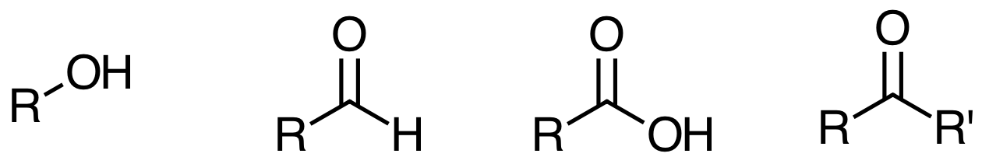
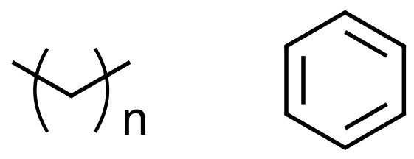
Rules of thumb for biodegradability
Molecular features that generally increase aerobic biodegradability:
Feature | Structure
Groups susceptible to enzymatic hydrolysis (esters, including phosphate esters) and amides
Oxygen atoms in the form of hydroxyl, aldehyde, or carboxylic acid groups, ketones (not ether, with the exception of ethoxylate groups)
Unsubstituted linear alkyl chains (especially ≥ 4 carbons) and phenyl rings
Chem. Reviews, 2007, Vol. 107, No. 6, 2207-2227
Notes:
The addition of chlorine atom to a phenyl ring makes the ring less susceptible to attack by oxygenase enzymes, which use an electrophilic form of oxygen as the oxidant; strongly electron-withdrawing groups such as chlorine are therefore to be avoided if possible.
Molecular features that generally increase aerobic biodegradability:
Groups susceptible to enzymatic hydrolysis (esters, including phosphate esters) and amides
Oxygen atoms in the form of hydroxyl, aldehyde, or carboxylic acid groups, ketones (not ether, with the exception of ethoxylate groups)
Unsubstituted linear alkyl chains (especially ≥ 4 carbons) and phenyl rings

Slide 41
Class Exercise Options
  Predicting Biodegradation: U.S. EPA EPISuite tool, BIOWIN
  Design for Biodegradability Discussion Questions

Slide 42
Exercise #1
Predicting Biodegradation: U.S. EPA EPISuite, BIOWIN

Slide 43
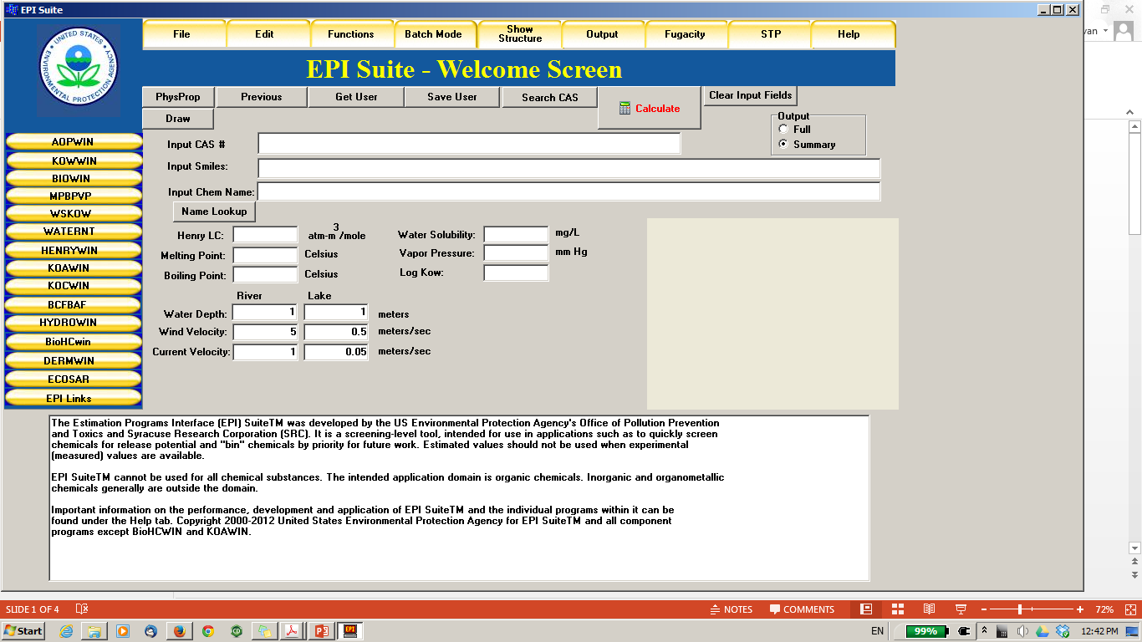
Predicting Biodegradation: EPA, EPISuite
EPI = Estimation Programs Interface http://www.epa.gov/oppt/exposure/pubs/episuitedl.htm

Slide 44
BIOWIN Models Based on Molecular Fragment Contributions
Six aerobic degradation models
  BIOWIN1&2: qualitative, based on database of 264 chemicals
  BIOWIN3&4: estimation of rate, based on 200 chemicals
  BIOWIN5&6: qualitative, based on database of 884 chemicals
New anaerobic degradation model
  BIOWIN 7: “screening level”, methanogenic bacteria, 169 chemicals

Slide 45
BIOWIN Demonstration/Exercise
Interface with ChemDraw
Exercise:
  Compare molecules with similar structure
  How do the aerobic (BIOWIN 6) and anaerobic (BIOWIN 7) estimates change?
  Note any parts of the molecule that are not used in the model
  When there is ambiguity, do the BIOWIN1-5 models help reveal any trends?

Slide 46
TEAM 1

Slide 47
TEAM 1
1.
Increasing number of rings & molecular weight
2.
Favors biodegradation
- OH
- Low molecular weight
Disfavors biodegradation
- High molecular weight
- Cl
3.
Most biodegradable (aerobic)
Least biodegradable
4.
1>2>4>3>5
Most biodegradable (anaerobic)
Least biodegradable
5.
4>1>2>3>5
Notes:
Increasing number of rings

Slide 48
TEAM 2

Slide 49
TEAM 2
1.
Bisphenol A derivatives: Halogenated and BPS
2.
Favors biodegradation
- Low molecular weight
Disfavors biodegradation
- High molecular weight
Tertiary carbon BPA
Halogens, but F better than Cl
3.
Poor biodegradation due to high MW
4.
Most biodegradable (aerobic)
Least biodegradable
1>6>3>4>2>5
5.
Most biodegradable (anaerobic)
Least biodegradable
6.
6>2>4=5>3>1

Slide 50
TEAM 3

Slide 51
TEAM 3
Different plasticizers
Linear and branched;
Two green plasticizers: Reduced ring to cyclo and isosorbide ring
1.
2.
Favors biodegradation
Linear chains
Cyclo
Esters
Disfavors biodegradation
Side chains and branching
Ethers
3.
4.
Most biodegradable (aerobic)
Least biodegradable
1>4>2>3>5
5.
Most biodegradable (anaerobic)
Least biodegradable
1>5>2>4>3

Slide 52
TEAM 4

Slide 53
TEAM 4
1.
Explosives (TNT, nitroglycerine)
2.
Favors biodegradation
Small molecular weight
OH
Disfavors biodegradation
CH₃
Large MW
NNO₂CH₃
3.
Most biodegradable (aerobic)
Least biodegradable
4>5>1=2=3
4.
Degrades faster due to small MW
Most biodegradable (anaerobic)
Least biodegradable
4>5>2>1>3
5.

Slide 54
Exercise #2
Designing for Biodegradability Discussion Questions
Notes:
Use the “rules of thumb” for increasing and decreasing resistance to aerobic biodegradation (the next two slides) as a reference for students to work through the discussion questions either as a whole group, or in small groups.
This activity is available also as a hand-out. You are welcome to provide the handout to students, have them work through the questions on their own, using the rules of thumb as a guide. And, then lead a group discussion with slides 57-60 to discuss the answers that the students came up with

Slide 55
Designing for Biodegradability: Discussion Questions
Feature | Structure
Halogens: Especially chlorine and fluorine and if more than 3 in a molecule
Chain branching if extensive: Quaternary C’s are problematic
Tertiary amine, nitro, nitroso, azo, and arylamino groups
Polycyclic aromatic residues
Heterocyclic residues
Aliphatic ether bonds (except in ethoxylates)
Features that increase resistance to aerobic biodegradation
Notes:
The addition of chlorine atom to a phenyl ring makes the ring less susceptible to attack by oxygenase enzymes, which use an electrophilic form of oxygen as the oxidant; strongly electron-withdrawing groups such as chlorine are therefore to be avoided if possible.

Slide 56
Designing for Biodegradability: Discussion Questions
Molecular features that generally increase aerobic biodegradability:
Feature | Structure
Groups susceptible to enzymatic hydrolysis (esters, including phosphate esters) and amides
Oxygen atoms in the form of hydroxyl, aldehyde, or carboxylic acid groups, ketones (not ether, with the exception of ethoxylate groups)
Unsubstituted linear alkyl chains (especially ≥ 4 carbons) and phenyl rings

Slide 57
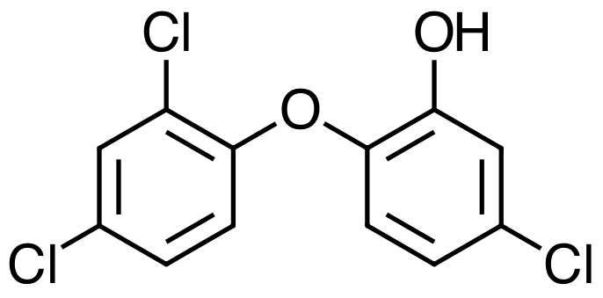
Designing for Biodegradability: Discussion Questions
Triclosan was used extensively as an antimicrobial agent in soaps, detergents and other household products.
In 2016, the U.S. FDA announced that as of September 2017, they would prohibit the sale of consumer antiseptic washes containing triclosan. There are some health concerns linked to triclosan, including it being a possible endocrine disrupting chemical. Based on the structure, would you expect the chemical to persist in aerobic conditions?
U.S. Food and Drug Administration. September 2, 2016,
https://www.fda.gov/NewsEvents/Newsroom/PressAnnouncements/ucm517478.htm
Notes:
Yes, based on the structure this should persist in aerobic conditions. The students should be able to identify the functional groups that will increase the resistance to degradation using the “rules of thumb” slides as a reference – the ether group and the chlorine groups will increase the resistance.

Slide 58
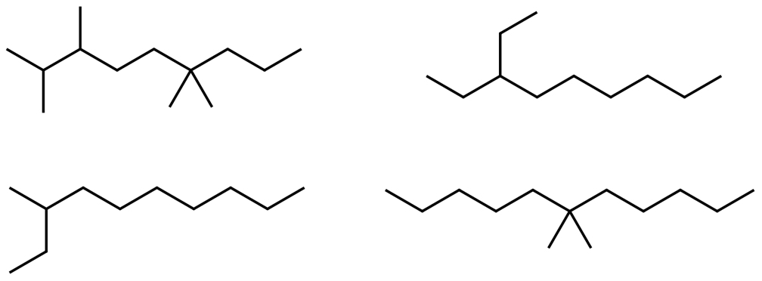
Designing for Biodegradability: Discussion Questions
Name the following alkanes. Identify the isomers.
Rank the alkanes in terms of their biodegradability (based on the design rules). Justify your ranking.
Write condensed and bond-line formulas for three isomers of the alkane C₅H₁₂. Based on biodegradability design rules, rank the isomers in terms of biodegradability. Justify your ranking.
Notes:
Depending on the level of the students in your class, you can have them name the alkanes for practice – and, also write the different formulas for the isomers. If you have more advanced students, then focus on the persistence of the alkanes based on the chain branching – quaternary carbons will persist longer than tertiary, followed by secondary – use the “rules of thumb” ppt slides as a reference

Slide 59
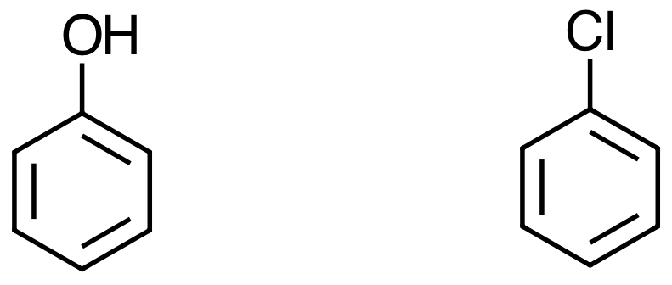
Designing for Biodegradability: Discussion Questions
Aerobic biodegradation of a phenyl ring typically proceeds by the electrophilic addition of oxygen to the phenyl ring. The oxygen reactive species can take on different forms, depending on the enzyme and conditions. Propose a simple mechanism for the electrophilic addition in which oxygen is introduced to phenol and compare it to chlorobenzene. Use a simple “E+” to represent the reactive oxygen species. Which do you believe will be more biodegradable under aerobic conditions and why?
Dr. Dalila Kovacs, Grand Valley State University
Notes:
Aerobic biodegradation of a phenyl ring typically proceeds by the electrophilic addition of oxygen to the phenyl ring. The oxygen reactive species can take on different forms, depending on the enzyme and conditions. Propose a simple mechanism for the electrophilic addition of oxygen to phenol and compare it to chlorobenzene. Use a simple “E+” to represent the reactive oxygen species. Which do you believe will be more biodegradable under aerobic conditions and why?
Remember the rule: The addition of chlorine atom to a phenyl ring makes the ring less susceptible to attack by oxygenase enzymes, which use an electrophilic form of oxygen as the oxidant; strongly electron-withdrawing groups such as chlorine are therefore to be avoided if possible.
The students should propose that the phenol should be more biodegradable based on the rules of thumb. The electron donating groups (-OH) allows for oxygen to more readily attack the benzene ring. The strongly electron-withdrawing group (-Cl) will hinder this.

Slide 60
Designing for Biodegradability: Discussion Questions
The aromatic compounds shown are chlorinated derivatives of phenol that are mainly used as fungicides and pesticides, besides a variety of other uses. While their chemical properties protect crops from destructive insects, one problem is their rate of bioaccumulation in the environment and their biodegradability– how long they persist in soil, water, and our bodies. Interestingly, the number and location of the chlorine substituents on the aromatic ring affect the biodegradability of these compounds. Organic chemists currently work to synthesize new polyhalophenols that retain the desired pesticide properties, but are degraded quickly to safe byproducts.

Slide 61
Design for Biodegradation?
Since we know the chemical moieties, functional groups, and types of bonds which make the molecule biodegradable, can we build-in biodegradability into chemical products?
YES!

Slide 62
Outline
The Waste Treatment Pyramid
Reduced Solvent Use
Waste as a Feedstock
Biodegradation
  Design rules/rules of thumb for biodegradation
Designing Products and/or Waste to Biodegrade

Slide 63
Example: Detergents
Tetrapropylene alkylbenzene sulfonate (TPPS) was used as a surfactant for laundry detergents and accumulated into the water supply due to incomplete degradation.
Water tended to foam when coming out of the tap.
Tetrapropylene alkylbenzene sulfonate
(TPPS)
Low biodegradation!!

Slide 64
Example: Detergents
TPPS was replaced by linear alkylbenzene sulfonate (LAS).
Replacing the methyl branched chain of TPPS by a linear carbon chain reduces the biopersistence.
linear alkylbenzene sulfonate (LAS).
High biodegradation!!

Slide 65
Example: Pesticides
DDT – Dichlorodiphenyltrichloroethane, which was used as agricultural pesticide, is persistent in the environment.
Not only does it bioaccumulates, but it undergoes a reaction to DDE which is even more toxic than DDT.
Toxic
DDT
DDE
Methoxychlor shares many insecticidal properties as DDT and it’s potency, but it is not persistent.
It degrades into methoxychlor phenol, which has also low toxicity and it is easily excreted.
Low toxicity
methoxychlor
Methoxychlor phenol

Slide 66
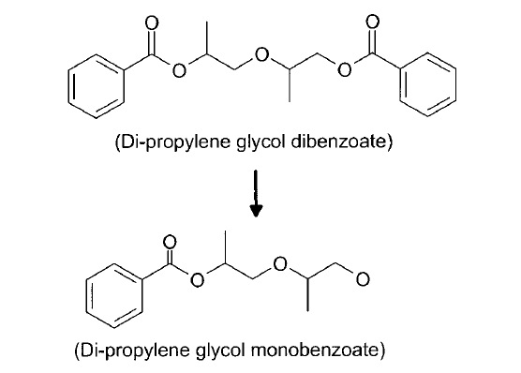
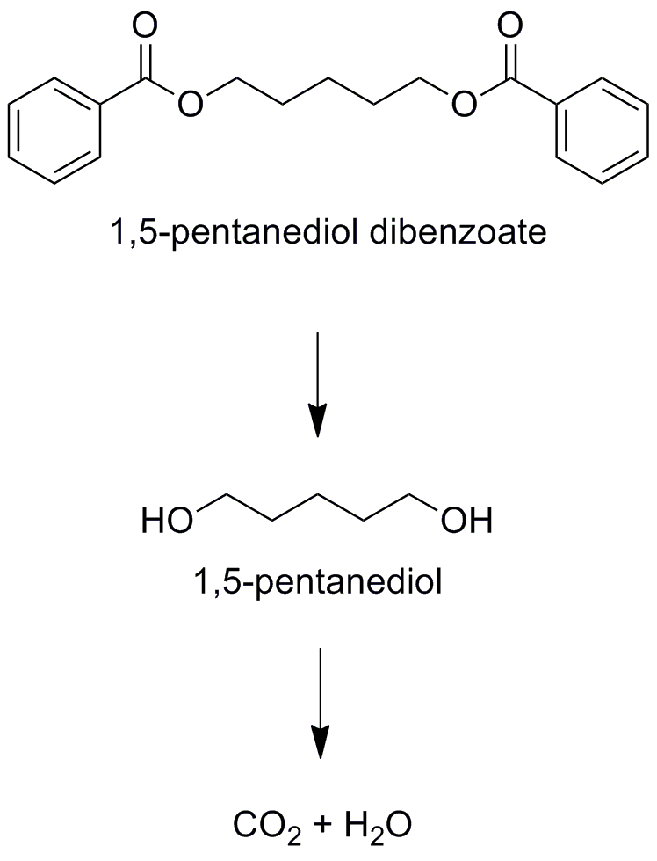
Example: Plasticizers
Plasticizers are additives in plastic applications. Almost 90% of plasticizers are used in PVC, giving this material improved flexibility and durability.
Di-propylene glycol dibenzoate decomposes into a product which is toxic to bacteria, and therefore stops the biodegradation process.
With slightly changed structure, 1,5-pentanediol dibenzoate biodegrades into CO₂ and H₂O
kills bacteria,
biodegradation halts
complete degradation
to CO₂ + H₂O

Slide 67
Example: Antibacterial Products
Triclosan is an antibacterial and antifungal agent found in some consumer products, including toothpaste, soaps, detergents, toys, and surgical cleaning treatments.
It persists in the environment.
Low biodegradation
Chlorophene is a bacteriocide and fungicide in cosmetics.
It is very biodegradable in the media and entirely removeable from the wastewater.
High biodegradation

Slide 68
Summary
The Waste Treatment Pyramid: Prevention of waste and the reduction in the use of materials is the best way to avoid waste in the first place!
Reduced Solvent Use: Solvents contribute to a large % of the materials used in chemical processes and products; reducing the use of solvents can have a great impact
Waste as a Feedstock: waste can be processed to be a valuable feedstock or platform chemical for use in many industry sectors
Biodegradation: Understanding design rules and rules of thumb for biodegradation can help to predict if a molecule will be persistent
Designing for biodegradation is possible!

Slide 69
Homework #3
Estimating Biodegradation of Organic Molecules

Slide 70
Estimating Biodegradation of Organic Molecules
Calculation of the Biodegradation Index (BI):
BI = 3.199 + a₁f₁ + a₂f₂ +a₃f₃ + …. + a_{n}f_{n} + a_{m}MW
Variable | Meaning
a_{n} | Assigned contribution factor to functional group (see attached table)
f_{n} | # of times/frequency a functional group in a molecule
a_{m} | Molecular weight contribution factor (-0.00221)
MW | Molecule weight of molecule
*BI is an indicator of aerobic biodegradation rate. A value to 5 indicates the compound is expected to degrade over HOURS. A value of 4 corresponds to a biodegradation of DAYS. Last, values of 3,2, or 1 correspond to biodegradation in WEEKS, MONTHS, and YEARS respectively. These values of BI should not be viewed as an accurate quantitative predictor of biodegradation. Rather, it should be viewed as a relative ranking of the probability that compound will degrade in the assigned timeframe.
J.W. Raymond et al. / Journal of Hazardous Materials B84 (2001) 189–215
Notes:
See enclosed activity – also,

