Slide 1
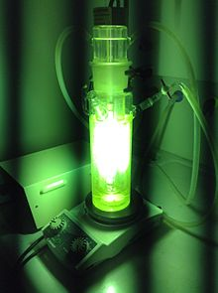

Yale-UNIDO Train-the-Facilitator Workshop in Green Chemistry
Energy delivery in Chemistry
CENTER for GREEN CHEMISTRY
and GREEN ENGINEERING at YALE
Source: wikipedia

Slide 2
Topics To Be Covered
Role of energy in a chemical process
Microwaves
Flow chemistry
Photochemistry
Electrochemistry
Mechanochemistry

Slide 3
What’s important in a chemical reaction
Catalyst: play on the activation energy
Products: safe + biodegradable
Feedstock: renewable
Medium + energy

Slide 4
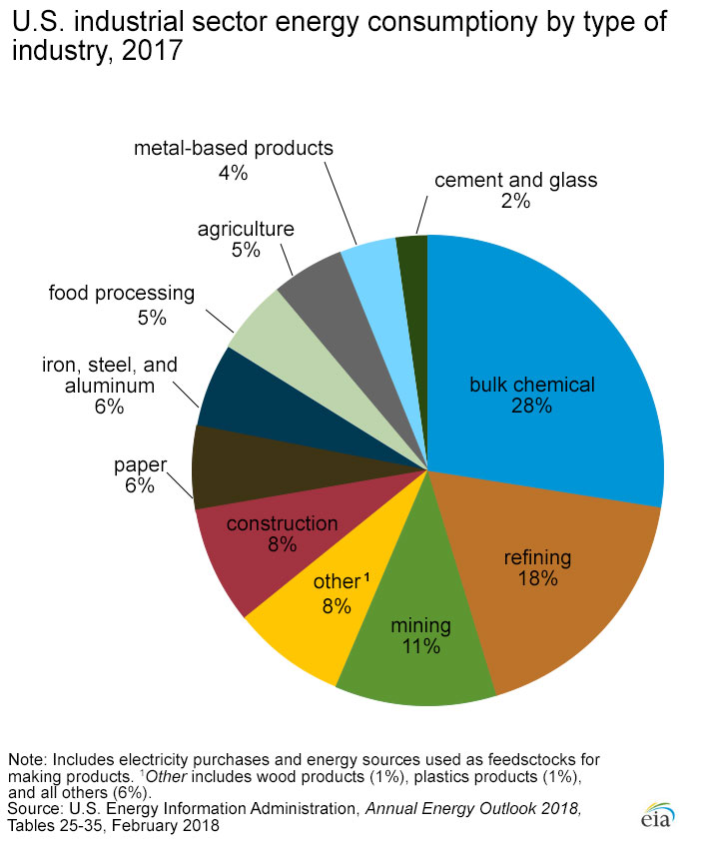
Use of energy in the chemical industry
Chemical industry energy use in the US
  Chemistry accounts for a large portion of energy use
  E.g. the Haber Bosch process alone (production of ammonia) represents 1% all al energy consumption in the world.
N. Notman, Haber-Bosch power consumption slashed, Chem. World, Oct 2012
https://www.eia.gov/energyexplained/index.php?page=us_energy_industry

Slide 5
Why do we need energy in a chemical process?
What do you think?

Slide 6
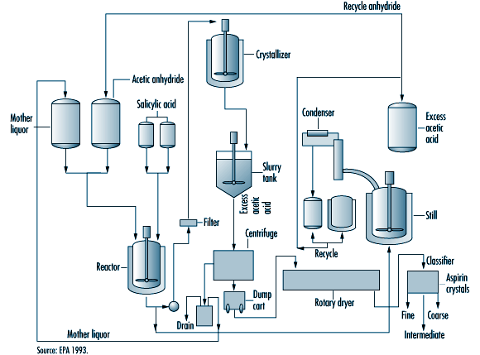
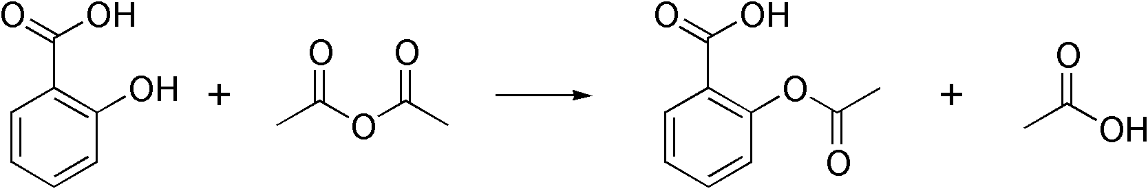
Use of energy in a chemical process
Synthetic process of acetylsalicylic acid (aspirin)
Reaction heating (endothermic reaction)
Reaction cooling (exothermic reaction)
Agitation, pumping…
Working up
  Distillation
  Drying
  Filtrations
  …

Slide 7
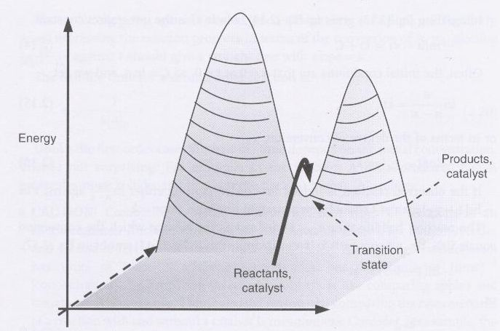
Use of energy: Activation energy
During reaction: Activation Energy
  Activation energy = energy barrier for the reaction
  It can be provided by:
    Thermal heating
    Another energy delivery methods
      Electrochemistry
      Photochemistry
      Sonochemistry
      Microwave
      Mechanochemistry
During the reaction | At purification step | When things go wrong

Slide 8
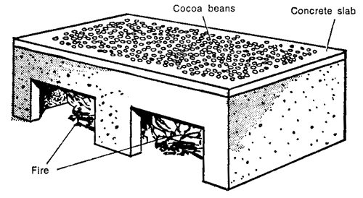
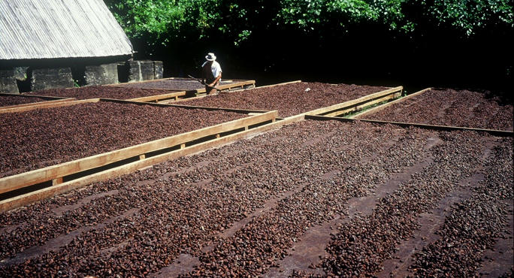
Use of energy: Purification
After reaction
  Heat for distillation to separate and purify or concentrate desired products
  Heat to dry product material
  Energy for waste treatment
25% of chemical industry energy input is distillations and drying processes
Eg: sun vs artificial cocoa bean drying
During the reaction | At purification step | When things go wrong

Slide 9
Use of energy: Purification
Solutions for energy reduction during purification:
  Tandem reactions (less steps = less purification)
  Heterogeneous catalysis (easy separation)
  Tunable/switchable solvents (easy separation)
  Biphasic medium where the product separate (easy separation)
  Solventless processes (easy separation, no heating of solvent)
During the reaction | At purification step | When things go wrong

Slide 10
Use of energy: Sources of energy wastes
Apparatus operated below design specification
Bad maintenance (leaks…)
Lack of monitoring
Lack of energy recovery (for heating buildings for instance)
Bad energy source choice
From UK data, the relative energy consumption/t of product have dropped from 170 in 1960 to 60 in 2000
In USA 50% of industry
consumption is chemistry + refinery
During the reaction | At purification step | When things go wrong

Slide 11
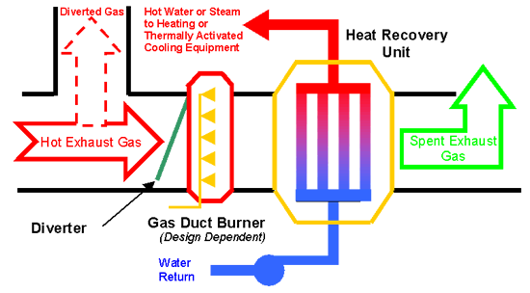
Use of energy: Sources of energy wastes
A green engineering solution: heat recovery
  Eg: a biomass burner to generate energy
During the reaction | At purification step | When things go wrong
https://reich-chemistry.wikispaces.com/Michael+Gautreau+Brett+Fredericks+wiki+project2009?responseToken=9d3531ae35b397f7a71d66ae7f508307

Slide 12
Use of energy: Let’s focus on the reaction
During reaction: Activation Energy
  Activation energy = energy barrier for the reaction
  It can be provided by:
    Thermal heating
    Another energy delivery methods
      Electrochemistry
      Photochemistry
      Sonochemistry
      Microwave
      Mechanochemistry
During the reaction | At purification step | When things go wrong

Slide 13
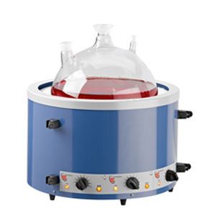
Use of energy: Activation reaction
Thermal heating
  Delivered from natural gas or other fossil fuels
  either using the heat of combustion directly or superheated steam.
  In the lab we use rather electricity with hot plates or heating mantels

Slide 14
Use of energy: Activation reaction
Thermal heating in batch: limitations:

Slide 15
Use of energy: Activation reaction
Thermal heating in batch: limitations:
  Solvent needs to be heated to heat the molecule: it’s a loss of energy
  Homogeneity issues: there is a gradient of temperatures in the batch
  Heating of products after reaction… potential degradation
reacted
degraded

Slide 16
Use of energy: Activation reaction
Thermal heating in batch: limitations:
  Solvent needs to be heated to heat the molecule: it’s a loss of energy
  Green solution: Solventless processes
Advantage | Disadvantage
No solvent heating/distilling | High viscosity/solubility problems
Easy separation

Slide 17
Use of energy: Activation reaction
Thermal heating in batch: limitations:
  Solvent needs to be heated to heat the molecule: it’s a loss of energy
  Green solution: Ways to direct energy better towards the reaction and only the reaction.
    Microwaves (heats up only polar molecules)
    Sonochemistry (localized bursts of energy)
    Electrochemistry (electronic activation)
    Photochemistry (photonic activation)
    Mechanochemistry (to reaction solids together: no solvent heating)

Slide 18
Use of energy: Activation reaction
Thermal heating in batch: limitations:
  Homogeneity issues:
  Degradation issues:
  Green solution: Flow chemistry
    The reaction can be heated only on a small volume (homogeneous)
    The reaction can be heated only when needed and reacted products don’t need to be overheated
reacted
degraded

Slide 19
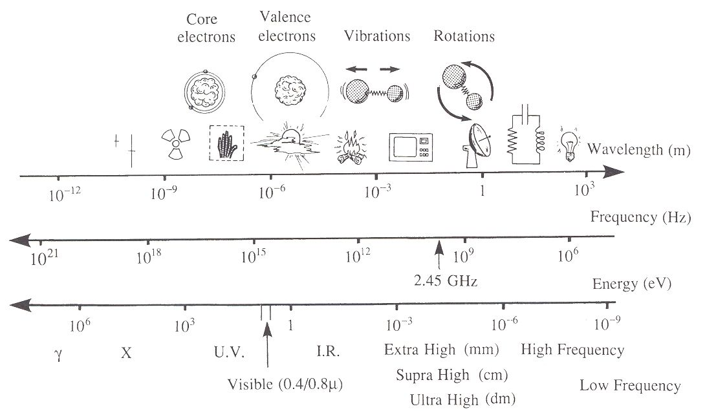
CHEM 462: 20. Energy input reduction (I)
Microwave
Principle of microwaves
  Microwaves reactors (and oven) have a fixed frequency at 2.45 GHz (to avoid interferences with telecommunications and cell phones)
  This correspond to a time scale of 10⁻¹² s, which is the time it takes for a molecule to rotate
  Microwaves do not have enough energy to break a bond or to make a molecule vibrate: It is even lower than Brownian motion energy
10⁻²
Practical Microwave Synthesis for Organic Chemists: Strategies, Instruments, and Protocols, Green Chem., 2004, 6 , 128–141

Slide 20
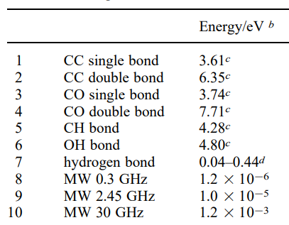
CHEM 462: 20. Energy input reduction (I)
Microwave
Principle of microwaves
  Microwaves reactors (and oven) have a fixed frequency at 2.45 GHz (to avoid interferences with telecommunications and cell phones)
  This correspond to a time scale of 10⁻¹² s, which is the time it takes for a molecule to rotate
  Microwaves do not have enough energy to break a bond or to make a molecule vibrate: It is even lower than Brownian motion energy
Practical Microwave Synthesis for Organic Chemists: Strategies, Instruments, and Protocols, Green Chem., 2004, 6 , 128–141

Slide 21
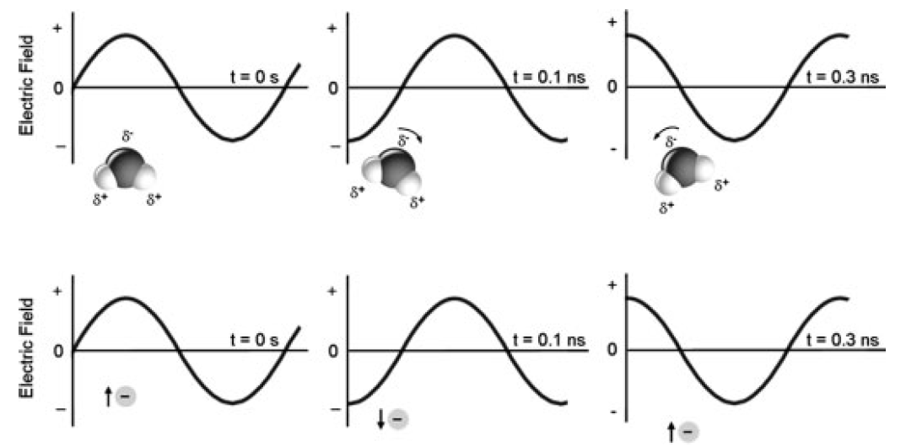
Microwave: mechanism
Main mechanism for microwave heating: Dipolar polarization mechanism
Alignment of the molecule with the electric field
Dipole realigns to the field, generating heat through molecular friction/dielectric loss

Slide 22
CHEM 462: 20. Energy input reduction (I)
Microwave: mechanism
Dipolar polarization mechanism
  Molecules that produce heat under microwaves
    Water
    Ethanol
    DMSO
    DMF
    CH₂Cl₂
  Bad microwaves solvents are benzene, CCl₄ and ethers.
Molecule must be polar
Molecule must be protic or viscous
Molecule produces heat
Notes:
Viscocity of water (1cP), methanol (0.59 CP), DCM (0.44 cP), ether (0.224 cP)

Slide 23
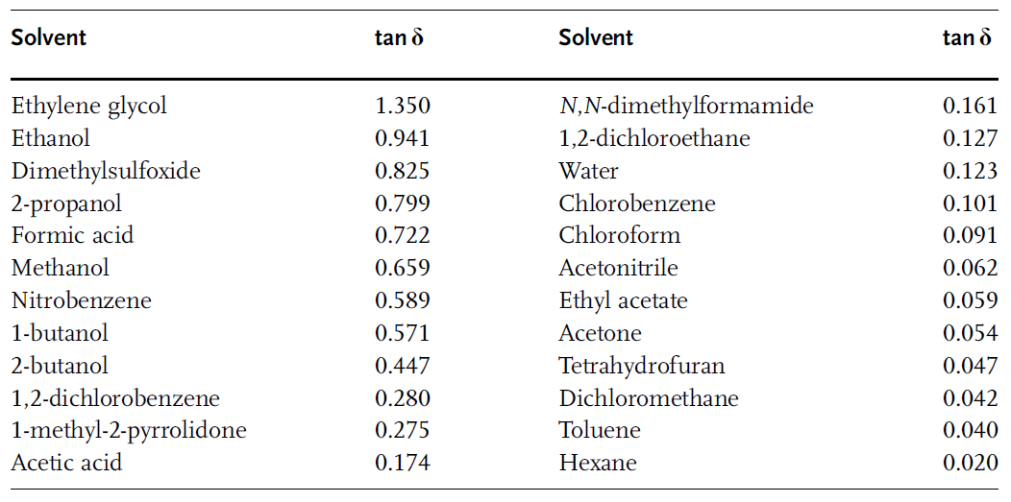
Microwave: solvents
Solvents may be ranked for their microwave performance
the higher tan δ, the better the microwave heating

Slide 24
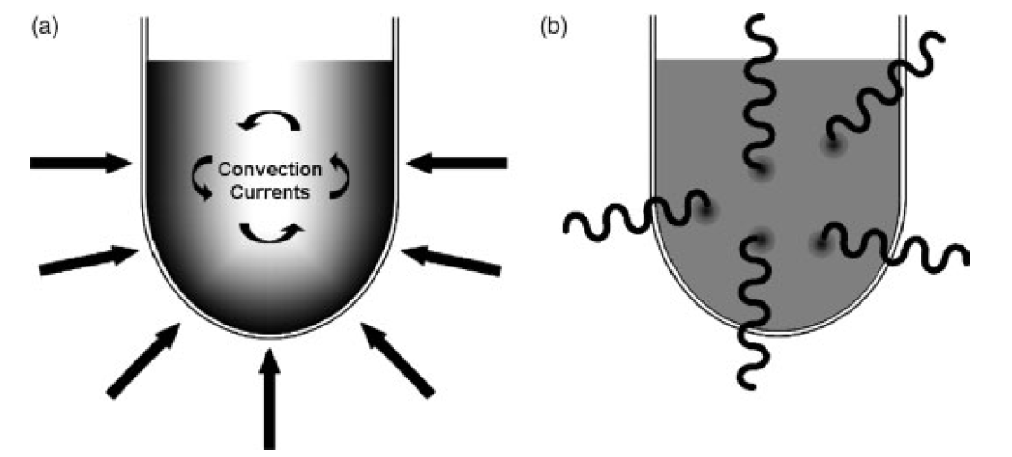
CHEM 462: 20. Energy input reduction (I)
Microwave
Advantages of microwave heating
  Heating uniformity: (conduction, convection and radiation are secondary)
  Heating speed: Target temperature easier to reach fast especially in small volumes
  Effect of super heating: heating above the boiling point of the solvent
  Selective heating: polar molecules could be heated without solvent heating
  Ohmic heating for metals and magnetic materials: local extreme heatings
Notes:
Viscocity of water (1cP), methanol (0.59 cP), DCM (0.44 cP), ether (0.224 cP)

Slide 25
CHEM 462: 20. Energy input reduction (I)
Microwave: industry applications
  Devulcanization of rubber (recycling process): advantageous because no solvent needed, good heat repartition
  Dupont process for HCN production: gaseous reaction, so only the solid catalyst is heated. Locally, temperature is 1200°C!
Pt
Local ohmic heating
Al₂O₃
Notes:
Viscocity of water (1cP), methanol (0.59 cP), DCM (0.44 cP), ether (0.224 cP)

Slide 26
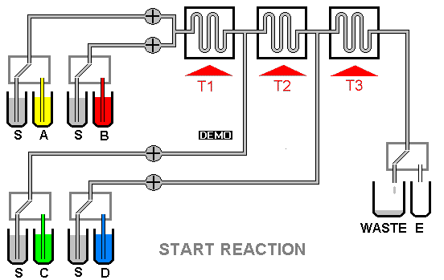
Flow chemistry
Flow chemistry: Chemical method taking place in a tube. The chemical reaction is performed in a continuous fashion.
The volume in which the reaction takes place is small (a few mm³ to cm³)
=> it’s easy to control conditions within this volume (temperature, pressure…)
Chem. Commun., 2011, 47, 4583–4592

Slide 27
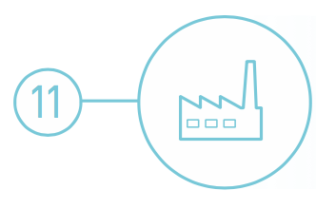
Continuous Flow Reactors
Real-time Analysis for Pollution Prevention
Replacing batch reactors on large, medium, and even small scale has distinct advantages:
  Precise control of reaction conditions.
  Reproducible reaction outcome (product purity).
  Minimizes waste, and provides increased safety.
Image Sources: http://encyclopedia.che.engin.umich.edu/Pages/Reactors/menu.html, https://www.technologynetworks.com/drug-discovery/product-news/automated-compound-library-production-294622

Slide 28
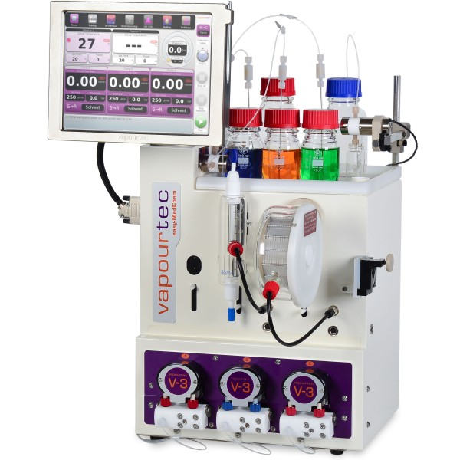
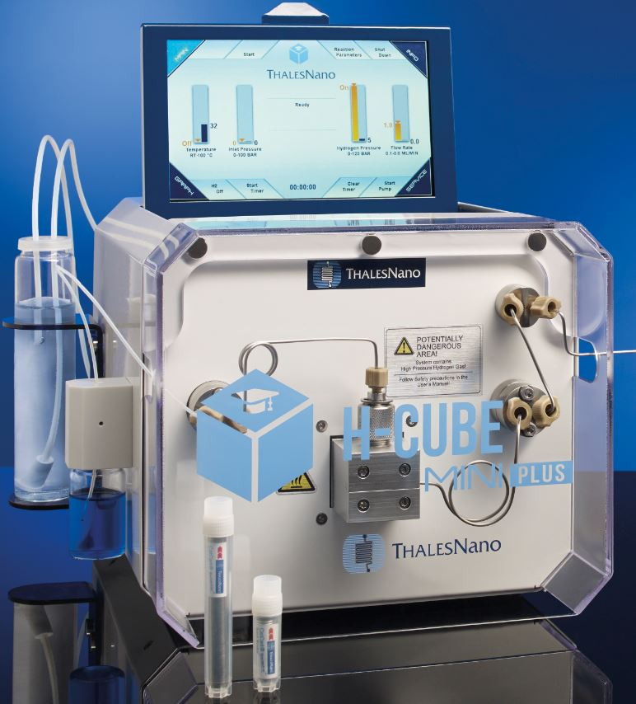
Flow chemistry
Advantages:
  Particular interest in reactions that can not be scaled up.
  Good heat transfer
  Mass transfers
  Continuous production
  Constant quality
  Safety (reactive reagents, better control of dangerous reactions)
  More facile scale up
Can be combined with
  Photochemistry
  Microwave
  Electrochemistry
In such systems, high pressure can take place in a very small volume => improved safety

Slide 29
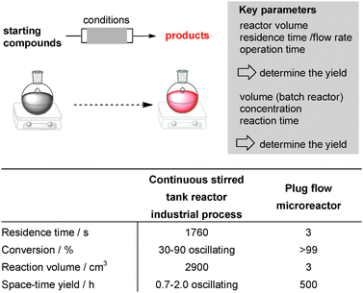
Flow chemistry
Flow vs batch: Faster, + selective reactions
Flow
Batch
Chem. Commun., 2011, 47, 4583–4592

Slide 30
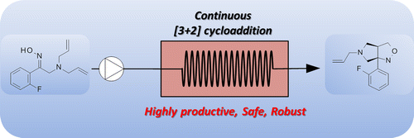
Flow chemistry: upsacling
120 g/h
Large scale
“This thermal process required very high temperatures to be efficient that were not easily reached in conventional reactors”
bicyclic isoxazolidines: [3 + 2] cycloaddition: oximes generate in situ nitrones (reaction intermediate which is instable)
Rincón, J. A.; Mateos, C.; García-Losada, P.; Mergott, D. J. Org. Process Res. Dev. 2015, 19 (2), 347–351

Slide 31
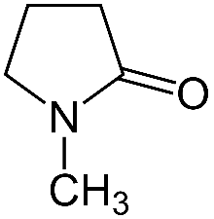
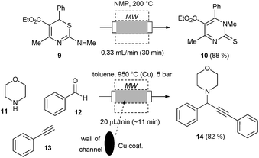
Flow chemistry/microwave
Combining flow with microwave heating
NMP
G. Shore, W.-J. Yoo, C.-J. Li and M. G. Organ, Chem.–Eur. J., 2010, 16, 126

Slide 32
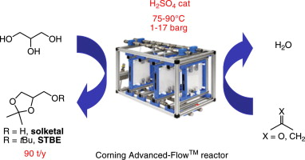
Flow chemistry: biomass conversion
From glycerol to biofuel
  Glycerol is a by product from the biodiesel industry (abundant)
  Solketal tert-butyl ether (STBE) can be an effective fuel additive
virtual STBE production of 90 t/y, with less than 4 equivalents of acetone and 1 equivalent of isobutene
Monbaliu, J.-C. M.; Winter, M.; Chevalier, B.; Schmidt, F.; Jiang, Y.; Hoogendoorn, R.; Kousemaker, M. A.; Stevens, C. V. Bioresour. Technol. 2011, 102 (19), 9304–9307

Slide 33
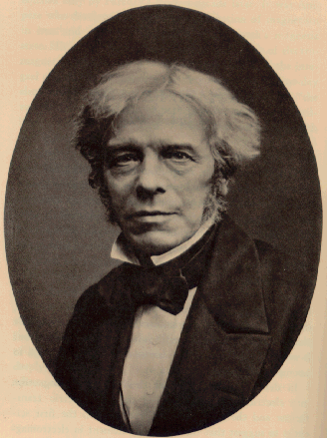
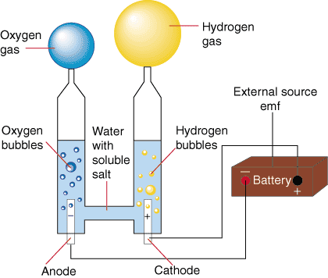
Electrochemistry
Electrochemistry is the use of electricity to perform chemistry
The principle was discovered Michael Faraday in 1832
At the heart of central technologies
  Water splitting (H₂ production)
  Batteries
  Fuel cells
Michael Faraday

Slide 34
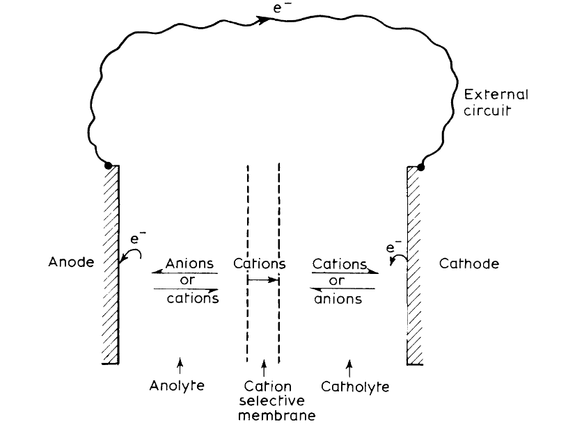
Electrochemistry: principles
For electrolysis to occur, electrons must pass from the anode to the cathode through an external, electrical circuit interconnecting the two electrodes.
There must be a mechanism for charge transport between the electrodes within the cell
There may or may not be a separator
Pletcher, D.; Walsh, F. C. Organic electrosynthesis. In Industrial Electrochemistry; Springer Netherlands: Dordrecht, 1993; pp 294–330.

Slide 35
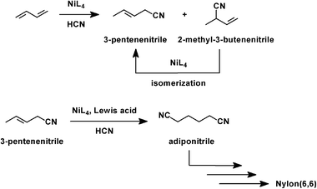
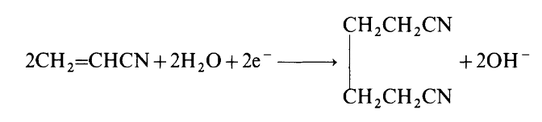
Electrochemistry: Applications
Industrial electroorganic synthesis: Monsanto hydrodimerization of acrylonitrile to adiponitrile
  A precursor to the diamine used in the synthesis of Nylon-6,6.
  400 000 metric tons of adiponitrile in 2014, or ∼30% of the adiponitrile market
  competitive with the conventional route starting from butadiene.
Montsanto process
Dupont process
Pletcher, D.; Walsh, F. C. Organic electrosynthesis. In Industrial Electrochemistry; Springer Netherlands: Dordrecht, 1993; pp 294–330.

Slide 36
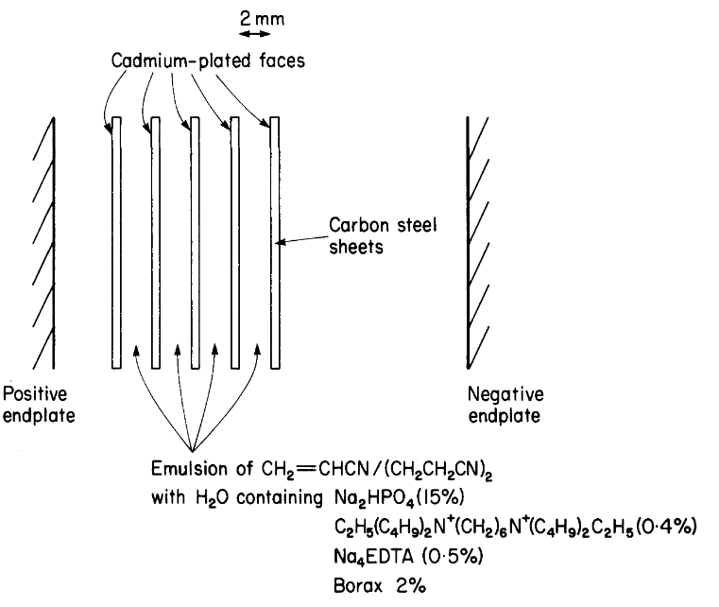
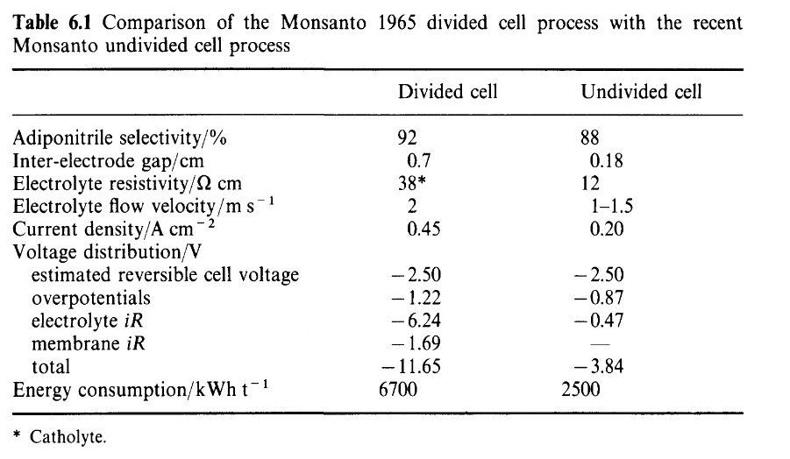
Electrochemistry: Applications
Monsanto process
Industrial electroorganic synthesis: Monsanto hydrodimerization of acrylonitrile to adiponitrile
Pletcher, D.; Walsh, F. C. Organic electrosynthesis. In Industrial Electrochemistry; Springer Netherlands: Dordrecht, 1993; pp 294–330.

Slide 37
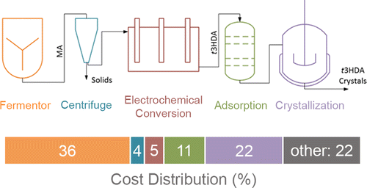
Electrochemistry: Applications
Modern electrochemistry: merger with biocatalysis: muconic acid production
Working electrode: Pb, Fe, Ni, Sn, and Zn
Electro step: 94% yield and 100% faradaic efficiency
Bioengineered Saccharomyces cerevisiae
Glucose
bio
electro
Matthiesen, J. E.; Suástegui, M.; Wu, Y.; Viswanathan, M.; Qu, Y.; Cao, M.; Rodriguez-Quiroz, N.; Okerlund, A.; Kraus, G.; Raman, D. R.; et al. ACS Sustain. Chem. Eng. 2016, 4 (12), 7098–7109

Slide 38
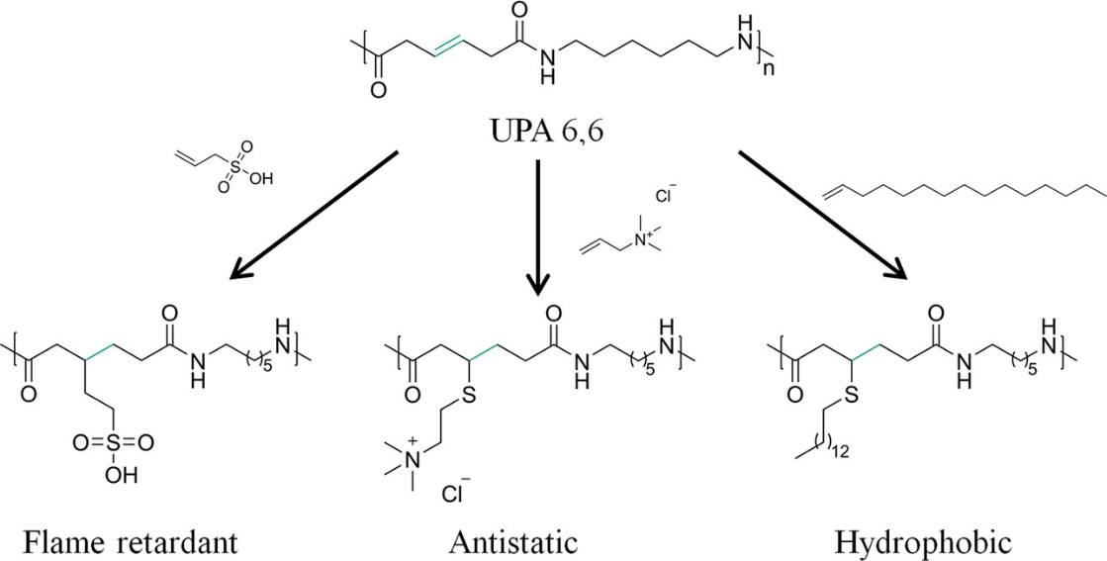
Electrochemistry: Applications
Modern electrochemistry: merger with biocatalysis: muconic acid production
Specialty Nylon 6,6 for improved performance
Glucose
bio
electro
Matthiesen, J. E.; Suástegui, M.; Wu, Y.; Viswanathan, M.; Qu, Y.; Cao, M.; Rodriguez-Quiroz, N.; Okerlund, A.; Kraus, G.; Raman, D. R.; et al. ACS Sustain. Chem. Eng. 2016, 4 (12), 7098–7109

Slide 39
CHEM 462: 20. Energy input reduction (II)
Photochemistry
Photochemistry is the use of light to perform chemistry
Advantages for green chemistry
  Energy is directly targeted to the chemical bond to break
  Photons are clean reagents compared to radical initiators
  Because of directed energy input, lower heating are required: better selectivity are achievable
  Photochemical reactions open interesting pathways.
Source: wikipedia

Slide 40
CHEM 462: 20. Energy input reduction (II)
Photochemistry
Some limitations of photochemistry
  The power of transmitted light is function of the square of the distance to the source: this causes limitations.
  Fouling: Fouling comes from little particles coming from the reactor. Those particles scatter light and render the solution less transparent to light => reduce yield
  Managing the light input: Often the reaction uses only one single wavelength and the lamps used are polychromatic. Lamps also produce heat to some extent => loss of energy
  Lamps and transparent reactors are often expensive
  Cooling: photochemical systems made not be so energy efficient because cooling systems are often need to avoid heating from the lamps.
The use of flow reactors and LED lamps are leading to rapid growth of photochemical processes
Source: wikipedia

Slide 41

CHEM 462: 20. Energy input reduction (II)
Photochemistry: the light source
Using solar radiation directly for chemistry
Using solar radiation -> energy -> photochemistry
More controlled conditions.
Makes sense energetically
Seems like a good idea BUT:
The solar spectrum is not focused on the relevant wavelength
Issues with variability in sun availability
Issues with exposing chemical reaction to the outside world: not easy to control cleaning of tubes, fouling…

Slide 42
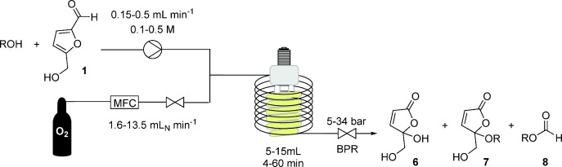
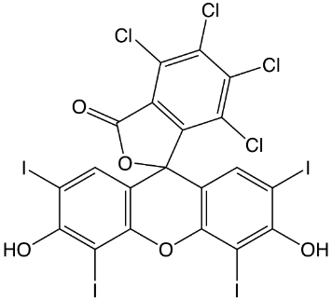
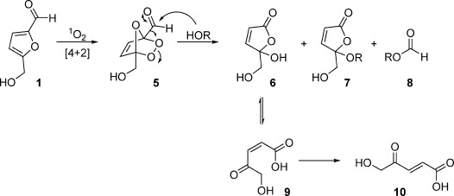
Photochemistry: application
5-HMF (Hydroxymethylfurfural) can be produced from biomass. It is inherently unstable
Yet production is taking off as it is increasingly viewed as a key platform molecule: need to convert it to molecule of use
Photocatalyst (dye):
Rose bengal
6: 5-hydroxy-5-(hydroxymethyl)-
furan-2(5 H)-one (interesting monomer)
5-HMF
10: 5-hydroxy-4-keto-pentenoic acid (interesting monomer)
Heugebaert, T. S. A.; Stevens, C. V.; Kappe, C. O. ChemSusChem 2015, 8 (10), 1648–1651

Slide 43
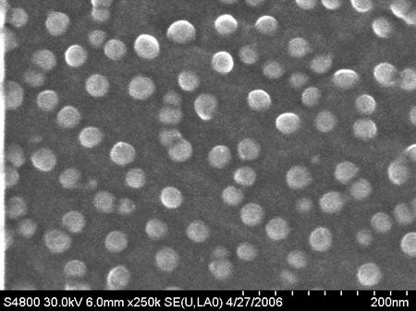
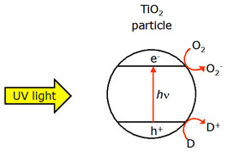
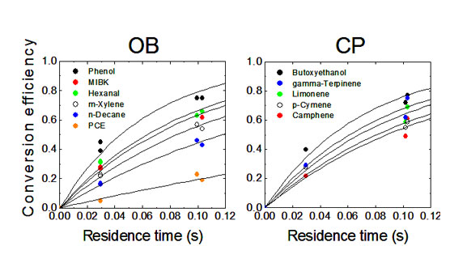
Photochemistry: application for depollution
Titanium dioxide nanoparticles
  At the nanoparticles state, titanium dioxide absorb visible light and creates an electron hole
  Conduction electrons
D here can be pollutants: like NO, SO but also organic molecules
  Valence electrons

Slide 44

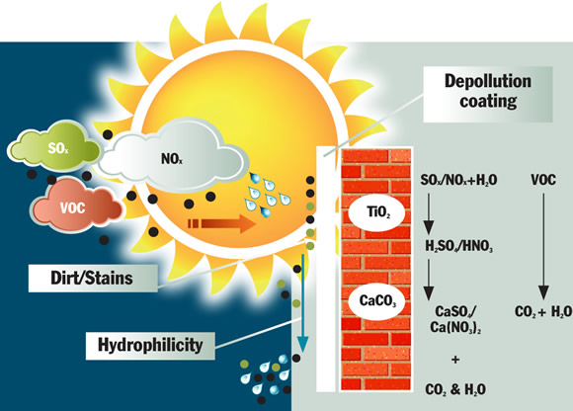
Photochemistry: application for depollution
Photoactive materials
http://cristalactiv.com/ourproducts/

Slide 45
Mechanochemistry
Chemistry physically activated. Several mechanisms:
High energy
Friction generated heat
Physical comminution (particle size reduction)
“hot spots”, estimated at 10000 K, lasting 10^{‐7} seconds: plasma effects
Low energy
Physical mixing in solid state: diffusion aided reaction at interfaces
Shearing forces deliver energy for molecule activation
May be aided by catalytic amounts of solvents (liquid assisted grinding)
Wilkening, M., Düvel, A., Preishuber-Pflügl, F., et al. (2016). Structure and ion dynamics of mechanosynthesized oxides and fluorides. Zeitschrift für Kristallographie - Crystalline Materials, 232(1-3), pp. 107-127.

Slide 46
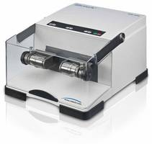
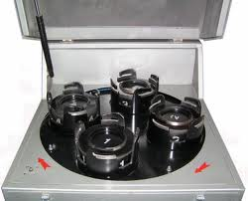
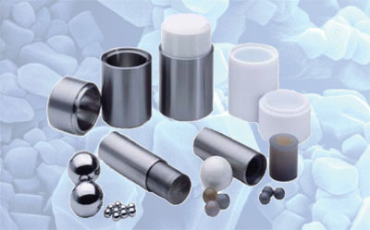
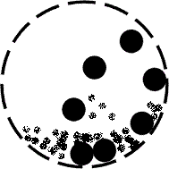
Mechanochemistry
Planetary mill with ~100 balls
Vibrational mill with 1-2 balls
High energy
Low energy

Slide 47
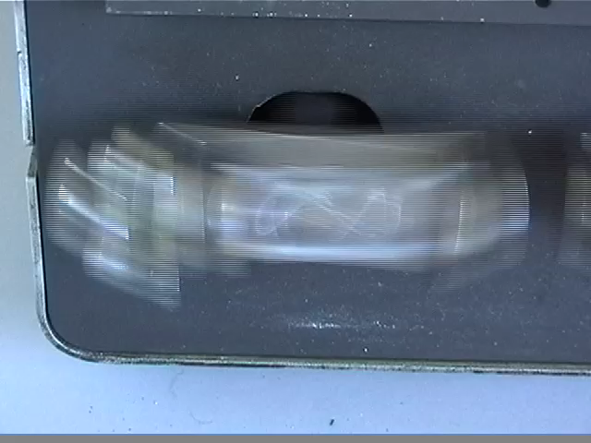
A vibrational mill
Tomislav Friscic, McGill

Slide 48
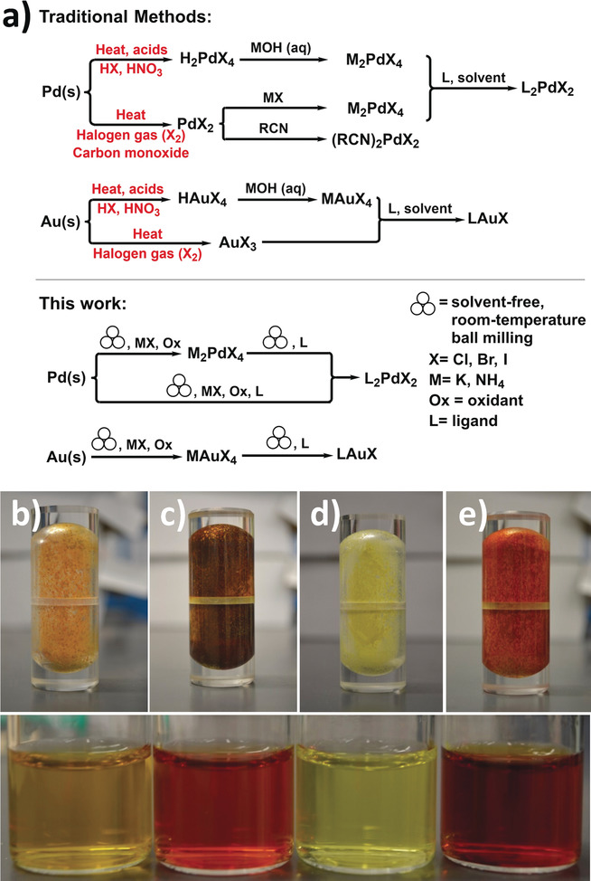

Mechanochemistry
Noble metals recycling
Noble metal widely used as catalysts and in electronics
Traditional recycling: aggressive conditions (aqua regia, a mixture of concentrated nitric and hydrochloric acids)
Tomislav Friščić and his team showed they could use mechanochemistry for generating:
Soluble metal salts
Metal complexes (with ligands)
They used:
mild oxidant: Oxone
halide salts
Tomislav Friscic
“It’s a remarkable result that illustrates the value of mechanochemistry, it’s a very benign protocol which doubles the solvent savings and offers an alternative to recycle valuable catalysts that are often discarded.” Carsten Bolm
b) (NH₄)₂PdCl₄; c) (NH₄)₂PdBr₄; d) NH₄AuCl₄; e) NH₄AuBr₄.
Angew. Chem. Int. Ed. 2018, DOI: 10.1002/anie.201712602
https://cen.acs.org/articles/96/i5/Shaking-gold-palladium.html?utm_source=Newsletter&utm_medium=Newsletter&utm_campaign=CEN

Slide 49
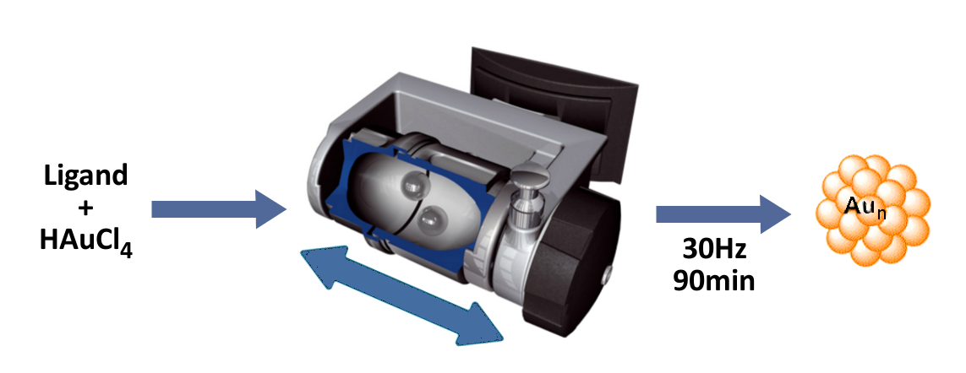
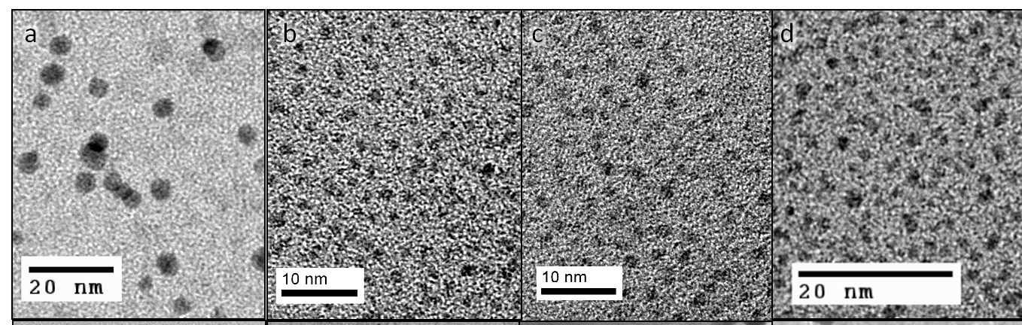
Mechanochemistry: nanoparticles synthesis
Ligand and metal precursor are loaded and milled: no solvent, no additive, no reducer
a. 4.2nm
b. 1.8nm
c. 1.5nm
d. 1.3nm
XPS shows reduced Au(0)
M. J. Rak, N. Saade, T. Friscic, A. Moores, Green Chem., 2014, 16, 86-89.

Slide 50
Topics Covered
Role of energy in a chemical process
Microwaves
Flow chemistry
Photochemistry
Electrochemistry
Mechanochemistry

Slide 51
Sponsored by Yale-UNIDO Initiative
QUESTIONS?
CENTER for GREEN CHEMISTRY
and GREEN ENGINEERING at YALE

