Slide 1
Fundamentals of Green Chemistry
Awareness Raising Workshop
GLOBAL GREEN CHEMISTRY INITIATIVE
EXPERT
YALE REPRESENTATVE
CENTER for GREEN CHEMISTRY
and GREEN ENGINEERING at YALE

Slide 2
Agenda
8:30 Welcome Remarks
9:00 – 10:00 Introduction
10:00 – 10:20 Break
10:20 – 12:00 Fundamentals of Green Chemistry
12:30 – 12:45 Lunch and Networking
12:45 – 14:15 Areas or Research in Green Chemistry
14:15 – 14:30 Break
14:30 – 16:00 Case Study examples
16:00 Closing Remarks

Slide 3
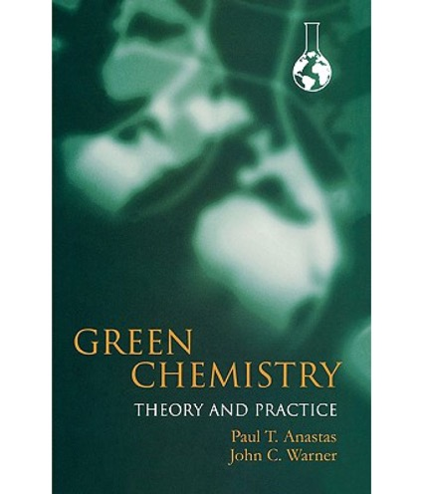
What is Green Chemistry?
Green chemistry is the design of chemical products and processes to reduce or eliminate the generation and use of hazardous substances.
Anastas, P. T., Warner, J. C. (2000). Green chemistry: Theory and Practice.
New York; Oxford University Press.
Notes:
Definition of the green chemistry: Green chemistry is the design of chemical products and processes that reduce or eliminate the use and generation of hazardous substances.
. The field was developed 25 years ago by Anastas and Warner, and presented in their seminal work “Green Chemistry: Theory and Practice”.

Slide 4
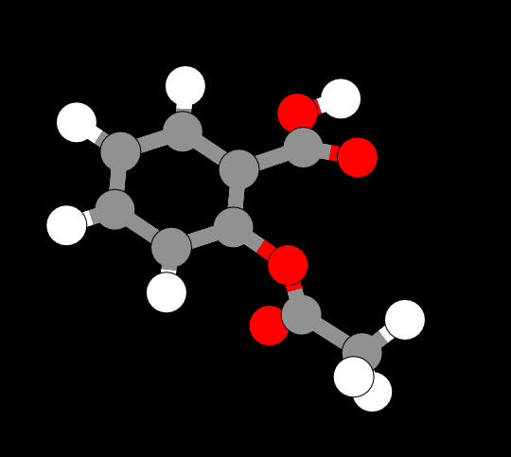
The focus on chemical design
The moment chemists initiate designing, they are making choices about the human health and environmental impacts of their product:
Design is intended
All characteristics, including performance and toxicity, can be designed
Image source: ChemDoodle Web Components

Slide 5
The chemical designing process
DECISION MAKING
Type of resources
What materials (feedstocks, additives) are needed?
Are the materials readily available?
How much material is needed?
Manufacturing process
What technology is needed?
What is the scale of the experiment?
Ultimately determining the characteristics of the waste stream, energy requirement and the toxicity of the entire process.
Notes:
Types of resources:
While the starting materials are important (feedstocks), at the design phase the decision on the solvents, additional reactants is also necessary.
Decision on the scale of the manufacturing process is needed. Each industry is different, for example a big pharma will have other scale than a startup.
All these decisions determine the characteristics of the waste streem, energy usage, and toxicity of the entire process.

Slide 6
It’s not just how you design but what you design…
Schematic of potential benefits vs. investments
As the investments increase, so do the benefits. The largest benefit is when the company re-defines the problem and finds a novel solution.
Notes:
Example:
Tesla has developed an electric car, which is independent of the petroleum (redefining a problem)
Nissan has optimized the battery so the car can run longer without charging (optimizing the existing solution)

Slide 7
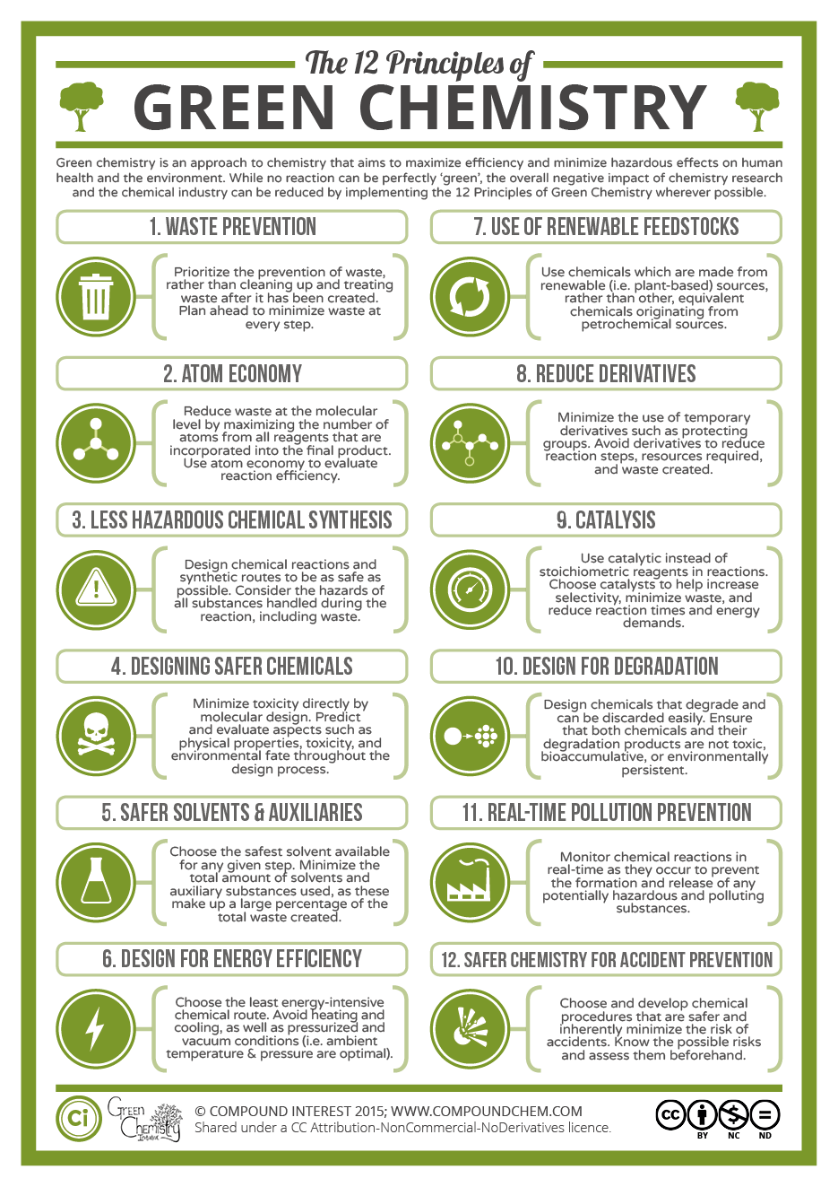
The 12 Principles of Green Chemistry
The principles address:
  Toxicity
    - Reducing the hazard
  Feedstocks
    - Use of renewable resources
  Designing safer products
    - Non toxic products by design
  Biodegradability
    - Enhancing breaking down at the end of life
  Energy
    - Reducing the energy needs
  Accidents
    - Eliminating accidents
  Efficiency
    - Shorter processes and synthesis
Source: https://www.acs.org/content/acs/en/greenchemistry/what-is-green-chemistry/principles/12-principles-of-green-chemistry.html
Notes:
Green chemistry is defined by 12 Principles, which address various topics. Most principles have tools or metrics associated to help the researcher and guide them through green chemistry improvements.

Slide 8
Twelve Principles… isn’t that how it is done now?

Slide 9
Twelve Principles… isn’t that how it is done now?
Entire industries are geared toward cleaning up after wasteful chemical syntheses
Today’s scientific literature is filled with synthetic pathways that are inefficient in terms of design
Reagents are seldom selected with regard to hazard
Industrial chemicals do not have minimal hazard as a performance criterion
Persistence of chemicals in the biosphere and in our bodies is a major global health issue (CDC 250 chemicals since 1945)
The vast majority of organic chemicals are made by depleting (non-renewable) feedstocks
Our chemical industry deals with safety through engineering and security through barricades.

Slide 10
Benefits of Green Chemistry
For the environment:
  Products which will biodegrade and won’t persist in the environment
For human health:
  Products with won’t cause toxicity to humans
For the economy:
  Novel products which boost competitiveness
For sustainability:
  Products made from renewable resources
For science:
  New scientific knowledge

Slide 11
Green Chemistry across industrial sectors
Defense and aerospace
Adhesives
Coatings
Corrosion, inhibitors
Automotive
Solvents
Polymers
Fuels
Household cleaners
Surfactants
Fragrances
Dyes
Electronics
Solder
Housings
Displays
Agriculture
Pesticides
Fungicides
Fertilizers
Cosmetics
Builders
Chelating agents
Dyes
Pharmaceuticals

Slide 12
Green Chemistry is a fundamental change in thinking
Green Chemistry moves our consideration of how to deal with environmental problems from the circumstantial to the intrinsic.
Hazard must be recognized as a flaw in the designing process
Circumstantial
  - Use
  - Exposure
  - Handling
  - Treatment
  - Protection
  - Recycling
  - Costly
Intrinsic
  - Molecular design for reduced toxicity
  - Reduced ability to manifest hazard
  - Inherent safety from accidents/ terrorism
  - Increased potential profitability

Slide 13
Approaching risks: exposure vs. smart design
The traditional approach to hazards focuses on reducing risk by minimizing exposure.
- For example, wearing personal protective equipment or space ventilation if the chemical is volatile.
Green chemistry focuses on reducing risk by reducing hazard
- If there is no hazard, exposure becomes irrelevant

Slide 14
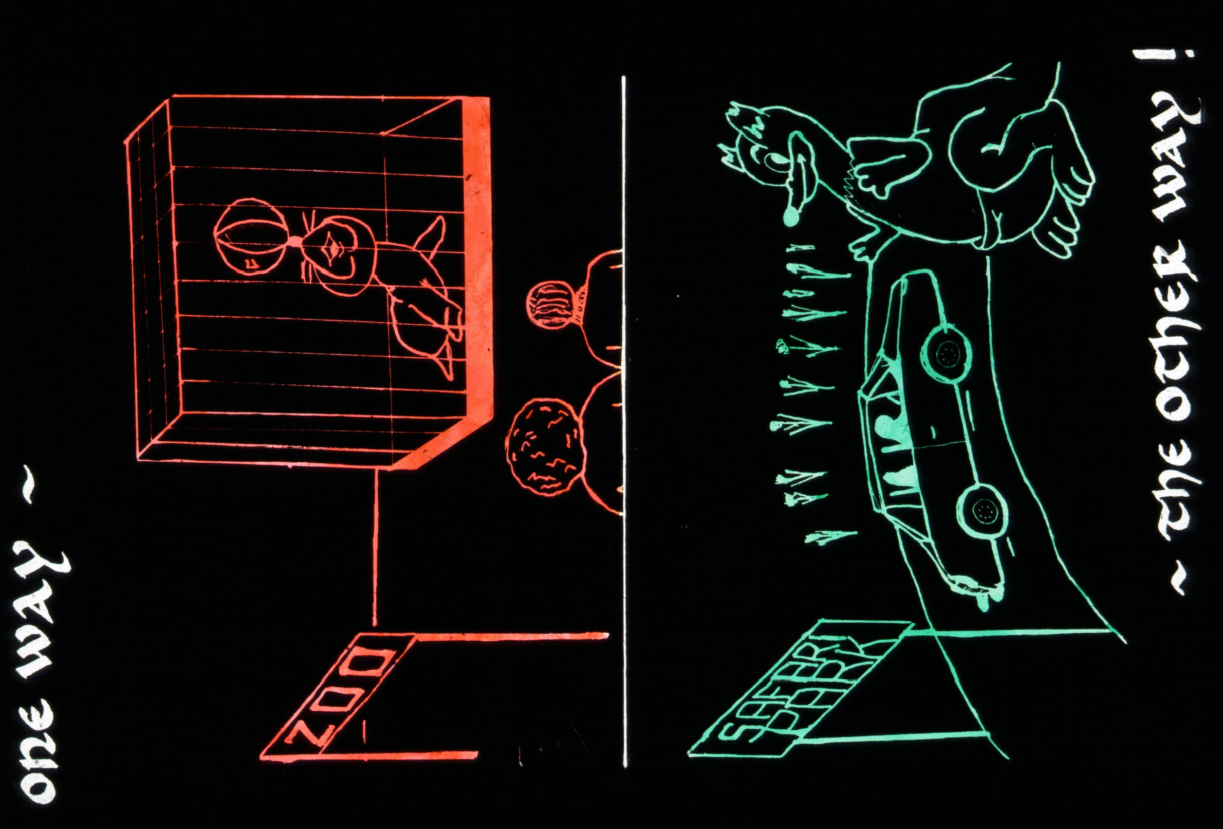

?

Slide 15
The Twelve Principles of
Green Chemistry

Slide 16
PRINCIPLE 1
It is better to prevent waste than to treat or clean up waste after it is formed.

Slide 17
What is waste?
Anything that is is a leftover from the product/process and cannot be re-used.
Waste can be produced in any stage of a process life-cycle:
Origins of feedstock
Manufacturing
Distribution
Use
End of life

Slide 18
When is a waste not a waste?
When the waste can be reused into another application where it becomes a feedstock.
When the wasted can be reduced or completely eliminated.

Slide 19
Principle 1: Waste prevention
Case study: Phenols
Traditional method of obtaining phenols (drop-in platform chemicals) from petroleum.
Petroleum
Phenols (benzene, toluene, xylenes)
Disadvantage: Not sustainable – dependent on depleting resources
Production of phenols from biomass waste using depolymerization
Advantage: Uses abundant product (waste) as a starting material

Slide 20
PRINCIPLE 2
Synthetic methods should be designed to maximize the incorporation of all materials used into the final product.

Slide 21
Principle 2: Atom economy
Ideally all atoms from the reagents are incorporated into a final product
  - High atom economy ↔ less waste production
There are no co-products or by products in the reaction
The molecular waste is therefore reduced

Slide 22
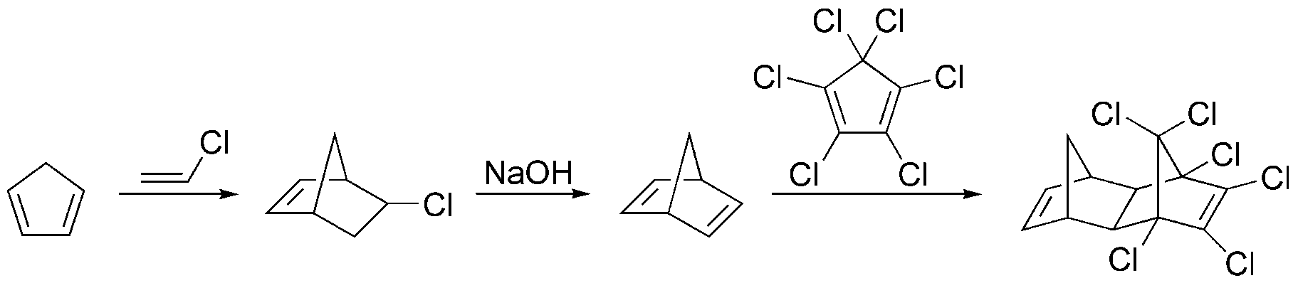
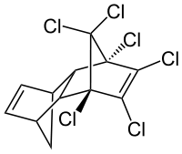
Atom efficient reactions
Cycloadditions/Rearrangements/Additions
Cycloadditions, e.g. Diels-Alder (100% atom economy)
273
62.5
363
40
FW = 66
"Aldrin"
Overall atom economy = 363 / (66 + 62.5 + 40 + 273)
= 82.2 %

Slide 23
Principle 2: Atom economy
Case study: styrene
Traditional method of styrene production:
Disadvantages:
Use of benzene, a known carcinogen, as a starting material
High temperature (800-950 ⁰C)

Slide 24
Principle 2: Atom economy
Case study: styrene
Styrene production from butadiene using Diels-Alder reaction
Advantages:
Diels-Alder reaction =100% atom economy
Use of non-toxic starting material

Slide 25
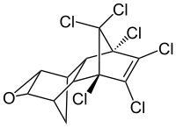
Aldrin – Polychlorinated Pesticides
Aldrin was banned under Stockholm Convention on Persistent Organic Pollutants 2001 (US ban in 1974) - “the dirty dozen”
An estimated 270 million kilograms of aldrin and related cyclodiene pesticides were produced between 1946 and 1976.
Exposure linked to health problems such as Parkinson’s, breast cancer and immune, reproductive, and nervous system damage.
Accumulation in fatty tissues.

Slide 26
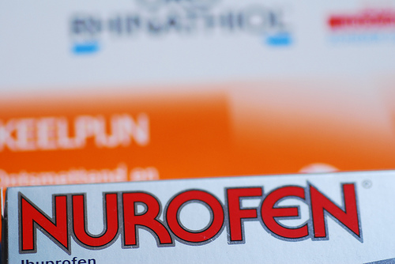
Principle 2: Atom economy
Case study: ibuprofen
Boots, Nottingham, produced ibuprofen under a patented route for some 20 years before the route came off patent and was open for re-engineering.
Ibuprofen is a common anti-inflammatory that is taken worldwide under a range of trade names, advil, nurofen……
The former Boots process, ran by Knoll in Nottingham produced 3000 Ton pa., ≈ 50 % of the market share.
12 Billion Tablets pa.
1900 Kg batches (x20 per week).

Slide 27
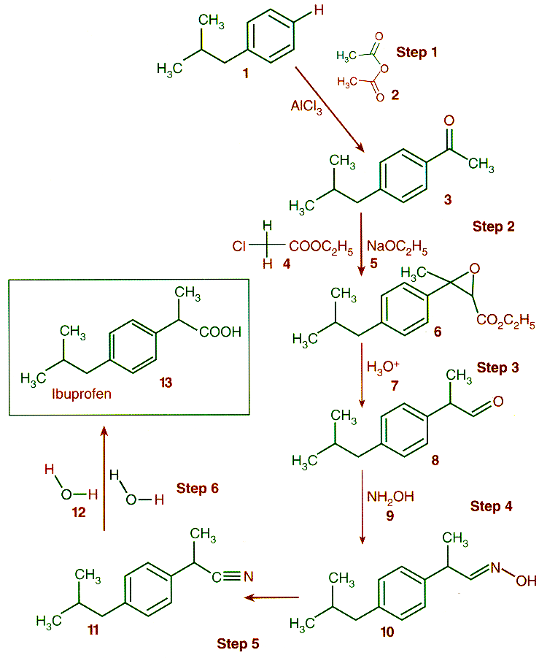
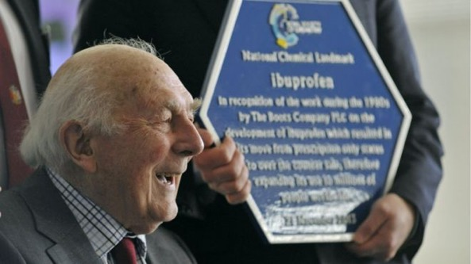
Multiple unit operations
6 stoichiometric steps
Energetic reactions (exotherm)
Damaging solvents
Waste water streams
Poor recovery
AE_{Trost} < 40 %
atom efficiency: 40%

Slide 28
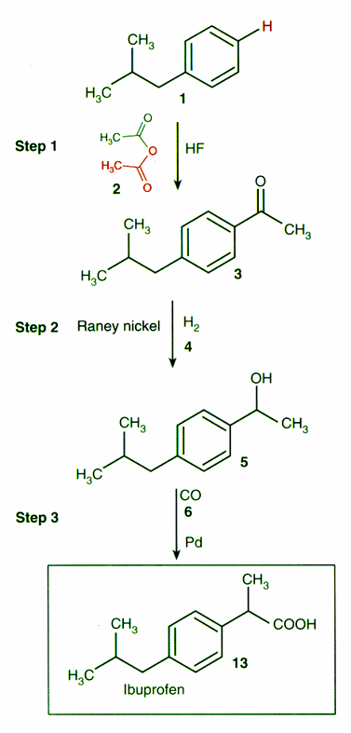
Fewer process steps
Cleaner solvents
3 catalytic steps
Good recovery
Higher yields
AE_{Trost} > 77 %
(up to 100% if AcOH is used)
atom efficency: 77%

Slide 29
atom efficiency: 40%
atom efficency: 77%
A textbook example: Ibuprofen

Slide 30
PRINCIPLE 3
Wherever practicable, synthetic methodologies should be designed to use and generate substances that possess little or no toxicity to human health or to the environment.

Slide 31
Principle 3: Non-toxic substances
Ideally, non-toxic substances are used to synthesize a chemical product.
Polycarbonate (thermoplastic polymer) has been made using phosgene, a chemical warfare agent.

Slide 32
Principle 3: Non-toxic substances
Opportunity: polymers
Traditional synthesis of polyurethane using isocyanides
Disadvantages
Using isocyanides which cause skin and respiratory problems
When burned, they form toxic and corrosive fumes
Highly regulated by the US government

Slide 33
Principle 3: Non-toxic substances
Case study: polyurethane
Non-isocyanide synthesis of polyurethane using green chemistry
Advantages
No isocyanide is used in the synthesis.
Product is stable, and has increased resistance properties due to intramolecular hydrogen bonds.
Hybrid Coating Technologies
Nanotech Industries

Slide 34
Principle 3: Non-toxic substances
Conventional paper bleaching: Chlorine dioxide (ClO₂)
Disadvantages:
Produces unacceptable quantities of chlorinated pollutants, and many are exceptionally toxic.
Novel technology for paper bleaching with TAML/H₂O₂ using green chemistry.
Advantages:
Alternative catalytic breakdown of H₂O₂ to provide the oxidative equivalent
Lower temperature and time requirement

Slide 35
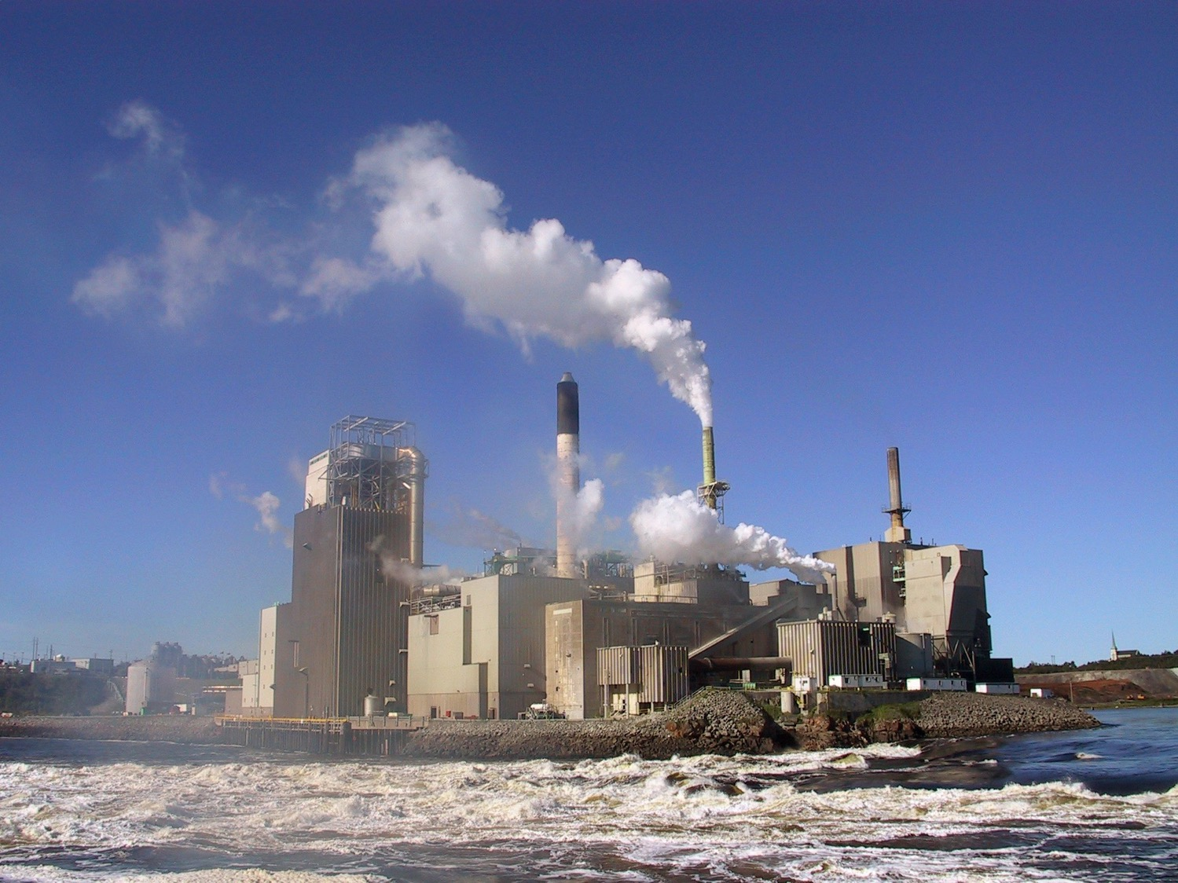
Water Consumption in Paper and Pulping
225 tons of water per ton of paper (US and EU)
450 tons of water per ton of paper (E.Asia)

Slide 36
PRINCIPLE 4
Chemical products should be designed to preserve efficacy of function while reducing toxicity.

Slide 37
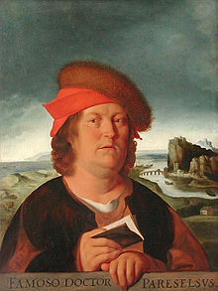
Paracelsus (1493-1541) - the “father of toxicology”
“the dose makes the poison”
“Everything is toxic. It is simply depends on the dose”

Slide 38
The modern motto of toxicology
“Everything is toxic. It is simply depends on the dose”
Often otherwise phrased as
“The dose makes the poison.”

Slide 39
Principle 4: Reduce Toxicity
Chemists can design chemicals which have reduced toxicity by:
Manipulation of chemical bonds, chemical functional groups
  Reactive functional groups have a greater potential to be toxic -> removing these groups is likely to reduce toxicity
Modification or termination of the biological pathway
  While difficult to achieve, if the chemical is modified not to interact with the biological pathway, no biological effect is triggered and the toxicity can be avoided.
Reducing or eliminating bioavailability.
  - If a chemical does not absorb into a body, it cannot cause harm.

Slide 41
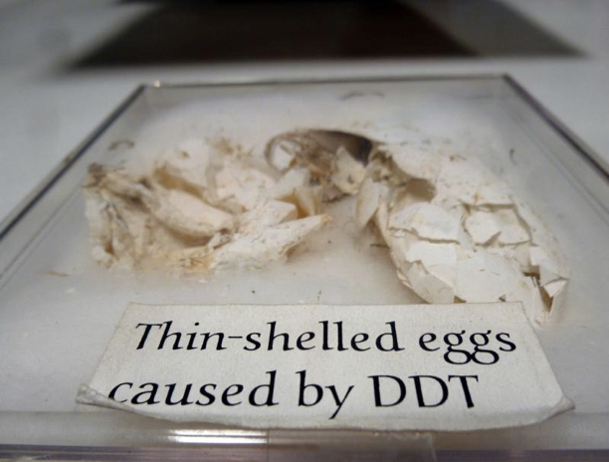
Principle 4: Reduce Toxicity
Case study: pesticides
DDT - Dichlorodiphenyltrichloroethane - agricultural pesticide and a malarial control agent
DDT
Disadvantages
Carcinogenic
Threat to wildlife, especially birds- almost led to the extinction of a bald eagle population
Notes:
DDT was used in the second half of World War II to control malaria and typhus among civilians and troops. After the war, DDT was made available for use as an agricultural insecticide and its production and use duly increased. Müller was awarded the Nobel Prize in Physiology or Medicine "for his discovery of the high efficiency of DDT as a contact poison against several arthropods" in 1948
Unfortunately it’s effect on birds was not tested. Research have shown that for certain species, DDT causes the thinning of eggshells which led almost to species extinction.

Slide 42

Chip Bok’s political cartoon on 29 June 2007

Slide 43
Principle 4: Reduce Toxicity
Case study: pesticides
Spinosad: a natural product for insect control
  Produced by bacteria Saccharopolyspora spinosa
  Isolated from Caribbean soil sample
  It targets insects nervous system
  Demonstrates high selectivity, low mammalian toxicity, and a good environmental profile
  Dow AgroSciences

Slide 44
PRINCIPLE 5
The use of auxiliary substances (e.g. solvents, separation agents, etc.) should be made unnecessary wherever possible, and innocuous when used.

Slide 45
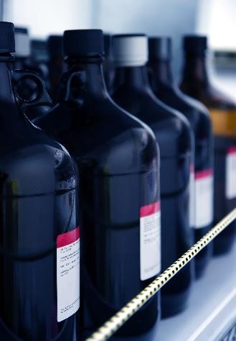
Traditional Solvents
Volatile Organic Compounds:
  - Chloroform, carbon tetrachloride, methylene chloride, perchloroethylene (PERC)
  - Benzene, Toluene, Xylene (BTX)
  - Acetone, Ethylene Glycol, methylethyl ketone (MEK)
CFCs
Image source: Adobe Stock

Slide 46
What Are the Concerns for Solvents?
Inherent toxicity
  Many of them are known carcinogens
Flammability
  Relatively low flash point and ignition point lead to high flammability profile
Explosivity
  They can easily explode causing harm
Stratospheric Ozone Depletion
  Decreasing ozone layer causes more radiation to reach the earth and causing skin cancers, cataracts, damage to immune systems, injury to plants, injury to marine organisms
Atmospheric Ozone Production
  - Increasing Global Warming Potential

Slide 47
Green Chemistry Solvents
Aqueous Solvents
  Solvents based on water and not organic solvents
Solventless Conditions
  Reactions done without solvents, for example, the ones used in mechanochemistry
Supercritical Fluids
  - scCO₂ which can evaporate after changing reaction conditions
Ionic Liquids
Notes:
22

Slide 48
PRINCIPLE 6
Energy requirements should be recognized for their environmental and economic impacts and thus should be minimized. Synthetic methods should be conducted at ambient temperature and pressure.

Slide 49
Principle 6: Minimize energy usage
Most energy is used for heating, cooling, separations and pumping.
Ideally, all reactions are performed at ‘ambient’ conditions – room temperature and atmospheric pressure – in order to minimize energy usage.

Slide 50
Principle 6: Synthesis of Atorvastatin
Atorvastatin (Lipitor), a cholesterol- lowering drug, suffers from high energy consumption as a result of 2 cryogenic reactions (-70ºC)
New biocatalytic syntheses uses DERA enzyme and shortens the process
Scientific Reports volume 7, Article number: 42064 (2017)
Notes:
From 1996 to 2012 under the trade name Lipitor, atorvastatin became the world's best-selling medication of all time, with more than $125 billion in sales over approximately 14.5 years.
Lipitor alone "provided up to a quarter of Pfizer Inc.'s annual revenue for years."
Pfizer's patent on atorvastatin expired in November 2011.

Slide 51
Sitagliptin is the active ingredient in JANUVIA and JANUMET, drugs utilised in the treatment of type 2 diabetes
A Chemocatalytic*
B Biocatalytic
* 2006 Greener Synthetic Pathway Award
K. B. Hansen et al. “Highly Efficient Asymmetric Synthesis of Sitagliptin” J. Am. Chem. Soc. 131, 8798 (2009)

Slide 52
PRINCIPLE 7
A raw material or feedstock should be renewable rather than depleting wherever technically and economically practicable.

Slide 53
Renewable feedstocks
CO₂
Biomass (algae, corn, switchgrass, poplar, willow, sorghum, and bamboo)
Agricultural waste (ex. Manure)
Images from Adobe Stock

Slide 54
Biomass platforms
Only about 4% utilized by humans
(food, ethanol, sweeteners)
Building blocks for a diverse chemical platform.
Nature’s richest source of aromatic carbon. Used in polymers, adhesives, production of phenolic chemicals.
Converted into polymers, lubricants, and detergents.

Slide 55
Principle 7: Renewable feedstocks
Case study: Catechol synthesis
Traditional synthesis of Catechol using benzene
Synthesis of Catechol from D-Glucose using Green Chemistry
Notes:
The new synthesis of catechol can be done from glucose rather than carcinogen.

Slide 56
Principle 7: Renewable feedstocks
Design and manufacture of new, high-performance bio-based materials
Many applications—resins, polymers, composites, and foams, and even circuit boards and a leather substitute
Derived from renewable, biological feedstocks such as chicken feathers, flax, vegetable oils, lignin, and cellulose
Manufacture process consumes less water and energy than conventional petroleum-based processes, produces less waste, and is industrially viable
Wool

Slide 57
PRINCIPLE 8
Unnecessary derivatization (blocking group, protection/deprotection, temporary modification of physical/chemical processes) should be avoided whenever possible.

Slide 58
Principle 8: Derivatization
Traditional approach
Substrate
Intermediate A
Intermediate B
Intermediate C
Intermediate D
Intermediate E
Product
Green Chemistry approach
Substrate
Product
Notes:
Whenever possible, limit number of steps and unnecessary transformations. Avoid the use of protecting groups as it requires extra reagents and generates more waste.

Slide 59
Principle 8: Derivatization
Traditional approach
Orthogonal Strategy
1 – FMOC – Removed by base (Pyr)
2 – Benzyl Ester – Removed by hydrogenolysis
3 – t-Bu Ether – Removed with TFA
Biological approach
Enzymatic cascades to manage reactivity and selectivity
Notes:
Whenever possible, limit number of steps and unnecessary transformations. Avoid the use of protecting groups as it requires extra reagents and generates more waste.

Slide 60
Principle 8: Derivatization
Case study: 6-aminopenicillanic acid
Synthesis of 6-aminopenicillanic acid – core moiety of penicillin
Traditional synthesis of 6-aminopenicillanic acid using 3 steps and intermediate products:
New synthesis using enzyme and less derivatives

Slide 61
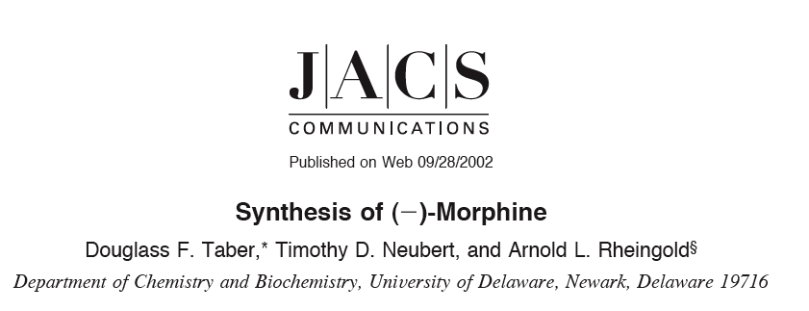
23 synthetic steps, 0.77% Yield, Many protecting groups
AE < 0.001%

Slide 62
PRINCIPLE 9
Catalytic reagents (as selective as possible) are superior to stoichiometric reagents.

Slide 63
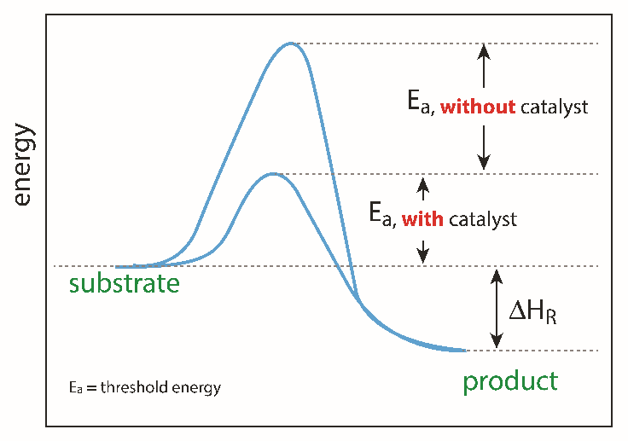
Principle 9: Catalytic reagents
Catalysts can facilitate complex reactions by:
  Lowering the activation energy of the reaction
  Reducing temperature necessary to achieve a reaction
  Controlling the site of the reaction (selectivity enhancement)
Image source: Adobe stock
Notes:
Catalysts lower the activation (threshold energy) in the reaction.

Slide 64
Principle 9: Catalytic reagents
Case study: Naproxen synthesis
Synthesis of Naproxen using Green Chemistry
  chiral transition metal complex
  97% yield in three steps
H₂
  Dartt and Davis

Slide 65
Principle 9: Catalytic reagents
Case study: producing paper
Polyoxometalate (POM) catalysts
  - non-toxic, inorganic cluster compounds
  - selectively delignify wood
  utilize only air and water
Converts trees to paper without the use or generation of toxic chemicals
  Hill, Emory University; Weinstock, USDA Forest Service

Slide 66
PRINCIPLE 10
Chemical products should be designed so that at the end of their function they do not persist in the environment and break down into innocuous degradation products.

Slide 67
Principle 10: Biodegradability
Case study: plasticizers
Conventional plasticizers such as DiNP are a needed additive to soften plastics
Disadvantages:
DiNP exposure has been linked to liver toxicity, endocrine disruption and carcinogenicity
They are persisting in the environment

Slide 68
Principle 10: Biodegradability
Case study: plasticizers
Alternative plasticizers such as isosorbide diester made from starch
Advantages:
Offers 1 to 1 substitution of DiNP in plastics
Thermally stable and biodegradable

Slide 69
Principle 10: Biodegradability
Case study: plastics
Conventional plastics (PET) are made from petroleum
Disadvantages
Will persist in the environment
Is made from depleting resources
Petroleum
high temperature
vacuum
catalyst

Slide 70
Principle 10: Biodegradability
Case study: plastics
Synthesis of PolyLactic Acid (PLA) from starch
Advantages
Has PET performance
Made from renewable materials
Biodegradable in the environment

Slide 71
PRINCIPLE 11
Analytical methodologies need to be further developed to allow for real-time, in-process monitoring and control prior to the formation of hazardous substances.

Slide 72
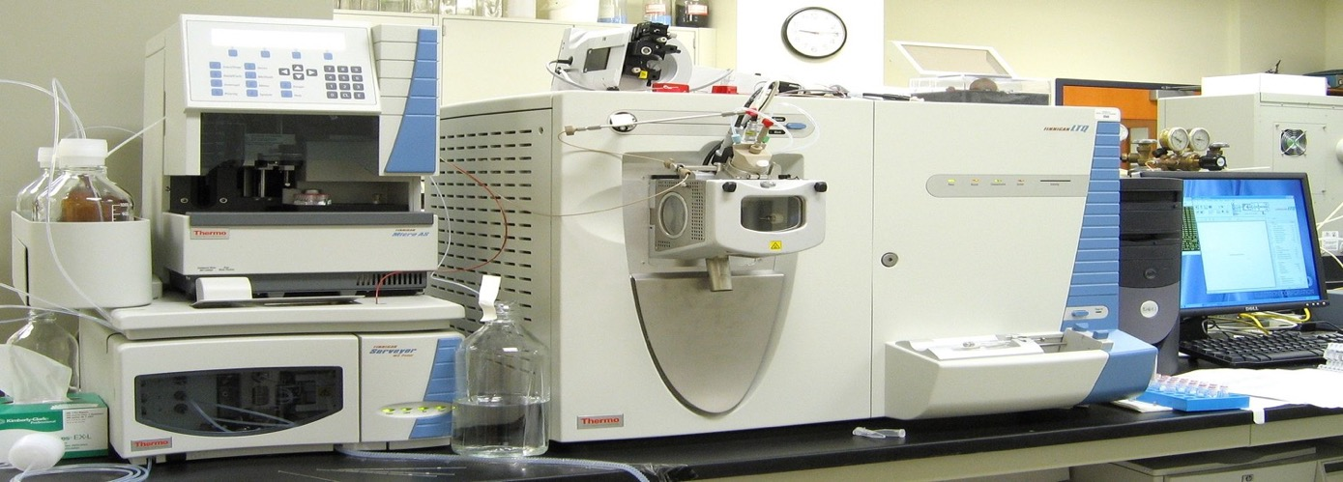
Green Analytical Chemistry
Green Chemistry is applicable to all chemical processes, including the methods, protocols and processes of environmental analytical chemistry.
Source: Wikipedia

Slide 73
Role of Analytical Chemistry
Analytical chemistry has been at the heart of the environmental movement since its inception. It’s been used in:
    Identification
    Monitoring
    Measurement
    Characterization

Slide 74
Continuous flow hydrogenation
Substrate and H2 mixed with solvent (scCO₂)
Solution passes over heated fixed catalyst bed
Products collected by expansion of solvent
Solvent recycled
Substrate
+ H₂
sc
Fluid
Reactor
+
Catalyst
on-line IR
Product(s)
Fluid

Slide 75
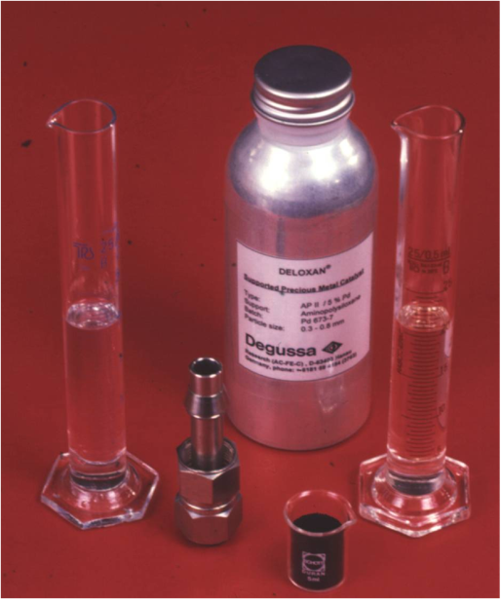
Continuous flow hydrogenation
First experiment in Nottingham; hydrogenation of cyclohexene
100% conversion and selectivity
Monitored spectroscopically

Slide 76

Continuous flow hydrogenation
Hydrogenation of cyclohexene
100% conversion and selectivity
Monitored spectroscopically
2
Reactant
£$€¥
0
2
Product
0
£$€¥
3200
3000
2800
Wavenumbers (cm⁻¹)

Slide 77
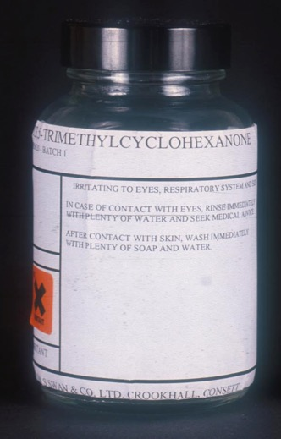
Commercial hydrogenation
1.7 mol equiv H₂
Up to 48 % in solution!
Quantitative conversion (>99% analytical purity)
No need for energy intensive separation
Green Chem., 2003, 5, 99.

Slide 78
PRINCIPLE 12
Substances and the form of a substance used in a chemical process should be chosen so as to minimize the potential for chemical accidents, including releases, explosions, and fires.

Slide 79
Principle 12: Minimize hazard
Accidents can be avoided by minimizing hazard.
Approaches to design safer chemistry can include the use of solids or low vapor pressure substances in place of volatile liquids.
Other approaches include avoiding the use of molecular halogens in large quantities.

Slide 80
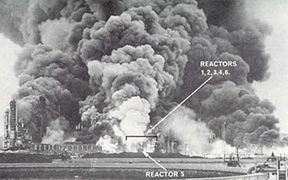
Flixborough (UK) 1974

Slide 81
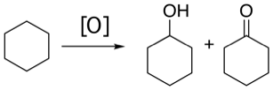
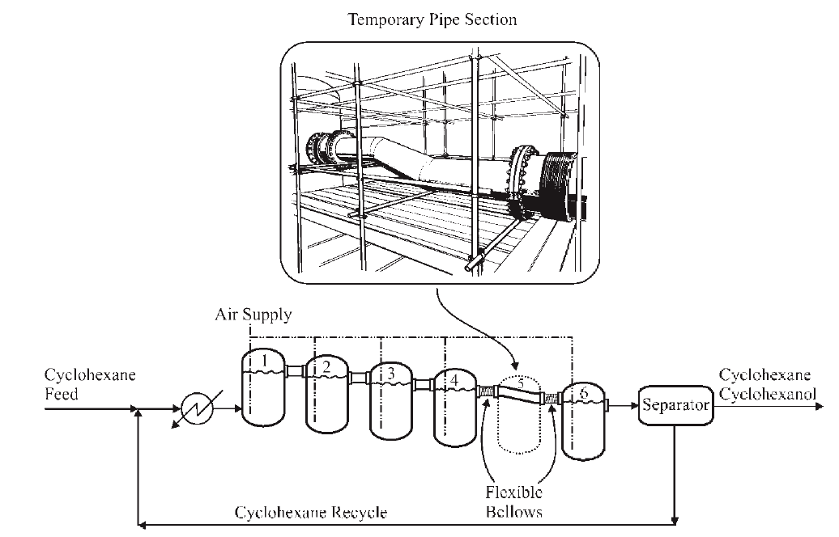
250 °C / 10 bar

Slide 82
E. coli cell
H₂
5000 KPa
O₂
900 KPa
cis,cis-muconic acid
conc.
HNO₃
Nylon 6,6
Adipic acid

Slide 83
Principle 12: Minimize hazard
Designing safer polymers for use in airplanes
Polyhydroxyamide (PHA): synthesized under mild conditions, moldable into seats, bins, wall panels decomposes into fire-resistant polybenzoxazole (PBO) and water upon heating
  Westmoreland, UMass Amherst

Slide 84
Green Chemistry Principles and life-cycle
Chem. Soc. Rev., 2015, 44, 5758-5777

Slide 85
Sponsored by Yale-UNIDO Initiative
QUESTIONS?
CENTER for GREEN CHEMISTRY
and GREEN ENGINEERING at YALE

