Slide 1
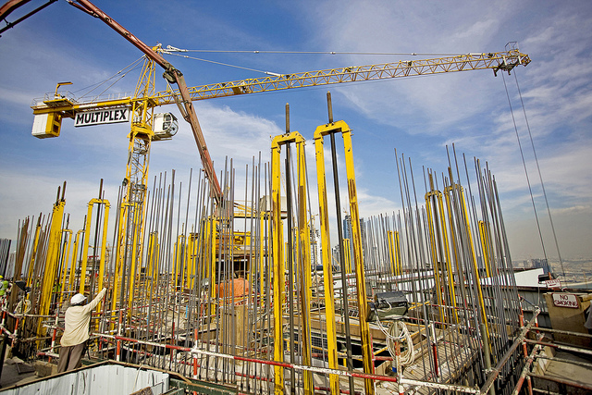

Yale-UNIDO Train-the-Facilitator Workshop in Green Chemistry
Sustainability
CENTER for GREEN CHEMISTRY
and GREEN ENGINEERING at YALE
Image: Flickr, The Glenium Sky admixture, Author: BASF - We create chemistry

Slide 2
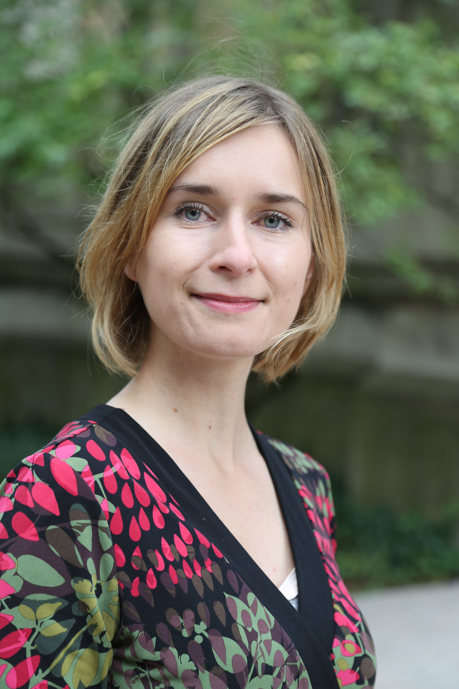
Karolina Mellor, PhD
Program Manager and Green Chemistry Educator at the Center for Green Chemistry and Green Engineering at Yale
10+ years of biotech academic and professional experience –MSc in biotechnology, PhD in molecular biology.
5+ years at the Center for Green Chemistry & Green Engineering at Yale.
Expertise in research translation to educational materials including classes, workshops, publications, case studies, educational games and online certificates.
Technology transfer experience.
Received three National Science Foundation (NSF) educational grants.
Currently co-leads operations, outreach and development of the Center for Green Chemistry and Green Engineering.

Slide 3

Prof. Philip Jessop
Professor and Canada Research Chair at Queen’s University
and Technical Director at GreenCentre Canada
26 years of experience in green chemistry research.
4 years in Japan, 7 years at University of California Davis, then at Queen’s since 2003.
Head of the editorial board of the journal Green Chemistry.
GreenCentre Canada helps commercialize green chemistry technologies.
190 publications, 2 books, 23 patent applications, 2 spin-off companies.
Research interests: green solvents, CO₂ utilization.

Slide 4

What does “green” mean?

Slide 5
What does “green” mean?

Slide 6


Is it heavy?
Nothing is “heavy” in the absolute sense. “Heavy” is relative.
Nothing is “green” in the absolute sense. “Green” is relative.

Slide 7
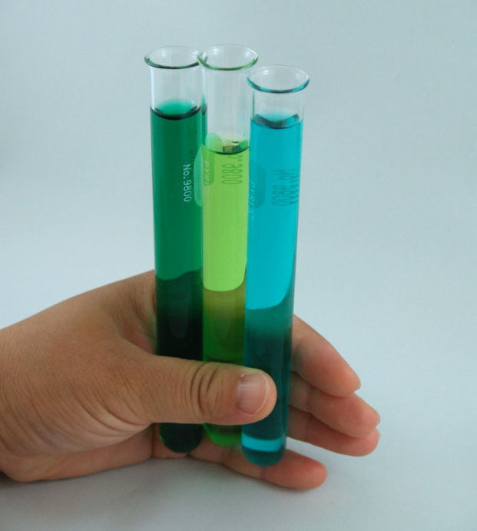
What does “green” mean?
The least harmful of the available choices.

Slide 8
Topics To Be Covered
Sustainability – Myths and Facts
Society, Economy, and the Environment
Business and Sustainability
  Applying Green Chemistry to Management
Different Models of Sustainability
Case Study: The Interface Company
Green Washing
Life-Cycle Assessment

Slide 9
Sustainability Myths

Slide 10
Myth #1:
Nobody knows what sustainability really means.

Slide 11
The Definition of Sustainability
UN World Commission on Environment and Development: “Sustainable development is development that meets the needs of the present without compromising the ability of future generations to meet their own needs.”
Sustainability presumes that resources are finite and should be used conservatively and wisely with a view to long-term priorities and consequences of the ways in which resources are used.
In simplest terms, sustainability is about our children and our grandchildren, and the world we will leave them.
- The Brundtland Report (Our Common Future)

Slide 12
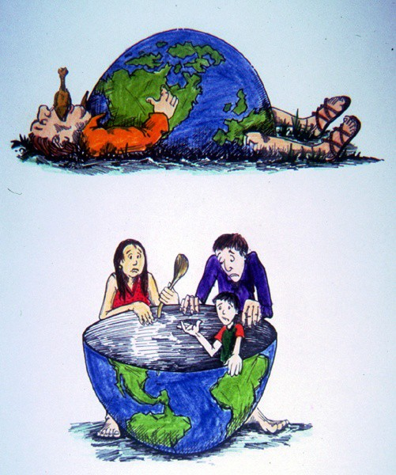
The Definition of Sustainability
Sustainability wants to avoid this
While also making sure we can lead comfortable lives.
Image Source: Wikipedia

Slide 13
Myth #2:
Sustainability is all about the environment.

Slide 14
Sustainability is Not Just About the Environment
Sustainability includes a broad group social and economic development issues including: poverty, hunger, health, education, climate change, water, sanitation, energy, and environment.
This requires giving all countries access to natural resources such as water, energy, and food - all of which come, one way or another, from the environment.

Slide 15
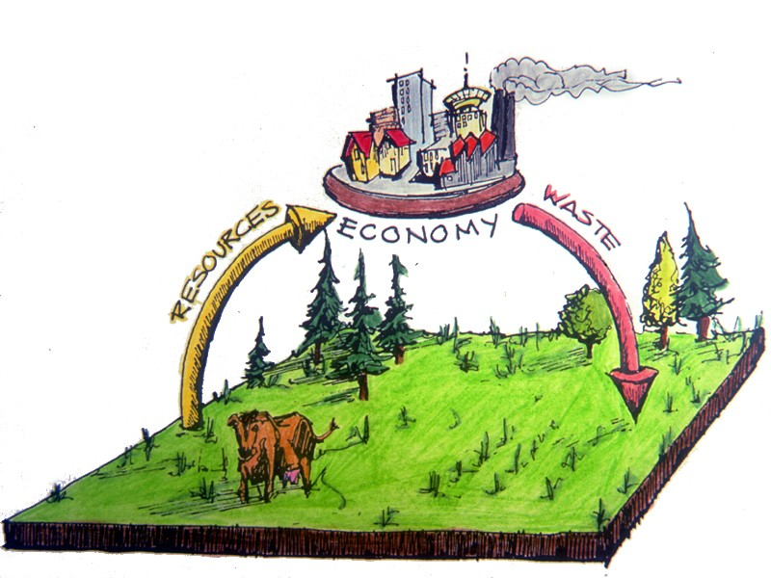
Sustainability is Not Just About the Environment
Sustainability has transformed into an environmental term because the economy is driven by natural resources.
If too many of us use resources inefficiently or generate waste too quickly for the environment to absorb and process, future generations won’t be able to meet their needs.
Image Source: Wikipedia

Slide 16
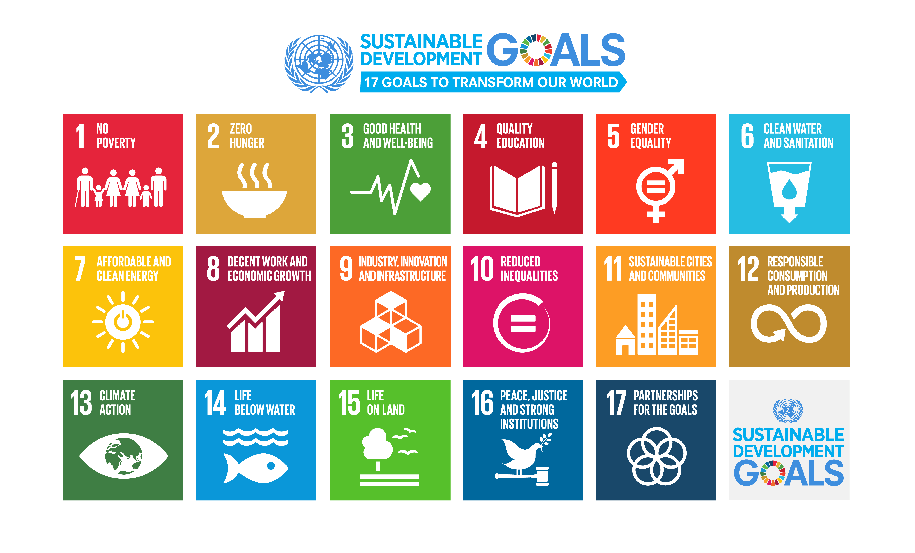
Sustainability is Not Just About the Environment
https://www.un.org/sustainabledevelopment/sustainable-development-goals/

Slide 17
Myth #3:
“Sustainable” is a synonym for “green”.

Slide 18
Sustainability & Green
Green
Sustainability
Green concepts tend to focus on technologies/products causing less harm to human health and the environment
Avoiding resource depletion is a part of green chemistry (it’s one of the principles of green chemistry)
Sustainability and green overlap since a sustainable solution has to preserve health and environment
Sustainability adds social and economic factors
Notes:
Old version said avoiding resource depletion was not part of green chemistry!

Slide 19
Myth #4:
Sustainability is all about recycling.

Slide 20
A question we need to ask:
Is recycling sustainable?
Sustainability and Recycling

Slide 21
Sustainability and Recycling
Material | Energy savings
Aluminum | 95%
Cardboard | 24%
Glass | 5-30%
Paper | 40%
Plastics | 70%
Steel | 60%
Recycling
  Converting waste materials into new materials and objects.
  Available for metals, plastic, paper, glass.
Cost-benefit of recycling: energy savings

Slide 22
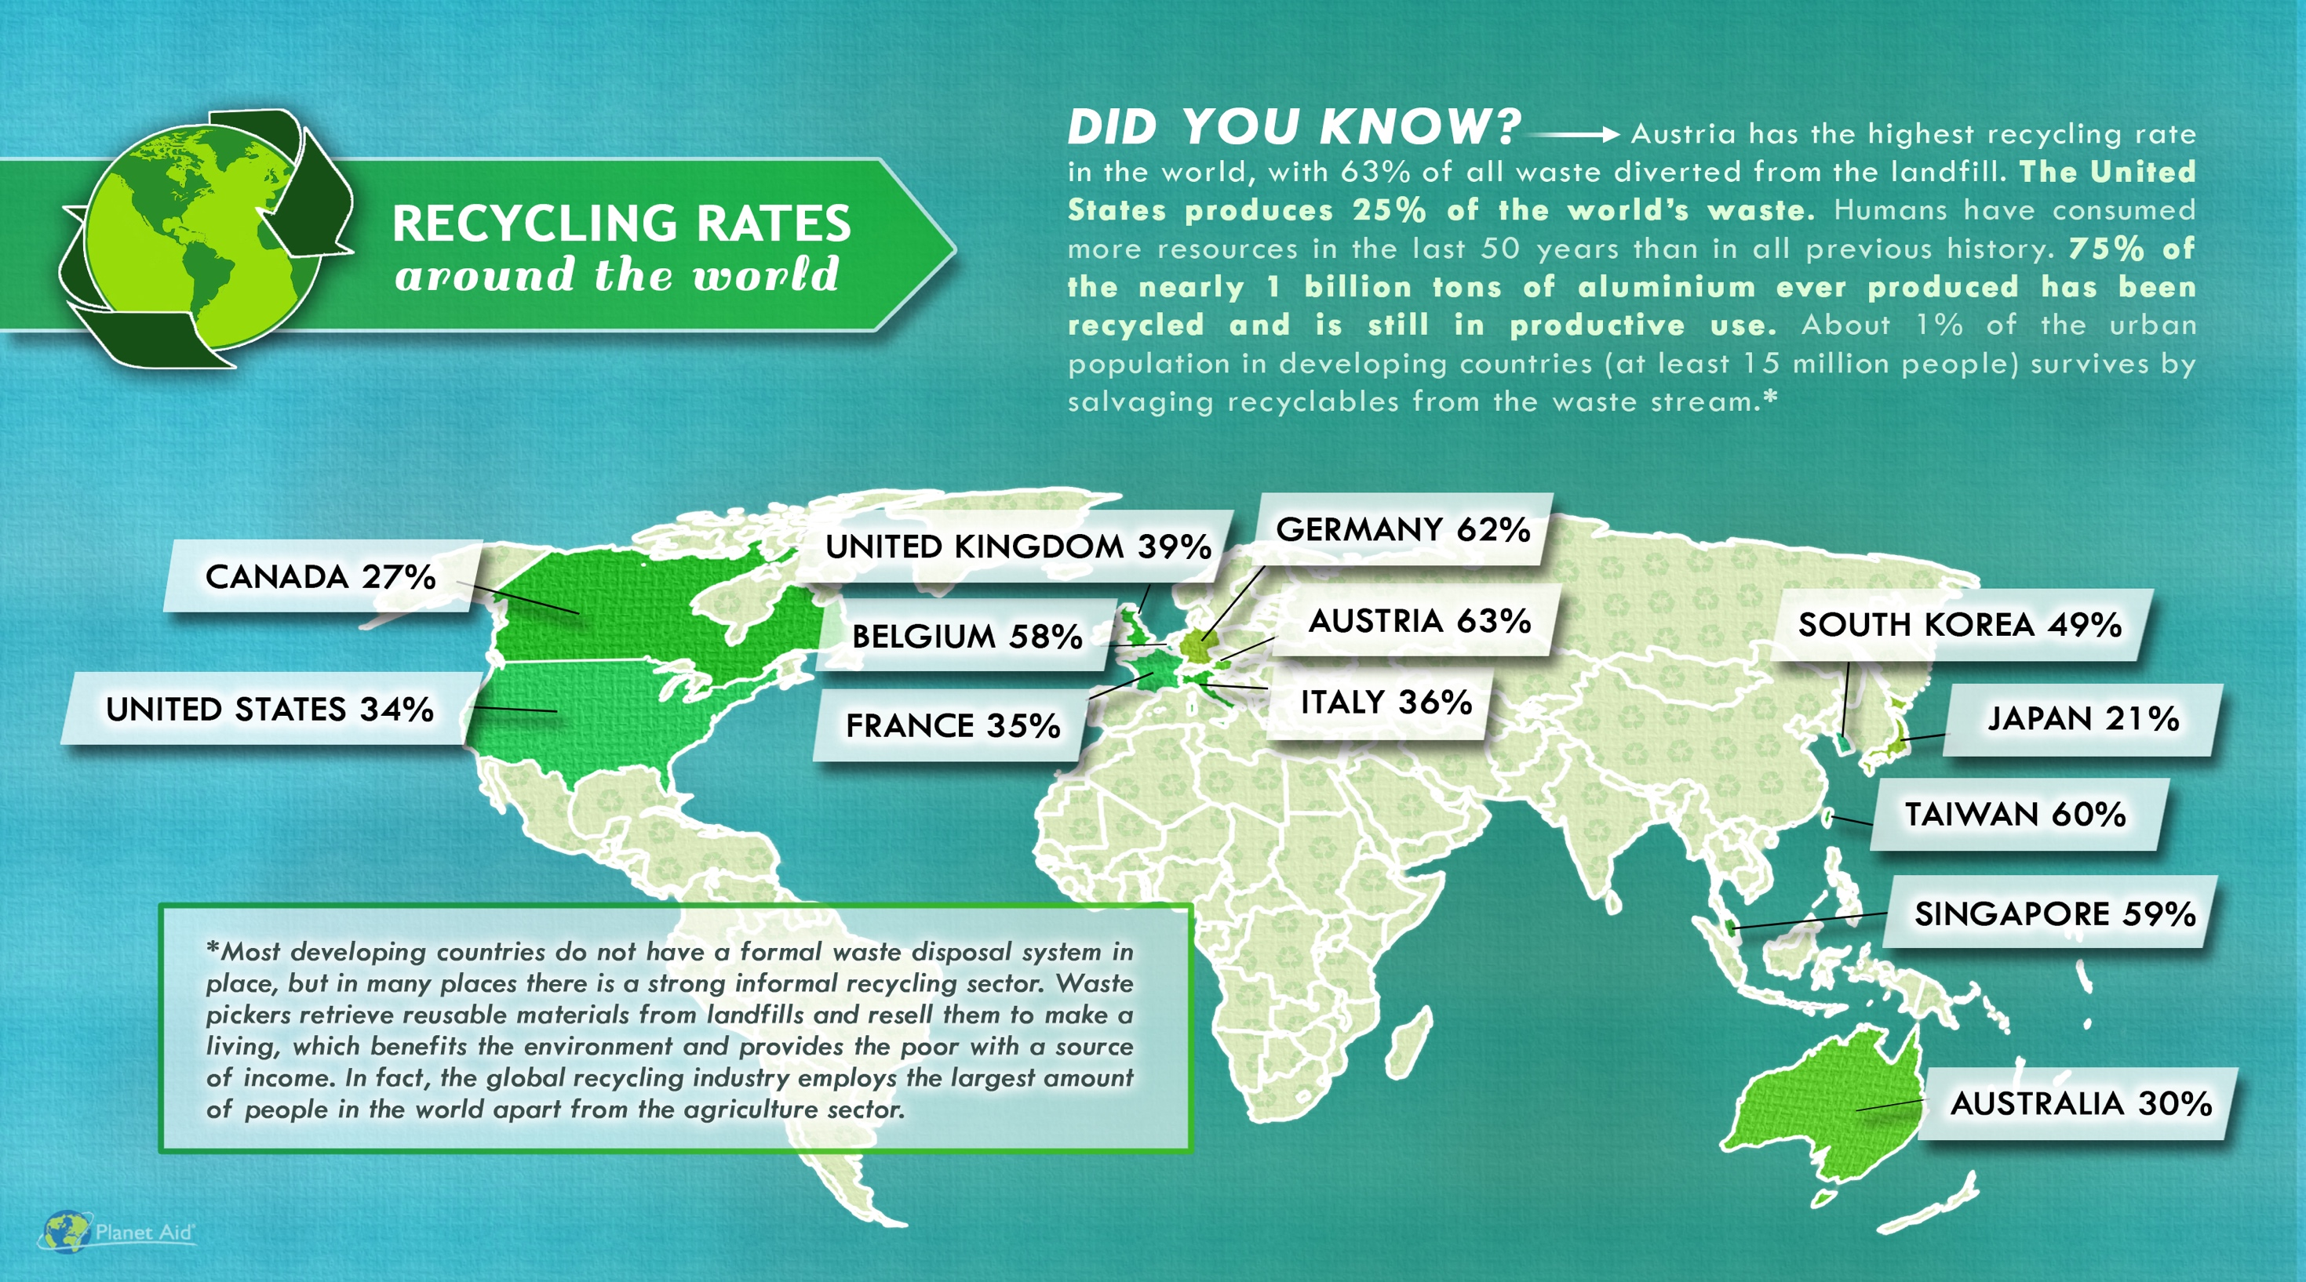
SOUTH AFRICA 43%
http://www.planetaid.org/blog/recycling-rates-around-the-world

Slide 23
Myth #5:
Sustainability is too expensive.

Slide 24
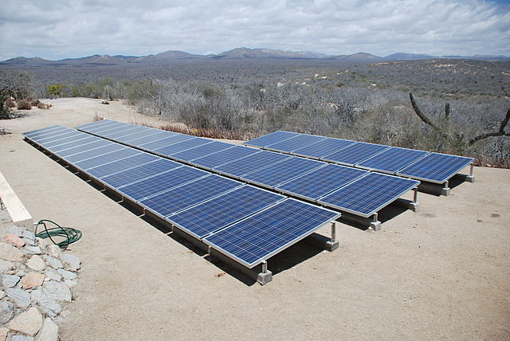
Sustainability and Expense
More sustainable ways of doing things usually costs less over the life-time of a product or service.
It is the upfront costs that can sometimes be higher.
Image: Wikimedia Commons, Solar panels installed in Baja Sur California, Author: BishopBandita

Slide 25

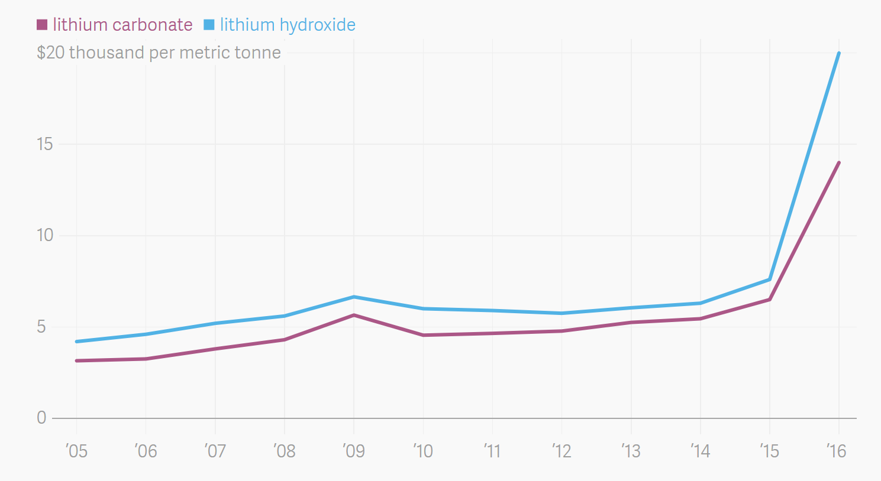
Sustainability and Expense
What is rare is expensive.
It is hard to imagine that an expensive process/product is sustainable.
Roasted gold ore from Cripple Creek, Colorado, USA
More intense use of lithium in batteries means higher cost of lithium and more difficult access
https://commons.wikimedia.org/wiki/File:Roasted_Cripple_Creek_gold_ore_3.jpg, https://www.theatlas.com/charts/S1Isjut3

Slide 26
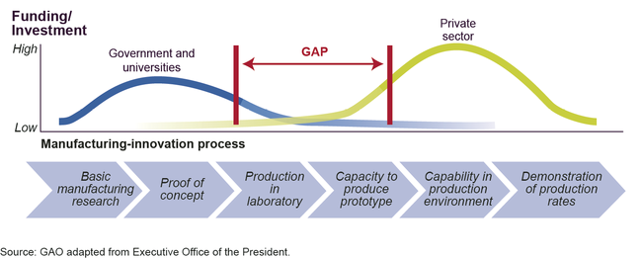
Sustainability and Expense
Developing new technologies comes with risks and upfront investments
Image: https://www.gao.gov/products/GAO-14-181SP

Slide 27
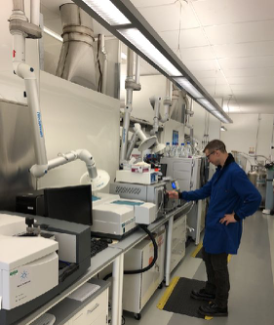
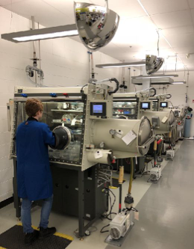
Sustainability and Expense

Slide 28
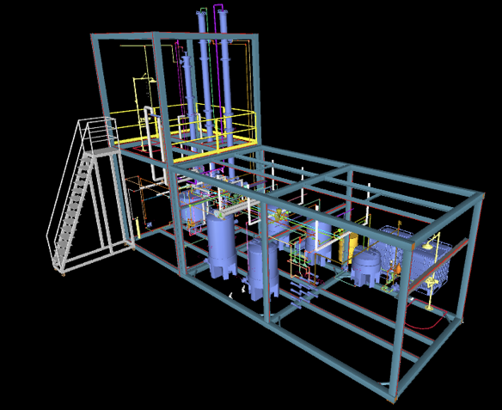
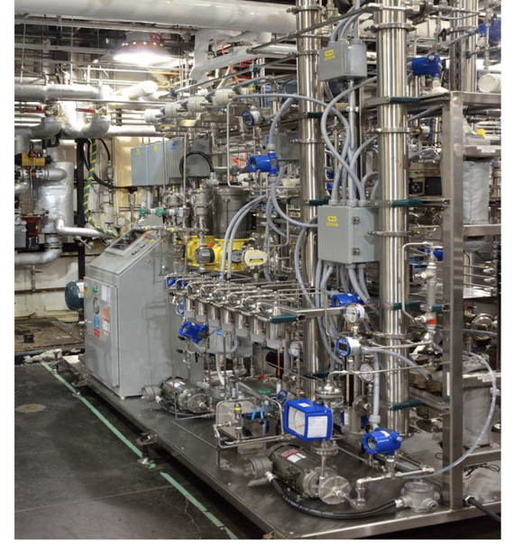
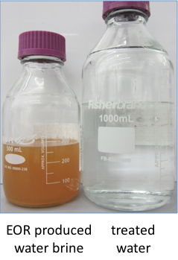
Sustainability and Expense

Slide 29
Myth #6:
Sustainability means lowering our standard of living.

Slide 30
Sustainability and Standard of Living
Once we start becoming organized and innovate, the breakthroughs can be extraordinary.
These innovations will allow us to use resources more productively, which in turn will allow us to be prosperous, fed, entertained, and secure.
The innovation at the heart of sustainable living will be a powerful economic engine.

Slide 31
Myth #7:
Consumer choices and grassroots activism, not government intervention, offer the fastest and most efficient routes to sustainability.

Slide 32
Sustainability and The Government
Popular grassroots actions are helpful and essential to creating change. But progress on some reforms, such as curbing CO₂ emissions, can only happen if central authorities commit to making it happen.
That is why tax credits, mandatory fuel-efficiency standards, and other government regulations are both practical and necessary.

Slide 33
Myth #8:
New technology is always the answer.

Slide 34
Is new technology the answer to sustainability?
Sustainability and Technology
Notes:
Or, should we make sure that whatever we develop is sustainable for many years to come?

Slide 35
Water treatment technologies for developing world
Lifestraw
Water purifying bicycle
Hamster Ball-Shaped Solarball
Life sack
“Pure” Water Bottle Filters Water With UV Rays
Ceramic water filter
Notes:
The LifeStraw is a water filter designed to be used by one person to filter water for drinking. It filters a maximum of 4000 litres of water, enough for one person for three years. It removes almost all of waterborne bacteria and parasites.
The solarball is a water purification device based on evaporation purification. It consists of a clear plastic sphere which users would fill with water and then wear on their heads. A solarball can produce three liters of clean water per day.

Slide 36
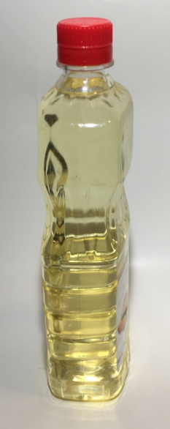
Myth #9:
Otto Diesel
vegetable oil

Slide 37
Sustainability and Population
This is not a myth, but it represents a false solution.
Every environmental problem is ultimately a population problem. If the world’s population were only 100 million people, we would be hard-pressed to generate enough waste to overwhelm nature’s cleanup systems. We could dispose all our trash in a landfill in some remote area, and nobody would notice.

Slide 38
Sustainability and Population
Population experts agree that the best way to limit population is to educate women and raise the standard of living overall in developing countries.
But that strategy cannot possibly happen quickly enough to put a dent in the population on any useful timescale.
The U.N. projects that the planet will have to sustain another 2.6 billion people by 2050. But even at the current population level of 7 billion people, we’re using up resources at an unsustainable rate.

Slide 39
Myth #10:
Once you understand the concept, living sustainably is easy to figure out.

Slide 40
Sustainability ≠ Simple
All too often, a choice that seems sustainable turns out on closer examination to be problematic.
Probably the best current example is the rush to produce ethanol for fuel from corn.
What are the issues with ethanol?

Slide 41
Sustainability ≠ Simple
Corn Cultivation:
Competition with food supply
Land demand
Nutritional needs
Diseases
Initial investment
Ethanol Demand and Corn Prices:
Large increase in demand for corn for ethanol production.
  Current production capacity is at over 5 billion gallons.
  It is projected to increase to over 9 billion gallons with current plants currently under construction.
Bushels of corn sold for over $8 (USD) each in July 2012.
Corn prices continue to fluctuate.

Slide 42
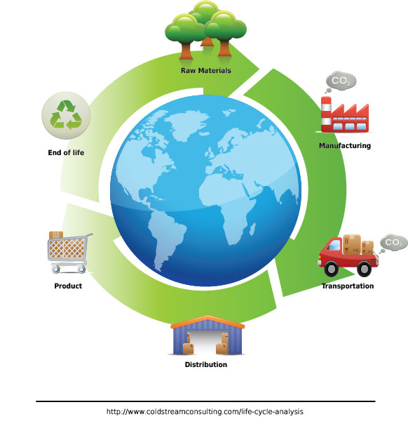
Sustainability ≠ Simple
You cannot really declare any practice “sustainable” until you have done a complete life-cycle analysis of its environmental costs.
Even then, technology and public policy keep evolving, and that evolution can lead to unforeseen and unintended consequences.
The admirable goal of living sustainably requires plenty of thought on an ongoing basis.

Slide 43
Sponsored by Yale-UNIDO Initiative
QUESTIONS?
CENTER for GREEN CHEMISTRY
and GREEN ENGINEERING at YALE

