Slide 1
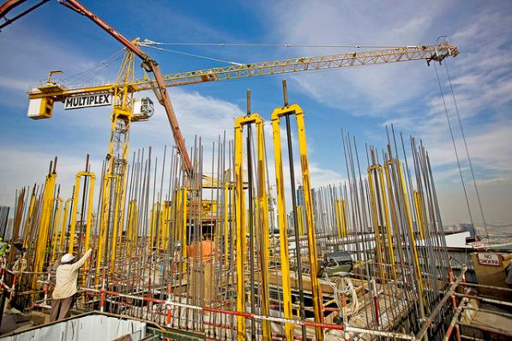
Yale-UNIDO Train-the-Facilitator Workshop in Green Chemistry
Sustainability
CENTER for GREEN CHEMISTRY
and GREEN ENGINEERING at YALE
Image: Flickr, The Glenium Sky admixture, Author: BASF - We create chemistry

Slide 2
Topics To Be Covered
Sustainability – Myths and Facts
Society, Economy, and the Environment
Business and Sustainability
Applying Green Chemistry to Management
Different Models of Sustainability
Case Study: The Interface Company
Green Washing
Life-Cycle Assessment

Slide 3
Sustainability
When a word becomes so popular you begin hearing it everywhere, in all sorts of marginally related or even unrelated contexts, it means one of two things. Either the word has devolved into:
A meaningless cliché, or
It has real conceptual heft.

Slide 4
Sustainability
“Sustainable“, which at first conjures up a similarly vague sense of environmental virtue, actually belongs in the second category:
It has real conceptual heft.
Despite its simplicity sustainability is a concept many people have a difficult time wrapping their minds around.

Slide 5
Sustainability Myths

Slide 6
Myth #1:
Nobody knows what sustainability really means.

Slide 7
What is sustainability?
Take a moment to write a sentence or two about what sustainability is.

Slide 8
The Definition of Sustainability
UN World Commission on Environment and Development: “Sustainable development is development that meets the needs of the present without compromising the ability of future generations to meet their own needs.”
Sustainability presumes that resources are finite and should be used conservatively and wisely with a view to long-term priorities and consequences of the ways in which resources are used.
In simplest terms, sustainability is about our children and our grandchildren, and the world we will leave them.
- The Brundtland Report (Our Common Future)

Slide 9
The Definition of Sustainability
Sustainability wants to avoid this
While also making sure we can lead comfortable lives.
A related concept is circular economy – how to efficiently close the loops in use of resources
Image Source: Wikipedia

Slide 10
Myth #2:
Sustainability is all about the environment.

Slide 11
Sustainability is Not Just About the Environment
Sustainability include a broad range of social and economic development issues including: poverty, hunger, health, education, climate change, water, sanitation, energy, and environment.
This requires giving all countries access to natural resources such as water, energy, and food - all of which come, one way or another, from the environment.
Clearly, access to technology, healthcare, and diverse political issues in the structure of the society are also involved.

Slide 12
Sustainability is Not Just About the Environment
Sustainability has transformed into an environmental term because the economy is without exception driven by natural resources, although that might not sometimes be obvious.
If too many of us use resources inefficiently or generate waste too quickly for the environment to absorb and process, future generations won’t be able to meet their needs.
Image Source: Wikipedia

Slide 13
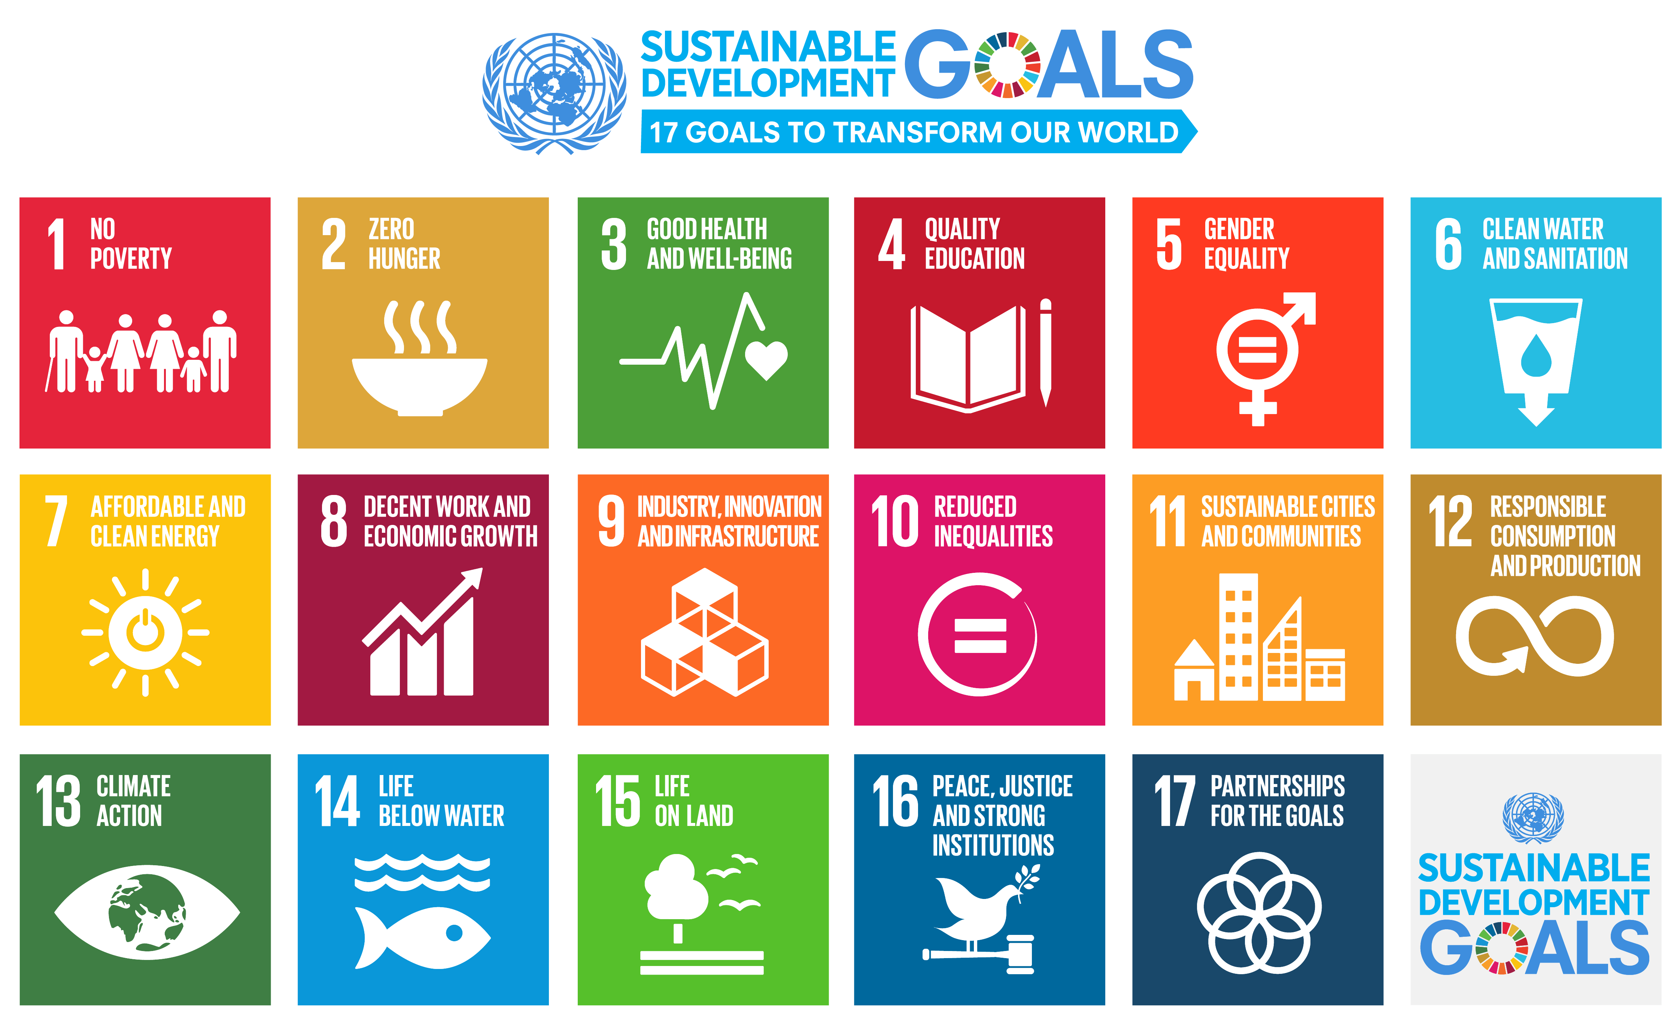
Sustainability is Not Just About the Environment
“A blueprint on how to achieve a better, more sustainable future for all.”
How do the goals interconnect?
What are the challenges?
https://www.un.org/sustainabledevelopment/sustainable-development-goals/

Slide 14
Myth #3:
“Sustainable” is a synonym for “Green”.

Slide 15
Relationship of “Sustainability” vs. “Green”
Green
Sustainability
“Green” concepts tend to focus on technologies/products causing less harm to human health and the environment
In popular discourse it is often assumed that green = natural as opposed to artificial
Yet natural may not always be sustainable
Sustainability and green overlap since a sustainable solution must be able to preserve health and environment
Sustainability adds the important idea of preserving resources for the next generation
One example are GM crops, is a society built on non-GM crops sustainable or not?
Think about terms of sustainability vs. survivability on a large (societal, planetary) scale

Slide 16
Sustainability & Green
Both terms often used outside of context, outside of true metric
=> Green washing
g oing green
Image Source: Wikipedia

Slide 17
Myth #4:
Sustainability is all about recycling.

Slide 18
A question we need to ask: Is recycling sustainable?
Sustainability and Recycling
Inputs
(raw materials
energy, auxiliaries)
useful
waste

Slide 19
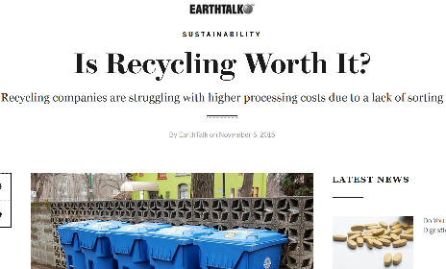
Sustainability and Recycling
Recycling
Converting waste materials into new materials and objects.
Available for metals, plastic, paper, glass.
Material | Energy savings
Aluminum | 95%
Cardboard | 24%
Glass | 5-30%
Paper | 40%
Plastics | 70%
Steel | 60%
Cost-benefit of recycling: energy savings

Slide 20
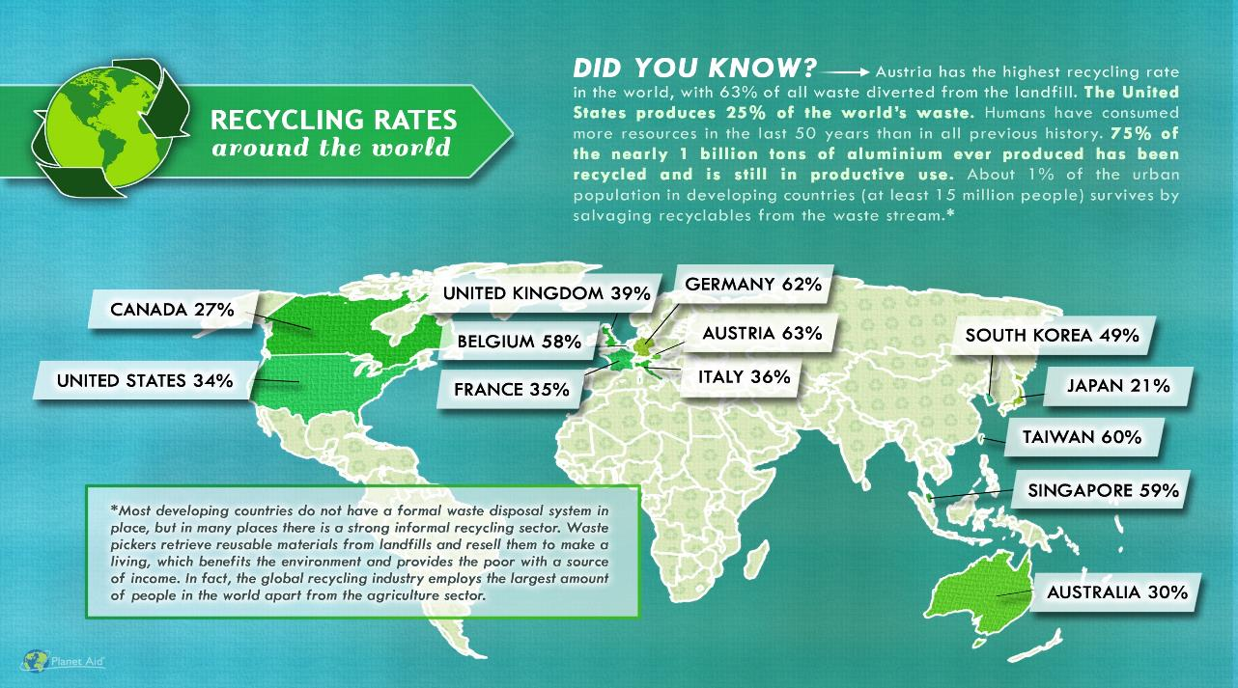
SOUTH AFRICA 43%
http://www.planetaid.org/blog/recycling-rates-around-the-world

Slide 21
Myth #5:
Sustainability is too expensive.

Slide 22
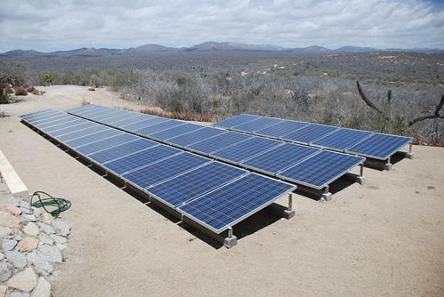
Sustainability and Expense
More sustainable ways of doing things usually costs less over the life-time of a product or service.
It is the upfront costs that can sometimes be higher: cost of innovation, implementation, training, redesign, all contribute to something chemists know as “activation energy” ☺
Image: Wikimedia Commons, Solar panels installed in Baja Sur California, Author: BishopBandita

Slide 23
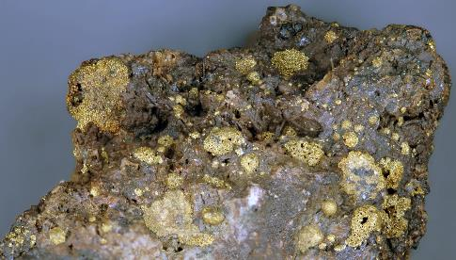
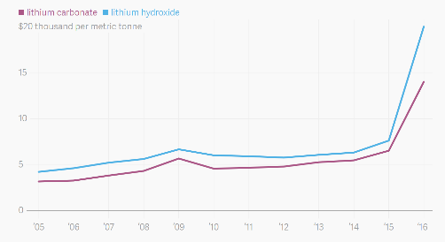
Sustainability and Expense
What is rare is expensive.
It is hard to imagine that an expensive process/product is sustainable.
Roasted gold ore from Cripple Creek, Colorado, USA
More intense use of lithium in batteries means higher cost of lithium and more difficult access
https://commons.wikimedia.org/wiki/File:Roasted_Cripple_Creek_gold_ore_3.jpg, https://www.theatlas.com/charts/S1Isjut3

Slide 24
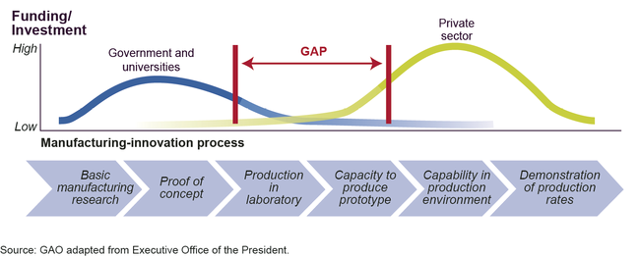
Sustainability and Expense
Developing new technologies comes with risks and upfront investments
Image: https://www.gao.gov/products/GAO-14-181SP

Slide 25
Myth #6:
Sustainability means lowering our standard of living.

Slide 26
Sustainability and Standard of Living
Once we start becoming organized and innovate, the breakthroughs can be extraordinary.
These innovations will allow us to use resources more productively, which in turn will allow us to be prosperous, fed, entertained, and secure.
The innovation at the heart of sustainable living will be a powerful economic engine.

Slide 27
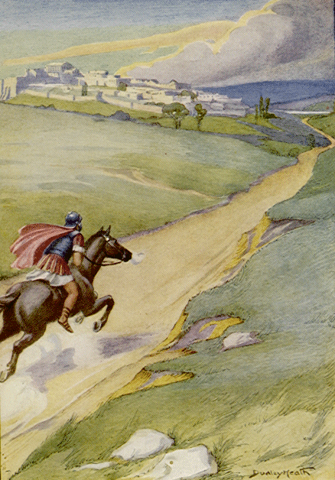
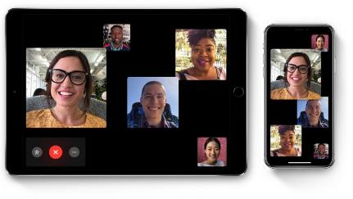
Battle of New Orleans (1815)
The Battle of New Orleans took place directly after the signing of the Treaty of Ghent on December 24, 1814, before news of the treaty could reach the United States; the Americans defended against a British assault on New Orleans, resulting in a major American victory. In just over a half hour, the Americans suffered around 70 casualties, while the British suffered roughly 2,000 casualties. Now technology allows us to communicate much faster.
Wikipedia
https://www.freeholdboropublications.com/2469/folioliterary/messenger/
https://www.businessinsider.com/how-to-use-apples-group-facetime-video-chat-feature-2018-10

Slide 28
Comuna 13 – Medellin, Colombia
Once one of the most dangerous neighborhoods in Medellín, the Comuna 13, which clings to the mountainside above the San Javier metro station, has undergone an impressive transformation in recent times and is now considered safe to visit. The focal point of a trip to the comuna is the area around the escaleras electricas, the outdoor escalators that provide access to homes in marginalized barrios that were formerly isolated from the city below.
Photo credit: Dr Karolina Mellor

Slide 29
Myth #7:
Consumer choices and grassroots activism, not government intervention, offer the fastest and most efficient routes to sustainability.

Slide 30
Sustainability and The Government
Popular grassroots actions are helpful and essential to creating change. But progress on some reforms, such as curbing CO₂ emissions, can only happen if central authorities commit to making it happen. That is why tax credits, mandatory fuel-efficiency standards, and other government regulations are both practical and necessary.
Participation and dedication of governments is a necessary component of societal, environmental, technological sustainability – by definition

Slide 31
Myth #8:
New technology is always the answer.

Slide 32
Is new technology the answer to sustainability?
Sustainability and Technology
Notes:
Or, should we make sure that whatever we develop is sustainable for many years to come?

Slide 33
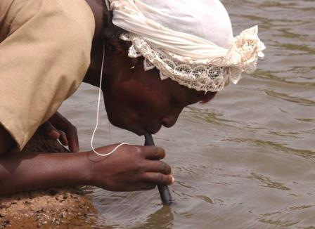
Water treatment technologies for developing world
Lifestraw
Water purifying bicycle
Hamster Ball-Shaped Solarball
Life sack
“Pure” Water Bottle Filters Water With UV Rays
Ceramic water filter

Slide 34
Myth #9:
Sustainability is ultimately a population problem.

Slide 35
Sustainability and Population
This is not a myth, but it represents a false solution.
Every environmental problem is ultimately a population problem. If the world’s population were only 100 million people, we would be hard-pressed to generate enough waste to overwhelm nature’s cleanup systems. We could dispose all our trash in a landfill in some remote area, and nobody would notice.

Slide 36
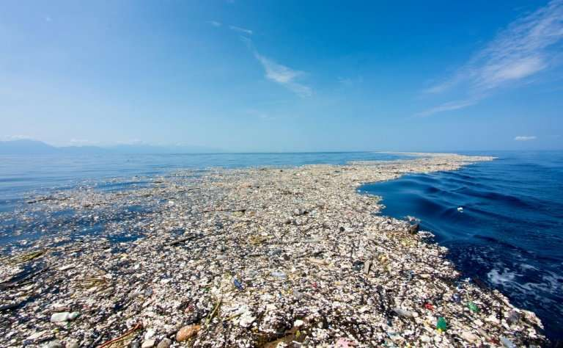
The Great Pacific Garbage Patch
Floating at or just below the surface with a surface area of two Texases a depth of up to 90 feet.
Almost 90% of the patch is plastic waste.
https://phys.org/news/2018-03-pacific-plastic-dump-larger.html
Notes:
The Great Pacific Garbage Patch
This out-of-sight, out-of-mind free landfill in the middle of the Pacific gained some space in the public conscious after Oprah’s Earth Day oeuvre, but I still encounter tons of people who are completely ignorant of this phenomenon. It is a startling reminder of the unseen costs of the West’s out-of-control consumerism.
This garbage patch, swept together and kept in place by ocean gyres (currents), reaches from California to Japan, floating at or just below the surface with a surface area of two Texases, and a depth of up to 90 feet. Almost 90% of the patch is plastic waste, which has blown into the ocean or washed in from waterways across the continent. The environmental effects of this patch are difficult to measure, due to the enormity of the aqueous dump and the vast number of species dependent on the local ecosystem

Slide 37
Sustainability and Population
Population experts agree that the best way to limit population is to educate women and raise the standard of living overall in developing countries.
But that strategy cannot possibly happen quickly enough to put a dent in the population on any useful timescale.
The U.N. projects that the planet will have to sustain another 2.6 billion people by 2050. But even at the current population level of 7 billion people, we’re using up resources at an unsustainable rate.

Slide 38
Myth #10:
Once you understand the concept, living sustainably is easy to figure out.

Slide 39
Sustainability ≠ Simple
All too often, a choice that seems sustainable turns out on closer examination to be problematic.
Probably the best current example is the rush to produce ethanol for fuel from corn.
What are the issues with ethanol?

Slide 40
Sustainability ≠ Simple
Corn Cultivation:
Competition with food supply
Land demand
Nutritional needs
Diseases
Initial investment
Ethanol Demand and Corn Prices:
Large increase in demand for corn for ethanol production.
Current production capacity is at over 5 billion gallons.
It is projected to increase to over 9 billion gallons with current plants currently under construction.
Bushels of corn sold for over $8 (USD) each in July 2012.
Corn prices continue to fluctuate.

Slide 41
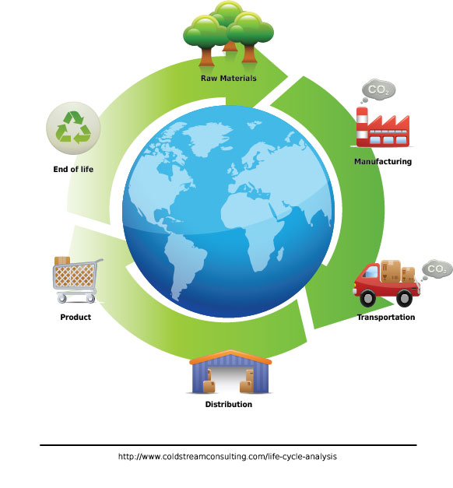
Sustainability ≠ Simple
You cannot really declare any practice “sustainable” until you have done a complete life-cycle analysis of its environmental costs.
Even then, technology and public policy keep evolving, and that evolution can lead to unforeseen and unintended consequences.
The admirable goal of living sustainably requires plenty of thought on an ongoing basis.

Slide 42
Sponsored by Yale-UNIDO Initiative
QUESTIONS?
CENTER for GREEN CHEMISTRY
and GREEN ENGINEERING at YALE

