Slide 1
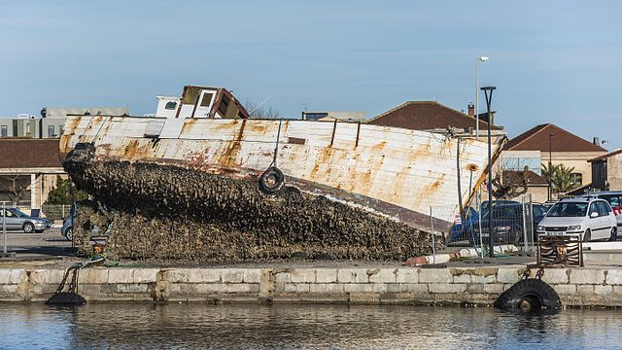

Yale-UNIDO Train-the-Facilitator Workshop in Green Chemistry
Accidents and Unintended Consequences
CENTER for GREEN CHEMISTRY
and GREEN ENGINEERING at YALE
Image: Wikimedia Commons, Quai Paul Riquet (embankment) in Sète, Hérault, France, Author: Christian Ferrer

Slide 2
Topics To Be Covered
Chemical and Industrial Accidents
  Union Carbide, 1984
  Cuyahoga River, 1969
  Port of Tianjin, 2015
Unintended Consequences
Green Chemistry is Everybody’s Job
Perspective and Context
Green Chemistry – Where do we go from here?

Slide 3
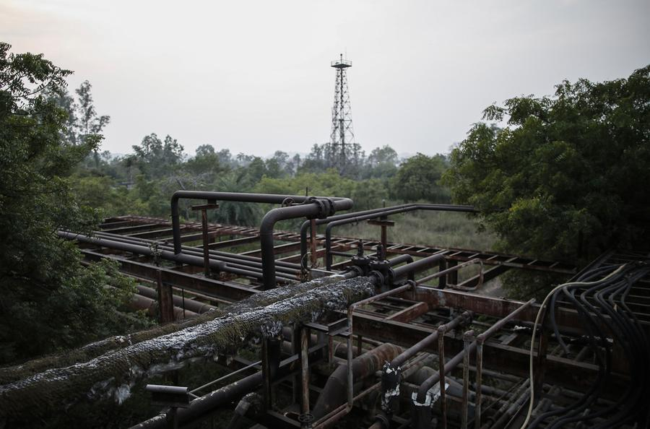
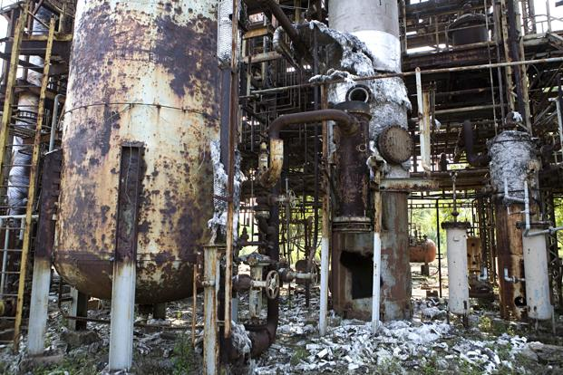
Industrial and Chemical Accidents
What do you see?
What do you think happened?
Aftermath of infrastructure damage
https://www.theatlantic.com/photo/2014/12/bhopal-the-worlds-worst-industrial-disaster-30-years-later/100864/

Slide 4
Union Carbide, 1984
Poison gas leaked from a Union Carbide factory (Bhopal, India), killing thousands of people instantaneously, and injuring many more (many of whom died later of exposure). Up to 20,000 people have died as a result of exposure (3-8,000 immediately after). More than 120,000 still suffer from illness caused by exposure.
How did this happen?
Methyl isocyanate – used to make pesticides was being stored in large quantities on-site at the plant.
Methyl isocyanate is a highly reactive molecule, through an exothermic process with water
Most safety systems either failed, were inoperative or ignored by employees
  Example of poor hazard management, poor safety management practice, poor use of early warning system etc
Water was released into the tank holding the methyl isocyanate.
The reaction occurred and the methyl isocyanate rapidly boiled, producing large quantities of toxic gas, released into the surrounding region

Slide 5
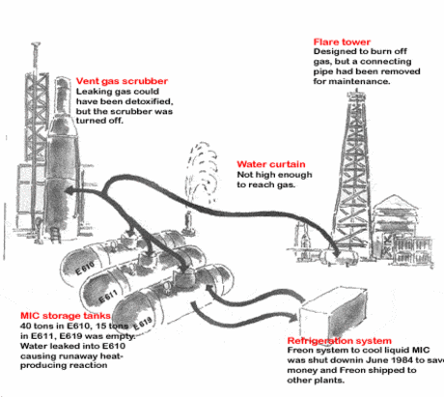
ACCIDENTS: BHOPAL
cleaning of pipes starts
9 pm
H₂O enters MIC tank
10 pm
leak starts
11 pm
tea break
12 midnight
1 am
siren sounds briefly
http://bhopal.org/index.php?id=22
2 am
siren turned back on again
3 am
Fundamental errors:
• Failure to have and maintain monitoring equipment
• Failure to have adequate backup equipment
• Decision to store large amounts of intermediate
Have we learned these lessons?
4 am
leak stops
Notes:
9.00 Water cleaning of pipes starts.
10.00 Water enters tank 610, reaction starts.
10.30 Gases are emitted from the VGS-tower. First burning of eyes in population
10:45 Plant operator knew there was some leaking.
12-12:15 tea break. Control room left empty.
12:20 tank’s rupture disk burst. the hot gas flowed through a vent gas scrubber and possibly also a flare tower, neither of which were operational. 00.30 The large siren sounds and is turned off.
12.50 The siren is heard within the plant area. The workers escape.
1 am Police are alerted. Residents of the area evacuate. Union Carbide director denies any leak.
2 am The first people reached Hamidia hospital. Symptoms include visual impairment and blindness, respiratory difficulties, frothing at the mouth, and vomiting.
2.10 The alarm is heard outside the plant.
4.00 The gases are brought under control.
6.00 A police loudspeaker broadcasts: "Everything is normal".
Dead: 2,000 to 5,000 (disputed)

Slide 6
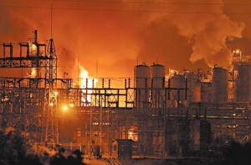
HAVE WE LEARNED THE LESSONS OF BHOPAL?
Chemistry World 2009, 30 April,
http://prospect.rsc.org/blogs/cw/?m=200904
Notes:
The US Chemical Safety Board has stated in a preliminary report that a major explosion at Bayer CropScience’s plant in Institute, West Virginia, last year was preventable. They found that deficiencies in the plant equipment and safety procedures, as well as inadequate training caused the thermal runaway of the ‘controlled’ decomposition process of methomyl (an intermediate in the production of Bayer’s Larvin insecticide), killing two operators and exposing staff and emergency services personnel to hazardous chemicals.The accident occurred after an upgrade to the computer system controlling the reactors. Operators had not been adequately trained on the new system and had overridden safety systems to overcome inadequacies in the vessel heating system. A detailed investigation is ongoing.

Slide 7
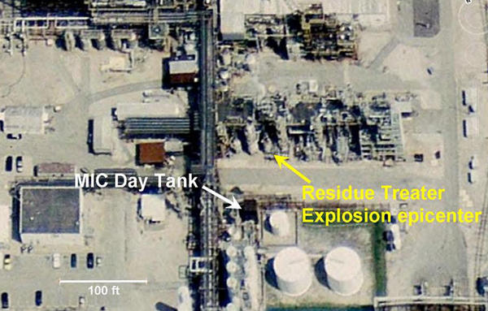
HAVE WE LEARNED THE LESSONS OF BHOPAL?
The Charleston Gazette
http://www.wvgazette.com/News/Bayerexplosion/200904220737
Notes:
During a hearing Tuesday, House Energy and Commerce Chairman Henry Waxman, D-Calif., recalled investigating the Institute plant -- then owned by Union Carbide -- just after a leak of MIC killed thousands at a sister facility in Bhopal, India."Twenty-five years after the catastrophe in India, I think it's finally time to ask whether it makes sense to allow Bayer to continue producing and storing such massive amounts of this highly toxic chemical," Waxman said in opening the hearing.Despite objections from Bayer lawyers and executives, both Waxman's committee and the federal Chemical Safety Board are examining the Institute plant's MIC stockpile as part of separate probes of the August 2008 explosion and fire that killed two workers.Committee staff and safety board investigators remain unconvinced that storing large amounts of MIC is a good idea, or that Bayer has done enough to reduce or eliminate the practice.After hearing the evidence uncovered so far, Kanawha County Commission President Kent Carper said Wednesday it's clear what needs to be done."There has to be a radical change," Carper said. "It is time to reduce the amount of MIC. The risk to the community is just too great."For nearly 25 years -- since learning about MIC in the days after Bhopal -- residents of Institute and nearby communities have urged various plant owners to eliminate the chemical stockpile.

Slide 8
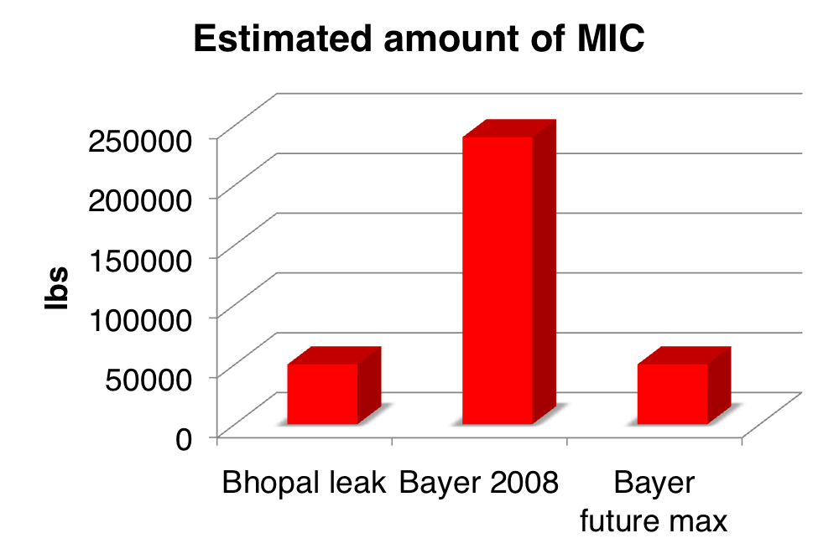
HAVE WE LEARNED THE LESSONS OF BHOPAL?
data from: Saturday Gazette-Mail, 26 Aug 2009
http://www.wvgazette.com/News/200908260495
Notes:
“Bayer CropScience's Institute plant will eliminate 80 percent of the huge methyl isocyanate stockpile that has fueled public safety concerns in the Kanawha Valley since a leak of the chemical killed thousands of people in Bhopal, India, a quarter century ago.Bayer officials announced the plan just two days before Friday's one-year anniversary of the Aug. 28, 2008, explosion and fire that killed Institute plant workers Bill Oxley and Barry Withrow.The one-year project will cost $25 million and shut down production of two MIC-based pesticide ingredients, but is not expected to cost any workers their jobs, Bayer officials said.Bayer officials said they planned to eliminate all above-ground storage of MIC and produce the chemical only on a "make-and-use" basis. After the changes, Bayer hopes to keep its daily maximum MIC inventory below 50,000 pounds -- still far more than any other chemical plant in the nation.”
Update: Bayer now vows to eliminate MIC from this plant.

Slide 9
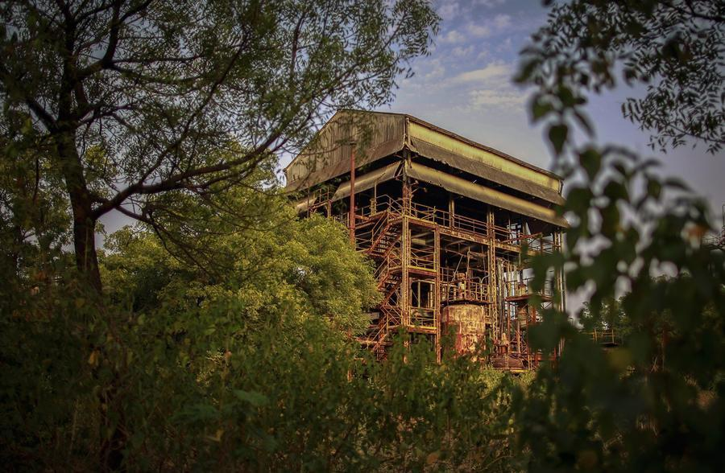
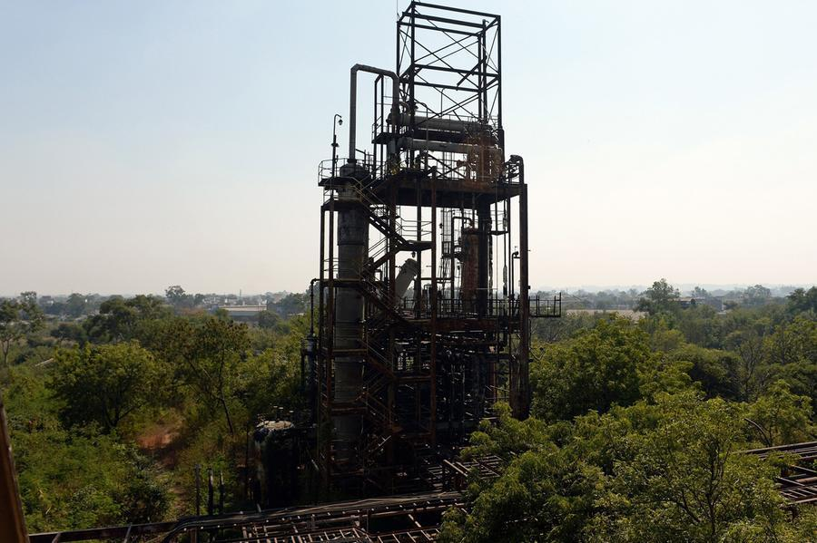
Union Carbide, 1984
Flare tower where toxic methyl isocyanate gas was released into the air.
What is left of the abandoned
Union Carbide plant.
https://www.theatlantic.com/photo/2014/12/bhopal-the-worlds-worst-industrial-disaster-30-years-later/100864/

Slide 10
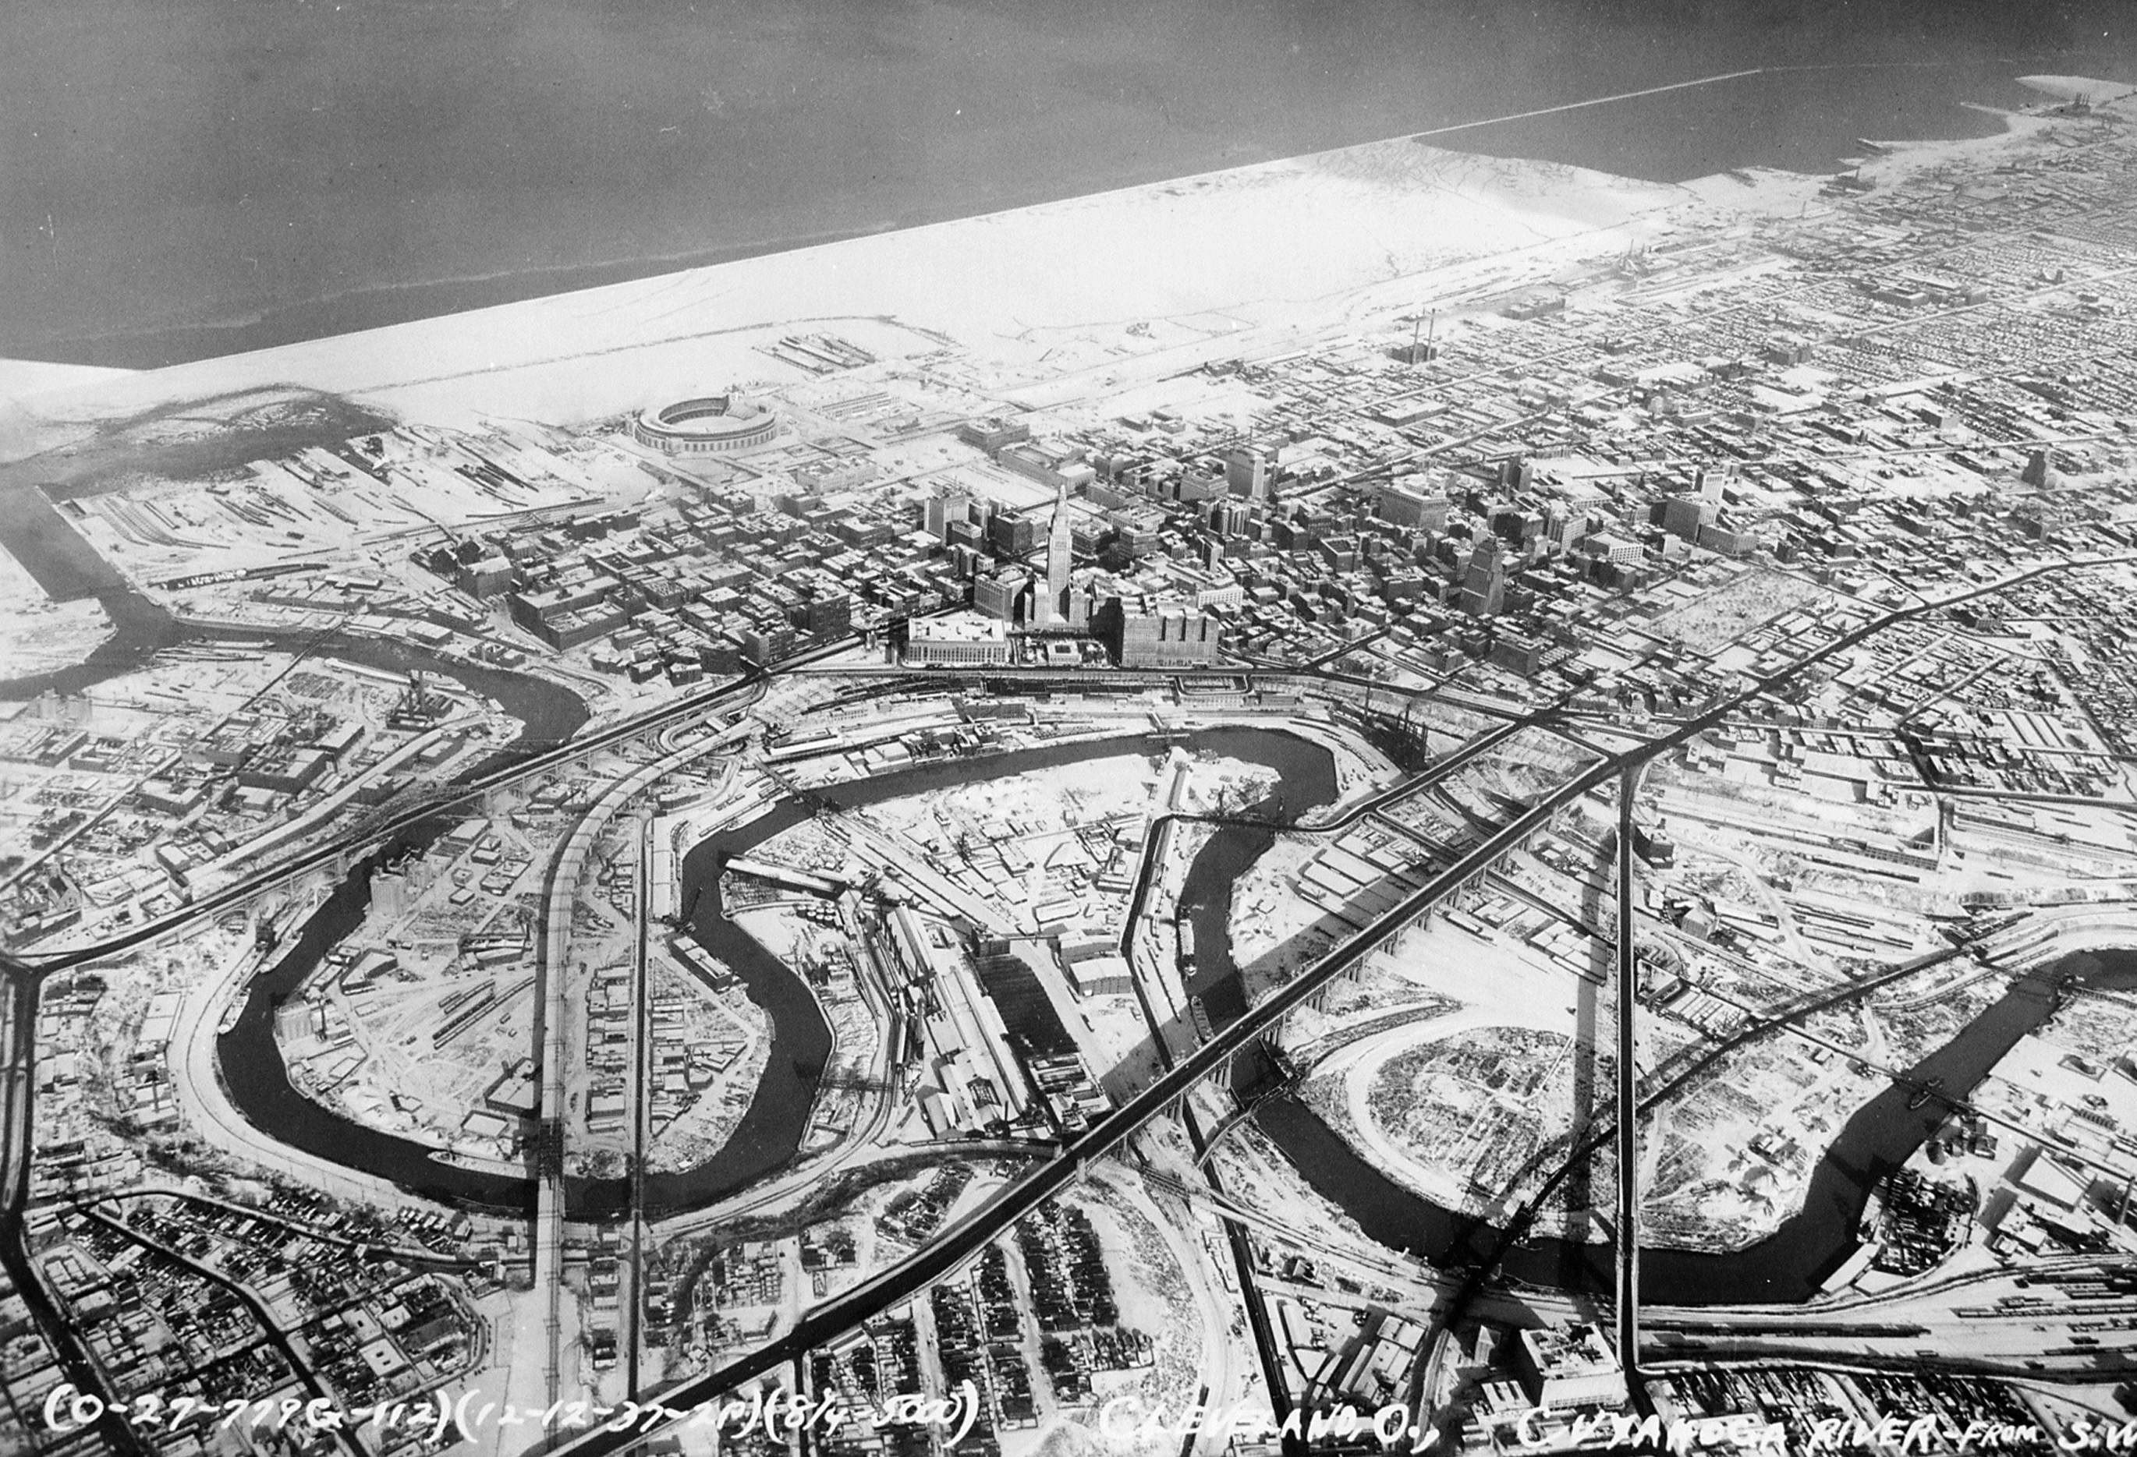
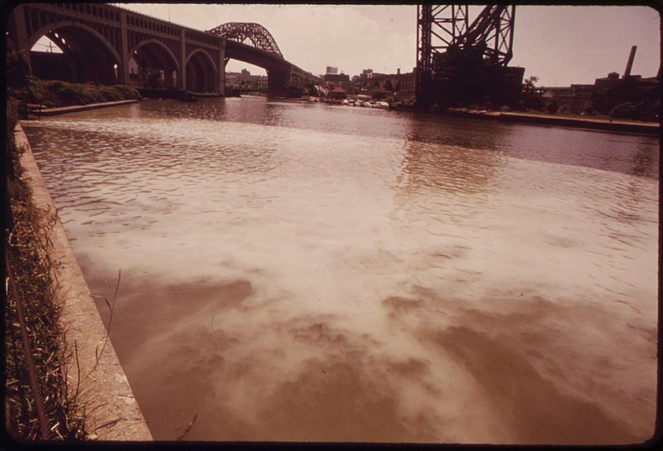
Cuyahoga River – Cleveland, Ohio, 1969
  There were many things being dumped in the river such as: gasoline, oil, paint, and metals. The river was called "a rainbow of many different colors."
  Fires erupted on the river several times before June 22, 1969, when a river fire captured national attention when Time Magazine reported it.
  Some river! Chocolate-brown, oily, bubbling with subsurface gases, it oozes rather than flows. "Anyone who falls into the Cuyahoga does not drown," Cleveland's citizens joke grimly. "He decays."
  - Time Magazine, August 1969

Slide 11
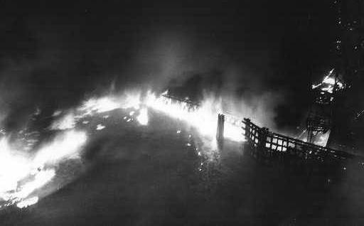
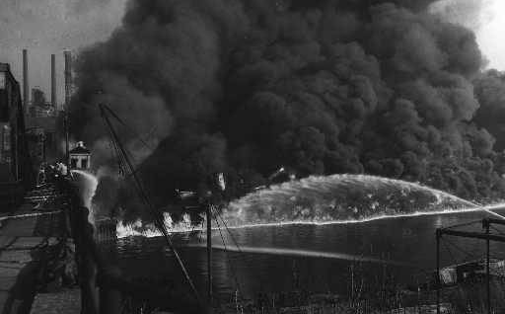
Cuyahoga River – Cleveland, Ohio, 1969
Images Courtesy of The Cleveland Press Collection, Cleveland State University Library; Author: Fred Bottomer, and James Thomas

Slide 12
Port of Tianjin, 2015
A series of explosions killed 173 people and injured hundreds of others at a container storage station.
The first two explosions occurred within 30 seconds of each other at the facility. The second explosion was far larger and involved the detonation of about 800 tons of ammonium nitrate. Fires caused by the initial explosions continued to burn uncontrolled throughout the weekend, repeatedly causing eight additional secondary explosions.
The facility stored large quantities of sodium cyanide and calcium carbide, as well as 800 tons of ammonium nitrate, which is principally used in manufacturing fertilizer.
In total, 304 buildings, 12,428 cars, and 7,533 intermodal containers were damaged.
The cost of damage was estimated at $9 billion.

Slide 13
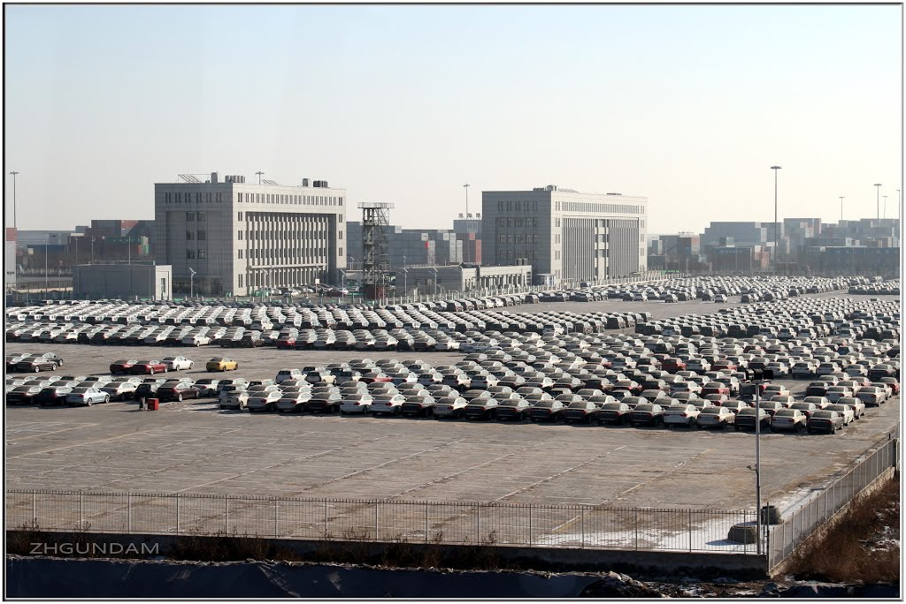
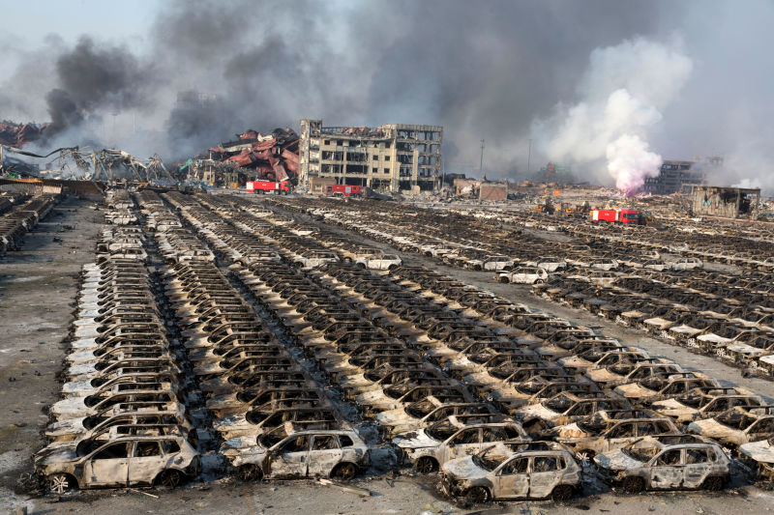
Port of Tianjin, 2015
Before
After
https://sploid.gizmodo.com/photos-from-the-devastating-aftermath-of-the-tianjin-ex-1723899654

Slide 14
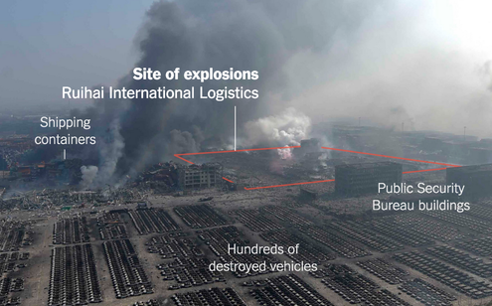
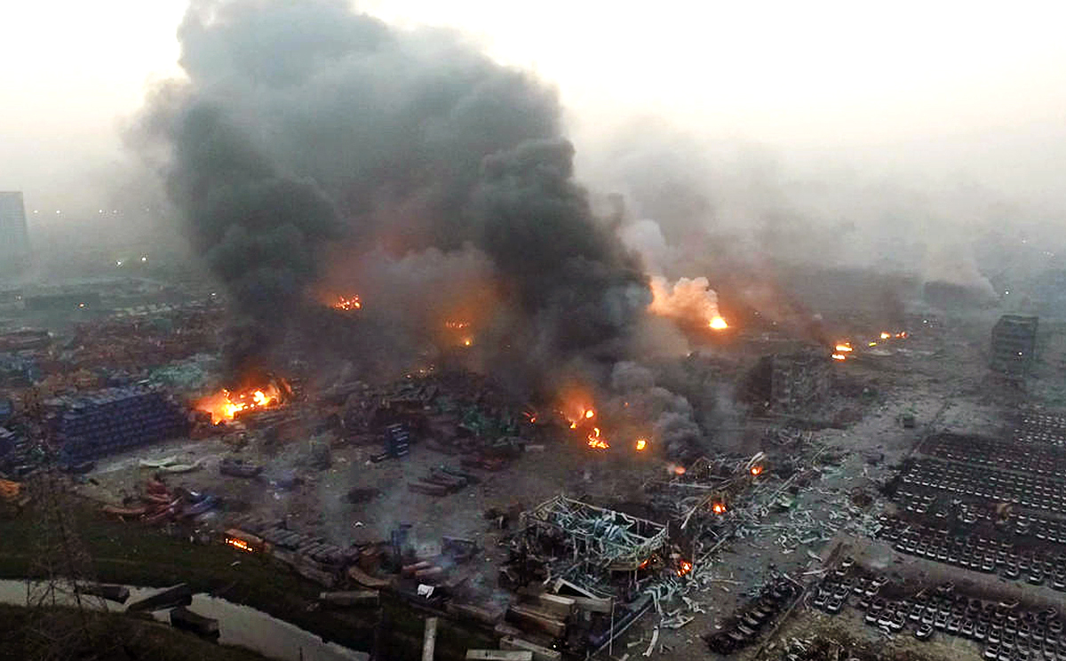
Port of Tianjin, 2015
https://www.nytimes.com/2015/08/21/world/asia/cyanide-levels-tianjin-china-explosion.html
http://www.radionacional.com.pe/sites/default/files/noticias/explosion%20tianjin.jpg

Slide 15
Top Five Chemicals Involved in Accidents with Injuries (2008)
Carbon monoxide (2,364 accidents): This colorless and odorless gas lurks silently and cause minor symptoms, such as headache and dizziness, or even sudden death. Many of the accidents in the CDC study involving CO happened at private homes. Of the five listed chemicals, CO had the highest rate of fatalities.
Ammonia (1,153): Ammonia can also cause sudden death. More than half of the accidents involving this colorless gas happened in agriculture, where it is applied directly on soil, and in food manufacturing plants, where it is used as a refrigerant.
Chlorine (783): Chlorine is a vital industrial chemical used to produce a wide range of products, including vinyl chlorine, plastics, aerosols, silicone, and foam. Most of the recorded injuries happened at paper and printing manufacturing facilities and at swimming pools.
Hydrochloric acid (326): Used to manufacture fertilizers, dyes and rubber, hydrochloric acid is highly corrosive to human skin. Most of the reports involving hydrochloric acid happened in warehousing and transportation.
Sulfuric acid (318): Another corrosive substance, sulfuric acid is used to make explosives, glue, other acids, and used to purify petroleum and in the pickling of metal. A high percentage of recorded incidents with sulfuric acid involved equipment failure.
https://www.chem.info/article/2016/06/top-5-chemicals-involved-injury-causing-accidents

Slide 16
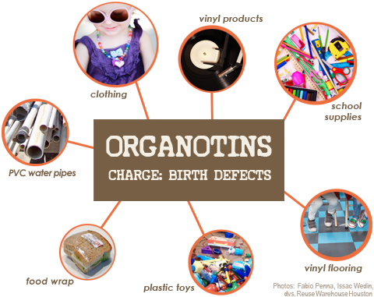
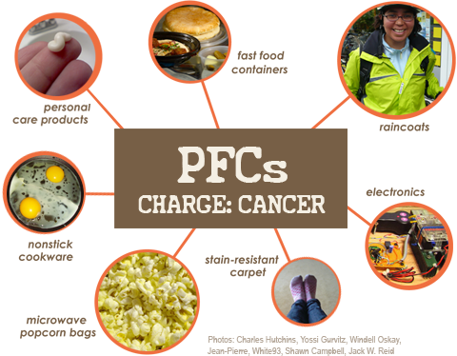
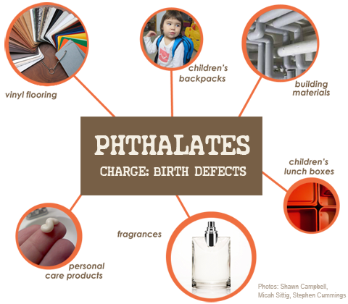
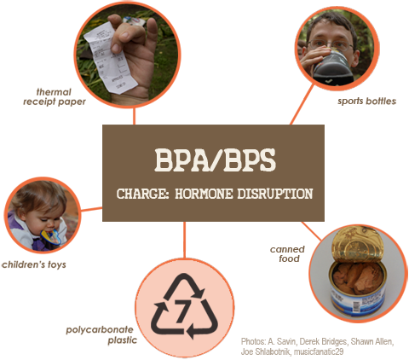
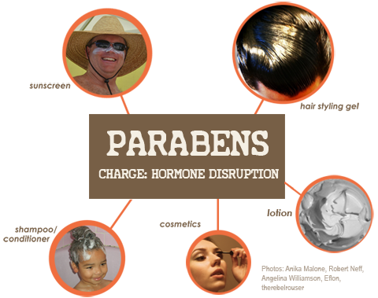
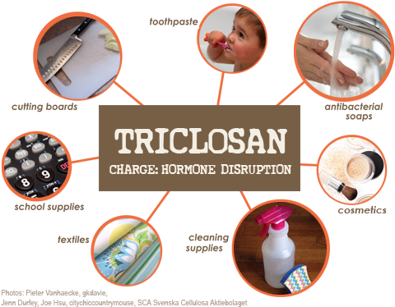
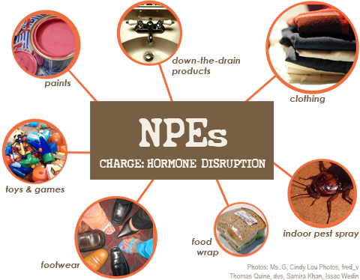
Consumer Products
Notes:
Organotin biocides, pesticides, PVC, obesity, immune damage: birth defects
Nonylphenol ethoxylates: household cleaners, drain cleaners, paints; ED, repro, birth defects, extreme aq tox
Triclosan: removed by FDA as a result of association with ED
Pesticides: kill bees, associated with Alziemers
Flame retardants: endocrine disruption
Preservatives in personal care products
Tricolosan: pesticide is found in products like toothpaste and cosmetics; endocrine disruption, learning disabilities, infertility
PFCs: stain-resistance, water-resistance; cancer, kidney disease
We can't escape them: even chemicals that are no longer manufactured are out there for good (eg PCBs) These chemicals migrate through the ecosystem through air/water and via global supply chains à 95% of Americans have synthetic chemicals used to make plastics and cosmetics in their blood (CDC).

Slide 17
Unintended Consequences – Industrial Era
Steffen et al. The trajectory of the Anthropocene: The Great Acceleration (Anthropocene Review) 16 January 2015. Design: Globaia

Slide 18
Unintended Consequences – Industrial Era
With an increasing population, the need for resources is even greater – which negatively impacts the environment.
Steffen et al. The trajectory of the Anthropocene: The Great Acceleration (Anthropocene Review) 16 January 2015. Design: Globaia

Slide 19
We’ve tried to fix some of these problems, but ended up doing the right thing in the wrong way.

Slide 20
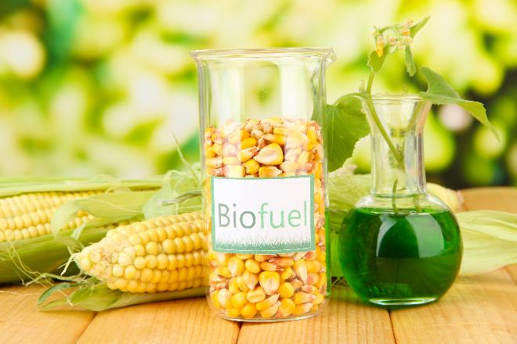
More Unintended Consequences
Biofuels made from corn that compete with food, livestock feed, and land use.
Image source: Adobe Stock
Notes:
Biofuels, specifically made from corn, an abundant vegetable, seems like a great idea. But when the corn needs land, fertilizers, water, and infrastructure for harvesting, then production of biofuel becomes unintended consequence.

Slide 21
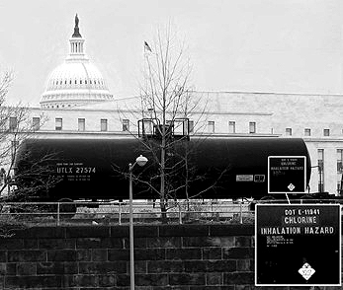
More Unintended Consequences
Purifying water with acutely lethal substances.
Chlorine transported in Washington D.C.
Image Source: http://jimdougherty.net/misc/
Notes:
Everyone should have an access to clean water. What if to get purified water, acutely lethal substances like chlorine are used?

Slide 22
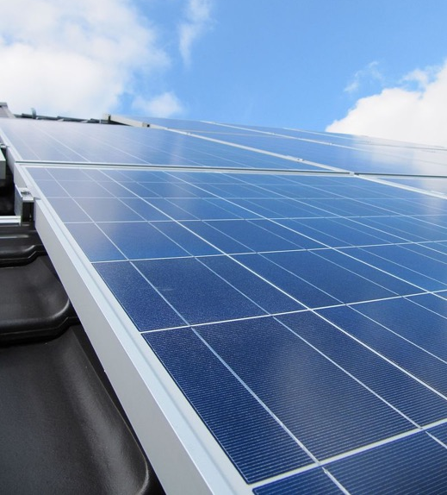
More Unintended Consequences
Renewable energy through the use of precious, rare, toxic metals in photovoltaics.
Solar panel installed on the roof of the building.
Image source: Wikipedia
Notes:
Energy which does not rely on petroleum but rather on solar can be a good thing. But what if the solar panel technology relies on rare earth and precious metals?

Slide 23
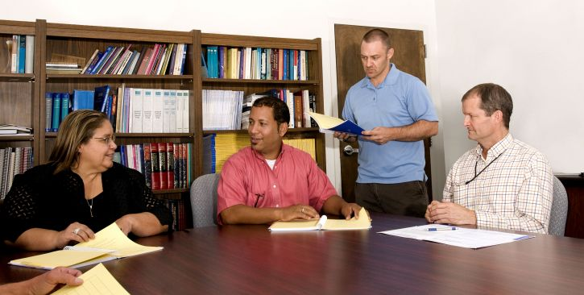
Why do Green Chemistry?
“It’s not my job…”
Image source: Pixnio, Author: Amanda Mills, USCDCP

Slide 24

Chefs
The meals I make are delicious!
Sure, they’re poisonous.
But there are other chefs working on “non-lethal cooking”.
Image source: Wikipedia, Author: MMS

Slide 25
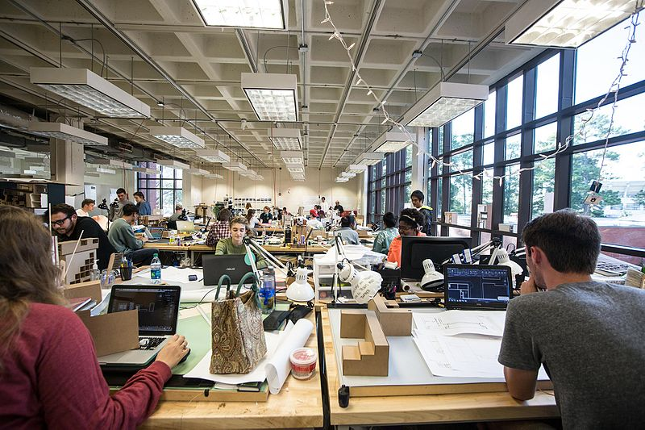
Architects
The homes I’ve built are luxurious and attractive.
Sure, they collapse and kill people on a regular basis.
But there are other builders who are working on “safe housing.”
Image source: Wikimedia Commons, Author: Auburn University College of Architecture, Design and Construction

Slide 26
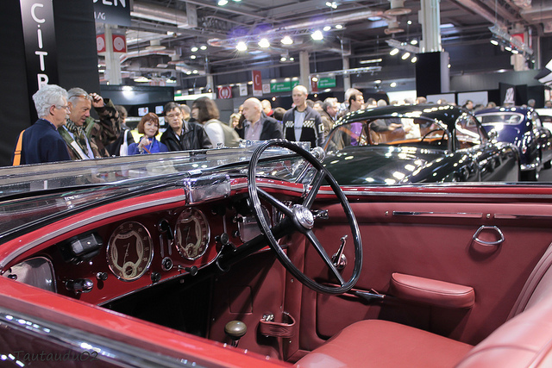
Car Designers
I build the fastest and most beautiful cars in the world.
Sure, they often fall apart and explode unexpectedly.
But there are other car designers working on “sustainable cars.”
Image source: Flickr, Author: Thomas Bersy

Slide 27
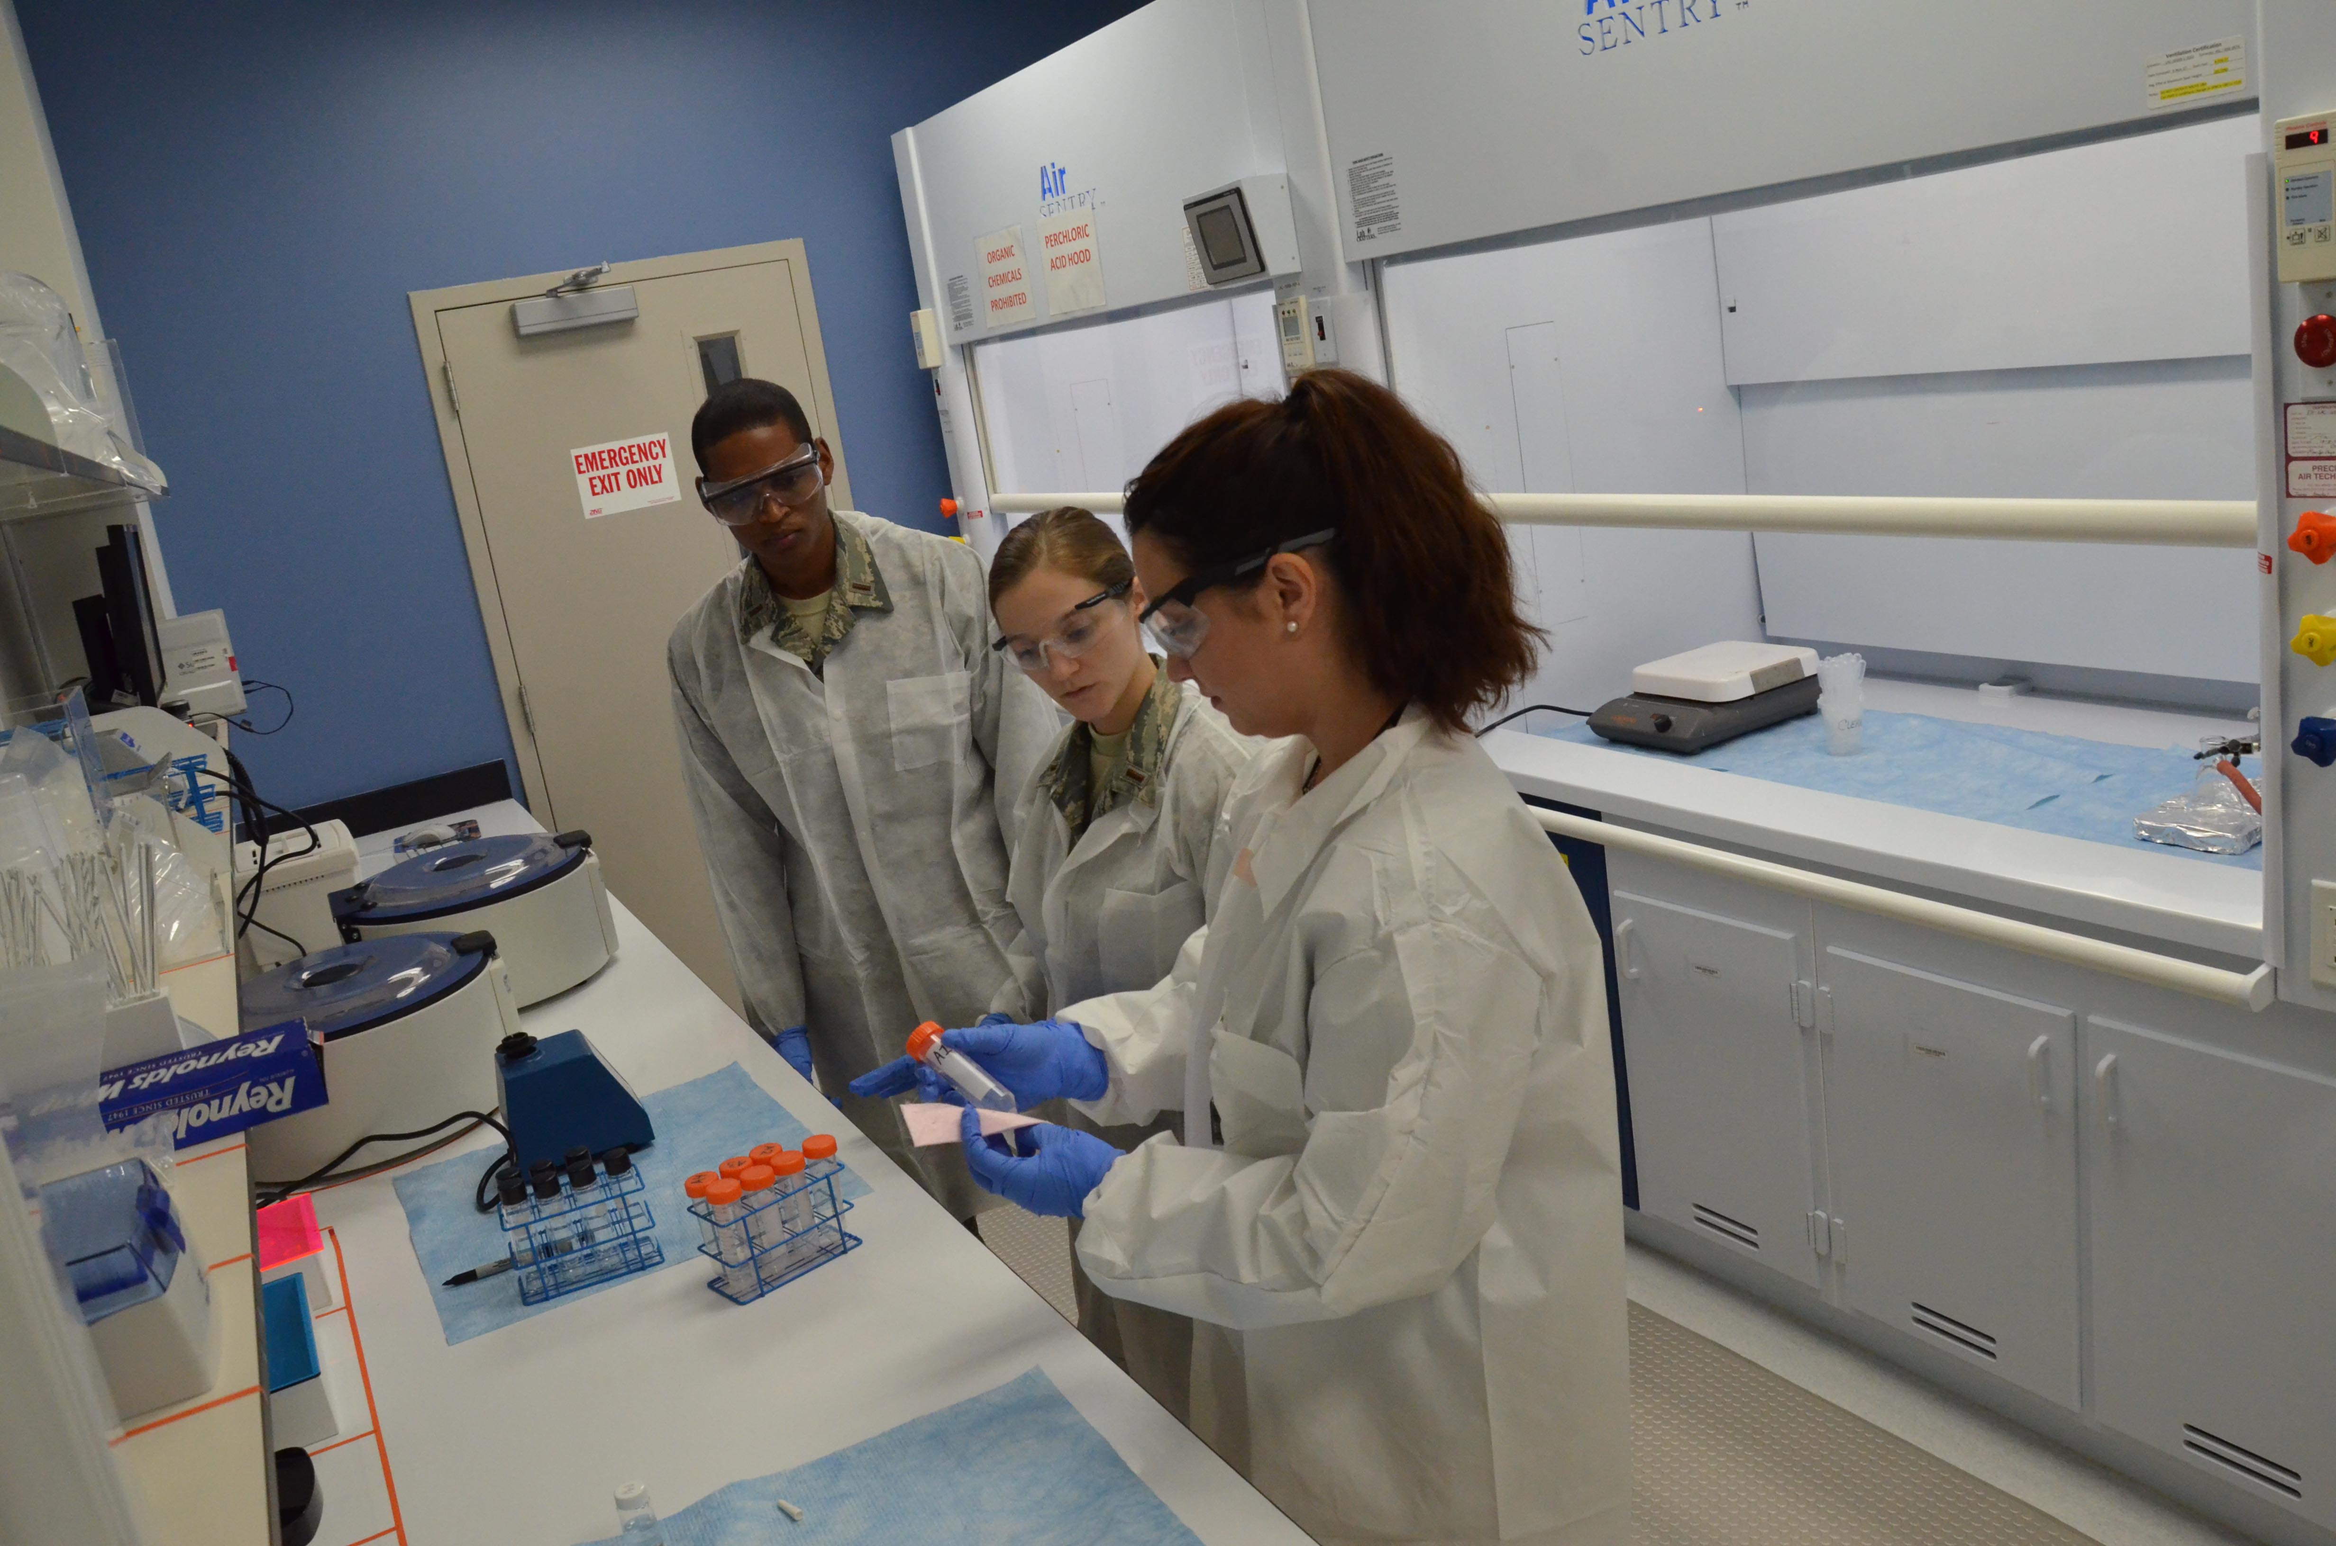
Chemists
I’ve developed some of the best methodologies and processes for making hundreds of target molecules.
Sure, they harm humans and the environment.
But there are other chemists working on “green chemistry”.
Image source: U.S. Air Force photo by Susan A. Romano

Slide 28
It’s Time for a New Perspective
We need to remember that fundamentally green chemistry is about redesigning the tools of our trade - the molecules, and the transformations, and the processes themselves.
The fact that even today the vast majority of chemists and chemical engineers are generally and fundamentally unaware of the inherent nature and the consequences of the molecules we use or make is an important condemnation of our chemistry community and an important challenge to us to ensure that it is changed.

Slide 29
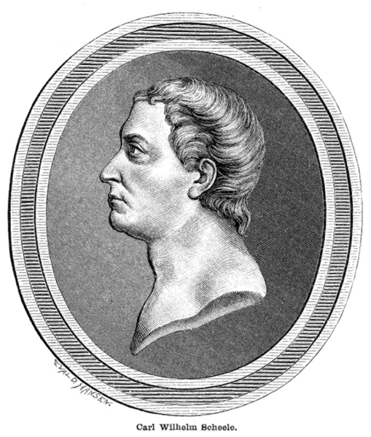
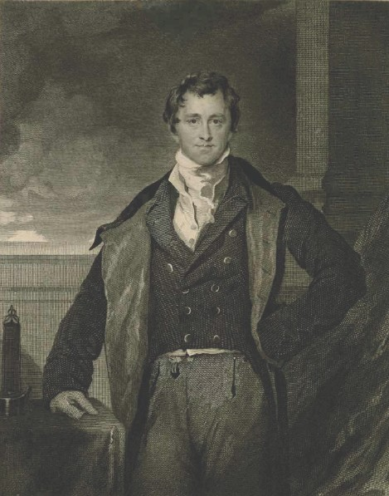
Carl Scheele and Humphry Davy
Carl Scheele - discoverer of fluorine, chlorine (credited to Humphrey Davy), manganese, barium, nitrogen and oxygen (credited to Priestly) - died from exposure to hydrocyanic acid.
Humphry Davy discovered a fifth of the elements known at the time. He died of overexposure to nitrous oxide.
Image source: Wikimedia Commons, Authors Unknown

Slide 30
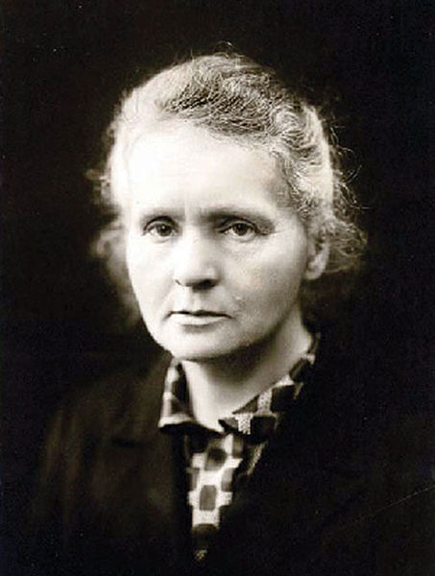
Madame Curie
Marie Curie, died of radiation induced leukemia a few years after receiving her Nobel Prize. Her lab notebooks from the 1890’s are still kept in lead-lined boxes and people must wear protective clothing in order to view them.
It wasn’t until 1938 (less than 100 years ago) that radioactive consumer products such as toothpaste and laxatives were banned from the market.
Image source: Wikimedia Commons, Author Unknown

Slide 31
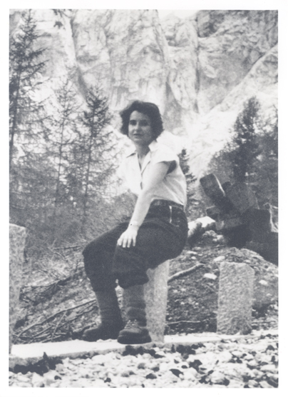
Rosalind Franklin
Rosalind Franklin - co-discoverer of the structure of DNA - died due to the tools of her research at the age of 37, four years before she could receive her Nobel Prize along with Watson and Crick.
Image source: The National Library of Medicine's Profiles in Science, Author Unknown, From the personal collection of Jenifer Glynn

Slide 32
These luminaries were not careless, thoughtless, or stupid.
They were just working in the context and perspectives of their time.
There didn’t yet exist an understanding of the molecular basis of hazard.

Slide 33
Impediments to Innovation
Why people are afraid of new ideas?
(Why are people afraid of green chemistry?)
People don't like to do things differently from the way they have done them before.
New ideas and new perspectives often face harsh opposition.

Slide 34
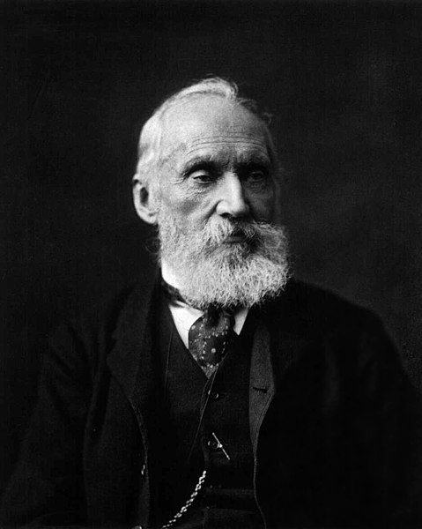
Lord Kelvin
Lord Kelvin - discoverer of the temperature scale named after him - insisted from his calculations that the Earth was only 24 million years old, long after Rutherford had demonstrated this to be false by using radio isotope dating.
Image source: Wikimedia Commons, Author: Photo by Messrs. Dickinson, London, New Bond Street

Slide 35
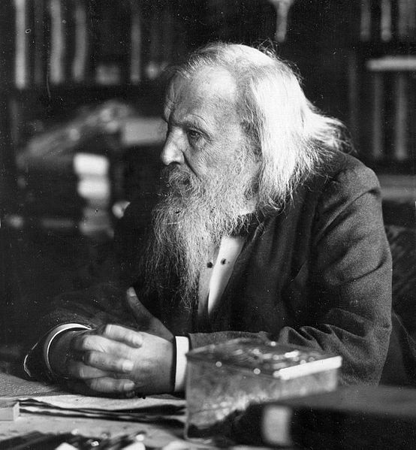
Dmitri Mendeleev
Mendeleev, inventor of the periodic table, refused to acknowledge the existence of radiation - or even of the electron.
Image source: Wikimedia Commons, Author Unknown

Slide 36
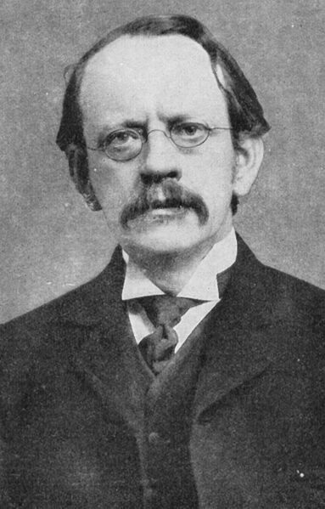
J.J. Thompson
J.J. Thompson is quoted famously in defense of "ether" as “it is as essential to our lives as the air we breathe”
(long after it was disproven)
Image source: Wikimedia Commons, Author Unknown

Slide 37
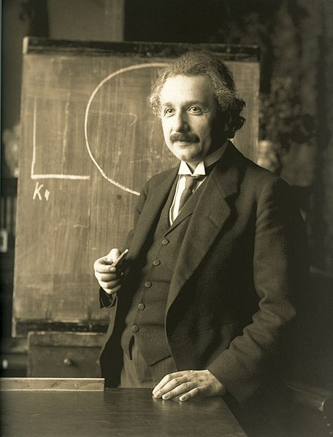
Albert Einstein
Einstein's rejection of quantum mechanics “God does not play dice with the universe” is legendary.
Image source: Wikimedia Commons, Author: Ferdinand Schmutzer

Slide 38
Leadership
These cases are not meant to ridicule or demean the great scientists of the past. Exactly to the contrary. Many of them were geniuses and all of them dramatically moved science forward.
The point is that leaders in scientific thought - even those who have had great breakthroughs - do not necessarily recognize the next generation of new and innovative ideas.

Slide 39

Because it leads to CHANGE
Why is Working Toward Green Chemistry Important?
Image source: https://earthobservatory.nasa.gov/Features/OrbitsCatalog/page2.php

Slide 40
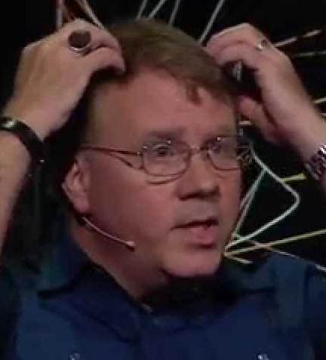
What is Green Chemistry?
John Warner
“Green Chemistry is a revolutionary approach to the way that products are made; it is a science that aims to reduce or eliminate the use and/or generation of hazardous substances in the design phase of materials development”
– John Warner, Co-Founder of Green Chemistry

Slide 41
How Do We Proceed From Here?
With brilliance and optimism
Science and technology have risen to the challenge and we have the creativity and capability to do it again.

Slide 42
How Do We Proceed From Here?
Responsibly
With power comes responsibility. With all the knowledge, perspective, and training you acquire, you also have acquired the ability to impact others – to impact the world. Once you have the power to impact the world, you have the responsibility to impact it for the better.

Slide 43
How Do We Proceed From Here?
With conviction, courage, and commitment
  Green Chemistry and Green Engineering
  Because we can.
  Because we must.

Slide 44
Topics Covered
Chemical and Industrial Accidents
  Union Carbide, 1984
  Cuyahoga River, 1969
  Port of Tianjin, 2015
Unintended Consequences
Green Chemistry is Everybody’s Job
Perspective and Context
Green Chemistry – Where do we go from here?

Slide 45
Sponsored by Yale-UNIDO Initiative
QUESTIONS?
CENTER for GREEN CHEMISTRY
and GREEN ENGINEERING at YALE

