Slide 1

Yale-UNIDO Train-the-Facilitator Workshop in Green Chemistry
Circular Bioeconomy
CENTER for GREEN CHEMISTRY
and GREEN ENGINEERING at YALE

Slide 2


John C. Warner
The Mechanisms to Achieve
a Circular Bioeconomy
President and CTO
warnerbabcock institute for green chemistry
john.warner@warnerbabcock.com
Distinguished Professor of Green Chemistry
Monash University – School of Chemistry
John.Warner@Monash.edu
Cofounder
beyondbenign green chemistry education
john@beyondbenign.org
ENVR E-158A Green Chemistry
Harvard Extension School
JohnWarner@FAS.Harvard.Edu
@johnwarnerorg

Slide 3
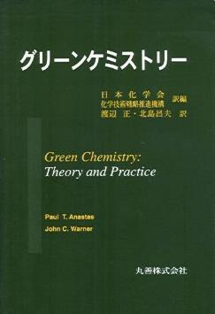
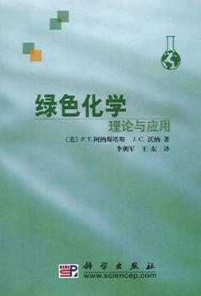
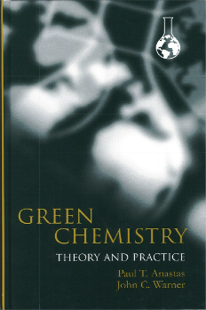
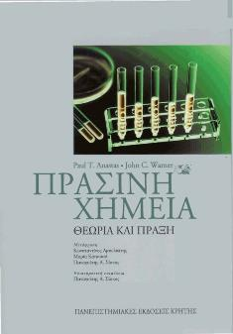
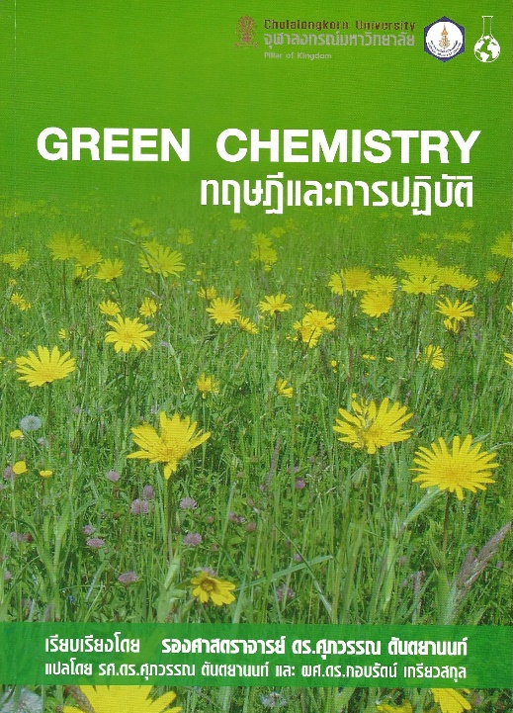
Green Chemistry
is the design of chemical products and processes that reduce or eliminate the use and/or generation of hazardous substances.

Slide 4
The Twelve Principles of Green Chemistry
1. Prevention. It is better to prevent waste than to treat or clean up waste after it is formed.
2. Atom Economy. Synthetic methods should be designed to maximize the incorporation of all materials used in the process into the final product.
3. Less Hazardous Chemical Synthesis. Whenever practicable, synthetic methodologies should be designed to use and generate substances that possess little or no toxicity to human health and the environment.
4. Designing Safer Chemicals. Chemical products should be designed to preserve efficacy of the function while reducing toxicity.
5. Safer Solvents and Auxiliaries. The use of auxiliary substances (solvents, separation agents, etc.) should be made unnecessary whenever possible and, when used, innocuous.
6. Design for Energy Efficiency. Energy requirements should be recognized for their environmental and economic impacts and should be minimized. Synthetic methods should be conducted at ambient temperature and pressure.
7. Use of Renewable Feedstocks. A raw material or feedstock should be renewable rather than depleting whenever technically and economically practical.
8. Reduce Derivatives. Unnecessary derivatization (blocking group, protection/deprotection, temporary modification of physical/chemical processes) should be avoided whenever possible .
9. Catalysis. Catalytic reagents (as selective as possible) are superior to stoichiometric reagents.
10. Design for Degradation. Chemical products should be designed so that at the end of their function they do not persist in the environment and instead break down into innocuous degradation products.
11. Real-time Analysis for Pollution Prevention. Analytical methodologies need to be further developed to allow for real-time in-process monitoring and control prior to the formation of hazardous substances.
12. Inherently Safer Chemistry for Accident Prevention. Substance and the form of a substance used in a chemical process should be chosen to minimize the potential for chemical accidents, including releases, explosions, and fires.

Slide 5
Green Chemistry
More environmentally
benign than alternatives
Perform better
than alternatives
More economical
than alternatives

Slide 6
Green Chemistry
Safety
Green
Chemistry
Performance
Cost

Slide 7

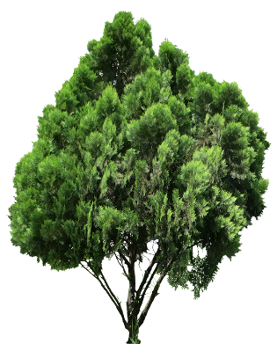


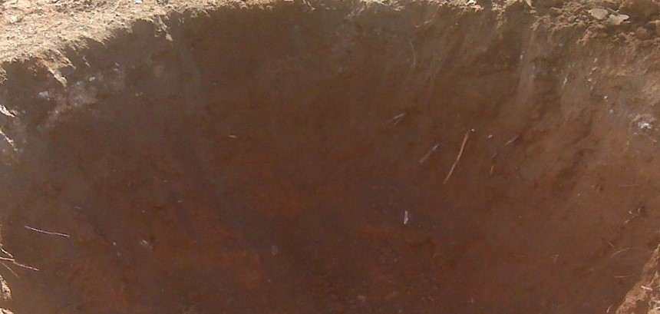

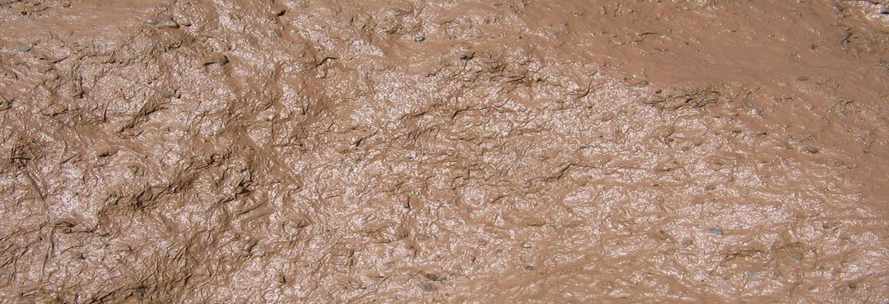
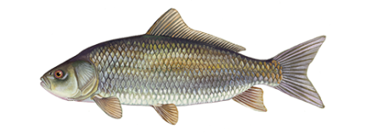

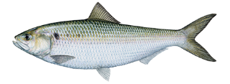

Slide 8
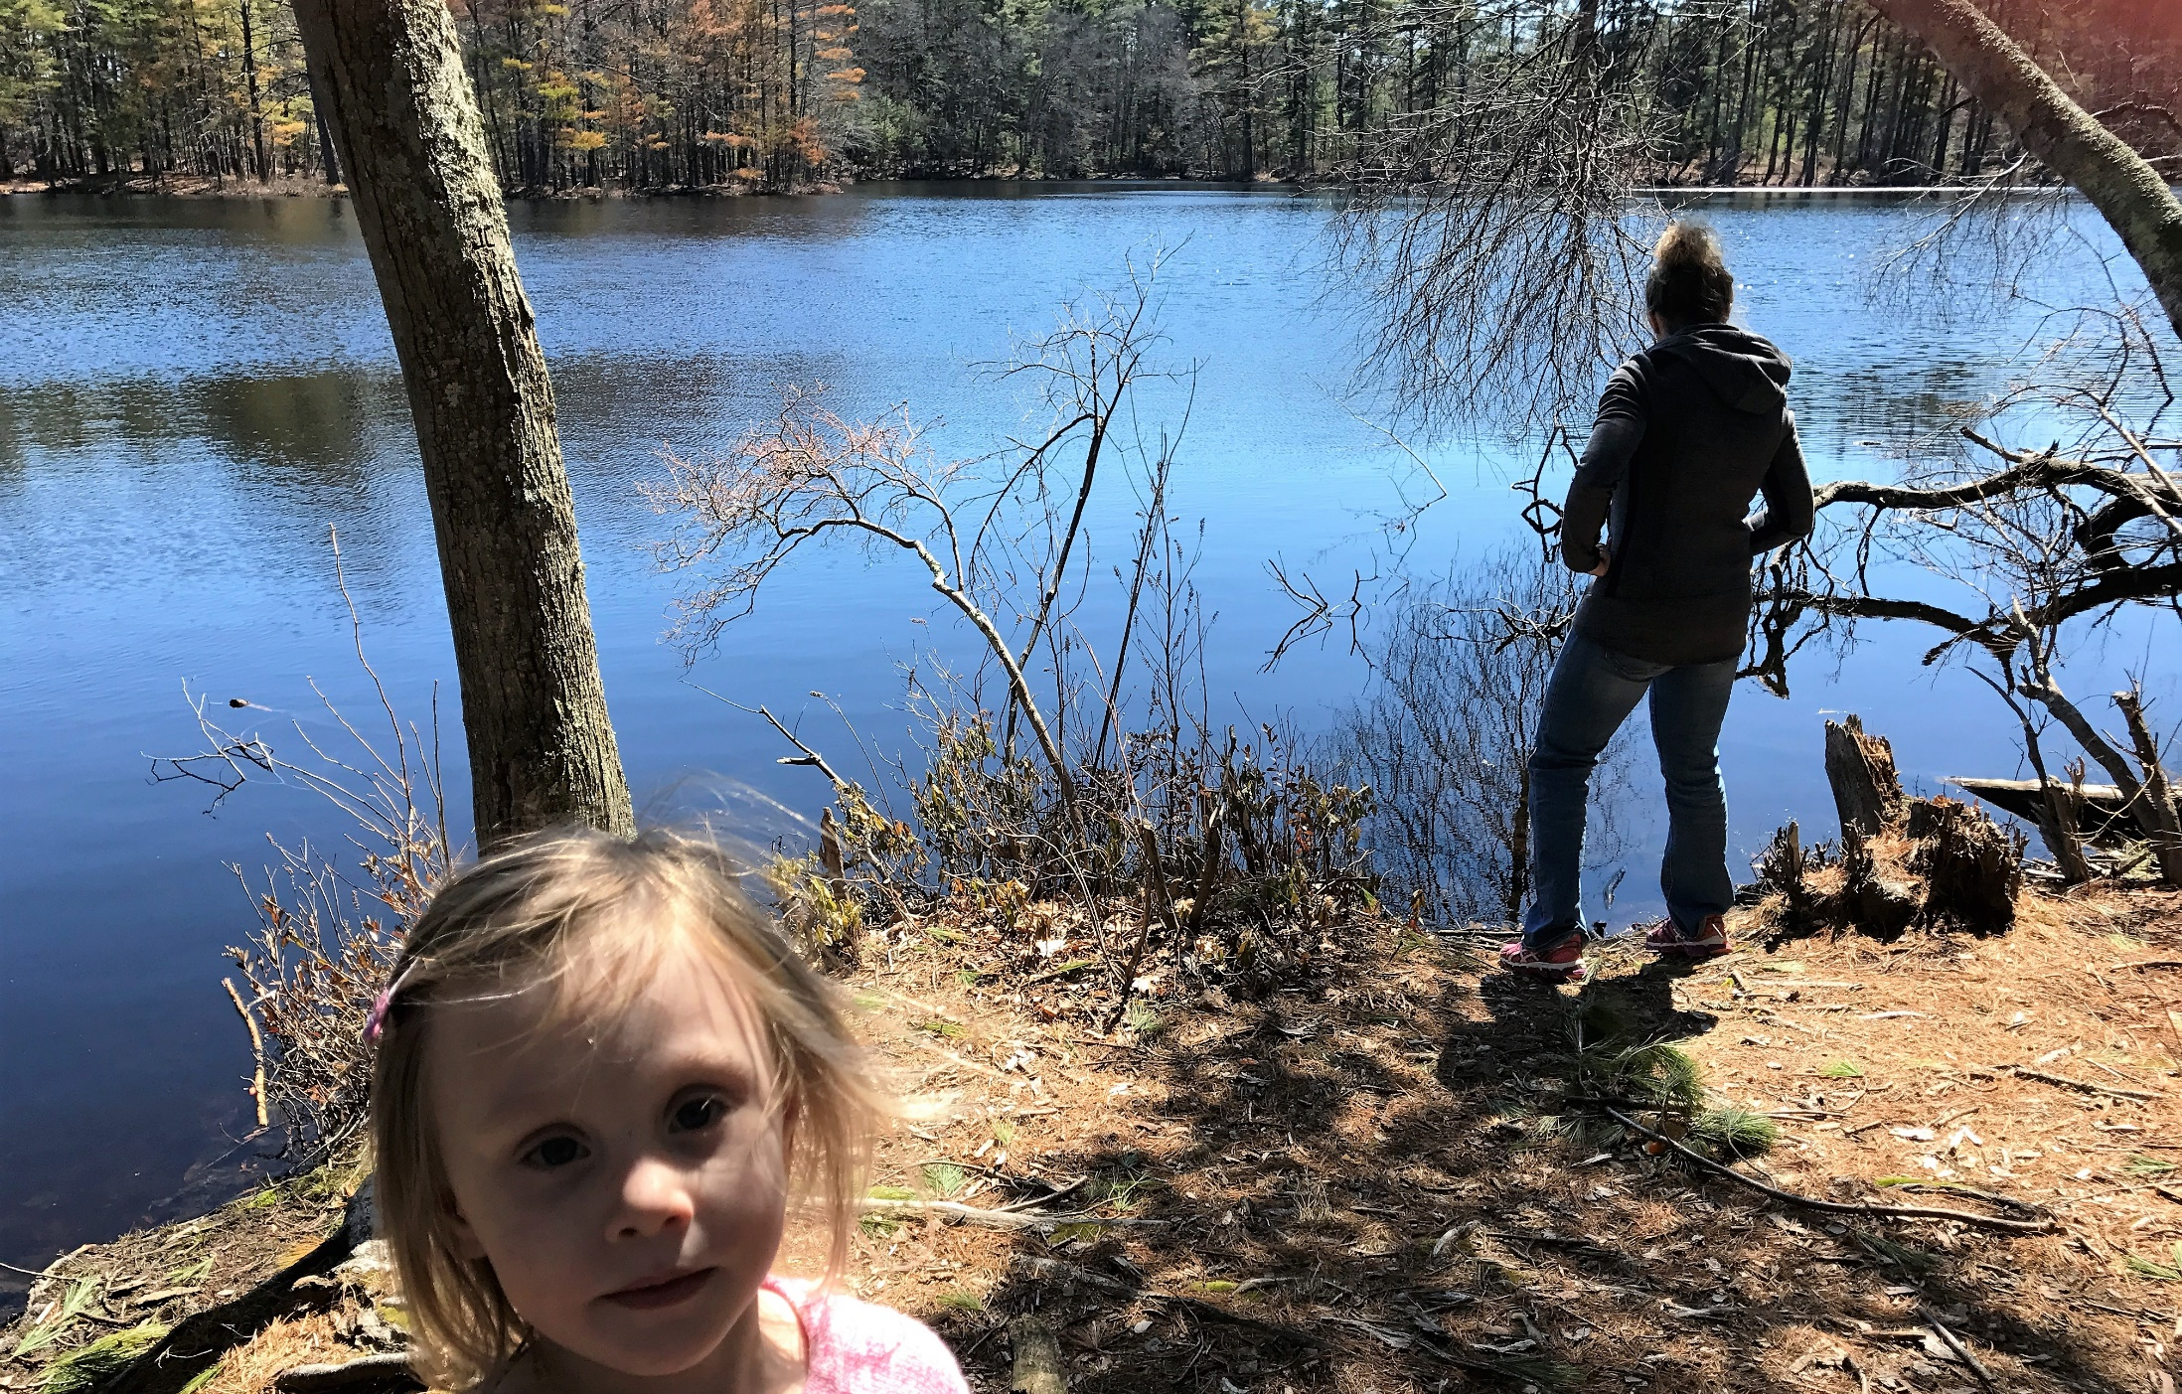

Slide 9
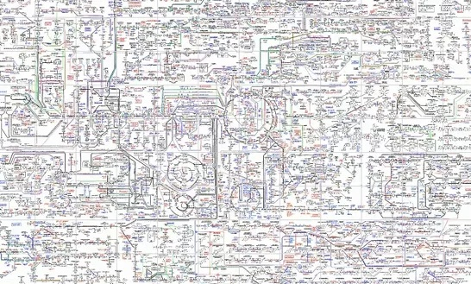

Slide 10
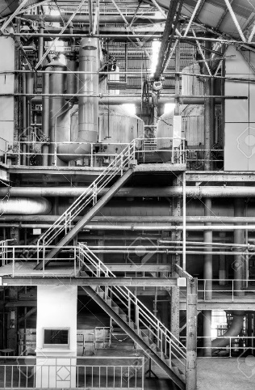
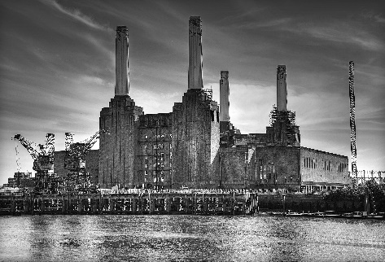
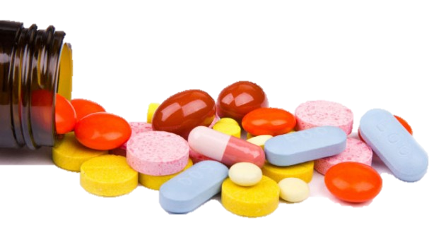
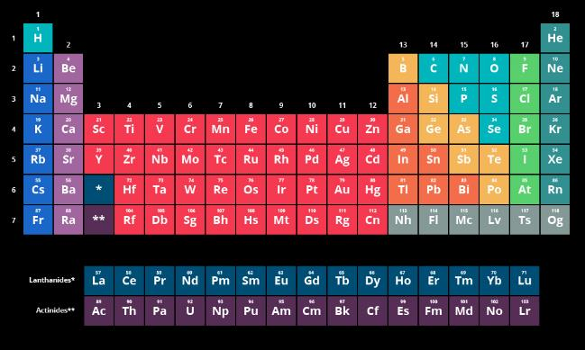


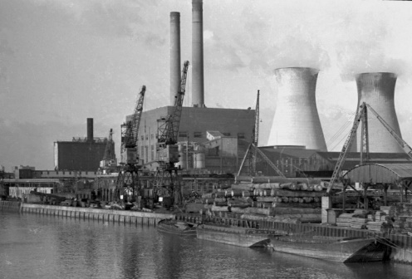
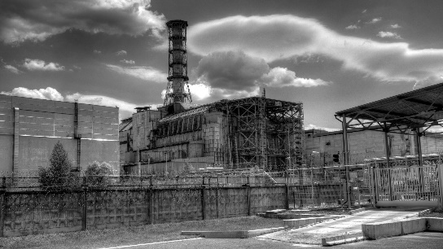


Slide 11
Invention?
Use
Collection
Natural
Resources
Distribution
Manufacturing

Slide 12
Commercialization
Basic
Research
Use
Collection
Scale Up
Natural
Resources
Distribution
Manufacturing
Applied
Research
Development

Slide 13
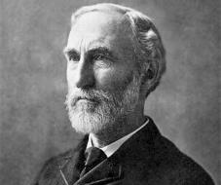
Enthalpy and Entropy
“The greatest mind in
American History”
– Albert Einstein
Josiah Willard Gibbs
February 11, 1839 – April 28,1903
ΔG
=
ΔH
-
ΤΔS
Gibbs Free Energy
Enthalpy
Entropy

Slide 14

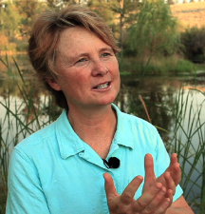
Molecular Biomimicry
Janine Benyus
ΔG
=
ΔH
-
ΤΔS
Gibbs Free Energy
Enthalpy
Entropy
Human’s Bias
Nature’s Bias

Slide 15
Molecular Mechanisms of Sustainable/Circular Materials
1. Equilibrium Discontinuities
2. Collaborative Structures
3. Pre-associative Reactivity
4. Synchronous Orthogonal Mechanisms
5. Resilience and Molecular Diversity

Slide 16
Molecular Mechanisms of Sustainable/Circular Materials
1. Equilibrium Discontinuities
2. Collaborative Structures
3. Pre-associative Reactivity
4. Synchronous Orthogonal Mechanisms
5. Resilience and Molecular Diversity

Slide 17
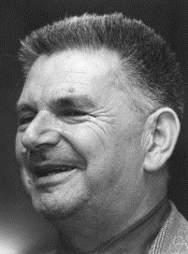
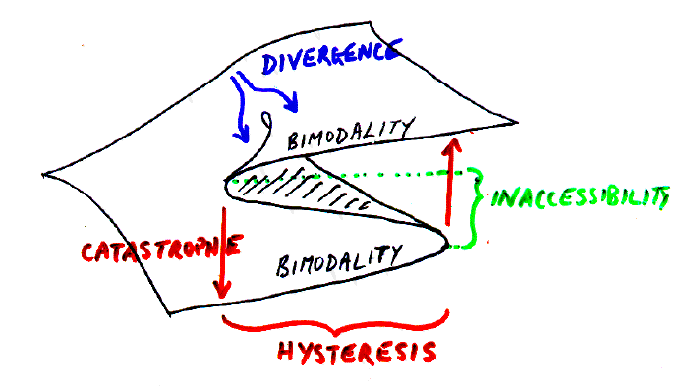
Equilibrium Discontinuities
Rene Thom
September 2, 1923 – October 25, 2002
Catastrophe Theory

Slide 18
Equilibrium Discontinuities

Slide 19
Equilibrium Discontinuities

Slide 20
Equilibrium Discontinuities

Slide 21
Equilibrium Discontinuities
Product Stability
Response
Product Perfomance
Shelf life stability
Input

Slide 22
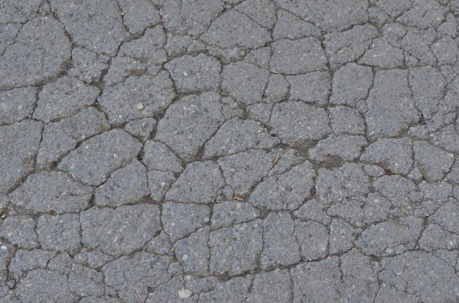



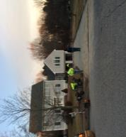
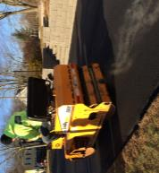
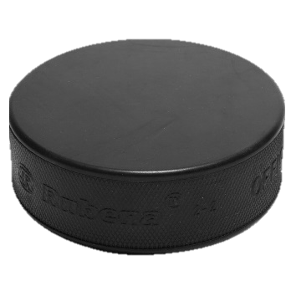



Construction Materials: Asphalt Paving
Monday, November 25, 2013
17ºF (-8ºC)
70% Recycled Material
Novel asphalt binder additive compositions and methods of use. Warner, John C.; Muollo, Laura Rose; Walker, Rowan Lewis; Bianchini, Jason R., Priority Date: November 11, 2013, US 2018/0257985.
Asphalt binder additive compositions and related methods. Warner, John C.; Muollo, Laura Rose; Walker, Rowan Lewis; Bianchini, Jason R., Priority Date: November 11, 2013, US 9,994,485, WO 2015/070180, EP 3107958, JP 2016537497.
Delta-S

Slide 23


Hair and Fabric Shaping and Toning
“Photoreactive Polymers and Devices for use in Hair Treatments” Warner, John C.; Cannon, Amy S.; Raudys, Jennifer;
Undurti, Arundhati; PCT Int. Appl. WO 2004058187. Filed December 22, 2003. Published December 23, 2004. CA 2510162.
Filed December 22, 2003. Published July 15, 2004. EP 1575537. Filed December 22, 2003. Published September 21, 2005.
“Photoinduced Copolymer Functionalized Substrates” Warner, John C.; Cannon, Amy S.; Dye, Kevin PCT Int. Appl.
WO 2007139810. Filed May 23, 2007. Published December 6, 2007.

Slide 24
Molecular Mechanisms of Sustainable/Circular Materials
1. Equilibrium Discontinuities
2. Collaborative Structures
3. Pre-associative Reactivity
4. Synchronous Orthogonal Mechanisms
5. Resilience and Molecular Diversity

Slide 25

Collaborative Structures
I am good
at math!
Take workshops!
Get better at what
you don’t do well!
Collaborate!
Do more of what
you love to do!
I am good at
communication!

Slide 26

Collaborative Structures

Slide 27
Collaborative Structures

Slide 28
Collaborative Structures
Surroundings
Molecule
Molecule
Molecule
Molecule
Molecule
Surroundings

Slide 29
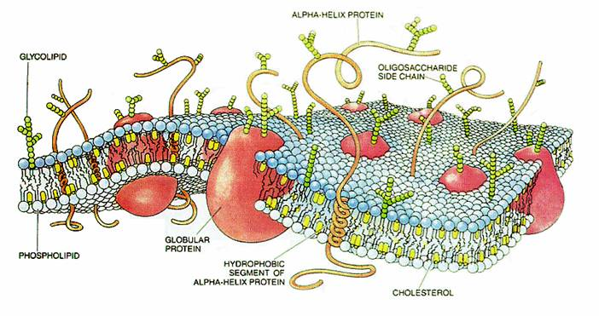
Collaborative Structures

Slide 30
Collaborative Structures
Surroundings
Auxiliary
Auxiliary
Molecule
Molecule
Molecule
Auxiliary
Auxiliary
Molecule
Molecule
Auxiliary
Auxiliary
Surroundings

Slide 31


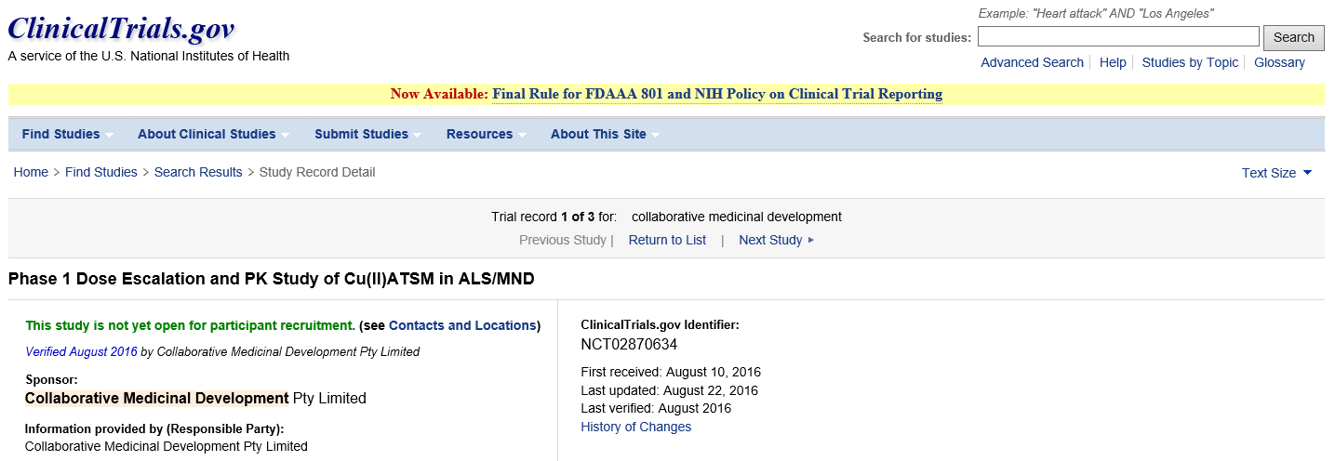
Parkinson’s/ALS Disease Therapeutic
Increased
Bioavailability
NCD
Cu ATSM
Metal complexes and methods of treatment. Warner, John C.; Cheruku, Srinivasa R.; Hari, Anitha; Norman, James J., Priority Date: November 11, 2013, US 2016/0271175, WO 2015/070177, EP 3068762, CA 2930290, CN 105899519.

Slide 32
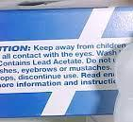

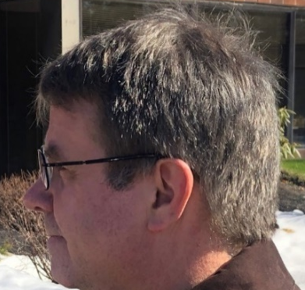









Hair Color Restoration
Tyrosinase
Tyrosinase
Formulation and processes for hair coloring, continuation. Warner, John C.; Muollo, Laura; Stewart, Amie, Priority Date: October 14, 2013, US 9,522,102.
Formulation and processes for hair coloring. Warner, John C.; Muollo, Laura; Stewart, Amie, Priority Date: October 14, 2013, US 8,828,100, WO 2015/057254, EP 3057561, JP 2016533376, KR 20160068958, CN 105792797.

Slide 33
Molecular Mechanisms of Sustainable/Circular Materials
1. Equilibrium Discontinuities
2. Collaborative Structures
3. Pre-associative Reactivity
4. Synchronous Orthogonal Mechanisms
5. Resilience and Molecular Diversity

Slide 34
Pre-associative Reactivity
For over 180 years
of “Modern Chemistry”…
But Nature…
Heat things under high temperature
Runs reactions at “room” temperature
Apply high pressures
Runs reactions at ambient pressure
Use organic solvents
Uses water as a solvent

Slide 35
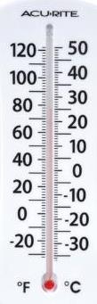
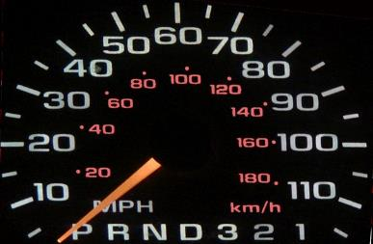
Pre-associative Reactivity
A thermometer is a
molecular speedometer…

Slide 36
Pre-associative Reactivity

Slide 37
Pre-associative Reactivity
There is almost never a reactive collision in Nature!

Slide 38
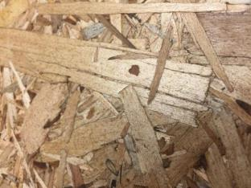
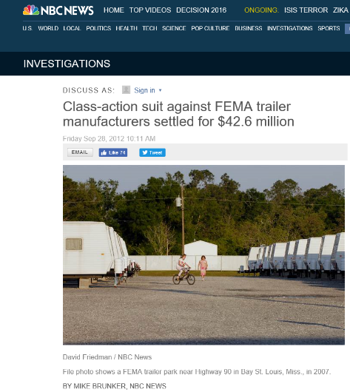

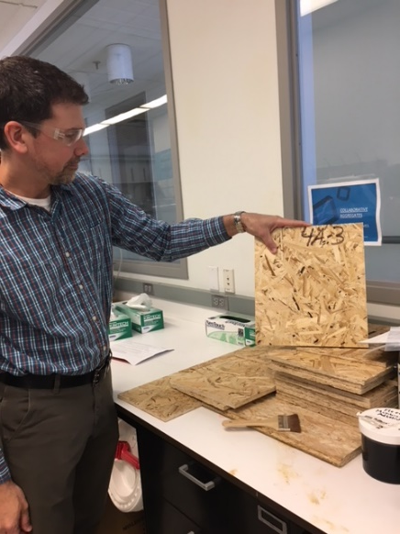
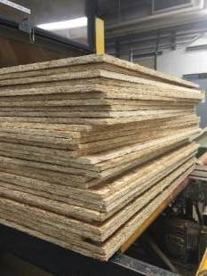
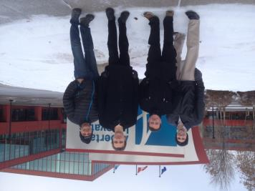

Low Temperature Formaldehyde Free Wood Composites
“Lignocellulosic Compositions and Methods of Making Same” Warner, John C.; Whitfield, Justin R.; Gladding, Jeffery A.; Allen, Richard M., US Patent Filed May 26, 2015
Lignocellulosic composites and methods of making same. Warner, John C.; Whitfield, Justin R.; Gladding, Jeffery A.; Allen, Richard M., Priority Date: May 26, 2016, US 2018/0147824. WO 2016/191521, EP 3302969, CA 2986427, JP 2018516784.

Slide 39
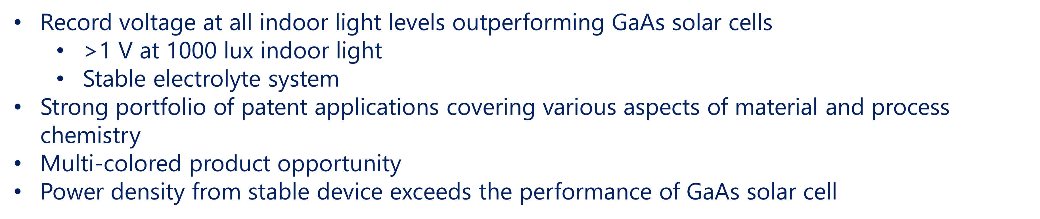
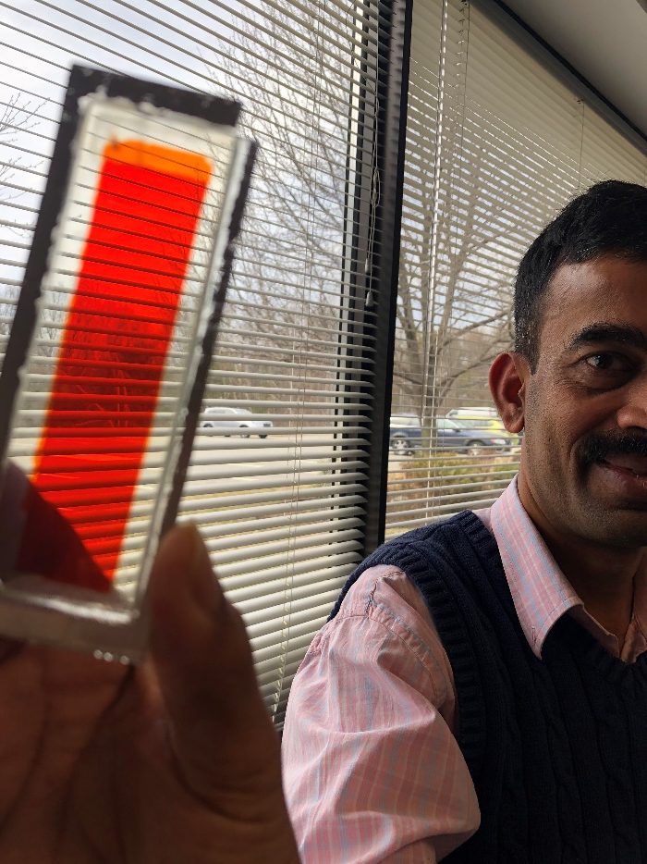
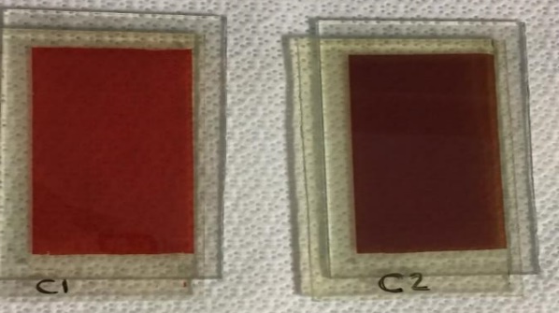
High Performance, Printable, Copper Based Solar Cells
Solar cell dyes for copper redox based dye sensitized solar cells and combinations thereof. Warner, John C. et al., Priority Date: July 10, 2018, US Provisional 62/696,010.
Copper redox based dye sensitized solar cells. Warner, John C. et al., Priority Date: September 21, 2018, US Provisional 62/734,511.
Stilbene and fused stilbene derivatives as solar cell dyes. Warner, John C. Priority Date: May 9, 2017. US Provisional 62/503,645, WO 2018/208712.

Slide 40
Molecular Mechanisms of Sustainable/Circular Materials
1. Equilibrium Discontinuities
2. Collaborative Structures
3. Pre-associative Reactivity
4. Synchronous Orthogonal Mechanisms
5. Resilience and Molecular Diversity

Slide 41




Synchronous Orthogonal Mechanisms

Slide 42

Synchronous Orthogonal Mechanisms

Slide 43
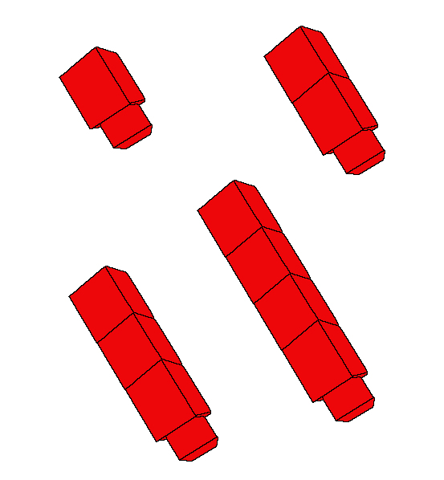

Synchronous Orthogonal Mechanisms

Slide 44
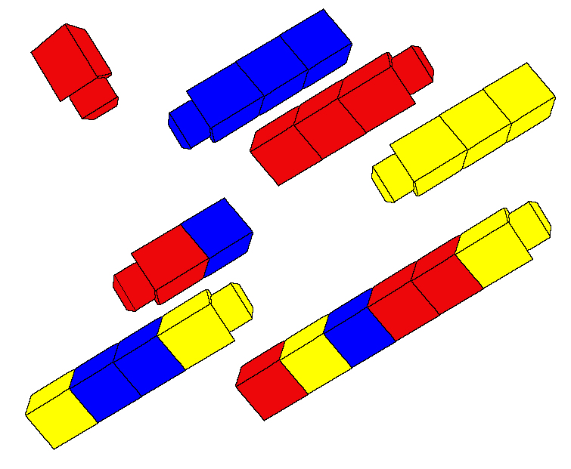
Synchronous Orthogonal Mechanisms

Slide 45
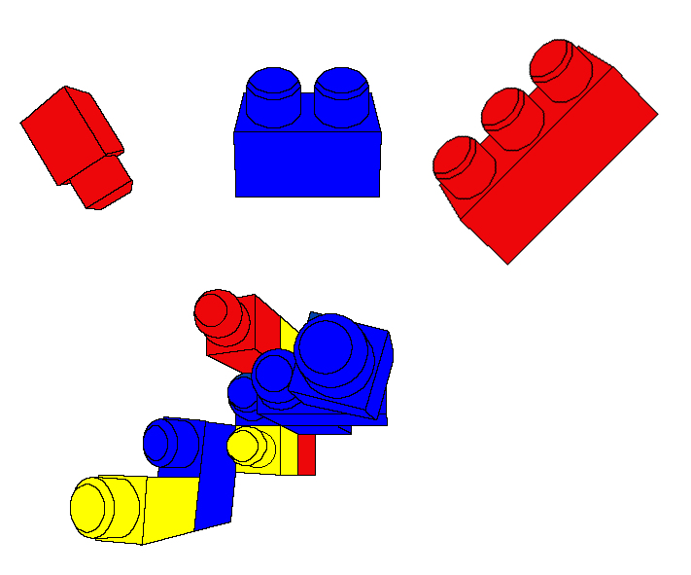
Synchronous Orthogonal Mechanisms
The introduction of a NEW building
block is a game changer.

Slide 46
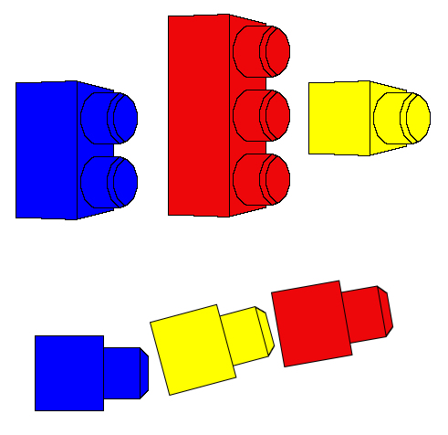
Synchronous Orthogonal Mechanisms
These are not reversible
This is Reversible
Designed for Disassembly!

Slide 47
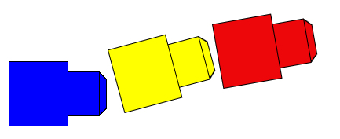

Synchronous Orthogonal Mechanisms
But if these building blocks are at the molecular level…

Slide 48
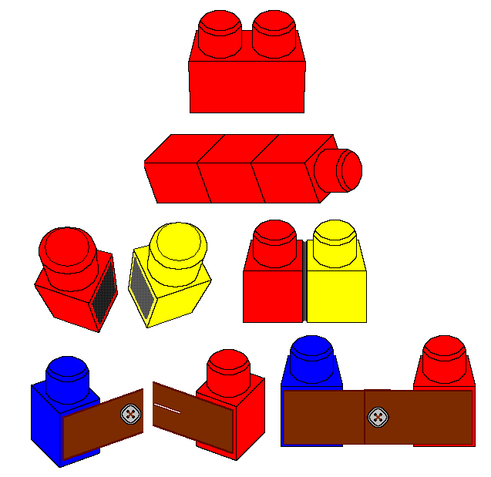
Synchronous Orthogonal Mechanisms
Permanent
Reversible
“Snap”
Reversible
“Velcro”
Reversible
“Button”

Slide 49
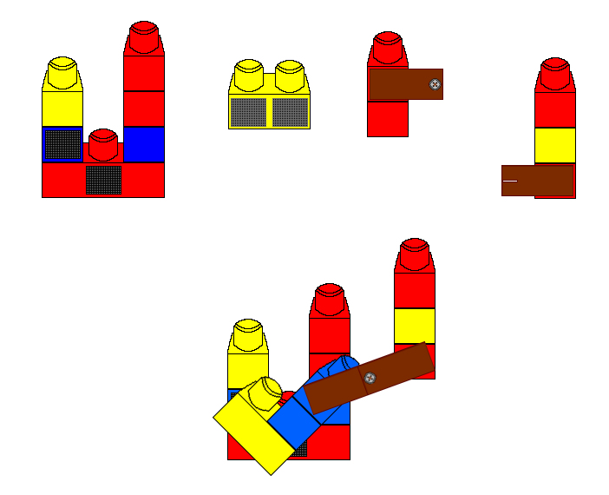
Synchronous Orthogonal Mechanisms

Slide 50

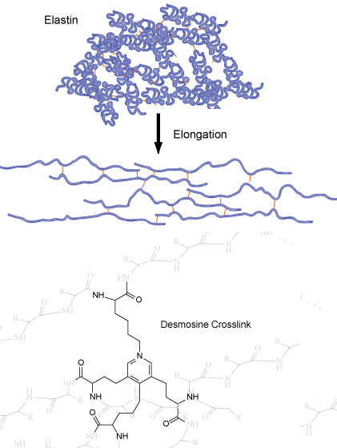

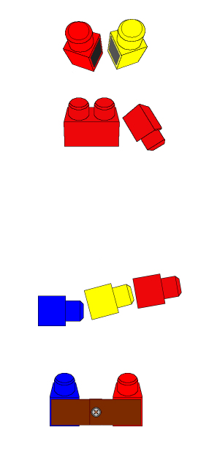
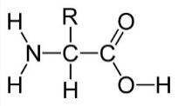

Synchronous Orthogonal Mechanisms
Elastin

Slide 51


BPA Free Can Lining
Bisphenol-A free crosslinked polymer compositions. Warner, John C.; Whitfield, Justin; Kearney, Frederick R.; Gladding, Jeffrey; Hari, Anitha, Priority Date: June 27, 2016. US Provisional 62/355,074, WO 2018/005430.

Slide 52




Photo Osmotic Desalination
Reversibly switchable surfactants and methods of extracting natural products, coating surfaces, cleaning laundry, and osmotic extraction using same. Warner, John C.; Cheruku, Srinivasa, Priority Date: June 23, 2016. US Provisional 62/353,805, WO 2017/223413.

Slide 53
Molecular Mechanisms of Sustainable/Circular Materials
1. Equilibrium Discontinuities
2. Collaborative Structures
3. Pre-associative Reactivity
4. Synchronous Orthogonal Mechanisms
5. Resilience and Molecular Diversity

Slide 54
Resilience and Molecular Diversity
Biomaterials [Carbohydrates, Proteins, Lipids]
Highly Functionalized Molecules
Petroleum Products [Hydrocarbons]
Singly Functionalized Compounds [Olefins, Alkylchlorides]
Highly Functionalized Molecules

Slide 55
Resilience and Molecular Diversity

Slide 56
Resilience and Molecular Diversity
Biomaterials [Carbohydrates, Proteins, Lipids]
Highly Functionalized Molecules
Petroleum Products [Hydrocarbons]
Singly Functionalized Compounds [Olefins, Alkylchlorides]
Highly Functionalized Molecules

Slide 57
Resilience and Molecular Diversity
?
Why is this so hard?

Slide 58
Resilience and Molecular Diversity
Biobased materials are easily synthesized…
…but extremely difficult (expensive) to purify

Slide 59

Resilience and Molecular Diversity

Slide 60
Resilience and Molecular Diversity
Designing systems based on high purity is a trap!
Locking the system into narrow and
demanding process conditions.
Nature doesn’t do this.
Nature designs using molecular diversity.

Slide 61

Resilience and Molecular Diversity
“Fluid Cell
Membranes”

Slide 62
Resilience and Molecular Diversity
A biobased process that creates a product with a
diversity of components can be valued in its mixed form.
As long as the process is reproducible at commercial scale.
By valuing the unique diversity of a biobased process:
Your manufacturing is cost effective.
Your product has a higher value than the synthetic counterparts

Slide 63










Ocean Plastics Recycling and Reclamation
June 29, 2015
http://www.parley.tv/updates/2015/7/3/adidas-x-parley
https://www.maritime-executive.com/article/adidas-uses-ocean-plastic-in-shoe
https://solecollector.com/news/2015/07/parley-adidas-ultra-boost-recycled-ocean-gillnet

Slide 64



Electronics Recycling and Reclamation
LiCoO₂
Method for the recovery of lithium cobalt oxide from lithium ion batteries. Poe, Sarah L.; Paradise, Christopher L.; Muollo, Laura R.; Pal, Reshma; Warner, John C.; Korzenski, Michael B., Priority Date: June 21, 2011, US 9,972,830, WO 2012/77620, EP 2724413, JP 2014526953, KR 20140039302, CN 103620861.

Slide 65
Molecular Mechanisms of Sustainable/Circular Materials
1. Equilibrium Discontinuities
2. Collaborative Structures
3. Pre-associative Reactivity
4. Synchronous Orthogonal Mechanisms
5. Resilience and Molecular Diversity

Slide 66


warnerbabcock.com
beyondbenign.org
johnwarner.org
in
John.Warner@WarnerBabcock.com
t
@JohnWarnerOrg

