Slide 1
Catalysis
Designing future catalysts to be more benign
Lecture #15
Date:
Course #

Slide 2
Outline
What is Catalysis?
Why its important and improves performance
Categories of Catalysis
  Homogeneous vs. Heterogeneous
Greener Alternatives for Catalysis
Current Trends for the Next Generation of Catalysts
Additional applications for catalysts

Slide 3
UNIDO Catalysis Video
https://www.youtube.com/watch?time_continue=3&v=p2_A3EBmawg

Slide 4
Learning Objectives
Explain why the incorporation of catalysts is key to Green Chemistry
Understand the difference between homogeneous, heterogeneous, and biocatalysis
  Describe three examples of greener alternatives which use biphasic systems, biocatalysis, or photocatalysis

Slide 5
Catalysis Drives the Chemical Industry
Petroleum
Fine chemicals
Consumer Products
Pharmaceuticals
Catalytic processes contribute to more than 35% of global GDP
Source: Wikipedia Commons

Slide 6
Catalysis
Catalysis is the increase in the rate of a chemical reaction due to the participation of a catalyst.
Scientifically, a catalyst (material that enables catalysis) allows for the lowering of the activation energy for a reaction to occur.
Decreased activation energy results in faster and less energy intensive reactions and processes.

Slide 7
Activation energy
The Activation Energy, E_{a}, is the minimum energy necessary to form an activated complex in a reaction
Or….
The minimum energy requirement to overcome a reaction barrier and initiate a reaction

Slide 8
Why add a catalyst?
Doesn’t adding a catalyst increase the amount of raw materials in any given process?
Yes…..BUT the added benefits of a catalyst outweighs the addition of a new reagent.

Slide 9
Catalysis
Recall the 12 principles of green chemistry (lecture 3)?
Principle #1: It is better to prevent waste than to treat or clean up waste after it is formed.
Principle #6: Energy requirements should be minimized. Synthetic methods should be conducted at ambient temperature and pressure.
Principle #9: Catalytic reagents are superior to stoichiometric reagents.

Slide 10
Catalysts
Advantages
Disadvantages
Using catalysts should reduce:
energy required (e.g. heat)
the use of stoichiometric reagents
by-products
waste.
Many catalysts contain heavy metals so…
Removal and separation of catalyst residues
Recyclability of catalyst
Degradation of catalyst over time.
Potential toxicity to humans and the environment

Slide 11
Catalysis Reaction Diagram
Lowered activation energy!
In general it’s more effective, safer, and sustainable to use catalysts than not!
https://commons.wikimedia.org/wiki/File:Catalysis-_Reaction_progress.png

Slide 12
Outline
What is Catalysis?
Why its important and improves performance
Categories of Catalysis
  Homogeneous vs. Heterogeneous
Greener Alternatives for Catalysis
Current Trends for the Next Generation of Catalysts
Additional applications for catalysts

Slide 13
Types of Catalysts
Homogeneous catalyst
A catalytic reaction where the catalyst is in the SAME phase as the reactants. Ideally, the catalyst is soluble in a solution.
Heterogeneous catalyst
A catalytic reaction where the catalyst is in a DIFFERENT phase as the reactants. Ideally, the catalyst is immiscible in a solution and is a solid.

Slide 14
Homogeneous vs. Heterogeneous
Homogeneous
Heterogeneous
Difficult separation
Difficult to regenerate
Expensive
High reaction rates
Less sensitive
High selectivity
Known mechanisms
Easy separation
Easy regeneration
Cheap
Lower rates
Sensitive to more
Lower selectivity
Requires more energy
Unique mechanisms

Slide 15
Mechanistic Differences
Homogeneous:
*Catalyst has to be
properly separated from
the reaction mixture
Reactants
Intermediate
Product
Catalyst
Heterogeneous:
Product
Reactants
Solid Catalyst Surface

Slide 16
Outline
What is Catalysis?
Why its important and improves performance
Categories of Catalysis
  Homogeneous vs. Heterogeneous
Greener Alternatives for Catalysis
Current Trends for the Next Generation of Catalysts
Additional applications for catalysts

Slide 17
Designing a Green Catalyst
Not all catalysts are created equal. Chemists need to consider various factors when deciding on the catalyst.
Low toxicity
Earth abundance
Efficiency
  - Rate and energy input
Compatible with green solvent
Longevity and Recyclability
Ease of production
  - Large volume and consistent in quality
High selectivity for desired product(s)
Many metals which are used as catalysts are depleting
http://www.rsc.org/chemistryworld/Issues/2011/January/CriticalThinking.asp

Slide 18
Factors on catalyst viability as a greener alternative
1. Selectivity
  The amount of reactant converted into the final product. A high percentage of consumed reactant is necessary. A greener alternative catalyst will not be beneficial if the amount and rate of by-product is increased. Making it a less atom economical reaction.

Slide 19
Factors on catalyst viability as a greener alternative
2. Turnover Frequency (TOF)
  The number of moles of product made/active site per second
Catalyst active site
Low active site density
High active site density
Low TOF will mean larger quantity of catalyst is required to have effective production yields. This results in higher costs and potentially more waste.

Slide 20
Factors on catalyst viability as a greener alternative
3. Turnover Number
  The amount of desired product/mole of catalyst
  The turnover number directly relates to the catalyst lifetime and how many times it can be used before its efficiency is minimal. So a greener alternative catalyst must have a higher turnover number to make is commercially viable. If not, this can lead to increased costs and waste.

Slide 21
Alternative Types of Catalysts
Biphasic Catalysis
Also referred to as Phase Transfer Catalysis, act by transporting reactants from one liquid phase to another. Often times the reactions happen at the interface of the phases. Most common is aqueous/organic layers
Biocatalysis
A catalytic reaction where proteins and enzymes perform chemical transformations/reactions. Often in the same solution.
Sometimes referred to as enzymatic catalysis.
Photocatalysis
Utilize the UV energy to carry out chemical reactions
Proven to be effective in reducing harmful waste during processes

Slide 22
Alternative Types of Catalysts
Metal Organic Frameworks
High surface area
Tunable pores allow for wide range of possibilities to selectively sequester chemical compounds
Zeolites
3-D framework of crystalline hydrated alumino-silicates consisting of TO₄ tetrahedra (T = Si or Al)
Nature of the Zeolite is determined by the Si/Al ratio and base used in preparation of the catalyst – the catalyst can be fine-tuned for specific purposes

Slide 23
Biphasic Catalysis
Most common biphasic systems leverage aqueous/organic layers due to their distinct hydrophilic and lipophilic properties.
The dual systems allow reactants to travel between layers and allow the desired product to remain in one layer. This facilitates easy separations.
Commonly used biphasic catalysts consist of various quaternary ammonium salts.

Slide 24
Biphasic Catalysis
Biphasic catalysis allow the transportation of reactive anions, X-, from the aqueous layer to the organic layer where it reactions with the desired substrate.
After the reaction, the catalyst returns to the aqueous layer to be transformed back into its original salt form to transport more X- anion across the biphasic layer.
The reactive cycle continues until the quaternary salts can no longer pass the bilayers.
Q⁺X⁻ + RY
Q⁺Y⁻ + RX
Organic Layer
Aqueous Layer
Q⁺X + Y⁻
X⁻ + Q⁺Y⁻

Slide 25
Biphasic Catalysis
Advantages:
High productivity - reactions are often very rapid and expedient due to anions having limited interaction with water molecules (entropic effects)
High Selectivity – Operates at lower temperatures leading to reduction in by-products.
Product separation – organic soluble products will be present in the organic layer with little to no water. This allows products to be extracted and purified.
Utilize more benign solvents

Slide 26
Biocatalysis-Enzymes
Similar to traditional Homogeneous and Heterogeneous catalysts, enzyme lowers the activation energy to expedite chemical reactions.
However, enzymes are much more effective and and accurate.
https://commons.wikimedia.org/wiki/File:Carbonic_anhydrase_reaction_in_tissue.svg

Slide 27
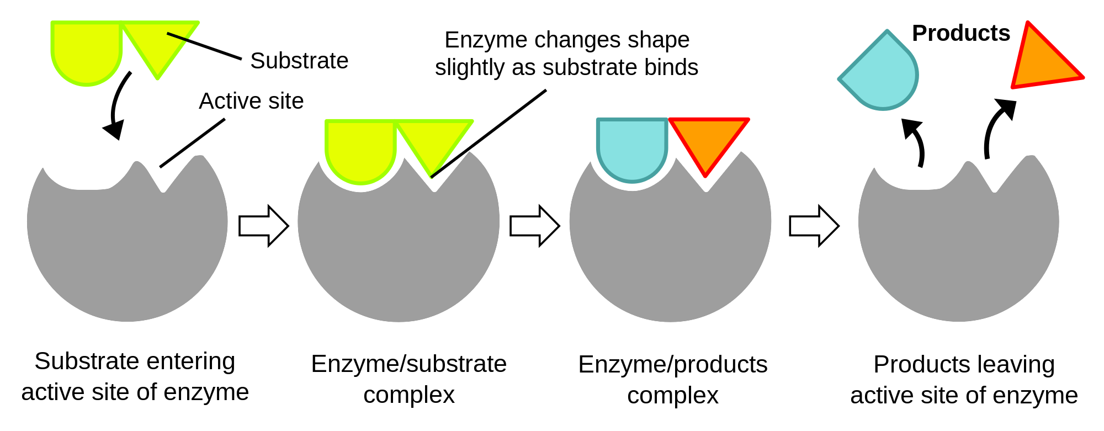
How are Enzymes so Accurate?
Mechanism:
Protein/Enzyme
Protein/Enzyme
Protein/Enzyme
Protein/Enzyme
https://commons.wikimedia.org/wiki/File:Induced_fit_diagram.svg

Slide 28
Enzymes
Advantages
Disadvantages
Reactions run in water w/o organic solvents
Reactions run at room temperature
No toxic metals
No carcinogens
No toxic waste
VERY High selectivity
No protecting groups needed
Overall minimal energy is required.
Reaction times may be slower compared to traditional organic synthesis
Reactions sample are more dilute
Enzymes are more expensive and difficult to recover
Enzymes lose activity quickly
Sensitive to elevated temperatures
Inhibition of the reaction can occur and may be difficult to alter equilibrium
Complication is recovery and isolation of desired product

Slide 29
Enzymatic Rxn Categories
Hydrolases:
Catalyze the hydrolysis of esters, amides, and glycosides
Transferases:
Catalyze the transfer of specific functional groups from one molecule to another (ex. Transmethylases and transaminases)
Lyases:
Catalyze group removal such as decarboxylations

Slide 30
Enzymatic Rxn Categories
Oxoreductases:
Catalyze the oxidation of alcohols to carbonyls and dehydration of alkanes to alkenes. Typical enzymes are oxidases, peroxidases, and dehyrdogenases.
Isomerases:
Catalyze the transfer of stereochemistry from cis to trans isomers.
Ligases:
Catalyze bond forming reactsions, such as condensation reactions

Slide 31
Example
Biocatalysis of S-Ibuprofen:
A. niger is an epoxide hydrolase
responsible for the selective
hydrolysis of the R-enantiomer of
ibuprofen.
Only selective for the S-enantiomer which is active configuration of ibuprofen.
Eliminates the amount of waste produced
Carvalho, P., Contesini, F. J., Ikegaki, M., Brazilian Journal of Microbiology, 2006, 37: 329-337
Notes:
Carvalho, P., Contesini, F. J., Ikegaki, M., Brazilian Journal of Microbiology, 2006, 37: 329-337, http://www.scielo.br/pdf/bjm/v37n3/v37n3a24

Slide 32
Photocatalysis
The use of light, at various wavelengths, as a source of energy to activate/charge catalysts to perform chemical transformations
We can look to nature and find photocatalysis as a fundamental reaction to support life….PHOTOSYNTHESIS
Sun Light = light energy
Chlorophyll = natural photocatalyst
https://upload.wikimedia.org/wikipedia/commons/2/27/Photosynthesis_Images.jpg

Slide 33
Photocatalyst
Photocatalysts are strong oxidizing agents in the presence of oxygen and water that they are generally known for their mechanisms to breakdown organic matter to water and carbon dioxide.
However, photocatalysis has direct applications in the industrial sector. Titanium dioxide is a popular semiconductor that can utilize UV light to overcome the band gap energy requirements to promote electrons from the valence band.

Slide 34
Photocatalyst
Mechanism:
Photocatalyst absorbs light energy to produce pairs of electrons
Electrons in the valence band are “excited” and move to the conduction band.
The “excited” electrons then help to promote organic compounds to react via oxidation and decompose to CO₂ and water
Light energy
Organic
Compounds
Water and CO₂
e-
Conduction band
Band gap
energy
Photocatalyst surface
Valence band

Slide 35
Applications of Photocatalysts
Destruction of hazardous chemicals or pollutants – e.g., Photocatalytic oxidation of Arsenic:
Step 1: Absorption of photon energy (hν) with formation of an electron-hole pair. The electron (e⁻) moves to the conduction band, leaving an electron vacancy (h⁺) in the valence band:
TiO₂ + hν −> e⁻ + h⁺
Step 2: The hole readily accepts electrons and so is a powerful oxidizing agent capable of oxidizing adsorbed hydroxyl ions and water to hydroxyl radicals:
h⁺ + OH⁻_{abs} −> •HO_{ads}
h⁺ + H₂O_{abs} −> •HO_{ads} + H⁺
Step 3: The radicals formed then oxidize the arsenite to arsenate in a series of complex reactions involving an As(IV) intermediate:
As(III) + •HO −> As(IV) + OH⁻
As(IV) + •HO −> As(V) + OH⁻
Light source
https://upload.wikimedia.org/wikipedia/commons/a/ab/Photocatalysis_dye_degredation.png
Notes:
Titanium dioxide is commonly used as a photocatalyst to oxidize organic molecules and break them down – and, also to oxidize inorganic species such as arsenic – oxidizing the arsenite to arsenate, which can readily be removed from drinking water by binding it to iron.

Slide 36
Metal Organic Frameworks (MOF’s)
MOF’s are 3-D microporous crystalline materials comprise of inorganic metal nodes and organic linkers
Extraordinary high surface area
Tunable pore sizes depending on transition metal and organic linker combinations.
The tunable pores allow for wide range of possibilities to selectively sequester chemical compounds
Many shapes and sizes
https://commons.wikimedia.org/wiki/File:Metal-Organic_Framework_(6898958430).jpg
Notes:
For more info about MOF’s: “Recent advances in gas storage and separation using metal–organic frameworks”, Li, H., et. al., Materials Today, Vol. 21, Issue 2, March 2018, pp. 108-121, https://doi.org/10.1016/j.mattod.2017.07.006

Slide 37
Metal Organic Frameworks (MOF’s)
Illustration of MOF coordination:
+
Transition Metal
Organic Linker
MOF
MOF’s have tunable properties by changing the inorganic moiety and the organic linkers.

Slide 38
Applications of MOF’s
Gas Storage
  CO₂ and Methane storage
  One interesting application of MOF’s
  include the capturing and
  storage of toxic gases.
  Ex: Carbon Monoxide
Separations
  MOF’s help facilitate the separations
  of very similar chemical structures
  that otherwise couldn’t be achieved
Creative Commons Liscense: “Recent advances in gas storage and separation using metal–organic frameworks” Volume 21, Number 2. https://doi.org/10.1016/j.mattod.2017.07.006
Notes:
Creative Commons Liscense: “Recent advances in gas storage and separation using metal–organic frameworks” Volume 21, Number 2. https://doi.org/10.1016/j.mattod.2017.07.006
“Recent advances in gas storage and separation using metal–organic frameworks”, Li, H., et. al., Materials Today, Vol. 21, Issue 2, March 2018, pp. 108-121, https://doi.org/10.1016/j.mattod.2017.07.006

Slide 39
Zeolites
Zeolites have been well known in the scientific industry. However, they have been more familiar to engineers due to their use in industrial separations. Industrial uses:
  Zeolite A – most widely produced zeolite, used as a detergent builder (removes Ca & Mg ions) (traditionally used – sodium tripolyphosphate)
  Zeolites are used in catalytic cracking of heavy oil to gasoline (traditionally used – thermal, high-energy process; AlCl₃ catalyst)
Until recent years have zeolites been used by chemists for catalysts.
Like all greener alternative catalysts, zeolites can provide more environmentally friendly materials by increasing selectivity and reducing waste
ZSM-5 Zeolite
https://commons.wikimedia.org/wiki/File:Zeolite-ZSM-5-3D-vdW.png

Slide 40
Zeolites
Zeolites: 3-D framework of crystalline hydrated alumino-silicates consisting of TO₄ tetrahedra (T = Si or Al)
  Nature of the Zeolite is determined by the Si/Al ratio and base used in preparation of the catalyst
45 naturally occurring zeolites have been discovered
Exhibit acidity in presence of water
Natural zeolites – vary in pores sizes
Synthetic zeolites – tailored pore sizes, tuned acidities

Slide 41
Zeolites
Commercial uses of Zeolites: ZSM-5 (pore size 0.55 nm)
  Used for selectively making p-xylene from toluene (used in making PET)
  Toluene is small enough to enter pores, m and o-xylene are too large to exit, only get p-xylene
  ZSM-5 is also used in Mobil MTG process and in the alkylation of benzene to ethyl benzene
ZSM-5 Zeolite
https://commons.wikimedia.org/wiki/File:Zeolite-ZSM-5-3D-vdW.png

Slide 42
Application of Zeolites
Selective production of p-xylene
o-xylene
ZSM-5
ZSM-5
p-xylene
m-xylene
*Only p-xylene can
selectively pass through
she ZSM-5 pores due to
the location of methyl
groups.
Flow of reaction mixture

Slide 43
Zeolites
Not stable at high temperatures or in presence of water.
Depends on concentration of Al
  More Al = the less stable
The manipulation of the ratio of Aluminum to Silicon Oxides allows for a range of combinations in which zeolites can be customized depending on their anticipated use.

Slide 44
Outline
What is Catalysis?
Why its important and improves performance
Categories of Catalysis
  Homogeneous vs. Heterogeneous
Greener Alternatives for Catalysis
Current Trends for the Next Generation of Catalysts
Additional applications for catalysts

Slide 45
Need to Develop More Sustainable Catalysts
European Commission Press Release, June 2010
Notes:
Image Source: http://europa.eu/rapid/press-release_MEMO-10-263_en.htm
For the critical raw materials, their high supply risk is mainly due to the fact that a high share of the worldwide production comes from China (antimony, fluorspar, gallium, germanium, graphite, indium, magnesium, rare earths, tungsten), Russia (PGM), the Democratic Republic of Congo (cobalt, tantalum) and Brazil (niobium and tantalum). This production concentration, in many cases, is compounded by low substitutability and low recycling rates.
One of the most powerful forces influencing the economic importance of raw materials in the future is technological change. In many cases, their rapid diffusion can drastically increase the demand for certain raw materials. Based on a study commissioned by the German Federal Ministry of Economics and Technology, the demand from driving emerging technologies is expected to evolve sometimes very rapidly by 2030.

Slide 46
Current trend in catalyst design
Reduce Loading
High Surface Area Support
Atomic Layer deposition
Earth Abundant Alternative
Abundant metal
Alloy - Synergistic Effect
Adjust other parameters
  - Solvent
  - Surfactants
Notes:
The ideal catalyst would be the overlap area!!

Slide 47
Other catalyst improvements:
Non-precious metal catalysis
Catalysts derived from non-precious metals
  Much lower costs (i.e., Pd(OAc)₂ is $75/gram, Ni(OAc)₂ is $10/gram)
  Generally more “benign” (Fe, Ni, Cu, Zn)
  More abundant (see Endangered Elements, slide 17)
  Generally easier to extract from the earth (less polluting processes)
Historical examples:
  Haber-Bosch (Fe)
  Steam reforming (Ni)
  Fisher-Tropsch (Co/Fe)
  Water-gas shift reaction (Fe/Cr/Cu/Zn)
Current advancements for non-precious metal catalysis:
  Cross-couplings, Hydrogenations, Oxidations, Aminations, Alkoxylations, Hydrosilyations, C-H activations
Notes:
For more information on Non-precious metal catalysis, see the Organic Process Research & Development special issue : https://pubs.acs.org/toc/oprdfk/19/10
And
Getting Down to Earth: The Renaissance of Catalysis with Abundant Metals, Acc. Chem. Res., 2015, 48 (9), pp 2495–2495
DOI: 10.1021/acs.accounts.5b00385, https://pubs.acs.org/doi/abs/10.1021/acs.accounts.5b00385#

Slide 48
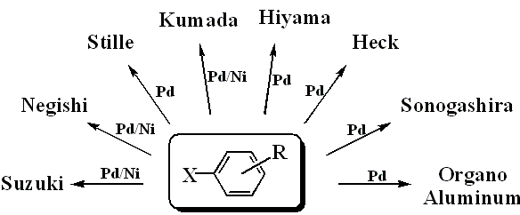

Other catalyst improvements:
Non-precious metal catalysis
Palladium to Nickel
Example: Cross Coupling Reactions
  → Connect two separate organic molecules together with high selectivity and high yield
 | USD mol⁻¹
Ni | $1.20
Pd | $1,500
Image Source: http://www.novelcs.com/NCSChemistry.html
Notes:
Pd is used catalytically, in small amount, to carry out the reaction
In some cases, Pd needs NOT to be purified

Slide 49
Other catalyst improvements: alloys
In addition to moving away from precious metals, scientists use metal alloys for synergistic effect:
Alloying of multiple metals
  - Bronze – Copper + Tin (or Zinc)
  - Monel – Copper + Nickel
  - Stainless Steel – Steel (Iron + C) + Chromium with many others
The surface area
  - Thin layer deposition
  - Ultra high area support

Slide 50
Outline
What is Catalysis?
Why its important and improves performance
Categories of Catalysis
  Homogeneous vs. Heterogeneous
Greener Alternatives for Catalysis
Current Trends for the Next Generation of Catalysts
Additional applications for catalysts

Slide 51
Automotive Industry
Composition of parts:
Ceramic support with heat shield. Provides strength and stability over a wide range of temperatures
A washcoat, which facilitates high surface area for the catalyst
Active catalyst: Pt, Pd, and Rh
High quality steel to house and support the converter
https://commons.wikimedia.org/wiki/File:Catalyticconverter.jpg

Slide 52
Automotive Industry
Some reactions happening in the catalytic converter:
2 NO + 2 CO
Hydrocarbon + NO
2 NO₂ + 4 CO
Hydrocarbon + O₂
2 CO + O₂
Catalyst
N₂ + 2CO₂
N₂ + CO₂ + H₂O
N₂ + 4CO₂
CO₂ + H₂O
2CO₂
Catalyst
Catalyst
Pt and Pd are responsible
for the catalytic removal of
hydrocarbons and carbon
monoxide
Rh catalysts are responsible for
the removal of NOx
Catalyst
Catalyst

Slide 53
Automotive Industry
A catalytic converter has a high operating efficiency.
  Reduces hydrocarbon and CO emissions by 95%
  Reduces NOx emissions by 90%
Expected designed life span on 160,000 km

Slide 54
Other applications
Fine Chemicals
  Cross-coupling reactions
  Oxidation reactions
  Reductive reactions
  C-H activation reactions
Pharmaceuticals
Conversion of crude petroleum
Conversion of biomass materials to valuable platform chemicals
Fertilizers (Haber-Bosch)

Slide 55

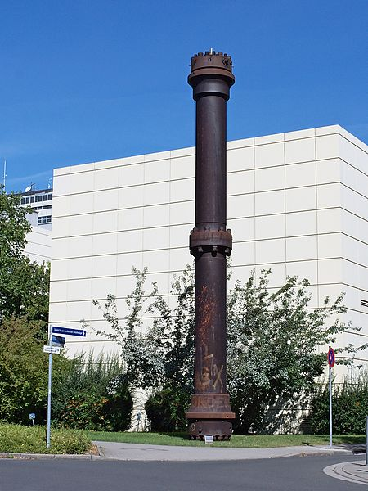
Haber-Bosch Process
History:
  Developed in early 1900’s by Fritz Haber, later modified as an industrial process to make fertilizers by Carl Bosch
  Considered one of the most important technological advances of the 20th century
  Allowed for the mass-production of plant fertilizers & increasing productivity of agricultural land
  One of the 1st industrial processes to use high pressure to create a chemical reaction
  Process also used in World War I to manufacture explosives
Today
  Used to produce 450 million tons of nitrogen fertilizer/year
  3-5% of the world’s natural gas production is consumed by this process
Images, WikiMedia Commons: https://commons.wikimedia.org/wiki/File:The_Haber%E2%80%93Bosch_process.png
https://commons.wikimedia.org/wiki/File:Ammoniak_Reaktor_BASF.jpg
Notes:
Article: ThoughtCo., Overview of the Haber-Bosch Process, March 6, 2017 by Amanda Briney, https://www.thoughtco.com/overview-of-the-haber-bosch-process-1434563
Reactor image: High pressure reactor (steel) used for ammonia production following the Haber process. Built in 1921 by the Badische Anilin- und Sodafabrik AG in Ludwigshafen am Rhein. Now re-erected on the premises of the University Karlsruhe, Germany.

Slide 56
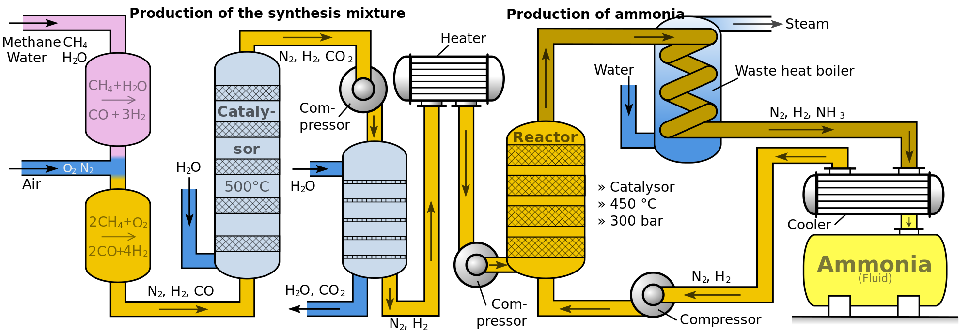
Haber-Bosch Process
WikiMedia Commons: https://commons.wikimedia.org/wiki/File:Haber-Bosch-En.svg
Notes:
Flow diagram of the Haber-Bosch Process:
Description from Wikipedia: This conversion is typically conducted at 15–25 MPa (150–250 atm; 2,200–3,600 psi) and between 400–500 °C (752–932 °F), as the gases (nitrogen and hydrogen) are passed over four beds of catalyst, with cooling between each pass so as to maintain a reasonable equilibrium constant. On each pass only about 15% conversion occurs, but any unreacted gases are recycled, and eventually an overall conversion of 97% is achieved.^{[3]}
The steam reforming, shift conversion, carbon dioxide removal, and methanation steps each operate at pressures of about 2.5–3.5 MPa (25–35 bar; 360–510 psi), and the ammonia synthesis loop operates at pressures ranging from 6–18 MPa (60–180 bar; 870–2,610 psi), depending upon which proprietary process is used.^{[3]}
The process works today much like it originally did by using extremely high pressure to force a chemical reaction. It works by fixing nitrogen from the air with hydrogen from natural gas to produce ammonia. The process must use high pressure because nitrogen molecules are held together with strong triple bonds. The Haber-Bosch process uses a catalyst or container made of iron or ruthenium with an inside temperature of over 800̊F (426̊C) and a pressure of around 200 atmospheres to force nitrogen and hydrogen together (Rae-Dupree, 2011). The elements then move out of the catalyst and into industrial reactors where the elements are eventually converted into fluid ammonia (Rae-Dupree, 2011). The fluid ammonia is then used to create fertilizers.
Today chemical fertilizers contribute to about half of the nitrogen put into global agriculture and this number is higher in developed countries.

Slide 57
Summary
Catalysis is the increase in the rate of a chemical reaction due to the participation of a catalyst.
Scientifically, a catalyst (material that enables catalysis) allows for the lowering of the activation energy for a reaction to occur.
Decreased activation energy results in faster and less energy intensive reactions and processes.
There are advantages and disadvantages to using homogeneous or heterogeneous catalysis. Depending on the application a scientist should keep this in mind.
Greener alternatives are available due to the research efforts made through Green Chemistry.
The next generation of catalysts will need to be developed that utilized non-precious metals all while maintain performance and recyclability.
Catalysis can be found in many commercial processes that we depend on to make our medicines, cleaning supplies, and even our cars.

