Slide 1
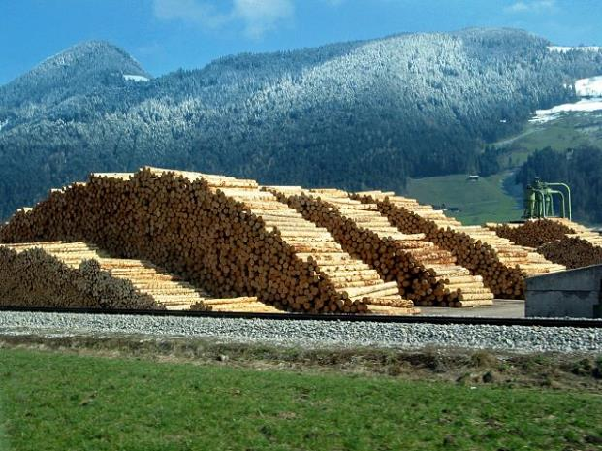

Yale-UNIDO Train-the-Facilitator Workshop in Green Chemistry
Renewable Feedstocks for molecules
CENTER for GREEN CHEMISTRY
and GREEN ENGINEERING at YALE
Image: Wikimedia Commons, Author: R. Möhler

Slide 2

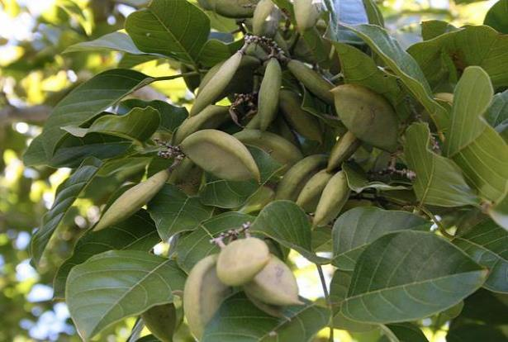
Use of Renewable Feedstocks
A raw material or feedstock should be renewable rather than depleting whenever technically and economically practical.
Image: Wikipedia, Pongamia Pinnata Seeds

Slide 3
Topics To Be Covered
What can we make from petroleum (focus on molecules)
The biorefinery
Renewable Feedstocks
  Triglycerides
  Lignocellulosic Feedstocks
  N containing polymers
  Latex polymer
  Small molecule feedstocks
Examples
  From lignin
  Vanillin
  Platform molecules
  Fatty acids
The Advantages and Drawbacks of bio-based molecules

Slide 4
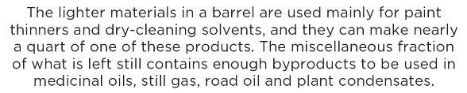
What can be made from one barrel of oil?
low value
high volume
high value
low volume
http://www.visualcapitalist.com/can-made-one-barrel-oil/

Slide 5
Notes:
Today, the list of petroleum based products is even longer.

Slide 6
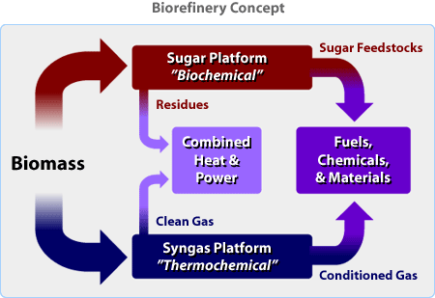
The biorefinery
What is a Biorefinery?
A biorefinery is a facility that integrates biomass conversion processes and equipment to produce fuels, power, and chemicals from BIOMASS. The biorefinery concept is analogous to today's petroleum refineries, which produce multiple fuels and products from petroleum. Industrial biorefineries have been identified as the most promising route to the creation of a new domestic biobased industry.
http://www.nrel.gov/biomass/biorefinery.html

Slide 7

How do we get chemicals from biomass?
1. Extraction of desired compound
Linolenic acid
Notes:
Flax -> linseed oil -> Linolenic acid (47-55% of linseed oil).
Drying agent in paints, varnishes, inks.

Slide 8
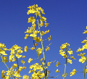
How do we get chemicals from biomass?
1. Extraction of desired compound
Linolenic acid
2. Extraction of precursor
Erucic acid
Erucamide
Notes:
Modified rape seed -> erucic acid (60,000 tpa in Europe) -> erucamide (slip agent for polyethylene bags)

Slide 9
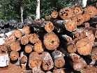
How do we get chemicals from biomass?
1. Extraction of desired compound
Linolenic acid
2. Extraction of precursor
Erucic acid
Erucamide
3. Hydrolysis
Notes:
Waste from pulp mills -> -> levulinic acid (70% yield) and from there to many products.
DALA (delta-aminolevulinic acid), a biodegradable herbicide.

Slide 10
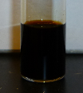
How do we get chemicals from biomass?
4. Pyrolysis
350-
500 ˚C
oil + char
Notes:
Pyrolysis. Heat it up to 350-500 ˚C, obtain gas, liquid (pyrolysis oil) and solid (char) products. The pyrolysis oil is the most valuable, as a source of chemicals and as a fuel. The char, if very pure, can be valuable, but often it is not pure.
Gasification. Solves problem of variable quality feedstocks. Gasify at 400-600 ˚C. Get CO, H2, char and unfortunately tars and hydrocarbons. Tar can be combusted at high temperature to make CO2, water, and cracked tar compounds.The CO2 and C (charcoal) are reacted to make CO in the “reduction” step.

Slide 11
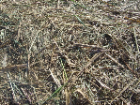
How do we get chemicals from biomass?
4. Pyrolysis
350-
500 ˚C
oil + char
CO₂
drying
1200 ˚C combustion
5. Gasification to syngas
H₂ + CO + charcoal + tar
400-600 ˚C
synthesis
gas
Ru
Fe
Ni
Cu
polyethylene
fuels &
solvents
CH₄
CH₃OH
Fischer-Tropsch chemistry
Notes:
Pyrolysis. Heat it up to 350-500 ˚C, obtain gas, liquid (pyrolysis oil) and solid (char) products. The pyrolysis oil is the most valuable, as a source of chemicals and as a fuel. The char, if very pure, can be valuable, but often it is not pure.
Gasification. Solves problem of variable quality feedstocks. Gasify at 400-600 ˚C. Get CO, H2, char and unfortunately tars and hydrocarbons. Tar can be combusted at high temperature to make CO2, water, and cracked tar compounds.
The CO2 and C (charcoal) are reacted to make CO in the “reduction” step.

Slide 12
Biomass feedstock
Only about 4% utilized by humans
(food, ethanol, sweeteners)
Building blocks for a diverse chemical platform.
Nature’s richest source of aromatic carbon. Used in polymers, adhesives, production of phenolic chemicals.
Converted into polymers, lubricants, and detergents.

Slide 13

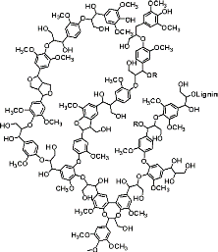
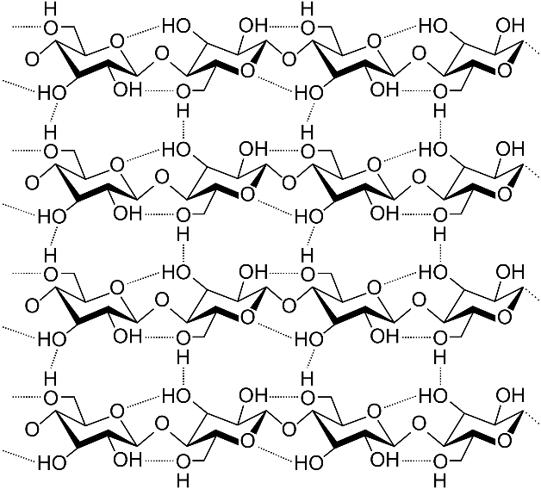
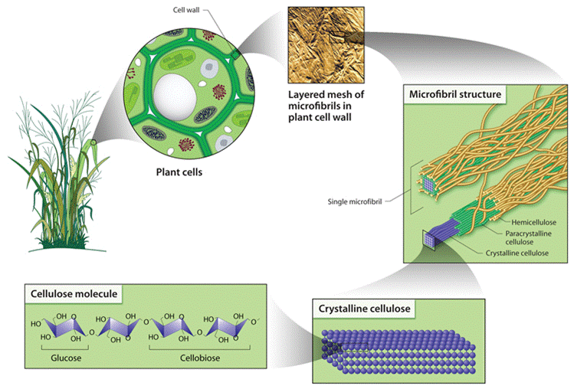
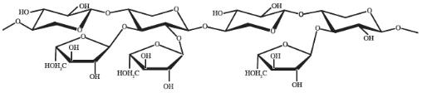
Lignocellulosic feedstock
Cellulose
Lignin
Hemicellulose
Nature has evolved plant cell wall structure to prevent easy degradation by chemical attack… hence the challenge
Images: Creative commons

Slide 14


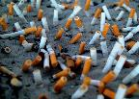
Lignocellulosic feedstock
Cellulose
syngas
image from PNG All
Notes:
images from Wikipedia except lab coat from http://www.pngall.com/lab-coat-png

Slide 15
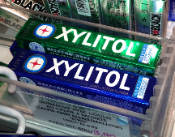
Lignocellulosic feedstock
Hemicellulose
syngas
Notes:
Xylitol photo by PG Jessop.

Slide 16

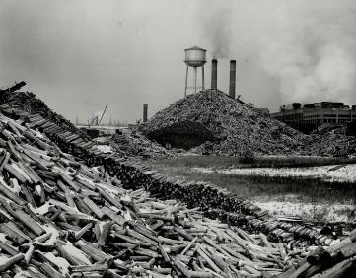
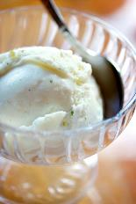
Lignocellulosic feedstock
Liquid
Smoke
Lignin
artificial vanillin
Paper Mill, Thorold, ON

Slide 17
Carbohydrate Feedstocks
Carbohydrates can be used as feedstocks for chemical processes.
Carbohydrates are created in several forms:
• Sucrose sugar, C₁₂H₂₂O₁₁, is squeezed from sugar cane as sap and is extracted from sugar beets and sugar cane with water.
• Starch, a polymer of glucose readily isolated from grains (such as corn) and from potatoes, and is readily broken down by adding water to produce glucose.
• Huge amounts of cellulose, which occur in the woody parts of plants, can be broken down to glucose with cellulase enzymes.

Slide 18
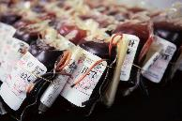
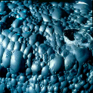
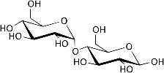
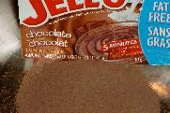
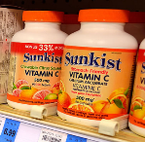


Carbohydrate Feedstocks
MSG
Starch

Slide 19
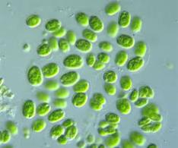
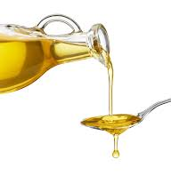
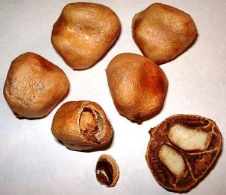
Triglycerides Feedstock
Lipid oils can be extracted from the seeds of some plants.
• Volatile solvent n-hexane, C₆H₁₄, is used to extract the oils.
• Solvents are distilled off from the extract and recirculated through the process.
Oils (25% of biomass usage): first renewable raw material used towards the chemical industry
-> surfactants, cosmetic products, and lubricants as major products
Images: Creative commons
Image: Wikimedia Commons, Marula - Sclerocarya birrea – Seeds, Author: Genet

Slide 20
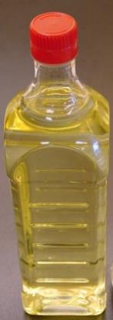
Triglycerides Feedstock

Slide 21
Triglycerides Feedstock
Fatty acids are obtained from triglycerides extracted from vegetable or algae oil:
  100 million tonnes of oils and fats are produced annually, 25% from soya
  14% of it is used for chemicals manufacture
  The rest is used for food and for making biodiesel
  25% of all the biomass used for molecules is from fatty acids
  Problems associated with the usage of vegetable oil:
    Mix of several acids in the oil
    Low concentration of a given acid
    =>genetic engineering was used:
      E.g. rapeseed can have an erucic acid concentration varying from 0- 50%
      E.g. rapeseed can have a lauric acid concentration varying from 0- 37%
      E.g. sunflower oil can contain up to 92% of oleic acid
Green Chemistry: An Introductory Text, M. Lancaster, RSC Publishing, Cambridge, 2012

Slide 22
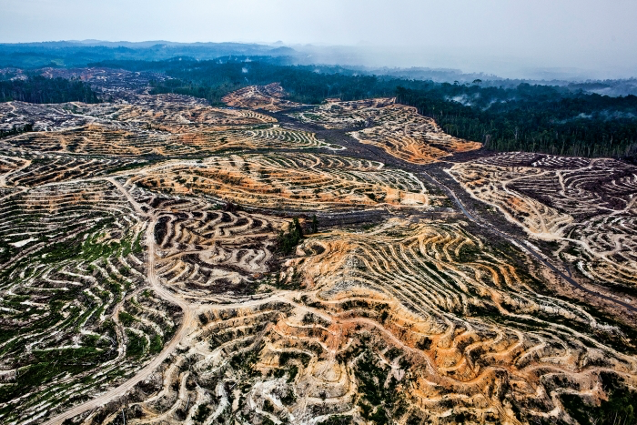
Triglycerides Feedstock
Credit: Ulet Ifansasti/Greenpeace

Slide 23

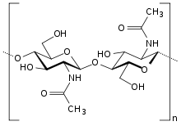

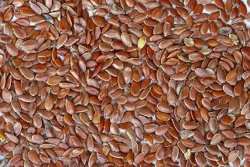
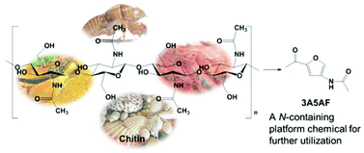
N containing polymers
Proteins
Chitin
Grain seeds can be used as sources of protein.
• Grain seeds are generally used for food.
• They are potentially useful as chemical feedstocks for specialty applications.
• Transgenic plants can be used to make specialty proteins, such as medicinal agents.
Can give access to glucosamine
Meier, M. A.; Metzger, J. O.; Schubert, U. S., Chem Soc Rev 2007, 36 (11), 1788-1802
G.W. Huber, S. Iborra, A. Corma, Chem. Rev., 2006, 106, 4044−4098
X. Chen, S. L. Chew, F.M. Kerton, N. Yan, Green Chem., 2014, 16, 2204-2212
Image: Wikimedia Commons, Brown Flax Seeds, Author: Sanjay Acharya

Slide 24
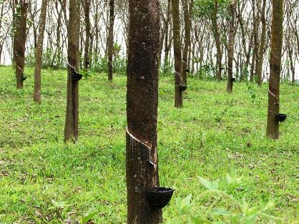
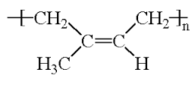
Terpenes
Hydrocarbon terpenes can be tapped from rubber trees as a latex suspension in tree sap.
Steam treatment and distillation are used to extract terpenes from sources such as pine or citrus tree biomass.
Latex rubber
Image: Wikimedia Commons, Rubber trees in Kerala, India, Author: M. Arunprasad

Slide 25

Fossil vs biomass: the differences
Petroleum & natural gas
Biomass (other than triglycerides & terpenes)
Oxidation
Dehydration
Reduction
Redox rearrangements (-CO₂)
Images: Creative commons
Notes:
25

Slide 26
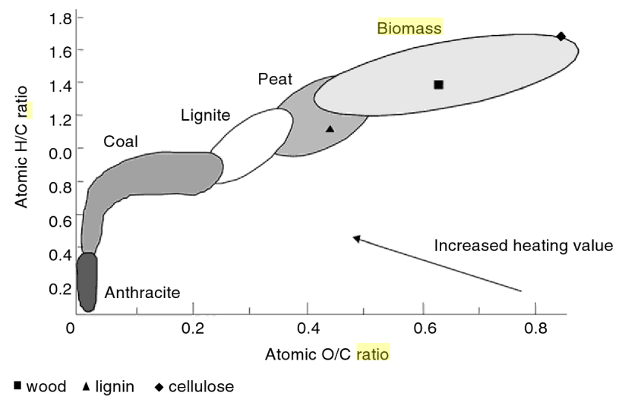
methanol
Fossil vs biomass: the differences
ethylene glycol
ethylene, PE, propylene, PP
ethylene oxide
Crude Oil
caprolactam
Biomass
Triglycerides
vinyl chloride
cumene
xylene
toluene
1
acrylonitrile
& styrene
phenol
terephthalic acid
ratio
Adapted from: Basu, Biomass Gasification and Pyrolysis: Practical Design and Theory
Notes:
26

Slide 27
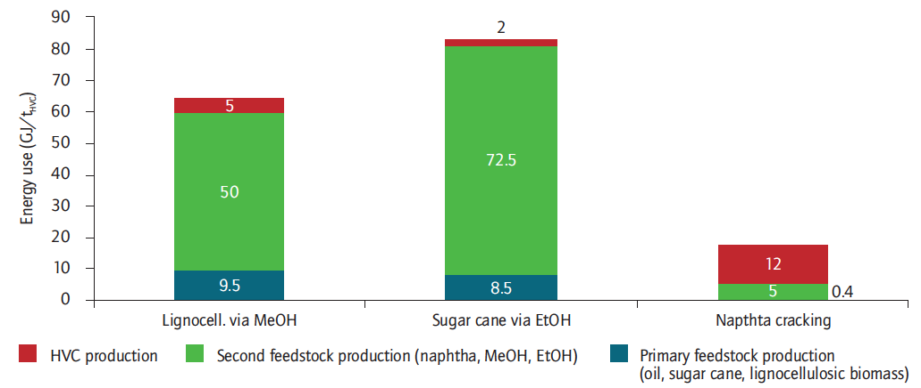
Fossil vs biomass: the differences
Resources
Primary
Feedstock
Second
Feedstock
High value compound
Technology Roadmap: Energy and GHG Reductions in the Chemical Industry via Catalytic Processes, Int. Energy Agency, 2013.
Notes:
27

Slide 28
Fossil vs biomass: the differences
gasification
then FT
farming
MTO
Resources
Primary
Feedstock
Second
Feedstock
High value compound
removal of water is here
lowering O/C ratio is here
Technology Roadmap: Energy and GHG Reductions in the Chemical Industry via Catalytic Processes, Int. Energy Agency, 2013.
Notes:
28

Slide 29
Fossil vs biomass: the differences
fermentation
drying
farming
dehydration
Resources
Primary
Feedstock
Second
Feedstock
High value compound
removal of water is here
lowering O/C ratio is here
Technology Roadmap: Energy and GHG Reductions in the Chemical Industry via Catalytic Processes, Int. Energy Agency, 2013.
Notes:
29

Slide 30
Fossil vs biomass: the differences
oil
production
distillation
cracking
Resources
Primary
Feedstock
Second
Feedstock
High value compound
no removal of water required
Technology Roadmap: Energy and GHG Reductions in the Chemical Industry via Catalytic Processes, Int. Energy Agency, 2013.
Notes:
30

Slide 31
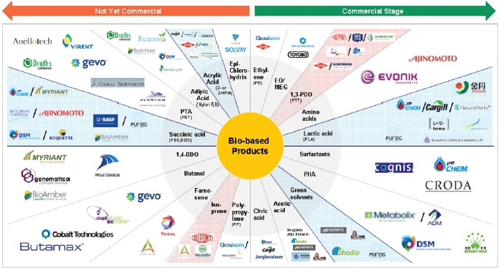
Companies that make bio-based products
Image: National Research Council. 2015. Industrialization of Biology: A Roadmap to Accelerate the Advanced Manufacturing of Chemicals. Washington, DC: The National Academies Press. https://doi.org/10.17226/19001.

Slide 32
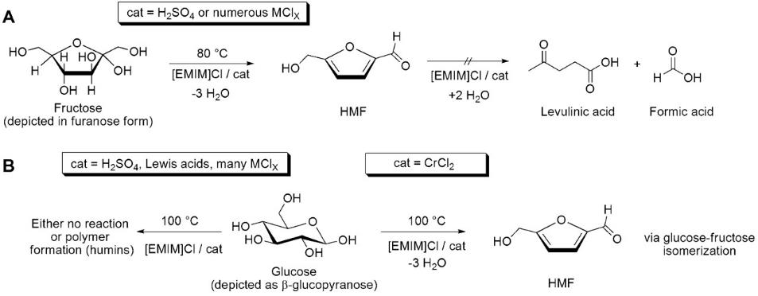
The platform strategy
The idea is to depolymerize cellulose (or ideally lignocellulose) and form a molecule that could further be derived in to many more.
E.g : 5-hydroxymethylfurfural (HMF)
H. B. Zhao, J. E. Holladay, H. Brown and Z. C. Zhang, Science, 2007, 316, 1597–1600

Slide 33
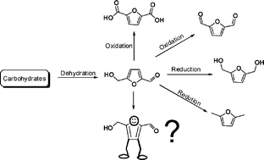
The platform strategy
5-hydroxymethylfurfural (HMF) as a building block
FDA: replacement monomer for terephthalic acid
polyurethane foams
biofuel and fuel additive
A. A. Rosatella, S.P. Simeonov, R. F. M. Fradea, C.A.M. Alfonso Green Chemistry 13.4 (2011): 754-793.

Slide 34
The Top 10 Chemical Targets
(platform chemicals from saccharide feedstocks)

Slide 35
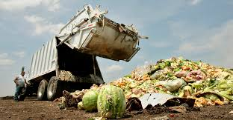
Avoiding competing with food
These are great examples, but some compete with food.
Idea: using waste from the food industry?
Idea: using urban waste
Images: Creative commons

Slide 36
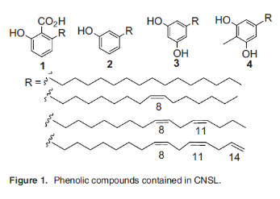
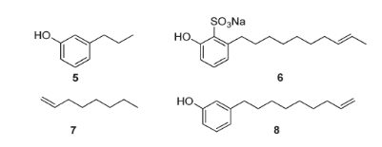
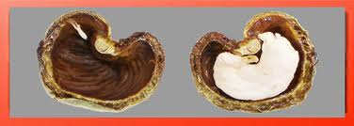
CHEM 462: 24.Chemicals from renewable feedstock
Avoiding competing with food: biomass waste
From cashew nut shell waste: David Cole Hamilton
  byproduct of the cashew nut processing industry available at about 300 000 tonnes/year worldwide
  5: tsetse fly pheromone 6: detergent
  7: plasticizer 8: precursor to chemicals
the top five producers being
- Vietnam (1.1 million tons)
Nigeria (0.95 million tons)
India (0.75 million tons)
Cote d’Ivoire (0.45 million tons%)
Brazil (0.11 million tons)
David Cole-Hamilton (St Andrews, UK) Eur. J. Lipid Sci. Technol. 2012, 114, 1183 Mubofu, Egid B. Pure App. Chem. 88.1-2 (2016): 17-27
Notes:
36

Slide 37
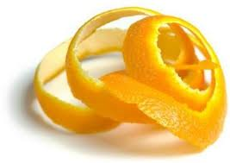
CHEM 462: 24.Chemicals from renewable feedstock
Avoiding competing with food: biomass waste
Orange peels: James Clark (York, UK)
  Global agriculture produces about 15.6 million tons of orange and other citrus waste annually in the form of discarded peels
    biofuels
    bio-based solvents
    Fragrances
    water purifiers
low temperature microwaves
+ cellulose
http://cleantechnica.com/2012/07/07/opec-uses-orange-peel-for-biofuel-and-other-biobased-products/
Notes:
37

Slide 38
Why use renewable feedstocks?
Economic reasons:
  The inherent long-term tendency for petroleum price to increase.
  A fluctuation of a few cents in the price of crude oil can result in massive price swings for downstream products.
  The constant decrease in cost of renewable resources.
Scientific reasons:
  The constant improvement in quality of renewable feedstocks.
  Modern plant breeding.
  Genetic manipulation.
  Breakthroughs in catalysis (enzymes, etc.).
Environmental reasons:
  Biological compatibility (to an extent).
  The use of waste streams (wood pulping, agriculture, etc.).
  Mitigate CO₂ emissions

Slide 39
Some Potential Challenges of Using Renewable Feedstocks
Feedstock cultivation
  Competition with food supply
  Land demand
  Nutritional needs
  Diseases
  Initial investment
Harvesting method to maximise yields and minimise degradation of product
Post harvest processing
Product extraction and purification
Product standardization
Complexity
Product storage, packing, and distribution
New methodologies for alternative feedstocks

Slide 40
Topics Covered
What can we make from petroleum (focus on molecules)
The biorefinery
Renewable Feedstocks
  Triglycerides
  Lignocellulosic Feedstocks
  N containing polymers
  Latex polymer
  Small molecule feedstocks
Examples
  From lignin
  Vanillin
  Platform molecules
  Fatty acids
The Advantages and Drawbacks of bio-based molecules

Slide 41
Sponsored by Yale-UNIDO Initiative
QUESTIONS?
CENTER for GREEN CHEMISTRY
and GREEN ENGINEERING at YALE

