Slide 1
Stoichiometry and Reactions
Lecture #6
Date:
Course #

Slide 2
Outline
Stoichiometry & Calculations
Reactions
Important Named Reactions
Lab vs. Nature
Green Chemistry in Perspective
Reagents, solvents, and reactors
Biomimicry

Slide 3
Outline
Stoichiometry & Calculations
Reactions
Important Named Reactions
Lab vs. Nature
Green Chemistry in Perspective
Reagents, solvents, and reactors
Biomimicry

Slide 4
Molecular Weights & Formula Weights
Remember atomic mass?
C = 12.01 μ
Li = 6.941 μ
W = 183.9 μ
1 μ = 1.66054 x 10⁻²⁴ g

Slide 5
Periodic Table of Elements
https://upload.wikimedia.org/wikipedia/commons/6/68/Periodic_table_vectorial.png
Notes:
It is important to remind the students on where to find the atomic mass on the periodic table. Emphasize its importance in stoichiometry and calculations for chemical reactions: Limiting reagents, Theoretical yields, and composition.

Slide 6
Molecular Weights for Molecules
How to calculate molecular weight (MW):
Cl₂ = 2 x 35.45 = 70.90 μ
H₂O = [2 x 1.008] + [1 x 16.00] = 18.02 μ
NaCl = 22.99 + 70.90 = 93.89 μ

Slide 7
Molecular Weights for Molecules
What is the molecular weight of sucrose C₁₂H₂₂O₁₁?
MW_{sucrose} = [12 x 12.01] + [22 x 1.008] + [11 x 16.00]
= 342.30 μ

Slide 8
Formula Weights for Ions [everything]:
You can use “formula weight” for everything.
Ions
Molecules
Compounds
Atoms.

Slide 9
Formula Weights for Ions [everything]:
What is the formula weight of aluminum sulfate?
Aluminum Sulfate: Al₂(SO₄)₃
Al x 2: 2 x 26.98 53.96
S x 3: 3 x 32.07 96.21
O x 4 x 3: 12 x 16.00 192.00
FW_{aluminum sulfate} = 342.17

Slide 10
Avogrado’s Number: The Mole
We use common names for numbers a lot.
Dozen eggs: 12 eggs
Gross of pencils: 144 pencils
Ream of paper: 500 papers
The same is for Avogadro’s number:
Mole of atoms: 6.022 x 10²³ atoms

Slide 11
Avogrado’s Number: The Mole
We can use this to convert things at the atomic scale to things we can do in the lab.
1 mole of C atoms has a mass of 12.01 g
1 mole of Li atoms has a mass of 6.941 g
1 mole of W atoms has a mass of 183.9 g
1 mole of Cl₂ molecules has a mass of 70.90 g
1 mole of H₂O molecules has a mass of 18.02 g
1 mole of sucrose has a mass of 342.30 g
1 mole of aluminum sulfate has a mass of 342.17 g

Slide 12
Avogrado’s Number: The Mole
1 molecule of H₂O has 2 atoms of H and 1 atom of O.
1 mole of H₂O has 2 moles of H and 1 mole of O.

Slide 13
Molar Mass
The molecular weight of sucrose is 342.30 g/mol.
Unit Identification

Slide 14
Molar Mass
How many moles of H₂O in 100 g of H₂O?
MWH₂O = 18.02 g/mol
18.02 g H₂O = 1 mol H₂O
1 mol H₂O
18.02 g H₂O
100 g H₂O x
= 5.55 mol H₂O

Slide 15
Molar Mass
Calculate the mass in pounds of 6.73 moles of sucrose:
MW_{sucrose} = 342.30 g/mol
1 lb = 453.6 g
342.30 g sucrose
1 mol sucrose
1 lb sucrose
453.6 g sucrose
6.73 mol sucrose x
x
= 5.08 lb sucrose

Slide 16
Molar Mass
What is the mass in grams of 1 molecule of sucrose?
1 mol sucrose = 342.30 g sucrose
1 mol sucrose = 6.022 x 10²³ molecules of sucrose
Avogadro's
Number
342.30 g sucrose
1 mol sucrose
1 mol sucrose
6.022 x 10²³ molecules of sucrose
x
= 5.68 x 10⁻²² g/molecule

Slide 17
Writing and Balancing Equations
H₂CO (g) + O₂ (g) H₂O (l) + CO₂ (g)
“1 mole of formaldehyde gas reacts with 1 mole of oxygen gas to form 1 mole of liquid water and 1 mole of carbon dioxide gas.”
What is implied…
“30 g H₂CO reacts with 32 g O₂ to form 18 g H₂O and 44 g CO₂”

Slide 18
Stoichiometric Coefficients
Equations are balanced by including stoichiometric coefficients so that the number of atoms of each type is the same on each side of the equation.
N₂ + 3 H₂ 2 NH₃
“1 mole of nitrogen reacts with 3 moles of hydrogen
to form 2 moles ammonia.”

Slide 19
Stoichiometric Coefficients
Balance the reaction of methane:
C + H₂ CH₄
C + 2 H₂ CH₄

Slide 20
Stoichiometric Coefficients
Step-by-step: Balancing the reactions:
NH₃ + O₂
NO + H₂O
Look at N:
NH₃ + O₂
NO + H₂O
Look at H:
2 NH₃ + O₂
NO + 3 H₂O
Look back at N:
2 NH₃ + O₂
2 NO + 3 H₂O
Look at O:
2 NH₃ + 5/2 O₂
2 NO + 3 H₂O
Multiply by 2:
4 NH₃ + 5 O₂
4 NO + 6 H₂O

Slide 21
Stoichiometric Coefficients
Balance the following reaction:
Ca(C₂H₃O₂)₂ + Na₃PO₄
NaC₂H₃O₂ + Ca₃(PO₄)₂
3 Ca(C₂H₃O₂)₂ + 2 Na₃PO₄
6 NaC₂H₃O₂ + Ca₃(PO₄)₂

Slide 22
Stoichiometric Coefficients
Balance the following reaction:
2

Slide 23
Stoichiometric Coefficients
Balance the following reaction:
3

Slide 24
Outline
Stoichiometry & Calculations
Reactions
Important Named Reactions
Lab vs. Nature
Green Chemistry in Perspective
Reagents, solvents, and reactors
Biomimicry

Slide 25
Product and Reaction Predictions
Knowing formulas and stoichiometry allows you to predict things.

Slide 26
Product and Reaction Predictions
Barium chloride and sulfuric acid react to form barium sulfate and what else?
BaCl₂ + H₂SO₄
BaSO₄ + ?
Cl⁻
SO₄²⁻
Cl⁻
H⁺
Ba²⁺
H⁺
BaCl₂ + H₂SO₄
BaSO₄ + 2 HCl

Slide 27
Stoichiometry of Chemical Reactions
You can use dimensional analysis…
Just like 1000 g = 1 kg
An amount of 6.48 mole of NH₃ reacts with how many moles of O₂?
4 NH₃ + 5 O₂
4 NO + 6 H₂O
5 mol O₂ = 4 mol NH₃
5 mol O₂
4 mol NH₃
6.48 mol NH₃ X
= 8.10 mol O₂

Slide 28
Stoichiometry of Chemical Reactions
Using the following reaction:
4 NH₃ + 5 O₂
4 NO + 6 H₂O
How much H₂O will be formed from 5.44 g O₂?
Strategy:
convert g O₂ to mol O₂,
then mol O₂ to mol H₂O,
and then mol H₂O to g H₂O.
1 mol O₂
32 g O₂
6 mol H₂O
5 mol O₂
18 g H₂O
1 mol H₂O
5.44 g O₂
x
x
x
= 3.67 g H₂O

Slide 29
Stoichiometry of Chemical Reactions
Nitric acid forms when nitrogen dioxide reacts with water, giving nitrogen monoxide as a byproduct. How much nitrogen dioxide is needed to produce each kg of nitric acid?
Step One: Translate to chemistry
NO₂ + H₂O
HNO₃ + NO
Step Two: Balance reaction
3 NO₂ + H₂O
2 HNO₃ + NO
Step Three: Do the math
kg HNO₃ -> g HNO₃ -> mol HNO₃ -> mol NO₂ -> g NO₂

Slide 30
Stoichiometry of Chemical Reactions
Step Three: The math
1000 g HNO₃
1 kg HNO₃
1 mol HNO₃
63.01 g HNO₃
3 mol NO₂
2 mol HNO₃
x
46.01 g NO₂
1 mol NO₂
1 kg HNO₃
x
x
x
= 1095 g NO₂

Slide 31
Stoichiometry of Chemical Reactions
Practice Problem:
Acetylene, C₂H₂, is burned in oxygen to form carbon dioxide and water. How many grams of oxygen are required to react with 52.0 g acetylene?
Translation:
C₂H₂ + O₂ -> CO₂ + H₂O
Balance:
2 C₂H₂ + 5 O₂ -> 4 CO₂ + 2 H₂O
Math:
1 mol C₂H₂
26.04 g C₂H₂
5 mol O₂
2 mol C₂H₂
32 g O₂
1 mol O₂
= 159.8 g O₂
52.0 g C₂H₂
x
x
x

Slide 32
Types of Chemical Reactions
1. Addition/Combination Reactions
X + Y XY
Na + Cl NaCl

Slide 33
Types of Chemical Reactions
2. Elimination/Decomposition Reaction
$$2 CuO→2 Cu+O_{2} \\ 2 H_{2}O→2 H_{2}+O_{2} \\ CaCO_{3}→CaO+CO_{2} \\ 2 KClO_{3}→2KCl+3 O_{2} \\ 4 HNO_{3}→4 NO_{2}+2 H_{2}O+O_{2}$$
XY X + Y

Slide 34
Types of Chemical Reactions
3. Single Replacement Reaction
$$Fe+CuSO_{4}→Cu+FeSO_{4} \\ Mg+Ni{\left(NO_{3}\right)}_{2}→Ni+Mg{\left(NO_{3}\right)}_{2} \\ Cl_{2}+NiI_{2}→I_{2}+NiCl_{2} \\ F_{2}+2 NaCl→Cl_{2}+2 NaF$$
X + YZ Y + XZ

Slide 35
Types of Chemical Reactions
4. Double Replacement Reaction
$$AgNO_{3}+NaCl→AgCl+NaNO_{3} \\ 2 KI+Pb{\left(NO_{3}\right)}_{2}→2KNO_{3}+PbI_{2}$$
AX + BY AY + BX

Slide 36
Types of Chemical Reactions
5. Combustion Reaction
$$2{ C}_{2}H_{2}+5 O_{2}→4 CO_{2}+2 H_{2}O \\ C_{3}H_{8}+5 O_{2}→3 CO_{2}+4 H_{2}O \\ C_{2}H_{8}+6 O_{2}→4 CO_{2}+4 H_{2}O \\ S+O_{2}→SO_{2} \\ 2 Mg+O_{2}→2 MgO$$

Slide 37
Outline
Stoichiometry & Calculations
Reactions
Important Named Reactions
Lab vs. Nature
Green Chemistry in Perspective
Reagents, solvents, and reactors
Biomimicry

Slide 38
Named Reactions
“Addition” reactions
Hydrogenation
Notes:
Double bond is like a slot for a pair of atoms
Triple bond is like 2 slots for two pairs of atoms
Atom Economy? Good?

Slide 39
Named Reactions
“Addition” reactions
2. Chlorination or Bromination of Alkenes
3. Hydration

Slide 40
Types of Reactions (Cont’d)
Elimination: Taking part of a molecule out
A ---> B + C or more
Dehydrogenation
Dehydroxylation
Dehalogenation
O₂ (not shown) was used as a reagent to abstract the –H’s from methanol, the reactant

Slide 41
Types of Reactions (Cont’d)
Substitution: Trading some parts of the molecule with other molecule
AB + CD ---> AC +BD
Friedel-Craft Reaction
(Electrophilic Aromatic Substitution)

Slide 42
Outline
Stoichiometry & Calculations
Reactions
Important Named Reactions
Lab vs. Nature
Green Chemistry in Perspective
Reagents, solvents, and reactors
Biomimicry

Slide 43
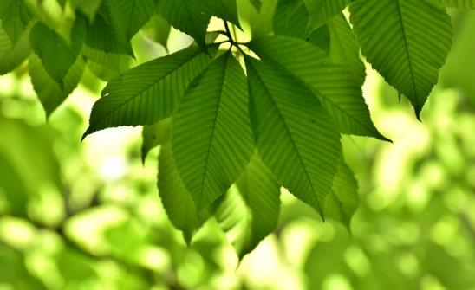
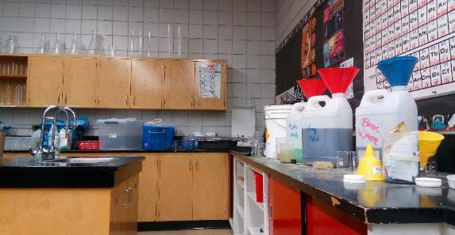
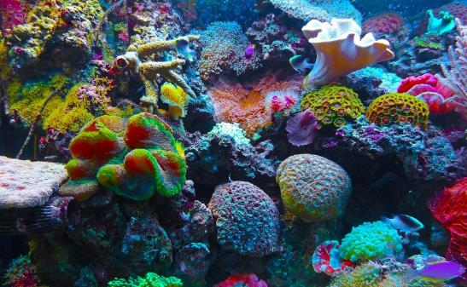
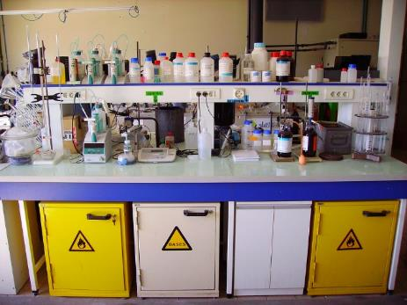
Nature vs. Lab
Image Sources: Wikipedia Commons, Flickr, Pixabay
Notes:
https://commons.wikimedia.org/wiki/File:Chemistry_Lab_at_a_Highschool.jpg
https://www.flickr.com/photos/cjp24/5744968358
https://pixabay.com/en/leaves-tree-sun-summer-green-3509394/
https://pixabay.com/en/coral-coral-reef-reef-sea-567688/

Slide 44
Nature vs. Lab
Chemical transformations happen at ambient temperatures
Minimal waste
Utilize water as a solvent and reagent
Complex molecules seamlessly
Domino and Cascade reactions
Enzymes
High selectively
Chemical transformations happen high temperatures and high pressure
Varying amount of waste produced
Utilize petroleum-based solvents
Complex molecules take skills specialized catalysts
Step-be-step synthesis
Precious metal catalysts
Moderate selectivity

Slide 45
Outline
Stoichiometry & Calculations
Reactions
Important Named Reactions
Lab vs. Nature
Green Chemistry in Perspective
Reagents, solvents, and reactors
Biomimicry

Slide 46
Designing an Ideal Green Reaction
Generate no waste or by-product/Use waste sources
Always addition reaction? No.
Must consider the whole picture.
High yield and high rate
Earth abundant feedstock and catalyst
Energy efficient
Does not require high external energy input.
UV light driven.
Microwave assisted.
No solvent or environmentally benign solvent
Water
Recyclable organic solvent
scCO2
Notes:
Many of these concepts will be elaborated in the next few lectures

Slide 47
Alternative Starting Materials
Renewable Sources
CO₂
Biomass Sources: algae, switchgrass, hemp, and bamboo
Non-competitive food sources
Waste as Starting Materials
Food Waste
Agricultural Waste
Municipal Waste
Adobe stock images

Slide 48
Alternative Solvent Media
Medical Chemistry solvent Selection Guide
Preferred | Usable | Undesirable
Water Acetone Ethanol 2-Propanol 1-Propanol Ethyl Acetate Isopropyl acetate Methanol MEK 1-Butanol t-Butanol | Cyclohexane Heptane Toluene Methylcyclohexane TBME Isooctane Acetonitrile 2-MeTHF THF Xylenes DMSO Acetic Acid Ethylene Glycol | Pentane Hexane(s) Di-isopropyl ether Diethyl ether Dichloromethane Dichloroethane Chloroform NMP DMF Pyridine DMAc Dioxane Dimethoxyethane Benzene Carbon tetrachloride

Slide 49
Microwave Reactors
Expedite chemical reactions by using microwaves as an energy source.
Microwaves allow for molecules to vibrate at a higher frequencies to facilitate chemical transformations which leads to reduced reaction times.
The limiting barrier for microwave reactors is the scalability.
Microwave
irradiation

Slide 50
Microfluidics
Image Source: Wikipedia Commons
Notes:
https://commons.wikimedia.org/wiki/File:Microfluidic_gel_electrophoresis_microsystems.png

Slide 51
Microfluidics
Advantages:
Faster reaction times
Increased mixing capabilities
Lower energy requirements
Increased worker safety
Higher purity = Less work-up procedures
Disadvantages:
More upstream research time
Can be time consuming to optimize reaction conditions
Clogging in microchannels
Currently, limited reactions are possible

Slide 52
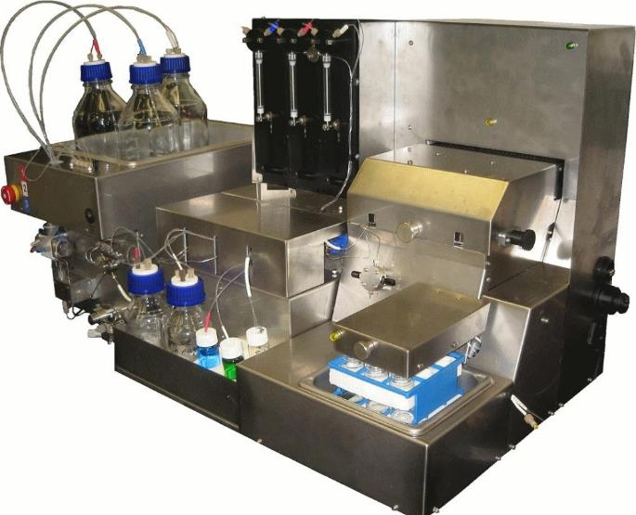
Flow Chemistry
Image Source: Wikipedia Commons
Notes:
Discuss with students what they think the flow reactor looks like. Then move on to the next slides to discuss the potential benefits of flow chemistry.
https://commons.wikimedia.org/wiki/File:Propel_Segmented_Flow_Chemistry_System.jpg
https://commons.wikimedia.org/wiki/File:Uniqsis-FlowSyn_Flow_Reactor.jpg

Slide 53
Flow Chemistry
Compounds are manufactured/synthesized today
utilizing a “batch” system.
Step 1
Step 2
Step 3
Decant & purify
Decant & purify
Decant & purify
Vessel 1
Vessel 2
Vessel 3
Vessel 4

Slide 54
Flow Chemistry
Flow reactors allow chemistry to become automated.
Reagent
A
Input 1
Input 2
Input 3
Reagent
B
Vessel 1
Vessel 2
Vessel 3
Vessel 4
Final Product

Slide 55
Flow Chemistry
Advantages:
Faster reaction times
Increased mixing capabilities
Lower energy requirements
Increased worker safety
Higher purity = Less work-up procedures
Disadvantages:
More upstream research time
Can be time consuming to optimize reaction conditions
Clogging in microchannels
Currently, limited reactions are possible
Notes:
Faster reaction times = increase mass transfer and putting molecules closer together.

Slide 56
Biomimicry
Biomimicry is the science and art of emulating nature's best biological ideas to solve human problems.
Bios = life Mimic = to copy or emulate

Slide 57
Overview of Innovation
Thermal insulation
Cool or heat (buildings, clothing)
Remediate soil
Self-assembling materials
Prevent corrosion
Prevent mineral build-up
Prevent biotic build-up
Generate energy
Sterile, disposable packaging
“After 3.8 billion years of research and development, failures are fossils, and what surrounds us is the secret of survival.”
- Janine Benyus
Notes:
57

Slide 58
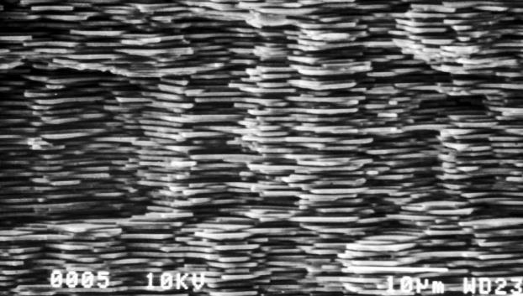
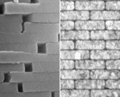
High Tech Materials
3,000x stronger than CaCO₃
Made by abalone
Image: Flickr (Lisa Ann Yount)
Notes:
58
mother of pearl or nacre
ceramics, body armor, rope, construction materials, aeronautics, biomedical devices or implants.
structure = flexibility + strength --- 3000 times stronger than CaCO₃

Slide 59
How We Make Things?
“Heat, beat, and treat”
Image: Pixabay
Notes:
59
GE ceramics factory

Slide 60
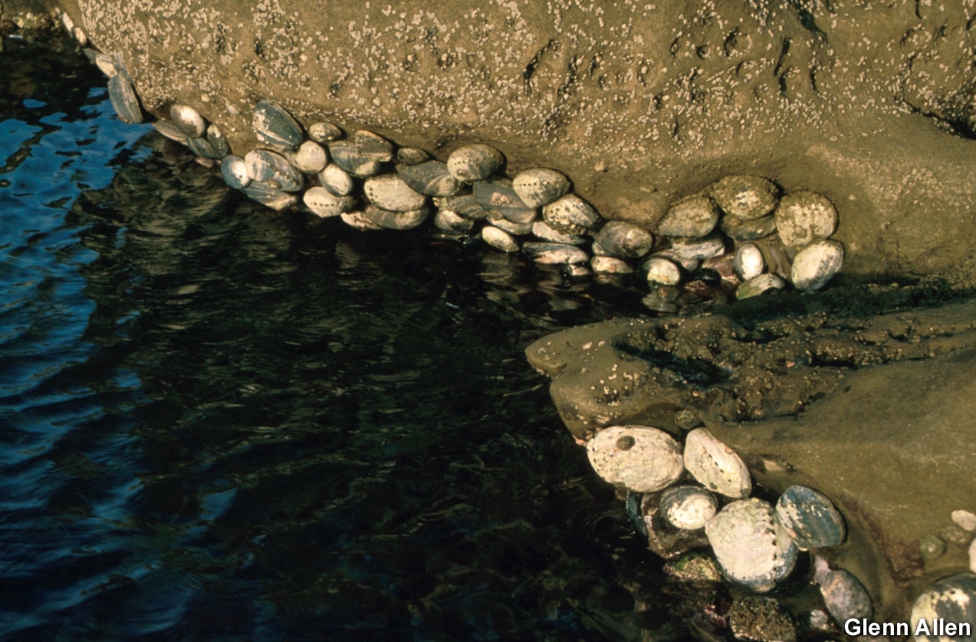
Abalone Ceramics Factory
Notes:
60
Ambient temperature and pressure, no toxics, biodegradable.
No waste, sustainable feedstock, no toxic substances, no outside sources of energy
Another example of crystallization from the “bottom up”: “Bell Labs Scientists Create World's First Micro-Patterned Crystals Inspired by Bioengineering Found in Nature” BUSINESS WIRE, Feb. 21, 2003:
About two years ago (2001), Aizenberg and her colleagues made the surprising discovery that thousands of calcite crystals spread throughout the exoskeletons of brittlestars, starfish-like marine invertebrates, collectively form an unusual kind of compound eye for the animals. The brittlestar's calcite microlenses expertly compensate for birefringence and spherical aberration, two common types of distortions in lenses. This led the Bell Labs scientists to attempt to mimic nature's success and design crystals based on the brittlestar model, with the ultimate goal of building complexes arrays of microlenses like the brittlestar's.
Today lenses are typically made using a "top down" approach, in which a piece of glass is ground down to a lens' exact specifications. The brittlestar, on the other hand, makes its microlenses using a "bottom up" approach, in which successive layers of calcite are deposited onto an organic template in intricate patterns to form perfect crystalline lenses at the temperature of seawater.
"This is an excellent example where we can learn from Nature," said Cherry Murray, senior vice president of physical sciences research at Bell Labs. "In this case, a relatively simple organism has a solution to a very complex problem in integrated optics and materials design. By studying the brittlestar, we can learn about low-cost ways of forming single crystals in complex shapes at low temperatures. While many years from commercial use, this understanding could be very important to fabrication of nano-patterned materials."

Slide 61
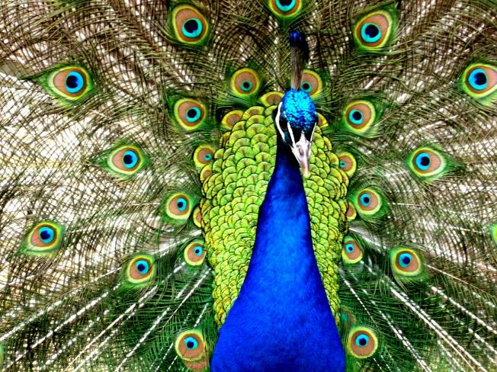
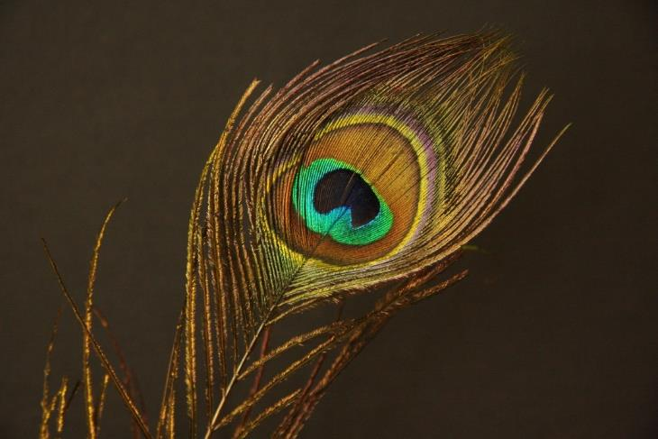
Peacock
How many chemical pigments are needed to produce this assortment of colors?
None! Color is produced through optical interference arising from the surface structure of the feathers
Image: Pixabay
Notes:
61
Take the peacock for example….

Slide 62
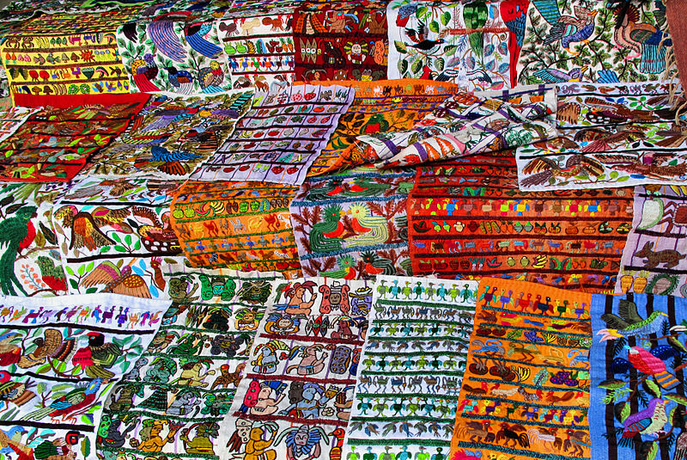
Textiles
How many pigments are used here?
Image: https://commons.wikimedia.org/wiki/File:Guatemalan_Textiles_(3747219020).jpg
Notes:
62
Image: This image was originally posted to Flickr by Francisco Anzola at https://www.flickr.com/photos/10345599@N03/3747219020. It was reviewed on 15 April 2014 by FlickreviewR and was confirmed to be licensed under the terms of the cc-by-2.0.

Slide 63
Textiles
The textiles sector uses thousands of chemicals:
Enzymes for textile processing
Chemicals for finishing textiles
Pre-treatment chemicals
Coating chemicals
Pigments
Polymers
Dyes and dying agents
Colorants
Many of them are toxic.
Notes:
63

Slide 64
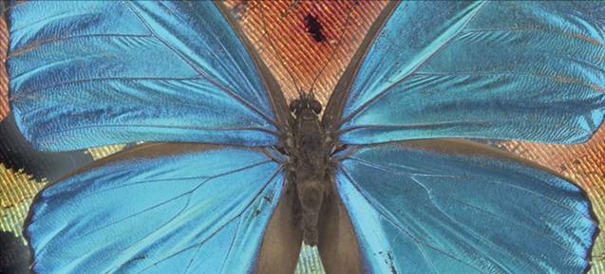
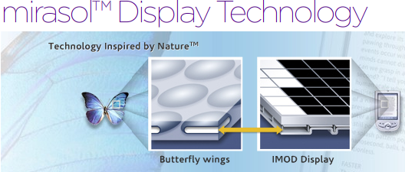
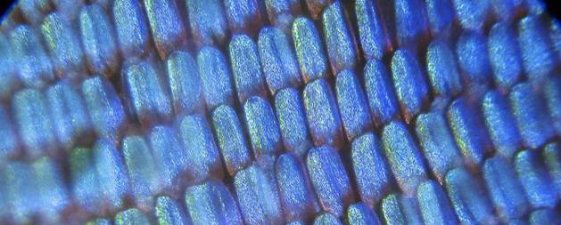
Display Technology
MEMS-based innovation that is bistable (low power consumption) and highly reflective (display can be see in direct sunlight).
Blue Morpho butterfly scales
IMOD = InterferometricMODulation
Image: mirasolTM
Notes:
64
Scales of the blue morpho butterfly inspired new digital display technology.
“Qualcomm’s mirasol display technology is based on a reflective technology called IMOD (InterferometricMODulation), with MEMS structures at its core. This MEMS–based innovation is both bistable, meaning it is both extremely low power, and highly reflective, meaning the display itself can be seen even in direct sunlight.”
MEMs = microelectromechanical systems

Slide 65
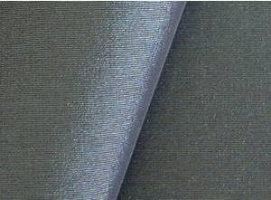
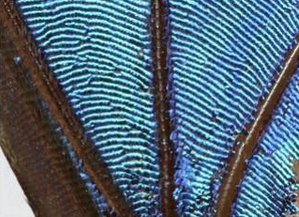
Structural Color
Teijin Limited of Japan
Morphotex Fibers
No dyes or pigments
Color based on varying thickness and structure of fibers
Reduced energy consumption and chemical release by eliminating dye processes
Image: Professor Greg Parker
Image: asknature
Notes:
65
Left - Morphotex structural colored fibers
Right - Morpho Butterfly wings.
Teijin Fibers Limited of Japan produces Morphotex fibers. No dyes or pigments are used. Rather, color is created based on the varying thickness and structure of the fibers. Energy consumption and industrial waste are reduced because no dye process must be used.

Slide 66
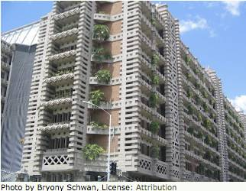
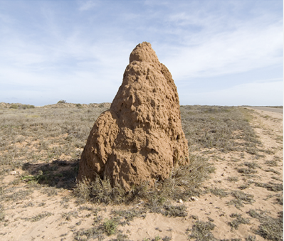
Architecture
90% less energy for ventilation than a comparable conventional building
Eastgate Building in Harare, Zimbabwe
Image: www.morpho-biomimicry.be/
Notes:
66
Eastgate Building in Harare, Zimbabwe
Modeled after termite mound - which can only tolerate a temperature difference of 1 degree day or night.
Uses 90% less energy for ventilation than a comparable conventional building (by utilizing natural air flow through the building rather than relying on traditional HVAC system)

Slide 67
Architecture
Sea Sponge
Image: WikiCommons
Notes:
67
The Swiss Re headquarters in London, otherwise known as "the gherkin," employs a cylindrical design to aid in ventilation with many engineering similarities to the structure of sea sponges.

Slide 68
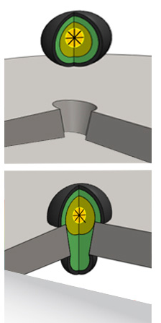
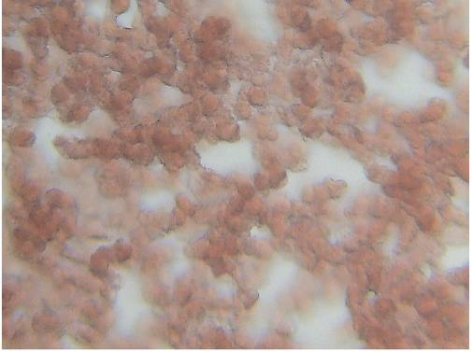
Self-Healing Materials and Systems
Image: Pixabay, Brinker
Notes:
68
Brinker technology developed a way to seal leaks in oil and water pipelines called Platelets. The technology works by injecting the formula into wells/pipes, as the platelets flow through the system, they are attracted to leak causing holes due to the pressure change encountered as they flow over them. The platelet fills the hole, preventing further leakage
Mimics human blood clotting.

Slide 69
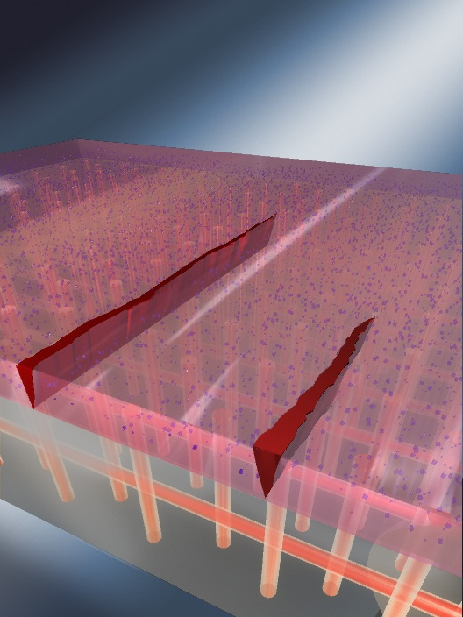
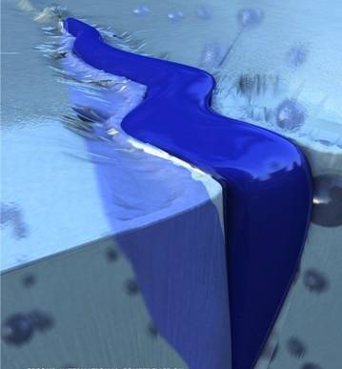
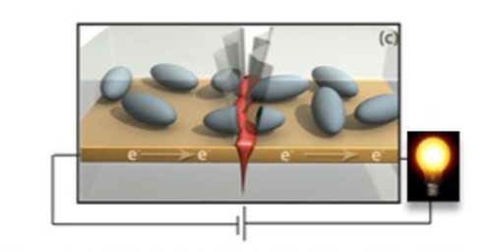
Self-Healing Materials and Systems
Notes:
69
The concept is also applied to polymer and metal systems
Univ Ill Urbana Champagne researchers working on self healing materials: ‘healing’ material incorporated in capsules within polymers. When ruptured (due to cracking or similar), the material in the capsule is released and fills the void and restore structural integrity. Polymers and now iron/steel (self-healing electronics: restore electrical conductance)

Slide 70
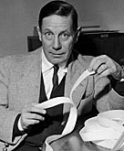
Velcro
"I will design a unique, two-sided fastener, one side with stiff hooks like the burrs and the other side with soft loops like the fabric of my pants. I will call my invention 'velcro' a combination of the word velour and crochet. It will rival the zipper in its ability to fasten.”
- George de Mestral, 1945
Image: WikiCommons
Notes:
70
- hook-by loop fastener was invented in
1945 Swiss engineer George de Mestral who was irritated by the burrs that would cling to his clothing on walks
- inspiration: burdock plant

Slide 71
Still More to Be Learned
“Pond scum may be a synonym for ‘primitive’, but the tiny organisms that compose it easily beat the human state of the art when it comes to capturing energy from the sun. Some purple bacteria answering to that unflattering description use light energy with almost 95% efficiency – more than four times that of the best man-made solar cells.”
- University of Southern California news release, August 22, 1994
Images: WikiCommons
Notes:
71
Bioluminescent bacteria, combine chemicals to light up their bodies
Dragonflies out maneuver helicopters
Hummingbirds cross the Gulf of Mexico on less than one tenth an ounce of fuel
Ants carry 100’s lbs equivalent in dead heat

Slide 72
Still More to Be Learned
“If the age of Earth were a calendar year and today were a breath before midnight on New Year’s Eve, we showed up a scant fifteen minutes ago, and all of recorded history has blinked by in the last sixty seconds.”
- Janine Benyus
Images: WikiCommons
Notes:
72
Bees, turtles and birds navigate w/out maps
penguins dive without scuba gear
Artic fish and frogs freeze solid and then spring back to life, having protected their organs from ice damage
Chameleons and cuttlefish hide without moving by changing patterns in their skin to blend in with their surroundings
How do they do it?!

Slide 73
Summary
Stoichiometry & Calculations
Knowing formulas and stoichiometry allows you to predict reactions
Reactions
Types of reactions: Composition (synthesis), single displacement, double displacement, combustion, elimination (decomposition)
Important Named Reactions
Lab vs. Nature: different approaches for creating materials and “products”!
Green Chemistry in Perspective
Reagents, solvents, and reactors – many considerations in creating a greener chemical product
Biomimicry – using nature as mentor and teacher to inspire new ways of creating greener, more benign products and processes

