Slide 1
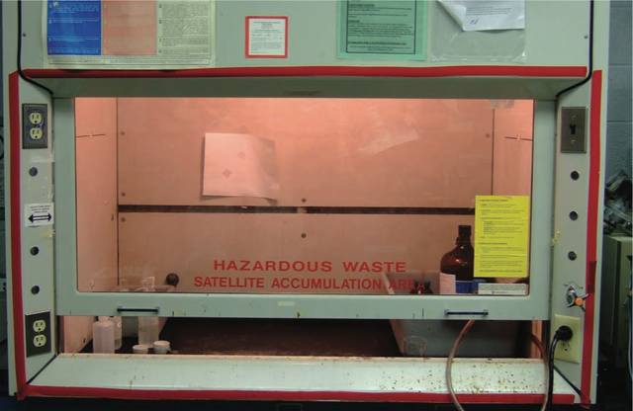

Yale-UNIDO Train-the-Facilitator Workshop in Green Chemistry
Designing for Reduced Hazard
CENTER for GREEN CHEMISTRY
and GREEN ENGINEERING at YALE
Image: Wikimedia Commons, Fume Hood , Author: U.S. National Institute for Occupational Safety and Health

Slide 2
Absorption
Dermal
Respiratory
Digestive
Skin is the first barrier to absorption for the chemical. The skin can keep chemicals out of the body, or it can let them in, depending on the physical and chemical properties of the chemical. Absorption of a chemical will result in the chemical circulating inside the body and perhaps causing adverse effects.
As chemicals are inhaled, they may reach the lungs. The lung surface is a poor barrier against the entry of many chemicals into the body, which means that absorption of chemicals into the lung can be rapid and efficient.
If chemicals are swallowed, either intentionally or unintentionally, they enter the gastrointestinal tract (GI). From there, they may either pass through the body or be absorbed into the body.

Slide 3
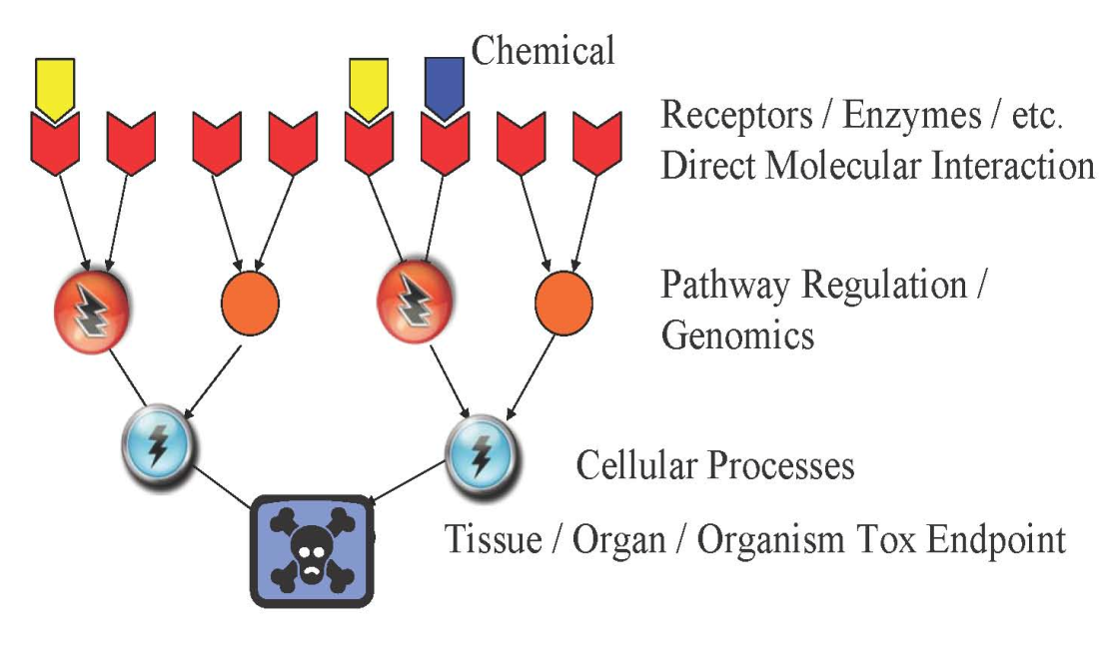
Understanding Physicochemical Properties Associated with Reduced Hazard
DESIGN
Chemical and Physical Properties
pKa chain branching log P molecular refractivity mol. wt. hydrolyzable groups
E_{HOMO} E_{LUMO} electronegativity hardness dipole log D_{7.4} # H-bond accept/donor

Slide 4
Property-Based Guidelines for Bioavailability
Dermal
Respiratory
Digestive
Parameter | Preferred | Not Preferred
Physical state | solid | liquid
LogP | Less than 0 or greater than 5 | Between 0 and 5
Molecular weight | More than 400 Da | Less than 400 Da
Parameter | Preferred | Not Preferred
Particle size | More than 5 nm | Less than 5 nm
LogP | Less than 0 or greater than 5 | Between 0 and 5
Molecular weight | More than 400 Da | Less than 400 Da
Vapor pressure [mmHg] | Less than 0.001 | More than 0.001
Parameter | Preferred | Not Preferred
Particle size | More than 100 nm | Less than 100 nm
LogP | Less than 0 or greater than 5 | Between 0 and 5
Phase | solid | liquid
Molecular Weight [Da] | More than 500 Da | Less than 400 Da
LogP – measure of partition coefficient of a molecule between aqueous and lipophilic phases.
Notes:
LogP – measure of partition coefficient of a molecule between aqueous and lipophilic phases.
Da – Dalton, unit of molar mass, g/mol

Slide 5
Safer Chemical Design Game
Educational game based on ADME and scientific data for surfactants to make connection between physico-chemical properties and health.
http://gwiz.yale.edu
Courtesy of Molecular Design Research Network and Dr. Karolina Mellor

Slide 6
Approaches to Hazard Minimization through Molecular Design

Slide 7
Green Chemistry Molecular Design Pyramid
Toxicodynamics
Not well understood and relatively complex
Receptor
binding
Key events
Bioaccumulation/
Persistence
Bioavailability Structure/Shape Activity Mechanism of Action
Shape/
Molar Volume
Reactive
Functional
Groups
That’s what we want to target
Solubility
Electronic
Charge
Chemists can control quite well
Molecular
Weight
Volatility
Particle
size
Toxicokinetics

Slide 8
Approaches to Hazard Minimization Through Molecular Design
Elimination of the molecular initiating event that activates pathway
Changing reactive functional groups
Reducing or eliminating bioavailability
Reduction of need for associated hazardous substances
Design for End-of-Use product life

Slide 9
Elimination of the molecular initiating event that activates pathway
Where the mechanistic pathway of action is known, molecular structures can be designed such that the necessary reactions are either impossible or highly disfavored resulting in significant toxicity reduction.

Slide 10
B. Changing Reactive Functional Groups
In the absence of specific mechanistic information, chemists can modify structure such that certain reactive functional groups, e.g. cyano, electrophilic, etc, can be minimized or eliminated from the chemical structure where feasible.

Slide 11
C. Reducing or Eliminating Bioavailability
In order for a chemical to manifest its intrinsic hazard, it must be able to reach the toxicological target, human, animal, environmental or global. Through structural molecular design, properties such as solubility, log Kow, and volatility can adjusted to reduce hazard manifestation.
Notes:
The octanol/water partition coefficient (Kow) is defined as the ratio of a chemical's concentration in the octanol phase to its concentration in the aqueous phase of a two-phase octanol/water system

Slide 12
D. Reduction of Need for Associated Hazardous Substances
Many chemical substances, if not hazardous themselves, require the use of other hazardous substances e.g. paints with VOCs, surfaces requiring specific cleaners, plastics with various additives.
Through molecular design, these associated substances can be eliminated by making the desired properties integral to the product

Slide 13
E. Design for End-of-Useful Product Life
Persistence of chemical in the environment is a problem that can be designed out of molecular structure.
By creating products that degrade to innocuous by-products under designed conditions, e.g., heat, light, time one can reduce or eliminate this hazard.
Design for utilization of waste as a feedstock is an important goal.

Slide 14
By Changing the Molecular Charge: Cephalosporins
Cephalosporins: Antibiotic molecules used for gram+ bacteria
Clinical nephrotoxicity was recognized early – damage to proximal tubular epithelia.
Mechanism: the drug is rapidly transported across basolateral membrane via the organic anion transporter, OAT1. Transport out of cell into lumen is less well characterized (involves other OAT, OAT4).
Cephalosporin has a very low affinity for OAT4 due to its zwitterionic character, resulting in considerable intracellular accumulation
In contrast, cephalothin, an anionic analog of the original zwitterionic drug, rapidly moves across the epithelia from blood into urine
Is thus not a neurotoxin
Cephaloridine
Cephalothin
Notes:
Cephalosporins are a type of beta-lacatam antibiotic.
First generation:Cephaloridine

Slide 15
By Manipulating Sterics: Paraquat and Diquat
Diquats and Paraquats are herbicides (plant killer), primarily for weed and grass control
Paraquat
Diquat
Both: Toxic doses are life threatening. Impacts GI tract, kidney lungs, liver, heart, other organs
Paraquat is not metabolized by the liver. It has life-threatening effects on the gastrointestinal tract, kidney, liver, heart and other organs
In animal studies, diquat causes mild, reversible injury
Registered as a restricted use pesticide
Not registered as a restricted use pesticide
http://npic.orst.edu/RMPP/rmpp_ch12.pdf
Notes:
Paraquat is a non-selective contact herbicide of the diphenyl class. It was introduced in the 1960s and became used worldwide. However it was soon recognized that paraquat also cause selective pulmonary toxicity to humans (damage to alveolar cells type I and II, causing edema, inflammation and hermorrhage, lung fibrosis).
Steric effects are nonbonding interactions that influence the shape and reactivity of ions and molecules. Steric effects complement electronic effects, which usually dictate shape and reactivity. Steric effects result from repulsive forces between overlapping electron clouds.

Slide 16
By Manipulating Electrophilicity: Acrylates
Acrylate is understood to be carcinogenic because it can readily undergo Michael addition reactions
The addition of a methyl group to form methacrylate decreases the electrophilicity of the b-carbon, and decreases tendency for Michael reactions.
While this does not reduce the commercial efficacy, but whereas acrylate causes cancer is experimental assays, methacrylate does not.
Acrylate
carcinogenic
Methacrylate
non-carcinogenic
Notes:
Electr

Slide 17
By Facilitating Detoxification: Benzene
Benzene is known to cause hematotoxicity and leukemia in humans
This is understood to be due to one of its metabolites, (E,E)-muconaldehyde.
Toluene is comparatively much less toxic, as the methyl group is oxidized more easily than the benzene ring to give benzoic acid
hematotoxicity,
leukemia
hepatic oxidation
non-toxic
[detoxification]

Slide 18
By Isosteric Substitution: Carbon with Silicon
DDT
(Toxic to insects)
Si-DDT Analog
(Non-toxic to insects)
DDT is well known to be environmentally persistent.
DDT analog with Silicon above was synthesized.
While less persistent, the analog turned out to be non-toxic to insects.
This is due to the more readily oxidized (metabolized) Si-H bond compared to C-H and also the larger size of the molecule.

Slide 19
Designing New Molecules is Not a Trivial Task
Even if chemists design one chemical, it has to undergo tests

Slide 20
QSAR-Quantitative Structure Activity Relationship
QSAR = classification models used in the chemical and biological sciences and engineering
QSAR established relationship
Known data sets
"predictor" variables
QSAR
potency of the response variable
Structure, physico-chemical properties, chemical functionalities
Biological activity: toxicology and eco-toxicology
[like LC50 or oxidative stress]
QSAR predicted potency of the response variable
New molecules
"predictor" variables
QSAR
QSAR uses the learnt rules to predict biology
Wikipedia

Slide 21
Why use QSAR?
Not sufficient data on most chemicals
Not all chemicals can be tested
QSAR has been used successfully for over 60 years
Better to predict than have nothing

Slide 22
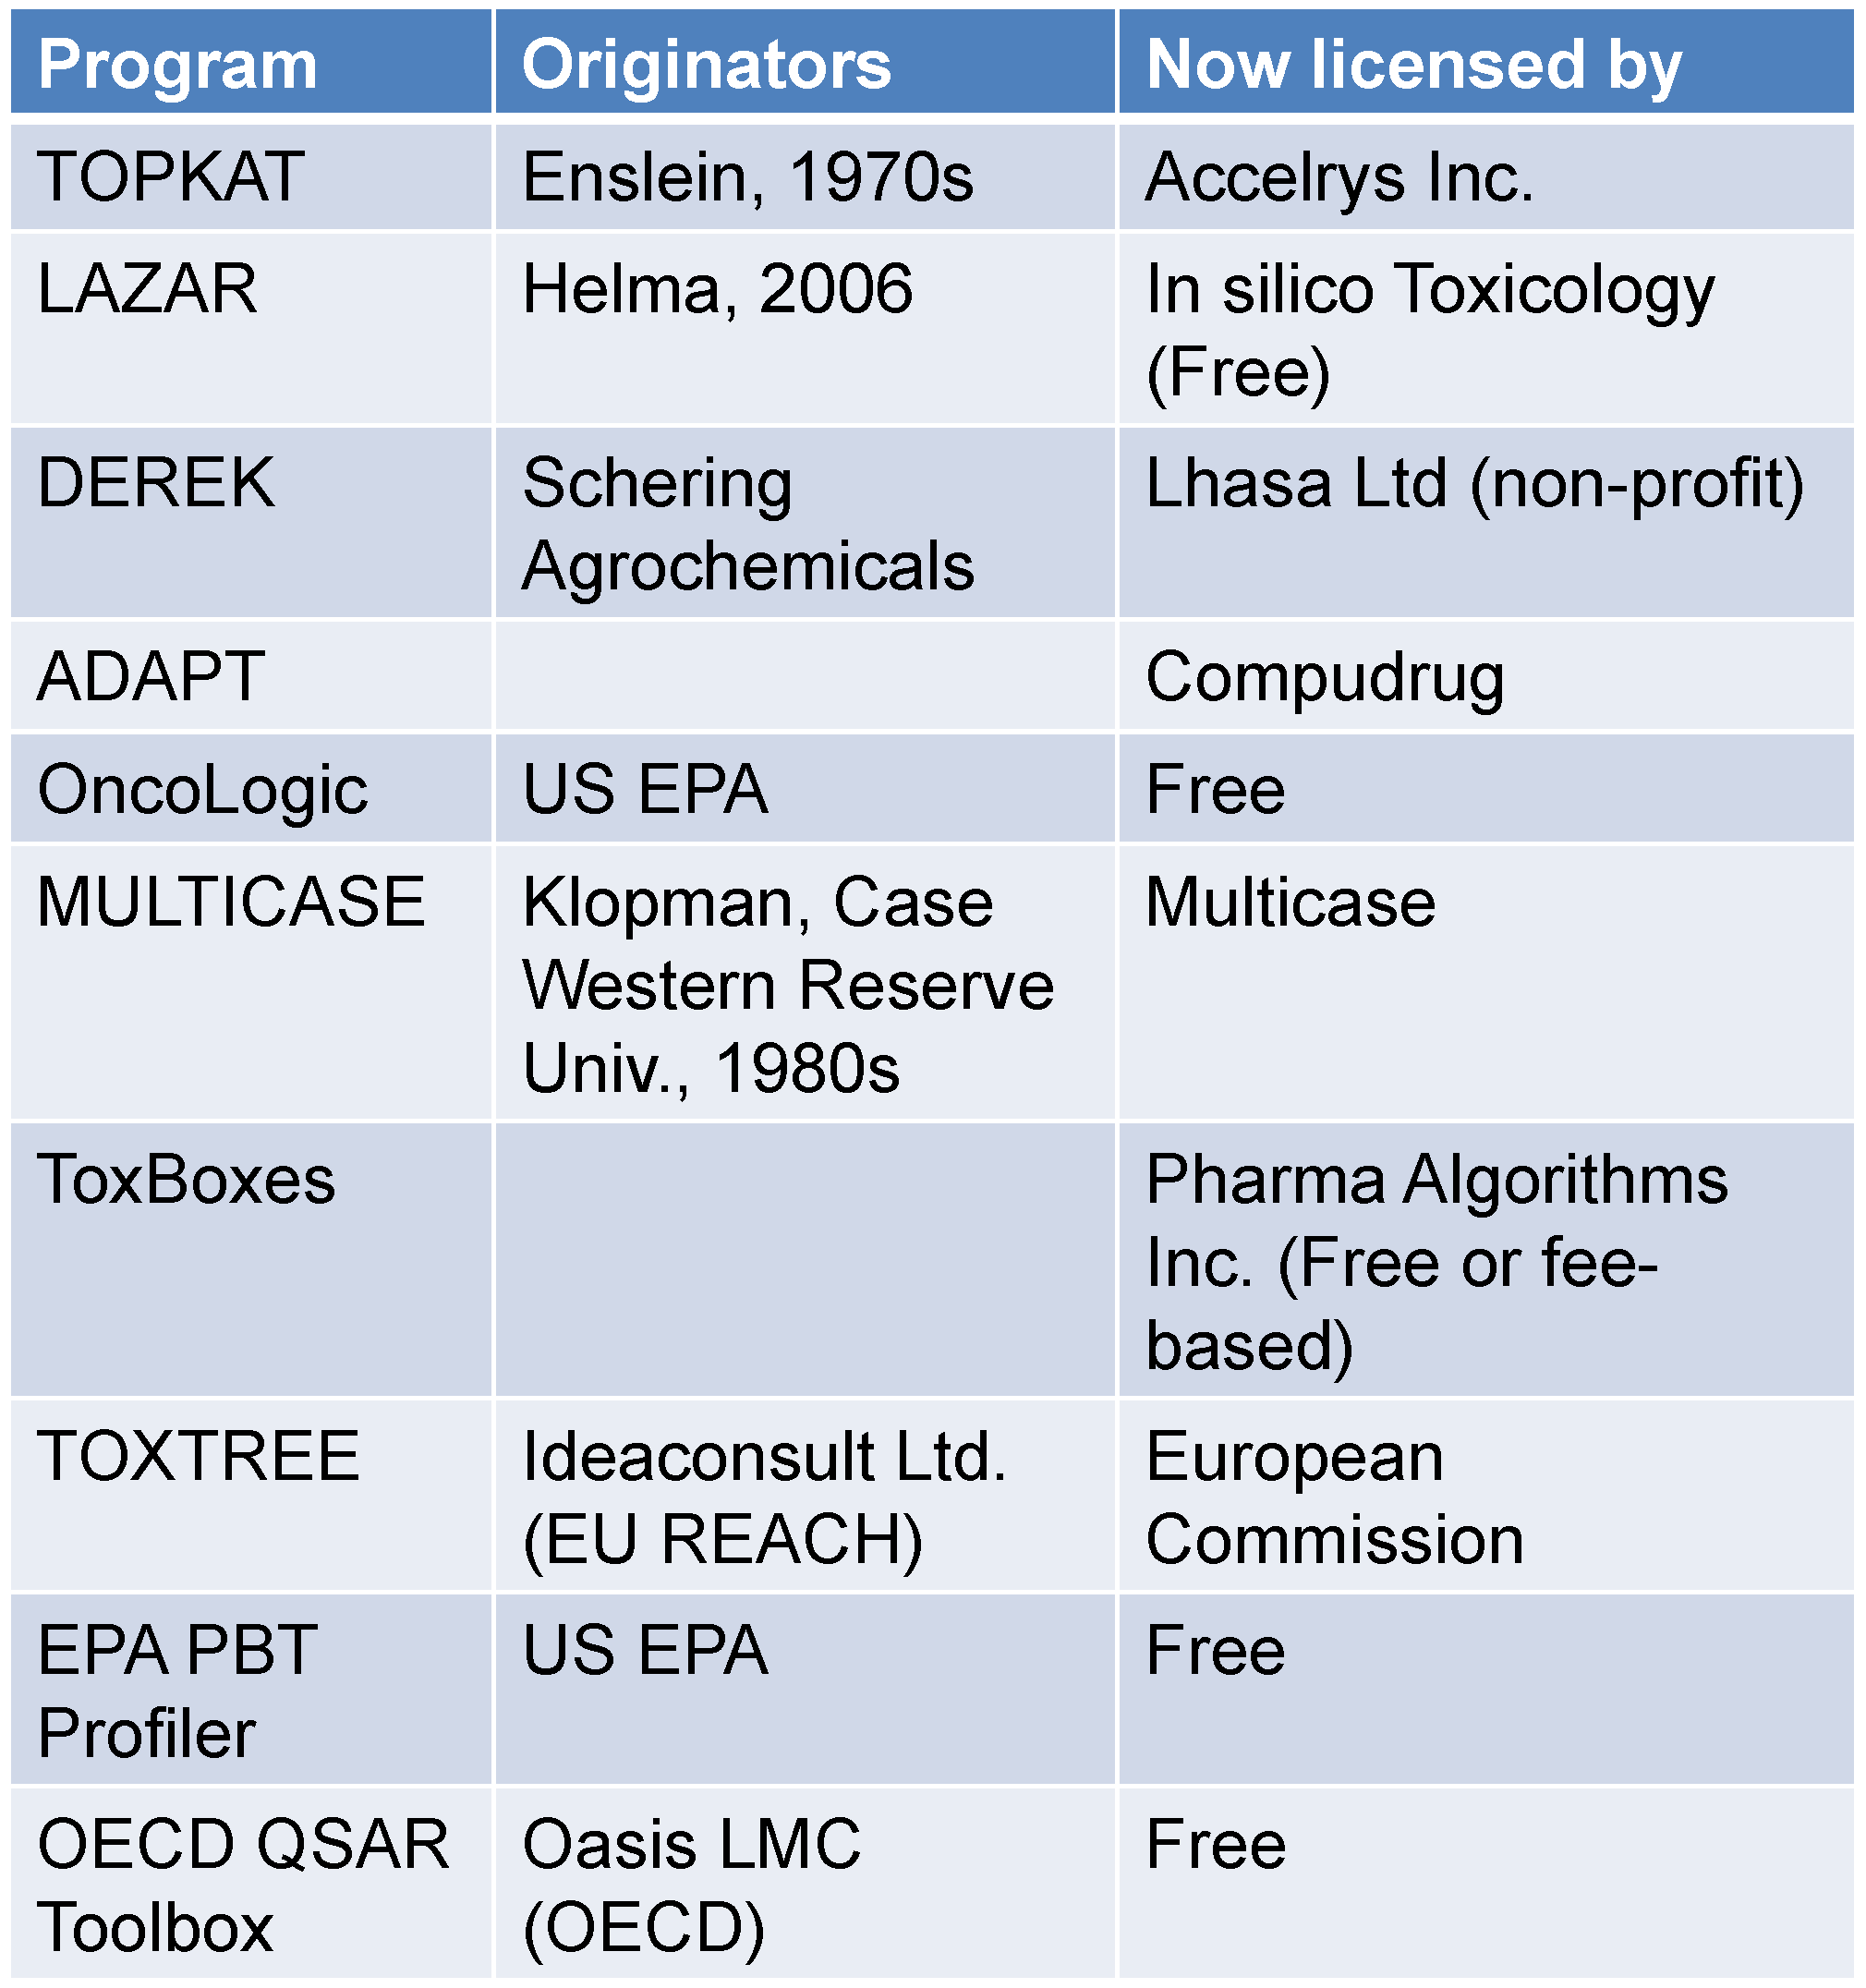
Examples of Popular Toxicity Prediction Tools
Current limitations
Prediction accuracy not higher than 65-70% for non-carcinogenic chemicals.
Lack of validation with up-to-date data.
Application to a narrow range of chemical structures.
Qualitative output.

Slide 23
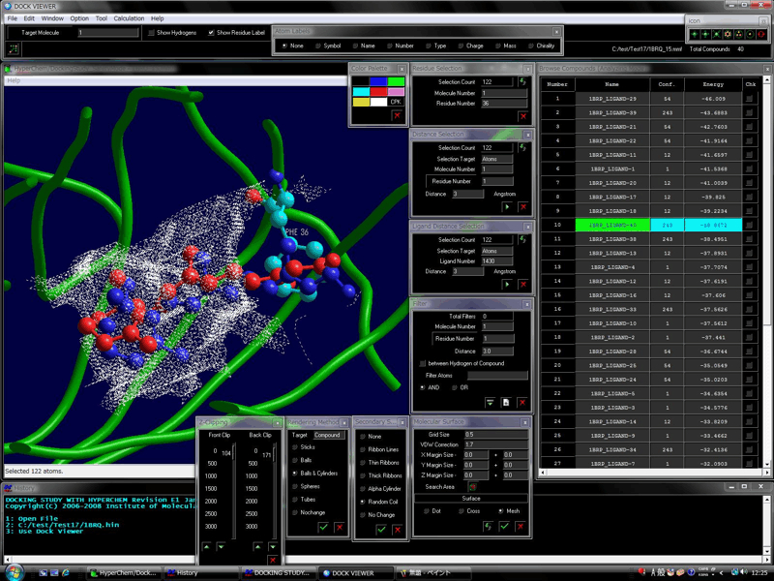
Next generation: powers of computational Chemistry
Docking software have been able to model very precisely the active site of a target enzyme (target to a drug for instance, or to a toxic).
In drug design such software are used to predict the best molecules for biological activity. Only the best performing are synthesized and tested.
Similar ideas can be used in toxicology
http://www.molfunction.com/software5.htm
Notes:
Jakub’s slide

Slide 24
What’s the need?
Create a reliable tool for chemists which will not only predict the toxicity of existing chemicals but will allow a design of future molecules with reduced hazard

Slide 25

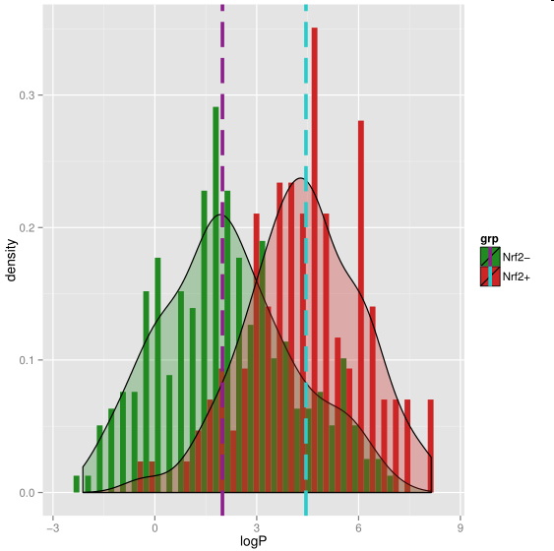
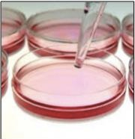
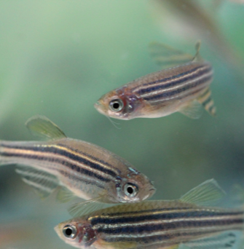

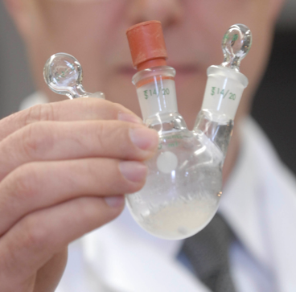





Molecular Design Research Network
Toxicology
Chemistry
Molecular Biology
Computational Chemistry
Notes:
MoDRN is the collaboration between 4 universities Baylor, GW, UWASH and Yale that uses advances in biology, toxicology, computational chemistry and engineering to develop a robust and well validated computer software that will not only predict toxicity of existing compounds but it will serve as a tool to redefine guidelines for the next generation molecules with reduced hazard. The network will employ the newest strategies of computer modeling to build a computer software which will allow to understand what causes toxic endpoints and what can we do to avoid it. Our efforts will not only limit to research. To have the biggest possible impact we will engage educators and students on undergraduate and high school level to by including safer chemical design in students’ lesson plans and by developing interactive and hands-on teaching tools for undergraduate and high school students. Finally we plan to work with our colleagues across academia, colleagues across many industry sectors and policymakers on the government level to further inform and disseminate safe chemical concepts.

Slide 26
Sponsored by Yale-UNIDO Initiative
QUESTIONS?
CENTER for GREEN CHEMISTRY
and GREEN ENGINEERING at YALE

