Slide 1
Green Chemistry and Energy
Lecture #19
Date
Course #

Slide 2
Outline
Current state of energy consumption: Globally
Source of energy:
  Power plant – coal, oil, natural gas
  Renewable – Biofuels, solar cell, Fuel cells, hydro, etc.
Energy in the Laboratory
  Thermal
  Cooling
  Distillation
  Equipment
  Synthesis
New Modern Applications

Slide 3
Outline
Current state of energy consumption: Globally
Source of energy:
  Power plant – coal, oil, natural gas
  Renewable – Biofuels, solar cell, Fuel cells, hydro, etc.
Energy in the Laboratory
  Thermal
  Cooling
  Distillation
  Equipment
  Synthesis
New Modern Applications

Slide 4
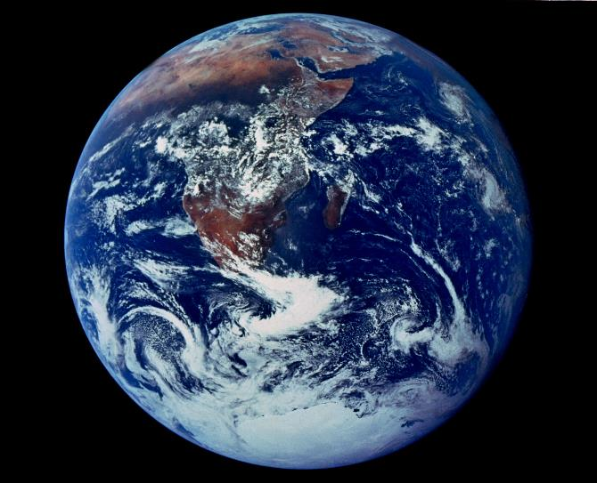
Humanity’s Top Ten Problems for next 50 years
ENERGY
WATER
FOOD
ENVIRONMENT
POVERTY
TERRORISM & WAR
DISEASE
EDUCATION
DEMOCRACY
POPULATION
2003 6.3 Billion People
2050 8-10 Billion People
From: The ENERGY REVOLUTION
(The Terawatt Challenge),
Nobel Laureate Richard Smalley
https://commons.wikimedia.org/wiki/File:Apollo_17_Image_Of_Earth_From_Space.jpeg
Notes:
Image Source: https://commons.wikimedia.org/wiki/File:Apollo_17_Image_Of_Earth_From_Space.jpeg
Energy Independence, Transcript of the Testimony of Richard E. Smalley to the Senate Committee on Energy and Natural Resources —April 27, 2004: http://www.americanenergyindependence.com/energychallenge.aspx

Slide 5
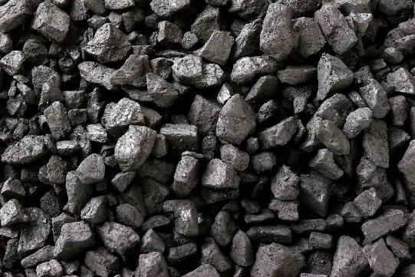
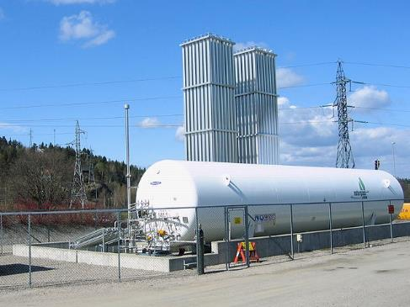
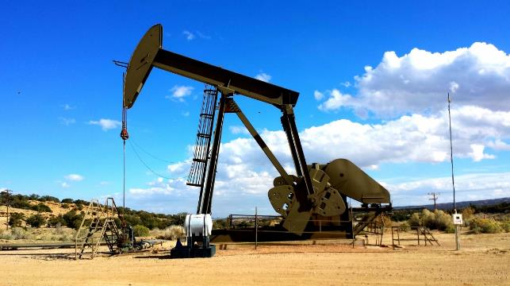
World Energy Consumption: 19th – 20th Century
Coal
Natural Gas
Oil
https://commons.wikimedia.org/wiki/File:LNG_installation.JPG
https://pxhere.com/en/photo/775734
https://commons.wikimedia.org/wiki/File:CSIRO_ScienceImage_10945_Coal.jpg

Slide 6
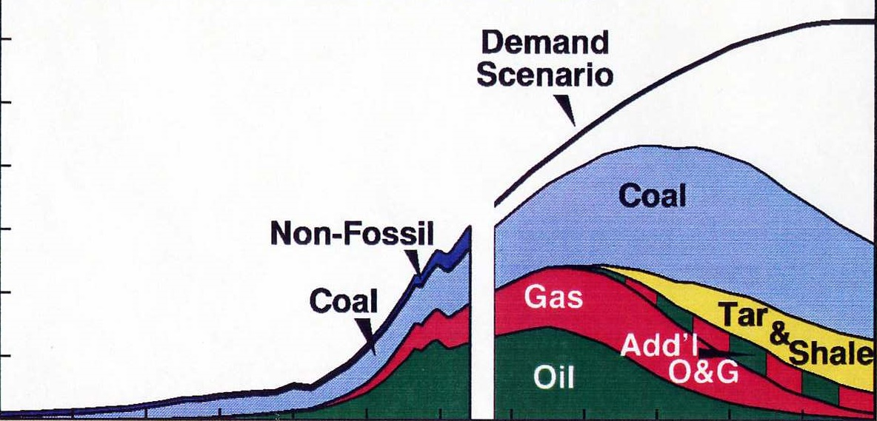
World Oil Energy Projections
Millions of Barrels per Day (Oil Equivalent)
300
200
100
0
1860 1900 1940 1980 2020 2060 2100
Source: John F. Bookout (President of Shell USA) ,“Two Centuries of Fossil Fuel Energy” International Geological Congress, Washington DC; July 10,1985. Episodes, vol 12, 257-262 (1989).
Notes:
Energy Independence, Transcript of the Testimony of Richard E. Smalley to the Senate Committee on Energy and Natural Resources —April 27, 2004: http://www.americanenergyindependence.com/energychallenge.aspx

Slide 7
The ENERGY REVOLUTION (The Terawatt Challenge)
The Basis of Prosperity
20st Century = OIL
21st Century = ??
14 Terawatts
210 M BOE/day
From: The ENERGY REVOLUTION
(The Terawatt Challenge),
Nobel Laureate Richard Smalley
Notes:
From: Energy Independence, Transcript of the Testimony of Richard E. Smalley to the Senate Committee on Energy and Natural Resources —April 27, 2004: http://www.americanenergyindependence.com/energychallenge.aspx
The world energy demands in 2003 – 14 terawatts, 210 Million barrels of oil equivalent/day – the basis of our energy in the 20th century has been grounded in oil and petroleum. Will this change in the 21st century?

Slide 8
The ENERGY REVOLUTION (The Terawatt Challenge)
14 Terawatts
210 M BOE/day
30 -- 60 Terawatts
450 – 900 MBOE/day
From: The ENERGY REVOLUTION
(The Terawatt Challenge),
Nobel Laureate Richard Smalley
Notes:
Energy Independence, Transcript of the Testimony of Richard E. Smalley to the Senate Committee on Energy and Natural Resources —April 27, 2004: http://www.americanenergyindependence.com/energychallenge.aspx
The world energy demands in 2003 – 14 terawatts, 210 Million barrels of oil equivalent/day – the basis of our energy in the 20th century has been grounded in oil and petroleum. Will this change in the 21st century?
Richard Smalley, the late Nobel Laureate projected that in 2050 the world energy demands will have doubled or quadrupled – in many of his presentations leading up to his passing 2005, he stated the importance of shifting our energy dependence from oil and petroleum to renewable sources – such as solar, wind and geothermal.

Slide 9
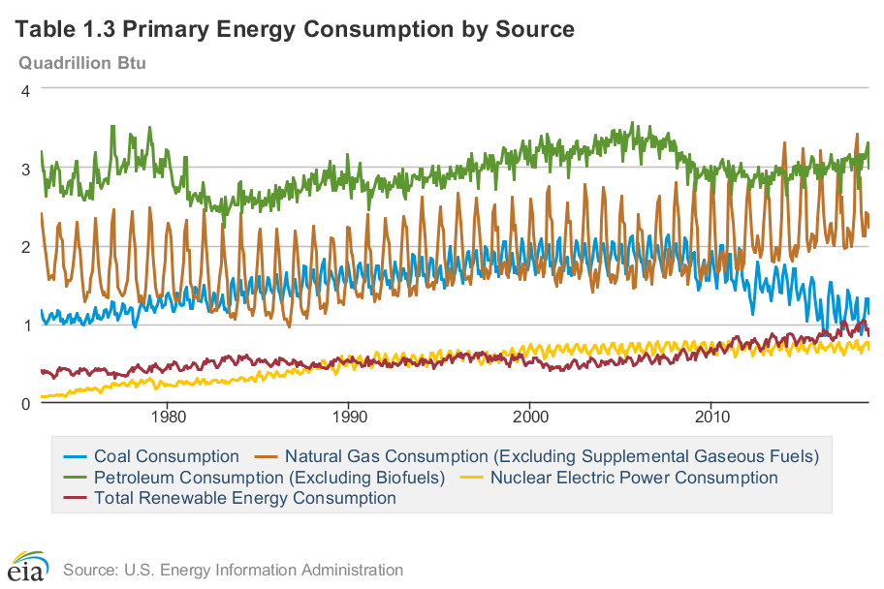
Current Statistics: World Energy Consumption
Renewable energy consumption:
has only slightly increased in the U.S. since 1973
Up from 0.5 quadrillion Btu to 1 quadrillion Btu since 2000
https://www.eia.gov/totalenergy/data/browser/?tbl=T01.03
Notes:
This statistic shows the daily demand for crude oil - including biofuels - worldwide from 2006 to 2017, and estimated figures for 2018 and 2019. In 2010, global crude oil demand was 86.4 million barrels per day. In 2018, it is expected to increase to approximately 99 million barrels per day.
What is noticeable about renewable energy consumption?
From the U.S. Energy Information Administration: https://www.eia.gov/totalenergy/data/browser/?tbl=T01.03

Slide 10
Greenhouse Gas Emissions
Source: Boden, T.A., Marland, G., and Andres, R.J. (2017). National CO2 Emissions from Fossil-Fuel Burning, Cement Manufacture, and Gas Flaring: 1751-2014, Carbon Dioxide Information Analysis Center, Oak Ridge National Laboratory, U.S. Department of Energy, doi 10.3334/CDIAC/00001_V2017.
Source: IPCC (2014)
Notes:
Source: Boden, T.A., Marland, G., and Andres, R.J. (2017). National CO2 Emissions from Fossil-Fuel Burning, Cement Manufacture, and Gas Flaring: 1751-2014, Carbon Dioxide Information Analysis Center, Oak Ridge National Laboratory, U.S. Department of Energy, doi 10.3334/CDIAC/00001_V2017.
Source: IPCC (2014)
Carbon dioxide (CO2): Fossil fuel use is the primary source of CO2. CO2 can also be emitted from direct human-induced impacts on forestry and other land use, such as through deforestation, land clearing for agriculture, and degradation of soils. Likewise, land can also remove CO2 from the atmosphere through reforestation, improvement of soils, and other activities.
Methane (CH4): Agricultural activities, waste management, energy use, and biomass burning all contribute to CH4 emissions.
Nitrous oxide (N2O): Agricultural activities, such as fertilizer use, are the primary source of N2O emissions. Fossil fuel combustion also generates N2O.
Fluorinated gases (F-gases): Industrial processes, refrigeration, and the use of a variety of consumer products contribute to emissions of F-gases, which include hydrofluorocarbons (HFCs), perfluorocarbons (PFCs), and sulfur hexafluoride (SF6).
Electricity and Heat Production (25% of 2010 global greenhouse gas emissions): The burning of coal, natural gas, and oil for electricity and heat is the largest single source of global greenhouse gas emissions.
Industry (21% of 2010 global greenhouse gas emissions): Greenhouse gas emissions from industry primarily involve fossil fuels burned on site at facilities for energy. This sector also includes emissions from chemical, metallurgical, and mineral transformation processes not associated with energy consumption and emissions from waste management activities. (Note: Emissions from industrial electricity use are excluded and are instead covered in the Electricity and Heat Production sector.)
Agriculture, Forestry, and Other Land Use (24% of 2010 global greenhouse gas emissions): Greenhouse gas emissions from this sector come mostly from agriculture (cultivation of crops and livestock) and deforestation. This estimate does not include the CO2 that ecosystems remove from the atmosphere by sequestering carbon in biomass, dead organic matter, and soils, which offset approximately 20% of emissions from this sector.[2]
Transportation (14% of 2010 global greenhouse gas emissions): Greenhouse gas emissions from this sector primarily involve fossil fuels burned for road, rail, air, and marine transportation. Almost all (95%) of the world's transportation energy comes from petroleum-based fuels, largely gasoline and diesel.
Buildings (6% of 2010 global greenhouse gas emissions): Greenhouse gas emissions from this sector arise from onsite energy generation and burning fuels for heat in buildings or cooking in homes. (Note: Emissions from electricity use in buildings are excluded and are instead covered in the Electricity and Heat Production sector.)
Other Energy (10% of 2010 global greenhouse gas emissions): This source of greenhouse gas emissions refers to all emissions from the Energy sector which are not directly associated with electricity or heat production, such as fuel extraction, refining, processing, and transportation.

Slide 11
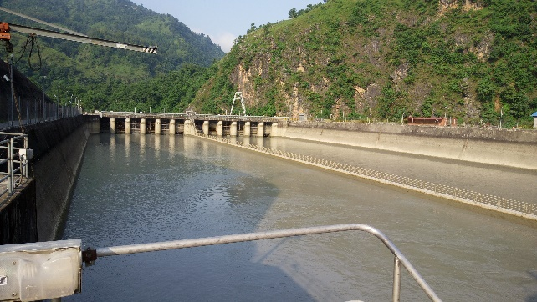
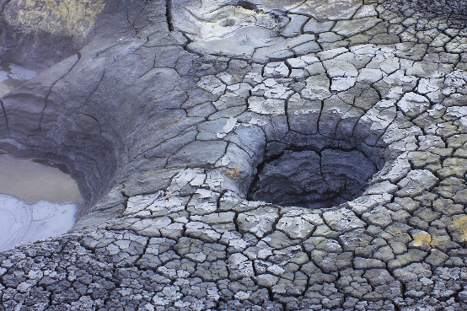

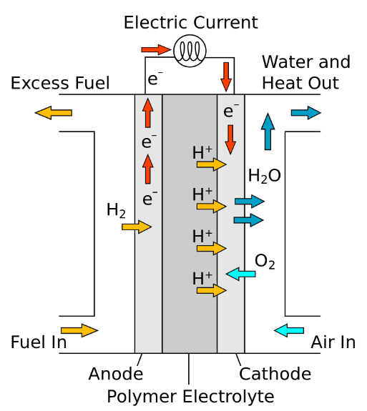

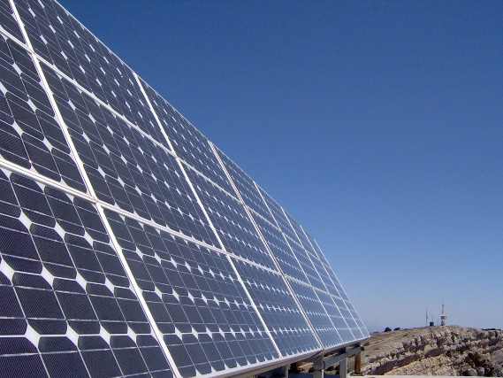

Alternatives to Fossil Fuels
Hydroelectric
Geothermal
Biomass
Hydrogen
Wind
Ocean Energy
Solar
Image Sources: Wikipedia Commons, Maxpixel, Pixabay
Notes:
Image Sources: https://commons.wikimedia.org/wiki/File:Water_reservoir_of_Kaligandaki_A_Hydroelectric_Power_Station_in_Syangja_district.jpg
https://www.maxpixel.net/Geothermal-Energy-Geothermal-Steam-Iceland-2399187
https://commons.wikimedia.org/wiki/File:Lush_green_pine_forest_(Unsplash).jpg
https://www.maxpixel.net/Wind-Energy-Pinwheel-Current-Wind-Power-Energy-3762943
https://pixabay.com/en/wave-sea-shore-energy-power-1703979/
https://commons.wikimedia.org/wiki/File:Solar_Panels.jpg
https://commons.wikimedia.org/wiki/File:PEM_fuel_cell.svg

Slide 12
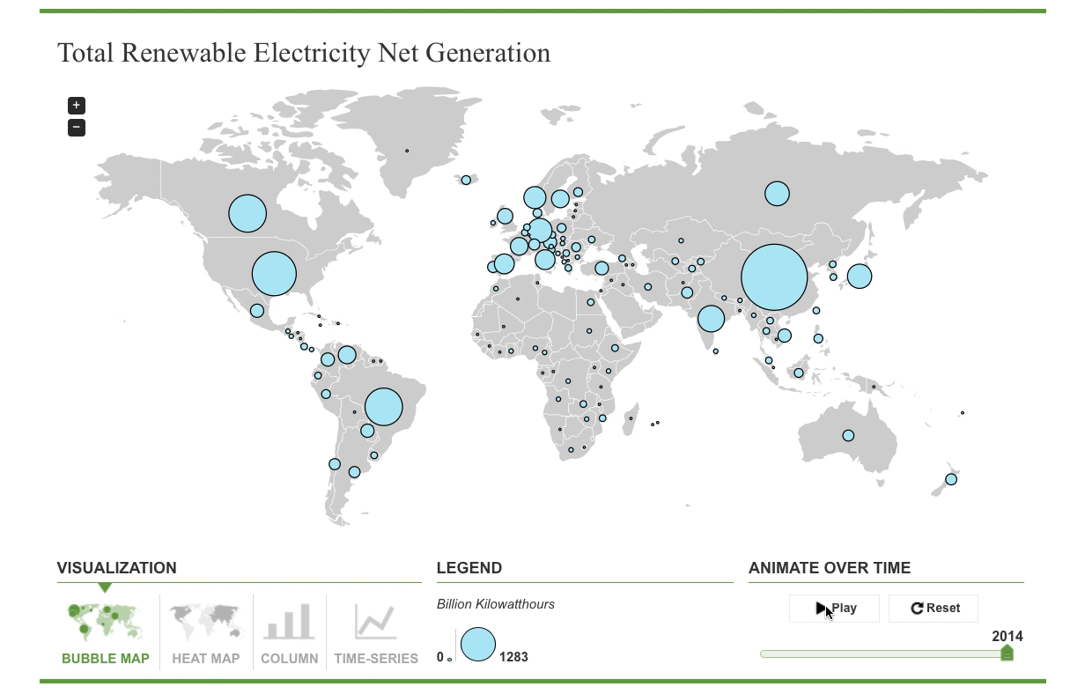
World Renewable Electricity: 1980-2014
Source: US Energy Information Administration
Notes:
From U.S. Energy Information Administration – International Energy Statistics: https://www.eia.gov/beta/international/data/ - use this interactive map to look at international energy statistics.
This shows world renewable electricity generation from 1980 to 2014

Slide 13
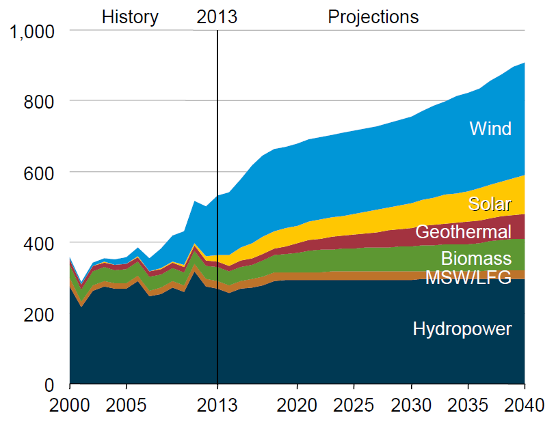
World Renewable Energy Projections
Renewable electricity generation by fuel type from 2000 – 2040 (billion kilowatthours)
Can biomass have a larger role?
Notes:
Based upon initial projections on renewable energy sources, wind and solar are projected to have the biggest long term energy generation. However, with advancements being made in the biomass conversion technologies via Green Chemistry, it is entirely possible that biomass could have a larger role in the near future.
Image Source: https://commons.wikimedia.org/wiki/File:US_renewable_electricity_generation_AEO_Reference_case_2000-2040.png

Slide 14
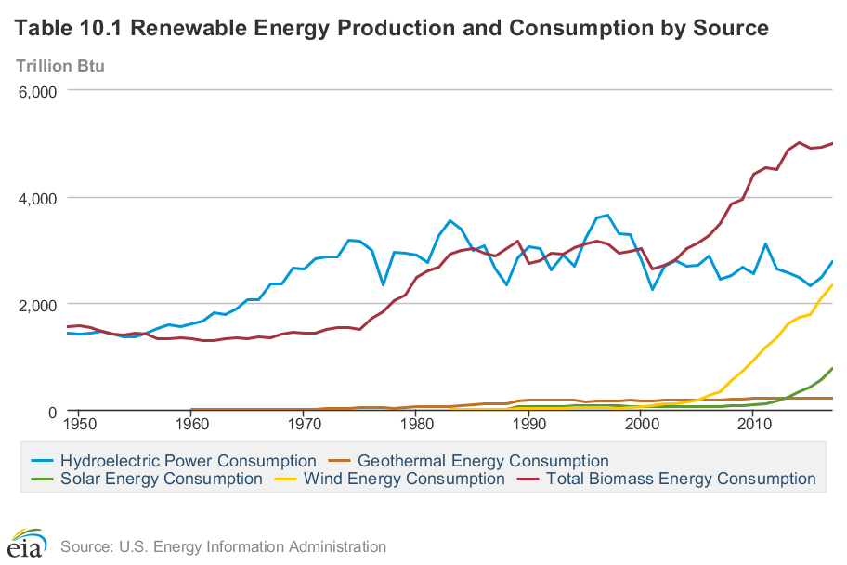
Current Statistics: World Renewable Energy Consumption
Notes:
From the U.S. Energy Information Administration: https://www.eia.gov/totalenergy/data/browser/?tbl=T01.03

Slide 15
Outline
Current state of energy consumption: Globally
Sources of energy:
  Power plant – coal, oil, natural gas
  Renewable – Biofuels, solar cell, Fuel cells, hydro, etc.
Energy in the Laboratory
  Thermal
  Cooling
  Distillation
  Equipment
  Synthesis
New Modern Applications

Slide 16


Biomass
Most biomass energy is obtained by burning:
  [CH₂O] + O₂ → CO₂ + H₂O
CO₂ output can be considered neutral
Actual energy content of dried biomass is ~14-17 GJ/ton
  1/3 that of oil and significantly less than natural gas (55 GJ/ton)
Image Source: Public Domain, https://www.maxpixel.net/Wood-Biomass-Trunks-334549
Image Source: Creative Commons, https://pixabay.com/en/background-biomass-crop-cut-70997/
Notes:
Image Source: Creative Commons, https://pixabay.com/en/background-biomass-crop-cut-70997/
Image Source: Public Domain, https://www.maxpixel.net/Wood-Biomass-Trunks-334549

Slide 17
Biomass Conversion
Water content
Of substrate
15%
Burning
Heat, CO₂, H₂O
Thermolysis
Char, oil, gases
Pyrolysis
Gases, Char
Biomass
Gasification
CO, H₂, CO₂, CH₄
Hydrothermolysis
Oil, char, gases (CO₂)
Fermentation
Ethanol, CO₂
Anaerobic
digestion
CH₄, H₂O
>85%
C. Okkerse & H. van Bekkum, Green Chemistry, 1999, 1, 107-114

Slide 18
Biomass
Biodiesel
Ruldolf Diesel: groundnut oil
Diesel fraction of crude oil: saturated hydrocarbons
Modern diesel engine can’t run satisfactorily on a pure vegetable oil feedstock because of problems of high viscosity, deposit formation in the injection system and poor cold-start properties.
Contents of vegetable oils – triglycerides, which must be converted to form the fatty acid esters.
  Reacted with a low MW alcohol (MeOH)
  Separation of ester

Slide 19
Types of Biofuel
First Generation Biofuels
Grains are used to produce ethynol
Food versus fuel
2. Second Generation Biofuels
Using agricultural wastes ←→ lignocellulosics
Lignocellulosics for ethanol
Oils for biodiesel
Grasses
These crops were not domesticated for use as biofuels
3. Third Generation Biofuels (looking to the future)
Algae

Slide 20

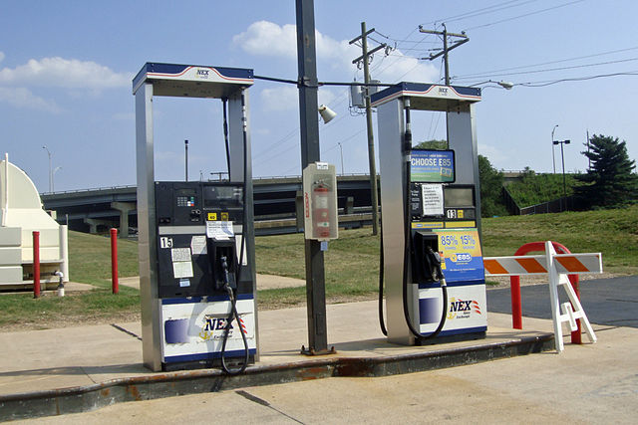
First Generation: The Corn-based Ethanol Production Process
Grind up the feedstock so it can be easily and quickly processed.
Sugar is dissolved out of the material.
The sugar is fed to microbes that use it for food, producing ethanol and carbon dioxide in the process.
Purify the ethanol to desired concentration.
Images: Wikipedia Commons, Corncobs, Author: Sam Fentress;
Wikimedia Commons, Biofuel Pumps, Author: Mario Roberto Duran Ortiz
Notes:
Source: More information available here: https://afdc.energy.gov/fuels/ethanol_fuel_basics.html – U.S. Department of Energy, Ethanol Fuel Basics

Slide 21
Food verses Biofuel: The Math
To fill up an average 25 gallon SUV gas tank with ethanol requires the same amount of grain as it takes to feed 1 person for 1 year.
Every person in the U.S. uses 500 gallons of gasoline per year.
That means that each year, every person in the U.S. would use enough gasoline to feed 20 people for one year.
There are 300 million people in the U.S. – if each person was using enough food to feed 20 people to run their cars, that alone would require enough grain to feed 6 billion people.
Notes:
Source: Sharon Astyk, “Ethics of Biofuels” Resilience (Dec. 28 2006), https://www.resilience.org/stories/2006-12-28/ethics-biofuels/

Slide 22
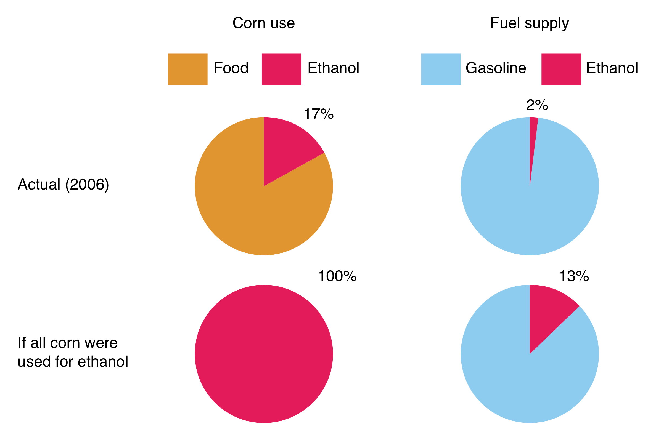
Ethanol Supply: The Effect on Corn Supply and on Gasoline Supply
“Ethics of Biofuels” Energy Bulletin (Dec. 28 2006)
Notes:
Source: Sharon Astyk, “Ethics of Biofuels” Resilience (Dec. 28 2006), https://www.resilience.org/stories/2006-12-28/ethics-biofuels/

Slide 23
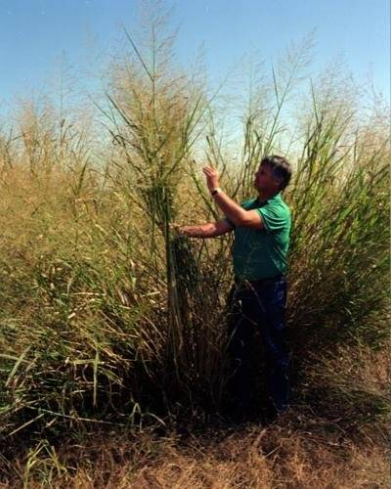


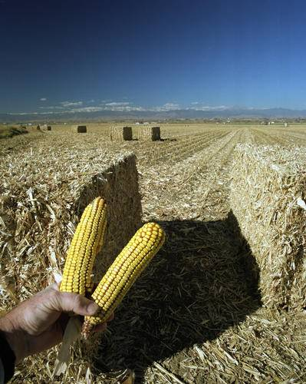
Second Generation Biofuels: Cellulosic Feedstock
Switchgrass
Wheat Straw
Hybrid Poplar
Corn Stalks
Image, Wikimedia Commons, Author: David Hawgood

Slide 24
Second Generation Biofuels
  To qualify as second generation, a feedstock must not be suitable for human consumption and meet the following criteria:
    Should grow on marginal (non-agricultural) land.
    Should not require large amounts of water or fertilizer.
    Certain food products can become second generation fuels when they are no longer useful for consumption:
        Waste vegetable oil (2nd generation feedstock).
        Virgin vegetable oil (1st generation feedstock).

Slide 25
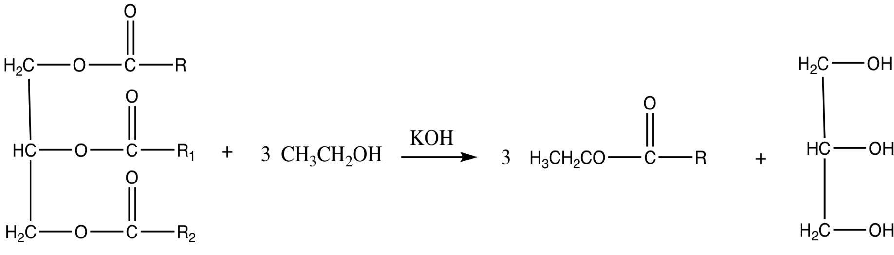
Second Generation Biofuels: Oils and biodiesel
Biodiesel refers to vegetable oil or animal fat-based diesel fuel consisting of long-chain esters. The main component of vegetable oil is triglycerides, which require transesterification prior to usage as a fuel.
Biodiesel Reaction
Oils or fats
Biodiesel (mixture of esters)
Glycerol
Notes:
Source: our own drawings

Slide 26
Advantages of Biodiesel
Reduces other pollutants.
Reduces lifecycle greenhouse gases by 86%
35% reduction in unburned hydrocarbons through life cycle. Hydrocarbons are smog and ozone precursors.
8% reduction in sulfur oxides. The release of sulfur oxides can lead to acid rain.
3% reduction in methane.
47% reduction in particulate matter (PM10 68%).
79% reduction in wastewater.
96% reduction in hazardous waste, but double the non-hazardous waste.
Compared to conventional diesel processing, biodiesel requires additional processing and has a lower overall energy return. Energy return is one of the important parameters that enables engineers to evaluate the efficiency and viability of a process. Energy return describes the amount one can gain from the production verses the amount of energy input. Biodiesel lags far behind conventional diesel processing in this regard.
BDI Biodiesel Fueling Sustainability Fact Sheet: https://www.biodiesel.org/docs/default-source/ffs-basics/biodiesel-fueling-sustainability.pdf?sfvrsn=8
Notes:
For more information about biodiesel and fact sheets see BDI Biodiesel: Biodiesel Fact Sheets: https://www.biodiesel.org/what-is-biodiesel/biodiesel-fact-sheets
Biodiesel Fueling Sustainability fact shee from BDI Biodiesel: https://www.biodiesel.org/docs/default-source/ffs-basics/biodiesel-fueling-sustainability.pdf?sfvrsn=8

Slide 27
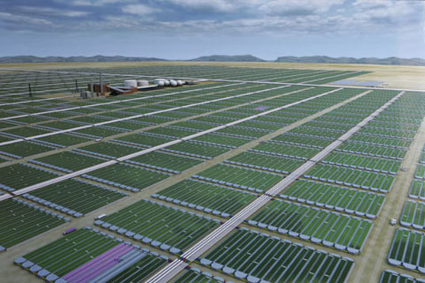
Third Generation Biofuels: Algae Feedstock
Image Source: http://news.algaeworld.org/2018/05/biofuel-from-algae-cuk-scientist-finds-key-to-increase-yield-by-30-per-cent/
Notes:
Image Source: http://news.algaeworld.org/2018/05/biofuel-from-algae-cuk-scientist-finds-key-to-increase-yield-by-30-per-cent/

Slide 28


What is algae?
Algae is a large and diverse group of simple, usually autotrophic, organisms that can have either unicellular or multicellular forms.
Image Source: Flickr
Notes:
https://www.flickr.com/photos/59003943@N00/5909549545
https://www.flickr.com/photos/102642344@N02/9934131623

Slide 29
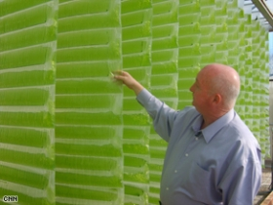
Is Algae “Green Gold”?
Currently being developed.
30 times more oil per acre than current crops that are being used.
No sulfur.
Non-toxic
Highly biodegradable,
Not subject to a commodity risk like crude oil, corn, and soybeans are.
Source: EcoFriend Article, “Algae BioFuels: PetroSun’s Subsidiary to Develop Bio-diesel Form Algae” India (2006), available at http://www.ecofriend.org/entry/algae-biofuels-petrosuns-subsidiary-to-develop-bio-diesel-form-algae/
Notes:
Source: EcoFriend Article, “Algae BioFuels: PetroSun’s Subsidiary to Develop Bio-diesel Form Algae” India (2006), available at http://www.ecofriend.org/entry/algae-biofuels-petrosuns-subsidiary-to-develop-bio-diesel-form-algae/

Slide 30
Advantages
Algae: The Pros and Cons
Disadvantages
Versatility in growth methods
Versatility in uses
Speed of production
Potential for huge production levels
CO2 reduction
Energy intensive
Not competitive against foreign oil (yet)
Needs funding
Technology not ready (yet)

Slide 31
How to Overcome the Technical Roadblocks to Low-Cost Advanced Biofuel Production
Make all of the components of biomass available for biofuel and co-product production:
Use the appropriate parts of specific plants.
Improve the efficiency of biomass to biofuel conversion:
Do it faster, cheaper, and sustainably.
Minimize the cost of biomass transportation.
Move more for less.

Slide 32
Biofuels as an Alternative
Biofuels are NOT THE COMPLETE answer to sustainable energy, but biofuels may be A PART of the answer.
Biofuels may offer environmental and economic advantages over fossil fuels, but the magnitude of these advantages depends on how a biofuel crop is grown and converted into a usable fuel.

Slide 33
Solar Energy
Two main methods:
  Using sunlight as a source of heat
  Converting the sun’s energy into electricity (photovoltaics)
Silicon
Gallium arsenide
Cadmium telluride
Dye-sensitized solar cells
Organic solar cells

Slide 34
History of PV/Solar Cells
In general, the goals of the Photovoltaic Energy Systems Program
shall include improving the reliability and conversion efficiencies
of and lowering the costs of photovoltaic conversion. Research
efforts shall emphasize advancements in the performance, stability,
and durability of photovoltaic materials.
“…an application where simplicity and reliability
were paramount and cost was nearly ignored.”
A year of bad news was punctuated in December, when the
President announced that because of the energy crisis the
lights on the national Christmas tree would not be turned on.
Practicality (electrons/$)!
First application: power for Vanguard satellite in the late ’50s
First world oil shock: electricity brown outs and
rapidly rising prices for fuels and other necessities
Boeing and Kodak fabricated the 1st thin-film
PV cells with efficiencies greater than 10%.
Renewable Energy and Energy Efficiency
Technology Competitiveness Act
Si ~25% efficiency (in lab), high cost, large energy buy-back time
DSSC >10% efficiency (in lab), not in market yet
First solar silicon cell at Bell Labs
Gratzel developed first dye-sensitized nanostructured solar cell
1st Si PV cell
World oil shock
REEETA
1954
1973
1989
2003
1981
1991
10% efficiency
1st DSSC
Slide credit: Amy Cannon, Beyond Benign
* Energy Information Administration, www.eia.doe.gov

Slide 35
Producing electrons from sunlight
(Solar output (photons/unit area))
(Efficiency (electrons/photons))
Practicality
(electrons/$)
*
=
Manufacturing costs ($/unit area)
Slide credit: Amy Cannon, Beyond Benign
Notes:
This slide discusses the balance between solar output, efficiency and manufacturing costs. There are ways to maximize the “practicality” of producing solar energy devices by either increasing efficiency, or decreasing the manufacturing costs… provided that the solar output is something that can not be changed!

Slide 36
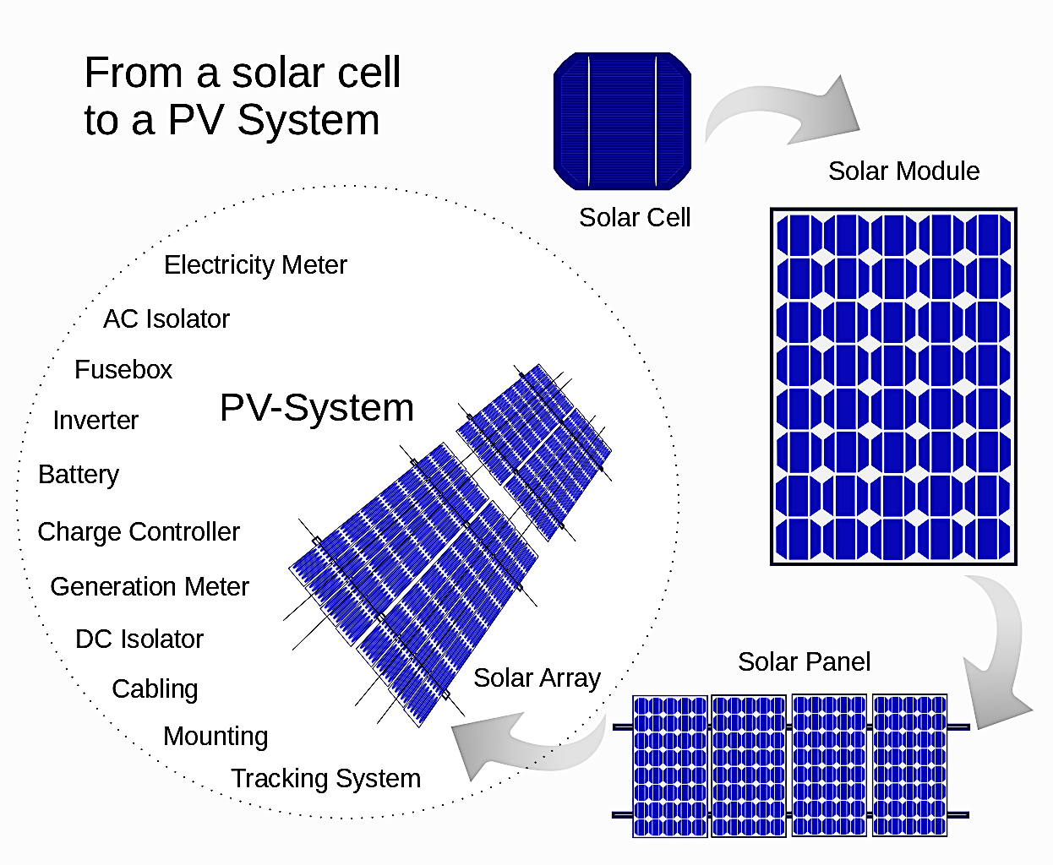
Solar cell to Solar Energy
Source: Wikicommons, https://commons.wikimedia.org/wiki/File:From_a_solar_cell_to_a_PV_system.svg
Notes:
Source: Wikicommons, https://commons.wikimedia.org/wiki/File:From_a_solar_cell_to_a_PV_system.svg

Slide 37
What needs to change?
Current solar cell technologies utilizes precious metals to convert solar to usable electricity.
Toxic materials are used in the production of solar cells/panels. For this reason, recycling and proper disposal of unusable solar panels is an issue.
The lifespan of a solar cell is approximately 15 years.
So what’s the solution/current research??....
The need for more environmentally conscious solar cells using non-precious materials and less toxic counterparts needs to be developed and commercialized.

Slide 38

TiO₂ Dye-Sensitized Solar Cells
S
*
S
+
Electrolyte
with I⁻/I₂
2
Catalytic layer to promote
I⁻ to I₂ regeneration
[
T
i
O
]
[
T
i
O
]
-
2
n
2
n
Sensitizer Dye
3
1
hv
e
-
4
1
/
2
I
2
I
-
5
TiO₂ Semiconductor
ITO electrode
S
S
+
Insulating Seal
Slide source: Amy Cannon, Beyond Benign
Notes:
TiO2 dye sensitized photovoltaics work much like a leaf does in photosynthesis. A sensitizer dye absorbs light from the sun and is transferred into its excited state. The dye then transfers and electron into the semiconductor, which transfers an electron into the current. The electron returns to the cell and, with the help of a catalyst, reduces an iodine to iodide, which then transfers an electron back to the dye, bringing it back to its original state.
Michael Graetzel created the first dye-sensitized solar cell in 1991. The key to these “new” types of solar energy devices was the surface area of the semi-conductor. Nanometer size TiO2 particles were used which greatly increased the surface area and the ability to generate electrons from photons.

Slide 39
Conventional Titanium Dioxide Film Formation
Heat to
180-200°C
H⁺
O-Ti-O-Ti
Ti-O-Ti-O
O-Ti-O-Ti
O-Ti-O
Heat to 450°C
Sintered TiO₂
Slide source: Amy Cannon, Beyond Benign
Notes:
Titanium dioxide semi-conductors are created by either pre-formed titanium dioxide of a particular size (generally nanometer scale), or by growing them through a sol-gel process. They are grown in pressurized tubes that allow for the particles to grow to a certain size. The sol-gel solution is coated onto a conductive surface and sintered at high temperatures (which restricts what surfaces can be used).

Slide 40
New Method of Forming Titanium Dioxide Films
Heat to
180-200°C
Heat to
180-200°C
H⁺
Process at Ambient Temperature
with trimesic acid.
Sintered TiO₂
“The Low Temperature Processing of Titanium Dioxide Films by the Addition of Trimesic Acid” Cannon, Amy S.; Guarrera, Donna J.; Morelli. Alessandra; Pressler, Whitney; Warner, John C. J. Sol Gel Sci. 2004
Notes:
By adding a small amount of an organic acid (trimesic acid) the sol-gel solution can be coated at ambient temperatures to create a good robust semi-conductor, reducing the use of high temperatures in the final processing step. The organic acid creates an anhydride linkage between the titanium dioxide particles.

Slide 41
TiO₂ Dye-Sensitized Solar Cells
 | Challenges | Benefits/Opportunities
Performance | Efficiency not as good as traditional photovoltaics (silicon based and other rare metals based devices) | Does not rely on angle of incidence from the light source; works in low-light conditions and at any angle from the source; can harvest indoor and outdoor light
Sensitizer dyes | Traditionally expensive polypyridine complexes of ruthenium Chemical stability: dyes are generally subject to oxidation | New organic dyes avoid the use of expensive metals Becoming more stable to oxidation
Titanium dioxide semi-conductor | Traditional processing requires high temperatures Traditional processing require use of binder to create robust conductor film | Low-temperature processes with addition of small organic molecules Avoids use of binder
Electrolyte | Traditionally volatile solvent used in electrolyte solutions, reducing lifetime of solar energy devices | Non-volatile systems are being explored (i.e., ionic liquids) to increase the lifetime of solar energy device
Notes:
TiO2 dye sensitized photovoltaics work much like a leaf does in photosynthesis. A sensitizer dye absorbs light from the sun and is transferred into its excited state. The dye then transfers and electron into the semiconductor, which transfers an electron into the current. The electron returns to the cell and, with the help of a catalyst, reduces an iodine to iodide, which then transfers an electron back to the dye, bringing it back to its original state.
Michael Gratzel created the first dye-sensitized solar cell in 1991. The key to these “new” types of solar energy devices was the surface area of the semi-conductor. Nanometer size TiO2 particles were used which greatly increased the surface area and the ability to generate electrons from photons.
Nazeeruddin, M. K., Baranoff, E., Gratzel, M., Solar Energy, Vol. 85, Issue 6, June 2011, 1172-1178 “Dye-sensitized solar cells: A brief overview”
Ambient lighting: Gratzel, M., Nature Photonics, 11, 372-378 (2017)
Open-access article: https://www.sigmaaldrich.com/technical-documents/articles/material-matters/efficient-dye-sensitized.html - Efficient Dye-Sensitized Solar Cells for Direct Conversion of Sunlight to Electricity, Grazel, M., Kalyanasundaram, K., Material Matters, 2009, 4.4, 88

Slide 42
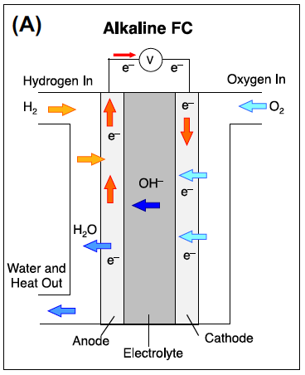
Fuels Cells as a renewable energy
Fuel cells are like batteries….but they don’t run down or need to be recharged.
They produce electricity as long as a source of fuel is supplied.
  Example: H₂
Converts H₂ + O₂ intro electricity and water
A fuel cell consists of an anode and cathode where redox chemistry occurs. In order for a flow of electrons, an electrolyte medium is necessary.
Electricity is generated when the flow of electrons go through and external circuit and supply power.
Sources: https://www.energy.gov/eere/fuelcells/types-fuel-cells
Notes:
Fuel cells work like batteries, but they do not run down or need recharging. They produce electricity and heat as long as fuel is supplied. A fuel cell consists of two electrodes—a negative electrode (or anode) and a positive electrode (or cathode)—sandwiched around an electrolyte. A fuel, such as hydrogen, is fed to the anode, and air is fed to the cathode. In a hydrogen fuel cell, a catalyst at the anode separates hydrogen molecules into protons and electrons, which take different paths to the cathode. The electrons go through an external circuit, creating a flow of electricity. The protons migrate through the electrolyte to the cathode, where they unite with oxygen and the electrons to produce water and heat.

Slide 43
Fuel cells
Fuel cells – benefits:
  Overall efficiency is higher than conventional heat engines (up to 80%, practically ~40%)
  Local pollution is minimized
  Possibility of obtaining fuel from renewable resource
  Reliable in that they have no moving parts
Fuel cells – problems:
  Source of hydrogen
    PowerballTM – sodium hydride pellets coated w/ polyethene
  Hydrogen needs to be produced
    Steam reforming of methanol, natural gas or petroleum
  CO is toxic to the fuel cell catalyst

Slide 44
Types of fuel cells
Phosphoric Acid Fuel Cell
  most established and used in some power generating projects
  utilizes 100% phosphoric acid
  operates at just over 200°C and above atmospheric pressure
  efficiencies are just over 40%
Solid Oxide Fuel Cell
  operates at the highest temps of all current fuel cell types (1000°C)
Proton Exchange Membrane(PEM) Fuel Cells
  polymer electrolyte, low operating temperatures (80°C)
  perfluorinated sulphonic acid polymers
  problems: cost, dehydration of polymers, catalyst poisoning
Molten Carbonate Fuel Cells
  lithium and potassium carbonates – operate ~650°C
  favored for commercial power production
  55% efficient (with potential of over 80%)
Alkaline Fuel Cells
  Used in space and military applications due to high efficiency (~70%)
  Problem: sensitive to CO₂, which reacts with electrolyte to form potassium carbonate (need highly pure oxygen)

Slide 45
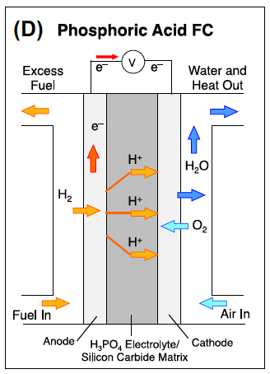
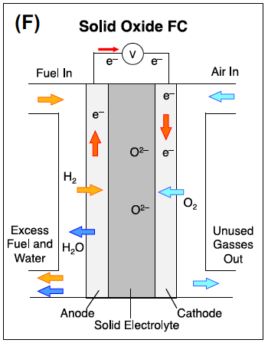
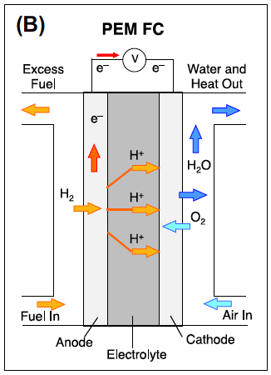
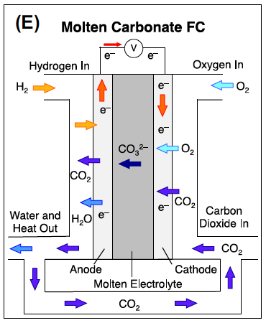
Type of fuels cells
Sources: https://www.energy.gov/eere/fuelcells/types-fuel-cells
Notes:
Sources: https://www.energy.gov/eere/fuelcells/types-fuel-cells
Phosphoric acid fuel cells (PAFCs) use liquid phosphoric acid as an electrolyte—the acid is contained in a Teflon-bonded silicon carbide matrix—and porous carbon electrodes containing a platinum catalyst. The electro-chemical reactions that take place in the cell are shown in the diagram to the right.
The PAFC is considered the "first generation" of modern fuel cells. It is one of the most mature cell types and the first to be used commercially. This type of fuel cell is typically used for stationary power generation, but some PAFCs have been used to power large vehicles such as city buses.
PAFCs are more tolerant of impurities in fossil fuels that have been reformed into hydrogen than PEM cells, which are easily "poisoned" by carbon monoxide because carbon monoxide binds to the platinum catalyst at the anode, decreasing the fuel cell's efficiency. PAFCs are more than 85% efficient when used for the co-generation of electricity and heat but they are less efficient at generating electricity alone (37%–42%). PAFC efficiency is only slightly more than that of combustion-based power plants, which typically operate at around 33% efficiency. PAFCs are also less powerful than other fuel cells, given the same weight and volume. As a result, these fuel cells are typically large and heavy. PAFCs are also expensive. They require much higher loadings of expensive platinum catalyst than other types of fuel cells do, which raises the cost.
Solid oxide fuel cells (SOFCs) use a hard, non-porous ceramic compound as the electrolyte. SOFCs are around 60% efficient at converting fuel to electricity. In applications designed to capture and utilize the system's waste heat (co-generation), overall fuel use efficiencies could top 85%.
SOFCs operate at very high temperatures—as high as 1,000°C (1,830°F). High-temperature operation removes the need for precious-metal catalyst, thereby reducing cost. It also allows SOFCs to reform fuels internally, which enables the use of a variety of fuels and reduces the cost associated with adding a reformer to the system.
SOFCs are also the most sulfur-resistant fuel cell type; they can tolerate several orders of magnitude more sulfur than other cell types can. In addition, they are not poisoned by carbon monoxide, which can even be used as fuel. This property allows SOFCs to use natural gas, biogas, and gases made from coal. High-temperature operation has disadvantages. It results in a slow startup and requires significant thermal shielding to retain heat and protect personnel, which may be acceptable for utility applications but not for transportation. The high operating temperatures also place stringent durability requirements on materials. The development of low-cost materials with high durability at cell operating temperatures is the key technical challenge facing this technology.
Scientists are currently exploring the potential for developing lower-temperature SOFCs operating at or below 700°C that have fewer durability problems and cost less. Lower-temperature SOFCs have not yet matched the performance of the higher temperature systems, however, and stack materials that will function in this lower temperature range are still under development.
Polymer electrolyte membrane (PEM) fuel cells—also called proton exchange membrane fuel cells—deliver high power density and offer the advantages of low weight and volume compared with other fuel cells. PEM fuel cells use a solid polymer as an electrolyte and porous carbon electrodes containing a platinum or platinum alloy catalyst. They need only hydrogen, oxygen from the air, and water to operate. They are typically fueled with pure hydrogen supplied from storage tanks or reformers.
PEM fuel cells operate at relatively low temperatures, around 80°C (176°F). Low-temperature operation allows them to start quickly (less warm-up time) and results in less wear on system components, resulting in better durability. However, it requires that a noble-metal catalyst (typically platinum) be used to separate the hydrogen's electrons and protons, adding to system cost. The platinum catalyst is also extremely sensitive to carbon monoxide poisoning, making it necessary to employ an additional reactor to reduce carbon monoxide in the fuel gas if the hydrogen is derived from a hydrocarbon fuel. This reactor also adds cost.
PEM fuel cells are used primarily for transportation applications and some stationary applications. Due to their fast startup time and favorable power-to-weight ratio, PEM fuel cells are particularly suitable for use in passenger vehicles, such as cars and buses.
Molten carbonate fuel cells (MCFCs) are currently being developed for natural gas and coal-based power plants for electrical utility, industrial, and military applications. MCFCs are high-temperature fuel cells that use an electrolyte composed of a molten carbonate salt mixture suspended in a porous, chemically inert ceramic lithium aluminum oxide matrix. Because they operate at high temperatures of 650°C (roughly 1,200°F), non-precious metals can be used as catalysts at the anode and cathode, reducing costs.
Improved efficiency is another reason MCFCs offer significant cost reductions over phosphoric acid fuel cells. Molten carbonate fuel cells, when coupled with a turbine, can reach efficiencies approaching 65%, considerably higher than the 37%–42% efficiencies of a phosphoric acid fuel cell plant. When the waste heat is captured and used, overall fuel efficiencies can be over 85%.
Unlike alkaline, phosphoric acid, and PEM fuel cells, MCFCs do not require an external reformer to convert fuels such as natural gas and biogas to hydrogen. At the high temperatures at which MCFCs operate, methane and other light hydrocarbons in these fuels are converted to hydrogen within the fuel cell itself by a process called internal reforming, which also reduces cost.
The primary disadvantage of current MCFC technology is durability. The high temperatures at which these cells operate and the corrosive electrolyte used accelerate component breakdown and corrosion, decreasing cell life. Scientists are currently exploring corrosion-resistant materials for components as well as fuel cell designs that double cell life from the current 40,000 hours (~5 years) without decreasing performance.
Alkaline fuel cells (AFCs) were one of the first fuel cell technologies developed, and they were the first type widely used in the U.S. space program to produce electrical energy and water on-board spacecraft. These fuel cells use a solution of potassium hydroxide in water as the electrolyte and can use a variety of non-precious metals as a catalyst at the anode and cathode. In recent years, novel AFCs that use a polymer membrane as the electrolyte have been developed. These fuel cells are closely related to conventional PEM fuel cells, except that they use an alkaline membrane instead of an acid membrane. The high performance of AFCs is due to the rate at which electro-chemical reactions take place in the cell. They have also demonstrated efficiencies above 60% in space applications.
A key challenge for this fuel cell type is that it is susceptible to poisoning by carbon dioxide (CO2). In fact, even the small amount of CO2 in the air can dramatically affect cell performance and durability due to carbonate formation. Alkaline cells with liquid electrolytes can be run in a recirculating mode, which allows for electrolyte regeneration to help reduce the effects of carbonate formation in the electrolyte, but the recirculating mode introduces issues with shunt currents. The liquid electrolyte systems also suffer from additional concerns including wettability, increased corrosion, and difficulties handling differential pressures. Alkaline membrane fuel cells (AMFCs) address these concerns and have lower susceptibility to CO2 poisoning than liquid-electrolyte AFCs do. However, CO2 still affects performance, and performance and durability of the AMFCs still lag that of PEMFCs. AMFCs are being considered for applications in the W to kW scale. Challenges for AMFCs include tolerance to carbon dioxide, membrane conductivity and durability, higher temperature operation, water management, power density, and anode electrocatalysis.

Slide 46
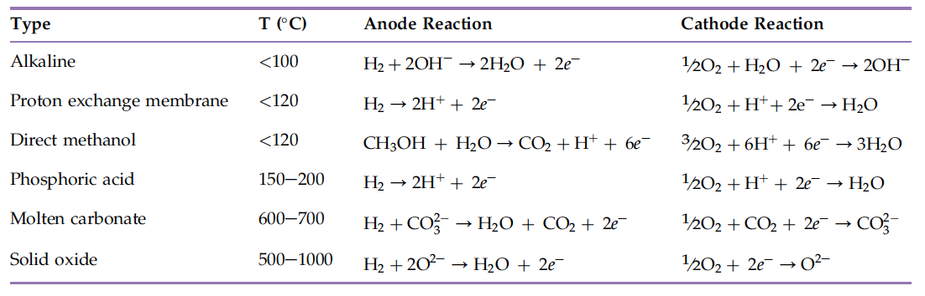
Type of fuel cells
Redox Reactions in fuel Cells
Sources: https://www.energy.gov/eere/fuelcells/types-fuel-cells
Notes:
Sources: https://www.energy.gov/eere/fuelcells/types-fuel-cells

Slide 47
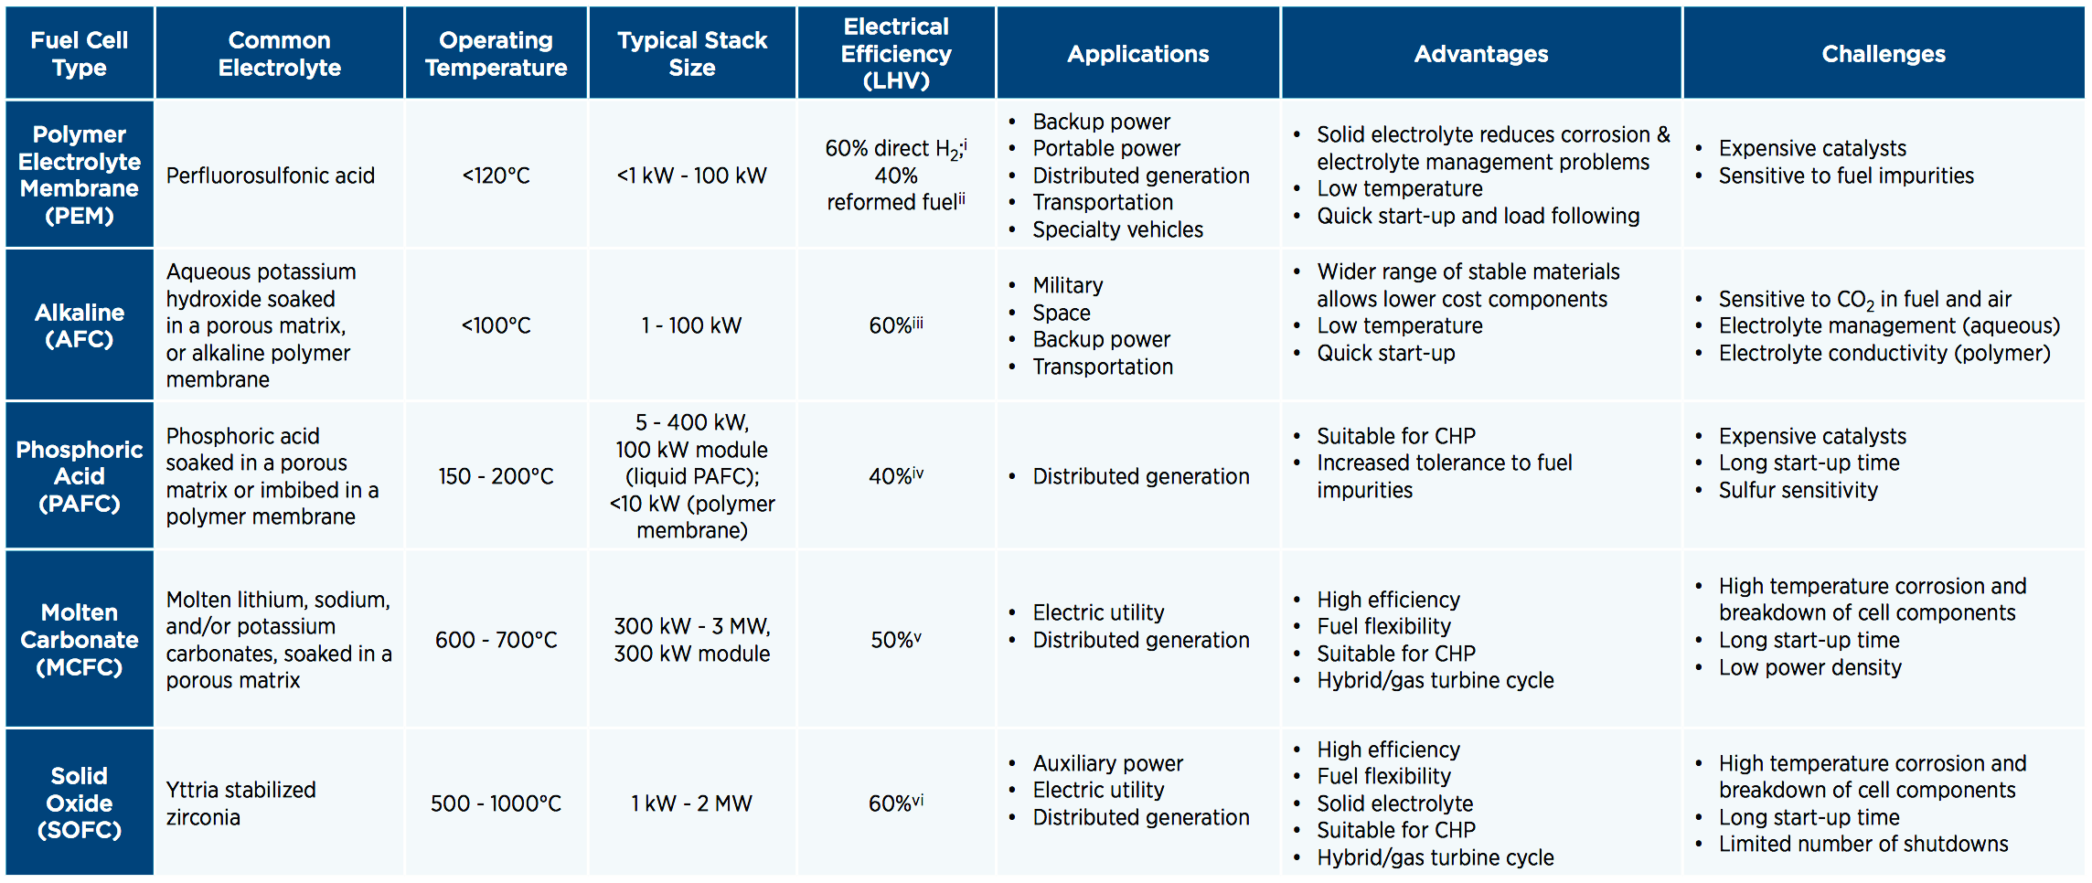
Comparison of Fuel Cells
https://www.energy.gov/eere/fuelcells/comparison-fuel-cell-technologies
Notes:
https://www.energy.gov/eere/fuelcells/comparison-fuel-cell-technologies
ª NREL Composite Data Product 8, "Fuel Cell System Efficiency"
^{b} Panasonic Headquarters News Release, "Launch of New 'Ene-Farm' Home Fuel Cell Product More Affordable and Easier to Install"
^{c} G. Mulder et al., "Market-ready stationary 6 kW generator with alkaline fuel cells," ECS Transactions 12 (2008) 743-758
^{d} Doosan PureCell Model 400 Datasheet
^{e} FuelCell Energy DFC300 Product Specifications
^{f} Ceramic Fuel Cells Gennex Product Specifications

Slide 48
Current Research Efforts
Cost - Platinum represents one of the largest cost components of a fuel cell. R&D efforts are focusing on approaches that will increase activity and utilization of current platinum group metal (PGM) and PGM-alloy catalysts, as well as non-PGM catalyst approaches for long-term applications.
Performance -To improve fuel cell performance, R&D efforts are focusing on developing ion-exchange membrane electrolytes with enhanced efficiency and durability at reduced cost; improving membrane electrode assemblies (MEAs) through integration of state-of-the-art MEA components; developing transport models and in-situ and ex-situ experiments to provide data for model validation; identifying degradation mechanisms and developing approaches to mitigate their effects; and maintaining core activities on components, sub-systems, and systems specifically tailored for stationary and portable power applications.

Slide 49
Current Research Efforts
3. Durability—A key performance factor is durability, in terms of a fuel cell system lifetime that will meet application expectations. Durability targets for fuel cells range from 40,000 hours and 5,000 hours. In the most demanding applications, realistic operating conditions include (1) impurities in the fuel and air, (2) starting and stopping, (3) freezing and thawing, and (4) humidity and load cycles. These result in stresses on the chemical and mechanical stability of the fuel cell system materials and components. R&D focuses on understanding the fuel cell degradation mechanisms and developing materials and strategies that will mitigate them.

Slide 50

Other Forms of Renewable Energy
Wind Power
By David Dixon, CC BY-SA 2.0, https://commons.wikimedia.org/w/index.php?curid=30857880
https://commons.wikimedia.org/wiki/File:GreenMountainWindFarm_Fluvanna_2004.jpg
Notes:
https://commons.wikimedia.org/wiki/File:GreenMountainWindFarm_Fluvanna_2004.jpg
By David Dixon, CC BY-SA 2.0, https://commons.wikimedia.org/w/index.php?curid=30857880

Slide 51
Wind Energy
Advantages
Disadvantages
Abundant source of energy
Free source
No air pollutants and greenhouse gases
Long term economic value
Low maintenance
Cost and Technology immaturity
Aesthetics
Potential risk to wildlife (flying animals)
Remoteness of Location
Noise Pollution
Safety Concern in open water
Notes:
Aesthetic impact: Many people are concerned with the visual effects that wind turbines have on the beautiful scenery of nature. They believe that giant wind turbines distract viewers from the beautiful surroundings. Fig. 2 shows just how big wind turbines can be.
Wildlife: Wind turbines may be dangerous to flying animals. Many birds and bats have been killed by flying into the rotors. Experts are now conducting research to learn more about the effects that wind turbines have on marine habitats.
Remoteness of location: Although this may be an advantage (placing wind turbines in desolate areas, far away from people), it may also be a disadvantage. The cost of travel and maintenance on the turbines increases and is time consuming. Offshore wind turbines require boats and can be dangerous to manage.
Noise: Some wind turbines tend to generate a lot of noise which can be unpleasant
Safety at Sea: In the darkness/at night it may be difficult for incoming boats to see wind turbines thus leading to collisions.

Slide 52
Other Forms of Renewable Energy
Ocean Energy
A source of energy generated by the repetitive waves that roll into shorelines, docks, and in the deep ocean. It leverages the ocean natural currents to provide an alternative source of energy.
https://commons.wikimedia.org/wiki/File:Eco_Wave_Power_Technology.png
Notes:
https://commons.wikimedia.org/wiki/File:Eco_Wave_Power_Technology.png

Slide 53
Ocean Energy
Advantages
Disadvantages
Truly Renewable
Abundant and widely available
Variety of ways to harness the oceans motion
Easily predictable
No damage to land
Suitable for a limited range of locations (mainly on coast lines)
Potential effects on marine ecosystems
Potential to disturb boats
Weak performance in rough weather storms
Potential noise pollution
Notes:
Renewable: The best thing about wave energy is that it will never run out. There will always be waves crashing upon the shores of nations, near the populated coastal regions. The waves flow back from the shore, but they always return. Unlike fossil fuels, which are running out, in some places in the world, just as quickly as people can discover them. Unlike ethanol, a corn product, waves are not limited by a season. They require no input from man to make their power, and they can always be counted on.
Abundant and Widely Available :Another benefit to using this energy is its nearness to places that can use it. Lots of big cities and harbors are next to the ocean and can harness the power of the waves for their use. Coastal cities tend to be well-populated, so lots of people can get use from wave energy plants.
Variety of Ways To Harness : A final benefit is that there are a variety of ways to gather it. Current gathering methods range from installed power plant with hydro turbines to seafaring vessels equipped with massive structures that are laid into the sea to gather the wave energy.
Easily Predictable : The biggest advantages of wave power as against most of the other alternative energy sources is that it is easily predictable and can be used to calculate the amount that it can produce. The wave energy is consistent and proves much better than other sources which are dependent on wind or sun exposure.
No Damage to Land : Unlike fossil fuels which cause massive damage to land as they can leave large holes while extracting energy from them , wave power does not cause any damage to earth. It is safe, clean and one of the preferred method to extract energy from ocean.
Suitable to Certain Locations : The biggest disadvantage to getting your energy from the waves is location. Only power plants and towns near the ocean will benefit directly from it. Because of its source, wave energy is not a viable power source for everyone. Landlocked nations and cities far from the sea have to find alternate sources of power, so wave energy is not the clean energy solution for everyone.
Effect on marine Ecosystem : As clean as wave energy is, it still creates hazards for some of the creatures near it. Large machines have to be put near and in the water to gather energy from the waves. These machines disturb the seafloor, change the habitat of near-shore creatures (like crabs and starfish) and create noise that disturbs the sea life around them. There is also a danger of toxic chemicals that are used on wave energy platforms spilling and polluting the water near them.
Source of Disturbance for Private and Commercial Vessels : Another downside is that it disturbs commercial and private vessels. Power plants that gather wave energy have to be placed by the coastline to do their job, and they have to be near cities and other populated areas to be of much use to anybody. But these are places that are major thoroughfares for cargo ships, cruise ships, recreational vehicles and beach goers. All of these people and vessels will be disrupted by the installation of a wave energy gathering source. This means that government officials and private companies that want to invest in wave energy sources have to take into account and consider the needs of those they may be disturbing.
Weak Performance in Rough Weather : The performance of wave power drops significantly during rough weather. They must withstand rough weather.
Noise and Visual pollution : Wave energy generators may be unpleasant for some who live close to coastal regions. They look like large machines working in the middle of the ocean and destroy the beauty of the ocean. They also generate noise pollution but the noise is often covered by the noise of waves which is much more than that of wave generators.

Slide 54
Other Forms of Renewable Energy
Hydroelectric:
Utilize the natural gradient of water flow (gravity) and pressure to turn mechanical turbines.
Turbines covert the mechanical energy into electricity to supply the grid.
Power generated is a function of the height through which water falls and the flow rate: P(kW) ~ 10 x H(m) x R (m³/s)
Source:https://commons.wikimedia.org/wiki/File:Hydroelectric_dam.svg
Notes:
Source:https://commons.wikimedia.org/wiki/File:Hydroelectric_dam.svg

Slide 55
Outline
Current state of energy consumption: Globally
Source of energy:
  Power plant – coal, oil, natural gas
  Renewable – Biofuels, solar cell, Fuel cells, hydro, etc.
Energy in the Laboratory
  Thermal
  Cooling
  Distillation
  Equipment
  Synthesis
Next Generation of Applications of Renewable Energy

Slide 56
Energy Use in the Lab
Considerations:
Equipment costs
Methods for heating a reaction
Methods for separating materials
Methods to qualitatively and quantitatively analyze materials
Alternative methods for performing the chemistry

Slide 57
Energy efficiency: Conservation of Thermal Energy
Monitoring, control and maintenance
Loss prevention
Waste heat recovery
Matching energy sources to requirements

Slide 58
Energy usage
Chemicals and petroleum industries account for 50% of industrial energy usage.
~1/4 of the energy used is consumed in distillation and drying processes.
https://commons.wikimedia.org/wiki/File:Overall_mass_balance_of_a_distillation_column_for_separation_of_a_binary_feed_in_its_components_v01.svg
Notes:
Image Source: https://commons.wikimedia.org/wiki/File:Overall_mass_balance_of_a_distillation_column_for_separation_of_a_binary_feed_in_its_components_v01.svg

Slide 59
Alternative forms of energy for synthesis
Photochemical Reactions
Microwave Reactions

Slide 60
Photochemical Reactions
Prerequisites for a photochemical reactions:
Atom of molecule must absorb light (Grotthuss-Draper law)
1 photon can activate only one molecule (Stark-Einstein law)
Source of photons?
  Electrical
  Costly
  Only viable if quantum yield is far higher than 1
(Quantum yield: # of molecules of reactant consumed per photon absorbed)

Slide 61
Advantages and Challenges of Photochemical Rxns
Advantages
Disadvantages
Directly targets energy at specific molecules, and reducing energy consumption
photons are very clean reagents, leaving no residues
Energy is more directed and rxn temperatures are generally low (higher selectivity, reduced by-product formation)
Some reaction pathways are more readily available via photochemical processes leading to products that would be difficult to make by other routes
Reactor fouling - slight fouling can prevent rxns from occurring - little flexibility in material used in reactors
Monochromatic light is required and generally only polychromatic light is available, therefore wasting a good portion of the energy - reduces energy efficiency & increases process costs.
Light sources are expensive
Power of the transmitted light drops off as the square of the distance from the light - efficiently run rxns must be as close as possible to light source.

Slide 62
Examples of photochemical reactions
Commercial photochemical processes
1. Caprolactam process
Quantum yield is only ~80%
Utilizes visible light (535nm), relatively low-cost
Light source: low-pressure mercury lamp doped with thallium iodide (helps intensity the required wavelength and reduce the intensity of lower wavelengths)
A continuous counter-current flow reactor is used (made of glass)
Traditional process: Air oxidation of cyclohexane followed by reaction with hydroxylamine hydrogensulfate

Slide 63
Examples of photochemical reactions
Commercial photochemical processes
Caprolactam process
Vitamin D3
  Photochemical electrocyclic ring opening followed by a thermal 1,7-hydride shift
  no viable thermal alternative
NOCl → NO˙ + Cl˙ (535nm)

Slide 64
Microwave chemistry
Wavelengths between 1 mm and 1 m
  Frequency fixed at 2.45 GHz
More directed source of energy
Heating rate of 10°C per second is achievable
Possibility of overheating (explosions)
Solvent-free conditions are possible
Interaction with matter characterized by penetration depth
Watch Video on Micorwave Chemistry
https://www.youtube.com/watch?v=UqS7b6V7Um8
Image Source: http://cem.com/en/discover-sp/
Notes:
Image Source: http://cem.com/en/discover-sp/

Slide 65
Microwave chemistry
Two Principal Mechanisms for Interaction With Matter
dipole interactions
  Occurs with polar molecules. The polar ends of a molecule tend to align themselves and oscillate in step with the oscillating electrical field of the microwaves. Collisions and friction between the moving molecules result in heating. The more polar a molecule, the more effectively it will couple with (and be influenced by) the microwave field
(2) ionic conduction
Ions in solution do not have a dipole moment. They are charged species that are distributed and can couple with the oscillating electrical field of the microwaves. The effectiveness or rate of microwave heating of an ionic solution is a function of the concentration of ions in solution.
http://www.milestonesci.com/synth-fund.php

Slide 66
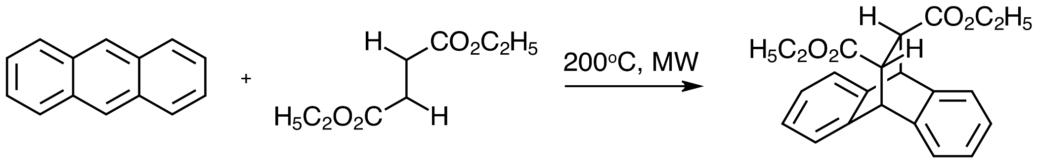
Microwave chemistry
Chemistry can be performed via microwave that might not have a viable thermal route. Or, reactions can be performed in a fraction of the time required via the thermal route
Example: Diels-Alder via microwave
This reaction proceeds by conventional methods either by using equimolar amounts of aluminum chloride as an activator, or without and activator by heating in dioxane for several hours (or in p-xylene for several hours). Both processes present challenges for health and safety and efficiency. This reaction proceeded by microwave in a fraction of the time and does not require an activator:
Nuchter, M., Ondruschka, B., Bonrath, W., Gum, A., Green Chem., 2004, 6, 128-141
Notes:
For more information about microwave synthesis: https://pubs.rsc.org/en/content/articlehtml/2004/gc/b310502d - DOI: 10.1039/B310502D (Critical Review) Nuchter, M., Ondruschka, B., Bonrath, W., Gum, A., Green Chem., 2004, 6, 128-141
The reaction of fumaric acid diethyl ester with anthracene to the respective Diels–Alder adduct is a well-investigated^{1e} and comparatively simple reaction. It proceeds in high yield under conventional conditions in the presence of equimolar amounts of anhydrous aluminium chloride as an activator. ⁵¹ If no activator is used, heating for several days in dioxane or for several hours in p-xylene is required to achieve high yields.⁵²
S. Caddick, Tetrahedron, 1995, 51, 10403

Slide 67
Outline
Current state of energy consumption: Globally
Source of energy:
  Power plant – coal, oil, natural gas
  Renewable – Biofuels, solar cell, Fuel cells, hydro, etc.
Energy in the Laboratory
  Thermal
  Cooling
  Distillation
  Equipment
  Synthesis
Next Generation of Applications of Renewable Energy

Slide 68
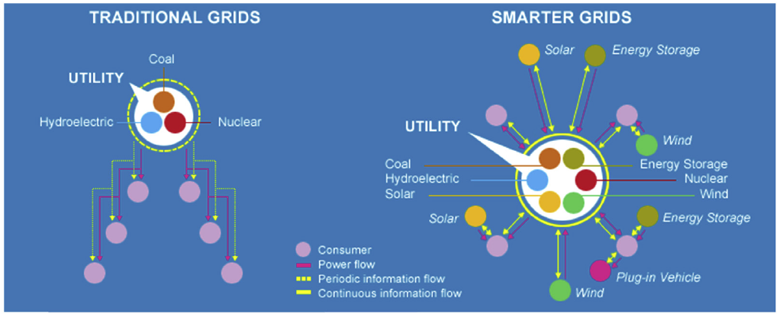
Smart Grids Network System
Source: Courtesy of International Business Machines Corporation, © International Business Machines Corporation,
IBM e Electric cars e United States 2010. http://www.ibm.com/smarterplanet/us/en/smart_grid/article/electric_cars.html.
Notes:
Source: Smarter planet: Energy and Utilities, Slideshare, IBM, 2011
https://www.slideshare.net/gmattathil/smarter-planet-energy-and-utilities –
The picture illustrates the differences in power and information flow between traditional
power grids and new-generation smart grids.42 Unidirectional power/information flow is
characteristic of traditional grids where the power generation sources are largely made up
of coal, nuclear, and hydroelectric energy generator sources. Bidirectional power/information
flow is a key component of smart grids where modern microgrids at consumers’ residences
and places of business can not only communicate to the main power grid but also
contribute power generation to the entire network.
Smart grids are essential to the establishment of a network of consumer-based microgrids as they can allow integration of renewable sources of energy such as solar and wind and for the possibility of a more efficient
expansion of the balancing authority. Customers will have far more control over their power
use, generation, and costs. Advancing information technology will allow “ control stations” to
take the form of cell phone apps. Individuals will be able to turn off power when it is at its
highest price/highest demand and turn it on when the cost drops. Via the touch of a button,
consumers will be able to program the energy use for their residence, place of business, plugin
EV, appliances, energy storage, and contribution of energy to the grid network.
Additional articles: UK electricity company powers ahead with smart grid, August 2018, https://www.smartcitiesworld.net/news/news/uk-electricity-company-powers-ahead-with-smart-grid-3250 -

Slide 69
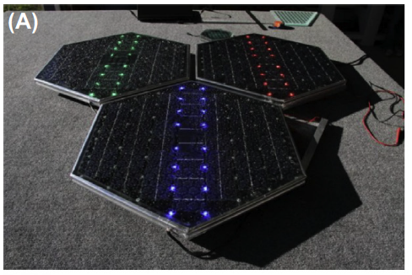
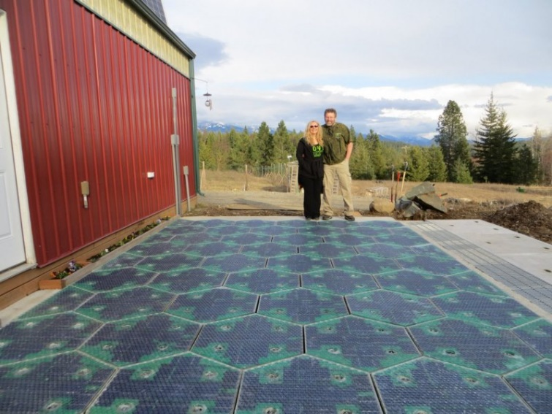
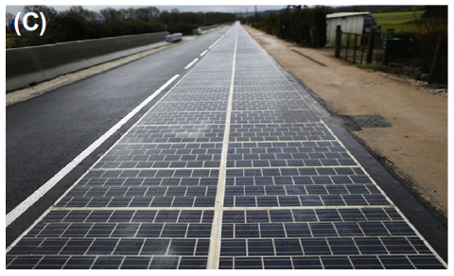
Smart Roadways
Solar to Electricity Concepts
http://www.solarroadways.com/.
https://commons.wikimedia.org/wiki/File:Solar_Roadway_Parking_Lot_Prototype.jpg
Notes:
https://commons.wikimedia.org/wiki/File:Solar_Roadway_Parking_Lot_Prototype.jpg
Anthony S. World’s first solar road opens in France: it’s ridiculously expensive. Ars Tech 2016. http://arstechnica.com/cars/2016/12/worlds-first-solar-roadopens-in-france/.
http://www.solarroadways.com/.
Intelligent transportation systems, or smart roads, are just beginning to come onto market.
Both solar-to-electricity and solar-to-thermal energy conversion concepts and designs are
currently being implemented in both experimental and initial commercial capacities for the
generation of renewable energy systems integrated with transportation roadways. An
example of this type of technology is the solar-powered hexagonal road panels developed
by the company Solar Roadways

Slide 70
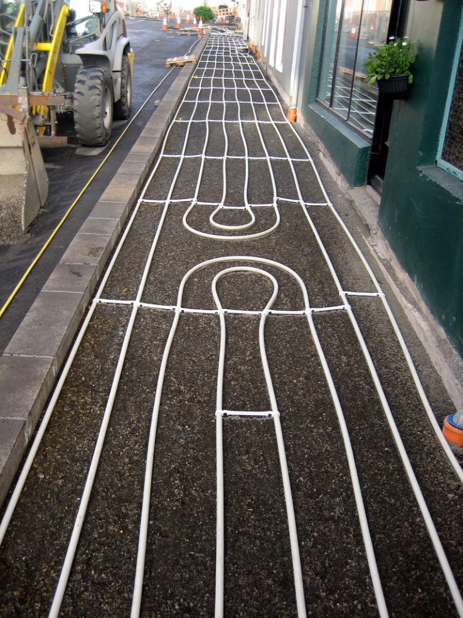
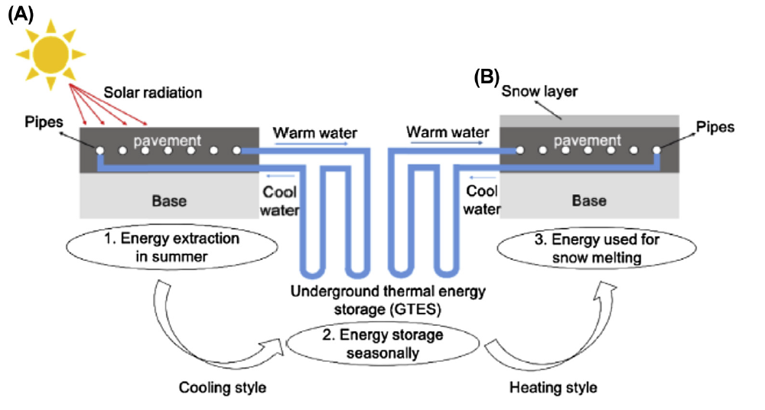
Smart Roadways
Solar to Thermal Concept
Geothermally heated sidewalk, Iceland (source: flickr/ Canadian Veggie, creative commons)
Notes:
Image Source: Pan P, Wu S, Xiao Y, Liu G. A review on hydronic asphalt pavement for energy harvesting and snow melting. Renew Sustain
Energy Rev 2015;48:624e34.
Asphalt solar collector systems are the most modern popular forms of thermal energy solar
harvesting. They come in two forms: porous asphalt layers between two impermeable layers
and asphalt concrete layers with a network of piping through them, referred to as hydronic
asphalt pavement (HAP). HAP is a developing renewable energy application that yields a
unique method of solar energy utilization via asphalt thermal radiation.53 HAP systems
have networks of piping where high thermal energy-retaining fluid is circulated below
the surface of the pavement. Energy from high surface temperatures from asphalt can be
transferred to a circulating fluid in the pipes beneath the asphalt. This benefits the structural
integrity of the road in the summer time by cooling the pavement. The now high-thermalenergy
fluid can be stored in insulated, underground tanks. In the summer time, this process
protects the structural integrity and reduces the degradation of roadways. In the wintertime,
the thermal energy from sunlight during the day can be stored in underground tanks,
allowing for the heating of the roads at night and/or when snow and ice begins to form
on the roadway. The picture illustrates the principles of both work functions of the HAP
system. Cold fluid is pumped up from an insulated underground storage medium and cools
the pavement as the fluid flows at a slow rate parallel to the surface top layer. The warm fluid is then circulated back to the storage medium where it
can be stored for later use. During the deicing phase of HAP systems, warm fluid from the
insulated storage medium is laterally pumped underneath the frozen pavement, allowing
for heated pavement and snow/ice melt

Slide 71
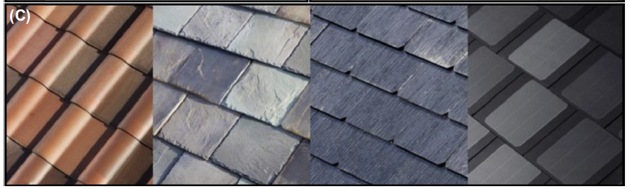
Smart roofing
Tesla Roofing
Source: EnergySage; 2016. http://news.energysage.com/tesla-solar-panel-roof-the-next-solar-shingles/
and Tesla Powerwall: https://www.tesla.com/en_AU/powerwall?redirect.no.
Notes:
Source: EnergySage; 2016. http://news.energysage.com/tesla-solar-panel-roof-the-next-solar-shingles/
and Tesla Powerwall: https://www.tesla.com/en_AU/powerwall?redirect.no.
The picture illustrates Tesla’ s new solar roof shingles. Made of material as durable as quartz and being esthetically attractive, these efficient solar roof shingles allow for extremely robust and easy addition to any residence seeking alternative energy home integration and renewable energy offsetting of GHGs. Similar to the same business model discussed earlier with Tesla’ s car sales, these high-quality solar roof shingles are expected to initially be sold at a relatively high price, where the revenue will be reinvested for research and production of more affordable models for a larger consumer base.

Slide 72
Summary
Energy production and consumption historically has been dependent on oil and petroleum → can we shift to renewable sources for our global energy needs?
  Green chemistry will be essential in shifting toward renewable sources
  Renewable – Biofuels, solar cell, fuel cells, hydro, etc.
Energy in the Laboratory
  Thermal, Cooling, Distillation, Equipment, Synthesis
Next Generation of Applications of Renewable Energy: Smart systems!

