Slide 1
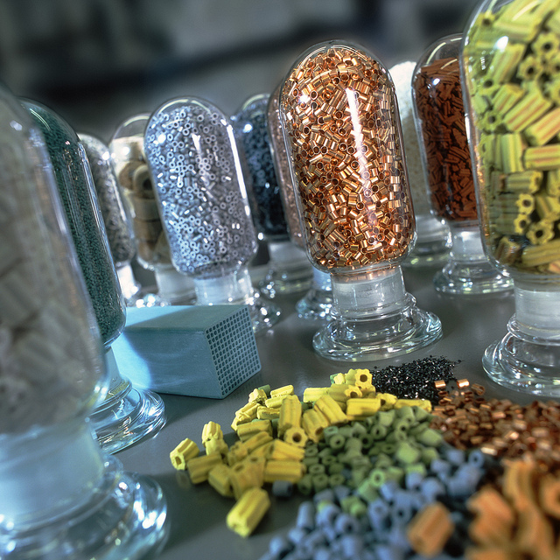

Yale-UNIDO Train-the-Facilitator Workshop in Green Chemistry
Catalysis
CENTER for GREEN CHEMISTRY
and GREEN ENGINEERING at YALE
Image: Flickr, Catalysts, Author: BASF Catalysts

Slide 2
Topics To Be Covered
What is a Catalyst?
Catalytic Cycle
Types of Catalysts
Catalysts and Sustainability
Important Improvements Using Catalysts
Enzymatic Reactions
Examples and Considerations

Slide 3
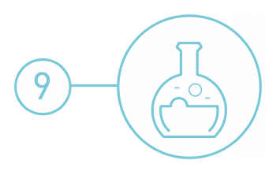
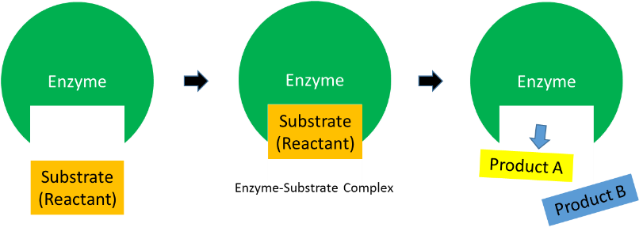
Catalysis
Catalytic reagents (as selective as possible) are superior to stoichiometric reagents.
Source: Wikipedia

Slide 4
What is catalyst?
A catalyst is a substance that increases the rate at which a chemical reaction approaches equilibrium, but is not consumed in the process.
The catalyst is not a reagent or a product as it is not consumed: it’s noted above the equation arrow
The catalyst participates in the kinetic equations but not in the equilibrium constant
A + Cat → ACat (1)
B + ACat → ABCat (2)
ABCat → CatP (3)
CatP → Cat + P (4)
A + B → P
Cat
Overall reaction
A + B → P

Slide 5
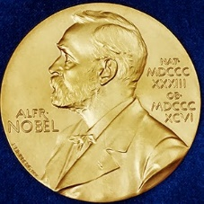
Nobel Prizes for catalysis
Ostwald, 1909, Catalysis (Ostwald Process)
Sabatier (together with Grignard), 1912, Heterogeneous Catalytic Hydrogenation
Haber, 1918, Ammonia Synthesis
Harden-Euler-Chelpin, 1929, Fermentation of Sugar by Enzymes
Bergius, Bosch, 1931, Catalytic High Pressure Chemistry
Ziegler, Natta, 1963, Alkene Polymerization
Fischer, Wilkinson, 1973, Organometallic Sandwich Complexes
Noyori, Sharpless and Knowles, 2001, Enantioselective Catalysis
Chauvin, Grubbs, Schrock, 2005, Metathesis
Ertl, 2007, Heterogeneous Catalysis
Suzuki, Heck, Negishi, 2010, Coupling reactions
Arnold, 2018, directed evolution (-> biocatalysis)

Slide 6
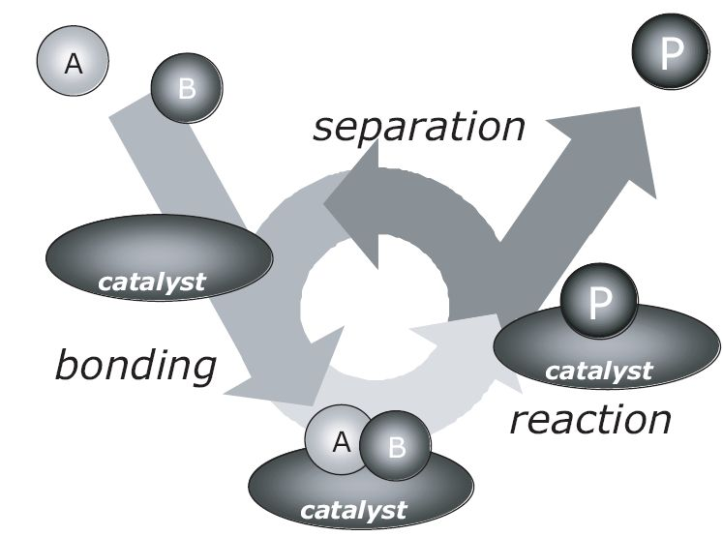
The catalytic cycle
Catalysis can be viewed as a cyclic event: A catalytic cycle is defined as the succession of chemical changes undergone by the catalyst until it recovers its initial state.
The catalyst remains reusable at the end of the process to go for a new cycle
If at any point the cycle breaks, catalysis stops!
A stoichiometric reaction can be view as a catalytic reaction going through 1 cycle
I. Chorkendorff, J. W. Niemantsverdriet, Concepts of Modern Catalysis and Kinetics, Wiley-VCH, 2003

Slide 7
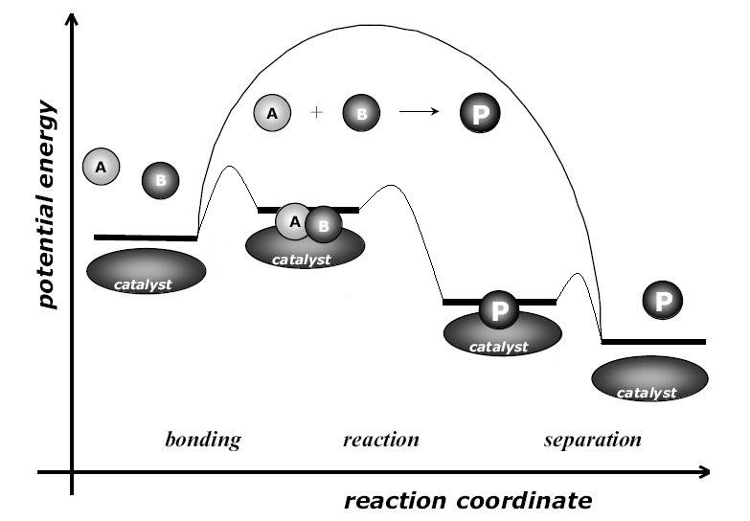
Catalysis = kinetic phenomenon
Catalysis can be viewed as a cyclic event: A catalytic cycle is defined as the succession of chemical changes undergone by the catalyst until it recovers its initial state.
Any reaction needs some energy to happen: the activation energy: Ea
When using a catalyst, an alternative path is created for a reaction, more complex, but energetically much more favorable.
Smaller activation energy for catalytic reaction => larger reaction rate
Ea
Ea
Ea < Ea
Reaction rate > reaction rate
I. Chorkendorff, J. W. Niemantsverdriet, Concepts of Modern Catalysis and Kinetics, Wiley-VCH, 2003

Slide 8
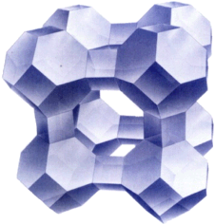
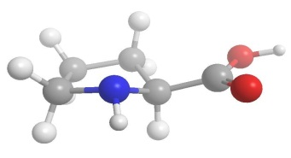
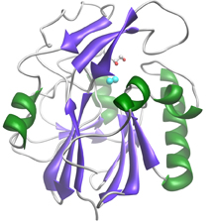
Examples of catalysts
Many molecules/enzymes/materials can be catalysts:
zeolite (crystalline aluminosilicate)
enzyme (biocatalyst)
copper-zinc crystallites on silica
Catalysis, Concepts and green applications, by Gadi Rothenberg, Wiley-VCH 2008.

Slide 9
Catalysts are widely used by industry and by nature
Catalyst | Reactions catalyzed
Iron oxide | Ammonia from nitrogen and hydrogen
Chromium-Molybdenum Alloy Nickel-Molybdenum Alloy Zeolite (Porous Aluminum and Silica Oxide) | Petroleum Industry
Acid (HCl, H₂SO₄, HNO₃) | Many organic reactions
Enzymes | Starch into sugars and sugars to ethanol

Slide 10
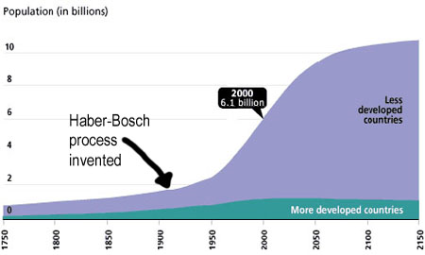
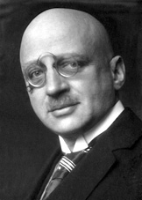
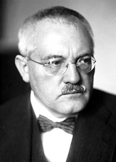
Haber Bosch Process
The Haber-Bosch process, which allows fertilizer production, is facilitated by a catalyst.
The invention of the process led to a global increase in human population.
Consumes 1% of the total human energy use on the planet
Fritz Haber
(1868-1934)
Nobel Prize 1918
Carl Bosch
(1874-1940)
Nobel Prize 1931
The Haber-Bosch process accounts for ~ 40 % of the overall N₂ fixation on earth and the only source of NH₃ for the subsequent synthesis of all nitrogen containing man-made materials
Source: Wikipedia

Slide 11
A kinetic process
At room temperature the reaction is thermodynamically driven:
ΔG= –16.4 kJ mol^{–1}; ΔH°=–45.9 kJ mol^{–1}
At 298 K
thermo: yes
kinetics: no
At 800 K
thermo: no
kinetics: no
At 700 K
thermo: no
But “Le Chatelier” can push with high pressure
kinetics: yes – catalyst!
N₂ + H₂
But: very high E_{a}:
heating required!
NH₃
Lower free energy
(more stable)
Kinetics= the rate of reaction and how fast equilibrium is reached
Thermodynamics= whether reaction is favorable (lower free energy)
“Le Chatelier” allows us to shift an equilibrium to the side that we would like to favor.
Chorkendorff & Niemantsverdriet, Concepts of Modern Catalysis and Kinetics, Wiley-VCH (2003)

Slide 12
Terminology: Types of Catalysts
 | Homogeneous | Heterogeneous | Biocatalysis
Form | Soluble metal complexes, usually mononuclear | Metals, usually supported, or metal oxides | Enzymes (polypeptides), many with a metal based active site
Active site | Well-defined, discrete molecules | Poorly defined | Well defined
Temperature | Low (<250ºC) | High (250 – 500°C) | 25°C mostly Up to 100°C
Selectivity | High | Low | High
Product separation | Generally problematic on large scale | Easy | From yeasts or bacteria. Amenable to large scale
Green? | Less Green | More Green Separation, Recycle/Regeneration | Very green

Slide 13
Criteria to design a Green Catalyst?
An ideal green catalyst would have a preferred parameters from each type.
 | Homogeneous | Heterogeneous | Biocatalysis
Form | Soluble metal complexes, usually mononuclear | Metals, usually supported, or metal oxides | Enzymes (polypeptides), many with a metal based active site
Active site | Well-defined, discrete molecules | Poorly defined | Well defined
Temperature | Low (<250ºC) | High (250 – 500°C) | 25°C mostly Up to 100°C
Selectivity | High | Low | High
Product separation | Generally problematic on large scale | Easy | From yeasts or bacteria. Amenable to large scale
Green? | Less Green | More Green Separation, Recycle/Regeneration | Very green
Notes:
After click text turns green – what are the criteria to design a green catalyst?

Slide 14
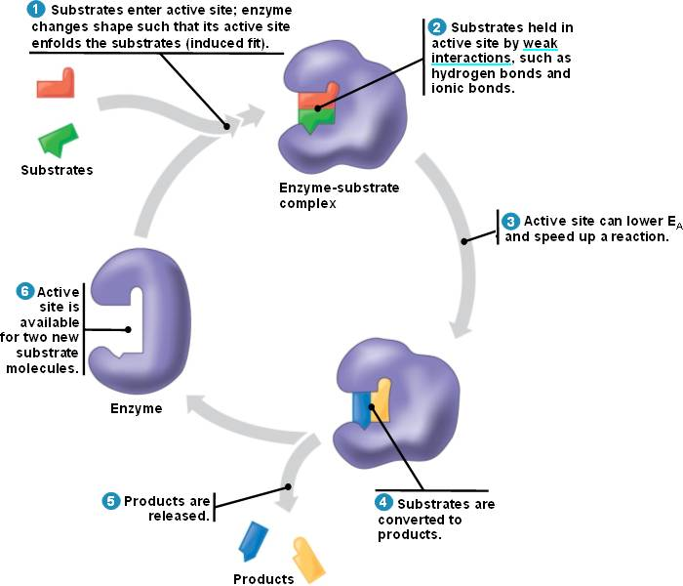
Terminology: Types of Catalysts
Still, all types of catalysts relies on the same principle and go through a catalytic cycle.
Homogeneous catalysis
Heterogeneous catalysis
Biocatalysis
metal crystallite
oxide support
Catalysis, Concepts and green applications, by Gadi Rothenberg, Wiley-VCH 2008. - http://bio1151.nicerweb.com/Locked/media/ch08/catalytic.html

Slide 15
Catalysts evaluation: TON, TOF, selectivity
Catalysts are not eternal! The important question is how many cycles can they achieve on average and how fast
Terminology
  Turn over number (TON) = total number of cycles
  Turn over frequency (TOF) = number of cycles/time
  TOF = TON / time
 | Inorganic Catalyzed Reaction | Enzymatic Reactions
TOF | 0.01 – 10000 s⁻¹ (Very slow) | 100 up to 40 million s⁻¹ (Extremely fast)
Selectivity | Medium to good selectivity | Excellent selectivity

Slide 16
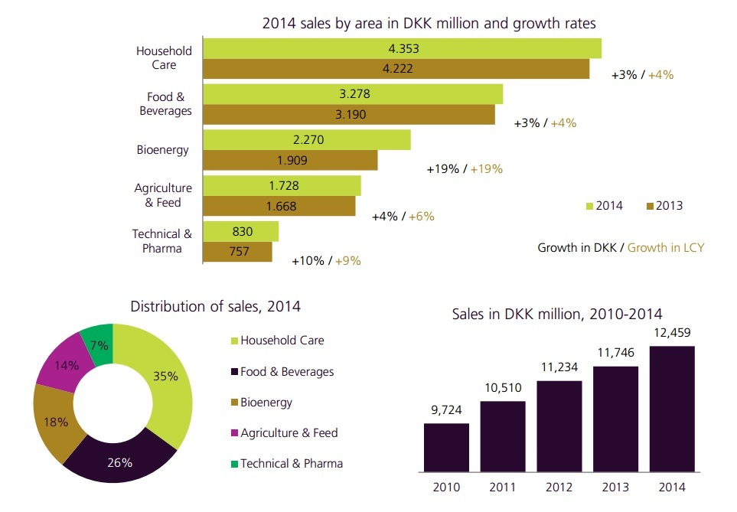
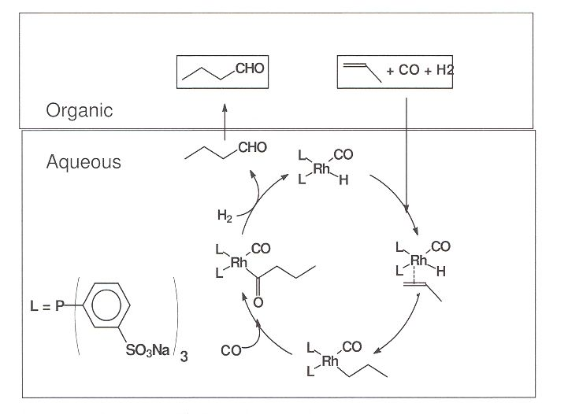
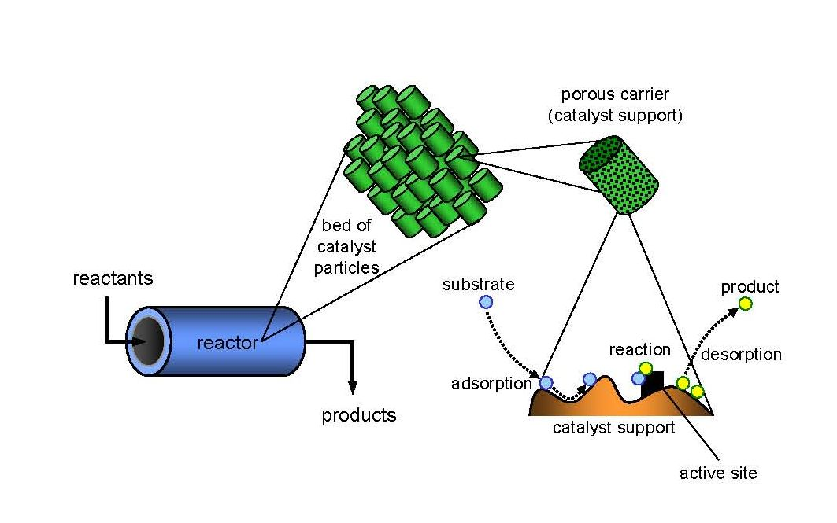
Catalysis in Industry
Homogeneous catalysis
Heterogeneous catalysis
Biocatalysis
Recovery is a real challenge
For processes for which heterogeneous is not good
Over 90 vol% of the chemicals worldwide are manufactured with the aid of solid catalysts
800 000 tons of solid catalysts are prepared each year
Heterogeneous catalysts allow continuous processes or flow reactors
Biocatalysis relies on the use of yeast and bacteria to perform chemistry
Fast growing market in many sectors
DKK 12.46 billion = $1.94 billion
Catalysis, Concepts and green applications, by Gadi Rothenberg, Wiley-VCH 2008 - K. H. Shaughnessy, Chem. Rev. 2009, 109, 643-710. Source: Novozyme

Slide 17
Catalysis Drives the Chemical Industry
Petroleum
Fine chemicals
Consumer Products
Pharmaceuticals
Catalytic processes contribute to more than 35% of global GDP.
Source: Wikipedia

Slide 18
Important Heterogeneous Catalytic Processes
.
Automotive three-way catalysis:
  NO_{x}/CO/HC → N₂/CO₂/H₂O
  Pt/Rh/Pd supported on ceria/alumina.
  Makes exhaust 99% cleaner.
Haber-Bosch process:
  N₂ + 3 H₂ → 2 NH₃
  Fe/Ru catalysts, high pressure and temperature.
  Critical for fertilizer & nitric acid production.
Fischer-Tropsch chemistry:
  n CO + 2n H₂ → (CH₂)_{n} + n H₂O , syn gas to liquid fuels.
  Fe/Co catalysts.
  Source of fuel for Axis in WWII.
set of chemical reactions that changes a mixture of carbon monoxide gas and hydrogen gas into liquid hydrocarbons (like gasoline or kerosene)

Slide 19
Designing a Green Catalyst
Not all catalysts are created equal. Chemists need to consider various factors when deciding on a catalyst.
Is the catalyst non-toxic?
Is it actually used in sub-stoichiometric amounts?
Does it require special conditions (sensitivity to solvent, moisture, oxygen)?
Is it derived from abundant/renewable resources?
Can it be reused?
Can it be separated from the products?
Might it lead to dangerous conditions (Runaway/chain reactions)?
Many metals which are used as catalysts are quickly depleting.
http://www.rsc.org/chemistryworld/Issues/2011/January/CriticalThinking.asp

Slide 20
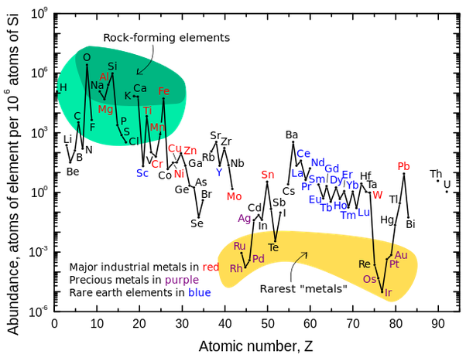
Metal scarcity
Source: Wikipedia

Slide 21
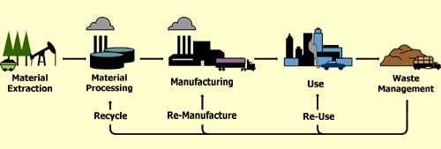
Use a lifecycle as a guide
Material Extraction
  Abundance?
Processing/Manufacturing
  Energy?
  Waste?
  Toxicity of materials?
Use
  Selectivity?
  Turnover number?
  Safety?
End-of-life
  Reusability?
  Ease of separation?
Source: Wikipedia

Slide 22
The Need to Develop More Sustainable Catalysts
Raw materials (e.g. rare precious metals) are dispersed around the world and access to them is frequently political.
To gain economic and environmental independence, we must design catalysts which are locally sourced and abundant.
European Commission Press Release, June 2010

Slide 23
Current Trends in Catalyst Design
Earth Abundant Alternatives
Abundant metal
Alloy - Synergistic Effect
Adjust other parameters
  - Solvents
  - Surfactants
Reduce Loading
High Surface Area Support
Atomic Layer deposition

Slide 24
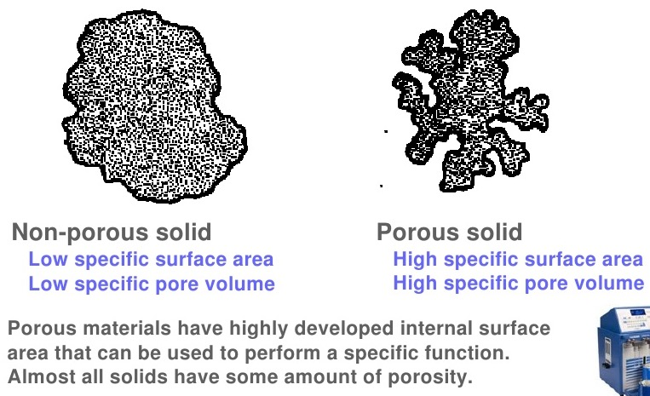
Increased Surface Area
High surface area porous support:
<50 cm² g⁻¹
50 – 4000 cm² g⁻¹

Slide 25
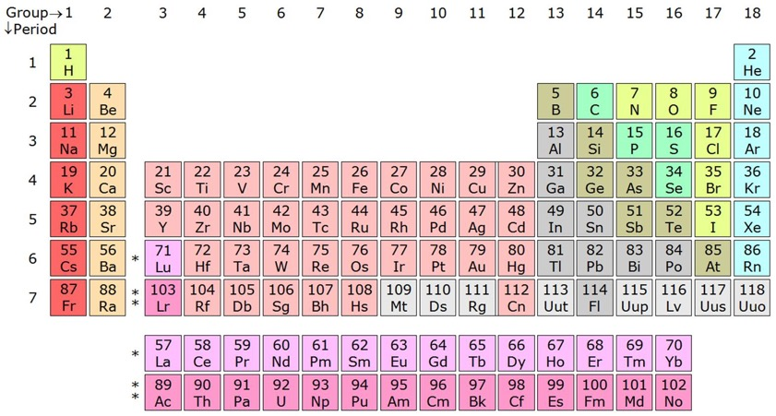

Example: The Haber-Bosch Process
Improving the Haber-Bosch process by using an iron catalyst:
Originally Fritz Haber discovered this reaction using an osmium (Os) based catalyst
  Os metal is rare, toxic and too expensive: it could not be made industrial.
Rapidly alternatives with either iron (Fe) or ruthenium (Ru) were developed
Today’s catalysts: finely divided Ru on a solid support of Fe₃O₄/Fe₂O₃/Al₂O₃/K₂O/CaO
$$N_{2}+3H_{2 }→2NH_{3}$$
Notes:
Beware: Osmiun has never been a “traditional” catalysts for HB. It was the first catalyst discovered by F. Haber, but it was only commercialized with Ru or Fe based calasysts. I corrected it. AHM

Slide 26
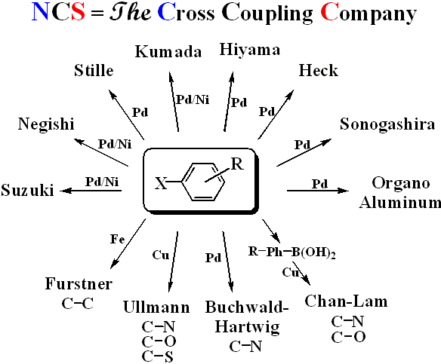
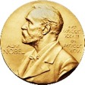
Example: Cross coupling reaction
Cross Coupling Reactions:
  → Connecting two separate organic molecules together with high selectivity and high yield.
 | USD mol⁻¹
Ni | $1.20
Pd | $1,500
New chemistry innovations allowed the replacement of expensive palladium catalysts with nickel.
These reactions were awarded Nobel Prizes.
Notes:
Pd is used catalytically, in small amount, to carry out the reaction. In some cases, Pd needs NOT to be purified

Slide 27
Eliminate More Reactions:
Minimizing functionalization-defunctionalization
A Simple Dream
Ideally:

Slide 28
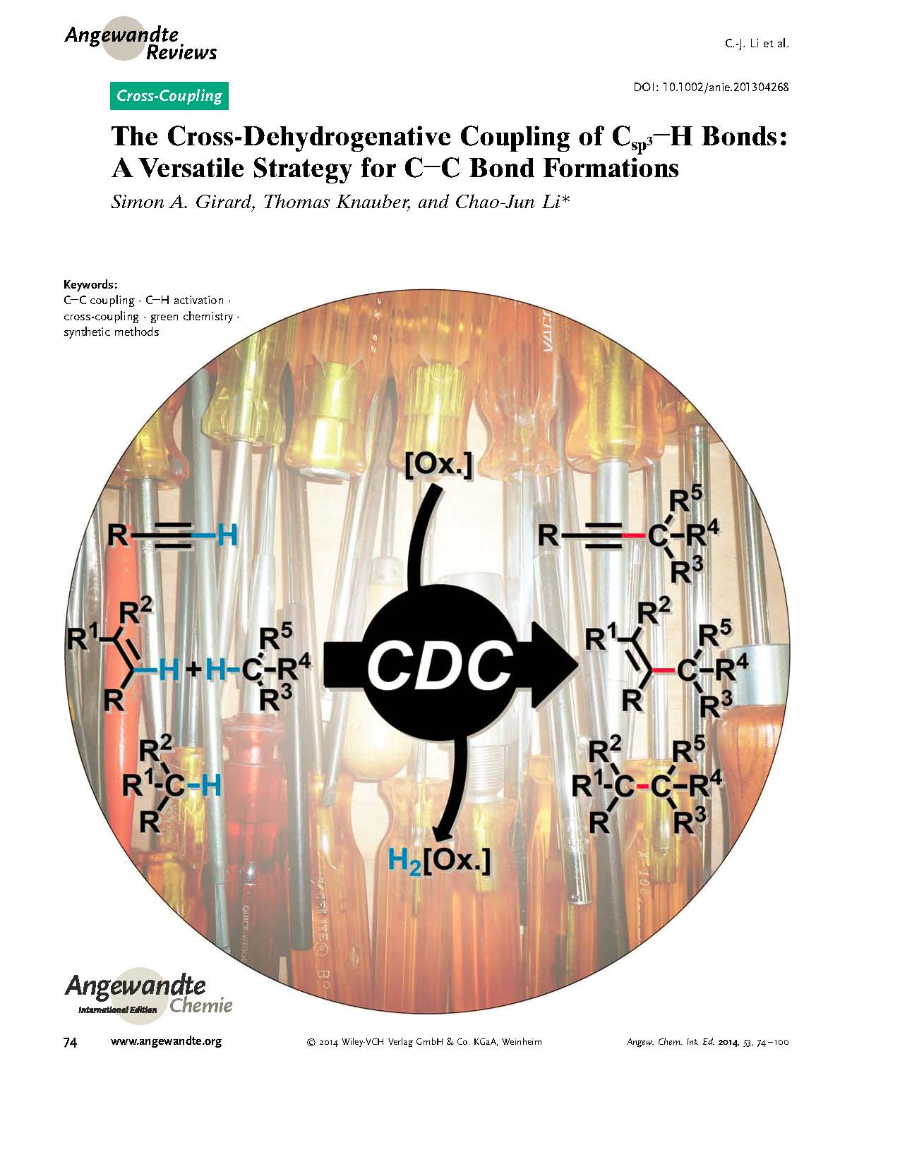
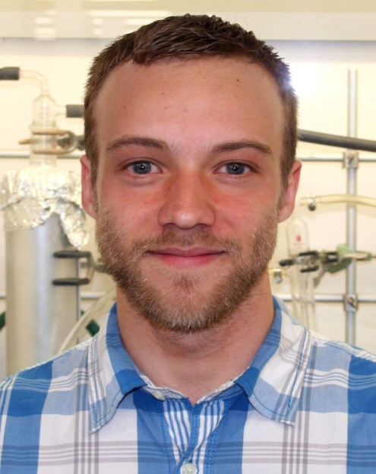


Slide 29
All are possible!

Slide 30
The Ultimate CDC Reaction
Non-oxidative conversion of methane to benzene
(McGill Patent Applied, 2013) Li, L.; Fan, S.; Mu, X.; Mi, Z.; Li, C.-J.
J. Am. Chem. Soc. 2014, 136, 7793 (highlighted in Chem. & Eng. News, June 9, 2014)
Angew. Chem. Int. Ed. 2014
Notes:
Natural gas is a mixture of small alkanes, such as methane and ethane. It is very plenty on earth and exists in different forms. Shale gas is one source of natural gas which is trapped within shale formations. Over the past decade, shale gas is increasing rapidly and becomes an important clean fuel. At the end of 2012, the price of shale gas is only half of oil in USA.
Obviously, if we can use shale gas instead of the oil as a new carbon source, the future chemical industry will be largely changed. Our recent work is focusing on the production of aromatic compounds directly from shale gas, which is one of the seven basic building blocks in chemical industry

Slide 31
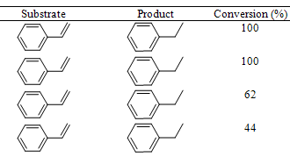
Example: replacing palladium by iron in hydrogenation
Hydrogenation:
  Usually with expensive, rare metals: Pd, Rh, Ru, Pt
  or toxic, Ni
  iron (Fe) is abundant and non toxic
synthesized
in EtOH
The iron oxide shell protects Fe(0) from oxidation with water, while allowing interesting reactivity
synthesized
in EtOH and water (99:1)
synthesized
in EtOH and water (1:1)
industrial
in EtOH
R. Hudson, A. Rivière, C. M. Cirtiu, K. L. Luska, A. Moores, Chem.Comm. 2012, 48, 3360-3362.
Notes:
Pd is used catalytically, in small amount, to carry out the reaction. In some cases, Pd needs NOT to be purified

Slide 32
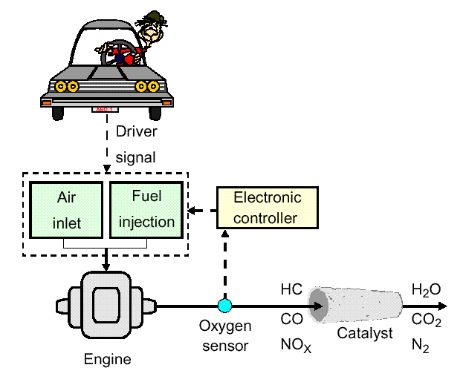
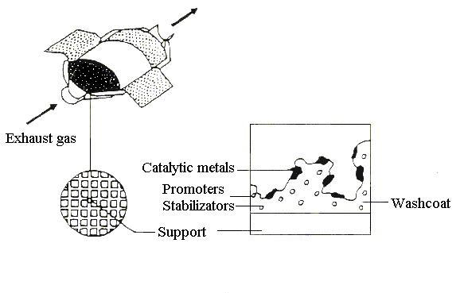
Automotive Emissions Control System
“Three-way” Catalyst
CO → CO₂
HC → CO₂ + H₂O
NO_{x} → N₂
Monolith reactor
Most widely deployed heterogeneous catalyst in the world.
You probably own one!
Pt, Rh, Pd Alumina, ceria, lanthana, etc.
Notes:
HYDROCARBONS

Slide 33
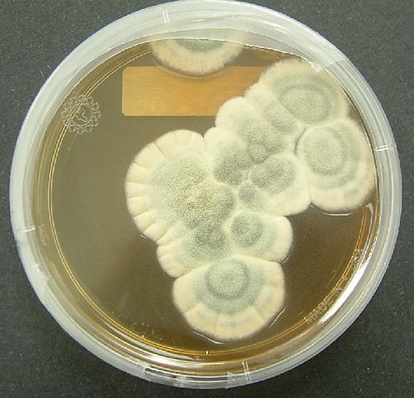
Enzymatic Reactions
Enzymatically driven reactions that occur in nature are often highly specific and compartmentalized.
Many of these reactions occur in ambient temperature and pressure with a water solvent.
Today, over 5000 of enzymatic reactions types have been identified, and that number continues to grow.
Image: Wikimedia Commons, Penicillium notatum, Author: Crulina 98

Slide 34
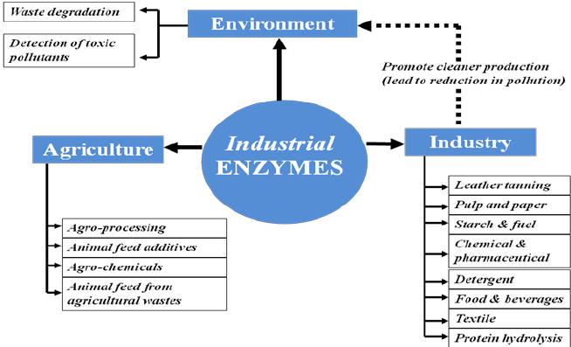
Enzymatic Reactions
Enzymes are biological catalysts and are used in industry, agriculture, and by nature.

Slide 35
Enzymatic Reactions
This is a general representation of enzymatic reactions – the lock and key mechanism.
The substrate (reactant) binds with the enzyme and forms the Enzyme-substrate complex and is transformed into products A and B, which are released from the active site upon reaction completion.

Slide 36
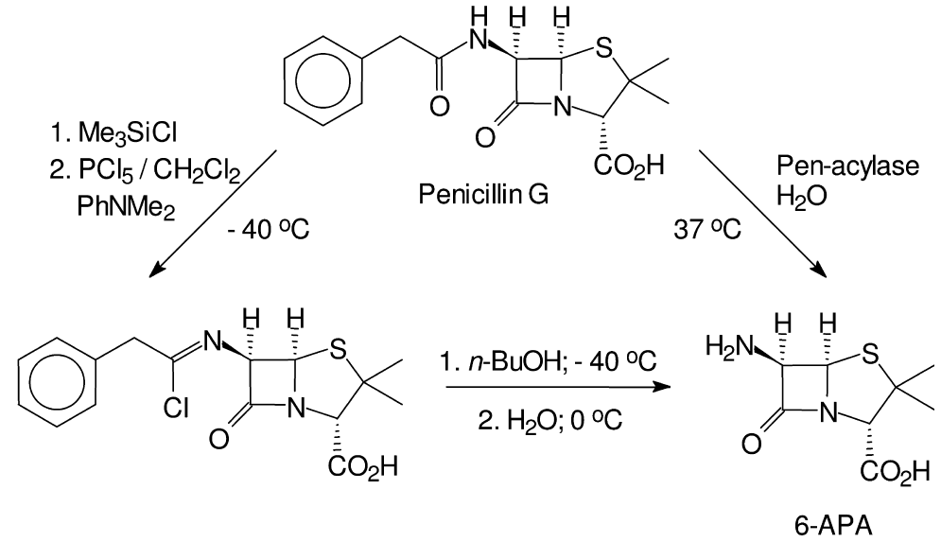
Examples on Enzymatic Catalysis
Conventional manufacturing of 6-aminopenicillanic acid (6-APA) - a key raw material for semi-synthetic penicillin and cephalosporin involved the use of environmentally unattractive reagents – requires a chlorinated hydrocarbon solvent and a reaction temperature of –40°C.
In contrast, enzymatic cleavage of penicillin G is performed in water at 37°C and the only reagent used is to adjust the pH.
The enzymatic process currently accounts for the majority of the several thousand tons of 6-APA produced annually on a world-wide basis.
Notes:
An illustrative example of the benefits to be gained by replacing conventional chemistry by biocatalysis is provided by the manufacture of 6-aminopenicillanic
acid (6-APA), a key raw material for semi-synthetic penicillin and cephalosporin antibiotics, by hydrolysis of penicillin G [115]. Up until the mid-1980s a chemical
procedure was used for this hydrolysis (Fig. 1.37). It involved the use of environmentally unattractive reagents, a chlorinated hydrocarbon solvent (CH2Cl2)
and a reaction temperature of –40C. Thus, 0.6 kg Me3SiCl, 1.2 kg PCl5, 1.6 kg PhNMe2, 0.2 kg NH3, 8.41 kg of n-BuOH and 8.41 kg of CH2Cl2 were required
to produce 1 kg of 6-APA [116].
In contrast, enzymatic cleavage of penicillin G (Fig. 1.37) is performed in water at 37C and the only reagent used is NH3 (0.9 kg per kg of 6-APA), to adjust
the pH. The enzymatic process currently accounts for the majority of the several thousand tons of 6-APA produced annually on a world-wide basis.
30 1 Introduction: Green Chemistry and Catalysis Fig. 1.37

Slide 37
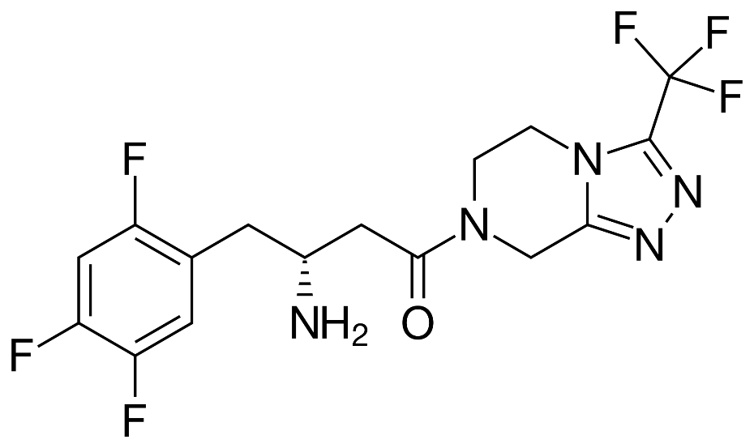
Case Study
Sitagliptin – Rhodium to Enzyme
Sitagliptin is Merck's top-selling diabetes drug.
It brought $1.9 billion in sales in 2009.
Traditional synthesis used high pressure and a heavy metal – rhodium.
The new improved synthesis with enzymes allows for 99.95% selectivity to the desired product and eliminates all heavy metal wastes.
Sitagliptin, the active ingredient in Merck's Januvia.
http://www.rsc.org/chemistryworld/News/2010/June/17061002.asp (Accessed on 4/1/2016)
Savile, C. K.; Janey, J. M.; Mundorff, E. C.; Moore, J. C.; Tam, S.; Jarvis, W. R.; Colbeck, J. C.; Krebber, A.; Fleitz, F. J.; Brands, J.; Devine, P. N.; Huisman, G. W.; Hughes, G. J., Biocatalytic Asymmetric Synthesis of Chiral Amines from Ketones Applied to Sitagliptin Manufacture. Science 2010, 329 (5989), 305-309.
Notes:
http://www.rsc.org/chemistryworld/News/2010/June/17061002.asp

Slide 38
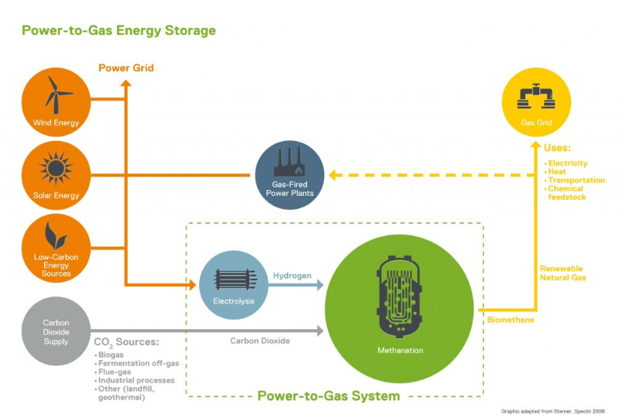
Enzymatic catalysis for energy
Bacteria have been used to turn CO₂ into methane
http://www.electrochaea.com/about/ - Video: http://www.electrochaea.com/technology/
Notes:
http://www.rsc.org/chemistryworld/News/2010/June/17061002.asp

Slide 39
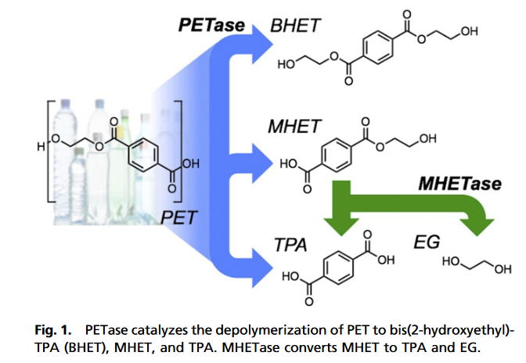
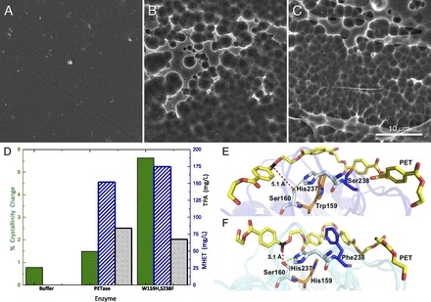
Enzymatic catalysis for plastic degradation
With specific mutations a PETase properties were improved to degrade plastics. Bacterium in question: Ideonella sakaiensis 201-F6
A. No enzyme B. wild-type PETase C. mutant type PETase
PET films
Austin, H. P.; Allen, M. D.; Donohoe, B. S.; Rorrer, N. A.; Kearns, F. L.; Silveira, R. L.; Pollard, B. C.; Dominick, G.; Duman, R.; El Omari, K.; et al. Proc. Natl. Acad. Sci. U. S. A. 2018, 115 (19), E4350–E4357.
Notes:
http://www.rsc.org/chemistryworld/News/2010/June/17061002.asp

Slide 40
The Pros and Cons of Enzymatic Reactions
Pros:
Cons:
  Mild conditions.
  Aqueous environment.
  Atmospheric conditions.
  A very specific and high reaction rate.
  Separations are often complicated.
  They can be expensive to produce.
  Some people might experience allergic reactions to some enzymes.

Slide 41
Topics Covered
What is a Catalyst?
Catalytic Cycle
Types of Catalysts
Catalysts and Sustainability
Important Improvements Using Catalysts
Enzymatic Reactions
Examples and Considerations

Slide 42
Sponsored by Yale-UNIDO Initiative
QUESTIONS?
CENTER for GREEN CHEMISTRY
and GREEN ENGINEERING at YALE

