Slide 1
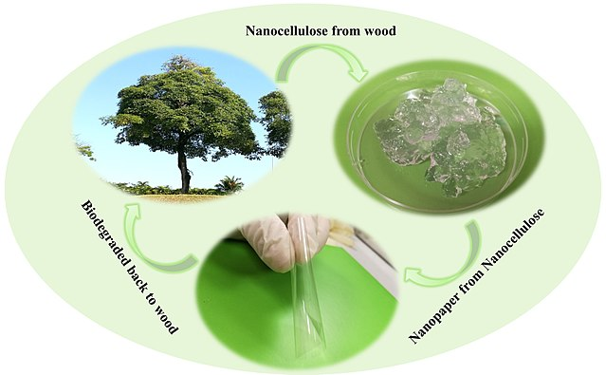
Yale-UNIDO Train-the-Facilitator Workshop in Green Chemistry
Green Chemistry, principles and metrics
CENTER for GREEN CHEMISTRY
and GREEN ENGINEERING at YALE
Image: Wikipedia, Biodegradation of nanocellulose, Author: Shaohui Li, Pooi See Lee

Slide 2
Topics To Be Covered
What is Green Chemistry
Twelve principles
Chemical and green chemistry Design
The Market and demand for Green Chemistry
Examples of the 12 principles

Slide 3
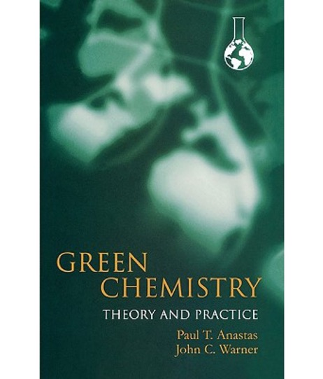
What is Green Chemistry?
Green chemistry is the design of chemical products and processes to reduce or eliminate the generation and use of hazardous substances.
Hazardous = to human health and environment
Anastas, P. T., Warner, J. C. (2000). Green chemistry: Theory and Practice.
New York; Oxford University Press.
Notes:
Definition of the green chemistry: Green chemistry is the design of chemical products and processes that reduce or eliminate the use and generation of hazardous substances.
. The field was developed 25 years ago by Anastas and Warner, and presented in their seminal work “Green Chemistry: Theory and Practice”.

Slide 4


The birth of Green Chemistry?
As a scientific endeavor, Green Chemistry was born in the 1990s with researchers theorizing that sustainability questions call for chemistry
Paul Anastas (EPA, US)
John Warner (Polaroid Corp.)
Together they wrote a book in 1998, setting the foundation of green chemistry
P. Anastas, J. Warner in Green Chemistry: Theory and Practice (New York, 1998).

Slide 5
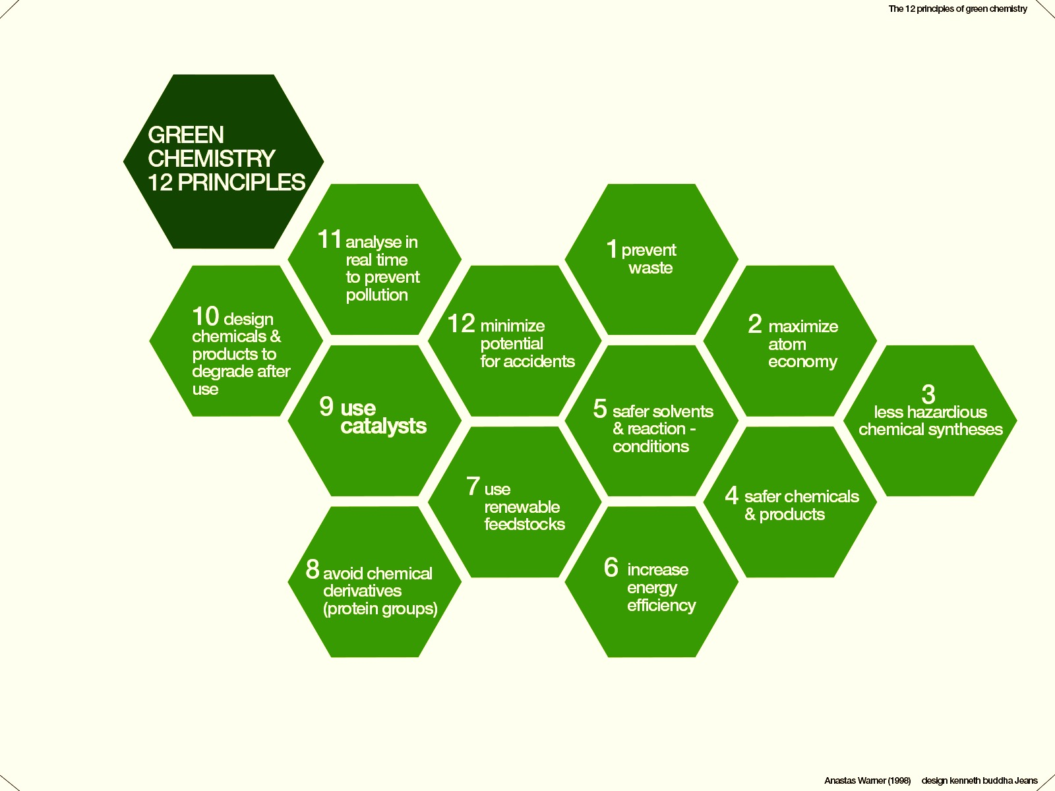
The 12 Principles of Green Chemistry
Waste Prevention
Atom Economy
Less Hazardous Chemical Synthesis
Designing Safer Chemicals
Safer Solvents and Auxiliaries
Design for Energy Efficiency
Use of Renewable Feedstocks
Reduce Derivatives
Catalysis
Design for Degradation
Real-time Analysis for Pollution Prevention
Inherently Safer Chemistry for Accident Prevention
Anastas, P. T.; Warner, J.C. Green Chemistry: Theory and Practice, Oxford University Press,1998
Notes:
Green chemistry is defined by 12 Principles, which address various topics. Most principles have tools or metrics associated to help the researcher and guide them through green chemistry improvements.

Slide 6
The 12 Principles of Green Chemistry
The principles address:
  Toxicity
    - Reducing the hazard
  Feedstocks
    - Use of renewable resources
  Designing safer products
    - Non toxic products by design
  Biodegradability
    - Enhancing break down at the end of life
  Energy
    - Reducing the energy needs
  Accidents
    - Eliminating accidents
  Efficiency
    - Shorter processes and synthesis
Anastas, P. T.; Warner, J.C. Green Chemistry: Theory and Practice, Oxford University Press,1998

Slide 7
Isn’t That How it is Done Now?
Entire industries are geared toward cleaning up after wasteful chemical syntheses.
Today’s scientific literature is filled with synthetic pathways that are inefficient in terms of design.
Reagents are seldom selected with regard to hazard.
Industrial chemicals do not have minimal hazard as a performance criterion.
Persistence of chemicals in the biosphere and in our bodies is a major global health issue (CDC 250 chemicals since 1945).
The vast majority of organic chemicals are made from depleting (non-renewable) feedstocks.
Our chemical industry deals with safety through engineering and security through barricades.

Slide 8
The Chemical Design Process
DECISION MAKING
Type of resources
What materials (feedstocks, solvents, additives) are needed?
Are the materials readily available?
How much material is needed?
Manufacturing process
What technology is needed?
What is the scale of the experiment/operation?
Ultimately determining the characteristics of the waste stream, energy requirements, and the toxicity of the entire process.
Notes:
Types of resources:
While the starting materials are important (feedstocks), at the design phase the decision on the solvents, additional reactants is also necessary.
Decision on the scale of the manufacturing process is needed. Each industry is different, for example a big pharma will have other scale than a startup.
All these decisions determine the characteristics of the waste stream, energy usage, and toxicity of the entire process.

Slide 9

Traditional Design Criteria
Solubility
Melting Point
Glass transition temperature
Mechanical Properties (Tensile Strength, Modulus, Elongation)
Refractive Index
Surface Tension
Yields/selectivity
Image: HP

Slide 10

Green Chemistry Inspired Design Criteria
Solubility
Melting Point
Glass transition temperature
Mechanical Properties (Tensile Strength, Modulus, Elongation)
Refractive Index
Surface Tension
Toxicity
Environmental Impact
As you can see, Green Chemistry’s view on the development of new products isn’t far from what’s currently being practiced. It’s simply thinking of the toxicological effects at the inception of product development that makes it a powerful tool.
Image: Philips

Slide 11
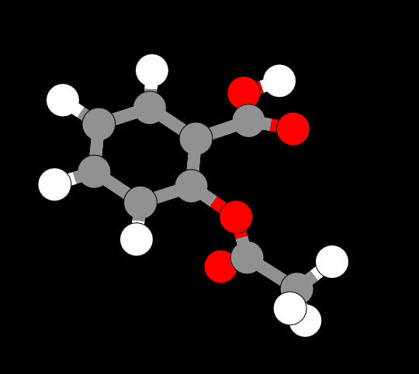
Focus on Chemical Design
The moment chemists begin to design, they are making choices about the health and environmental impacts of their product:
Design is intentional.
All characteristics, including performance and toxicity, can be designed.
Image source: ChemDoodle Web Components

Slide 12
A Fundamental Change in Thinking
Green Chemistry moves our consideration of how to deal with environmental problems from the circumstantial to the intrinsic.
Hazard must be recognized as a flaw in the designing process.
Circumstantial
  - Use
  - Exposure
  - Handling
  - Treatment
  - Protection
  - Recycling
  - Costly
Intrinsic
  - Molecular design for reduced toxicity
  - Reduced ability to manifest hazard
  - Inherent safety from accidents
  - Increased potential profitability

Slide 13
Approaching Risk: Exposure Versus Design
The conventional approach to hazards focuses on reducing risk by minimizing exposure.
- For example, wearing personal protective equipment or space ventilation if the chemical is volatile.
Green chemistry focuses on reducing risk by reducing hazard.
- If there is no hazard, exposure becomes irrelevant.

Slide 14
Another design principle: Function vs molecule
Green Chemistry also needs to rethink the problem de novo. We move from considering the molecule/material to the function.
Thinking about function calls for interdisciplinary research to “think outside the box”
Molecule/materials
  - Bis phenol A/phtalate
  - Epoxy resin
  - Cis platinum
  - Poly ethylene terephthalate (PET)
  - dichloromethane
Function
  - Plasticizing
  - Coating
  - Catalyst
  - Materials which can be molded, does not leak..
  - Solvent

Slide 15
Traditional approach
More environmentally
benign than alternatives
Performs better
than alternatives
More economical
than alternatives

Slide 16
Holistic approach
Safety
Green
Chemistry
Performance
Cost

Slide 17
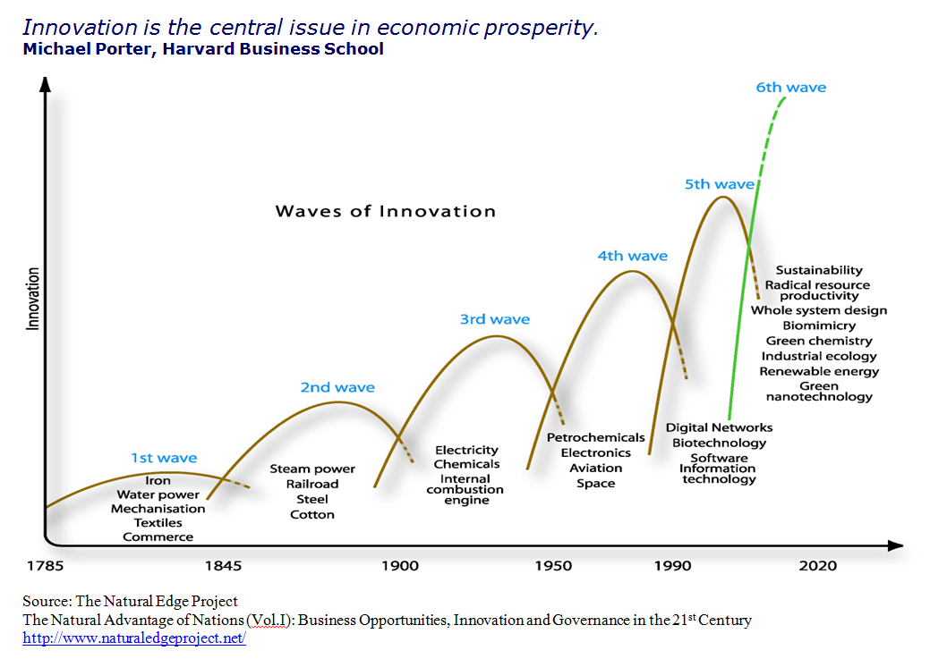
Green Chemistry Future

Slide 18
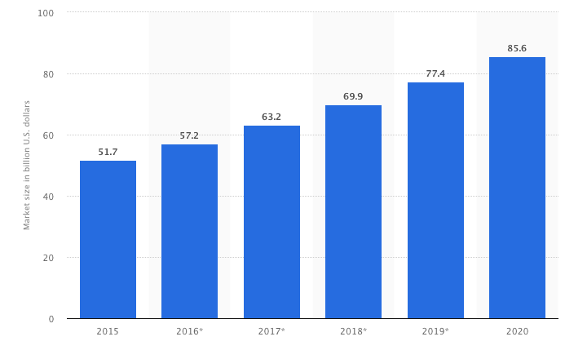
Green Chemistry Market Predictions
Forecasted market size of the green chemistry industry worldwide from 2015 to 2020 (in billion U.S. dollars).
* Calculated based on the compound annual growth rate (CAGR) of 10.6 between 2015 and 2020, as stated by the source. Figures from 2016 to 2020 are forecasted.
Source: statista.com

Slide 19
Green Chemistry Across Industrial Sectors
Defense and aerospace
Adhesives
Coatings
Corrosion, inhibitors
Automotive
Solvents
Polymers
Fuels
Household cleaners
Surfactants
Fragrances
Dyes
Electronics
Solder
Housings
Displays
Agriculture
Pesticides
Fungicides
Fertilizers
Cosmetics
Builders
Chelating agents
Dyes
Pharmaceuticals

Slide 20
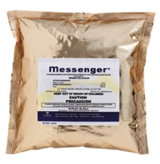
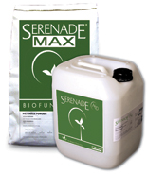
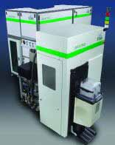

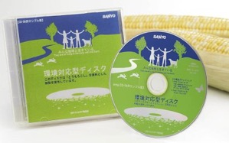
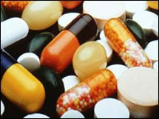
Green Chemistry Innovation in Other Fields
Home and Garden
Electronics
Clothing
Building materials
Cleaning products
Food products
Jewelry
And more!
Entertainment
Medicine
Image source: Wikipedia

Slide 21

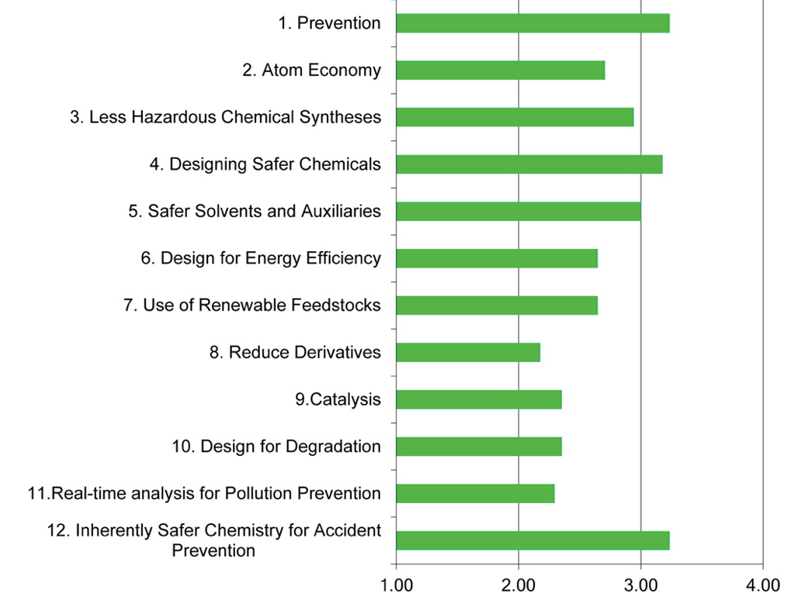
How Frequently Are The 12 Principles of Green Chemistry Implemented in Chemical Manufacturing?
Survey done on chemical manufacturers contacted via The Nexus (ACS Green Chemistry Inst.)
This graph illustrates the frequency that the 12 principles of green chemistry are implemented in chemical manufacturing. Average chemical manufacturer responses (n = 17) to the 2012 Roundtable survey question “In your opinion, how frequently does your company implement the following principles of green chemistry?” on a scale of 1 to 4, where 1 is never implemented (same value used for not applicable), 2 is rarely implemented, 3 is regularly implemented, and 4 is fully implemented. The magnitude of each bar is the average response calculated using the corresponding scale value (e.g., 3 for regularly implemented).
Implementing Green Chemistry in Chemical Manufacturing: A Survey Report Robert J. Giraud, Paul A. Williams, Amit Sehgal, Ettigounder Ponnusamy, Alan K. Phillips, and Julie B. Manley
ACS Sustainable Chemistry & Engineering 2014 2 (10), 2237-2242

Slide 22
Benefits of Green Chemistry
For the environment:
For human health:
For the economy:
For sustainability:
For science:
  Products will biodegrade and won’t persist in the environment.
  Products that won’t cause toxic harm to humans (employees, consumers)
  Novel products can boost competitiveness.
Products made from renewable, abundant resources.
  Fundamental new insights.

Slide 23
The 12 Principles of Green Chemistry
Waste Prevention
Atom Economy
Less Hazardous Chemical Synthesis
Designing Safer Chemicals
Safer Solvents and Auxiliaries
Design for Energy Efficiency
Use of Renewable Feedstocks
Reduce Derivatives
Catalysis
Design for Degradation
Real-time Analysis for Pollution Prevention
Inherently Safer Chemistry for Accident Prevention
Anastas, P. T.; Warner, J.C. Green Chemistry: Theory and Practice, Oxford University Press,1998
Notes:
Green chemistry is defined by 12 Principles, which address various topics. Most principles have tools or metrics associated to help the researcher and guide them through green chemistry improvements.

Slide 24
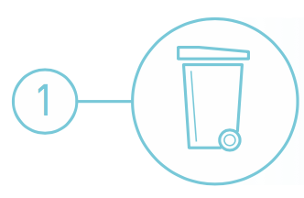
Waste Prevention
It is better to prevent waste than to treat or clean up waste after it is formed.
What is Waste? - Waste is anything that is a leftover from the product/process and cannot be re-used.
Waste can be produced in any stage of a process life-cycle:
Origins of feedstock
Manufacturing
Distribution
Use
End of life
When is waste not waste?
When it can be reused, becoming a feedstock.
When it can be reduced or completely eliminated.

Slide 25
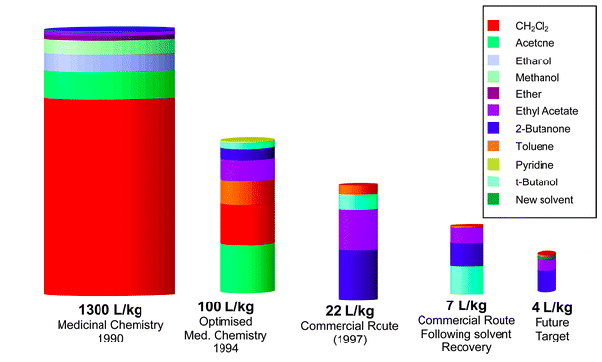
Waste Prevention
Case study: Sildenafil citrate production - Pfizer
Sildenafil citrate, commonly known as Viagra, is a selective inhibitor of phosphodiesterase 5 (PDE5). This new drug immediately became a major seller, achieving sales of more than $1 billion during its first year on the market. With such a rapid sales take off it was critical that the environmental performance of the synthesis was good from the outset.
Conventional sildenafil citrate synthesis included:
11 step synthesis, which gave a 4.2% overall yield.
Tin chloride, a heavy metal and a major environmental polluter.
The use of stoichiometric quantities of thionyl chloride in a solvent. This has a high environmental impact.
Hydrogen peroxide, which causes burns upon skin contact and is a fire and transportation hazard, especially when in contact with organic materials.
Produced over 1300 L of waste per 1 kg of product.
The amount of organic waste produced by the sildenafil citrate processes at various time points
Dunn, P.J et al Green Chem., 2004, 6, 43-48

Slide 26
Waste Prevention
Case study: Sildenafil citrate production - Pfizer
Sildenafil citrate, commonly known as Viagra, is a selective inhibitor of phosphodiesterase 5 (PDE5). This new drug immediately became a major seller, achieving sales of more than $1 billion during its first year on the market. With such a rapid sales take off it was critical that the environmental performance of the synthesis was good from the outset.
Alternative production of sildenafil citrate:
Average yield of last three steps = 97% yield.
Reduction of the ratio of solvent waste/kg product over 17 years from 1300 L/kg to only 7 L/kg by minimizing solvent use, increasing solvent recovery, improving solvent selection, and telescoping steps.
Only the solvents t-butanol, ethyl acetate, 2-butanone, and a trace of toluene still require disposal.
The amount of organic waste produced by the sildenafil citrate processes at various time points
Dunn, P.J et al Green Chem., 2004, 6, 43-48

Slide 27
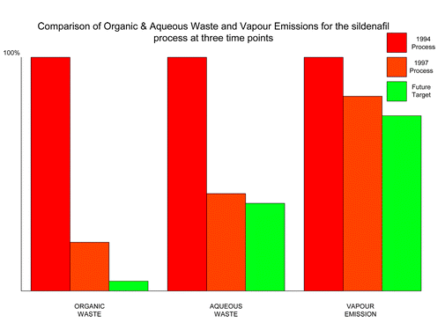
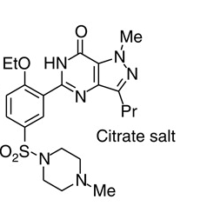
Waste Prevention
Case study: Sildenafil citrate production - Pfizer
Alternative production of sildenafil citrate:
Average yield of last three steps = 97% yield.
Reduction of the ratio of solvent waste/kg product over 17 years from 1300 L/kg to only 7 L/kg by minimizing solvent use, increasing solvent recovery, improving solvent selection, and telescoping steps.
Only the solvents t-butanol, ethyl acetate, 2-butanone, and a trace of toluene still require disposal.
Dunn, P.J et al Green Chem., 2004, 6, 43-48
Pfizer, Inc

Slide 28
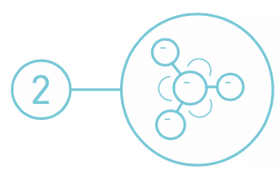
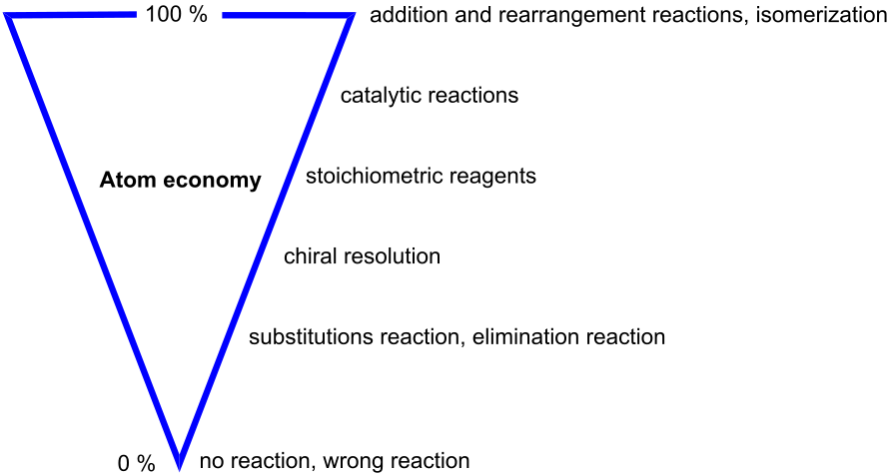
Atom Economy
Synthetic methods should be designed to maximize the incorporation of all materials used in the process into the final product.
Image: Wikimedia Commons, Author: Astrid 91

Slide 29
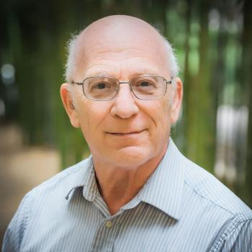
Atom Economy
Barry Trost
In 1990 Barry Trost introduced the concept of synthetic efficiency: Atom Economy (AE). It refers to the concept of maximizing the use of raw materials so that the final product contains the maximum number of atoms from the reactants.
The ideal reaction would incorporate all of the atoms of the reactants.
The AE is measured as the ratio of the molecular weight of the desired product over the molecular weights of all reactants used in the reaction.
Additional considerations when designing a green reaction:
Generation of co-products and waste, toxicity of co-products and waste, energy needs, purification steps, solvent and catalyst usage

Slide 30
Atom Economy
Case study: Ibuprofen
Conventional synthesis of ibuprofen:
  6 stoichiometric steps.
  <40% atom utilization.

Slide 31
Atom Economy
Case study: Ibuprofen
Alternative catalytic synthesis of ibuprofen:
  3 catalytic steps.
  80% atom utilization.
  BHC
Notes:
Both ROS start with same raw material – Methyl propyl Benzene. Original route - chemicals like Hydroxylamine, Sodium Ethoxide, Ethylchloro acetate, AlCl3 used, you don’t see in the final product.

Slide 32
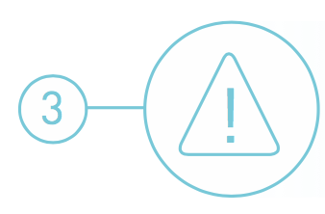
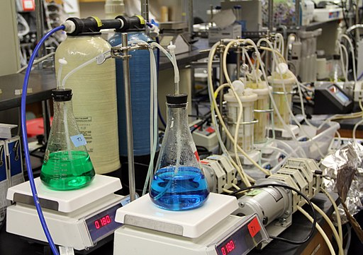
Less Hazardous Chemical Synthesis
Whenever practicable, synthetic methodologies should be designed to use and generate substances that possess little or no toxicity to human health and the environment.
Image: Wikimedia Commons, Center for Biofilm Research Laboratory Montana State University

Slide 33
Less Hazardous Chemical Synthesis
Case study: Synthesis of adipic acid
Adipic acid (AA), also referred to as hexanedioic acid, is one of the most produced commodity chemicals worldwide. With a projected global market size of more than 7 billion US dollars by 2019, AA is a versatile building block for an array of processes in the chemical, pharmaceutical and food industries. Its primary use is as a precursor for the synthesis of the polyamide Nylon-6,6.
Conventional synthesis of adipic acid:
Uses benzene, a known carcinogen, as a starting material.
Involves oxidation with an excess of HNO₃, and production of greenhouse gas nitrous oxide (N₂O), the latter accounting for approximately 5–8% of the worldwide anthropogenic N₂O emissions.

Slide 34
Less Hazardous Chemical Synthesis
Case study: Synthesis of adipic acid
Alternative synthesis of adipic acid:
Development of biocatalytic processes for producing adipic acid and catechol from sugars.
Biocatalytic process using yeast converts sugars to cis,cis-muconic acid, and this intermediate stage allows ready access to catechol and adipic acid.
Uses water as solvent at ambient temperature and pressure.
Raj, K et al. Biocatalytic production of adipic acid from glucose using engineered Saccharomyces cerevisiae. Metabolic Engineering Communications. 6, 2018, 28-32

Slide 35
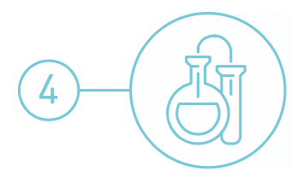
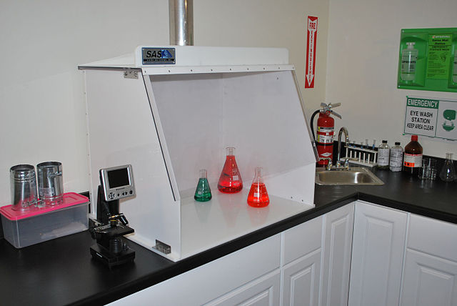
Designing Safer Chemicals
Chemical products should be designed to preserve efficacy of the function while reducing toxicity.
Image: Wikimedia Commons, Author: Sentryair

Slide 36
Designing Safer Chemicals
The modern motto of toxicology: “Everything is toxic. It simply depends on the dose”
Often otherwise phrased as
“The dose makes the poison.”
Risk = Hazard x Exposure
Green chemistry and engineering focus on reducing risk by reducing hazard.

Slide 37
Designing Safer Chemicals
Hazard types to avoid:
  Toxicological/Eco-toxicological
    Carcinogenicity
    Reproductive
    Developmental
    Neurological
    Global warming potential
    Ozone depleting potential
    Bioaccumulation
    Persistence
  Physical
    Explosivity
    Flammability
    Corrosivity
Physical/Chemical Properties to consider:
  Water solubility
  Log Kow
  Volatility
  Molar volume
  Aspect ratio
  Radical formation
  Nucleophilicity
  Electrophilicity
  pH/pKa
  Surface area
  Reducing potential
  Oxidizing potential
  Polarizability
See class on design without toxicity

Slide 38
Designing Safer Chemicals
Case study: Antifoulants
Antifoulants are generally dispersed in the paint as it is applied to the hull. Organotin compounds such as tributyltin oxide (TBTO) have traditionally been used. TBTO works by gradually leaching from the hull and killing the fouling organisms in the surrounding area.
Conventional use of organotin compounds as antifoulants:
TBTO and other organotin antifoulants have long half-lives in the environment (the half-life of TBTO in seawater is over 6 months).
They bioconcentrate in marine organisms (the concentration of TBTO in marine organisms has been found to be up to 104 times greater than in the surrounding water).
Organotin compounds are chronically toxic to marine life and can enter food chain.
They are bioaccumulative.
Tributyltin oxide (TBTO)

Slide 39
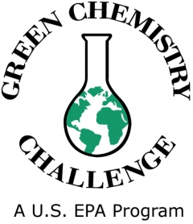
Designing Safer Chemicals
Case study: Antifoulants
Awardee in 1996
Alternative antifoulants (Dow chemicals):
Sea-Nine® 211 works by maintaining a hostile growing environment for marine organisms. When organisms attach to the hull (treated with DCOI), proteins at the point of attachment with the hull react with the DCOI. This reaction with the DCOI prevents the use of these proteins for other metabolic processes. The organism detaches itself and searches for a more hospitable surface to grow upon.
Only organisms attached to hull of ship are exposed to toxic levels of DCOI.
Readily biodegrades once leached from ship (half-life is less than one hour in sea water).
https://www.epa.gov/greenchemistry/presidential-green-chemistry-challenge-1996-designing-greener-chemicals-award

Slide 40
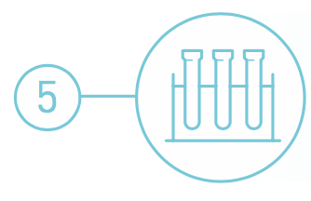
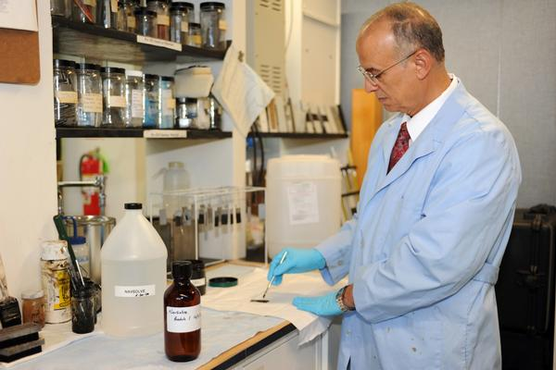
Safer Solvents and Auxiliaries
The use of auxiliary substances (solvents, separation agents, etc.) should be made unnecessary whenever possible and, when used, innocuous.
Image: Dr. El Sayed Arafat from NAWCAD’s Materials Lab, U.S. Navy

Slide 41
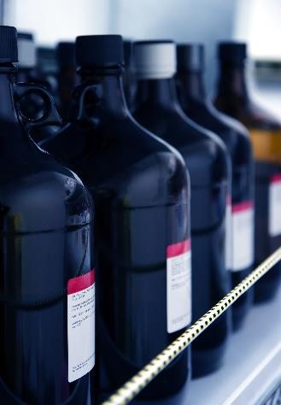
Safer Solvents and Auxiliaries
Solvents account for the vast majority of mass wasted in syntheses and processes. Moreover, many conventional solvents are toxic, flammable, and/or corrosive.
Solvents volatility and solubility have contributed to air, water and land pollution, have increased the risk of workers’ exposure, and have led to serious accidents.
Recovery and reuse, when possible, is often associated with energy-intensive distillation and sometimes cross contamination. In an effort to address all those shortcomings, chemists have started to search for safer solutions.

Slide 42
Safer Solvents and Auxiliaries
Problematic organic solvents
Greener alternatives
Easily separable, safe
Avoidance
Zero
Volatility
Environmentally
benign and safe
No Solvent Supercritical fluids
Water solvent Ionic liquids

Slide 43
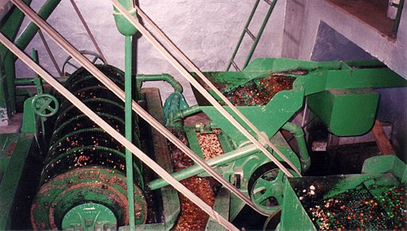
Safer Solvents and Auxiliaries
Case study: Coffee decaffeination
Conventional method of coffee decaffeination:
Coffee decaffeination was performed in a chlorinated organic solvent, dichloromethane (DCM), exposure to which can lead to headaches, mental confusion, nausea, vomiting, dizziness and fatigue.
Coffee beans were heated with steam and then exposed to DCM for decaffeination.
Image: Wikimedia Commons, Coffee Mechanical Separator, Aquapulp

Slide 44
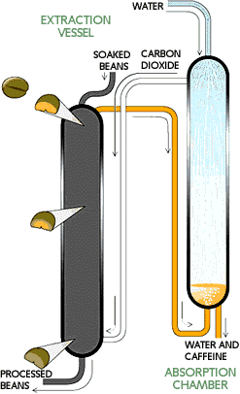
Safer Solvents and Auxiliaries
Case study: Coffee decaffeination
Alternative method for coffee decaffeination:
Soaking green coffee beans in water doubles their size, allowing the caffeine to dissolve into water inside the bean.
Caffeine removal occurs in an extraction vessel (70 feet high,10 feet in diameter), suffused with carbon dioxide at roughly 90 °C and 250 atm. Caffeine diffuses into this scCO₂. The beans enter at the top of the chamber and move toward the bottom over 5 hours.
Decaffeinated beans at the bottom of the vessel are removed, dried and roasted.
Recovery of dissolved caffeine occurs in an absorption chamber. A shower of water droplets leaches the caffeine out of the supercritical carbon dioxide. The caffeine in this aqueous extract is then often sold to soft-drink manufacturers and drug companies. The purified carbon dioxide is recirculated for further use.
Zosel, K. Practical Applications of Material Separation with Supercritical Gases. Angew. Chem., Int. Ed. 1978, 17, 702-709

Slide 45

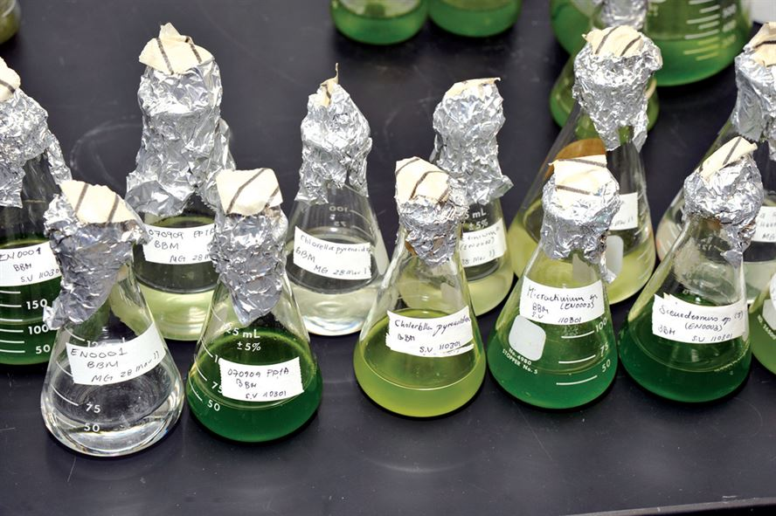
Design for Energy Efficiency
Energy requirements should be recognized for their environmental and economic impacts and should be minimized. Synthetic methods should be conducted at ambient temperature and pressure.
Image: U.S. Air Force photo/Bill Evans

Slide 46
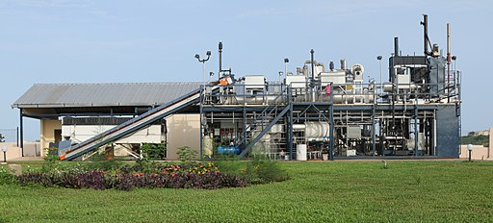
Design for Energy Efficiency
Most energy is used for heating, cooling, separations and pumping.
Ideally, all reactions are performed at ‘ambient’ conditions – room temperature and atmospheric pressure – in order to minimize energy usage.
Image: Wikimedia Commons, Janicki Omni Processor Pilot Plant in Dakar, Senegal , Author: Janicki Bioenergy

Slide 47
Design for Energy Efficiency
Case Study: Atorvastatin
Atorvastatin, a cholesterol-lowering drug, suffers from an energy-demanding synthesis as a result of two cryogenic reactions at - 70 ºC
New biocatalytic synthesis uses enzyme DERA and shortens the process by removing two energy intensive chemical steps.
Notes:
Deoxyribose-5-phosphate Aldolase as a Synthetic Catalyst'

Slide 48
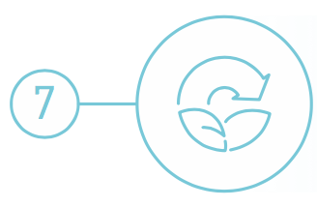
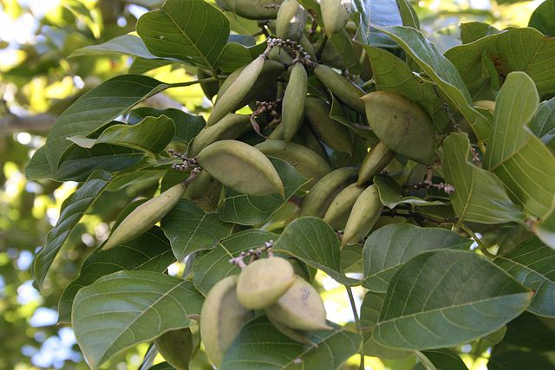
Use of Renewable Feedstocks
A raw material or feedstock should be renewable rather than depleting whenever technically and economically practical.
Image: Wikipedia, Pongamia Pinnata Seeds

Slide 49
Use of Renewable Feedstocks
Only about 4% utilized by humans
(food, ethanol, sweeteners)
Building blocks for a diverse chemical platform.
Nature’s richest source of aromatic carbon. Used in polymers, adhesives, production of phenolic chemicals.
Converted into polymers, lubricants, and detergents.

Slide 50
Use of Renewable Feedstocks
Case study: Production of levulinic acid
Levulinic acid is used as a precursor for pharmaceuticals, plasticizers, and various other additives. It is also widely used as a building block or starting material for a wide number of compounds.
Conventional synthesis:
Obtained by heating hexoses (glucose, fructose) or starch in dilute hydrochloric acid or sulfuric acid.
The yield depends on the nature of the acid, acid concentration, temperature, and pressure.
The reaction also produces hard to remove by-products.

Slide 51
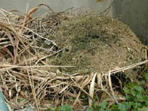
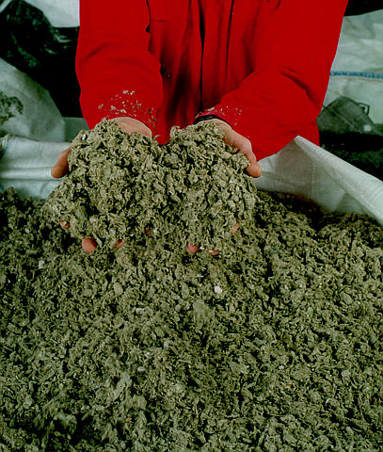
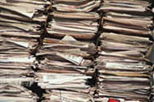
Use of Renewable Feedstocks
Case study: Production of levulinic acid
See class on renewables
Agricultural
residues,
waste wood
Alternative synthesis:
Levulinic acid can be obtained from paper mill sludge, agricultural and municipal waste and paper.
Utilizes a high-temperature, dilute-acid hydrolysis process that converts cellulosic biomass.
Municipal solid waste
and waste paper
Levulinic acid
Paper mill
sludge
Biofine, Inc

Slide 52
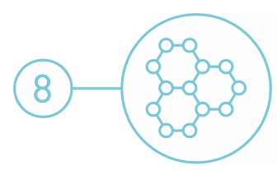
Reduce Derivatives
Unnecessary derivatization (blocking group, protection/deprotection, temporary modification of physical/chemical processes) should be avoided whenever possible.
Image: Wikimedia Commons, Center for Biofilm Research Laboratory Montana State University

Slide 53
Reduce Derivatives
Conventional approach
Substrate
Intermediate A
Intermediate B
Intermediate C
Intermediate D
Intermediate E
Product
Green Chemistry approach
Substrate
Product
Notes:
Whenever possible, limit number of steps and unnecessary transformations. Avoid the use of protecting groups as it requires extra reagents and generates more waste.

Slide 54
Reduce Derivatives
Case study: 6-aminopenicillanic acid
Synthesis of 6-aminopenicillanic acid – core moiety of penicillin
Conventional synthesis of 6-aminopenicillanic acid using 3 steps and intermediate products:
Alternative synthesis using enzyme and fewer derivatives:

Slide 55
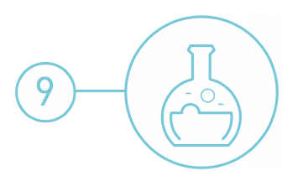
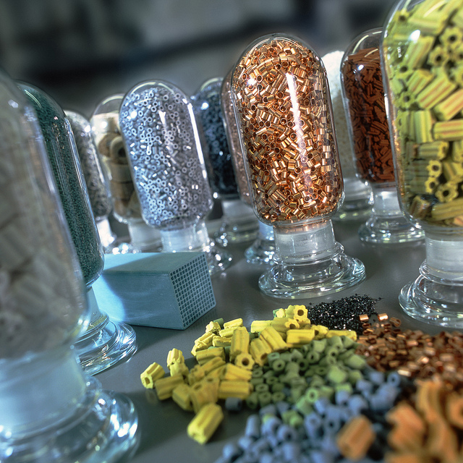
Catalysis
Catalytic reagents (as selective as possible) are superior to stoichiometric reagents.
Image: Flickr, Catalysts, Author: BASF Catalysts

Slide 56
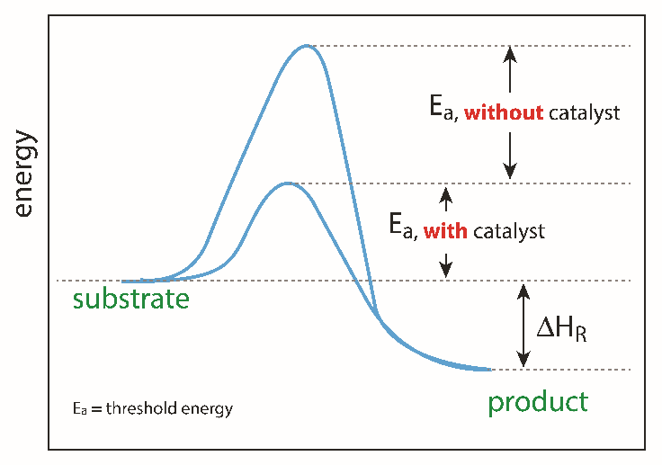
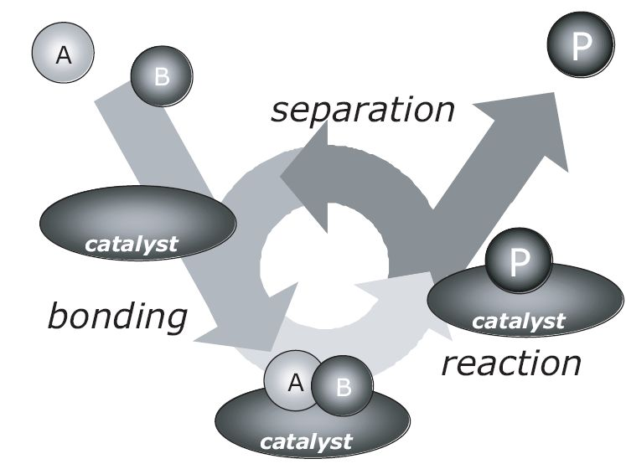
Catalysis
Catalysts can facilitate complex reactions by:
  Lowering the activation energy of the reaction.
  Reducing temperature necessary to achieve a reaction.
  Controlling the site of the reaction (selectivity enhancement).
  Catalysis is a cyclic event
Image source: Adobe stock
I. Chorkendorff, J. W. Niemantsverdriet, Concepts of Modern Catalysis and Kinetics, Wiley-VCH, 2003
Notes:
Catalysts lower the activation (threshold energy) in the reaction.

Slide 57
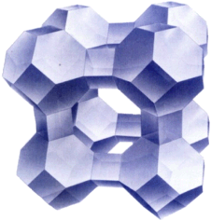
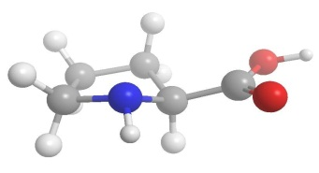
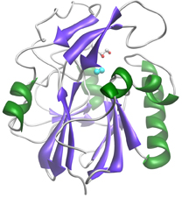
Catalysis
Many molecules/enzymes/materials can be catalysts
zeolite (crystalline aluminosilicate)
enzyme (biocatalyst)
copper-zinc crystallites on silica
Catalysis, Concepts and green applications, by Gadi Rothenberg, Wiley-VCH 2008.

Slide 58
Catalysis
Heterogeneous vs Homogeneous
Distinct solid phase
Readily regenerated & recycled
Readily separated
Rates not as fast
Diffusion limited
Sensitive to poisons
Lower selectivity
Long service life
High energy process
Poor mechanistic understanding
Same phase as rxn medium
Expensive and/or difficult to separate
Difficult to separate
Very high rates
Not diffusion controlled
Robust to poisons
High selectivity
Short service life
Mild conditions
Mechanisms well understood
Green
catalyst

Slide 59
Catalysis
See class on catalysis
Case study: Green naproxen synthesis
Nonsteroidal anti-inflammatory drug (NSAID) of the propionic acid class (the same class as ibuprofen) that relieves pain, fever, swelling, and stiffness; COX inhibitor
  97% yield in three steps
  Dartt and Davis
Notes:
cyclooxygenase

Slide 60

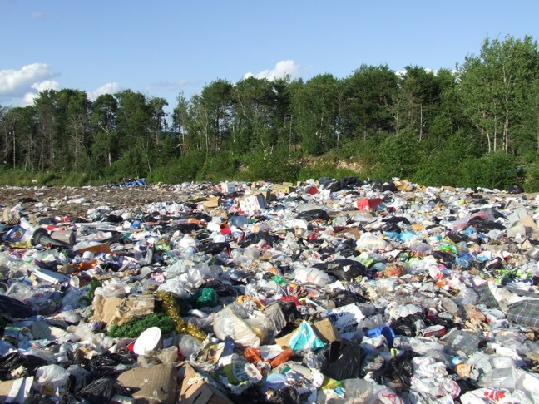
Design for Degradation
Chemical products should be designed so that at the end of their function they do not persist in the environment and instead break down into innocuous degradation products.
Image: Wikicommons, a landfill in Dryden, Ontario, Author: Michelle Arseneault

Slide 61
Design for Degradation
Early examples of non degrading products:
  Sulfonated detergents
    Alkylbenzene sulfonates – 1950’s & 60’s
    Foam in sewage plants, rivers, and streams
    Persistence was due to long alkyl chain
    Introduction of an alkene group into the chain increased degradation
  Chlorofluorocarbons (CFCs)
    Do not break down, persist in atmosphere and contribute to destruction of the ozone layer.
  DDT
    Bioaccumulate and cause thinning of egg shells

Slide 62
Design for Degradation
Case study: Plastics
Conventional plastics (PET) are made from petroleum:
PET Plastic persists in the environment
It is made from depleting resources
Petroleum
high temperature
vacuum
catalyst

Slide 63
Design for Degradation
Case study: Plastics
Alternative process:
Synthesis of PolyLactic Acid (PLA) from starch:
The development of a biobased, compostable, and recyclable polylactic acid (PLA) polymer that uses 20–50 percent less fossil fuel resources than comparable petroleum-based polymers.
It is the first family of polymers derived entirely from renewable resources that can compete cost-effectively with traditional fibers and plastic packaging materials.
The manufacturing process consists of three solvent-free steps that lead to the production of lactic acid, lactide, and PLA high polymer with very high yields and internal recycling schemes that reduce waste.
PLA can be biodegraded under industrial compositing conditions. They do not degrade though in the environment
Cargill Dow LLC

Slide 64
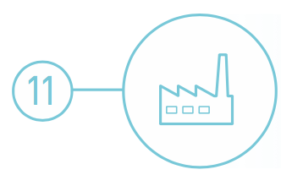
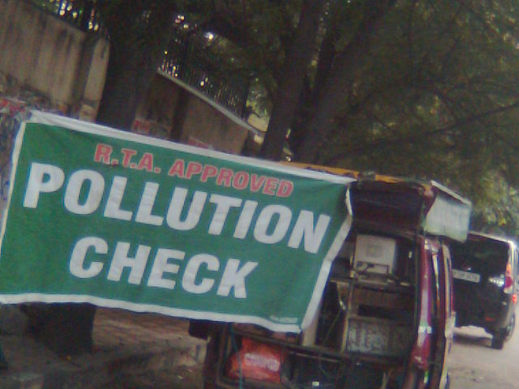
Real-time Analysis for Pollution Prevention
Analytical methodologies need to be further developed to allow for real-time in-process monitoring and control prior to the formation of hazardous substances.
Image: Wikimedia Commons, Author: Hindustanilanguage

Slide 65
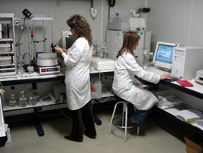

Real-time Analysis for Pollution Prevention
Real time analysis for a chemist is the process of “checking the progress of chemical reactions as it happens”.
Knowing when your product is “done” can save a lot of waste, time, and energy!
Image: Wikimedia Commons

Slide 66
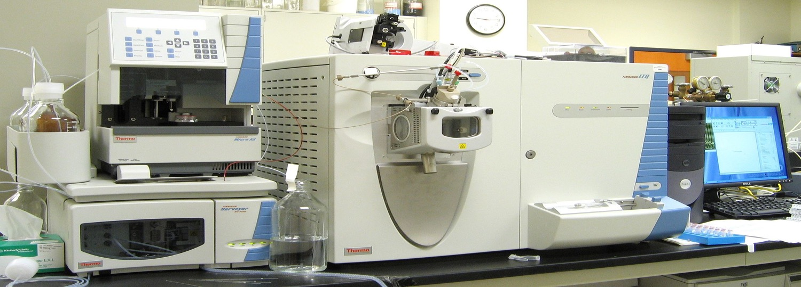
What Does Green Analytical Chemistry Mean?
Real-time Analysis for Pollution Prevention
Green Chemistry is applicable to all chemical processes, including the methods, protocols and processes of environmental analytical chemistry.
Image: Wikipedia

Slide 67
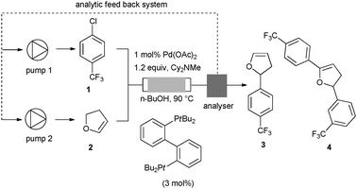

Examples of Green Analytical Chemistry Methodologies
Real-time Analysis for Pollution Prevention
In-line HPLC analyzer, on flow
Supercritical Fluid Extraction
Desired product
Real-time adaptation of addition of 1 and 2 to max. 3

Slide 68

Real-time Analysis for Pollution Prevention
Case study: Real-time analysis in cooling systems
In 2008 Nalco Company won the EPA Greener Reaction Conditions Award for their innovative 3D TRASAR® Technology.
Alternative Cooling System with 3D TRASAR® Technology:
The 3D TRASAR® System allows for the real-time monitoring of mineral scale buildup.
This system can also utilize poor-quality water.
3D Scale Control prevents mineral scale formation to increase efficiency.
3D Bio-control performs a real-time check for planktonic and sessile bacteria. This reduces the amount of biocide used since biocides are then added only when necessary, rather than on a set schedule.
The 3D TRASAR® System greatly reduces the amount of wastewater discharged from cooling systems.
https://www.epa.gov/greenchemistry/presidential-green-chemistry-challenge-2008-greener-reaction-conditions-award
Image: Wikipedia, A lavender-colored nonpotable water pipeline in Mountain View, California, Author: Grendelkhan

Slide 69


Inherently Safer Chemistry
for Accident Prevention
Substance and the form of a substance used in a chemical process should be chosen so as to minimize the potential for chemical accidents, including releases, explosions, and fires.
Image: Flickr, Author: sea turtle

Slide 70
Inherently Safer Chemistry
for Accident Prevention
Accidents can be avoided by minimizing hazards
Approaches to design safer chemistry can include the use of solids or low vapor pressure substances in place of volatile liquids.
Other approaches include avoiding the use of molecular halogens in large quantities.
Continuous flow processes can help to minimize chemical hazards.

Slide 71
Inherently Safer Chemistry
for Accident Prevention
Case study: Production of gasoline alkylate with AlkyClean® Technology
In 2016 Albemarle and CB&I won the EPA green chemistry award for their inherently safer AlkyClean® process technology.
AlkyClean® Technology:
The AlkyClean® solid acid alkylation process produces high quality alkylate without using liquid acid catalysts.
The solid acid alkylation process is safer for both people working directly in production and for people in the area surrounding the production facility.
There are also environmental and economic benefits since neither acid-soluble oils nor spent acids are produced.
Conventional alkylate production:
Alkylate is typically produced from the reaction of isobutane and light olefins.
This requires the use of liquid acid catalyzed processes, such as hydrofluoric acid.
Hydrofluoric acid is extremely toxic. When released it forms clouds that can be lethal for up to five miles.

Slide 72
More examples available
Inherently Safer Chemistry
for Accident Prevention
Presidential Green Chemistry Challenge Winners
https://www.epa.gov/greenchemistry/presidential-green-chemistry-challenge-winners
How Industrial Applications in Green Chemistry Are Changing Our World (white paper) by American Chemical Society

Slide 73
Topics Covered
What is Green Chemistry
Twelve principles
Chemical and green chemistry Design
The Market and demand for Green Chemistry
Examples of the 12 principles

Slide 74

Sponsored by Yale-UNIDO Initiative
QUESTIONS?
CENTER for GREEN CHEMISTRY
and GREEN ENGINEERING at YALE

