Slide 1
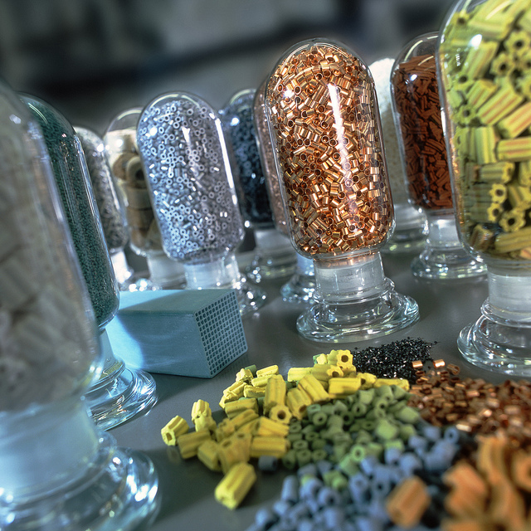

Yale-UNIDO Train-the-Facilitator Workshop in Green Chemistry
Catalysis
CENTER for GREEN CHEMISTRY
and GREEN ENGINEERING at YALE
Image: Flickr, Catalysts, Author: BASF Catalysts

Slide 2
Topics To Be Covered
Activation Energy for Reaction
What is a Catalyst?
Types of Catalysts
Catalysts and Sustainability
Important Improvements Using Catalysts
Enzymatic Reactions
Examples and Considerations

Slide 3
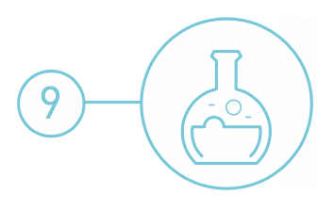
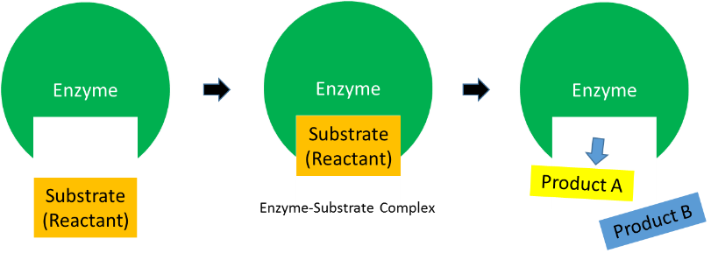
Catalysis
Catalytic reagents (as selective as possible) are superior to stoichiometric reagents.
Source: Wikipedia

Slide 4
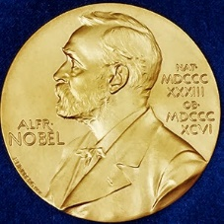
Nobel Prizes for catalysis
Ostwald, 1909, Catalysis (Ostwald Process)
Sabatier (together with Grignard), 1912, Heterogeneous Catalytic Hydrogenation
Haber, 1918, Ammonia Synthesis
Harden-Euler-Chelpin, 1929, Fermentation of Sugar by Enzymes
Bergius, Bosch, 1931, Catalytic High Pressure Chemistry
Ziegler, Natta, 1963, Alkene Polymerization
Fischer, Wilkinson, 1973, Organometallic Sandwich Complexes
Noyori, Sharpless and Knowles, 2001, Enantioselective Catalysis
Chauvin, Grubbs, Schrock, 2005, Metathesis
Ertl, 2007, Heterogeneous Catalysis
Suzuki, Heck, Negishi, 2010, Coupling reactions
Arnold, 2018, directed evolution (-> biocatalysis)
Notes:
After click text turns green – what are the criteria to design a green catalyst?

Slide 5
What is catalysis?
A catalyst is a substance that increases the rate at which a chemical reaction approaches equilibrium, but is not consumed in the process.
The catalyst is not a reagent or a product as it is not consumed: it’s noted above the equation arrow
The catalyst participates in the kinetic equations but not in the equilibrium constant
A + Cat → ACat (1)
B + ACat → ABCat (2)
ABCat → CatP (3)
CatP → Cat + P (4)
A + B → P
Cat
Overall reaction
A + B → P
Notes:
After click text turns green – what are the criteria to design a green catalyst?

Slide 6
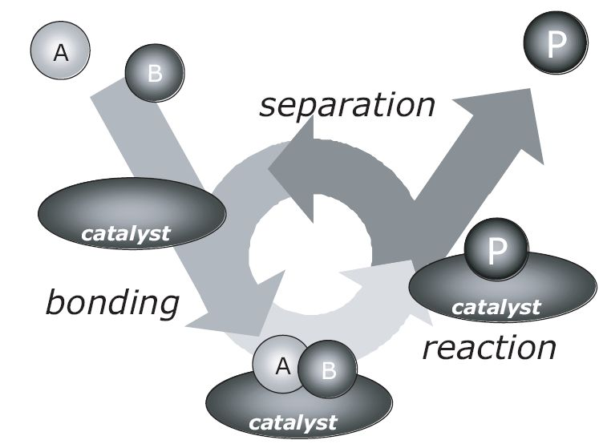
The catalytic cycle
Catalysis can be viewed as a cyclic event: A catalytic cycle is defined as the succession of chemical changes undergone by the catalyst until it recovers its initial state.
The catalyst remains reusable at the end of the process to go for a new cycle
I. Chorkendorff, J. W. Niemantsverdriet, Concepts of Modern Catalysis and Kinetics, Wiley-VCH, 2003
Notes:
After click text turns green – what are the criteria to design a green catalyst?

Slide 7
The catalytic cycle
Catalysis can be viewed as a cyclic event: A catalytic cycle is defined as the succession of chemical changes undergone by the catalyst until it recovers its initial state.
If at any point the cycle breaks, catalysis stops!
A stoichiometric reaction can be view as a catalytic reaction going through 1 cycle
I. Chorkendorff, J. W. Niemantsverdriet, Concepts of Modern Catalysis and Kinetics, Wiley-VCH, 2003
Notes:
After click text turns green – what are the criteria to design a green catalyst?

Slide 8
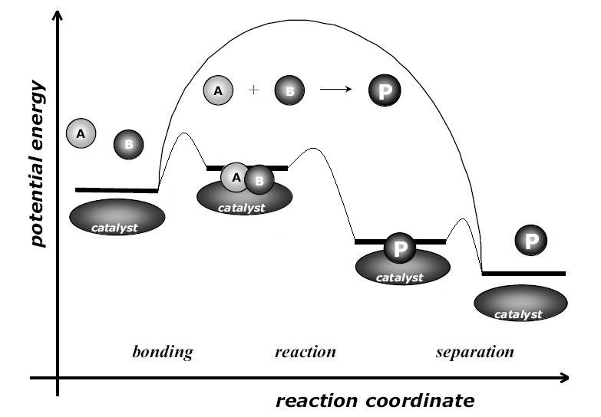
Catalysis=kinetic phenomenon
Catalysis can be viewed as a cyclic event: A catalytic cycle is defined as the succession of chemical changes undergone by the catalyst until it recovers its initial state.
Any reaction needs some energy to happen: the activation energy: Ea
When using a catalyst, an alternative path is created for a reaction, more complex, but energetically much more favorable.
Smaller activation energy for catalytic reaction => larger reaction rate
Ea
Ea
Ea < Ea
Reaction rate > reaction rate
I. Chorkendorff, J. W. Niemantsverdriet, Concepts of Modern Catalysis and Kinetics, Wiley-VCH, 2003
Notes:
After click text turns green – what are the criteria to design a green catalyst?

Slide 9
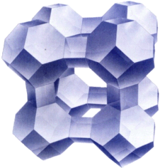
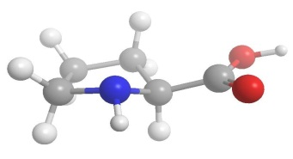
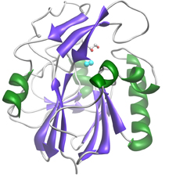
Examples of catalysts
Many molecules/enzymes/materials can be catalysts
zeolite (crystalline aluminosilicate)
enzyme (biocatalyst)
copper-zinc crystallites on silica
Catalysis, Concepts and green applications, by Gadi Rothenberg, Wiley-VCH 2008.
Notes:
After click text turns green – what are the criteria to design a green catalyst?

Slide 10
Catalysts are widely used by industry and by nature
Catalyst | Reactions catalyzed
Iron oxide | Ammonia from nitrogen and hydrogen
Chromium-Molybdenum Alloy Nickel-Molybdenum Alloy Zeolite (Porous Aluminum and Silica Oxide) | Petroleum Industry
Acid (HCl, H₂SO₄, HNO₃) | Many organic reactions
Enzymes | Starch into sugars and sugars to ethanol

Slide 11
Terminology: types of Catalysts
An ideal green catalyst would have a preferred parameters from each type.
 | Homogeneous | Heterogeneous | Biocatalysis
Form | Soluble metal complexes, usually mononuclear | Metals, usually supported, or metal oxides | Enzymes (polypeptides), many with a metal based active site
Active site | Well-defined, discrete molecules | Poorly defined | Well defined
Temperature | Low (<250ºC) | High (250 – 500°C) | 25°C mostly Up to 100°C
Selectivity | High | Low | High
Product separation | Generally problematic on large scale | Facile | From yeasts or bacteria. Amenable to large scale
Green? | Less Green | More Green Separation, Recycle/Regeneration | Very green
Notes:
After click text turns green – what are the criteria to design a green catalyst?

Slide 12
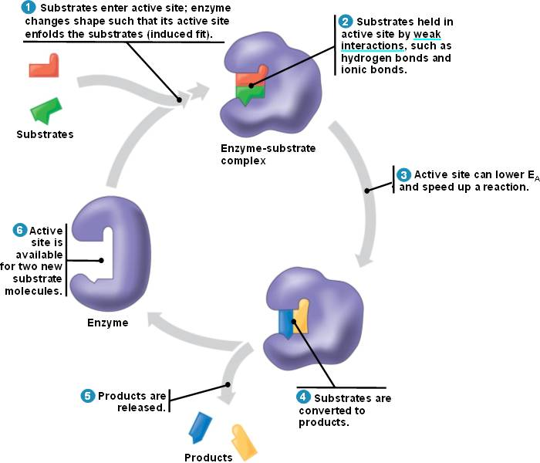
Terminology: types of Catalysts
Still, all types of catalysts relies on the same principle and go through a catalytic cycle.
Homogeneous catalysis
Heterogeneous catalysis
Biocatalysis
metal crystallite
oxide support
Catalysis, Concepts and green applications, by Gadi Rothenberg, Wiley-VCH 2008. - http://bio1151.nicerweb.com/Locked/media/ch08/catalytic.html
Notes:
After click text turns green – what are the criteria to design a green catalyst?

Slide 13
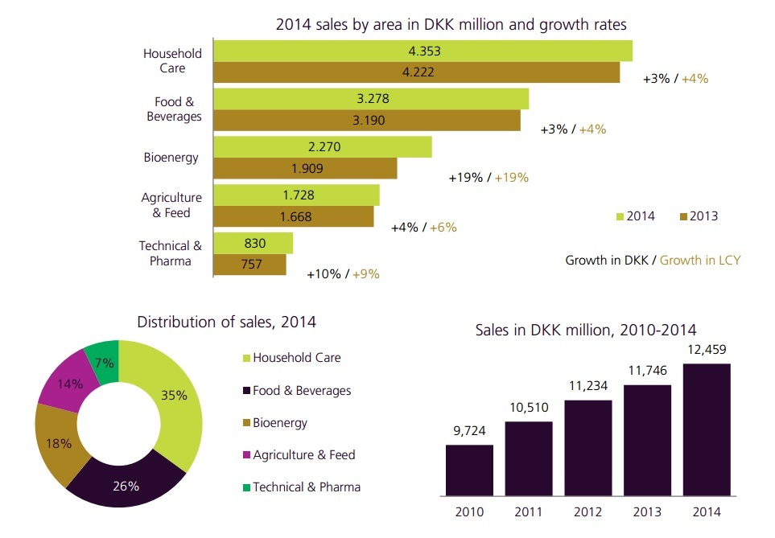
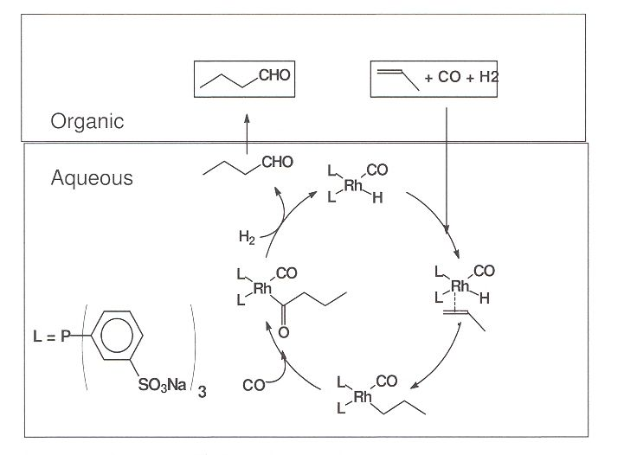
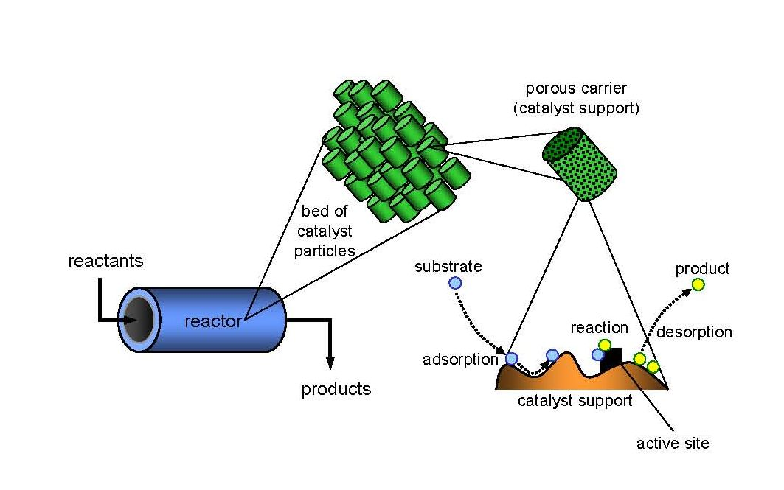
Catalysis in industry
Homogeneous catalysis
Heterogeneous catalysis
Biocatalysis
Recovery is a real challenge
For processes for which heterogeneous is not good
To ease recovery: biphasic separation or heterogenization
Over 90 vol% of the chemicals worldwide are manufactured with the aid of solid catalysts
800 000 tons of solid catalysts are prepared each year
Heterogeneous catalysts allow continuous processes or flow reactors
Biocatalysis relies on the use of yeast and bacteria to perform chemistry
Fast growing market in many sectors
DKK 12.46 billion = $1.94 billion
Catalysis, Concepts and green applications, by Gadi Rothenberg, Wiley-VCH 2008 - K. H. Shaughnessy, Chem. Rev. 2009, 109, 643-710. Source: Novozyme
Notes:
After click text turns green – what are the criteria to design a green catalyst?

Slide 14
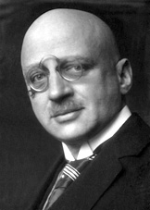
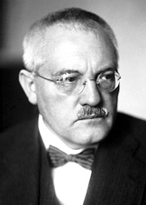
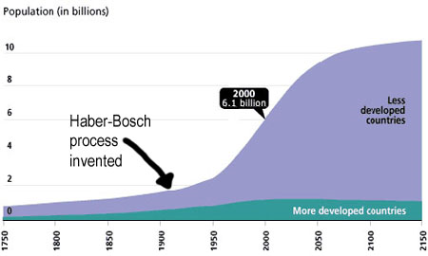
Haber Bosch
The Haber-Bosch process, which allows fertilizer production, is facilitated by a catalyst.
The invention of the process led to a global increase in human population.
Consumes 1% of the total human energy use on the planet
Fritz Haber
(1868-1934)
Nobel Prize 1918
Carl Bosch
(1874-1940)
Nobel Prize 1931
The Haber-Bosch process accounts for ~ 40 % of the overall N₂ fixation on earth and the only source of NH₃ for the subsequent synthesis of all nitrogen containing man-made materials
Source: Wikipedia

Slide 15
A kinetic process
catalysis = kinetic phenomenon
Let’s look closer at Haber Bosch
At room temperature
Thermodynamic data: ΔG=–16.4 kJ mol^{–1}, ΔH°=–45.9 kJ mol^{–1}
What do you think? Can the reaction occur?
Very high activation energy:
heating required!
N₂ + H₂
NH₃
I. Chorkendorff, J. W. Niemantsverdriet, Concepts of Modern Catalysis and Kinetics, Wiley-VCH, 2003

Slide 16
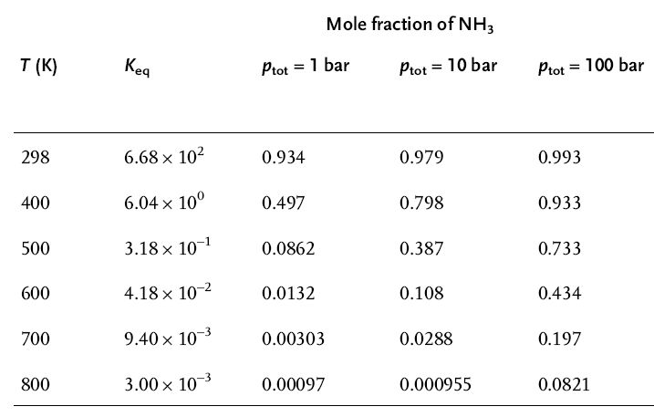


A kinetic process
catalysis = kinetic phenomenon
Let’s look closer at Haber Bosch
So what happens to the thermodynamic when you heat?
At 298 K
Thermo:
Kinetics: Not enough energy
No thermal reaction possible
Heating
N₂ + H₂
NH₃
At 800 K
Thermo:
Kinetics:
N₂ + H₂
NH₃
I. Chorkendorff, J. W. Niemantsverdriet, Concepts of Modern Catalysis and Kinetics, Wiley-VCH, 2003

Slide 17
A kinetic process
catalysis = kinetic phenomenon
Let’s look closer at Haber Bosch
So what happens to the thermodynamic when you heat?
Catalysis = solution !
At 700 K
Thermo:
But “Le Chatelier” can push with high pressure
Kinetics: Catalyst
Heating
N₂ + H₂
NH₃
I. Chorkendorff, J. W. Niemantsverdriet, Concepts of Modern Catalysis and Kinetics, Wiley-VCH, 2003

Slide 18
Catalysts evaluation: TON, TOF, selectivity
Catalysts are not eternal! The important question is how many cycles can they achieve on average and how fast
Terminology
  Turn over number (TON) = total number of cycles
  Turn over frequency (TOF) = number of cycles/time
  TOF = TON / time
  Selectivity: see class on metrics
 | Inorganic Catalyzed Reaction | Enzymatic Reactions
^{TOF} | 0.01 – 10000 s⁻¹ (Very slow) | 100 up to 40 million s⁻¹ (Extremely fast)
^{Selectivity} | Medium to good selectivity | Excellent selectivity
Notes:
After click text turns green – what are the criteria to design a green catalyst?

Slide 19
Catalysis Drives the Chemical Industry
Petroleum
Fine chemicals
Consumer Products
Pharmaceuticals
Catalytic processes contribute to more than 35% of global GDP.
Source: Wikipedia

Slide 20
Important Heterogeneous Catalytic Processes
Haber-Bosch process:
  N₂ + 3 H₂ → 2 NH₃
  Fe/Ru catalysts, high pressure and temperature.
  Critical for fertilizer and nitric acid production.
Fischer-Tropsch chemistry:
  n CO + 2n H₂ → (CH₂)_{n} + n H₂O , syn gas to liquid fuels.
  Fe/Co catalysts.
  Source of fuel for Axis in WWII.
Fluidized catalytic cracking:
  High MW petroleum → low MW fuels, like gasoline.
  Zeolite catalysts, high temperature combustor.
  Likely in your fuel tank.
Automotive three-way catalysis:
  NO_{x}/CO/HC → N₂/CO₂/H₂O
  Pt/Rh/Pd supported on ceria/alumina.
  Makes exhaust 99% cleaner.

Slide 21
Designing a Green Catalyst
Not all catalysts are created equal. Chemists need to consider various factors when deciding on a catalyst.
Is the catalyst non-toxic?
Is it actually used in sub-stoichiometric amounts?
Does it require special conditions (sensitivity to solvent, moisture, oxygen)?
Is it derived from abundant/renewable resources?
Can it be reused?
Can it be separated from the products?
Might it lead to dangerous conditions (Runaway/chain reactions)?
Many metals which are used as catalysts are quickly depleting.
http://www.rsc.org/chemistryworld/Issues/2011/January/CriticalThinking.asp

Slide 22
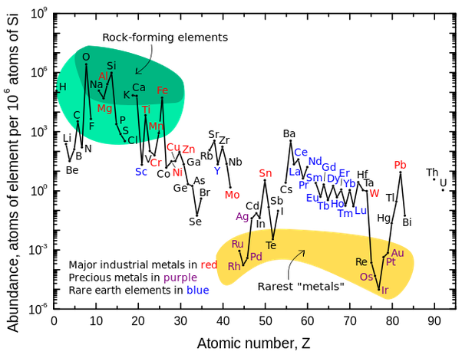
Metal scarcity
Source: Wikipedia

Slide 23
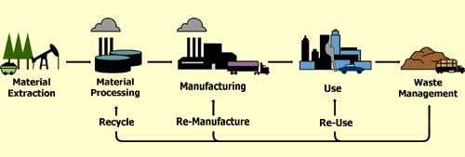
Use a lifecycle as a guide
Material Extraction
  Abundance?
Processing/Manufacturing
  Energy?
  Waste?
  Toxicity of materials?
Use
  Selectivity?
  Turnover number?
  Safety?
End-of-life
  Reusability?
  Ease of separation?

Slide 24
The Need to Develop More Sustainable Catalysts
Raw materials (e.g. rare precious metals) are dispersed around the world and access to them is frequently political.
To gain economic and environmental independence, we must design catalysts which are locally sourced and abundant.
European Commission Press Release, June 2010

Slide 25
Current Trends in Catalyst Design
Reduce Loading
High Surface Area Support
Atomic Layer deposition
Earth Abundant Alternatives
Abundant metal
Alloy - Synergistic Effect
Adjust other parameters
  - Solvents
  - Surfactants

Slide 26
Current Trends in Catalyst Design
Reduce Loading
High Surface Area Support
Atomic Layer deposition
Earth Abundant Alternatives
Abundant metal
Alloy - Synergistic Effect
Adjust other parameters
  - Solvents
  - Surfactants

Slide 27
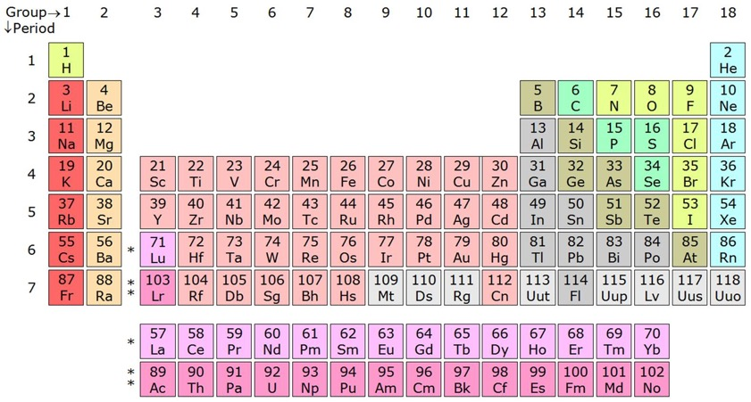

Example: The Haber-Bosch Process
Improving the Haber-Bosch process by using an iron catalyst:
$$N_{2}+3H_{2 }→2NH_{3}$$
Originally Fritz Haber discovered this reaction using an osmium (Os) based catalyst
  Os metal is rare, toxic and too expensive: it could not be made industrial.
Rapidly alternatives with either iron (Fe) or ruthenium (Ru) were developed
Today’s catalysts: finely divided Ru on a solid support or Fe₃O₄/Fe₂O₃/Al₂O₃/K₂O/CaO
Notes:
Beware: Osmiun has never been a “traditional” catalysts for HB. It was the first catalyst discovered by F. Haber, but it was only commercialized with Ru or Fe based calasysts. I corrected it. AHM

Slide 28
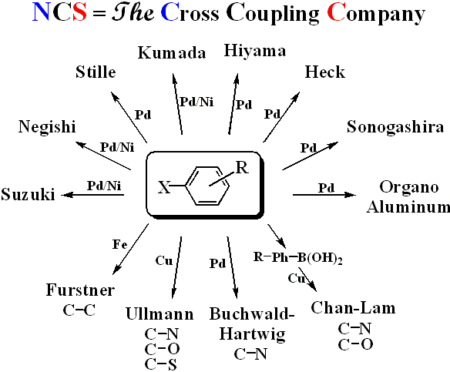
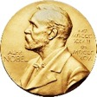
Example: Cross coupling reaction
Cross Coupling Reactions:
  → Connecting two separate organic molecules together with high selectivity and high yield.
 | USD mol⁻¹
Ni | $1.20
Pd | $1,500
New chemistry innovations allowed the replacement of expensive palladium catalysts with nickel.
These reactions were awarded Nobel Prizes.
Notes:
Pd is used catalytically, in small amount, to carry out the reaction
In some cases, Pd needs NOT to be purified

Slide 29
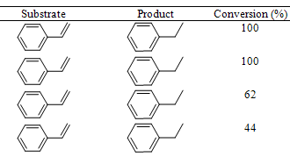
Example: replacing palladium by iron in hydrogenation
Hydrogenation:
  Usually with expensive, rare metals: Pd, Rh, Ru, Pt
  or toxic, Ni
  iron (Fe) is abundant and non toxic
synthesized
in EtOH
The iron oxide shell protects Fe(0) from oxidation with water, while allowing interesting reactivity
synthesized
in EtOH and water (99:1)
synthesized
in EtOH and water (1:1)
industrial
in EtOH
R. Hudson, A. Rivière, C. M. Cirtiu, K. L. Luska, A. Moores, Chem.Comm. 2012, 48, 3360-3362.
Notes:
Pd is used catalytically, in small amount, to carry out the reaction
In some cases, Pd needs NOT to be purified

Slide 30
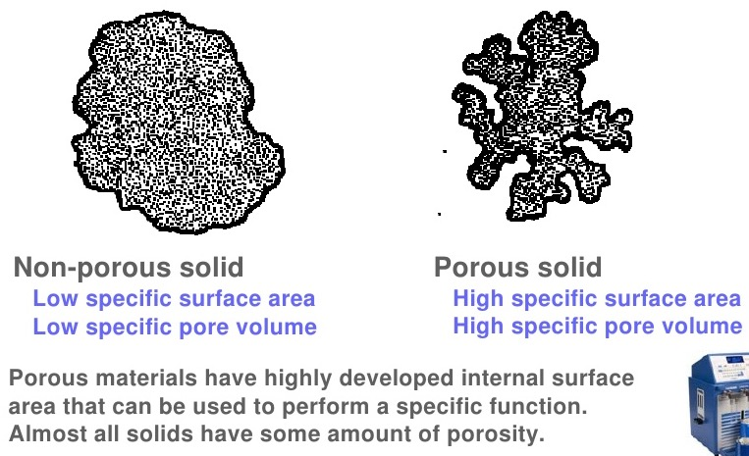
Increased Surface Area
High surface area porous support:
<50 cm² g⁻¹
50 – 4000 cm² g⁻¹

Slide 31
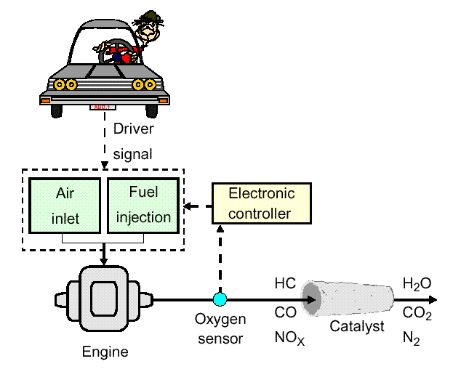
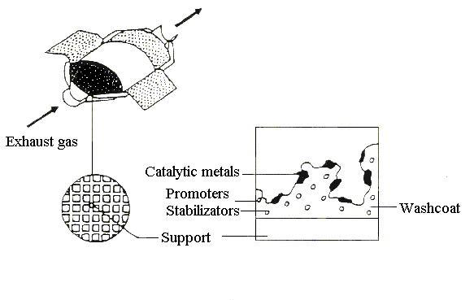
Automotive Emissions Control System
“Three-way” Catalyst
CO → CO₂
HC → CO₂ + H₂O
NO_{x} → N₂
Monolith reactor
Most widely deployed heterogeneous catalyst in the world.
You probably own one!
Pt, Rh, Pd Alumina, ceria, lanthana, etc.

Slide 32
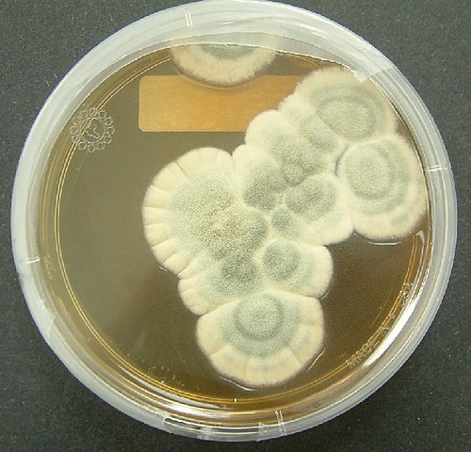
Enzymatic Reactions
Enzymatically driven reactions that occur in nature are often highly specific and compartmentalized.
Many of these reactions occur in ambient temperature and pressure with a water solvent.
Today, over 5000 of enzymatic reactions types have been identified, and that number continues to grow.
Image: Wikimedia Commons, Penicillium notatum, Author: Crulina 98

Slide 33
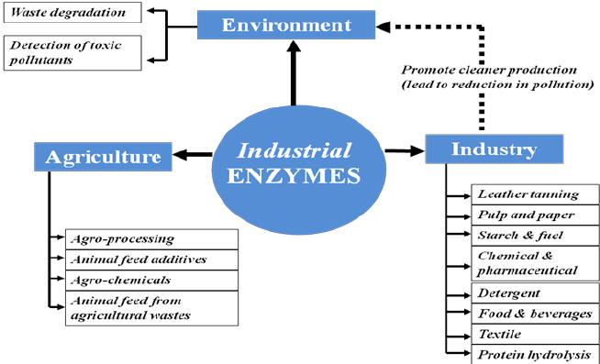
Enzymatic Reactions
Enzymes are biological catalysts and are used in industry, agriculture, and by nature.

Slide 34
Enzymatic Reactions
This is a general representation of enzymatic reactions – the lock and key mechanism.
The substrate (reactant) binds with the enzyme and forms the Enzyme-substrate complex and is transformed into products A and B, which are released from the active site upon reaction completion.

Slide 35
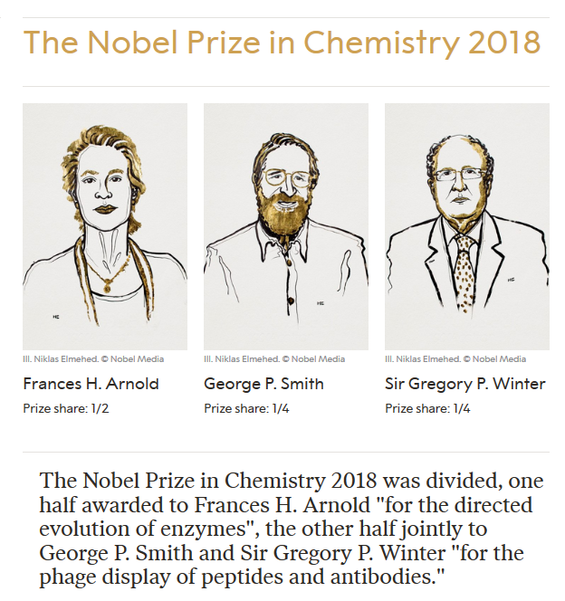
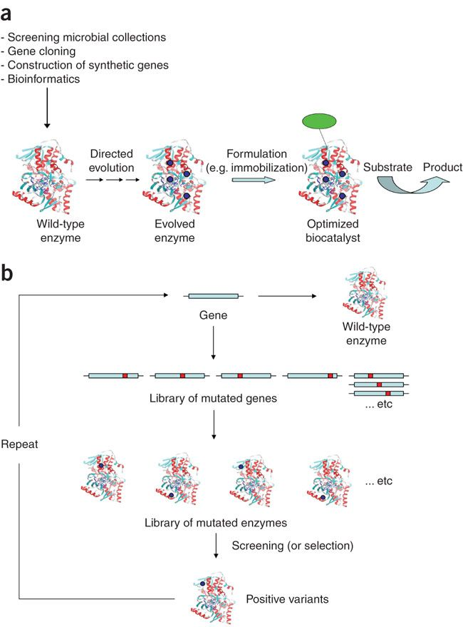
Enzymatic Reactions
a) Stages in the discovery and development of a robust biocatalyst for practical applications
b)Directed evolution of enzymes by iterative cycles of random mutagenesis, protein expression and screening or selection of the desired activity.
Turner, N. J. Directed evolution drives the next generation of biocatalysts. Nat. Chem. Biol. 2009, 5 (8), 567–573.

Slide 36
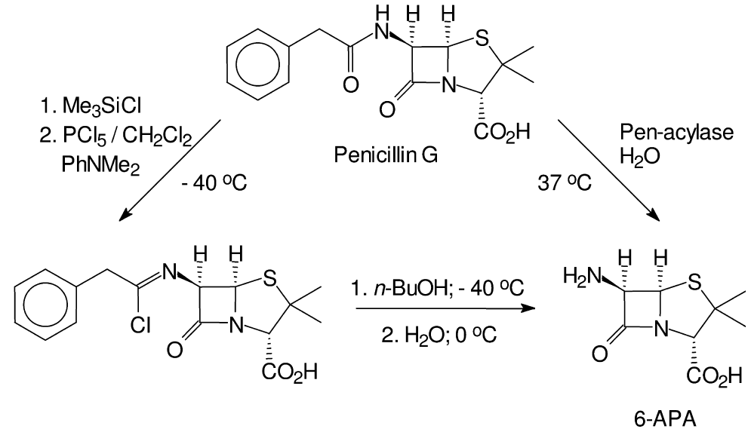
Examples on Enzymatic Catalysis
Conventional manufacturing of 6-aminopenicillanic acid (6-APA) - a key raw material for semi-synthetic penicillin and cephalosporin involved the use of environmentally unattractive reagents – requires a chlorinated hydrocarbon solvent and a reaction temperature of –40°C.
In contrast, enzymatic cleavage of penicillin G is performed in water at 37°C and the only reagent used is to adjust the pH.
The enzymatic process currently accounts for the majority of the several thousand tons of 6-APA produced annually on a world-wide basis.
Notes:
An illustrative example of the benefits to be gained by replacing conventional
chemistry by biocatalysis is provided by the manufacture of 6-aminopenicillanic
acid (6-APA), a key raw material for semi-synthetic penicillin and cephalosporin
antibiotics, by hydrolysis of penicillin G [115]. Up until the mid-1980s a chemical
procedure was used for this hydrolysis (Fig. 1.37). It involved the use of environmentally
unattractive reagents, a chlorinated hydrocarbon solvent (CH2Cl2)
and a reaction temperature of –40C. Thus, 0.6 kg Me3SiCl, 1.2 kg PCl5, 1.6 kg
PhNMe2, 0.2 kg NH3, 8.41 kg of n-BuOH and 8.41 kg of CH2Cl2 were required
to produce 1 kg of 6-APA [116].
In contrast, enzymatic cleavage of penicillin G (Fig. 1.37) is performed in
water at 37C and the only reagent used is NH3 (0.9 kg per kg of 6-APA), to adjust
the pH. The enzymatic process currently accounts for the majority of the
several thousand tons of 6-APA produced annually on a world-wide basis.
30 1 Introduction: Green Chemistry and Catalysis
Fig. 1.37

Slide 37
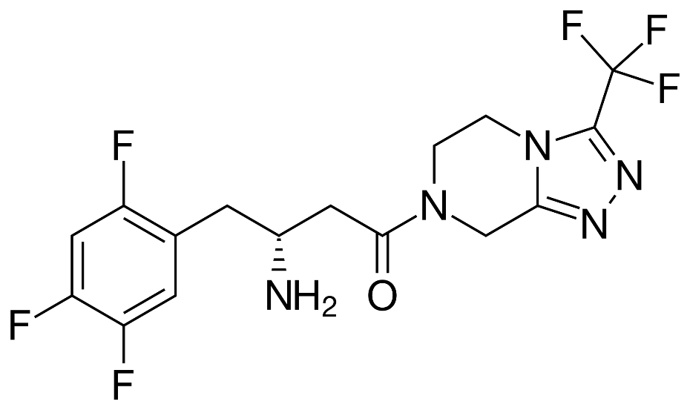
Case Study
Sitagliptin – Rhodium to Enzyme
Sitagliptin is Merck's top-selling diabetes drug.
It brought $1.9 million in sales in 2009.
Traditional synthesis used high pressure and a heavy metal – rhodium.
The new improved synthesis with enzymes allows for 99.95% selectivity to the desired product and eliminates all heavy metal wastes.
Sitagliptin, the active ingredient in Merck's Januvia.
http://www.rsc.org/chemistryworld/News/2010/June/17061002.asp (Accessed on 4/1/2016)
Savile, C. K.; Janey, J. M.; Mundorff, E. C.; Moore, J. C.; Tam, S.; Jarvis, W. R.; Colbeck, J. C.; Krebber, A.; Fleitz, F. J.; Brands, J.; Devine, P. N.; Huisman, G. W.; Hughes, G. J., Biocatalytic Asymmetric Synthesis of Chiral Amines from Ketones Applied to Sitagliptin Manufacture. Science 2010, 329 (5989), 305-309.
Notes:
http://www.rsc.org/chemistryworld/News/2010/June/17061002.asp

Slide 38
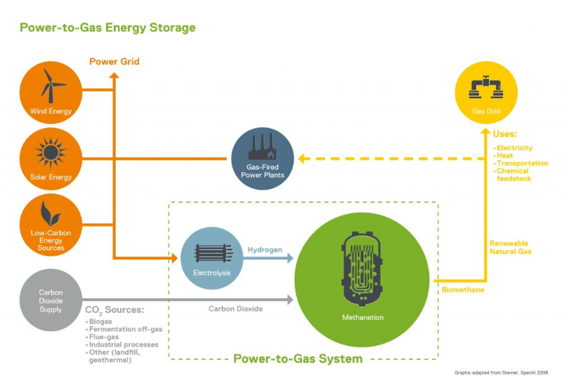
Enzymatic catalysis for energy
Bacteria have been used to turn CO₂ into methane
http://www.electrochaea.com/about/ - Video: http://www.electrochaea.com/technology/
Notes:
http://www.rsc.org/chemistryworld/News/2010/June/17061002.asp

Slide 39
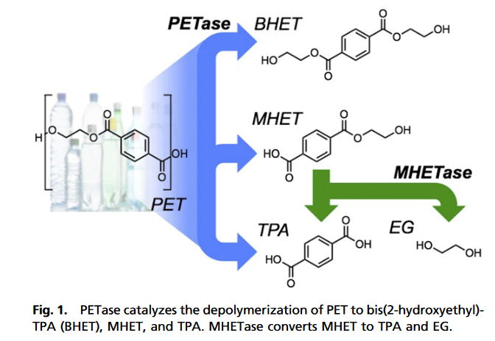
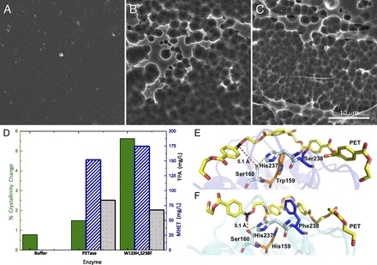
Enzymatic catalysis for plastic degradation
With specific mutations a PETase properties were improved to degrade plastics. Bacterium in question: Ideonella sakaiensis 201-F6
A. No enzyme B. wild-type PETase C. mutant type PETase
PET films
Austin, H. P.; Allen, M. D.; Donohoe, B. S.; Rorrer, N. A.; Kearns, F. L.; Silveira, R. L.; Pollard, B. C.; Dominick, G.; Duman, R.; El Omari, K.; et al. Proc. Natl. Acad. Sci. U. S. A. 2018, 115 (19), E4350–E4357.
Notes:
http://www.rsc.org/chemistryworld/News/2010/June/17061002.asp

Slide 40
The Pros and Cons of Enzymatic Reactions
Pros:
Cons:
  Mild conditions.
  Aqueous environment.
  Atmospheric conditions.
  A very specific and high reaction rate.
  Separations are often complicated.
  They can be expensive to produce.
  Some people might experience allergic reactions to some enzymes.

Slide 41
Topics Covered
Activation Energy for Reaction
What is a Catalyst?
Types of Catalysts
Catalysts and Sustainability
Important Improvements Using Catalysts
Enzymatic Reactions
Examples and Considerations

Slide 42
Sponsored by Yale-UNIDO Initiative
QUESTIONS?
CENTER for GREEN CHEMISTRY
and GREEN ENGINEERING at YALE

