Slide 1

Yale-UNIDO Train-the-Facilitator Workshop in Green Chemistry
Entropy at the Intersection of Innovation and Sustainability
CENTER for GREEN CHEMISTRY
and GREEN ENGINEERING at YALE

Slide 2


John C. Warner
Entropy at the Intersection of Innovation and Sustainability
President and CTO
warnerbabcock institute for green chemistry
john.warner@warnerbabcock.com
Distinguished Professor of Green Chemistry
Monash University – School of Chemistry
John.Warner@Monash.edu
Cofounder
beyondbenign green chemistry education
john@beyondbenign.org
ENVR E-158A Green Chemistry
Harvard Extension School
JohnWarner@FAS.Harvard.Edu
@johnwarnerorg

Slide 3

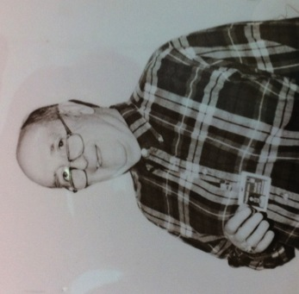
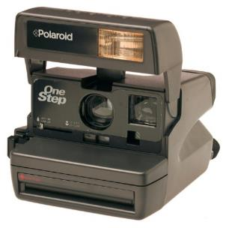
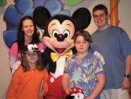
1988-1997
"Thermographic Recording Film." Dombrowski, Edward J.; Guarrera, Donna J.; Jones, Robert L.; Mischke, Mark R.; Warner, John C.; Yang, Jiyue, US Patent 5,750,464. May 12, 1998.
"Thermographic Recording Films." Dombrowski, Edward J.; Jones, Robert L.; Warner, John C.; Yang, Jiyue, US Patent 5,750,463. May 12, 1998.
“Process for Fixing an Image, and Medium for Use Therin.” Marshall, John L.; Shon Baker, Rita S.; Takiff, Larry C.; Telfer, Stephen J.; Warner, John C., US Patent 5,741,630. April 21, 1998.
"Copolymers Having Pendant Functional Thymine Groups." Grasshoff, J. Michael; Taylor, Lloyd D.; Warner, John C., US Patent 5,708,106. January 13, 1998.
“Photographic Development” Guarrera, Donna J.; Mattucci, Neil C.; Mehta, Avinash C.; Taylor, Lloyd D.; Warner, John C. US Patent 5,705,312. January 6, 1998.
“Photographic System” Guarrera, Donna J.; Mattucci, Neil C.; Mehta, Avinash C.; Taylor, Lloyd D.; Warner, John C. PCT Int. Appl. WO 9,729,405. August 14, 1997.
“Method of Imaging Using a Polymeric Photoresist Having Pendant Vinylbenzyl Thymine Groups” Grasshoff, J. Michael; Taylor, Lloyd D.; Warner, John C., US Patent 5,616,451. April 1, 1997.
“Process for Fixing an Image, and Medium for Use Therin.” Marshall, John L.; Shon Baker, Rita S.; Takiff, Larry C.; Telfer, Stephen J.; Warner, John C., US Patent 5,582,956. December 10, 1996.
“Low-Volatility, Substituted 2-Phenyl-4,6-bis[Halomethyl]-1,3,5-triazine for Lithographic Printing Plates.” Fitzgerald, Maurice J.; Kearney, Frederick R.; Liang, Rong-Chang; Schwarzel, William C.; Guarrera, Donna, J.; Hardin, John M.; Warner, John C., US Patent 5,561,029. October 1, 1996.
“Process for Fixing an Image, and Medium for Use Therin.” Marshall, John L.; Shon Baker, Rita S.; Takiff, Larry C.; Telfer, Stephen J.; Warner, John C., PCT Int. Appl. WO 9,529,067. Nov 2, 1995.
“Vinylbenzyl Thymine Monomers and Their Use in Photoresists.” Grasshoff, J. Michael; Taylor, Lloyd D.; Warner, John C., US Patent 5,455,349. October 3, 1995.
“Imaging Medium and Process.” Fehervari, Agota F.; Gaudiana, Russell A.; Kolb, Eric S.; Mehta, Parag G.; Taylor, Lloyd D.; Warner, John C., US Patent 5,424,268. June 13, 1995.
“Thermally-Processable Image Recording Materials Including Substituted Purine Compounds.”Ford, M.; Guarrera, D. J.; Mischke, M.; Pai, R.; Warner, John C., US Patent 5,411,929. May 2, 1995.
"Copolymeric Mordants and Photographic Products and Processes Containing Same." Grasshoff, J. Michael; Taylor, Lloyd D.; Warner, John C., US Patent 5,395,731. March 7, 1995.
"Process and Composition for Use in Photographic Materials Containing Hydroquinones. Continuation in Part." Taylor, Lloyd D.; Warner, John. C., US Patent 5,338,644. August 16, 1994.
"Process and Composition for Use in Photographic Materials Containing Hydroquinones." Taylor, Lloyd D.; Warner, John. C., US Patent 5,177,262. January 5, 1993.
Lloyd Taylor

Slide 4
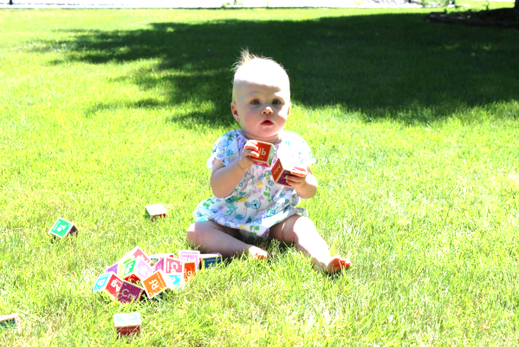
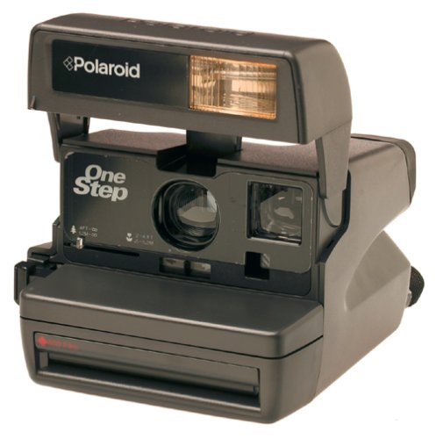


Slide 5
Dye*
+
Ag
Dye
Ag
+*
o
Ag

Slide 10
Water
Molecule
Polymer
Ceramic Beads
Additives

Slide 12
Dry
Film

Slide 13
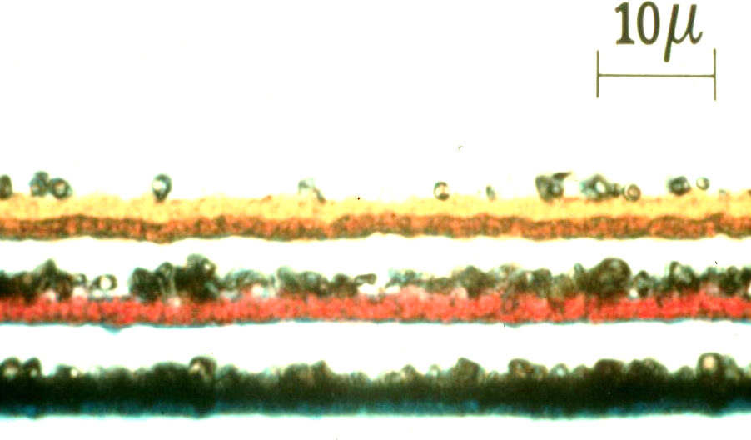

Slide 15
Base
Base

Slide 16
Base

Slide 20
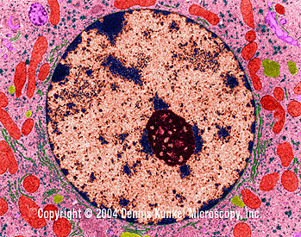
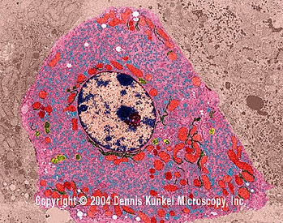
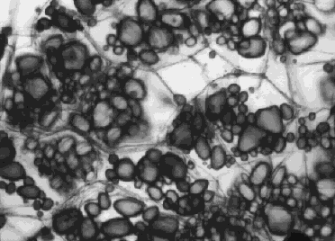
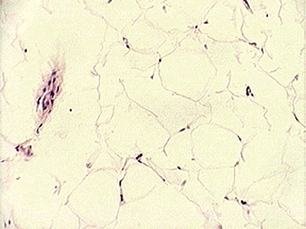
Phase Separation in Nature
Glycogen in Liver Cells
Starch in Potato Cells
Triglycerides in Adipose Cells

Slide 21
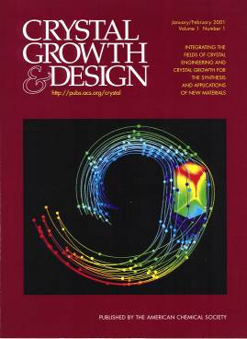
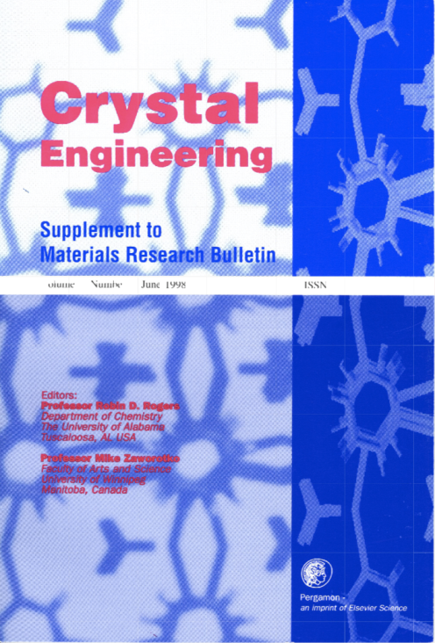
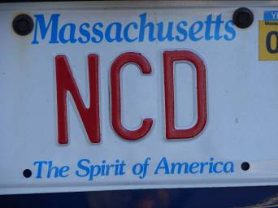
Noncovalent Derivatization
Warner, John C. et al., US Patent 5,338,644. August 16, 1994.
Warner, John C. et al., US Patent 5,177,262. January 5, 1993.

Slide 22
Materials Construction
Electrons
Neutrons
Protons
Hints
From
Nature
Atoms
Molecules
Materials

Slide 23
Covalent Derivatization

Slide 24
Intermolecular Interactions
Surroundings
Molecule
Molecule
Molecule
Molecule
Molecule
Surroundings

Slide 25
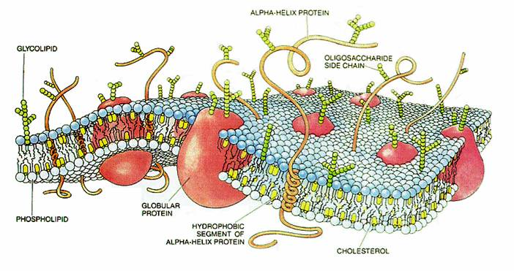

Slide 26
Binary Intermolecular Interactions
Surroundings
Auxiliary
Auxiliary
Molecule
Molecule
Molecule
Auxiliary
Auxiliary
Molecule
Molecule
Auxiliary
Auxiliary
Surroundings

Slide 27
Phase Behavior
Highly Ordered
Entropically Unfavorable
Enthalpically Favorable
Highly Disordered
Entropically Favorable
Enthalpically Unfavorable
A
B
Pure Appl. Chem., 2006, 78, 2035-2041.

Slide 28
Noncovalent Derivative
Isopleth

Slide 29
Hydroquinone
bis-[N,N-Diethyl]terephthalamide System
190
180
170
160
150
140
Temperature
130
120
110
100
0
10
20
30
40
50
60
70
80
90
100
% Hydroquinone

Slide 30
Hydroquinone
bis-[N,N-Dimethyl]terephthalamide System
220
210
200
190
Temperature
180
170
160
150
0
10
20
30
40
50
60
70
80
90
100
% Hydroquinone

Slide 31
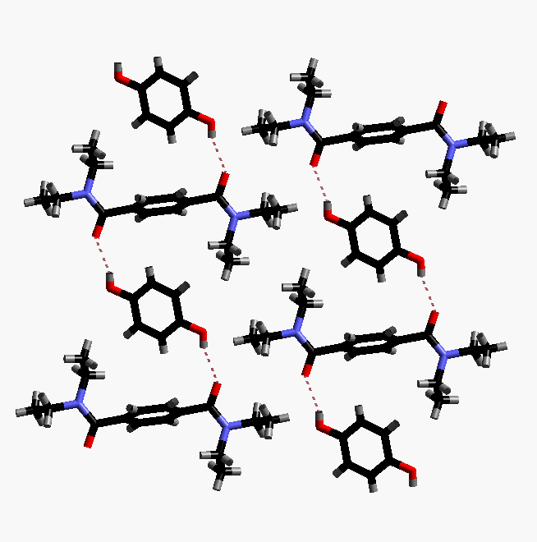
1:1 Bis[N,N-Diethyl]terephthalamide:Hydroquinone

Slide 32
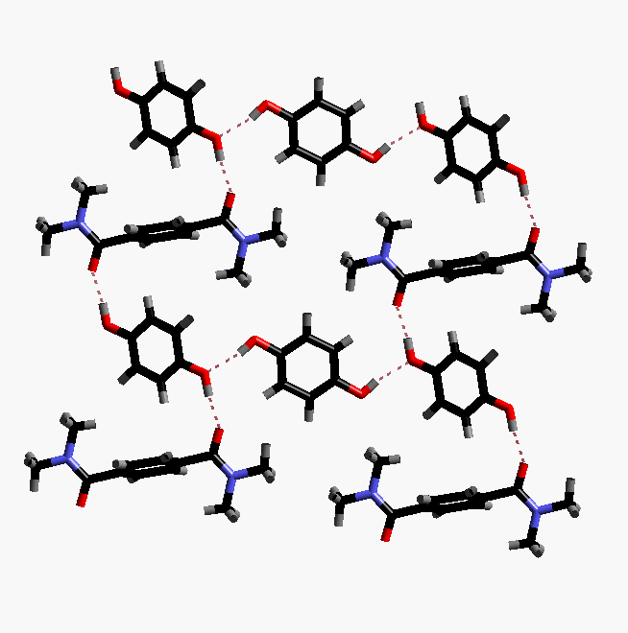
1:2 Bis[N,N-Dimethyl]terephthalamide:Hydroquinone

Slide 33
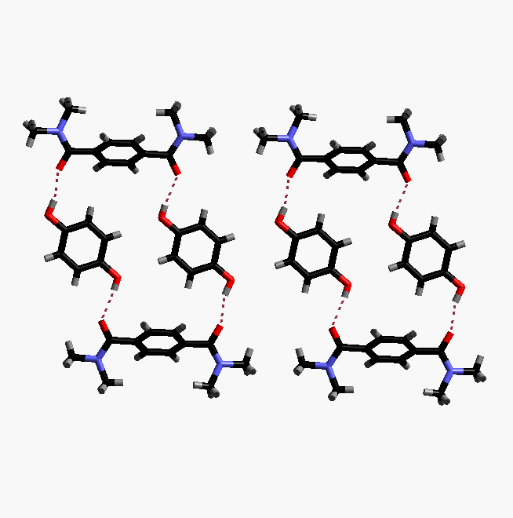
1:1 Bis[N,N-Dimethyl]terephthalamide:Hydroquinone

Slide 34
Terephthalamide - Hydroquinone Motifs
Chains:
Networks:
Isolated Rings:

Slide 35
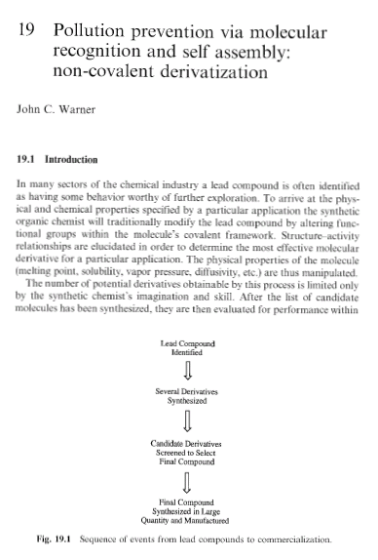
“Pollution Prevention via Molecular Recognition and Self Assembly: Non-Covalent Derivatization.”
Warner, John C., in “Green Chemistry: Frontiers in Benign Chemical Synthesis and Processes.”
Oxford University Press, London. pp 336 - 346. 1998.
“Environmentally Benign Synthesis Using Crystal Engineering: Steric Accommodation in Non-Covalent
Derivatives of Hydroquinones.” Foxman, Bruce M.; Guarrera, Donna J.; Taylor, Lloyd D.; Warner, John C.
Crystal Engineering.1998, 1, 109.
"Noncovalent Derivatization: Green Chemistry Applications of Crystal Engineering." Cannon, Amy S.; Warner,
John C. Crystal Growth and Design 2002, 2(4) 255-257.

Slide 36
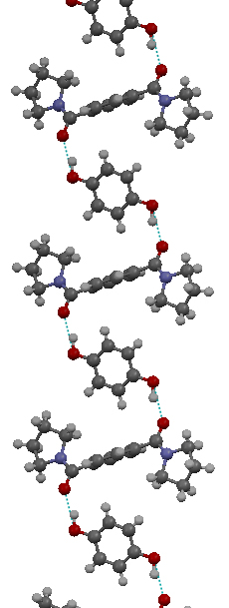
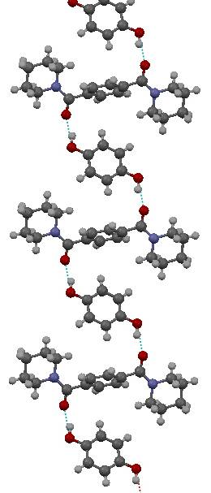
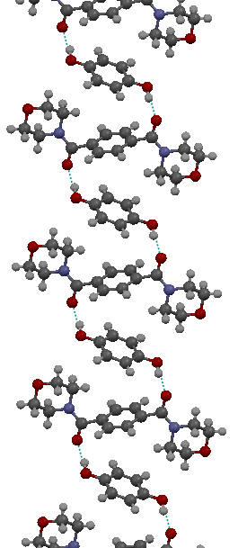
N5TPA
N6TPA
NOTPA

Slide 37
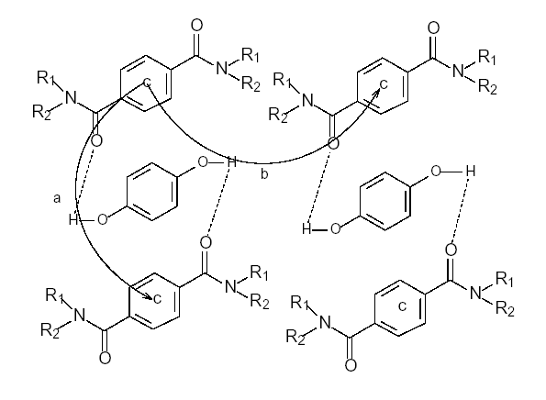

Slide 40
Hydroquinone Complex Dissolution

Slide 41
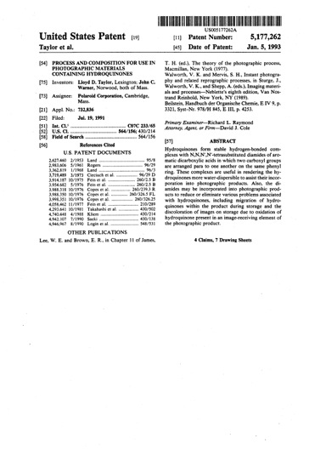
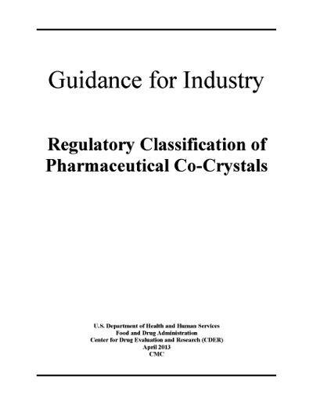
  "Process and Composition for Use in Photographic Materials Containing Hydroquinones."
  Taylor, Lloyd D.; Warner, John. C., US Patent 5,177,262. July 19, 1991.
  “Pollution Prevention via Molecular Recognition and Self Assembly: Non-Covalent Derivatization.” Warner, John C., in “Green Chemistry: Frontiers in Benign Chemical Synthesis and Processes.” Anastas, P. and Williamson, T. Eds., Oxford University Press, London. pp 336 - 346. 1998.
“Guidance for Industry, Regulatory
Classification of Pharmaceutical
Co-Crystals”,
FDA, April 2013

Slide 42
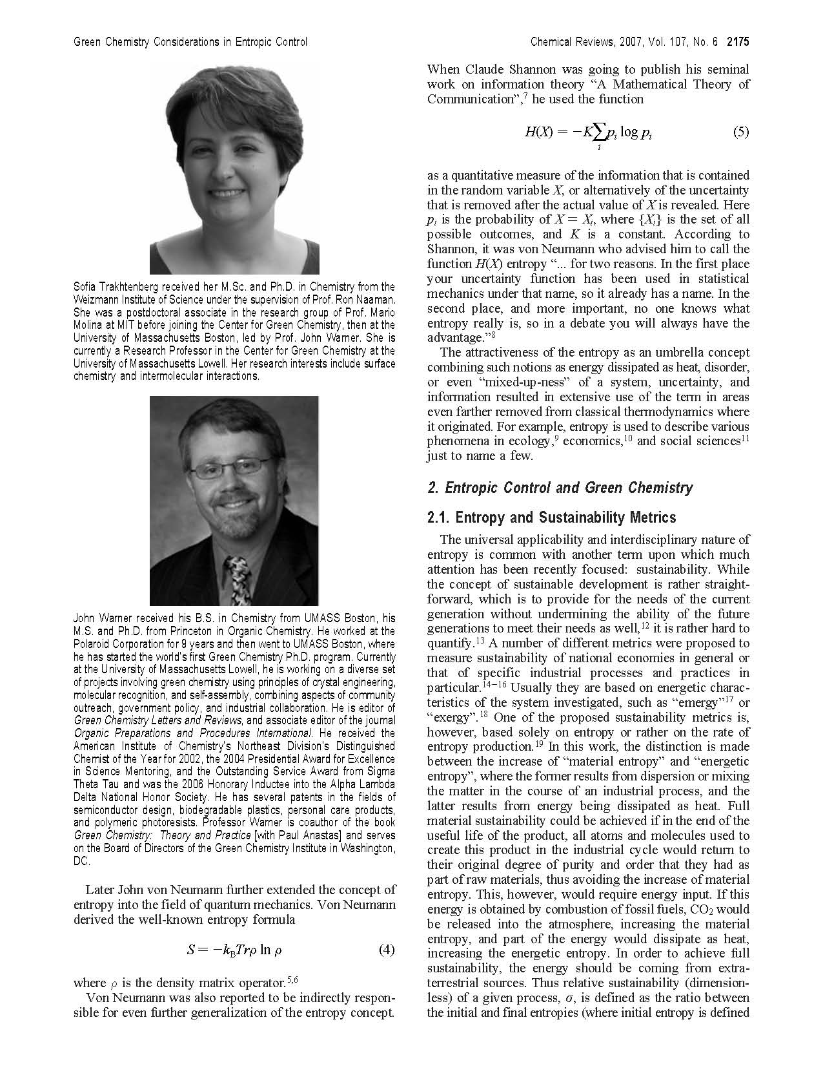
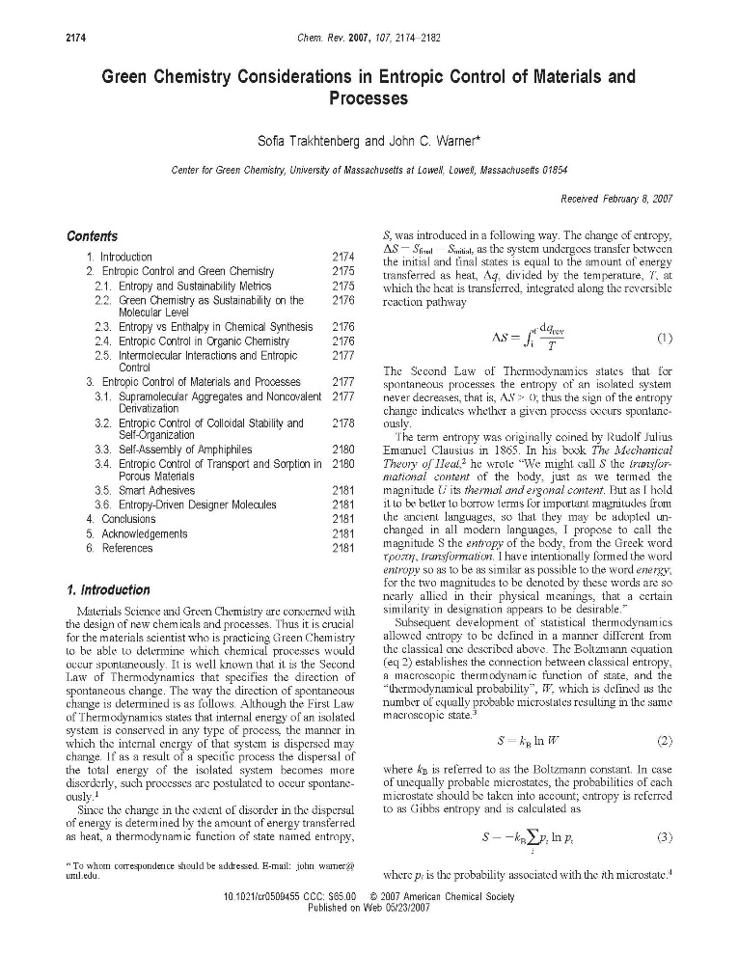
Chem. Reviews 2007, 107(6) 2174-2182.

Slide 43
ΔG
=
ΔH
ΔH
-
TΔS

Slide 44
ΔG
=
ΔH
-
TΔS
TΔS
“Natural Processes”

Slide 45
Titanium Dioxide Film Formation: Sol-Gel Process
Heat to
180-200°C
H⁺
O-Ti-O-Ti
Ti-O-Ti-O
O-Ti-O-Ti
O-Ti-O
Heat to 450°C
Sintered TiO₂

Slide 46
Titanium Dioxide Film Formation: Sol-Gel Process
Heat to
180-200°C
H⁺
Process at Ambient Temperature
with trimesic acid.
Sintered TiO₂
J. Sol Gel Sci.2005 36 157-162.

Slide 47
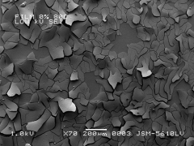
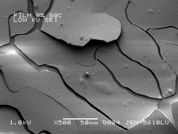
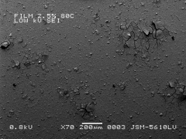
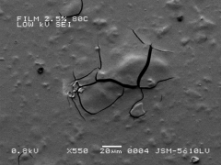
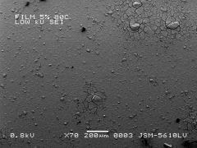
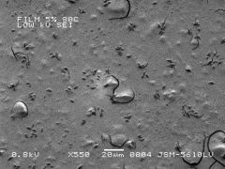
SEM of Titanium Dioxide films with 0 % trimesic acid at (a) 70X and (b) 500X
SEM of Titanium Dioxide films with 2.5 % trimesic acid at (a) 70X and (b) 550X
SEM of Titanium Dioxide films with 5 % trimesic acid at (a) 70X and (b) 550X

Slide 48
Aqueous Dispersion Milling

Slide 49
Viscosity vs. Weight Percent of Additive
6000
5000
4000
Viscosity (cPs)
1
3000
2
3
2000
4
1000
0
0
0.5
1
1.5
2
2.5
3
3.5
4
Weight %
Chem. Mater. 2004 16, 5138-5140.
1
2
3
4

Slide 50
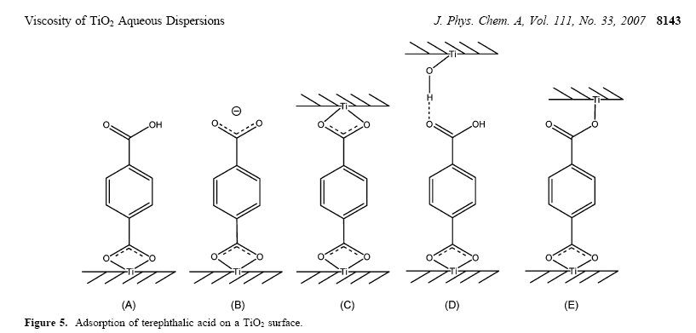

Slide 51
Viscosity vs. Weight Percent of Additive
4000
3500
3000
2500
5
Viscosity (cPs)
2000
6
7
1500
8
1000
500
0
0
0.5
1
1.5
2
2.5
3
3.5
4
Weight %
5
6
7
8

Slide 52
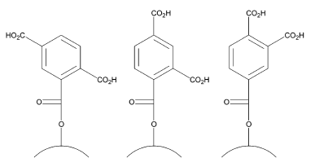
Viscosity vs. Weight Percent of Additive
4000
3500
3000
2500
5
Viscosity (cPs)
2000
6
7
1500
8
1000
500
0
0
0.5
1
1.5
2
2.5
3
3.5
4
Weight %
5
6
7
8

Slide 53
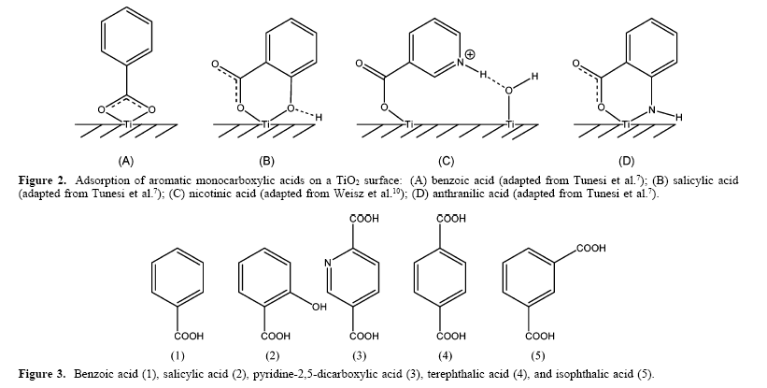
J. Phys. Chem. 2007, 111 8139-8146.

Slide 54
Palm-sized photocatalytic reactor
UV LEDs coated with TiO₂ for oxidation of Arsenic.
Low-power, battery operated system
Oxidized arsenic removed by adsorption to zero-valent iron (iron filings). Arsenic is permanently bound to iron.
Benefits of using iron:
  Fast kinetics, requiring residence times of 1 minute for removal of As
  A high load capacity
  Insensitivity to pH
  Cost-effective
Compartment for
battery supply
Top view
Side view

Slide 55

Electrolyte
with I⁻/I₂
S
*
S
+
Catalytic layer to promote
I⁻ to I₂ regeneration
2
A dye, absorbed on TiO₂
is excited by light
Sensitizer Dye
[
T
i
O
]
[
T
i
O
]
-
The excited dye injects an e- into the TiO₂
2
n
2
n
3
The electron leaves
the TiO₂ and is carried
through as current
1
hv
e
-
4
The e⁻ returns to
the device and reduces
the electrolyte
-
TiO₂ Semiconductor
1
/
2
I
2
I
ITO electrode
5
Insulating Seal
The dye is reduced by the electrolyte
S
S
+

Slide 56
Thymine Photopolymers

Slide 57
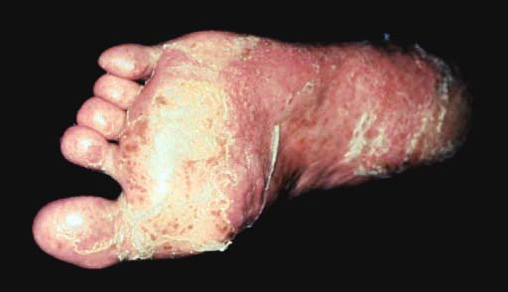

Pustular Psoriasis

Slide 58
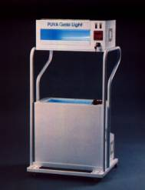
PUVA Phototherapy

Slide 59
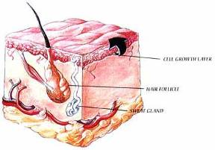
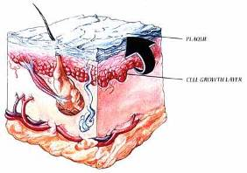
Psoriasis – What’s Happening?
Normal
Psoriatic

Slide 60
Thymine in DNA

Slide 61
Photodimerization of Thymine in DNA
*Diagram taken from Principles of Biochemistry, 2nd Edition, Horton, et al.

Slide 62
Vinylbenzyl Thymine
Polymerization
Site
π-Stacking Site
Photodimerization Site
Triple
H-Bonding
Site
Derivatization Site pKa ~ 9

Slide 63
Organic Soluble Polymers
Styrene
Methacrylate
Water Soluble Polymers
Cationic
Anionic

Slide 64
Polymer Crosslinking
"Non-Catalytic Photoinduced Immobilization Processes in
Polymer Films". Elsevier 2007 34, 665-695.

Slide 65
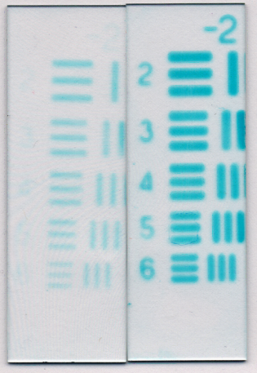
APPLICATION: Photoresists
Warner, John C. et al., US Patent 5,616,451. April 1, 1997.
Warner, John C. et al., US Patent 5,455,349. October 3, 1995.
Warner, John C. et al., US Patent 5,395,731. March 7, 1995.

Slide 66

Calculated Water Contact Angle
n | Theta (º)
0 | 63.6 ± 12.2
2 | 76.3 ± 11.3
4 | 81.8 ± 3.5
6 | 88.9 ± 6.3
8 | 94.2 ± 5.6
J. Polymer Sci., Part A: Polymer Chem. 2007 45, 1296-1303.

Slide 67
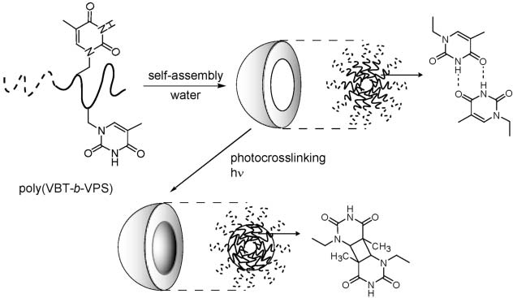
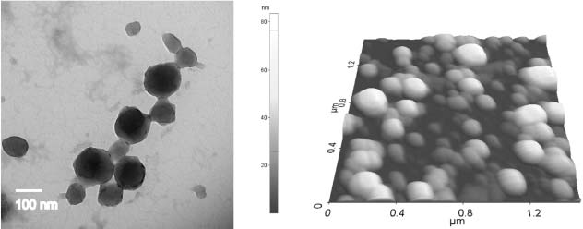
Critical micelle concentration (CMC) values of block copolymer systems
Entry Polymer code Irradiation/J cm CMC ppm/mg mL
1 poly(VMT-b-VPS) 0 140
2 poly(VBT-b-VPS)-H 0 31
3 poly(VBT-b-VPS)-H 0.3 27
4 poly(VBT-b-VPS)-H 5 9.8
Chem. Commun. 2007 2503-2505.
Polymer Preprints 2006, 47, 829-830.

Slide 68
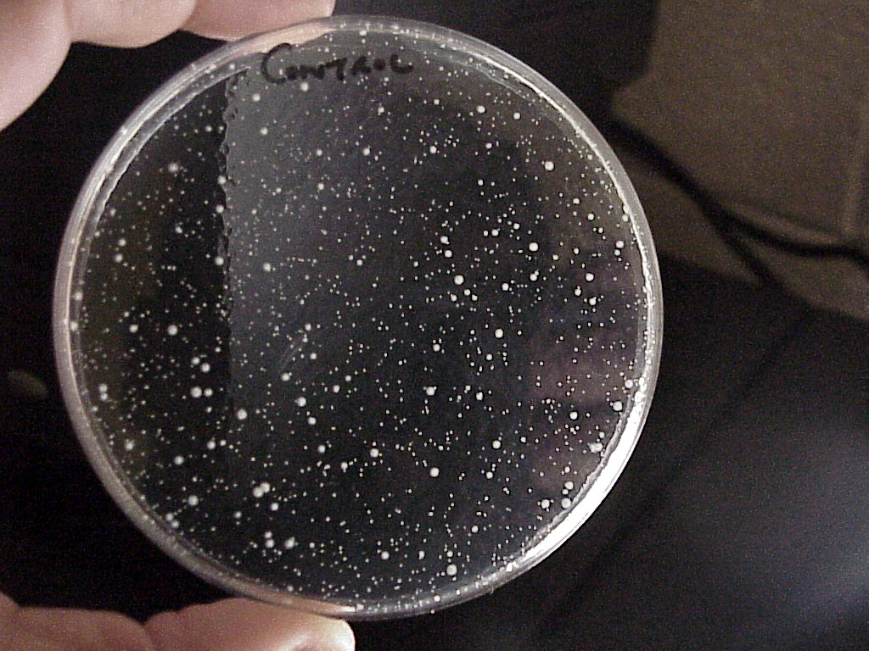
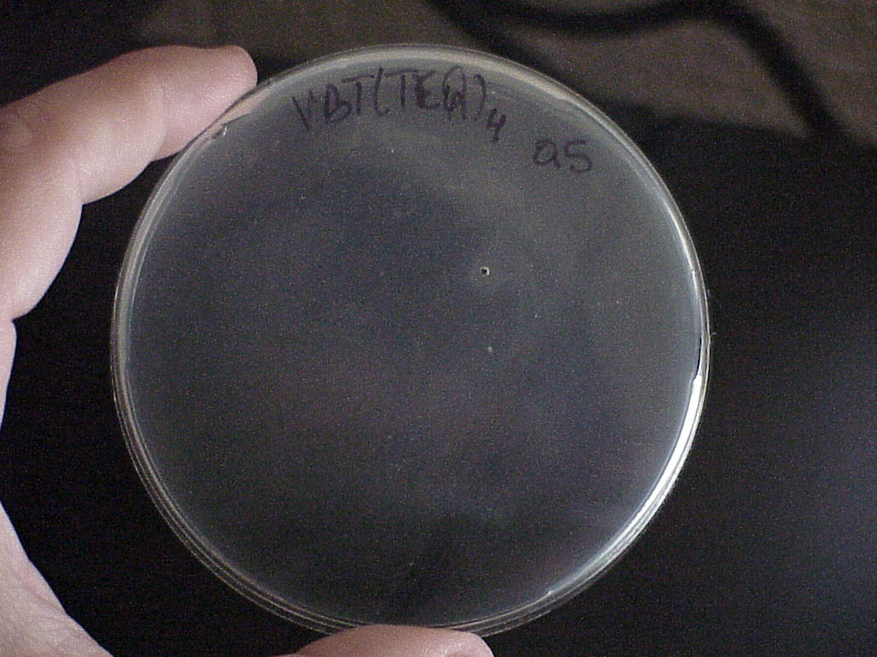
APPLICATION: Antimicrobial surfaces
E- Coli Bacterial growth
Control plate : no polymer
Coated plate : no bacterial growth
J. Bio. Mat. Res. 2006 79A(4), 874-881.

Slide 69
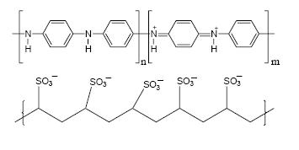
APPLICATION: Templated Conductive Polymers
Enzyme Horseradish
Peroxidase + Aniline
J. Am. Chem. Soc. 2005 127, 9100-9104

Slide 70
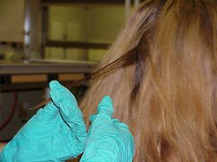
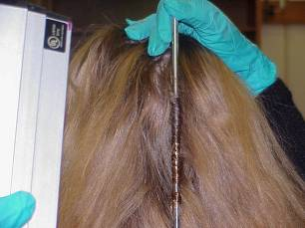
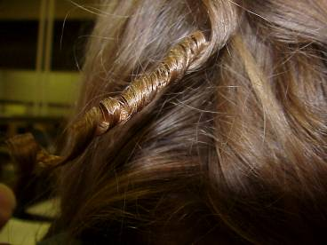
APPLICATION: Hair and Fabric Curling and Toning
Cannon, Amy S.; Raudys, Jennifer; Undurti, Arundhati; Warner, John C. PCT Int. Appl. 2004, 23pp WO 2004058187.
Society of Cosmetic Chemists Annual Scientific Seminar
Proceedings, Boston, MA 2006, 46-47.

Slide 71
APPLICATION: Enzymatic Reversal
J. Macr. Sci. 2005 A42 1541-1546.
U.S. Pat. Appl. Publ. 2005, US 2003224497.

Slide 72

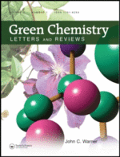

john.warner@warnerbabcock.com

Slide 73

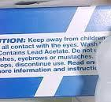













Hair Color Restoration
Tyrosinase
Tyrosinase
“Formulation and Processes for Hair Coloring” Warner, John C.; Muollo, Laura; Stewart,
Amie. US Patent 8,828,100. Filed Oct. 14, 2013. Published September 9, 2014.

Slide 74








Slide 75






john.warner@warnerbabcock.com
JohnWarnerOrg

