Slide 1
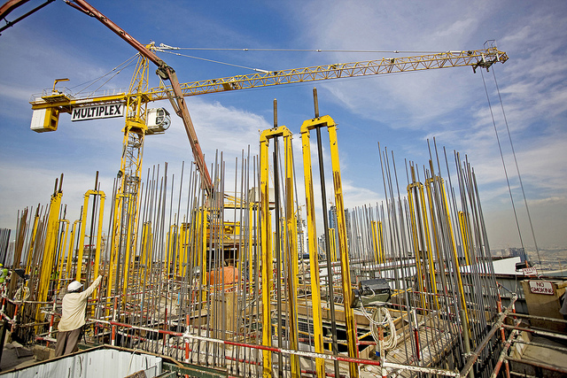
Yale-UNIDO Train-the-Facilitator Workshop in Green Chemistry
Sustainability
CENTER for GREEN CHEMISTRY
and GREEN ENGINEERING at YALE
Image: Flickr, The Glenium Sky admixture, Author: BASF - We create chemistry

Slide 2
Topics To Be Covered
Sustainability – Myths and Facts
Society, Economy, and the Environment
Business and Sustainability
Applying Green Chemistry to Management
Different Models of Sustainability
Case Study: The Interface Company
Green Washing
Life-Cycle Assessment

Slide 3
Sustainability
When a word becomes so popular you begin hearing it everywhere, in all sorts of marginally related or even unrelated contexts, it means one of two things. Either the word has devolved into:
A meaningless cliché, or
It has real conceptual heft.

Slide 4
Sustainability
For example, the phrase “Green” or “Going Green” is a meaningless cliché. It has been used so frequently that it led to Green Washing.
Anything or anyone can “be green” these days.
g oing green

Slide 5
Sustainability
“Sustainable“, which at first conjures up a similarly vague sense of environmental virtue, actually belongs in the second category:
It has real conceptual heft.
Despite its simplicity sustainability is a concept many people have a difficult time wrapping their minds around.

Slide 6
The Top Ten Sustainability Myths

Slide 7
Myth #1:
Nobody knows what sustainability really means.

Slide 8
What is sustainability?
Take a moment to write a sentence or two about what sustainability is.

Slide 9
The Definition of Sustainability
UN World Commission on Environment and Development: “Sustainable development is development that meets the needs of the present without compromising the ability of future generations to meet their own needs.”
Sustainability presumes that resources are finite and should be used conservatively and wisely with a view to long-term priorities and consequences of the ways in which resources are used.
In simplest terms, sustainability is about our children and our grandchildren, and the world we will leave them.
- The Brundtland Report (Our Common Future)

Slide 10
The Definition of Sustainability
Sustainability wants to avoid this
While also making sure we can lead comfortable lives.
Image Source: Wikipedia

Slide 11
Myth #2:
Sustainability is all about the environment.

Slide 12
Sustainability is Not Just About the Environment
Sustainability include a broad group social and economic development issues including: poverty, hunger, health, education, climate change, water, sanitation, energy, and environment.
This requires giving all countries access to natural resources such as water, energy, and food - all of which come, one way or another, from the environment.

Slide 13
Sustainability is Not Just About the Environment
Sustainability has transformed into an environmental term because the economy is driven by natural resources.
If too many of us use resources inefficiently or generate waste too quickly for the environment to absorb and process, future generations won’t be able to meet their needs.
Image Source: Wikipedia

Slide 14
Myth #3:
“Sustainable” is a synonym for “green”.

Slide 15
Sustainability ≠ Green
Although there’s a fair amount of overlap between the terms, “green” can suggest to the public a preference for the natural over the artificial.
With more than six billion people on the planet today, and another three billion expected by the middle of the century, society cannot hope to give future generations a comfortable standard of living without a heavy relying on technology and innovations such as genetically altered food products.

Slide 16
Myth #4:
Sustainability is all about recycling.

Slide 17
A question we need to ask: Is recycling sustainable?
Sustainability and Recycling

Slide 18
Sustainability and Recycling
Material | Energy savings
Aluminum | 95%
Cardboard | 24%
Glass | 5-30%
Paper | 40%
Plastics | 70%
Steel | 60%
Recycling
Converting waste materials into new materials and objects.
Available for metals, plastic, paper, glass.
Cost-benefit of recycling: energy savings

Slide 19
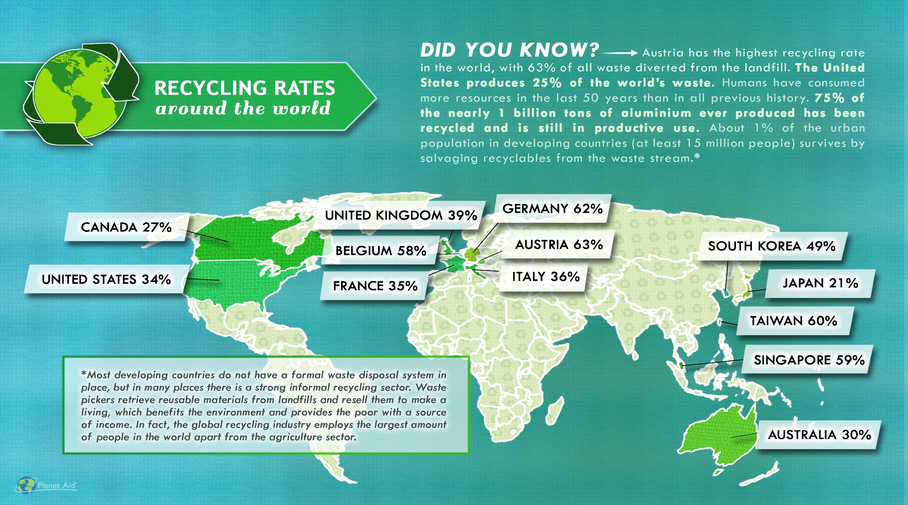
http://www.planetaid.org/blog/recycling-rates-around-the-world

Slide 20
Myth #5:
Sustainability is too expensive.

Slide 21
Sustainability and Expense
If there is an 800-pound gorilla in the room of sustainability, this myth is it. That’s because there’s a grain of truth to it.
But only a grain. It’s only true in the short term and under certain circumstances, but certainly is not true in the long term.

Slide 22
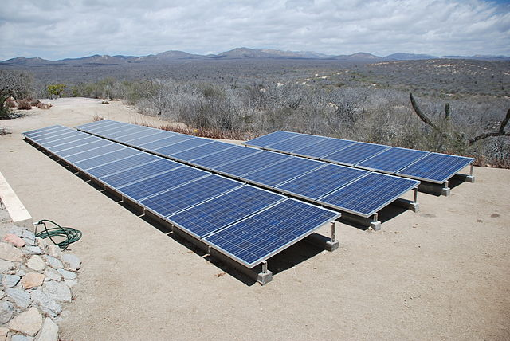
Sustainability and Expense
More sustainable ways of doing things usually costs less over the life-time of a product or service.
It is the upfront costs that can sometimes be higher.
Image: Wikimedia Commons, Solar panels installed in Baja Sur California, Author: BishopBandita

Slide 23
Myth #6:
Sustainability means lowering our standard of living.

Slide 24
Sustainability and Standard of Living
Once we start becoming organized and innovate, the breakthroughs can be extraordinary.
These innovations will allow us to use resources more productively, which in turn will allow us to be prosperous, fed, entertained, and secure.
The innovation at the heart of sustainable living will be a powerful economic engine.

Slide 25
Myth #7:
Consumer choices and grassroots activism, not government intervention, offer the fastest and most efficient routes to sustainability.

Slide 26
Sustainability and The Government
Popular grassroots actions are helpful and essential to creating change. But progress on some reforms, such as curbing CO2 emissions, can only happen if central authorities commit to making it happen. That is why tax credits, mandatory fuel-efficiency standards, and other government regulations are both practical and necessary.

Slide 27
Myth #8:
New technology is always the answer.

Slide 28
Is new technology the answer to sustainability?
Sustainability and Technology
Notes:
Or, should we make sure that whatever we develop is sustainable for many years to come?

Slide 29
Water treatment technologies for developing world
Lifestraw
Water purifying bicycle
Hamster Ball-Shaped Solarball
Life sack
“Pure” Water Bottle Filters Water With UV Rays
Ceramic water filter

Slide 30
Myth #9:
Sustainability is ultimately a population problem.

Slide 31
Sustainability and Population
This is not a myth, but it represents a false solution.
Every environmental problem is ultimately a population problem. If the world’s population were only 100 million people, we would be hard-pressed to generate enough waste to overwhelm nature’s cleanup systems. We could dispose all our trash in a landfill in some remote area, and nobody would notice.

Slide 32
Sustainability and Population
Population experts agree that the best way to limit population is to educate women and raise the standard of living overall in developing countries.
But that strategy cannot possibly happen quickly enough to put a dent in the population on any useful timescale.
The U.N. projects that the planet will have to sustain another 2.6 billion people by 2050. But even at the current population level of 7 billion people, we’re using up resources at an unsustainable rate.

Slide 33
Myth #10:
Once you understand the concept, living sustainably is easy to figure out.

Slide 34
Sustainability ≠ Simple
All too often, a choice that seems sustainable turns out on closer examination to be problematic.
Probably the best current example is the rush to produce ethanol for fuel from corn.
What are the issues with ethanol?

Slide 35
Sustainability ≠ Simple
Corn Cultivation:
Competition with food supply
Land demand
Nutritional needs
Diseases
Initial investment
Ethanol Demand and Corn Prices:
Large increase in demand for corn for ethanol production.
Current production capacity is at over 5 billion gallons.
It is projected to increase to over 9 billion gallons with current plants currently under construction.
Bushels of corn sold for over $8 (USD) each in July 2012.
Corn prices continue to fluctuate.

Slide 36
Sustainability ≠ Simple
You cannot really declare any practice “sustainable” until you have done a complete life-cycle analysis of its environmental costs.
Even then, technology and public policy keep evolving, and that evolution can lead to unforeseen and unintended consequences.
The admirable goal of living sustainably requires plenty of thought on an ongoing basis.

Slide 37
Why are Businesses Paying Attention?
Pollution, contamination, and waste are increasing along with population.
We blame society and corporations for encouraging increased customer demand, pushing consumption of life supporting resources further and further.
Even as these resources decline, consumption of these resources is still rising.

Slide 38
Why are Businesses Paying Attention?
The problem of declining resources is not felt as acutely in developed areas as it is in less developed parts of the world.
The UN Human Development Report from 2012 suggests that the richest 1% of the world, approximately 70 million people, receive as much income as the poorest 56%, or 4 billion people.
Companies are at risk of losing access to raw materials and to employees.
Unfortunately, we are not acting upon knowledge that we have as quickly as we need to in order to prevent the continuous degradation of the Earth and our ability to survive. This creates a sense of urgency in today’s corporate boardroom.
Green Chemistry & Chemical Stewardship Online Certificate Program: https://osha.washington.edu/pages/green-chemistry-chemical-stewardship-online-certificate-program

Slide 39
Society, economy, and the environment are the key dimensions of sustainability.
Society, Economy, and the Environment
Why?
Economic or physical water scarcity, poor air quality, and destroyed ecosystems that sustain life not only in terms of food but also employment, are all signs that we lack sustainability in day-to-day practices.

Slide 40
The traditional view of economy, society, and the environment:
Society, Economy, and the Environment
Economy
Society
When society, economy, and the environment are viewed as separate unrelated parts of a community, the community’s problems are also viewed as isolated issues. Economic development councils try to create more jobs. Social needs are addressed by health care services and housing authorities. Environmental agencies try to prevent and correct pollution problems.
Environment

Slide 41
The current view of economy, society, and the environment: The Triple Bottom Line
Society, Economy, and the Environment
Economy
Society
Understanding the three parts and their links is key to understanding sustainability, because sustainability is about more than quality of life. It is about balancing society, economy, and the environment.
Environment

Slide 42
A representation of the ideal economy, society, and the environment:
Society, Economy, and the Environment
The economy exists entirely within society because all parts of the human economy require interaction among people. However, society is much more than just the economy. Friends and families, music and art, religion and ethics are all important elements of society, but are not primarily based on the exchanging of goods and services.
Society, in turn, exists within the environment. Our basic requirements – air, food, and water – come from the environment as do the energy and raw materials for housing, transportation, and the products we depend on.
Environment
Society
Economy

Slide 43
Triple Bottom Line (TBL)
Society, Economy, and the Environment
TBL measures the impact of an organization's activities on the world by looking at profitability and shareholder values through its social, financial, and environmental capital.
Economy
Society
Environment
Most of major companies that include sustainability in their business plan use this model.

Slide 44
Pressures that companies are facing:
Sustainability and Business
Fiduciary responsibility to make profit: CEOs in public companies have a fiduciary responsibility to shareholders. It is the law for them to deliver profits. Even private companies and small companies have a fiscal responsibility to investors or venture capitalists to return profit on their investment. While there may be a desire to be more sustainable, it has not yet been included within the scope of fiduciary responsibility.
Fear of increased costs, process complexity, and reduced quality of the end product: There is an underlying assumption that being sustainable will drive up costs, erode profits, and threaten the ability of the company to maintain standards and ultimately survive in a competitive marketplace.
Measurement and Monitoring: Challenges surround what to measure along the three dimensions of the Triple Bottom Line. This includes internal agreement as to what to measure, how to measure, and finally how to put auditing procedures in place. Even if a company wanted to be sustainable, the methodology for setting objectives and measuring the results are often in nascent states.
Green Chemistry & Chemical Stewardship Online Certificate Program:
https://osha.washington.edu/pages/green-chemistry-chemical-stewardship-online-certificate-program

Slide 45
Sustainability and Business
Sustainability and Green Chemistry are imperative to business practices, can provide solutions at lower costs, use fewer resources, and the processes and results can be measured.

Slide 46
How?
Sustainability and Business
With the ability to establish multiple value creation levers over the short and long term such as:
Stronger brand and greater pricing power.
Increased margins, producing greater profits and maximizing total shareholder return.
Improve customer loyalty and reduce the rate of churn.
Boosting market share and revenue growth.
Create the culture aligned with sustainability goals: “maximize resource efficiency”, “eliminate and minimize hazards and pollution”, and “design systems holistically and use life cycle thinking” by focusing on design.
B. Torok and T. Dransfield (eds), 1st edn, JAN 2018, Elsevier, Amsterdam, The Netherlands, ISBN-13: 978-0128092705, 1058 pp.

Slide 47
Who?
Sustainability and Business
An awareness of the Principles of GC&GE should not be limited to the members of the design teams of sustainable and innovative products and processes.
Green chemistry requires top-down implementation of sustainable innovation from managers and leaders in addition to the bottom-up (emergence) implementation from designers (followers).
Managers must be aware of the principles in order to implement sustainable approaches across multiple scales.
Leaders must be aware of the principles in order to develop business models and strategies that are sustainable in the long term.
B. Torok and T. Dransfield (eds), 1st edn, JAN 2018, Elsevier, Amsterdam, The Netherlands, ISBN-13: 978-0128092705, 1058 pp.

Slide 48
Framework of Innovation Management Process: Seven Opportunities to Apply Green Chemistry
Sustainability and Business
Inputs
Human - The multidisciplinary approach requires innovative teams with diverse skill sets and knowledge. Actors require the ability to network and collaborate within the departments of an organization and beyond.
Physical/Natural - Renewable materials and energy; designing new materials, products, processes, and systems that are benign to human health and the environment.
Financial - A positive impact on value creation levers (stronger brand and greater pricing power) that can lead to increased total shareholder return.
B. Torok and T. Dransfield (eds), 1st edn, JAN 2018, Elsevier, Amsterdam, The Netherlands, ISBN-13: 978-0128092705, 1058 pp.

Slide 49
Sustainability and Business
Framework of Innovation Management Process: Seven Opportunities to Apply Green Chemistry
Innovation Strategy
Companies that follow a sustainable business should be able to derive competitive advantages that are based on a sustainable value proposition.
By reducing the costs associated with waste, companies can improve operational efficiencies and gain a competitive advantage via a cost advantage.
A greener product that’s certified as sustainable can be sold at a higher price.
B. Torok and T. Dransfield (eds), 1st edn, JAN 2018, Elsevier, Amsterdam, The Netherlands, ISBN-13: 978-0128092705, 1058 pp.

Slide 50
Sustainability and Business
Framework of Innovation Management Process: Seven Opportunities to Apply Green Chemistry
Knowledge Management
The leaders and managers of sustainability will require new core competencies that include sustainability literacy, external collaboration, and systems thinking.
Project teams that pursue sustainability initiatives, or that are involved in the creation of a new product or process, will require diverse skill sets.
B. Torok and T. Dransfield (eds), 1st edn, JAN 2018, Elsevier, Amsterdam, The Netherlands, ISBN-13: 978-0128092705, 1058 pp.

Slide 51
Sustainability and Business
Framework of Innovation Management Process: Seven Opportunities to Apply Green Chemistry
Organization and Culture
At the executive level, prioritization decisions based on values take the form of decisions to invest, or not, in new products, services, and processes.
Employees should prioritize decisions that lead to sustainable innovation and ultimately sustainable development.
Organization and culture can also attract top talent that pays close attention to a firm’s behavior and could reduce employee turnover.
B. Torok and T. Dransfield (eds), 1st edn, JAN 2018, Elsevier, Amsterdam, The Netherlands, ISBN-13: 978-0128092705, 1058 pp.

Slide 52
Sustainability and Business
Framework of Innovation Management Process: Seven Opportunities to Apply Green Chemistry
Project Management
Awareness of Green Chemistry can guide project managers as they operate within the multiple levels of reporting (middle, upper manager, and executive levels).
As for project management, designers and managers should consider the entire life cycle of a product, including those of the materials and energy inputs.
B. Torok and T. Dransfield (eds), 1st edn, JAN 2018, Elsevier, Amsterdam, The Netherlands, ISBN-13: 978-0128092705, 1058 pp.

Slide 53
Sustainability and Business
Framework of Innovation Management Process: Seven Opportunities to Apply Green Chemistry
Portfolio Management
Leaders and managers can evaluate the sustainability of the projects that make up a portfolio in the context of the Green Chemistry
A challenge for leadership is the development of performance metrics for sustainability efforts that are different from the usual metrics of portfolio management, such as patent portfolio size and R&D expenditure.
B. Torok and T. Dransfield (eds), 1st edn, JAN 2018, Elsevier, Amsterdam, The Netherlands, ISBN-13: 978-0128092705, 1058 pp.

Slide 54
Sustainability and Business
Framework of Innovation Management Process: Seven Opportunities to Apply Green Chemistry
Commercialization
The most effective methods of ideation for product innovation are customer visit teams, ethnographic research, leader user analysis, and focus groups.
Feedback from marketing and sales teams involved in the diffusion stage will help the designers of new products in the ideation phase since these teams will best understand market orientation or pull.
B. Torok and T. Dransfield (eds), 1st edn, JAN 2018, Elsevier, Amsterdam, The Netherlands, ISBN-13: 978-0128092705, 1058 pp.

Slide 55
Different Models of Sustainability
Nike – low carbon, closed loop model
The company is reducing the use of petroleum-derived solvents (PDSs) across the manufacturing process of their footwear product lines. Since 1995, there has been an actual 96% reduction in the use of PDSs per pair of shoes through the adoption of water-based adhesives.
https://news.nike.com/news/sustainable-innovation

Slide 56
Different Models of Sustainability
Unilever
As a result of their sustainability initiatives, Unilever factories are releasing 37% less emissions than in 2008, and waste is down 85%. The example highlights how innovators are attempting to utilize matter and energy in a way that enhances performance and value while protecting the environment.
https://www.nytimes.com/2015/11/22/business/unilever-finds-that-shrinking-its-footprint-is-a-giant-task.html?_r=0

Slide 57
The Interface Company Case Study
Does running a business by conviction mean sacrificing profit?
Prepared by
Abigail Enghirst ~ Karen Schenck ~ Justin Vickerman ~ Karen Wisont

Slide 58
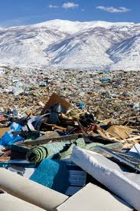
A Sizeable Global Industry
Case Study: The Interface Company
Market Value
Global: $150 billion (2012)
US: >$10 billion (2010)
Production and Waste
Produced annually: 3 million tons (6 billion pounds)
Discarded annually: ~2 million tons (4 billion pounds)
Interface Waste
1996: 15 million lbs
2009: 3.4 million lbs
Interface: $927 million (2010)
Municipal solid waste: 1% (by weight) 2% by volume
75% reduction
$372 million cumulative avoided waste cost
Notes:
It wasn’t the potential cost savings that led Interface to examine their waste stream, though, it was their founder/CEO, Ray Anderson who had an vision to transform the company to sustainability, which he defined as eventually operating the petrol–intensive company in such a way as to eventually take nothing from the earth that is not naturally and rapidly renewable. This vision was inspired by a story Anderson read about the reindeer population on St. Matthew Island.
http://www.allbusiness.com/economy-economic-indicators/economic-indicators/11749247-1.html
http://www.reportlinker.com/p099484/World-Flooring-and-Carpets-Market.html
http://wasteage.com/Recycling_And_Processing/carpet-diversion-201012/
http://www.informinc.org/fact_CWPcarpet.php
one gallon of oil is lost for every three square yards that are disposed in landfills
60% of carpet made in the US is made of nylon

Slide 59
Where is Interface?
Case Study: The Interface Company
Notes:
Sales focused in US and Europe, looking to Asia for new growth

Slide 60
Ray Anderson
Case Study: The Interface Company
A “Spear in the Chest”
“I stood indicted as a plunderer, a destroyer of the earth, a thief of my grandchildren’s future. And I thought, my God, someday what I do here will be illegal. Someday they’ll send people like me to jail.”
“I was so wrong, for so long…There is a better way to make a bigger profit…and at the same time do it honestly and legitimately, not at the expense of the earth.”

Slide 61
Good Intentions = Lost Revenue
Case Study: The Interface Company
Profitable company
Ray Anderson decided to become first truly sustainable company
$780 million in sales (1994)
$50 million cost savings (1994-1997) $1.2 billion in sales (1998)
Drop in sales, cumulative losses Anderson replaced (as President 1997, as CEO 2001)
Must a company sacrifice profit to pursue conviction?
Notes:
Suggested as an alternative to #2

Slide 62
Ray Anderson’s Vision
Case Study: The Interface Company
“To be the first company that, by its deeds, shows the entire industrial world what sustainability is in all its dimensions:
people, process, product, place and profits — by 2020 —
and in doing so we will become restorative through the power of influence.”
Notes:
Accomplishing any mission begins with a clear vision, which Ray Anderson had basically articulated back in 1994.

Slide 63
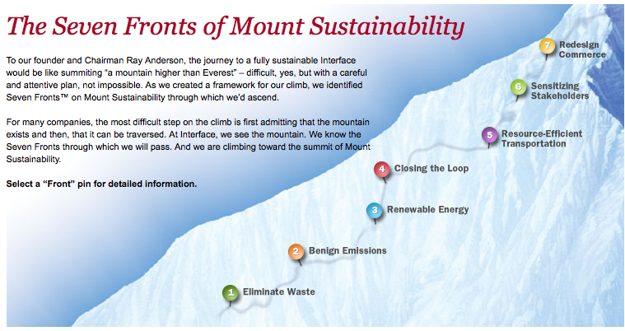
Notes:
Anderson describing the seven faces of mount sustainability
“We realized there are seven faces of the mountain…today we would say there are eight faces and we’re still looking for the ninth. At the time we identified the seven faces of the mountain, we said, “we’ve got to climb each one of those to its own peak and we’ll meet at the top.” And that point at the top will represent will represent sustainability—take nothing, do no harm. And the first face of the mountain is eliminate waste. Any cost that we incur that does not add value to our customer is by definition waste. Today we would say any fossil fuel energy is by definition waste. The second face of the mountain is one of emissions to be sure that whatever we emit from our factories is harmless to the environment. That means working with our suppliers upstream because what comes into our factories will go out either as product or as solid waste, liquid effluent, or gaseous emissions. The third face of the mountain is energy. We want to operate our factories on renewable energy. Today we’re a fourth of the way there. The fourth face of the mountain is material flows. We want to get our products back at the end of their first life and give them life after life. The fifth face of the mountain is the transportation face—moving people and product in climate-neutral, resource-efficient, harmless-to-the-environment way. We’re quite well along the on that with people; we have a way to go yet with product, though. The sixth face of the mountain is maybe the most important because nothing of lasting value happens without it—that is the culture shift. It’s one mind at a time adopting this new paradigm, this new way of thinking about the world and the industrial system and our place within that industrial system. And then the seventh face of the mountain, we really think that someday we’ll be able to reinvent the way we go to market—instead of selling products, stuff, we’ll sell the service that the product delivers to the customer. For carpets it’s the color and the texture, the design, the ambience, the comfort under foot, the acoustical value…all the reasons anybody would want our carpet. In the first place, just sell them the service and retain ownership in the stuff, the means of delivering the service. The eighth face of the mountain has just emerged more clearly for us—and that is the social equity face of the mountain. We have a long way to go to figure that face of the mountain out. And I couldn’t begin to tell you how far we are up that particular face because it’s a whole different set of metrics. We in fact invented a whole new set of metrics called EcoMetrics; this is just as important on the environmental initiative as the financial metrics are on financial side of the business and now we have the SocioMetrics to figure out, the social equity side of this”

Slide 64
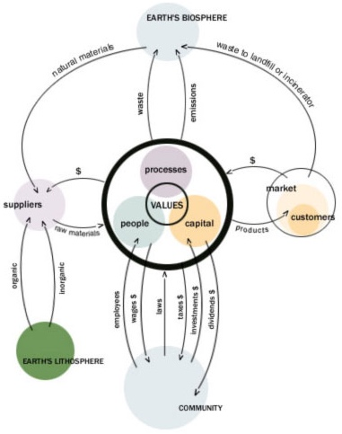
A 20th Century Company
Case Study: The Interface Company
Center
- Common to all companies
- Values are core
Suppliers
- Materials for capital
Customers
- Capital for products
- Used products to landfill
Biosphere
- Collects waste and emissions
Lithosphere
- Suppliers take materials (oil)
Community
- Employees for wages
- Capital exchange
- Regulation
Notes:
64
Here’s where you’re aiming (peak of Mount Sustainability is the 21st century prototypical company)…
CONVICTION

Slide 65
…to A Prototypical 21st Century Company Climbing the Mountain
Case Study: The Interface Company
x
x
Step 1
Eliminate
Waste
1
Notes:
65
Eliminate waste in manufacturing process
Eliminate product waste sent to landfills or incinerators at end of useful-life
CONVICTION

Slide 66
Case Study: The Interface Company
…to A Prototypical 21st Century Company Climbing the Mountain
x
x
x
Step 2
Benign
Emissions
2
1
Notes:
66
Eliminate emissions generated during manufacturing processes

Slide 67
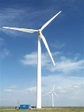
Case Study: The Interface Company
…to A Prototypical 21st Century Company Climbing the Mountain
x
x
x
Step 3
Renewable
Energy
3
2
1
Notes:
67
Supply energy from renewable sources (solar, wind, biomass, etc.)

Slide 68
Case Study: The Interface Company
…to A Prototypical 21st Century Company Climbing the Mountain
x
x
x
x
Step 4
Closing The Loop
x
x
4
3
2
1
Notes:
68
Prevent toxic emissions upstream – what comes in will go out. End-of-pipe solutions are unsustainable – we must leave toxic substances in the lithosphere

Slide 69
Case Study: The Interface Company
…to A Prototypical 21st Century Company Climbing the Mountain
x
x
x
x
x
Step 5
Resource
Efficient
Transportation
x
x
5
x
x
4
3
2
1
Notes:
69
Eliminate harmful emissions from transportation (employee commutes, business travel, supplier shipments, product shipments – all transportation in the business cycle)

Slide 70
Case Study: The Interface Company
…to A Prototypical 21st Century Company Climbing the Mountain
x
x
x
x
x
S
S
Step 6
Sensitizing Stakeholders
x
x
6
S
5
x
x
4
3
2
1
S
Notes:
70
Introduce valuable sensitivity connections — ties to the community, suppliers and customers, and within the organization

Slide 71
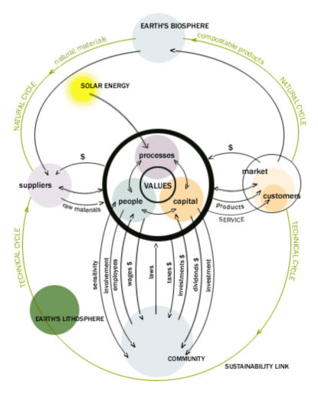
Case Study: The Interface Company
…to A Prototypical 21st Century Company Climbing the Mountain
Step 7
Redesign
Commerce
7
6
5
4
3
2
1
Notes:
71
Redesign commerce — shift emphasis from selling products to providing service, ensure that price reflects full costs, increase market share at the expense of inefficient competitors, shift tax laws from taxing good things (income and capital) to bad things (pollution, waste, emissions)
Introduce closed loop recycling via the Natural Cycle — emphasizing natural raw materials and compostable products
Technical Cycle — giving man-made materials and precious organic molecules life after life

Slide 72
Mission Zero Goals: Approximately 60% Progress as Assessed in 2010
100
90
% progress to goal
80
70
60
50
40
Sensitizing Stakeholders
30
R.E. Transportation
Redesign Commerce
Benign Emissions
Renewable Energy
Closing the Loop
20
Waste
10
0
Notes:
Based on Anderson’s 1994 “spear in the chest,” the new direction of Interface was based on the vision “to be the first company that, by its deeds, shows the entire industrial world what sustainability is in all it’s dimensions: people, process, product, place and profits – and in doing so, become restorative through the power of influence.”
Anderson understood that sustainability had to be approached from a systems perspective or a “whole company” approach. Over the years as the commitment to sustainability reached all parts of Interface, it evolved into a shared mission: Mission Zero.
Sixteen years into the journey, and a decade away from the date Interface predicted for achieving the vision (2020), the company is approximately 60% along. They are doing better along some faces than others but are making strides on all faces.
Not all initiatives have been successes…but by fostering an engaged culture of people connected to Mission Zero who feel empowered to effect change, there is continued innovation.
Some lowlights and highlights
72

Slide 73
Finding Balance Between Conviction and Profit
“Innovative business models and products must work financially, or it won’t matter how good they are ecologically and socially.” -Senge
Focus on profit
Balance of profit and conviction
Focus on conviction
Economic
Environmental
Environmental
Social
Economic
Social
Social
Environmental
Economic
Notes:
While Interface made great strides in the environmental and social realms, after the initial savings from waste reduction was realized, net income dropped dramatically
They lost sight of the business end of things (like creating a product that people wanted—today’s carpet tiles are much more attractive)
In its early years, Interface the typical industrial firm
Plunders of the earth focused on profits through destruction
Spear in the chest moment resulted in pendulum swing far to the left
Economic loss, the firm becomes unsustainable
Today – sustainable equilibrium achieved
Earning economic profit
Continuing progresses towards mission zero
Simulating creative innovation fostered by intrinsic motivation

Slide 74
“Ultimately there is only one bottom line.” - Ben Packard, former VP of Global Responsibility, Starbucks
Case Study: The Interface Company
“But for those who think that business exists to make a profit, I suggest they think again. Business makes a profit to exist.” -Anderson
Notes:
Abraham Maslow, the psychologist, had it right in his hierarchy of human needs: self-actualization is at the top and that translates into higher purpose (and by the way I would add parenthetically there is no more strategic issue for a company or any other organization than its ultimate purpose). And for those who think that business exists to make a profit, I suggest they think again. Business makes a profit to exist, and surely it must exist for some higher, nobler purpose than that.

Slide 75
The Ingredients of Prototypical 21st Century Success
Case Study: The Interface Company
Environment
Financial
Social
Lead by example
Leave the world a better place
Maintain sustainable profits and growth within the industry
Notes:
"To be the first company that, by its deeds, shows the entire industrial world what sustainability is in all its dimensions: people, process, product, place and profits – and in doing so, become restorative through the power of influence". -Ray Anderson

Slide 76
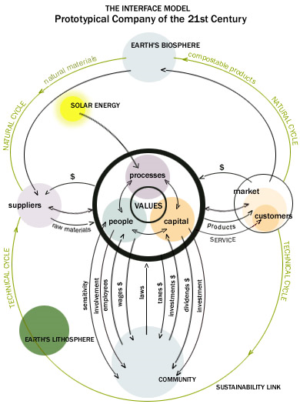

Slide 77
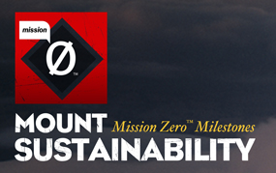
Case Study: The Interface Company
“The choice between conviction and profits is a false choice; more creativity is required.”
-Ray Anderson
Notes:
A leader with a passion for sustainability can change the course of his company.
A company with a unified vision can change business as usual.
No mountain is too high for hard work and ingenuity to conquer.

Slide 78
Sustainability Discussion
What sustainable practices are incorporated in your company?
Is there a room for improvement?
How can YOU contribute to sustainability within your organization and what can these contributions be?
How successful would the Interface model be at your organization?
Do you have to sacrifice some profit to become a sustainable company?

Slide 79
Green Washing
The act of misleading consumers regarding practices of a company or the environmental benefits of a product or a service.
Deceptive use of Green Marketing, or claiming to do good and doing the opposite.

Slide 80
Examples of Green Washing

Slide 81
Other Green Washing Phrases to Consider
Cruelty free, bio, eco, carbon neutral, earth-friendly, true green

Slide 82
Reasons Companies Use Green Washing
Using Green Wave for Profit
Consumers are likely to buy green products or services and because many consumers can’t tell of the product claim is true.
Keeping with the Green Trend
To show competitive advantage over the competitor.
Public Relations

Slide 83
Common Features of Green Washing
Suggestive pictures
Irrelevant claims
Hidden trade-offs
Green product
Distraction from the greater impact made by the product

Slide 84
Preventing Green Washing
Better regulation
Certifications
Consumer awareness
Reporting green washing

Slide 85
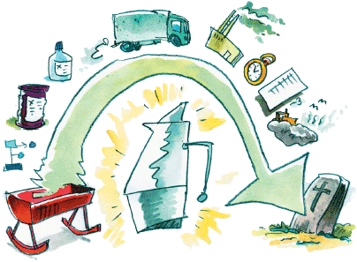
Reporting and Metrics
Cradle to Grave
Cradle to Shelf
Comprehensive Evaluation of Impact

Slide 86
Life-Cycle Assessment
Two attributes make LCA distinct and useful as an analytical tool:
Whole system consideration of the total product life-cycle.
Presentation of tradeoffs among multiple environmental issues.
LCA is quantitative (within limits)

Slide 87
The Four Steps of an LCA
Goal and Scope Definition (ISO 14040)
The Life-Cycle Analysis (ISO 14041) - What are the energy, raw materials, emissions, and wastes? What data is needed?
Life-Cycle Impact Assessment (ISO 14042) - Assess environmental impacts identified in the life-cycle inventory.
Life-Cycle Improvement - (ISO 14043) Identify opportunities to reduce the environmental impacts by modification of the life-cycle inventory.
ISO1400 link provided for reference only.
Phases
Portions of LCA procedure
Goal and Scope
Interpretation
Inventory Analysis
Impact Assessment

Slide 88
ISO
ISO is an independent, non-governmental international organization with a membership of 162 national standards bodies.
It is an organization setting international standards.
ISO also publishes technical reports, technical specifications, publicly available specifications and guides.

Slide 89
Life-Cycle Inventory
Each process is subdivided into the unit processes/steps, where a detailed input/output analysis is conducted.
Process materials,
reagents, solvents, &
catalysts (including
reuse & recycle
from another stage).
Energy
Raw Material Inputs
Reuse/Recycle
Unit Process
Primary Product
Includes reuse
and recycle of
materials from
another stage.
Useful Co-Product
Waste
Fugitive &
Untreated Waste
Treatment &
Disposal

Slide 90
Scope of ISO 14040
ISO 14040 contains general information on:
Goal and scope of LCA
LCI phase
LCIA phase
Interpretation phase
Reporting and critical review
Limitations
Relationship between phases
Conditions for use of value choices and optional elements
Normative references: Need to use 14044 to apply 14040
Phases of an LCA

Slide 91
An input/output analysis is required for each process.
Life-Cycle Inventory
Data Needs Input/Output Analysis
Inputs
Outputs
Raw Material Acquisition
Water
Effluent
Airborne
Emissions
Solid Wastes
Other
Environmental
Releases
Useable
Products
Manufacturing, Processing, & Formulation
Energy
Distribution & Transportation
Use/Re-Use/Maintenance
Raw Materials
Recycle
Waste Management
System Boundary

Slide 92
Motivations for Implementing LCA

Slide 93
Life-Cycle Analysis Helps Avoid Shifting the Issues
Looking at the entire life-cycle helps ensure reducing waste at one point does not simply create more waste at another point in the life-cycle.
Issues may be shifted – intentionally or inadvertently – among:
Processes or manufacturing sites
Geographic locale
Different budgets and planning cycles (first cost)
Environmental media – air, water, soil (MTBE)
Sustainability dimension: economic, social, environmental burdens
Depends on “boundaries”
Be conscious of what is shifted and where!

Slide 94
Phase 1: Goal and Scope
Goal
Goal statement is the first component of an LCA and guides much of the subsequent analysis
Goal must state:
Intended use
Reasons for study
Audience
Whether comparative and disclosed to public
Scope
Scope provides background information, details methodological choices, and lays out report format
Scope includes:
Product system
Functions of systems
Functional unit
System boundary
Allocation procedures
Impact categories, assessment method and interpretation type
Scope follows the goal and provides background information, details methodological choices, and tells how the report will be formatted.
Data requirements
Assumptions
Limitations
Initial data quality requirements
Type of critical review, if any
Type and format of report

Slide 95
Phases 2 and 3: LCI and LCIA
Life Cycle Inventory (LCI) Phase
Data collection
As much input and output data as possible is collected
Can be presented in report or kept private, if confidentiality agreements warrant
Useful for other researchers that could use that data
Life Cycle Impact Assessment (LCIA) Phase
Conversion of inventory data into environmental impact potentials
Impact categories, indication, and characterization models are chosen
Data are grouped based on potential to cause certain environmental impacts (classification)
Input and output quantities converted to potential impacts based on characterization factors (characterization)
Optional steps: Normalization, grouping, weighting

Slide 96
Phase 4: Interpretation
Continually ongoing during assessment to help guide other phases.
Discussion of inventory analysis and impact assessment results in LCA study.
In an LCI study, only inventory needs to be discussed.
Can be modeled as conclusions and recommendations to the decision maker.
Should be consistent with and based on goal and scope of the study.
Should reflect the various uncertainties inherent in LCA including:
LCA is based on a relative approach using a functional unit.
Impacts are “potential”.

Slide 97
Example of an LCA
Possible Goal:
Is an electric car greener than a combustion engine vehicle?
Possible Scope:
Do analysis on environmental damage and human toxicity.
Output:
Global warming (GWP), terrestrial acidification (TAP), particulate matter formation (PMFP), photochemical oxidation formation (POFP), human toxicity (HTP), freshwater eco‐toxicity (FETP), terrestrial eco‐toxicity (TETP), freshwater eutrophication (FEP), mineral resource depletion (MDP), fossil resource depletion (FDP).

Slide 98
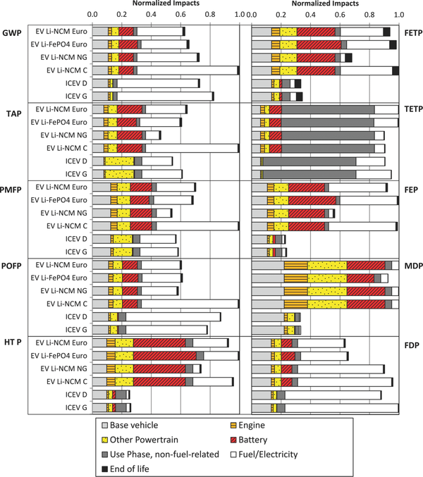
Comparative Environmental Life Cycle Assessment of Conventional and Electric Vehicles
ICEV = internal combustion engine vehicle
EV = electric vehicle
LiNCM = lithium nickel cobalt manganese
LiFePO₄ = lithium iron phosphate
PbA = lead acid
The study compares 4 electric cars (with different batteries) and 2 conventional cars in terms of environmental impact
Journal of Industrial Ecology Volume 17, Issue 1, pages 53-64, 4 OCT 2012 DOI: 10.1111/j.1530-9290.2012.00532.x http://onlinelibrary.wiley.com/doi/10.1111/j.1530-9290.2012.00532.x/full#jiec532-fig-0001
Notes:
Normalized impacts of vehicle production. Results for each impact category have been normalized to the largest total impact. Global warming (GWP), terrestrial acidification (TAP), particulate matter formation (PMFP), photochemical oxidation formation (POFP), human toxicity (HTP), freshwater eco‐toxicity (FETP), terrestrial eco‐toxicity (TETP), freshwater eutrophication (FEP), mineral resource depletion (MDP), fossil resource depletion (FDP), internal combustion engine vehicle (ICEV), electric vehicle (EV), lithium iron phosphate (LiFePO₄), lithium nickel cobalt manganese (LiNCM), coal (C), natural gas (NG), European electricity mix (Euro).
IF THIS IMAGE HAS BEEN PROVIDED BY OR IS OWNED BY A THIRD PARTY, AS INDICATED IN THE CAPTION LINE, THEN FURTHER PERMISSION MAY BE NEEDED BEFORE ANY FURTHER USE. PLEASE CONTACT WILEY'S PERMISSIONS DEPARTMENT ON PERMISSIONS@WILEY.COM OR USE THE RIGHTSLINK SERVICE BY CLICKING ON THE 'REQUEST PERMISSIONS' LINK ACCOMPANYING THIS ARTICLE. WILEY OR AUTHOR OWNED IMAGES MAY BE USED FOR NON-COMMERCIAL PURPOSES, SUBJECT TO PROPER CITATION OF THE ARTICLE, AUTHOR, AND PUBLISHER.

Slide 99
Results from LCA study
Electric cars powered by the present European electricity mix offer a 10% to 24% decrease in global warming potential relative to conventional diesel or gasoline vehicles
Electric cars exhibit the potential for significant increases in human toxicity, freshwater eco‐toxicity, freshwater eutrophication, and metal depletion impacts, largely emanating from the vehicle supply chain (energy consumption, battery replacement)
Recommendation:
Improving the environmental profile of electric cars requires engagement around reducing vehicle production supply chain impacts and promoting clean electricity sources in decision making regarding electricity infrastructure.

Slide 100
s

Slide 101
Limitations of LCA
Not a complete assessment of all environmental issues because only those identified in the goal and scope are considered.
LCI can rarely, if ever, include every single process and capture every single input and output due to system boundaries, data gaps, cut-off criteria, etc.
LCI data collected contains uncertainty.
Characterization models are far from perfect.
Sensitivity and other uncertainty analyses are not fully developed.

Slide 102
Critical Review
Necessary component for comparative studies disclosed to the public.
Verifies process and consistency with principles.
Not an endorsement.
Does not verify or validate goals.
Can improve credibility of study.
Critical review process is defined in the goal and scope.
Requires external independent chair person and at least two other members.
Image: shenandoahchiropractic.com

Slide 103
Summary Features of an LCA
Systematic procedure for environmental assessment through product or process life cycle.
Functional unit basis for comparisons differs from many other environmental management techniques.
Amenable to data confidentiality needs and proprietary matters.
Open to updates based on new science and developing techniques.
Not overly restrictive.
Impacts identified are all expressed as potential.
LCIA converts LCI results to environmental issues based on characterization factors.
Systematic approach to identify, check, evaluate, and present information based on goal and scope.
Iterative process with continual interpretation.
May link to other environmental management techniques.
Note: Features identified are based on those put forth in ISO 14040:2006

Slide 104
In-Class Exercise: LCA and Input-Output
Use the Input-Output (Embodied Energy & Operating Energy) Quick tool to estimate energy resulting from production of product.
Use economic activity to derive estimates of materials and energy resources required for that activity, as well as the resulting environmental emissions.
Online Tool : http://www.eiolca.net
Task: Estimate Embodied energy and emissions associated with manufacturing of an automobile verses a bicycle.
Use the database – look into energy use for us 2002.
Total energy TJ/1million $ (scale for 1 car worth $35000).
Look at greenhouse gas emissions.
Compare automobile and a bicycle.

Slide 105
Topics Covered
Sustainability – Myths and Facts
Society, Economy, and the Environment
Business and Sustainability
Applying Green Chemistry to Management
Different Models of Sustainability
Case Study: The Interface Company
Green Washing
Life-Cycle Assessment

Slide 106
Sponsored by Yale-UNIDO Initiative
QUESTIONS?
CENTER for GREEN CHEMISTRY
and GREEN ENGINEERING at YALE

