Slide 1
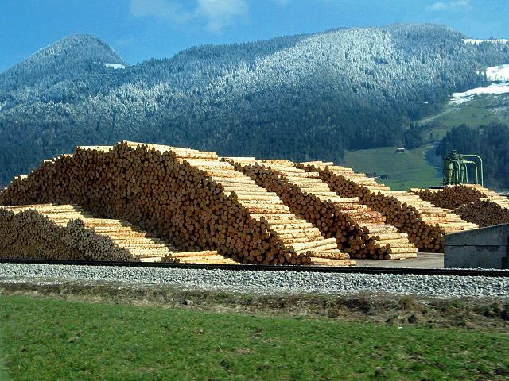

Yale-UNIDO Train-the-Facilitator Workshop in Green Chemistry
Renewable Feedstocks for energy
CENTER for GREEN CHEMISTRY
and GREEN ENGINEERING at YALE
Image: Wikimedia Commons, Author: R. Möhler

Slide 2

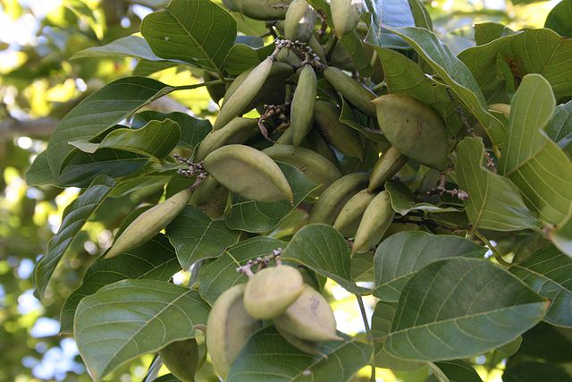
Use of Renewable Feedstocks
A raw material or feedstock should be renewable rather than depleting whenever technically and economically practical.
Image: Wikipedia, Pongamia Pinnata Seeds

Slide 3
Topics To Be Covered
Where does stuff come from
Fossil carbon
  Gas
  Oil
  Coal
First, Second, and Third Generation Feedstocks
  Bioethanol
  Ethanol from cellulose
  Biodiesel
  Biofuel from algae
The Advantages and Drawbacks of Biofuel

Slide 4

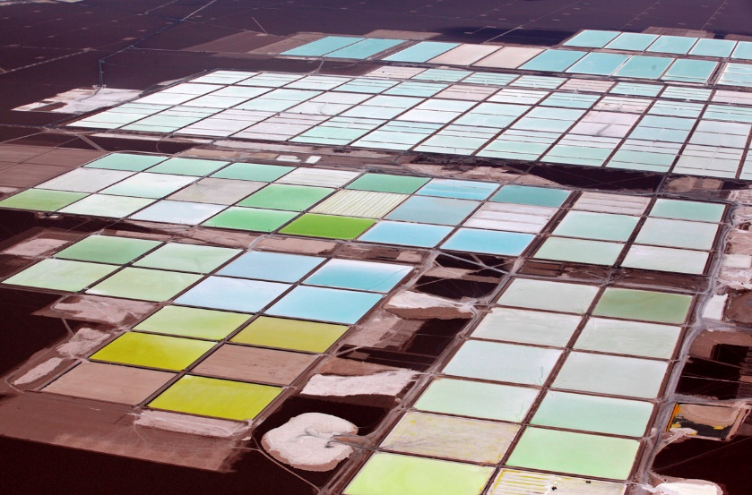

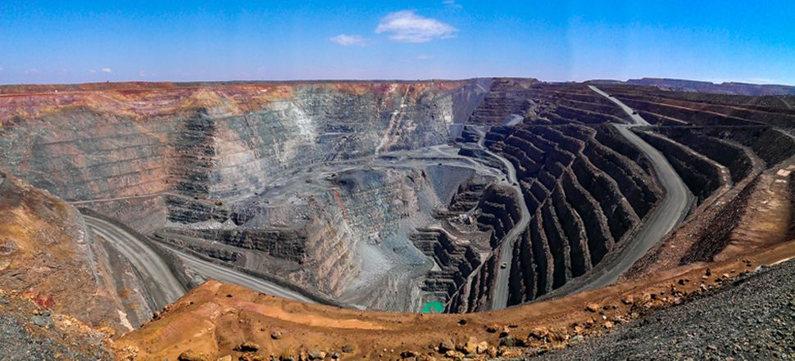
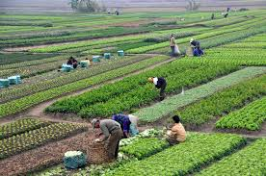
Where does stuff come?
CHEM 512: Heterogeneous catalysis
Brine pools (Lithium mine, Soquimich, Atacama, Chile)
vs
Biomass
Mined materials
Fimiston Open Pit (Gold mine, Australia)
Notes:
Lithium, the key ingredient in our Rechargeable batteries is extracted from Brine. Brine pumped out from 130 ft below lake’s surface and water is evaporated to obtain Lithium Carbonate.
At this Gold Mine in Australia, 15 mn tonnes of rock is moved per year to generate 28 tonnes of Gold. Gold generates a minimum of two million tonnes of solid waste to produce a single kilogram
One kilogram also takes 691,000 litres of water, and 141 kilograms of cyanide. this gold mine in Australia shows what that means on scale to meet our needs

Slide 5
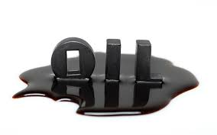
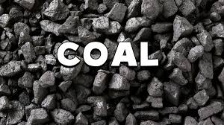

Where does stuff come?
CHEM 512: Heterogeneous catalysis
C
For carbon
vs
Biomass
Mined materials

Slide 6

Renewable vs. Fossil Feedstocks
Feedstock:
A raw material to supply or fuel a machine or industrial process.
Renewable or Depleting is a question of time:
A renewable resource is determined to be renewable if it can be replenished in a relevant amount of time.
Fossil fuels are depleting because they cannot be replenished in a practical timeframe from vegetation.
Image: Wikimedia Commons, Author: Johnlacrosse

Slide 7
Fossil carbon timeline
Fossil carbon is formed over 300 million years
    CO₂
Absorption
Decomposition 99,99%
Death
Millions of years
Sequestration 0.01%
Fossil fuel: gas, oil, char…
Source: DOE

Slide 8
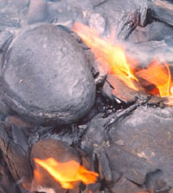
Fossil carbon
Formation of fossil fuels: what happens during sequestration?
  Transformation under high temperature and pressure of cellulose, lignin, lipids, chitin, proteins…
    into kerogen and bitumen (high molecular weight, viscous material). Kerogen from an oil shale deposit of western USA: C₂₁₅H₃₃₀O₁₂N₅S
    Then cracking of this material into lower molecular weight material: crude oil and natural gas.
    Reforming can also afford coal
      Oil shale containing kerogen
Image: Wikimedia Commons

Slide 9
How is petroleum generated and used?
Biomaterials [Carbohydrates, Proteins, Lipids]
Highly Functionalized Molecules
1. High temperature, and pressure; natural process of oil creation
2. Oil extraction and processing
Over millennia
Petroleum Products [Hydrocarbons – highly reduced state]
3. Separation and oxidation, high energy input
Functionalized Compounds [Olefins, Alkylchlorides]
4. Further functionalization, replacing reactive groups with functional groups of interest
Highly Functionalized Molecules

Slide 10
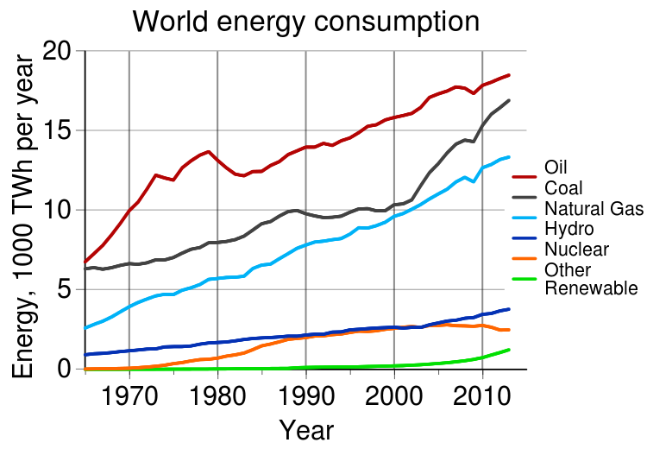
Where does energy come from?
Fossil fuels provide a significant part of our energy supply
(about three quarters): oil + coal + gas
Increasing world energy consumption since 1990.
Oil, coal and natural gas remain the predominant sources of energy, but the use of renewables is still increasing.
Source: Statistical Review of World Energy
The graph includes a prediction for year 2035, where the projected energy consumption will reach 770 quadrillion British Thermal Unit [BTU].
Source: U.S. Energy Information Administration [U.S. EIA].

Slide 11
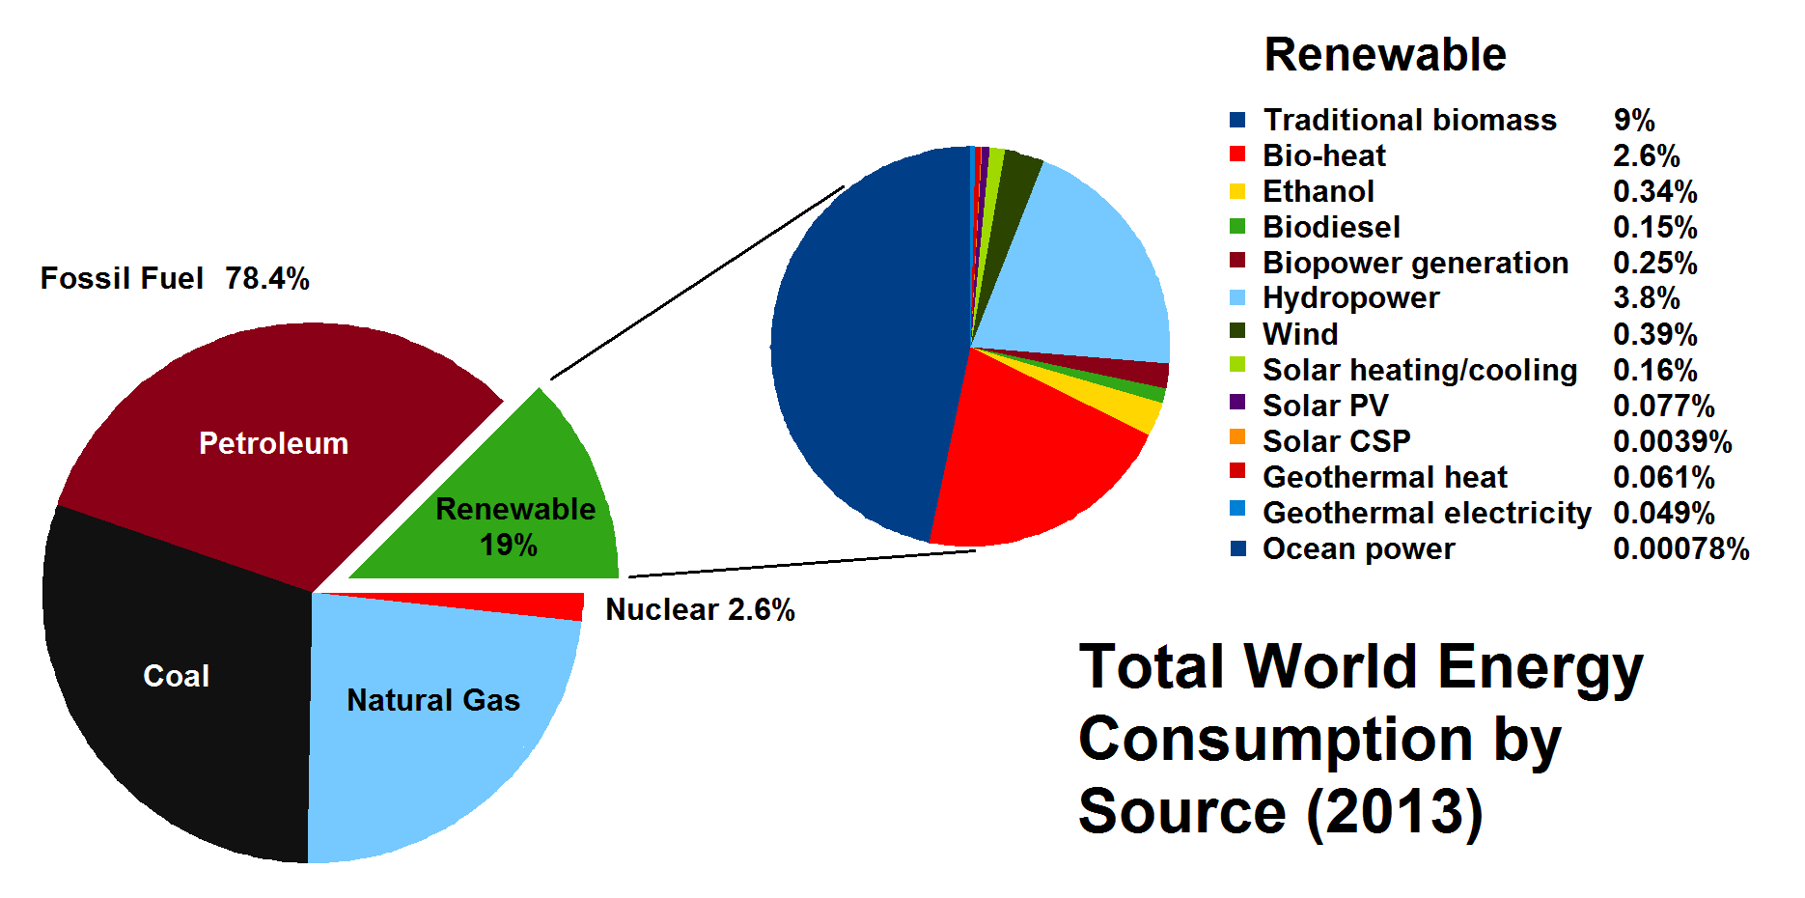
Where does energy come from?
World energy consumption by source as reported in 2013.
While the use of fossil fuels is still predominant, by 2013 there was an increase in the use of renewable sources of energy. Most renewable energy comes from biomass.
Source: REN21 Renewables 2014 Global Status Report.

Slide 12
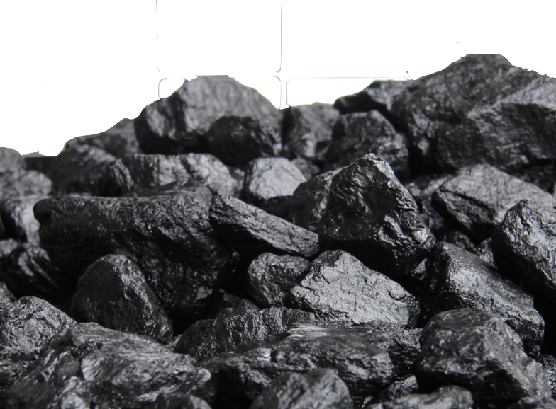
CO₂ emissions from energy sources
Energy Source | g CO₂ per kWh | g CO₂ per kJ
Wind | 10 | 0.0028
Hydroelectric | 10 | 0.0028
Biogas | 11 | 0.0031
Biomass (wood, steam turbine) | 22 | 0.0061
Solar PV | 32 | 0.0089
Geothermal | 38 | 0.0106
Nuclear | 66 | 0.0183
Natural gas | 443 | 0.1231
Diesel | 778 | 0.2161
Heavy oil | 778 | 0.2161
Coal | 1050 | 0.2917
Sovacool, Energy Policy 36 (2008) 2940

Slide 13
The Egyptian context
CHEM 512: Heterogeneous catalysis
renewables
hydro-electric
Energy consumption by source
coal
Energy production capacity
Total capacity – 39 GW
Hydroelectric – 2.8 GW
Wind – 0.75 GW
Solar – 0.03 GW
Nuclear - none
natural
gas
oil
2016 data
Source: EIA
https://www.eia.gov/beta/international/analysis_includes/countries_long/Egypt/egypt.pdf

Slide 14
The Egyptian context
CHEM 512: Heterogeneous catalysis
Energy consumption by year – doubling every 18 years
Mtoe
Source: https://energypedia.info/wiki/Egypt_Energy_Situation
Notes:
million tonnes of oil equivalents

Slide 15
The Egyptian context
CHEM 512: Heterogeneous catalysis
Reserves
  Oil reserves ~4 billion barrels (net exporter)
  Natural gas reserves ~70 trillion cu ft (net importer)
  Enormous wind power potential
  Enormous solar power potential
Source: Wikipedia

Slide 16
How are petroleum products made?
By using a fractionation column.
By oxidation (typically by a powerful oxidizing agent like chloride) and adding numerous additives.

Slide 17
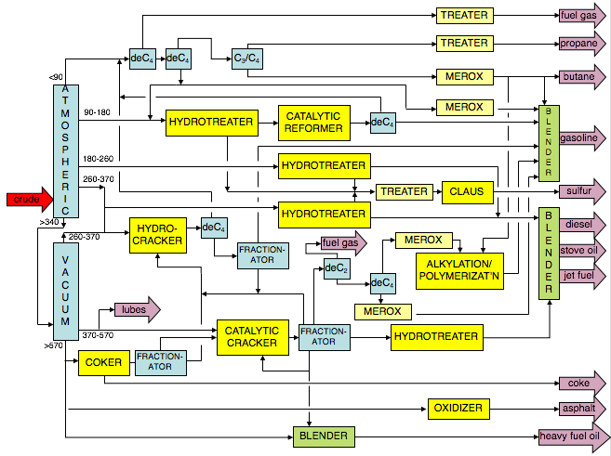
How are petroleum products made?

Slide 18

What about energy from renewable resources?

Slide 19
Renewable feedstocks
Renewable feedstocks include the following materials:
Biomass (algae, corn, switchgrass, poplar, willow, sorghum, and bamboo)
Agricultural waste (ex. manure)
Urban waste (garbage, sewage)
CO₂
Source: Adobe Stock
Notes:
Switchgrass – perennial, warm season bunchgrass
Poplar, Willow, Sorghum – types of plants & shrubs found in northern hemisphere

Slide 20
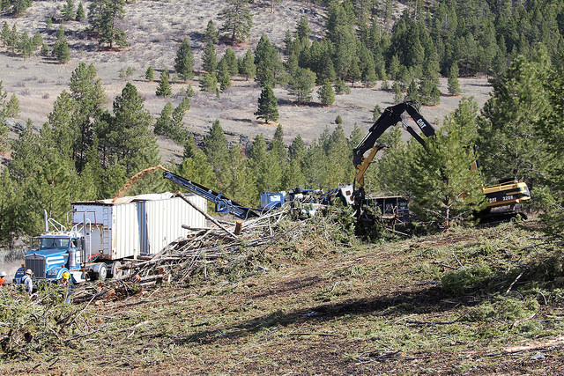
Environmental Consequences
At first glance, we might think that biofuels are inherently environmentally friendly, but is this true?
That depends on how the biofuels are produced.
Image: Flickr, Tribal Biofuel, Author: U.S. Department of Agriculture

Slide 21
Environmental Issues
Bioenergy can have positive impacts:
• Green house gas reduction (through fossil-fuel substitution).
• More agrobiodiversity, soil carbon increase, less erosion.
But these impacts can also be negative:
• Greenhouse gas from cultivation, soil carbon, life-cycle, direct and indirect land-use changes.
• Loss of biodiversity from land-use changes, water use, agrochemicals, erosion.
Competition with food
Notes:
Cattle Belching and addtion of fertilizers & pesticides to soil produces Methane & Nitrous Oxide respectively.

Slide 22
Types of Biofuel
First Generation Biofuels
Oils for diesel
Grains are used to produce ethanol
Food versus fuel
Second Generation Biofuels
Using agricultural wastes ←→ lignocellulosics
Lignocellulosics from agrowaste
Grasses
These crops were not domesticated for use as biofuels
Third Generation Biofuels (looking to the future)
Algae

Slide 23
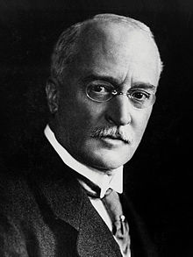

Biodiesel
The first Diesel engine was exhibited to function with vegetable oil
In 1900 a small Diesel engine was exhibited by the Otto company which, on the suggestion of the French Government, was run on Arachide oil, and operated so well that very few people were aware of the fact. The motor was built for ordinary oils, and without any modification was run on vegetable oil. Rudolf Diesel
Rudolf Diesel
Chalkley, Alfred Philip (1912), Diesel engines for land and marine work (2nd ed.), New York, New York, USA: D. Van Nostrand, p. 3

Slide 24
Biodiesel
Biodiesel refers to vegetable oil or animal fat-based diesel fuel consisting of long-chain esters. The main component of vegetable oil is triglycerides, which require transesterification prior to usage as a fuel. Transesterification is essential to get a good fuel.
BIODIESEL

Slide 25
Advantages of Biodiesel
40% reduction in global warming potential compared to conventional diesel
8% reduction in sulfur oxides. The release of sulfur oxides can lead to acid rain.
3% reduction in methane.
32% reduction in particulate matter (PM10 68%).
83.6% reduction in particulate matter soot.
79% reduction in wastewater.
96% reduction in hazardous waste, but double the non-hazardous waste.
By using spent oil, diesel can be turned from a first to second generation fuel
Compared to conventional diesel processing, biodiesel requires additional processing and has a lower overall energy return. Energy return is one of the important parameters that enables engineers to evaluate the efficiency and viability of a process. Energy return describes the amount one can gain from the production verses the amount of energy input. Biodiesel lags far behind conventional diesel processing in this regard.
Source: National Biodiesel Board,” Lifecycle Summary,” available at http://www.nbb.org/pdf_files/fuelfactsheets/LifeCycle_Summary.PDF
Notes:
Source: National Biodiesel Board,” Lifecycle Summary,” available at http://www.nbb.org/pdf_files/fuelfactsheets/LifeCycle_Summary.PDF

Slide 26
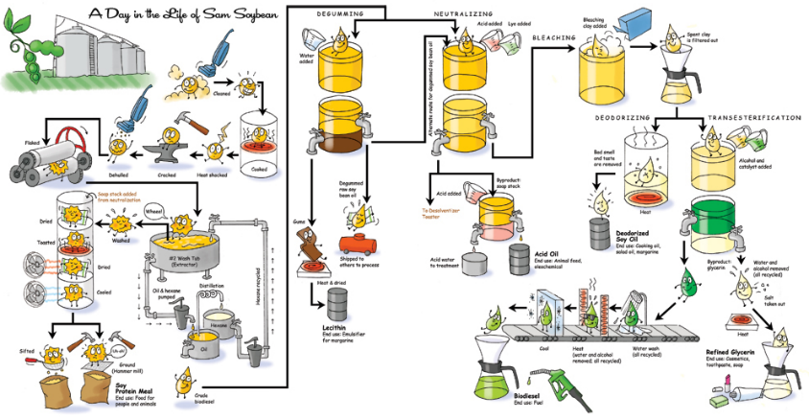
Steps Required to Produce Biofuel from Soybeans
Retrieved: nancymeyersdesign.com

Slide 27
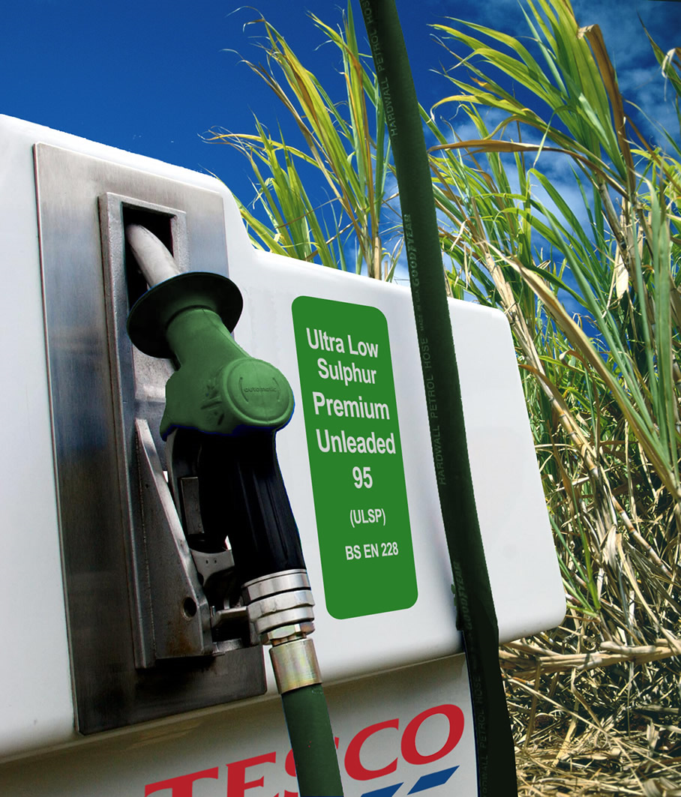
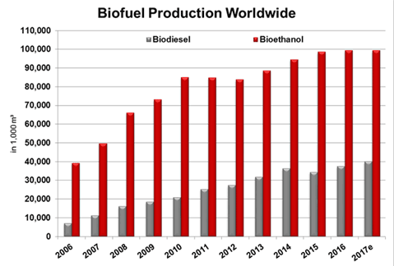
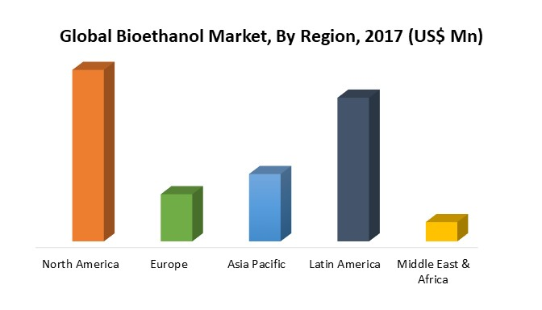
First Generation bioethanol
This biofuel can be generated from:
  Corn -> Starch
  Sugar cane -> Sugar
  Lignocellulosic materials (waste or grasses) -> Cellulose
http://www.cropenergies.com/en/Bioethanol/Markt/Dynamisches_Wachstum/
https://marketresearch.biz/report/bioethanol-market/

Slide 28
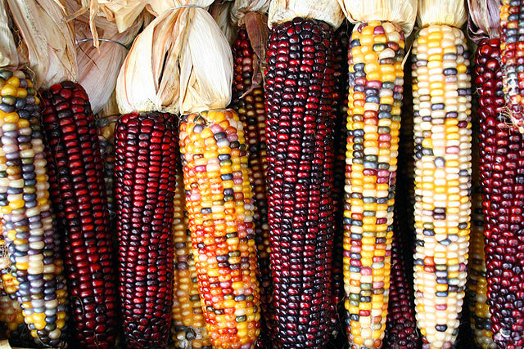
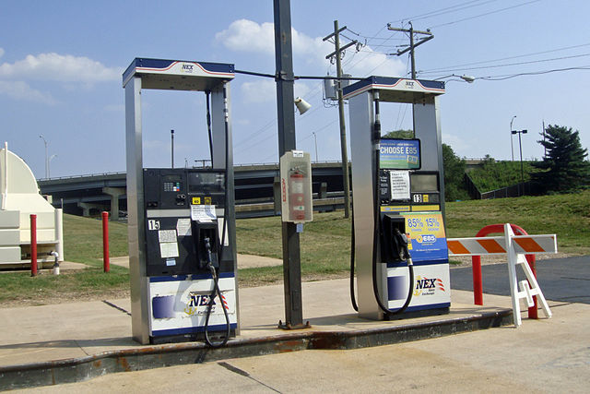
Bioethanol from Corn
Grind up the feedstock so it can be easily and quickly processed.
Sugar is dissolved out of the material.
The sugar is fed to microbes that use it for food, producing ethanol and carbon dioxide in the process.
Purify the ethanol to desired concentration.
Images: Wikipedia Commons, Corncobs, Author: Sam Fentress; Wikimedia Commons, Biofuel Pumps, Author: Mario Roberto Duran Ortiz
Notes:
Source: Department of Energy, Alternative Fuels Data Center, “How is Ethanol Made?”, available at http://www.eere.energy.gov/afdc/altfuel/eth_made.html

Slide 29
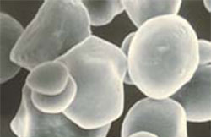
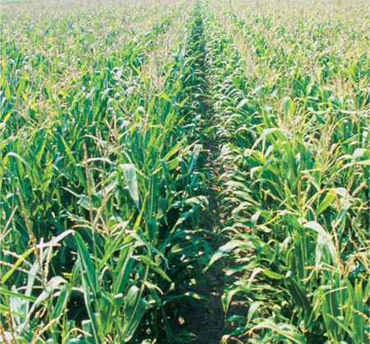
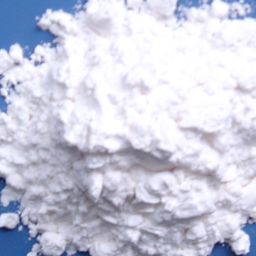
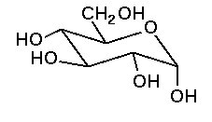
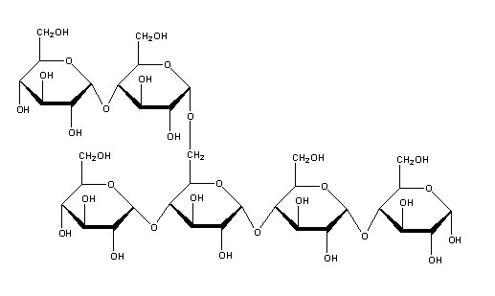
Bioethanol: the US case – from Corn
  Ethanol is produced from cornstarch
  Cornstarch need to be converted into glucose by enzymes: the process is less efficient
Sugar
Cornstarch
Ethanol

Slide 30
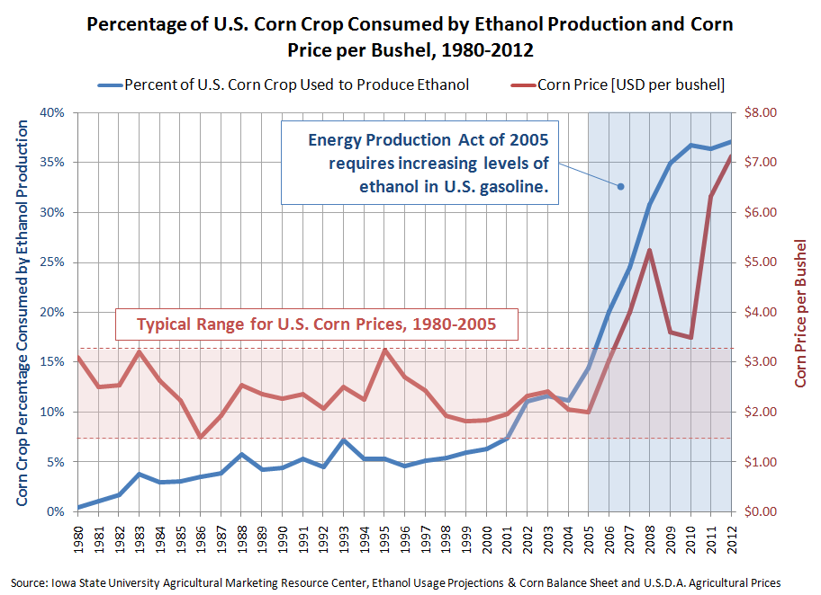
Bioethanol: the US case – from Corn
  To provide energy for the USA, the surface necessary to plant with corn is… the whole surface of the USA.
  Bioethanol from corn is controversial: scientists (Pimentel and others) claim that bioethanol from corn costs more energy to produce than the energy it delivers… Is it really worth then?
  In 2004/5, George Bush launched a program dedicated to bioethanol from corn.

Slide 31
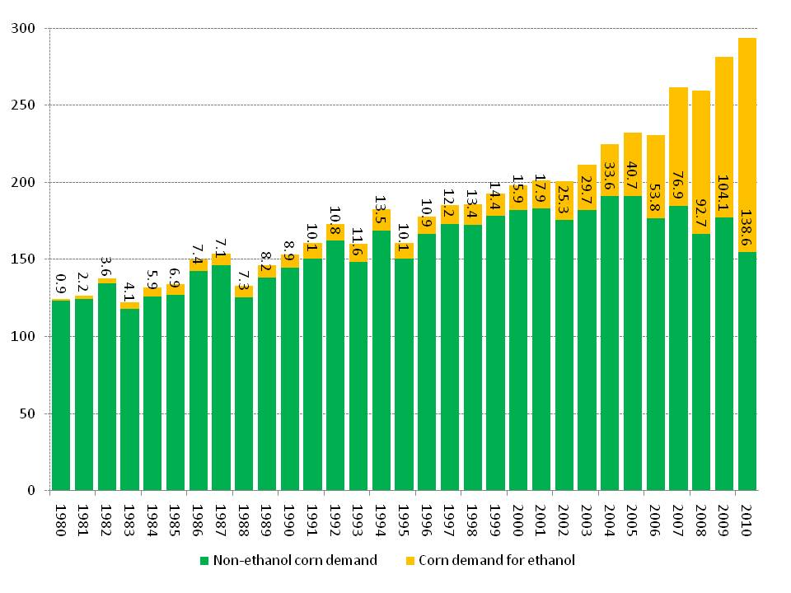
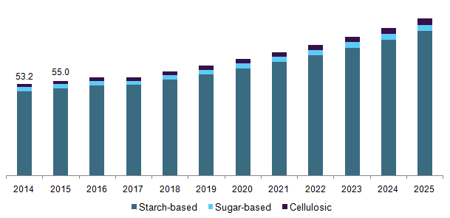
Bioethanol: the US case – from Corn
Bioethanol pushed the demand for U.S. corn
Million tonnes/year
Fuel Ethanol Market Analysis 2018 – 2025, Grand view research 2017.

Slide 32
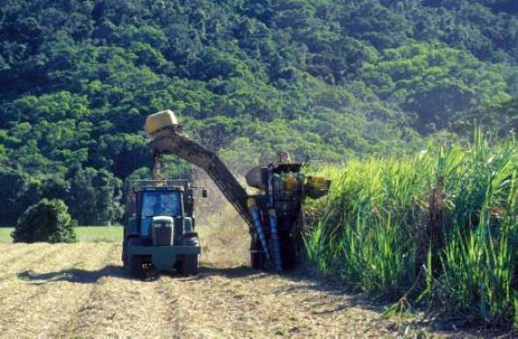
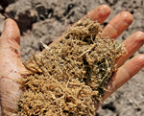
Bioethanol: the Brazilian case - from sugar
  Canes are crushed -> sugar juice
  For ethanol the sugar juice is diluted into 20% solution and fermented (yeast) for 8 hours: 6-10% ethanol solution. The yeast is removed and either recycled or dried and used as animal feed.
  The fibrous material left from the crusher is then used and burnt to provide electricity.
  From that 95 or 100% ethanol can be obtained by distillation (or membrane-filtration).
  For sugar production. the syrup can be filtered, condensed and sugar is recrystallized.
Fibrous remains of processed sugarcane, called bagasse, are burned in Brazil to generate electricity
Images: Wikipedia

Slide 33
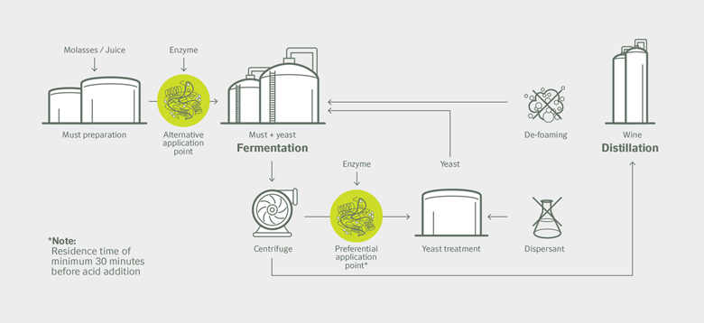
Bioethanol: the Brazilian case - from sugar
  A fermentation process
    In the example below, Nozoyme introduces a new enzyme able to prevent foaming (no more surfactant use)
https://www.novozymes.com/en/news/news-archive/2016/11/launch-of-worlds-first-biological-foam-control-for-sugarcane-ethanol

Slide 34


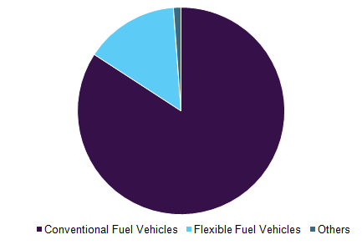
Bioethanol: the Brazilian case - from sugar
Ethanol can be used directly as a liquid fuel:
  Either mixed with normal gasoline: a blend can have up to 25% of ethanol (US)
  Another strategy is to use 100% ethanol: it requires a special engine: 12.6% of transportation energy is made up with ethanol in Brazil (flex fuel technology)
  reduced CO₂ emissions by more than 350 million tons since the introduction of flex-fuel vehicles (any combination of ethanol & gasoline), 26 million such vehicles
Global fuel ethanol market volume by application, 2016 (%)
Petrobras gas station at São Paulo with dual fuel service, marked A for alcohol (ethanol) and G for gasoline
Source: Wikipedia, Ethanol fuel in Brazil - Fuel Ethanol Market Analysis 2018 – 2025, Grand view research 2017.

Slide 35
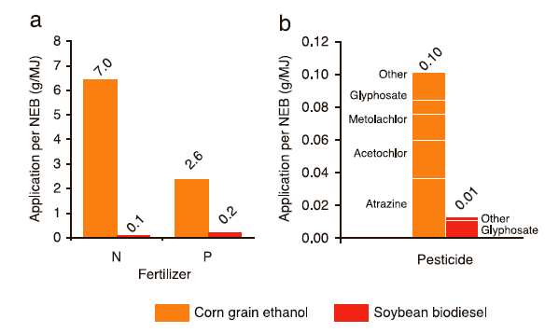
Environmental Consequences per Unit Energy
Comparing corn bioethanol and biodiesel
Greenhouse Gas Emissions per Unit Energy
Soybean biodiesel needs less fertilizer and pesticide than corn ethanol.
Soybean biodiesel produces significantly less greenhouse gas.
Data of Lee et al. and Muir et al, collated in Gressel“Genetic Glass Ceilings, Hopkins, 2007
Notes:
NEB = net energy balance

Slide 36
Food verses Biofuel: The Math
To fill up an average 25 gallon SUV gas tank with ethanol requires the same amount of grain as it takes to feed 1 person for 1 year.
The average person in the U.S. uses 500 gallons of gasoline per year.
The average person in the U.S. uses enough gasoline to feed 20 people for one year.
There are 300 million people in the U.S. – if each person was using enough food to feed 20 people to run their cars, that alone would require enough grain to feed 6 billion people.
Notes:
Source: Sharon Astyk, “Ethics of Biofuels” Energy Bulletin (Dec. 28 2006), available at http://www.energybulletin.net/24169.html

Slide 37
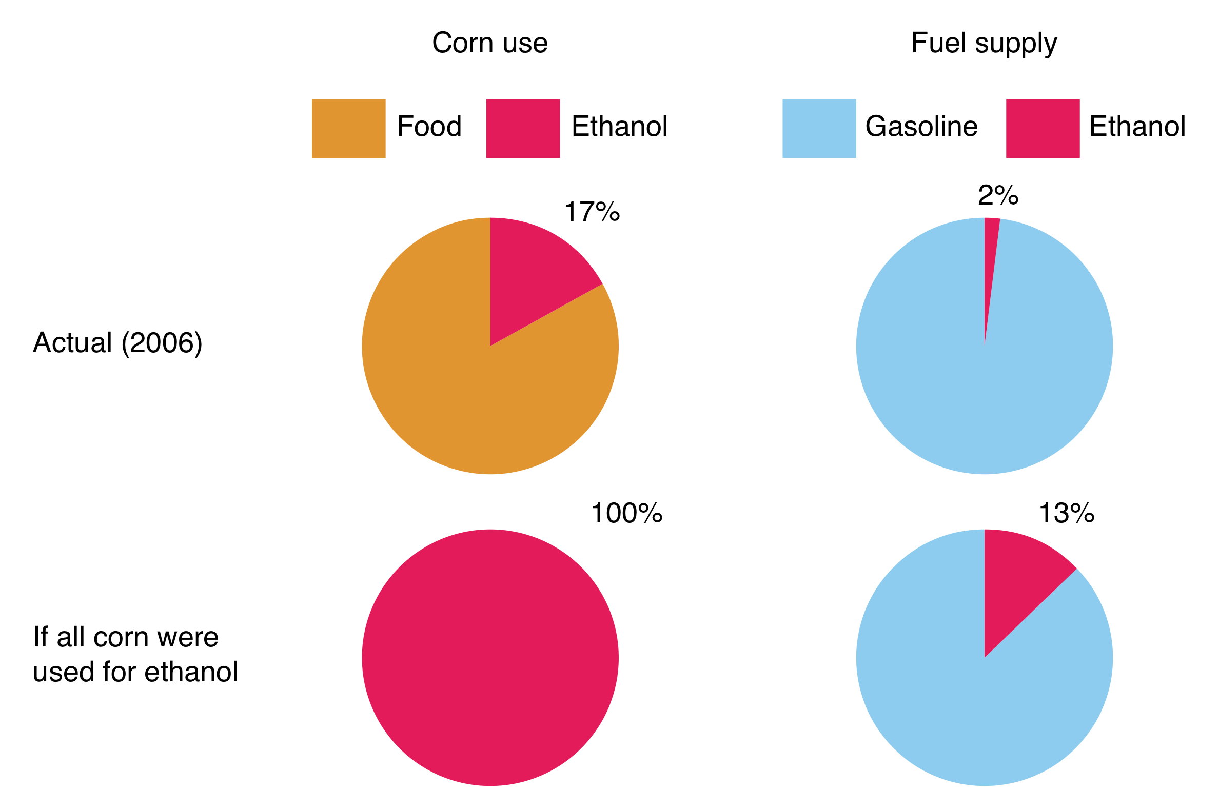
Ethanol Supply: The Effect on Corn Supply and on Gasoline Supply

Slide 38
Types of Biofuel
First Generation Biofuels
Oils for diesel
Grains are used to produce ethanol
Food versus fuel
Second Generation Biofuels
Using agricultural wastes ←→ lignocellulosics
Lignocellulosics from agrowaste
Grasses
These crops were not domesticated for use as biofuels
Third Generation Biofuels (looking to the future)
Algae

Slide 39
Second Generation Biofuels
  To qualify as second generation, a feedstock must not be suitable for human consumption and meet the following criteria:
    Should grow on marginal (non-agricultural) land.
    Should not require large amounts of water or fertilizer.
    Certain food products can become second generation fuels when they are no longer useful for consumption:
        Waste vegetable oil (2nd generation feedstock).
        Virgin vegetable oil (1st generation feedstock).

Slide 40
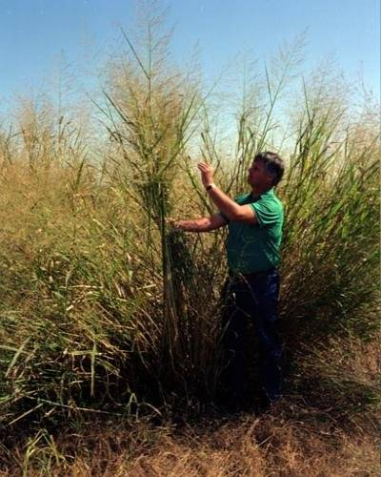
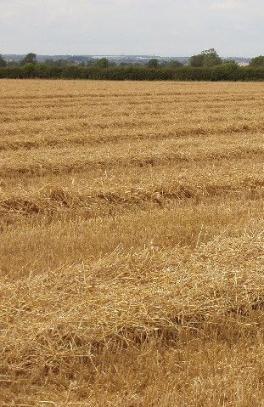
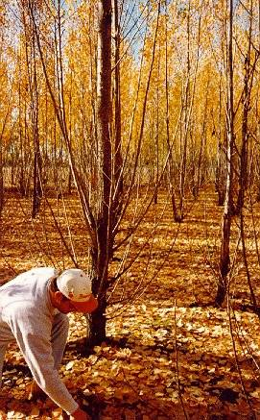
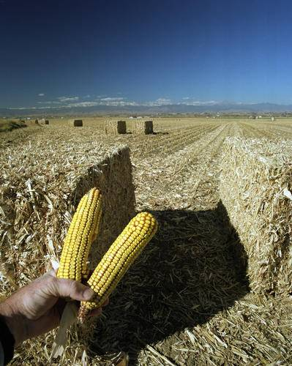
Second Generation Biofuels: Cellulosic Feedstock
Switchgrass
Wheat Straw
Hybrid Poplar
Corn Stalks
Image, Wikimedia Commons, Author: David Hawgood

Slide 41
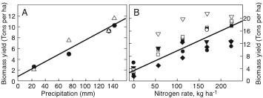
Switchgrass as a Feedstock
Switchgrass still needs water and fertilizer to grow.
Nutrients needed:
corn versus switchgrass.
Water
Nitrogen fertilizer
kg ha⁻¹ yr⁻¹ | Corn | Switchgrass
N | 148 | 0
P | 23 | 4
K | 50 | 6
Data of Lee et al. and Muir et al, collated in Gressel,
“Genetic Glass Ceilings, Hopkins, 2007

Slide 42
Types of Biofuel
First Generation Biofuels
Oils for diesel
Grains are used to produce ethanol
Food versus fuel
Second Generation Biofuels
Using agricultural wastes ←→ lignocellulosics
Lignocellulosics from agrowaste
Grasses
These crops were not domesticated for use as biofuels
Third Generation Biofuels (looking to the future)
Algae

Slide 43
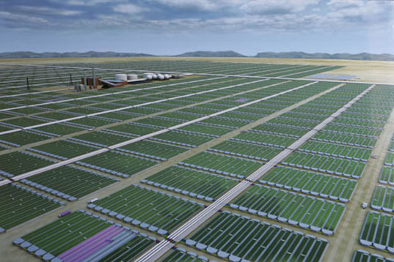
Third Generation Biofuels: Algae Feedstock
Image: Wikipedia

Slide 44
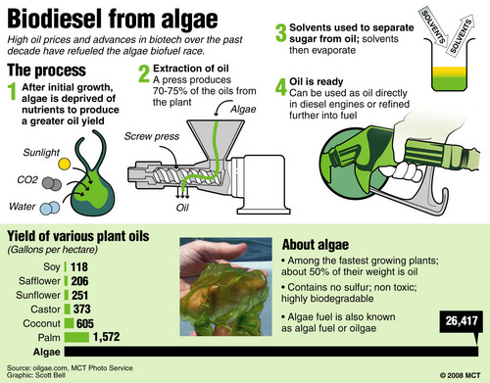
Biodiesel from algae
“It has more oil per pound than corn and soybeans, does not divert crops from the food supply and can potentially be grown in sewage water and seawater without impacting the freshwater supply.” J. Zimmerman
http://www.csa.com/discoveryguides/biofuel/review7.php

Slide 45
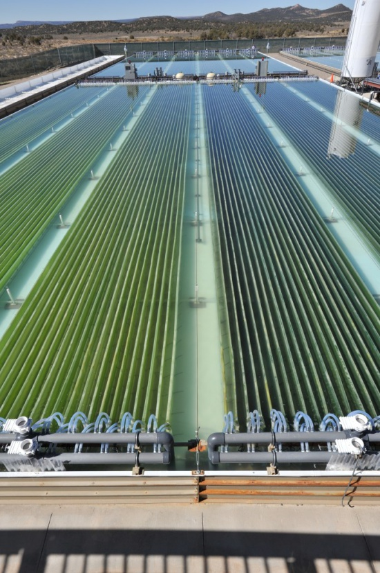
Biodiesel from algae
Adaptable to large scale
  On a larger scale, Solix has built a pilot-scale demonstration facility with three-quarters of an acre of photosynthetic area forecasted to generate 1,500–2,000 gallons/year of biocrude, or an estimated several tons of biomass per year if the solids are included (2011)
  Note: Solix today seems focused on the specialty nutrition products from algea
“The ideal location is in a dry, sunny, flat desert, with a carbon dioxide source such as a coal-fired power plant and a significant wastewater source"Bryan McCarty, Solix Biofuels' vice president of engineering
https://www.asme.org/engineering-topics/articles/bioengineering/scaling-algae-growth-for-biofuels

Slide 46
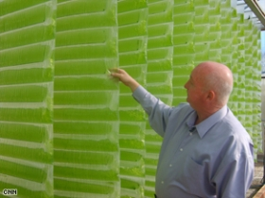
Is Algae “Green Gold”?
Currently being developed.
30 times more oil per acre than current crops that are being used.
No sulfur.
Non-toxic
Highly biodegradable,
Not subject to a commodity risk like crude oil, corn, and soybeans are.
Notes:
Source: EcoFriend Article, “Algae BioFuels: PetroSun’s Subsidiary to Develop Bio-diesel Form Algae” India (2006), available at http://www.ecofriend.org/entry/algae-biofuels-petrosuns-subsidiary-to-develop-bio-diesel-form-algae/

Slide 47
Pros
Algae: The Pros and Cons
Cons
Versatility in growth methods
Versatility in uses
Speed of production
Potential for huge production levels
CO₂ consumption
Cleans up wastewater
Energy intensive
Not competitive against foreign oil (yet)
Needs funding
Technology not ready (yet)

Slide 48
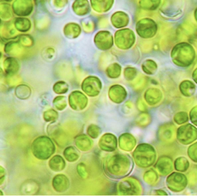
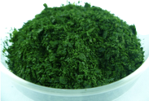
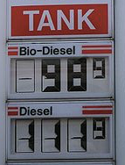
Cultivation
Dewatering
Cell Disruption
Drying
Lipid Extraction
Transesterification
Purification and
solvent removal

Slide 49
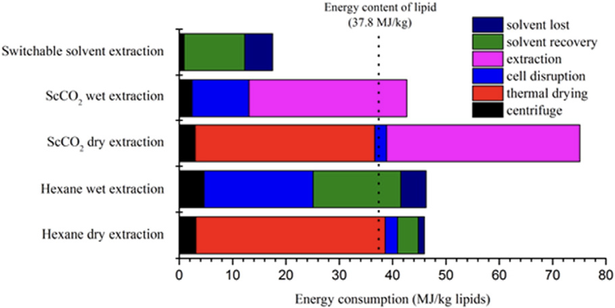
Algae: The Pros and Cons
Du et al. Algal Res. (2015) 11, 271

Slide 50
How to Overcome the Technical Roadblocks to Low-Cost Advanced Biofuel Production
Make all of the components of biomass available for biofuel and co-product production:
Use the appropriate parts of specific plants.
Improve the efficiency of biomass to biofuel conversion:
Do it faster, cheaper, and sustainably.
Minimize the cost of biomass transportation.
Move more for less.

Slide 51
Biofuels as an Alternative
Biofuels are not THE answer to sustainable energy, but biofuels may be part of the answer.
Biofuels may offer environmental and economic advantages over fossil fuels, but the magnitude of these advantages depends on how a biofuel crop is grown and converted into a usable fuel.

Slide 52
Topics Covered
Where does things come from
Fossil carbon
  Gas
  Oil
  Coal
First, Second, and Third Generation Feedstocks
  Bioethanol
  Ethanol from cellulose
  Biodiesel
  Biofuel from algae
The Advantages and Drawbacks of Biofuel

Slide 53
Sponsored by Yale-UNIDO Initiative
QUESTIONS?
CENTER for GREEN CHEMISTRY
and GREEN ENGINEERING at YALE

