Slide 1
Renewable Feedstocks
Lecture #11
Date
Course #

Slide 2
Outline
What is a Feedstock?
  Renewable vs. Depleting
  Current feedstock consumption
Types of Renewable Feedstocks
  CO₂
  Biomass
  Agricultural
Industrial Applications
Challenges and Opportunities

Slide 3
Outline
What is a Feedstock?
  Renewable vs. Depleting
  Current feedstock consumption
Types of Renewable Feedstocks
  CO₂
  Biomass
  Agricultural
Industrial Applications
Challenges and Opportunities

Slide 4
Video
https://www.youtube.com/watch?v=-g-7DIXccpM

Slide 5
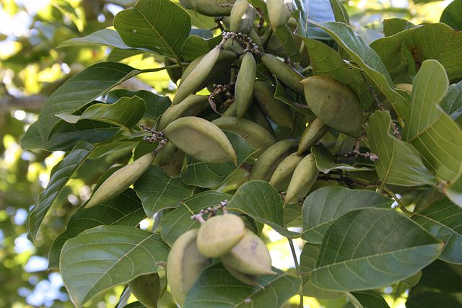
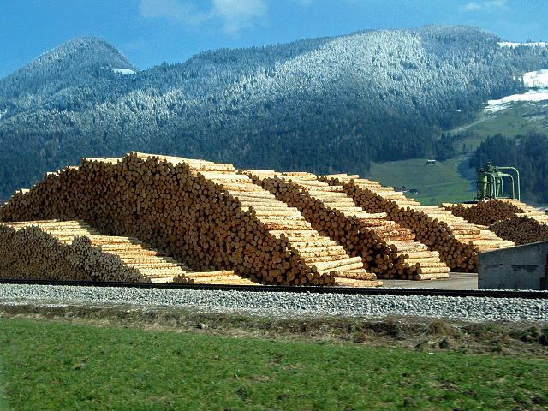
Use of Renewable Feedstocks
A raw material or feedstock should be renewable rather than depleting whenever technically and economically practical.
Image: Wikipedia, Pongamia Pinnata Seeds

Slide 6

Green Chemistry Pillars
More environmentally
benign than alternatives
Perform better than
available alternatives
More Economical than
available alternatives

Slide 7
Green Chemistry Pillars
Green Chemistry
More environmentally
benign than alternatives
Perform better than
available alternatives
More Economical than
available alternatives

Slide 8
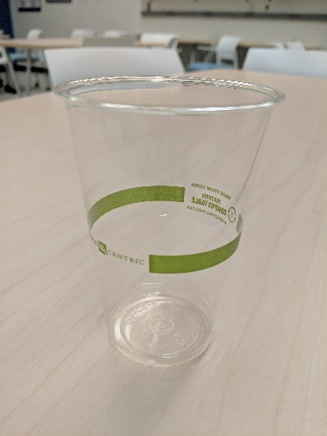

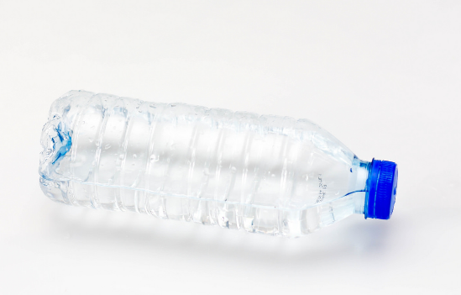
What is a Feedstock?
PLA Plastic
PET Plastic
Paper (not recycled)
Image Source: Flickr, Pixabay
Notes:
Image Source: https://www.flickr.com/photos/30478819@N08/23973212068
https://pixabay.com/en/paper-blank-white-empty-page-2221812/
PLA plastic cup picture from Beyond Benign

Slide 9

What is a Feedstock?
PET Plastic
Image Source: Flickr
Notes:
Image Source: https://www.flickr.com/photos/30478819@N08/23973212068

Slide 10
What is a Feedstock?
PET Plastic
Image Source: Flickr
Notes:
Image Source: https://www.flickr.com/photos/30478819@N08/23973212068

Slide 11
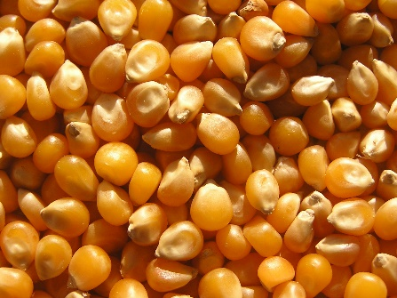
What is a Feedstock?
CORN
PLA Plastic
Image Source: Wikipedia Commons, and Beyond Benign
Notes:
Image Source: https://commons.wikimedia.org/wiki/File:Ab_food_06.jpg
Image Source: PLA cup picture from Beyond Benign

Slide 12
Renewable vs. Depleting
Feedstock: raw material to supply or fuel a machine or industrial process
Renewable or Depleting: A question of Time!
A renewable resource is determined to be renewable if it can be replenished in a relevant amount of time.
Fossil fuels are depleting because they cannot be replenished in a practical timeframe from vegetation.

Slide 13
Green Chemistry Principle #. 7
A raw material feedstock should be renewable rather than depleting whenever technically and economically practical.

Slide 14
Outline
What is a Feedstocks?
  Renewable vs. Depleting
  Current feedstock consumption
Types of Renewable Feedstocks
  CO₂
  Biomass
  Agricultural
Industrial Applications
Challenges and Opportunities

Slide 15
Renewable Feedstocks
CO₂
Biomass (Lignin, algae, corn, switchgrass, poplar, willow, sorghum, and bamboo)
Agricultural waste (ex. Manure)
Adobe Stock Images

Slide 16
Why is CO₂ Renewable as a feedstock??
Net contribution of GHG to atmosphere
CO₂
Feedstock production
Harvesting feedstock production
Biofuel production
Fuel distribution
Combustion
= Product end of life
(Biodegradation or Burning)
CO₂ cycle for bioethanol
Product Distribution
Product Synthesis
Source: fabricadecarne.ro
Image: adapted from: http://manuenvironment.blogspot.com/2010/09/what-is-environment.html
Notes:
Cycle adapted from Source: http://manuenvironment.blogspot.com/2010/09/what-is-environment.html
Note that the net contribution of GHG to the atmosphere is likely positive since energy is needed in all of the steps of this cycle.

Slide 17
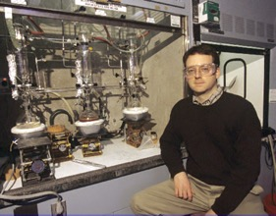
Using CO₂ as a feedstock: Prof. Geoffrey W. Coates
Development of catalysts able to incorporate carbon monoxide and dioxide
into polymers
Utilize renewable sources of carbon mon-
oxide and dioxide gases such as biomass
(agricultural waste) and other low-cost
sources such as coal or industrial waste
High turnover numbers, frequencies, and
selectivities
Polycarbonate coatings manufactured with these catalysts have the potential to sequester or avoid up to 180 million metric tons of CO₂ emissions
Notes:
This was in the video

Slide 18
Biomass platforms
Only about 4% utilized by humans
(food, ethanol, sweeteners)
Building blocks for a diverse chemical platform
Nature’s richest source of aromatic carbon. Used in polymers, adhesives, production of phenolic chemicals.
Converted into polymers, lubricants, and detergents.

Slide 19
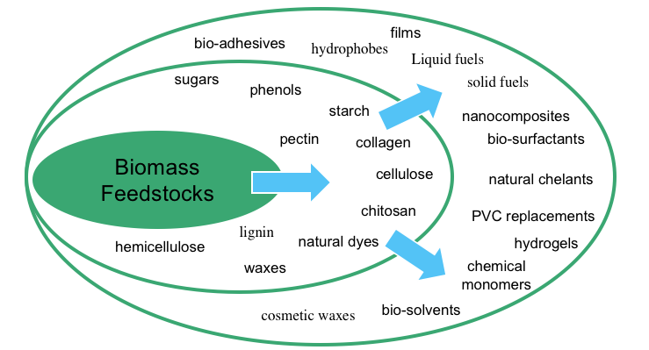
Biomass Platform
Specialty Chemicals
Commodity Chemicals
Consumer Chemicals

Slide 20
What is Valorization?
Biomass valorization is the process of reusing, recycling or composting waste materials and converting them into more useful products
examples: materials, chemicals, fuels or other sources of energy
Valorization as a “waste-to-energy” concept is becoming more prevalent due to the rapid depletion of natural resources and increase in waste generation.

Slide 21
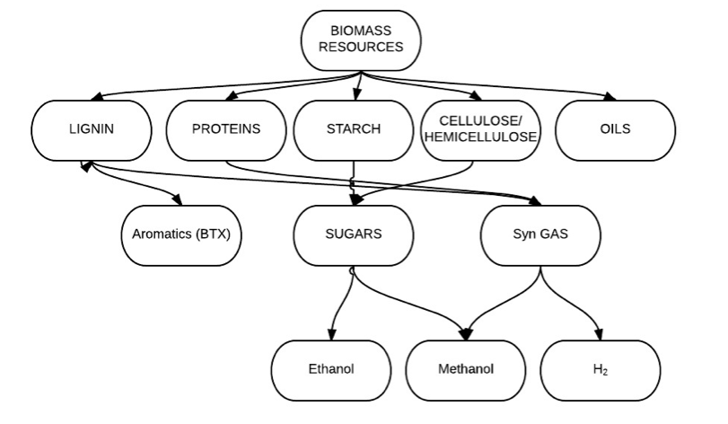
Biomass Valorization: Today
Image Source: PowerPoint from Yale University

Slide 22
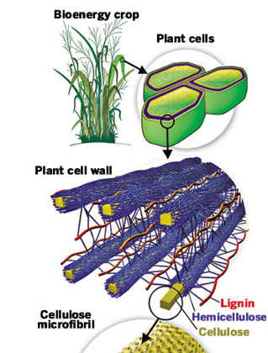
Lignocellulose Biomass
Images: Creative Commons
Notes:
Images: Creative Commons

Slide 23
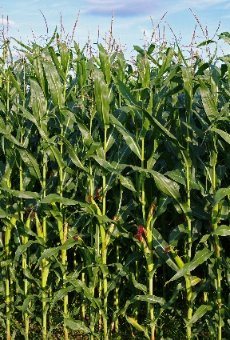
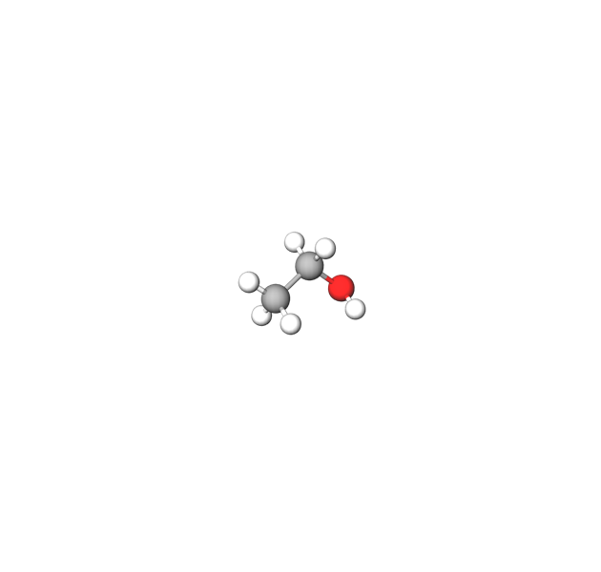
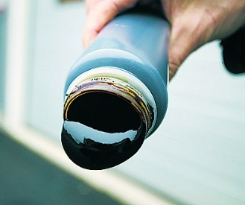
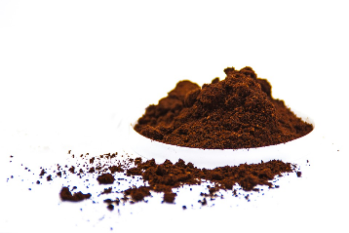

Main Industries for Lignocellulose
PAPER INDUSTRY
BIOETHANOL
INDUSTRY
Lignin powder
Burnt or Discarded
Bioethanol
Images: Creative Commons
Notes:
Images: https://pixabay.com/en/paper-stack-white-655112/
https://pixabay.com/en/coffee-powder-white-background-1173942/
https://commons.wikimedia.org/wiki/File:ZeaMays.jpg
https://upload.wikimedia.org/wikipedia/commons/7/76/Svartlut_76.jpg

Slide 24
Lignin – Very Abundant!
Lignin = 30% of all non-fossil Carbon on the planet
= 20-35% of wood by weight
= 300 billion tons bioavailability (+ 20 billion tons per year)
= 50 million tons extracted from pulp and paper industry
BUT…..
= 1.1 million tons utilized (~ 2%)
= 409 $/ton in 2006 → 660$/ton in 2013
= 730 million dollar market
= considered supply constrained
→ Most produced lignin not of a high enough purity to sell
Frost & Sullivan 2014

Slide 25
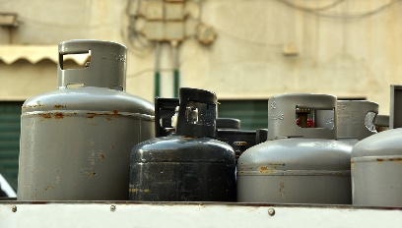



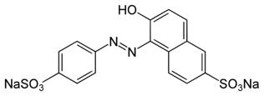
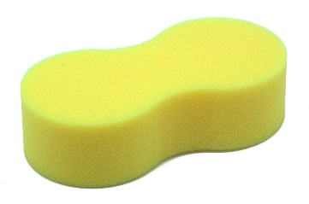
Petroleum Source Phenols
Petroleum
Nylon
Phenols
Polycarbonates
Pharmaceuticals
(Including
Salicylic Acid)
Yellow Dye #6
Polyurethane Foams
Images: Flickr, Wikipedia, Pixabay
Notes:
Images:
Images: https://www.flickr.com/photos/recyclethis/161604528
https://en.wikipedia.org/wiki/List_of_polyurethane_applications#/media/File:%C3%89ponge_type_4_(1).jpg
https://pixabay.com/en/pill-medicine-capsule-illness-pain-3264943/
https://fr.wikipedia.org/wiki/Fichier:CD_DVD_Collections.jpg
https://pixabay.com/en/gas-energy-gas-bottle-transport-3814281/

Slide 26
Lignin – Source of Renewable ‘Drop-in’
Platform Chemicals
Needs of New Methodology:
Economical
Sustainable
Selective
Efficient
Nylon
Polyurethane Foams
Pharmaceuticals
(Including
Salicylic Acid)
Images: Flickr, Wikipedia, Pixabay
Notes:
Images: https://www.flickr.com/photos/recyclethis/161604528
https://en.wikipedia.org/wiki/List_of_polyurethane_applications#/media/File:%C3%89ponge_type_4_(1).jpg
https://pixabay.com/en/pill-medicine-capsule-illness-pain-3264943/

Slide 27
Depolymerization Strategy
Addition of H₂ across bonds to cleave them: Hydrogenolysis!
Type of reaction? Atom Economy if 1 equivalent of H₂?

Slide 28
Major Challenges
Lignin – Structure is very complex, depends on plant material & isolation method
Difficult to obtain products selectively because of lignin complexity → purification difficult and costly
Lignin solubility (insoluble)
Lignin from pulp & paper industry deactivates most catalysts….

Slide 29
Food Waste Biomass
Our food supply chain (FSC) has recently been recognized as being inefficient, producing large and accumulative quantities of waste
Food waste biomass is rich in carbohydrates, sugars, and fibers.
Residues produced by our FSC contain valuable functionalized molecules such as flavonoids, waxes, biopolymers or fatty acids
The inherent and diverse chemical content of FSCW together with the drive to reduce our environmental footprint and our society’s concerns over the depletion of our fossil resources has led to 2nd generation FSCW valorization initiatives.
Image source: https://commons.wikimedia.org/wiki/File:GI_Market_food_waste.jpg
Notes:
Image source: https://commons.wikimedia.org/wiki/File:GI_Market_food_waste.jpg
Our society currently faces the twin challenges of resource depletion and waste accumulation leading to
rapidly escalating raw material costs and increasingly expensive and restrictive waste disposal legislation.
The variety of food processes used in the food and drink industry globally generate food supply chain
waste on a multi tonne scale every year. Such resides include wheat straw surpluses, spent coffee
grounds or citrus peels, all of which represent a resource for an integrated, product focused biorefinery.
Orange peel is particularly interesting: pectin and D-limonene, two marketable components, can be produced
together with several flavonoids under the same conditions at a litre scale using low temperature
microwave treatment. The running costs for such a process on large scale (50 000 metric tonnes per
annum) have been estimated on the basis of the combined production of pectin and D-limonene.

Slide 30
Food Waste Biomass
The Food and Agriculture Organization of the United Nations (FAO) estimated last year that up to a third of the food aimed for human consumption is wasted every year globally.
A large variety of food products and processing generates food waste streams on the magnitude of multi tonnes scale every year.
This creates the opportunity to add value to a waste stream that hasn’t been thoroughly researched.
Monetizing food supply chain waste could lead to a viable biomass alternative.
Image source: https://commons.wikimedia.org/wiki/File:GI_Market_food_waste.jpg
Notes:
Image source: https://commons.wikimedia.org/wiki/File:GI_Market_food_waste.jpg
Our society currently faces the twin challenges of resource depletion and waste accumulation leading to
rapidly escalating raw material costs and increasingly expensive and restrictive waste disposal legislation.
The variety of food processes used in the food and drink industry globally generate food supply chain
waste on a multi tonne scale every year. Such resides include wheat straw surpluses, spent coffee
grounds or citrus peels, all of which represent a resource for an integrated, product focused biorefinery.
Orange peel is particularly interesting: pectin and D-limonene, two marketable components, can be produced
together with several flavonoids under the same conditions at a litre scale using low temperature
microwave treatment. The running costs for such a process on large scale (50 000 metric tonnes per
annum) have been estimated on the basis of the combined production of pectin and D-limonene.

Slide 31
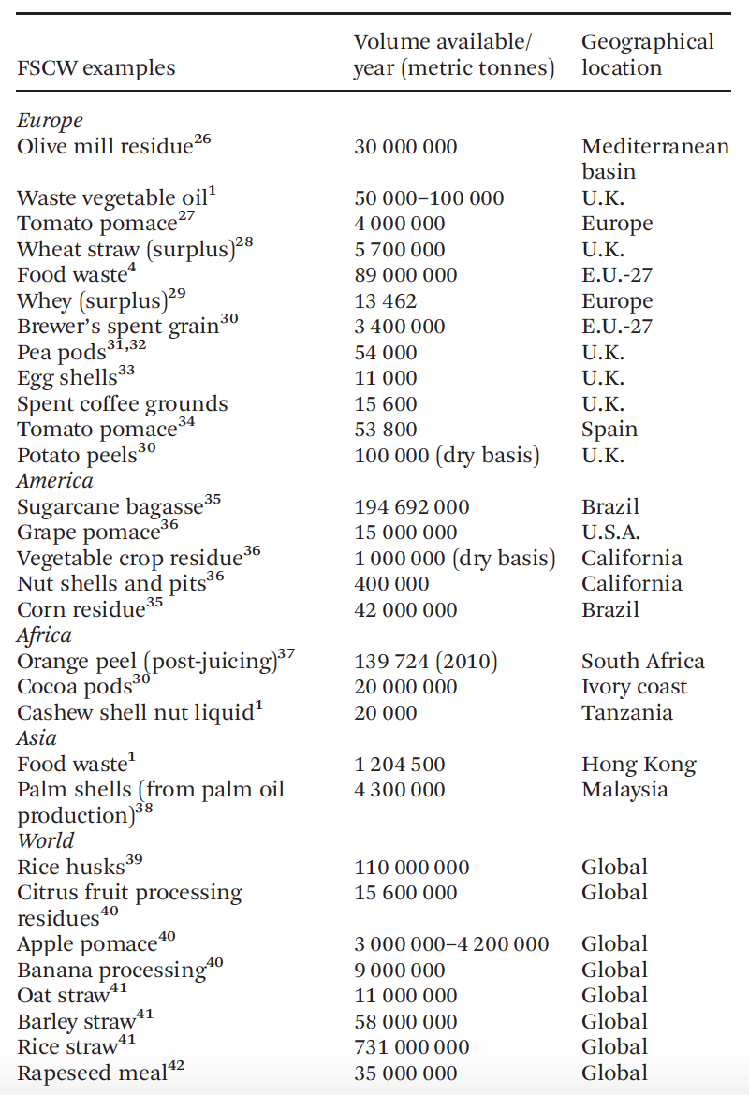
Food Waste Biomass Availability
The European Union alone produces each year just under 90 million tonnes of food waste
38% of which is directly produced by the food manufacturing sector
The Americas produces around 250 million tonnes of food waste. A large portion is due to Brazil’s large usage of sugarcane.
Globally, an estimated 973 million tonnes of waste is generated from various food supply chains
Green Chem., 2013, 15, 307
Notes:
Table Source: Image Source: Green Chem., 2013, 15, 307
Without aiming to report all available types of FSCW,
Table 1 lists examples of different pre-consumer types of agroindustrial
residues available around the globe. The intention
is to illustrate available volumes of this resource, showing how
non animal-derived waste issued from the production of processed
foods accumulates on a global scale in significant
quantities.

Slide 32
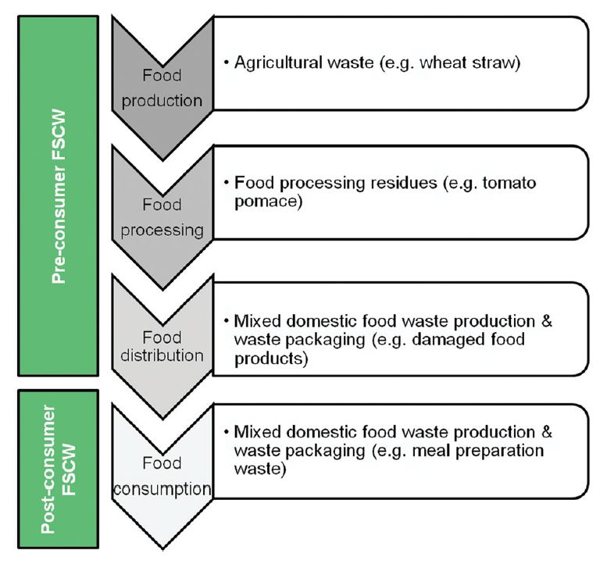
Food Waste Biomass
Simplified food waste chain highlighting the difference between pre and post-consumer FSCW.
Post-consumer waste is often times the most visible form on food waste biomass, especially as a daily consumer of products.
Post-consumer waste is very difficult to collect and separate due to it becoming a “mixed” waste stream.
Pre-consumer waste can be captured more effectively since it’s a single waste stream for production, processing, and distribution.
Image Source: Green Chem., 2013, 15, 307
Notes:
Image Source: Green Chem., 2013, 15, 307
Although post-consumer waste is often the most visible,
especially on a daily basis from the consumer’s perspective, it
is not only difficult to collect and segregate, but also challenging
to valorise given its heterogeneous composition. Preconsumer
waste is generated in a more concentrated manner,
especially when considering the ever increasing rate of global
food production and processing, ensuring as little
feedstock variability as possible when using pre-consumer
FSCW as a raw material.

Slide 33
Terpenes: Applications
Biosolvents
Bioplastics
Limonene
Notes:
Image Source: https://commons.wikimedia.org/wiki/File:Orange-Fruit-Pieces.jpg
https://www.youtube.com/watch?v=1DK1CVfSQgU

Slide 34
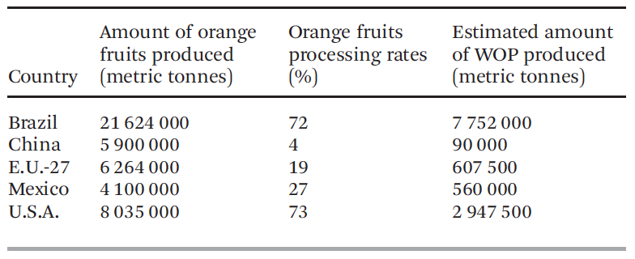
Terpenes: Global Availability
Image Source: Wikipedia Commons
Notes:
Image Source: https://commons.wikimedia.org/wiki/File:Orange-Fruit-Pieces.jpg
https://www.youtube.com/watch?v=1DK1CVfSQgU

Slide 35
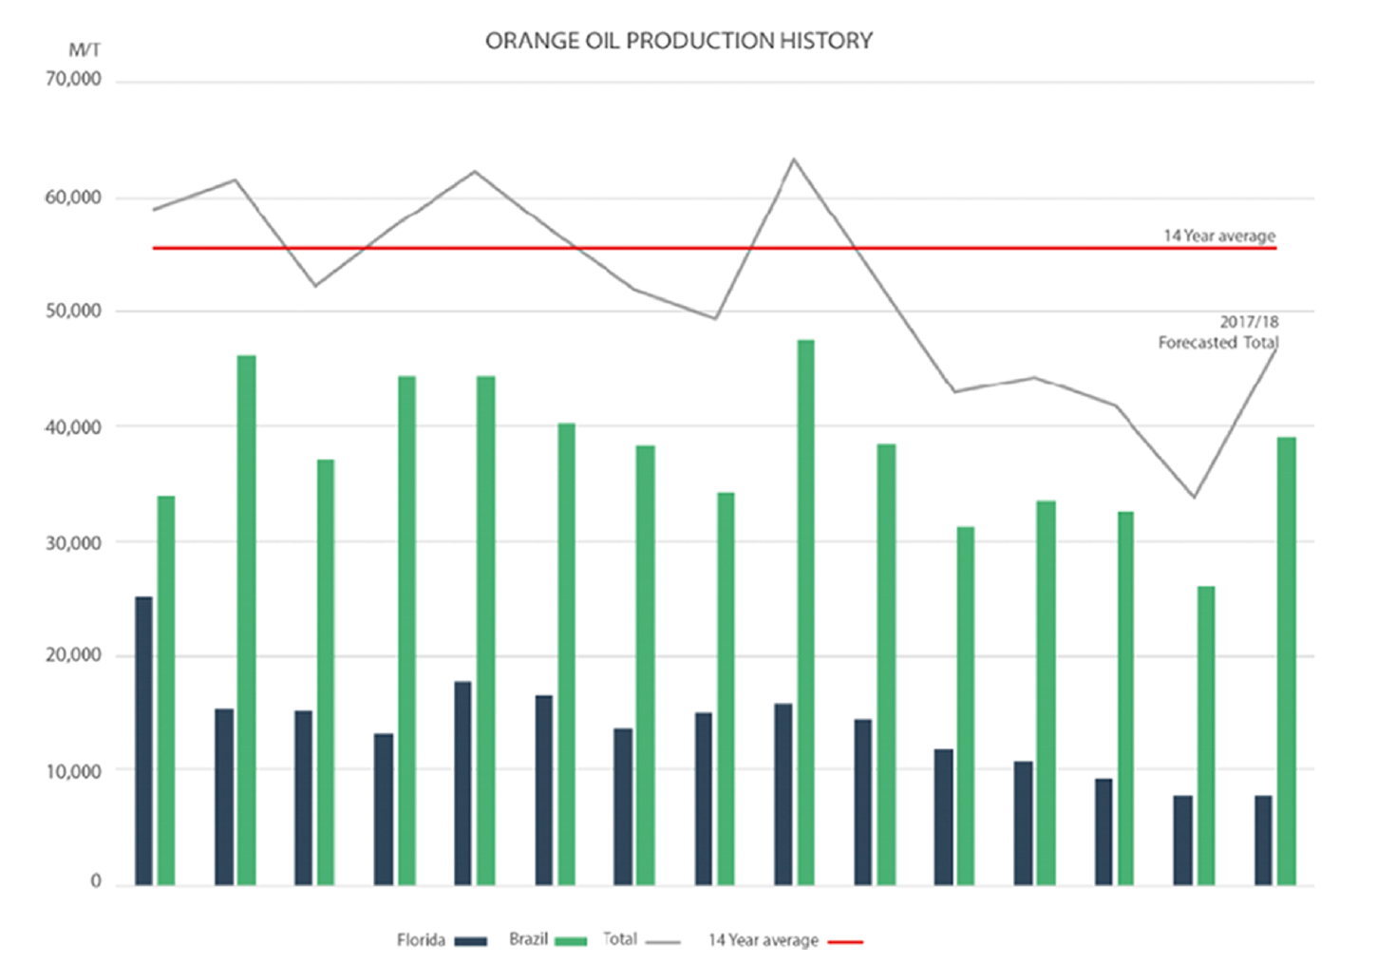
Terpenes: Global Availability
Notes:
Source: Ultra International B.V. Market ReportBrazilian Orange
Summer 2017, Spikkenisse (NL), 2017. http://ultranl.com/market/
brazilian-orange-oil-update-summer-2017/

Slide 36
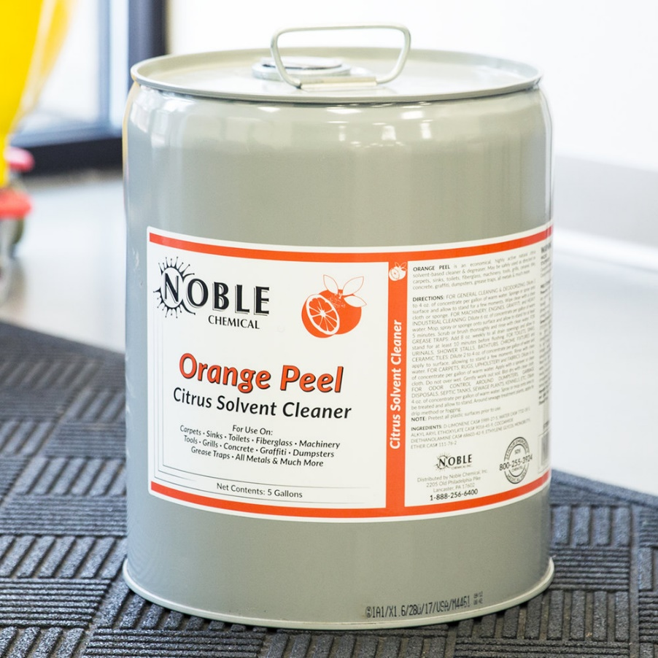
Limonene: Biosolvent and Degreaser
Degreasers typically contain high volatile organic compounds in the formulation. Leading to high flash times and limiting the application times.
Limonene as an active degreaser is an environmentally friendly alternative with comparable performance. Not to mention better smell.
Commercially available
Notes:
Image Source: https://www.webstaurantstore.com/noble-chemical-5-gallon-640-oz-orange-peel-citrus-solvent-cleaner/147ORANGPL5G.html?utm_source=Google&utm_medium=cpc&utm_campaign=GoogleShopping&gclid=EAIaIQobChMI4ZLoq9Cs3wIVko3ICh10Vw-OEAQYBSABEgLDTvD_BwE

Slide 37
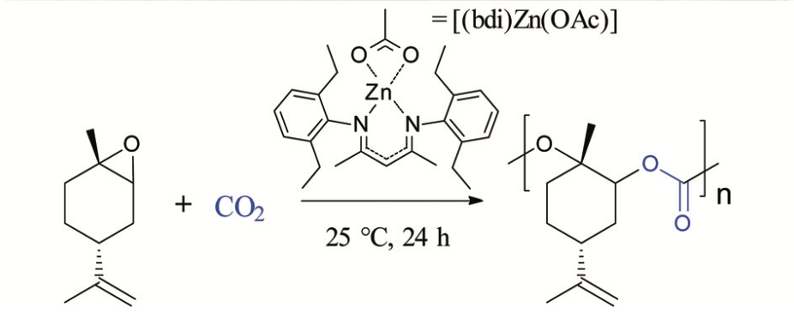
Limonene: Polycarbonate Materials
Polycarbonates are a thermoplastics that are strong and tough materials
They can be easily worked, molded, and thermoformed into rigid materials
Contain application is electronics, construction, and automotive industries
Source: Green Chem., 2016, 18, 760–770
Image: Wikipedia, public domain
Notes:
Source: Green Chem., 2016, 18, 760–770
Image source: https://en.wikipedia.org/wiki/File:Polycarbonate_Greenhouse-00.jpg

Slide 38
Advantages
Environmental:
Improved management of waste
Lowering the environmental burden of the food supply chain
Renewable material
Encompasses the cradle-to-grave platform
Reduces carbon footprint
Notes:
Image Source: Green Chem., 2013, 15, 307

Slide 39
Advantages
Economic:
Reduction in the dependence of fossil resources
Provides an additional value stream for both business and the food supply chain.
Reduction in the production of waste, which can reduce the cost of waste disposal annually on a companies bottom line
Provides opportunities to shift toward more energy efficient processes.
Notes:
Image Source: Green Chem., 2013, 15, 307

Slide 40
Advantages
Social:
Satisfy public and customer demand for more environmentally responsible products.
Increases the opportunity for a new and skilled workforce in the renewables technology sector
Increase the positive reputation and image of a company/business.
Increase the opportunity for more stakeholder engagement.
Notes:
Image Source: Green Chem., 2013, 15, 307

Slide 41
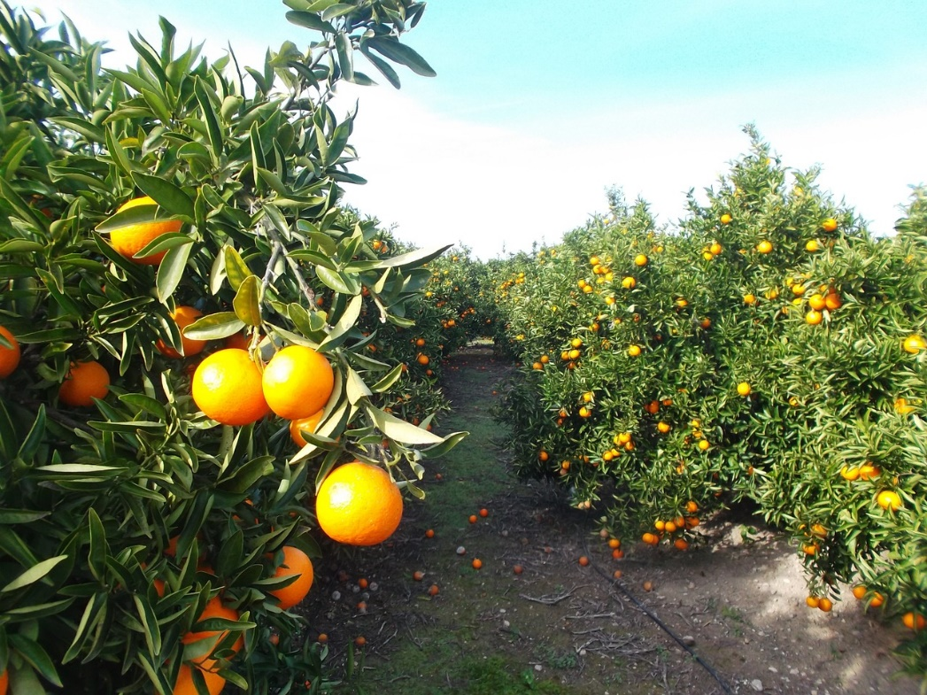
Challenges
Terpenes, D-Limonene, production is dependent on the orange growth season.
A poor growing season can limit supply and thus making the supply chain inconsistent from year to year.
Logistical challenges exist for capturing large volumes of orange peel waste.
This can yield to economic challenges in the commercialization of future products
Image Source: Creative Commons, https://www.maxpixel.net/Orange-Oranges-Citrus-Fruit-Fruit-1327052
Notes:
Image Source: Creative Commons, https://www.maxpixel.net/Orange-Oranges-Citrus-Fruit-Fruit-1327052

Slide 42
Sugars as a platform chemical
Step 1:
Glucose is produced by the hydrolysis of cellulosic materials. Glucose is then transformed into various furan derivatives.
Notes:
The furan feedstocks are derived from carbohydrates, such as glucose and xylose, which are produced by the hydrolysis of cellulose and hemicellulose. The furan feedstocks undergo Diels-Alder cycloaddition reactions with additional compounds that add carbon molecules and remove oxygen to produce the desired aromatic chemicals.

Slide 43
Sugars as a platform chemical
Step 2:
The furan compounds undergo Diels-Alder cycloaddition reactions with additional substrate compounds that yield desired aromatic chemicals.

Slide 44
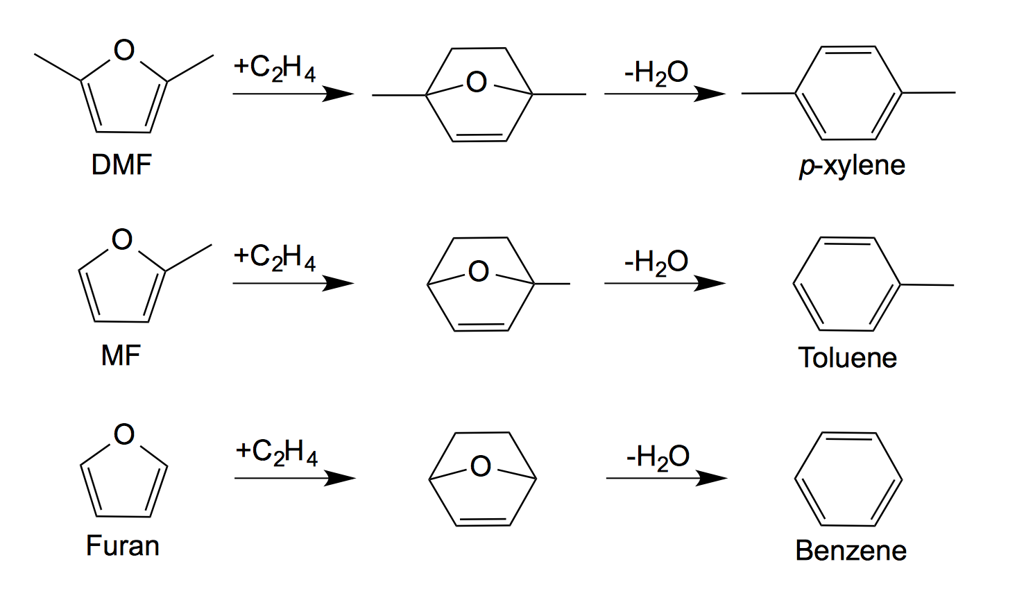
Reaction Examples
Notes:
DMF = Dimethyl furan
MF = methyl furan

Slide 45
Outline
What is a Feedstocks?
  Renewable vs. Depleting
  Current feedstock consumption
Types of Renewable Feedstocks
  CO₂
  Biomass
  Agricultural
Industrial Applications
Challenges and Opportunities

Slide 46
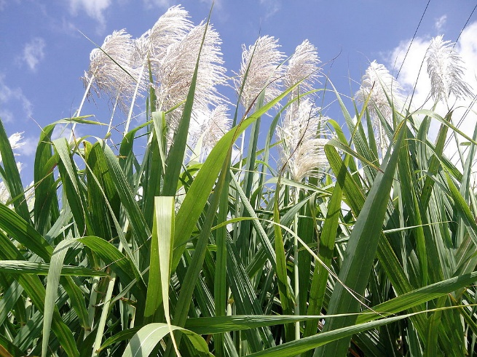
Industrial Application: Braskem
Platform Chemical
Bioethanol
Bio-ethylene/polyethylene
Bioplastics
Monomer for various
biopolymers
Sugarcane
Image Source: https://commons.wikimedia.org/wiki/File:%22Flowers_of_sugar_cane%22.jpg
Notes:
Image Source: https://commons.wikimedia.org/wiki/File:%22Flowers_of_sugar_cane%22.jpg

Slide 47
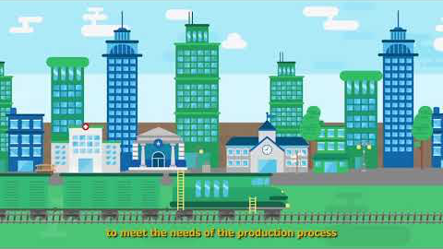
How it’s made
Source: https://www.youtube.com/watch?time_continue=204&v=UOPhqlx0f6Y
Notes:
Source: https://www.youtube.com/watch?time_continue=204&v=UOPhqlx0f6Y

Slide 48
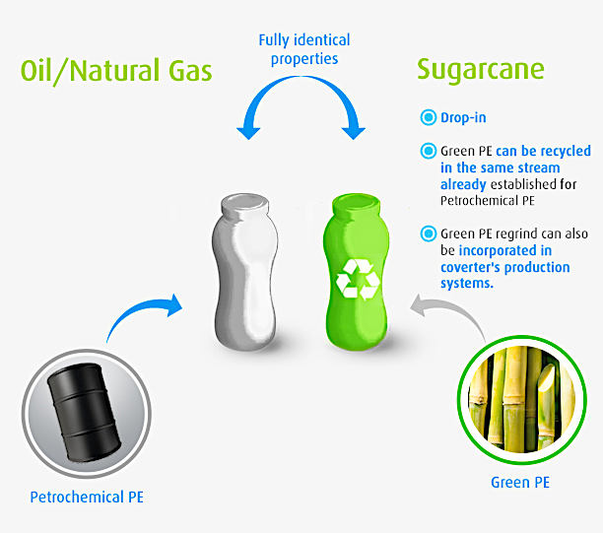
Commercial Properties of Green PE
Braskem’s Polyethylene has the same technical properties, appearance and versatility of applications of polyethylene from fossil source. The replacement of fossil source polyethylene for Braskem’s green Polyethylene does not require investment in new machines in plastics converters.

Slide 49
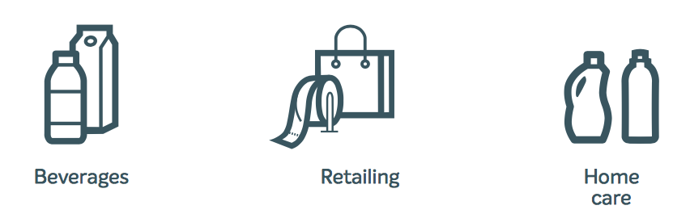
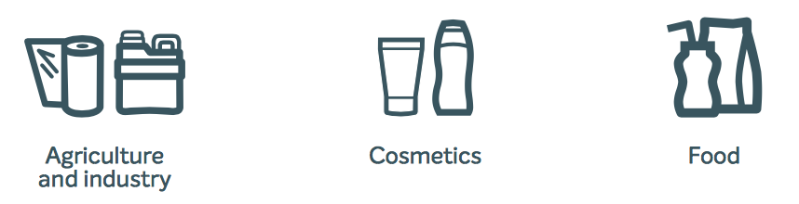
Commercial Applications
Source: Braskem, Inc. “I’m Green Polyethylene Brochure”
Notes:
Source: Braskem, Inc. “I’m Green Polyethylene Brochure”

Slide 50
Commercial Application
Allbird Sugar footwear line:
Developed in partnership with Braskem in 2018.
Contains a bio-based EVA resin polymer made from Braskem’s bioethylene.
Commercially available
Ethylene
Vinyl Acetate
Ethylene-Vinyl Acetate
Image Source: https://www.allbirds.com/products/mens-wool-runners
Notes:
Image Source: https://www.allbirds.com/products/mens-wool-runners

Slide 51
Industrial Application: Biofine, Incorporated
Thermochemical process to fractionate cellulosic biomass into levulinic acid (LA), formic acid, furfural and a high energy bone dry char using high-temperature, dilute-acid hydrolysis.
Yields in this two-stage process are ~50-70%, resulting in about 0.5 Ib LA/lb cellulose.
The cellulose in the biomass is first converted into soluble sugars, which are then converted into LA (CH₃COCH₂CH₂C0₂H).
Furfural, formic acid, and a high BTU solid fuel suitable for burning or gasification are co-product.
One promising feedstock is municipal solid waste (MSW), which is abundant and consists of 50% to 60% cellulose in the form of wood, cardboard, and paper. Sorting facilities currently separate MSW into components for recycling. Much of the cellulose fraction is not recyclable, and disposal of this fraction has always been accomplished by landfilling, landspreading, composting, or incineration, all of which add little value, can be costly, and have poor public acceptance.

Slide 52
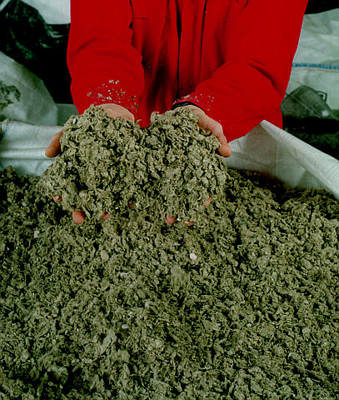
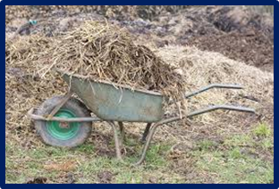
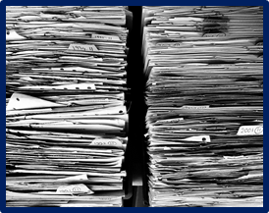
The BioFine Process
Paper mill
sludge
Agricultural
residues,
Waste wood
Levulinic acid
one-ton-per-day
Municipal solid waste
and waste paper
Image Source: Masx Pixel, Pixbay, Flickr
Notes:
Image Sources: https://www.maxpixel.net/Manure-Wheelbarrow-Wheelbarrows-Waste-Agriculture-2168726
https://pixabay.com/en/files-paper-office-paperwork-stack-1614223/
https://www.flickr.com/photos/pnnl/3365375855

Slide 53
Levulinic acid
Green Chemistry Challenge Award
1999 Small Business Award
> 70% yields
Product is removed from medium as it is formed (preventing tar formation)

Slide 54
A platform chemical
butanediol
Acrylic acid
Succinic acid
MTHF
(fuel additive)
THF
Diphenolic acid
gamma
butyrolactone
DALA (δ-amino levulinic acid)
(non-toxic, biodegradable herbicide)

Slide 55
Outline
What is a Feedstocks?
  Renewable vs. Depleting
  Current feedstock consumption
Types of Renewable Feedstocks
  CO₂
  Biomass
  Agricultural
Industrial Applications
Challenges and Opportunities

Slide 56
Challenges with Renewables
Feedstock cultivation
  Competition with food supply
  Land demand
  Nutritional needs
  Diseases
  Initial investment
Harvesting method to maximise yields and minimise degradation of product
Post harvest processing
Product extraction and purification
Product standardization
Complexity
Product storage, packing and distribution
New methodologies for alternative feedstocks
Choice of feedstock determines your process

Slide 57
Why use renewable feedstocks?
Economics
  Inherent long-term tendency for petroleum price increases (finite resources)
  A fluctuation of a few cents in crude oil price can result in massive price swings for downstream products
  Decreasing cost of renewable resources
  Lack of petroleum infrastructure
Scientific Opportunities:
  Better quality renewable feedstocks
  Modern plant breeding
  Genetic manipulation
  Breakthroughs in catalysis (enzymes, etc.)
Environment
  Biological compatibility (to an extent)
  Use of waste streams (wood pulping, agriculture, etc.)

Slide 58
Use of Renewable Feedstocks
Ideal Benefits:
Renewable
Doesn’t compete with food sources
Commercial and Industrial Waste
Poses no intrinsic hazards to humans and the environment
Can be converted into desired products with minimal steps.
Conversion process uses minimal energy
100 % yield
100% atom economy

Slide 59
Summary
A renewable feedstock should be renewable rather than depleting whenever technically and economically practical.
A renewable resource is determined to be renewable if it can be replenished in a relevant amount of time.
Biomass valorization is the process of reusing, recycling or composting waste materials and converting them into more useful products

