Slide 1
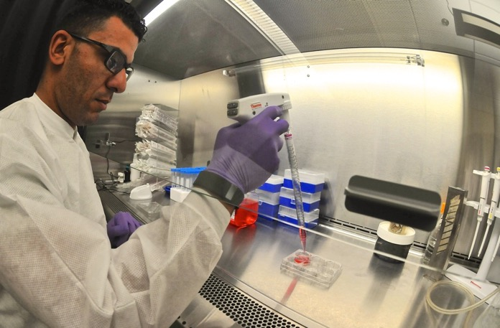
Yale-UNIDO Train-the-Facilitator Workshop in Green Chemistry
Innovation
CENTER for GREEN CHEMISTRY
and GREEN ENGINEERING at YALE
Image: Wikimedia Commons, Refining Innovation, Author: U.S. Army Photo by Sgt. Aaron Ellerman, 204th Public Affairs Detachment

Slide 2
Topics To Be Covered
Transformative Innovation
  What is it that we really want?
Nature as Inspiration
  Design Challenges
Biomimicry
  Color
  Adhesives
  Self-Cleaning
There is Still More We Can Learn from Nature

Slide 3
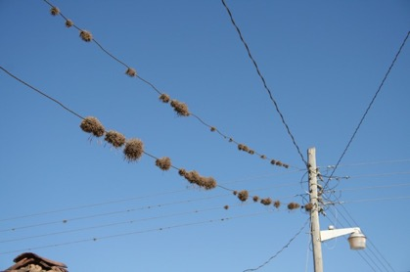
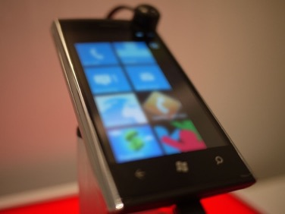
Key Concepts of Transformative Innovation
Consider the function or service and NOT the product
Original product: Telephone Lines
What we really wanted is long distance communication.
Why not have a cellphone?
Images: WikiCommons

Slide 4
Decaf Coffee Innovation
Original product: Facility to decaffeinate coffee
What we really wanted is decaffeinated coffee.
Why not have coffee beans that don’t have caffeine?
Coffee decaffeination using
methylene chloride
Coffee beans without caffeine
Images: WikiCommons

Slide 5
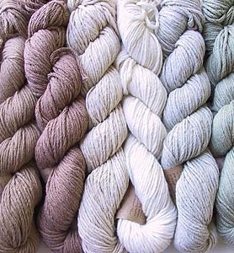
Colored Fabric Innovation
Original product: dye for cotton
What we really wanted is colored cotton
Why not have a naturally colored cotton?
Dye produces various colors, but adds cost and waste issues
Naturally colored cotton
Images: WikiCommons, http://www.knittersreview.com/

Slide 6
Clean Clothes Innovation
Original product: detergent
What we really wanted is clean clothes
Why not have self cleaning clothes?
Self-cleaning clothes
Detergent
Images: WikiCommons

Slide 7
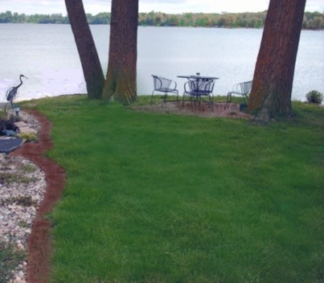
Grass Innovation
Original product: lawn mower
What we really wanted short grass
Why not have a no-mow grass?
Lawn mower
No-mow grass
Images: WikiCommons

Slide 8
What Does That Mean for the Chemical Industry?
Color without “dye”?
Scent without “fragrance”?
Adhesion without “adhesive”?
Disinfection without “disinfectant”?
Solvency without the “solvent”?
Catalysis without the catalyst?
Transformation without reaction?
Look to nature for inspiration

Slide 9
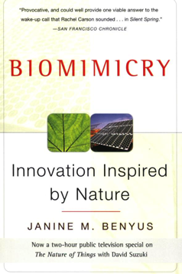
How Nature Does Things..
Nature runs on sunlight
Nature uses only the energy it needs
Nature fits form to function
Nature recycles everything
Nature rewards cooperation
Nature banks on diversity
Nature demands local expertise
Nature curbs excesses from within
Nature taps the power of limits
Janine Benyus, Biomimicry
Notes:
9

Slide 10
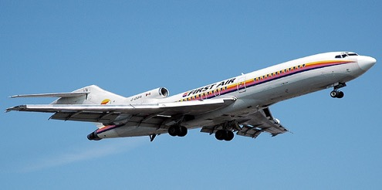
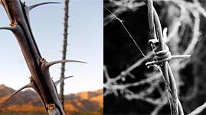
Biomimicry Is Not New…
Images: FirstAir, WikiCommons, The Biomimicry Institute
Notes:
10

Slide 11
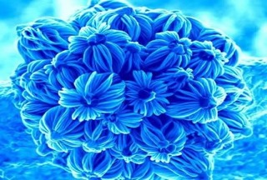
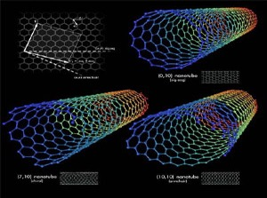
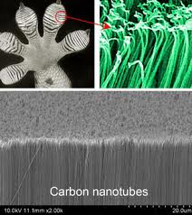
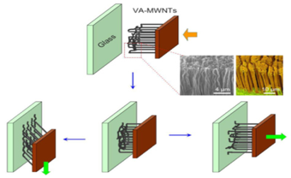
… But Now It Is Molecular
We can now imitate the nano-scale design features that give many natural materials some of their most interesting properties
Images: Pinterest (The Church – Micro), WikiCommons, GecksinTM
Notes:
11
Now applying its principles to emerging technologies; nature has been working at the nanoscale for billions of years. Technology has finally reached the point where we can manipulate materials as the nanoscale too…..
So we can innovate in new ways, for example adhesion without adhesives: Gecco “sticks” w/out adhesive…. Nano fibers on the feet interact with surface via VdW forces allowing the gecco to move upside down and sideways across surfaces. Scientists trying to mimic this with nanomaterials VIDEO

Slide 12
Some Design Challenges
    Filter particulates from air
    Filter water
    Create color
    Detect fire
    Retard fire
    Adhere or join
    Destroy macrobiotic pests / microbiotic pests
    Distribute data / information
    Distribute electricity
Notes:
12

Slide 13
Overview of Innovation
    Thermal insulation
    Cool or heat (buildings, clothing)
    Remediate soil
    Self-assembling materials
    Prevent corrosion
    Prevent mineral build-up
    Prevent biotic build-up
    Generate energy
    Sterile, disposable packaging
“After 3.8 billion years of research and development, failures are fossils, and what surrounds us is the secret of survival.”
- Janine Benyus
Notes:
13

Slide 14
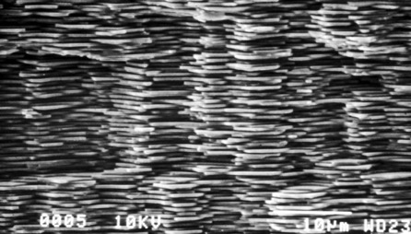
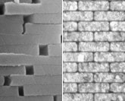
High Tech Materials
3,000x stronger than CaCO₃
Made by abalone
Image: Flickr (Lisa Ann Yount)
Notes:
14
mother of pearl or nacre
ceramics, body armor, rope, construction materials, aeronautics, biomedical devices or implants.
structure = flexibility + strength --- 3000 times stronger than CaCO₃

Slide 15
How We Make Things?
“Heat, beat, and treat”
Image: Pixabay
Notes:
15
GE ceramics factory

Slide 16
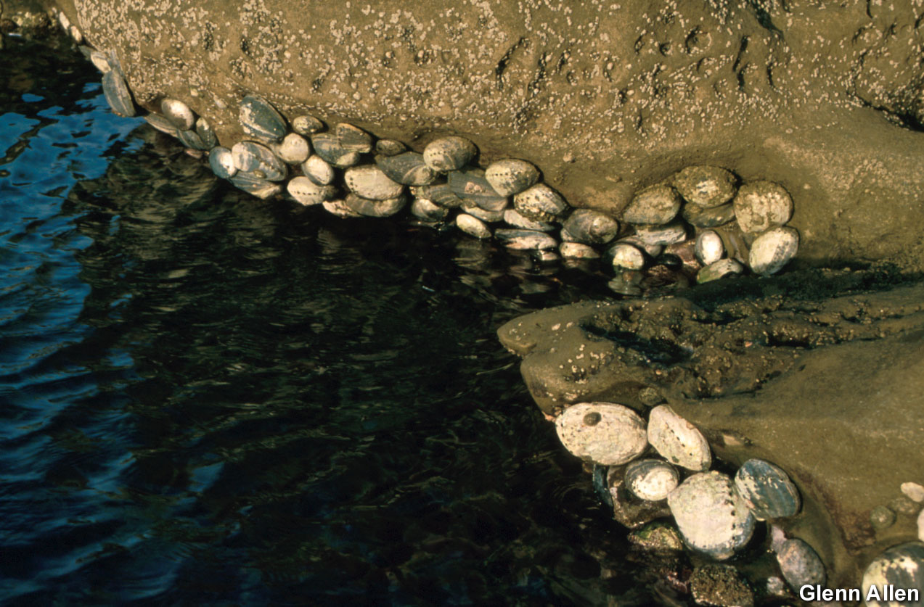
Abalone
Ceramics Factory
Notes:
16
Ambient temperature and pressure, no toxics, biodegradable.
No waste, sustainable feedstock, no toxic substances, no outside sources of energy
Another example of crystallization from the “bottom up”: “Bell Labs Scientists Create World's First Micro-Patterned Crystals Inspired by Bioengineering Found in Nature” BUSINESS WIRE, Feb. 21, 2003:
About two years ago (2001), Aizenberg and her colleagues made the surprising discovery that thousands of calcite crystals spread throughout the exoskeletons of brittlestars, starfish-like marine invertebrates, collectively form an unusual kind of compound eye for the animals. The brittlestar's calcite microlenses expertly compensate for birefringence and spherical aberration, two common types of distortions in lenses. This led the Bell Labs scientists to attempt to mimic nature's success and design crystals based on the brittlestar model, with the ultimate goal of building complexes arrays of microlenses like the brittlestar's.
Today lenses are typically made using a "top down" approach, in which a piece of glass is ground down to a lens' exact specifications. The brittlestar, on the other hand, makes its microlenses using a "bottom up" approach, in which successive layers of calcite are deposited onto an organic template in intricate patterns to form perfect crystalline lenses at the temperature of seawater.
"This is an excellent example where we can learn from Nature," said Cherry Murray, senior vice president of physical sciences research at Bell Labs. "In this case, a relatively simple organism has a solution to a very complex problem in integrated optics and materials design. By studying the brittlestar, we can learn about low-cost ways of forming single crystals in complex shapes at low temperatures. While many years from commercial use, this understanding could be very important to fabrication of nano-patterned materials."

Slide 17
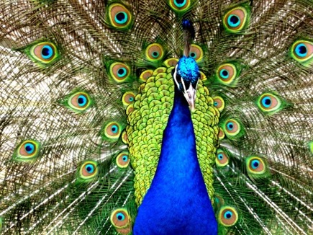
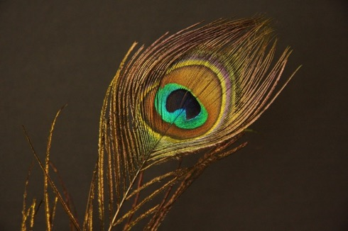
Peacock
How many chemical pigments are needed to produce this assortment of colors?
None! Color is produced through optical interference arising from the surface structure of the feathers
Image: Pixabay
Notes:
17
Take the peacock for example….

Slide 18
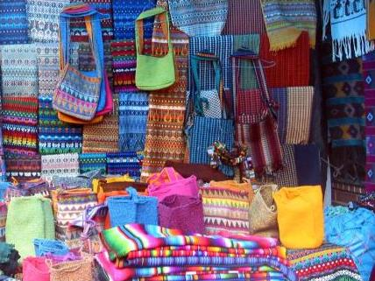
Textiles
How many pigments used here?
Image: www.eveandersson.com/
Notes:
18

Slide 19
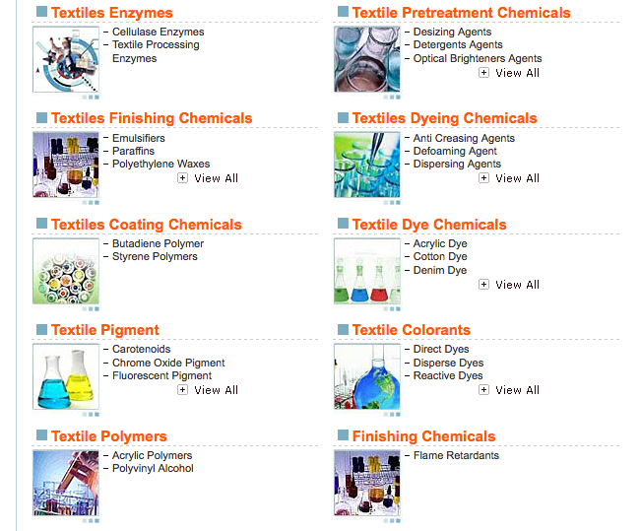
Textiles
The textiles sector uses thousands of chemicals.
Many of them toxic.
Notes:
19

Slide 20
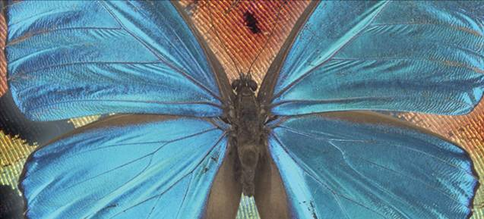
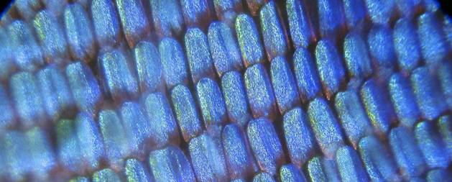
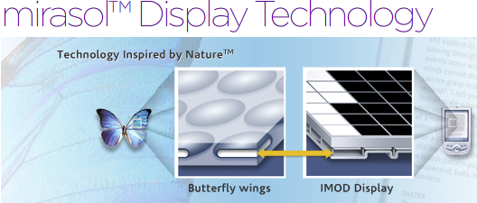
Display Technology
Blue Morpho butterfly scales
MEMS-based innovation that is bistable (low power consumption) and highly reflective (display can be see in direct sunlight)
IMOD = InterferometricMODulation
Image: mirasolTM
Notes:
20
Scales of the blue morpho butterfly inspired new digital display technology.
“Qualcomm’s mirasol display technology is based on a reflective technology called IMOD (InterferometricMODulation), with MEMS structures at its core. This MEMS–based innovation is both bistable, meaning it is both extremely low power, and highly reflective, meaning the display itself can be seen even in direct sunlight.”
MEMs = microelectromechanical systems

Slide 21
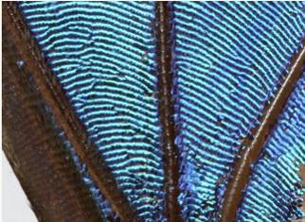
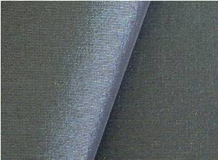
Color Without Chemicals
Morphotex Fibers
No dyes or pigments
Color based on varying thickness and structure of fibers
Reduced energy consumption and chemical release by eliminating dye processes
Teijin Limited of Japan
Image: asknature
Notes:
21
Left - Morphotex structural colored fibers
Right - Morpho Butterfly wings.
Teijin Fibers Limited of Japan produces Morphotex fibers. No dyes or pigments are used. Rather, color is created based on the varying thickness and structure of the fibers. Energy consumption and industrial waste are reduced because no dye process must be used.

Slide 22
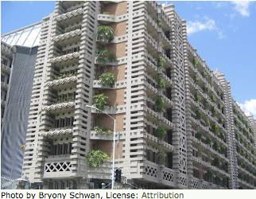
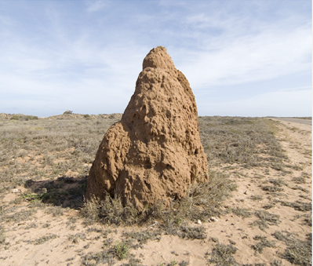
Architecture
90% less energy for ventilation than a comparable conventional building
Eastgate Building in Harare, Zimbabwe
Image: www.morpho-biomimicry.be/
Notes:
22
Eastgate Building in Harare, Zimbabwe
Modeled after termite mound - which can only tolerate a temperature difference of 1 degree day or night.
Uses 90% less energy for ventilation than a comparable conventional building (by utilizing natural air flow through the building rather than relying on traditional HVAC system)

Slide 23
Architecture
Sea Sponge
Image: WikiCommons
Notes:
23
The Swiss Re headquarters in London, otherwise known as "the gherkin," employs a cylindrical design to aid in ventilation with many engineering similarities to the structure of sea sponges.

Slide 24
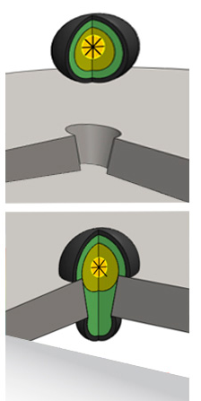
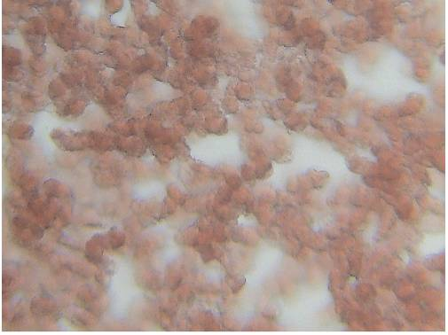

Self-Healing Materials and Systems
Image: Pixabay, Brinker
Notes:
24
Brinker technology developed a way to seal leaks in oil and water pipelines called Platelets. The technology works by injecting the formula into wells/pipes, as the platelets flow through the system, they are attracted to leak causing holes due to the pressure change encountered as they flow over them. The platelet fills the hole, preventing further leakage
Mimics human blood clotting.

Slide 25
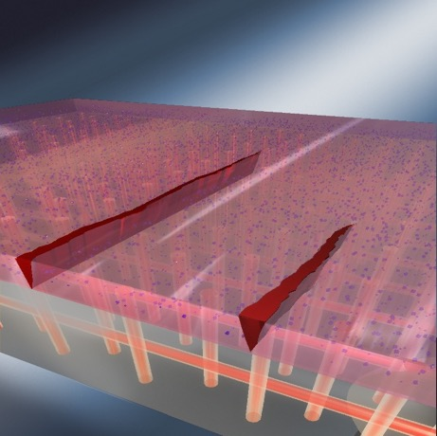
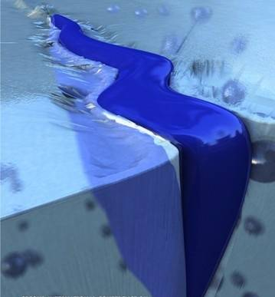
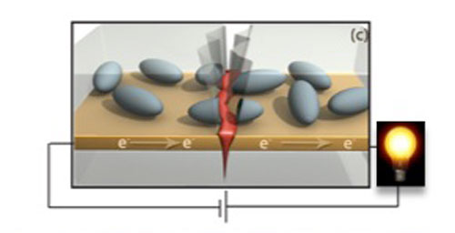

Self-Healing Materials and Systems
Notes:
25
The concept is also applied to polymer and metal systems
Univ Ill Urbana Champagne researchers working on self healing materials: ‘healing’ material incorporated in capsules within polymers. When ruptured (due to cracking or similar), the material in the capsule is released and fills the void and restore structural integrity. Polymers and now iron/steel (self-healing electronics: restore electrical conductance)

Slide 26
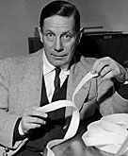

Velcro
"I will design a unique, two-sided fastener, one side with stiff hooks like the burrs and the other side with soft loops like the fabric of my pants. I will call my invention 'velcro' a combination of the word velour and crochet. It will rival the zipper in its ability to fasten.”
- George de Mestral, 1945
Image: WikiCommons
Notes:
26
- hook-by loop fastener was invented in
1945 Swiss engineer George de Mestral who was irritated by the burrs that would cling to his clothing on walks
- inspiration: burdock plant

Slide 27
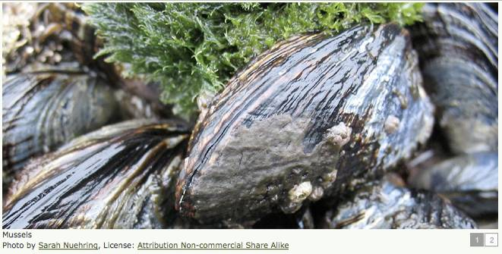
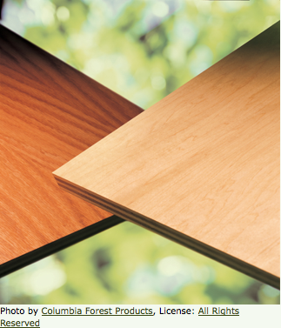
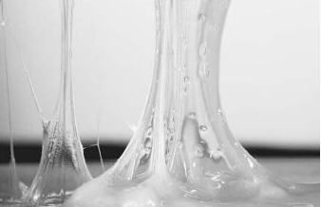
Adhesives
Blue Mussel
soy-based
formaldehyde-free
Notes:
27
In the event that adhesives are necessary….. Look to nature to determine a biocompatible, harmful chemical and VOC-free option
Columbia's PureBond is a soy-based formaldehyde-free technology used in the construction of hardwood plywood products.
Columbia Forest Products learned about natural adhesives from the blue mussel. This ocean species attaches itself firmly to underwater structures without use of toxic chemicals.

Slide 28
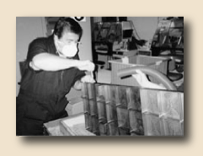
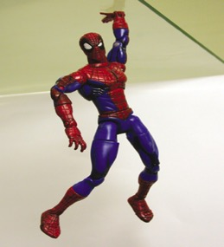
Adhesives
Image: WikiCommons, Geim, A. K. et al. Microfabricated adhesive mimicking gecko foot-hair. Nature Materials
Notes:
28
self-cleaning (doesn’t stick to non-target materials like sand)
reusable
doesn’t use adhesive
a square centimeter can support 4 kg
how does it work?
gecko foot hairs typically have diameters of 200 to 500 nm. Gecko feet are made of keratin, “gecko tape” the experimental material made in 2003 made of a synthetic polymer

Slide 29
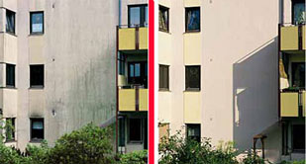
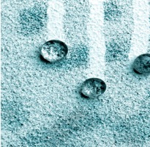
Cleaning
Other uses:
Clothing waterproofing
Teflon alternatives
Glass coating
StoCoat Lotusan®
Superhydrophobicity
The surface structure of lotus leafs minimizes adhesion of dirt particles to the surface
Lotus Effect
Image: StoCorp, WikiCommons
Notes:
29
Avoid use of harsh chemical cleaners or repainting

Slide 30
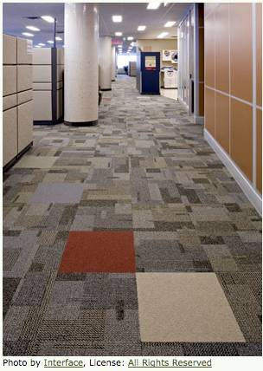
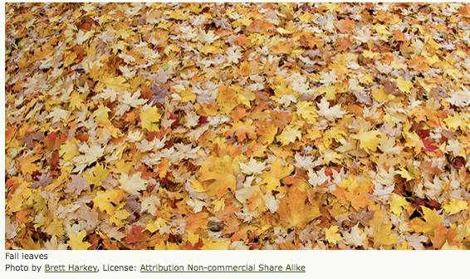
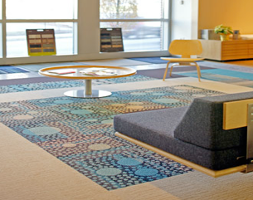
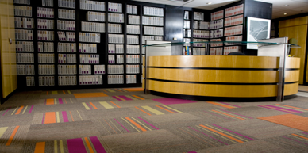

Organized Chaos…
Notes:
30
The organized chaos of a blanket of fall leaves inspired InterfaceFLOR designers to create Entropy, a line of carpet tiles with a random pattern. This randomness means that when any tile gets worn, it can be quickly replaced without worrying about mismatching dyes or patterns. This reduces waste and manufacturing costs. Entropy is part of InterfaceFLOR's i2 collection.

Slide 31
Carbon Sequestration
Image: WikiCommons
Notes:
31
Gas exchange mechanism in human lungs: inspiration for carbon sequestration?

Slide 32
Still More to Be Learned
“Pond scum may be a synonym for ‘primitive’, but the tiny organisms that compose it easily beat the human state of the art when it comes to capturing energy from the sun. Some purple bacteria answering to that unflattering description use light energy with almost 95% efficiency – more than four times that of the best man-made solar cells.”
- University of Southern California news release, August 22, 1994
Images: WikiCommons
Notes:
32
Bioluminescent bacteria, combine chemicals to light up their bodies
Dragonflies out maneuver helicopters
Hummingbirds cross the Gulf of Mexico on less than one tenth an ounce of fuel
Ants carry 100’s lbs equivalent in dead heat

Slide 33
Still More to Be Learned
“If the age of Earth were a calendar year and today were a breath before midnight on New Year’s Eve, we showed up a scant fifteen minutes ago, and all of recorded history has blinked by in the last sixty seconds.”
- Janine Benyus
Images: WikiCommons
Notes:
33
Bees, turtles and birds navigate w/out maps
penguins dive without scuba gear
Artic fish and frogs freeze solid and then spring back to life, having protected their organs from ice damage
Chameleons and cuttlefish hide without moving by changing patterns in their skin to blend in with their surroundings
How do they do it?!

Slide 34
Topics To Be Covered
Transformative Innovation
  What is it that we really want?
Nature as Inspiration
  Design Challenges
Biomimicry
  Color
  Adhesives
  Self-Cleaning
There is Still More We Can Learn from Nature

Slide 35
Sponsored by Yale-UNIDO Initiative
QUESTIONS?
CENTER for GREEN CHEMISTRY
and GREEN ENGINEERING at YALE

