Slide 1
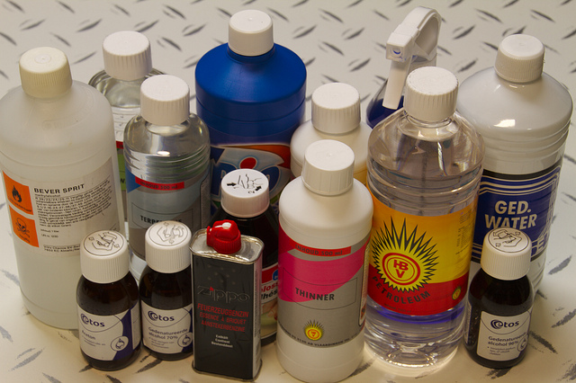

Yale-UNIDO Train-the-Facilitator Workshop in Green Chemistry
Solvents
CENTER for GREEN CHEMISTRY
and GREEN ENGINEERING at YALE
Image: Flikr, Solvents used during the Tamper Evident Seals Workshop, Author: Dennis van Zuijlekom

Slide 2
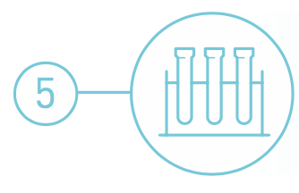
Safer Solvents and Auxiliaries
The use of auxiliary substances (solvents, separation agents, etc.) should be made unnecessary whenever possible and, when used, innocuous.
Image: thoughtco.com, Author: unknown

Slide 3
Topics To Be Covered
The problems with solvents
Minimizing solvent use
Selecting greener conventional solvents
Using unconventional solvents

Slide 4
What is a solvent?
A solvent is any substance that dissolves another substance(s) so that the resulting mixture is a homogenous solution.
Also conveys energy:
endothermic: brings energy to molecules
exothermic: heat sink

Slide 5
When are solvents used?
Solvents are used in all stages of a product’s life-cycle:
During manufacturing:
  - To facilitate intermolecular chemical reactions via solute molecules & ions.
During processing:
  - To aid in manipulation of chemicals, but not as an integral part of the molecule itself.
During extraction/separation:
  - To separate or purify the chemical products from co-products, byproducts and impurities.
During cleaning:
  - To remove oil, grease and silica from mechanical parts.
During product formulation:
  - To design a product and process (quantities, raw materials, mixture design and testing)

Slide 6
Solvent Usage by Sector
Source: Int. J. Mol. Sci. 2015, 16(8), 17101-17159; doi:10.3390/ijms160817101

Slide 7
Waste in a “Typical” Pharmaceutical Synthesis

Slide 8
Life Cycle Analysis of a Pharmaceutical
Basis: 1 kg of active pharmaceutical ingredient (API).
Process studied has 7 stages.
26 API materials are directly used in the process.
These 26 API materials are made from 125 commercially available raw materials.
LCA includes:
  Process:
    Materials
    Energy
    Transportation
  Treatment:
    Wastewater treatment
    Incineration
    Landfill

Slide 9
Key Findings of the Life Cycle Analysis (LCA) of a Pharmaceutical
Solvent use (excluding incineration) is a major contributor to:
  Energy (ca. 75%)
  Resource utilization (about 80%)
  Photochemical ozone creation potential (ca. 70%)
  Greenhouse gases (about 50%)
Solvent-related energy use alone contributes to:
  30% of the materials
  70% of resource depletion
  90% of the greenhouse gas emissions
Notes:
Photochemical Ozone Creation Potential measures the production of ozone from a VOC emission through computer modelling of a complex series of chemical reactions in the atmosphere.

Slide 10
Conventional Solvents
Volatile Organic Compounds
  Chloroform, carbon tetrachloride, methylene chloride, perchloroethylene (PERC)
  Benzene, Toluene, Xylene (BTX)
  Acetone, Ethylene Glycol, methylethyl ketone (MEK)
Notes:
VOCs have been linked to atmospheric ozone generation, commonly known as smog.
PERC is used in dry cleaning.
CFCs deplete an ozone layer which results in severe environmental effects

Slide 11
What are the concerns for solvents?
Inherent Toxicity
  Methylene chloride, chloroform, carbon tetra chloride and other halogenated solvents are suspected human carcinogens.
Flammability
  Because of their physicochemical properties (low flash point and autoignition temperatures), solvents are flammable.
Explosivity
  They can explode, and since they are used in large volumes, the explosion can be disastrous.
Stratospheric Ozone Depletion
  They reduce the ozone layer which protects the earth from the radiation.
Global Warming Potential
Notes:
In a typical chemical reactions, solvent accounts the majority of the reaction weight and therefore, post-processing solvent removal, which is typically achieved through distillation or vacuum evaporation (Video: solvent distillation) , is a very energy costly procedure for large scale synthesis. Moreover, products that are sensitive to impurities may requires extra cycles of distillations. This contributes to another (expensive) problem to deal with waste. Careless disposal of solvents are also known to pose great threat to the environment since many of which are toxic even at low concentration. To make matters worse, most organic solvents are volatile, possibly explosive and moderately toxic upon exposure, these qualities pose great concerns to any individuals who are involved in handling solvent.

Slide 12
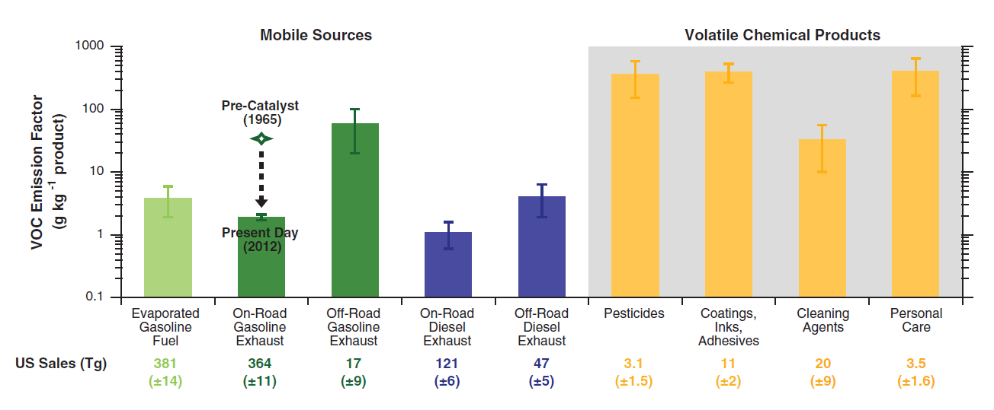
What are the concerns for solvents?
Transportation emissions in the United States and Europe have declined rapidly
The use of volatile chemical products (VCPs)—including pesticides, coatings, printing inks, adhesives, cleaning agents, and personal care products—now constitutes half of fossil fuel VOC emissions in industrialized cities.
Total VOC emission factors for end uses of petrochemical sources considered in his study, including from mobile sources and volatile chemical products.
McDonald et al., Science 2018 359, 760–764

Slide 13
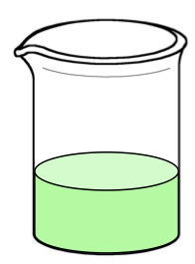
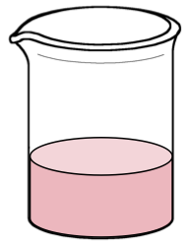
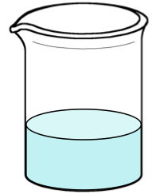
Minimizing solvent use
Murphy’s Law of Solvents
“The best solvent for any process step is bad for the subsequent step.”
1st step
2nd step
3rd step
4th step
polar
aprotic
nonpolar
aprotic
polar
aprotic
polar
protic

Slide 14
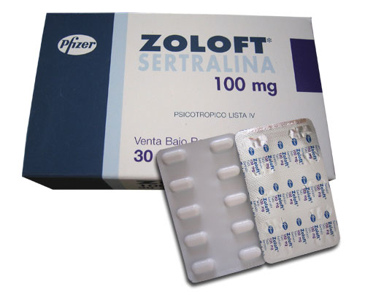
Minimizing solvent use: Compromise Solvents
• 4 solvents for 3 steps
• 60,000 gallons per y
• 1 solvent for 3 steps
• 6,000 gallons per y
• saved 45% of starting material

Slide 15
Minimizing solvent use: Switchable Solvents
CO₂
N₂ or Ar
low polarity solvent
high polarity solvent
Nature (2005) 436, 1102
Ind Eng Chem Res (2008) 47, 539

Slide 16
Minimizing solvent use: Switchable Solvents
75 ˚C
CO₂
6 h
1.0 mL styrene
4.5 mL DBU/PrOH
45 mg initiator
filter or centrifuge
N₂
+
Nature (2005) 436, 1102
Ind Eng Chem Res (2008) 47, 539
Mn = 412,000
PDI = 1.57

Slide 17
Minimizing Solvent Use: Don’t add a solvent
Two options:
Use a liquid reagent as the solvent
Solventless (no liquid at all)
Advantages:
  Solvent concerns eliminated.
  Solvent costs eliminated.
  Lots of research on this field: it works!
Disadvantages:
  Exothermic reactions can be dangerous on large scale
  High viscosity (option 1) or no mass transfer at all (option 2)
  need close collaboration with chemical engineers to overcome above problems.
  Efficient mixing can be a problem, particularly for solventless conditions.
  Solvents still often required for extraction, separation and purification of products.
Reactions between solids… can be done by mechanochemistry

Slide 18
Topics To Be Covered
The problems with solvents
Minimizing solvent use
Selecting greener conventional solvents
Using unconventional solvents

Slide 19
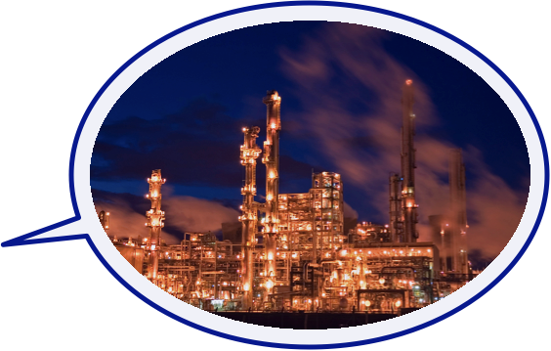
What is a greener solvent?
What is a green solvent?
solvent #1
solvent #2
solvent #3
A green solvent is the solvent that makes a product or process have the least environmental impact over its entire life cycle.

Slide 20
Environmental impact during solvent manufacture
Environmental impact during solvent use
Solvent performance during use
Environmental impact after solvent use
How is hexane made?
How is DMF made?
distillation
oil
hexane

Slide 21
Environmental impact during solvent manufacture
Environmental impact during solvent use
Solvent performance during use
Environmental impact after solvent use
Capello et al., Green Chem (2007) 9, 927

Slide 22
Environmental impact during solvent manufacture
Environmental impact during solvent use
Solvent performance during use
Environmental impact after solvent use
Impact per kg (relative to 1 kg of toluene)
data from: Isoni, Green Chem. (2016) 18, 6564

Slide 23
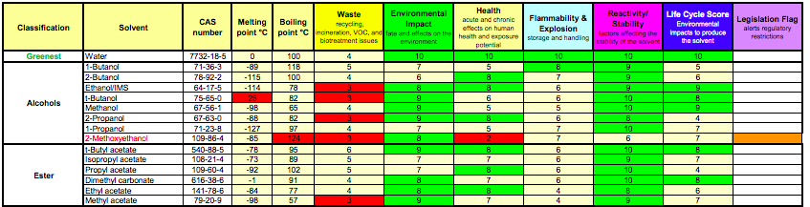
GSK solvent selection guide ranking
Environmental impact during solvent manufacture
Environmental impact during solvent use
Solvent performance during use
Environmental impact after solvent use
Solvent selection guide in practice. Each solvent is ranked from 1-10 and color-coded for convenience (1 being the worst, 10 being the best, across 6 different categories.
http://solventguide.gsk.com/

Slide 24
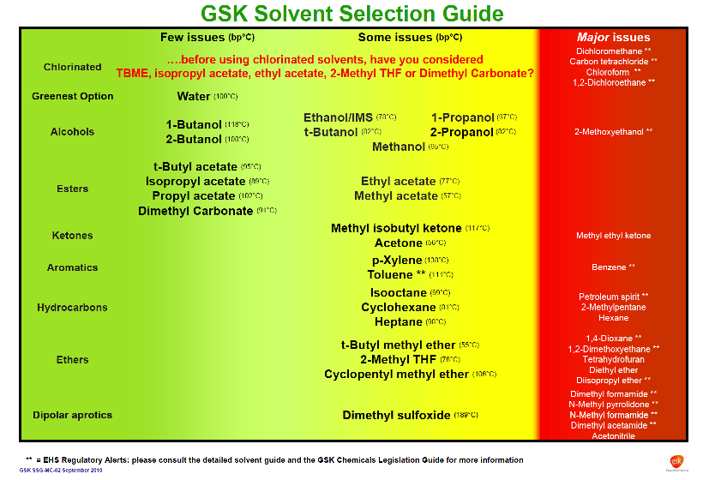
Notes:
Another view of the solvent selection guide: Green and yellow indicate a preferred solvent. Red suggests major heath or environmental issues.

Slide 25
Environmental impact during solvent manufacture
Environmental impact during solvent use
Solvent performance during use
Environmental impact after solvent use
For green-ness
boiling point / energy to distill
flash point
cumulative energy demand
life cycle analysis
For utility
π* polarity/polarizability
β basicity / hydrogen-bond accepting ability
α acidity / hydrogen-bond donating ability
viscosity
α, β, and π* are Kamlet-Taft solvent parameters

Slide 26
Environmental impact during solvent manufacture
Environmental impact during solvent use
Solvent performance during use
Environmental impact after solvent use
HMPA
The aprotic solvents
(α < 0.5)
High basicity
tetramethyl-urea
OP(OEt)₃
DMA
NMP
DMSO
NEt₃
Me₂py
DMF
NBu₃
4-Mepy
quinoline
BzNMe₂
pyridine
THF
MEK
butyrolactone
Et₂O
EtOAc
acetone
Pr₂O
EtO₂CEt
MeOAc
EtO₂CPh
propylene
carbonate
PhCN
MeOC₂H₄OMe
MeO₂CH
sulfolane
PhNO₂
dioxane
anisole
MeCN
Low basicity
EtO₂CCl₃
cyclohexane, hexane, heptane
p-xylene
toluene
benzene
PhCl
PhBr
CCl₄ &
Cl₂C=CCl₂
MeNO₂
Cl₂C=CClH
CHCl₃
CH₂Cl₂
ClC₂H₄Cl
Jessop, Green Chem (2012) 14, 1245
Low polarity
High polarity

Slide 27
Environmental impact during solvent manufacture
Environmental impact during solvent use
Solvent performance during use
Environmental impact after solvent use
The aprotic solvents
(α < 0.5)
High basicity
PEG
PPG
2-MeTHF
γ-valerolactone
MEK
acetone
(EtO)₂CO
EtOAc
propylene
carbonate
iPrOAc
Low basicity
heptane
Jessop, Green Chem (2012) 14, 1245
Low polarity
High polarity

Slide 28
Environmental impact during solvent manufacture
Environmental impact during solvent use
Solvent performance during use
Environmental impact after solvent use
The protic solvents
(α > 0.5)
tBuOH
iPrOH
High basicity
1-propanol
hexanol
butanol
octanol
ethanol
methanol
PhCH₂OH
glycerol
ethylene glycol
glycerol
hexanoic acid
acetic acid
formamide
phenol
Low basicity
water
CF₃CO₂H
(CF₃)₂CHOH
CF₃CH₂OH
Jessop, Green Chem (2012) 14, 1245
Low polarity
High polarity

Slide 29
Environmental impact during solvent manufacture
Environmental impact during solvent use
Solvent performance during use
Environmental impact after solvent use
The protic solvents
(α > 0.5)
tBuOH
iPrOH
High basicity
1-propanol
butanol
ethanol
methanol
ethyl lactate
glycerol
Low basicity
water
Jessop, Green Chem (2012) 14, 1245
Low polarity
High polarity

Slide 30
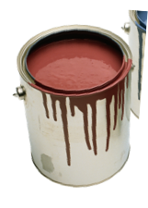
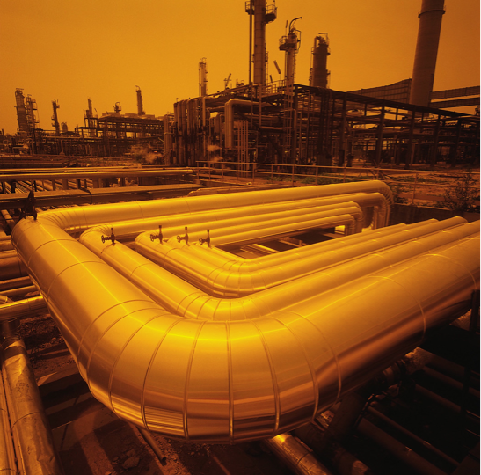
Environmental impact during solvent manufacture
Environmental impact during solvent use
Solvent performance during use
Environmental impact after solvent use
Contained system
Direct to sewage
Direct to environment
Water is probably NOT a green solvent
Water probably IS a green solvent
Water probably IS a green solvent

Slide 31
Which solvent is greener?
DIfferent types of comparisons
• solvent impact during use
• solvent impact during manufacture and use
• LCA of the entire process
solvent #1
solvent #2
solvent #3
A green solvent is the solvent that makes a product or process have the least environmental impact over its entire life cycle.

Slide 32
Solvent Exercise: Solvent Ratings in 9 Criteria
Give ratings (Green Yellow or Red) in the 9 provided categories based on solvent physicochemical properties.
CATEGORY | RATING (RED-YELLOW-GREEN)
Incineration
Recycle
Biotreatability
VOC emmision
Environmental impact to water
Environmental impact to air
Health hazard
Exposure hazard
Safety hazard
Notes:
Goal: To give the participants an understanding of how the physicochemical and hazardous properties of solvents effect safety and environmental impact.
This activity uses published solvent selection guides generated by a major pharmaceutical company, which uses them to evaluate solvents used in their large-scale process chemistry. The company has rated each solvent according to nine criteria on a “red-yellow-green”/traffic light scale, based on the physicochemical and hazardous properties.

Slide 33
Solvent Exercise
SOLVENT 1
SOLVENT 2
Molecular weight | 60.05
Boiling point [°C] | 118 °C
Melting point [°C] | 17°C
Flash Point [°C] | 39°C
Auto Ignition Temperature [°C] | 426°C
Solubility [g/L] | miscable
Vapor Pressure [mm] | 15.5 mm
Percent Volatile | 100
Exposure Limits [ACGIH: TWA] | 10 ppm
Evaporation Rate | 0.97 BuAc
Toxicological data Oral Rat LD50: Skin Rabbit LD50: Inhalation Rat LC50: | 3.31 g/kg 1060 mg/kg 11.4 mg/L 4H
Ecotoxicology data EC50 Water flea (Daphnia magna): LC50 Bluegill (Lepomis macrochirus): | 65 mg/L 48 H 75 mg/L 96 H
Ozone creation potential | 16
Heat of combustion [Btu/lb] | 5645 Btu/lb
Persistence and Degradability: | biodegradable
Azeotropes | Multiple present
Molecular weight | 82.4
Boiling point [°C] | 81 °C
Melting point [°C] | 7 °C
Flash Point [°C] | -20 °C
Auto Ignition Temperature [°C] | 245
Solubility [g/L] | 0.06 g/L
Vapor Pressure [mm] | 98 mm
Percent Volatile | 100
Exposure Limits [ACGIH: TWA] | 300 ppm
Evaporation Rate | not known
Toxicological data Oral Rat LD50: | 12.705 g/kg
Ecotoxicology data EC50 algae | 3.8 mg/L
Ozone creation potential | 60
Heat of combustion [Btu/lb] | 18684 Btu/lb
Persistence and Degradability: | Slow biodegradation
Azeotropes | Some present
Notes:
Participants should be divided into groups of 4-5 and provided with the solvent cards for acetic acid and cyclohexene, without the names of the solvents and the “red-yellow-green” ratings left blank.
The solvent card would contain categories like:
1. Incineration
2. Recycle
3. VOC emmision
4. Environmental impact to water
5. Environmental impact to air
6. Health hazard
7. Exposure hazard
8. Safety hazard
The groups should be given approximately 20 minutes to discuss the chemical data provided on the cards and provide their own ratings in each of the eight categories. The solvent identities are left blank to avoid biasing the evaluation.
The debriefing will also take approximately 20 minutes. The groups will be asked to report which criteria received a green light and which criteria received a red light and the results will then be tabulated. Then the solvent identities and actual red-yellow-green ratings from the pharmaceutical industry scientists should be revealed. This is likely to result in some “what were they thinking?” comments from the participants.

Slide 34
Vapor Pressure (mm) - an indication of a liquid's evaporation rate; High vapor pressure = volatile
Solubility in Water (gm/L) – an indication if the solvent can be easily separated
Odor Threshold (ppm) - the lowest concentration of a certain odor compound that is perceivable by the human sense of smell; Strong odors = lower value
Log Kow - octanol/water partition coefficient (Kow) - ratio of a chemical's concentration in the octanol phase to its concentration in the aqueous phase; Higher log kow = more lipophilic
EC50 - concentration of a compound where 50% of its maximal effect (mortality) is observed;
Low EC50 = more toxic
Ozone Creation Potential POCP - an indicator of the ability of a VOC to contribute to ozone formation. A measure of the reactivity of an organic compound with hydroxyl radicals & subsequent formation of ozone.
High value = more potential
Exposure Limit 8hr TWA (ppm) – a legal limit for exposure of an employee to a chemical substance during 8 hours. Lower value = more harmful
Flash point - the lowest temperature at which vapors of a volatile material will ignite; Lower value = more flammable
Heat of Combustion - energy released as heat when a substance undergoes complete combustion with oxygen under standard conditions; High = easier to burn
Dielectric constant - A measure of a substance's ability to insulate charges from each other.
Higher value = more insulation
Autoignition temperature - lowest temperature at which substance spontaneously ignites.
Lower value = more flammable

Slide 35
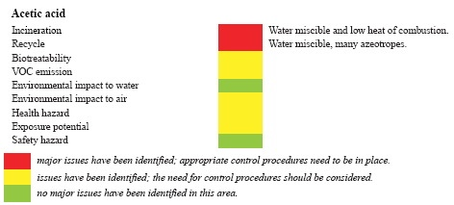
Solvent Exercise – Solvent 1
Acetic Acid
major issues have been identified; appropriate control procedures need to be in place.
issues have been identified; the need for control procedures should be considered
no major issues have been identified area

Slide 36
Solvent Exercise – Solvent 2
Cyclohexane
major issues have been identified; appropriate control procedures need to be in place.
issues have been identified; the need for control procedures should be considered
no major issues have been identified area

Slide 37
Solvent Exercise
Acetic acid (glacial)
  Used in chemical industry to produce photographic film, wood glue, and synthetic fibers.
  Used in food industry as additive.
  Demand: 6.5 million metric tons/year.
Cyclohexane
  Used in chemical industry as precursor for nylon.
  Known organic solvent.
  Global cyclohexane market valued at $5.8 billion in 2013.
Notes:
Issues and answers:
1. How much the ratings change depending on the way the solvent is used in industry (i.e., compare a situation where a worker is cleaning the inside of a tank with a situation where solvent is part of an effluent that is being released into a river). The answer - a lot.
2. Is it possible that either of these solvents will ever receive all “green lights” in every category? The answer - almost certainly not. This can function as a segue into a discussion of alternative solvents being developed by green chemists.

Slide 38
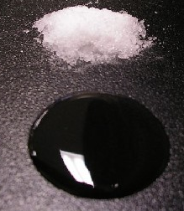
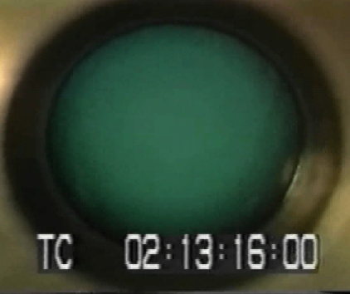
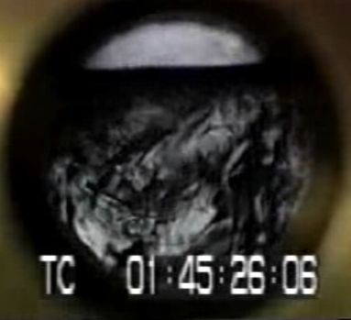
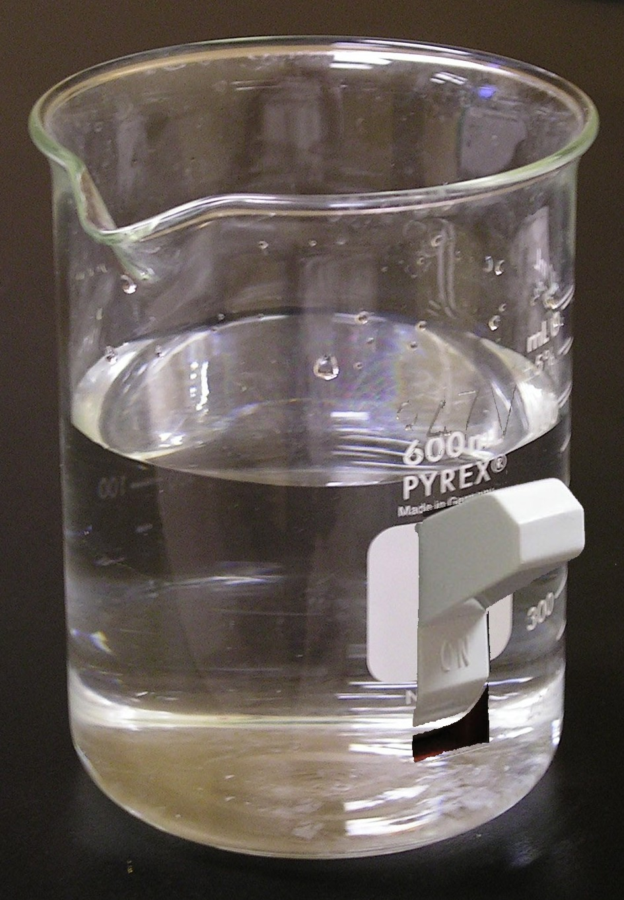
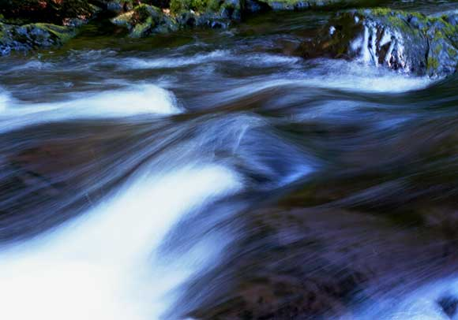
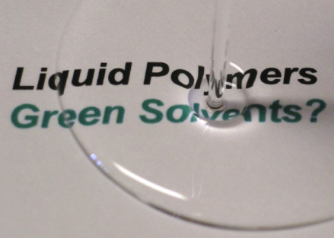
Unconventional Solvents
supercritical CO₂
ionic liquid
CO₂-expanded liquid
water
liquid polymer
switchable solvent

Slide 39
Water as a solvent
Water based solvents with generalized applications.
Advantages:
  Innocuous.
  Well characterized.
  Versatility among applications.
  One of the most obvious alternatives to VOCs.
  Cheap, readily available, and plentiful
  In some cases faster reaction (‘on water’ reactions)
  Useful in biphasic processes in conjunction with other solvents.
Disadvantages:
Low solubility of organic substrates
Incompatibility with many reagents
Removal of water is energy intensive.
Clean up of aqueous waste difficult.
Notes:
Water, the most popular choice for nature, is undoubtedly the most benign solvent there is. It is easily accessible and cheap to employ, and has the lowest toxicity to the environment. Not only it is non-flammable and non-explosive, but it also has a high heat capacity. With addition of surfactants or other miscible organic co-solvent, water emerges as a new choice in chemical synthesis including oxidations, reductions, nucleophilic substitutions, and electrochemical synthesis. However, water is not perfect and its cons should be considered before it is used in large scale synthesis. Aside from its poor compatibility of organic molecules, distillation of water from reagent requires more demanding condition relatively to other solvents such as methanol. Removal of water, even in vacuum, is more energy intensive (thus less economically viable) than conventional organic solvent. Therefore each solvent selection or replacement needs to be discussed on a case-by-case basis. Replacement of organic solvents to water may be done at least for safety reasons

Slide 40
Water: Solving the incompatibility problem
RMgBr reacts with water more than carbonyls
http://students.washington.edu/~haoli/photo_gallery/archives/olympic/
Li, 1995
Notes:
Water, the most popular choice for nature, is undoubtedly the most benign solvent there is. It is easily accessible and cheap to employ, and has the lowest toxicity to the environment. Not only it is non-flammable and non-explosive, but it also has a high heat capacity. With addition of surfactants or other miscible organic co-solvent, water emerges as a new choice in chemical synthesis including oxidations, reductions, nucleophilic substitutions, and electrochemical synthesis. However, water is not perfect and its cons should be considered before it is used in large scale synthesis. Aside from its poor compatibility of organic molecules, distillation of water from reagent requires more demanding condition relatively to other solvents such as methanol. Removal of water, even in vacuum, is more energy intensive (thus less economically viable) than conventional organic solvent. Therefore each solvent selection or replacement needs to be discussed on a case-by-case basis. Replacement of organic solvents to water may be done at least for safety reasons

Slide 41

Water: Solving the solubility problem
Using safe, nontoxic, and inexpensive surfactants, micelles can be
formed in water.
Micelles have hydrophilic exteriors and hydrophobic interiors, allowing for the
encapsulation (and reaction) of organic molecules in aqueous environments.
increasing effective concentration increases reaction rates.
Recycling of the surfactant is very efficient.
Bruce Lipschultz
Shu Kobayashi
Image: Bruce H. Lipshutz (Wkipedia)

Slide 42
Solvent Usage by Sector
Source: Int. J. Mol. Sci. 2015, 16(8), 17101-17159; doi:10.3390/ijms160817101

Slide 43
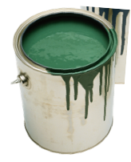
Water for Oil-Based Paints
solvent vapours
water vapour
Oil-based paint
organic solvent
soluble polymer
vapour emissions
flammability
smog
inhalation hazards
higher Tg polymer
Water-based paint
water as solvent
insoluble polymer (latex)
no vapour emissions
no flammability
no smog
no inhalation hazards
lower Tg polymer
solvent vapours
water vapour

Slide 44


Water for Oil-Based Paints
Oil-based paint
organic solvent
soluble polymer
vapour emissions
flammability
smog
inhalation hazards
higher Tg polymer
Water-based paint
water as solvent
insoluble polymer (latex)
no vapour emissions
no flammability
no smog
no inhalation hazards
lower Tg polymer
We need a paint that is water-soluble while in the can, but water-insoluble once it has dried.

Slide 45
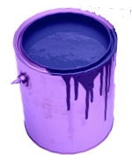
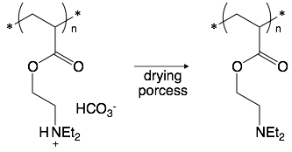
Water for Oil-Based Paints
water + CO2
Switchable paint
carbonated water as solvent
soluble polymer
no vapour emissions
no flammability
no smog
no inhalation hazards
higher Tg polymer
water + CO2
in the can
as dried on the surface
hydrophilic
hydrophobic
Jessop, Green Chem (2018) 20, 1899

Slide 46
Supercritical Fluids: CO₂
Advantages:
Similar advantages to water
  Natural, inert, non-flammable, cheap, plentiful.
  Easily available commercially in > 99.9% pure form.
  By-product of brewing, ammonia synthesis, combustion.
Already being adopted in a variety of commercial processes (see later).
Non-toxic and properties well understood.
Easily removed and recycled, and can be disposed of with no net increase in global CO₂.
  Simple product isolation, by evaporation to 100% dryness.
Potential for product processing (extraction, particle micronozation, chromatography, textile dyeing, etc.).
Small molecules (e.g., CO₂, H₂O) used under conditions of elevated pressure and temperature to form a fluid that is neither liquid nor gas.
Disadvantages:
  High pressure required.
  May have poor solvency for polar molecules.
  May require Surfactants.
Notes:
scCO₂ is very attractive as a solvent because it can be removed easily by simply decreasing the pressure in the reaction vessels. This eliminates the need of solvent distillation, which is an energy intensive process, while leaving behind a product with high purity. Besides its’ non-toxic profile, scCO₂ is often readily available as an industrial by-product and can be obtained without burning fossil fuels. Several companies offer CO₂ recovery, and turn this industrial by-product into a profitable reagent. Such recovery is especially popular in breweries, distilleries, ammonia or ethylene oxide productions.

Slide 47
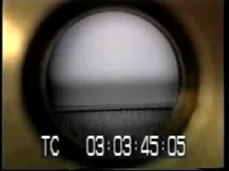
Supercritical CO₂
scCO₂ moves like a gas and dissolves things like a liquid

Slide 48
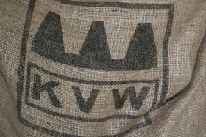
Supercritical Fluid Extraction
A novel separation process.
It can be used for:
  Separation and purification of oils, flavours and medicinal components.
  Removal of greasy material.
  Conversion of azeotropic water-ethanol mixture to an anhydrous ethanol.
  Fractionation and purification of polymers.
  Decaffeination of coffee beans
FDA: CO₂ “not a solvent”

Slide 49
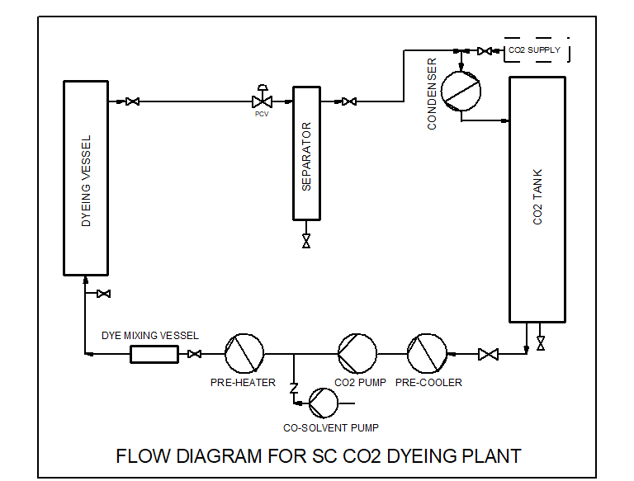
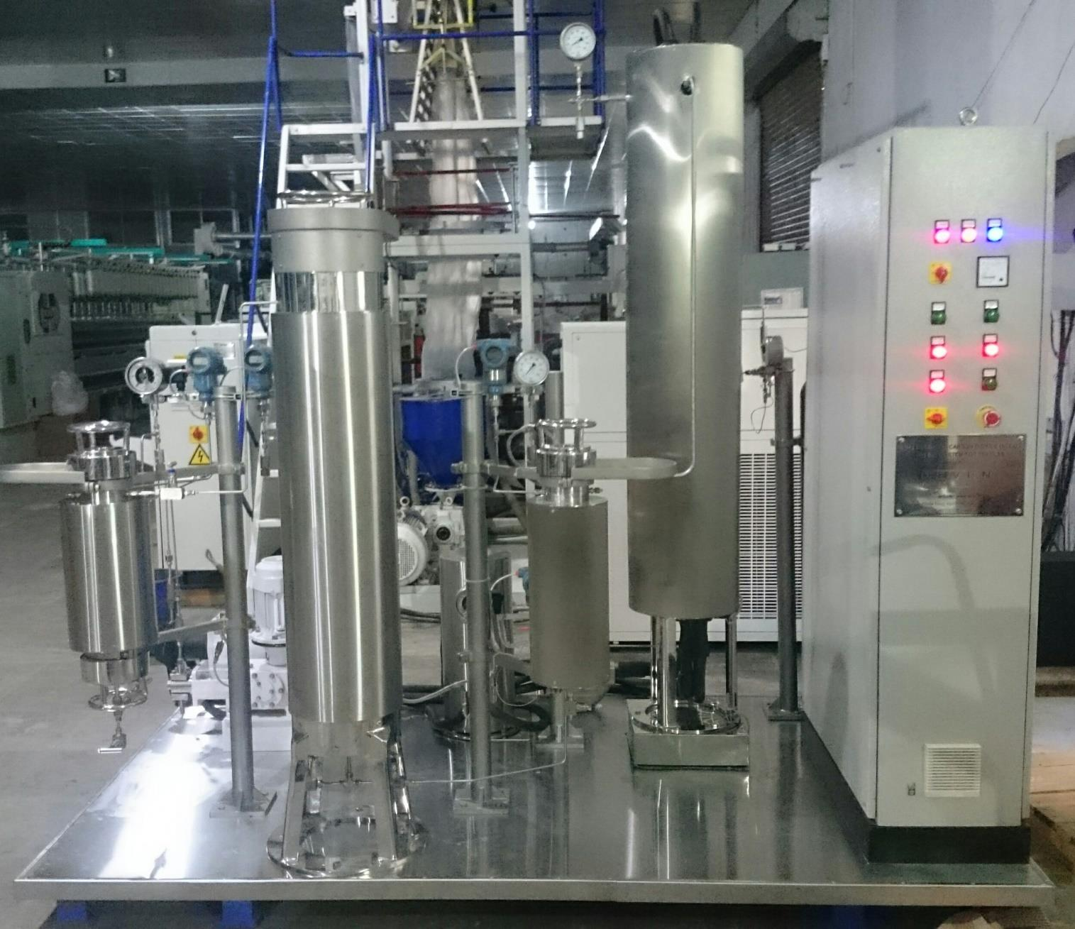
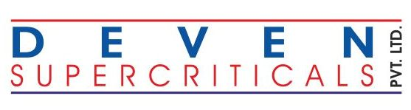
Textile Dyeing with scCO₂ (waterless Dyeing)
More Efficient Process Developed and Patented by Dr. Swapneshu Baser, Deven Supercriticals Pvt. Ltd., India
Process:
Dissolution of Dye in SC CO₂
Swelling of Textile Material by SC CO₂
Efficient Diffusion of Dye in Textile Matrix
Depressurise to Entrap Dye in Textile Matrix
Advantages:
No Water Usage
Zero Discharge process
No ETP requirement
Re-use of unused Dye collected in Separator
Lower overall cost of Dyeing

Slide 50
Limitation of using scCO₂
High pressures required:
  Standard HPLC apparatus used in lab, reactors made of stainless steel, many commercially available.
  Higher initial investment for large scale work.
Weak solvent:
  Relatively non-polar, with high quadrupole moment.
  For polar molecules, require use of co-solvents (MeOH, MeCN, THF, toluene).
  Simple modification of reagents to improve solubility.
Energy considerations:
  Compression, Liquification of CO₂ requires energy.
  Energy consumption reduced minimal decompression and recycling.
Reacts in the presence of good nucleophiles:
  Often reversible, can be exploited synthetically.

Slide 51
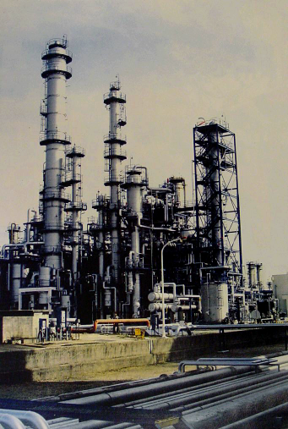
Reactions in Supercritical Fluids
N₂ hydrogenation (Haber-Bosch Process, BASF 1913)
scC₂H₄ polymerization (ICI in 1937)
Olefin hydration (Shell, BP, Erdöl, Hibernia, ICI, VEBA…)
Idemitsu Petrochemical

Slide 52
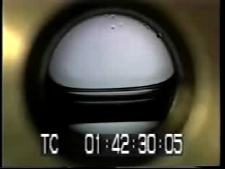
CO₂-Expanded Liquids
CO₂-expanded NEt₃ (Jessop, 1996)
Volumetric expansion of aprotic solvents by CO₂
at 40˚C (Kordikowski, 1995)
Review paper: Chem. Rev. 2007, 107, 2666

Slide 53
CO₂-Expanded Liquids
Charged substance mixtures that form a liquid at ambient temperatures.
“Salts whose crystal structure has been perturbed so they are a liquid at room temperature.”
Advantages:
Less organic content than conventional solvents
Variable solvent properties
Highly adjustable polarity
Lowered melting point
Viscosity drops greatly
Excellent mass transfer rates
Improved solubility of reagent gases
Better solvent strength than scCO₂
Lower pressure than scCO₂
Disadvantages:
  Still requires some pressure
  Still requires some organic solvent
  Doesn’t work with water
Viscosity of CO₂-expanded crude oil at 49 ˚C
J. Petrol. Technol. (1965) 102.
Notes:
Ionic liquids have been found useful for a wide range of chemical reactions and processes, including hydrogenation reactions, biocatalysis reactions such as transesterification and perhydrolysis, and electrochemical applications such as battery electrolytes
Another use for ionic liquids is as a medium for separation of biologically produced feedstocks from a fermentation broth, such as acetone, ethanol, or butanol

Slide 54
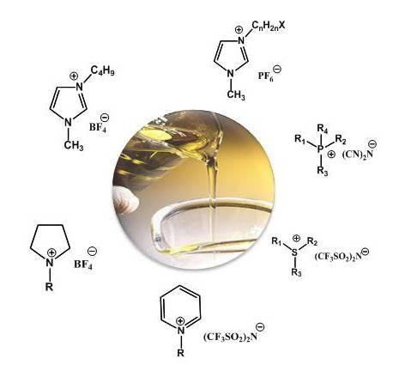
Ionic Liquids
A salt: A cation and an anion
It has to be liquid below 100°C
Wide chemical variability => adapted to applications
http://www.rtil.eu/pmwiki/pmwiki.php/About/IonicLiquids

Slide 55
Ionic Liquids
Charged substance mixtures that form a liquid at ambient temperatures.
“Salts whose crystal structure has been perturbed so they are a liquid at room temperature.”
Advantages:
Very low vapour pressure – attractive alternative to VOCs.
Good solvents for a wide range of organic, inorganic and polymeric compounds.
Anion and cation can be fine tuned to give a wide range of solvent properties (e.g. hydrophilic, hydrophobic) which can be exploited.
Wide range of reactions already demonstrated in this medium.
Can be used in conjunction with other alternative solvents (particularly CO₂).
Claimed to be recyclable (essential for widespread use) although there may be regulatory problems with this.
Effectively, properties similar to many other high boiling, polar solvents.
Disadvantages:
  Expensive compared to other solvents although cheaper versions are appearing.
  Have to be prepared:
    Usually involves use of other solvents.
  Work-up to separate/extract products usually involves other solvents.
  Recycling also usually involves other solvents to extract unwanted residues.
  Questionable toxicity – some certainly are toxic and have been shown to have a detrimental effect on aquatic life – problem as not VOC so will tend to persist in local environment, on land/sea etc.
  Still requires disposal at end of life (incineration?).
  Always POLAR
Notes:
Ionic liquids have been found useful for a wide range of chemical reactions and processes, including hydrogenation reactions, biocatalysis reactions such as transesterification and perhydrolysis, and electrochemical applications such as battery electrolytes
Another use for ionic liquids is as a medium for separation of biologically produced feedstocks from a fermentation broth, such as acetone, ethanol, or butanol

Slide 56
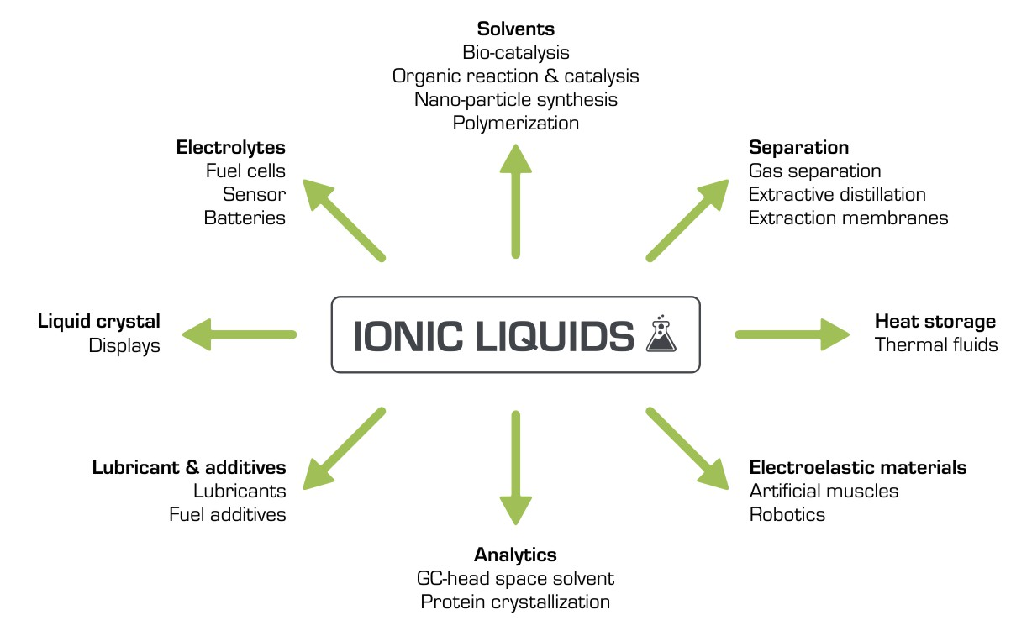
Ionic Liquids
Organic transformations in IL
Diels-Alder reactions
Alkylation reactions
Hydroformylation reactions
Friedel Crafts reactions
Pd-mediated C-C bond formation
Alkene polymerisation
Biotransformations
T. Welton, Chem. Rev., 1999, 99, 2071. http://www.researchinschools.org/projects/ionic_liquids.html

Slide 57
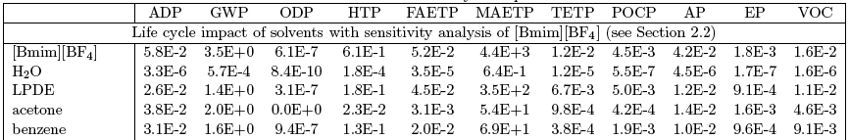
Ionic Liquids: Are they green?
Zhang, Env. Sci. Tech., 2008, 42, 1724

Slide 58
Ionic Liquids: Are they green?
Zhang, Env. Sci. Tech., 2008, 42, 1724
Jessop, Green Chem (2011) 13, 1391

Slide 59
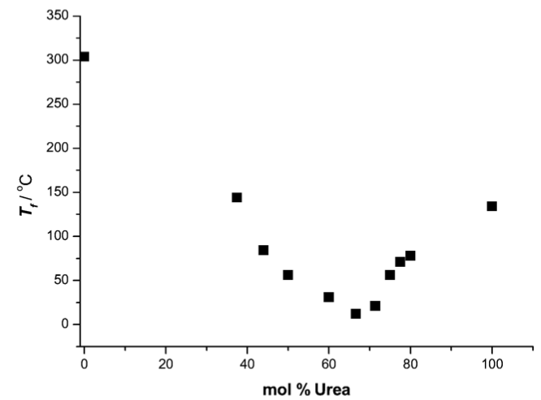
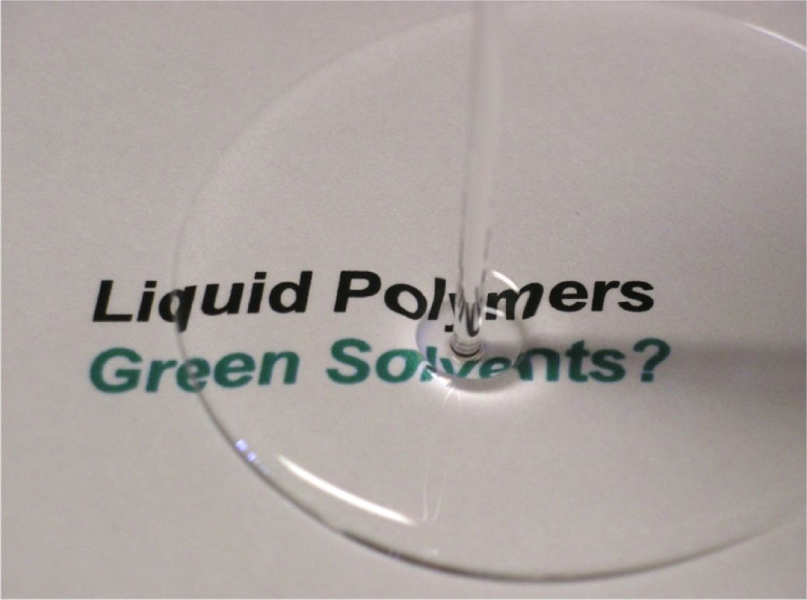
Alternatives to Ionic Liquids
Deep eutectic solvent
Liquid polymers
+
choline chloride
(mp 302 ˚C)
urea
(mp 134 ˚C)
Abbott, Chem. Commun., 2003, 70

Slide 60
Topics Covered
The problems with solvents
Minimizing solvent use
Selecting greener conventional solvents
Using unconventional solvents

Slide 61
Sponsored by Yale-UNIDO Initiative
QUESTIONS?
CENTER for GREEN CHEMISTRY
and GREEN ENGINEERING at YALE

