Slide 1
Green Analytical Chemistry
Lecture #20
Date:
Course #
Notes:
C&E News article on Greening the Analytical Lab
Volume 93 Issue 47 | pp. 14-16
Issue Date: November 30, 2015
How Companies And Scientists Are Greening The Analytical Lab
https://cen.acs.org/articles/93/i47/Companies-Scientists-Greening-Analytical-Lab.html

Slide 2
Outline
What is Green Analytical Chemistry?
Analytical Method Assessment
  Tools and Techniques for Assessing Greenness of Analytical Methods
Sample Preparation
Analytical Techniques and Methods
  Chromatography
  Spectroscopy
  Mass spectrometry
Process Analytical Technology (PAT)

Slide 3
Outline
What is Green Analytical Chemistry?
Analytical Method Assessment
  Tools and Techniques for Assessing Greenness of Analytical Methods
Sample Preparation
Analytical Techniques and Methods
  Chromatography
  Spectroscopy
  Mass spectrometry
Process Analytical Technology (PAT)

Slide 4
What is Green Analytical Chemistry?
Principle # 11) Real-Time Analysis for Pollution Prevention
Analytical methodologies need to be further developed to allow for real-time in-process monitoring and control prior to the formation of hazardous substances.
Green Analytical Chemistry
The use of analytical chemistry techniques and methodologies that reduce or eliminate solvents, reagents, preservatives, and other chemicals that are hazardous to human health or the environment and that may also enable faster and more energy efficient analyses without compromising performance criteria.
Notes:
Green Analytical Chemistry definition from Vanhoenacker, G., Sandra, P., David, F., Sandra, K., Pereira, A., 2010, Green chromatography (Part 1): Introduction and liquid chromatography, LC-GC Europe, 23, 242-259
“Green Analytical Chemistry” by Paul Ferguson and Douglas Raynie, in Green Techniques for Organic Synthesis and Medicinal Chemistry, 2nd Edition, Zhang, W. and Cue, B. W., Eds., Wiley, 2018, pp. 43-66

Slide 5
What is Green Analytical Chemistry?
“Green analytical chemistry can be defined as research that optimizes analytical processes to provide the required information in a manner that is inherently safe, nontoxic, and environmentally benign, and with the least possible consumption of material and energy and generation of waste.”
M. Koel, M. Kaljurand, Crit. Rev. Anal. Chem., 42, 192-195 (2012).
Notes:
M. Koel, M. Kaljurand, Crit. Rev. Anal. Chem., 42, 192-195 (2012).

Slide 6
Misconceptions in Green Analytical Chemistry
Microscale = Green
Yes, a microscale method will be greener than its larger-scale counterpart, but you must still keep in mind sampling theory and appropriate sample size.
No Organic Solvents = Green
Aqueous solvents may be less toxic than most organics, but you still must consider wastewater generation or the energy needed for solvent evaporation. Consider all 12 Principles, not just toxicity or flammability.
Notes:
Douglas Raynie, Green Analytical Chemistry: https://www.beyondbenign.org/webinar/implementing-green-chemistry-introductory-analytical-course/

Slide 7
12 Principles of Green Analytical Chemistry
Direct analytical techniques should be applied to avoid sample treatment.
Minimal sample size and minimal number of samples are goals.
In situ measurements should be performed.
Integration of analytical processes and operations save energy and reduce the use of reagents.
Automated and miniaturized methods should be selected.
Derivatization should be avoided.
Generation of large volumes of analytical waste should be avoided and proper management of analytical waste should be provided.
Multi-analyte or multi-parameter methods are preferred versus methods using one analyte at a time.
The use of energy should be minimized.
Reagents obtained from renewable sources should be preferred.
Toxic reagents should be eliminated or replaced.
The safety of the operator should be increased.
Notes:
12 principles of Green Analytical chemistry from: Galuszka, A., Migaszewski, Z., Namiesnik, J., 2013, The 12 principles of green analytical chemistry and the SIGNIFICANCE mnemonic of green analytical practices, Trends Anal. Chem., 50, 78-84
“Green Analytical Chemistry” by Paul Ferguson and Douglas Raynie, in Green Techniques for Organic Synthesis and Medicinal Chemistry, 2nd Edition, Zhang, W. and Cue, B. W., Eds., Wiley, 2018, pp. 43-66

Slide 8
12 Principles of Green Analytical Chemistry
Direct analytical techniques should be applied to avoid sample treatment. – Real-time Analysis/PAT
Minimal sample size and minimal number of samples are goals. – Sample Prep
In situ measurements should be performed. – Real-time Analysis/PAT
Integration of analytical processes and operations save energy and reduce the use of reagents. - Real-time Analysis/PAT
Automated and miniaturized methods should be selected. - Real-time Analysis/PAT
Derivatization should be avoided. – Sample Prep
Generation of large volumes of analytical waste should be avoided and proper management of analytical waste should be provided. – Analytical Methods
Multi-analyte or multi-parameter methods are preferred versus methods using one analyte at a time. – Analytical Methods
The use of energy should be minimized.
Reagents obtained from renewable sources should be preferred. – Sample Prep & Analytical Methods
Toxic reagents should be eliminated or replaced. - Sample Prep & Analytical Methods
The safety of the operator should be increased. - Sample Prep & Analytical Methods & Real-time Analysis/PAT
Notes:
Each of these principles falls in to 3 general areas, although there is some overlap. See the next slide for organizing of Sample Prep, Analytical Methods, and Real-time Analysis/PAT
Green Analytical Chemistry definition from Vanhoenacker, G., Sandra, P., David, F., Sandra, K., Pereira, A., 2010, Green chromatography (Part 1): Introduction and liquid chromatography, LC-GC Europe, 23, 242-259
“Green Analytical Chemistry” by Paul Ferguson and Douglas Raynie, in Green Techniques for Organic Synthesis and Medicinal Chemistry, 2nd Edition, Zhang, W. and Cue, B. W., Eds., Wiley, 2018, pp. 43-66

Slide 9
Green Analytical Chemistry
Sample Prep
Solvent selection/use
Green media and/or reagents
Instrumental Analysis
Techniques:
Spectroscopy
Real-time Analysis/PAT
At-line
On-line
Reduction of scale
Extraction/separation processes
Chromatography
Method improvement
In-line
Etc.
iStock photos: Standard license
Notes:
iStock images: Beyond Benign has the rights to use these images.

Slide 10
Outline
What is Green Analytical Chemistry?
Analytical Method Assessment
  Tools and Techniques for Assessing Greenness of Analytical Methods
Sample Preparation
Analytical Techniques and Methods
  Chromatography
  Spectroscopy
  Mass spectrometry
Process Analytical Technology (PAT)

Slide 11
Analytical Method Assessment:
Tools & Techniques
Tools for measuring the “greenness” of analytical methods:
  NEMI – National Environmental Methods Index: Searchable database for analytical methods
  Eco-tool (Galuszka, et. al.)
Scoring of solvents
  total hazard value (tHV) and total analytical hazard value (taHV) (Tobiszewski, et. al.) (see next slide)
Notes:
For more information about the mentioned method assessments, see the articles:
NEMI: https://www.nemi.gov/about/ - also, see the article Chem. Rev., 2007, 106, 6, 2695-2708
Galuszka, A., Konieczka, P., Migaszewski, Z. Namiesnik, J., 2012, Analytical eco-scale for assessing the greenness of analytical procedures, Trends Anal. Chem., 37, 61-72
Tobiszewski, M., Namiesnik, J., 2015, Scoring of solvents used in analytical laboratories by their toxicological and exposure hazards, Ecotox. Environ. Safety, 120, 169-173

Slide 12
tHV and taHV values of common solvents used in analytical procedures
 | Compound Name | tHV | taHV
Hydrocarbons | Pentane* | 23.4 | 36.4
 | Hexane* | 53.8 | 81.4
 | Cyclohexane* | 57.9 | 79.8
 | Heptane* | 15.2 | 20.9
Alcohols | Methanol | 8.8 | 15.7
 | Ethanol | 4.1 | 7.2
 | Isopropanol | 3.9 | 6.8
Ethers | Diethyl ether | 8.7 | 16
 | Methyl t-butyl ether | 2.7 | 3.8
 | Tetrahydrofuran | 9.1 | 14.9
Ketones | Acetone | 1.5 | 2.6
Organic acids | Formic acid | 25.8 | 43.0
 | Acetic acid | 1.3 | 2.1
Esters | Ethyl acetate | 5.0 | 7.3
Chlorinated hydrocarbons | Dichloromethane* | 39.3 | 59.8
 | Chloroform* | 70.7 | 103.8
 | 1,1,1-Trichloroethane* | 34.7 | 49.0
Others | Acetonitrile | 18.8 | 26.9
Total hazard value (tHV)
Total analytical hazard value (taHV)
Use toxicological and exposure data to create values
Factors in solvent volatility
Hazard values can be combined with solvent use to create impact assessments for analytical procedures
These organic solvents are compatible with different modes of liquid chromatography and other analytical techniques.
* These solvents are immiscible with water and can be used as part of liquid-liquid extraction sample preparation
Tobiszewski, M., Namiesnik, J., 2015, Scoring of solvents used in analytical laboratories by their toxicological and exposure hazards, Ecotox. Environ. Safety, 120, 169-173
Notes:
For more information about the mentioned method assessments, see the articles:
NEMI: https://www.nemi.gov/about/ - also, see the article Chem. Rev., 2007, 106, 6, 2695-2708
Galuszka, A., Konieczka, P., Migaszewski, Z. Namiesnik, J., 2012, Analytical eco-scale for assessing the greenness of analytical procedures, Trends Anal. Chem., 37, 61-72
Tobiszewski, M., Namiesnik, J., 2015, Scoring of solvents used in analytical laboratories by their toxicological and exposure hazards, Ecotox. Environ. Safety, 120, 169-173

Slide 13
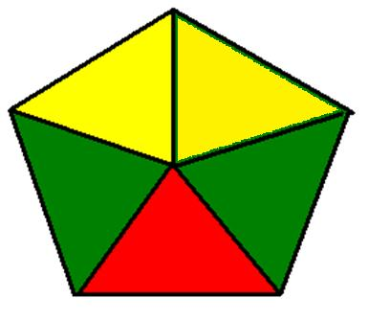
Analytical Method Assessment:
Tools & Techniques
NEMI Greenness metric
Tools for measuring the “greenness” of analytical methods:
  NEMI – National Environmental Methods Index: Searchable database for analytical methods – Greenness metric
  Greenness Assessment Profile
  Eco-tool (Galuszka, et. al.)
  AMVI – Analytical Method Volume Intensity – a metric for HPLC methodology
Scoring of solvents
  total hazard value (tHV) and total analytical hazard value (taHV) (Tobiszewski, et. al.) (see next slide)
Toxicity
PBT
Corrosivity
Waste
Greenness Assessment Profile
Health
Safety
Environmental
Waste
Energy
Notes:
The NEMI greenness metric offers a quick visual on the “greenness” of a method – each of the quadrants are defined as above – the quadrants is left white if not considered “green”
For more information about the Greenness Assessment Profile – see the following webinar by Douglas Raynie, South Dakota State University: https://www.beyondbenign.org/webinar/implementing-green-chemistry-introductory-analytical-course/
The eco-tool helps identify and potentially improve the weakest or least green aspect of an analytical method and help set priorities (Galuszka reference below for more detailed info on eco-tool)
For more information about the mentioned method assessments, see the articles:
NEMI: https://www.nemi.gov/about/ - also, see the article Chem. Rev., 2007, 106, 6, 2695-2708
Galuszka, A., Konieczka, P., Migaszewski, Z. Namiesnik, J., 2012, Analytical eco-scale for assessing the greenness of analytical procedures, Trends Anal. Chem., 37, 61-72
Tobiszewski, M., Namiesnik, J., 2015, Scoring of solvents used in analytical laboratories by their toxicological and exposure hazards, Ecotox. Environ. Safety, 120, 169-173

Slide 14
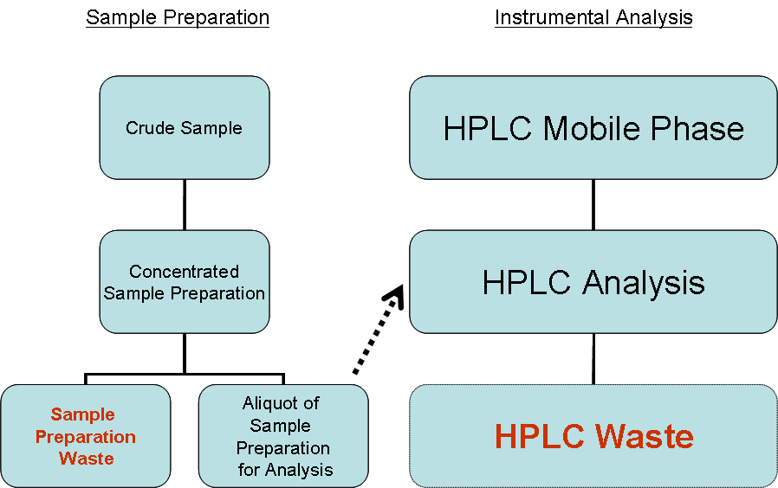
Analytical Method Assessment:
An example for HPLC (AMVI)
Merck Analytical Method Volume Intensity (AMVI):
AMVI = Total Solvent Consumption/Peak Number
Total Solvent Consumption = (Σ solvent sample prep + Σ solvent HPLC) *Replicates
Peak Number = Σ analyte peaks specified in method
Notes:
R. Helmy, R. Hartman, C. J. Welch, and M. Al-Sayah, Green Chem., 2011, 13, (934-939)
The goal of the AMVI is to measure the total volume of solvent consumed and waste generated by an analytical method, so as to provide a basis for comparing the environmental efficiency of various analytical methods.
This metric combines the two main waste streams in HPLC analytical methodology – that from sample prep and that from the HPLC analysis, allowing practitioners where they can make the biggest impact on solvent waste generation.

Slide 15
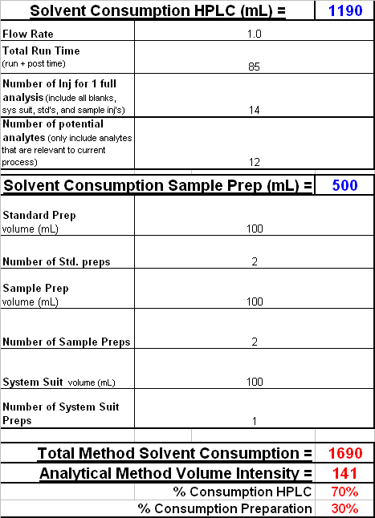
Analytical Method Assessment:
An example for HPLC (AMVI)
Number of peaks in HPLC: 9
70% of the waste is from HPLC analysis!
System peaks
Notes:
Example taken from: R. Helmy, R. Hartman, C. J. Welch, and M. Al-Sayah, Green Chem., 2011, 13, (934-939)
Using the AMVI assessment, you can see that 70% of the solvent waste is from HPLC analysis – this gives the researchers an opportunity to make improvements!

Slide 16
Analytical Method Assessment:
An example for HPLC (AMVI)
First method: AMVI = 141 (70% HPLC waste)
Column used: 250 x 4.6 mm i.d. column with 5 um particles
Switching to 150 mm x 3.0 mm i.d. column with 3.5 um particles
AMVI reduced to 59 (65% due to solvent use in sample prep)
How to address sample prep?
Switching solvent in sample prep to a solvent that allows the API to be more soluble
AMVI reduced to 30 (67% due to HPLC waste)
Notes:
Example taken from: R. Helmy, R. Hartman, C. J. Welch, and M. Al-Sayah, Green Chem., 2011, 13, (934-939)
Using the AMVI assessment, you can see that 70% of the solvent waste is from HPLC analysis – this gives the researchers an opportunity to make improvements!
And, by looking at the solubility of the API in the solvent that wsa used in sample prep, they were able to find that the API was more soluble in another solvent and therefore, much less solvent had to be used in the solvent prep.

Slide 17
Outline
What is Green Analytical Chemistry?
Analytical Method Assessment
  Tools and Techniques for Assessing Greenness of Analytical Methods
Sample Preparation
Analytical Techniques and Methods
  Chromatography
  Spectroscopy
  Mass spectrometry
Process Analytical Technology (PAT)

Slide 18
Sample Preparation
Dissolution of a desired analyte(s) into solution, sample pre-concentration and/or removal of interfering matrix components
  Homogenization
  Filtration
  Centrifugation
  Extraction
  Pre-concentration
  Derivatization
Principles #2, 6, 10-12 of Green Analytical Chemistry principles address sample preparation:
(2) Minimizing sample size and number
(6) Derivatives should be avoided
When direct analytical methods are applied, sample prep can be avoided!
Real-time analysis and Process Analytical Technology
Notes:
Sample preparation often includes many processes, including the ones listed in this slide – many involve the use of solvents, or special equipment or processes. Whenever direct analytical methods can be used, sample preparation can oftentimes be avoided.

Slide 19
Sample Preparation: Solvent Selection
Solvent Selection Guides can help guide analytical scientists towards safer solvents with similar solvent properties
  Pfizer Solvent Selection Guide
  GSK Solvent Selection Guide
  ACS GCI Pharma Roundtable Solvent Selection Guide
  Sanofi’s Solvent Selection Guide
Notes:
“Green chemistry tools to influence a medicinal chemistry and research chemistry based organization”
Dunn and Perry, et. al., Green Chem., 2008, 10, 31-36
Henderson, R.K., et. al., Green Chem., 2011, 13, 854
http://www.acs.org/content/acs/en/greenchemistry/industry-business/pharmaceutical.html

Slide 20
Preferred | Useable | Undesirable
Water | Cyclohexane | Pentane
Acetone | Heptane | Hexane(s)
Ethanol | Toluene | Di-isopropyl ether
2-Propanol | Methylcyclohexane | Diethyl ether
1-Propanol | Methyl t-butyl ether | Dichloromethane
Ethyl acetate | Isooctane | Dichloroethane
Isopropyl acetate | Acetonitrile | Chloroform
Methanol | 2-MethylTHF | Dimethyl formamide
Methyl ethyl ketone | Tetrahydrofuran | N-Methylpyrrolidinone
1-Butanol | Xylenes | Pyridine
t-Butanol | Dimethyl sulfoxide | Dimethyl acetate
 | Acetic acid | Dioxane
 | Ethylene glycol | Dimethoxyethane
 |  | Benzene
 |  | Carbon tetrachloride
Notes:
From the article referenced below – this table is a brief summary of preferred solvents, “useable” solvents (or, ones that should be used minimally and that still need viable alternatives), and undesirable solvents which have high hazards associated with them – see the next slide that explains more about undesirable solvents and why
“Green chemistry tools to influence a medicinal chemistry and research chemistry based organization”
Dunn and Perry, et. al., Green Chem., 2008, 10, 31-36

Slide 21
Red Solvent | Flash point (°C) | Reason
Pentane | -49 | Very low flash point, good alternative available.
Hexane(s) | -23 | More toxic than the alternative heptane, classified as a HAP in the US.
Di-isopropyl ether | -12 | Very powerful peroxide former, good alternative ethers available.
Diethyl ether | -40 | Very low flash point, good alternative ethers available.
Dichloromethane | n/a | High volume use, regulated by EU solvent directive, classified as HAP in US.
Dichloroethane | 15 | Carcinogen, classified as a HAP in the US.
Chloroform | n/a | Carcinogen, classified as a HAP in the US.
Dimethyl formamide | 57 | Toxicity, strongly regulated by EU Solvent Directive, classified as HAP in the US.
N-Methylpyrrolidinone | 86 | Toxicity, strongly regulated by EU Solvent Directive.
Pyridine | 20 | Carcinogenic/mutagenic/reprotoxic (CMR) category 3 carcinogen, toxicity, very low threshold limit value (TLV) for worker exposures.
Dimethyl acetate | 70 | Toxicity, strongly regulated by EU Solvent Directive.
Dioxane | 12 | CMR category 3 carcinogen, classified as HAP in US.
Dimethoxyethane | 0 | CMR category 2 carcinogen, toxicity.
Benzene | -11 | Avoid use: CMR category 1 carcinogen, toxic to humans and environment, very low TLV (0.5 ppm), strongly regulated in EU and the US (HAP).
Carbon tetrachloride | n/a | Avoid use: CMR category 3 carcinogen, toxic, ozone depletor, banned under the Montreal protocol, not available for large-scale use, strongly regulated in the EU and the US (HAP).
“Green chemistry tools to influence a medicinal chemistry and research chemistry based organization”
Dunn and Perry, et. al., Green Chem., 2008, 10, 31-36
Notes:
This table summarizes the reason why the undesired solvents have been flagged as “undesirable” – you will see that some are because they have chronic hazards (i.e., chloroform is a known carcinogen) and others have physical hazards, such as diethyl ether having a very low flash point and being a peroxide former (both of which pose a physical hazard). It is useful to note that not all of the hazards are human heath hazards, but also can be due to flammability or explosion hazards (physical hazards)
“Green chemistry tools to influence a medicinal chemistry and research chemistry based organization”
Dunn and Perry, et. al., Green Chem., 2008, 10, 31-36

Slide 22
Undesirable Solvent | Alternative
Pentane | Heptane
Hexane(s) | Heptane
Di-isopropyl ether or diethyl ether | 2-MeTHF or tert-butyl methyl ether
Dioxane or dimethoxyethane | 2-MeTHF or tert-butyl methyl ether
Chloroform, dichloroethane or carbon tetrachloride | Dichloromethane
Dimethyl formamide, dimethyl acetamide or N-methylpyrrolidinone | Acetonitrile
Pyridine | Et₃N (if pyridine is used as a base)
Dichloromethane (extractions) | EtOAc, MTBE, toluene, 2-MeTHF
Dichloromethane (chromatography) | EtOAc/heptane
Benzene | Toluene
Notes:
This table provides alternatives to undesirable solvents – the “undesirable solvents” on the left are aligned with suitable alternatives with similar solvent properties (and reduced hazards) on the right – this is a good reference for when looking to make a switch of solvents
“Green chemistry tools to influence a medicinal chemistry and research chemistry based organization”
Dunn and Perry, et. al., Green Chem., 2008, 10, 31-36

Slide 23
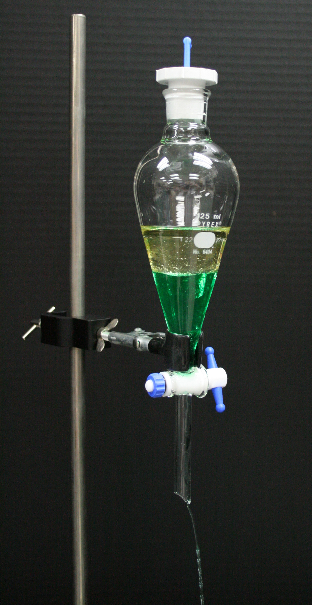
Sample Preparation: Liquid Approaches
Solid-Liquid Extraction
  Most common, simplest approach of dissolving a solid sample in a solvent
  Important factor: selection of the appropriate solvent!
Liquid-Liquid Extraction
  Least “green” approach – use of a solvent to dissolve the sample and then extract with an immiscible solvent. Can generate lots of solvent waste.
Sub- or Supercritical Water Extraction
  Water has powerful solvation properties at a critical temp of 374◦C and 218 atm
  Drawbacks: potential for breakdown of analyte at high temps, oxidative properties of water, energy use/specialized equipment
Supercritical Fluid Extraction
  Carbon dioxide as a solubilizing agent (above 32◦C and 72 atm); similar polarity as hexane or heptane (good for extracting hydrophobic analytes)
  Drawbacks: high temp/pressure; requires special equipment
Others: Ionic Liquids, Coacervative Liquids
Image from Creative commons
Notes:
“Green Analytical Chemistry” by Paul Ferguson and Douglas Raynie, in Green Techniques for Organic Synthesis and Medicinal Chemistry, 2nd Edition, Zhang, W. and Cue, B. W., Eds., Wiley, 2018, pp. 43-66
Image from Creative commons
Ionic liquids: benefits of being non-volatile, non-flammable and have interesting solvent properties – ILs are finding applications within analytical chemistry as sorptive phases in solid-phase microextractions
Coacervative liquids – coacervates are water immiscible surfactant-rich liquids produced in colloidal solutions by the action of a drying agent. In coacervative extraction, coacervatives are obtained from ionic amphiphile by the change of pH in solution, addition of an electrolyte or addition of an organic solvent in which the analyte has low solubility.

Slide 24
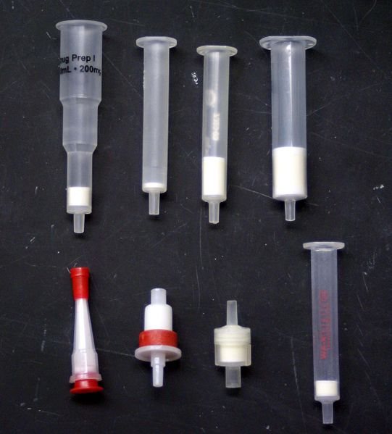
Sample Preparation: Solid Approaches
Solid-Phase Extraction
  Solid separation medium (sorbent) is packed into a cartridge, preconditioned with the appropriate solvent, the sample is added to the top of the sorbent bed and analytes are eluted using the appropriate solvent system
  Benefits: Typically much smaller volume of solvent use (as compared to liquid-liquid extraction); small amounts of solvent waste; inexpensive materials; can be automated to a variety of instruments for analysis
Solid-Phase Microextraction
  Fused-silica fiber derivatized with a liquid polymer is placed in a liquid sample to adsorb the analyte, then transferred for direct analysis, or dissolved in a liquid for HPLC analysis
  Benefits: uses no to low volumes of solvent, useful for trace analyses
Stir-Bar Sorptive Extraction
  Uses small magnetic stir bars coated with polydimethylsiloxane (PDMS)
Image Source: Wikipedia Commons
Notes:
“Green Analytical Chemistry” by Paul Ferguson and Douglas Raynie, in Green Techniques for Organic Synthesis and Medicinal Chemistry, 2nd Edition, Zhang, W. and Cue, B. W., Eds., Wiley, 2018, pp. 43-66
Image from Wikimedia commons: https://commons.wikimedia.org/wiki/File:SPE_Cartridges.jpg
Solid-phase extraction - Based on properties of sorbent; as a general rule automating any liquid handling sample preparation step is likely to be faster, provide more reproducible results, reduce solvent usage and increase operator safety.
Stir-bar sorptive extraction – similar to solid-phase, the sample is transfered for direct analysis of desorbed in a liquid for HPLC analysis. The stir-bars can be recycled for use if the analytes and interferences can effectively be desorbed

Slide 25
Outline
What is Green Analytical Chemistry?
Analytical Method Assessment
  Tools and Techniques for Assessing Greenness of Analytical Methods
Sample Preparation
Analytical Techniques and Methods
  Chromatography
  Spectroscopy
  Mass spectrometry
Process Analytical Technology (PAT)

Slide 26
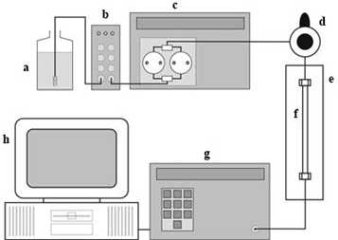
Analytical Techniques and Methods: Chromatography
Liquid Chromatography – techniques for improving sustainability of liquid chromatographic methods
  Solvent Selection
    Solvent Selection guides previously mentioned
    Alternatives to methylene chloride in chromatography
    Ethanol typically good replacement for acetonitrile
  Solvent flow rate can be reduced if the LC column internal column diameter (i.d.) is decreased (AVMI example)
  Reducing particle size and column length (keeping L/d_{p} constant)
  Changes in temperature
Image Source: Wikipedia Commons
Notes:
Solvent flow rate example: For example, a simple switch from a 4.6 mm to 3.0 mm i.d. column running at 1.0 ml/min on the 4.6 mm id column and a scaled flow rate of 0.43 ml/min on the 3.0 mm id column will provide a ~60% reduction in mobile phase consumption while still compatible with HPLC instrumentation.
Reducing particle size example: A separation on a 150 mm column packed with 5 micron particles (L/dp = 30,000) should have similar chromatographic efficiency (and resolution) to a 100 mm column packed with 3 micron particles (L/dp = 33,000)
Changes in temperature – for ionizable analytes, it is a key variable for affecting chromatographic selectivity and resolution; increasing the temperature also increases the rate of mass transfer during the chromatographic process leading to increased chromatographic efficiency and improved peak shapes
“Green Analytical Chemistry” by Paul Ferguson and Douglas Raynie, in Green Techniques for Organic Synthesis and Medicinal Chemistry, 2nd Edition, Zhang, W. and Cue, B. W., Eds., Wiley, 2018, pp. 43-66
Image from Wikimedia commons: https://commons.wikimedia.org/wiki/File:HPLC_simp.png

Slide 27
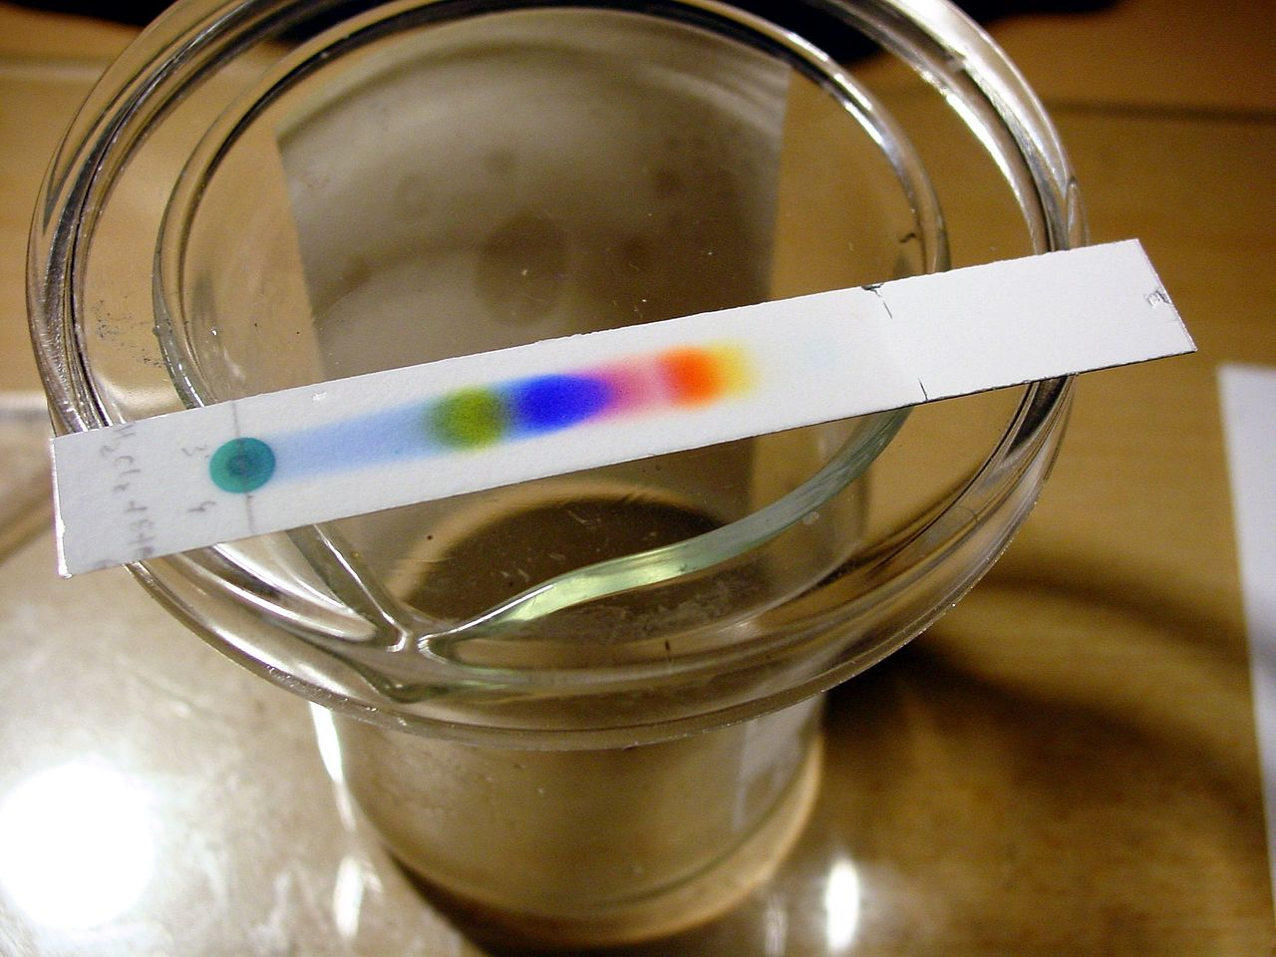
Analytical Techniques and Methods: Chromatography
Thin-Layer and Flash Chromatography
  Traditional solvent based approaches
  TLC: Being coupled with MS detection to minimize solvent use and sample prep
  Flash: Can result in large volumes of solvent waste
Gas Chromatography
  Generally “greener” in comparison to liquid; generates little to no waste compared to liquid
  However, GC uses helium as the carrier gas (in short supply!)
Image Source: Wikipedia Commons
Notes:
Helium is in short supplie – it has been estimated that only 25 – 30 years of helium were available for use under current demand levels; however, a helium field has recently been discovered in Tanzania and has increased this, but it’s still a reducing resource
Other gases that have been uses as carriers are hydrogen (which has an explosion hazard) and nitrogen – which is “greener”, but provides the poorest u_{opt} – requiring longer analysis times
“Green Analytical Chemistry” by Paul Ferguson and Douglas Raynie, in Green Techniques for Organic Synthesis and Medicinal Chemistry, 2nd Edition, Zhang, W. and Cue, B. W., Eds., Wiley, 2018, pp. 43-66
Image from Wikimedia commons: https://commons.wikimedia.org/wiki/File:TLC_black_ink.jpg

Slide 28
A convenient guide to help select replacement solvents for dichloromethane in chromatography
Taygerly, J.P., Peterson, E.A., et. al., Green Chemistry, 2012, 14, 3020-3025.
Notes:
Figure 2: Green Chromatography Solvent Selection Guide. Starting from the appropriate DCM–MeOH concentration, compare vertically across the bar chart to identify greener solvent mixtures of similar eluting ability. For example, if a compound suitably elutes in 5% DCM–MeOH in the absence of an additive, the “Neutral Compounds” bar chart predicts that 60% 3:1 EtOAc : EtOH in heptanes or 40% i-PrOH in heptanes would be suitable starting points to evaluate greener solvent alternatives.
A 3:1 (v/v) solution of ethyl acetate/ethanol has been found to a viable alternative for dichloromethane (DCM) in flash chromatography and HPLC. This alternative is based on a publication in the journal Green Chemistry by Taygerly and Peterson titled “A convenient guide to help select replacement solvents for dichloromethane in chromatography”. The chromatography guide is experimentally-derived, and provides chemists options for choosing greener options, with a particular focus on the use of DCM. The guide itself was developed for use by medicinal chemists looking for alternatives to DCM and methanol, which is widely used by chemists to purify their compounds. The quick-reference guide provides chemists with a reference tool for guiding the substitution according to solvent polarity and eluting ability. The tool cross-references these properties to guide users towards the following greener options for solvents: heptanes, ethyl acetate: ethanol, isopropanol, and methyl t-butyl ether. Sigma-Aldrich offers a greener alternative to chlorinated solvents (in particular, DCM) in chromatography (Sigma-Aldrich SKU 745588).
Taygerly, J.P., Peterson, E.A., et. al., Green Chemistry, 2012, 14, 3020-3025.

Slide 29
Analytical Techniques and Methods: Chromatography
“New” Advances in Chromatography:
UPLC or UHPLC
  Launched in 2004 by Waters – Ultra Performance Liquid Chromatography (or Ultra-High)
Supercritical Fluid Chromatography (SFC)
Notes:
Waters Beginner’s Guide to UPLC for more information : http://www.waters.com/waters/en_US/UPLC---Ultra-Performance-Liquid-Chromatography-Beginner%27s-Guide/nav.htm?locale=en_US&cid=134803622
Image from Waters UPLC beginner’s guide

Slide 30
Analytical Techniques and Methods: Chromatography
HPLC: Traditional HPLC methods use particles between 2.5 – 5 µm in their columns
UPLC (Ultra-Performance Liquid Chromatography) (UPLC is a Waters trademark) or UHPLC: Utilizes sub 2 µm particles)
  Smaller particles in columns, higher pressures (specialized equipment) reduces separation times and maintains resolution
  Results in drastic reduction in solvent use
Notes:
Waters Beginner’s Guide to UPLC for more information : http://www.waters.com/waters/en_US/UPLC---Ultra-Performance-Liquid-Chromatography-Beginner%27s-Guide/nav.htm?locale=en_US&cid=134803622
Image from Waters UPLC beginner’s guide

Slide 31
Analytical Techniques and Methods: SFC
Supercritical Fluid Chromatography (SFC)
  Lower environmental impact
  Shorter separation times
Supercritical CO₂ as a solvent (low viscosity) enables higher flow rates
  Requires high pressures, specialized equipment
  Highly nonpolar solvent – can require a co-solvent (typically ethanol, methanol or isopropanol)
Most commonly used in chiral separations
Notes:
March 1, 2015, LCGC North America, Vol. 33, Issue 3, pp 166-174: http://www.chromatographyonline.com/modern-supercritical-fluid-chromatography-possibilities-and-pitfalls-0
Waters, Supercritical Fluid Chromatography Primer, https://www.agilent.com/cs/library/primers/public/5991-5509EN.pdf

Slide 32
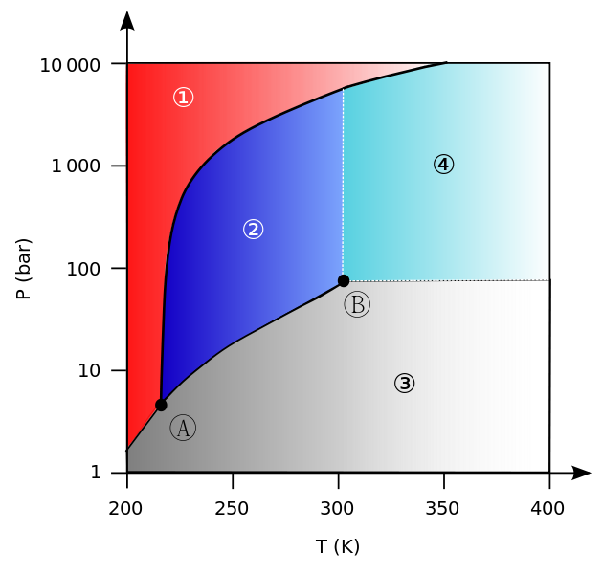
Analytical Techniques and Methods: SFC
What are SCF’s?
A SCF is defined as a substance above its critical temperature (T_{C}) and critical pressure (P_{C}).
The critical point (B) represents the highest temperature and pressure at which the substance can exist as a vapor and liquid in equilibrium.
SFC’s are used in separations, reactions, and more
Carbon dioxide (CO₂) is the most widely used SFC
Phase diagram for carbon dioxide (CO₂)
1) Solid phase; 2) Liquid phase; 3) Gas phase; 4) Supercritical phase; A) Triple point; B) Critical point
Image Source: Wikipedia Commons
Notes:
Image: Wikimedia Commons: https://commons.wikimedia.org/wiki/File:Carbon_dioxide_pressure-temperature_phase_diagram_international.svg
Background information on Supercritical Fluids:
Le Portail Des Fluides Supercritiques, http://www.supercriticalfluid.org/Supercritical-fluids.146.0.html
Supercritical Fluids, LibreTexts, https://chem.libretexts.org/Textbook_Maps/Physical_and_Theoretical_Chemistry_Textbook_Maps/Supplemental_Modules_(Physical_and_Theoretical_Chemistry)/Physical_Properties_of_Matter/States_of_Matter/Supercritical_Fluids

Slide 33
Analytical Techniques and Methods: SFC
Method Advantages
  Equilibration is extremely fast
  Reproducibility is excellent
  Aqueous based samples can be injected
  High efficiency
Greener Benefits
  Lower operating costs (inexpensive solvent source)
  Co-solvent use of ethanol, methanol, isopropanol less hazardous than traditional acetonitrile used commonly in HPLC
  Liquid waste volume drastically reduced
  CO₂ used is recycled from other industries
Notes:
Waters, Supercritical Fluid Chromatography Primer, https://www.agilent.com/cs/library/primers/public/5991-5509EN.pdf

Slide 34
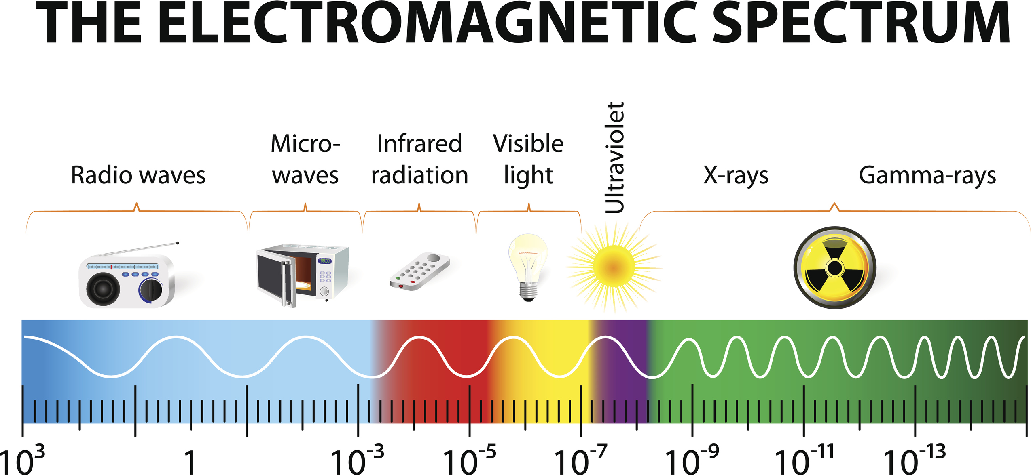
Analytical Techniques and Methods: Spectroscopy
X-Ray Fluorescence
Infrared Spectroscopy
Raman Spectroscopy
Image Source: iStock
Notes:
iStock photo – Beyond Benign has rights

Slide 35
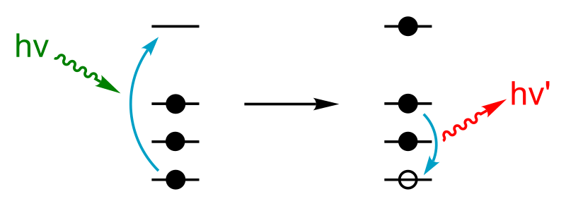
Analytical Techniques and Methods: Spectroscopy
X-Ray Fluorescence
  + Non-destructive
  + Can analyze elemental composition of gas, liquid or solid samples
  + Can detect down to ppm levels
  ? Works by firing x-rays into the sample and analyzing the emission fluorescence spectra, which can be used for multiple elements simultaneously
Notes:
“Green Analytical Chemistry” by Paul Ferguson and Douglas Raynie, in Green Techniques for Organic Synthesis and Medicinal Chemistry, 2nd Edition, Zhang, W. and Cue, B. W., Eds., Wiley, pp. 43-66
For more information on X-ray fluorescence: https://www.thermofisher.com/us/en/home/industrial/spectroscopy-elemental-isotope-analysis/spectroscopy-elemental-isotope-analysis-learning-center/elemental-analysis-information/xrf-technology.html - ThermoFisher,
Image from WikiMedia Commons – open source

Slide 36
Analytical Techniques and Methods: Spectroscopy
Infrared Spectroscopy
  Most utilized technique for organic analyte analysis
  Near-Infrared (NIR): Wavenumber 12,500 – 4,000 cm⁻¹ (primarily used)
    Based on transmission or diffusion when irradiating a sample (solid or liquid)
    + Non-destructive
    + Requires little to no sample prep
    Not very sensitive, and spectra generated is complicated
    -> Good for bulk material identification and confirmation, or for on-line applications
  Mid-Infrared (MIR): Wavenumber 4,000 – 400 cm⁻¹
Notes:
“Green Analytical Chemistry” by Paul Ferguson and Douglas Raynie, in Green Techniques for Organic Synthesis and Medicinal Chemistry, 2nd Edition, Zhang, W. and Cue, B. W., Eds., Wiley, pp. 43-66
More info on IR spectroscopy:
https://www.compoundchem.com/2015/02/05/irspectroscopy/ - Compound Interest, Analytical Chemistry – Infrared (IR) Spectroscopy

Slide 37
Analytical Techniques and Methods: Spectroscopy
Raman Spectroscopy
  Uses laser light to irradiate a sample to generate Raman scattered light
  + High sensitivity
  + High spectral resolution
  + Generates information on composition, bonding, chemical environment and crystalline structure
  + Useful for on-line PAT (see next slides on PAT) due to collecting data rapidly
  + Requires little to no sample prep – can be gaseous, liquid or solid
  + Can be quantitative or qualitative
Notes:
“Green Analytical Chemistry” by Paul Ferguson and Douglas Raynie, in Green Techniques for Organic Synthesis and Medicinal Chemistry, 2nd Edition, Zhang, W. and Cue, B. W., Eds., Wiley, pp. 43-66
Info on Raman Spectroscopy: https://www.nanophoton.net/raman/raman-spectroscopy.html

Slide 38
Analytical Techniques and Methods:
Mass Spectrometry
Mass Spectrometry: Produces charged particles (ions) from chemical substances to be analyzed. Uses electric and magnetic fields to measure the “weight” (mass) of charged particles. Mass spectrometers consist of 3 parts:
  Source: in which ions are produced from the chemical substances to be analyzed
  Analyzer: in which ions are separated according to mass
  Detector: produces a signal from the separated ions
Traditionally: coupled with a separation technique (HPLC, GC, etc.) due to requirement for samples to be introduced via high vacuum for analysis
Notes:
Background information on Mass Spectrometry: https://www.jeolusa.com/DesktopModules/Bring2mind/DMX/API/Entries/Download?EntryId=285&Command=Core_Download&language=en-US&PortalId=2&TabId=337
Background on DART: Cody, R. B., Direct Analysis in Real Time (DARTTM) Mass Spectrometry, JEOL News, Vol. 40, No. 1, 8 (2005), https://www.chem.utoronto.ca/_shared/files/facilities/mass/DART_Mass_Spectrometry.pdf
Video of AccuTOF-DART mass spectrometer sampling: https://www.youtube.com/watch?time_continue=20&v=x3YCspCboo4

Slide 39
Analytical Techniques and Methods:
Mass Spectrometry
Newer technologies: DART (Direct Analysis in Real-Time) overcomes the requirement for high vacuum and allows for sampling with little to no sample prep
  Drastically reduces solvent use; easy analysis (increased efficiency)
  Solid, liquid, gas samples can be used in DART
Notes:
Background information on Mass Spectrometry: https://www.jeolusa.com/DesktopModules/Bring2mind/DMX/API/Entries/Download?EntryId=285&Command=Core_Download&language=en-US&PortalId=2&TabId=337
Background on DART: Cody, R. B., Direct Analysis in Real Time (DARTTM) Mass Spectrometry, JEOL News, Vol. 40, No. 1, 8 (2005), https://www.chem.utoronto.ca/_shared/files/facilities/mass/DART_Mass_Spectrometry.pdf
Video of AccuTOF-DART mass spectrometer sampling: https://www.youtube.com/watch?time_continue=20&v=x3YCspCboo4

Slide 40
Outline
What is Green Analytical Chemistry?
Analytical Method Assessment
  Tools and Techniques for Assessing Greenness of Analytical Methods
Sample Preparation
Analytical Techniques and Methods
  Chromatography
  Spectroscopy
  Mass spectrometry
Process Analytical Technology (PAT)

Slide 41
Process Analytical Technology (PAT)
Experimental approaches used to understand synthetic chemistry reactions and processes
Traditional analytical approaches: Taking samples over multiple time points and analyzing these off-line using HPLC, TCL (i.e.)
PAT: More frequent, faster and automated measurements enabling the study of kinetic processes and enable real-time process control
  At-line: The measurement system is taken to the sample and the measurement is performed there (may require some sample prep)
  On-line: The measurement system is located near the reaction and samples are collected and analyzed automatically over multiple time points (most common: chromatography)
  In-line: The measurement is taken in real time using a probe or sensor placed in the reaction vessel. (most common: mid-IR, NIR, Raman)
Notes:
“Green Analytical Chemistry” by Paul Ferguson and Douglas Raynie, in Green Techniques for Organic Synthesis and Medicinal Chemistry, 2nd Edition, Zhang, W. and Cue, B. W., Eds., Wiley, pp. 43-66

Slide 42
Direct Analysis Approaches
Chromatography (HPLC, GC, TLC, etc.)
Spectroscopy (IR, NIR, Raman, UV)
Thermocouples
Pressure sensors
pH probes
Focused beam reflectance,
Ion-Selective Electrodes
Reflectance Spectroscopy
NMR
ONE APPROACH CAN NOT PROVIDE FULL PROCESS UNDERSTANDING!
Spectroscopic approaches → can miss impurities and has sensitivity challenges
NMR (for on-line) → poor sensitivity
Chromatography → long analysis times
Mass Spectroscopy → high concentrations can cause suppression effects
Notes:
“Green Analytical Chemistry” by Paul Ferguson and Douglas Raynie, in Green Techniques for Organic Synthesis and Medicinal Chemistry, 2nd Edition, Zhang, W. and Cue, B. W., Eds., Wiley, pp. 43-66

Slide 43
Summary
Green Analytical Chemistry approaches can result in reduction in solvent use and increased efficiencies. Approaches include:
  Sample Preparation
  Analytical Techniques and Methods
    Chromatography
    Spectroscopy
    Mass spectrometry
Analytical Method Assessment: Understanding the tools and techniques to assess the greenness of analytical methods
Process Analytical Technology (PAT) for understanding reactions and processes

