Slide 1
Train-the-Facilitator 5-day Workshop
GLOBAL GREEN CHEMISTRY INITIATIVE
Professor Audrey Moores, McGill University
Dr. Karolina Mellor, Yale University
CENTER for GREEN CHEMISTRY
and GREEN ENGINEERING at YALE

Slide 2
Moores group: Sustainable Nanomaterials
Green Chem., 2010, 12, 570-573.
Synlett, 2010, 2002-2008
Org. Lett., 2011, 13, 442-445.
Chem. Comm., 2012, 48, 3360-3362.
Green Chem., 2012, 14, 622-624.
Heterocycle, 2012, 86 (2), 1970.
Green Chem., 2013, 15, 2141-2148.
GreenChem. 2014, 16, 4493-4505
Langmuir 2015, 31(2), 789-798.
ACS Sustainable Chem. Eng. 2015, 3 (5), 814–820
ACS Catal. 2017, 7, 6128–6133.
Pure Appl. Chem., 2017, 89 (12), 1817-1827
Green Chem., 2011, 13, 288-291.
Nordic Pulp and Paper Res. J., 2014, 29 (1), 77-84.
J. Am. Chem. Soc. 2015 137 (19), 6124–6127
RSC Adv. 2015, 5, 53207-53210
Green Chem. 2016 18 (1), 129-133.
Green Chem., 2014, 16, 86-89.
Faraday Discuss. 2014, 170, 155-167.
RSC Adv. 2016, 6, 58365-58370.
Chem. Mater. 2017, 29 (18), 7766–7773
Beilstein J. Chem. Org. 2017, 13, 1963-1968.
ACS sustainable Chem. Eng. 2017, 5 (12), 11752–11760
Cur. Op. Green Sustain. Chem. 2018, 12, 33-37
Green Chem. 2017, 19, 2855 - 2862

Slide 3
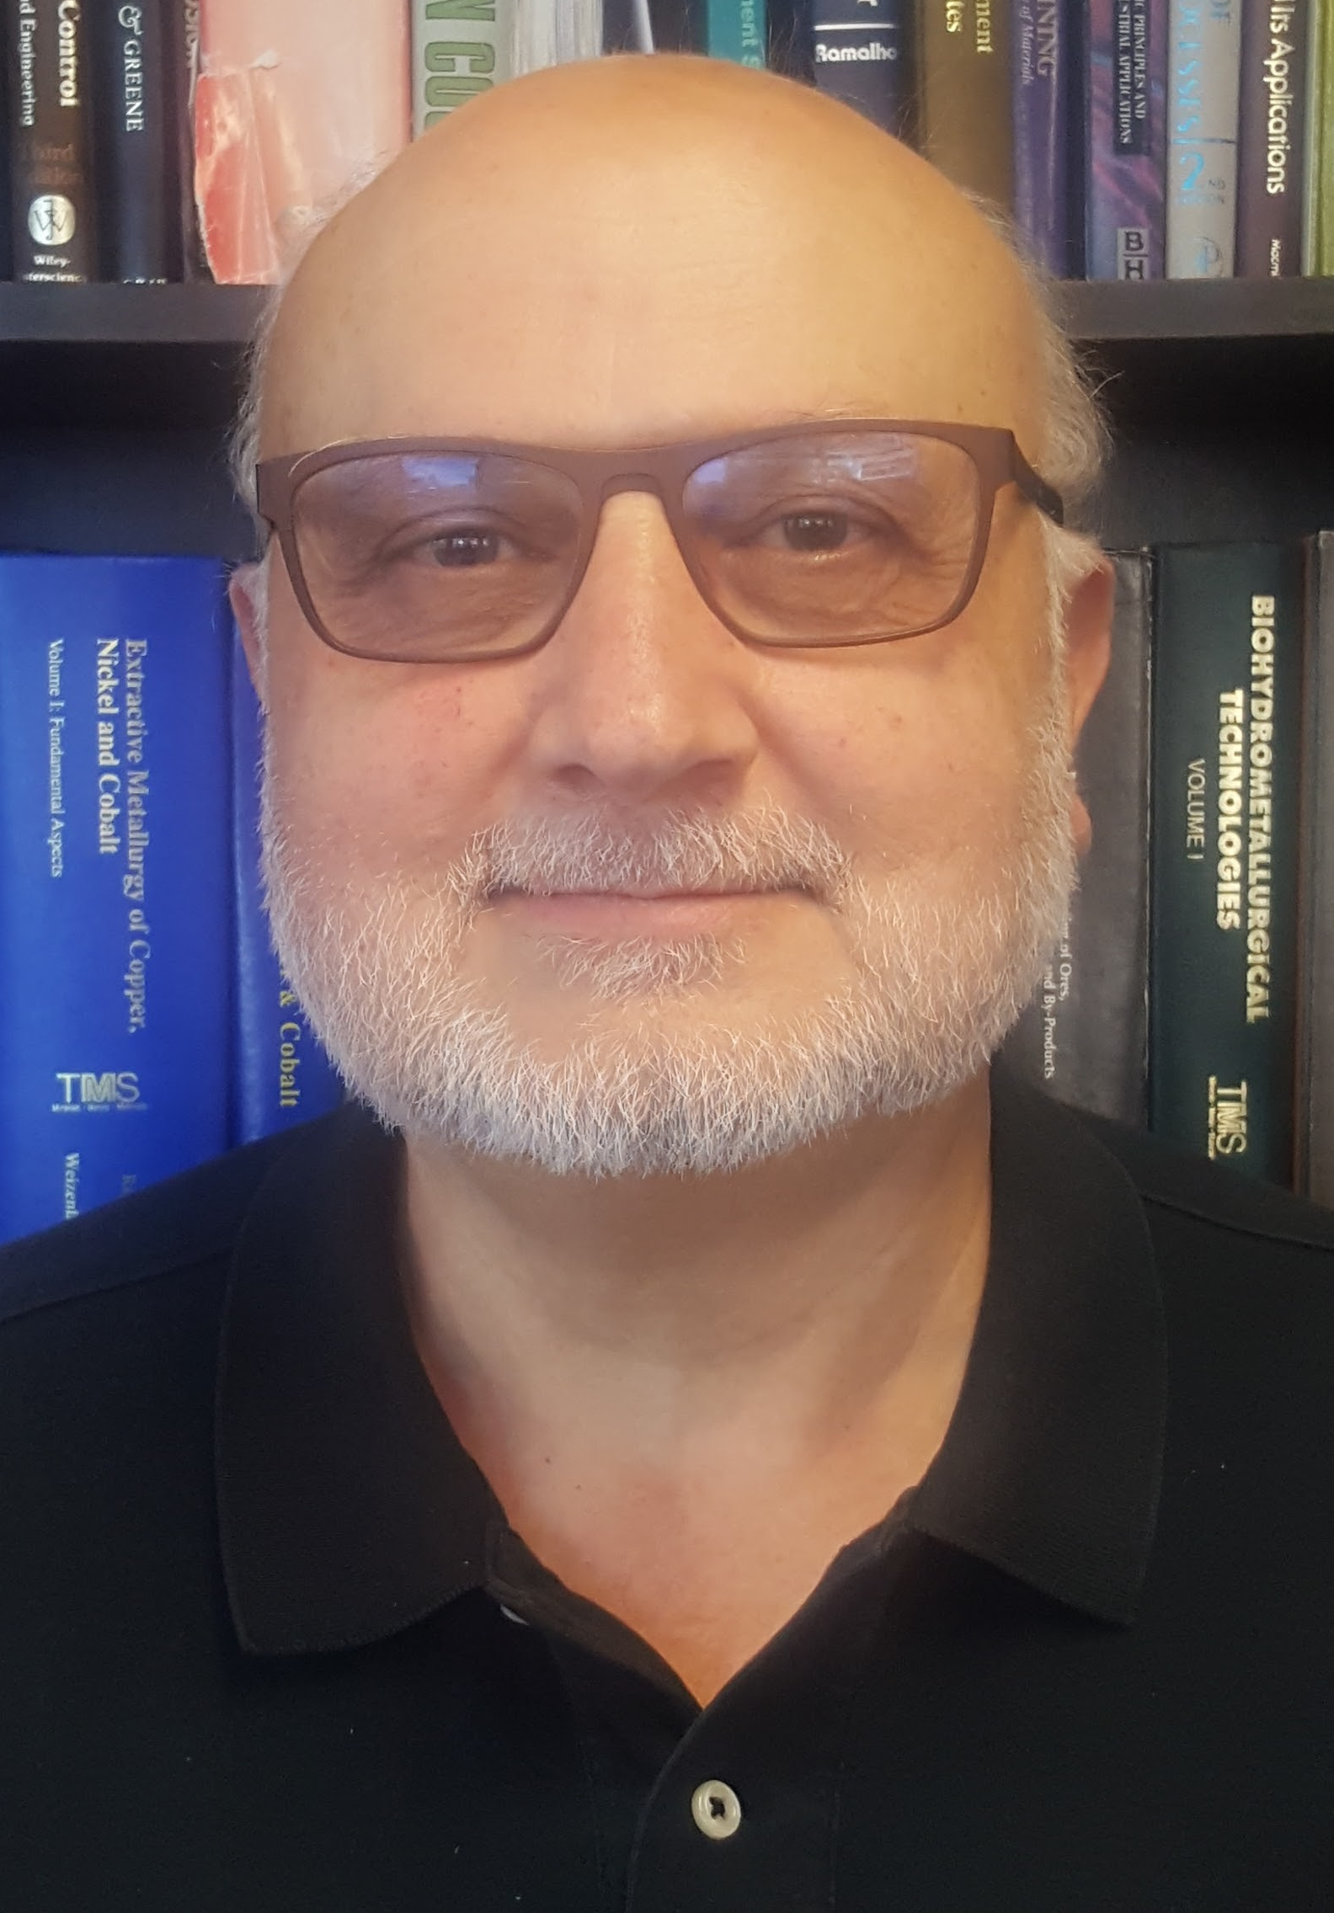
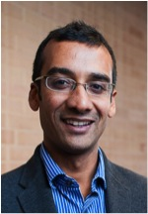
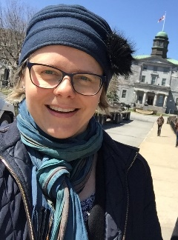
SUSTAINABLE MATERIALS THEME
McGill Sustainability Systems Initiative
Co leads:
George Demopoulos
Dept. of Mining and Materials Engineering, Faculty of Engineering
Nil Basu
Dept. of Natural Resource Science and School of Human Nutrition, Faculty of Agriculture and Environmental Sciences
Audrey Moores
Dept. of Chemistry, Faculty of Science
MATERIALS THEME

Slide 4
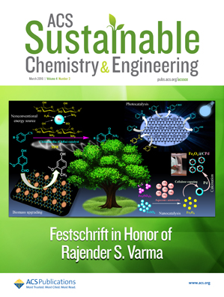
A Leader in Advancing Green Chemistry & Green Engineering Concepts
2016 Impact Factor: 5.951
Editor-in-Chief: David Allen University of Texas, Austin
Team of Associate Editors:
Bing Joe Hwang Peter Licence Audrey Moores
Thalappil Pradeep Bert Sels Bala Subramaniam Michael Tam Julie Carrier Lina Zhang
Jinlong Gong
ACS Sustainable Chemistry & Engineering invites Letters, Articles, Features, and Perspectives (Reviews) that address grand challenges of sustainability in the chemical enterprise and advance principles of Green Chemistry and Green Engineering.
Examples of topics in the journal's scope include:
Green Chemistry
Green Engineering & Manufacturing
Biomass or Wastes as Resources
Renewable Energy
Life-Cycle Assessment
@ACSSustainable
pubs.acs.org/sustainable

Slide 5
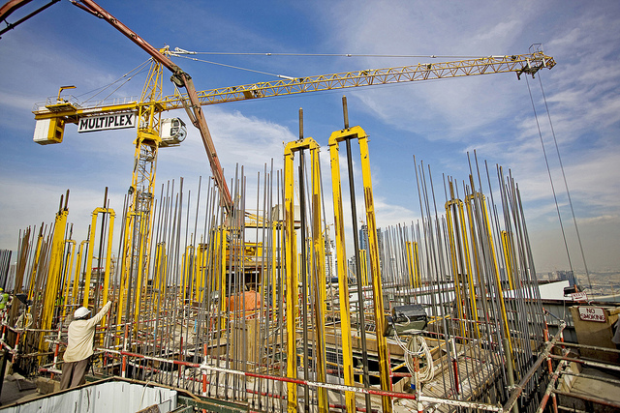
Yale-UNIDO Train-the-Facilitator Workshop in Green Chemistry
Sustainability
CENTER for GREEN CHEMISTRY
and GREEN ENGINEERING at YALE
Image: Flickr, The Glenium Sky admixture, Author: BASF - We create chemistry

Slide 6
Topics To Be Covered
Sustainability – Myths and Facts
Society, Economy, and the Environment
Business and Sustainability
Applying Green Chemistry to Management
Different Models of Sustainability
Case Study: The Interface Company
Green Washing
Life-Cycle Assessment

Slide 7
Sustainability Myths

Slide 8
Myth #1:
Nobody knows what sustainability really means.

Slide 9
What is sustainability?
Take a moment to write a sentence or two about what sustainability is.

Slide 10
The Definition of Sustainability
UN World Commission on Environment and Development: “Sustainable development is development that meets the needs of the present without compromising the ability of future generations to meet their own needs.”
Sustainability presumes that resources are finite and should be used conservatively and wisely with a view to long-term priorities and consequences of the ways in which resources are used.
In simplest terms, sustainability is about our children and our grandchildren, and the world we will leave them.
- The Brundtland Report (Our Common Future)

Slide 11
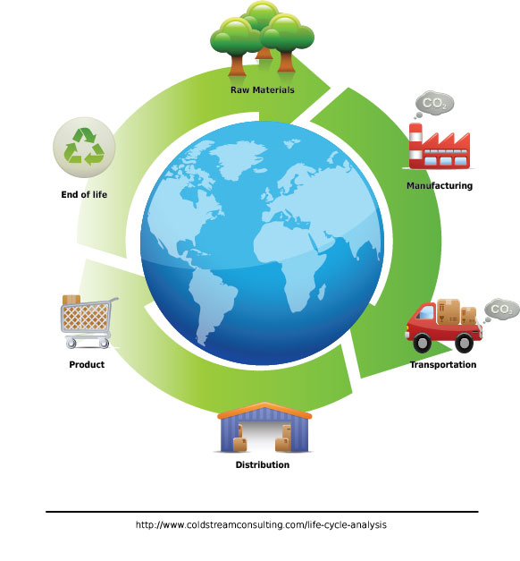
The Definition of Sustainability
“We do not inherit the earth from our ancestors; we borrow it from our children”
Moses Henry Cass
Image Source: Wikipedia

Slide 12
The Definition of Sustainability
Sustainability wants to avoid this
While also making sure we can lead comfortable lives.
Image Source: Wikipedia

Slide 13
Myth #2:
Sustainability is all about the environment.

Slide 14
Sustainability is Not Just About the Environment
Sustainability include a broad group social and economic development issues including: poverty, hunger, health, education, climate change, water, sanitation, energy, and environment.
This requires giving all countries access to natural resources such as water, energy, and food - all of which come, one way or another, from the environment.

Slide 15
Sustainability is Not Just About the Environment
Sustainability has transformed into an environmental term because the economy is driven by natural resources.
If too many of us use resources inefficiently or generate waste too quickly for the environment to absorb and process, future generations won’t be able to meet their needs.
Image Source: Wikipedia

Slide 16
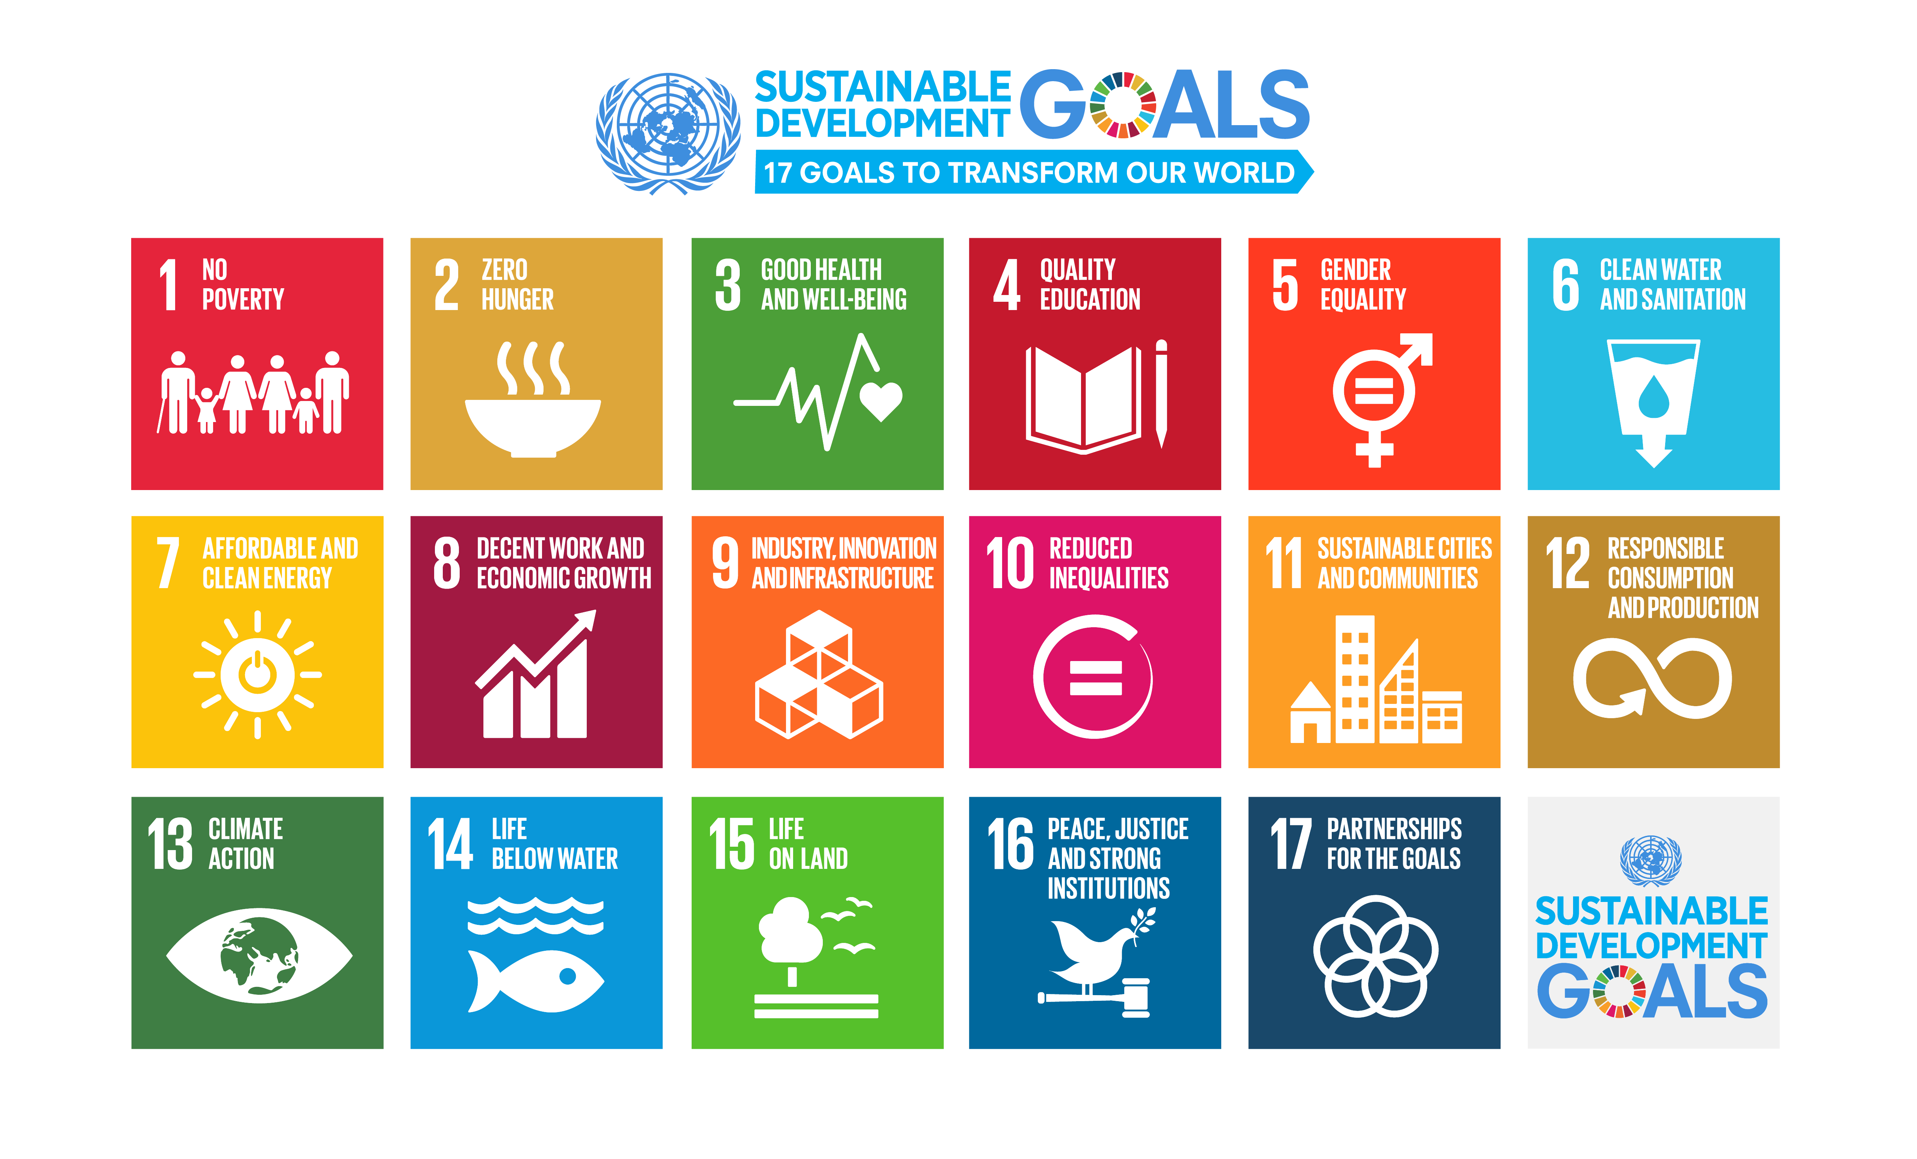
Sustainability is Not Just About the Environment
https://www.un.org/sustainabledevelopment/sustainable-development-goals/

Slide 17
Myth #3:
“Sustainable” is a synonym for “green”.

Slide 18
Sustainability & Green
Green
Sustainability
Green concepts tend to focus on technologies/products causing less harm to human health and the environment
In popular discourse it is often assumed that green = natural as opposed to artificial
Yet natural may not always be sustainable
Sustainability and green overlap since a sustainable solution has to preserve health and environment
Sustainability adds the important idea of preserving resources for the next generation

Slide 19
Sustainability & Green
Both terms of often used outside of context, outside of true metric
=> Green washing
g oing green
Image Source: Wikipedia

Slide 20
Myth #4:
Sustainability is all about recycling.

Slide 21
A question we need to ask: Is recycling sustainable?
Sustainability and Recycling

Slide 22
Sustainability and Recycling
Material | Energy savings
Aluminum | 95%
Cardboard | 24%
Glass | 5-30%
Paper | 40%
Plastics | 70%
Steel | 60%
Recycling
Converting waste materials into new materials and objects.
Available for metals, plastic, paper, glass.
Cost-benefit of recycling: energy savings

Slide 23
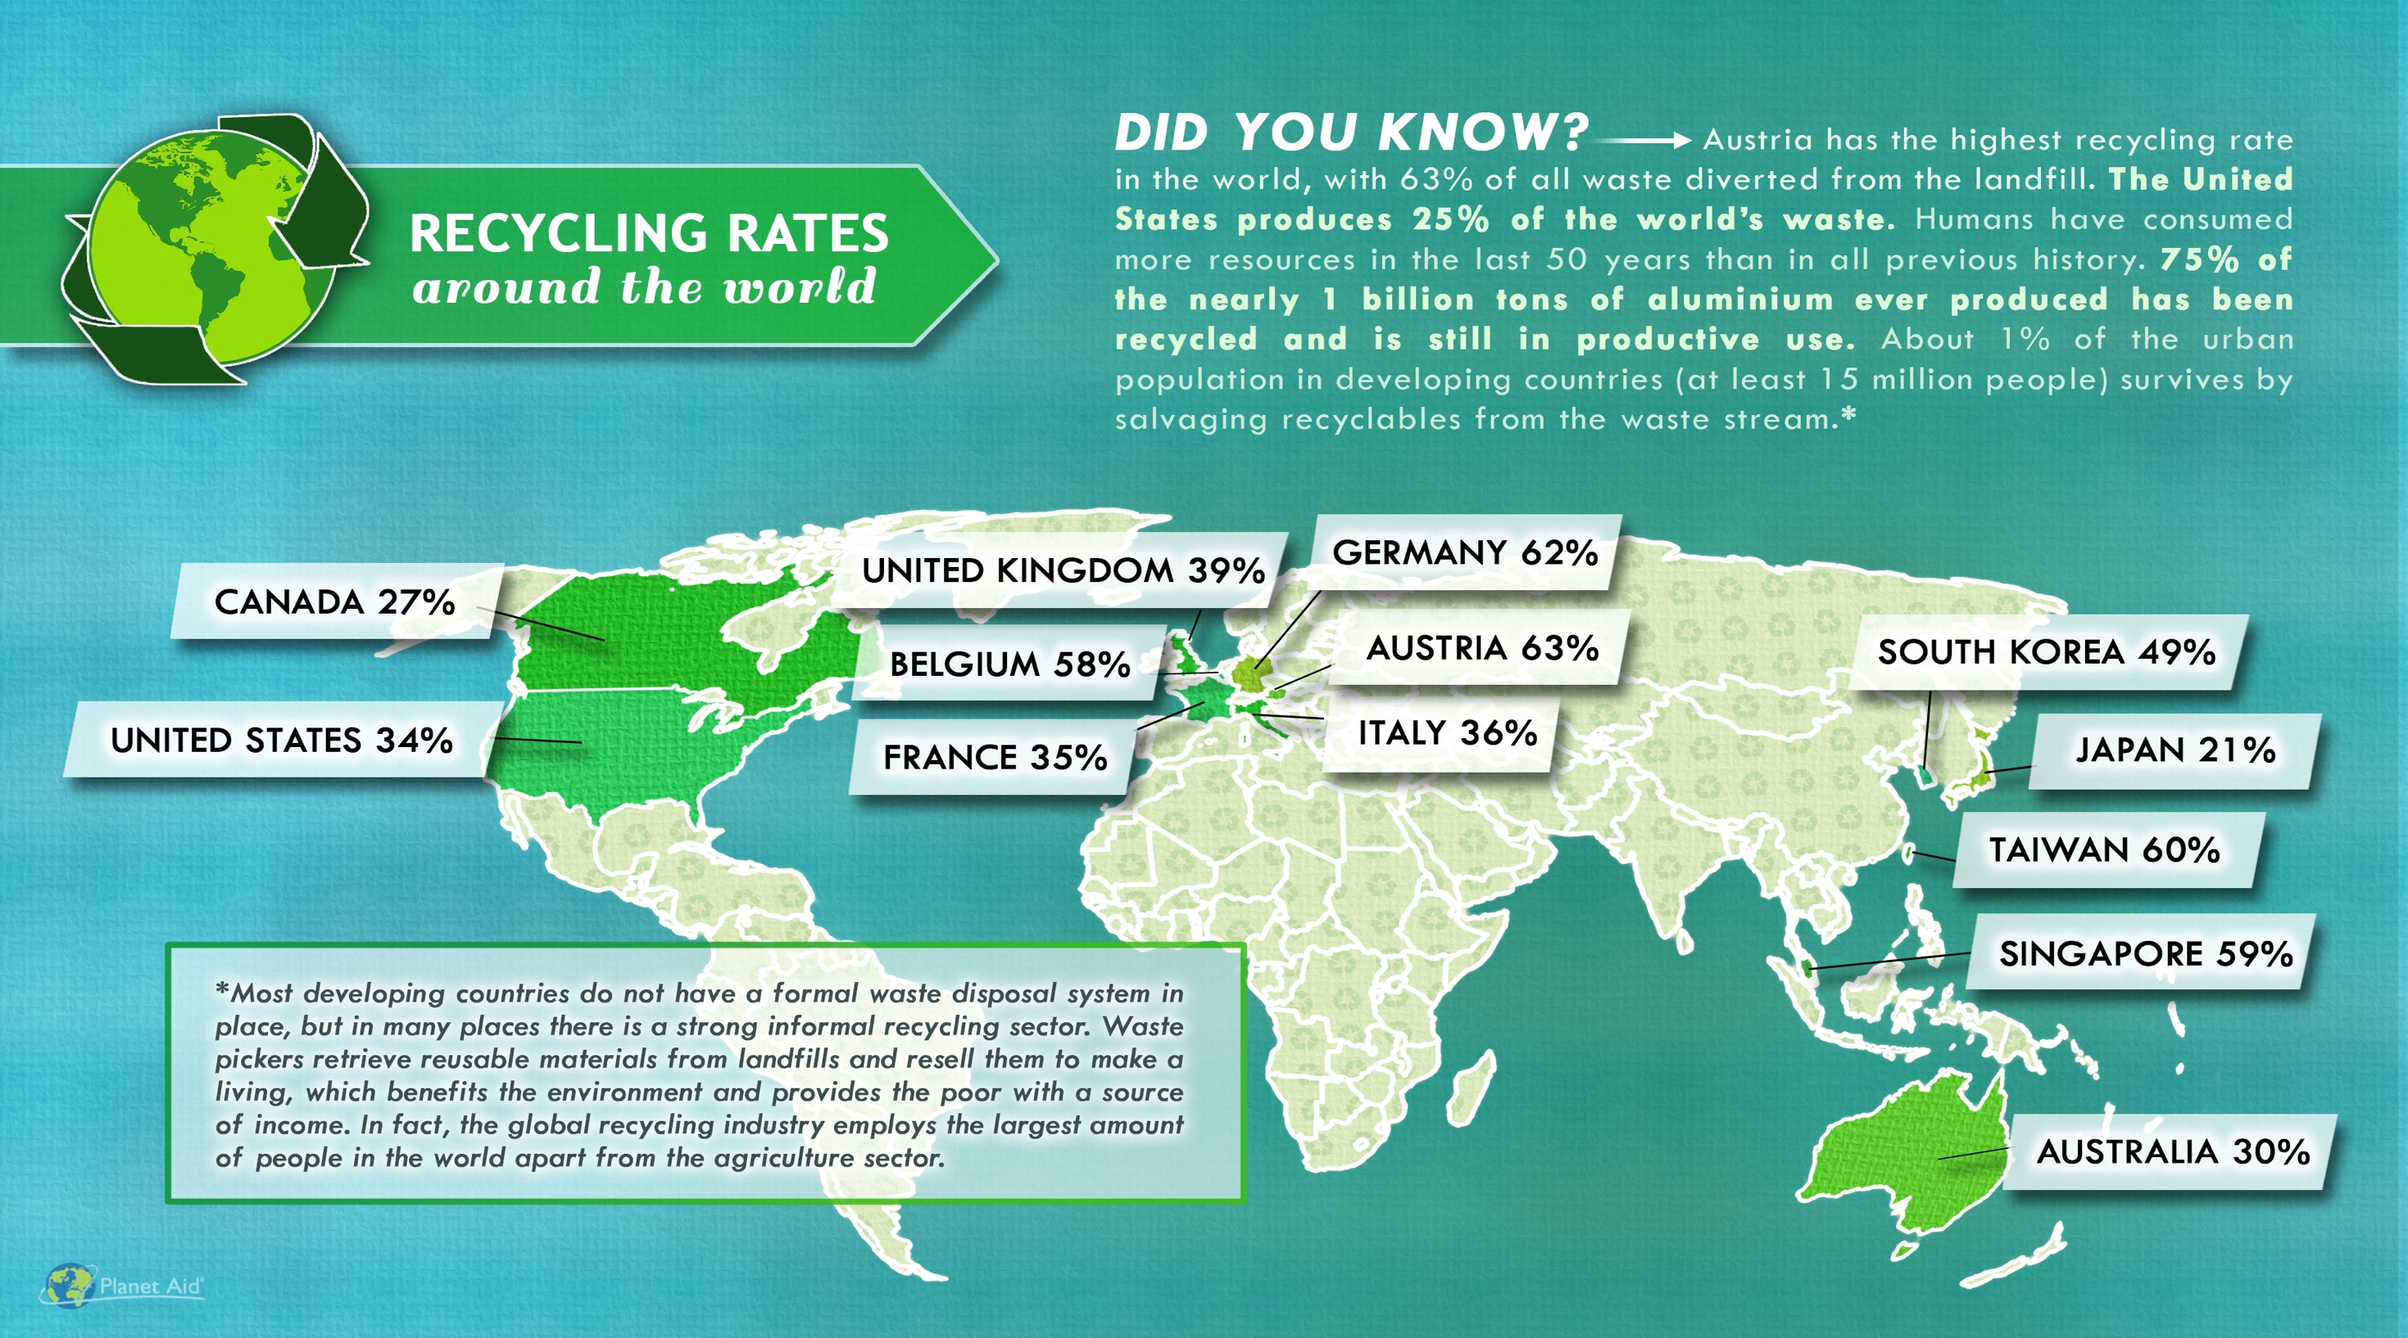
SOUTH AFRICA 43%
http://www.planetaid.org/blog/recycling-rates-around-the-world

Slide 24
Myth #5:
Sustainability is too expensive.

Slide 25
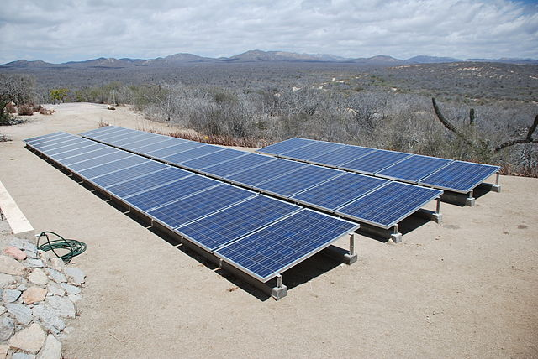
Sustainability and Expense
More sustainable ways of doing things usually costs less over the life-time of a product or service.
It is the upfront costs that can sometimes be higher.
Image: Wikimedia Commons, Solar panels installed in Baja Sur California, Author: BishopBandita

Slide 26
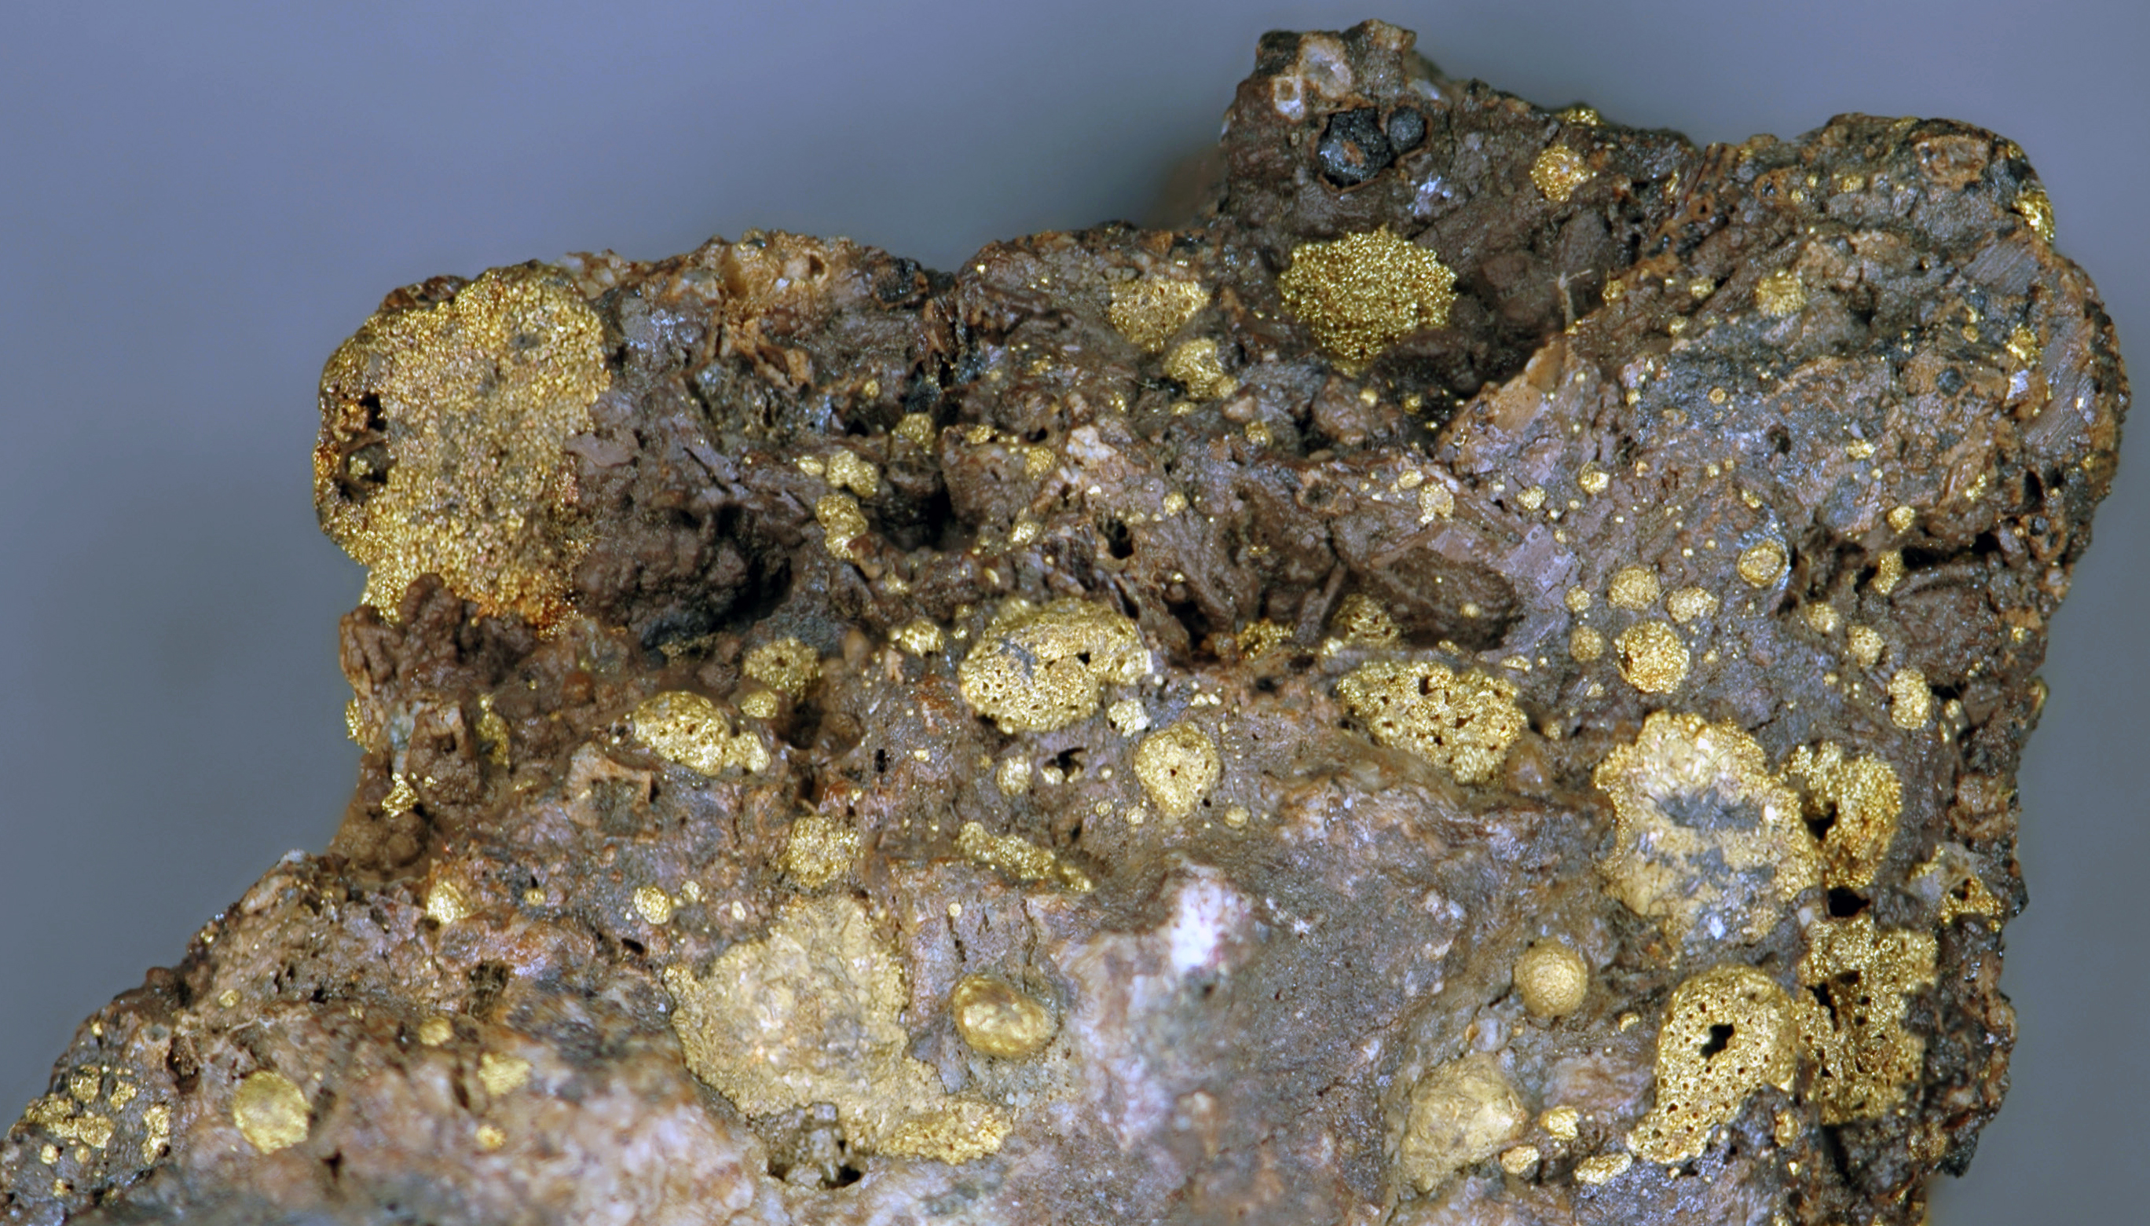
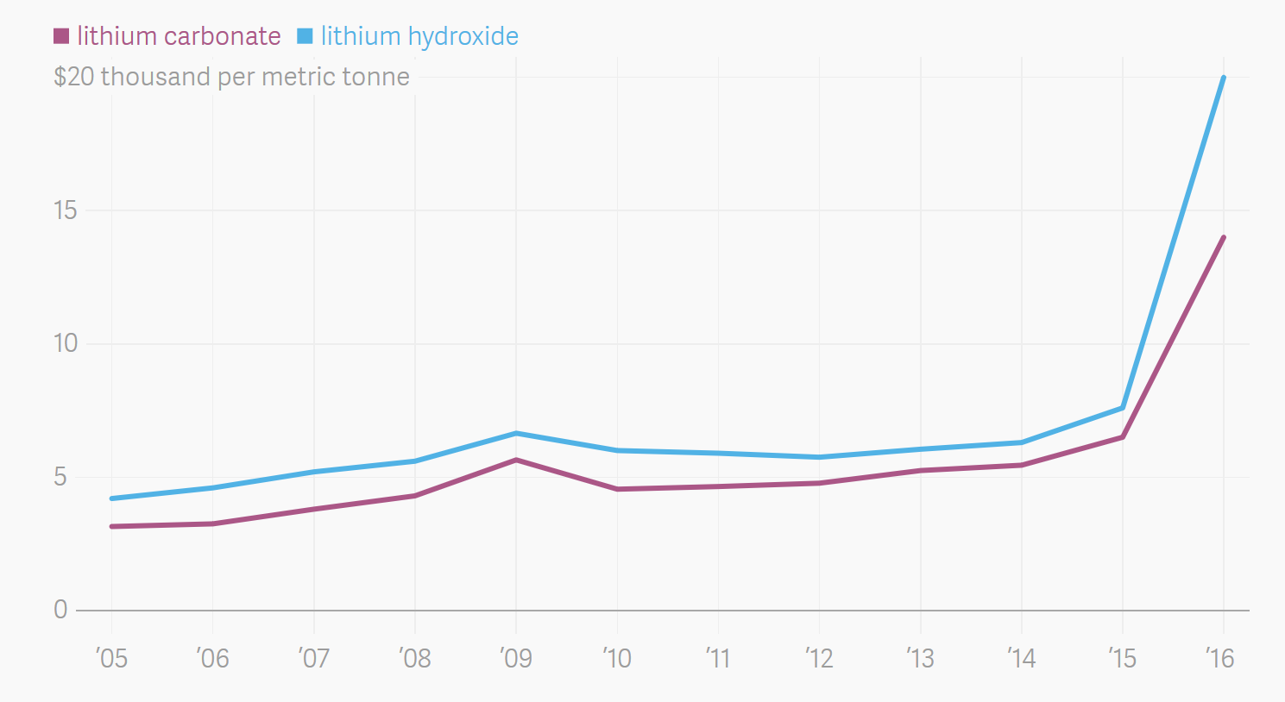
Sustainability and Expense
What is rare is expensive.
It is hard to imagine that an expensive process/product is sustainable
Roasted gold ore from Cripple Creek, Colorado, USA
More intense use of lithium in batteries means higher cost of lithium and more difficult access
https://commons.wikimedia.org/wiki/File:Roasted_Cripple_Creek_gold_ore_3.jpg, https://www.theatlas.com/charts/S1Isjut3

Slide 27
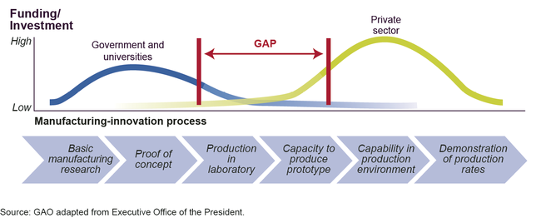
Sustainability and Expense
Developing new technologies comes with risks and upfront investments
Image: https://www.gao.gov/products/GAO-14-181SP

Slide 28
Myth #6:
Sustainability means lowering our standard of living.

Slide 29
Sustainability and Standard of Living
Once we start becoming organized and innovate, the breakthroughs can be extraordinary.
These innovations will allow us to use resources more productively, which in turn will allow us to be prosperous, fed, entertained, and secure.
The innovation at the heart of sustainable living will be a powerful economic engine.

Slide 30
Myth #7:
Consumer choices and grassroots activism, not government intervention, offer the fastest and most efficient routes to sustainability.

Slide 31
Sustainability and The Government
Popular grassroots actions are helpful and essential to creating change. But progress on some reforms, such as curbing CO₂ emissions, can only happen if central authorities commit to making it happen. That is why tax credits, mandatory fuel-efficiency standards, and other government regulations are both practical and necessary.

Slide 32
Myth #8:
New technology is always the answer.

Slide 33
Is new technology the answer to sustainability?
Sustainability and Technology
Notes:
Or, should we make sure that whatever we develop is sustainable for many years to come?

Slide 34
Water treatment technologies for developing world
Lifestraw
Water purifying bicycle
Hamster Ball-Shaped Solarball
Life sack
“Pure” Water Bottle Filters Water With UV Rays
Ceramic water filter

Slide 35
Myth #9:
Sustainability is ultimately a population problem.

Slide 36
Sustainability and Population
This is not a myth, but it represents a false solution.
Every environmental problem is ultimately a population problem. If the world’s population were only 100 million people, we would be hard-pressed to generate enough waste to overwhelm nature’s cleanup systems. We could dispose all our trash in a landfill in some remote area, and nobody would notice.

Slide 37
Sustainability and Population
Population experts agree that the best way to limit population is to educate women and raise the standard of living overall in developing countries.
But that strategy cannot possibly happen quickly enough to put a dent in the population on any useful timescale.
The U.N. projects that the planet will have to sustain another 2.6 billion people by 2050. But even at the current population level of 7 billion people, we’re using up resources at an unsustainable rate.

