Slide 1
The Molecule
Lecture #5
Date:
Course #

Slide 2
Outline
Molecules and Compounds
Drawing Molecules
Nomenclature of Molecules
Functional Groups
  Properties

Slide 3
Outline
Molecules and Compounds
Drawing Molecules
Nomenclature of Molecules
Functional Groups
  Properties

Slide 4
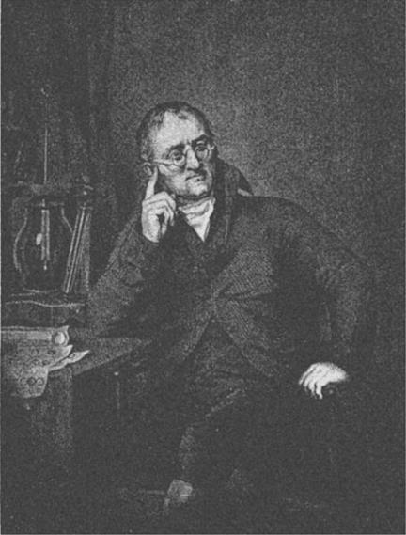
Continuation of Dalton’s Theory
    Compounds/Molecules are formed when atoms of different elements combine in fixed proportions
    A chemical reaction involves a rearrangement of atoms. No atoms are created or destroyed.
John Dalton
Image Source: Wikipedia Commons
Notes:
https://commons.wikimedia.org/wiki/File:Dalton_John_desk.jpg

Slide 5
What are Molecules
A molecule is an electrically neutral group of two or more atoms held together in a definite spatial arrangement by forces called covalent bonds.
Molecules are collection of atoms (≥2) that are tightly bound together
A molecule is the smallest amount of a pure substance that can exist
O₂
H₂O
C₆H₁₂O₆
H₂
NaOH
N₂
AgNO₃
He
NaCl

Slide 6
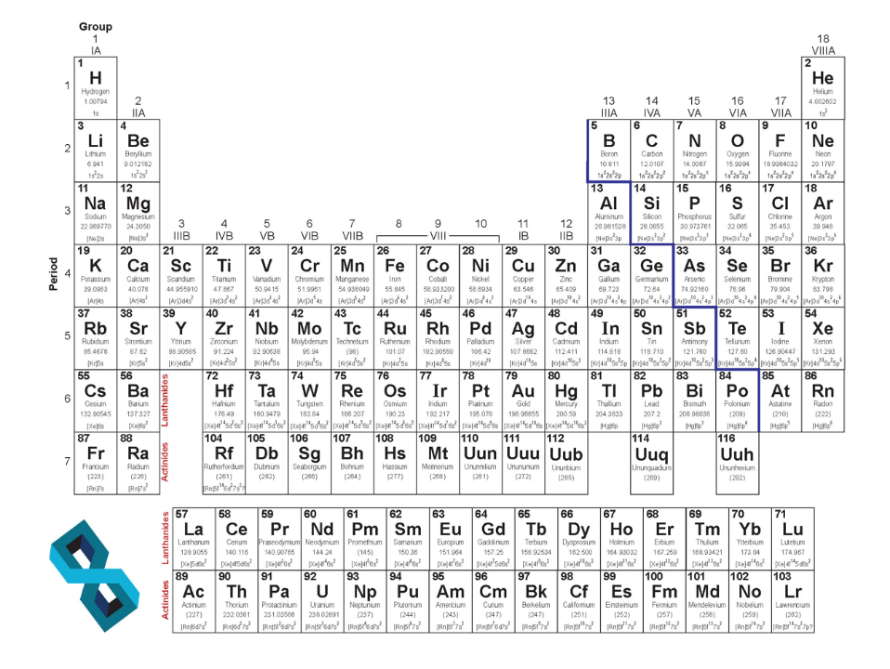
  Binary compounds
Non-Metals
    Ionic Compounds
      Made with 1 metal and 1 nonmetal
    Covalent Molecule
      Made with 2 nonmetals
Metals

Slide 7
  Ionic Compounds
  Cations
  When the number of electrons is less than the number of protons, the net charge on the ion is the same as the excess number of protons.
  When a metal loses one or more electrons.
  Common cations have a charge equal to their group number.
Ca²⁺ Na¹⁺ Al³⁺ Mg²⁺ K¹⁺

Slide 8
https://upload.wikimedia.org/wikipedia/commons/6/68/Periodic_table_vectorial.png
Notes:
Show how periodic table can allow chemists to identify the charge on cations.

Slide 9
  Ionic Compounds
  Anions
  When the number of electrons is greater than the number of protons, the net charge on the ion is the same as the excess number of electrons.
  When a nonmetal gains one or more electrons.
  Common anions have a charge equal to their group number minus 8.
S²⁻ P³⁻ F¹⁻ N³⁻ O²⁻

Slide 10
https://upload.wikimedia.org/wikipedia/commons/6/68/Periodic_table_vectorial.png
Notes:
Show how periodic table can allow chemists to identify the charge on anions.

Slide 11
  Common Anions
  CH₃CO₂⁻ or C₂H₃O₂⁻ or AcO⁻ acetate
  CO₃²⁻ carbonate
  HCO₃⁻ bicarbonate
  OH⁻ hydroxide
  NO₂⁻ nitrite
  NO₃⁻ nitrate
  PO₄³⁻ phosphate
  SO₄²⁻ sulfate
  SO₃²⁻ sulfite

Slide 12
  Ionic Compounds
Transition elements form more than one cation.
Use roman numerals, I, II, III, IV…
Fe²⁺ Iron(II)
Fe⁴⁺ Iron(IV)

Slide 13
  Binary Ionic Compounds
    Total compound is neutral. (We know most charges by group number)
    We do not have to indicate numbers like we do with covalent molecules…
    Except transition elements, because their charge can vary, we must identify the charge with the roman numeral.

Slide 14
Examples
Name the following binary ionic compounds:
Ca₃N₂ calcium nitride
Al₂S₃ aluminum sulfide
Cu₂S copper(I) sulfide
BaF₂ barium fluoride
FeCl₃ iron(III) chloride
Hg₂Cl₂ mercury(I) chloride
Notes:
ANIMATE slide! This can be done before or after formatting. Also this is up to future teachers preference.

Slide 15
Examples
Name the following binary ionic compounds:
NaOH sodium hydroxide
AlPO₄ aluminum phosphate
NH₄Cl ammonium chloride
KCH₃CO₂ potassium acetate
Ca(CN)₂ calcium cyanide
Fe(NO₃)₃ iron(III) nitrate
* when there is more than one polyatomic ion,
you put them in parentheses ().

Slide 16
Covalent Molecules
When two atoms have less than a full octet, they can SHARE some number of their valence electrons to fill them.
What’s a full octet?
The outer most electrons in
the atoms valence shell

Slide 17
The “Octet Rule”
All elements want to have the same number of valence electrons as its nearest noble gas.
Noble gases have a full octet, which contributes to their stability and non-reactivity.
Neon has a full octet 8 electrons
Image Source: Wikipedia Commons
Notes:
https://commons.wikimedia.org/wiki/File:Electron_shell_010_neon.png

Slide 18
The “Octet Rule”
Lithium has one valence electron
Lithium wants to lose one electron
Image Source: Wikipedia Commons
Notes:
https://commons.wikimedia.org/wiki/File:Electron_shell_003_Lithium.svg

Slide 19
The “Octet Rule”
Chlorine has seven valence electrons
Chlorine wants to gain one electron
Image Source: Wikipedia Commons
Notes:
https://commons.wikimedia.org/wiki/File:Electron_shell_017_Chlorine.svg

Slide 20
Outline
Molecules and Compounds
Drawing Molecules
Nomenclature of Molecules
Functional Groups
  Properties

Slide 21
Lewis Dot Structures
Since the nucleus (protons & neutrons) of atoms don’t change, it makes sense to let the corresponding element represent the nucleus.
This simplification allows the valence electrons to be the only variable.
Valence electrons are visualized as dots for Lewis dot structures.
Place a single dot on each side of the element before adding another one.
No more than two dots on one side of the element.

Slide 22
Lewis Dot Structures
Atoms with their outer valence electrons as dots:
Li
C
N
Ne

Slide 23
Covalent Molecules
Ions:
Li
Cl
N
Ne
Li
1+
1-
3-
Cl
N
Ne
Notes:
Edit slide

Slide 24
Covalent Molecules
Ions:
Shared
electrons
Cl
+
Cl
Cl
Cl
O
Shared
electrons
C
+
O
+
O
C
O

Slide 25
Rules for Drawing Lewis Dot Structures
Step 1: Draw skeleton of structure
  You will usually have one kind of element and one or more of another kind of element. Put the single element in the middle.
AB
AB₂
AB₃
AB₄
AB₅
B
B
B
B
B
B
A
A
A
B
A
B
B
A
B
B
B
B
B
B

Slide 26
-
-
CH₄
PCl₃
NO₂
ICl₂
H
Cl
P
Cl
H
C
H
O
N
O
Cl
I
Cl
Cl
H

Slide 27
Rules for Drawing Lewis Dot Structures
Step 2: Count Electrons
  Look at the atoms in your system. Total the number of valence electrons for all of the atoms. Add one electron for each negative charge, subtract one electron for each positive charge.
CH₄
4 + (4 x 1) = 8
PCl₃
5 + (3 x 7) = 26
-
NO₂
5 + (2 x 6) + 1 = 18
-
ICl₂
7 + (2 x 7) + 1 = 22

Slide 28
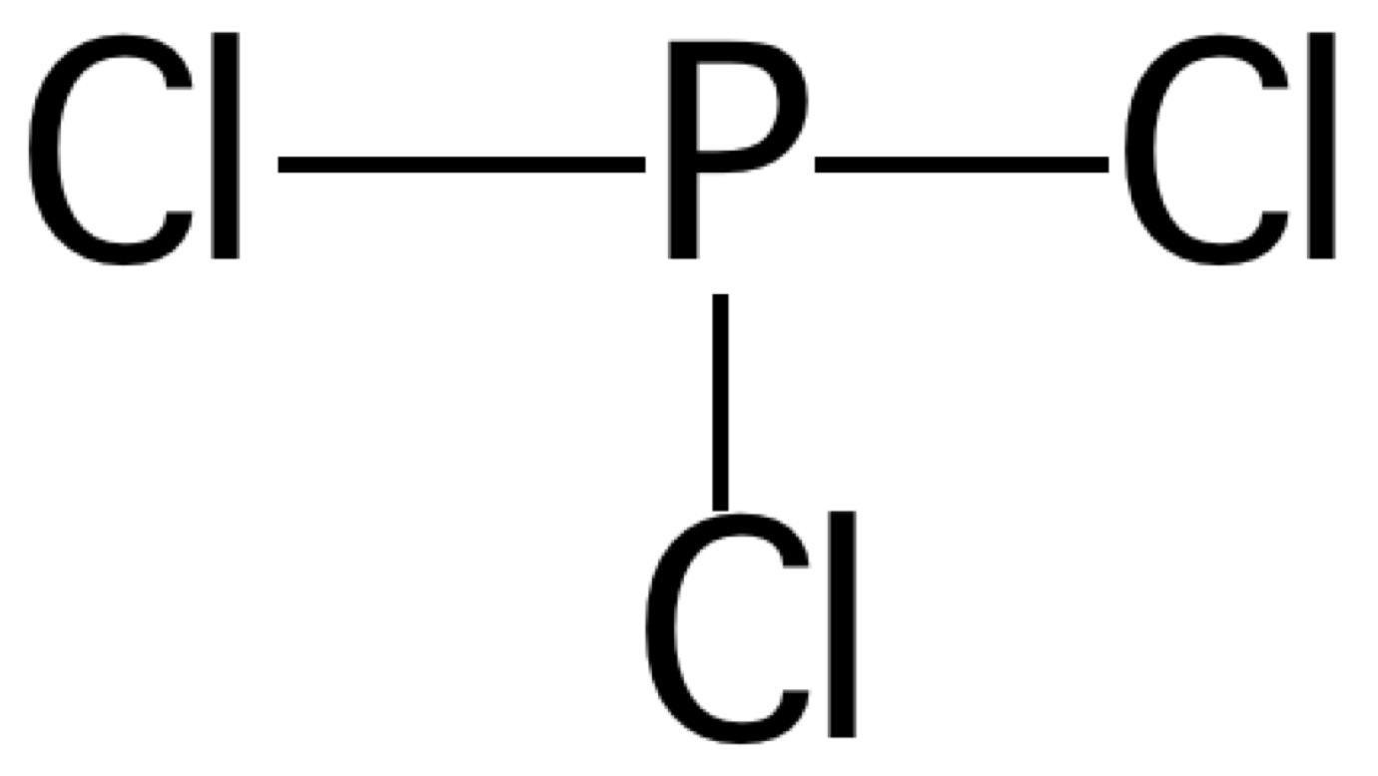
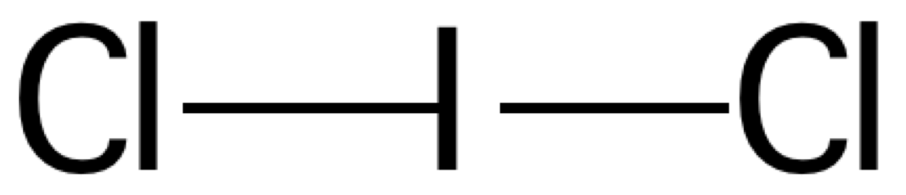
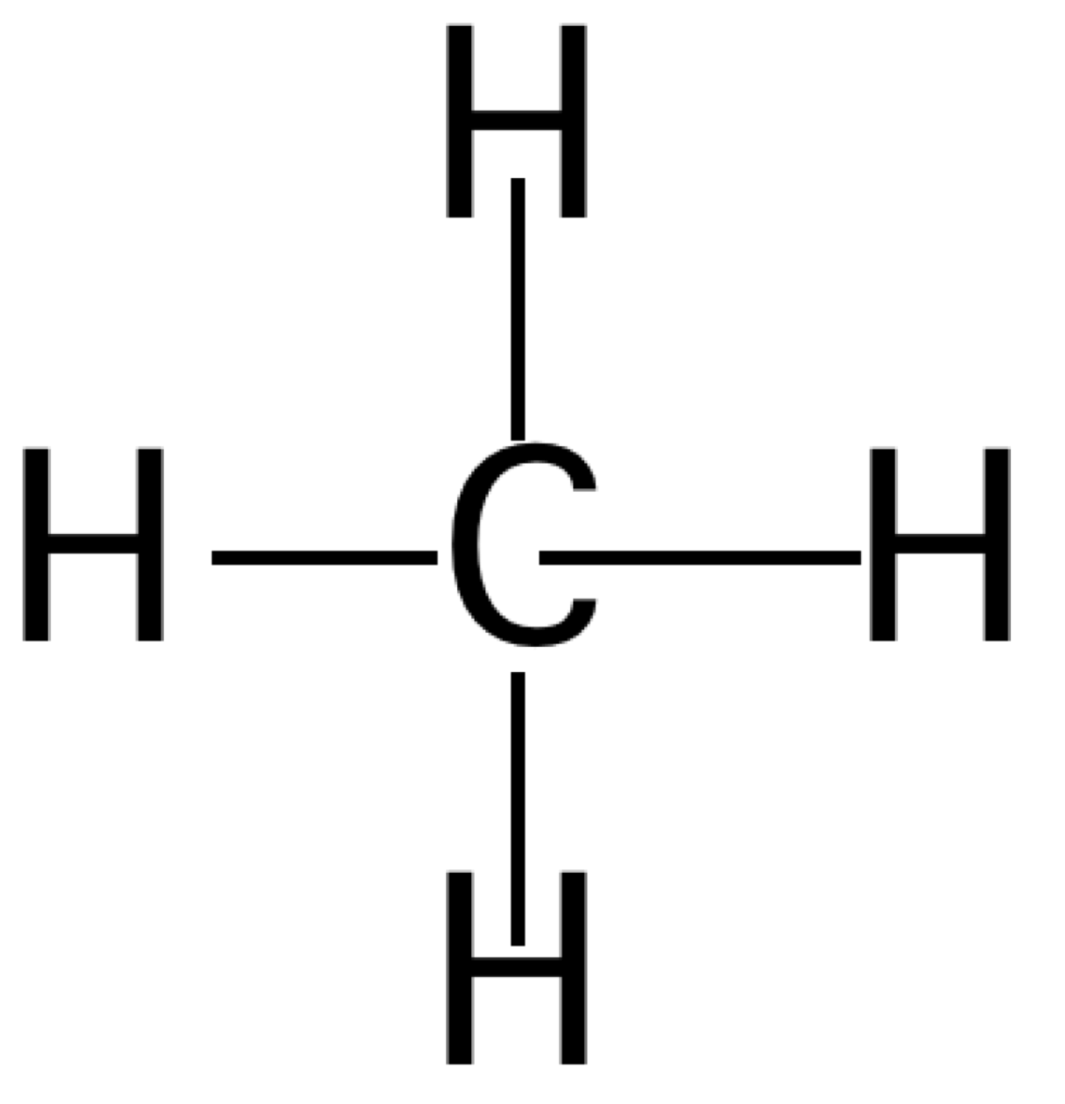
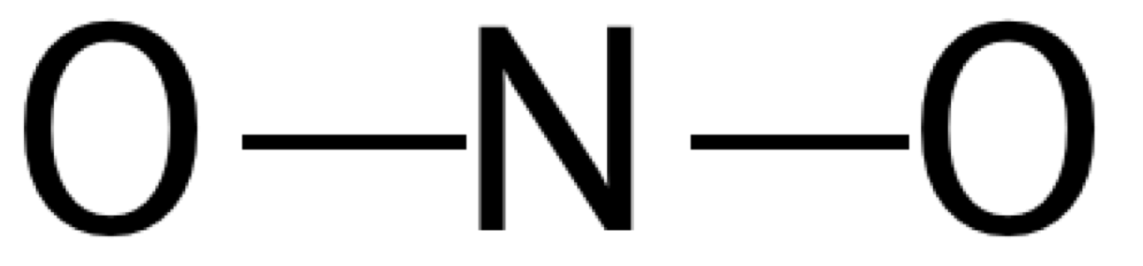
Rules for Drawing Lewis Dot Structures
Step 3: Draw Bonds
  Connect the “outer” atoms to the “inner” atoms using pairs of electrons. [Use a line to indicate a pair of bonding electrons].

Slide 29
Rules for Drawing Lewis Dot Structures
Step 4: Fill octets of “outer” atoms
  Add electron pairs to outer atoms so that they all have their full octet
  [Hydrogen only needs 2 electrons for this, all other atoms need 8].

Slide 30
Rules for Drawing Lewis Dot Structures
Step 5: Put remaining electrons on the central atom
  Count the electrons that you have used so far. If you have any left, put them on the central atom.
8 used
0 left
24 used
2 left
16 used
2 left
16 used
6 left

Slide 31
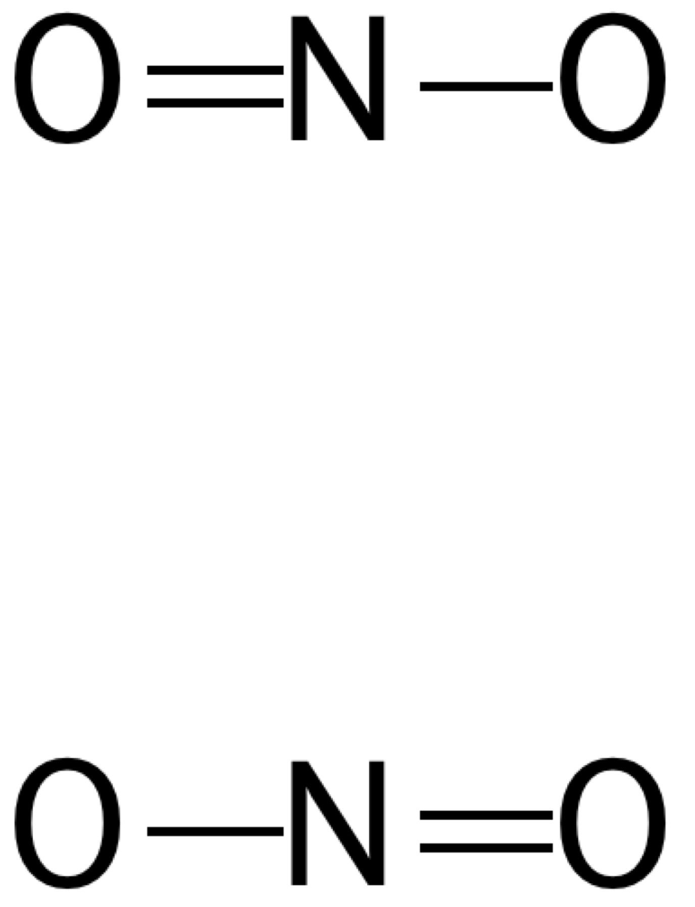
Rules for Drawing Lewis Dot Structures
Step 6: Make multiple bonds if necessary
  Count the electrons on the central atom. If there is less than a full octet, take a lone pair of electrons from one of the outer atoms and make a double bond.
  Repeat if necessary. If you have more than one choice of atoms to chose from, draw all possibilities and connect them with a double headed arrow, they are called resonance forms.

Slide 32
Rules for Drawing Lewis Dot Structures
Step 7: Assign formal charges
  Formal Charge [fc] = ve – ½ be - le
  # of valence electrons - ½ # bonded electrons - # of lone electrons
  Indicate formal charge on the structure if not zero.
-1
-1
-1
O(s): 6 – ½(2) – 6 = -1
O(d): 6 – ½(4) – 4 = 0
N: 5 – ½(6) – 2 = 0
C: 4 – ½ (8) – 0 = 0
H: 1 – ½ (2) – 0 = 0
Cl: 7 – ½ (2) – 6 = 0
P: 5 – ½ (6) – 2 = 0
Cl: 7 – ½(2) – 6 = 0
I: 7 – ½(4) – 6 = -1

Slide 33
Rules for Drawing Lewis Dot Structures
Step 8: Add up formal charges to give total charge
  Add up all the formal charges. If you started with a neutral molecule, the sum should be zero. If you started with a charged species, then the sum should equal that charge. If you come up with a different number, then you probably did something wrong, and should start again. Indicate total charge by putting the structure in a pair of brackets and write the charge in the top right.
-1
-1
-1
-1
-1

Slide 34
That was easy!

Slide 35
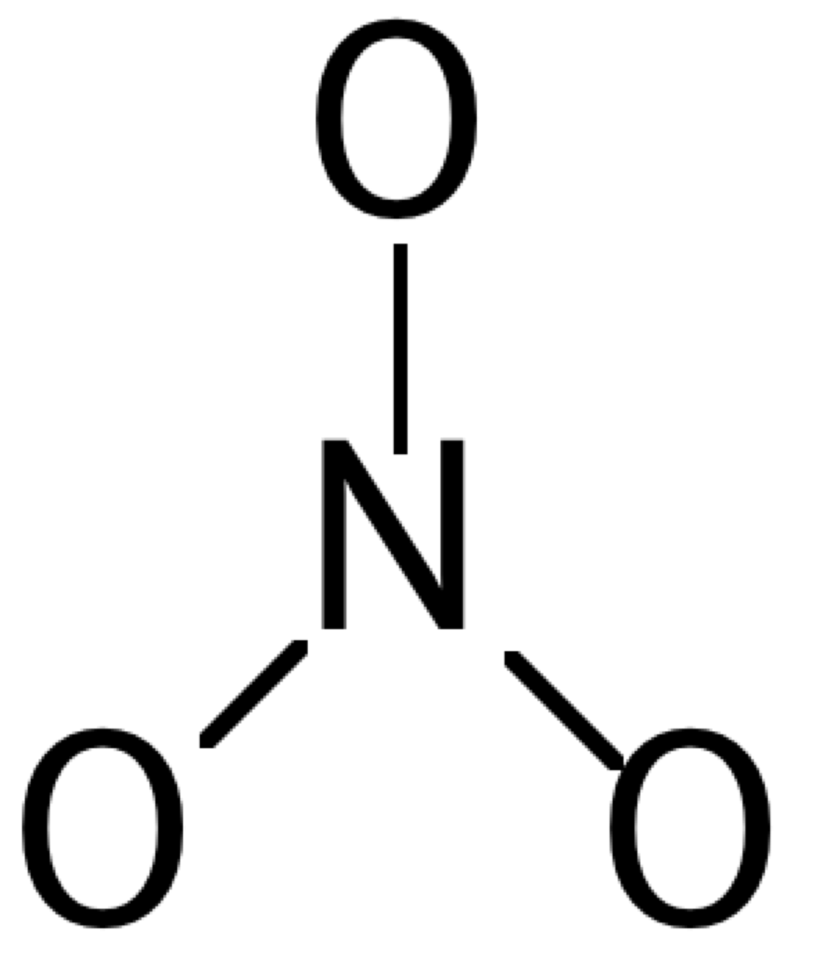
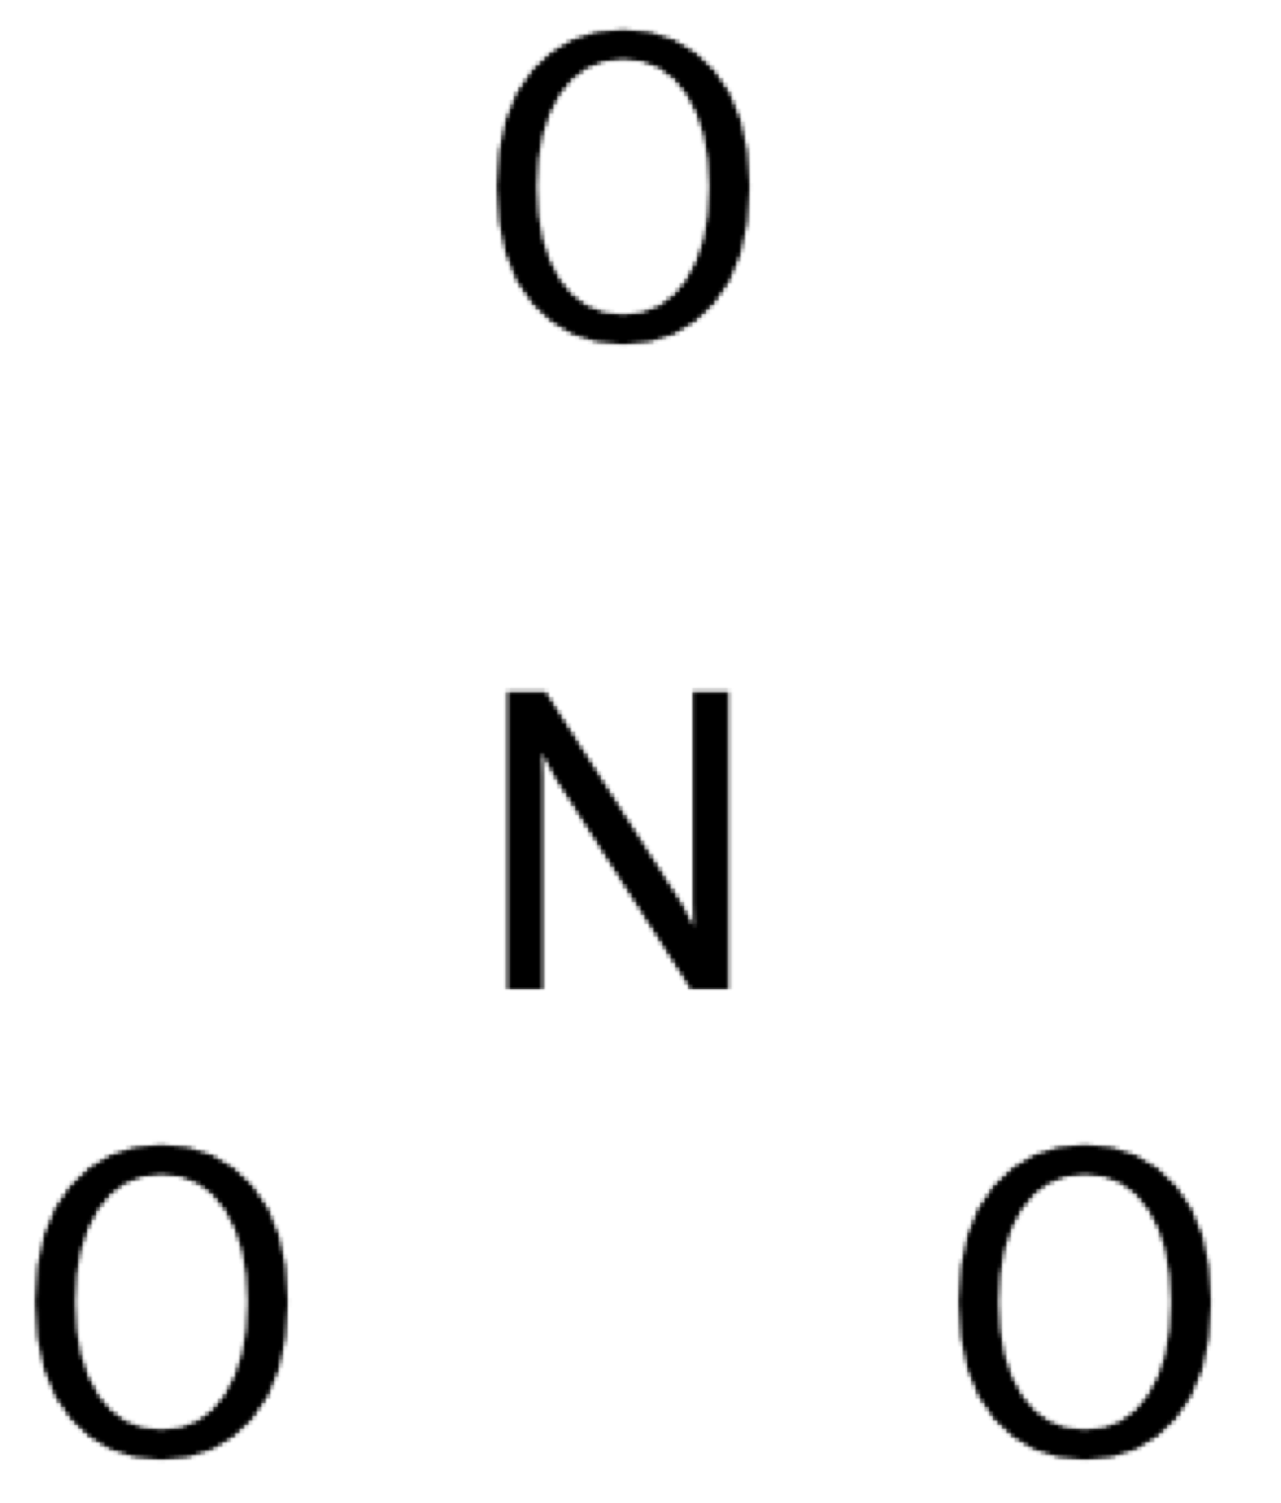
Lewis Dot Structures: In-Class Practice
Draw the Lewis dot structure of a Nitrate ion.
NO₃⁻¹
Step 1:
Step 2:
Step 3:
Step 4:
5 + (3 x 6) + 1 = 24
Notes:
Animate this slide according to your preferences.

Slide 36
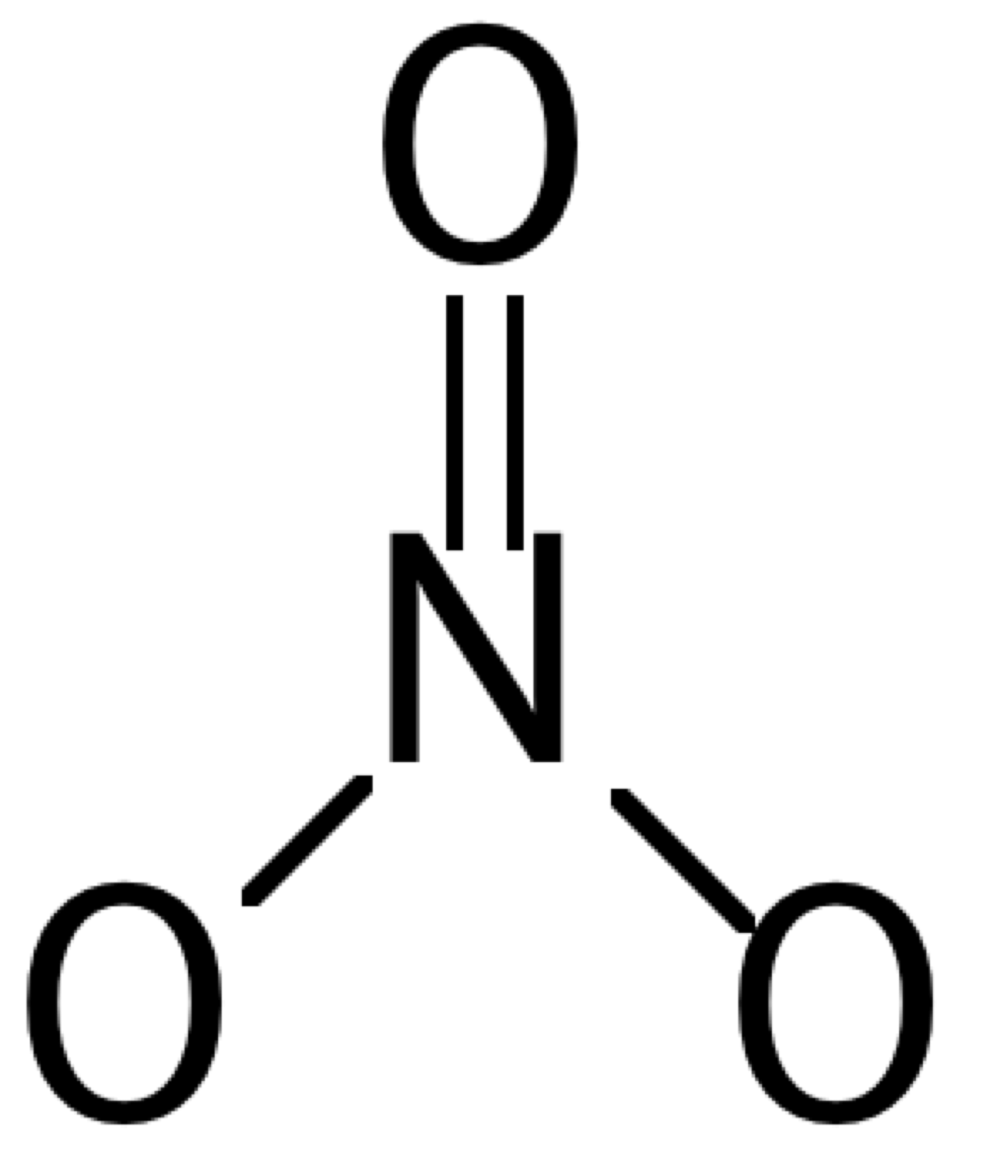
Lewis Dot Structures: In-Class Practice
Step 5:
Step 6:
O
O
24 used
0 left
N
N
O
O
O
O
Step 7:
-1
-1
O
O
O(s): 6 – ½(2) – 6 = -1
O(d): 6 – ½(4) – 4 = 0
N: 5 – ½(8) – 0 = +1
-1
+1
N
+1
N
+1
O
O
O
O
-1
-1
-1

Slide 37
Lewis Dot Structures: In-Class Practice
Step 8:
-1
-1
-1
O
O
-1
+1
-1
-1
N
+1
N
+1
O
O
O
O
-1
Notes:
Animate this slide according to your preferences.

Slide 38
Lewis Dot Structures: Ionic Molecules
Class Exercise:
  Have students apply steps for Lewis dots structures of covalent molecules to ionic compounds.

Slide 39
Outline
Molecules and Compounds
Drawing Molecules
Nomenclature of Molecules
Functional Groups
  Properties

Slide 40
Nomenclature: Covalent Molecules
  Rules:
  Name of first element comes first, preceded by numeric prefix (see next slide).
  Second element is given suffix –ide, and also uses numeric prefix.

Slide 41
Covalent Molecules: Prefixes
Number | Prefix
1 | mono- (or none)
2 | di-
3 | tri-
4 | tetra-
5 | penta-
6 | hexa-
7 | hepta-
8 | octa-
9 | nona-
10 | deca-

Slide 42
Nomenclature: Covalent Molecules
Name the following compounds:
P₄O₆ tetraphosphorous hexaoxide
CO₂ carbon dioxide
N₂O dinitrogen monoxide
SF₆ sulfur hexafluoride
NI₃ nitrogen triiodide

Slide 43
Now you know how to draw and name covalent molecules.
When compounds get more complex, how do we name them?

Slide 44
Outline
Molecules and Compounds
Drawing Molecules
Nomenclature of Molecules
Functional Groups
  Properties

Slide 45
Nomenclature of Organic Compounds
What is the name of this compound?
Notes:
If you are lecturing to a more entry-level chemistry students (gen.chem), its is recommended to further emphasize nomenclature on ionic and covalent compounds.
If your are lecturing to non entry-level chemistry students continue to discuss how to name organic molecules.

Slide 46
Organic Nomenclature
Naming organic compounds
  IUPAC name
    Based on structure, can reconstruct structure based on the name.
    N,N-diethylethanamine and N-methyl-1-phenylpropan-2-amine
  Common name
    Easier to communicate.
    Naproxen, Ibuprofen, and Methamphetamine.
  Memorize (You will be required to know on the Exams)
    Prefix and suffix.
    Functional groups.
    Basic rules.

Slide 47
Hydrocarbons
There are four basic types of organic hydrocarbons, those chemicals with only carbon and hydrogen:
1. Single bonds (alkane): suffix is "ane", formula C_{n}H_{(2n+2)}
2. Double bonds (alkene): suffix is "ene", formula C_{n}H_{2n}
3. Triple bonds (alkyne): suffix is "yne", formula C_{n}H_{(2n-2)}
4. (Mono) Cyclic compounds: use prefix "cyclo“, CnH2n
"C₆H₁₄" --- alkane, 6 carbons, "hexane”
"C₆H₁₂" --- alkene or cycloalkane, 6 carbons, "hexene” or “Cyclohexane”

Slide 48
Organic Nomenclature: Hydrocarbons
The name of every organic molecule has 3 parts:
The parent name indicates the number of carbons in the longest continuous chain.
The suffix indicates what functional group is present.
The prefix tells us the identity, location, and number of substituents attached to the carbon chain.
Prefix
+
Parent
+
Suffix
What/Where are
the substituents
Longest carbon chain
What is the functional group

Slide 49
Hydrocarbons: Parent Chain
Number of
Carbon atoms
Parent Chain
Alkane/Alkene
1 meth- -ane/ene
2 eth-
3 prop-
4 but-
5 pent-
6 hex-
7 hept-
8 oct-
9 non-
10 dec-
Notes:
Carbon always forms 4 bonds

Slide 50
Hydrocarbons: Suffix
Our first functional group is alkane, so the suffix is –ane.
  For later functional groups we will drop the –ane root suffix for others.

Slide 51
Hydrocarbons: Prefix
Substituents will be “branches” on the alkane structur.e
  A “branch” is another alkane minus one hydrogen = an alkyl group.
  Example: if -CH₃ is a branch on a longer chain = side chain.
  Since it is a side chain it will replace the –ane suffix with –yl.
    -CH₃ = a methyl group

Slide 52
Hydrocarbons: Common Prefixes
Alkyl group |  | IUPAC name | Abbreviation
CH₃- |  | methyl | Me-
CH₃CH₂- |  | ethyl | Et-
CH₃CH₂CH₂- |  | n-propyl | n-Pr
CH₃CHCH₃ |  | isopropyl or i-propyl | i-Pr
CH₃CH₂CH₂CH₂- |  | n-butyl | n-Bu
CH₃CH₂CHCH₃ |  | sec-butyl | s-Bu
(CH₃)₂CHCH₂- |  | isobutyl or i-butyl | i-Bu
(CH₃)₃C- |  | tert-butyl or t-butyl | t-Bu
C₆H₅- |  | phenyl | Ph

Slide 53
Organic Nomenclature: Alkanes
Example:
1. Find the parent carbon chain and add the suffix.
Correct:
Incorrect:
8 carbon atom chain
8 carbons = octane
7 carbon atom chain
Note that it does not matter if the chain is straight or it bends.
Notes:
ReDraw these

Slide 54
Organic Nomenclature: Alkanes
Also note that if there are two chains of equal length, pick the chain with more substituents.
Example: Two different longest carbon chains of the same length
7 carbons in the chain
2 substituents
7 carbons in the chain
1 substituents
More substituents
Less substituents
Correct
Incorrect
Notes:
ReDraw these

Slide 55
Organic Nomenclature: Alkanes
2. Number the atoms in the carbon chain by giving the first substituent the lowest number.
Correct:
Incorrect:
Start numbering here
Start numbering here
First substituent is at C2
First Substituent at C3
Notes:
ReDraw these

Slide 56
Organic Nomenclature: Alkanes
If the first substituent is the same distance from both ends, number the chain to give the second substituent the lower number.
Example: Giving a lower number to the 2nd substituent
Methyl groups at C2, C3, & C5
Methyl groups at C2, C4, & C5
2nd substituent is lower
2nd substituent is higher
Correct
Incorrect
Notes:
ReDraw these

Slide 57
Organic Nomenclature: Alkanes
When numbering a carbon chain results in the same numbers from either end of the chain, assign the lower number alphabetically to the first substituent.
Example: Two different groups equal distant form each end
Ethyl at C3
Methyl at C5
Methyl at C3
Ethyl at C5
“Ethyl” is earlier = lower number
”Ethyl” is later = higher number
Correct
Incorrect
Notes:
ReDraw these

Slide 58
Organic Nomenclature: Alkanes
3. Name and number the substituents.
Name the substituents as alkyl groups.
Every carbon belongs to either the longest chain or a substituent, not both.
Each substituent needs its own number.
If two or more identical substituents are bonded to the longest chain, use prefixes to indicate how many: di- for two groups, tri- for three groups, tetra- for four groups, and so forth.
Methyl at C2
Methyl at C6
This molecule has 3 substituents
bonded to the longest carbon chain
Ethyl at C5
Notes:
ReDraw these

Slide 59
Organic Nomenclature: Alkanes
4. Combine substituent names and numbers + parent and suffix.
Precede the name of the parent by the names of the substituents.
Alphabetize the names of the substituents, ignoring all prefixes (except iso, as in isopropyl and isobutyl when present).
Precede the name of each substituent by the number that indicates its location.
Separate numbers by commas and separate numbers from letters by hyphens. The name of an alkane is a single word, with no spaces after hyphens and commas.
Notes:
ReDraw these

Slide 60
Organic Nomenclature: Alkanes
Identify all pieces of the compound. Each methyl groups gets assigned is own number if multiple are present.
2,6-dimethyl
Methyl at C2
Methyl at C6
Ethyl at C5

Slide 61
Organic Nomenclature: Alkanes
Then put all the pieces of the name together
Substituent names & numbers
+
parent
+
suffix
5-ethyl-2,6-dimethyl
+
oct
+
ane
*Notice substituents
are alphabetized
Answer: 5-ethyl-2,6-dimethyloctane

Slide 62
Organic Nomenclature: Alkenes
Alkenes are named in the same general way that alkanes are named.
In the IUPAC system, change the –ane ending of the parent alkane name to the suffix –ene.
Choose the longest continuous chain that contains both atoms of the triple bond and number the chain to give the triple bond the lower number.

Slide 63
More Examples
Notes:
Answers:
a) octene
b) cyclohexane
c) octyne
d)1,3-octadiene
e) cylcoheptane
f)1,3-octadiyne
g) 1-octene octene
h) 1,3-dimethylcyclohexane
i) cyclooctyne

Slide 64
Outline
Molecules and Compounds
Drawing Molecules
Nomenclature of Molecules
Functional Groups
  Properties

Slide 65
Notes:
Change of one functional group can result in change in many aspects of the molecule
OPTIONAL: Have students made flash cards of Functional Groups

Slide 66
Key Characteristics of Functional Groups
Functional Group |  | *Typical Characteristic | Examples
Amine | R–NH₂ | Basic, bitter taste, feel slippery | Trimethylamine
Sulfide | R–S–R | Rotten Smell | Dimethylsufide Methanethiol
Ester | R-C(O)-OR | Sweet Smell | Isoamyl acetate Ethyl acetate
Cyanide | R–CN | “bitter almond” or maybe odorless | Zyclon-B
Carboxylic Acid | R-C(O)-OR | Sour | Acetic Acid Benzoic acid
*Mostly applicable to small molecules

Slide 67
Organic Nomenclature: Functional Groups
Step 1: Identify the Functional Group or Groups
Note: -OH, it’s an alcohol, so parent chain will end with -ol

Slide 68
Organic Nomenclature: Functional Groups
Step 2: Find the parent chain (aka the longest hydrocarbon chain) that contains the functional group
Note: Long chain with the functional group, -OH, is highlighted

Slide 69
Organic Nomenclature: Functional Groups
Step 3: Let the functional group carbon take the lowest chain number, then assign the side chains with the lowest numbers
Note: 3 methyl group sidechains are identified at position 4, 6, 7
IUPAC name: 4, 6, 7-trimethylnonan-2-ol
Use a comma “,” to separate the numbers.
Use a hyphen “-“ to separate numbers and letter.
This tells you there are 3 methyl groups at the 4, 6, and 7 positions. DON’T forget tri to indicate there are 3 of them.
Parent chain tells you a) it’s a 9 carbon chain, and b) the functional group is in the 2 position.

Slide 70
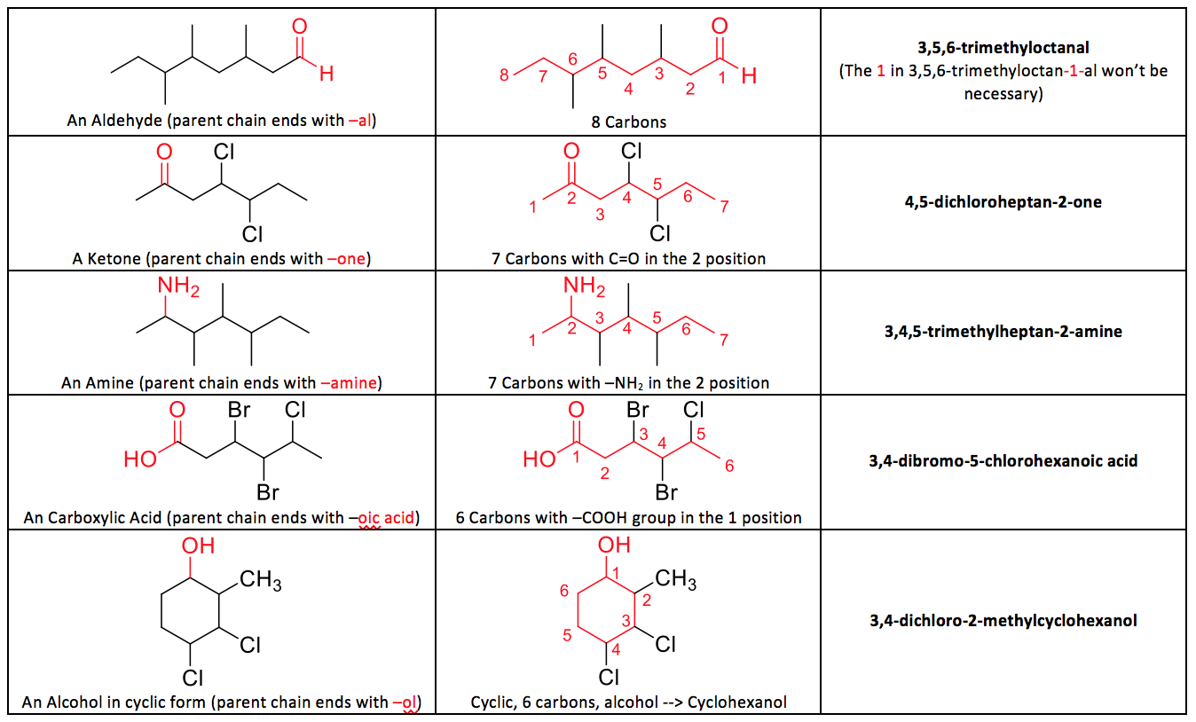
Other Functional Groups

Slide 71
Practice Problems

Slide 72
Summary
Molecules and Compounds
  Molecule: A molecule is the smallest amount of a pure substance that can exist
  Ionic compound: Made with 1 metal and 1 nonmetal
Drawing Molecules: Lewis Dot Structures!
Nomenclature of Molecules
  Covalent molecules: Name of first element comes first, preceded by numeric prefix (see next slide). Second element is given suffix –ide, and also uses numeric prefix.
Functional Groups
  Different functional groups can change the characteristics and properties of a molecule

Slide 73
Homework #1
Molecules and Nomenclature

