Slide 1
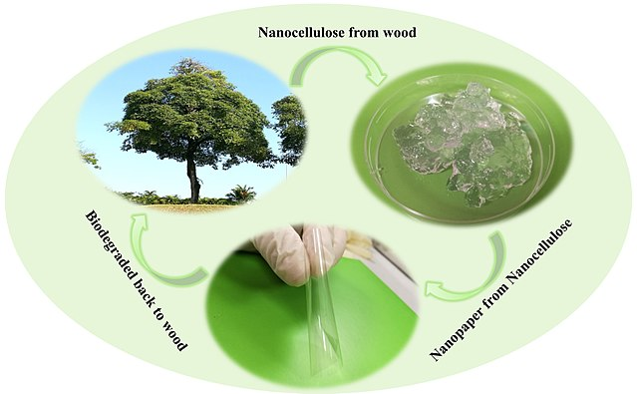

Yale-UNIDO Train-the-Facilitator Workshop in Green Chemistry
Green Chemistry: Principles and Metrics
CENTER for GREEN CHEMISTRY
and GREEN ENGINEERING at YALE
Image: Wikipedia, Biodegradation of nanocellulose, Author: Shaohui Li, Pooi See Lee

Slide 2
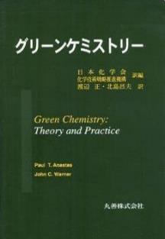
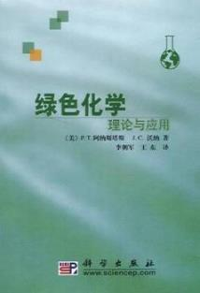
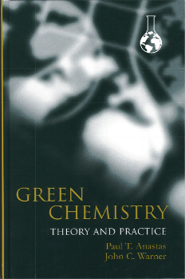
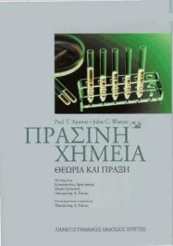
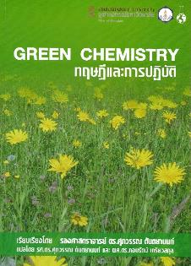
Green Chemistry
is the design of chemical products and processes that reduce or eliminate the use and/or generation of hazardous substances.

Slide 3
The Twelve Principles of Green Chemistry
1. Prevention. It is better to prevent waste than to treat or clean up waste after it is formed.
2. Atom Economy. Synthetic methods should be designed to maximize the incorporation of all materials used in the process into the final product.
3. Less Hazardous Chemical Synthesis. Whenever practicable, synthetic methodologies should be designed to use and generate substances that possess little or no toxicity to human health and the environment.
4. Designing Safer Chemicals. Chemical products should be designed to preserve efficacy of the function while reducing toxicity.
5. Safer Solvents and Auxiliaries. The use of auxiliary substances (solvents, separation agents, etc.) should be made unnecessary whenever possible and, when used, innocuous.
6. Design for Energy Efficiency. Energy requirements should be recognized for their environmental and economic impacts and should be minimized. Synthetic methods should be conducted at ambient temperature and pressure.
7. Use of Renewable Feedstocks. A raw material or feedstock should be renewable rather than depleting whenever technically and economically practical.
8. Reduce Derivatives. Unnecessary derivatization (blocking group, protection/deprotection, temporary modification of physical/chemical processes) should be avoided whenever possible .
9. Catalysis. Catalytic reagents (as selective as possible) are superior to stoichiometric reagents.
10. Design for Degradation. Chemical products should be designed so that at the end of their function they do not persist in the environment and instead break down into innocuous degradation products.
11. Real-time Analysis for Pollution Prevention. Analytical methodologies need to be further developed to allow for real-time in-process monitoring and control prior to the formation of hazardous substances.
12. Inherently Safer Chemistry for Accident Prevention. Substance and the form of a substance used in a chemical process should be chosen to minimize the potential for chemical accidents, including releases, explosions, and fires.

Slide 4

Prevention
It is better to prevent waste than to treat or clean up waste after it is formed.

Slide 5
The Pollution Prevention Act of 1990
Pollution
Prevention
Source
Reduction
Recycling
Treatment
Disposal

Slide 6
The Cost of Using Hazardous Materials
Storage
Transportation
Treatment
Disposal
Regulatory Costs
Liability
Worker Health and Safety
Corporate Reputation
Community Relations
New Employee Recruitment

Slide 7
Environmental Costs (1992 Perspective)
Industry spent $115 billion in 1992 on waste treatment, control, and disposal..
It was estimated at that time that it would cost as much as $700 billion to clean up existing hazardous waste sites. risen significantly.
These costs, and the costs associated with regulatory compliance, have risen significantly.

Slide 8
Approaches to Pollution Prevention
Inventory controls
Process controls
In-process recycling
Housekeeping changes
Green Chemistry

Slide 9

Atom Economy
Synthetic methods should be designed to maximize the incorporation of all materials used in the process into the final product.

Slide 10
Balancing Reactions

Slide 11
Atom Economy
Feedstock(s)
Product
54 g
28 g
82 g
Theoretical Yield = 82 g

Slide 12
Atom Economy
unreacted feedstock(s)
Feedstock(s)
Product
8.1 g
4.2 g
54 g
28 g
69.7 g
Theoretical Yield = 82 g
Actual Yield = 69.7 g
Percent Yield = 69.7/82 = 0.85
85% Yield

Slide 13
Atom Economy
Unreacted feedstock(s)
Feedstock(s)
Product
+
Co-Product(s)
106 g
352 g
180 g
278 g
Theoretical Yield = 180 g
Actual Yield = 180 g
100% Yield !
E-Factor = mass of nonproducts (waste) / mass of products
278 g / 180 g = 1.54 E-Factor

Slide 14

Environmental Impact Factor
Roger Sheldon
Environmental Impact Factor (E-factor)
E-factor = mass waste/ mass product
Industry Sector
E-Factor
Production Volume (Tonnage)
Oil Refining
< 0.1
1,000,000 – 100,000,000
Bulk Chemicals
1 - 5
10,000 – 1,000,000
Fine Chemicals
5 - 50
100 – 10,000
Pharmaceuticals
25 - 100
10 – 1,000
Sheldon, R. A. Chem Ind (London), 1992, 903..

Slide 15
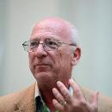
Atom Economy
Barry Trost
Atom Economy
Atom Economy = mass of desired product / mass of feedstocks
106 g
352 g
180 g
278 g
Atom Economy = mass of desired product / mass of feedstocks
180 g / 458 g = 0.393 = 39.3%
Trost, B. M.; Science 1991, (254), pp 1471-1477.

Slide 16
Atom Economy
Unreacted feedstock(s)
Feedstock(s)
Product
+
Co-Product(s)
+
Byproduct(s)
68 g
56 g
Condition #1:
73.16 g
50.84 g
59% Selectivity
Condition #2:
119.04 g
4.96 g
96% Selectivity

Slide 17
Atom Economy
Unreacted feedstock(s)
Feedstock(s)
Product
+
Co-Product(s)
+
Byproduct(s)
Decomposed
Feedstocks
Decomposed
Products
Decomposed
Co-Products
Decomposed
Biproducts
minor byproducts
subsequent reactions of components present

Slide 18

Less Hazardous Chemical Synthesis
Whenever practicable, synthetic methodologies should be designed to use and generate substances that possess little or no toxicity to human health and the environment.

Slide 19
Less Hazardous Synthesis
Phosgene
+
Methylisocyanate
Methylamine
+
1-Naphthyl Methylcarbamate
1-Naphthol
Bhopal Disaster December 2, 1984
The worst industrial accident in history.
40 tons of methyl isocyanate were accidentally released when a holding tank overheated at a pesticide plant, located in the city of Bhopal.
Over 500,000 people were exposed.
Over 3,000 immediate deaths.
Estimates range from 8,000-16,000 subsequent deaths

Slide 20
Less Hazardous Synthesis
Phosgene
+
Methylisocyanate
Methylamine
+
1-Naphthyl Methylcarbamate
1-Naphthol
+
+

Slide 21

Less Hazardous Chemical Synthesis
Case study: Synthesis of adipic acid
• one of the most produced commodity chemicals worldwide
• projected global market size >US$ 7 billion by 2019
• versatile building block in chemical, pharmaceutical and food industries
• precursor for the synthesis of the polyamide Nylon-6,6.
Conventional synthesis:
• benzene, a known carcinogen, is a starting material
• oxidation with excess of HNO₃, production of nitrous oxide (N₂O) a GHG (5–8% of worldwide anthropogenic N₂O emissions).

Slide 22
Less Hazardous Chemical Synthesis
Alternative synthesis of adipic acid:
• development of biocatalytic processes for producing adipic acid and catechol from sugars.
• biocatalytic process using yeast converts sugars to cis,cis-muconic acid, and this intermediate stage allows ready access to catechol and adipic acid.
• uses water as solvent at ambient temperature and pressure.
Check out: Raj et al. “Biocatalytic production of adipic acid from glucose using engineered Saccharomyces cerevisiae” Metabolic Engineering Communications. 2018, 6, 28-32.

Slide 23

Designing Safer Chemicals
Chemical products should be designed to preserve efficacy of the function while reducing toxicity.

Slide 24
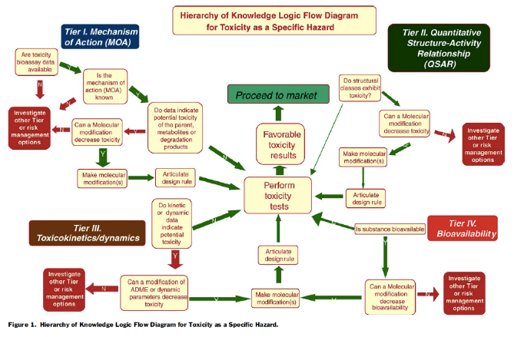
Designing Safer Chemicals
“The Incorporation of Hazard Reduction as a Chemical Design Criterion in Green Chemistry”
Anastas, Nicholas; Warner, John C. J. Chem. Health and Safety 2005, 12(2), 9-13.

Slide 25

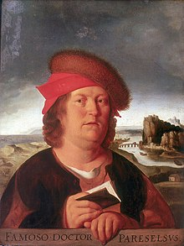
Designing Safer Chemicals
“Everything is toxic. It is simply depends on the dose”
Often otherwise phrased as
“The dose makes the poison.”
Risk = Hazard x Exposure
Green chemistry and engineering focus on reducing risk by reducing hazard.

Slide 26
Designing Safer Chemicals
Hazard types to avoid:
  Toxicological/Eco-toxicological
    Carcinogenicity
    Reproductive
    Developmental
    Neurological
    Global warming potential
    Ozone depleting potential
    Bioaccumulation
    Persistence
  Physical
    Explosivity
    Flammability
    Corrosivity
Physical/Chemical Properties to consider:
  Water solubility
  Log Kow
  Volatility
  Molar volume
  Aspect ratio
  Radical formation
  Nucleophilicity
  Electrophilicity
  pH/pKa
  Surface area
  Reducing potential
  Oxidizing potential
  Polarizability

Slide 27
Designing Safer Chemicals
Case study: Antifoulants
Antifoulants are generally dispersed in the paint as it is applied to the hull. Organotin compounds such as tributyltin oxide (TBTO) have traditionally been used: gradually leaches from the hull, killing the fouling organisms in the surrounding
Conventional use of organotin compounds as antifoulants:
• TBTO and related antifoulants have long half-lives in the environment (the half-life of TBTO in seawater is >6 months).
• they bioconcentrate in marine organisms (the concentration of TBTO in marine organisms has been found to be up to 104 times greater than in the surrounding water).
• organotin compounds are chronically toxic to marine life and can enter food chain. Extreme neurological hazard.
• bioaccumulative
tributyltin oxide (TBTO)

Slide 28
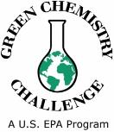
Designing Safer Chemicals
Case study: Antifoulants
Awardee in 1996
Alternative antifoulants (Dow Chemicals):
• Sea-Nine® 211 (DCOI) works by maintaining a hostile growing environment for marine organisms
• when organisms attach to the hull treated with DCOI, proteins at the point of attachment react with the DCOI
• reaction with DCOI prevents the use of these proteins for other metabolic processes: organism detaches itself and searches for a more hospitable surface to grow upon.
• Only organisms attached to hull of ship are exposed to toxic levels of DCOI.
• readily biodegrades once leached from ship (half-life is less than one hour in sea water).
https://www.epa.gov/greenchemistry/presidential-green-chemistry-challenge-1996-designing-greener-chemicals-award

Slide 29

Safer Solvents and Auxiliaries
The use of auxiliary substances (solvents, separation agents, etc.) should be made unnecessary whenever possible and, when used, innocuous.

Slide 30
Solvents
Unreacted feedstock(s)
Solvents
Feedstock(s)
Product
+
Co-Product(s)
+
Byproduct(s)
Decomposed
Feedstocks
Decomposed
Products
Decomposed
Co-Products
Decomposed
Biproducts
Solvents
minor byproducts
subsequent reactions of components present
Purification

Slide 31
Criteria for Use of Solvents
Usefulness in reaction (performance)
Ease of recycle
Price
Safety (flash point, flammability)

Slide 32

Safer Solvents and Auxiliaries
Problematic organic solvents
greener alternatives
easily separable, safe
avoidance
zero
volatility
environmentally
benign and safe
no solvent
supercritical fluids
ionic liquids
water solvent

Slide 33
Solvent Selection Guides
Preferred | Useable | Undesirable
Water | Cyclohexane | Pentane
Acetone | Heptane | Hexane(s)
Ethanol | Toluene | Di-isopropyl ether
2-Propanol | Methylcyclohexane | Diethyl ether
1-Propanol | Methyl t-butyl ether | Dichloromethane
Ethyl acetate | Isooctane | Dichloroethane
Isopropyl acetate | Acetonitrile | Chloroform
Methanol | 2-MethylTHF | Dimethyl formamide
Methyl ethyl ketone | Tetrahydrofuran | N-Methylpyrrolidinone
1-Butanol | Xylenes | Pyridine
t-Butanol | Dimethyl sulfoxide | Dimethyl acetate
 | Acetic acid | Dioxane
 | Ethylene glycol | Dimethoxyethane
 |  | Benzene
 |  | Carbon tetrachloride
Dunn and Perry, et. al., Green Chem., 2008, 10, 31-36

Slide 34

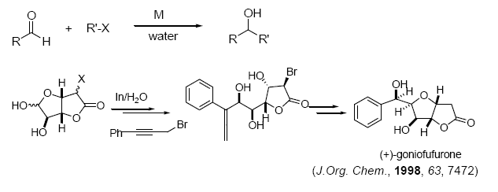
Water as a Solvent
Li, C.-J. Tetrahedron, 1996, 52, 5643
Li, C.-J. Acc. Chem. Res. 2002, 35, 533

Slide 35
Ionic Liquids
Unique properties
  High ionic conductivity
  Non-volatility
  Non-flammable
  High thermal stability
  Liquid over a wide temp range
  Highly solvating, yet non-coordinating
Melting point*
Density*
Viscosity*
Miscibility with water*

Slide 36
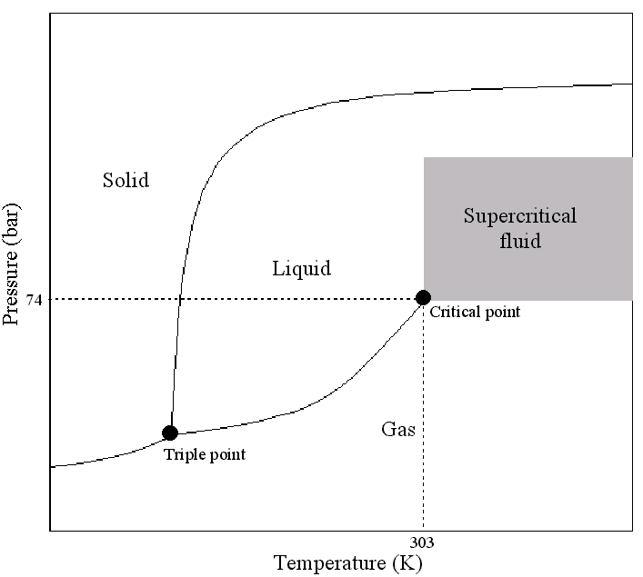
Supercritical CO2

Slide 37
Safer Solvents and Auxiliaries
Case study: Manufacturing process for sertraline, the active ingredient in the popular drug Zoloft®
Zoloft® is an anti-depressant; once one of the best selling pharmaceuticals on the market.
Conventional sertraline synthesis:
• synthesis was a three step process.
• used 4 hazardous solvents (methylene chloride, tetrahydrofuran, toluene, and hexane).
Zoloft®

Slide 38
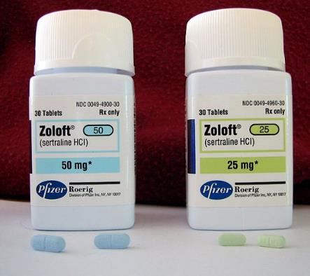
Safer Solvents and Auxiliaries
Case study: Manufacturing process for sertraline, the active ingredient in the popular drug Zoloft®
Alternative sertraline synthesis:
• process was streamlined to a single step, carried out in ethanol, a much less toxic solvent.
• new process is catalytic, cutting down on starting materials by 60%, 45%, and 20% for the three reaction components.
• combined steps eliminated 180 tons of TiCl₄, 150 tons of 50% NaOH, 180 tons of 35% HCl waste, and 600 tons of solid TiO₂.
Image: Wikimedia Commons, Author: Ragesoss
Pfizer, Inc

Slide 39

Design for Energy Efficiency
Energy requirements should be recognized for their environmental and economic impacts and should be minimized. Synthetic methods should be conducted at ambient temperature and pressure.

Slide 40
Energy in a Chemical Process
Thermal (electric)
Cooling (water condensers, water circulators)
Distillation
Equipment (lab hood)
Photo
Microwave
Source of energy:
Power plant – coal, oil, natural gas

Slide 41
Conservation of Thermal Energy
Monitoring, control and maintenance
Loss prevention
Waste heat recovery
Matching energy sources to requirements

Slide 42
Energy Usage
Chemicals and petroleum industries account for 50% of industrial energy usage.
~1/4 of the energy used is consumed in distillation and drying processes.

Slide 43
Alternative Forms of Energy
Photochemical Reactions
Microwave Reactions
Solid State Chemistry (mechanochemistry)

Slide 44

Design for Energy Efficiency
Case Study: Atorvastatin
Atorvastatin, a cholesterol-lowering drug (Lipitor®), suffers from an energy-demanding synthesis as a result of two cryogenic reactions at - 70 ºC
New biocatalytic synthesis uses enzyme DERA and shortens the process by removing two energy intensive chemical steps.
DERA: deoxyribose-5-phosphate aldolase
CBzNH
CBzNH
DERA

Slide 45

Use of Renewable Feedstocks
A raw material or feedstock should be renewable rather than depleting whenever technically and economically practical.

Slide 46
Biomaterials
Biomaterials [Carbohydrates, Proteins, Lipids]
Highly Functionalized Molecules
Petroleum Products [Hydrocarbons]
Singly Functionalized Compounds [Olefins, Alkylchlorides]
Highly Functionalized Molecules

Slide 48
Biomaterials
Biomaterials [Carbohydrates, Proteins, Lipids]
Highly Functionalized Molecules
Petroleum Products [Hydrocarbons]
Singly Functionalized Compounds [Olefins, Alkylchlorides]
Highly Functionalized Molecules

Slide 49
Polymers from Renewable Resources
Polylactic acid
Polyhydroxyalkanoates (PHAs)

Slide 50

Use of Renewable Feedstocks
Case study: Production of levulinic acid
• precursor for pharmaceuticals, plasticizers, and various other additives
• widely used as a building block/starting material
Conventional synthesis:
• made by heating hexoses (glucose, fructose) or starch in dilute HCl or H₂SO₄
• yield depends on acid, its concentration, temperature, pressure
• reaction also produces hard to remove by-products.
formic acid
fructose
hydroxymethylfurfural (HMF)
levulinic acid

Slide 51
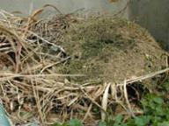
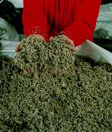

Use of Renewable Feedstocks
Case study: Production of levulinic acid
agricultural
residues,
waste wood
Alternative synthesis:
• levulinic acid can be obtained from paper mill sludge, agricultural and municipal waste and paper.
• uses a high-temperature, dilute-acid hydrolysis process that converts cellulosic biomass.
municipal solid waste
and waste paper
hydrolysis
levulinic acid
paper mill
sludge
Biofine, Inc

Slide 52
The Biofine Process – Levulinic Acid Family
butanediol
Acrylic acid
Succinic acid
MTHF
(fuel additive)
THF
Diphenolic acid
gamma
butyrolactone
DALA (δ-amino levulinic acid)
(non-toxic, biodegradable herbicide)

Slide 53

Reduce Derivatives
Unnecessary derivatization (blocking group, protection/deprotectio, temporary modification of physical/chemical processes) should be avoided whenever possible.

Slide 54
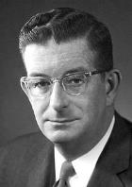
R. B. Woodward’s Synthesis of
RESERPINE
R. B. Woodward’s Synthesis of
RESERPINE

Slide 55
Protecting Groups
[H]
Protection
Deprotection
[H]

Slide 56
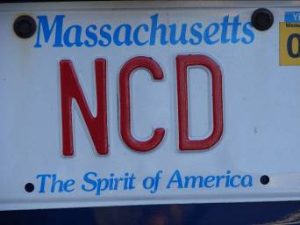
Noncovalent Derivatization

Slide 57
Solid State Reactions
+
Extremely low yield in solution

Slide 58
Solid State Reactions
+

Slide 59
Solid State Reactions

Slide 60
Solid State Reactions

Slide 61

Reduce Derivatives
Case study: 6-aminopenicillanic acid (6-APA)
6-APA: core moiety of penicillin
Conventional synthesis of 6-aminopenicillanic acid using 3 steps and intermediates:
Alternative synthesis using enzyme and fewer derivatives:

Slide 62

Catalysis
Catalytic reagents (as selective as possible) are superior to stoichiometric reagents.

Slide 63

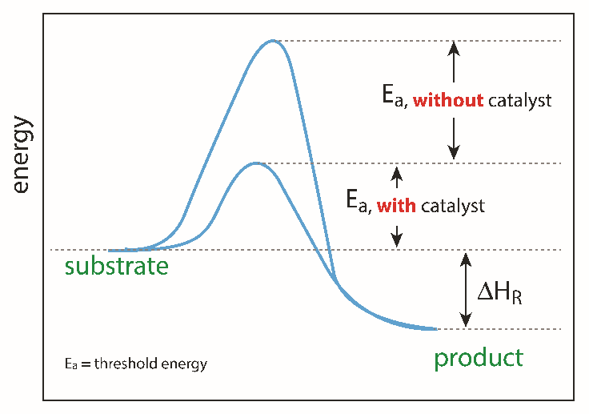
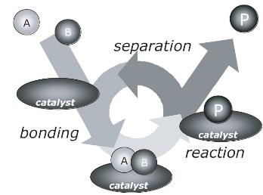
Catalysis
Catalysts can facilitate complex reactions by:
lowering the activation energy (E_{a}) of the reaction.
• reducing temperature necessary to achieve a reaction.
• controlling the site of the reaction (selectivity enhancement).
• catalysis is a cyclic event
I. Chorkendorff, J. W. Niemantsverdriet, Concepts of Modern Catalysis and Kinetics, Wiley-VCH, 2003
Image source: Adobe stock
Notes:
Catalysts lower the activation (threshold energy) in the reaction.

Slide 64
Why are Catalysts Considered Green?
Reduce energy requirements of a reaction
Reduce amount of material used
Increase atom economy
Ability to be reused

Slide 65
Questions to Ask?
Is the catalyst used in stoichiometric or sub-stoichiometric amounts?
Can the catalyst be reused?
  How many times can it be reused?
  Will the activity of the catalyst decrease as it is reused?
Is the catalyst non-toxic?
Is the catalyst expensive?
Does the catalyst require special conditions?
  Air sensitive?

Slide 66
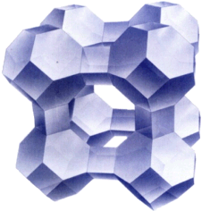
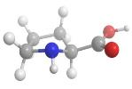
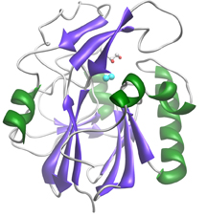
Catalysis
Many molecules/enzymes/materials can be catalysts
zeolite (crystalline alumosilicate)
enzyme (biocatalyst)
copper-zinc crystallites on silica
Catalysis, Concepts and green applications, by Gadi Rothenberg, Wiley-VCH 2008.

Slide 67
Catalysis: Green Naproxen Synthesis
Nonsteroidal anti-inflammatory drug (NSAID) of the propionic acid class (the same class as ibuprofen) that relieves pain, fever, swelling, and stiffness; COX inhibitor
  97% yield in three steps
  Dartt and Davis
Notes:
cyclooxygenase

Slide 68
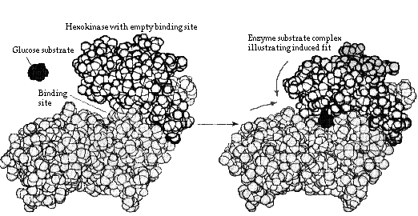
Biocatalysis
Enzymes or whole-cell microorganisms
Benefits
  Fast rxns due to correct orientations
  Orientation of site gives high stereospecificity
  Substrate specificity
  Water soluble
  Naturally occurring
  Moderate conditions
  Possibility for tandem rxns (one-pot)

Slide 69

Design for Degradation
Chemical products should be designed so that at the end of their function they do not persist in the environment and instead break down into innocuous degradation products.

Slide 70
PBTs
Persistent
Bioaccumulative
Toxic
EPA’s PBT list:
https://www.epa.gov/toxics-release-inventory-tri-program/persistent-bioaccumulative-toxic-pbt-chemicals-covered-tri

Slide 71
Early Examples of Persistence
Synthetic detergents
1950’s and 60’s – high level of foam in sewage plants and in rivers & streams
  Inefficient operation of sewage plants (and washing machines)
  Branched alkyl structures resulted in persistence issue
  Moved to linear alkyl chains
  First time that structure was linked to performance/function (persistence)
Cheer: https://www.youtube.com/watch?v=lMxlAIeI8QI
Dash: https://www.youtube.com/watch?v=F1YTHr4mTQA

Slide 72
Early Examples of Persistence
Pesticides: DDT
Ideal insecticide:
  Inexpensive to prepare
  Very wide spectrum in activity
  Non-toxic to humans (or so they thought)
  Persistent, negating the requirement for re-treatment
  Inventors awarded Nobel Prize in 1948
1962: Rachel Carson, Silent Spring (https://youtu.be/Ipbc-6IvMQI)
  Linked widespread DDT use to cancer and thinning of bird eggs shells
  Carcinogen, endocrine disruptor, developmental and reproductive effects
Replaced in the developed world with more expensive pesticides, such as organophosphates

Slide 73
Current Examples of Persistence
Plastics
Increased production and use in the 20th century:
  Low cost, ease of manufacture, versatility, resistance to water
Parley for the Oceans: http://www.parley.tv/#fortheoceans

Slide 74

Design for Degradation: PLASTICS
Conventional plastics (e.g. PET) are made from petroleum:
• PET Plastic persists in the environment
• made from depleting resources
petroleum product
high temperature
vacuum
catalyst

Slide 75
Design for Degradation: PLASTICS
Alternative process:
Cargill Dow LLC
Synthesis of PolyLactic Acid (PLA) from starch:
• a biobased, compostable, and recyclable PLA polymer that uses 20–50 percent less fossil fuel resources than comparable petroleum-based polymers.
• the first family of polymers derived entirely from renewable resources that can compete cost-effectively with traditional fibers and plastic packaging materials.
• manufacturing process consists of three solvent-free steps that lead to the production of lactic acid, lactide, and PLA high polymer with very high yields and internal recycling schemes that reduce waste.
• PLA can be biodegraded under industrial compositing conditions - does not degrade though in the environment

Slide 76

Real-time Analysis
Analytical methodologies need to be further developed to allow for real-time in-process monitoring and control prior to the formation of hazardous substances.

Slide 77


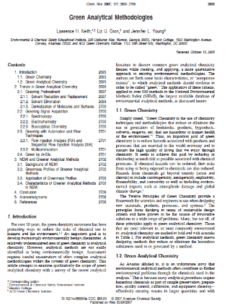

Green Analytical Methodologies
Jennifer Young
Liz Gron
Lawrence Keith
Chem. Rev. 2007 107, 2695-2706

Slide 78
Relationship to Green Chemistry
Gains in quality, safety and/or efficiency will vary depending on the product and are likely to come from:
  Reducing production cycle times by using on-, in-, and/or at-line measurements and controls. Energy reduction
  Preventing rejects, scrap, and re-processing. Waste reduction
  Considering the possibility of real time release.
  Increasing automation to improve operator safety and reduce human error. Safety
  Facilitating continuous processing to improve efficiency and manage variability
    Using small-scale equipment (to eliminate certain scale-up issues) and dedicated manufacturing facilities. Process Intensification
    Improving energy and material use and increasing capacity. Energy

Slide 79
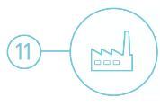
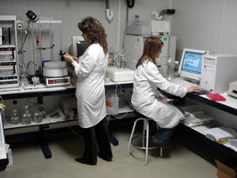

Real-time Analysis for Pollution Prevention
Real time analysis for a chemist is the process of “checking the progress of chemical reactions as it happens”.
Knowing when your product is “done” can save a lot of waste, time, and energy!
Image: Wikimedia Commons

Slide 80
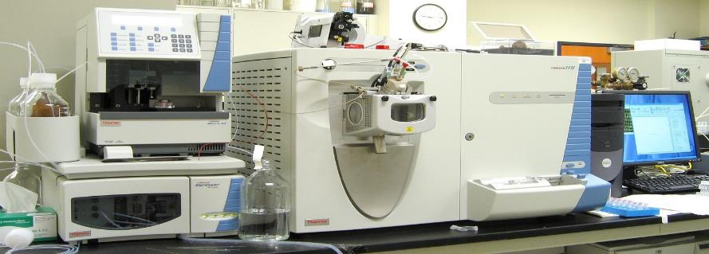
What Does Green Analytical Chemistry Mean?
Real-time Analysis for Pollution Prevention
Green Chemistry is applicable to all chemical processes, including the methods, protocols and processes of analytical chemistry.
Image: Wikipedia

Slide 81
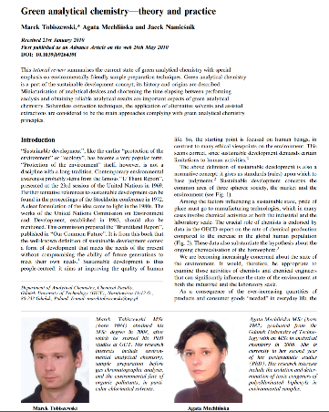
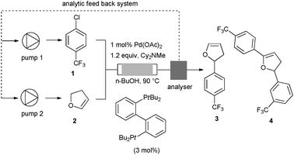
Examples of Green Analytical Chemistry Methodologies
Real-time Analysis for Pollution Prevention
X-ray fluorescence detection for multi-metal matrix
In-line HPLC analyzer, on flow
Desired product
Real-time adaptation of addition of 1 and 2 to max. 3
Image Sources: https://www.thermofisher.com, https://www.intechopen.com/books/herbicides-advances-in-research/recent-advances-in-the-extraction-of-triazines-from-water-samples, J. P. McMullen, M. T. Stone, S. L. Buchwald and K. F. Jensen, Angew. Chem., 2010, 39, 7230

Slide 82
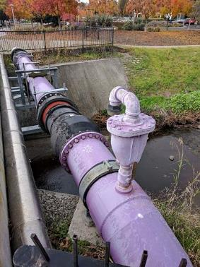
Real-time Analysis for Pollution Prevention
Case study: Real-time analysis in cooling systems
In 2008 Naclo Company won the EPA Greener Reaction Conditions Award for their innovative 3D TRASAR® Technology.
Alternative Cooling System with 3D TRASAR® Technology:
3D TRASAR® System allows for the real-time monitoring of mineral scale buildup.
system can also utilize poor-quality water.
3D Scale Control prevents mineral scale formation to increase efficiency.
3D Bio-control performs a real-time check for planktonic and sessile bacteria. This reduces the amount of biocide used since biocides are then added only when necessary, rather than on a set schedule.
3D TRASAR® System greatly reduces the amount of wastewater discharged from cooling systems.
https://www.epa.gov/greenchemistry/presidential-green-chemistry-challenge-2008-greener-reaction-conditions-award
Image: Wikipedia, A lavender-colored nonpotable water pipeline in Mountain View, California, Author: Grendelkhan
Notes:
The system monitors antiscalant levels using a fluorescent-tagged, scale-dispersant polymer and responds quickly when conditions favor scale formation. In addition, 3D Bio-control, also part of the 3D TRASAR® system, is the only online, real-time test for measuring planktonic and sessile bacteria. It uses resazurin, another fluorescent molecule, which changes its fluorescent signature when it interacts with respiring microbes. By adding an oxidizing biocide in response to microbial activity, 3D Bio-control generally reduces the use of biocide and also prevents biofilm from building up on surfaces, maintaining efficient heat transfer.

Slide 83

Inherently Safer Chemistry
Substance and the form of a substance used in a chemical process should be chosen so as to minimize the potential for chemical accidents, including releases, explosions, and fires.

Slide 84
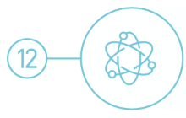
Inherently Safer Chemistry
for Accident Prevention
Accidents can be avoided by minimizing hazards
approaches to design safer chemistry can include the use of solids or low vapor pressure substances in place of volatile liquids.
• other approaches include avoiding the use of molecular halogens in large quantities.
• continuous flow processes can help to minimize chemical hazards.

Slide 85
Inherently Safer Chemistry
for Accident Prevention
Case study: Production of gasoline alkylate with AlkyClean® Technology
In 2016 Albemarle and CB&I won the EPA Green Chemistry Award for their inherently safer AlkyClean® process technology.
Conventional alkylate production:
• alkylate is typically produced from the reaction of isobutane and light olefins.
• requires the liquid acid-catalyzed processes, such as hydrofluoric acid.
• hydrofluoric acid is extremely toxic, upon release it forms clouds that can be lethal for up to five miles.
AlkyClean® Technology:
• AlkyClean® solid acid alkylation process produces high quality alkylate without using liquid acid catalysts.
• solid acid alkylation process is safer for both people working directly in production and for people in the area surrounding the facility.
• environmental and economic benefits since no acid-soluble oils or spent acids are produced.

Slide 86
The United States Presidential Green Chemistry Challenge

Slide 87
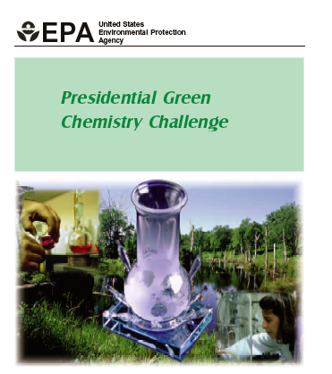

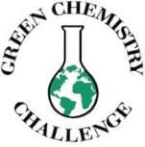
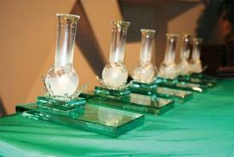
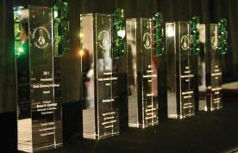
US Presidential Green Chemistry Challenge
The Presidential Green Chemistry Challenge Awards promote the environmental and economic benefits of developing and using novel green chemistry. These prestigious annual awards recognize chemical technologies that incorporate the principles of green chemistry into chemical design, manufacture, and use.

Slide 88
US Presidential Green Chemistry Challenge
1996
1997
1998
1999
2000
2001
2002
2003
2004
2005
2006
Academic
Mark Holzapple
Joseph DeSimone
Barry Trost, Karen Draths & John Frost
Terry Collins
Chi Hue Wong
C.-J. Li
Eric Beckman
Richard Gross
Charles Eckert
&
Charles Liotta
Robin Rogers
Galen Suppes
Small Business
Donlar Corporation
Legacy Systems
PYROCOOL Technologies
Biofine
RevTech
Eden Bioscience
SC Fluids
AgraQuest
Jeneil Biosurfactants
Metabolix
Akron Cons.
&
Nupro Tech.
Synthetic Pathways
Pharmacia
BHC Company
Flexsys America
Lilly Research Laboratories
Roche Colorado
Bayer Corporation
Pfizer
Sud-Chemie
Bristol-Myers Squibb Co
Archer Daniels Midland & Merck
Merck
Solvents and Reaction Conditions
Dow
Imation
Argonne National Labs
Nalco Chemical Company
Bayer Corporation
Novozymes
Cargill Dow
DuPont
Buckmann Laboratories
BASF
Codexis
Designing Safer Chemicals
Rohm and Haas
Albright
and Wilson
Rohm and Haas
Dow AgroSciences
Dow AgroSciences
PPG
CSI
Shaw Industries
Engelhard Co
Archer Daniels Midland
SC Johnson
2007
2008
2009
2010
2011
2012
2013
2014
2015
2016
2017
Academic
Michael Krische
RobertMaleczka &
Milton Smith
Krzysztof Matyiaszewski
James Liao
Bruce Lipshutz
Robert Waymouth
&
Geoffrey Coates
Richard Wool
Shannon Stahl
Eugene Y.-X. Chen
Paul Chiric
Eric Schelter
Small Business
NovaSterilis
SIGNa
Virent Energy
LS9, Inc
BioAmber
Elevance
Faraday Technology
Amyris
Renmatix
Verdezyne
UniEnergy Technologies
Synthetic Pathways
Columbia Forest
Hercules
Battelle
Eastman
Dow
BASF
Genomatica
Codexis
Life Technologies
Solazyme
LanzaTech
CBI &
Albemarle
Merck & Co
Solvents and Reaction Conditions
Headwaters Technology
Nalco
CEM
Merck
Codexis
Krayton Performance Polymers
Cytec
Dow
QD Vision
Soltex
Dow
AgroSciences
Amgen & Bachem
Designing Safer Chemicals
Cargill
DOW AgroScience
P&G
&
Cook
Clarke
Sherwin Williams
Buckman
Cargill
The Solberg Co.
Hybrid Coatings Technologies
Newlight Technologies
Dow
Papierfabrik August Koehler

Slide 89
More examples available!
Presidential Green Chemistry Challenge Winners
https://www.epa.gov/greenchemistry/presidential-green-chemistry-challenge-winners
How Industrial Applications in Green Chemistry Are Changing Our World (white paper) by American Chemical Society

Slide 90
Sponsored by Yale-UNIDO Initiative
QUESTIONS?
CENTER for GREEN CHEMISTRY
and GREEN ENGINEERING at YALE

