Slide 1
Areas of Research in Green Chemistry
FEEDSTOCKS

Slide 2
PRINCIPLE 7
A raw material or feedstock should be renewable rather than depleting wherever technically and economically practicable.
Recap…

Slide 3
Energy Consumption: data and projections
Increasing world energy consumption since 1990.
The graph includes prediction for year 2035, where the use will reach 770 quadrillion British Thermal Unit [BTU]. Source: U.S. Energy Information Administration [U.S. EIA].

Slide 4
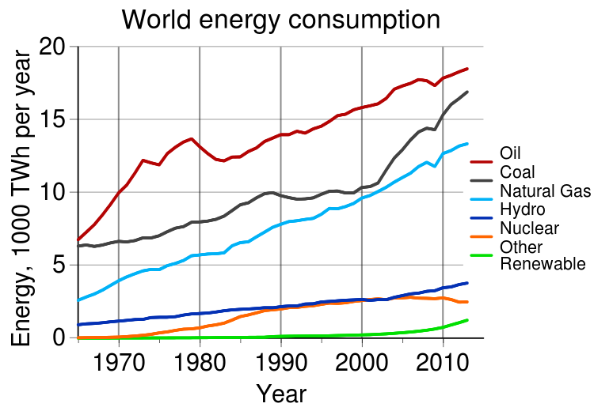
Energy Feedstocks Consumption
Increasing world energy consumption years 1970-2010. Oil, coal and natural gas are still predominant sources of energy, but renewables are on the increase too. Source: Statistical Review of World Energy.

Slide 5
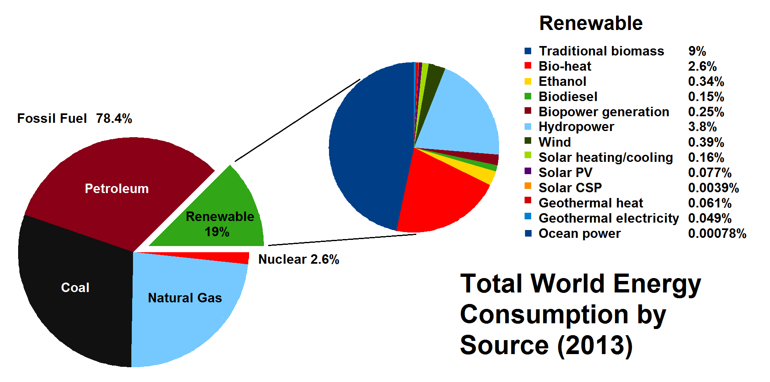
Energy Feedstocks Sources
World energy consumption by source reported in 2013. While fossil fuel is still predominant, in 2013 there has been an increase in renewable source of energy. Most renewable energy comes from biomass. Source: REN21 Renewables 2014 Global Status Report.

Slide 6
Renewable vs. Depleting feedstocks
Feedstock
A raw material to supply or fuel or industrial process
Renewable or Depleting: A question of time!
A renewable resource is determined to be renewable if it can be replenished in a relevant amount of time
Fossil fuels are depleting because they cannot be replenished in a practical timeframe from vegetation

Slide 7
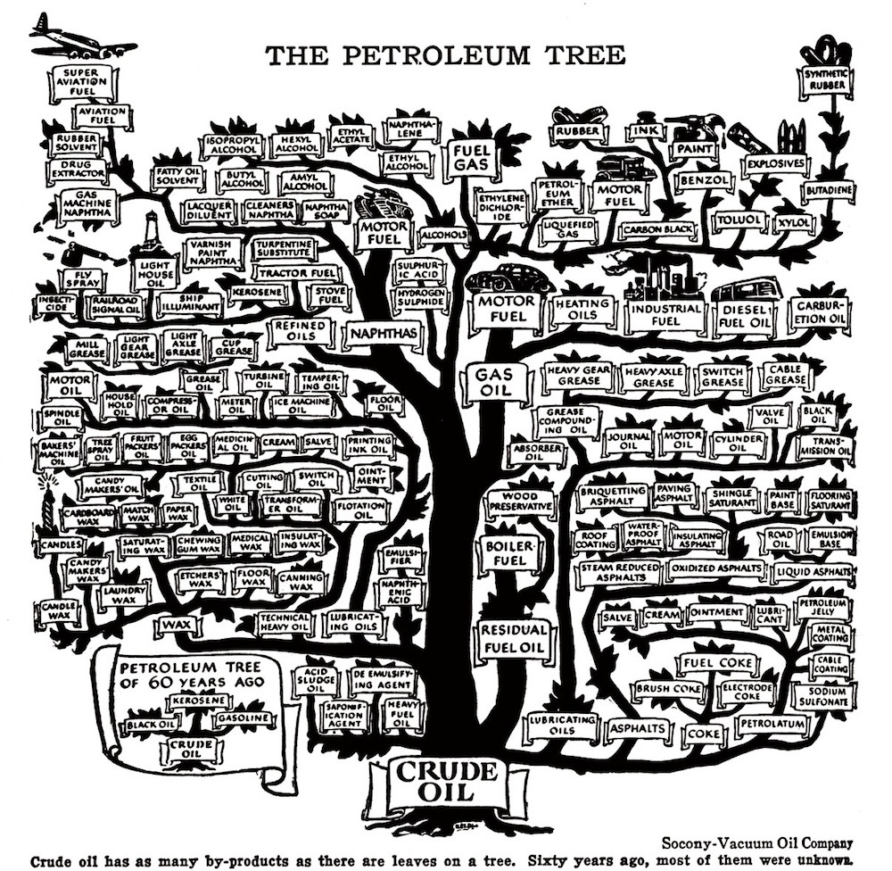
Notes:
Petroleum has been the most popular feedstock. It is used to generate everything from motor fuel to paints, rubbers and inks. This was possible due to additives.

Slide 8
Notes:
Today, the list of petroleum based products is even longer.

Slide 9
Renewable feedstocks
Renewable feedstocks include the following materials:
CO₂
Biomass (algae, corn, switchgrass, poplar, willow, sorghum, and bamboo)
Agricultural waste (ex. manure)

Slide 10
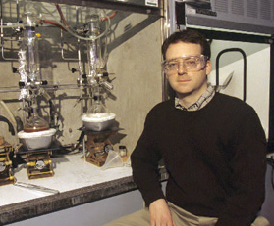
Using CO₂ as a feedstock:
Prof. Geoffrey W. Coates
Development of catalysts able to incorporate
carbon monoxide and dioxide into polymers
Utilize renewable sources of carbon
monoxide and dioxide gases such as biomass
(agricultural waste) and other low-cost
sources such as coal or industrial waste
High turnover numbers, frequencies, and
selectivities
Polycarbonate coatings manufactured with these catalysts have the potential to sequester or avoid up to 180 million metric tons of CO₂ emissions
Notes:
This was in the video

Slide 11
Biomass platforms
Only about 4% utilized by humans
(food, ethanol, sweeteners)
Building blocks for a diverse chemical platform.
Nature’s richest source of aromatic carbon. Used in polymers, adhesives, production of phenolic chemicals.
Converted into polymers, lubricants, and detergents.

Slide 12
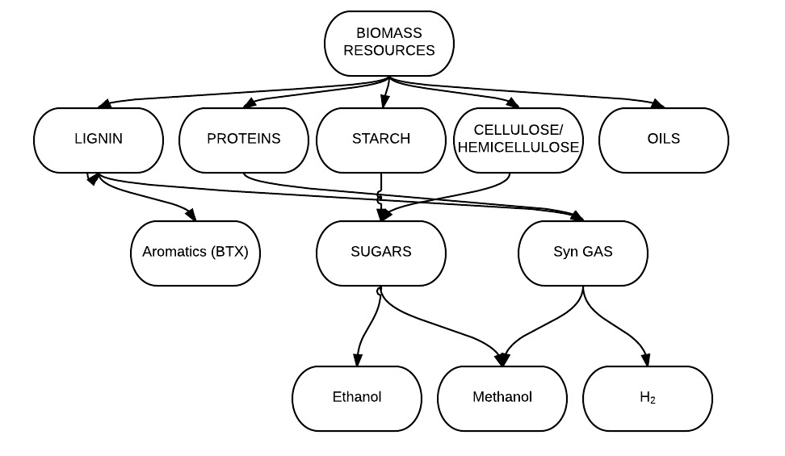
Biomass valorization today
Biomass is a robust feedstock and can be used as a source of proteins, starches, cellulose and oils.

Slide 13
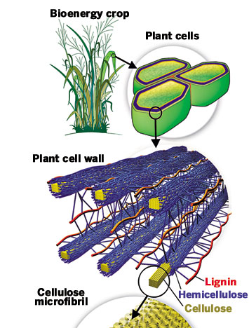
Lignocellulose Biomass
Lignocellulose is a complex polymer obtained from plant cell walls.

Slide 14
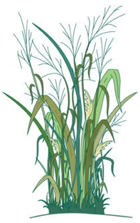
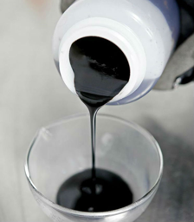

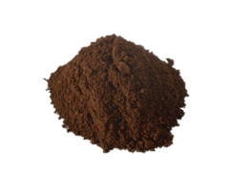
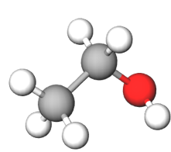
Main Industries for Lignocellulose
Retains applied nitrogen longer in the plants’ root zone, optimizing crop utilization and yield, and reducing nutrient run-off.
Retains applied nitrogen longer in the plants’ root zone, optimizing crop utilization and yield, and reducing nutrient run-off.
PAPER INDUSTRY
BIOETHANOL INDUSTRY
Lignin powder
Bioethanol
Burnt or Discarded

Slide 15
Lignin – Source of Renewable ‘Drop-in’ Platform Chemicals
A Need of New Technology:
Economical
Sustainable
Selective
Efficient
phenol
Lignin structure includes aromatic (ring) structures.
If broken down selectively, it can be a source of drop –in platform chemicals such as phenol

Slide 16
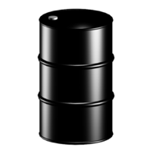


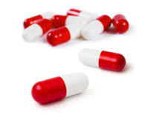
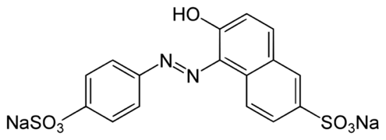
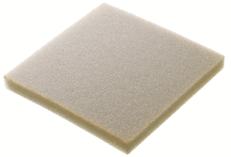
Traditional synthesis and use of phenols
Petroleum
Nylon
Phenols
Polycarbonates
Pharmaceuticals
(Including Salicylic Acid)
Yellow Dye #6
Polyurethane Foams
Notes:
Traditionally, phenol is made out of petroleum. Since it is a platform chemical, it can be used to produce polycarbonates, pharmaceuticals, nylon etc.

Slide 17
A depolymerization strategy for the valorization of lignin
With an addition of hydrogen and a selective catalyst, lignin can be broken down into phenols.
Lignin
Phenols

Slide 18
Why use renewable feedstocks?
Economic reasons:
  - Inherent long-term tendency for petroleum price increases
  - A fluctuation of a few cents in crude oil price can result in massive price swings for downstream products
  - Constant decrease on cost of renewable resources
Scientific reasons:
  - Constant improvement of quality of renewable feedstocks
  - Modern plant breeding
  - Genetic manipulation
  - Breakthroughs in catalysis (enzymes, etc.)
Environmental reasons:
  - Biological compatibility (to an extent)
  - Use of waste streams (wood pulping, agriculture, etc.)

Slide 19
Challenges with Renewables
Feedstock cultivation
  - Competition with food supply
  - Land demand
  - Nutritional needs
  - Diseases
  Initial investment
Harvesting method to maximise yields and minimise degradation of product
Post harvest processing
Product extraction and purification
Product standardization
Complexity
Product storage, packing, and distribution
New methodologies for alternative feedstocks

Slide 20
Areas of Research in Green Chemistry
CATALYSIS

Slide 21
PRINCIPLE 9
Catalytic reagents (as selective as possible) are superior to stoichiometric reagents.

Slide 22
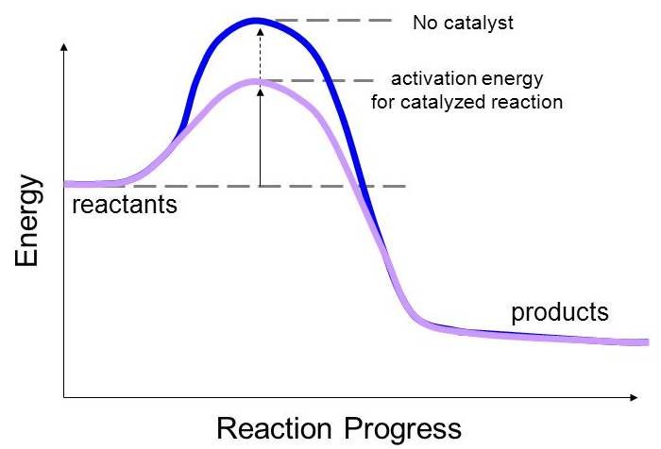
What is a Catalyst?
→ A substance that increases the rate of a chemical reaction without itself undergoing any permanent chemical change.
Advantages:
Lowers activation energy of the reaction
Can be recycled and reused
It is used in minuscule amounts
Shortens reaction time
Source: Wikipedia

Slide 23
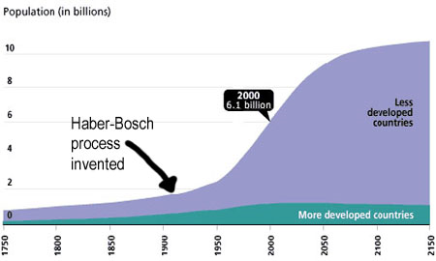
Catalysts are widely used by industry and by nature
Catalyst | Reactions catalyzed
Iron oxide | Ammonia from nitrogen and hydrogen
Chromium-Molybdenum Alloy Nickel-Molybdenum Alloy Zeolite (Porous Aluminum and Silica Oxide) | Petroleum Industry
Acid (HCl, H₂SO₄, HNO₃) | Many organic reactions
Enzymes | Starch into sugars and sugars to ethanol
Haber-Bosch process, which allows fertilizer production, is facilitated by a catalyst.
The reaction led to a global increase in human population.
Source: Wikipedia

Slide 24
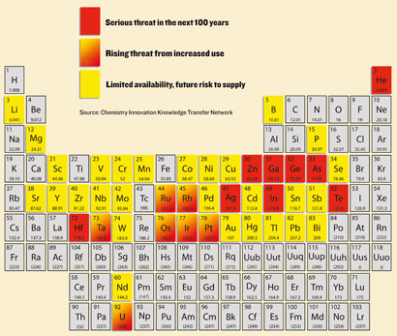
Designing a Green Catalyst
Not all catalysts are created equal. Chemists need to consider various factors when deciding on the catalyst.
Low toxicity
Earth abundance
Efficiency
  - Rate and energy input
Compatible with green solvent
Longevity and Recyclability
Ease of production
  - Large volume and consistent in quality
High selectivity for desired product(s)
Many metals which are used as catalysts are depleting
http://www.rsc.org/chemistryworld/Issues/2011/January/CriticalThinking.asp

Slide 25
Current trend in catalyst design
Reduce Loading
High Surface Area Support
Atomic Layer deposition
Earth Abundant Alternative
Abundant metal
Alloy - Synergistic Effect
Adjust other parameters
  - Solvent
  - Surfactants

Slide 26
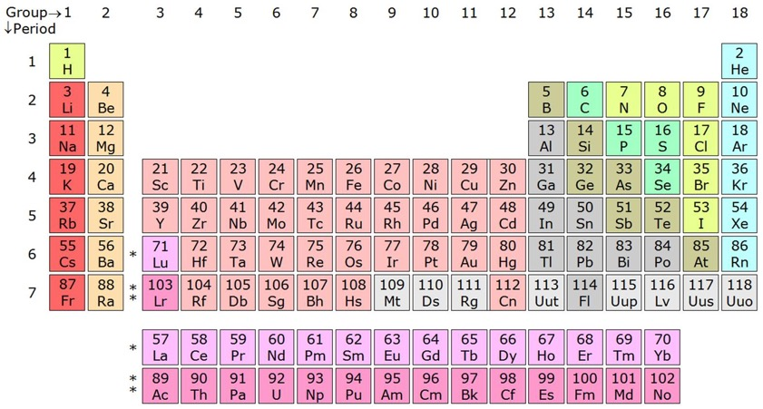

Improving the Haber-Bosch process using iron catalyst
Traditionally the HB reaction was made using Osmium metal as catalyst.
  - Osmium metal is rare and toxic, which made the reaction unsustainable.
Because Iron is in the same column as Osmium, its properties are similar
(Fe₃O₄) can be an alternative catalyst to provide comparable yield.
$$N_{2}+3H_{2 }→2NH_{3}$$

Slide 27
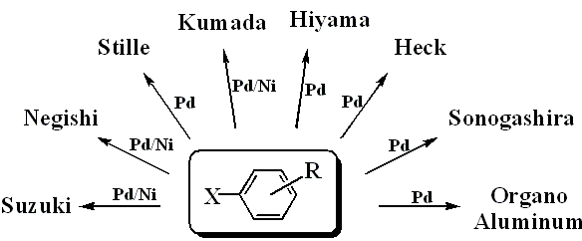

Other catalyst improvements: from Palladium to Nickel
Cross Coupling Reactions
  → Connect two separate organic molecules together with high selectivity and high yield
 | USD mol⁻¹
Ni | $1.20
Pd | $1,500
Notes:
Pd is used catalytically, in small amount, to carry out the reaction
In some cases, Pd needs NOT to be purified

Slide 28
Other catalyst improvements: alloys
In addition to moving away from precious metals, scientists use metal alloys for synergistic effect:
Alloying of multiple metals
  - Bronze – Copper + Tin (or Zinc)
  - Monel – Copper + Nickel
  - Stainless Steel – Steel (Iron + C) + Chromium with many others
The surface area
  - Thin layer deposition
  - Ultra high area support

Slide 29
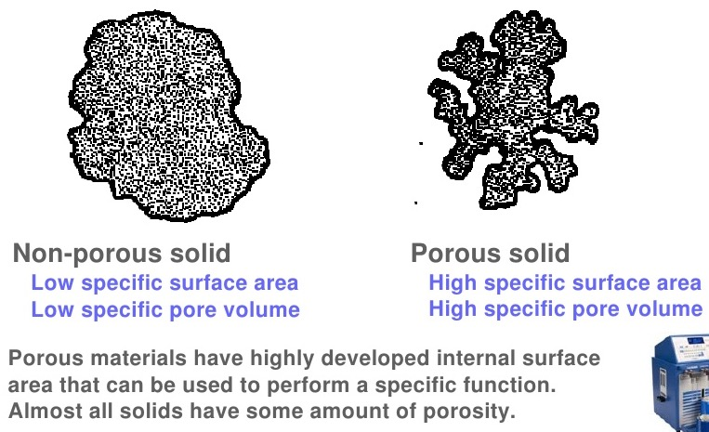
Increase Surface Area
High surface area porous support
<50 cm² g⁻¹
50 – 4000 cm² g⁻¹

Slide 30
Areas of Research in Green Chemistry
SOLVENTS

Slide 31
PRINCIPLE 5
The use of auxiliary substances (e.g. solvents, separation agents, etc.) should be made unnecessary wherever possible, and innocuous when used.

Slide 32
What is a solvent?
A solvent is any substance that dissolves another substance(s) so that the resulting mixture is a homogenous solution.

Slide 33
When solvents are used?
Solvents are used in all stages of a product’s life-cycle:
During manufacturing
  - To facilitate intermolecular chemical reactions via solute molecules & ions.
During processing
  - To aid in manipulation of chemicals, but not as an integral part of the molecule itself.
During extraction/separation
  - To separate or purify the chemical products from co-products, byproducts and impurities.
During cleaning
  - To remove oil, grease and silica from mechanical parts.
During product Formulation
  - To design a product and process (quantities, raw materials, mixture design and testing)

Slide 34
Uses of Solvents
As a Solvent
Dissolution
Extraction
Degreasing
Inks, dyes, paints, coatings
Dilution, dispersal
Dry cleaning
As Something Else
Fuels
Feedstocks
Drugs of abuse
Beverages
Antifreeze
Explosives
Pollutants
Everything has been touched by a solvent

Slide 35
Traditional Solvents
Volatile Organic Compounds
  Chloroform, carbon tetrachloride, methylene chloride, perchloroethylene (PERC)
  Benzene, Toluene, Xylene (BTX)
  Acetone, Ethylene Glycol, methylethyl ketone (MEK)
Chlorofluorocarbons (CFCs)
Notes:
VOCs have been linked to atmospheric ozone generation, commonly known as smog.
PERC is used in dry cleaning.
CFCs deplete an ozone layer which results in severe environmental effects
In a typical chemical reactions, solvent accounts the majority of the reaction weight and therefore, post-processing solvent removal, which is typically achieved through distillation or vacuum evaporation (Video: solvent distillation) , is a very energy costly procedure for large scale synthesis. Moreover, products that are sensitive to impurities may requires extra cycles of distillations. This contributes to another (expensive) problem to deal with waste. Careless disposal of solvents are also known to pose great threat to the environment since many of which are toxic even at low concentration. To make matters worse, most organic solvents are volatile, possibly explosive and moderately toxic upon exposure, these qualities pose great concerns to any individuals who are involved in handling solvent.

Slide 36
What are the concerns for solvents?
Inherent Toxicity
  Methylene chloride, chloroform, carbon tetra chloride and other halogenated solvents are suspected human carcinogens.
Flammability
  Because of their physicochemical properties (low flash point and autoignition temperatures), solvents are flammable.
Explosivity
  They can explode, and since they are used in large volumes, the explosion can be disastrous.
Stratospheric Ozone Depletion
  They reduce the ozone layer which protects the earth from the radiation.
Atmospheric Ozone Production
  CFCs contribute to ozone production which in turn increases a green house effect.
Global Warming Potential

Slide 37
Solvent Selection Process by ACS and GSK
Screen solvents based on
  reaction type
  process requirements
  reactant/product solubility
  EHS
Evaluate experimentally
Review the entire route/ process and look for synergies
Refine experimentation
American Chemical Society
GlaxoSmithKline
To identify candidates for experimental evaluation
Notes:
Regulations on solvent handlings have been recognized in the green chemistry community. The act was initiated by the American Chemical Society (ACS) and GSK (GlaxoSmithKline) when they released their guidelines for safer solvent handlings. These guidelines were created based on the characterization of each solvent, and were validated experimentally. The selection was refined, and repeatedly match Environmental Health and Safety (EHS) standards. These guides assist green chemists with some preliminary guidance in their solvent selection process by ranking the solvents based on their reactivity and reusability, and more importantly impacts on the environment and human health.

Slide 38
Solvent selection parameter
Solvent Acceptability Reactivity Compatibility Product quality Process safety Vapor pressure Odor threshold Exposure limits Autoignition temperature Flash point complexity (number and nature of different solvents used) | Green Chemistry Metrics greenhouse gas potential emissions on incineration Log K_{ow} aquatic toxicity acidification persistence eutrophication Total Organic Carbon (TOC) oil equivalents
Mass Total solvent mass Mass productivity or reaction mass efficiency | Energy recovery (boiling point) heat of combustion ease of drying
Notes:
Solvent selection criteria used by ACS and GSK to evaluate solvent list and create solvent guide which helps industry to replace commonly used toxic solvents with a safer and greener alternative.

Slide 39
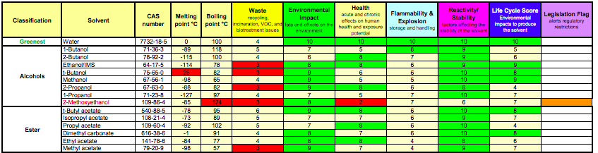
GSK solvent selection guide ranking
Solvent selection guide in practice. Each solvent is ranked from 1-10 and color-coded for convenience (1 being the worst, 10 being the best). Ranking is across 6 different categories, which include waste production, environmental impact, human health, hazard, reactivity and life cycle.
This effort took several years and it is still ongoing.
http://solventguide.gsk.com/

Slide 40
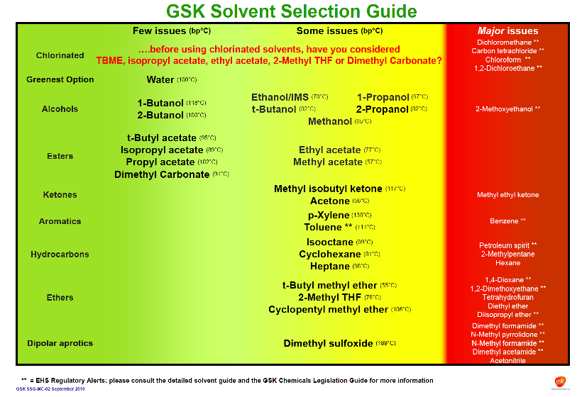
Notes:
Another view of the solvent selection guide: Green and yellow indicate a preferred solvent. Red suggests major heath or environmental issues.

Slide 41
Other green chemistry solvents
Aqueous Solvents
Supercritical Fluids
Ionic Liquids
Solventless Conditions

Slide 42
Aqueous Solvents
Water based solvents with generalized applications.
Advantages
  Innocuous
  Inexpensive
  Well characterized
  Versatility among applications
Disadvantages
  High boiling point
  Separation difficulties
  Effluent contamination
Notes:
Water, the most popular choice for nature, is undoubtedly the most benign solvent there is. It is easily accessible and cheap to employ, and has the lowest toxicity to the environment. Not only it is non-flammable and non-explosive, but it also has a high heat capacity. With addition of surfactants or other miscible organic co-solvent, water emerges as a new choice in chemical synthesis including oxidations, reductions, nucleophilic substitutions, and electrochemical synthesis. However, water is not perfect and its cons should be considered before it is used in large scale synthesis. Aside from its poor compatibility of organic molecules, distillation of water from reagent requires more demanding condition relatively to other solvents such as methanol. Removal of water, even in vacuum, is more energy intensive (thus less economically viable) than conventional organic solvent. Therefore each solvent selection or replacement needs to be discussed on a case-by-case basis. Replacement of organic solvents to water may be done at least for safety reasons

Slide 43
Supercritical fluids
Small molecules (e.g., CO₂, H₂O) used under conditions of elevated pressure and temperature to form a fluid that is neither liquid nor gas.
Advantages
  Innocuous
  Inexpensive
  “Tunable” solvent properties
  Enhanced performance
  Versatility among applications
  Ease of separation
Disadvantages
  High pressure required
  Poor solvency
  Surfactants required
Notes:
scCO₂ is very attractive as a solvent because it can be removed easily by simply decreasing the pressure in the reaction vessels. This eliminates the need of solvent distillation, which is an energy intensive process, while leaving behind a product with high purity. Besides its’ non-toxic profile, scCO₂ is often readily available as an industrial by-product and can be obtained without burning fossil fuels. Several companies offer CO₂ recovery, and turn this industrial by-product into a profitable reagent. Such recovery is especially popular in breweries, distilleries, ammonia or ethylene oxide productions.

Slide 44
Ionic liquids
Charged substance mixtures that form a liquid at ambient temperatures.
“Salts whose crystal structure has been perturbed so they are a liquid at room temperature.”
Advantages
  Very low volatility
  Variable composition (high design potential - can be tailored for many applications)
  Easily recycled
Disadvantages
  Not necessarily benign
  Manufacture costs uncertain
  Ease of separation uncertain
Notes:
Ionic liquids have been found useful for a wide range of chemical reactions and processes, including hydrogenation reactions, biocatalysis reactions such as transesterification and perhydrolysis, and electrochemical applications such as battery electrolytes
Another use for ionic liquids is as a medium for separation of biologically produced feedstocks from a fermentation broth, such as acetone, ethanol, or butanol

Slide 45
Solventless conditions
Use of neat conditions or solid state techniques
Advantages
  Solvent concerns eliminated
  Solvent costs eliminated
Disadvantages
  High temperature and/or pressure required
  Lower purity product obtained
  “Work-up”

Slide 46
Areas of Research in Green Chemistry
WASTE

Slide 47
PRINCIPLE 1
It is better to prevent waste than to treat or clean up waste after it is formed.

Slide 48
Types of waste
Solid waste
Liquid waste
Animal by product
Biodegradable waste
Chemical waste
Bulky waste

Slide 49
Established waste treatment technologies
Incineration
  Solid organic waste is combusted. Some thermal treatments allow energy capture.
  Solid mass reduction by 95-96%.
Landfill
  Consolidated material buried with mud and other sealing agents to enable chemical, bacteriological, and physical degradation
  Semi-anaerobic conditions lead to production of methane and CO₂
  If captured, landfill gas (methane) from decomposing garbage can be used to produce electricity, heat, fuels
http://vireoenergy.se/landfill-gas

Slide 50
Cost-benefit of recycling: energy savings
Established waste treatment technologies
Recycling
  Converting waste materials into new materials and objects.
  Available for metals, plastic, paper, glass.
Composting
  Organics undergo a biological decomposition to form a material (compost) that is non-toxic to plant growth.
  By-product of the reaction are CO₂, water and heat.
Material | Energy savings
Aluminum | 95%
Cardboard | 24%
Glass | 5-30%
Paper | 40%
Plastics | 70%
Steel | 60%

Slide 51
Waste treatment pyramid: 4 Rs
Reduce, Reuse, Recycle, Recover
Prevention
Most favored option
Reduction
Reuse
Recycling
Energy recovery
Disposal
Recycling
Composting
Incineration
Least favored option
Landfill
Notes:
Need for technologies to Reduce and Reuse waste.
Ultimately, the waste production should be Prevented

Slide 52
Alternative waste treatment technologies
Anaerobic conditions and biogas production.
  Adopted for farm waste.
  Can reduce greenhouse gas emissions and can provide a cost-effective source of renewable energy.
  Recovered biogas can be an energy source for electricity, heating or transportation fuel.
Pyrolysis
  Thermal decomposition 200–300 °C occurring in the absence of oxygen.
  Precursor of both the combustion and gasification processes.
  The products of biomass pyrolysis include biochar, bio-oil and gases like methane, hydrogen, carbon monoxide, and carbon dioxide.

Slide 53
Alternative waste treatment technologies
Gasification
  Converts organic based materials into CO, H₂ and CO₂.
  Achieved by reacting the material at high temperatures (>700 °C), without combustion, with a controlled amount of oxygen and/or stem.
  The resulting gas mixture is called syngas.
  Syngas is combustible and often used as a fuel.
Alcohol production (biomass conversion into mixed alcohol fuels)
  Biological/chemical method for converting any biodegradable material into useful chemicals, such as biofuels (e.g., ethanol, propanol, n-butanol, isopropanol, 3-pentanol).
  Made by enzymatic breakdown of biomass into simple sugars, followed by yeast fermentation into alcohols.
Notes:
Syngas can be used in the Fischer–Tropsch process to produce diesel, or converted into e.g. methane, methanol, and dimethyl ether in catalytic processes.

Slide 54
Other waste reducing alternative: One pot synthesis
Strategy to improve the efficiency of a chemical reaction by conducting multi-steps in just one reactor
It bypasses several purification steps and therefore minimizes chemical waste, besides saving time (development and execution) and energy.
It is very effective when the reaction:
  - Has an unstable or toxic intermediate
  - Has equilibration between intermediate products or starting material and intermediate compound
  - Where the side product can be converted into a final product.
Successfully used in production of hormones and antibiotics.

Slide 55
Prevent waste
Design products which are biodegradable.
Use a waste as a feedstock for another process.

Slide 56
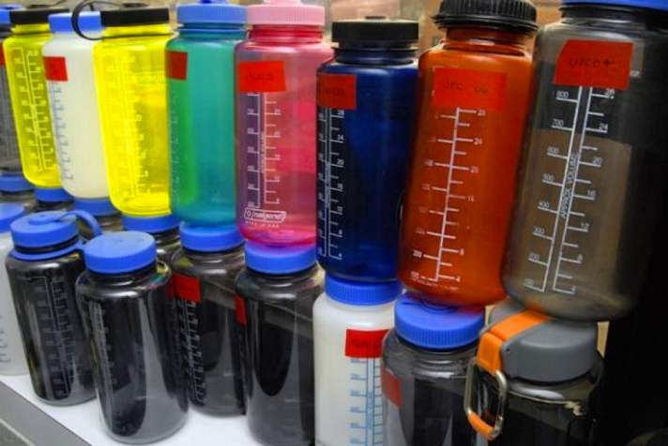
Waste reducing technology:
CO₂ utilization
CO₂ is a common byproduct (waste) of many reactions. It is also a green house gas. There are technologies which use CO₂ gas as a feedstock.
Carbonate materials – polycarbonate plastic
Carbonate
Notes:
While the plastic is made of CO2, the structure includes BPA. BPA can leach into water and interfere with human hormones. This is an example of unintended consequence.

Slide 57
Newlight Technologies for AirCarbon: Greenhouse Gas Transformed into High-Performance Thermoplastic
Methane is emitted by natural sources such as wetlands. It is also the second most prevalent greenhouse gas emitted in the U.S. from human activities, such as leakage from natural gas systems and the raising of livestock.
Newlight AirCarbon is a carbon capture technology that combines methane with air to produce to produce polymers at environmentally friendly, ambient conditions.
This technology allows polymerization beyond previous maximum limits and generate a yield of nine kilograms of polymer for every one kilogram of biocatalyst (9:1) – nine times more material compared to previous technologies.
The process matches the performance of a wide range of petroleum-based plastics while out-competing on price and it is being used to make bags, cell phone cases, containers, furniture and other products.

Slide 58
Thank you!

