Slide 1
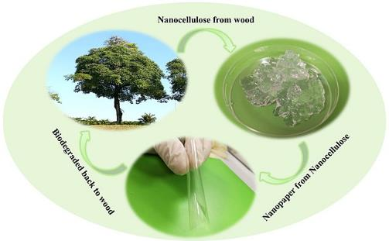

Yale-UNIDO Train-the-Facilitator Workshop in Green Chemistry
A Big Picture Introduction
CENTER for GREEN CHEMISTRY
and GREEN ENGINEERING at YALE
Image: Wikipedia, Biodegradation of nanocellulose, Author: Shaohui Li, Pooi See Lee

Slide 2
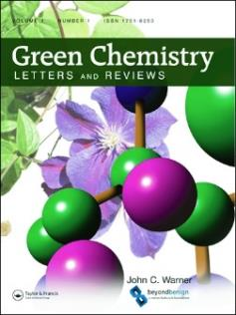


John C. Warner
Green Chemistry:
The Missing Elements
President and CTO
warnerbabcock institute for green chemistry
john.warner@warnerbabcock.com
Distinguished Professor of Green Chemistry
Monash University – School of Chemistry
John.Warner@Monash.edu
Cofounder
beyondbenign green chemistry education
john@beyondbenign.org
ENVR E-158A Green Chemistry
Harvard Extension School
JohnWarner@FAS.Harvard.Edu
@johnwarnerorg

Slide 3








warnerbabcock.com
beyondbenign.org
Green Chemistry
John Warner Center
For Start-Ups in
Green Chemistry
Green Chemical Futures

Slide 4
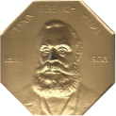








warnerbabcock
institute for green chemistry
Polaroid
Inventing Chemistry
AAAS-LEMELSON
Invention Ambassadors
Doing Chemistry
Managing Chemistry
California Department of
Toxic Substances Control
Teaching Chemistry
beyondbenign
green chemistry education

Slide 5










EPA Is Reconsidering Dry Cleaners' Use of Cancer-Causing Chemical
Babies exposed to
cancer chemicals
Oceans awash in toxic seas of plastic
Child obesity is linked to chemicals in plastics
The Poisoning of America
Serious contamination threat
from Africa’s mounting e-waste
Yes, Bisphenol-A Does Enter the Body from Plastic Bottles
5,000 evacuated after
hazardous Pa. acid spill
Chicago’s Toxic Air
Household Dust Contains Highly Toxic Chemicals

Slide 6
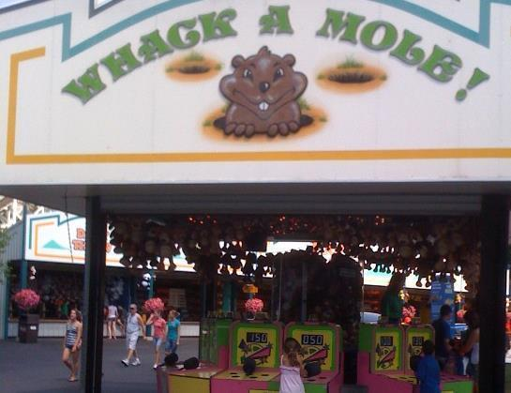
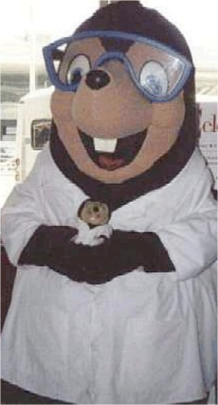

Slide 7
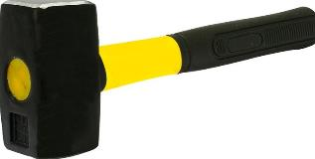

PTHALATES
BIS PHENOL A
BROMINATED FLAME
RETARDANTS
OCEAN
PLASTICS
NANOPARTICLES

Slide 8
Despair

Slide 9
Asking the Right Questions
Why would a chemist
make a hazardous material?
How do we train chemists?

Slide 10
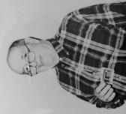
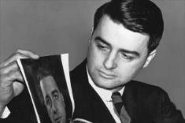
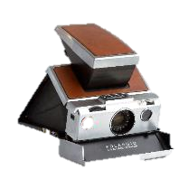
Polaroid Corporation – 1988-1997
Polaroid
Lloyd D. Taylor
Edwin Land
"Thermographic Recording Films." Dombrowski, Edward J.; Jones, Robert L.; Warner, John C.; Yang, Jiyue US Patent 5,750,463. Filed April 22, 1997. Published May 12, 1998.
“Acid-Catalyzed Thermal Decomposition of Secondary Acid Generator and Formation of Second Acid; Copper Compound and Reactive Material Used to Decompose Superacid Precursor” Marshall, John L.; Baker, Rita Shon S.; Takiff, Larry C.; Telfer, Stephen J.; Warner, John C. US Patent 5,741,630. Filed April 25, 1994. Published April 21, 1998.
“Copolymers having pendant functional thymine groups” Grasshoff, J. Michael; Taylor, Lloyd D.; Warner, John C. US Patent 5,708,106. Filed May 3, 1996. Published January 13, 1998.
“Photograph Development” Guarrera, Donna J.; Mattucci, Neil C.; Mehta, Avinash C.; Taylor, Lloyd D.; Warner, John C. US Patent 5,705,312. Filed Nov. 25, 1996. Published January 6, 1998.
“Photograph System” Guarrera, Donna J.; Mattucci, Neil C.; Mehta, Avinash C.; Taylor, Lloyd D.; Warner, John C. PCT Int. Appl. WO 1997029405. Filed January 21, 1997. August 14, 1997. DE 69701493. Filed January 21, 1997. Published April 27, 2000. EP 0820607. Filed January 21, 1997. Published January 28, 1998.
“Images by Exposure to Actinic Radiation; Solvent Removal of Non-Exposed Areas” Grasshoff, J. Michael; Taylor, Lloyd D.; Warner, John C. US Patent 5,616,451. Filed May 24, 1995. Published April 1, 1997.
“Process for Fixing an Image, and Medium for Use Therein” Ehret, Anne; Marshall, John L.; Baker, Rita Shon S.; Takiff, Larry C.; Telfer, Stephen J.; Warner, John C. US Patent 5,582,956. Filed April 28, 1994. Published December 10, 1996.
“Low-Volatility, Substituted 2-Phenyl-4,6-bis[Halomethyl]-1,3,5-triazine for Lithographic Printing Plates.” Fitzgerald, Maurice J.; Kearney, Frederick R.; Liang, Rong-Chang; Schwarzel, William C.; Guarrera, Donna, J.; Hardin, John M.; Warner, John C. PCT Int. Appl. WO 1996034315. Filed April 19, 1996. Published October 31, 1996. CA 2189459. Filed April 19, 1996. Published October 31, 1996. DE 69609136. Filed April 19, 1996. Published August 10, 2000. EP 0767932. Filed April 19, 1996. Published April 16, 1997.
“Low-Volatility, Substituted 2-Phenyl-4,6-bis[Halomethyl]-1,3,5-triazine for Lithographic Printing Plate Preparation” Fitzgerald, Maurice J.; Kearney, Frederick R.; Liang, Rong-Chang; Schwarzel, William C.; Guarrera, Donna, J.; Hardin, John M.; Warner, John C. US Patent 5,561,029. Filed April 28, 1995. Published October 1, 1996.
“Vinylbenzyl Thymine Monomers and Polymers and Products Prepared from Same” Grasshoff, J. Michael; Taylor, Lloyd D.; Warner, John C. PCT Int. Appl. WO 1995031755. Filed May 10, 1995. Published November 23, 1995. CA 2185144. Filed May 10, 1995. Published November 23, 1995. EP 0759193. Filed May 10, 1995. Published February 26, 1997. DE 69504652. Filed May 10, 1995. Published October 15, 1998.
“Process for Fixing an Image” Ehret, Anne; Marshall, John L.; Baker, Rita Shon S.; Takiff, Larry C.; Telfer, Stephen J.; Warner, John C. PCT Int. Appl. WO 95029067. Filed April 25, 1995. Published November 2, 1995. CA 2186514. Filed April 25, 1995. Published November 2, 1995. DE 69506396. Filed April 25, 1995. Published January 14, 1999. EP 0757628. Filed April 25, 1995. Published February 12, 1997.
“Vinylbenzyl Thymine Monomers and their use in photoresists” Grasshoff, J. Michael; Taylor, Lloyd D.; Warner, John C. US Patent 5,455,349. Filed May 13, 1994. Published October 3, 1995.
“Imaging Medium and Process.” Fehervari, Agota F.; Gaudiana, Russell A.; Kolb, Eric S.; Mehta, Parag G.; Taylor, Lloyd D.; Warner, John C. US Patent 5,424,268. Filed May 13, 1994. Published June 13, 1995.
“Thermally-Processable Image Recording Materials Including Substituted Purine Compounds.” Ford, Maureen F.; Guarrera, Donna J.; Mischke, Mark M.; Pai, Ramdas; Warner, John C. US Patent 5,411,929. Filed June 30, 1994. Published May 2, 1995.
"Copolymeric Mordants and Photographic Products and Processes Containing Them" Grasshoff, J. Michael; Taylor, Lloyd D.; Warner, John C. US Patent 5,395,731. Filed May 13, 1994. Published March 7, 1995.
"Process and Composition for Use in Photographic Materials Containing Hydroquinones." Taylor, Lloyd D.; Warner, John C. US Patent 5,338,644. Filed December 23, 1992. Published August 16, 1994.
“Process and Composition for Use in Photographic Materials Containing Hydroquinones." Taylor, Lloyd D.; Warner, John C. US Patent 5,177,262. Filed July 19, 1991, Published January 5, 1993. EP 0523470. Filed July 3, 1992, Published February 3, 1993. CA 2070450. Filed June 4, 1992, Published January 20, 1993. DE 69218312. Filed July 3, 1992, Published April 24, 1997. JP 06230540. Filed July 16, 1992.
Perkin Medal
Land 1974
Warner 2014

Slide 11
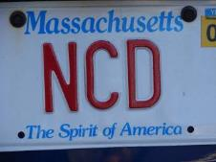
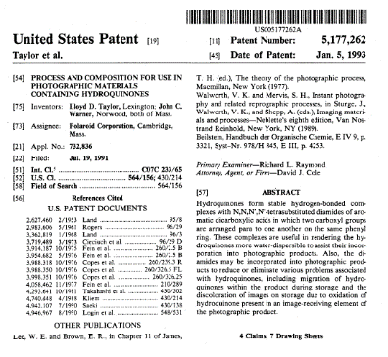
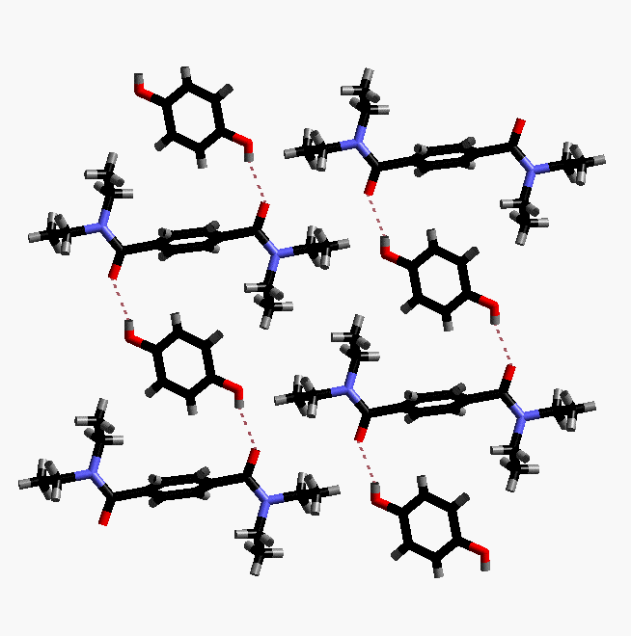
Non Covalent Derivatization
190
180
170
160
150
140
Temperature
130
120
110
100
0
10
20
30
40
50
60
70
80
90
100
% Hydroquinone
US Patent 5,177,262. Filed Jul 19, 1991.

Slide 12
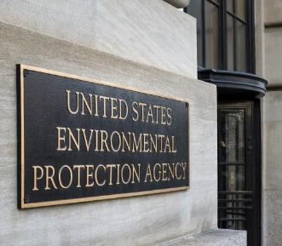
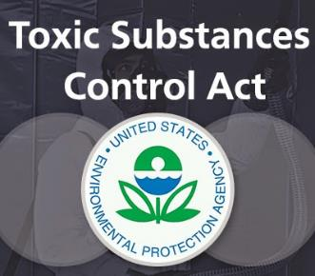
EPA Approval
Low Volume Exemption
PreManufacturing Notification
“Small particles”?
“Molecular Complexes”?

Slide 13

Polaroid
Cambridge, MA
Washington, DC

Slide 14

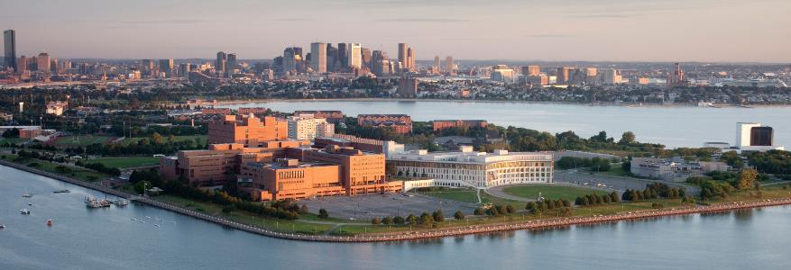
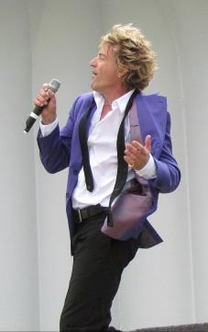
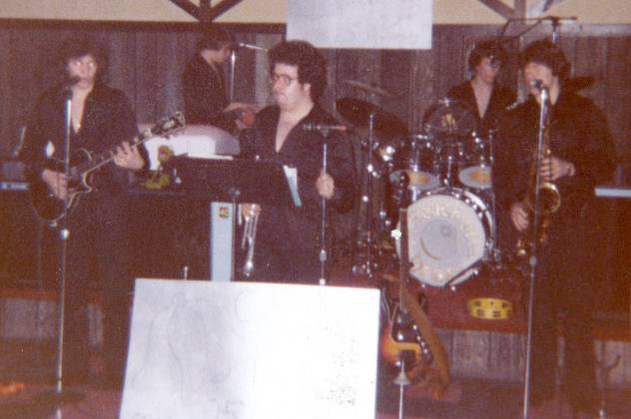
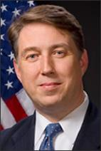

Paul Anastas
A Touch of Brass
EPA
Office of Pollution
Prevention and Toxics

Slide 15
Old Technology
Several Solvents
High Energies
Hazardous Reagents
New Technology
Aqueous Conditions
Low Energies
Non-hazardous Reagents

Slide 16
?
Isn’t anything “better” for human health and the environment going to be new and different?

Slide 17
Meanwhile…

Slide 18

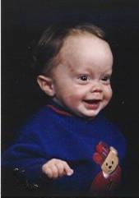
John Patrick Warner
[Nov 12, 1991- Mar 20 1993]

Slide 19
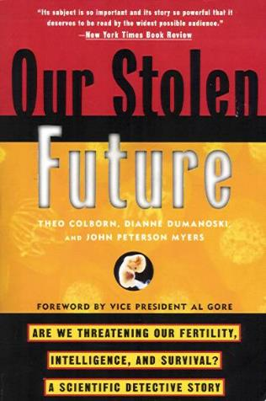

John “Pete” Myers

Slide 20
I have synthesized over 2500 compounds!
I have never been taught what makes a chemical toxic!
I have no idea what makes a chemical an environmental hazard!
I have synthesized over 2500 compounds!
I HAVE NO IDEA WHAT
MAKES A CHEMICAL TOXIC!

Slide 21

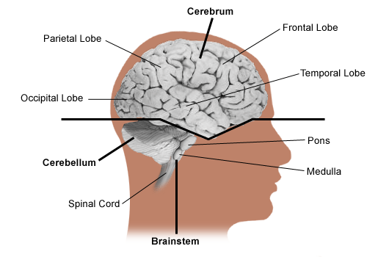
What causes brain tumors?
The majority of brain tumors have abnormalities of genes involved in cell cycle control, causing uncontrolled cell growth. These abnormalities are caused by alterations directly in the genes, or by chromosome rearrangements which change the function of a gene.Patients with certain genetic conditions (i.e., neurofibromatosis, von Hippel-Lindau disease, Li-Fraumeni syndrome, and retinoblastoma) also have an increased risk to develop tumors of the central nervous system. There have also been some reports of people in the same family developing brain tumors who do not have any of these genetic syndromes. Research has been investigating parents of children with brain tumors and their past exposure to certain chemicals. Some chemicals may change the structure of a gene that protects the body from diseases and cancer. Workers in oil refining, rubber manufacturing, and chemists have a higher incidence of certain types of tumors. Which, if any, chemical toxin is related to this increase in tumors is unknown at this time.
http://cancer.stanfordhospital.com/healthInfo/cancerTypes/brain/default

Slide 22






Recent scientific research has clearly demonstrated an association between organochlorines and breast cancer. An analysis of chemical plant workers in Hamburg, Germany discovered a two-fold increase in breast cancer among the women workers who had been exposed to dioxin contamination. Significantly higher levels of breast cancer have been found in separate studies of women living near organochlorine chemical plants in Minnesota and Long Island. Other studies have revealed elevated breast cancer mortality among professional chemists.
http://www.fwhc.org/health/xeno.htm

Slide 23
Christie, D., K. Robinson, et al. (1991). “A prospective study in the Australian petroleum industry. II. Incidence of cancer.” Br J Ind Med 48(8): 511-4.
Lynge, E., A. Anttila, et al. (1997). “Organic solvents and cancer (review).” Cancer Causes Control 8(3): 406-19.
Persson, B. (1996). “Occupational exposure and malignant lymphoma.” Int J Occup Med Environ Health 9(4): 309-21.
Berlin, K., C. Edling, et al. (1995). “Cancer incidence and mortality of patients with suspected solvent- related disorders.” Scand J Work Environ Health 21(5): 362-7.
Walrath, J., F. P. Li, et al. (1985). “Causes of death among female chemists.” Am J Public Health 75(8): 883-5.
Olsson, H. and L. Brandt (1981). “Supradiaphragmatic presentation of non-Hodgkin's lymphoma in men occupationally exposed to organic solvents.” Acta Med Scand 210(5): 415-8.
Persson, B., M. Fredriksson, et al. (1993). “Some occupational exposures as risk factors for malignant lymphomas.” Cancer 72(5): 1773-8.

Slide 24
Every Year: (United States)
Chemistry and Chemical Engineering Graduates
15,000 Undergraduate Degrees
3,000 Masters Degrees
3,000 Doctoral Degrees
50.9 % Women Undergraduate Degrees (2004)

Slide 25
To get a degree in Chemistry…
No universities require any demonstration
of knowledge regarding
toxicity or environmental impact!

Slide 26
Conferences
Textbooks
Journals
Classes
Workshops
There was no SCIENCE for making things that were better for human health and the environment.

Slide 27
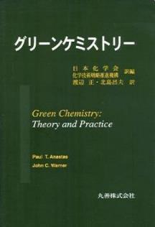
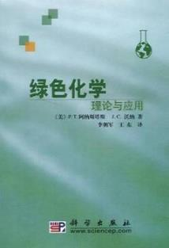
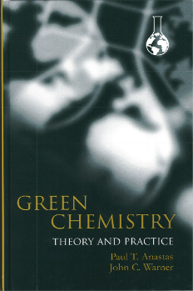
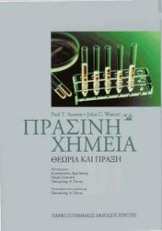
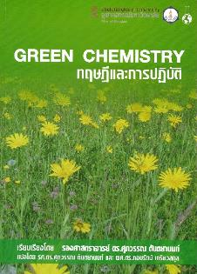
Green Chemistry
is the design of chemical products and processes that reduce or eliminate the use and/or generation of hazardous substances.

Slide 28
The Twelve Principles of Green Chemistry
1. Prevention. It is better to prevent waste than to treat or clean up waste after it is formed.
2. Atom Economy. Synthetic methods should be designed to maximize the incorporation of all materials used in the process into the final product.
3. Less Hazardous Chemical Synthesis. Whenever practicable, synthetic methodologies should be designed to use and generate substances that possess little or no toxicity to human health and the environment.
4. Designing Safer Chemicals. Chemical products should be designed to preserve efficacy of the function while reducing toxicity.
5. Safer Solvents and Auxiliaries. The use of auxiliary substances (solvents, separation agents, etc.) should be made unnecessary whenever possible and, when used, innocuous.
6. Design for Energy Efficiency. Energy requirements should be recognized for their environmental and economic impacts and should be minimized. Synthetic methods should be conducted at ambient temperature and pressure.
7. Use of Renewable Feedstocks. A raw material or feedstock should be renewable rather than depleting whenever technically and economically practical.
8. Reduce Derivatives. Unnecessary derivatization (blocking group, protection/deprotection, temporary modification of physical/chemical processes) should be avoided whenever possible .
9. Catalysis. Catalytic reagents (as selective as possible) are superior to stoichiometric reagents.
10. Design for Degradation. Chemical products should be designed so that at the end of their function they do not persist in the environment and instead break down into innocuous degradation products.
11. Real-time Analysis for Pollution Prevention. Analytical methodologies need to be further developed to allow for real-time in-process monitoring and control prior to the formation of hazardous substances.
12. Inherently Safer Chemistry for Accident Prevention. Substance and the form of a substance used in a chemical process should be chosen to minimize the potential for chemical accidents, including releases, explosions, and fires.

Slide 29
Green Chemistry
More environmentally
benign than alternatives
Perform better
than alternatives
More economical
than alternatives

Slide 30
Green Chemistry
Safety
Green
Chemistry
Performance
Cost

Slide 31
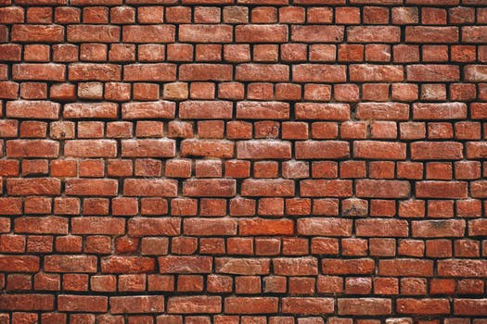
The biggest barrier for green chemistry…
…Is its invention

Slide 32
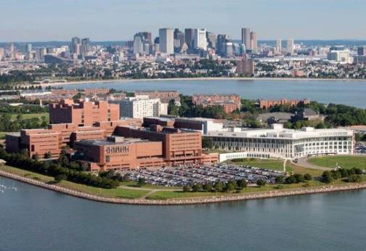


UMASS – 1996-2007
1997 Assistant Professor
1998 Associate Professor (Tenure)
1999 Director of Biochemistry
2000 Full Professor
2001 Chair Chemistry Department
2001 Director Green Chemistry PhD Program
2004 Professor Plastics Engineering (UML)

Slide 33
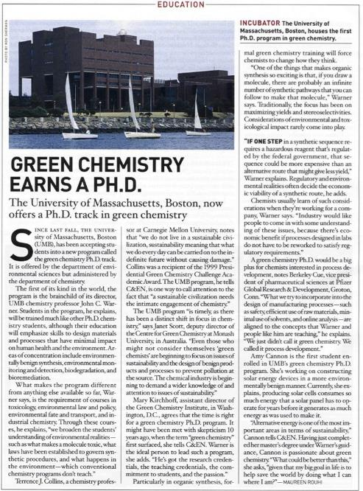

Slide 34
Of all the products and processes…
Maybe 10% are benign…
Maybe 25% have
alternatives available…
65% Still have to be
invented!

Slide 35
Where do products come from?
“The Environment”
Green
Chemistry
Chemicals
Policy
Molecules
Materials
Components
Devices
Products
Basic Research
Applied Research
Development
Manufacturing

Slide 36
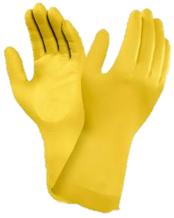
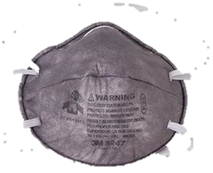
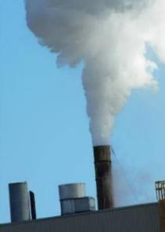
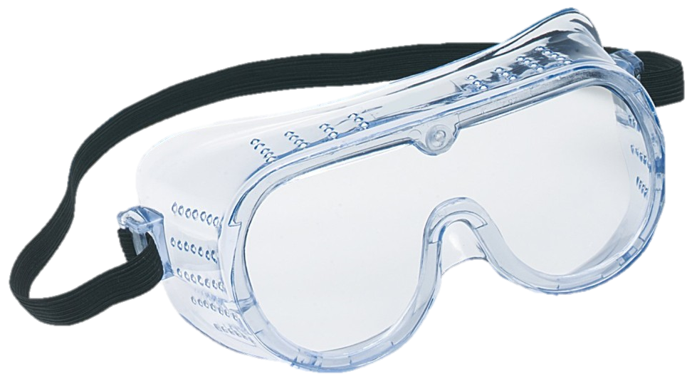
Chemists ALWAYS cared about Health and the Environment!

Slide 37
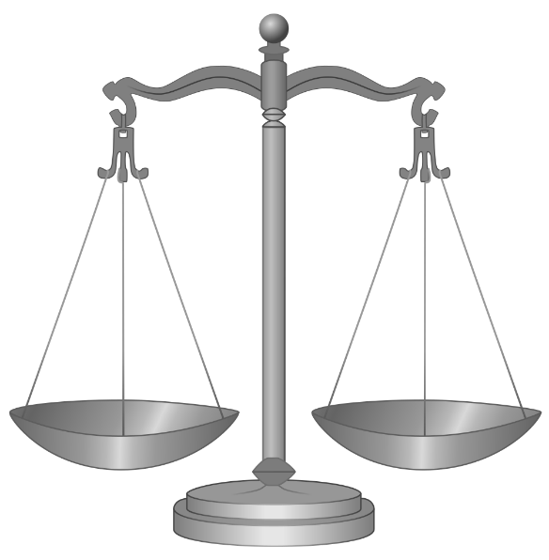
Risk = Exposure
x Hazard

Slide 38
The cost of using hazardous materials:
Storage
Transportation
Treatment
Disposal
Regulatory Costs
Liability
Worker Health and Safety
Corporate Reputation
Community Relations
New Employee Recruitment

Slide 39
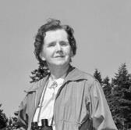

Environmental Regulations
EPACT
FFCA
CERFA
CRAA
120
110
100
90
80
70
60
50
40
30
20
10
0
AMFA
ARPAA
AJA
ASBCAA
ESAA-AECA
FFRAA
FEAPRA
IRA
NWPAA
CODRA/NMSPAA
FCRPA
MMPAA
PPA
PPVA
IEREA
ANTPA
GLCPA
ABA
CZARA
WRDA
EDP
OPA
RECA
CAAA
GCRA
GLFWRA
HMTUSA
NEEA
AQA
NAWCA
APA
SWDA
CERCLA
CZMIA
COWLDA
FWLCA
MPRSAA
RCRAA
WLDI
WQA
Number of Laws
NWPA
SDWAA
SARA
CAAA
CWA
SMCRA
SWRCA
SDWAA
ARPA
BLRA
ERDDAA
EAWA
NOPPA
PTSA
UMTRCA
ESAA
QGA
NCPA
MPRSAA
BLBA
FWPCA
MPRSA
CZMA
NCA
FEPCA
PWSA
MMPA
HMTA
ESA
TAPA
TSCA
FLPMA
RCRA
NFMA
CZMAA
FRRRPA
SOWA
DPA
AQA
FOIA
NEPA
EQIA
CAA
EPA
EEA
OSHA
FAWRAA
NPAA
FCMHSA
WRPA
AFCA
TA
FWCA
BPA
FHSA
NFMUA
WSRA
EA
RCFHSA
AEPA
FIFRA
PAA
NHPA
NBRA
WA
MBCA
FWCAA
WLDA
AA
IA
NPS
FAWRA
AEA
FWA
YA
RHA
NLRA
WPA
1870 2010

Slide 40
Sustainability
Economics
Agriculture
Education
Business
Chemistry
Engineering
Others
Sustainable Chemistry
Chemicals
Policy
Remediation
Technologies
Exposure
Controls
Green
Chemistry
Water
Purification
Alternative
Energy
Others
Green Chemistry
Solvents
Catalysts
Renewable
Feedstocks
Reduced
Toxicity
Non
Persistent
Reduced
Energy
Others

Slide 41
Sustainability
Economics
Agriculture
Education
Business
Chemistry
Engineering
Others
Sustainable Chemistry
Chemicals
Policy
Remediation
Technologies
Exposure
Controls
Green
Chemistry
Water
Purification
Alternative
Energy
Others
Green Chemistry
Prevention
Atom Economy
Less Hazardous Synthesis
Safer Chemicals
Solvents
Energy
Feed-stocks
Derivatives
Catalysis
Degradation
Real Time Analysis
Accident Prevention

Slide 42


Slide 43
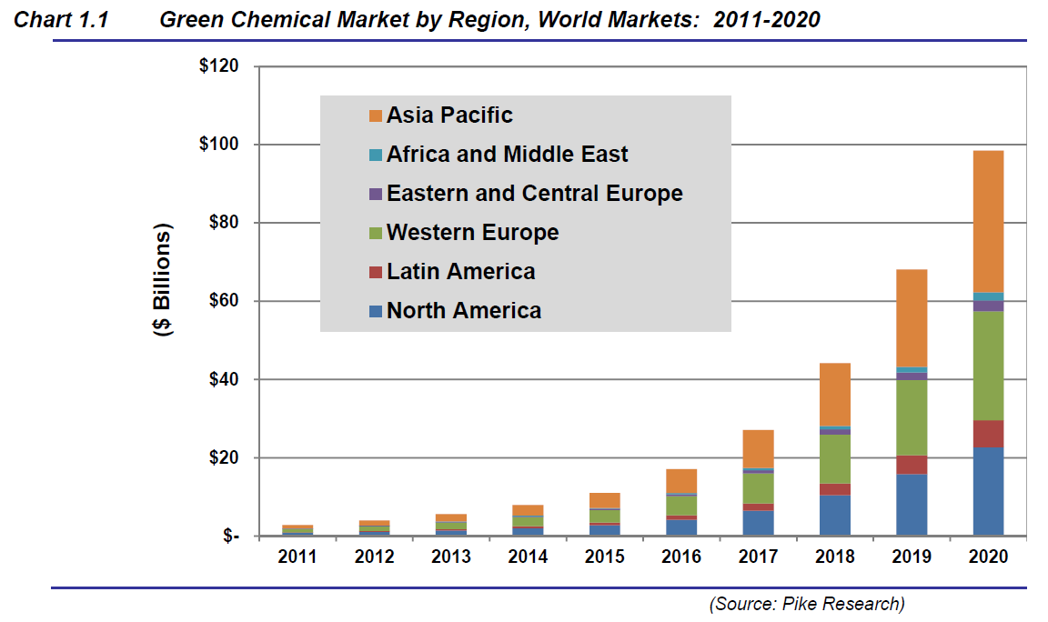


Slide 44
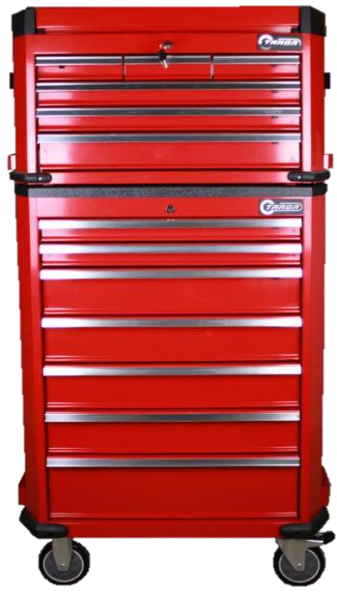
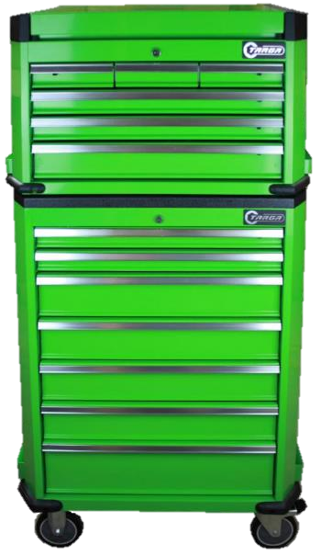
Carbon-Carbon Bonds
Oxidations
Reductions
Hydroxylations
Polymer Syntheses
Traditional Processes
Green Alternatives

Slide 45
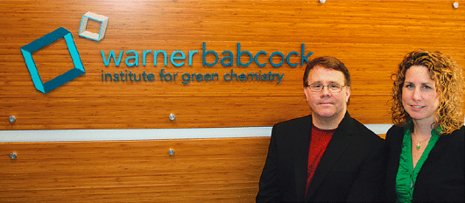
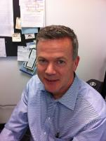

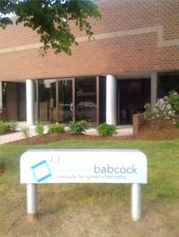


WBI - 2007 ->
John Warner
Amy Cannon
Jim Babcock
Joe Pont, CEO
100 Research Drive
Wilmington, MA 01887

Slide 46
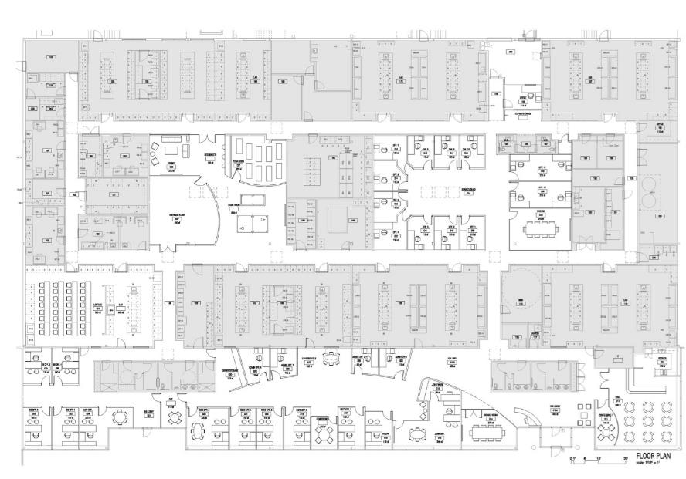
Fabrication & Physical Testing,
Biomaterials
Lab
Environment & Toxicology
Lab
Organic & Polymer Synthesis
Lab
Analytical Separations
Lab
Metal Oxide Research Labs
Applications and Coatings
Research Lab
…
WBI Scientists
Office Space
Chemicals & Lab Supplies
Microscopy & Surface Analysis
Lab
Learning Center
Particle Size & Surface Characterization Lab
Thermal Analysis & Spectroscopy Lab
NMR
Lab
Multi-use Chemistry
Lab
X-ray Lab
Beyond Benign
WBI Executive Office Space
Cafe

Slide 47
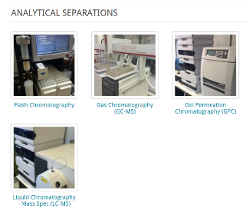
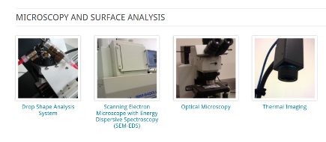
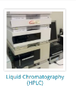
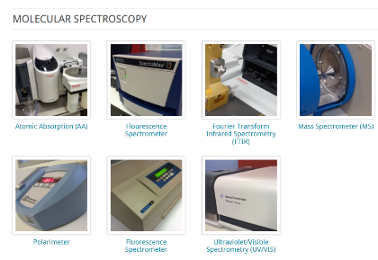
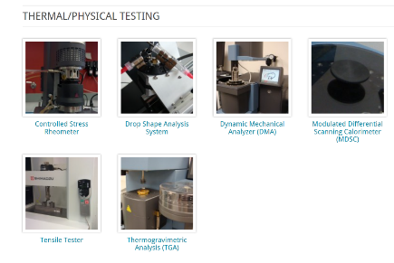
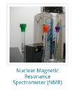

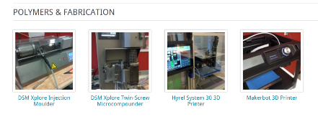
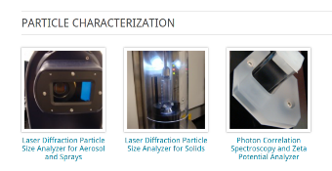
www.warnerbabcock.com

Slide 48

warnerbabcock institute for green chemistry

Slide 49

Pharmaceuticals
ALS
Alzheimer's
Oncology
Diabetes
“Dihydro-6-Azaphenalene Derivatives for the Treatment of CNS, Oncological Diseases and Related Disorders” Warner, John C.; Nguyen, Dieu; Gladding, Jeffery A.; Cheruku, Srinivasa R.; Loebelenz, Jean R.; Norman, James J.; Thota, Sambaiah; Lee, John W.; Rosenfeld, Craig. US Pat. Appl. US 20140094487. Filed September 27, 2013. Published April 3, 2014. PCT Int. Appl. WO 2014052906. Filed September 27, 2013. Published April 3, 2014. CA 2886749. Filed September 27, 2013. Published April 3, 2014.
“Preparation of Rilyazine Derivatives Useful in Treatment of Cancer” Warner, John C.; Gladding, Jeffery A.; Gero, Thomas W.; Cheruku, Srinivasa R. US Pat. Appl. US 20150065510. Filed August 29, 2014. Published March 5, 2015.
“Chillmauric Acids and Amylin/Amyloid Protein Disaggregation” Warner, John C.; Cheruku, Srinivasa R.; Loebelenz, Jean R. Provisional Patent Application 2015.

Slide 50




Parkinson’s/ALS Disease Therapeutic
Increased
Bioavailability
NCD
Cu ATSM
“Metal Complexes and Methods of Treatment” Warner, John C., Chreuku, Srinivasa R., Hari, Anitha; Norman, James J. PCT Int. Appl. WO 2015070177 Filed November 10, 2014. Published May 14, 2015.

Slide 51










Construction Materials: Asphalt Paving
Monday, November 25, 2013
17ºF (-8ºC)
70% Recycled Material
“Asphalt Binder Additive Compositions and Related Materials” Warner, John C., Muollo, Laura R.; Walker, Rowan L., Bianchini, J. R. PCT Int. Appl. WO 2015070180. Filed November 10, 2014. Published May 14, 2015.
Delta-S

Slide 52







Slide 53


Hair and Fabric Shaping and Toning
“Photoreactive Polymers and Devices for use in Hair Treatments” Warner, John C.; Cannon, Amy S.; Raudys, Jennifer;
Undurti, Arundhati; PCT Int. Appl. WO 2004058187. Filed December 22, 2003. Published December 23, 2004. CA 2510162.
Filed December 22, 2003. Published July 15, 2004. EP 1575537. Filed December 22, 2003. Published September 21, 2005.
“Photoinduced Copolymer Functionalized Substrates” Warner, John C.; Cannon, Amy S.; Dye, Kevin PCT Int. Appl.
WO 2007139810. Filed May 23, 2007. Published December 6, 2007.

Slide 54








Formaldehyde Free Wood Composites
Lignocellulosic composites and methods of making same. Warner, John C.; Whitfield, Justin R.; Gladding, Jeffery A.; Allen, Richard M., Priority Date: May 26, 2016, US 2018/0147824. WO 2016/191521, EP 3302969, CA 2986427, JP 2018516784.

Slide 55












Hair Color Restoration
Tyrosinase
Tyrosinase
Formulation and processes for hair coloring, continuation. Warner, John C.; Muollo, Laura; Stewart, Amie, Priority Date: October 14, 2013, US 9,522,102.
Formulation and processes for hair coloring. Warner, John C.; Muollo, Laura; Stewart, Amie, Priority Date: October 14, 2013, US 8,828,100, WO 2015/057254, EP 3057561, JP 2016533376, KR 20160068958, CN 105792797.

Slide 56










Ocean Plastics Recycling and Reclamation
June 29, 2015
http://www.parley.tv/updates/2015/7/3/adidas-x-parley
https://www.maritime-executive.com/article/adidas-uses-ocean-plastic-in-shoe
https://solecollector.com/news/2015/07/parley-adidas-ultra-boost-recycled-ocean-gillnet

Slide 57



Electronics Recycling and Reclamation
LiCoO₂
“Method for the recovery of lithium cobalt oxide from lithium ion batteries” Poe, Sarah L.; Paradise, Christopher L.; Muollo, Laura R.; Pal, Reshma; Warner, John C.; Korzenski, Michael B. US Pat. Appl. US 20140306162. Filed June 19, 2012. Published October 16, 2014.
“Sustainable process for reclaiming precious metals and base metals from electronic waste” Korzenski, Michael B.; Jiang, Ping; Norman, James; Warner, John C.; Ingalls, Laura; Gnanamgari, Dinakar; Strickler, Fred; Mendum, Ted. US Pat. Appl. US 20130336857. Filed August 19, 2011. Published December 19, 2013.
“Sustainable process for reclaiming precious metals and base metals from electronic waste” Korzenski, Michael B.; Jiang, Ping; Norman, James; Warner, John C.; Ingalls, Laura; Gnanamgari, Dinakar; Strickler, Fred; Mendum, Ted. PCT Int. Appl. WO 2012024603. Filed August 19, 2011. Published February 23, 2013. CN 103249849. Filed August 19, 2011. Published August 14, 2013. EP 2606158. Filed August 19, 2011. Published June 26, 2013.
“Non-fluoride containing composition for removal of polymers and other organic material from a surface” Korzenski, Michael B.; Jiang, Ping; Warner, John C.; Mendum, Ted; Lugus, Michelle; Whitfield, Justin; Vanbenschoten, Helen; Payne, Makonnen PCT Int. Appl. WO 2010091045. Filed Feb 3, 2010. Published August 12, 2010.

Slide 58



Direct Photolithographic Semiconductors
“Methods of producing metal oxide films, patterned metal oxide surfaces, and filtration of volatile organic compounds”
Warner, John C. et al., June 2, 2017, WO 2018/222976.

Slide 59








NCD Molecular Signal Amplification
“Wearable Personal Hydrazine Monitoring System” NASA Shared Services Center SBIR NNX17CJ36P $125,000 June 2017-December 2017.

Slide 60





Water Harvesting Technologies
Hydrophilic
Hydrophobic
“Photochromic water harvesting platform.” Warner, John C.; Cheruku, Srinivasa R.; Trakhtenberg, Sofia
June 23, 2016., WO 2017/223397.

Slide 61




Photo Osmotic Desalination
“Reversibly switchable surfactants and methods of extracting natural products, coating surfaces, cleaning laundry,
and osmotic extraction using same.” Warner, John C.; Cheruku, Srinivasa, June 23, 2016. WO 2017/223413.

Slide 62

BPA Free Can Lining
SAMHWA
“Bisphenol-A free crosslinked polymer compositions.” Warner, John C.; Whitfield, Justin; Kearney, Frederick R.;
Gladding, Jeffrey; Hari, Anitha, June 27, 2016. WO 2018/005430.

Slide 63

BPA Free Thermal Printing
“Thermal Recording Media” Cakar, Fadi Selim; Warner, John Charles; Whitfield, Justin Robert; Lugus, Michelle Wanch Li; Banerjee, Deboshri, PCT Int. Appl. WO 2015094630. June 25, 2015.
“Thermal Recording Materials Containing Phosphate Modifier” Chakar, Fadi Selim; Warner, John Charles; Whitfield, Justin Robert; Lugus, Michelle Wanch Li; Banerjee, Deboshri, US Pat. Appl. US 20150165806. June 18, 2015.
“Thermal Imaging” Warner, John C. US Pat. Appl. US 20140371064. December 18, 2014.
"Thermographic Recording Films." Dombrowski, Edward J.; Jones, Robert L.; Warner, John C.; Yang, Jiyue US Patent 5,750,463. May 12, 1998.

Slide 64



High Performance, Printable, Copper Based Solar Cells
“Stilbene and fused stilbene derivatives as solar cell dyes” Warner, John C. May 9, 2017. WO 2018/208712.

Slide 65












































First Century
Early Chemistry
Second Century
Third Century
Sherman
~1970s
Kwolek
~1950s
Woodward
~1950s
Carothers
~1930s
Midgley
~1920s
Baekeland
~1910s
Chardonnet
~1880s
Perkin
~1850s
GREEN CHEMISTRY
Sherman
~1970s
Democritus
~450 BC
Paracelsus
~1530s
Boyle
~1660s
Lavoisier
~1770s
Priestley
~1780s
Dalton
~1800s
Liebig
~1830s
Kwolek
~1950s
Woodward
~1950s
Carothers
~1930s
Midgley
~1920s
Baekeland
~1910s
Kekulé
~1860s
Chardonnet
~1880s
Perkin
~1850s
Mendeleev
~1870s
Priestley
~1780s
Dalton
~1800s
Boyle
~1660s
Lavoisier
~1770s
Liebig
~1830s
Paracelsus
~1530s
Democritus
~450 BC
Kekulé
~1860s
Gibbs
~1870s
Mendeleev
~1870s
Curie
~1900s
Gibbs
~1870s
Curie
~1900s
Hamilton
~1920s
Hamilton
~1920s
Cori
~1930s
Cori
~1930s
Franklin
~1950s
Franklin
~1950s
Carson
~1960s
Carson
~1960s

Slide 66


warnerbabcock.com
beyondbenign.org
johnwarner.org
in
John.Warner@WarnerBabcock.com
t
@JohnWarnerOrg

