Slide 1
Relationship Between pKa and Skin Irritation Answer key

Slide 2
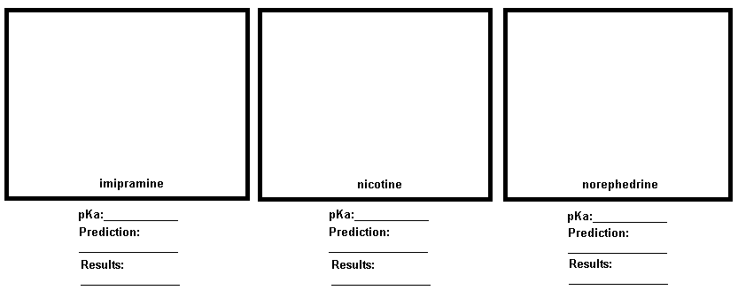
In Berner et al., researchers found that the severity of irritation from reduced sets of organic acids and bases in humans correlated with the acid and base strengths measured by pKa. Bases with a pKa >8 and acids with pKa ≤ 4 have significant has been previously reported; pKa appears highly predictive of acute skin irritation for acids and bases in man.
Find the structures of each compound and draw them in the corresponding box within the table below.
Look up the pKa for each compound and make a prediction based on Berner et al.’s pKa value for skin irritants. Check to see if the prediction was correct based on the results of the reading.
Where to find pKa info?
Point students to PubChem, NIH:
https://pubchem.ncbi.nlm.nih.gov/ - an open database for finding information about chemicals
After searching for the chemical in the search bar, pull up pKa data by clicking on Chemical and Physical Properties on the left side Contents, find hazard information under Safety and Hazards
9.4
8.5
9.44
Irritant – based on pKa
Irritant – based on pKa
Irritant – based on pKa
Irritant
Irritant – can be fatal at high doses (H310)
H315 – causes skin irritation

Slide 3
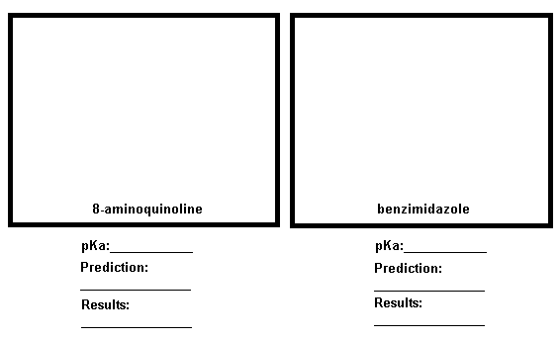
3.8
5.3
Irritant – based on pKa
Not an irritant based on pKa
H315 – causes skin irritation
H315 – causes skin irritation

Slide 4
Group Discussion
Compare results in a small group. How far off were the predictions versus the results?
Results will vary
How could skin pH play a role in the skin irritation and permeation of these chemicals?
The pH and pKa are related and can change in relation to eachother (pH = pKa + log (A-/HA), so depending on the pH of the skin, it could change the pKa in one direction or the other, therefore potentially changing the skin irritation.
Do you think this type of exposure or risk of skin irritation is manageable? Why or why not?
Results will vary

