Slide 1

Yale-UNIDO Train-the-Facilitator Workshop in Green Chemistry
Green Chemistry and Innovation
CENTER for GREEN CHEMISTRY
and GREEN ENGINEERING at YALE

Slide 2


John C. Warner
Green Chemistry and Innovation
President and CTO
warnerbabcock institute for green chemistry
john.warner@warnerbabcock.com
Distinguished Professor of Green Chemistry
Monash University – School of Chemistry
John.Warner@Monash.edu
Cofounder
beyondbenign green chemistry education
john@beyondbenign.org
ENVR E-158A Green Chemistry
Harvard Extension School
JohnWarner@FAS.Harvard.Edu
@johnwarnerorg

Slide 3
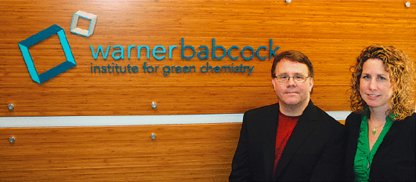
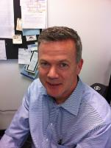

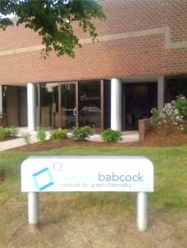


WBI - 2007 ->
John Warner
Amy Cannon
Jim Babcock
Joe Pont, CEO
100 Research Drive
Wilmington, MA 01887

Slide 4
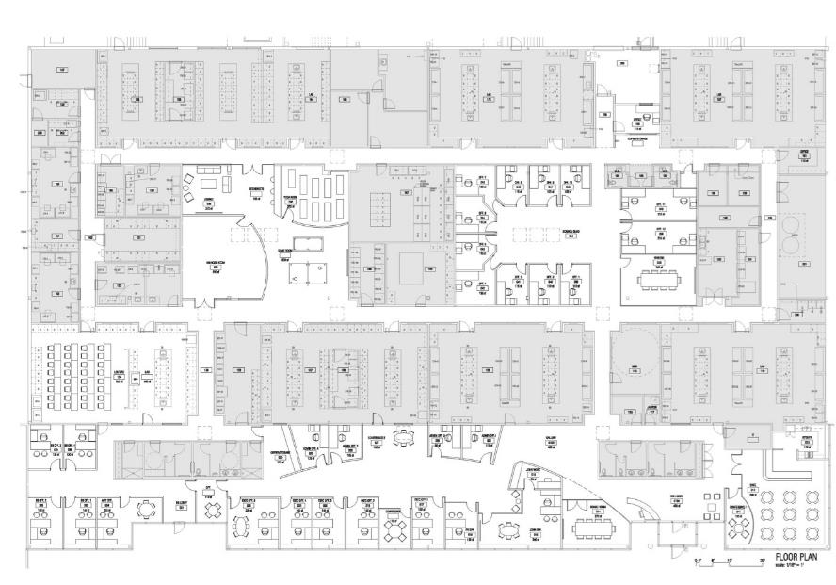
Fabrication & Physical Testing,
Biomaterials
Lab
Environment & Toxicology
Lab
Organic & Polymer Synthesis
Lab
Analytical Separations
Lab
Metal Oxide Research Labs
Applications and Coatings
Research Lab
…
WBI Scientists
Office Space
Chemicals & Lab Supplies
Microscopy & Surface Analysis
Lab
Learning Center
Particle Size & Surface Characterization Lab
Thermal Analysis & Spectroscopy Lab
NMR
Lab
Multi-use Chemistry
Lab
X-ray Lab
Beyond Benign
WBI Executive Office Space
Cafe

Slide 5

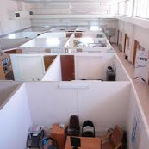
Science
Business
Explore
Basic
Research
Market
Analysis
Explore
Observe and define
structure and dynamics.
Observe and define
a product and market.
Identify and characterize
impact of changes of structure
on dynamics and dynamics on structure.
Understand
Understand
Identify and
characterize market
history and likely future trends
Design alterations in
structure and/or dynamics
to purposefully control response.
Parameterize
Parameterize
Design potential
products and assess potential
markets and parameters for success.
WBI
Create
Create a potentially useful prototype.
Develop
Develop a potentially successful product.
Technology Greenhouse
Technology Incubator
Commercialize
Commercialize a successful product.

Slide 6
3 Phase R&D Process
Hands on, in the lab,
develop intuitive
and mechanistic
understanding.
Superimpose the
chemistry literature,
and begin collaboration
with application-experienced
organizations
Identify pilot scale partner,
optimize key performance
and price attributes,
prepare for pilot
scale experiment.
Parameterization
Integration
Optimization
Ideas
Inventions
Potential
Products
Prototype
NewCo or
License
Technology reduced to practice
Technology articulated
Technical parameters assessed
Potential products identified
Feasibility demonstrated
Prelim patent written
Prelim freedom to operate assessed
Prelim market/costs analyzed
Potential partners identified
Technology demonstrated
Complete patent written
Full freedom to operate
Go forward cost estimate
3rd Party validation

Slide 7



JCW’s 185 Published Patent Applications - 72 Patent Families
(as of 12/06/2018)
63.
62.
61.
60.
59.
58.
57.
56.
55.
54.
US 62/353,925*
WO 2017223397
US 62/353,805*
WO 2017/223413
US 2018/0147824
WO 2016/191521
EP 3302969
CA 2986427
JP 2018/516784
US 2017/0189310
WO 2017/112999
BR 2016/050361
US 9,126,451
WO 2015/094630
CA 2915013
CN 105358328
EP 3083262
US 62/503,654*
WO 2018/208709
US 2018/0346433
WO 2017/083488
EP 3374354
CA 3005212
CN 108699019
US 62/234,198*
WO 2017/058748
US 9,932,424
US 2016/0264599
53.
52.
51.
50.
49.
48.
47.
46.
45.
44.
WO 2016/145060
EP 3268412
JP 201810862
US 9,630,981
WO 2016/134207
EP 3259278
JP 2018512382
US 2018/0094006
US 2017/0183364
US 9,404,933
WO 2016/057599
EP 3204450
JP 2017538791
US 62/015,154*
WO 2015/196134
US 9,889,103
US 9,763,902
WO 2015/148880
EP 3122342
US 2016/0271175
WO 2015/070177
EP 3068762
CA 2930290
CN 105899519
US 2018/0257985
US 9,994,485
WO 2015/070180
EP 3107958
43.
42.
41.
40.
39.
38.
37.
36.
35.
34.
33.
JP 2016537497
US 9,522,102
US 8,828,100
WO 2015/050542
EP 3057561
JP 2016533376
KR 20160068958
CN 105792797
US 9,394,299
WO 2015/034785
EP 304184
US 2016/0312121
WO 2015/057254
CN 105592893
US 9,856,381
WO 2015/026353
US 2014/0369901
US 2014/0371064
US 10,047,089
WO 2014/052906
EP 2900239
JP 6345674
KR 20150060775
CN 104994853
CA 2886749
US 2013/0263921
US 2013/0180587
US 2013/0074935
32.
31.
30.
29.
28.
27.
26.
25.
24.
23.
US 8,581,246
US 8,366,791
US 9,972,830
WO 201277620
EP 2724413
JP 2014526953
KR 20140039302
CN 103620861
US 2016/0122846
JP 2017110301
CN 105274338
US 9,238,850
WO 2012/024603
EP 2606158
JP 6068341
KR 20130099948
CN 103249849
US 2011/0232742
WO 2011/103494
US 2011/0232717
WO 2011/103503
US 2011/0226306
WO 2011/103506
US 8,118,880
WO 2012/067868
US 2011/0113571
WO 2011/060351
CN 10265495
22.
21.
20.
19.
18.
17.
16.
15.
14.
13.
12.
11.
US 2011/0113573
US 8,231,689
WO 2011/060354
EP 2501374
JP 2012/539054
US 61/150,216*
WO 2010/091045
US 60/802,851*
WO 2007/139810
US 7,550,136
WO 2004/058187
EP 1575537
JP 2004/562578
CA 2510162
US 2005/0266546
US 6,946,284
US 2003/0054207
WO 2003/008079
US 5,750,464
US 5,750,463
US 5,705,312
WO 1997029405
EP 0820607
JP 11508381
CA 2212884
DE 69701493
US 5,561,029
WO 1996/034315
10.
9.
8.
7.
6.
5.
4.
3.
2.
1.
EP 0767932
JP 2968342
CA 2189459
DE 69609136
US 5,411,929
US 5,424,268
US 5,395,731
US 5,708,106
US 5,616,451
US 5,455,349
WO 1995/031755
EP 0759193
JP 10500169
CA 2185144
DE 69504652
US 5,741,630
US 5,582,956
WO 1995/029067
EP 0757628
JP 9512498
CA 2186514
DE 9506396
US 5,338,644
US 5,177,262
EP 0523470
JP 2881072
CA 2070450
DE 69218312
72.
71.
70.
69.
68.
67.
66.
65.
64.
US 65/514,004*
WO 2018/222976
US 62/516585
WO 2018/222572
US 62/503,645*
WO 2018/204565
US 62/500,826*
WO 2018/204565
US 2018/0235316
WO 2018/156689
US 2018/0346778
WO 2018/094357
US 2018/0223172
US 2018/0016484
WO 2018/013949
US 62/355,074*
WO 2018/005430
WBI 2007- Present
UMASS 1996-2007
Polaroid 1988-1996

Slide 8


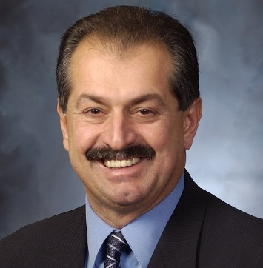
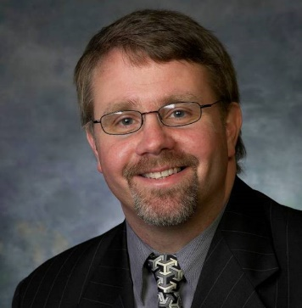
Innovation
Number of Employees
Andrew Liveris
President, Chairman, and CEO
The Dow Chemical Company
John Warner
President and CTO
Warner Babcock Institute
for Green Chemistry

Slide 9
John Warner’s 5 Elements of Innovation
1. All innovation begins with science fiction.
2. Innovation happens not within the field of focus but in the periphery.
3. Encyclopedic knowledge inhibits innovation in the absence of intuitive knowledge.
4. The ability to innovate is simultaneously proportional to wisdom and the tolerance of intellectual risk.
5. Innovation is orthogonal to complexity.

Slide 10
John Warner’s 5 Elements of Innovation
1. All innovation begins with science fiction.
2. Innovation happens not within the field of focus but in the periphery.
3. Encyclopedic knowledge inhibits innovation in the absence of intuitive knowledge.
4. The ability to innovate is simultaneously proportional to wisdom and the tolerance of intellectual risk.
5. Innovation is orthogonal to complexity.

Slide 11

Renovation
The 2011 World Science Fiction Convention
August 17-21, 2011, Reno, Nevada

Slide 12
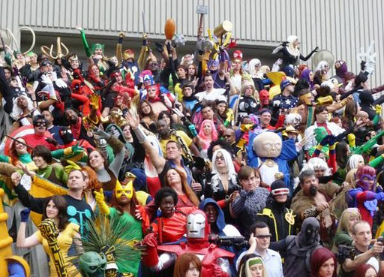

Slide 13
John Warner’s 5 Elements of Innovation
1. All innovation begins with science fiction.
2. Innovation happens not within the field of focus but in the periphery.
3. Encyclopedic knowledge inhibits innovation in the absence of intuitive knowledge.
4. The ability to innovate is simultaneously proportional to wisdom and the tolerance of intellectual risk.
5. Innovation is orthogonal to complexity.

Slide 14
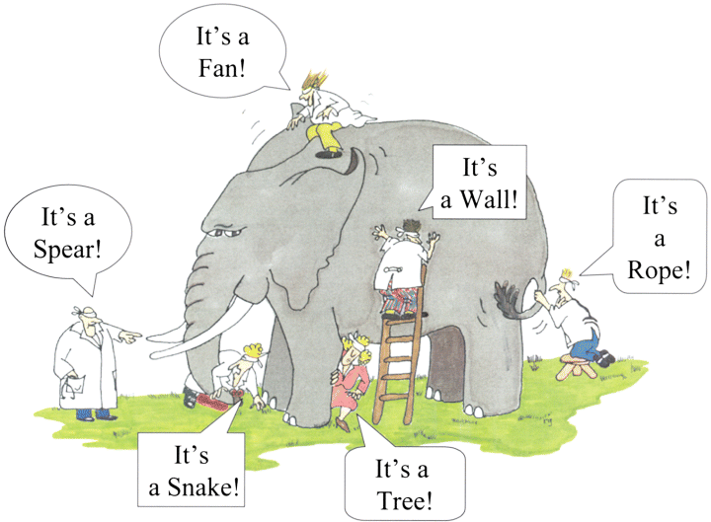

Slide 15
John Warner’s 5 Elements of Innovation
1. All innovation begins with science fiction.
2. Innovation happens not within the field of focus but in the periphery.
3. Encyclopedic knowledge inhibits innovation in the absence of intuitive knowledge.
4. The ability to innovate is simultaneously proportional to wisdom and the tolerance of intellectual risk.
5. Innovation is orthogonal to complexity.

Slide 16

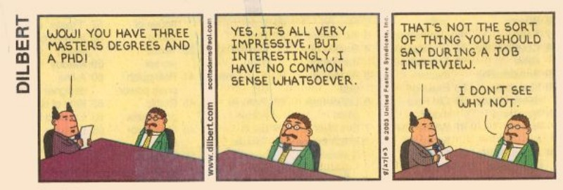
Encyclopedic Knowledge

Slide 17
John Warner’s 5 Elements of Innovation
1. All innovation begins with science fiction.
2. Innovation happens not within the field of focus but in the periphery.
3. Encyclopedic knowledge inhibits innovation in the absence of intuitive knowledge.
4. The ability to innovate is simultaneously proportional to wisdom and the tolerance of intellectual risk.
5. Innovation is orthogonal to complexity.

Slide 18
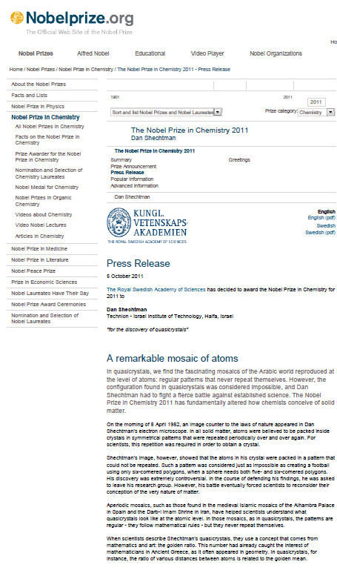
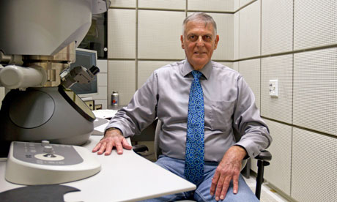
Daniel Shechtman, who has won the chemistry Nobel for discovering quasicrystals, was initially lambasted for 'bringing disgrace' on his research group
.
"His discovery was extremely controversial. In the course of defending his findings, he was asked to leave his research group," the Nobel committee at the Royal Swedish Academy of Sciences said in a statement.

Slide 19
John Warner’s 5 Elements of Innovation
1. All innovation begins with science fiction.
2. Innovation happens not within the field of focus but in the periphery.
3. Encyclopedic knowledge inhibits innovation in the absence of intuitive knowledge.
4. The ability to innovate is simultaneously proportional to wisdom and the tolerance of intellectual risk.
5. Innovation is orthogonal to complexity.

Slide 20
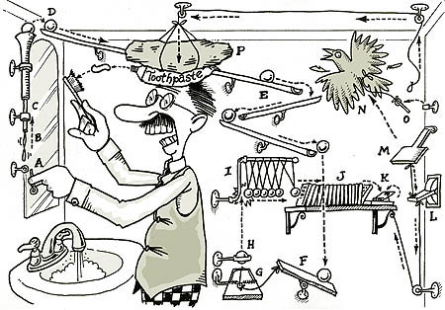

Slide 21

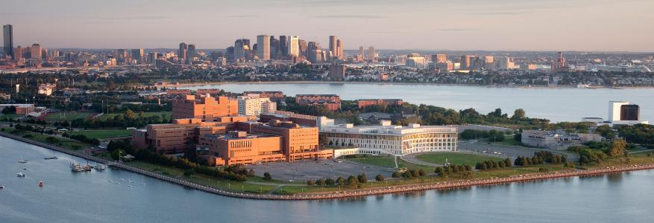
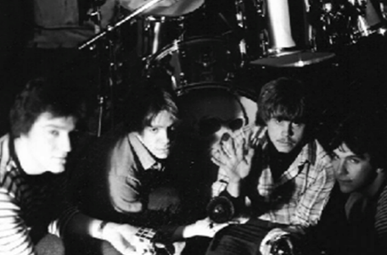
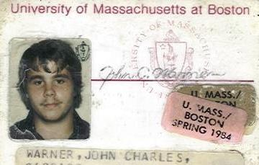
UMASS Boston – 1980-1984
The Elements

Slide 22
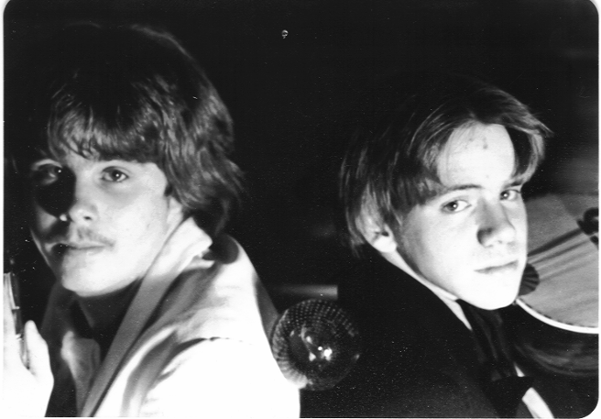
James “Opie” Neil
[1962 – 1981]

Slide 23
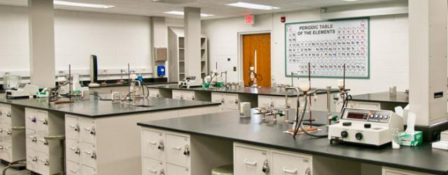
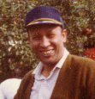
"N-Nitrosamines from the Reaction of N-Chlorodialkylamines with Sodium Nitrite." Nakajima, M.; Warner, J. C.; Anselme, J.-P. J. Chem. Soc., Chem. Commun., 1984, 451.
"N-Nitrosamines via the Phase-Transfer mediated Nitrosation of Secondary Amines with Sodium Nitrite and N-Haloamides." Nakajima, M.; Warner, J. C.; Anselme, J.-P. Tetrahedron Lett., 1984, 25, 2619.
"N-Nitrosamines from the Reaction of Sulfamoyl Chlorides with Sodium Nitrite." Warner, J. C.; Nakajima, M.; Anselme, J.-P. Bull. Soc. Chim. Belges, 1984, 93, 919.
"The Wittig Reaction in the Undergraduate Organic Laboratory." Warner, J. C.; Anastas, P. T.; Anselme, J.-P. J. Chem. Ed., 1985, 62, 346.
"Benzoyl Phenyl 1-Methylpyrazoles. Synthesis, Characterization, and Spectra." Kano, K.; Scarpetti, D.; Warner, J. C.; Anselme, J.-P.; Springer, J. P.; Arison, B. H. Can. J. Chem., 1986, 64, 2211.
Professor J.-P. Anselme

Slide 24
Science
4 years old
Art

Slide 25
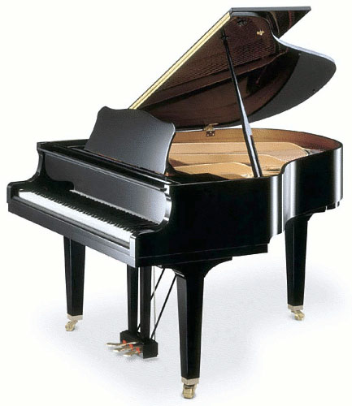

Slide 26
TS
Eact
SM
Energy
ΔG
P
Reaction Coordinate

Slide 27


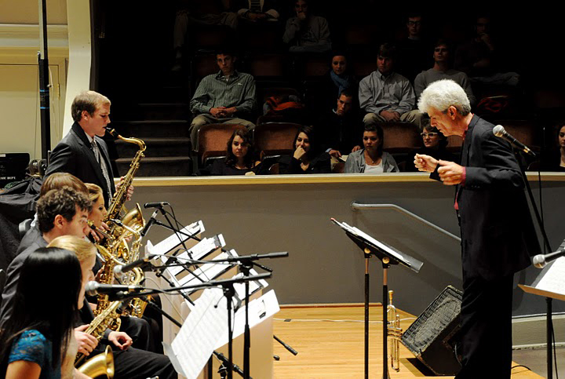

Slide 28
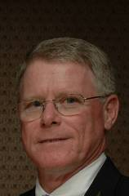
H
O
H
O
R
X
O
O
O
O
H
H
H
H
R
X
Ed Cannon

Slide 29
H
O
H
O
O
O
O
O
H₂O
O
H
H
Ed Cannon

Slide 30
H
O
H
O
O
R
X
O
O
O
R
X
Ed Cannon

Slide 31
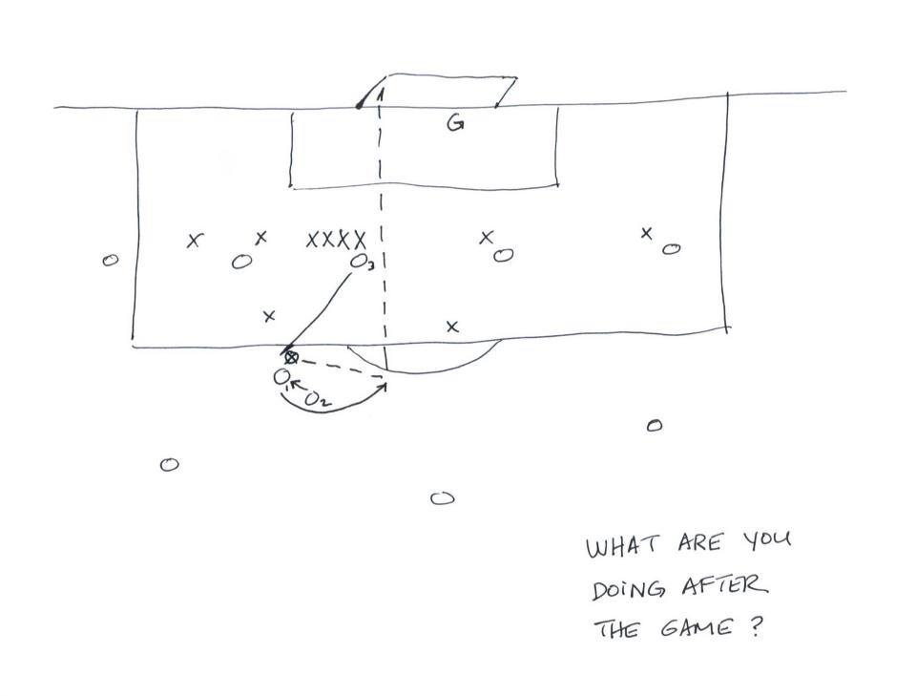
Ed Cannon

Slide 32
H
O
H
O
O
O
O
O
H₂O
O
H
H
R
X
Ed Cannon

Slide 33
H
O
H
O
O
R
X
O
O
O
R
X
Ed Cannon

Slide 34
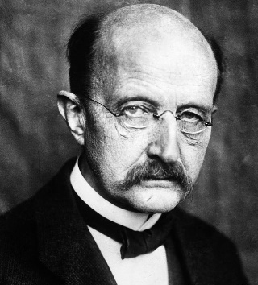
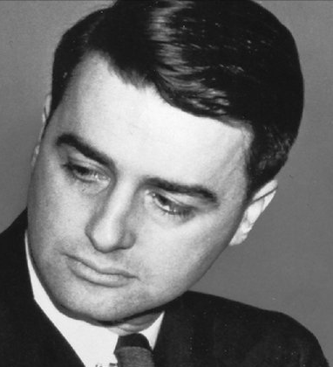
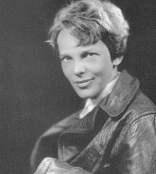
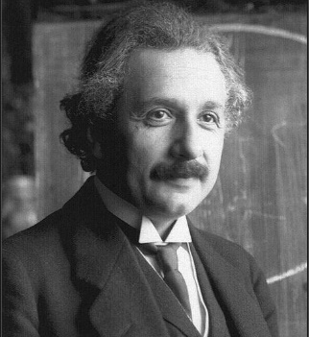
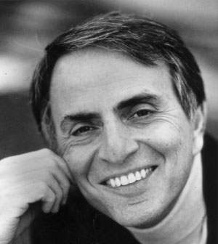
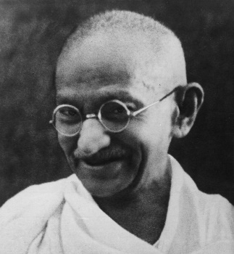
A new scientific truth does not triumph by convincing its opponents and making them see the light, but rather because its opponents eventually die, and a new generation grows up that is familiar with it.
(Max Plank)
Don’t do anything someone else can do. Don’t undertake a project unless it is manifestly important and nearly impossible.
(Edwin Land )
Never interrupt someone doing what you said couldn’t be done.
(Amelia Earhart )
The Intuitive mind is a sacred gift and the rational mind is a faithful servant. We have created a society that honors the servant and has forgotten the gift.
(Albert Einstein)
Somewhere, something incredible is waiting to be known.
(Carl Sagan)
First they ignore you, then they laugh at you, then they fight you, then you win.
(Mahatma Gandhi)

Slide 35
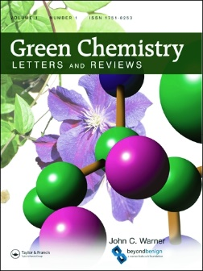
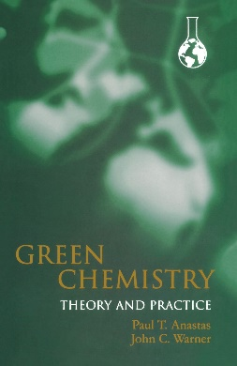
warnerbabcock.com
beyondbenign.org
johnwarner.org
in
John.Warner@WarnerBabcock.com
t
@JohnWarnerOrg

