Slide 1

Train-the-Facilitator
5-day Workshop
GLOBAL GREEN CHEMISTRY INITIATIVE
Nitesh H. Mehta, Green ChemisTree Foundation
Dr. Karolina Mellor, Yale University
CENTER for GREEN CHEMISTRY
and GREEN ENGINEERING at YALE

Slide 2


Background
      Chemical Engineer by training, an “Enviropreneur” serving industry for 20 years, Engaged & committed to two organizations:
      For-profit org., Founded by IIT-B technocrats passionate about Nature & Committed to Environment
      Developing, scaling-up & commercializing GC&E solutions for Industry
      60 people team now (30 chemists & chem. engineers)
      Registered not-for-profit organization (2009)
      Committed to accelerating implementation of GC&E in Chemical Industry
      Engaging all stakeholders (industry, government, regulatory, academia, students, policy makers, media, etc)
      Diverse Initiatives - Collaborating with local/international agencies (ACS-GCI, WBI, BB, etc)

Slide 3
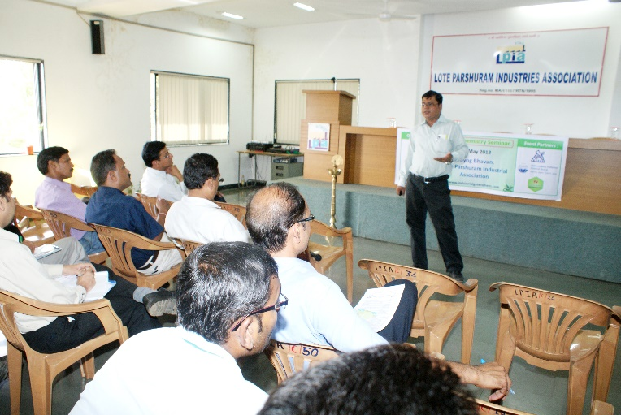
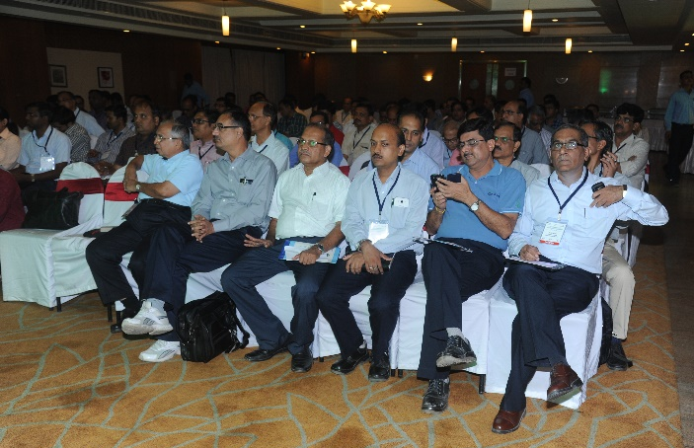
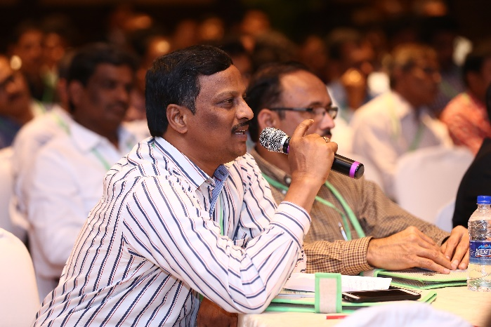
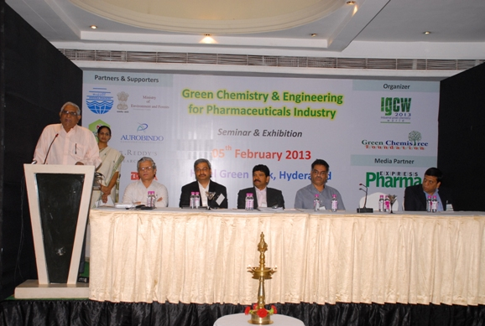
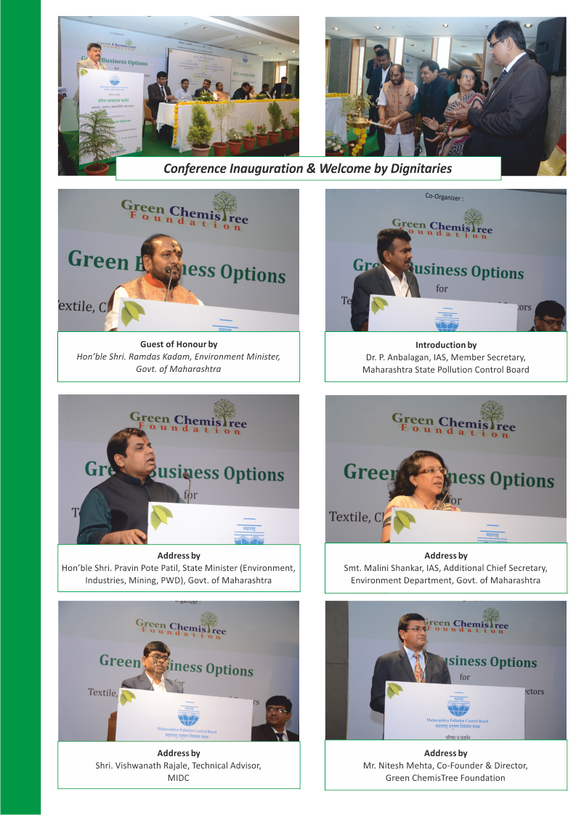
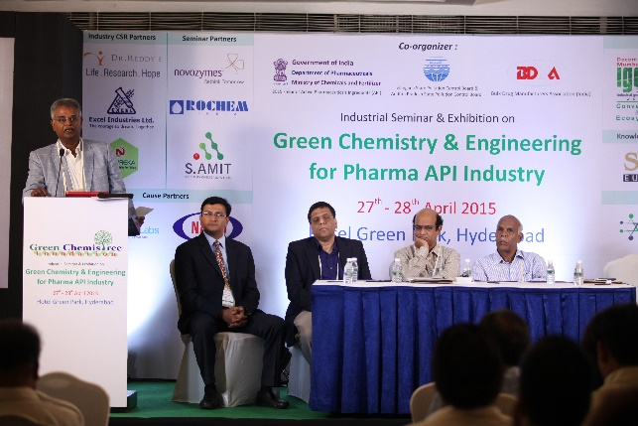
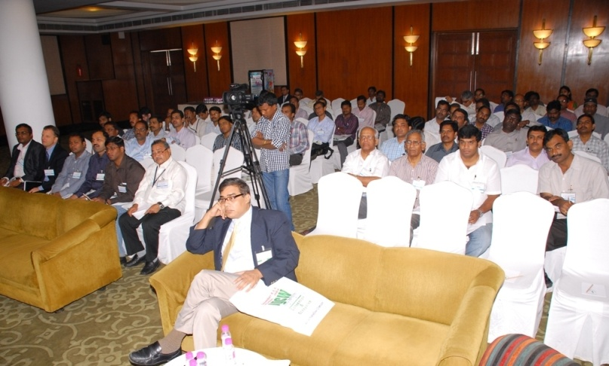
Green Chemistry Foundation – Activities & Initiatives
Green Chemistry Workshops for sector-specific / region-specific companies in collaboration with Industry Associations
Lote-parshuram / Roha-Mahad / Ambernath-Badlapur / Vapi / Ankleshwar / Ahmedabad / Hyderabad / Vizag
Green Chemistry Workshops in Collaboration with State Pollution Control Boards
Maharashtra, Andhra Pradesh & Telangana State Pollution Control Boards

Slide 4
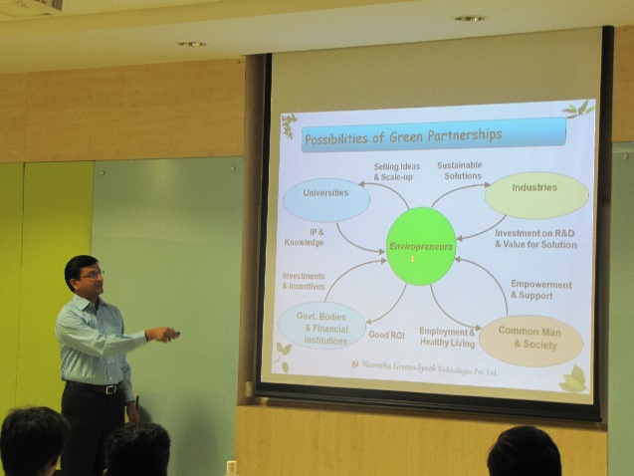
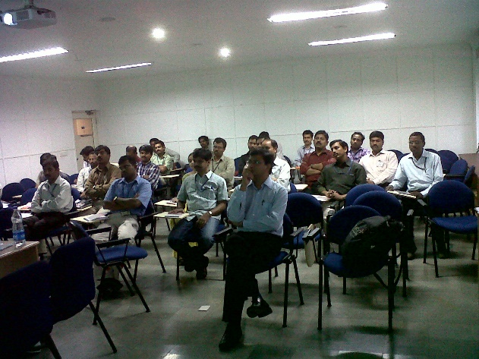
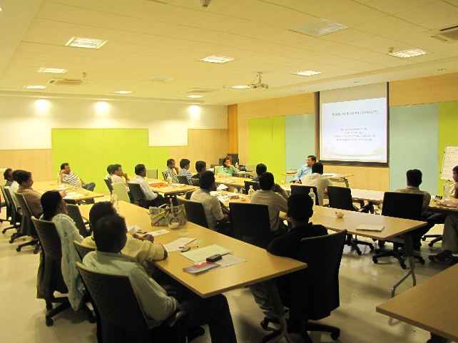
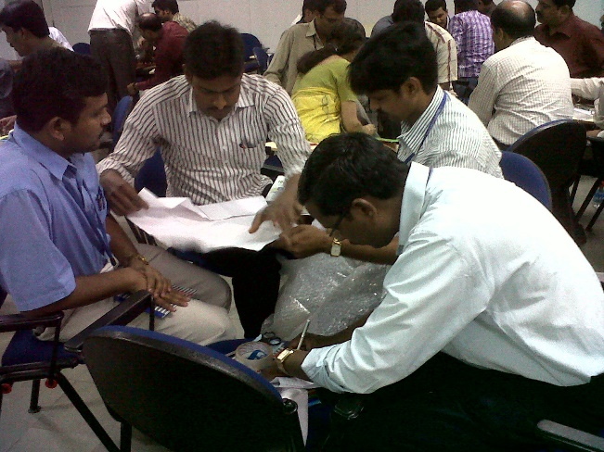
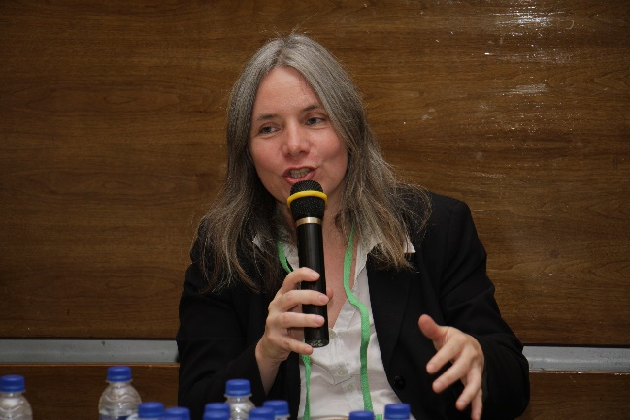
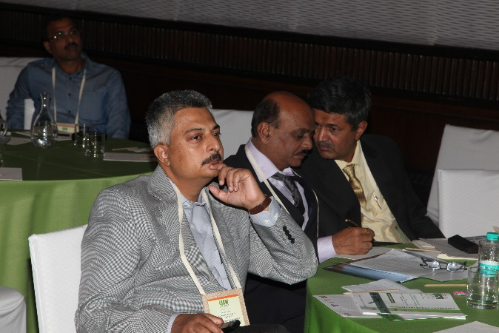
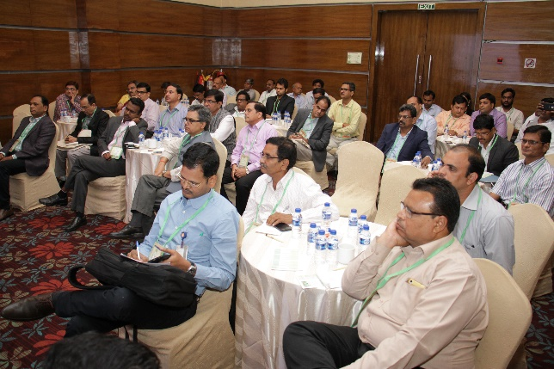
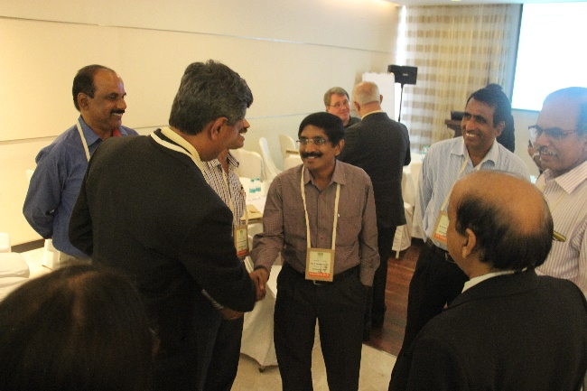
Green Chemistry Foundation – Activities & Initiatives
Green Chemistry Customized Workshops for Corporates
Dr. Reddy’s Labs, Cipla and Aurobindo Pharma
Green Chemistry Conference for State Pollution Control Board Officers

Slide 5
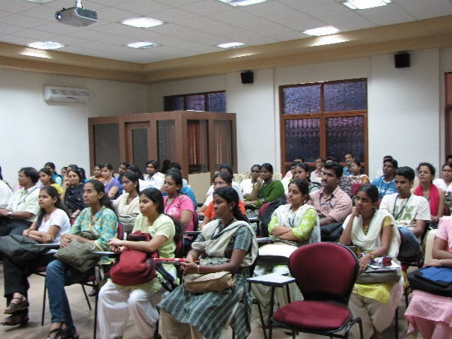
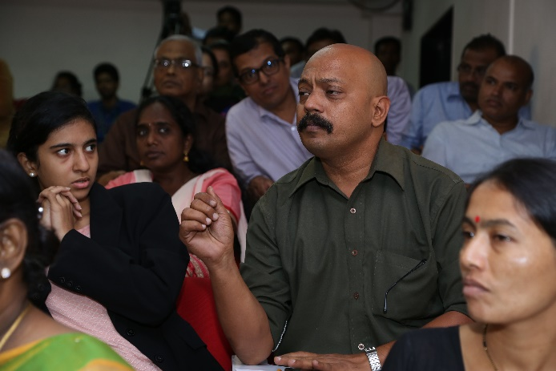
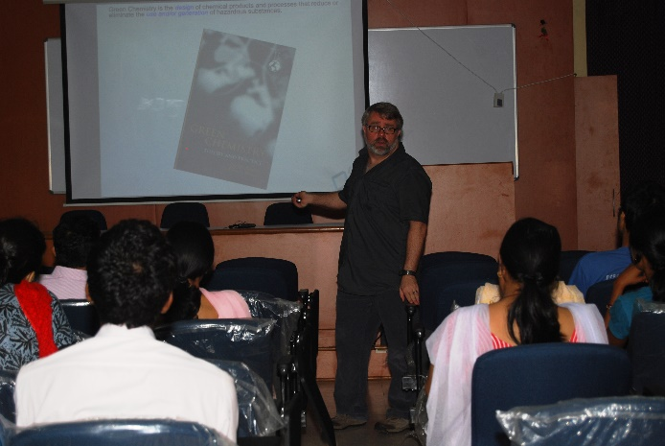
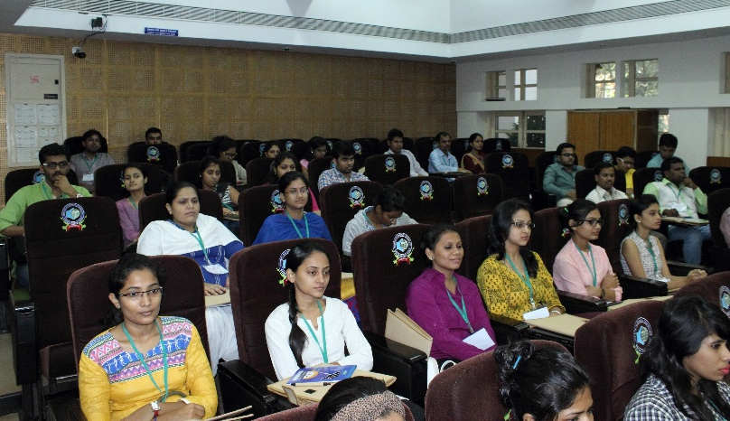
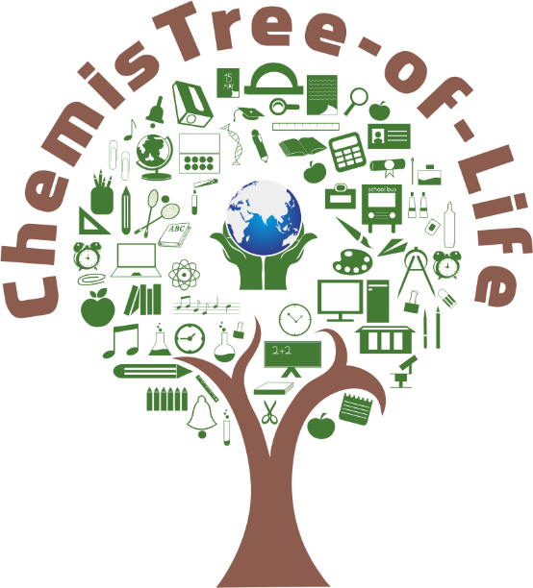
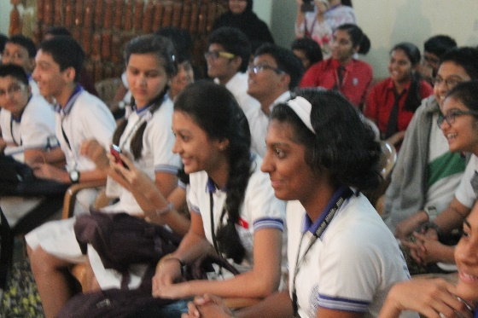
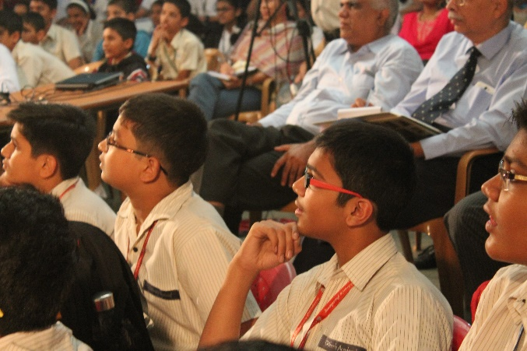
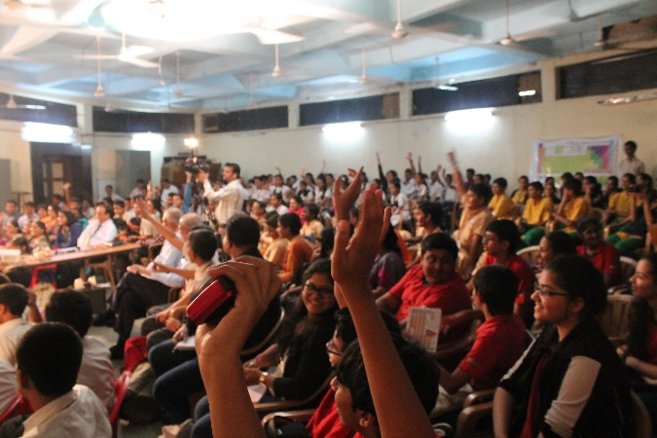
Green Chemistry Foundation – Activities & Initiatives
Green Chemistry Workshops for Teachers
Green Chemistry Workshops for Post-graduate and PhD Students
Opportunity for Teachers & Students to interact with global GC Experts, including John Warner
ChemisTree-of-life Inter-school Festival

Slide 6
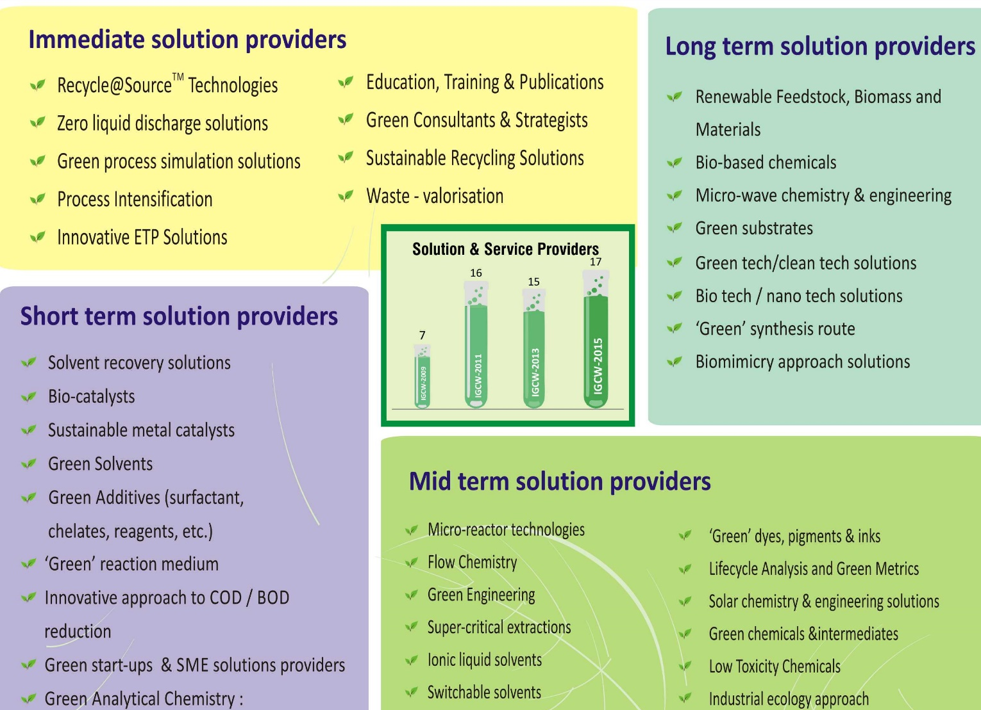
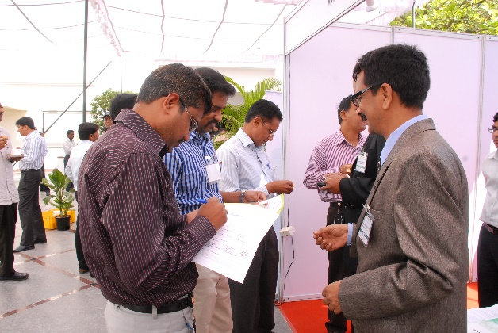
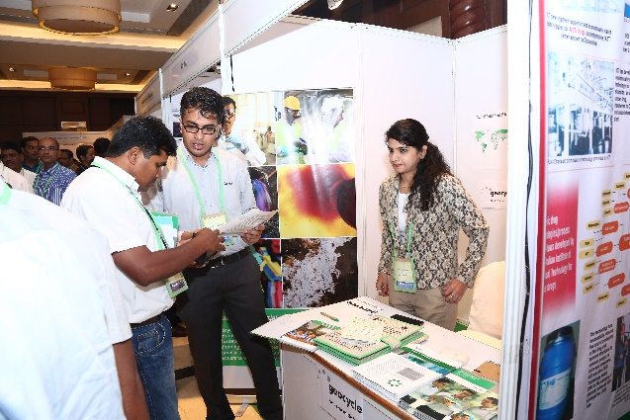
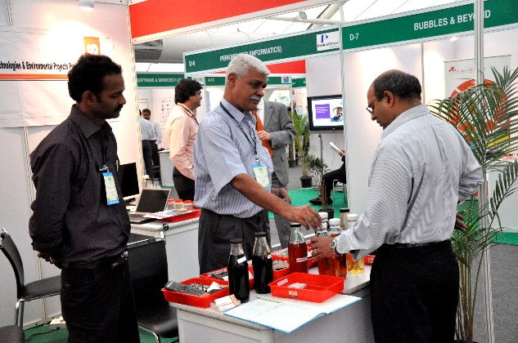
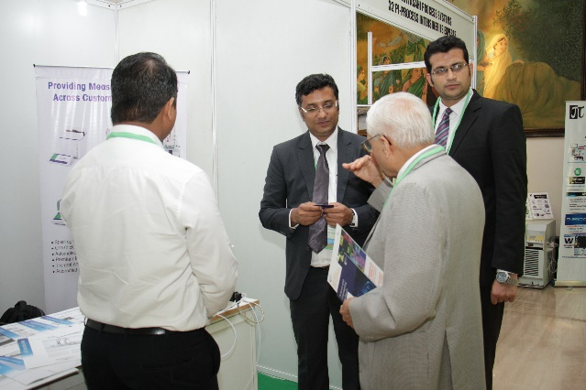
Green Chemistry Foundation – Activities & Initiatives
Connecting Solution Providers

Slide 7
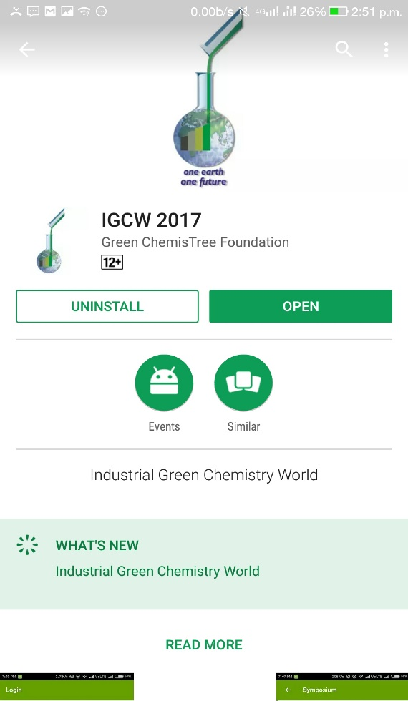
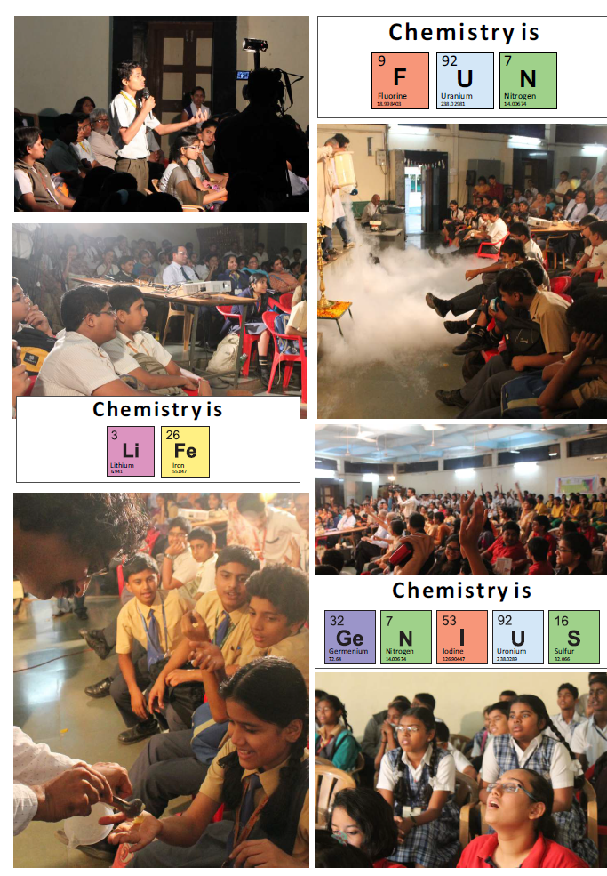
Green Chemistry Foundation – Initiatives in progress
Green Chemistry & Engineering
E-leaning Programmed for Young Professionals
Green Chemistry & Engineering APP / Interactive & networking platform
Green Chemistry Awareness & ChemisTree for life campaigns in schools

Slide 8
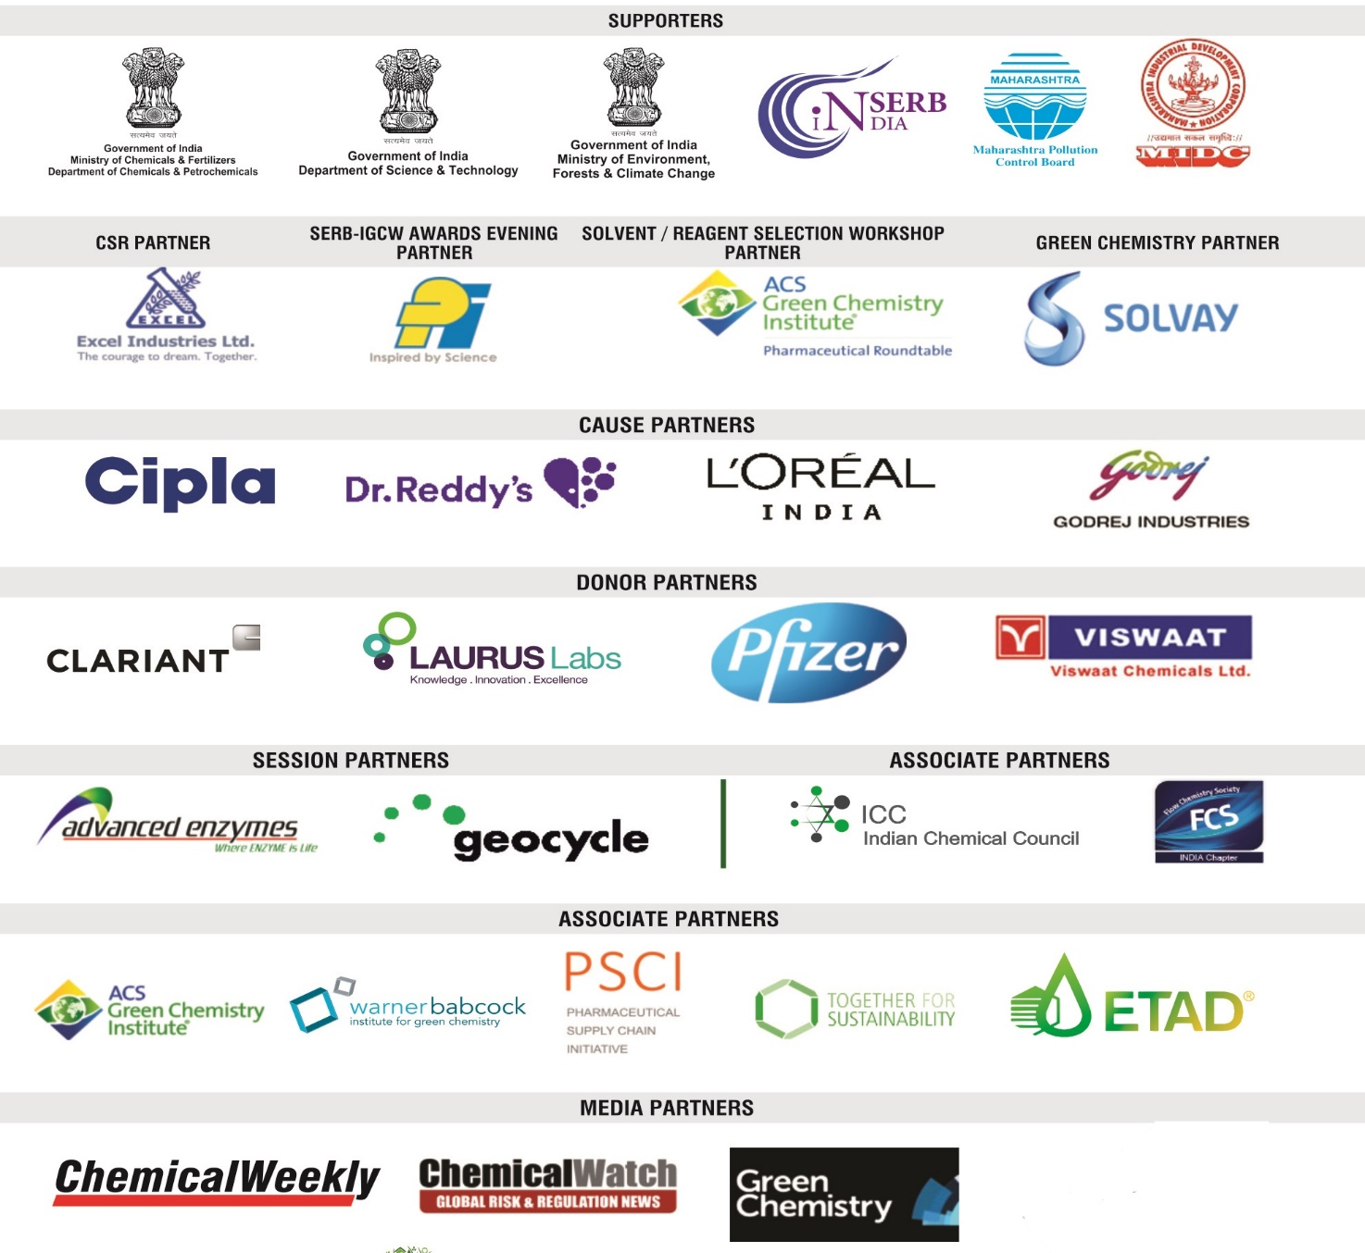
Green Chemistry Foundation – Collaborations

Slide 9
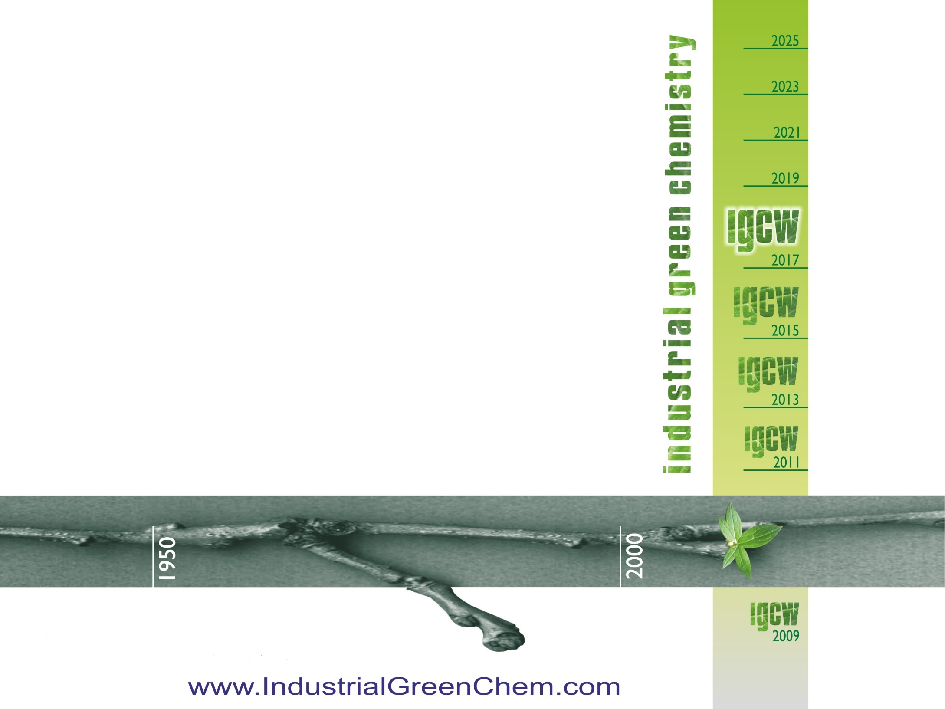
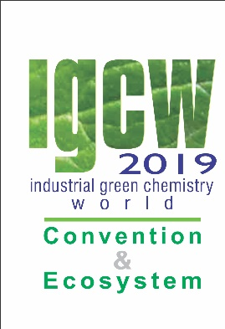
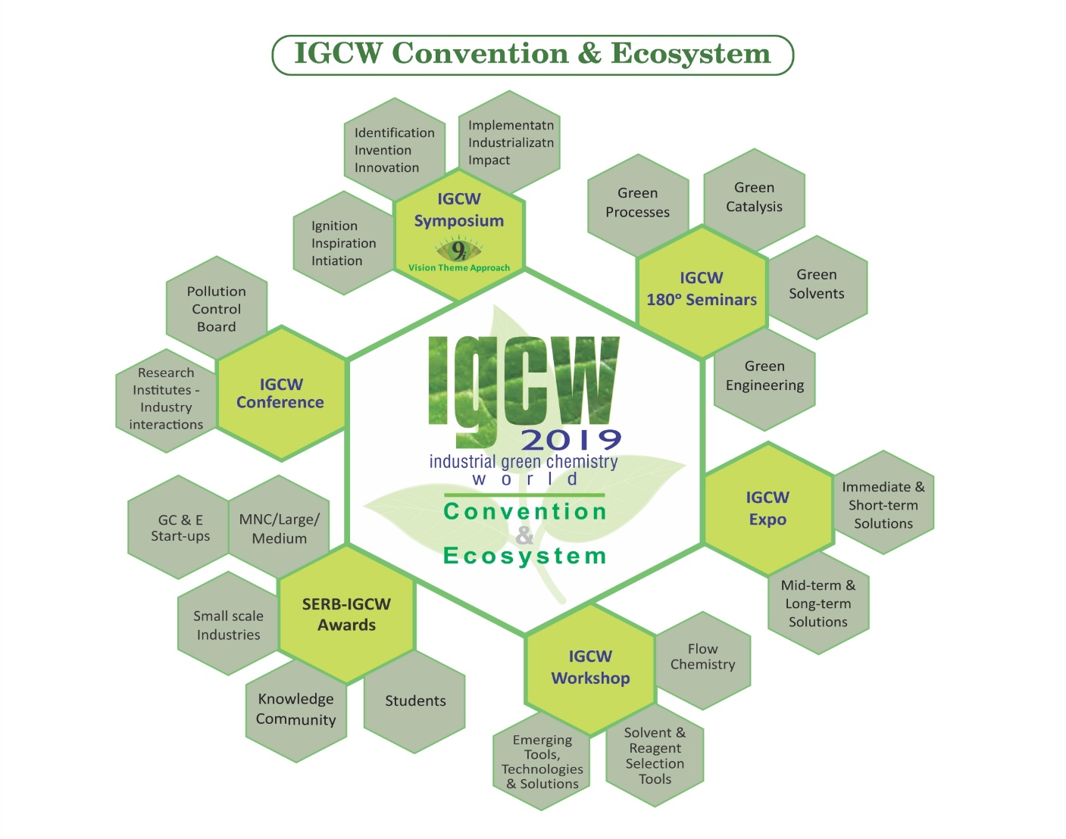
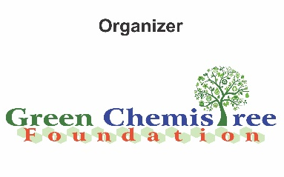
16th & 17th Oct.’2019
For details: connect@IndustrialGreenChem.com

Slide 10
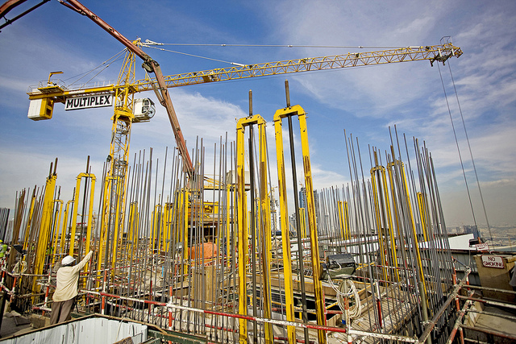
Yale-UNIDO Train-the-Facilitator Workshop in Green Chemistry
Sustainability
CENTER for GREEN CHEMISTRY
and GREEN ENGINEERING at YALE
Image: Flickr, The Glenium Sky admixture, Author: BASF - We create chemistry

Slide 11
Topics To Be Covered
Sustainability – Myths and Facts
Society, Economy, and the Environment
Business and Sustainability
  Applying Green Chemistry to Management
Different Models of Sustainability
Case Study: The Interface Company
Green Washing
Life-Cycle Assessment

Slide 12
Sustainability
When a word becomes so popular you begin hearing it everywhere, in all sorts of marginally related or even unrelated contexts, it means one of two things. Either the word has devolved into:
A meaningless cliché, or
It has real conceptual heft.

Slide 13
Sustainability
“Sustainable“, which at first conjures up a similarly vague sense of environmental virtue, actually belongs in the second category:
It has real conceptual heft.
Despite its simplicity sustainability is a concept many people have a difficult time wrapping their minds around.

Slide 14
Sustainability Myths

Slide 15
Myth #1:
Nobody knows what sustainability really means.

Slide 16
What is sustainability?
Take a moment to write a sentence or two about what sustainability is.

Slide 17
The Definition of Sustainability
UN World Commission on Environment and Development: “Sustainable development is development that meets the needs of the present without compromising the ability of future generations to meet their own needs.”
Sustainability presumes that resources are finite and should be used conservatively and wisely with a view to long-term priorities and consequences of the ways in which resources are used.
In simplest terms, sustainability is about our children and our grandchildren, and the world we will leave them.
- The Brundtland Report (Our Common Future)

Slide 18
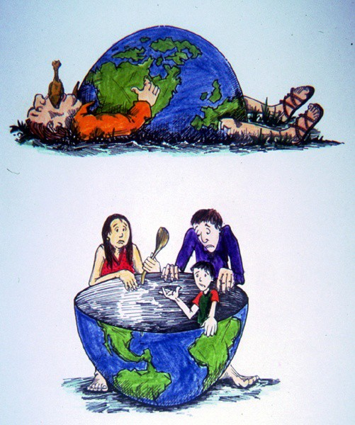
The Definition of Sustainability
Sustainability wants to avoid this
While also making sure we can lead comfortable lives.
Image Source: Wikipedia

Slide 19
Myth #2:
Sustainability is all about the environment.

Slide 20
Sustainability is Not Just About the Environment
Sustainability includes a broad group social and economic development issues including: poverty, hunger, health, education, climate change, water, sanitation, energy, and environment.
This requires giving all countries access to natural resources such as water, energy, and food - all of which come, one way or another, from the environment.

Slide 21
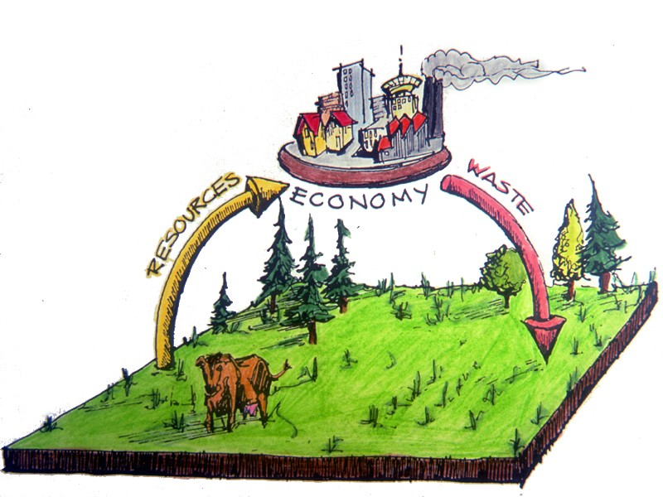
Sustainability is Not Just About the Environment
Sustainability has transformed into an environmental term because the economy is driven by natural resources.
If too many of us use resources inefficiently or generate waste too quickly for the environment to absorb and process, future generations won’t be able to meet their needs.
Image Source: Wikipedia

Slide 22
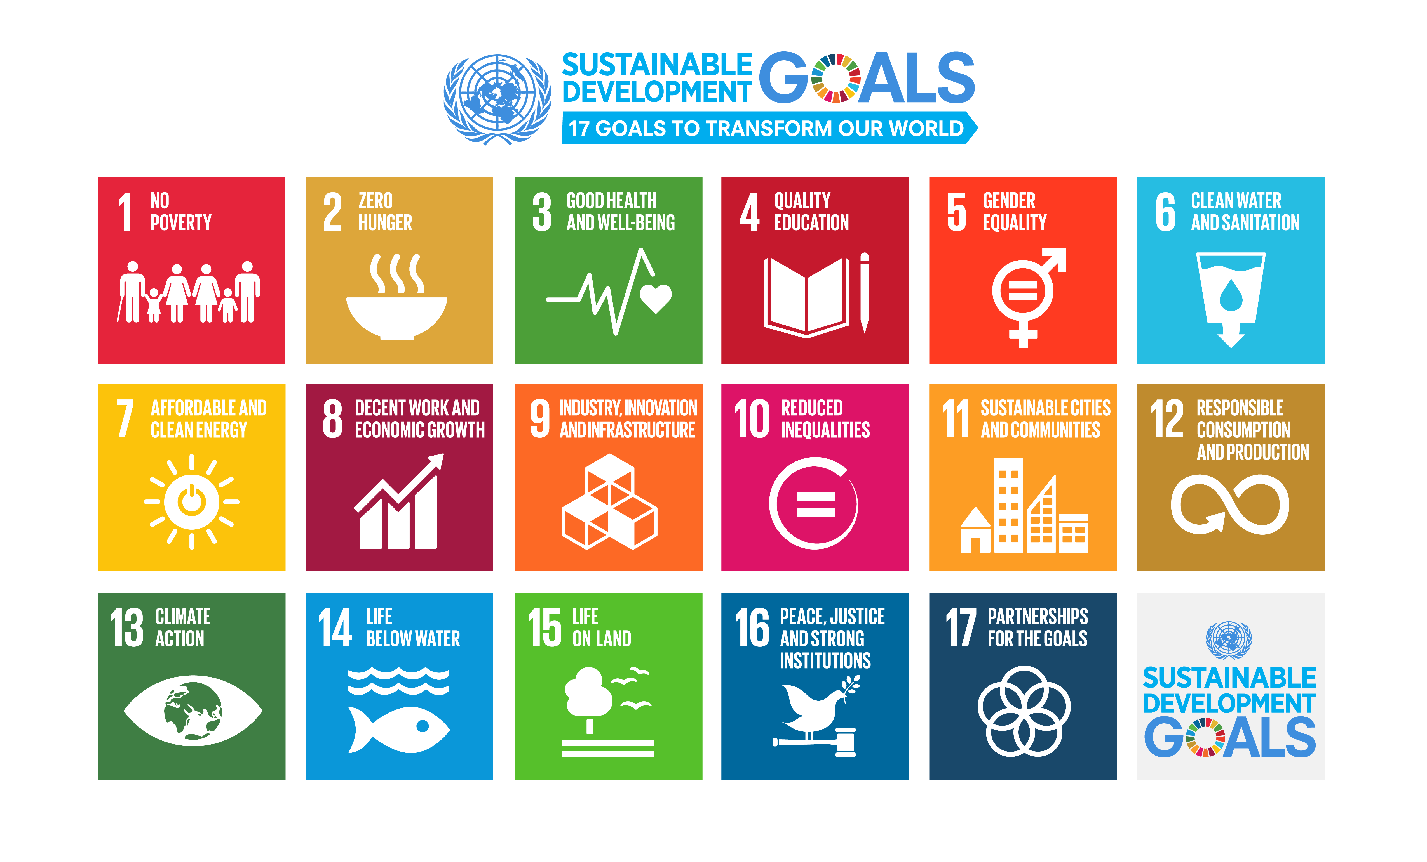
Sustainability is Not Just About the Environment
https://www.un.org/sustainabledevelopment/sustainable-development-goals/

Slide 23
Myth #3:
“Sustainable” is a synonym for “green”.

Slide 24
Sustainability ≠ Green
Although there’s a fair amount of overlap between the terms, “green” can suggest to the public a preference for the natural over the artificial.
With more than six billion people on the planet today, and another three billion expected by the middle of the century, society cannot hope to give future generations a comfortable standard of living without a heavy relying on technology and innovations such as genetically altered food products.

Slide 25



Sustainability & Green
Both terms often used outside of context, outside of true metric
=> Green washing
g oing green
Image Source: Wikipedia

Slide 26
Sustainability & Green
Green
Sustainability
Green concepts tend to focus on technologies/products causing less harm to human health and the environment
In popular discourse it is often assumed that green = natural as opposed to artificial
Yet natural may not always be sustainable
Sustainability and green overlap since a sustainable solution has to preserve health and environment
Sustainability adds the important idea of preserving resources for the next generation

Slide 27
Myth #4:
Sustainability is all about recycling.

Slide 28
A question we need to ask:
Is recycling sustainable?
Sustainability and Recycling

Slide 29
Sustainability and Recycling
Material | Energy savings
Aluminum | 95%
Cardboard | 24%
Glass | 5-30%
Paper | 40%
Plastics | 70%
Steel | 60%
Recycling
  Converting waste materials into new materials and objects.
  Available for metals, plastic, paper, glass.
Cost-benefit of recycling: energy savings

Slide 30
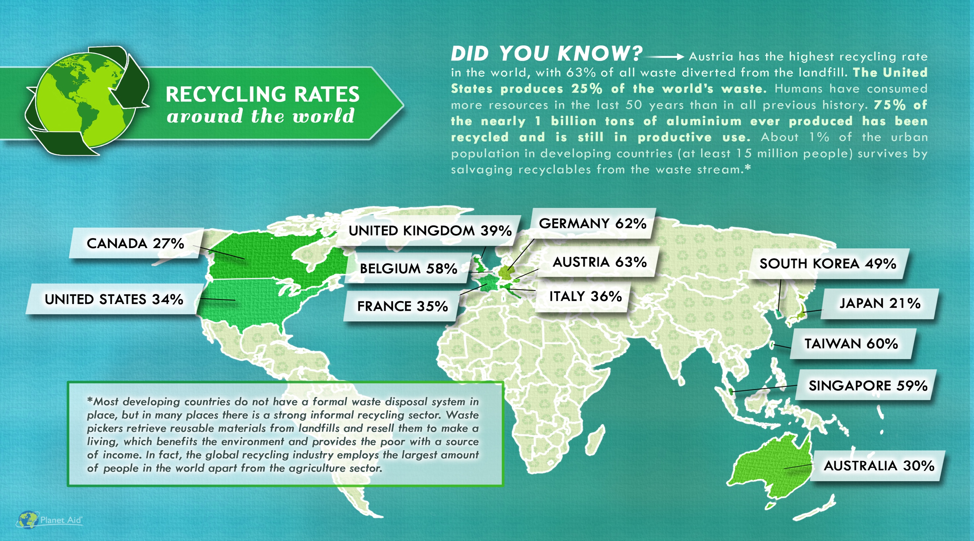
SOUTH AFRICA 43%
http://www.planetaid.org/blog/recycling-rates-around-the-world

Slide 31
Myth #5:
Sustainability is too expensive.

Slide 32
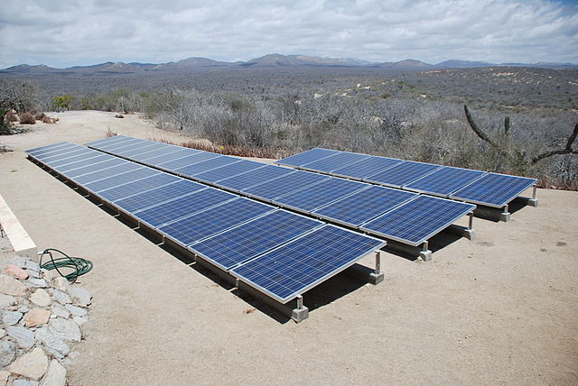
Sustainability and Expense
More sustainable ways of doing things usually costs less over the life-time of a product or service.
It is the upfront costs that can sometimes be higher.
Image: Wikimedia Commons, Solar panels installed in Baja Sur California, Author: BishopBandita

Slide 33
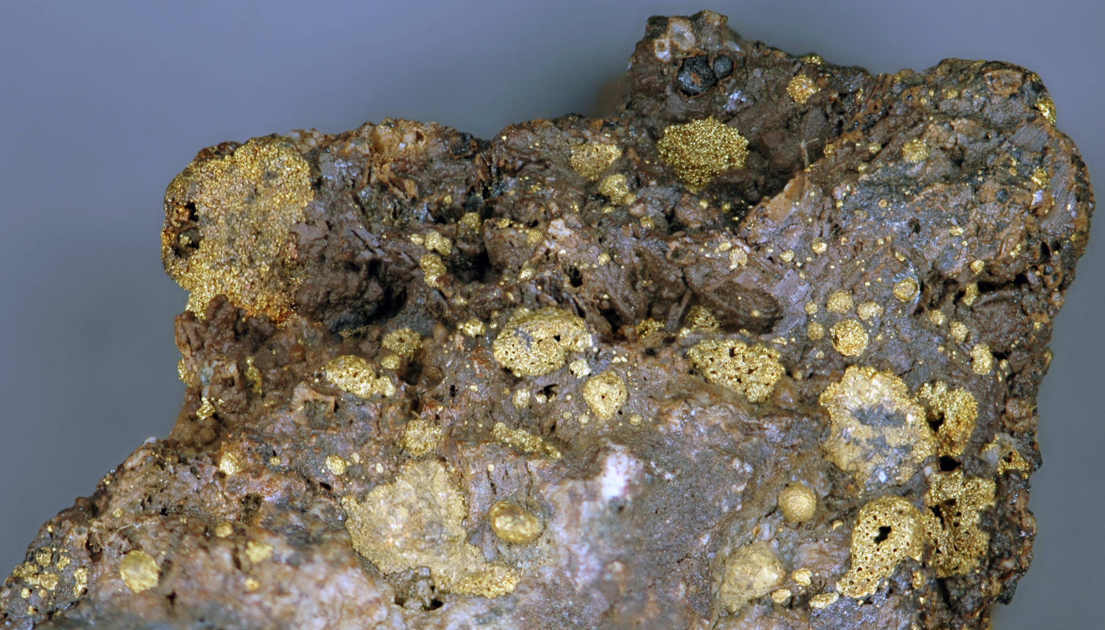
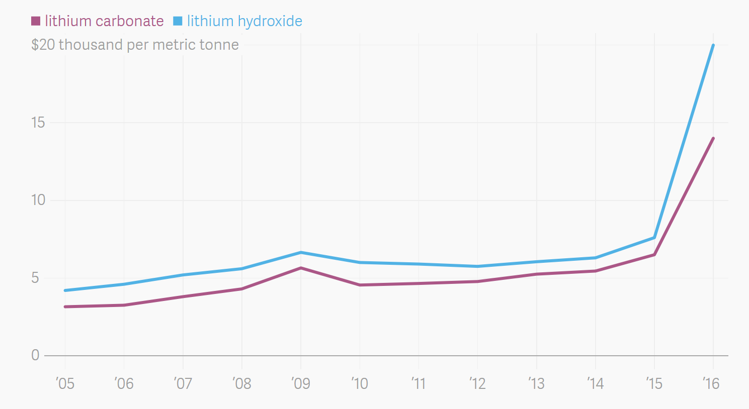
Sustainability and Expense
What is rare is expensive.
It is hard to imagine that an expensive process/product is sustainable.
Roasted gold ore from Cripple Creek, Colorado, USA
More intense use of lithium in batteries means higher cost of lithium and more difficult access
https://commons.wikimedia.org/wiki/File:Roasted_Cripple_Creek_gold_ore_3.jpg, https://www.theatlas.com/charts/S1Isjut3

Slide 34
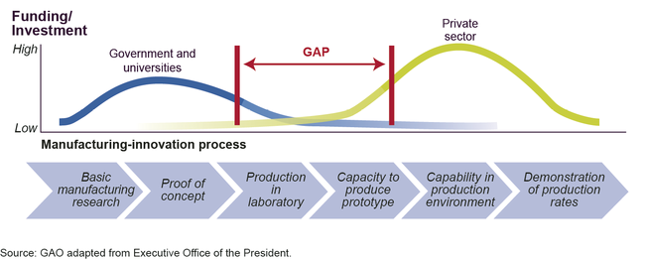
Sustainability and Expense
Developing new technologies comes with risks and upfront investments
Image: https://www.gao.gov/products/GAO-14-181SP

Slide 35
Myth #6:
Sustainability means lowering our standard of living.

Slide 36
Sustainability and Standard of Living
Once we start becoming organized and innovate, the breakthroughs can be extraordinary.
These innovations will allow us to use resources more productively, which in turn will allow us to be prosperous, fed, entertained, and secure.
The innovation at the heart of sustainable living will be a powerful economic engine.

Slide 37
Myth #7:
Consumer choices and grassroots activism, not government intervention, offer the fastest and most efficient routes to sustainability.

Slide 38
Sustainability and The Government
Popular grassroots actions are helpful and essential to creating change. But progress on some reforms, such as curbing CO₂ emissions, can only happen if central authorities commit to making it happen.
That is why tax credits, mandatory fuel-efficiency standards, and other government regulations are both practical and necessary.

Slide 39
Myth #8:
New technology is always the answer.

Slide 40
Is new technology the answer to sustainability?
Sustainability and Technology
Notes:
Or, should we make sure that whatever we develop is sustainable for many years to come?

Slide 41
Water treatment technologies for developing world
Lifestraw
Water purifying bicycle
Hamster Ball-Shaped Solarball
Life sack
“Pure” Water Bottle Filters Water With UV Rays
Ceramic water filter

Slide 42
Myth #9:
Sustainability is ultimately a population problem.

Slide 43
Sustainability and Population
This is not a myth, but it represents a false solution.
Every environmental problem is ultimately a population problem. If the world’s population were only 100 million people, we would be hard-pressed to generate enough waste to overwhelm nature’s cleanup systems. We could dispose all our trash in a landfill in some remote area, and nobody would notice.

Slide 44
Sustainability and Population
Population experts agree that the best way to limit population is to educate women and raise the standard of living overall in developing countries.
But that strategy cannot possibly happen quickly enough to put a dent in the population on any useful timescale.
The U.N. projects that the planet will have to sustain another 2.6 billion people by 2050. But even at the current population level of 7 billion people, we’re using up resources at an unsustainable rate.

Slide 45
Myth #10:
Once you understand the concept, living sustainably is easy to figure out.

Slide 46
Sustainability ≠ Simple
All too often, a choice that seems sustainable turns out on closer examination to be problematic.
Probably the best current example is the rush to produce ethanol for fuel from corn.
What are the issues with ethanol?

Slide 47
Sustainability ≠ Simple
Corn Cultivation:
Competition with food supply
Land demand
Nutritional needs
Diseases
Initial investment
Ethanol Demand and Corn Prices:
Large increase in demand for corn for ethanol production.
  Current production capacity is at over 5 billion gallons.
  It is projected to increase to over 9 billion gallons with current plants currently under construction.
Bushels of corn sold for over $8 (USD) each in July 2012.
Corn prices continue to fluctuate.

Slide 48
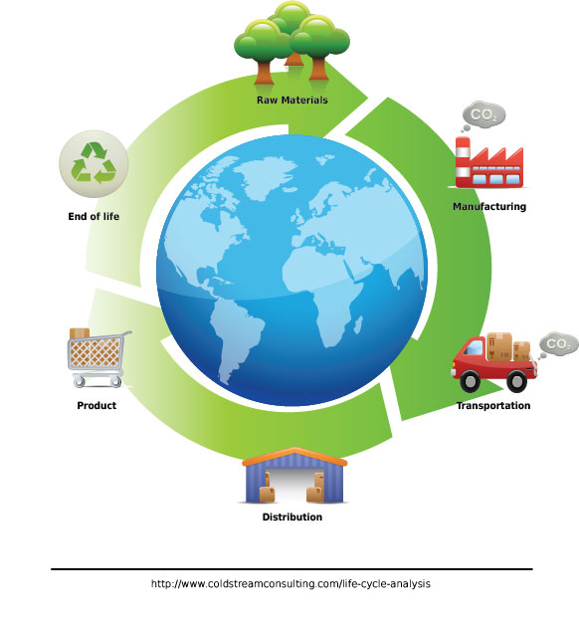
Sustainability ≠ Simple
You cannot really declare any practice “sustainable” until you have done a complete life-cycle analysis of its environmental costs.
Even then, technology and public policy keep evolving, and that evolution can lead to unforeseen and unintended consequences.
The admirable goal of living sustainably requires plenty of thought on an ongoing basis.

Slide 49
Sponsored by Yale-UNIDO Initiative
QUESTIONS?
CENTER for GREEN CHEMISTRY
and GREEN ENGINEERING at YALE

