Slide 1
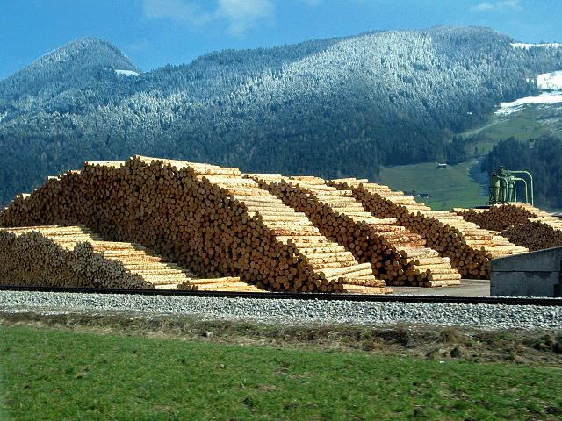

Yale-UNIDO Train-the-Facilitator Workshop in Green Chemistry
Renewable Feedstocks for molecules
CENTER for GREEN CHEMISTRY
and GREEN ENGINEERING at YALE
Image: Wikimedia Commons, Author: R. Möhler

Slide 2
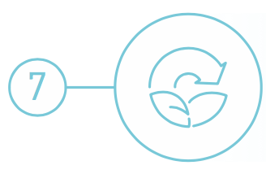
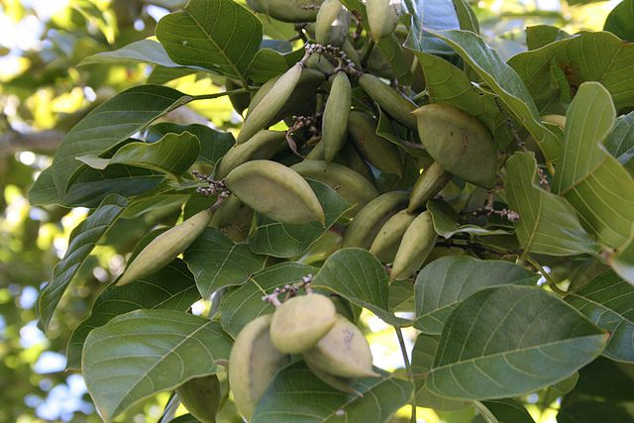
Use of Renewable Feedstocks
A raw material or feedstock should be renewable rather than depleting whenever technically and economically practical.
Image: Wikipedia, Pongamia Pinnata Seeds

Slide 3
Topics To Be Covered
What can we make from petroleum (focus on molecules)
The biorefinery
Renewable Feedstocks
  Triglycerides
  Lignocellulosic Feedstocks
  N containing polymers
  Latex polymer
  Small molecule feedstocks
Examples
  From lignin
  Vanillin
  Platform molecules
  Fatty acids
The Advantages and Drawbacks of bio-based molecules

Slide 4
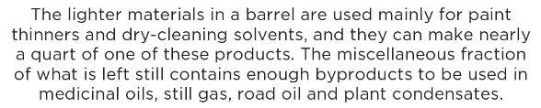
What can be made from one barrel of oil?
http://www.visualcapitalist.com/can-made-one-barrel-oil/

Slide 5
Notes:
Today, the list of petroleum based products is even longer.

Slide 6
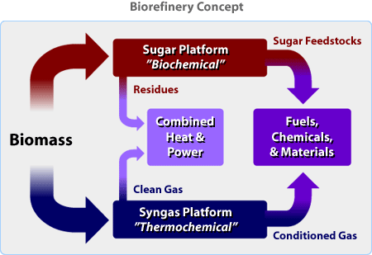
The biorefinery
What Is a Biorefinery?
A biorefinery is a facility that integrates biomass conversion processes and equipment to produce fuels, power, and chemicals from BIOMASS. The biorefinery concept is analogous to today's petroleum refineries, which produce multiple fuels and products from petroleum. Industrial biorefineries have been identified as the most promising route to the creation of a new domestic biobased industry.
http://www.nrel.gov/biomass/biorefinery.html

Slide 7
Renewable feedstocks
Renewable feedstocks include the following materials:
Biomass (algae, corn, switchgrass, poplar, willow, sorghum, and bamboo)
Agricultural waste (ex. manure)
Urban waste (garbage, sewage)
CO₂
Source: Adobe Stock

Slide 8
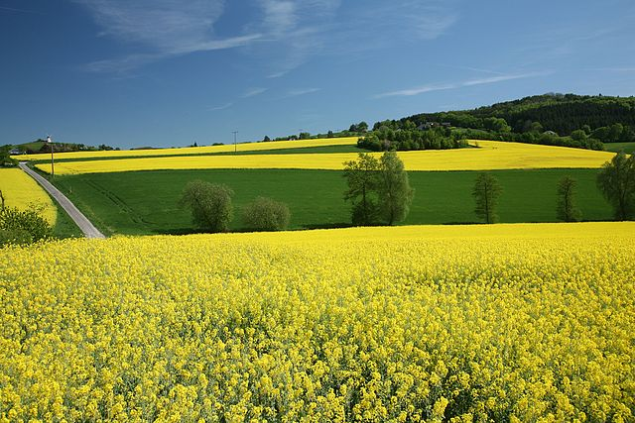
Biological feedstocks
Organisms have provided a huge share of the materials used by humans throughout their existence.
Biomass: Plant material generated by photosynthesis
• Biomass is the leading candidate to replace petroleum as a feedstock for the organic chemicals industry.
• Partially oxidized biomass material avoids expensive, and sometimes difficult oxidation steps in oxidizing petroleum
Image: Wikimedia Commons, Author: Daniel Schwen

Slide 9
Lignocellulolic feedstock
Only about 4% utilized by humans
(food, ethanol, sweeteners)
Building blocks for a diverse chemical platform.
Nature’s richest source of aromatic carbon. Used in polymers, adhesives, production of phenolic chemicals.
Converted into polymers, lubricants, and detergents.

Slide 10
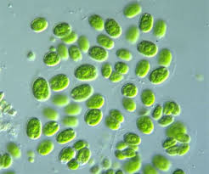
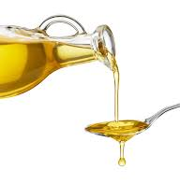
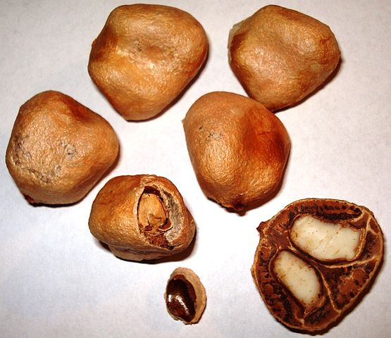
Triglicerides
Lipid oils can be extracted from the seeds of some plants.
• Volatile solvent n-hexane, C₆H₁₄, is used to extract the oils.
• Solvents are distilled off from the extract and recirculated through the process.
Oils (25% of biomass usage): first renewable raw material used towards the chemical industry
-> surfactants, cosmetic products, and lubricants as major products
Images: Creative commons
Image: Wikimedia Commons, Marula - Sclerocarya birrea – Seeds, Author: Genet

Slide 11
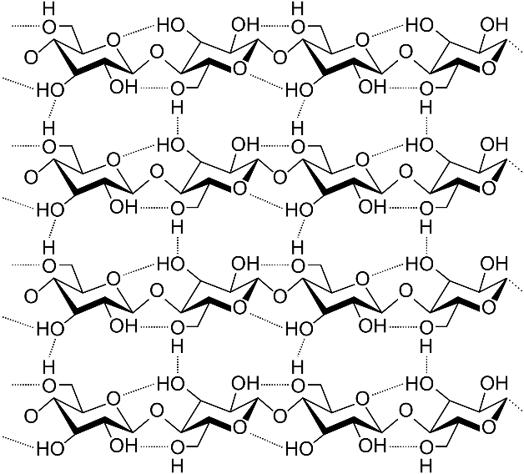
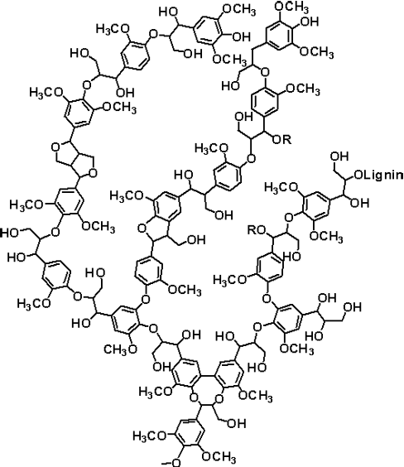

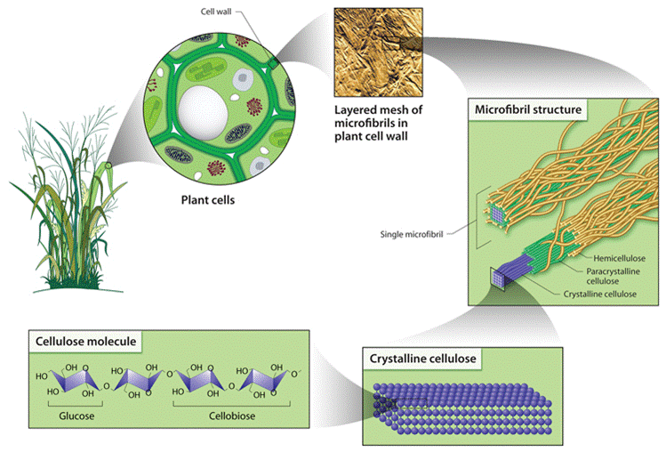
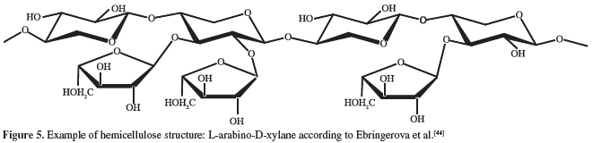
Lignocellulolic feedstock
Cellulose
Lignin
Hemicellulose
Nature has evolved plant cell wall structure to prevent easy degradation by chemical attack… hence the challenge
Images: Creative commons

Slide 12
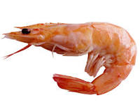
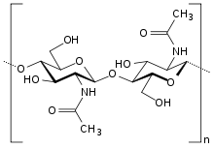
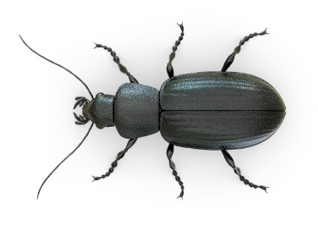
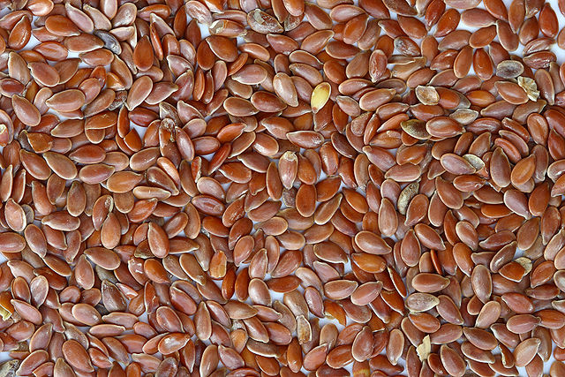
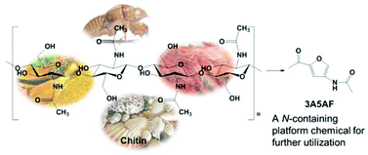
N containing polymers
Proteins
Chitin
Grain seeds can be used as sources of protein.
• Grain seeds are generally used for food.
• They are potentially useful as chemical feedstocks for specialty applications.
• Transgenic plants can be used to make specialty proteins, such as medicinal agents.
Can give access to glucosamine
Meier, M. A.; Metzger, J. O.; Schubert, U. S., Chem Soc Rev 2007, 36 (11), 1788-1802
G.W. Huber, S. Iborra, A. Corma, Chem. Rev., 2006, 106, 4044−4098
X. Chen, S. L. Chew, F.M. Kerton, N. Yan, Green Chem., 2014, 16, 2204-2212
Image: Wikimedia Commons, Brown Flax Seeds, Author: Sanjay Acharya

Slide 13
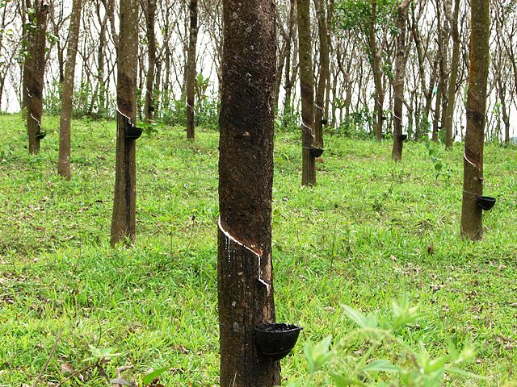
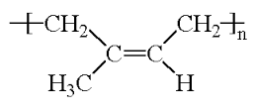
Latex rubber
Latex rubber can be collected from rubber tree sap (Hevea tree)
Latex rubber
Image: Wikimedia Commons, Rubber trees in Kerala, India, Author: M.arunprasad

Slide 14
Small Molecules Feedstocks
Small molecules arbohydrates can be used as feedstocks for chemical processes
Carbohydrates are created in several forms:
• Sucrose sugar, C₁₂H₂₂O₁₁, is squeezed from sugar cane as sap and is extracted from sugar beets and sugar cane with water.
• Starch, a polymer of glucose readily isolated from grains (such as corn) and from potatoes, and is readily broken down by adding water to produce glucose.
• Huge amounts of cellulose, which occur in the woody parts of plants, can be broken down to glucose with cellulase enzymes.

Slide 15
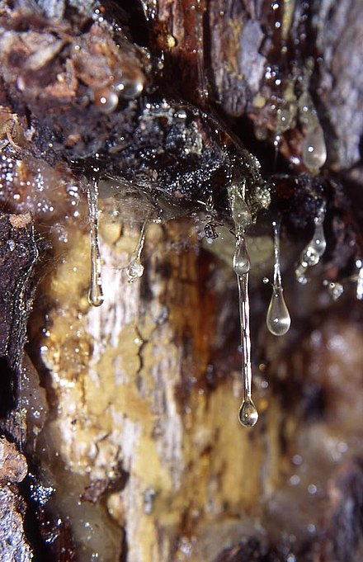
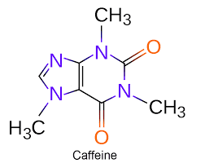
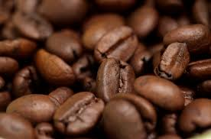
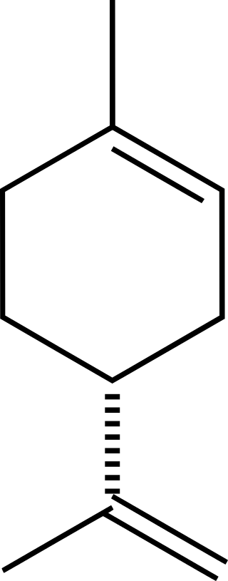
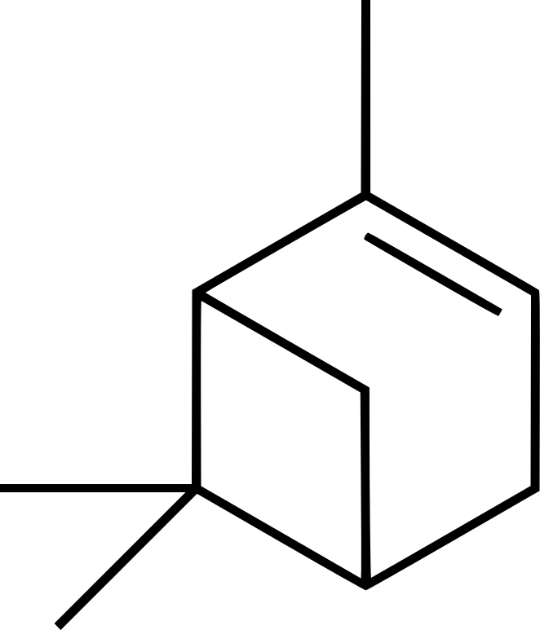
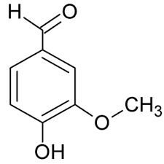
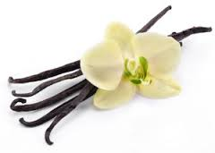
Small molecules feedstocks
sugars, oligosaccharides, peptides, oligopeptides, alcohols, amines
Steam treatment and distillation are used to extract such molecules => major challenge
Some terpenes
limonene
Α-pinene
Vanillin
conifer resins = source of terpenes
Meier, M. A.; Metzger, J. O.; Schubert, U. S., Chem Soc Rev 2007, 36 (11), 1788-1802
G.W. Huber, S. Iborra, A. Corma, Chem. Rev., 2006, 106, 4044−4098 – Wikipedia: terpenes

Slide 16
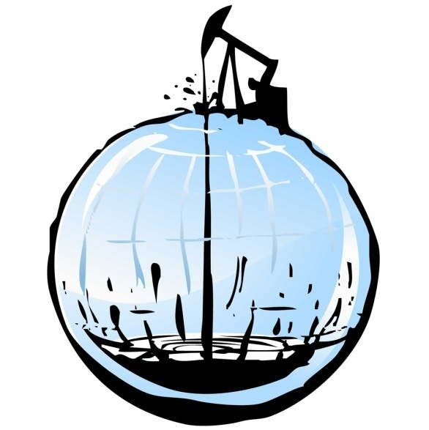
Fossil vs biomass: the process
Biomass needs to be reduced to used as fuel.. Or as molecules
Dehydration
Reduction
Redox rearrangements (-CO₂)
Images: Creative commons
Notes:
16

Slide 17
What can be made from renewable feedstocks?
Defense and aerospace
Adhesives
Coatings
Corrosion, inhibitors
Automotive
Solvents
Polymers
Fuels
Household cleaners
Surfactants
Fragrances
Dyes
Electronics
Solder
Housings
Displays
Agriculture
Pesticides
Fungicides
Fertilizers
Cosmetics
Builders
Chelating agents
Dyes
Specialty Chemicals
Pharmaceuticals
Used in Academic Research Labs

Slide 18
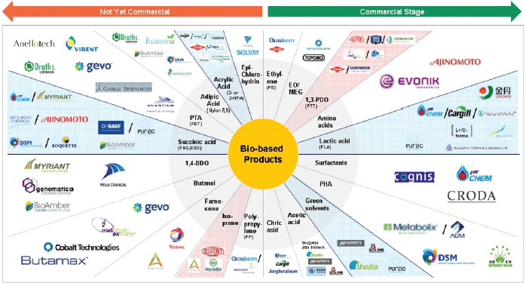
Companies that make bio-based products
Image: National Research Council. 2015. Industrialization of Biology: A Roadmap to Accelerate the Advanced Manufacturing of Chemicals. Washington, DC: The National Academies Press. https://doi.org/10.17226/19001.

Slide 19
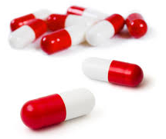
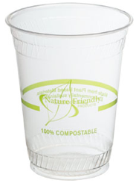

How are biological feedstocks processed?
?
Conventional chemistry
Microorganisms
(aerobic, anaerobic)
Enzymes
Fermentation
Images: Creative commons

Slide 20
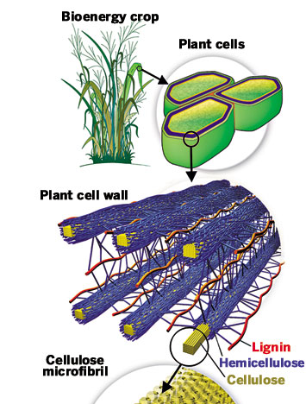
Example: Enzymatic lignocellulose breakdown
Lignocellulose is a complex polymer obtained from plant cell walls. It has many aromatic subunits.
Images: Creative commons

Slide 21
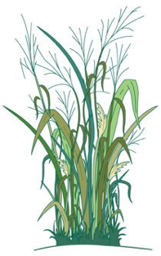

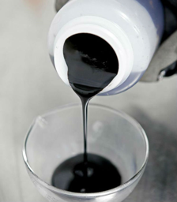
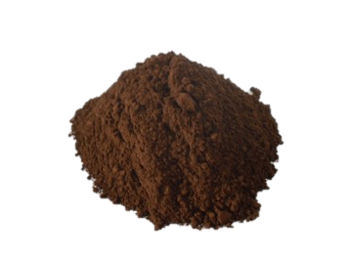
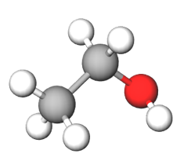
Main Industries for Lignocellulose
Retains applied nitrogen longer in the plants’ root zone, optimizing crop utilization and yield, and reducing nutrient run-off.
Retains applied nitrogen longer in the plants’ root zone, optimizing crop utilization and yield, and reducing nutrient run-off.
PAPER INDUSTRY
BIOETHANOL INDUSTRY
Lignin powder
Bioethanol
Burnt or Discarded
Images: Creative commons

Slide 22
Lignin: A Source of Renewable ‘Drop-in’ Platform Chemicals
A Need of New Technology:
Economical
Sustainable
Selective
Efficient
phenol
The lignin structure includes aromatic (ring) structures.
If it is broken down selectively, it can be a source of drop-in platform chemicals such as phenol.

Slide 23
A Depolymerization Strategy for the Valorization of Lignin
With the addition of hydrogen and a selective catalyst, lignin can be broken down into phenols.
Lignin
Phenols

Slide 24

The story of vanillin
Vanilla has been extracted and used, for instance for making chocolate drinks by the Aztecs
Vanillin can be found in many plants. The highest natural concentrations, 1–3% and sometimes higher, are found in the properly cured pods of the “vanilla bean”
M. B. Hocking, J. Chem. Ed., 1997, 1055-59

Slide 25
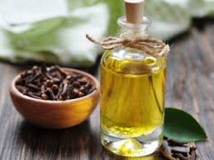
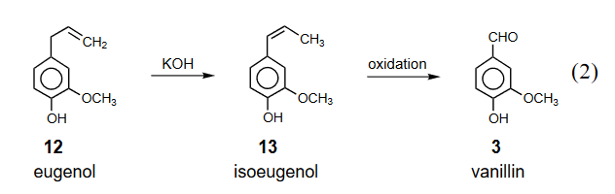
The story of vanillin
In 1874–75, synthetic vanillin could be prepared from eugenol (clove oil), it was competitive with naturally extracted vanillin and became the main source of vanillin until the 1920s
The next phase was to produce it from lignin
Clove oil (eugenol)
M. B. Hocking, J. Chem. Ed., 1997, 1055-59

Slide 26
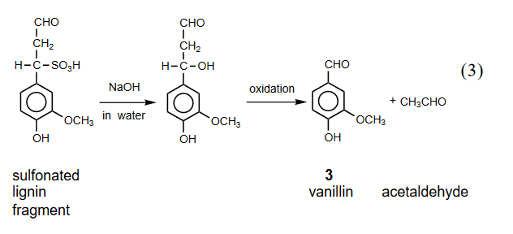
The story of vanillin
The conversion of lignin (waste pulping process) to vanillin was first suggested at the end of the XIXth century
Some of the research was done at McGill (1930s) with G.H. Tomlinson. Yields up to 10% with O₂ and 3-% with nitrobenzene where obtained
Tomlinson, G. H., II; Hibbert, H. J. Am. Chem. Soc. 1936, 58, 345–348.

Slide 27
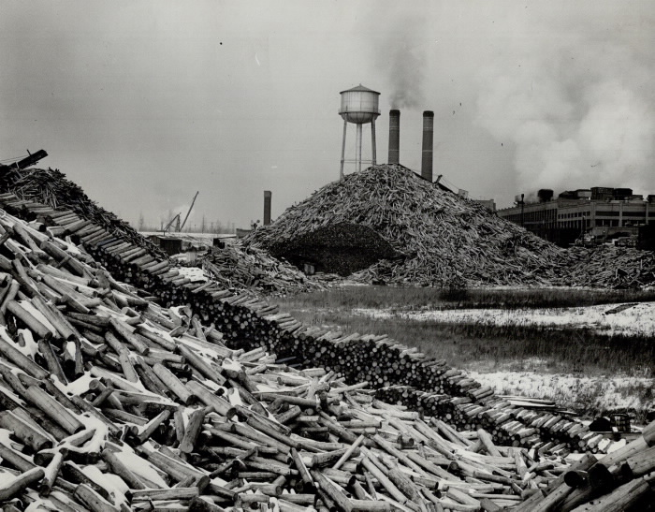
The story of vanillin
Paper mill, Thorold, ON
The vanillin production of Ontario Pulp and Paper became such a valuable component of their operations that the scale was gradually expanded to 3.4 million kilograms per year by 1981, sufficient to supply 60% of the then current world market. This also began to subtly affect the pulping component of their business”
M. B. Hocking, J. Chem. Ed., 1997, 1055-59

Slide 28
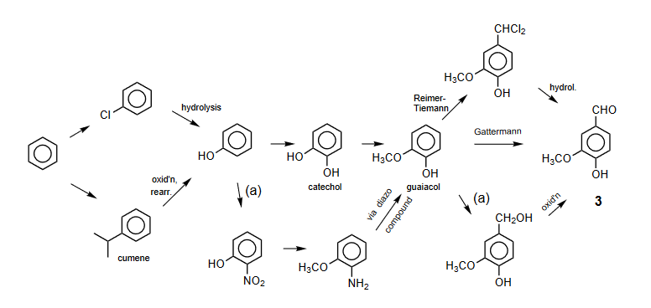
The story of vanillin
Since the 1970 it become more competitive and more environmentally friendly to produce vanillin from petro chemicals. Via guaiacol. This is a process developed by Rhodia.
M. B. Hocking, J. Chem. Ed., 1997, 1055-59

Slide 29
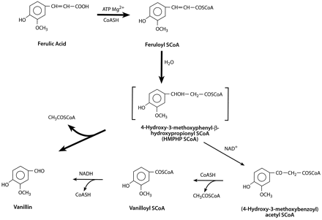
The story of vanillin
From 2000, Rhodia developed a biosynthesis of vanillin. With yeast, ferulic acid extracted from rice bran can be turned into vanillin. It’s not competitive with petro based vanillin, but it can be labeled “natural Vanillin”
Source: Wikipedia: Vanillin
M.J. Gasson, Y. Kitamura, W. R. McLauchlan et al., J. Biol. Chem., 1998, 273, 4163-4170.

Slide 30
Example: Penicillin production using fermentation
Penicillin antibiotics were among the first medications to be effective against many bacterial infections caused by staphylococci and streptococci. They are still widely used today, though many types of bacteria have developed resistance due to the extensive use.
The secondary metabolite of a fungus - Penicillium chrysogenum - grows using a carbon source of glucose and lactose.
Once the fungus reaches a stationary phase, it starts producing the antibiotic.
Images: Creative commons

Slide 31
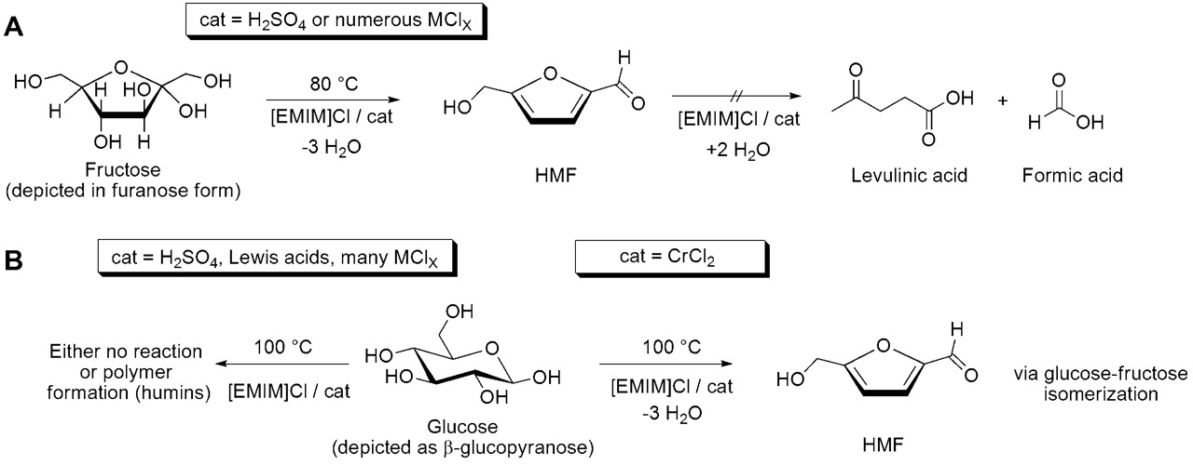
The platform strategy
The idea is to depolymerize cellulose (or ideally lignocellulose) and form a molecule that could further be derived in many more. E.g : 5-hydroxymethylfurfural (HMF)
H. B. Zhao, J. E. Holladay, H. Brown and Z. C. Zhang, Science, 2007, 316, 1597–1600

Slide 32
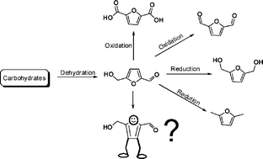
The platform strategy
5-hydroxymethylfurfural (HMF) as a building block
FDA: replacement monomer for terephthalic acid
polyurethane foams
biofuel and fuel additive
A. A. Rosatella, S.P. Simeonov, R. F. M. Fradea, C.A.M. Alfonso Green Chemistry 13.4 (2011): 754-793.

Slide 33
The Top 10 Chemical Targets
(platform chemicals from bio-feedstocks)

Slide 34
CHEM 462: 24.Chemicals from renewable feedstock
Fatty acid as feedstock
Fatty acids are obtained from triglycerides extracted from vegetable or algea oil
  100 million tonnes of oils and fats are produced annually, 25% from soya
  14% of it is used for chemicals manufacture
  The rest is used for food and for making biodiesel
  25% of all the biomass used for molecules is from fatty acids
  Problems associated with the usage of vegetable oil:
    Mix of several acids in the oil
    Low concentration of a given acid
    =>genetic engineering was used:
      E.g. rapeseed can have an erucic acid concentration varying from 0- 50%
      E.g. rapeseed can have a lauric acid concentration varying from 0- 37%
      E.g. sunflower oil can contain up to 92% of oleic acid
Green Chemistry: An Introductory Text, M. Lancaster, RSC Publishing, Cambridge, 2012

Slide 35
Fatty acid as feedstock
Use of fatty acids: surfactant
  3 Mt/a of surfactants produced in Europe only (mostly for household detergents)
  About a 1/6 of it comes from renewable material
Synthetic surfactant

Slide 36
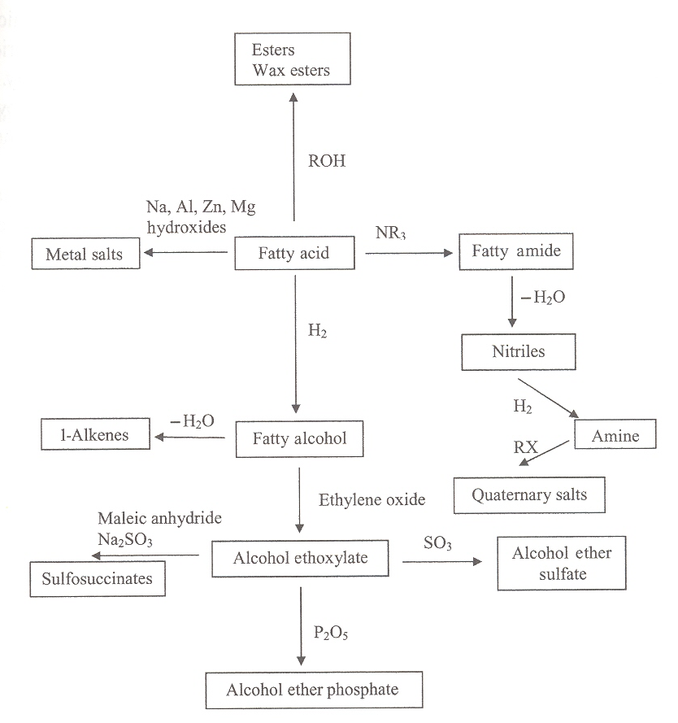
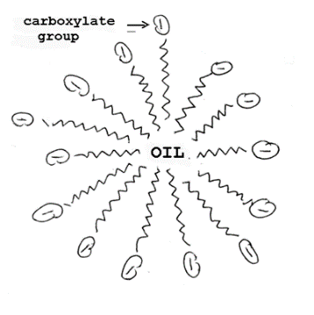
Fatty acid as feedstock
Major use of fatty acids: as surfactants
  soap
Ionic surfactants
Green Chemistry: An Introductory Text, M. Lancaster, RSC Publishing, Cambridge, 2012

Slide 37
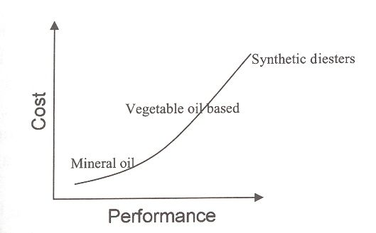
Fatty acid as feedstock
Use of fatty acids: lubricant
  Lubricant represents 2% of the non-food, non-fuel use of fatty acids
    Fatty acids have a higher viscosity
    Their properties are more stable with temperature
    Lower evaporation loss
    Lower toxicity
    Better biodegradability
  Vegetable oils can also be used
    Rape seed
    Canola
    Soyabean
    They all contains mixture of esters of fatty acids (16:0, 18:0, 18:1, 18:2, 18:3, 22:1)
Green Chemistry: An Introductory Text, M. Lancaster, RSC Publishing, Cambridge, 2012

Slide 38
Fatty acid as feedstock
Further chemical transformation via oxidation
  Doing this with recyclable catalyst selectively is the big challenge

Slide 39
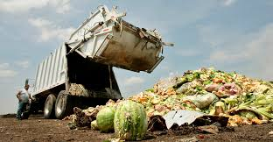
Fatty acid as feedstock
These are great examples, but some compete with food.
Idea: using waste from the food industry?
Idea: using urban waste
Images: Creative commons

Slide 40
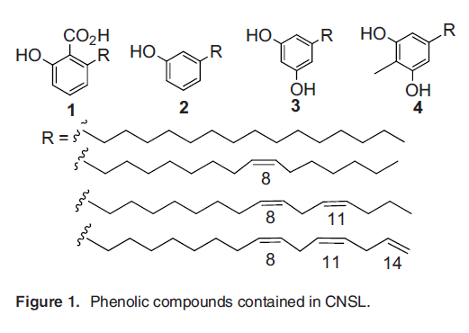
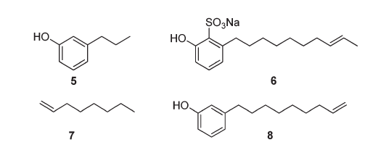

Recent development: biomass waste
CHEM 462: 24.Chemicals from renewable feedstock
From cashew nut shell waste: David Cole Hamilton
  byproduct of the cashew nut processing industry available at about 300 000 tonnes/year worldwide
  5: tsetse fly pheromone 6: detergent
  7: plasticizer 8: precursor to chemicals
the top five producers being
- Vietnam (1.1 million tons)
Nigeria (0.95 million tons)
India (0.75 million tons)
Cote d’Ivoire (0.45 million tons%)
Brazil (0.11 million tons)
David Cole-Hamilton (St Andrews, UK) Eur. J. Lipid Sci. Technol. 2012, 114, 1183 Mubofu, Egid B. Pure App. Chem. 88.1-2 (2016): 17-27
Notes:
40

Slide 41

Avoiding competing with food: biomass waste
CHEM 462: 24.Chemicals from renewable feedstock
Orange peels: James Clark (York, UK)
  Global agriculture produces about 15.6 million tons of orange and other citrus waste annually in the form of discarded peels
    biofuels
    bio-based solvents
    Fragrances
    water purifiers
low temperature microwaves
+ cellulose
http://cleantechnica.com/2012/07/07/opec-uses-orange-peel-for-biofuel-and-other-biobased-products/
Notes:
41

Slide 42
Why use renewable feedstocks?
Economic reasons:
  The inherent long-term tendency for petroleum price increases.
  A fluctuation of a few cents in the price of crude oil can result in massive price swings for downstream products.
  The constant decrease in cost of renewable resources.
Scientific reasons:
  The constant improvement in quality of renewable feedstocks.
  Modern plant breeding.
  Genetic manipulation.
  Breakthroughs in catalysis (enzymes, etc.).
Environmental reasons:
  Biological compatibility (to an extent).
  The use of waste streams (wood pulping, agriculture, etc.).
  Mitigate CO₂ emissions

Slide 43
Some Potential Challenges of Using Renewable Feedstocks
Feedstock cultivation
  Competition with food supply
  Land demand
  Nutritional needs
  Diseases
  Initial investment
Harvesting method to maximise yields and minimise degradation of product
Post harvest processing
Product extraction and purification
Product standardization
Complexity
Product storage, packing, and distribution
New methodologies for alternative feedstocks

Slide 44
Sponsored by Yale-UNIDO Initiative
QUESTIONS?
CENTER for GREEN CHEMISTRY
and GREEN ENGINEERING at YALE

