Slide 1
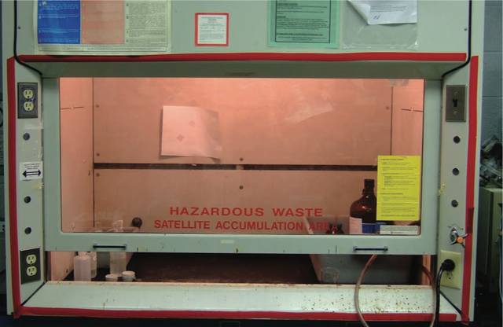

Yale-UNIDO Train-the-Facilitator Workshop in Green Chemistry
Designing for Reduced Hazard
CENTER for GREEN CHEMISTRY
and GREEN ENGINEERING at YALE
Image: Wikimedia Commons, Fume Hood , Author: U.S. National Institute for Occupational Safety and Health
Notes:
Problems: 17/18, 36

Slide 2
Topics To Be Covered
Toxicology
Assessing Hazards and Exposure
  What Happens When You’re Exposed?
Hazard Minimization Through Molecular Design
QSAR - Quantitative Structure Activity Relationship
Molecular Design Research Network (MoDRN)

Slide 3
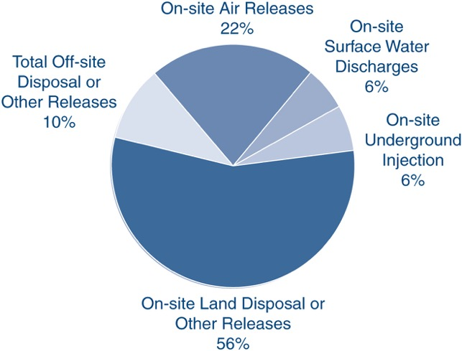
Chemicals in the Environment
In U.S., 1.78 million tons of toxic chemicals were released directly to air, water, and land in 2011
Only 650 of toxic chemicals out of 100,000 in commerce are tracked by Toxic Release Inventory
Mihelcic, J. R.; Zimmerman, J. B., Environmental engineering: Fundamentals, sustainability, design. Wiley Global Education: 2014.

Slide 4
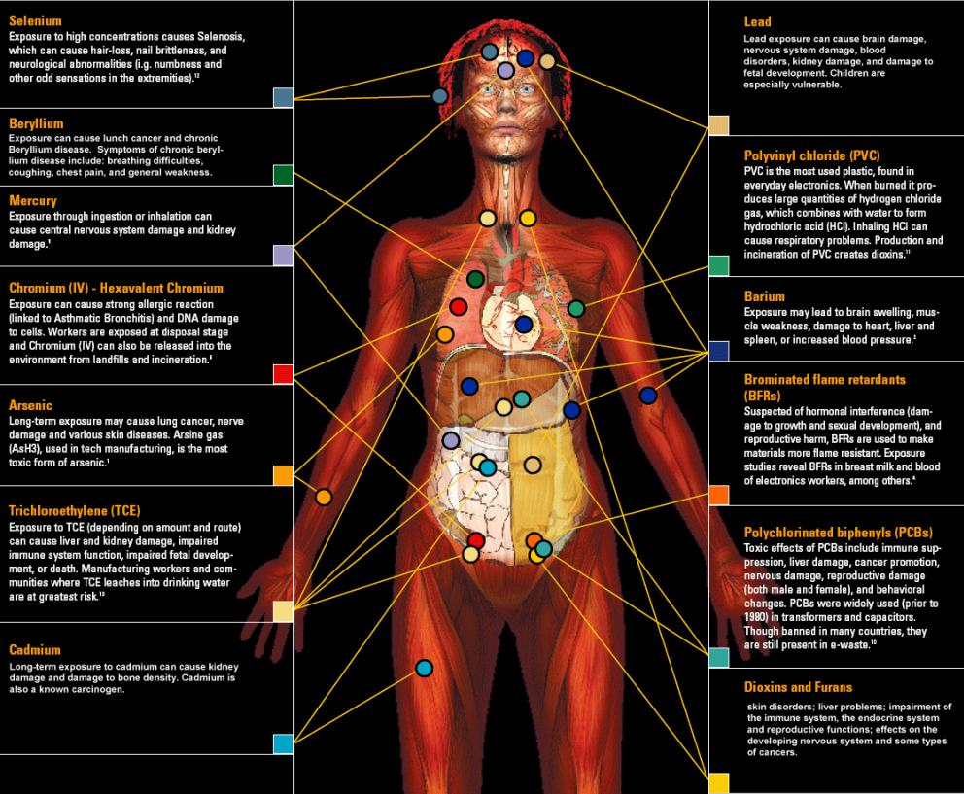
Body Burden
148 xenobiotics in the body
Xenobiotic: synthetic chemical, that is foreign to the body or to an ecological system.
Of the chemicals found:
  76 cause cancer in humans or animals,
  94 are toxic to the brain and nervous system, and
  79 cause birth defects or abnormal development.
The dangers of exposure to these chemicals in combination has never been studied.
One of Green Chemistry’s greatest strengths is the ability to design for reduced hazard.
Image Source: http://svtc.org/our-work/e-waste/

Slide 5
What is Toxicology
The traditional definition of toxicology is "the science of poisons."
A more descriptive definition of toxicology is
"the study of the adverse effects of chemicals or physical agents on living organisms".

Slide 6
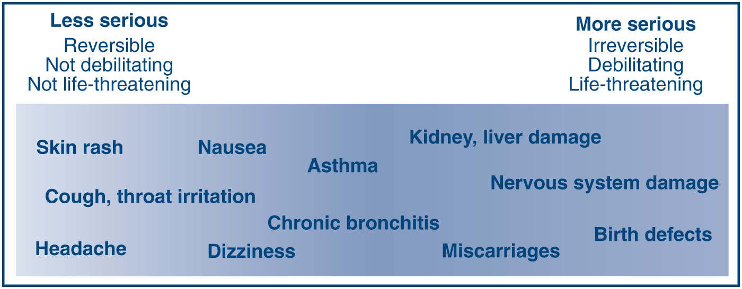
What Counts as Toxic
Mihelcic, J. R.; Zimmerman, J. B., Environmental engineering: Fundamentals, sustainability, design. Wiley Global Education: 2014.
Notes:
Debilitating – making something weak

Slide 7
Relating Toxic Endpoints to Molecular Features & Properties
Acute toxicity | Carcinogenicity | Bioconcentration
Subchronic & chronic toxicity | Neurotoxicity | Degradation & transport
Reproductive toxicity | Immunotoxicity | Aquatic toxicity
Developmental toxicity | Genotoxicity | Terrestrial organism toxicity
Relationships
Molecular weight | Molecular volume | Dipole moment
Hydrophilic surface area | Hydrophobic surface area | Rotatable bonds
Hydrogen bonds | Ionization potential | Electron affinity
Partition coefficients | Acid/base properties | Polarizability

Slide 8
Definitions
A toxic agent is anything that can produce an adverse biological effect.
It may be chemical, physical, or biological in form.
For example, toxic agents may be
chemical (such as cyanide),
physical (such as radiation), and
biological (such as snake venom)

Slide 9
Definitions
Compound | Kow | logKow
methanol | 0.18 | -0.74
benzene | 148 | 2.17
toluene | 537 | 2.73
decachloro-biphenyl | 182,000 | 8.26
[solute]_{octanol}
1-octanol
P = K_{ow} =
[solute]_{water}
water
methanol
-0.74
1-butanol
0.8
1-hexanol
2.0
1-decanol
4.6
C₆Cl₆
5.5
(C₆Cl₅)₂O
8.3
HCO₂H
-0.5
THF
0.5
NEt₃
1.45
toluene
2.73
hexane
4.0
octane
5.2
decane
6.3
stearic acid
8.2
-1
0
1
2
3
4
5
6
7
8
9
logK_{ow}
hydrophilic
hydrophobic
lipophobic
lipophilic

Slide 10
What is the most important factor in bringing about the adverse biological impact?

Slide 11
Dose
Dose is the amount of a substance administered at given times.
For example:
  650 mg Paracetamol/Tylenol as a single dose
  500 mg Penicillin every 8 hours for 10 days

Slide 12
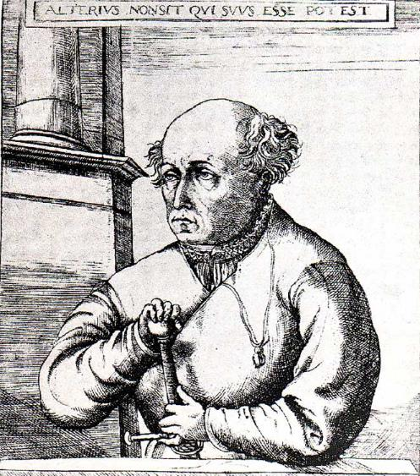
Dose Makes the Poison
An apparently nontoxic chemical can be toxic at high doses. (Too much of a good thing can be bad)
Highly toxic chemicals can be life saving when given in appropriate doses.
All things are poison, and nothing is without poison, the dosage alone makes it so a thing is not a poison.
Paracelsus 1494-1541

Slide 13
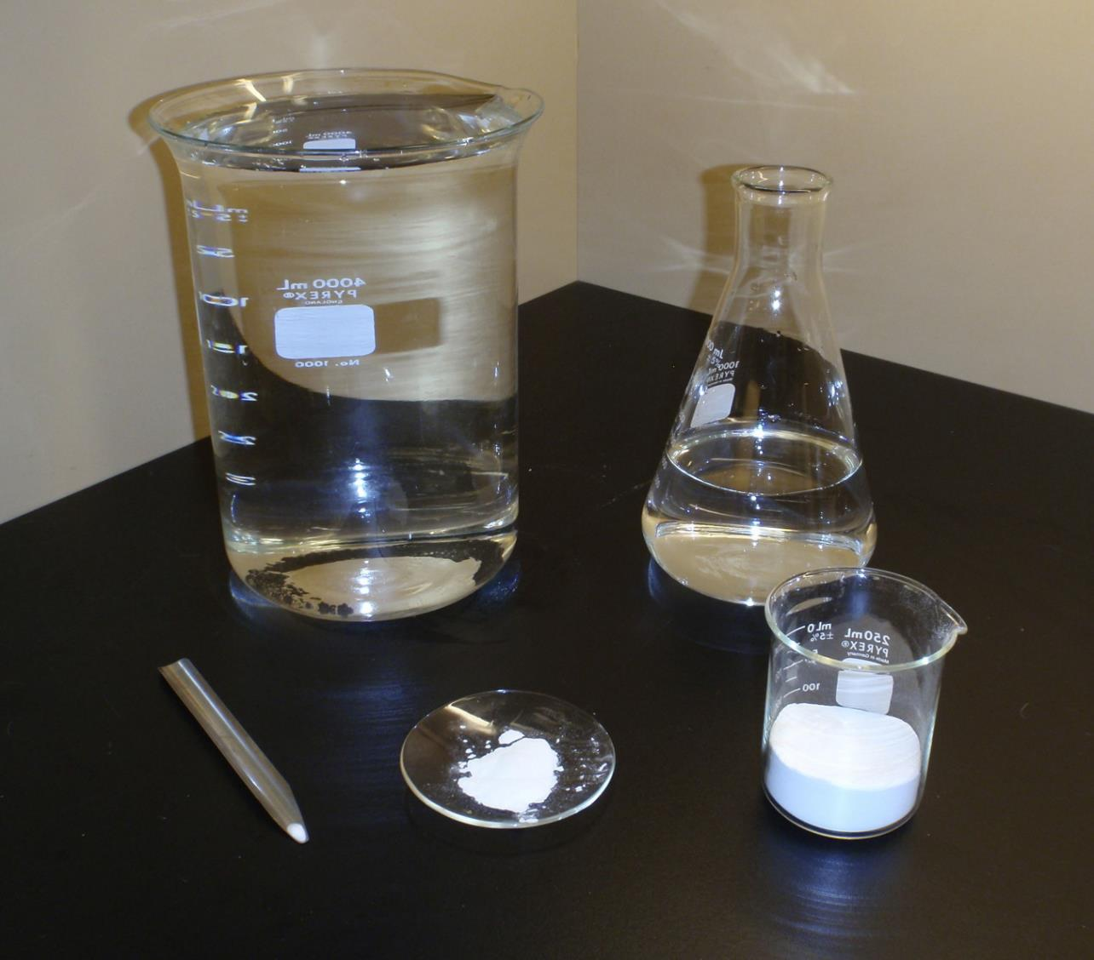
Lethal Doses
ethanol
water
caffeine
HgCl₂
NaCN
Notes:
1 Quart = 0.946 lit

Slide 14
Lethal Doses
Approximate Lethal Doses of Common Chemicals
(Calculated for a 160 lb. human from data on rats)
Chemical Lethal Dose
Sugar (sucrose) 900 g
Alcohol (ethyl alcohol) 1.5 L
Salt (sodium chloride) 250 g
Herbicide (2, 4-D) 125 mL
Arsenic (arsenic acid) 1-2 teaspoons
Nicotine one half teaspoon
Food poison (botulism) microscopic
Source: Marczewski, A.E., and Kamrin, M. Toxicology for the citizen, Retrieved August 17, 2000: www.iet.msu.edu/toxconcepts/toxconcepts.htm.
Notes:
1 Quart = 0.946 lit

Slide 15
How is toxicity testing done?

Slide 16
Dose-Response
The dose-response relationship is a fundamental and essential concept in toxicology. It correlates exposures and the spectrum of induced effects.
The dose-response relationship is based on observed data from:
experimental animal
Human in vitro cell studies
human clinical (but for drugs only…)
Notes:
In vitro comes from the Latin term "in glass." The term refers to studies of biological properties that are done in a test tube (i.e. in a glass vessel) rather than in a human or animal.In vitro studies are often contrasted to in vivo ("in life") studies which are done inside an organism.

Slide 17
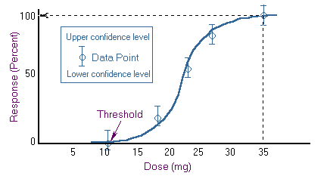
Dose-Response
Knowledge of the dose-response relationship:
  establishes causality that the chemical has in fact induced the observed effects
  establishes the lowest dose where an induced effect occurs - the threshold effect
  determines the rate at which injury builds up - the slope for the dose response.
log(dose)

Slide 18
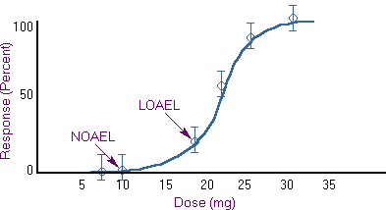
LD₅₀, NOAEL, LOAEL, and RfD
LD₅₀- A common dose estimate for acute toxicity is the LD₅₀ (Lethal Dose Response 50%).
This is a statistically derived dose at which 50% of the individuals will be expected to die.
NOAEL - No Observed Adverse Effect Level
Highest data point at which there was no adverse effect.
LOAEL - Low Observed Adverse Effect Level
Lowest data point in your experiment at which there was an adverse effect.
LD 50
RfD
log(dose)
UF = Uncertainty factor (10-1000)
UF is bigger when larger uncertainty on experiment
RfD – estimate of the maximum daily oral exposure to humans, that’s likely to be without risk of an effect
Notes:
RfD = reference dose

Slide 19
In-Class Discussion- Which Solvent Would You Use?
Solvent 99-2
100
90
Solvent 99-7
80
70
60
% Mortality
50
40
30
20
10
0
0 50 100 150 200 250 300 350
Inhaled Dose (ppm)
Plotted here are two theoretical curves for the toxicity of solvents used in the cleaning of silicon compounds. Both solvent 99-2 and 99-7 performed equally well against a variety of manufactured silicon compounds. The task at hand for you is to determine which solvent would you pick to be “safer” for use. As you can see from the accompanying data both compounds have an equivalent Lethal dose 50 value (LD50). These are based on average values during a 6 hour exposure period.

Slide 20
In-Class Discussion- Which Solvent Would You Use?
Solvent 99-2
100
90
Solvent 99-7
80
70
60
% Mortality
50
40
30
20
10
0
0 50 100 150 200 250 300 350
Inhaled Dose (ppm)
Solvent 99-7 causes lethality at much lower levels than 99-2 (20ppm versus 150 ppm respectively), and the response is much more predictable (i.e. less population heterogeneity). In case of Solvent 99-2, higher levels can be inhaled before any harmful effects should begin.

Slide 21
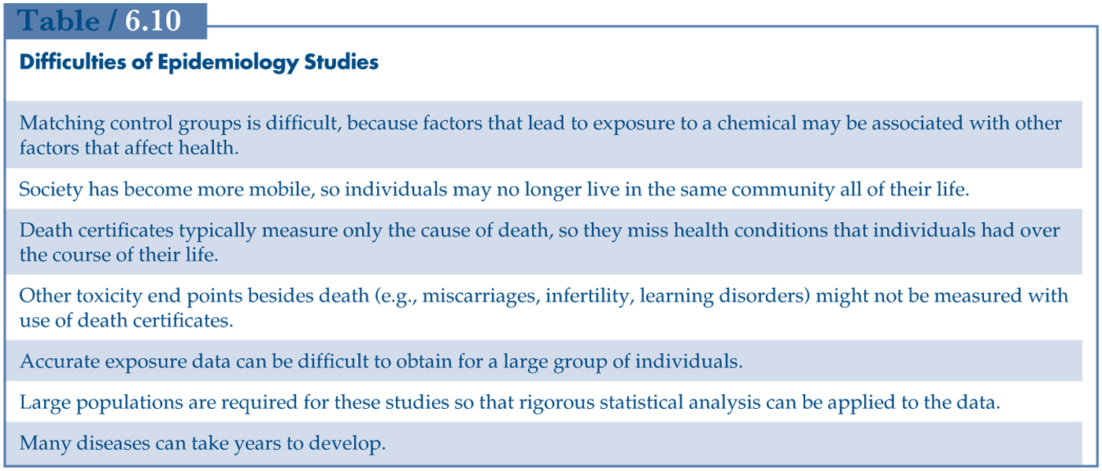
Hazard Assessment
Risk = f(Hazard, Exposure)
Review and analysis of toxicology data and assessing if the substance causes toxic effects
Sources include animal and human studies and computational data
These studies have difficulty with showing causation (if a risk factor lead to disease)
Mihelcic, J. R.; Zimmerman, J. B., Environmental engineering: Fundamentals, sustainability, design. Wiley Global Education: 2014.

Slide 22
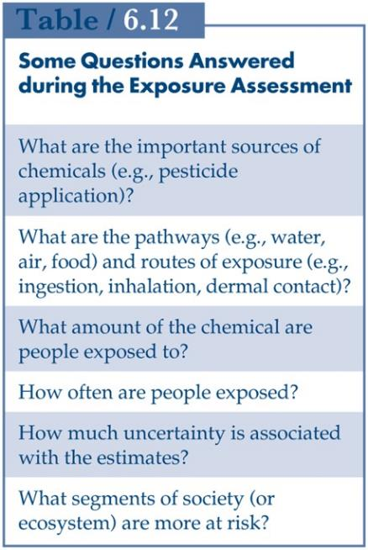
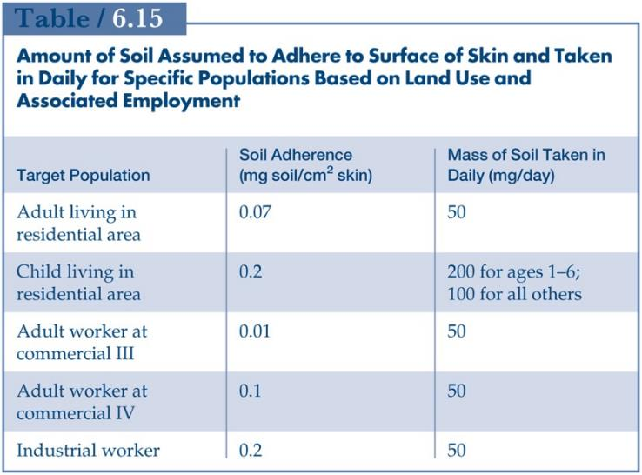

Exposure Assessment
Risk = f(Hazard, Exposure)
Determines the extent and frequency of human exposure to target chemicals.
Guidelines for residential, industrial and commercial sites
For engineers, the knowledge of hazard and exposure provides information whether the site needs to be remediated.
Example of exposure evaluation: workers touching soil
Mihelcic, J. R.; Zimmerman, J. B., Environmental engineering: Fundamentals, sustainability, design. Wiley Global Education: 2014.

Slide 23
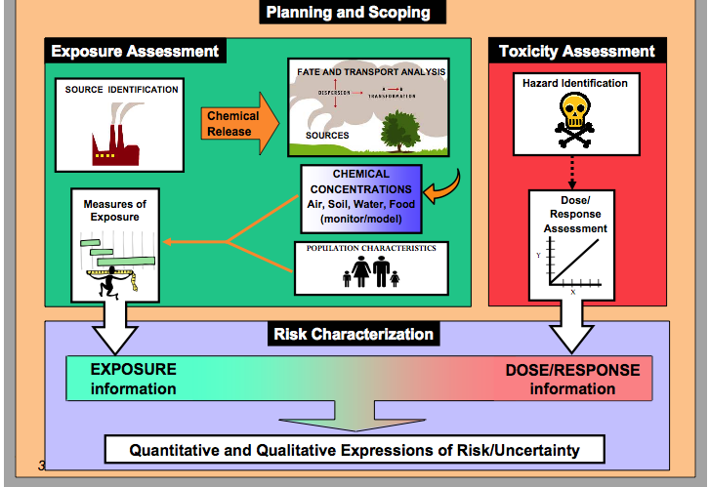
Hazard assessment, dose-response & exposure assessment
Risk Characterization

Slide 24
Tools For Hazard Characterization
ChemHAT - easy way to access summarized information on chemical hazards in the workplace
ChemSpider
Protox
Safer Choice - for consumers, businesses, and purchasers to find products that perform and are safer for human health and the environment.
toxicity assessment based on experimental or predicted LD₅₀
Notes:
Show tools

Slide 25
What happens once you are exposed to a toxicant?

Slide 26
ADME
ABSORBTION
DISTRIBUTION
METABOLISM
EXCRETION
http://blog.gyrosproteintechnologies.com/spinblog/adme-of-therapeutic-proteins

Slide 27
Chemical Processes in ADME
Place where the drug (or chemical) can take effect
Source: Wang and Skolnik, Chemistry and Biodiversity, 2009
Notes:
More complex
ADME can be controlled by these parameters

Slide 28
Absorption
Dermal
Respiratory
Digestive
Skin is the first barrier to absorption for the chemical. The skin can keep chemicals out of the body, or it can let them in, depending on the physical and chemical properties of the chemical. Absorption of a chemical will result in the chemical circulating inside the body and perhaps causing adverse effects.
As chemicals are inhaled, they may reach the lungs. The lung surface is a poor barrier against the entry of many chemicals into the body, which means that absorption of chemicals into the lung can be rapid and efficient.
If chemicals are swallowed, either intentionally or unintentionally, they enter the gastrointestinal tract (GI). From there, they may either pass through the body or be absorbed into the body.

Slide 29
Absorption
Dermal
Respiratory
Digestive
Parameter | Preferred | Not Preferred
Physical state | solid | liquid
LogP | Less than 0 or greater than 5 | Between 0 and 5
Molecular weight | More than 400 Da | Less than 400 Da
Parameter | Preferred | Not Preferred
Particle size | More than 5 nm | Less than 5 nm
LogP | Less than 0 or greater than 5 | Between 0 and 5
Molecular weight | More than 400 Da | Less than 400 Da
Vapor pressure [mmHg] | Less than 0.001 | More than 0.001
Parameter | Preferred | Not Preferred
Particle size | More than 100 nm | Less than 100 nm
LogP | Less than 0 or greater than 5 | Between 0 and 5
Phase | solid | liquid
Molecular Weight [Da] | More than 500 Da | Less than 400 Da
LogP – measure of partition coefficient of a molecule between aqueous and lipophilic phases.
Notes:
LogP – measure of partition coefficient of a molecule between aqueous and lipophilic phases.
Da – Dalton, unit of molar mass, g/mol

Slide 30
Distribution
Distribution is the movement of a chemical throughout the bloodstream and into other organs, such as the brain and the bones. Pharmaceuticals such as antibiotics and painkillers are designed to have high distribution rates so they can reach their target organs and have therapeutic effects. For chemicals such as detergents, distribution should be limited.
Distribution depends on many factors such as log P, polar surface area, acidic/basic properties, and molecular weight.
Distribution as opposed to absorption is more difficult to control.
Courtesy of Molecular Design Research Network and Dr. Karolina Mellor
Notes:
Polar Surface Area of a molecule is defined as the surface sum over all polar atoms, primarily oxygen and nitrogen, also including their attached hydrogen atoms. PSA is a commonly used medicinal chemistry metric for the optimization of a drug's ability to permeate cells.

Slide 31
Metabolism
As a chemical is distributed through the body, it will most likely undergo metabolism. Metabolism is the body’s way to transform the molecules into metabolites in the liver. This facilitates their excretion (removal) through the kidneys. The rate at which a chemical is metabolized is usually dependent on its accessibility to enzymes.
Metabolism is unpredictable. Metabolism can lead to detoxification or toxification of the organism.
Courtesy of Molecular Design Research Network and Dr. Karolina Mellor

Slide 32
Elimination
After the chemical is absorbed, the body can eliminate it by a process called excretion which can occur through the kidneys, the skin, the GI tract, and the lungs. If the chemical is not eliminated from the body, it can accumulate, or stay in the blood, which can lead to disease. Bioaccumulation is favored for lipophilic molecules in fatty tissues.
Excretion as opposed to absorption is more difficult to control.
Courtesy of Molecular Design Research Network and Dr. Karolina Mellor

Slide 33
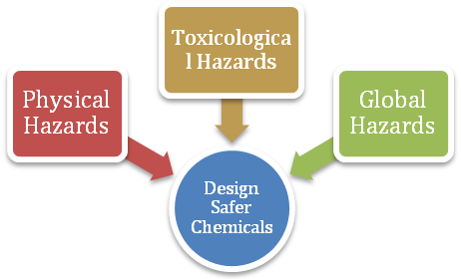
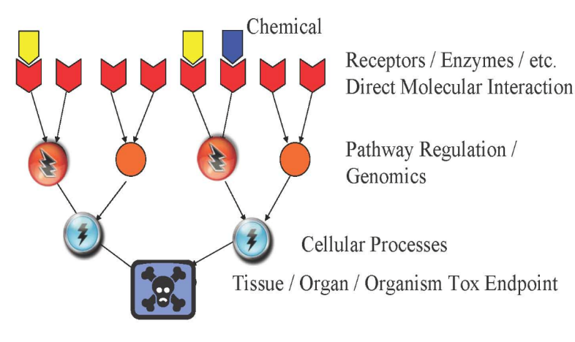
Understanding Physicochemical Properties Associated with Reduced Hazard
DESIGN
Chemical and Physical Properties
pKa chain branching log P molecular refractivity mol. wt. hydrolyzable groups
E_{HOMO} E_{LUMO} electronegativity hardness dipole log D_{7.4} # H-bond accept/donor
Flammability
Radioactivity
Risk of Explosion
Chemical Reactivity
Pollution
Persistence
Depletion of resources

Slide 34
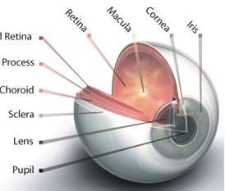
Property-Based Guidelines for Bioavailability
Acidic substance
Chemical
Basic substance
pKa<7
pKa>7
Absorption organs
GI tract
Skin
Lungs
Eyes
Unionized at pH>pKa
Lipid soluble
Un-ionized at pH>pKa
Absorbed across intestine membrane into blood
Notes:
Different absorption mechanisms - GI tract has largest SA, respiratory has largest blood flow & thinnest membrane, skin has variable thickness; different requirements for water sol

Slide 35
Property-Based Guidelines for Bioavailability
molecular size < 500 Da
log P_{ow} 0 - 5
Non-ionization at GI pH
Absorption organs
GI tract
Skin
Lungs
Eyes
water solubility
molecular size
vapor pressure < 0.001 mmHg
molecular size < 400 Da
log P_{ow} 0 - 6
presence of solvents
Ionization (polar, ionized)
Particle size < 5um
molecular size < 400 Da
vapor pressure < 0.001 mmHg
Voutchkova, A.; Osimitz, T.; Anastas, T. Chem. Rev. 2010, 110, 5845

Slide 36
Safer Chemical Design Game
Educational game based on ADME and scientific data for surfactants to make connection between physico-chemical properties and health.
http://gwiz.yale.edu
Courtesy of Molecular Design Research Network and Dr. Karolina Mellor

Slide 37
Approaches to Hazard Minimization through Molecular Design

Slide 38
Green Chemistry Molecular Design Pyramid
Toxicodynamics
Not well understood and relatively complex
Receptor
binding
Key events
Bioaccumulation/
Persistence
Bioavailability Structure/Shape Activity Mechanism of Action
Shape/
Molar Volume
Reactive
Functional
Groups
That’s what we want to target
Solubility
Electronic
Charge
Chemists can control quite well
Molecular
Weight
Volatility
Particle
size
Toxicokinetics

Slide 39
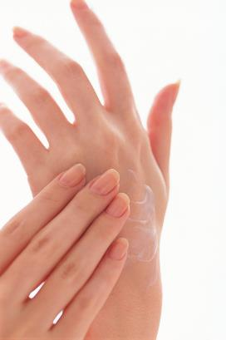
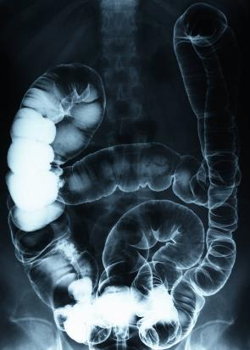
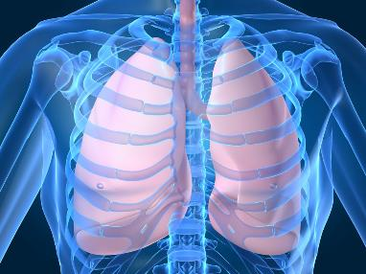
Hazard Minimization Through Molecular Design
High MW compounds can’t be absorbed through membranes (skin, lung, intestine, etc.).
Strategy #1. Use high MW compounds.

Slide 40

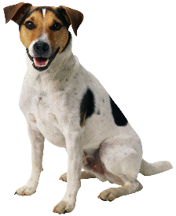
Hazard Minimization Through Molecular Design
Alcohol | Solubility in water | Toxicity
Methanol | miscible | Low
Pentanol | 22 g/L | Medium
Camphor | 1.2 g/L | High
1-Hexadecanol | 1x10⁻⁵ g/L | None
Cros, Thesis “Action of Amyl Alcohol on Organisms”, U of Strasbourg, 1863
Strategy #2. Make the compound very water-soluble or very water-insoluble.
Notes:
Cros tested dogs, pigeons, rabbits, by oral, inhalation, dermal and intravenous. Found that aquatic toxicity doesn’t correlate to water solubility. Toxicity increases with DECREASING solubility until there is no solubility and then the compound isn’t toxic anymore. Making the alcohol chain longer therefore increases toxicity up to a point. Why is there a cutoff? If the solubility is TOO low, then not enough of the compound dissolves to have any effect.
Because plants are less sensitive than animals, they require exposure to a higher concentration to cause narcosis.
Therefore a chemical may be too insoluble to affect plants but may still affect animals.
Some chemicals may be so insoluble that they affect neither.
How to do this?

Slide 41
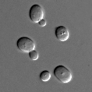
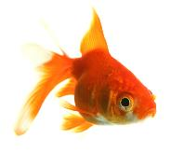

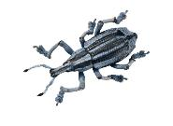

Hazard Minimization Through Molecular Design
C = concentration required to observe an adverse effect (higher C means less toxic)
1/C = toxicity
log(1/C) = a•logP - b
Lazarev, Neelektrolity, Voennomorskaya Medicinskaya Akademiya, 1944
log(1/MLD) = 1.065•logP – 0.425
log(1/MLD) = 0.881•logP – 0.989
log(1/LD₁₀₀) = 1.06•logP – 1.368
log(1/LD₅₀) = 0.618•logP – 2.863
log(1/C) = 0.681•logP – 3.04
Yeast cells
Goldfish
Cat
Grain weevil
Tomato plant
Hansch and Dunn, J. Pharm. Sci. 1972, 61, 1-19
Notes:
If the toxicity of a compound is caused solely by narcosis, then the toxicity is related to the logP.
Higher logP means more toxic, but there is a cutoff. E.g. equations given. MLD = median lethal dose

Slide 42
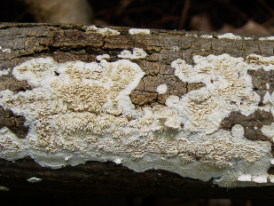
Hazard Minimization Through Molecular Design
More toxic
Irpex lacteus
http://www.herbarium.iastate.edu/fungi/fungispecies.php?sp=Irpex+lacteus+(Fr.)+Fr
Strategy #3.
Design the compound to have a low logP.
Less toxic
hydrophilic
hydrophobic
Hansch and Dunn, J. Pharm. Sci. 1972, 61, 1-19
Notes:
C is the minimum toxic dose for madison 517 fungus (irpex lacteus)

Slide 43
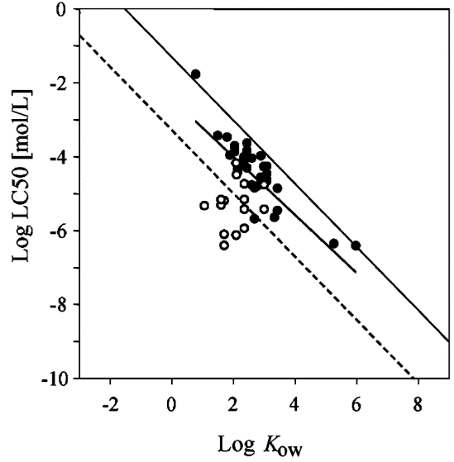
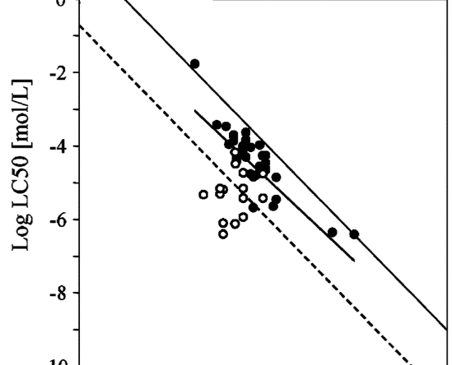
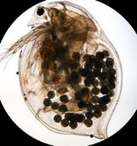
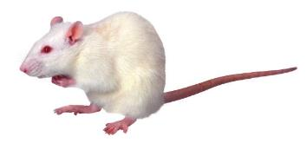
Hazard Minimization Through Molecular Design
10
C_{pred}
excess toxicity = T_{e} =
8
C_{obs}
6
Log (1/LC₅₀)
4
2
T_{e} = 1066
0
Could be:
• increased acute toxicity (lower LD₅₀ or LC₅₀)
• increased chronic toxicity (not evident in LD₅₀ or LC₅₀)
von der Ohe, Chem. Res. Toxicol. (2005) 18, 536.
Strategy #4. Avoid functional groups that cause specific effects (i.e. toxicophores).
Notes:
The prediction of toxicity by QSAR equations using logP is fine for giving a baseline (narcosis) toxicity, and is usually right if the compound exhibits no specific effects, meaning it doesn’t have a functional group that reacts with a specific enzyme for example.
Tpred = concentration predicted to cause toxic response by using the logP calculation.
Tobs = the (lower) concentration that actually causes toxic response
For example, the Te of divinylsulfone for rat oral LD50 is 1066. It’s 1066 times more toxic than one would expect by narcosis alone. Why? It does a Michael addition.
The graph shows LC50 for daphnia magna for compounds that are known to cause only narcosis (filled circles) and for anilines (hollow circles). Clearly some of the anilines show excess toxicity.
Keep in mind that it’s the Cobs that is important. The observed toxicity. Excess toxicity isn’t as important, but it does help us to design safer chemicals. In o
Daphnia picture from Wikipedia.

Slide 44
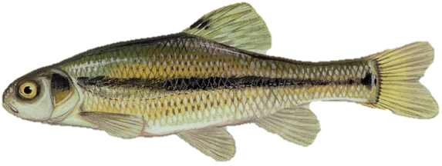
Hazard Minimization Through Molecular Design
Strategy #4a. Avoid ketones and aldehydes that are prone to imine formation.
C₆F₅CHO
T_{e} = 51
CH₃CHO
T_{e} = 131
Which has more excess toxicity?
or
Lipnick, Sci. Total Environ. (1991) 109/110, 131.
Notes:
If the toxicity of a compound is caused solely by narcosis, then the toxicity is related to the logP.
Higher logP means more toxic, but there is a cutoff. E.g. equations given. MLD = median lethal dose

Slide 45
Hazard Minimization Through Molecular Design
T_{e} = 35
T_{e} = >490
T_{e} = >490
T_{e} = 1884
S_{N}1
S_{N}2
Strategy #4b. Avoid allylic/propargylic/benzylic halides.
Factors that promote this reaction:
• electron-withdrawing groups or atoms (S_{N}2)
• resonance stabilization of carbocation (S_{N}1)
• good leaving group I, Br > Cl >> F
Lipnick, Sci. Total Environ. (1991) 109/110, 131.
Notes:
If the toxicity of a compound is caused solely by narcosis, then the toxicity is related to the logP.
Higher logP means more toxic, but there is a cutoff. E.g. equations given. MLD = median lethal dose

Slide 46
Hazard Minimization Through Molecular Design
Michael addition
T_{e} = >81,000
T_{e} = 180
T_{e} = 68
T_{e} = >3,800
Strategy #4c. Avoid Michael acceptors.
Which is safer?
or
logP = 0.98
0.99
Lipnick, Sci. Total Environ. (1991) 109/110, 131.
Notes:
If the toxicity of a compound is caused solely by narcosis, then the toxicity is related to the logP.
Higher logP means more toxic, but there is a cutoff. E.g. equations given. MLD = median lethal dose

Slide 47
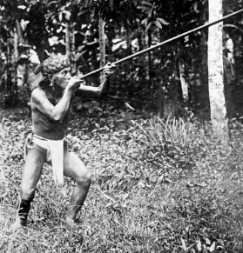
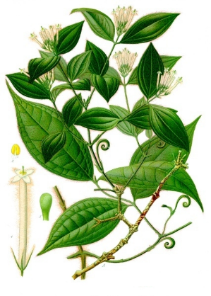
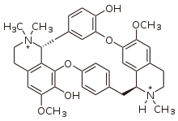

Hazard Minimization Through Molecular Design
Strategy #4d. Avoid acetylcholine mimics (cationic centres with 2 or more small R groups).
Strychnos toxifera
where at least two R = small
Note: such structures don’t have a lower oral LD₅₀. Why?
tubocurare
oral mouse LD₅₀ – 150 mg/kg
intravenous mouse LD₅₀ – 0.13 mg/kg
acetylcholine
Notes:
Some cationic electrophiles cause neurotoxicity. e.g. NR4+, if 2 or more R’s are small, will cause neuromuscular blocking (curare effect) by binding in the nicotinic acetylcholine receptor. That receptor is the signal recipient in muscles that causes the muscles to contract when the signal (acetylcholine) is received. Prevents muscles from contracting. Tubocurarine from tropical hanging vines is used in arrow poisons and in surgery.(vol 9, p 78 of Handbook of GC).
Note that this doesn’t affect ingestion toxicity because cationic compounds don’t generally pass through the stomach walls. Only dangerous in the bloodstream.

Slide 48
Hazard Minimization Through Molecular Design
estradiol
a nonylphenol
bisphenol A
Strategy #5. Avoid functional groups that mimic hormone structures.
Notes:
Some cationic electrophiles cause neurotoxicity. e.g. NR4+, if 2 or more R’s are small, will cause neuromuscular blocking (curare effect) by binding in the nicotinic acetylcholine receptor. That receptor is the signal recipient in muscles that causes the muscles to contract when the signal (acetylcholine) is received. Prevents muscles from contracting. Tubocurarine from tropical hanging vines is used in arrow poisons and in surgery.(vol 9, p 78 of Handbook of GC).
Note that this doesn’t affect ingestion toxicity because cationic compounds don’t generally pass through the stomach walls. Only dangerous in the bloodstream.

Slide 49
Hazard Minimization Through Molecular Design
More strategies for minimizing hazard
Elimination of the molecular initiating event that activates pathway
Changing reactive functional groups
Reducing or eliminating bioavailability
Reduction of need for associated hazardous substances
Design for End-of-Use product life

Slide 50
Elimination of the molecular initiating event that activates pathway
Where the mechanistic pathway of action is known, molecular structures can be designed such that the necessary reactions are either impossible or highly disfavored resulting in significant toxicity reduction.

Slide 51
B. Changing Reactive Functional Groups
In the absence of specific mechanistic information, chemists can modify structure such that certain reactive functional groups, e.g. cyano, electrophilic, etc, can be minimized or eliminated from the chemical structure where feasible.

Slide 52
C. Reducing or Eliminating Bioavailability
In order for a chemical to manifest its intrinsic hazard, it must be able to reach the toxicological target, human, animal, environmental or global. Through structural molecular design, properties such as solubility, log Kow, and volatility can adjusted to reduce hazard manifestation.
Notes:
The octanol/water partition coefficient (Kow) is defined as the ratio of a chemical's concentration in the octanol phase to its concentration in the aqueous phase of a two-phase octanol/water system

Slide 53
D. Avoid Associated Hazardous Substances
Many chemical substances, if not hazardous themselves, require the use of other hazardous substances e.g. paints with VOCs, surfaces requiring specific cleaners, plastics with various additives.
Through molecular design, these associated substances can be eliminated by making the desired properties integral to the product

Slide 54
E. Design for End-of-Useful Product Life
Persistence of chemical in the environment is a problem that can be designed out of molecular structure.
By creating products that degrade to innocuous by-products under designed conditions, e.g., heat, light, time one can reduce or eliminate this hazard.

Slide 55
By Changing the Molecular Charge: Cephalosporins
Cephalosporins: Antibiotic molecules used for gram+ bacteria
Clinical nephrotoxicity was recognized early – damage to proximal tubular epithelia.
Mechanism: the drug is rapidly transported across basolateral membrane via the organic anion transporter, OAT1. Transport out of cell into lumen is less well characterized (involves other OAT, OAT4).
Cephalosporin has a very low affinity for OAT4 due to its zwitterionic character, resulting in considerable intracellular accumulation
In contrast, cephalothin, an anionic analog of the original zwitterionic drug, rapidly moves across the epithelia from blood into urine
Is thus not a neurotoxin
Cephaloridine
Cephalothin
Notes:
Cephalosporins are a type of beta-lacatam antibiotic.
First generation:Cephaloridine
Nephrotoxicity - kidneys

Slide 56
By Manipulating Sterics: Paraquat and Diquat
Diquats and Paraquats are herbicides (plant killer), primarily for weed and grass control
Paraquat
Diquat
Both: Toxic doses are life threatening. Impacts GI tract, kidney lungs, liver, heart, other organs
Paraquat is not metabolized by the liver. It has life-threatening effects on the gastrointestinal tract, kidney, liver, heart and other organs
In animal studies, diquat causes mild, reversible injury
Registered as a restricted use pesticide
Not registered as a restricted use pesticide
http://npic.orst.edu/RMPP/rmpp_ch12.pdf
Notes:
Paraquat is a non-selective contact herbicide of the diphenyl class. It was introduced in the 1960s and became used worldwide. However it was soon recognized that paraquat also cause selective pulmonary toxicity to humans (damage to alveolar cells type I and II, causing edema, inflammation and hermorrhage, lung fibrosis).
Steric effects are nonbonding interactions that influence the shape and reactivity of ions and molecules. Steric effects complement electronic effects, which usually dictate shape and reactivity. Steric effects result from repulsive forces between overlapping electron clouds.

Slide 57
By Manipulating Electrophilicity: Acrylates
Acrylate is understood to be carcinogenic because it can readily undergo Michael addition reactions
The addition of a methyl group to form methacrylate decreases the electrophilicity of the β-carbon, and decreases tendency for Michael reactions.
Whereas acrylate causes cancer in experimental assays, methacrylate does not.
Acrylate
carcinogenic
Methacrylate
non-carcinogenic
Notes:
Electr

Slide 58
By Facilitating Detoxification: Benzene
Benzene is known to cause hematotoxicity and leukemia in humans
This is understood to be due to one of its metabolites, (E,E)-muconaldehyde.
Toluene is comparatively much less toxic, as the methyl group is oxidized more easily than the benzene ring to give benzoic acid
hematotoxicity,
leukemia
hepatic oxidation
less toxic
[detoxification]

Slide 59
By Isosteric Substitution: Carbon with Silicon
DDT
(Toxic to insects)
Si-DDT Analog
(Non-toxic to insects)
DDT is well known to be environmentally persistent.
DDT analog with Silicon above was synthesized.
While less persistent, the analog turned out to be non-toxic to insects.
This is due to the more readily oxidized (metabolized) Si-H bond compared to C-H and also the larger size of the molecule.

Slide 60
Designing New Molecules is Not a Trivial Task
Even if chemists design one chemical, it has to undergo tests

Slide 61
QSAR-Quantitative Structure Activity Relationship
QSAR = classification models used in the chemical and biological sciences and engineering
QSAR established relationship
Known data sets
"predictor" variables
QSAR
potency of the response variable
Structure, physico-chemical properties, chemical functionalities
Biological activity: toxicology and eco-toxicology
[like LC50 or oxidative stress]
QSAR predicted potency of the response variable
New molecules
"predictor" variables
QSAR
QSAR uses the learnt rules to predict biology
Wikipedia

Slide 62
Why use QSAR?
Not sufficient data on most chemicals
Not all chemicals can be tested
Allows rapid screening of candidate structures

Slide 63
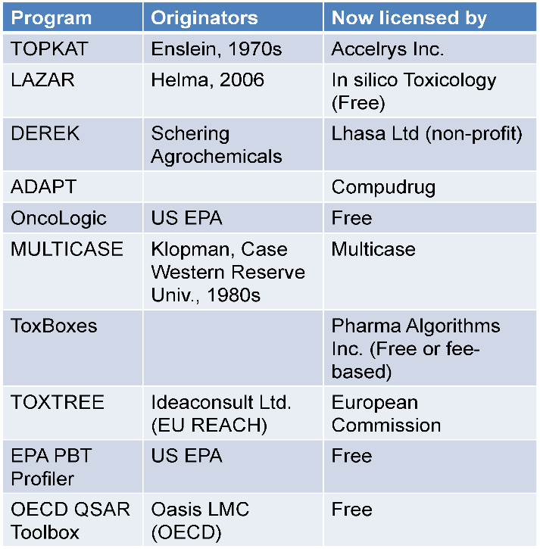
Examples of Popular Toxicity Prediction Tools
Current limitations
Prediction accuracy not higher than 65-70% for non-carcinogenic chemicals.
Lack of validation with up-to-date data.
Application to a narrow range of chemical structures.
Qualitative output.

Slide 64
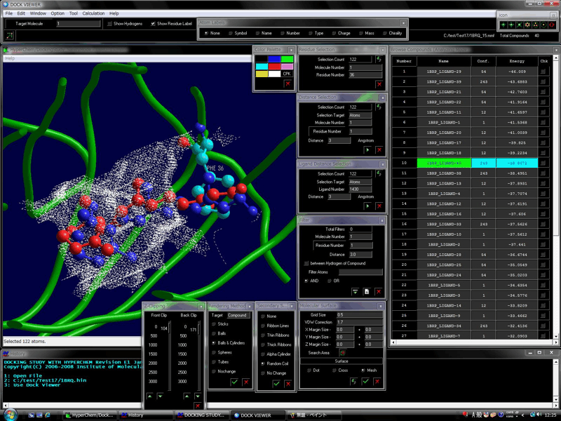
Next generation: powers of computational Chemistry
Docking software have been able to model very precisely the active site of a target enzyme (target to a drug for instance, or to a toxic).
In drug design such software are used to predict the best molecules for biological activity. Only the best performing are synthesized and tested.
Similar ideas can be used in toxicology
http://www.molfunction.com/software5.htm
Notes:
Jakub’s slide

Slide 65
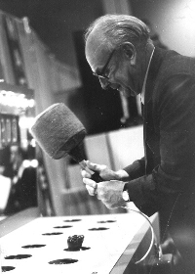
What’s the need?
Traditional organic solvents Low toxicity Volatile
Ionic liquids Nonvolatile Difficult to remove
Easy to remove Hazardous to skin
Not hazardous to skin Acutely toxic
Not acutely toxic Hydrolytically unstable

Slide 66
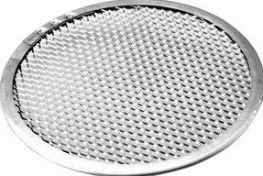
Virtual screening
all possible compounds
Performance
logK_{ow}
pK_{aH}
melting point
vapour pressure
solubility in water
compounds that will do the job
Safety, Health and Environment
flash point
vapour pressure
toxicity to mammals
toxicity to fish
toxicity to insects
eutrophication of surface waters
bioaccumulation potential
green compounds that will do the job

Slide 67

Virtual screening
Procedure (Virtual Screening)
Randomly generate thousands of structures
Predict properties (physical, chemical, health, environment) using QSAR
Reject those that don’t score well for performance criteria.
Consider only those that score well for EH&S criteria.

Slide 68
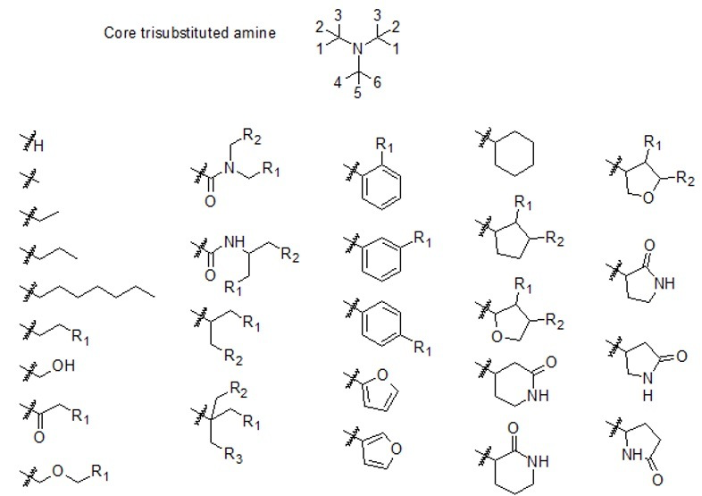
Virtual screening

Slide 69
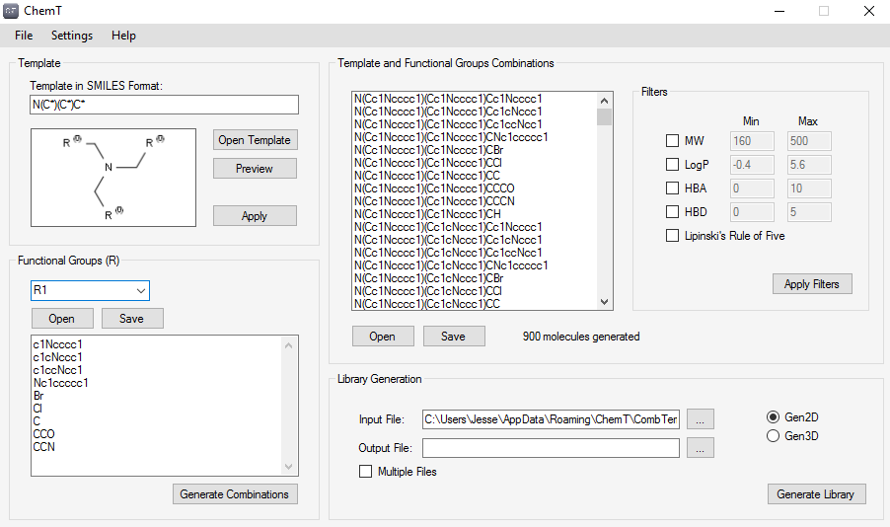
Virtual screening
ChemT (structure generator)

Slide 70
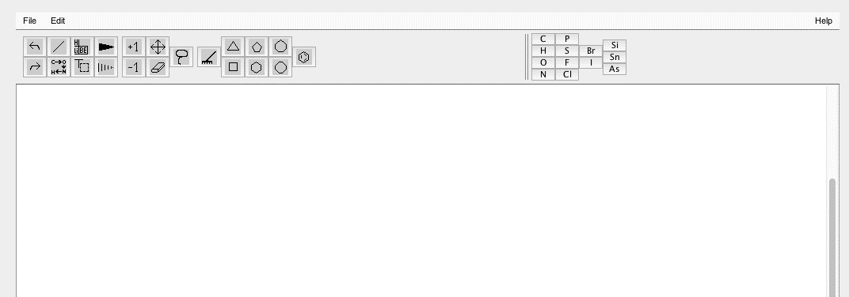
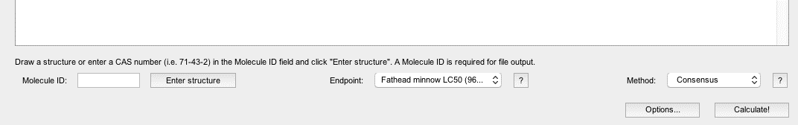
Virtual screening
2,3
Draw structure
”Copy SMILES to clipboard”
“Generate from SMILES on clipboard”
Choose endpoint
Choose “consensus”
Calculate
Find the generated data in a “ToxRuns” folder.
Open the file “Prediction Results Consensus.html”
1
5
4
6
TEST (Toxicity Estimation Software Tool)
https://www.epa.gov/chemical-research/toxicity-estimation-software-tool-test

Slide 71
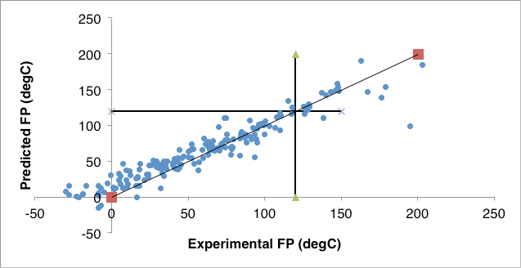
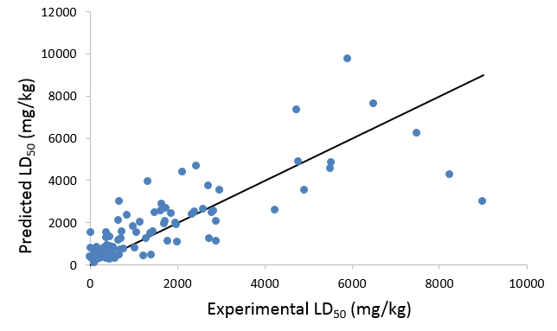
Virtual screening
false
positives
false
negatives
false
positives
false negatives

Slide 72
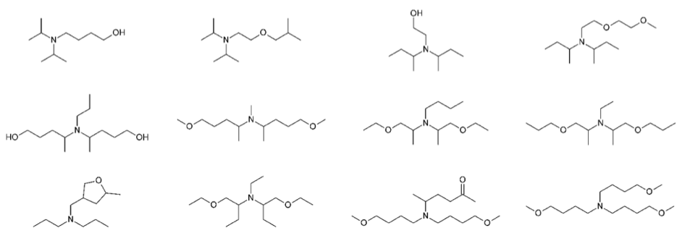
Virtual screening
Raw output (best 12 structures)

Slide 73
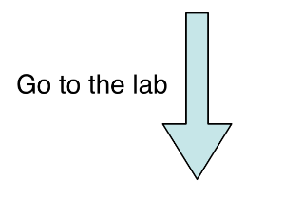
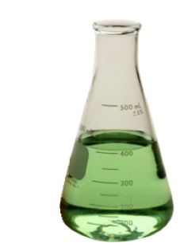
Virtual screening

Slide 74

Virtual screening
A company needs a basic tertiary amine for a product that would be used outdoors. They are worried about impact on aquatic life. Find the amine that would fit the company’s requirements while being the safest for daphnia magna.
Their requirements are:
• it must be a tertiary amine
• at least one R group on the nitrogen must be n-butyl
• the other two substituents on the N must consist of only C, H, O and/or N.
• the boiling point must be greater than 160 ˚C

Slide 75








Virtual screening: SMILES structures
• H’s are not usually shown. Normal number of H’s is assumed.
• Single bonds are not shown. Double bonds (=), triple bonds (#) and quadruple bonds ($) are shown.
• B,C,N,O,P,S,F,Cl,Br,I do not need square brackets if they are uncharged & achiral.
O
CCOCC
water
diethyl ether
C=CC#N
Cl
acrylonitrile
hydrogen chloride
• Use square brackets and show H’s if: chiral centre, charged, other element, or unusual # of H’s.
• Use a period to indicate no bond.
CCC[NH3+].[Cl-]
[Na+][Na+].[S-2]
propylammonium chloride
sodium sulfide
• Use numbers to indicate points of closure for rings (cut the rings to make a linear sequence)
• Use lower case letters to indicate atoms in aromatic rings (or use alternating double and single bonds).
BrC1CCCCC1
O1CCOCC1
c1ccncc1
C1CCCC2C1CCCC2
C1=CC=NC=C1
1
2
• Use parentheses to indicate branching.
O=C(C)C
O=C([H])[H]
CCC(=O)O
FC(F)(F)c(cc1)ccc1C#N

Slide 76
Topics Covered
Hazard and Risk – Past and Present
Toxicology
Assessing Hazards and Exposure
  What Happens When You’re Exposed?
Hazard Minimization Through Molecular Design
QSAR - Quantitative Structure Activity Relationship
Molecular Design Research Network (MoDRN)

Slide 77
Sponsored by Yale-UNIDO Initiative
QUESTIONS?
CENTER for GREEN CHEMISTRY
and GREEN ENGINEERING at YALE

