Slide 1
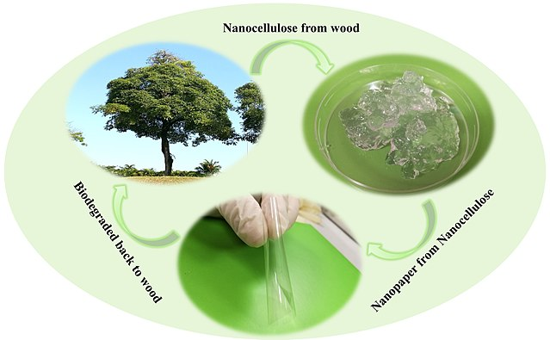

Yale-UNIDO Train-the-Facilitator Workshop in Green Chemistry
Green Chemistry, principles and metrics
CENTER for GREEN CHEMISTRY
and GREEN ENGINEERING at YALE
Image: Wikipedia, Biodegradation of nanocellulose, Author: Shaohui Li, Pooi See Lee

Slide 2
Topics To Be Covered
1. What is Green Chemistry?
2. The 12 Principles of Green Chemistry?
3. Designing chemicals products via Green Chemistry
4. Green Chemistry and the Market
5. Examples of the 12 principles
•

Slide 3
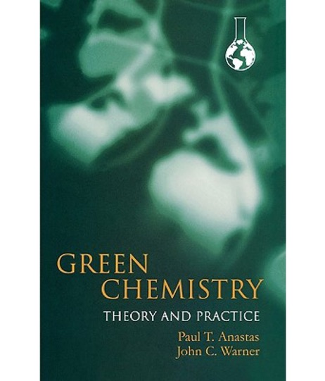



What is Green Chemistry?
Key reference: Anastas & Warner: “Green Chemistry: Theory & Practice” (1998, 2000)
impact factor: 8.6
impact factor: 30
Paul Anastas
(EPA)
John Warner (Polaroid Corp.)
Endavour started in 1990s…
Today embraced by researchers and industries around the world, including respectable chemical societies: Green Chemistry (1998)
Green chemistry is the design of chemical products and processes to reduce or eliminate the generation and use of hazardous substances.
Hazardous: to human health and to the environment
Notes:
Definition of the green chemistry: Green chemistry is the design of chemical products and processes that reduce or eliminate the use and generation of hazardous substances.
. The field was developed 25 years ago by Anastas and Warner, and presented in their seminal work “Green Chemistry: Theory and Practice”.

Slide 4
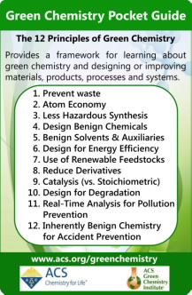
12 principles for Green Chemistry
• Waste Prevention
• Atom Economy
• Less Hazardous Chemical Syntheses
• Designing Safer Chemicals
• Safer Solvents and Auxiliaries
• Design for Energy Efficiency
• Use of Renewable Feedstocks
• Reduce Derivatives
• Catalysis
• Design for Degradation
Real-time analysis for Pollution Prevention
• Inherently Safer Chemistry for Accident Prevention
P. Anastas, J. Warner in: Green Chemistry: Theory and Practice (New York, 1998).

Slide 5

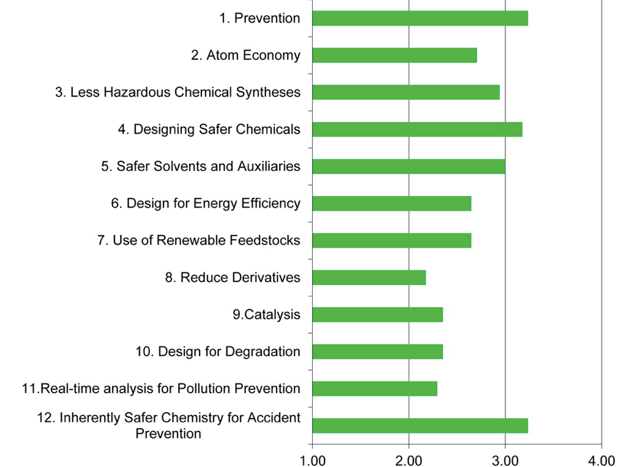
How Often Are the 12 Principles Implemented in Chemical Manufacturing?
“Implementing Green Chemistry in Chemical Manufacturing: A Survey Report”;
Giraud et al. ACS Sust. Chem. & Eng. 2014, 2, 2237-2242
Frequency of implementation of the 12 principles of Green Chemistry in chemical manufacturing.
Survey done on chemical manufacturers contacted via The Nexus (ACS Green Chemistry Inst.)
Average chemical manufacturer responses (n = 17) to the 2012 Roundtable survey question:
“In your opinion, how frequently does your company implement the following principles of Green Chemistry?”
1: never (or not applicable)
2: rarely
3: regularly
4: fully

Slide 6
The Chemical Design Process
DECISION MAKING
Type of resources
What materials (feedstocks, additives) are needed?
Are the materials readily available?
How much material is needed?
Manufacturing process
What technology is needed?
What is the scale of the experiment? (big companies operate ata different scale than a startup)
Ultimately determines characteristics of the waste stream, energy requirements, and toxicity of the entire process.
Feedstocks are important, but at the design phase decisions must be made on solvents, additional reactants, auxiliaries, catalysts
Notes:
Types of resources:
While the starting materials are important (feedstocks), at the design phase the decision on the solvents, additional reactants is also necessary.
Decision on the scale of the manufacturing process is needed. Each industry is different, for example a big pharma will have other scale than a startup.
All these decisions determine the characteristics of the waste streem, energy usage, and toxicity of the entire process.

Slide 7

Let us look at functional organic polymers
Conventional criteria important for the Chemical Design of a new product
• Solubility (manufacturing)
• Melting point (manufacturing, resource)
• Glass transition temperature (manufacturing, resource)
• Mechanical properties (tensile strength, modulus etc)
• Refractive index
• Surface Tension
• Yields/selectivity
Image: HP

Slide 8

Green Chemistry-Inspired Design Criteria
• Solubility (manufacturing)
• Melting point (manufacturing, resource)
• Glass transition temperature (manufacturing, resource)
• Mechanical properties (tensile strength, modulus etc)
• Refractive index
• Surface Tension
Yields/selectivity
Toxicity
• Environmental impact
Green Chemistry perspective is not far from what’s currently being practiced.
It is simply considering hazards at the inception of product development that makes it a powerful tool.
Image: Philips

Slide 9
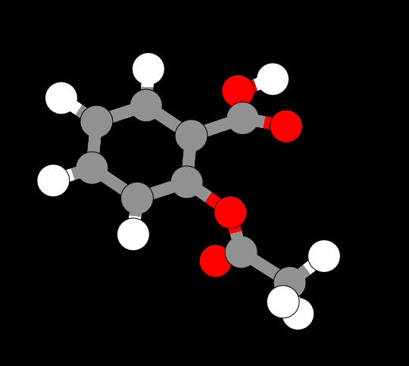
Focus on Chemical Design
The moment chemists begin to design, they are making choices about the health and environmental impacts of their product:
Design is intentional.
All characteristics, including performance and toxicity, can be designed.
Image source: ChemDoodle Web Components

Slide 10
Green Chemistry Across Industrial Sectors
Defense and aerospace
Adhesives
Coatings
Corrosion, inhibitors
Automotive
Solvents
Polymers
Fuels
Household cleaners
Surfactants
Fragrances
Dyes
Electronics
Solder
Housings
Displays
Agriculture
Pesticides
Fungicides
Fertilizers
Cosmetics
Builders
Chelating agents
Dyes
Pharmaceuticals

Slide 11
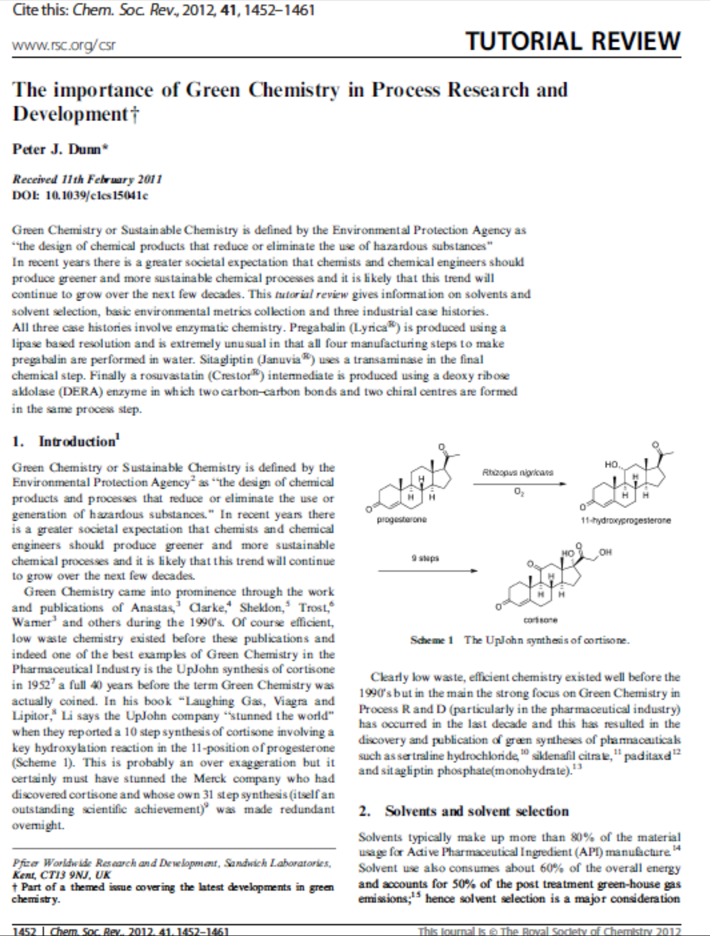
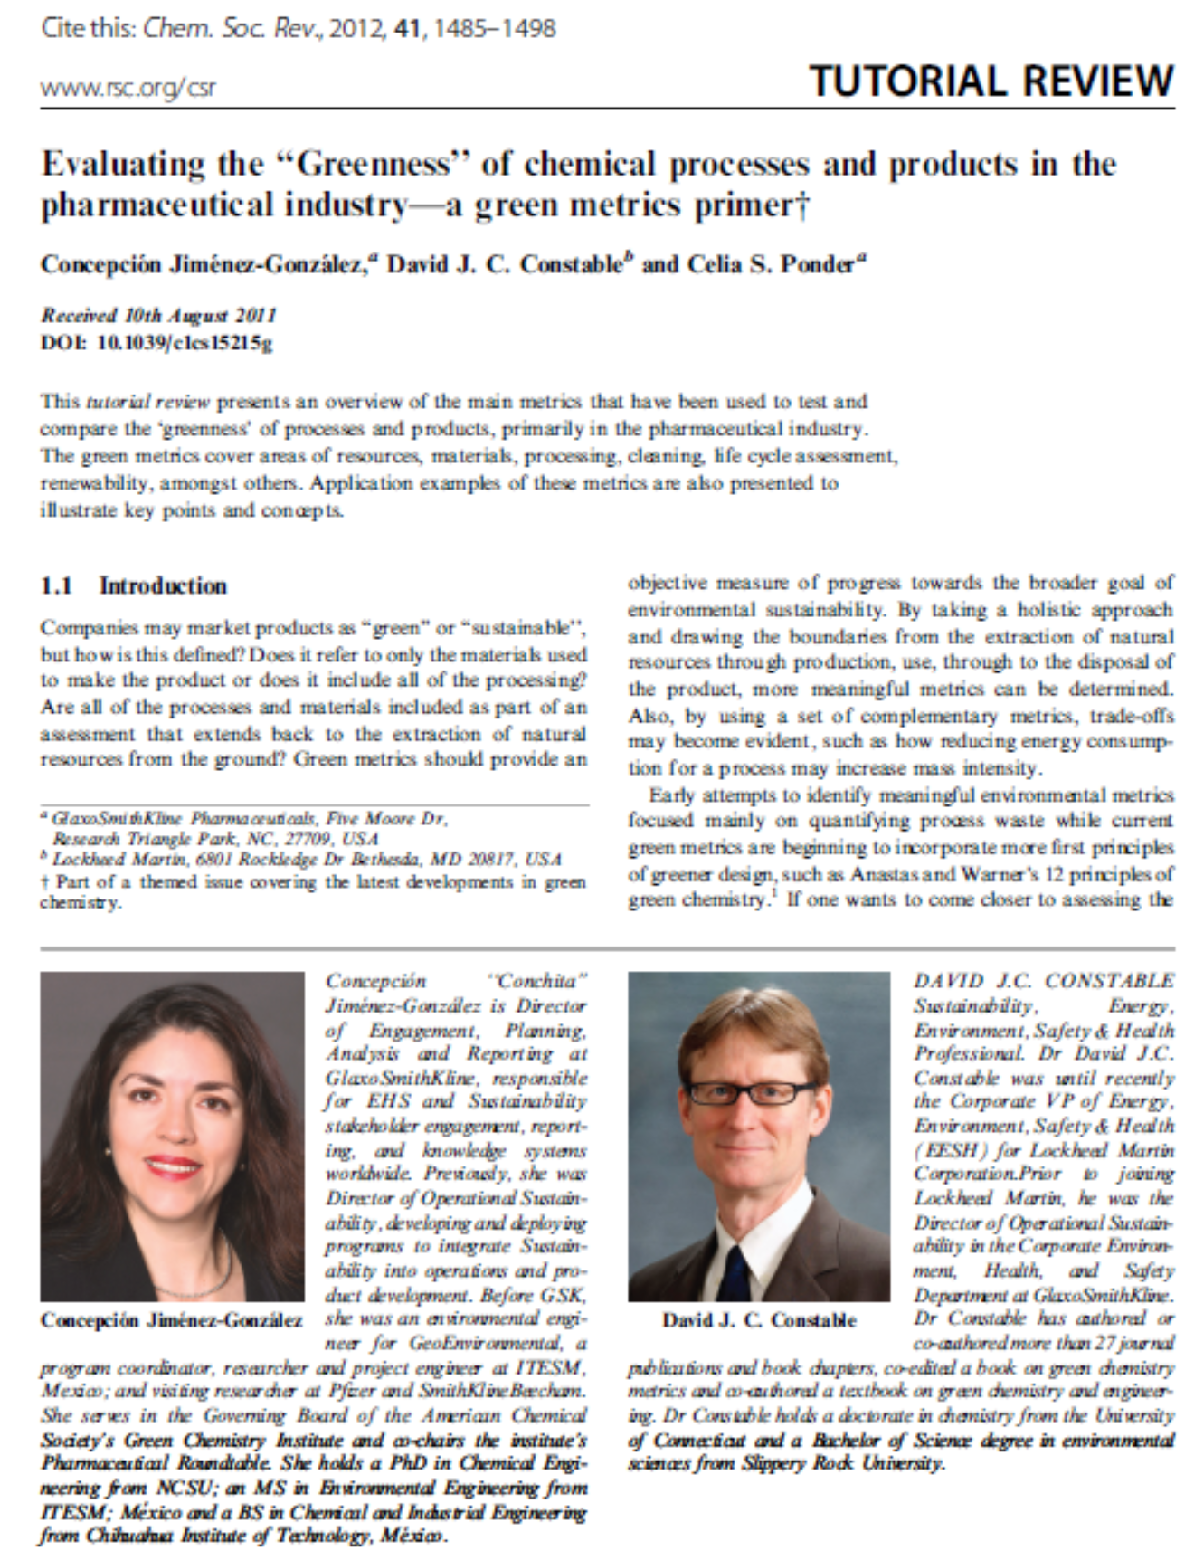
Pharmaceutical Industry

Slide 12

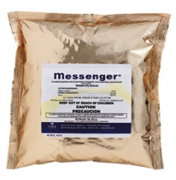
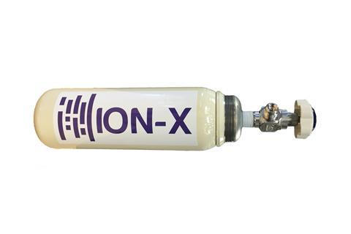
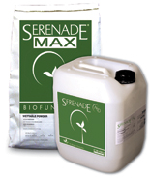
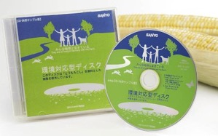
Green Chemistry Innovation in Other Fields
Electronics
New materials for storage/transport of silanes, germanes, arsine etc. (NuMat, Inc.)
clothing
home & garden
building materials
cleaning products
food products
Entertainment
jewelry
and more!
Image source: Wikipedia

Slide 13
Benefits of Green Chemistry
For the environment:
  Products will biodegrade and will not persist in the environment.
  Products & processes will not cause toxic harm to humans (employees, consumers)
For human health:
For the economy:
  Novel products can boost competitiveness
For sustainability:
Products made from renewable, abundant resources.
For science:
  Fundamental new insights

Slide 14
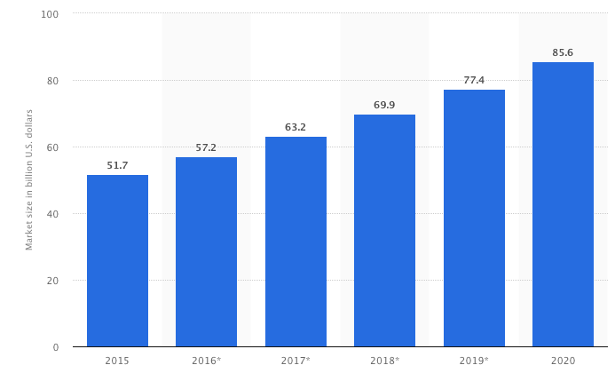
Green Chemistry Market Predictions
Forecasted market size of Green Chemistry industry worldwide from 2015 to 2020 (US$B)
Calculated based on the compound annual growth rate (CAGR) of 10.6 between 2015 and 2020, as stated by the source. Figures from 2016 to 2020 are forecasted.
“CleanTech”
Source: statista.com

Slide 15
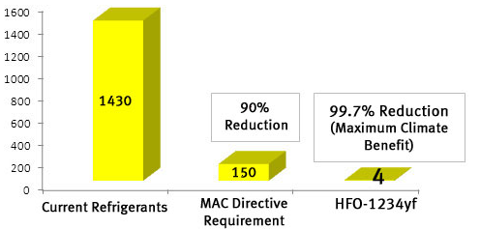
Growing Demand & Planning for “Greener” Chemicals
“How the Chemical Industry Joins the Fight Against Climate Change?”
In 2006, EU adopts the Mobile Air Conditioning (MAC) Directive to reduce climate impact of air conditioning in cars sold in the EU.
Effective in 2011 MAC Directive requires an automotive refrigerant with a GWP below 150.
• September 2016: New York Declaration urged a global reduction in the use of HFCs
• October 2016: negotiators from 197 nations at the summit of the UN Environment Programme (Kigali, Rwanda) reached a legally-binding amendment to the Montreal Protocol, to phase out HFCs.
Next day, Honeywell and Chemours (DuPont spin-off) actively backed regulations and moved towards more environmentally friendly refrigerants. (New York Times, 16/10/2016)
Global Warming Potential (GWP) Comparison
“The companies were driven less by idealism than by intense competition, and a bet that they could create more environmentally friendly alternatives.”
The development of HFC alternatives started in early 2000s
http://www.nytimes.com/2016/10/17/business/how-the-chemical-industry-joined-the-fight-against-climate-change.html?_r=0

Slide 16
But, Isn’t That How it is Done Now?
• Entire industries are geared toward cleaning up after wasteful chemical syntheses.
• Scientific literature is filled with synthetic pathways that are inefficient in terms of design.
• Reagents are seldom selected with regard to hazard.
• Industrial chemicals do not have minimal hazard as a performance criterion.
• Persistence of chemicals in the biosphere and in our bodies is a major global health issue (CDC 250 chemicals since 1945).
• The vast majority of organic chemicals are made from depleting (non-renewable) feedstocks (petrochemicals!).
• Our chemical industry deals with safety through engineering and security through barricades.

Slide 17
Dealing with Risk: Exposure vs Design
The conventional approach to hazards focuses, for example, on reducing risk by minimizing exposure.
- wearing personal protective equipment or space ventilation if the chemical is volatile.
If we can master the design and synthesis of molecules, why don’t we aim it toward eliminating hazards?
Green chemistry focuses on reducing risk by reducing hazard.
- If there is no hazard, exposure becomes irrelevant!

Slide 18
Green Chemistry: A Change in Perspecyive
Hazard must be recognized as a flaw in the designing process.
Green Chemistry moves our consideration of how to deal with environmental problems from the circumstantial to the intrinsic.
circumstantial
(depends on situation)
  • use
  • exposure
  • handling
  • treatment
  • protection
  • recycling
  • costly
intrinsic
(inherent in design)
  • molecular design for reduced toxicity
  • reduced ability to manifest hazard
  • inherent safety from accidents or terrorism
  • increased potential profitability

Slide 19
Another Design Principle: Function vs Molecule
Green Chemistry also rethinks the problem de novo. We move from considering the molecule/material to the function.
Thinking about function calls for interdisciplinary research to “think outside the box”
molecules/materials
  • bisphenol A/phtalates
  • epoxy resins
  • Cisplatinum
  • polyethylene terephthalate (PET)
  • dichloromethane
function
  • plasticizing
  • coating
  • catalyst
  materials which can be molded, do not leak..
  • solvent

Slide 20
Traditional approach
more environmentally
benign than alternatives
performs better
than alternatives
more economical
than alternatives

Slide 21
Holistic approach
safety
Green
Chemistry
performance
cost

Slide 22
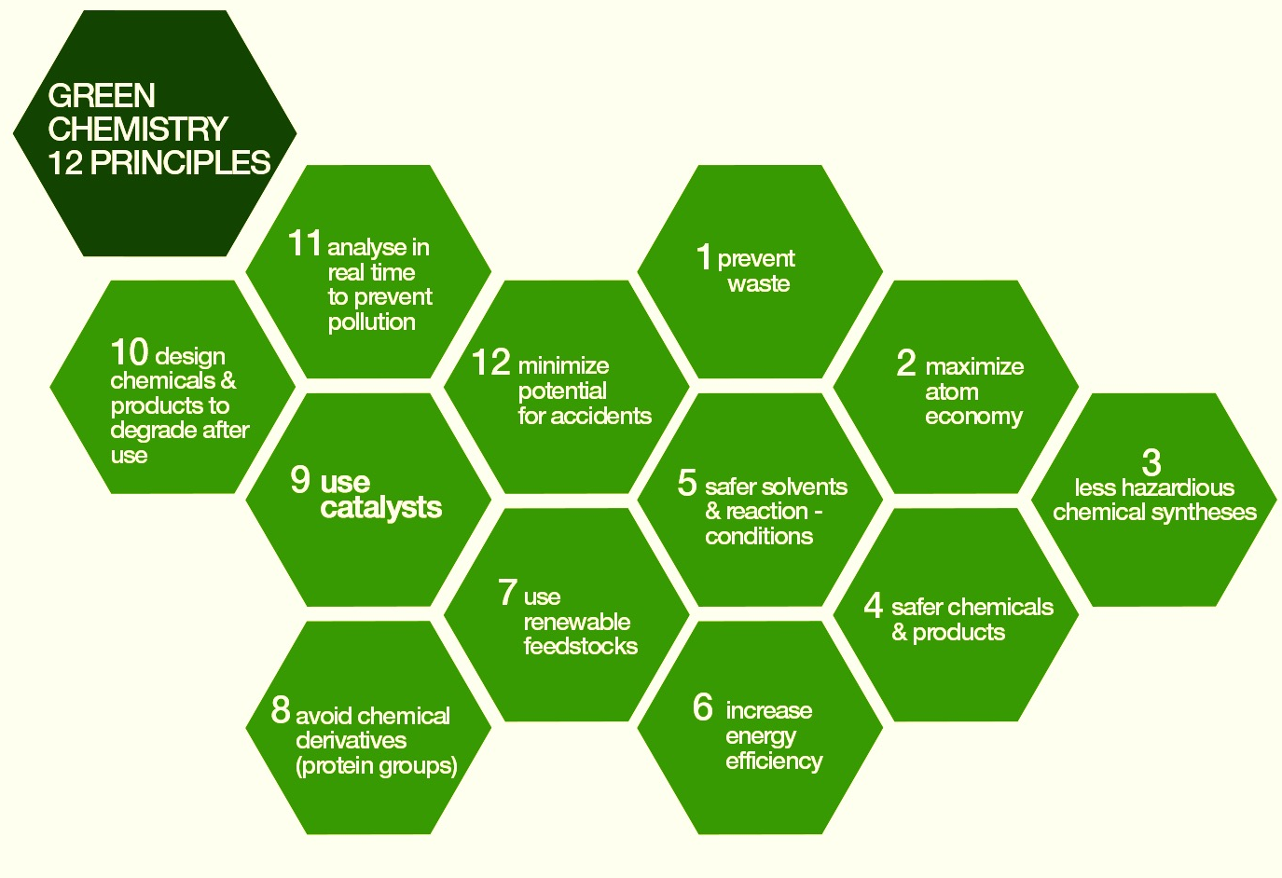
The 12 Principles of Green Chemistry
1. Waste Prevention
2. Atom Economy
3. Less Hazardous Chemical Synthesis
4. Designing Safer Chemicals
5. Safer Solvents and Auxiliaries
6. Design for Energy Efficiency
7. Use of Renewable Feedstocks
8. Reduce Derivatives
9. Catalysis
10. Design for Degradation
11. Real-time Analysis for Pollution Prevention
12. Inherently Safer Chemistry for Accident Prevention
Anastas, Warner; Green Chemistry: Theory and Practice, Oxford University Press (1998)
Notes:
Green chemistry is defined by 12 Principles, which address various topics. Most principles have tools or metrics associated to help the researcher and guide them through green chemistry improvements.

Slide 23
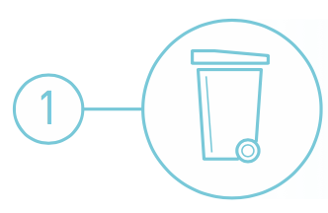
What is waste?
Waste Prevention
Waste is anything that is a leftover from the product/process and cannot be re-used.
Waste can be produced in any stage of a process life-cycle:
• origins of feedstock
• manufacturing
• distribution
• use
• end of life
When is waste NOT waste?
• when it can be reused, becoming a feedstock.
• When it can be reduced or completely eliminated.

Slide 24
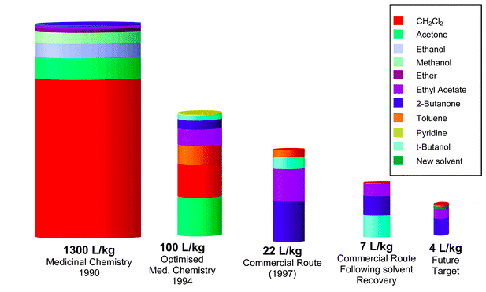
Waste Prevention
Case study: Sildenafil citrate production - Pfizer
Sildenafil citrate, commonly known as Viagra, is a selective inhibitor of phosphodiesterase 5 (PDE5). Sales > $1 billion during its first year on the market.
With such a rapid sales take off it was critical that the environmental performance of the synthesis was good from the outset!
Organic waste produced by sildenafil citrate processes at various time points
Conventional sildenafil citrate synthesis included:
• 11 steps for a 4.2% overall yield.
• SnCl₂, heavy metal and major environmental polluter.
• stoichiometric thionyl chloride (SOCl₂) in a solvent. This has a high environmental impact.
• hydrogen peroxide: burns upon skin contact, fire and transportation hazard, especially in contact with organic matter
• over 1300 L waste per kilogram of product.
Dunn et al. Green Chem. 2004, 6, 43-48

Slide 25
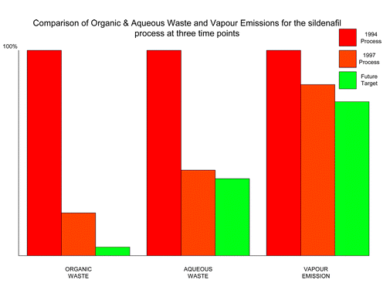
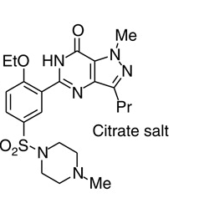
Waste Prevention
Alternative production of sildenafil citrate:
• average yield of last three steps = 97% yield.
• 7 L/kg by minimizing solvent use, increasing solvent recovery, better solvent choice, and telescoping steps.
• only the solvents tert-butanol, ethyl acetate, 2-butanone, and a trace of toluene still require disposal.
Dunn et al. Green Chem. 2004, 6, 43-48
Pfizer, Inc

Slide 26
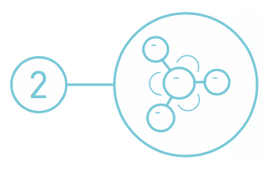

Atom Economy
In 1990 Barry Trost introduced a concept of synthetic efficiency: Atom Economy (AE)
It refers to the concept of maximizing the use of raw materials so that the final product contains the maximum number of atoms from the reactants.
An ideal reaction would incorporate all of the atoms of the reactants.
The AE is measured as the ratio of the molecular weight of the desired product over the molecular weights of all reactants used in the reaction.
Additional considerations when designing a green reaction:
• generation of co-products and waste
• toxicity of co-products and waste
• energy needs
• purification steps
• solvent and catalyst use
Barry Trost

Slide 27
Atom Economy
USE YOUR ATOMS!!!!

Slide 28
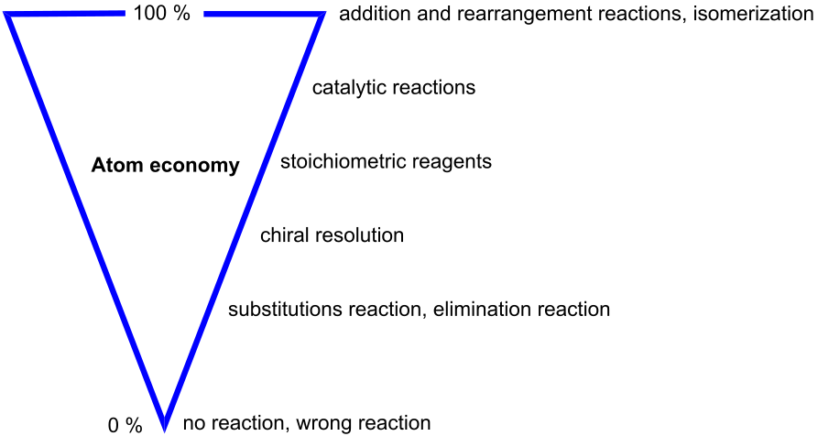
Atom Economy
Synthetic methods should be designed to maximize the incorporation of all materials used in the process into the final product.
Image: Wikimedia Commons, Author: Astrid 91

Slide 29
Atom Economy: Ibuprofen
Conventional synthesis of ibuprofen:
  • six stoichiometric steps
  • below 40% atom utilization

Slide 30
Atom Economy : Ibuprofen
Alternative catalytic synthesis of ibuprofen:
• 3 catalytic steps
• 80% atom utilization
  BHC

Slide 31
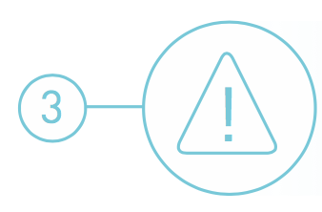
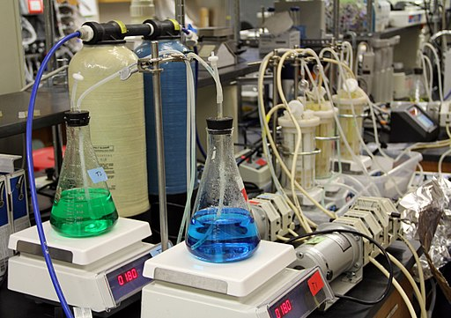
Less Hazardous Chemical Synthesis
Synthetic methodologies should be designed to use and generate substances that possess little or no toxicity to human health and the environment.
Image: Wikimedia Commons, Center for Biofilm Research Laboratory Montana State University

Slide 32
Less Hazardous Chemical Synthesis
Case study: Synthesis of adipic acid
• one of the most produced commodity chemicals worldwide
• projected global market size >US$ 7 billion by 2019
• versatile building block in chemical, pharmaceutical and food industries
• precursor for the synthesis of the polyamide Nylon-6,6.
Conventional synthesis:
• benzene, a known carcinogen, is a starting material
• oxidation with excess of HNO₃, production of nitrous oxide (N₂O) a GHG (5–8% of worldwide anthropogenic N₂O emissions).

Slide 33
Less Hazardous Chemical Synthesis
Alternative synthesis of adipic acid:
• development of biocatalytic processes for producing adipic acid and catechol from sugars.
• biocatalytic process using yeast converts sugars to cis,cis-muconic acid, and this intermediate stage allows ready access to catechol and adipic acid.
• uses water as solvent at ambient temperature and pressure.
Check out: Raj et al. “Biocatalytic production of adipic acid from glucose using engineered Saccharomyces cerevisiae” Metabolic Engineering Communications. 2018, 6, 28-32.

Slide 34
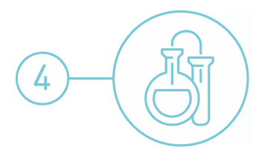
Designing Safer Chemicals
Chemical products should be designed to preserve efficacy of the function while reducing toxicity.

Slide 35
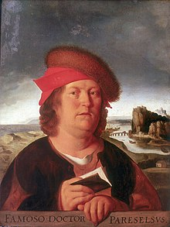
Designing Safer Chemicals
“Everything is toxic. It is simply depends on the dose”
Often otherwise phrased as
“The dose makes the poison.”
Risk = Hazard x Exposure
Green chemistry and engineering focus on reducing risk by reducing hazard.

Slide 36
Designing Safer Chemicals
Hazard types to avoid:
  Toxicological/Eco-toxicological
    Carcinogenicity
    Reproductive
    Developmental
    Neurological
    Global warming potential
    Ozone depleting potential
    Bioaccumulation
    Persistence
  Physical
    Explosivity
    Flammability
    Corrosivity
Physical/Chemical Properties to consider:
  Water solubility
  Log Kow
  Volatility
  Molar volume
  Aspect ratio
  Radical formation
  Nucleophilicity
  Electrophilicity
  pH/pKa
  Surface area
  Reducing potential
  Oxidizing potential
  Polarizability

Slide 37
Designing Safer Chemicals
Case study: Antifoulants
Antifoulants are generally dispersed in the paint as it is applied to the hull. Organotin compounds such as tributyltin oxide (TBTO) have traditionally been used: gradually leaches from the hull, killing the fouling organisms in the surrounding
Conventional use of organotin compounds as antifoulants:
• TBTO and related antifoulants have long half-lives in the environment (the half-life of TBTO in seawater is >6 months).
• they bioconcentrate in marine organisms (the concentration of TBTO in marine organisms has been found to be up to 104 times greater than in the surrounding water).
• organotin compounds are chronically toxic to marine life and can enter food chain. Extreme neurological hazard.
• bioaccumulative
tributyltin oxide (TBTO)

Slide 38
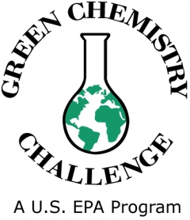
Designing Safer Chemicals
Case study: Antifoulants
Awardee in 1996
Alternative antifoulants (Dow Chemicals):
• Sea-Nine® 211 (DCOI) works by maintaining a hostile growing environment for marine organisms
• when organisms attach to the hull treated with DCOI, proteins at the point of attachment react with the DCOI
• reaction with DCOI prevents the use of these proteins for other metabolic processes: organism detaches itself and searches for a more hospitable surface to grow upon.
• Only organisms attached to hull of ship are exposed to toxic levels of DCOI.
• readily biodegrades once leached from ship (half-life is less than one hour in sea water).
https://www.epa.gov/greenchemistry/presidential-green-chemistry-challenge-1996-designing-greener-chemicals-award

Slide 39
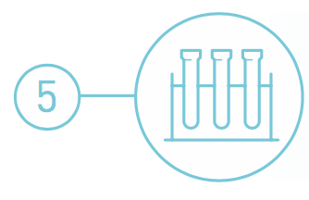
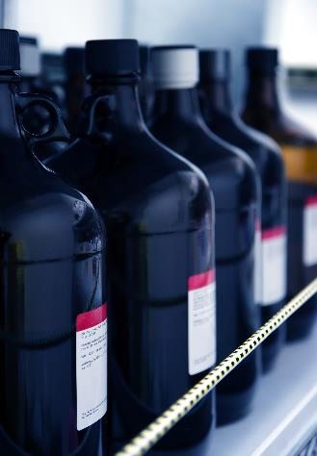
Safer Solvents and Auxiliaries
Solvents account for the vast majority of mass wasted in syntheses and processes. Moreover, many conventional solvents are toxic, flammable, and/or corrosive.
Solvents volatility and solubility have contributed to air, water and land pollution, have increased the risk of workers’ exposure, and have led to serious accidents.
Recovery and reuse, when possible, is often associated with energy-intensive distillation and sometimes cross contamination. In an effort to address all those shortcomings, chemists have started to search for safer solutions.

Slide 40
Safer Solvents and Auxiliaries
Problematic organic solvents
greener alternatives
easily separable, safe
avoidance
zero
volatility
environmentally
benign and safe
no solvent
supercritical fluids
ionic liquids
water solvent

Slide 41
Safer Solvents and Auxiliaries
Case study: Manufacturing process for sertraline, the active ingredient in the popular drug Zoloft®
Zoloft® is an anti-depressant; once one of the best selling pharmaceuticals on the market.
Conventional sertraline synthesis:
• synthesis was a three step process.
• used 4 hazardous solvents (methylene chloride, tetrahydrofuran, toluene, and hexane).
Zoloft®

Slide 42
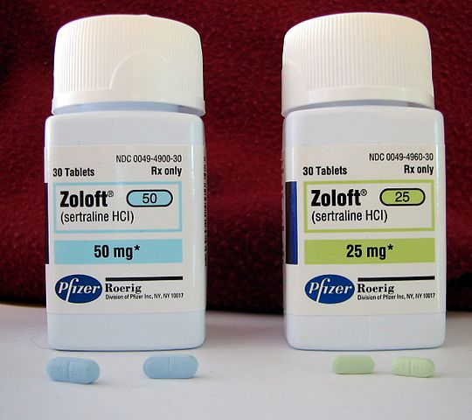
Safer Solvents and Auxiliaries
Case study: Manufacturing process for sertraline, the active ingredient in the popular drug Zoloft®
Alternative sertraline synthesis:
• process was streamlined to a single step, carried out in ethanol, a much less toxic solvent.
• new process is catalytic, cutting down on starting materials by 60%, 45%, and 20% for the three reaction components.
• combined steps eliminated 180 tons of TiCl₄, 150 tons of 50% NaOH, 180 tons of 35% HCl waste, and 600 tons of solid TiO₂.
Image: Wikimedia Commons, Author: Ragesoss
Pfizer, Inc

Slide 43

Design for Energy Efficiency
Energy requirements should be recognized for their environmental and economic impacts and should be minimized.
Synthetic methods should be conducted at ambient temperature and pressure.

Slide 44
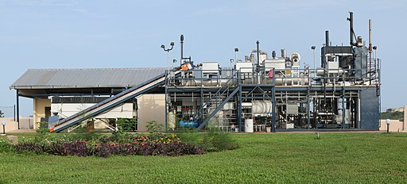
Design for Energy Efficiency
Most energy is used for heating, cooling, separations and pumping.
Ideally, all reactions are performed at ‘ambient’ conditions – room temperature and atmospheric pressure – in order to minimize energy usage.
Image: Wikimedia Commons, Janicki Omni Processor Pilot Plant in Dakar, Senegal , Author: Janicki Bioenergy

Slide 45
Design for Energy Efficiency
Case Study: Atorvastatin
Atorvastatin, a cholesterol-lowering drug (Lipitor®), suffers from an energy-demanding synthesis as a result of two cryogenic reactions at - 70 ºC
New biocatalytic synthesis uses enzyme DERA and shortens the process by removing two energy intensive chemical steps.
DERA: deoxyribose-5-phosphate aldolase
CBzNH
CBzNH
DERA

Slide 46
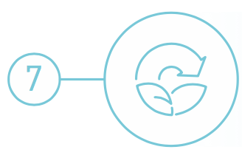
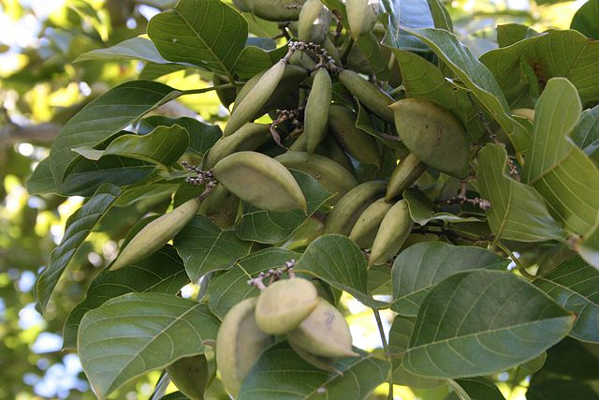
Use of Renewable Feedstocks
A raw material or feedstock should be renewable rather than depleting whenever technically and economically practical.
Image: Wikipedia, Pongamia Pinnata Seeds

Slide 47
Use of Renewable Feedstocks
Case study: Production of levulinic acid
• precursor for pharmaceuticals, plasticizers, and various other additives
• widely used as a building block/starting material
Conventional synthesis:
• made by heating hexoses (glucose, fructose) or starch in dilute HCl or H₂SO₄
• yield depends on acid, its concentration, temperature, pressure
• reaction also produces hard to remove by-products.
formic acid
fructose
hydroxymethylfurfural (HMF)
levulinic acid

Slide 48
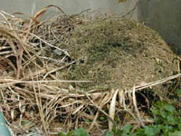
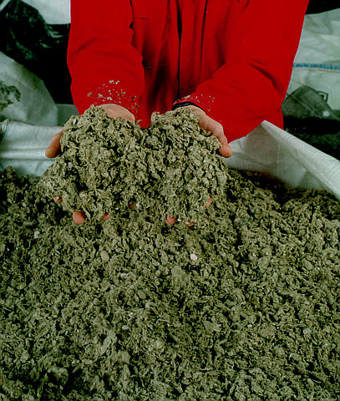

Use of Renewable Feedstocks
Case study: Production of levulinic acid
agricultural
residues,
waste wood
Alternative synthesis:
• levulinic acid can be obtained from paper mill sludge, agricultural and municipal waste and paper.
• uses a high-temperature, dilute-acid hydrolysis process that converts cellulosic biomass.
municipal solid waste
and waste paper
hydrolysis
levulinic acid
paper mill
sludge
Biofine, Inc

Slide 49
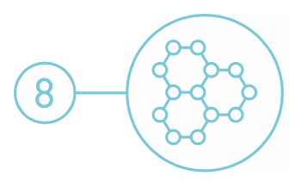
Reduce Derivatives
Unnecessary derivatization (blocking group, protection/deprotection, temporary modification of physical/chemical processes) should be avoided whenever possible.
Image: Wikimedia Commons, Center for Biofilm Research Laboratory Montana State University

Slide 50
Reduce Derivatives
Conventional approach
Substrate
Intermediate A
Intermediate B
Intermediate C
Intermediate D
Intermediate E
Product
Green Chemistry approach
Substrate
Product
Notes:
Whenever possible, limit number of steps and unnecessary transformations. Avoid the use of protecting groups as it requires extra reagents and generates more waste.

Slide 51
Reduce Derivatives
Case study: 6-aminopenicillanic acid (6-APA)
6-APA: core moiety of penicillin
Conventional synthesis of 6-aminopenicillanic acid using 3 steps and intermediates:
Alternative synthesis using enzyme and fewer derivatives:

Slide 52
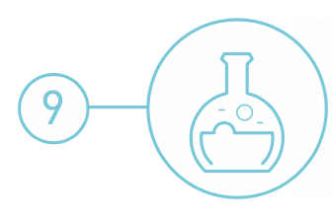
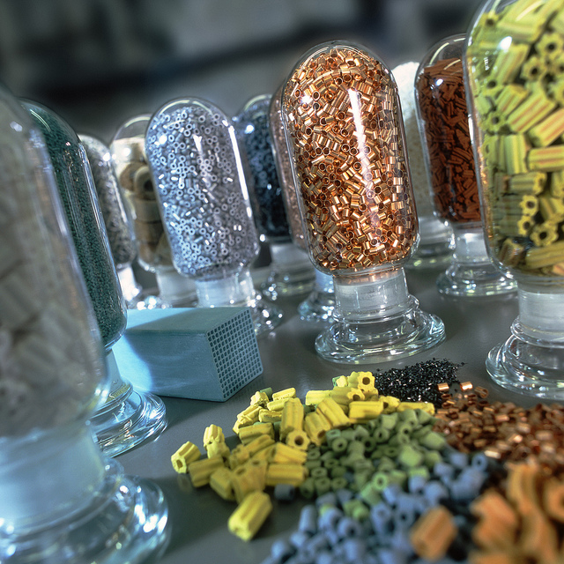
Catalysis
Catalytic reagents (as selective as possible) are superior to stoichiometric reagents.
Image: Flickr, Catalysts, Author: BASF Catalysts

Slide 53
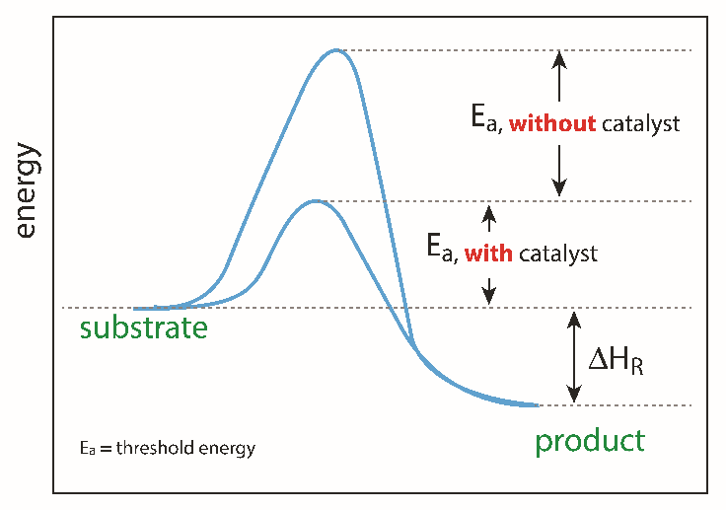
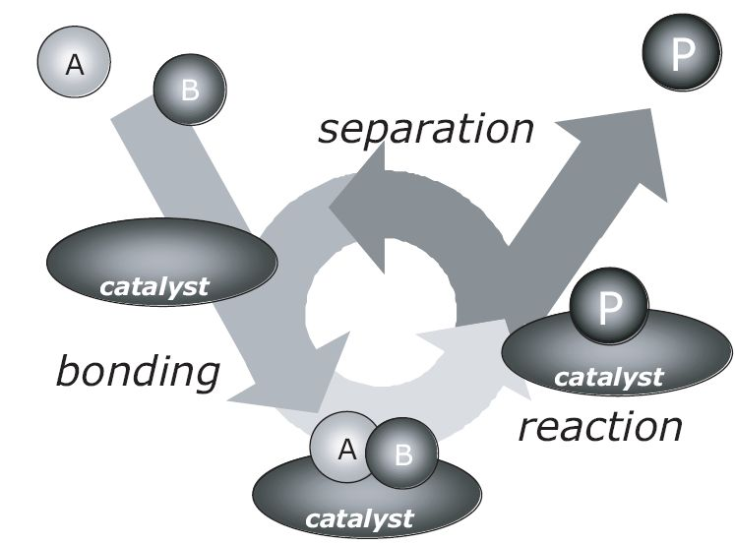
Catalysis
Catalysts can facilitate complex reactions by:
lowering the activation energy (E_{a}) of the reaction.
• reducing temperature necessary to achieve a reaction.
• controlling the site of the reaction (selectivity enhancement).
• catalysis is a cyclic event
I. Chorkendorff, J. W. Niemantsverdriet, Concepts of Modern Catalysis and Kinetics, Wiley-VCH, 2003
Image source: Adobe stock
Notes:
Catalysts lower the activation (threshold energy) in the reaction.

Slide 54
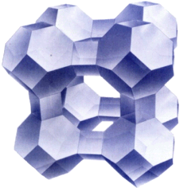
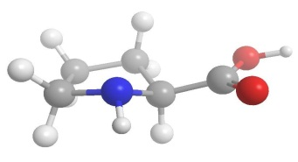
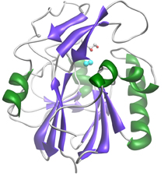
Catalysis
Many molecules/enzymes/materials can be catalysts
zeolite (crystalline alumosilicate)
enzyme (biocatalyst)
copper-zinc crystallites on silica
Catalysis, Concepts and green applications, by Gadi Rothenberg, Wiley-VCH 2008.

Slide 55
Catalysis: Green Naproxen Synthesis
Nonsteroidal anti-inflammatory drug (NSAID) of the propionic acid class (the same class as ibuprofen) that relieves pain, fever, swelling, and stiffness; COX inhibitor
  97% yield in three steps
  Dartt and Davis
Notes:
cyclooxygenase

Slide 56

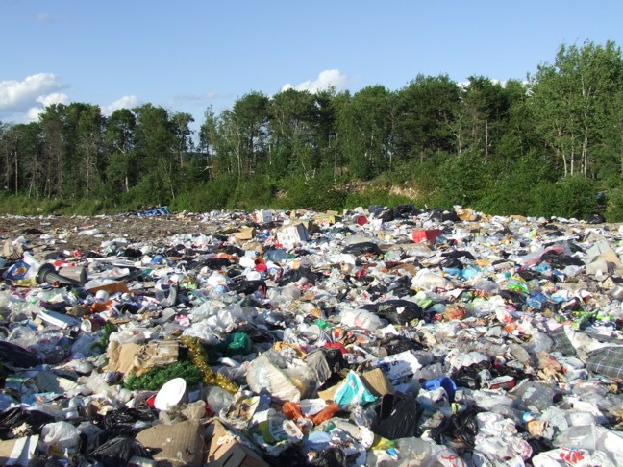
Design for Degradation
Chemical products should be designed so that at the end of their function they do not persist in the environment and instead break down into innocuous degradation products.
Image: Wikicommons, a landfill in Dryden, Ontario, Author: Michelle Arseneault

Slide 57
Design for Degradation
Early examples of non degrading products:
  sulfonated detergents
  • alkylbenzene sulfonates – 1950’s & 60’s
    • foam in sewage plants, rivers, and streams
    • persistence was due to long alkyl chain
    • introduction of an alkene group into the chain increased degradation
  chlorofluorocarbons (CFCs)
    • do not break down, persist in atmosphere and contribute to destruction of the ozone layer.
  DDT
    • bioaccumulate and cause thinning of egg shells

Slide 58
Design for Degradation: PLASTICS
Conventional plastics (e.g. PET) are made from petroleum:
• PET Plastic persists in the environment
• made from depleting resources
petroleum product
high temperature
vacuum
catalyst

Slide 59
Design for Degradation: PLASTICS
Alternative process:
Cargill Dow LLC
Synthesis of PolyLactic Acid (PLA) from starch:
• a biobased, compostable, and recyclable PLA polymer that uses 20–50 percent less fossil fuel resources than comparable petroleum-based polymers.
• the first family of polymers derived entirely from renewable resources that can compete cost-effectively with traditional fibers and plastic packaging materials.
• manufacturing process consists of three solvent-free steps that lead to the production of lactic acid, lactide, and PLA high polymer with very high yields and internal recycling schemes that reduce waste.
• PLA can be biodegraded under industrial compositing conditions - does not degrade though in the environment

Slide 60
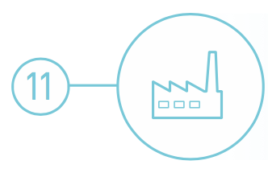
Real-time Analysis for Pollution Prevention
Analytical methodologies need to be further developed to allow for real-time in-process monitoring and control prior to the formation of hazardous substances.

Slide 61
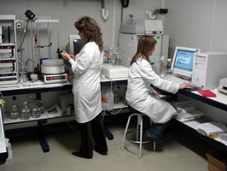

Real-time Analysis for Pollution Prevention
Real time analysis for a chemist is the process of “checking the progress of chemical reactions as it happens”.
Knowing when your product is “done” can save a lot of waste, time, and energy!
Image: Wikimedia Commons

Slide 62
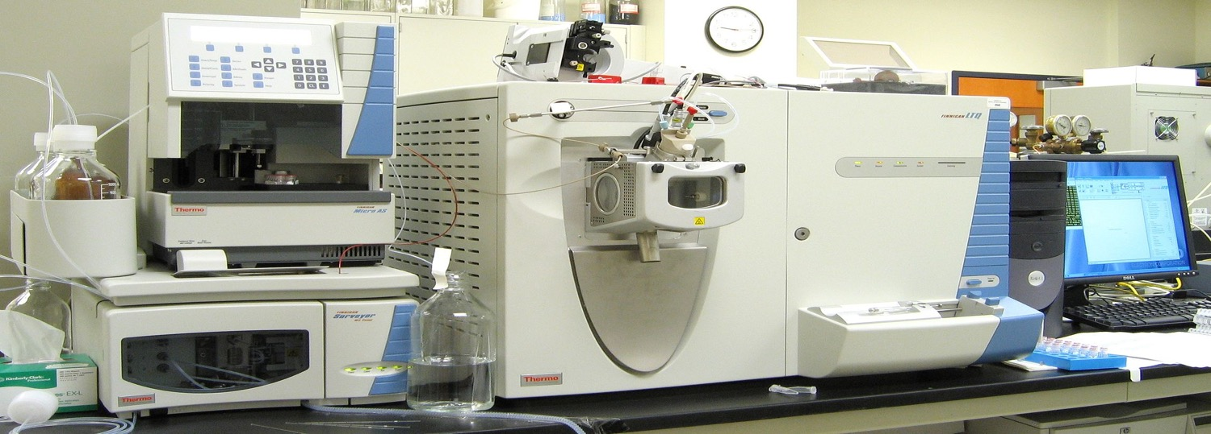
What Does Green Analytical Chemistry Mean?
Real-time Analysis for Pollution Prevention
Green Chemistry is applicable to all chemical processes, including the methods, protocols and processes of analytical chemistry.
Image: Wikipedia

Slide 63
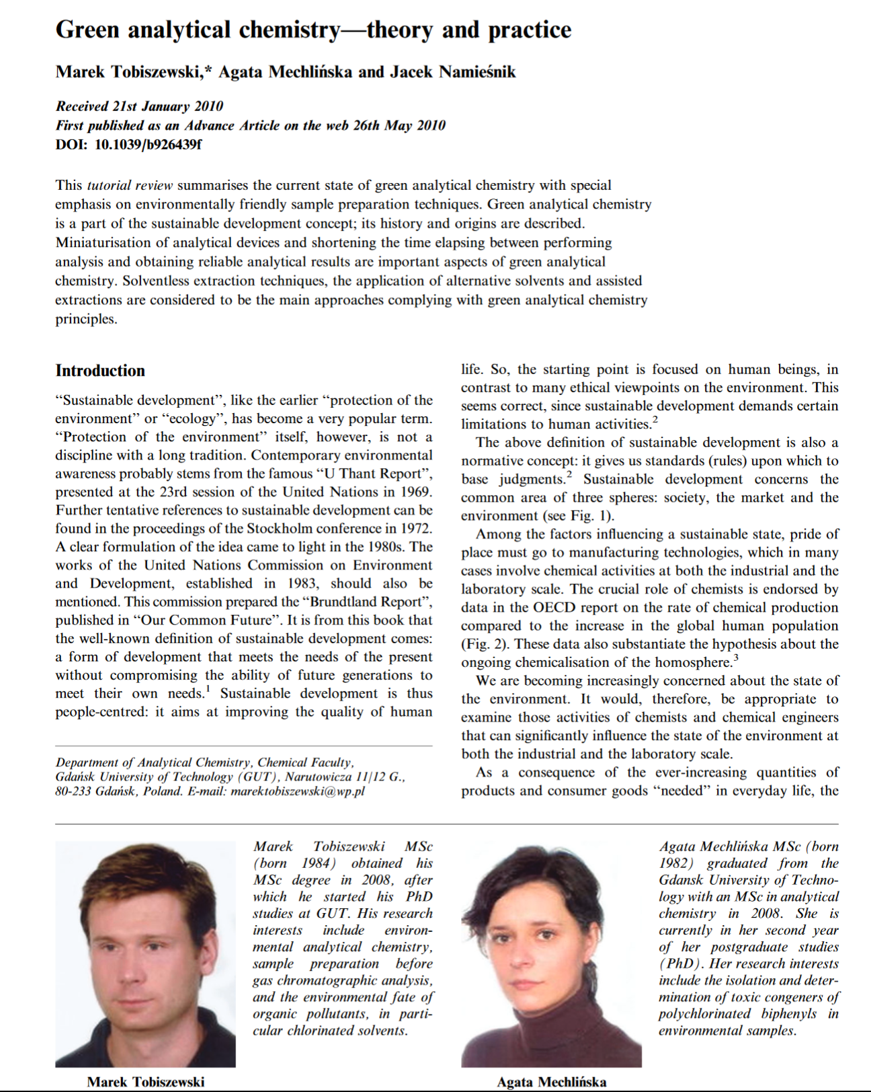
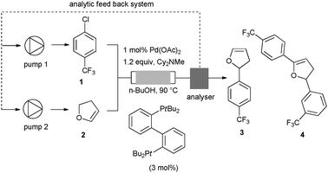
Examples of Green Analytical Chemistry Methodologies
Real-time Analysis for Pollution Prevention
X-ray fluorescence detection for multi-metal matrix
In-line HPLC analyzer, on flow
Desired product
Real-time adaptation of addition of 1 and 2 to max. 3
Image Sources: https://www.thermofisher.com, https://www.intechopen.com/books/herbicides-advances-in-research/recent-advances-in-the-extraction-of-triazines-from-water-samples, J. P. McMullen, M. T. Stone, S. L. Buchwald and K. F. Jensen, Angew. Chem., 2010, 39, 7230

Slide 64
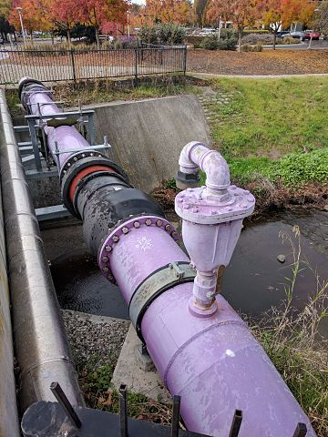
Real-time Analysis for Pollution Prevention
Case study: Real-time analysis in cooling systems
In 2008 Naclo Company won the EPA Greener Reaction Conditions Award for their innovative 3D TRASAR® Technology.
Alternative Cooling System with 3D TRASAR® Technology:
3D TRASAR® System allows for the real-time monitoring of mineral scale buildup.
system can also utilize poor-quality water.
3D Scale Control prevents mineral scale formation to increase efficiency.
3D Bio-control performs a real-time check for planktonic and sessile bacteria. This reduces the amount of biocide used since biocides are then added only when necessary, rather than on a set schedule.
3D TRASAR® System greatly reduces the amount of wastewater discharged from cooling systems.
https://www.epa.gov/greenchemistry/presidential-green-chemistry-challenge-2008-greener-reaction-conditions-award
Image: Wikipedia, A lavender-colored nonpotable water pipeline in Mountain View, California, Author: Grendelkhan
Notes:
The system monitors antiscalant levels using a fluorescent-tagged, scale-dispersant polymer and responds quickly when conditions favor scale formation. In addition, 3D Bio-control, also part of the 3D TRASAR® system, is the only online, real-time test for measuring planktonic and sessile bacteria. It uses resazurin, another fluorescent molecule, which changes its fluorescent signature when it interacts with respiring microbes. By adding an oxidizing biocide in response to microbial activity, 3D Bio-control generally reduces the use of biocide and also prevents biofilm from building up on surfaces, maintaining efficient heat transfer.

Slide 65
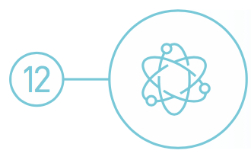
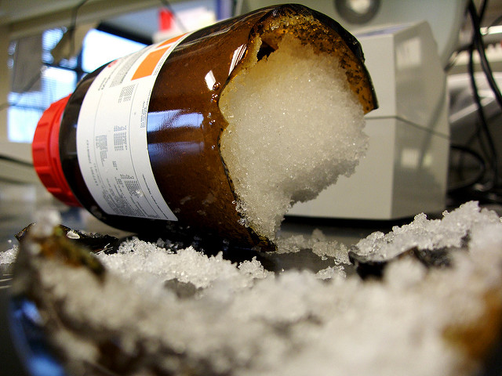
Inherently Safer Chemistry
for Accident Prevention
Substance and the form of a substance used in a chemical process should be chosen so as to minimize the potential for chemical accidents, including releases, explosions, and fires.
Image: Flickr, Author: sea turtle

Slide 66
Inherently Safer Chemistry
for Accident Prevention
Accidents can be avoided by minimizing hazards
approaches to design safer chemistry can include the use of solids or low vapor pressure substances in place of volatile liquids.
• other approaches include avoiding the use of molecular halogens in large quantities.
• continuous flow processes can help to minimize chemical hazards.

Slide 67
Inherently Safer Chemistry
for Accident Prevention
Case study: Production of gasoline alkylate with AlkyClean® Technology
In 2016 Albemarle and CB&I won the EPA Green Chemistry Award for their inherently safer AlkyClean® process technology.
Conventional alkylate production:
• alkylate is typically produced from the reaction of isobutane and light olefins.
• requires the liquid acid-catalyzed processes, such as hydrofluoric acid.
• hydrofluoric acid is extremely toxic, upon release it forms clouds that can be lethal for up to five miles.
AlkyClean® Technology:
• AlkyClean® solid acid alkylation process produces high quality alkylate without using liquid acid catalysts.
• solid acid alkylation process is safer for both people working directly in production and for people in the area surrounding the facility.
• environmental and economic benefits since no acid-soluble oils or spent acids are produced.

Slide 68
More examples available!
Inherently Safer Chemistry
for Accident Prevention
Presidential Green Chemistry Challenge Winners
https://www.epa.gov/greenchemistry/presidential-green-chemistry-challenge-winners
How Industrial Applications in Green Chemistry Are Changing Our World (white paper) by American Chemical Society

Slide 69
Sponsored by Yale-UNIDO Initiative
QUESTIONS?
CENTER for GREEN CHEMISTRY
and GREEN ENGINEERING at YALE

